Slide 1

AppSight: AI-Powered SaaS Optimization
Intelligent subscription management for modern enterprises

Slide 2

The Challenge
The Problem
The Solution
Companies waste millions on unused software subscriptions. Tools get purchased but never adopted. Teams migrate to new platforms but old contracts auto-renew. Without visibility, costs spiral.
AppSight combines access logs, billing data, and usage patterns to identify wasted spend and recommend optimization actions with confidence scores.

Slide 3

Meet NovaTech Solutions
200
40
₹1.5L
Employees
Subscriptions
Monthly Cost
Across 5 departments
Software tools in use
Enterprise platforms
A mid-sized IT services company with migration challenges: recently switched from ZohoCRM to Salesforce, Trello to Jira, and purchased an LMS that's largely unused.

Slide 4

Five Data Sources
Access Logs
Helpdesk Tickets
Billing Records
Okta/Azure AD records every login with timestamps, devices, and session duration
ServiceNow/Freshservice data showing support requests and issue patterns
Monthly costs, licensed seats, renewal dates, and payment methods
Project Metadata
Employee Surveys
Code repositories reveal which tools are actively referenced in development
Monthly feedback on actual usage versus access rights

Slide 5





How AppSight Works
Data Simulation
Generate realistic usage patterns with embedded scenarios
Ingestion & Cleaning
Validate, normalize, and unify data from all sources
Feature Engineering
Compute utilization rates, ticket volumes, and redundancy scores
Expert System
Apply rules to generate recommendations with confidence

Slide 6
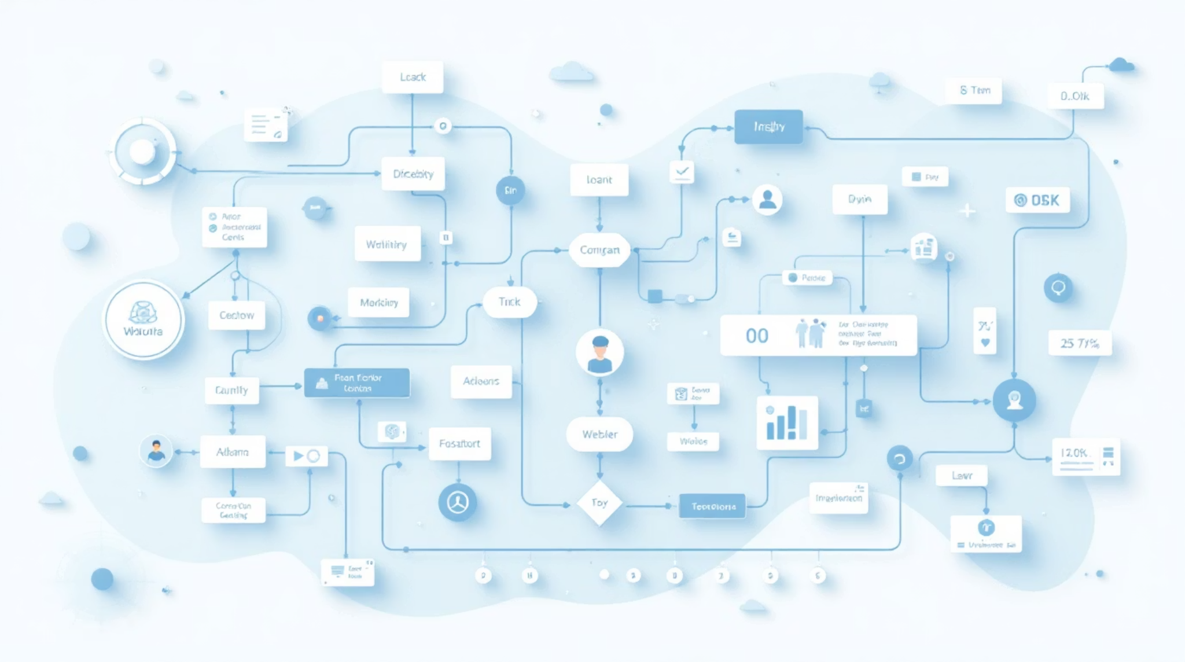
Expert System Rules
Dead App Detection
60+ days inactive, zero tickets, low criticality → RETIRE (92% confidence)
Ghost Subscription
Under 15% utilization, high cost, near renewal → RETIRE URGENT (95% confidence)
Redundant Tool
High redundancy score, low usage, not critical → CONSOLIDATE (85% confidence)
60+ rules use forward chaining for recommendations and backward chaining for goal-directed optimization.

Slide 7

AI-Powered Advisory
01
02
Structured Analysis
GPT-4o Enhancement
Expert system identifies issues with evidence and confidence scores
Generates executive-level justifications and action timelines
03
Human-Readable Reports
Professional advisory notes that feel like consultant insights

Slide 8

Real-Time Simulation
Timeline Engine
Compress time and watch recommendations evolve day by day. Set start and end dates, replay events, see utilization rates drop and thresholds cross.
Dashboard Interface
Portfolio overview with color-coded status
Full AppSight reports with rule details
Goal optimizer for backward chaining
Simulation controls with play/pause

Slide 9

Technology Stack
Python 3.x
Core language with Faker, NumPy, Pandas for data generation and manipulation
Experta
Expert system engine for forward and backward chaining rules
OpenAI GPT-4o
Generates advisory narratives and executive justifications
Streamlit
Interactive dashboard with charts, tables, and simulation controls

Slide 10

Key Benefits
Cost Savings
Identify ghost subscriptions and redundant tools to reduce SaaS spend significantly
Data-Driven Decisions
Combine quantitative metrics with qualitative feedback for accurate insights
Real-Time Visibility
Watch recommendations evolve as usage patterns change over time
Automated Analysis
Expert system plus AI advisory delivers consultant-level insights automatically

