Slide 1

AI UNIT - I

Slide 2

UNIT-I
Introduction to Artificial Intelligence and Search Strategies
Part-I
History and Introduction to AI,
Intelligent Agent,
Types of agents,
Environment and types,
Typical AI problems

Slide 3
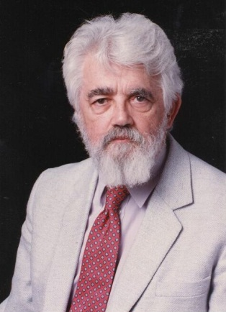
Artificial Intelligence
What is AI ?
Artificial Intelligence is concerned with the design of intelligence in an artificial device.
The term was coined by McCarthy in 1956.
There are two ideas in the definition.
1. Intelligence
2. Artificial device
John McCarthy

Slide 4

Definition of AI
“The exciting new effort to make computers think … machine with minds, … ” (Haugeland, 1985)
“The study of mental faculties through the use of computational models” (Charniak and McDermott, 1985)
“Activities that we associated with human thinking, activities such as decision-making, problem solving, learning … “ (Bellman, 1978)
“ The study of the computations that make it possible to perceive, reason, and act” (Winston, 1992)
“The art of creating machines that perform functions that require intelligence when performed by people” (Kurzweil, 1990)
“A field of study that seeks to explain and emulate intelligent behavior in terms of computational processes” (Schalkoff, 1990)
“The study of how to make computers do things at which, at the moment, people are better” (Rich and Knight, 1991)
“The branch of computer science that is concerned with the automation of intelligent behavior” (Luger and Stubblefield, 1993)
In conclusion, they falls into four categories: Systems that
think like human, act like human, think rationally, or act rationally.
?
What is your definition of AI?

Slide 5
AI Foundations?
AI inherited many ideas, viewpoints and techniques from other disciplines.
Psychology
Philosophy
To investigate human mind
AI
Theories of reasoning and learning
Linguistic
Mathematics
CS
The meaning and structure of language
Theories of logic probability, decision making and computation
Make AI a reality

Slide 6

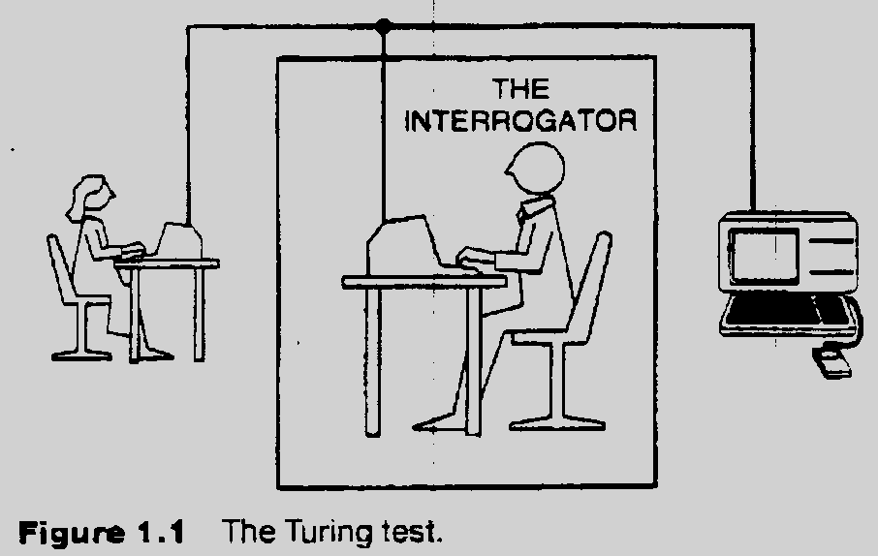
The Turing Test
(Can Machine think? A. M. Turing, 1950)
Requires:
  Natural language Processing
  Knowledge representation
  Automated reasoning
  Machine learning
  (vision, robotics) for full test
Notes:
Movie: The Imitation Game

Slide 7
Acting/Thinking Humanly/Rationally
Turing test (1950)
Requires:
  Natural language
  Knowledge representation
  automated reasoning
  machine learning
  (vision, robotics.) for full test
Methods for Thinking Humanly:
  Introspection, the general problem solver
  Cognitive sciences
Thinking rationally:
  Logic Problems: how to represent and reason in a domain
Acting rationally:
  Agents: Perceive and act

Slide 8
History of AI
McCulloch and Pitts (1943)
  Neural networks that learn
Minsky and Edmonds (1951)
  Built a neural net computer
Darmouth conference (1956):
  McCarthy, Minsky, Newell, Simon met,
  Logic theorist (LT)- Of Newell and Simon proves a theorem in Principia Mathematica-Russel.
  The name “Artficial Intelligence” was coined.
1952-1969
  GPS- Newell and Simon
  Geometry theorem prover - Gelernter (1959)
  Samuel Checkers that learns (1952)
  McCarthy - Lisp (1958), Advice Taker, Robinson’s resolution

Slide 9
History…. continued
1969-1979 Knowledge-based systems
  Expert systems:
    Dendral:I nferring molecular structures
    Mycin: diagnosing blood infections
    Prospector: recommending exploratory drilling.
1980-1988: AI becomes an industry
  R1: Mcdermott, 1982, order configurations of computer systems
  1981: Fifth generation
1986-present: return to neural networks
Recent event:
  AI becomes a science: planning, belief network

Slide 10
State of the art
Deep Blue defeated the world chess champion Garry Kasparov in 1997
During the 1991 Gulf War, US forces deployed an AI logistics planning and scheduling program that involved up to 50,000 vehicles, cargo, and people
NASA's on-board autonomous planning program controlled the scheduling of operations for a spacecraft
Proverb solves crossword puzzles better than most humans

Slide 11
Summary
Definition of AI
Turing Test
Foundations of AI
History

Slide 12
Intelligent Agents
Agents and environments
Rationality
PEAS (Performance measure, Environment, Actuators, Sensors)
Environment types
Agent types 0r The Structure of Agents

Slide 13
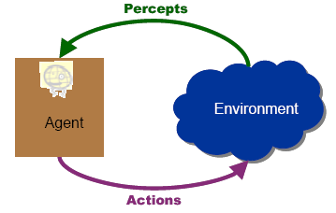
Agents
An agent is any thing that can be viewed as perceiving its environment through sensors and acting upon that environment through actuators/ effectors
Ex: Human Being , Calculator etc
Agent has goal –the objective which agent has to satisfy
Actions can potentially change the environment
Agent perceive current percept or sequence of perceptions

Slide 14
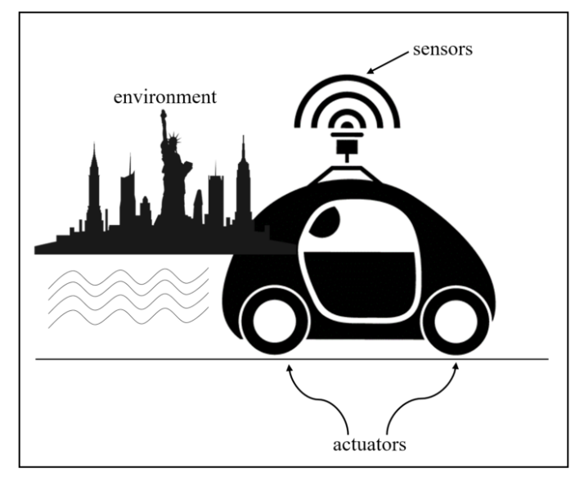
Agent-Driverless Taxi
Sensors, Actuators, Environment

Slide 15
Agents
An agent is anything that can be viewed as perceiving its environment through sensors and acting upon that environment through actuators/ effectors
1. Human agent: eyes, ears, and other organs used as sensors;
hands, legs, mouth, and other body parts used as actuators/ Effector
2. Robotic agent:
  Sensors:- cameras (picture Analysis) and infrared range finders for sensors, Solar Sensor.
  Actuators- various motors, speakers, Wheels
3. Software Agent(Soft Bot)
  Functions as sensors
  Functions as actuators
  Ex. Askjeeves.com, google.com
4. Expert System
  Ex- Cardiologist

Slide 16
What is an Intelligent Agent
Fundamental Facilities of Intelligent Agent
  Acting
  Sensing
  Understanding, reasoning, learning
In order to act one must sense , Blind actions is not characteristics of Intelligence.
Goal: Design rational agents that do a “good job” of acting in their environments
success determined based on some objective performance measure

Slide 17
What is an Intelligent Agent
Rational Agents
  An agent should strive to "do the right thing",
  based on what it can perceive and the actions it can perform.
    The right action is the one that will cause the agent to be most successful.
    Perfect Rationality ( Agent knows all & correct action)
      Humans do not satisfy this rationality
    Bounded Rationality-
      Human use approximations
      Definition of Rational Agent:
      For each possible percept sequence, a rational agent should select an action that is expected to maximize its performance measure.
      Rational=best? Yes, but best of its knowledge.
      Rational=Optimal?
      Yes, to the best of it’s abilities & constraints (Subject to resources)

Slide 18

What is an Intelligent Agent - Agent Function
Agent Function (percepts ==> actions)
  Maps from percept histories to actions f: P* 🡪 A
  The agent program runs on the physical architecture to produce the function f
  agent = architecture + program
      Action := Function(Percept Sequence)
      If (Percept Sequence) then do Action
Example: A Simple Agent Function for Vacuum World
      If (current square is dirty) then suck
      Else move to adjacent square

Slide 19
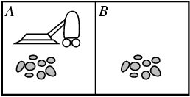
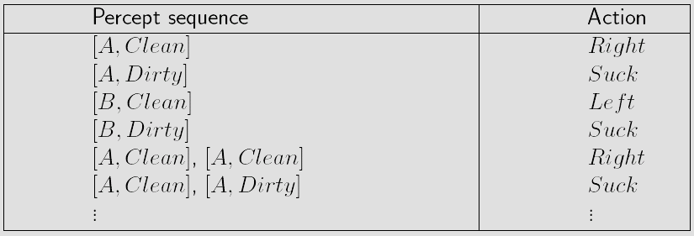
Example: Vacuum Cleaner Agent
Percepts: location and contents, e.g., [A, Dirty]
Actions: Left, Right, Suck, NoOp

Slide 20
What is an Intelligent Agent
Limited Rationality
  limited sensors, actuators, and computing power may make Rationality impossible
  Theory of NP-completeness: some problems are likely impossible to solve quickly on ANY computer
  Both natural and artificial intelligence are always limited
  Degree of Rationality: the degree to which the agent’s internal "thinking" maximizes its performance measure, given
    the available sensors
    the available actuators
    the available computing power
    the available built-in knowledge

Slide 21
PEAS Analysis
To design a rational agent, we must specify the task environment.
PEAS Analysis:
  Specify Performance Measure
  Environment
  Actuators
  Sensors

Slide 22
PEAS Analysis – Examples
Agent: Medical diagnosis system
  Performance measure: Healthy patient, minimize costs
  Environment: Patient, hospital, staff
  Actuators: Screen display (questions, tests, diagnoses, treatments, referrals)
  Sensors: Keyboard (entry of symptoms, findings, patient's answers)
Agent: Part-picking robot
  Performance measure: Percentage of parts in correct bins
  Environment: Conveyor belt with parts, bins
  Actuators: Jointed arm and hand
  Sensors: Camera, joint angle sensors

Slide 23
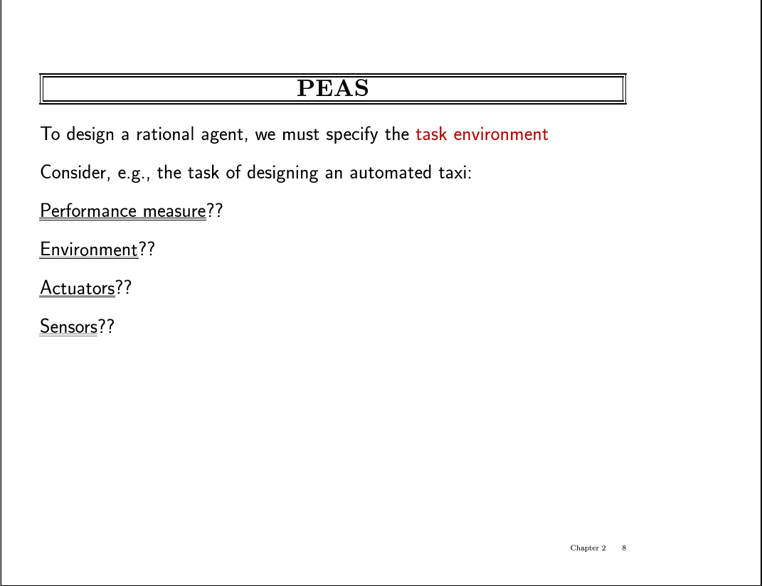

Slide 24
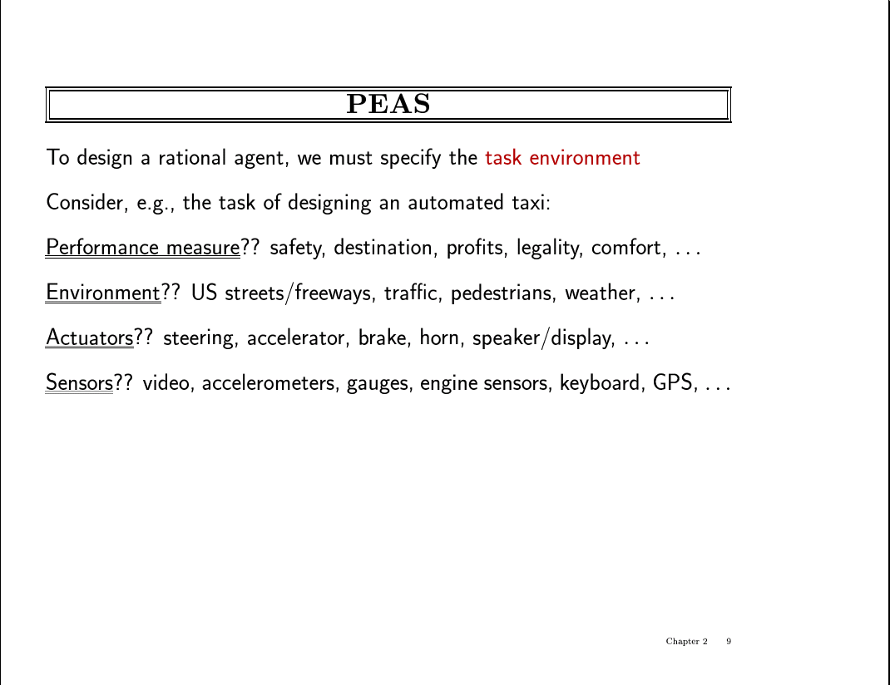

Slide 25
PEAS Analysis – More Examples
Agent: Internet Shopping Agent
  Performance measure??
  Environment??
  Actuators??
  Sensors??

Slide 26
Environment
Environment in which agent operates
  Absolute
  Agents point of view

Slide 27
Environment Types
Fully observable (vs. partially observable):
  An agent's sensors give it access to the complete state of the environment at each point in time.
  It is convenient bcoz agent need not maintain any internal state to keep track of the world.
  Ex. Chess (Ex: Deep Blue)
  Partially Observable:: When Noisy & inaccurate sensors or part of state r missing from the sensor data. (ex- Vacuum agent with only a local dirt sensor cannot tell whether there is dirt in other squares, & automated taxi cannot see what other drivers are thinking)
  Ex. Poker
Deterministic (vs. stochastic):
Deterministic AI environments are those on which the outcome can be determined base on a specific state. In other words, deterministic environments ignore uncertainty.
Most real world AI environments are not deterministic. Instead, they can be classified as stochastic.
Ex (stochastic ): Self-driving vehicles are a classic example of stochastic AI processes.

Slide 28
Environment Types (cont.)
Episodic (vs. sequential):
Episodic is an environment where each state is independent of each other. The action on a state has nothing to do with the next state.
Real-life Example: A support bot (agent) answer to a question and then answer to another question and so on. So each question-answer is a single episode.
The sequential environment is an environment where the next state is dependent on the current action. So agent current action can change all of the future states of the environment.
Real-life Example: Playing tennis is a perfect example where a player observes the opponent’s shot and takes action.

Slide 29
Static (vs. dynamic):
The Static environment is completely unchanged while an agent is precepting the environment.
Real-life Example: Cleaning a room (Environment) by a dry-cleaner Agent is an example of a static environment where the room is static while cleaning.
Dynamic Environment could be changed while an agent is precepting the environment. So agents keep looking at the environment while taking action.
Real-life Example: Playing soccer is a dynamic environment where players’ positions keep changing throughout the game. So a player hit the ball by observing the opposite team.

Slide 30
Discrete (vs. continuous):
Discrete Environment consists of a finite number of states and agents have a finite number of actions.
Real-life Example: Choices of a move (action) in a tic-tac game are finite on a finite number of boxes on the board (Environment).
While in a Continuous environment, the environment can have an infinite number of states. So the possibilities of taking an action are also infinite.
Real-life Example: In a basketball game, the position of players (Environment) keeps changing continuously and hitting (Action) the ball towards the basket can have different angles and speed so infinite possibilities.

Slide 31
Environment Types (cont.)
Complete vs. Incomplete
Complete AI environments are those on which, at any give time, we have enough information to complete a branch of the problem.
Ex: Chess is a classic example of a complete AI environment.
Ex: Poker, on the other hand, is an incomplete environments as AI strategies can’t anticipate many moves in advance and, instead, they focus on finding a good ‘equilibrium” at any given time.
Single agent (vs. multi-agent):
  An agent operating by itself in an environment.

Slide 32
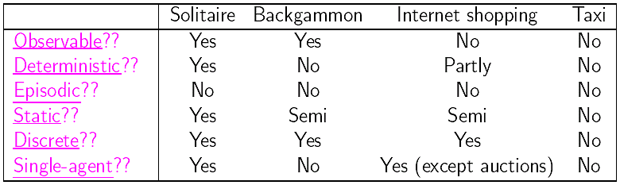
Environment Types (cont.)
The environment type largely determines the agent design.
The real world is (of course) partially observable, stochastic, sequential, dynamic, continuous, multi-agent

Slide 33
Examples | Fully vs Partially Observable | Deterministic vs Stochastic | Episodic vs Sequential | Static vs Dynamic | Discrete vs Continuous | Single vs Multi Agents
Brushing Your Teeth | Fully | Stochastic | Sequential | Static | Continuous | Single
Playing Chess | Partially | Stochastic | Sequential | Dynamic | Continuous | Multi-Agent
Playing Cards | Partially | Stochastic | Sequential | Dynamic | Continuous | Multi-Agent
Playing | Partially | Stochastic | Sequential | Dynamic | Continuou | Multi Agent
Autonomous Vehicles | Fully | Stochastic | Sequential | Dynamic | Continuous | Multi-Agent
Order in Restaurant | Fully | Deterministic | Episodic | Static | Discrete | Single Agent

Slide 34
End of First Lecture
Thanks

Slide 35
Agent types
Four basic types:
  Simple reflex agents
  Model-based reflex agents
  Goal-based agents
  Utility-based agents

Slide 36
Agents
An agent is any thing that can be viewed as perceiving its environment through sensors and acting upon that environment through actuators/ effectors
Ex: Human Being , Calculator etc
Agent has goal –the objective which agent has to satisfy
Actions can potentially change the environment
Agent perceive current percept or sequence of perceptions

Slide 37
Structure of an Intelligent Agent
All agents have the same basic structure:
  accept percepts from environment
  generate actions
A Skeleton Agent:
Observations:
  Agent may or may not build percept sequence in memory (depends on domain)
  Performance measure is not part of the agent; it is applied externally to judge the success of the agent
function Skeleton-Agent(percept) returns action
static: memory, the agent's memory of the world
memory ← Update-Memory(memory, percept)
action ← Choose-Best-Action(memory)
memory ← Update-Memory(memory, action)
return action

Slide 38
Agent Types
Simple reflex agents
  These are based on condition-action rules and implemented with an appropriate production system. They are stateless devices which do not have memory of past world states.
Reflex Agents with memory (Model-Based)
  have internal state which is used to keep track of past states of the world.
Agents with goals
  are agents which in addition to state information have a kind of goal information which describes desirable situations.
  Agents of this kind take future events into consideration.
Utility-based agents
  base their decision on classic axiomatic utility-theory in order to act rationally.
Note: All of these can be turned into “learning” agents

Slide 39
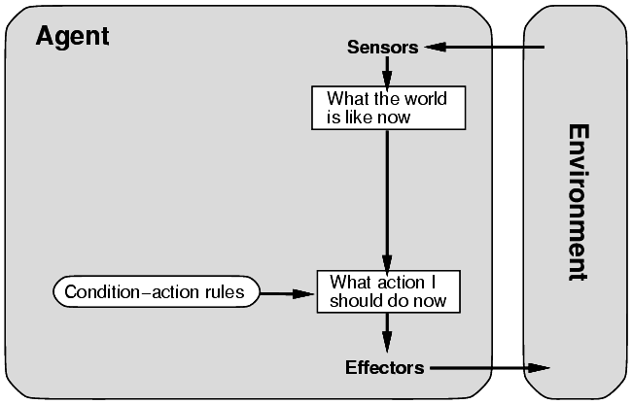
A Simple Reflex Agent
We can summarize part of the table by formulating commonly occurring patterns as condition-action rules:
Example:
if car-in-front-brakes
then initiate braking
Agent works by finding a rule whose condition matches the current situation
  rule-based systems
But, this only works if the current percept is sufficient for making the correct decision
function Simple-Reflex-Agent(percept) returns action
static: rules, a set of condition-action rules
state ← Interpret-Input(percept)
rule ← Rule-Match(state, rules)
action ← Rule-Action[rule]
return action
Notes:
There are three phases inside the loop here: figure out how
the environment has changed, figure out what is the best action,
figure out how this action changes the environment.
The key advantage of this architecture is that the "interpret"
function identifies "equivalence classes" of percepts: many
different percepts correspond to the SAME environmental situation,
from the point of view of what the agent should DO.
Therefore the table of rules can be much smaller than the lookup table
above.
It is not rational for an agent to pay attention to EVERY aspect
of the environment.

Slide 40
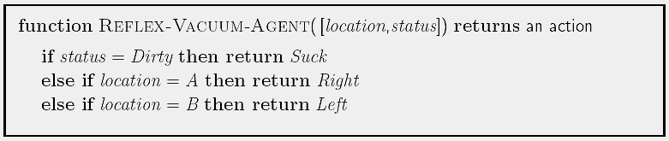
Example: Simple Reflex Vacuum Agent
Notes:
There are three phases inside the loop here: figure out how
the environment has changed, figure out what is the best action,
figure out how this action changes the environment.
The key advantage of this architecture is that the "interpret"
function identifies "equivalence classes" of percepts: many
different percepts correspond to the SAME environmental situation,
from the point of view of what the agent should DO.
Therefore the table of rules can be much smaller than the lookup table
above.
It is not rational for an agent to pay attention to EVERY aspect
of the environment.

Slide 41
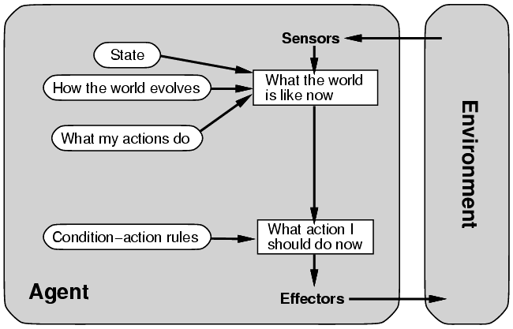
Agents that Keep Track of the World
Updating internal state requires two kinds of encoded knowledge
  knowledge about how the world changes (independent of the agents’ actions)
  knowledge about how the agents’ actions affect the world
But, knowledge of the internal state is not always enough
  how to choose among alternative decision paths (e.g., where should the car go at an intersection)?
  Requires knowledge of the goal to be achieved
function Reflex-Agent-With-State(percept) returns action
static: rules, a set of condition-action rules
state, a description of the current world
state ← Update-State(state, percept)
rule ← Rule-Match(state, rules)
action ← Rule-Action[rule]
state ← Update-State(state, action)
return action
Notes:
LEARNING IN INTELLIGENT AGENTS
With the reflex architecture, if the table of rules prescribes the
wrong action, and the agent discovers this and changes the table,
it has automatically generalized from its specific experience.
Generalization is a key phenomenon in learning. Generalization
always requires previous "background" knowledge to direct it.
All complex intelligent agents will have a lot of background knowledge
preprogrammed, because they do not have the time to receive enough
experience and feedback from the environment to allow them to learn to
behave correctly starting from scratch.
In linguistics this is called the "poverty of stimulus" argument. If
you calculate how many sentences a young child hears before it starts
to speak correct English, the number is too few to allow it to "guess"
the grammar of English. Therefore the baby must have a so-called
universal natural language grammar preprogrammed into it by its genes.
This argument is controversial, but there is scientific agreement
that background knowledge of some sort (often very hidden and implicit)
is necessary for learning in humans and AI systems.

Slide 42
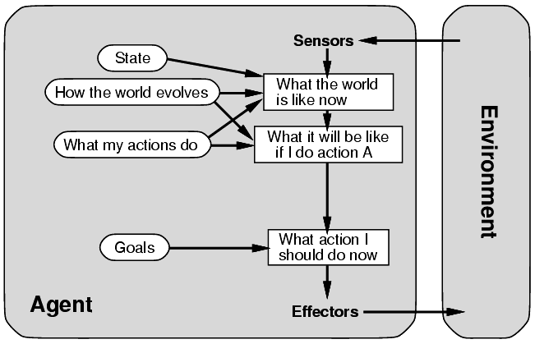
Agents with Explicit Goals
Reasoning about actions
  reflex agents only act based on pre-computed knowledge (rules)
  goal-based (planning) act by reasoning about which actions achieve the goal
  more adaptive and flexible

Slide 43
Agents with Explicit Goals
Knowing current state is not always enough.
  State allows an agent to keep track of unseen parts of the world, but the agent must update state based on knowledge of changes in the world and of effects of own actions.
  Goal = description of desired situation
Examples:
  Decision to change lanes depends on a goal to go somewhere (and other factors);
  Decision to put an item in shopping basket depends on a shopping list, map of store, knowledge of menu
Notes:
  Search (Russell Chapters 3-5) and Planning (Chapters 11-13) are concerned with finding sequences of actions to satisfy a goal.
  Reflexive agent concerned with one action at a time.
  Classical Planning: finding a sequence of actions that achieves a goal.
  Contrast with condition-action rules: involves consideration of future "what will happen if I do ..." (fundamental difference).

Slide 44
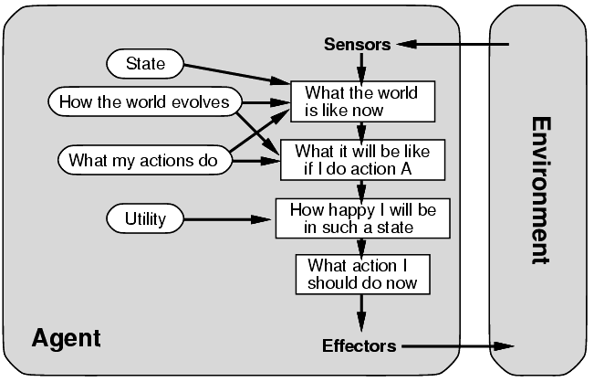
A Complete Utility-Based Agent
Utility Function
  a mapping of states onto real numbers
  allows rational decisions in two kinds of situations
    evaluation of the tradeoffs among conflicting goals
    evaluation of competing goals

Slide 45
Utility-Based Agents (Cont.)
Preferred world state has higher utility for agent = quality of being useful
Examples
  quicker, safer, more reliable ways to get where going;
  price comparison shopping
  bidding on items in an auction
  evaluating bids in an auction
Utility function: state ==> U(state) = measure of happiness

Slide 46
Shopping Agent Example
Navigating: Move around store; avoid obstacles
  Reflex agent: store map precompiled.
  Goal-based agent: create an internal map, reason explicitly about it, use signs and adapt to changes ().
Gathering: Find and put into cart groceries it wants, need to induce objects from percepts.
  Reflex agent: wander and grab items that look good.
  Goal-based agent: shopping list.
Menu-planning: Generate shopping list, modify list if store is out of some item.
  Goal-based agent: required; what happens when a needed item is not there? Achieve the goal some other way. e.g., no milk cartons: get canned milk or powdered milk.

Slide 47
General Architecture for Goal-Based Agents
Input percept
state ← Update-State(state, percept)
goal ← Formulate-Goal(state, perf-measure)
search-space ← Formulate-Problem (state, goal)
plan ← Search(search-space , goal)
while (plan not empty) do
action ← Recommendation(plan, state)
plan ← Remainder(plan, state)
output action
end
Simple agents do not have access to their own performance measure
  In this case the designer will "hard wire" a goal for the agent, i.e. the designer will choose the goal and build it into the agent
Similarly, unintelligent agents cannot formulate their own problem
  this formulation must be built-in also
The while loop above is the "execution phase" of this agent's behavior
  Note that this architecture assumes that the execution phase does not require monitoring of the environment
Notes:
GOALS AND GOAL FORMULATION
Often the first step in problem-solving is to simplify the
performance measure that the agent is trying to maximize.
Formally, a "goal" is a set of desirable world-states.
"Goal formulation" means ignoring all other aspects of the
current state and the performance measure, and choosing a goal.
Example: if you are in Arad (Romania) and your visa will expire
tomorrow, your goal is to reach Bucharest airport.

Slide 48
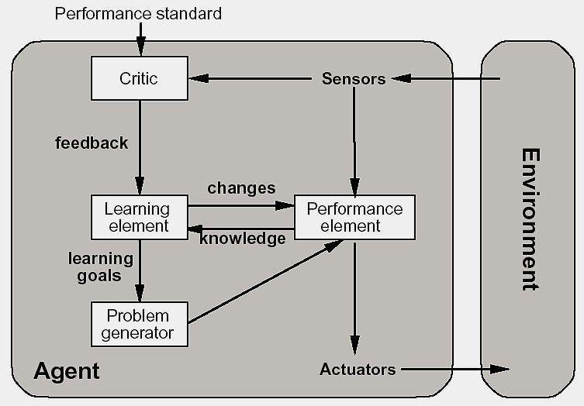
Learning Agents
Four main components:
  Performance element: the agent function
  Learning element: responsible for making improvements by observing performance
  Critic: gives feedback to learning element by measuring agent’s performance
  Problem generator: suggest other possible courses of actions (exploration)

Slide 49
Intelligent Agent Summary
An agent perceives and acts in an environment. It has an architecture and is implemented by a program.
An ideal agent always chooses the action which maximizes its expected performance, given the percept sequence received so far.
An autonomous agent uses its own experience rather than built-in knowledge of the environment by the designer.
An agent program maps from a percept to an action and updates its internal state.
Reflex agents respond immediately to percepts.
Goal-based agents act in order to achieve their goal(s).
Utility-based agents maximize their own utility function.

Slide 50
Exercise
News Filtering Internet Agent
  uses a static user profile (e.g., a set of keywords specified by the user)
  on a regular basis, searches a specified news site (e.g., Reuters or AP) for news stories that match the user profile
  can search through the site by following links from page to page
  presents a set of links to the matching stories that have not been read before (matching based on the number of words from the profile occurring in the news story)
(1) Give a detailed PEAS description for the news filtering agent
(2) Characterize the environment type (as being observable, deterministic, episodic, static, etc).

Slide 51
AI Problems
water jug problem in Artificial Intelligence
cannibals and missionaries problem in AI
tic tac toe problem in artificial intelligence
8/16 puzzle problem in artificial intelligence
tower of hanoi problem in artificial intelligence

Slide 52
Thanks End of Lecture-2
Agent Types
Environment types

Slide 53
Search Strategies
Problem solving and formulating a problem State Space Search- Uninformed and Informed Search Techniques,
Heuristic function,
A*,
AO* algorithms ,
Hill climbing,
simulated annealing,
genetic algorithms ,
Constraint satisfaction method

Slide 54
Search Strategies
Uninformed Search
  breadth-first
  depth-first
  uniform-cost search
  depth-limited search
  iterative deepening
  bi-directional search
  constraint satisfaction
Informed Search
  best-first search
  search with heuristics
  memory-bounded search
  iterative improvement search

Slide 55
Introduction to State Space Search
2.2 State space search
    • Formulate a problem as a state space search by showing the legal problem states, the legal operators, and the initial and goal states .
    A state is defined by the specification of the values of all attributes of interest in the world
    An operator changes one state into the other; it has a precondition which is the value of certain attributes
    The initial state is where you start
    The goal state is the partial description of the solution

Slide 56
State Space Search Notations
Let us begin by introducing certain terms.
An initial state is the description of the starting configuration of the agent
An action or an operator takes the agent from one state to another state which is called a successor state. A state can have a number of successor states.
A plan is a sequence of actions. The cost of a plan is referred to as the path cost. The path cost is a positive number, and a common path cost may be the sum of the costs of the steps in the path.
Search is the process of considering various possible sequences of operators applied to the initial state, and finding out a sequence which culminates in a goal state.

Slide 57
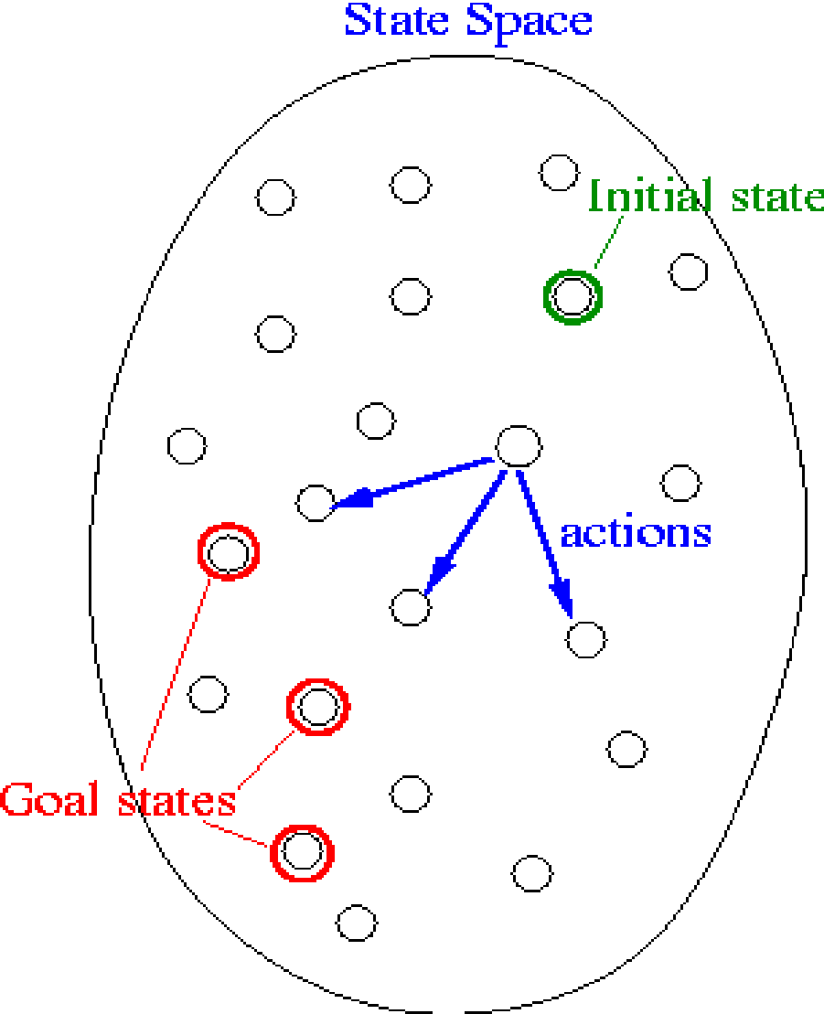
Search Problem
We are now ready to formally describe a search problem.
A search problem consists of the following:
    • S: the full set of states
    • s⁰ : the initial state
    • A:S→S is a set of operators
    • G is the set of final states. Note that G ⊆S
These are schematically depicted in above Figure

Slide 58
Search Problem
The search problem is to find a sequence of actions which transforms the agent from the initial state to a goal state g∈G.
A search problem is represented by a 4-tuple {S, s⁰, A, G}.
S: set of states
s⁰ ∈ S : initial state
A: S🡪S operators/ actions that transform one state to another state
G : goal, a set of states. G ⊆ S
This sequence of actions is called a solution plan. It is a path from the initial state to a goal state. A plan P is a sequence of actions.
P = {a⁰, a¹, … , a^{N}} which leads to traversing a number of states {s⁰, s¹, … , s^{N+1}∈G}.
A sequence of states is called a path. The cost of a path is a positive number. In many cases the path cost is computed by taking the sum of the costs of each action.

Slide 59
Representation of search problems
A search problem is represented using a directed graph.
    • The states are represented as nodes.
    • The allowed actions are represented as arcs.

Slide 60
Searching process
The steps for generic searching process :
Do until a solution is found or the state space is exhausted.
1. Check the current state
2. Execute allowable actions to find the successor states.
3. Pick one of the new states.
4. Check if the new state is a solution state
If it is not, the new state becomes the current state and the process is repeated

Slide 61
Examples
Illustration of a search process

Slide 62
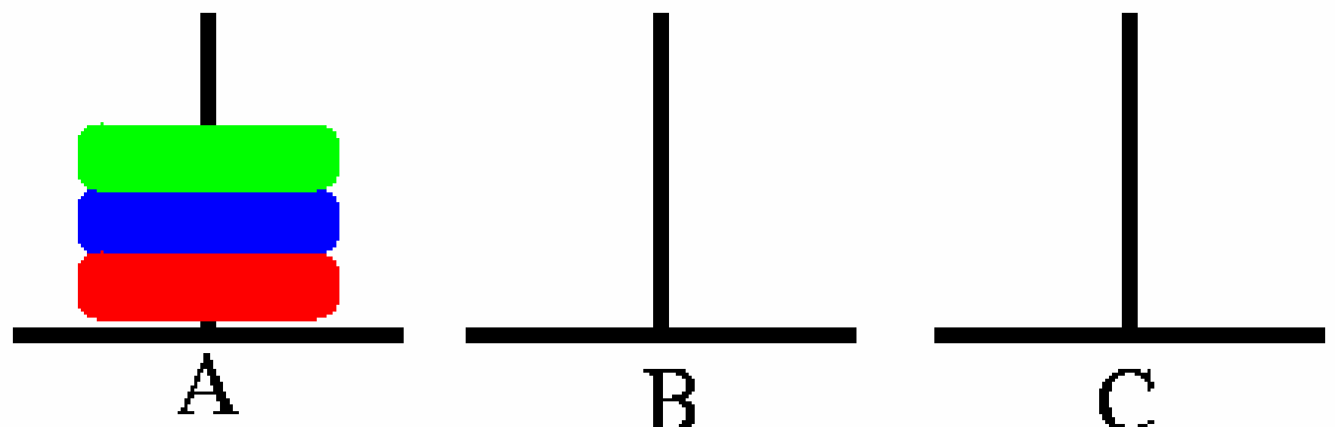
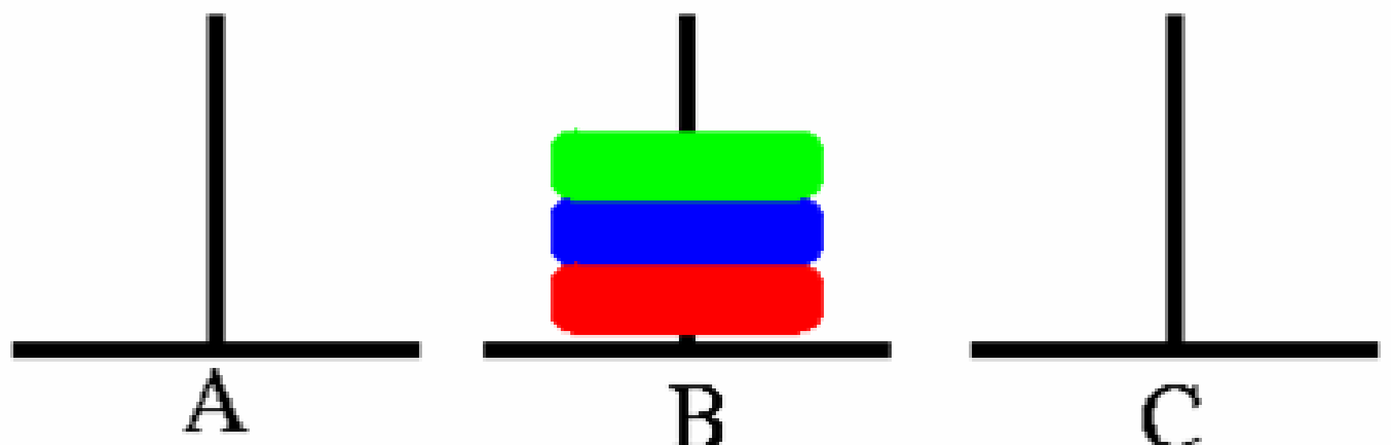
Example problem: Pegs and Disks problem
The initial state
Goal State

Slide 63
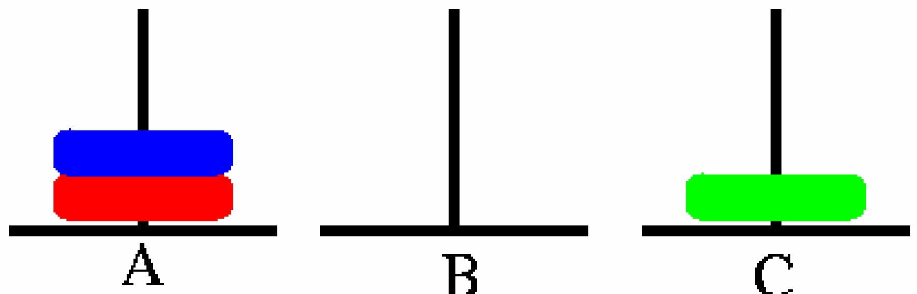
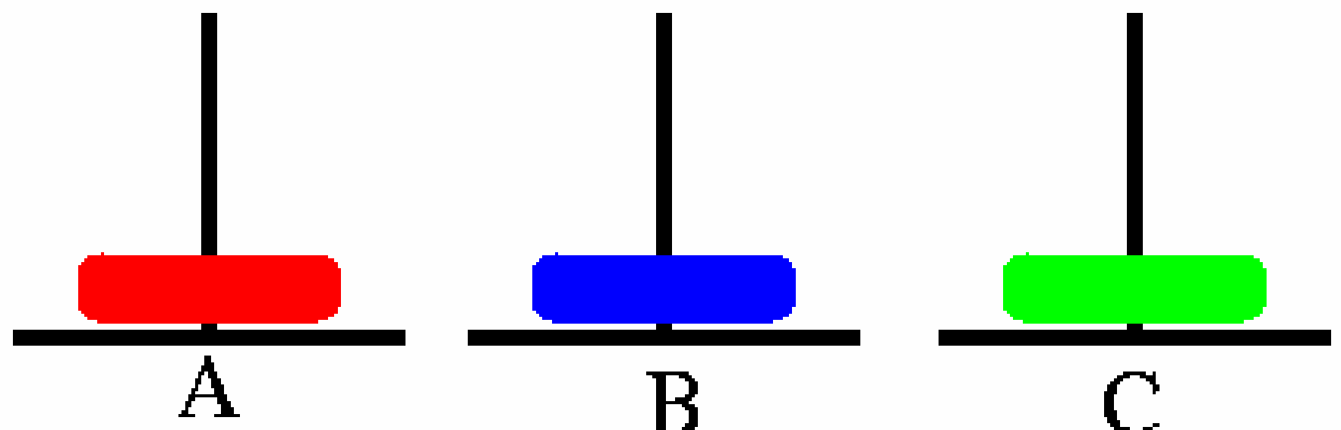
Example problem: Pegs and Disks problem
Now we will describe a sequence of actions that can be applied on the initial state.
Step 1: Move A → C
Step 2: Move A → B

Slide 64
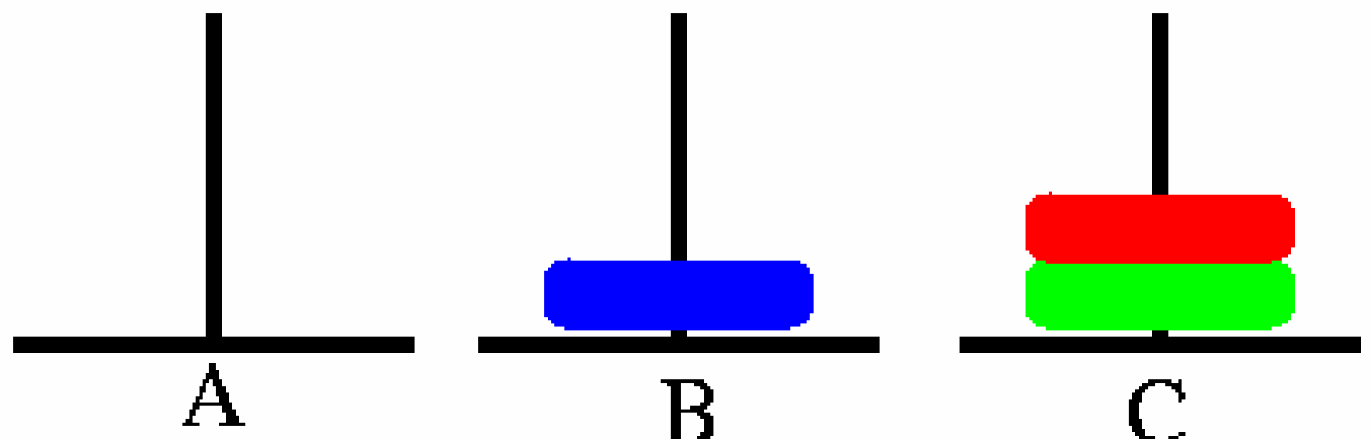
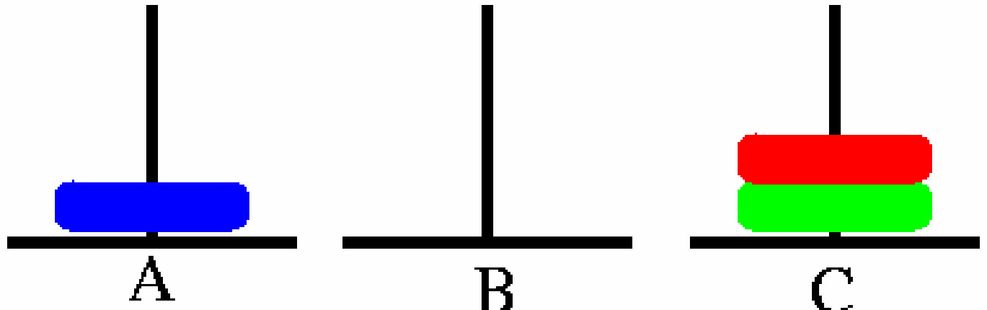
Example problem: Pegs and Disks problem
Step 3: Move A → C
Step 4: Move B→ A

Slide 65
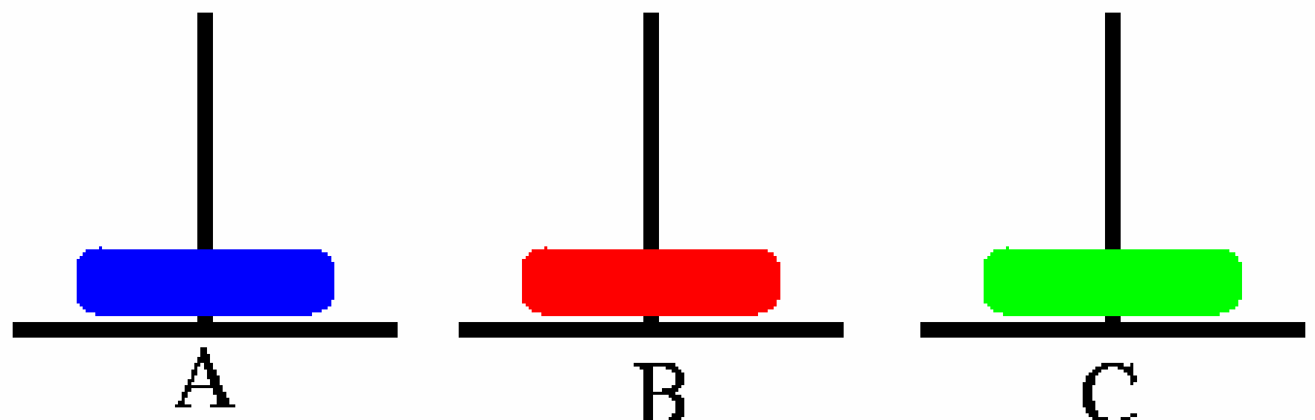
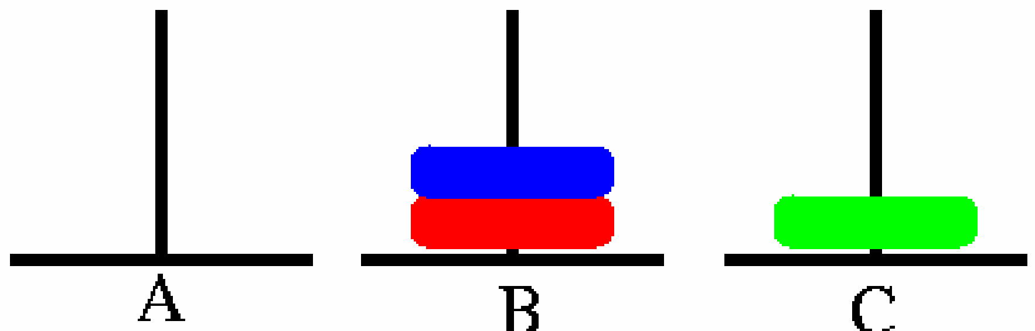
Example problem: Pegs and Disks problem
Step 5: Move C → B
Step 6: Move A → B

Slide 66
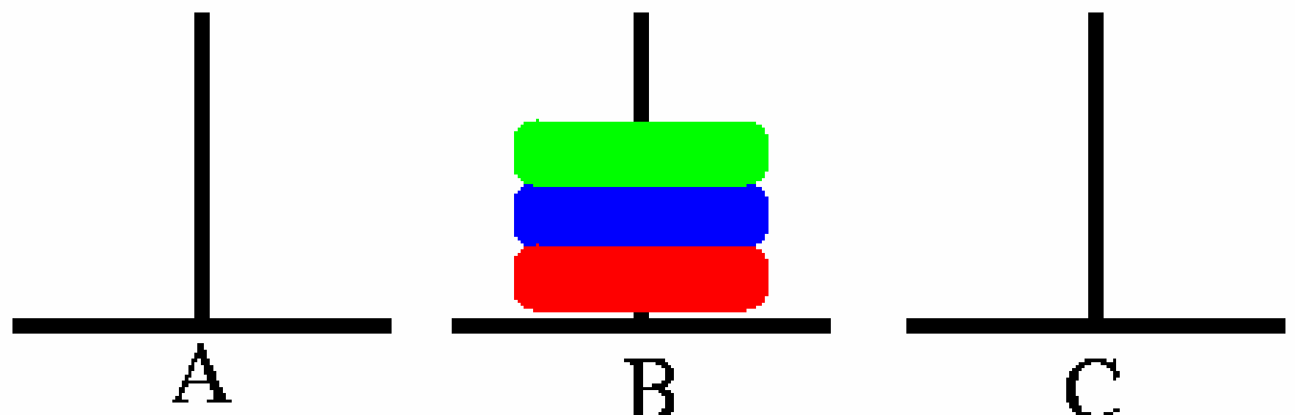
Example problem: Pegs and Disks problem
Step 7: Move C→ B

Slide 67
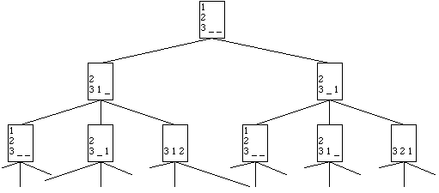
Example problem: Pegs and Disks problem

Slide 68
Search
Searching through a state space involves the following:
  A set of states
  Operators and their costs
  Start state
  A test to check for goal state
We will now outline the basic search algorithm, and then consider various variations of this algorithm.

Slide 69
The basic search algorithm
Let L be a list containing the initial state (L= the fringe)
Loop if L is empty return failure
Node 🡨 select (L)
if Node is a goal
then return Node
(the path from initial state to Node)
else
generate all successors of Node, and
merge the newly generated states into L
End Loop
In addition the search algorithm maintains a list of nodes called the fringe(open list). The fringe keeps track of the nodes that have been generated but are yet to be explored.

Slide 70
Evaluating Search strategies
What are the characteristics of the different search algorithms and what is their efficiency? We will look at the following three factors to measure this.
1. Completeness: Is the strategy guaranteed to find a solution if one exists?
2. Optimality: Does the solution have low cost or the minimal cost?
3. What is the search cost associated with the time and memory required to find a solution?
  Time complexity: Time taken (number of nodes expanded) (worst or average case) to find a solution.
  b. Space complexity: Space used by the algorithm measured in terms of the maximum size of fringe

Slide 71
The different search strategies
1. Blind Search strategies or Uninformed search
  a. Depth first search
  b. Breadth first search
  c. Depth Limited search
  d. Iterative deepening search
2. Informed Search
3. Constraint Satisfaction Search
4. Adversary Search

Slide 72
Search Tree – Terminology
• Root Node: The node from which the search starts, initial state of state space.
• Leaf Node: A node in the search tree having no children.
  • not yet expanded (i.e., in fringe) or
  • having no successors (i.e., “dead-ends”)
• Ancestor/Descendant: X is an ancestor of Y is either X is Y’s parent or X is an ancestor of the parent of Y. If X is an ancestor of Y, Y is said to be a descendant of X.
• Branching factor: the maximum number of children of a non-leaf node in the search tree
• Path: A path in the search tree is a complete path if it begins with the start node and ends with a goal node. Otherwise it is a partial path.
We also need to introduce some data structures that will be used in the search algorithms we call it Fringe/open list & Closed List.
Search tree may be infinite because of loops inside the state space even if state space is small

Slide 73
Node data structure
A node used in the search algorithm is a data structure which contains the following:
1. A state description
2. A pointer to the parent of the node
3. Depth of the node
4. The operator that generated this node
5. Cost of this path (sum of operator costs) from the start state
The nodes that the algorithm has generated are kept in a data structure called OPEN or fringe. Initially only the start node is in OPEN.

Slide 74
Comparing Uninformed Search Strategies
Completeness
  Will a solution always be found if one exists?
Time
  How long does it take to find the solution?
  Often represented as the number of nodes searched
Space
  How much memory is needed to perform the search?
  Often represented as the maximum number of nodes stored at once
Optimal
  Will the optimal (least cost) solution be found?

Slide 75
Comparing Uninformed Search Strategies
Time and space complexity are measured in
  b – maximum branching factor of the search tree
  m – maximum depth of the state space
  d – depth of the least cost solution

Slide 76
Breadth-First Search
Breadth-first search is the most common search strategy for traversing a tree or graph. This algorithm searches breadthwise in a tree or graph, so it is called breadth-first search.
BFS algorithm starts searching from the root node of the tree and expands all successor node at the current level before moving to nodes of next level.
The breadth-first search algorithm is an example of a general-graph search algorithm.
Breadth-first search implemented using FIFO queue data structure.

Slide 77
Breadth First Search
Algorithm Breadth first search
Let fringe be a list containing the initial state
Loop
if fringe is empty return failure
Node 🡨 remove-first (fringe)
if Node is a goal
then return the path from initial state to Node
else generate all successors of Node, and
(merge the newly generated nodes into fringe)
add generated nodes to the back of fringe
End Loop
Note that in breadth first search the newly generated nodes are put at the back of fringe or the OPEN list. The nodes will be expanded in a FIFO (First In First Out) order. The node that enters OPEN earlier will be expanded earlier.

Slide 78
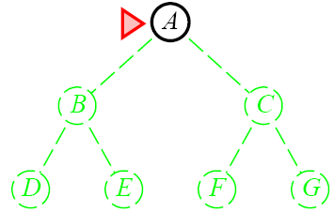
Breadth-First Search

Slide 79
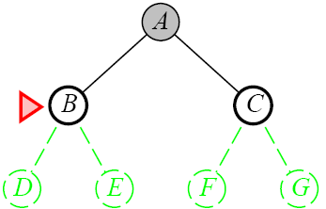
Breadth-First Search

Slide 80
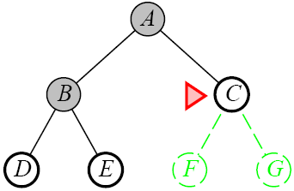
Breadth-First Search

Slide 81
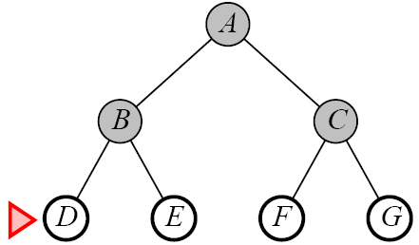
Breadth-First Search

Slide 82
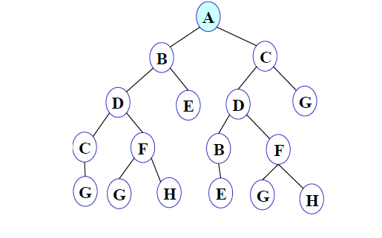

BFS illustrated
Step 1: Initially fringe contains only one node corresponding to the source state A.
Figure 3

Slide 83
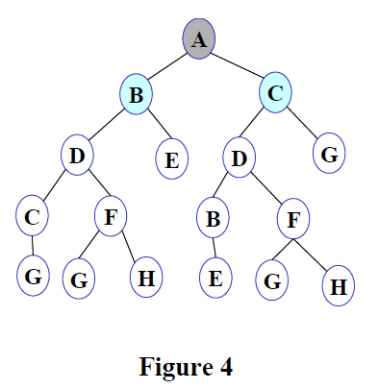

Step 2: A is removed from fringe. The node is expanded, and its children B and C are generated. They are placed at the back of fringe.

Slide 84
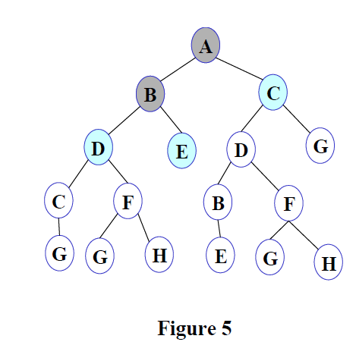
Step 3: Node B is removed from fringe and is expanded. Its children D, E are generated and put at the back of fringe.
Version

Slide 85
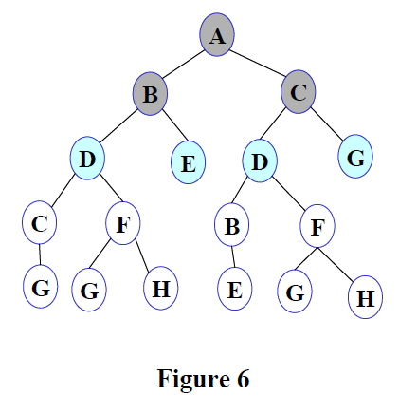

Step 4: Node C is removed from fringe and is expanded. Its children D and G are added to the back of fringe.

Slide 86
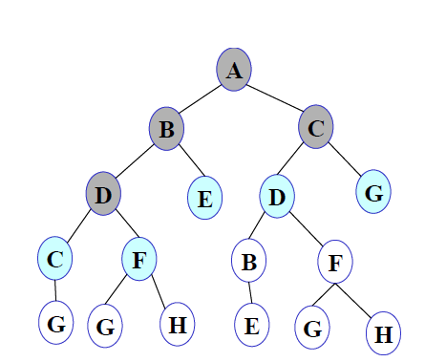

Step 5: Node D is removed from fringe. Its children C and F are generated and added to the back of fringe.

Slide 87
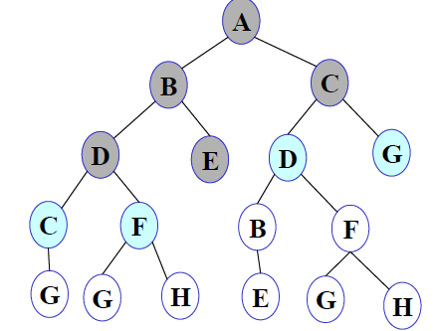

Step 6: Node E is removed from fringe. It has no children.

Slide 88
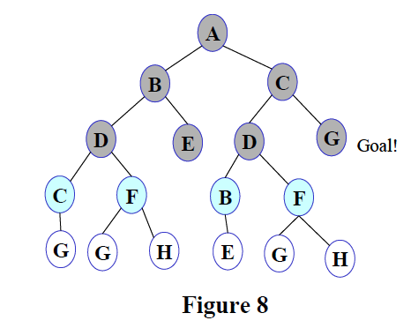
Step 7: D is expanded, B and F are put in OPEN.
Step 8: G is selected for expansion. It is found to be a goal node. So the algorithm returns the path A C G by following the parent pointers of the node corresponding to G. The algorithm terminates.

Slide 89
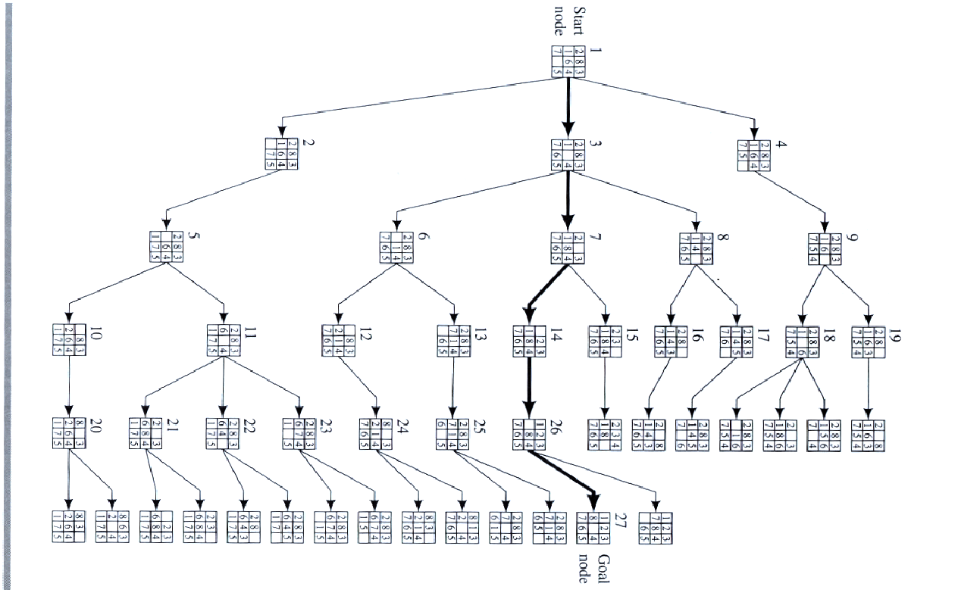
Example BFS

Slide 90
What is the Complexity of Breadth-First Search?
Time Complexity
  assume (worst case) that there is 1 goal leaf at the RHS
  so BFS will expand all nodes
  = 1 + b + b²+ ......... + b^{d}
  = O (b^{d})
Space Complexity
  how many nodes can be in the queue (worst-case)?
  at depth d-1 there are b^{d} unexpanded nodes in the Q = O (b^{d})
d=0
d=1
d=2
G
d=0
d=1
d=2
G

Slide 91
Properties of Breadth-First Search
Time Complexity: Time Complexity of BFS algorithm can be obtained by the number of nodes traversed in BFS until the shallowest Node. Where the d= depth of shallowest solution and b is a node at every state.
T (b) = 1+b²+b³+.......+ b^{d}= O (b^{d})
Space Complexity: Space complexity of BFS algorithm is given by the Memory size of frontier which is O(b^{d}).
Completeness: BFS is complete, which means if the shallowest goal node is at some finite depth, then BFS will find a solution.
Optimality: BFS is optimal if path cost is a non-decreasing function of the depth of the node.

Slide 92
Advantages & Disadvantages of Breadth First Search
Advantages of Breadth First Search
BFS will provide a solution if any solution exists.
If there are more than one solutions for a given problem, then BFS will provide the minimal solution which requires the least number of steps.
Disadvantages of Breadth First Search
It requires lots of memory since each level of the tree must be saved into memory to expand the next level.
BFS needs lots of time if the solution is far away from the root node.

Slide 93
Lessons From Breadth First Search
The memory requirements are a bigger problem for breadth-first search than is execution time
Exponential-complexity search problems cannot be solved by uniformed methods

Slide 94
Depth-First Search
Depth-first search isa recursive algorithm for traversing a tree or graph data structure.
It is called the depth-first search because it starts from the root node and follows each path to its greatest depth node before moving to the next path.
DFS uses a stack data structure for its implementation.
The process of the DFS algorithm is similar to the BFS algorithm.

Slide 95
Depth first Search
Algorithm
Let fringe be a list containing the initial state
Loop
if fringe is empty return failure
Node🡨 remove-first (fringe)
if Node is a goal
then return the path from initial state to Node
else generate all successors of Node, and
merge the newly generated nodes into fringe
add generated nodes to the front of fringe
End Loop

Slide 96
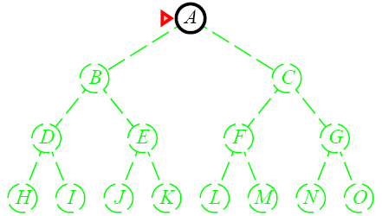
Depth-First Search

Slide 97
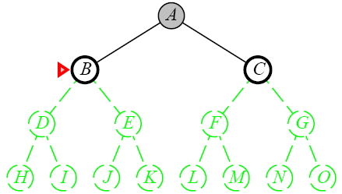
Depth-First Search

Slide 98
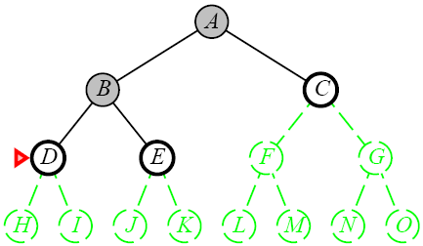
Depth-First Search

Slide 99
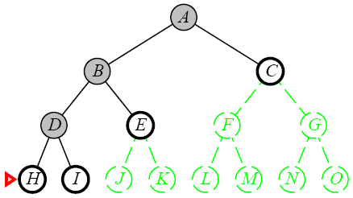
Depth-First Search

Slide 100
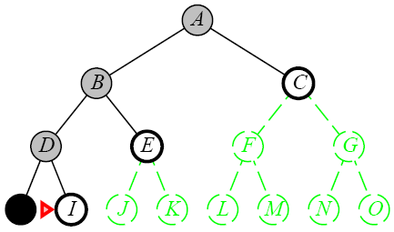
Depth-First Search

Slide 101
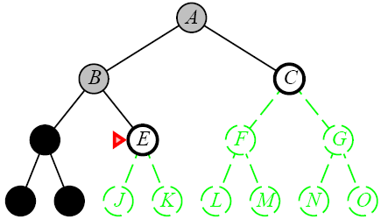
Depth-First Search

Slide 102
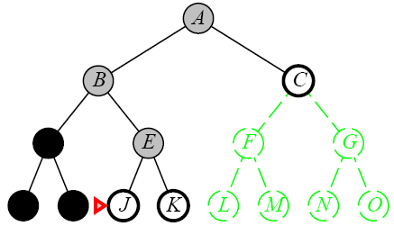
Depth-First Search

Slide 103
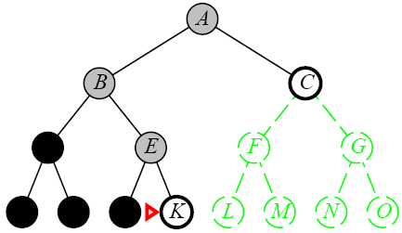
Depth-First Search

Slide 104
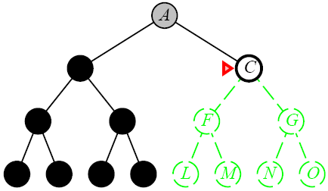
Depth-First Search

Slide 105
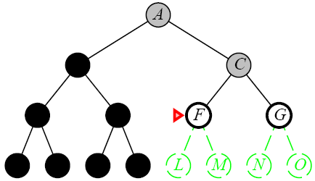
Depth-First Search

Slide 106
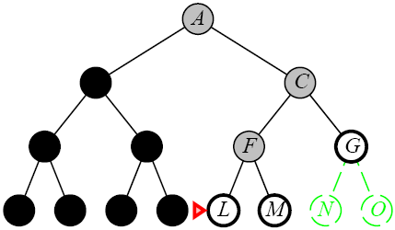
Depth-First Search

Slide 107
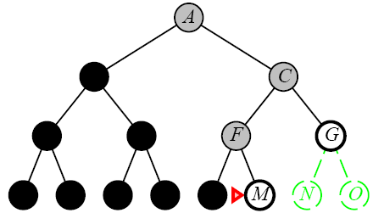
Depth-First Search

Slide 108


Let us now run Depth First Search on the search space given in Figure 34, and trace its progress.

Slide 109


Depth-First Search
Step 1: Initially fringe contains only the node for A.

Slide 110

Depth-First Search
Step 2: A is removed from fringe. A is expanded and its children B and C are put in front of fringe.

Slide 111

Depth-First Search
Step 3: Node B is removed from fringe, and its children D and E are pushed in front of fringe.

Slide 112

Depth-First Search
Step 4: Node D is removed from fringe. C and F are pushed in front of fringe.

Slide 113

Depth-First Search
Step 5: Node C is removed from fringe. Its child G is pushed in front of fringe

Slide 114

Depth-First Search
Step 6: Node G is expanded and found to be a goal node. The solution path A-B-D-C-G is returned and the algorithm terminates.

Slide 115


Depth-First Search on 8 Puzzle

Slide 116


Slide 117
Advantages and Disadvantages of DFS
Advantage:
DFS requires very less memory as it only needs to store a stack of the nodes on the path from root node to the current node.
It takes less time to reach to the goal node than BFS algorithm (if it traverses in the right path).
Disadvantage:
There is the possibility that many states keep re-occurring, and there is no guarantee of finding the solution.
DFS algorithm goes for deep down searching and sometime it may go to the infinite loop.

Slide 118
What is the Complexity of Depth-First Search?
Time Complexity
  assume (worst case) that there is 1 goal leaf at the RHS
  so DFS will expand all nodes
  =1 + b + b²+ ......... + b^{d}
  = O (b^{d}) )(Best case)
Space Complexity
  how many nodes can be in the queue (worst-case)?
  at depth l < d we have b-1 nodes
  at depth d we have b nodes
  total = (d-1)*(b-1) + b = O(bd)
d=0
d=1
d=2
G
d=0
d=1
d=2
d=3
d=4

Slide 119
Depth-First Search
Completeness: DFS search algorithm is complete within finite state space as it will expand every node within a limited search tree.
Time Complexity: Time complexity of DFS will be equivalent to the node traversed by the algorithm. It is given by:
T(n)= 1+ n²+ n³ +.........+ n^{m}=O(n^{m})
Where, m= maximum depth of any node and this can be much larger than d
(Shallowest solution depth)
Space Complexity: DFS algorithm needs to store only single path from the root node, hence space complexity of DFS is equivalent to the size of the fringe set, which is O(bm).
Optimal: DFS search algorithm is non-optimal, as it may generate a large number of steps or high cost to reach to the goal node.

Slide 120
Advantages and Disadvantages of Depth limited search
Advantages:
Depth-limited search is Memory efficient.
Disadvantages:
Depth-limited search also has a disadvantage of incompleteness.
It may not be optimal if the problem has more than one solution.

Slide 121
Depth Limited Search (DLS):
To avoid infinite search of DFS
Stop DFS at a fixed depth l, no mater what
Goal, may NOT be found: Incomplete Algorithm
  If goal depth d > l
Why DLS? To avoid getting stuck at infinite (read: large) depth
Time: O(b^{l}), Memory: O(bl)
Goal

Slide 122
Depth-Limited Search
A depth-limited search algorithm is similar to depth-first search with a predetermined limit.
Depth-limited search can solve the drawback of the infinite path in the Depth-first search.
In this algorithm, the node at the depth limit will treat as it has no successor nodes further.
Depth-limited search can be terminated with two Conditions of failure:
Standard failure value: It indicates that problem does not have any solution.
Cutoff failure value: It defines no solution for the problem within a given depth limit.

Slide 123

Depth-Limited Search

Slide 124


Slide 125
Depth-Limited Search Properties
Completeness: DLS search algorithm is complete if the solution is above the depth-limit.
Time Complexity: Time complexity of DLS algorithm is O(b^{ℓ}).
Space Complexity: Space complexity of DLS algorithm is O(b×ℓ).
Optimal: Depth-limited search can be viewed as a special case of DFS, and it is also not optimal even if ℓ>d.

Slide 126
Uninformed : Iterative Deepening Search(IDS)
The iterative deepening algorithm is a combination of DFS and BFS algorithms. This search algorithm finds out the best depth limit and does it by gradually increasing the limit until a goal is found.
This algorithm performs depth-first search up to a certain "depth limit", and it keeps increasing the depth limit after each iteration until the goal node is found.
This Search algorithm combines the benefits of Breadth-first search's fast search and depth-first search's memory efficiency.
The iterative search algorithm is useful uninformed search when search space is large, and depth of goal node is unknown.

Slide 127
Advantages and Disadvantages of IDS
Advantages:
It combines the benefits of BFS and DFS search algorithm in terms of fast search and memory efficiency.
Disadvantages:
The main drawback of IDDFS is that it repeats all the work of the previous phase.

Slide 128

Iterative Deepening Search

Slide 129


Example:
Following tree structure is showing the iterative deepening depth-first search. IDDFS algorithm performs various iterations until it does not find the goal node. The iteration performed by the algorithm is given as:

Slide 130

Iterative Deepening Search

Slide 131
Iterative Deepening Search

Slide 132

Iterative Deepening Search

Slide 133

Iterative Deepening Search

Slide 134
Iterative Deepening Search
Completeness:
This algorithm is complete is if the branching factor is finite.
Time Complexity:
Let's suppose b is the branching factor and depth is d then the worst-case time complexity is O(b^{d}).
Space Complexity:
The space complexity of IDDFS will be O(bd).
Optimal:
IDDFS algorithm is optimal if path cost is a non- decreasing function of the depth of the node.

Slide 135
Lessons From Iterative Deepening Search
Faster than BFS even though IDS generates repeated states
  BFS generates nodes up to level d+1
  IDS only generates nodes up to level d
In general, iterative deepening search is the preferred uninformed search method when there is a large search space and the depth of the solution is not known

Slide 136

Bi-directional search
Bidirectional search algorithm runs two simultaneous searches, one form initial state called as forward-search and other from goal node called as backward-search, to find the goal node.
Bidirectional search replaces one single search graph with two small subgraphs in which one starts the search from an initial vertex and other starts from goal vertex.
The search stops when these two graphs intersect each other.
Bidirectional search can use search techniques such as BFS, DFS, DLS, etc.

Slide 137
Bi-directional search
Works well only when there are unique start and goal states.
Requires the ability to generate “predecessor” states.
Can (sometimes) lead to finding a solution more quickly.
Time complexity: O(b^{d/2}). Space complexity: O(b^{d/2}).
Advantages:
Bidirectional search is fast.
Bidirectional search requires less memory
Disadvantages:
Implementation of the bidirectional search tree is difficult.
In bidirectional search, one should know the goal state in advance.

Slide 138

Example: BDS
In the below search tree, bidirectional search algorithm is applied. This algorithm divides one graph/tree into two sub-graphs. It starts traversing from node 1 in the forward direction and starts from goal node 16 in the backward direction.
The algorithm terminates at node 9 where two searches meet.

Slide 139

Also note that the algorithm works well only when there are unique start and goal states.

Slide 140
Time and Space Complexities
Completeness: Bidirectional Search is complete if we use BFS in both searches.
Time Complexity: Time complexity of bidirectional search using BFS is O(b^{d}).
Space Complexity: Space complexity of bidirectional search is O(b^{d}).
Optimal: Bidirectional search is Optimal.

Slide 141
Summary of algorithms
Criterion | Breadth-First | Uniform-Cost | Depth-First | Depth-Limited | Iterative Deepening DLS | Bidirectional (if applicable)
Complete? | Yes[a] | Yes[a,b] | No | No | Yes[a] | Yes[a,d]
Time | O(b^{d}) | O(b^{⎣1+C*/ε⎦}) | O(b^{m}) | O(b^{l}) | O(b^{d}) | O(b^{d/2})
Space | O(b^{d}) | O(b^{⎣1+C*/ε⎦}) | O(bm) | O(bl) | O(bd) | O(b^{d/2})
Optimal? | Yes[c] | Yes | No | No | Yes[c] | Yes[c,d]
There are a number of footnotes, caveats, and assumptions.
See Fig. 3.21, p. 91.
[a] complete if b is finite
[b] complete if step costs ≥ ε > 0
[c] optimal if step costs are all identical
(also if path cost non-decreasing function of depth only)
[d] if both directions use breadth-first search
(also if both directions use uniform-cost search with step costs ≥ ε > 0)
Note that d ≤ ⎣1+C*/ε⎦
Generally the preferred
uninformed search strategy

Slide 142
5.Uniform-cost search
Uniform-cost search is a searching algorithm used for traversing a weighted tree or graph.
This algorithm comes into play when a different cost is available for each edge.
The primary goal of the uniform-cost search is to find a path to the goal node which has the lowest cumulative cost.
Uniform-cost search expands nodes according to their path costs form the root node.
It can be used to solve any graph/tree where the optimal cost is in demand.
A uniform-cost search algorithm is implemented by the priority queue.
It gives maximum priority to the lowest cumulative cost.
Uniform cost search is equivalent to BFS algorithm if the path cost of all edges is the same.
This ensures that when a node is selected for expansion it is a node with the cheapest cost among the nodes in OPEN, “priority queue”
Let g(n) = cost of the path from the start node to the current node n. Sort nodes by increasing value of g.

Slide 143

Uniform-cost search
Advantages:
Uniform cost search is optimal because at every state the path with the least cost is chosen.
Disadvantages:
It does not care about the number of steps involve in searching and only concerned about path cost. Due to which this algorithm may be stuck in an infinite loop.

Slide 144
Uniform Cost Search in Tree
fringe 🡨 MAKE-EMPTY-QUEUE()
fringe 🡨 INSERT( root_node ) // with g=0
loop {
  if fringe is empty then return false // finished without goal
  node 🡨 REMOVE-SMALLEST-COST(fringe)
  if node is a goal
    print node and g
    return true // that found a goal
  L_{g} 🡨 EXPAND(node) // L_{g} is set of children with their g costs
  // NOTE: do not check L_{g} for goals here!!
  fringe 🡨 INSERT-ALL(L_{g}, fringe )
}

Slide 145
Uniform Cost Search in Graph
fringe 🡨 MAKE-EMPTY-QUEUE()
fringe 🡨 INSERT( root_node ) // with g=0
loop {
  if fringe is empty then return false // finished without goal
  node 🡨 REMOVE-SMALLEST-COST(fringe)
  if node is a goal
    print node and g
    return true // that found a goal
  L_{g} 🡨 EXPAND(node) // L_{g} is set of neighbours with their g costs
  // NOTE: do not check L_{g} for goals here!!
  fringe 🡨 INSERT-IF-NEW(L_{g}, fringe ) // ignore revisited nodes
  // unless is with new better g
}

Slide 146
Uniform cost search Properties
Completeness:
Uniform-cost search is complete, such as if there is a solution, UCS will find it.
Time Complexity:
Let C* is Cost of the optimal solution, and ε is each step to get closer to the goal node. Then the number of steps is = C*/ε+1. Here we have taken +1, as we start from state 0 and end to C*/ε.
Hence, the worst-case time complexity of Uniform-cost search is O(b^{1 + [C*/ε]})/.
Space Complexity:
The same logic is for space complexity so, the worst-case space complexity of Uniform-cost search is O(b^{1 + [C*/ε]}).
Optimal:
Uniform-cost search is always optimal as it only selects a path with the lowest path cost.

Slide 147
Consider the following problem…
A
1
10
5
5
S
B
G
15
5
C
We wish to find the shortest route from node S to node G; that is, node S is the initial state and node G is the goal state. In terms of path cost, we can clearly see that the route SBG is the cheapest route. However, if we let breadth-first search chose on the problem it will find the non-optimal path SAG, assuming that A is the first node to be expanded at level 1. Press space to see a UCS of the same node set…

Slide 148
Node A is removed from the queue and the revealed node (node G) is added to the queue. The queue is again sorted on path cost. Note, we have now found a goal state but do not recognise it as it is not at the front of the queue. Node B is the cheaper node. Press space.
Once node B has been expanded it is removed from the queue and the revealed node (node G) is added. The queue is again sorted on path cost. Note, node G now appears in the queue twice, once as G10 and once as G11. As G10 is at the front of the queue, we now proceed to goal state. Press space.
We now expand the node at the front of the queue, node A. Press space to continue.
Node S is removed from the queue and the revealed nodes are added to the queue. The queue is then sorted on path cost. Nodes with cheaper path cost have priority.In this case the queue will be Node A (1), node B (5), followed by node C (15). Press space.
We start with our initial state and expand it…
A
A
1
10
5
5
S
S
B
B
G
G
G
G
G
G
The goal state is achieved and the path S-B-G is returned. In relation to path cost, UCS has found the optimal route. Press space to end.
15
C
Press space to begin the search
Size of Queue: 0
Size of Queue: 1
Size of Queue: 3
Size of Queue: 0
Queue: Empty
Queue: S
Queue: A, B, C
Queue: B, G11, C
Queue: G10, G11, C15
Queue: Empty
Nodes expanded: 0
Nodes expanded: 1
Nodes expanded: 2
Nodes expanded: 3
Current action: Waiting….
Current action: Expanding
Current action: Backtracking
Current action: Expanding
FINISHED SEARCH
Current level: n/a
Current level: 0
Current level: 1
Current level: 0
Current level: 1
Current level: 2
UNIFORM COST SEARCH PATTERN

Slide 149
Uniform-Cost Search
GENERAL-SEARCH(problem, ENQUEUE-BY-PATH-COST)
exp. node nodes list CLOSED list
S
1
8
5
A
B
C
3
9
4
5
7
D
E
G
G’
G”

Slide 150
Uniform-Cost Search
GENERAL-SEARCH(problem, ENQUEUE-BY-PATH-COST)
exp. node nodes list CLOSED list
{S(0)}
S {A(1) B(5) C(8)}
A {D(4) B(5) C(8) E(8) G(10)}
D {B(5) C(8) E(8) G(10)}
B {C(8) E(8) G’(9) G(10)}
C {E(8) G’(9) G(10) G”(13)}
E {G’(9) G(10) G”(13) }
G’ {G(10) G”(13) }
Solution path found is S B G <-- this G has cost 9, not 10
Number of nodes expanded (including goal node) = 7
S
1
8
5
A
B
C
3
9
4
5
7
D
E
G
G’
G”

Slide 151
Uniform-Cost (UCS)
It is complete (if cost of each action is not infinitesimal)
  The total # of nodes n with g(n) <= g(goal) in the state space is finite
Optimal/Admissible
  It is admissible if the goal test is done when a node is removed from the OPEN list (delayed goal testing), not when it's parent node is expanded and the node is first generated
Exponential time and space complexity, O(b^d) where d is the depth of the solution path of the least cost solution

Slide 152

Comparing Search Strategies
And how on our small example?

Slide 153
How they perform
Depth-First Search:
  Expanded nodes: S A D E G
  Solution found: S A G (cost 10)
Breadth-First Search:
  Expanded nodes: S A B C D E G
  Solution found: S A G (cost 10)
Uniform-Cost Search:
  Expanded nodes: S A D B C E G
  Solution found: S B G (cost 9)
  This is the only uninformed search that worries about costs.
Depth First Iterative-Deepening Search:
  nodes expanded: S S A B C S A D E G
  Solution found: S A G (cost 10)
S
1
8
5
A
B
C
3
9
7
4
5
D
E
G
Depth-First Search:
Breadth-First Search:
Uniform-Cost Search:
Iterative-Deepening Search:

Slide 154
When to use what?
Depth-First Search:
  Many solutions exist
  Know (or have a good estimate of) the depth of solution
Breadth-First Search:
  Some solutions are known to be shallow
Uniform-Cost Search:
  Actions have varying costs
  Least cost solution is the required
  This is the only uninformed search that worries about costs.
Iterative-Deepening Search:
  Space is limited and the shortest solution path is required

Slide 155
Search Graphs
If the search space is not a tree, but a graph, the search tree may contain different nodes corresponding to the same state.
The way to avoid generating the same state again when not required
The search algorithm can be modified to check a node when it is being generated.
we use another list called CLOSED,
which records all the expanded nodes.
The newly generated node is checked with the nodes in CLOSED list & open list,

Slide 156

Algorithm outline-
The CLOSED list has to be maintained,
the algorithm is required to check every generated node to see if it is already there in OPEN or CLOSED.
this will require efficient way to index every node.
S🡪 Set of successor
M🡪node going to be generated

Slide 157
End of Part-3
(Blind Search Algorithms)

Slide 158
Informed Search
So far we have talked about the uninformed search algorithms which looked through search space for all possible solutions of the problem without having any additional knowledge about search space.
But informed search algorithm contains an array of knowledge such as how far we are from the goal, path cost, how to reach to goal node, etc.
This knowledge help agents to explore less to the search space and find more efficiently the goal node.
The informed search algorithm is more useful for large search space. Informed search algorithm uses the idea of heuristic, so it is also called Heuristic search.
At the heart of such algorithms there is the concept of a heuristic function.

Slide 159
Heuristics
Heuristic “Heuristics are criteria, methods or principles for deciding which among several alternative actions, promises to be the most effective in order to achieve some goal”.
quote by Judea Pearl
In heuristic search or informed search, heuristics are used to identify the most promising search path.
Admissibility of the heuristic function is given as:
h(n) <= h*(n)
Here h(n) is heuristic cost, and h*(n) is the estimated cost. Hence heuristic cost should be less than or equal to the estimated cost.

Slide 160
Example of Heuristic Function
A heuristic at a node n is an estimate of the optimum cost from the current node to a goal. It is denoted by h(n).
h(n) = estimated cost of the cheapest path from node n to a goal node
Example 1: We want a path from Kolkata to Guwahati
Heuristic for Guwahati may be straight-line distance between Kolkata and Guwahati
h(Kolkata) = euclideanDistance(Kolkata, Guwahati)

Slide 161

Example 2: 8-puzzle: Misplaced Tiles Heuristics is the number of tiles out of place.
1. Hamming distance The first picture shows the current state n, and the second picture the goal state.
h(n) = 5 (because the tiles 2, 8, 1, 6 and 7 are out of place. )
2. Manhattan Distance Heuristic:
This heuristic sums the distance that the tiles are out of place.
The distance of a tile is measured by the sum of the differences in the
x-positions and the y-positions.
For the above example, using the Manhattan distance heuristic,
h(n) = 1 + 1 + 0 + 0 + 0 + 1 + 1 + 2 = 6

Slide 162

Heuristic Search Algorithm Best-First Search.
The algorithm maintains a priority queue of nodes to be explored
A cost function f(n) is applied to each node.
The nodes are put in OPEN in the order of their f values.
Nodes with smaller f(n) values are expanded earlier.

Slide 163
Example of best first search
Nodes are visited in the order : a, b, c, f
Solution path is : a, c, f
a
h’=1.6
h’=0.7
b
c
h’=0.8
h’=1.8
d
h’=0.9
e
h’=0
f
h’=2.7
g
h
h’=4.9
i
h’=3.7
j
h’=0
k
h’=6.2
We will now consider different ways of defining the function f.
This leads to different search algorithms

Slide 164

Applying Best first search to solved 8 puzzle problem

Slide 165
Greedy Search
Greedy best-first search algorithm always selects the path which appears best at that moment.
It is the combination of depth-first search and breadth-first search algorithms.
It uses the heuristic function and search. In this search algorithm, we expand the node which is closest to the goal node and the closest cost is estimated by heuristic function,
i.e. f(n)= g(n).
Were, h(n)= estimated cost from node n to the goal.
The greedy best first algorithm is implemented by the priority queue.

Slide 166
Greedy Best first search algorithm
Step 1: Place the starting node into the OPEN list.
Step 2: If the OPEN list is empty, Stop and return failure.
Step 3: Remove the node n, from the OPEN list which has the lowest value of h(n), and places it in the CLOSED list.
Step 4: Expand the node n, and generate the successors of node n.
Step 5: Check each successor of node n, and find whether any node is a goal node or not. If any successor node is goal node, then return success and terminate the search, else proceed to Step 6.
Step 6: For each successor node, algorithm checks for evaluation function f(n), and then check if the node has been in either OPEN or CLOSED list. If the node has not been in both list, then add it to the OPEN list.
Step 7: Return to Step 2.

Slide 167
Greedy Search
Advantages:
Best first search can switch between BFS and DFS by gaining the advantages of both the algorithms.
This algorithm is more efficient than BFS and DFS algorithms.
Disadvantages:
It can behave as an unguided depth-first search in the worst case scenario.
It can get stuck in a loop as DFS.
This algorithm is not optimal.

Slide 169

Romania with step costs in km

Slide 170
Greedy best-first search
  expand the node that is closest to the goal : Straight line distance heuristic

Slide 171
Greedy best-first search properties
Time Complexity: The worst case time complexity of Greedy best first search is O(b^{m}).
Space Complexity: The worst case space complexity of Greedy best first search is O(b^{m}). Where, m is the maximum depth of the search space.
Complete: Greedy best-first search is also incomplete, even if the given state space is finite.
Optimal: Greedy best first search algorithm is not optimal.

Slide 172


Greedy best-first search example

Slide 173

Greedy best-first search example

Slide 174

Greedy best-first search example

Slide 175

Greedy best-first search example

Slide 176
Optimal Path

Slide 177
Greedy best-first search example

Slide 178
Greedy best-first search example

Slide 179
Greedy best-first search example

Slide 180
Greedy best-first search example

Slide 181
Greedy best-first search example

Slide 182
Greedy best-first search example

Slide 183
Greedy best-first search example

Slide 184
Greedy best-first search example

Slide 185
Romania with step costs in km
R1🡪 Arad🡪sibiu🡪fagaras🡪Bucharest =140+99+211=450

Slide 186
Romania with step costs in km
R1
R2
R1🡪 Arad🡪sibiu🡪fagaras🡪Bucharest =140+99+211=450 (Greedy)
R2 🡪 Arad🡪sibiu🡪Rimnicu vilcea🡪pitesti🡪Bucharest =140+80+97+101=418

Slide 187

A* Algorithm
The famous A* algorithm. Nilsson & Rafael in 1968.
In A* search algorithm, we use search heuristic as well as the cost to reach the node. Hence we can combine both costs as following, and this sum is called as a fitness number.
A* is a best first search f(n) = g(n) + h’(n)
  g(n) = sum of edge costs from start to n(start node 🡺 current node)
  h’(n) = estimate of lowest cost path from n to goal
  f’(n) = actual distance so far + estimated distance remaining (n 🡺 goal)

Slide 188
h(n) is said to be admissible if it underestimates the cost of solution that can be reached from n.
If C*(n) is the cost of the cheapest sol path from n to goal & if h’ is admissible,
  h’(n) <= C*(n).
we can prove that if h’(n) is admissible, then the search will find an optimal solution.

Slide 189
Advantages and Disadvantages of A* search
Advantages:
A* search algorithm is the best algorithm than other search algorithms.
A* search algorithm is optimal and complete.
This algorithm can solve very complex problems.
Disadvantages:
It does not always produce the shortest path as it mostly based on heuristics and approximation.
A* search algorithm has some complexity issues.
The main drawback of A* is memory requirement as it keeps all generated nodes in the memory, so it is not practical for various large-scale problems.

Slide 190

n
e
m
(m,p) (p|e)-current
(m,q)-previously calculated distance

Slide 191
A* search: properties
Points to remember:
A* algorithm returns the path which occurred first, and it does not search for all remaining paths.
The efficiency of A* algorithm depends on the quality of heuristic.
A* algorithm expands all nodes which satisfy the condition f(n)
Complete: A* algorithm is complete as long as:
  Branching factor is finite, Cost at every action is fixed.
Optimal: A* search algorithm is optimal if it follows below two conditions:
Admissible: The first condition requires for optimality is that h(n) should be an admissible heuristic for A* tree search. An admissible heuristic is optimistic in nature.
Consistency: Second required condition is consistency for only A* graph-search.
If the heuristic function is admissible, then A* tree search will always find the least cost path.
Time Complexity: The time complexity of A* search algorithm depends on heuristic function, and the number of nodes expanded is exponential to the depth of solution d. So the time complexity is O(b^d), where b is the branching factor.
Space Complexity: The space complexity of A* search algorithm is O(b^d)

Slide 192
Example of A* search
a
h’=1.6
h’=0.7
b
c
h’=0.8
h’=1.8
d
h’=0.9
e
h’=0
f
h’=2.7
g
h
h’=4.9
i
h’=3.7
j
h’=0
k
h’=6.2
Cost per arc = 1
h’ values are admissible, e.g. at b, actual cost of reaching goal (j) is 1+1=2 but h’ is only 0.7. At b, f (b) =g (b) + h’ (b) = 1 + 0.7 =1.7

Slide 193

A* search example

Slide 194

A* search example

Slide 195

A* search example

Slide 196

A* search example

Slide 197

A* search example

Slide 198

A* search example

Slide 199


A* Search
140

Slide 200

A* Search

Slide 201

A* Search

Slide 202

A* Search

Slide 203

A* Search

Slide 204
Romania with step costs in km
R1
R2
R1🡪 Arad🡪sibiu🡪fagaras🡪Bucharest =140+99+211=450 (Greedy)
R2 🡪 Arad🡪sibiu🡪Rimnicu vilcea🡪pitesti🡪Bucharest =140+80+97+101=418(A*)

Slide 205
AO* GRAPH AND-OR GRAPH
• The Depth first search and Breadth first search given earlier for OR trees or graphs can be easily adopted by AND-OR graph.
• The main difference lies in the way termination conditions are determined, since all goals following an AND nodes must be realized; whereas a single goal node following an OR node will do.
• So for this purpose we are using AO* algorithm.
• Like A* algorithm here we will use two arrays and one heuristic function.
• OPEN: • It contains the nodes that has been traversed but yet not been marked solvable or unsolvable.
• CLOSE: • It contains the nodes that have already been processed.

Slide 206
ALGORITHM
Step 1: Place the starting node into OPEN.
Step 2: Compute the most promising solution tree say T0.
Step 3: Select a node n that is both on OPEN and a member of T0. Remove it from OPEN and place it in CLOSE
Step 4: If n is the terminal goal node then level n as solved and level . all the ancestors of n as solved.
If the starting node is marked as solved then success and exit.
Step 5: If n is not a solvable node, then mark n as unsolvable.
If starting node is marked as unsolvable, then return failure and
exit.
Step 6: Expand n. Find all its successors and find their h (n) value, push them into OPEN.
Step 7: Return to Step 2.
Step 8: Exit

Slide 207

EXAMPLE FOR IMPLEMENTATION
Let us take the following example to implement the AO* algorithm

Slide 208




Slide 209



Slide 210




Slide 211
ADVANTAGES AND DISADVANTAGES OF AO*
Advantages:
It is an optimal algorithm.
If traverse according to the ordering of nodes. It can be used for both OR and AND graph.
Disadvantages:
Sometimes for unsolvable nodes, it can’t find the optimal path.

Slide 212

Problem Reduction/Decomposition with AO*
When a problem can be divided into a set of sub problems, where each sub problem can be solved separately and a combination of these will be a solution, AND-OR graphs or AND – OR trees are used for representing the solution.
The decomposition of the problem or problem reduction generates AND arcs.
One AND arc may point to any number of successor nodes, these must be solved so that the arc will rise to many arcs, indicating several possible solutions.
Hence the graph is known as AND - OR instead of AND

Slide 213

An algorithm to find a solution in an AND - OR graph must handle AND area appropriately. A* algorithm can not search AND - OR graphs efficiently
In figure (a) the top node A has been expanded producing two area one leading to B and leading to C-D .
the numbers at each node represent the value of f ' at that node (cost of getting to the goal state from current state).
For simplicity, it is assumed that every operation(i.e. applying a rule) has unit cost, i.e., each are with single successor will have a cost of 1 and each of its components.
With the available information till now , it appears that C is the most promising node to expand since its f ' = 3 , the lowest but going through B would be better since to use C we must also use D' and the cost would be 9(3+4+1+1). Through B it would be 6(5+1).

Slide 214

Thus the choice of the next node to expand depends not only n a value but also on whether that node is part of the current best path form the initial mode
the node G appears to be the most promising node, with the least f ' value. But G is not on the current best path, since to use G we must use GH with a cost of 9 and again this demands that arcs be used (with a cost of 27).
The path from A through B, E-F is better with a total cost of (17+1=18).
Thus we can see that to search an AND-OR graph, the following three things must
be done
  1. traverse the graph starting at the initial node and following the current best path, accumulate the set of nodes that are on the path and have not yet been expanded.
  2. Pick one of these unexpanded nodes and expand it. Add its successors to the
graph and compute f ' (cost of the remaining distance) for each of them
  3. Change the f ' estimate of the newly expanded node to reflect the new information produced by its successors. Propagate this change backward through the graph. Decide which of the current best path
.

Slide 215

The initial node is expanded and D is Marked initially as promising node.
D is expanded producing an AND arc E-F. f ' value of D is updated to 10.
Going backwards we can see that the AND arc B-C is better, it is now marked as current best path.
B and C have to be expanded next. This process continues until a solution is found or all paths have led to dead ends, indicating that there is no solution.
An A* algorithm the path from one node to the other is always that of the lowest cost and it is independent of the paths through other nodes

Slide 216
Problem decomposition into an and-or graph
Example 2
"The function of a financial advisor is to help the user decide whether to invest in a savings account, or the stock market, or both. The recommended investment depends on the investor's income and the current amount they have saved:

Slide 217
Problem decomposition into an and-or graph
Individuals with inadequate savings should always increase the amount saved as their first priority, regardless of income.
Individuals with adequate savings and an adequate income should consider riskier but potentially more profitable investment in the stock market.
Individuals with low income who already have adequate savings may want to consider splitting their surplus income between savings and stocks, to increase the cushion in savings while attempting to increase their income through stocks.
The adequacy of both savings and income is determined by the number of dependants an individual must support.
There must be at least £3000 in the bank for each dependant.
An adequate income is a steady income, and it must supply at least £9000 per year, plus £2500 for each dependant."

Slide 218
Problem decomposition into an and-or graph
How can we turn this information into an and-or graph?
Step 1: decide what the ultimate advice that the system should provide is.
It’s a statement along the lines of “The investment should be X”, where X can be any one of several things.
Advise user: investment should be X

Slide 219

Step 2: decide what sub-goals this goal can be split into.
In this case, X can be one of three things: savings, stocks or a mixture.
Add three sub-goals to the graph. Make sure the links indicate “or” rather than “and”.

Slide 220

Steps 3a, 3b and 3c: decide what sub-goals each of the goals at the bottom of the graph can be split into.
  It’s only true that “X is savings” if “savings are inadequate”. That provides a subgoal under “X is savings”
  It’s only true that “X is stocks” if “savings are adequate” and “income is adequate. That provides two subgoals under “X is stocks” joined by “and” links.
  Similarly, there are two subgoals under “X is mixture” joined by “and” links.

Slide 221
The next steps (4a,4b,4c,4d & 4e) mainly involve deciding whether something’s big enough.
  Step 4a: savings are only inadequate if they are smaller than a certain figure (let’s call it Y).
  Step 4b: savings are only adequate if they are bigger than this figure (Y).
  Step 4c: income is only adequate if it is bigger than a certain figure (let’s call it W), and also steady.
  Step 4d is the same as 4b. Step 4e is like 4c, but “inadequate”, “smaller” and “not steady”.

Slide 222
Advise user: investment should be X
X is savings
X is stocks
X is mixture
Savings are inadequate
Savings are adequate
Income is adequate
Savings are adequate
Income is inadequate
Amount saved < Y
Amount saved > Y
Income is steady
Income > W
Income < W
Income is not steady

Slide 223
Now we need a box in which the value of Y & W is calculated:
Y is Z times 3000
W is 9000 plus 2500 times Z
Z is the number of dependants, so we need a box in which this value is obtained:
Client has Z dependants
the bottom layers of the graph in the same way as we’ve added all the others:

Slide 224


Slide 225
Production rule: if savings adequate and income adequate then X is stocks

Slide 226
Production rule: if income < W and income is not steady
then income is
inadequate

Slide 227
Local Search Algorithm

Slide 228
MORE SEARCH ALGORITHMS
Local search: Only achieving a goal is needed,
  not the path to the goal
Possibilities:
  Non-determinism in state space (graph)
  Partially-observable state space
  On-line search (full search space is not available)

Slide 229
Local search algorithms and optimization
Systematic search algorithms to find the goal
Local search algorithms
  the path to the goal is irrelevant, e.g., n-queens problem
  state space = set of “complete” configurations
  keep a single “current” state and try to improve it, e.g., move to its neighbors
  Key advantages:
    use very little (constant) memory
    find reasonable solutions in large or infinite (continuous) state spaces
  Optimization problem (pure)-
    to find the best state (optimal configuration ) based on an objective function, e.g. reproductive fitness – no goal test and path cost
Instead of considering the whole state space, consider only the current state
Limits necessary memory; paths not retained
Amenable to large or continuous (infinite) state spaces where exhaustive algorithms aren’t possible
Local search algorithms can’t backtrack!

Slide 230

State-space Diagram/landscape for Hill Climbing
  Elevation = the value of the objective function or heuristic cost function
The state-space landscape is a graphical representation of the hill-climbing algorithm which is showing a graph between various states of algorithm and Objective function/Cost.
On Y-axis we have taken the function which can be an objective function or cost function, and state-space on the x-axis. If the function on Y-axis is cost then, the goal of search is to find the global minimum and local minimum. If the function of Y-axis is Objective function, then the goal of the search is to find the global maximum and local maximum.

Slide 231


1. Hill-Climbing Search
What we think hill-climbing looks like
What we learn hill-climbing is
Usually like

Slide 232
Hill-Climbing Algorithm
Hill climbing algorithm is a local search algorithm which continuously moves in the direction of increasing elevation/value to find the peak of the mountain or best solution to the problem. It terminates when it reaches a peak value where no neighbor has a higher value.
Hill climbing algorithm is a technique which is used for optimizing the mathematical problems. One of the widely discussed examples of Hill climbing algorithm is Traveling-salesman Problem in which we need to minimize the distance traveled by the salesman.
It is also called greedy local search as it only looks to its good immediate neighbor state and not beyond that.
A node of hill climbing algorithm has two components which are state and value.
Hill Climbing is mostly used when a good heuristic is available.
In this algorithm, we don't need to maintain and handle the search tree or graph as it only keeps a single current state.

Slide 233
Features of Hill Climbing:
Following are some main features of Hill Climbing Algorithm:
Generate and Test variant: Hill Climbing is the variant of Generate and Test method. The Generate and Test method produce feedback which helps to decide which direction to move in the search space.
Greedy approach: Hill-climbing algorithm search moves in the direction which optimizes the cost.
No backtracking: It does not backtrack the search space, as it does not remember the previous states.

Slide 234

Hill-climbing search
moves in the direction of increasing value until a “peak”
  current node data structure only records the state and its objective function
  neither remember the history nor look beyond the immediate neighbors

Slide 235
Algorithm for Simple Hill Climbing:
Step 1: Evaluate the initial state, if it is goal state then return success and Stop.
Step 2: Loop Until a solution is found or there is no new operator left to apply.
Step 3: Select and apply an operator to the current state.
Step 4: Check new state:
  If it is goal state, then return success and quit.
  Else if it is better than the current state then assign new state as a current state.
  Else if not better than the current state, then return to step2.
Step 5: Exit.

Slide 236


Hill-climbing search – greedy local search
Hill climbing, the greedy local search, often gets stuck
  Local maxima: a peak that is higher than each of its neighboring states, but lower than the global maximum
  Ridges: a sequence of local maxima that is difficult to navigate
  Plateau: a flat area of the state space landscape
    a flat local maximum: no uphill exit exists
    a shoulder: possible to make progress

Slide 237
Drawbacks of hill climbing
1. Local Maximum: A local maximum is a peak state in the landscape which is better than each of its neighboring states, but there is another state also present which is higher than the local maximum.
Solution: Backtracking technique can be a solution of the local maximum in state space landscape. Create a list of the promising path so that the algorithm can backtrack the search space and explore other paths as well.
2. Plateau: A plateau is the flat area of the search space in which all the neighbor states of the current state contains the same value, because of this algorithm does not find any best direction to move. A hill-climbing search might be lost in the plateau area.
Solution: The solution for the plateau is to take big steps or very little steps while searching, to solve the problem. Randomly select a state which is far away from the current state so it is possible that the algorithm could find non-plateau region.
3. Ridges: A ridge is a special form of the local maximum. It has an area which is higher than its surrounding areas, but itself has a slope, and cannot be reached in a single move.
Solution: With the use of bidirectional search, or by moving in different directions, we can improve this problem.

Slide 238
Hill-climbing search
Simple hill climbing is the simplest way to implement a hill climbing algorithm. It only evaluates the neighbor node state at a time and selects the first one which optimizes current cost and set it as a current state. It only checks it's one successor state, and if it finds better than the current state, then move else be in the same state. This algorithm has the following features:
Less time consuming
Less optimal solution and the solution is not guaranteed

Slide 239
Hill climbing example
2
8
3
1
2
3
start
1
6
4
h = -4
goal
8
4
h = 0
7
5
7
6
5
-5
-5
-2
2
8
3
1
2
3
1
4
h = -3
8
4
h = -1
7
6
5
7
6
5
-3
-4
2
3
2
3
1
8
4
1
8
4
h = -2
7
6
5
7
6
5
h = -3
-4
f(n) = -(number of tiles out of place)

Slide 240
Hill Climbing Search
Variants of Hill climbing
  Stochastic Hill Climbing
  First Choice Hill Climbing
  Random restart hill climbing
  Evolutionary Hill Climbing

Slide 241
  Stochastic Hill Climbing
    Basic hill climbing selects always up hill moves,
    This selects random from available uphill moves
    This help in addressing issues with simple hill climbing like ridge.
  Random restart hill climbing
    It tries to overcome other problem with hill climbing
    Initial state is randomly generated
    Reaches to a position from where no progressive state is possible
    Local maxima problem is handled by RRHC
  Evolutionary Hill Climbing
    Performs random mutations
    Genetic algorithm base search

Slide 242
Example of a local optimum
2
5
-4
1
7
4
start
8
6
3
goal
1
2
5
1
2
5
1
2
3
7
4
7
4
-4
8
4
0
8
6
3
8
6
3
7
6
5
-3
1
2
5
8
7
4
-4
6
3

Slide 243
















The N-Queens Problem
Suppose you have 8 chess queens...
...and a chess board
Notes:
We'll start with a description of a problem which involves a bunch of queens from a chess game, and a chess board.

Slide 244
The N-Queens Problem
Can the queens be placed on the board so that no two queens are attacking each other
?
Notes:
Some of you may have seen this problem before. The goal is to place all the queens on the board so that none of the queens are attacking each other.

Slide 245
The N-Queens Problem
Two queens are not allowed in the same row...
Notes:
If you play chess, then you know that this forbids two queens from being in the same row...

Slide 246


The N-Queens Problem
Two queens are not allowed in the same row, or in the same column...
Notes:
...or in the same column...

Slide 247
The N-Queens Problem
Two queens are not allowed in the same row, or in the same column, or along the same diagonal.
Notes:
...or along the same diagonal.
As a quick survey, how many of you think that a solution will be possible? In any case, we shall find out, because we will write a program to try to find a solution.
As an aside, if the program does discover a solution, we can easily check that the solution is correct. But suppose the program tells us that there is no solution. In that case, there are actually two possibilies to keep in mind:
1. Maybe the problem has no solution.
2. Maybe the problem does have a solution, and the program has a bug!
Moral of the story: Always create an independent test to increase the confidence in the correctness of your programs.

Slide 248
The N-Queens Problem
The number of queens, and the size of the board can vary.
N Queens
N columns
N rows
Notes:
The program that we write will actually permit a varying number of queens. The number of queens must always equal the size of the chess board. For example, if I have six queens, then the board will be a six by six chess board.

Slide 249
The N-Queens Problem
We will write a program which tries to find a way to place N queens on an N x N chess board.
Notes:
At this point, I can give you a demonstration of the program at work. The demonstration uses graphics to display the progress of the program as it searches for a solution.
During the demonstration, a student can provide the value of N. With N less than 4, the program is rather boring. But N=4 provides some interest. N=10 takes a few minutes, but it is interesting to watch and the students can try to figure out the algorithm used by the program.

Slide 250


How the program works
The program uses a stack to keep track of where each queen is placed.
Notes:
I want to show you the algorithm that the program uses. The technique is called backtracking. The key feature is that a stack is used to keep track of each placement of a queen.

Slide 251

How the program works
Each time the program decides to place a queen on the board, the position of the new queen is stored in a record which is placed in the stack.
ROW 1, COL 1
Notes:
For example, when we place the first queen in the first column of the first row, we record this placement by pushing a record onto the stack. This record contains both the row and column number of the newly-placed queen.

Slide 252
How the program works
We also have an integer variable to keep track of how many rows have been filled so far.
ROW 1, COL 1
1
filled
Notes:
In addition to the stack, we also keep track of one other item: an integer which tells us how many rows currently have a queen placed.

Slide 253
How the program works
Each time we try to place a new queen in the next row, we start by placing the queen in the first column...
ROW 2, COL 1
ROW 1, COL 1
1
filled
Notes:
When we successfully place a queen in one row, we move to the next row. We always start by trying to place the queen in the first column of the new row.

Slide 254
How the program works
...if there is a conflict with another queen, then we shift the new queen to the next column.
ROW 2, COL 2
ROW 1, COL 1
1
filled
Notes:
But each new placement must be checked for potential conflicts with the previous queen. If there is a conflict, then the newly-placed queen is shifted rightward.

Slide 255
How the program works
If another conflict occurs, the queen is shifted rightward again.
ROW 2, COL 3
ROW 1, COL 1
1
filled
Notes:
Sometimes another conflict will occur, and the newly-placed queen must continue shifting rightward.

Slide 256
How the program works
When there are no conflicts, we stop and add one to the value of filled.
ROW 2, COL 3
ROW 1, COL 1
2
filled
Notes:
When the new queen reaches a spot with no conflicts, then the algorithm can move on. In order to move on, we add one to the value of filled...

Slide 257
How the program works
Let's look at the third row. The first position we try has a conflict...
ROW 3, COL 1
ROW 2, COL 3
ROW 1, COL 1
2
filled
Notes:
...and place a new queen in the first column of the next row.

Slide 258
How the program works
...so we shift to column 2. But another conflict arises...
ROW 3, COL 2
ROW 2, COL 3
ROW 1, COL 1
2
filled
Notes:
In this example, there is a conflict with the placement of the new queen, so we move her rightward to the second column.

Slide 259
How the program works
...and we shift to the third column.
Yet another conflict arises...
ROW 3, COL 3
ROW 2, COL 3
ROW 1, COL 1
2
filled
Notes:
Another conflict arises, so we move rightward to the third column.

Slide 260
How the program works
...and we shift to column 4. There's still a conflict in column 4, so we try to shift rightward again...
ROW 3, COL 4
ROW 2, COL 3
ROW 1, COL 1
2
filled
Notes:
Yet another conflict arises, so we move to the fourth column. The key idea is that each time we try a particular location for the new queen, we need to check whether the new location causes conflicts with our previous queens. If so, then we move the new queen to the next possible location.

Slide 261
How the program works
...but there's nowhere else to go.
ROW 3, COL 4
ROW 2, COL 3
ROW 1, COL 1
2
filled
Notes:
Sometimes we run out of possible locations for the new queens. This is where backtracking comes into play.

Slide 262
How the program works
When we run out of
room in a row:
pop the stack,
reduce filled by 1
and continue working on the previous row.
ROW 2, COL 3
ROW 1, COL 1
1
filled
Notes:
To backtrack, we throw out the new queen altogether, popping the stack, reducing filled by 1, and returning to the previous row. At the previous row, we continue shifting the queen rightward.

Slide 263
How the program works
Now we continue working on row 2, shifting the queen to the right.
ROW 2, COL 4
ROW 1, COL 1
1
filled
Notes:
Notice that we continue the previous row from the spot where we left off. The queen shifts from column 3 to column 4. We don't return her back to column 1.
It is the use of the stack that lets us easily continue where we left off. The position of this previous queen is recorded in the stack, so we can just move the queen rightward one more position.

Slide 264
How the program works
This position has no conflicts, so we can increase filled by 1, and move to row 3.
ROW 2, COL 4
ROW 1, COL 1
2
filled
Notes:
The new position for row 2 has no conflicts, so we can increase filled by 1, and move again to row 3.

Slide 265
How the program works
In row 3, we start again at the first column.
ROW 3, COL 1
ROW 2, COL 4
ROW 1, COL 1
2
filled
Notes:
At the new row, we again start at the first column. So the general rules are:
When the algorithm moves forward, it always starts with the first column.
But when the algorithm backtracks, it continues whereever it left off.

Slide 266

Local search – example

Slide 267


Hill-climbing search - example
complete-state formulation for 8-queens
  successor function returns all possible states generated by moving a single queen to another square in the same column (8 x 7 = 56 successors for each state)
  the heuristic cost function h is the number of pairs of queens that are attacking each other
best moves reduce h = 17 to h = 12
local minimum with h = 1

Slide 268
Artificial Intelligence
Constraint satisfaction problems

Slide 269

Constraint satisfaction problems (CSPs)
Standard search problem: state is a "black box“ – any data structure that supports successor function and goal test
CSP:
  CSP is defined by 3 components (X, D, C):
  state is defined by variables X_{i} with values from domain D_{i}
  goal test is a set of constraints (C)specifying allowable combinations of values for subsets of variables
Allows useful general-purpose algorithms with more power than standard search algorithms

Slide 270

Example: Map-Coloring problem
Variables WA, NT, Q, NSW, V, SA, T
Domains D_{i} = {red,green,blue}
Constraints: adjacent regions must have different colors
e.g., WA ≠ NT, or (WA,NT) in {(red,green),(red,blue),(green,red), (green,blue),(blue,red),(blue,green)}

Slide 271

Example: Map-Coloring
Solutions are complete and consistent assignments
WA = red, NT = green,
Q = red, NSW = green,
V = red, SA = blue,T = green

Slide 272

Constraint graph
Binary CSP: each constraint relates two variables
Constraint graph: nodes are variables, arcs are constraints

Slide 273
Varieties of CSPs
Discrete variables
  finite domains:
    n variables, domain size d 🡪 O(d^{n}) complete assignments
    e.g., Boolean CSPs, incl. Boolean satisfiability (NP-complete)
  infinite domains:
    integers, strings, etc.
    e.g., job scheduling, variables are start/end days for each job
    need a constraint language, e.g., StartJob₁ + 5 ≤ StartJob₃
Continuous variables
  e.g., start/end times for Hubble Space Telescope observations
  linear constraints solvable in polynomial time

Slide 274
Varieties of constraints
Unary constraints involve a single variable,
  e.g., SA ≠ green
Binary constraints involve pairs of variables,
  e.g., SA ≠ WA
Higher-order constraints involve 3 or more variables,
  e.g., crypt arithmetic column constraints

Slide 275

Example: Cryptarithmetic
Variables: F T U W R O X₁ X₂ X₃
Domains: {0,1,2,3,4,5,6,7,8,9}
Constraints: Alldiff (F,T,U,W,R,O)
  O + O = R + 10 · X₁
  X₁ + W + W = U + 10 · X₂
  X₂ + T + T = O + 10 · X₃
  X₃ = F, T ≠ 0, F ≠ 0

Slide 276
Real-world CSPs Examples
Assignment problems
  e.g., who teaches what class
Timetabling problems
  e.g., which class is offered when and where?
Transportation scheduling
Factory scheduling
Notice that many real-world problems involve real-valued variables

Slide 277
Backtracking search
Variable assignments are commutative, e.g. a × b = b × a.
eg: [ WA = red then NT = green ] same as [ NT = green then WA = red ]
Only need to consider assignments to a single variable at each node
Depth-first search for CSPs with single-variable assignments is called backtracking search
Can solve n-queens for n ≈ 25

Slide 278
Backtracking search algorithm
Set each variable as undefined, empty stack. All variables are future variables.
Select a future variable as current variable.
If it exists, delete it from FUTURE and stack it (top = current variable),
if not, the assignment is a solution.
Select an unused value for the current variable.
If it exists, mark the value as used,
if not, set current variable as undefined,
mark all its values as unused,
unstack the variable and add it to FUTURE,
if stack is empty, there is no solution,
if not, go to 3.
Test constraints between past variables and the current one.
If they are satisfied, go to 2,
if not, go to 3.
(It is possible to use heuristics to select variables (2.) and values (3.).

Slide 279

Backtracking example

Slide 280

Backtracking example

Slide 281

Backtracking example

Slide 282

Backtracking example

Slide 283
Improving backtracking efficiency
General-purpose methods can give huge gains in speed:
  Which variable should be assigned next?
  In what order should its values be tried?
  Can we detect inevitable failure early?

Slide 284

Most constrained variable
Most constrained variable:
  choose the variable with the fewest legal values
a.k.a. minimum remaining values (MRV) heuristic

Slide 285

Most constraining variable
A good idea is to use it as a tie-breaker among most constrained variables
Most constraining variable:
  choose the variable with the most constraints on remaining variables

Slide 286

Least constraining value
Given a variable to assign, choose the least constraining value:
  The one that rules out the fewest values in the remaining variables
Combining these heuristics makes 1000 queens feasible

Slide 287

Forward checking: example
Idea:
  Keep track of remaining legal values for unassigned variables
  Terminate search when any variable has no legal values

Slide 288

Forward checking: example
Idea:
  Keep track of remaining legal values for unassigned variables
  Terminate search when any variable has no legal values

Slide 289

Forward checking: example
Idea:
  Keep track of remaining legal values for unassigned variables
  Terminate search when any variable has no legal values

Slide 290

Forward checking: example
Idea:
  Keep track of remaining legal values for unassigned variables
  Terminate search when any variable has no legal values

Slide 291
Constraint propagation
Forward checking propagates information from assigned to unassigned variables, but doesn't provide early detection for all failures:
NT and SA cannot both be blue!
Constraint propagation repeatedly enforces constraints locally

Slide 292
Constraint propagation
Forward checking does not detect the “blue” inconsistency, because it does not look far enough ahead.
Constraint propagation is the general term for propagating the implications of a constraint on one variable onto other variables.
The idea of arc consistency provides a fast method of constraint propagation that is substantially stronger than forward checking.

Slide 293
Constraint Satisfaction Problems
So far
  All solutions are equally good
In some real world applications, we
  Not only want feasible solutions, but also good
solutions
  We have different preferences on constraints
  Problems are too constrained that there is no solution satisfying all constraints

Slide 294
SEND MORE MONEY - Problem
S E N D
+ M O R E
= M O N E Y
Cryptarithmetic problem: mathematical puzzles where digits are replaced by symbols
Find unique digits the letters represent, satisfying the above constraints

Slide 295

SEND MORE MONEY - Model
Variables
  S, E, N, D, M, O, R, Y
Domain
    {0, …, 9}
Constraint
  AllDiff{S, E, N, D, M, O, R, Y }

Slide 296
SEND MORE MONEY - Model
Constraints
  Distinct variables, S ≠ E, M ≠ S, …
  S*1000 + E*100 + N*10 + D
+
M*1000 + O*100 + R*10 + E
=
M*10000 + O*1000 + N*100 + E*10 + Y

Slide 297
SEND MORE MONEY – How?
How would you solve the problem using CP techniques?
  Search tree with backtracking
  Constraint propagation
  Forward & backward checking
  Combination of above?
Different problems may find different techniques more appropriate

Slide 298
SEND MORE MONEY - Solution
S E N D
+ M O R E
= M O N E Y
9 5 6 7
+ 1 0 8 5
= 1 0 6 5 2
S E N D
+ M O S T
= M O N E Y
Is this the only solution?

Slide 299
Adversarial Search
Adversarial search is a search, where we examine the problem which arises when we try to plan ahead of the world and other agents are planning against us.
In previous topics, we have studied the search strategies which are only associated with a single agent that aims to find the solution which often expressed in the form of a sequence of actions.
But, there might be some situations where more than one agent is searching for the solution in the same search space, and this situation usually occurs in game playing.
The environment with more than one agent is termed as multi-agent environment, in which each agent is an opponent of other agent and playing against each other. Each agent needs to consider the action of other agent and effect of that action on their performance.
So, Searches in which two or more players with conflicting goals are trying to explore the same search space for the solution, are called adversarial searches, often known as Games.
Games are modeled as a Search problem and heuristic evaluation function, and these are the two main factors which help to model and solve games in AI.

Slide 300
Game Playing
Why do AI researchers study game playing?
It’s a good reasoning problem, formal and nontrivial.
Direct comparison with humans and other computer programs is easy.

Slide 301

Types of Games in AI:
Perfect information: A game with the perfect information is that in which agents can look into the complete board. Agents have all the information about the game, and they can see each other moves also. Examples are Chess, Checkers, Go, etc.
Imperfect information: If in a game agents do not have all information about the game and not aware with what's going on, such type of games are called the game with imperfect information, such as tic-tac-toe, Battleship, blind, Bridge, etc.
Deterministic games: Deterministic games are those games which follow a strict pattern and set of rules for the games, and there is no randomness associated with them. Examples are chess, Checkers, Go, tic-tac-toe, etc.
Non-deterministic games: Non-deterministic are those games which have various unpredictable events and has a factor of chance or luck. This factor of chance or luck is introduced by either dice or cards. These are random, and each action response is not fixed. Such games are also called as stochastic games.
Example: Backgammon, Monopoly, Poker, etc.

Slide 302
Zero-Sum Game
Zero-sum games are adversarial search which involves pure competition.
In Zero-sum game each agent's gain or loss of utility is exactly balanced by the losses or gains of utility of another agent.
One player of the game try to maximize one single value, while other player tries to minimize it.
Each move by one player in the game is called as ply.
Chess and tic-tac-toe are examples of a Zero-sum game.
The Zero-sum game involved embedded thinking in which one agent or player is trying to figure out:
  What to do.
  How to decide the move
  Needs to think about his opponent as well
  The opponent also thinks what to do
Each of the players is trying to find out the response of his opponent to their actions. This requires embedded thinking or backward reasoning to solve the game problems in AI

Slide 303
Formalization of the problem:
A game can be defined as a type of search in AI which can be formalized of the following elements:
Initial state: It specifies how the game is set up at the start.
Player(s): It specifies which player has moved in the state space.
Action(s): It returns the set of legal moves in state space.
Result(s, a): It is the transition model, which specifies the result of moves in the state space.
Terminal-Test(s): Terminal test is true if the game is over, else it is false at any case. The state where the game ends is called terminal states.
Utility(s, p): A utility function gives the final numeric value for a game that ends in terminal states s for player p. It is also called payoff function. For Chess, the outcomes are a win, loss, or draw and its payoff values are +1, 0, ½. And for tic-tac-toe, utility values are +1, -1, and 0.

Slide 304
Game tree
A game tree is a tree where nodes of the tree are the game states and Edges of the tree are the moves by players. Game tree involves initial state, actions function, and result Function.
Example: Tic-Tac-Toe game tree:
The following figure is showing part of the game-tree for tic-tac-toe game. Following are some key points of the game:
There are two players MAX and MIN.
Players have an alternate turn and start with MAX.
MAX maximizes the result of the game tree
MIN minimizes the result.

Slide 305

Game Tree (2-player, Deterministic, Turns)
computer’s
turn
opponent’s
turn
computer’s
turn
opponent’s
turn
leaf nodes
are evaluated
The computer is Max.
The opponent is Min.
At the leaf nodes, the
utility function
is employed. Big value
means good, small is bad.

Slide 306
Example Explanation:
From the initial state, MAX has 9 possible moves as he starts first. MAX place x and MIN place o, and both player plays alternatively until we reach a leaf node where one player has three in a row or all squares are filled.
Both players will compute each node, minimax, the minimax value which is the best achievable utility against an optimal adversary.
Suppose both the players are well aware of the tic-tac-toe and playing the best play. Each player is doing his best to prevent another one from winning. MIN is acting against Max in the game.
So in the game tree, we have a layer of Max, a layer of MIN, and each layer is called as Ply. Max place x, then MIN puts o to prevent Max from winning, and this game continues until the terminal node.
In this either MIN wins, MAX wins, or it's a draw. This game-tree is the whole search space of possibilities that MIN and MAX are playing tic-tac-toe and taking turns alternately.

Slide 307

Hence adversarial Search for the minimax procedure works as follows:
It aims to find the optimal strategy for MAX to win the game.
It follows the approach of Depth-first search.
In the game tree, optimal leaf node could appear at any depth of the tree.
Propagate the minimax values up to the tree until the terminal node discovered.
In a given game tree, the optimal strategy can be determined from the minimax value of each node, which can be written as MINIMAX(n). MAX prefer to move to a state of maximum value and MIN prefer to move to a state of minimum value then:

Slide 308

Minimax
Perfect play for deterministic games
Idea: choose move to position with highest minimax value
= best achievable payoff against best play
E.g., 2-ply game:

Slide 309
Minimax – Animated Example
Max
3
6
The computer can obtain 6 by choosing the right hand edge from the first node.
6
Min
5
3
Max
1
3
6
0
7
5
5
2
1
3
6
2
0
7

Slide 310

Minimax algorithm

Slide 311
Properties of Minimax
Complete- Min-Max algorithm is Complete. It will definitely find a solution (if exist), in the finite search tree.
Optimal- Min-Max algorithm is optimal if both opponents are playing optimally.
Time complexity- As it performs DFS for the game-tree, so the time complexity of Min-Max algorithm is O(b^{m}), where b is branching factor of the game-tree, and m is the maximum depth of the tree.
Space Complexity- Space complexity of Mini-max algorithm is also similar to DFS which is O(bm).

Slide 312
Limitation of the minimax Algorithm:
The main drawback of the minimax algorithm is that it gets really slow for complex games such as Chess, go, etc. This type of games has a huge branching factor, and the player has lots of choices to decide. This limitation of the minimax algorithm can be improved from alpha-beta pruning which we have discussed in the next topic.

Slide 313
Alpha-Beta Pruning
Alpha-beta pruning is a modified version of the minimax algorithm. It is an optimization technique for the minimax algorithm.
As we have seen in the minimax search algorithm that the number of game states it has to examine are exponential in depth of the tree.
Since we cannot eliminate the exponent, but we can cut it to half. Hence there is a technique by which without checking each node of the game tree we can compute the correct minimax decision, and this technique is called pruning.
This involves two threshold parameter Alpha and beta for future expansion, so it is called alpha-beta pruning. It is also called as Alpha-Beta Algorithm.

Slide 314
Alpha-beta pruning can be applied at any depth of a tree, and sometimes it not only prune the tree leaves but also entire sub-tree.
The two-parameter can be defined as:
  Alpha: The best (highest-value) choice we have found so far at any point along the path of Maximizer. The initial value of alpha is - ∞.
  Beta: The best (lowest-value) choice we have found so far at any point along the path of Minimizer. The initial value of beta is + ∞.
The Alpha-beta pruning to a standard minimax algorithm returns the same move as the standard algorithm does, but it removes all the nodes which are not really affecting the final decision but making algorithm slow. Hence by pruning these nodes, it makes the algorithm fast.

Slide 315
Condition for Alpha-beta pruning:
The main condition which required for alpha-beta pruning is:
α>=β
Key points about alpha-beta pruning:
The Max player will only update the value of alpha.
The Min player will only update the value of beta.
While backtracking the tree, the node values will be passed to upper nodes instead of values of alpha and beta.
We will only pass the alpha, beta values to the child nodes.

Slide 316

Working of Alpha-Beta Pruning:
Let's take an example of two-player search tree to understand the working of Alpha-beta pruning
Step 1: At the first step the, Max player will start first move from node A where α= -∞ and β= +∞, these value of alpha and beta passed down to node B where again α= -∞ and β= +∞, and Node B passes the same value to its child D.

Slide 317

Step 2: At Node D, the value of α will be calculated as its turn for Max. The value of α is compared with firstly 2 and then 3, and the max (2, 3) = 3 will be the value of α at node D and node value will also 3.
Step 3: Now algorithm backtrack to node B, where the value of β will change as this is a turn of Min, Now β= +∞, will compare with the available subsequent nodes value, i.e. min (∞, 3) = 3, hence at node B now α= -∞, and β= 3.

Slide 318

In the next step, algorithm traverse the next successor of Node B which is node E, and the values of α= -∞, and β= 3 will also be passed.
Step 4: At node E, Max will take its turn, and the value of alpha will change. The current value of alpha will be compared with 5, so max (-∞, 5) = 5, hence at node E α= 5 and β= 3, where α>=β, so the right successor of E will be pruned, and algorithm will not traverse it, and the value at node E will be 5.

Slide 319

Step 5: At next step, algorithm again backtrack the tree, from node B to node A. At node A, the value of alpha will be changed the maximum available value is 3 as max (-∞, 3)= 3, and β= +∞, these two values now passes to right successor of A which is Node C.
At node C, α=3 and β= +∞, and the same values will be passed on to node F.
Step 6: At node F, again the value of α will be compared with left child which is 0, and max(3,0)= 3, and then compared with right child which is 1, and max(3,1)= 3 still α remains 3, but the node value of F will become 1.

Slide 320

Step 7: Node F returns the node value 1 to node C, at C α= 3 and β= +∞, here the value of beta will be changed, it will compare with 1 so min (∞, 1) = 1. Now at C, α=3 and β= 1, and again it satisfies the condition α>=β, so the next child of C which is G will be pruned, and the algorithm will not compute the entire sub-tree G.

Slide 321

Step 8: C now returns the value of 1 to A here the best value for A is max (3, 1) = 3. Following is the final game tree which is the showing the nodes which are computed and nodes which has never computed. Hence the optimal value for the maximizer is 3 for this example.

Slide 322
Move Ordering in Alpha-Beta pruning:
The effectiveness of alpha-beta pruning is highly dependent on the order in which each node is examined. Move order is an important aspect of alpha-beta pruning.
It can be of two types:
Worst ordering: In some cases, alpha-beta pruning algorithm does not prune any of the leaves of the tree, and works exactly as minimax algorithm. In this case, it also consumes more time because of alpha-beta factors, such a move of pruning is called worst ordering. In this case, the best move occurs on the right side of the tree. The time complexity for such an order is O(b^{m}).
Ideal ordering: The ideal ordering for alpha-beta pruning occurs when lots of pruning happens in the tree, and best moves occur at the left side of the tree. We apply DFS hence it first search left of the tree and go deep twice as minimax algorithm in the same amount of time. Complexity in ideal ordering is O(b^{m/2}).

Slide 323
Rules to find good ordering:
Following are some rules to find good ordering in alpha-beta pruning:
Occur the best move from the shallowest node.
Order the nodes in the tree such that the best nodes are checked first.
Use domain knowledge while finding the best move. Ex: for Chess, try order: captures first, then threats, then forward moves, backward moves.
We can bookkeep the states, as there is a possibility that states may repeat.

Slide 324
Properties of α-β
Pruning does not affect final result. This means that it gets the exact same result as does full minimax.
Good move ordering improves effectiveness of pruning
With "perfect ordering," time complexity = O(b^{m/2})
  🡪 Reduced in doubles depth of search

Slide 325
Thank you!

