Slide 1
Knowledge

Slide 2
Knowledge Representation and Planning
Propositional logic
and predicate logic,
Knowledge Representation structures:
  frame,
  Conceptual dependencies,
  Semantic networks and script,
  Resolution in predicate logic,
  Unification algorithm,
  Forward and Backward chaining,
  Logic Programming
Planning: Forward and Backward planning, Goal Stack Planning, Hierarchical Planning.

Slide 3

Knowledge bases
Knowledge base = set of sentences in a formal language
Declarative approach to building an agent (or other system):
  Tell it what it needs to know
Then it can Ask itself what to do - answers should follow from the KB
Agents can be viewed at the knowledge level
  i.e., what they know, regardless of how implemented
Or at the implementation level
  i.e., data structures in KB and algorithms that manipulate them
Notes:
t inference engines were components of expert systems. The typical expert system consisted of a knowledge base and an inference engine. The knowledge base stored facts about the world. The inference engine applied logical rules to the knowledge base and deduced new knowledge. This process would iterate as each new fact in the knowledge base could trigger additional rules in the inference engine. Inference engines work primarily in one of two modes either special rule or facts: forward chaining and backward chaining. Forward chaining starts with the known facts and asserts new facts. Backward chaining starts with goals, and works backward to determine what facts must be asserted so that the goals can be achieved.^{[1]}
A simple example of Modus Ponens often used in introductory logic books is "If you are human then you are mortal". This can be represented in pseudocode as:
Rule1: Human(x) => Mortal(x)

Slide 4
INFERENCE METHODS
Unification (prerequisite)
Forward Chaining
Backward Chaining
  Logic Programming (Prolog)
Resolution
  Transform to CNF (Chomsky normal form )
  Generalization of Prop. Logic resolution
Notes:
In formal language theory, a context-free grammar G is said to be in Chomsky normal form (first described by Noam Chomsky)^{[1]} if all of its production rules are of the form:^{[2]:92–93,106}
A → BC, or A → a, or S → ε, where A, B, and C are nonterminal symbols, a is a terminal symbol (a symbol that represents a constant value), S is the start symbol, and ε denotes the empty string. Also, neither B nor C may be the start symbol, and the third production rule can only appear if ε is in L(G), namely, the language produced by the context-free grammar G.

Slide 5
Knowledge-based agent
A knowledge-based agent includes a knowledge base and an inference system.
A knowledge base is a set of representations of facts of the world.
Each individual representation is called a sentence.
The sentences are expressed in a knowledge representation language.
The agent operates as follows:
  1. It TELLs the knowledge base what it perceives.
  2. It ASKs the knowledge base what action it should perform.
  3. It performs the chosen action.

Slide 6
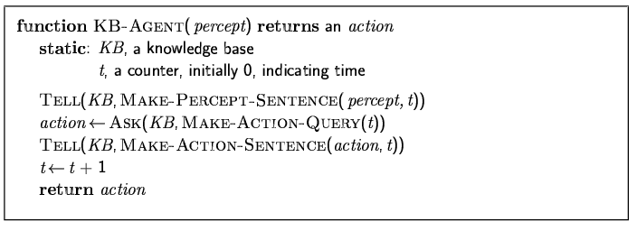
A simple knowledge-based agent
The agent must be able to:
Represent states, actions, etc.
  Incorporate new percepts
  Update internal representations of the world
  draw a logical conclusion for hidden properties of the world
  draw a logical conclusion for appropriate actions

Slide 7
Knowledge Representation (KR)
Given the world
Express the general facts or beliefs using a language
Determine what else we should (not) believe

Slide 8
Example 1
Given:
  “The red block is above the blue block”
  “The green block is above the red block”
Infer:
  “The green block is above the blue block”
  “The blocks form a tower”

Slide 9
Example 2
Given:
If it is sunny today, then the sun shines on the screen. If the sun shines on the screen, the blinds are brought down. The blinds are not down.
Find out:
Is it sunny today?

Slide 10
A KR language needs to be
expressive
unambiguous
flexible

Slide 11
The inference procedures need to be
Correct (sound)
Complete
Efficient

Slide 12
Candidates (for now)
English (natural language)
Java (programming language)
Logic (special KR language)

Slide 13
Knowledge Representations
Propositional logic
Predicate Logic (First-order logic)

Slide 14
Propositional logic
The symbols of propositional calculus are the propositional symbols:
P, Q, R, S, …
the truth symbols:
true, false
and connectives:
∧, ∨, ¬, →, ≡

Slide 15
Propositional Calculus Sentences
Every propositional symbol and truth symbol is a sentence.
Examples: true, P, Q, R.
The negation of a sentence is a sentence.
Examples: ¬P, ¬ false.
The conjunction, or and, of two sentences is a sentence.
Example: P ∧ ¬P

Slide 16
Propositional Calculus Sentences (cont’d)
The disjunction, or or, of two sentences is a sentence.
Example: P ∨ ¬P
The implication of one sentence from another is a sentence.
Example: P → Q
The equivalence of two sentences is a sentence.
Example: P ∨ Q ≡ R
Legal sentences are also called well-formed formulas or WFFs.

Slide 17
Propositional calculus semantics
An interpretation of a set of propositions is the assignment of a truth value, either T or F to each propositional symbol.
The symbol true is always assigned T, and the symbol false is assigned F.
The truth assignment of negation, ¬P, where P is any propositional symbol, is F if the assignment to P is T, and is T is the assignment to P is F.
The truth assignment of conjunction, ∧, is T
only when both conjuncts have truth value T; otherwise it is F.

Slide 18
Propositional calculus semantics (cont’d)
The truth assignment of disjunction, ∨, is F
only when both disjuncts have truth value F; otherwise it is T.
The truth assignment of implication, →, is F
only when the premise or symbol before the implication is T and the truth value of the consequent or symbol after the implication F; otherwise it is T.
The truth assignment of equivalence, ≡, is T
only when both expressions have the same truth assignment for all possible interpretations; otherwise it is F.

Slide 19
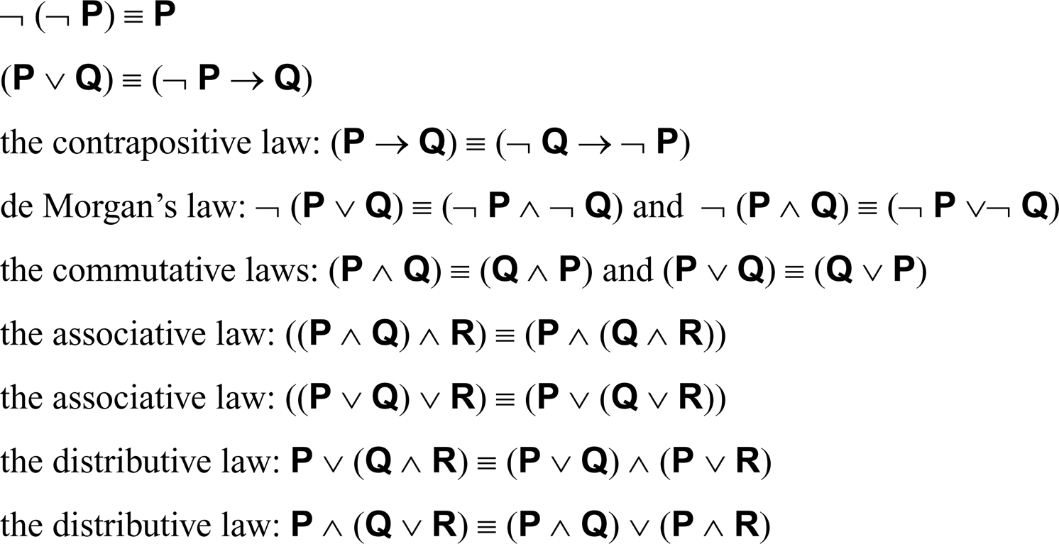
For propositional expressions P, Q, R

Slide 20
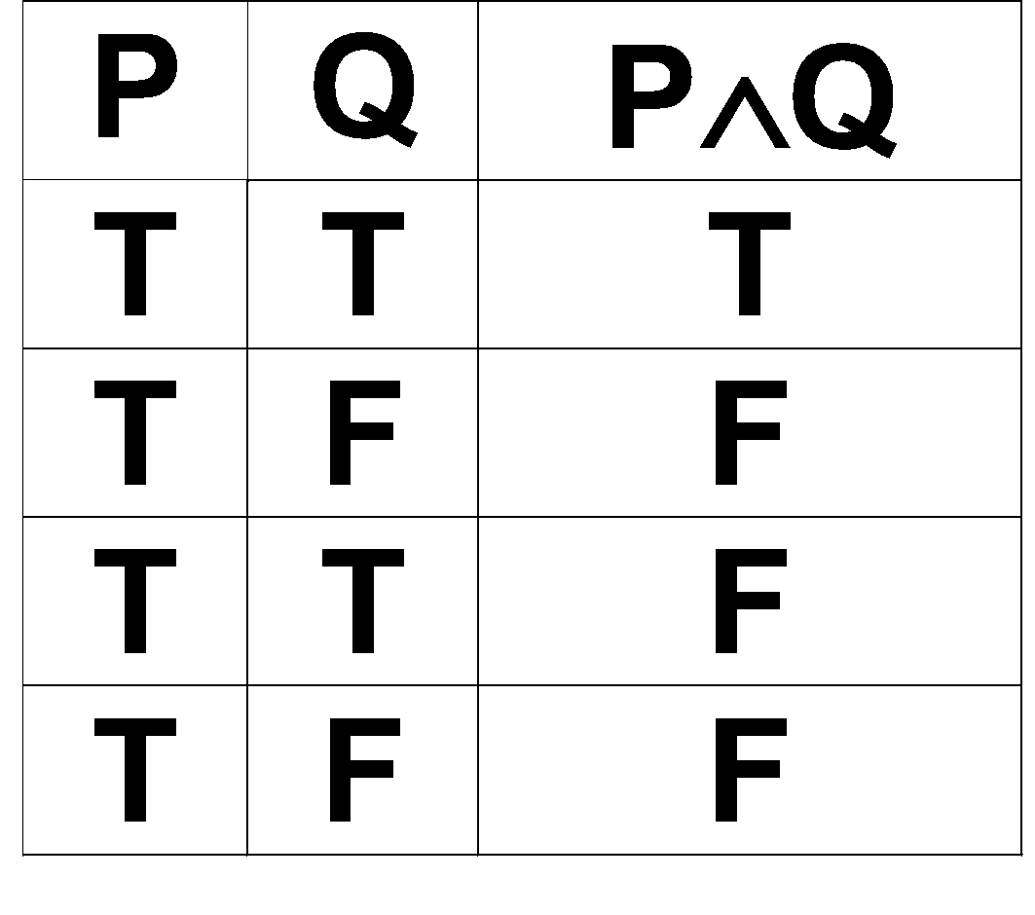
Fig. 2.1: Truth table for the operator ∧

Slide 21
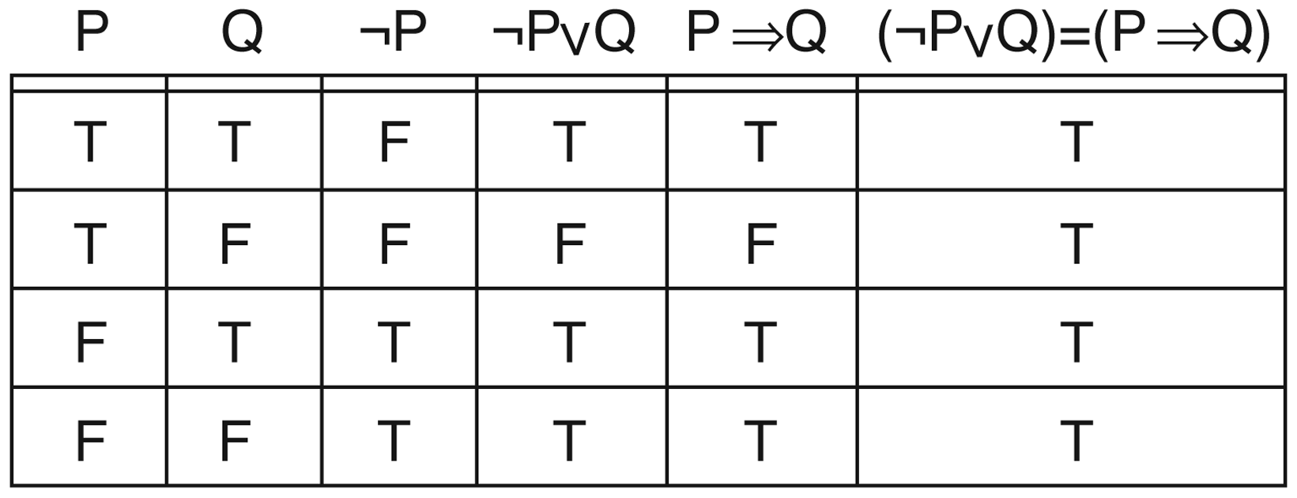
Fig. 2.2 Truth table demonstrating the equivalence of ¬P∨Q and P→Q

Slide 22
Proofs in propositional calculus
If it is sunny today, then the sun shines on the screen. If the sun shines on the screen, the blinds are brought down. The blinds are not down.
Prove: Is it sunny today? (T or F)
P: It is sunny today.
Q: The sun shines on the screen.
R: The blinds are down.
Premises: P→Q, Q→R, ¬R
Question: P

Slide 23
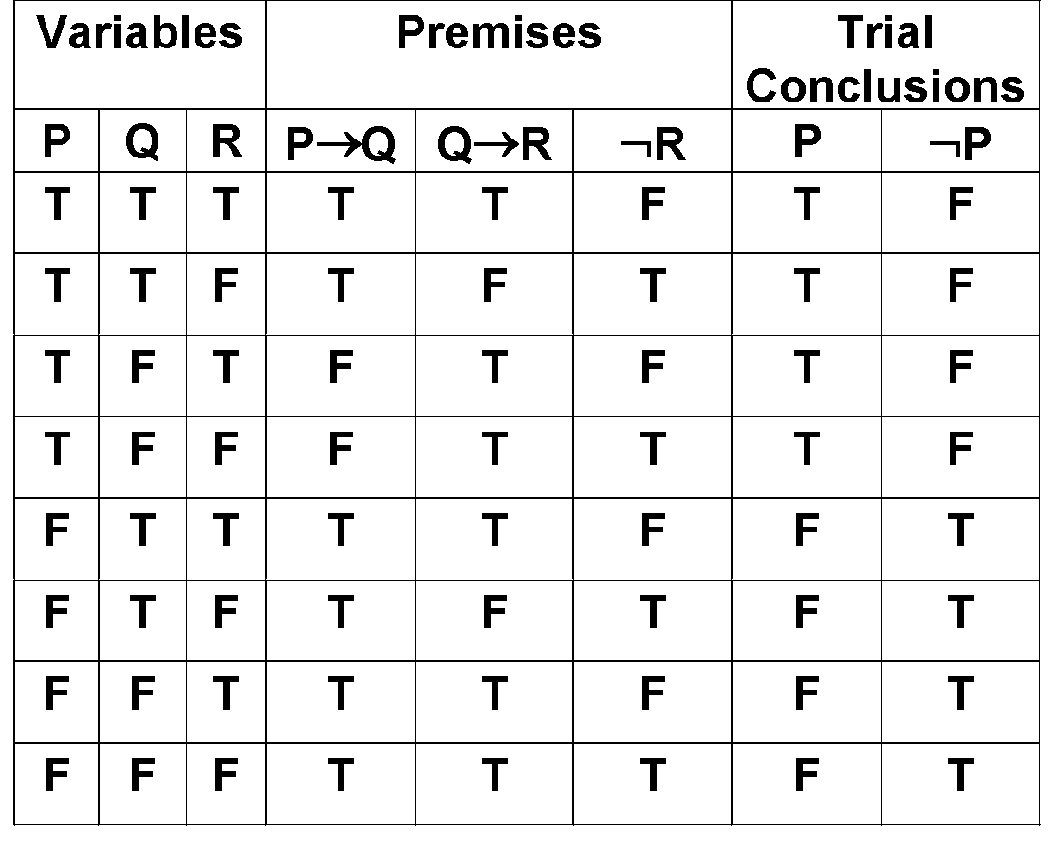
Prove using a truth table

Slide 24
Propositional calculus is cumbersome
Given:
  If it is sunny today, then the sun shines on the screen.
  If the sun shines on the screen, the blinds are brought down.
  The blinds are not down.
Prove : Is it sunny today?
- - -
Conclusion:
  If it is sunny on a particular day, then the sun shines on the screen.
  If the sun shines on the screen on a particular day, the blinds are brought down.
  The blinds are not down today.
Is it sunny today?

Slide 25
Problems with Propositional Logic

Slide 26
Propositional logic is a weak language
Hard to identify “individuals” (e.g., Mary, 3yrs)
Can’t directly talk about properties of individuals or relations between individuals (e.g., “Bill is tall”)
Generalizations, patterns, regularities can’t easily be represented (e.g., “all triangles have 3 sides”)
First-Order Logic (abbreviated FOL or FOPC) is expressive enough to concisely represent this kind of information
FOL adds relations, variables, and quantifiers, e.g.,
    “Every elephant is gray”: ∀ x (elephant(x) → gray(x))
    “There is a white alligator”: ∃ x (alligator(X) ^ white(X))

Slide 27
Example
Consider the problem of representing the following information:
  Every person is mortal.
  Confucius is a person.
  Confucius is mortal.
How can these sentences be represented so that we can infer the third sentence from the first two?

Slide 28
First-order logic
First-order logic (FOL) models the world in terms of
  Objects, which are things with individual identities
  Properties of objects that distinguish them from other objects
  Relations that hold among sets of objects
  Functions, which are a subset of relations where there is only one “value” for any given “input”
Examples:
  Objects: Students, lectures, companies, cars ...
  Relations: Brother-of, bigger-than, outside, part-of, has-color, occurs-after, owns, visits, precedes, ...
  Properties: blue, oval, even, large, ...
  Functions: father-of, best-friend, second-half, one-more-than ...

Slide 29
Syntax of FOL: Basic elements
Constants John, 2, DIT,...
Predicates Brother, >,...
Functions Sqrt, LeftLegOf,...
Variables x, y, a, b,...
Connectives ¬, ⇒, ∧, ∨, ⇔
Equality =
Quantifiers ∀, ∃
Notes:
‹#›

Slide 30
Quantifiers
Universal quantification
  (∀x)P(x) means that P holds for all values of x in the domain associated with that variable
  E.g., (∀x) dolphin(x) → mammal(x)
Existential quantification
  (∃ x)P(x) means that P holds for some value of x in the domain associated with that variable
  E.g., (∃ x) mammal(x) ∧ lays-eggs(x)
  Permits one to make a statement about some object without naming it

Slide 31
Quantifiers
Universal quantifiers are often used with “implies” to form “rules”:
  (∀x) student(x) → smart(x) “All students are smart”
Universal quantification is rarely used to make blanket statements about every individual in the world:
  “Everyone in the world is a student and is smart”
  (∀x)student(x)∧smart(x)
Existential quantifiers are usually used with “and” to specify a list of properties about an individual:
  (∃x) student(x) ∧ smart(x) “There is a student who is smart”
A common mistake is to represent this English sentence as the FOL sentence:
  (∃x) student(x) → smart(x)

Slide 32
Quantifier Scope
Switching the order of universal quantifiers does not change the meaning:
  (∀x)(∀y)P(x,y) = (∀y)(∀x) P(x,y)
Similarly, you can switch the order of existential quantifiers:
  (∃x)(∃y)P(x,y) = (∃y)(∃x) P(x,y)
Switching the order of universals and existential does change meaning:
  Everyone likes someone: (∀x)(∃y) likes(x,y)
  Someone is liked by everyone: (∃y)(∀x) likes(x,y)

Slide 33
Translating English to FOL
Every gardener likes the sun.
  ∀x gardener(x) → likes(x,Sun)
You can fool some of the people all of the time.
  ∃x ∀t person(x) ∧time(t) → can-fool(x,t)
You can fool all of the people some of the time.
  ∀x (person(x) → ∃t time(t) ∧can-fool(x,t))
  ∀x (person(x) → ∃t (time(t) ∧can-fool(x,t))
All purple mushrooms are poisonous.
  ∀x (mushroom(x) ∧ purple(x)) → poisonous(x)
No purple mushroom is poisonous.
  ¬∃x purple(x) ∧ mushroom(x) ∧ poisonous(x)
  ∀x (mushroom(x) ∧ purple(x)) → ¬poisonous(x)
  Purple(mushroom)
  Clinton is not tall.
  ¬tall(Clinton)
X is above Y iff X is on directly on top of Y or there is a pile of one or more other objects directly on top of one another starting with X and ending with Y.
  ∀x ∀y above(x,y) ↔ (on(x,y) ∨ ∃z (on(x,z) ∧ above(z,y)))
Equivalent
Equivalent

Slide 34
Knowledge bases
Knowledge base = set of sentences in a formal language
Declarative approach to building an agent (or other system):
  Tell it what it needs to know
Then it can Ask itself what to do - answers should follow from the KB
Agents can be viewed at the knowledge level
  i.e., what they know, regardless of how implemented
Or at the implementation level
  i.e., data structures in KB and algorithms that manipulate them
Notes:
t inference engines were components of expert systems. The typical expert system consisted of a knowledge base and an inference engine. The knowledge base stored facts about the world. The inference engine applied logical rules to the knowledge base and deduced new knowledge. This process would iterate as each new fact in the knowledge base could trigger additional rules in the inference engine. Inference engines work primarily in one of two modes either special rule or facts: forward chaining and backward chaining. Forward chaining starts with the known facts and asserts new facts. Backward chaining starts with goals, and works backward to determine what facts must be asserted so that the goals can be achieved.^{[1]}
A simple example of Modus Ponens often used in introductory logic books is "If you are human then you are mortal". This can be represented in pseudocode as:
Rule1: Human(x) => Mortal(x)

Slide 35
Inferencing Techniques
Forward Chaining
Backward Chaining
Resolution
Unification

Slide 36
Forward Chaining
Forward Chaining
  Start with atomic sentences in the KB and apply Modus Ponens in the forward direction, adding new atomic sentences, until no further inferences can be made.
  P 🡺Q and P is asserted to be true, so therefore Q must be true
Notes:
In propositional logic, modus ponendo ponens (Latin for "the way that affirms by affirming"; generally abbreviated to MP or modus ponens^{[1]}) or implication elimination is a rule of inference.^{[2]} It can be summarized as "P implies Q and P is asserted to be true, so therefore Q must be true." The history of modus ponens goes back to antiquity.^{[3]}

Slide 37
Forward Chaining
Given a new fact, generate all consequences
Assumes all rules are of the form
  C1 and C2 and C3 and…. --> Result
Each rule & binding generates a new fact
This new fact will “trigger” other rules
Keep going until the desired fact is generated
(Semi-decidable as is FOL in general)

Slide 38
FC: Example Knowledge Base
The law says that it is a crime for an American to sell weapons to hostile nations. The country Nono, an enemy America, has some missiles, and all of its missiles were sold to it by Col. West, who is an American.
Prove that Col. West is a criminal.

Slide 39
FC: Example Knowledge Base
…it is a crime for an American to sell weapons to hostile nations
  American(x) ∧Weapon(y) ∧Sells(x,y,z) ∧Hostile(z) ⇒ Criminal(x)
Nono…has some missiles
  ∃x Owns(Nono, x) ∧ Missiles(x)
  Owns(Nono, M₁) and Missle(M₁)
…all of its missiles were sold to it by Col. West
  ∀x Missle(x) ∧ Owns(Nono, x) ⇒ Sells( West, x, Nono)
Missiles are weapons
  Missle(x) ⇒ Weapon(x)

Slide 40
FC: Example Knowledge Base
An enemy of America counts as “hostile”
  Enemy( x, America ) ⇒ Hostile(x)
Col. West who is an American
  American( Col. West )
The country Nono, an enemy of America
  Enemy(Nono, America)

Slide 41
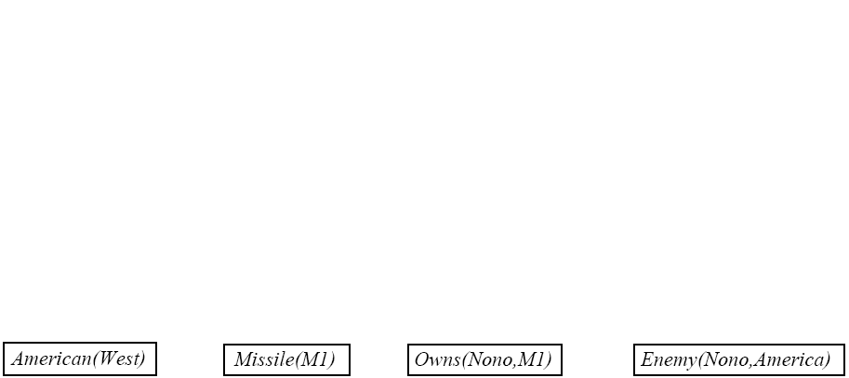
FC: Example Knowledge Base

Slide 42
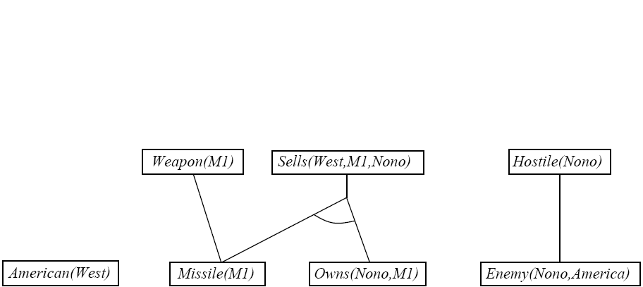
FC: Example Knowledge Base

Slide 43
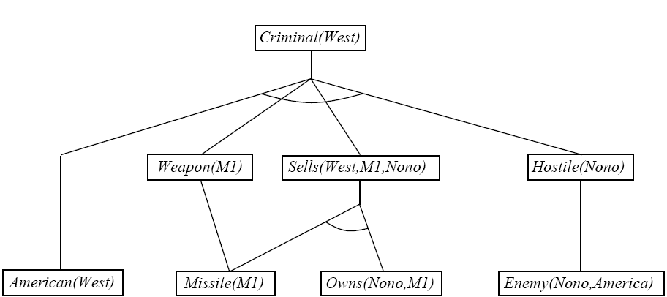
FC: Example Knowledge Base

Slide 44
Efficient Forward Chaining
Order conjuncts appropriately
  E.g. most constrained variable
Don’t generate redundant facts; each new fact should depend on at least one newly generated fact.
  Production systems
  RETE matching
  CLIPS

Slide 45
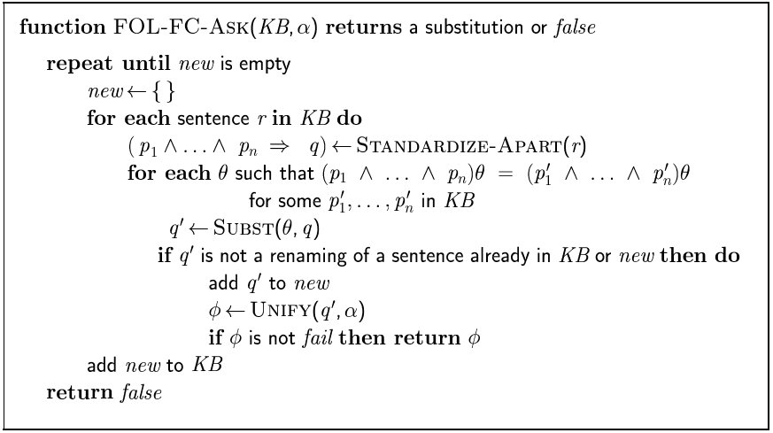
Forward Chaining Algorithm

Slide 46
Backward Chaining
Consider the item to be proven a goal
Find a rule whose head is the goal (and bindings)
Apply bindings to the body, and prove these (subgoals) in turn
If you prove all the subgoals, increasing the binding set as you go, you will prove the item.
Logic Programming (cprolog )

Slide 47

Backward Chaining Example

Slide 48
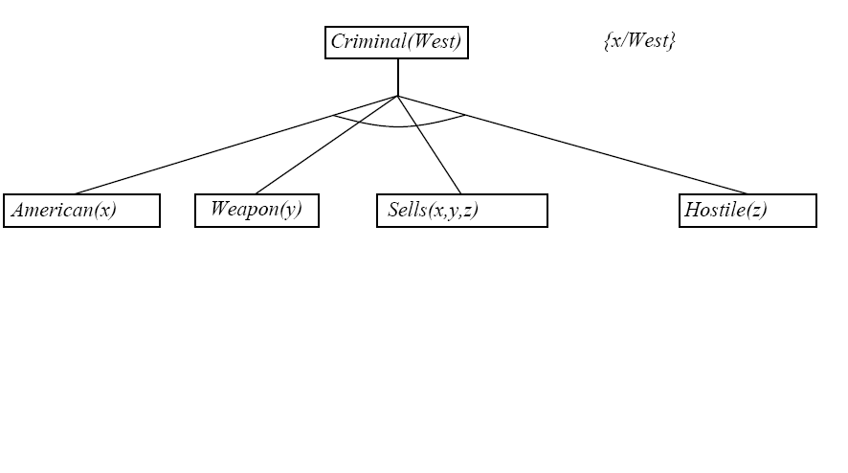
Backward Chaining Example

Slide 49
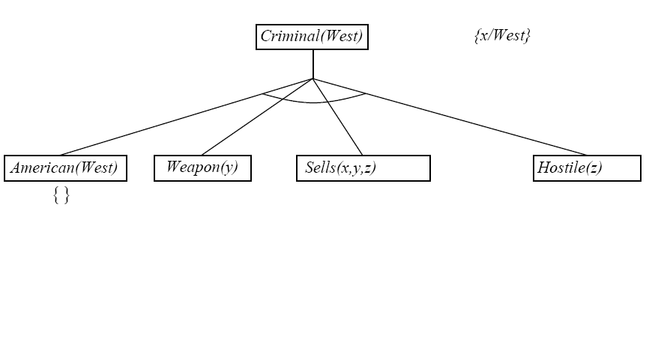
Backward Chaining Example

Slide 50
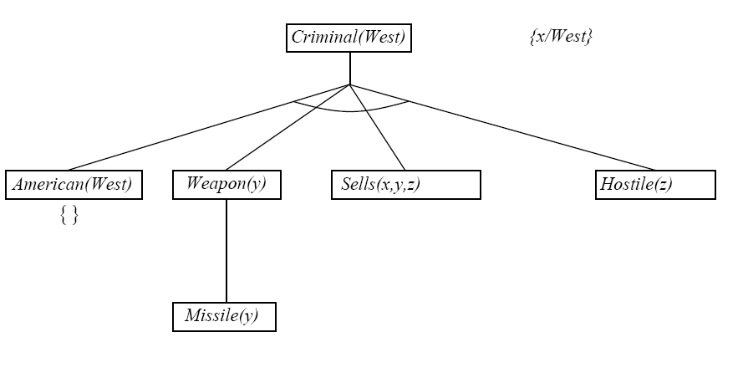
Backward Chaining Example

Slide 51
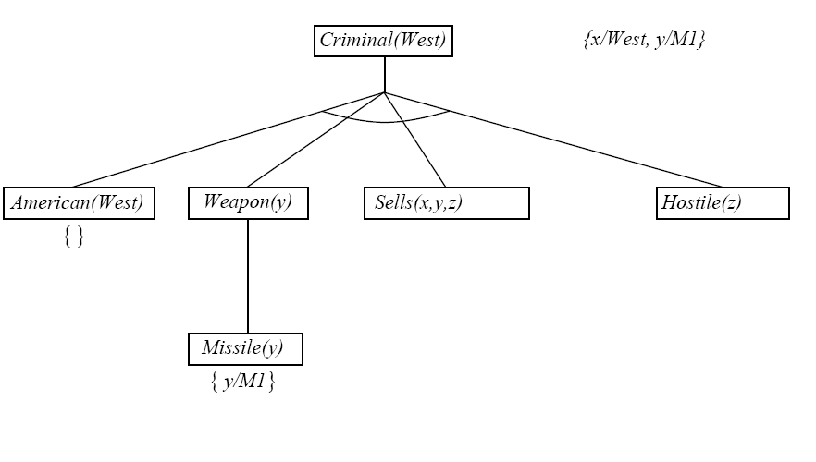
Backward Chaining Example

Slide 52
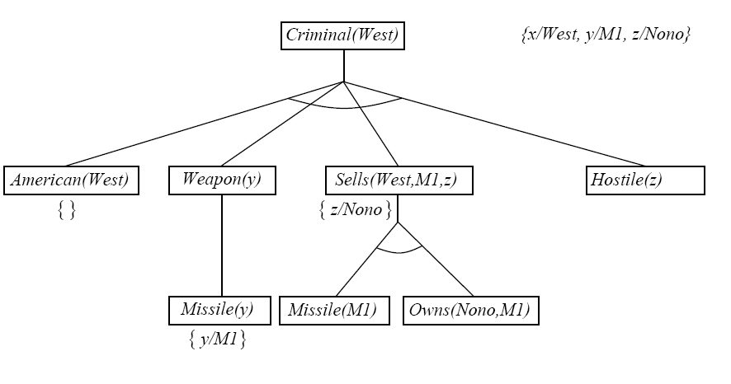
Backward Chaining Example

Slide 53
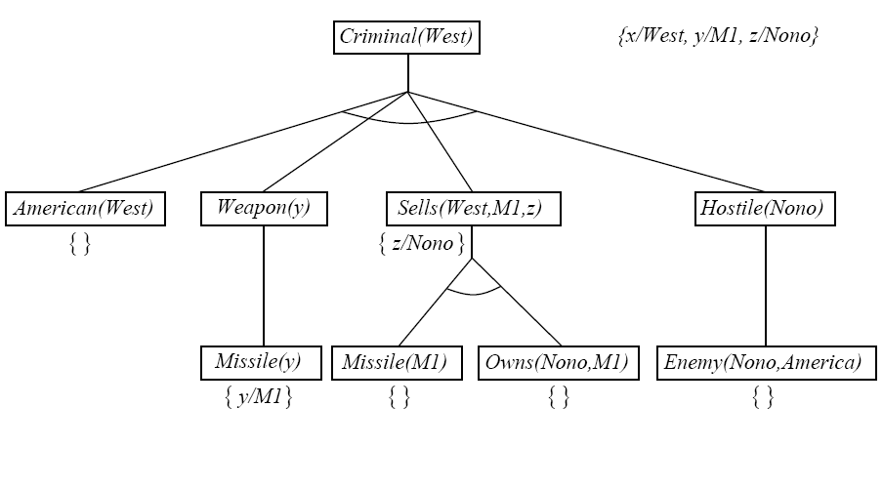
Backward Chaining Example

Slide 54
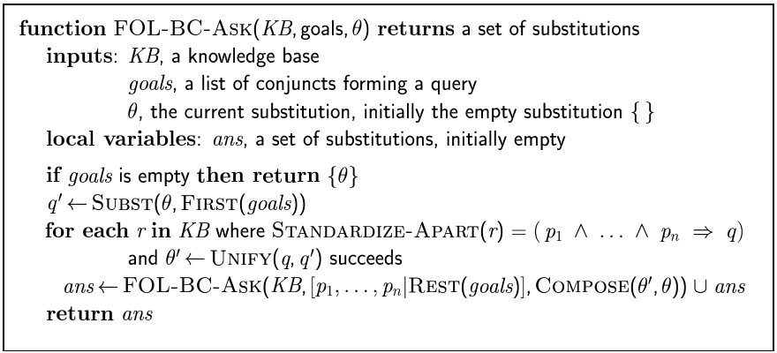
Backward Chaining Algorithm

Slide 55
Properties of Backward Chaining
Depth-first recursive proof search: space is linear in size of proof
Incomplete due to infinite loops
  Fix by checking current goal with every subgoal on the stack
Inefficient due to repeated subgoals (both success and failure)
  Fix using caching of previous results (extra space)
Widely used without improvements for logic programming

Slide 56
Inference Methods
Unification (prerequisite)
Forward Chaining
Backward Chaining
  Logic Programming (Prolog)
Resolution
  Transform to CNF (Chomsky normal form )
  Generalization of Prop. Logic resolution
Notes:
In formal language theory, a context-free grammar G is said to be in Chomsky normal form (first described by Noam Chomsky)^{[1]} if all of its production rules are of the form:^{[2]:92–93,106}
A → BC, or A → a, or S → ε, where A, B, and C are nonterminal symbols, a is a terminal symbol (a symbol that represents a constant value), S is the start symbol, and ε denotes the empty string. Also, neither B nor C may be the start symbol, and the third production rule can only appear if ε is in L(G), namely, the language produced by the context-free grammar G.

Slide 57
Resolution for proposition Logic
Convert everything to CNF
(conjunctive normal form/ clausal normal form)
If resolution is successful, proof succeeds
If there is a variable in the item to prove, return variable’s value from unification bindings
Notes:
the negation of a conjunction is the disjunction of the negations; and
the negation of a disjunction is the conjunction of the negations;
replace {\displaystyle P\rightarrow Q} with {\displaystyle \lnot P\lor Q}; replace {\displaystyle P\leftrightarrow Q} with {\displaystyle (P\lor \lnot Q)\land (\lnot P\lor Q)}

Slide 58
Resolution
Resolution allows a complete inference mechanism (search-based) using only one rule of inference
Resolution rule:
  Complementary literals P₁ and ¬P₁ “cancel out”
To prove a proposition F by resolution,
  Start with ¬F
  Resolve with a rule from the knowledge base (that contains F)
  Repeat until all propositions have been eliminated
  If this can be done, a contradiction has been derived and the original proposition F must be true.

Slide 59
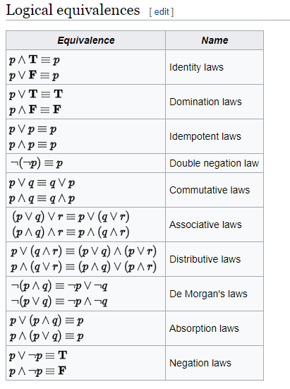

Slide 60
Rules
Eliminate implications and equivalences
this will eliminate all occurrences of 🡪,

Slide 61
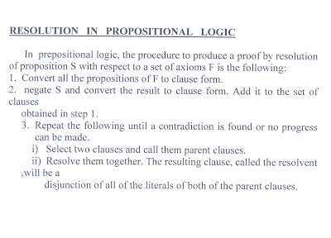
Resolution In Proposational LOgic.

Slide 62
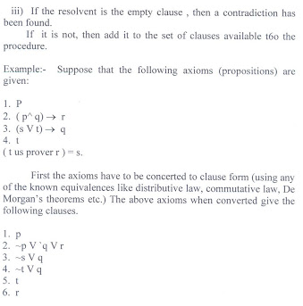

Slide 63
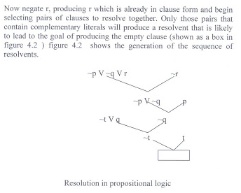

Slide 64
Propositional Resolution Example
Rules
  Cold and precipitation -> snow
    ¬cold ∨ ¬precipitation ∨ snow
  January -> cold
    ¬January ∨ cold
  Clouds -> precipitation
    ¬clouds ∨ precipitation
Facts
  January, clouds
Prove
  snow

Slide 65
Propositional Resolution Example
¬snow
¬cold ∨ ¬precipitation ∨ snow
¬January ∨ cold
¬cold ∨ ¬precipitation
¬January ∨ ¬precipitation
¬clouds ∨ precipitation
January
¬January ∨ ¬clouds
¬clouds
clouds

Slide 66
Resolution Theorem Proving (FOL(Predicate Logic))
Convert everything to CNF
Resolve, with unification (Negate goal and add bindings)
  Save bindings as you go!
If resolution is successful, proof succeeds
If there is a variable in the item to prove, return variable’s value from unification bindings

Slide 67
Converting to CNF(Rules)
Replace implication (A ⇒ B) by ¬A ∨ B
Move ¬ “inwards”
  ¬∀x P(x) is equivalent to ∃x ¬P(x) & vice versa
Standardize variables
  ∀x P(x) ∨ ∀x Q(x) becomes ∀x P(x) ∨ ∀y Q(y)
Skolemize
  ∃x P(x) becomes P(A)
Drop universal quantifiers
  Since all quantifiers are now ∀, we don’t need them
Distributive Law
a(b + c) = ab + ac

Slide 68
RESOLUTION IN PREDICATE LOGIC
Two literals are contradictory if one can be unified with the negation of the other.
For example man(x) and man (Himalayas) are contradictory since man(x) and man(Himalayas ) can be unified.
In predicate logic unification algorithm is used to locate pairs of literals that cancel out.
It is important that if two instances of the same variable occur, then they must be given identical substitutions.

Slide 69
The resolution algorithm for predicate logic as follows
Let f be a set of given statements and S is a statement to be proved.
1. Covert all the statements of F to clause form.
2. Negate S and convert the result to clause form. Add it to the set of clauses obtained in 1.
3. Repeat until either a contradiction is found or no progress can be made or a predetermined amount of effort has been expended.
a) Select two clauses. Call them parent clauses.
b) Resolve them together.
The resolvent will be the disjunction of all of these literals of both clauses. If there is a pair of literals T1 and T2 such that one parent clause contains Ti and the other contains T2 and if T1 and T2 are unifiable, then neither t1 nor T2 should appear in the resolvent. Here Ti and T2 are called complimentary literals.
C) If the resolvent is the empty clause , then a contradiction has been found. If it is not, then add it to the set of clauses available to the procedure.

Slide 70
Example: Using resolution to produce proof is illustrated in the following statements.
1. Marcus was a man.
2. Marcus was a Pompeian
3. All pompeians were Romans
4. Caesar was a ruler
5. All Romans were either loyal to Caesar or hated him.
6. Everyone is loyal to someone.
7. People only try to assassinate rulers they are not loyal to.
8. Marcus tried to assassinate Caesar.
Notes:
Marcus was a man.
All pompeians were Romans
All Romans were either loyal to Caesar or hated him.
Everyone is loyal to someone.
Marcus tried to assassinate Caesar.

Slide 71
Questions (Goals)
Was Marcus a Roman?
Was Marcus loyal to Caesar?
Who was Marcus loyal to?
Was Marcus a ruler?
Open PDF

Slide 72
Step-1:Examples for Conversion from Natural Language Sentences to Predicate Logic
Step 2: Convert to Clausal Form
Step 3: Negate query and start
  Step 4:Resolve with a rule from the knowledge base (that contains F)
Step 5: Repeat until either a contradiction is found or no progress can be made

Slide 73
Step-1:Examples for Conversion from Natural Language Sentences to Predicate Logic
1. Marcus was a man
Man(Marcus)
2. Marcus was a Pompeian
Pompeian(Marcus)
3. All Pompeians were Romans
∀x [Pompeian(x) 🡪 Roman(x)]
4. Caesar was a ruler
Ruler(Caesar)

Slide 74
5. All Romans were either loyal to Caesar or hated him
∀x [Roman(x) 🡪(LoyalTo(x, Caesar) ∨ Hate(x, Caesar))]
6. Everyone is loyal to someone
∀x ∃y LoyalTo(x,y)
7. People only try to assassinate rulers they aren't loyal to
∀x∀y[(Person(x) ∧ Ruler(y) ∧ TryAssassinate(x,y))🡪
¬LoyalTo(x,y)]
8. Marcus tried to assassinate Caesar
TryAssassinate(Marcus, Caesar)
Can you prove: ¬LoyalTo(x,Caesar)

Slide 75
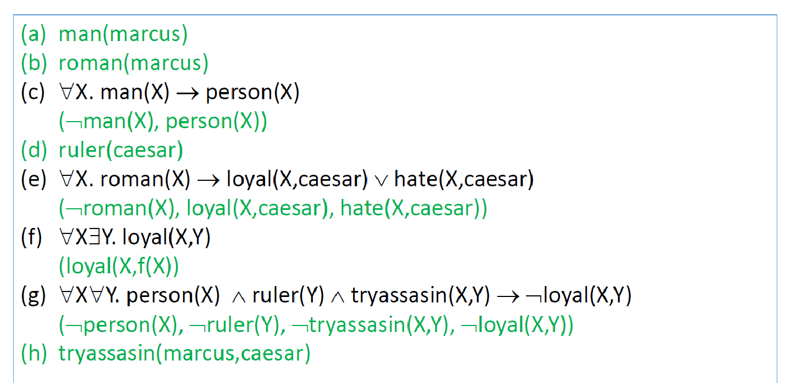
Step 2: Convert to Clausal Form

Slide 76
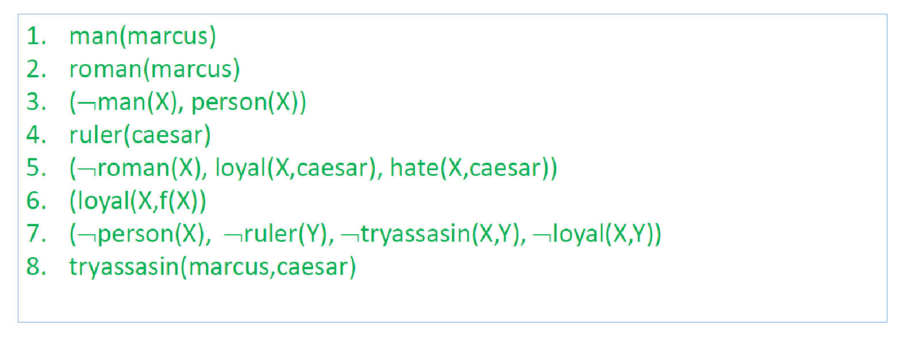
Convert to Clausal Form

Slide 77
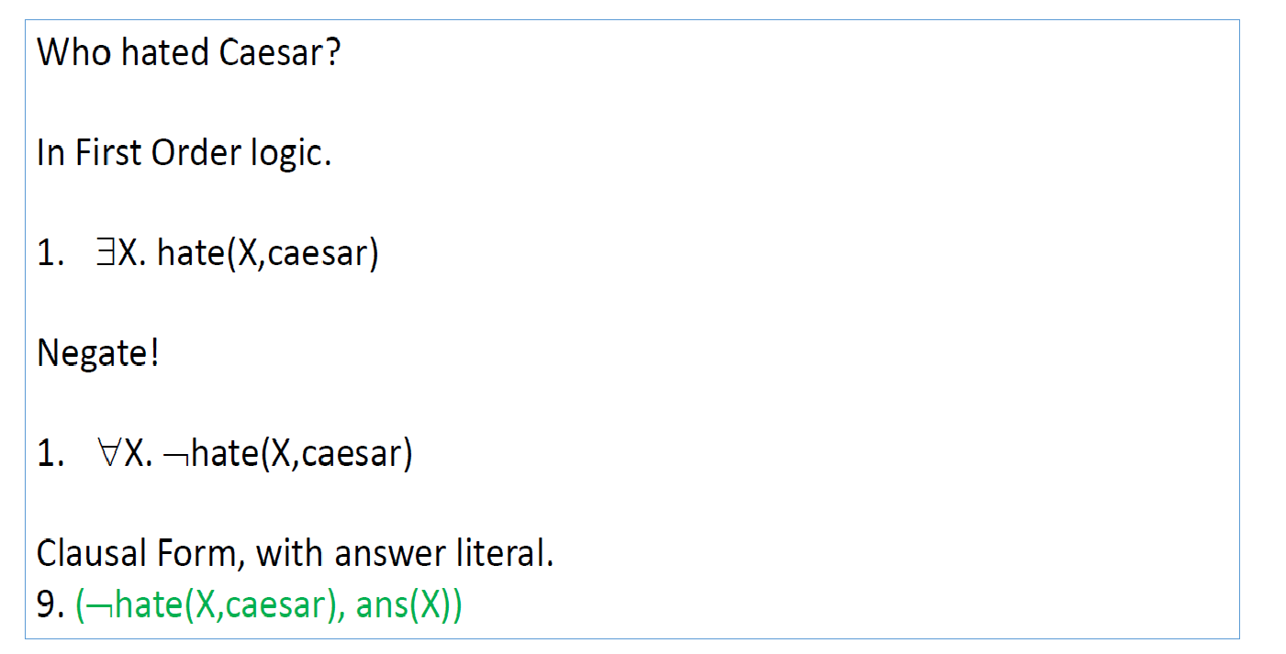
Query

Slide 78
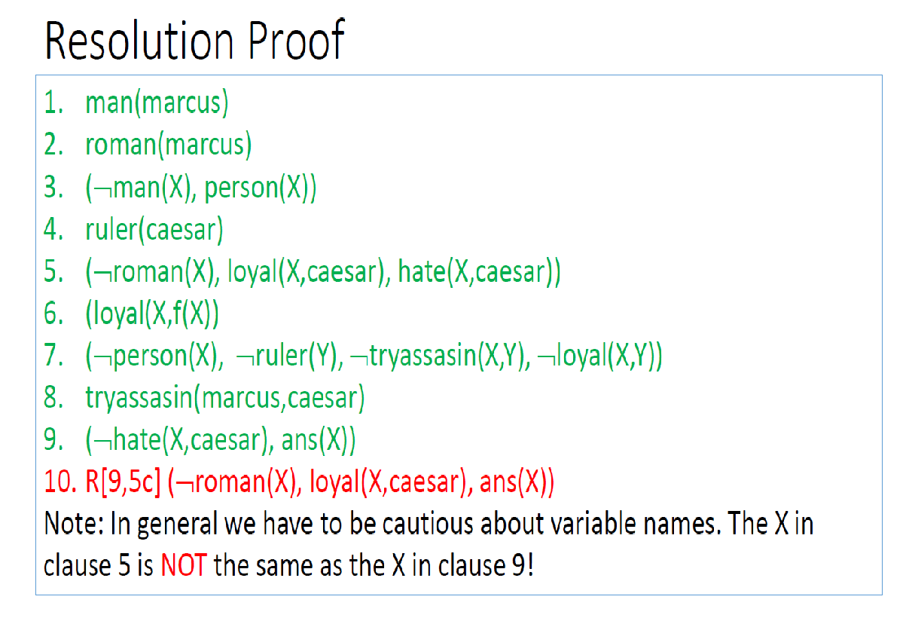

Slide 79
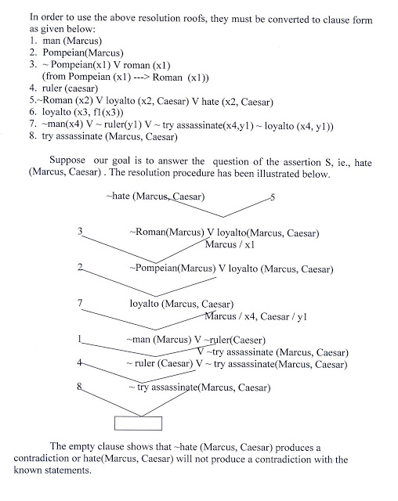

Slide 80
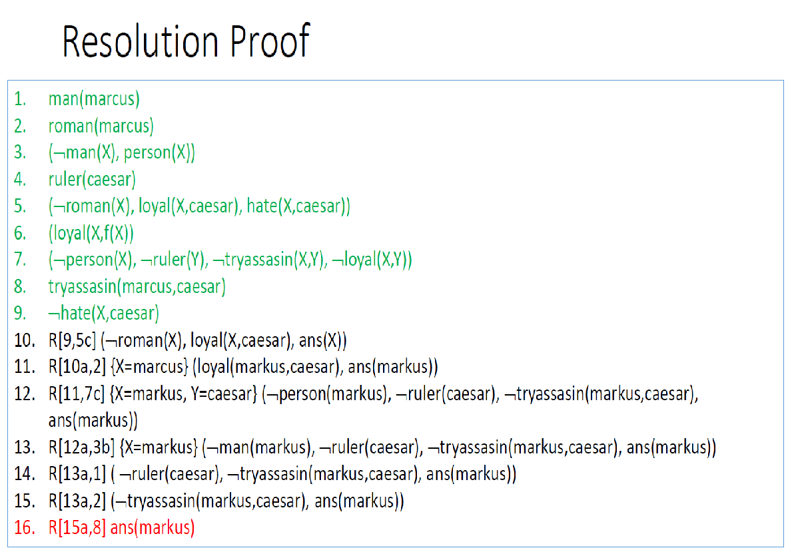

Slide 81
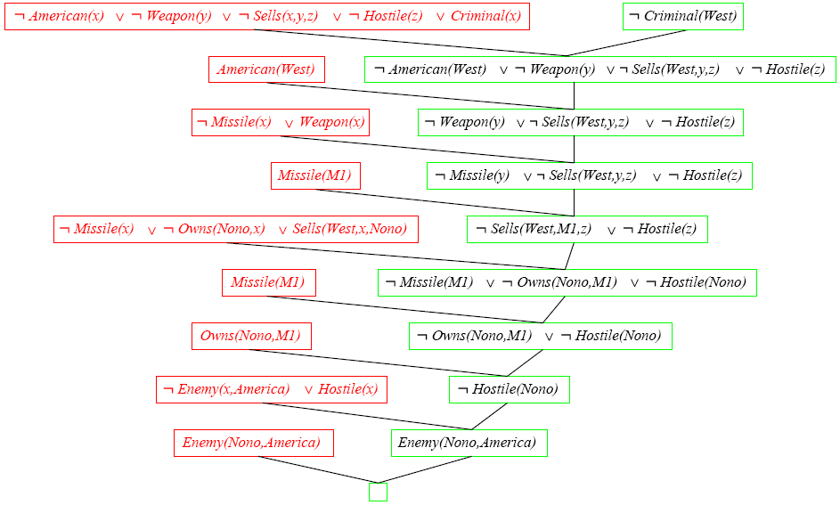
Another Resolution Example

Slide 82
UNIFICATION ALGORITHM
In propsoitional logic it is easy to determine that two literals can not both be true at the same time. Simply look for L and ~L . In predicate logic, this matching process is more complicated, since bindings of variables must be considered.
For example man (john) and man(john) is a contradiction while man (john) and man(Himalayas) is not.
Thus in order to determine contradictions we need a matching procedure that compares two literals and discovers whether there exist a set of substitutions that makes them identical .
There is a recursive procedure that does this matching . It is called Unification algorithm.
In Unification algorithm each literal is represented as a list, where first element is the name of a predicate and the remaining elements are arguments.
The argument may be a single element (atom) or may be another list.
For example we can have literals as
( tryassassinate Marcus Caesar)
( tryassassinate Marcus (ruler of Rome))
To unify two literals , first check if their first elements re same. If so proceed. Otherwise they can not be unified. For example the literals
( try assassinate Marcus Caesar)
( hate Marcus Caesar)
Can not be Unfied.

Slide 83
The unification algorithm recursively matches pairs of elements, one pair at a time. The matching rules are :
i) Different constants , functions or predicates can not match, whereas identical ones can.
ii) A variable can match another variable , any constant or a function or predicate expression, subject to the condition that the function or [predicate expression must not contain any instance of the variable being matched (otherwise it will lead to infinite recursion).
iii) The substitution must be consistent. Substituting y for x now and then z for x later is inconsistent. (a substitution y for x written as y/x)
The Unification algorithm is listed below as a procedure UNIFY (L1, L2). It returns a list representing the composition of the substitutions that were performed during the match. An empty list NIL indicates that a match was found without any substitutions. If the list contains a single value F, it indicates that the unification procedure failed.

Slide 84
Algorithm
UNIFY (L1, L2)
1. if L1 or L2 is an atom part of same thing do
(a) if L1 or L2 are identical then return NIL
(b) else if L1 is a variable then do
  (i) if L1 occurs in L2 then return F else return (L2/L1)
  else if L2 is a variable then do
  (i) if L2 occurs in L1 then return F else return (L1/L2)
  else return F.
2. If length (L1) is not equal to length (L2) then return F.
3. Set SUBST to NIL
( at the end of this procedure , SUBST will contain all the substitutions used to unify L1 and L2).
4. For I = 1 to number of elements in L1 do
i) call UNIFY with the i th element of L1 and I’th element of L2, putting the result in S
ii) if S = F then return F
iii) if S is not equal to NIL then do
(A) apply S to the remainder of both L1 and L2
(B) SUBST := APPEND (S, SUBST) return SUBST.

Slide 85
What is Unification?
Unification is a process of making two different logical atomic expressions identical by finding a substitution. Unification depends on the substitution process.
It takes two literals as input and makes them identical using substitution.

Slide 86
Unifier
Let S₁ and S₂ be two atomic sentences and P be a unifier such that, Ψ₁ P = Ψ₂ P, then it can be expressed as UNIFY(S₁, S₂).
Example: Find the MGU for Unify{King(x), King(John)}
Let S₁ = King(x), S₂ = King(John),
Substitution 1 = {John/x} is a unifier for these atoms and applying this substitution, and both expressions will be identical.
MGU (Most General Unifier)

Slide 87
UNIFY algorithm
The UNIFY algorithm is used for unification, which takes two atomic sentences and returns a unifier for those sentences (If any exist).
Unification is a key component of all first-order inference algorithms.
It returns fail if the expressions do not match with each other.
The substitution variables are called Most General Unifier or MGU.
E.g. Let's say there are two different expressions,
P(x, y), and P(a, f(z)).

Slide 88
Example 2
E.g. Let's say there are two different expressions,
P(x, y), and P(a, f(z)).
In this example, we need to make both above statements identical to each other. For this, we will perform the substitution.
P(x, y)......... (i)
P(a, f(z))......... (ii)
Substitute x with a, and y with f(z) in the first expression, and it will be represented as:
(a/x )and ( f(z)/y )
With both the substitutions, the first expression will be identical to the second expression and the
substitution set will be: [a/x, f(z)/y].
P(a, f(z))......... (i)
P(a, f(z))......... (ii)

Slide 89
Conditions for Unification:
Following are some basic conditions for unification:
Predicate symbol must be same, atoms or expression with different predicate symbol can never be unified. (P(x, y) P is Predicate symbol )
Number of Arguments in both expressions must be identical. (P(x, y) , P(x, y, z) can not be unified)
Unification will fail if there are two similar variables present in the same expression.
P(x, y)......... (i)
P(a, x)......... (ii)
(Sentence I and ii could not Unify, (infinity))

Slide 90
Algorithm
Step. 1: If S1 or S2 is a variable or constant, then:
a) If S1 or S2 are identical, then return NIL.
b) Else if S1 is a variable,
a. then if S1 occurs in S2, then return FAILURE
b. Else return { (S2/ S1)}.
c) Else if S2 is a variable,
a. If S2 occurs in S1 then return FAILURE,
b. Else return {(S1/ S2)}.
d) Else return FAILURE.
Step.2: If the initial Predicate symbol in S1 and S2 are not same, then return FAILURE.
Step. 3: IF S1 and S2 have a different number of arguments, then return FAILURE.
Step. 4: Set Substitution set(SUBST) to NIL.
Step. 5: For i=1 to the number of elements in S1.
a) Call Unify function with the ith element of S1 and ith element of S2, and put the result into Sub.
b) If Sub = failure then returns Failure
c) If Sub ≠ NIL then do,
a. Apply Sub to the remainder of both L1 and L2.
b. SUBST= APPEND(Sub, SUBST).
Step.6: Return SUBST.

Slide 91
Implementation of the Algorithm
Step.1: Initialize the substitution set to be empty.
Step.2: Recursively unify atomic sentences:
Check for Identical expression match.
If one expression is a variable v_{i}, and the other is a term t_{i} which does not contain variable v_{i}, then:
  Substitute t_{i} / v_{i} in the existing substitutions
  Add t_{i} /v_{i} to the substitution setlist.
  If both the expressions are functions, then function name must be similar, and the number of arguments must be the same in both the expression.

Slide 92
Example: 1
For each pair of the following atomic sentences find the most general unifier (If exist).
1. Find the MGU of {p(f(a), g(Y)) and p(X, X)}
Sol: S₀ => Here, L₁ = p(f(a), g(Y)),
L₂ = p(X, X)
SUBST θ= {f(a) / X}
S1 => L₁ = p(f(a), g(Y)), and L₂ = p(f(a), f(a))
SUBST 1= {f(a) / g(y)}, Unification failed.
Unification is not possible for these expressions.

Slide 93
Example 2. Find the MGU of {p(b, X, f(g(Z))) and p(Z, f(Y), f(Y))}
Here, L₁ = p(b, X, f(g(Z))) , and L₂ = p(Z, f(Y), f(Y))
S₀ => { p(b, X, f(g(Z))); p(Z, f(Y), f(Y))}
1. SUBST θ={b/Z}
S₁ => { p(b, X, f(g(b))); p(b, f(Y), f(Y))}
2. SUBST θ={f(Y) /X}
S₂ => { p(b, f(Y), f(g(b))); p(b, f(Y), f(Y))}
3. SUBST θ= {g(b) /Y}
S₂ => { p(b, f(g(b)), f(g(b)); p(b, f(g(b)), f(g(b))}
Unified Successfully.
Unifier = { b/Z, f(Y) /X , g(b) /Y}.

Slide 94
3. Find the MGU of {p (X, X), and p (Z, f(Z))}
Here, Ψ₁ = {p (X, X), and Ψ₂ = p (Z, f(Z))
S₀ => {p (X, X), p (Z, f(Z))}
SUBST θ= {X/Z}
S1 => {p (Z, Z), p (Z, f(Z))}
SUBST θ= {f(Z) / Z}, Unification Failed.
Hence, unification is not possible for these expressions.

Slide 95
4. Find the MGU of UNIFY(prime (11), prime(y))
Here, Ψ₁ = {prime(11) , and Ψ₂ = prime(y)}
S₀ => {prime(11) , prime(y)}
SUBST θ= {11/y}
S₁ => {prime(11) , prime(11)} , Successfully unified.
Unifier: {11/y}.

Slide 96
Knowledge Representations
Logical Representations
Semantic Network
Frames
Conceptual Dependency
Scripts

Slide 97
Techniques of knowledge representation
There are mainly four ways of knowledge representation which are given as follows:
Logical Representation
Semantic Network Representation
Frame Representation
Production Rules

Slide 98
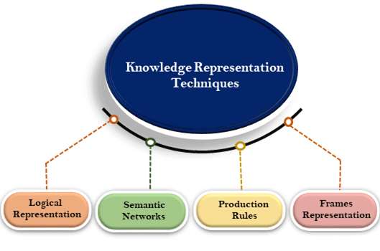
Techniques of knowledge representation

Slide 99
1. Logical Representation
Logical representation is a language with some concrete rules which deals with propositions and has no ambiguity in representation. Logical representation means drawing a conclusion based on various conditions.
It consists of precisely defined syntax and semantics which supports the sound inference.
Each sentence can be translated into logics using syntax and semantics.
Syntax:
Syntaxes are the rules which decide how we can construct legal sentences in the logic.
It determines which symbol we can use in knowledge representation.
How to write those symbols.
Semantics:
Semantics are the rules by which we can interpret the sentence in the logic.
Semantic also involves assigning a meaning to each sentence.
Logical representation can be categorized into mainly two logics:
Propositional Logics
Predicate logics

Slide 100
Advantages of logical representation:
Logical representation enables us to do logical reasoning.
Logical representation is the basis for the programming languages.
Disadvantages of logical Representation:
Logical representations have some restrictions and are challenging to work with.
Logical representation technique may not be very natural, and inference may not be so efficient.

Slide 101
2. Semantic Network Representation
Semantic networks are alternative of predicate logic for knowledge representation. In Semantic networks, we can represent our knowledge in the form of graphical networks. This network consists of nodes representing objects and arcs which describe the relationship between those objects. Semantic networks can categorize the object in different forms and can also link those objects. Semantic networks are easy to understand and can be easily extended.
This representation consist of mainly two types of relations:
IS-A relation (Inheritance)
Kind-of-relation
Example: Following are some statements which we need to represent in the form of nodes and arcs.
Statements:

Slide 102
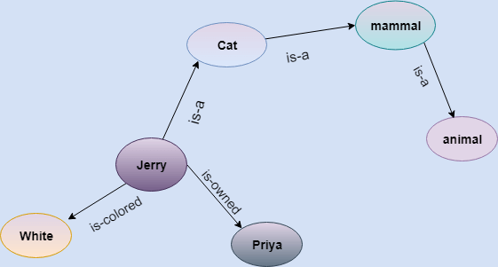
Example: Following are some statements which we need to represent in the form of nodes and arcs.
Statements:
Jerry is a cat.
Jerry is a mammal
Jerry is owned by Priya.
Jerry is white colored.
All Mammals are animal.
In this diagram, we have represented the different type of knowledge in the form of nodes and arcs. Each object is connected with another object by some relation.

Slide 103
Drawbacks in Semantic representation:
Semantic networks take more computational time at runtime as we need to traverse the complete network tree to answer some questions.
It might be possible in the worst case scenario that after traversing the entire tree, we find that the solution does not exist in this network.
Semantic networks try to model human-like memory (Which has 1015 neurons and links) to store the information, but in practice, it is not possible to build such a vast semantic network.
These types of representations are inadequate as they do not have any equivalent quantifier, e.g., for all, for some, none, etc.
Semantic networks do not have any standard definition for the link names.
These networks are not intelligent and depend on the creator of the system.
Advantages of Semantic network:
Semantic networks are a natural representation of knowledge.
Semantic networks convey meaning in a transparent manner.
These networks are simple and easily understandable.

Slide 104
3. Frame Representation
A frame is a record like structure which consists of a collection of attributes and its values to describe an entity in the world.
Frames are the AI data structure which divides knowledge into substructures by representing stereotypes situations.
It consists of a collection of slots and slot values. These slots may be of any type and sizes. Slots have names and values which are called facets.
Facets: The various aspects of a slot is known as Facets. Facets are features of frames which enable us to put constraints on the frames. Example: IF-NEEDED facts are called when data of any particular slot is needed. A frame may consist of any number of slots, and a slot may include any number of facets and facets may have any number of values. A frame is also known as slot-filter knowledge representation in artificial intelligence.
Frames are derived from semantic networks and later evolved into our modern-day classes and objects. A single frame is not much useful. Frames system consist of a collection of frames which are connected. In the frame, knowledge about an object or event can be stored together in the knowledge base. The frame is a type of technology which is widely used in various applications including Natural language processing and machine visions.

Slide 105
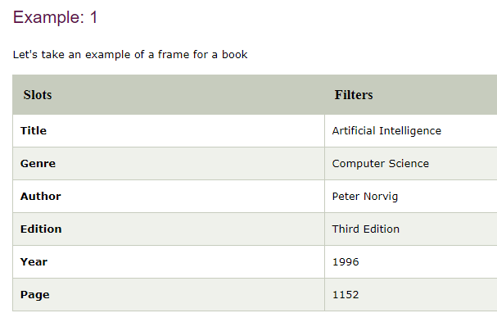

Slide 106
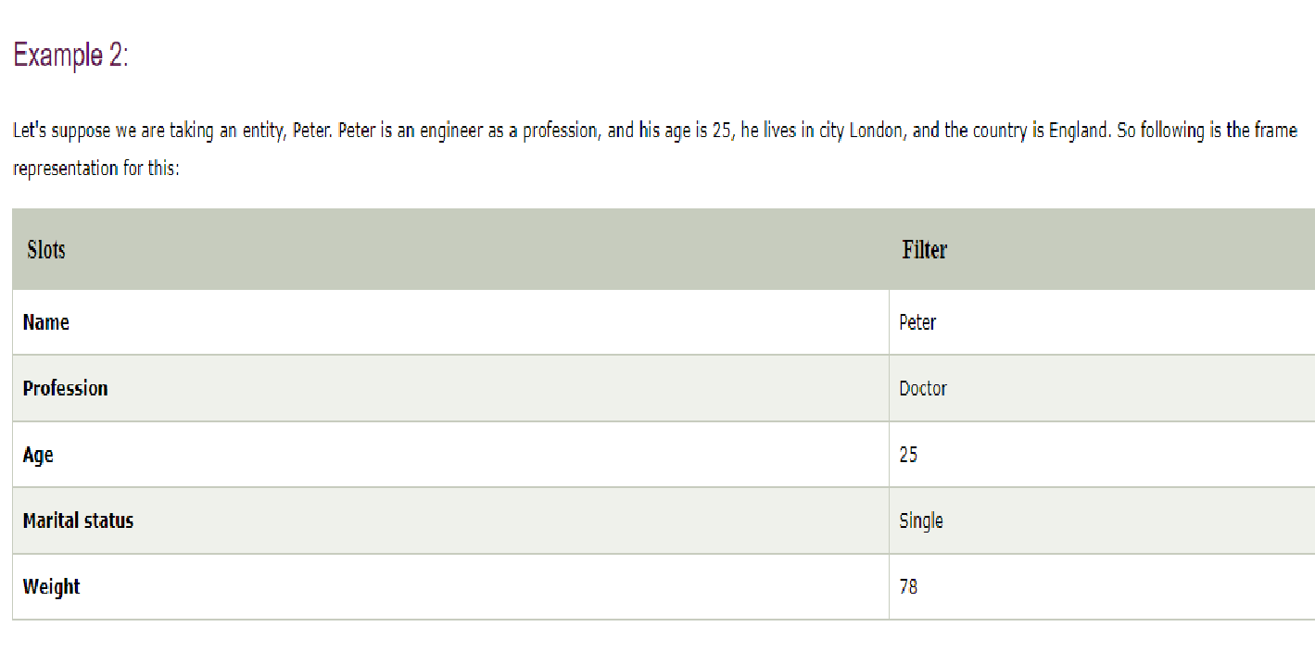
Example 2:
Let's suppose we are taking an entity, Peter. Peter is an engineer as a profession, and his age is 25, he lives in city London, and the country is England. So following is the frame representation for this:

Slide 107
Advantages of frame representation:
The frame knowledge representation makes the programming easier by grouping the related data.
The frame representation is comparably flexible and used by many applications in AI.
It is very easy to add slots for new attribute and relations.
It is easy to include default data and to search for missing values.
Frame representation is easy to understand and visualize.
Disadvantages of frame representation:
In frame system inference mechanism is not be easily processed.
Frame representation has a much generalized approach.

Slide 108
4. Production Rules
Production rules system consist of (condition, action) pairs which mean, "If condition then action". It has mainly three parts:
The set of production rules
Working Memory
The recognize-act-cycle
In production rules agent checks for the condition and if the condition exists then production rule fires and corresponding action is carried out.
The condition part of the rule determines which rule may be applied to a problem. And the action part carries out the associated problem-solving steps.
This complete process is called a recognize-act cycle.
The working memory contains the description of the current state of problems-solving and rule can write knowledge to the working memory.
This knowledge match and may fire other rules.
If there is a new situation (state) generates, then multiple production rules will be fired together, this is called conflict set. In this situation, the agent needs to select a rule from these sets, and it is called a conflict resolution.

Slide 109
Example:
IF (at bus stop AND bus arrives) THEN action (get into the bus)
IF (on the bus AND paid AND empty seat) THEN action (sit down).
IF (on bus AND unpaid) THEN action (pay charges).
IF (bus arrives at destination) THEN action (get down from the bus).

Slide 110
Advantages of Production rule:
The production rules are expressed in natural language.
The production rules are highly modular, so we can easily remove, add or modify an individual rule.
Disadvantages of Production rule:
Production rule system does not exhibit any learning capabilities, as it does not store the result of the problem for the future uses.
During the execution of the program, many rules may be active hence rule-based production systems are inefficient.

Slide 111
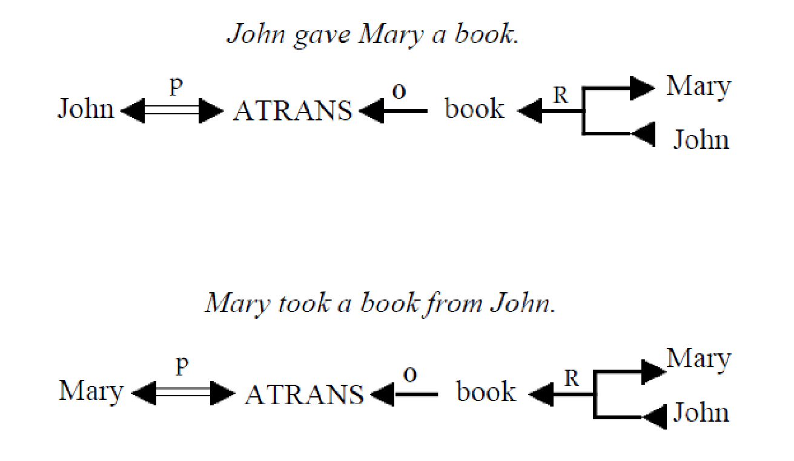
CD Examples

Slide 112
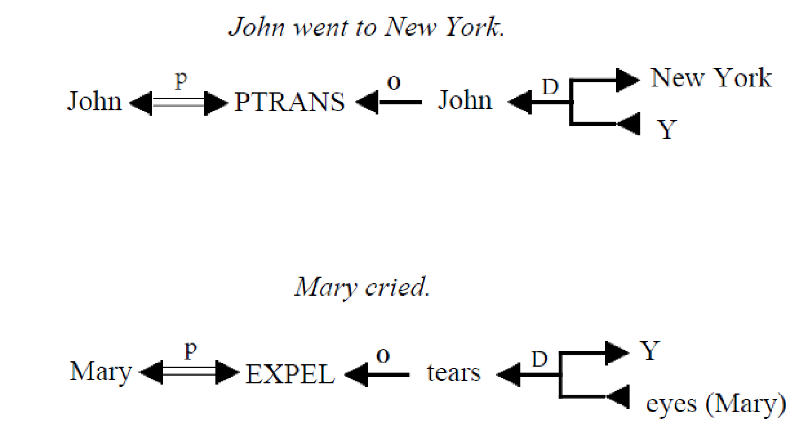

Slide 113
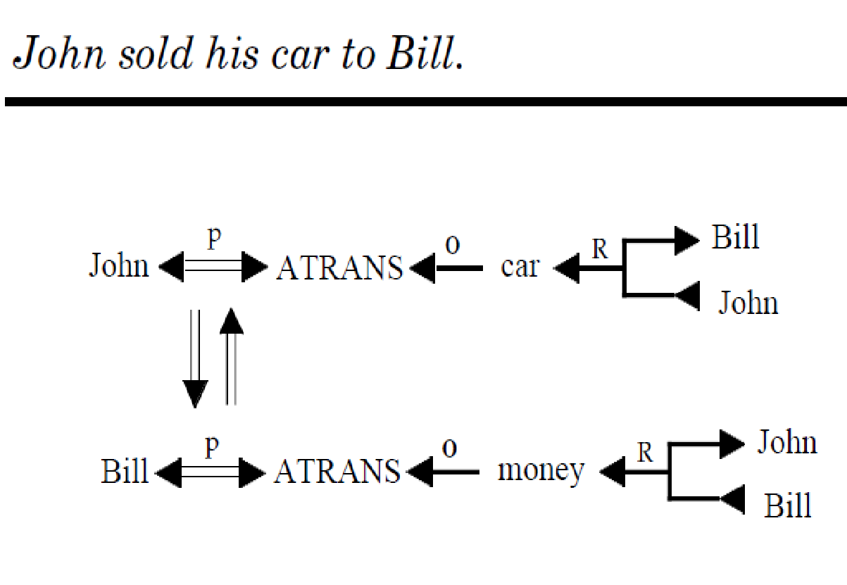

Slide 114
Planning in AI
What is planning in AI?

Slide 115
What is planning in AI?
The planning in Artificial Intelligence is about the decision making tasks performed by the robots or computer programs to achieve a specific goal.
The execution of planning is about choosing a sequence of actions with a high likelihood to complete the specific task.

Slide 116
Motivation
Many AI agents operate in an environment.
Two issues:
The agent wants to find a “good” sequence of actions that will take it from an initial to a goal state
Every action of the agent changes some part of the state of the environment, keeping the remaining part unchanged.
After every action, how to find which part changed, and which did not?

Slide 117
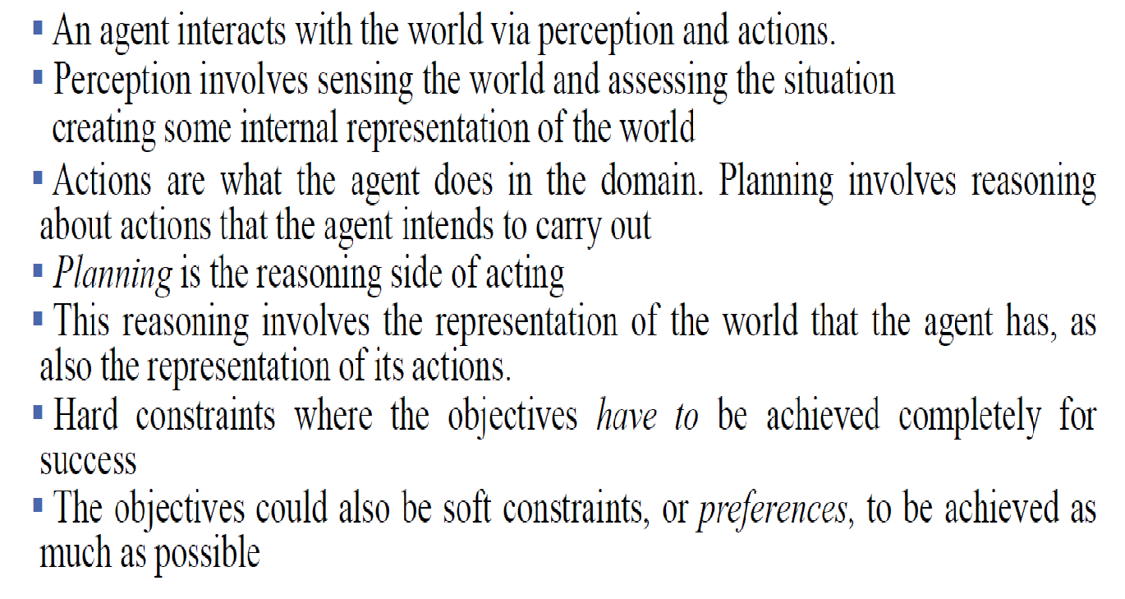
A planning agent

Slide 118
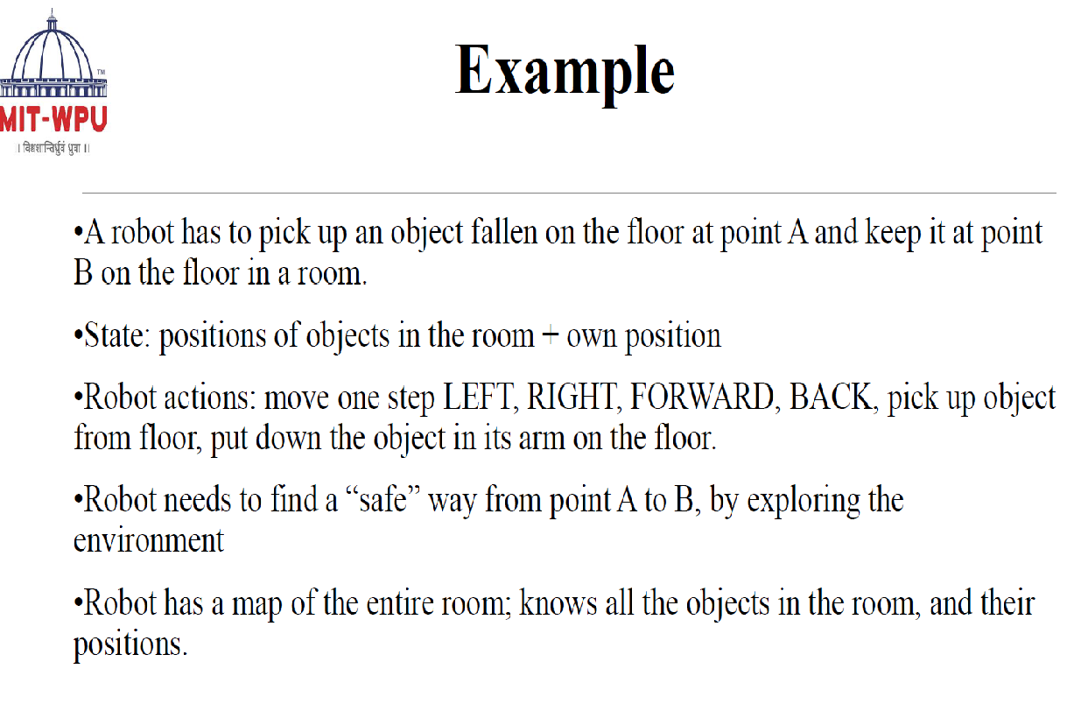

Slide 119


Slide 120
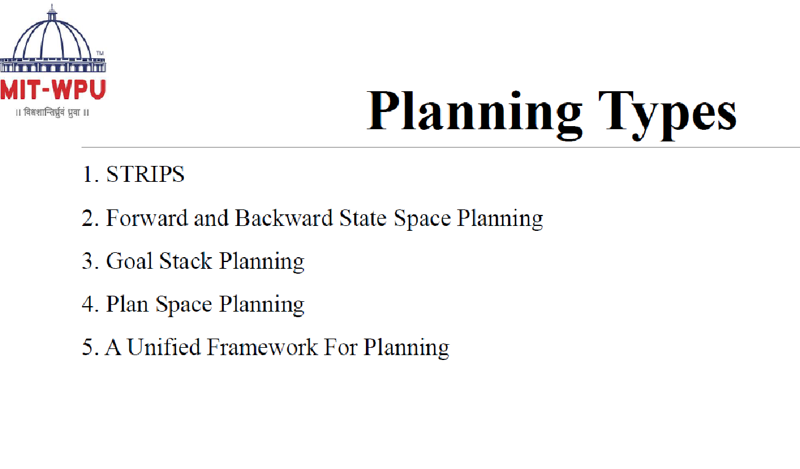

Slide 121
Blocks-World planning problem
The blocks-world problem is known as Sussman Anomaly.
Noninterleaved planners of the early 1970s were unable to solve this problem, hence it is considered as anomalous.
When two subgoals G1 and G2 are given, a noninterleaved planner produces either a plan for G1 concatenated with a plan for G2, or vice-versa.
In blocks-world problem, three blocks labeled as 'A', 'B', 'C' are allowed to rest on the flat surface. The given condition is that only one block can be moved at a time to achieve the goal.
The start state and goal state are shown in the following diagram.

Slide 122
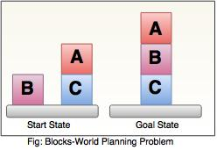
Blocks-World planning problem

Slide 123
Components of Planning System
The planning consists of following important steps:
Choose the best rule for applying the next rule based on the best available heuristics.
Apply the chosen rule for computing the new problem state.
Detect when a solution has been found.
Detect dead ends so that they can be abandoned and the system’s effort is directed in more fruitful directions.
Detect when an almost correct solution has been found.

Slide 124
Goal stack planning
This is one of the most important planning algorithms, which is specifically used by STRIPS. The stack is used in an algorithm to hold the action and satisfy the goal. A knowledge base is used to hold the current state, actions.
Goal stack is similar to a node in a search tree, where the branches are created if there is a choice of an action.

Slide 125
Goal stack planning
The important steps of the algorithm are as stated below:
i. Start by pushing the original goal on the stack. Repeat this until the stack becomes empty. If stack top is a compound goal, then push its unsatisfied subgoals on the stack.
ii. If stack top is a single unsatisfied goal then, replace it by an action and push the action’s precondition on the stack to satisfy the condition.
iii. If stack top is an action, pop it from the stack, execute it and change the knowledge base by the effects of the action.
iv. If stack top is a satisfied goal, pop it from the stack.

Slide 126
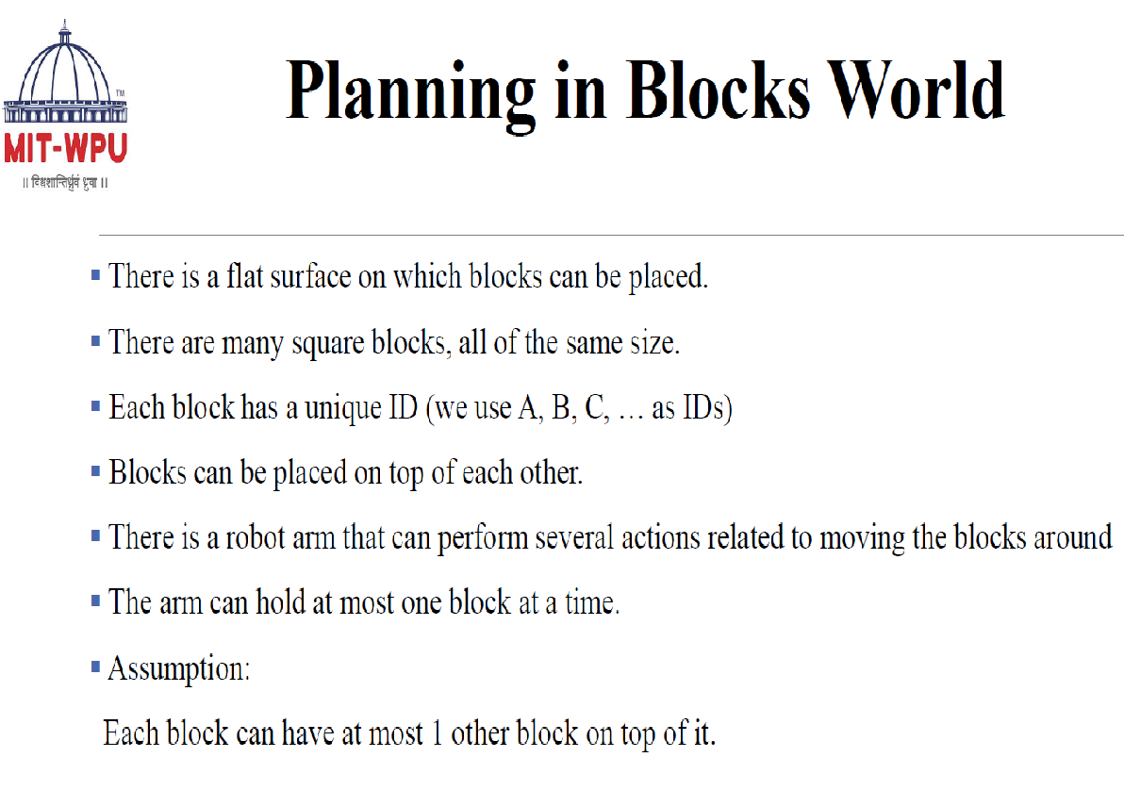

Slide 127
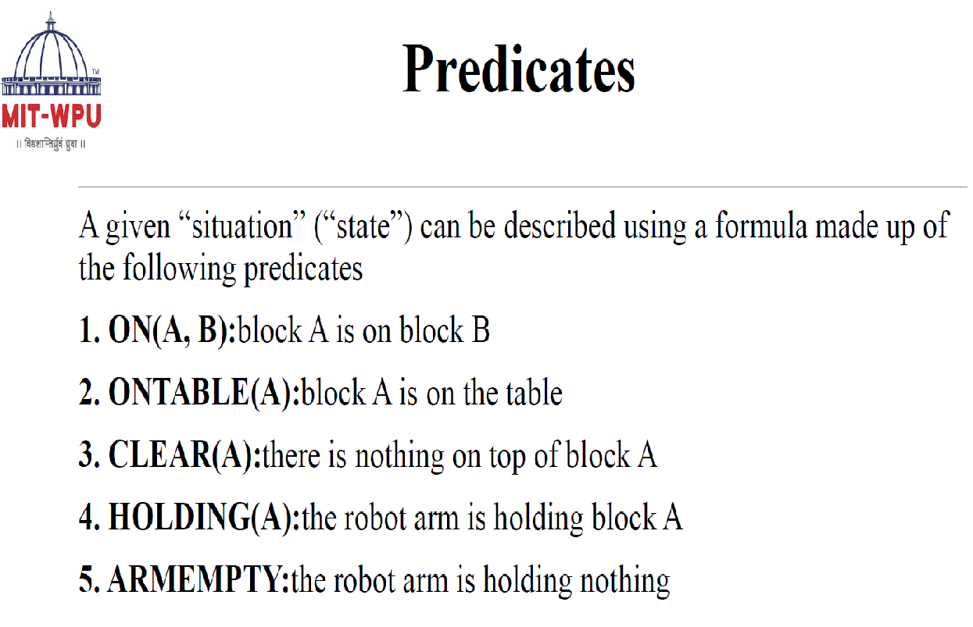

Slide 128
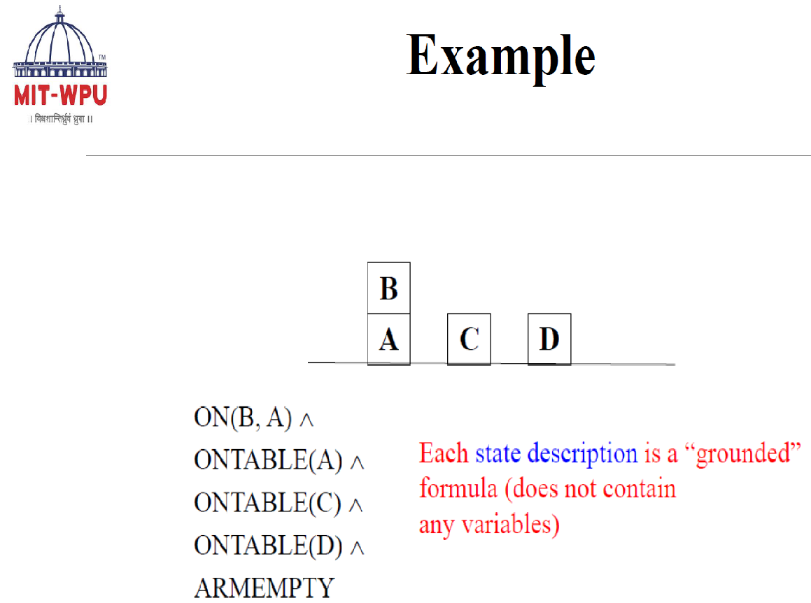

Slide 129
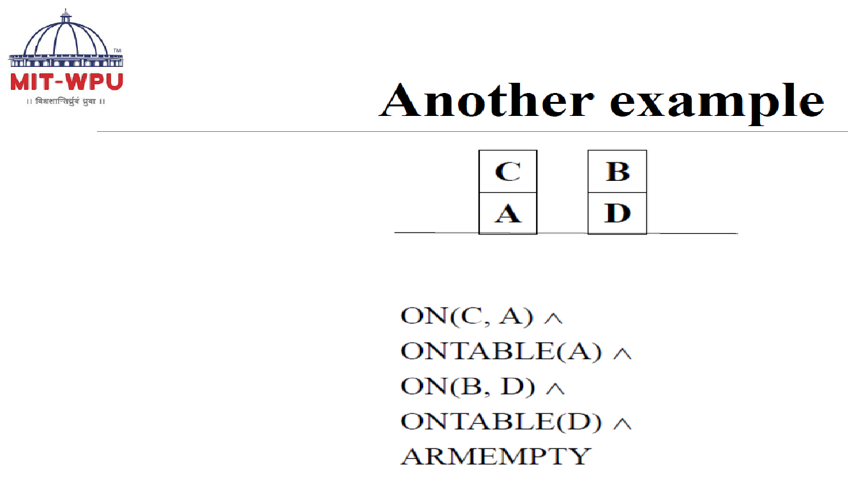

Slide 130
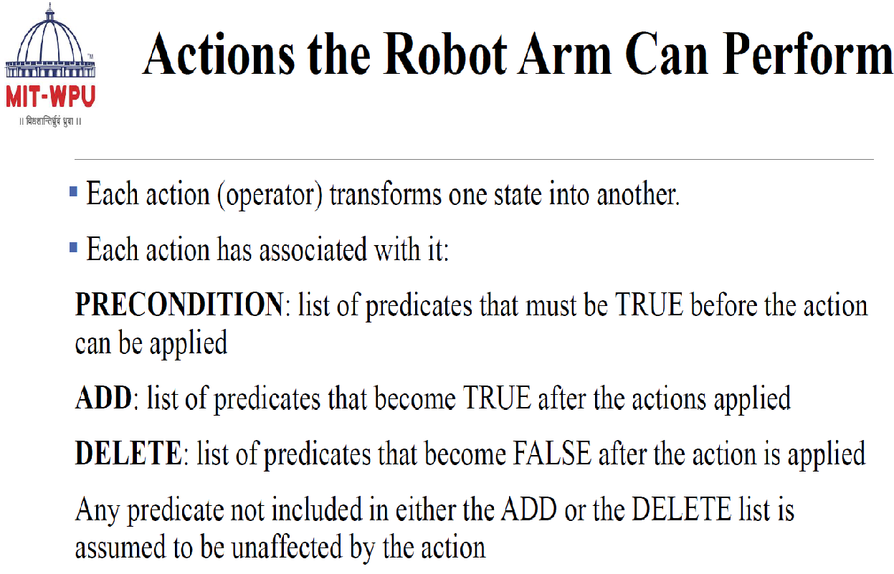

Slide 131
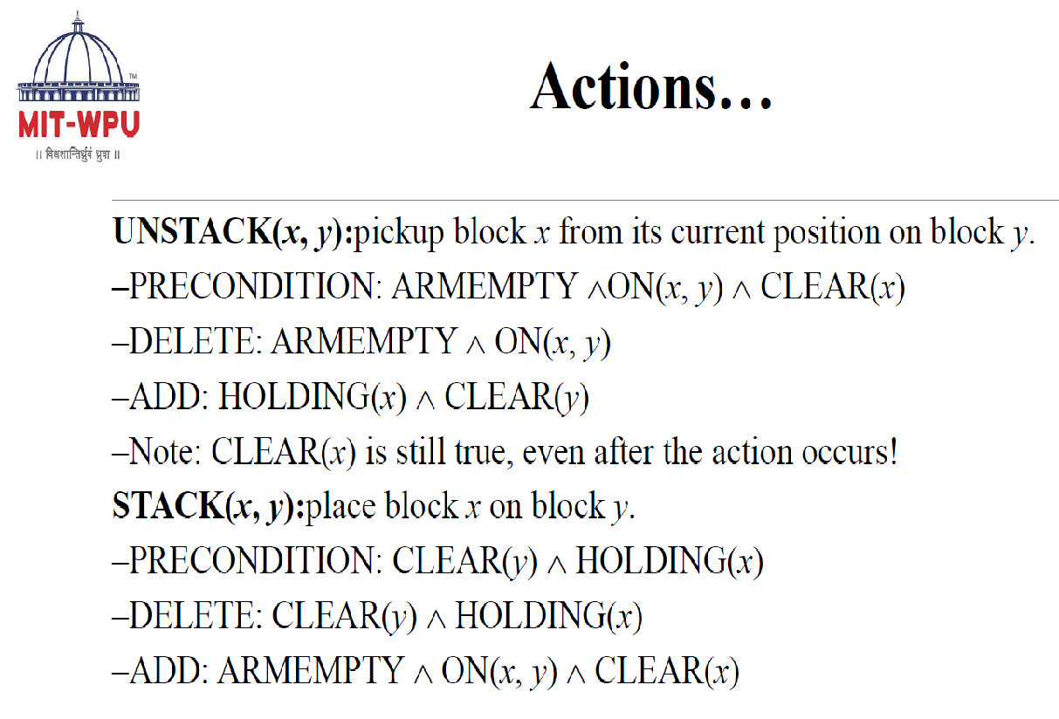

Slide 132
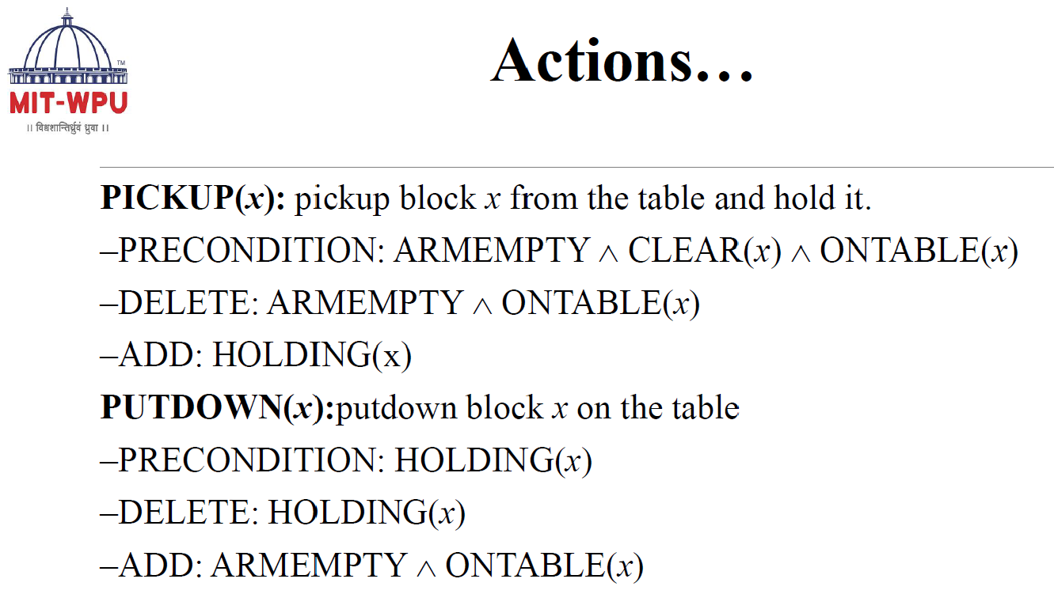

Slide 133
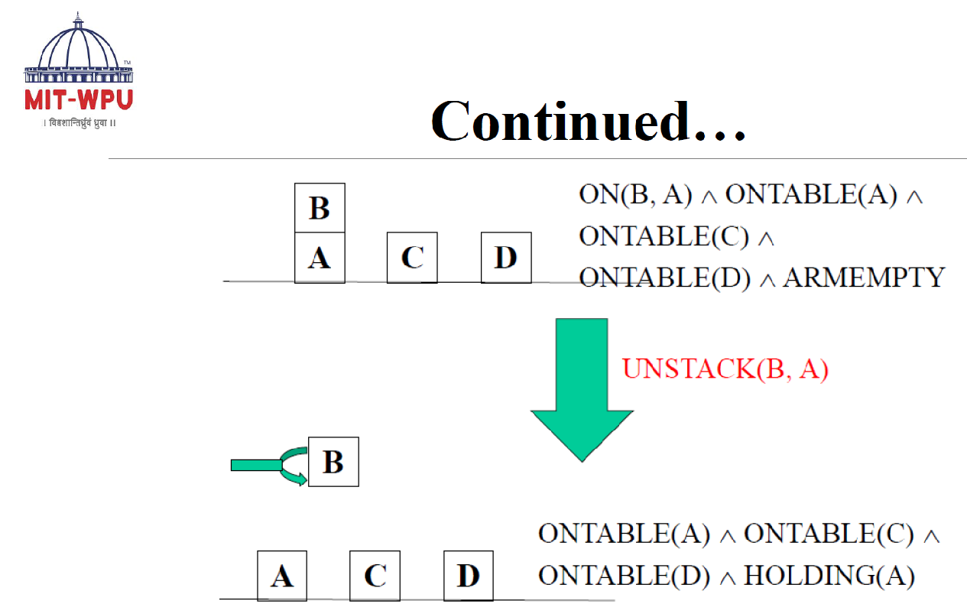

Slide 134
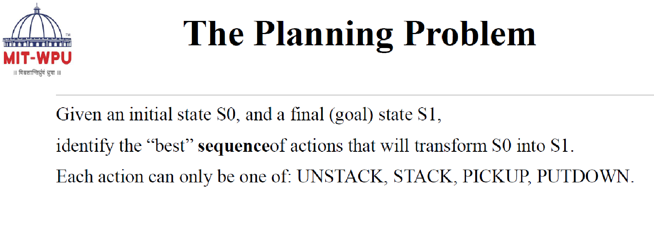

Slide 135
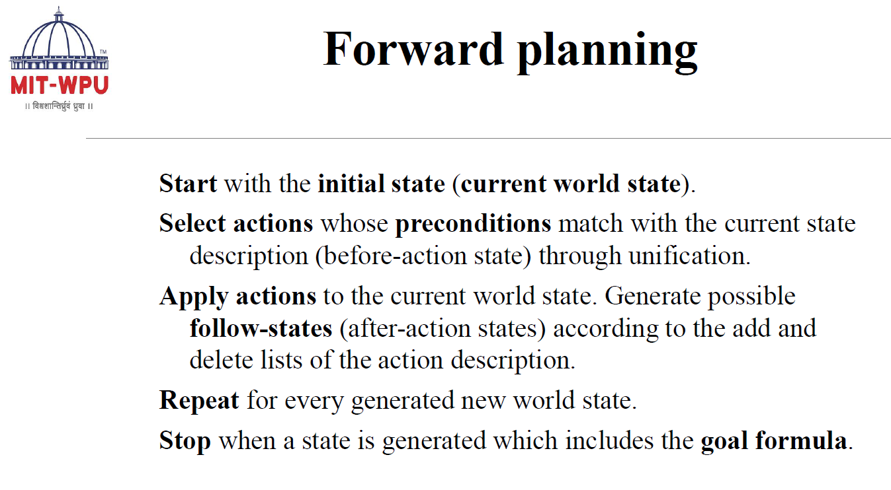

Slide 136
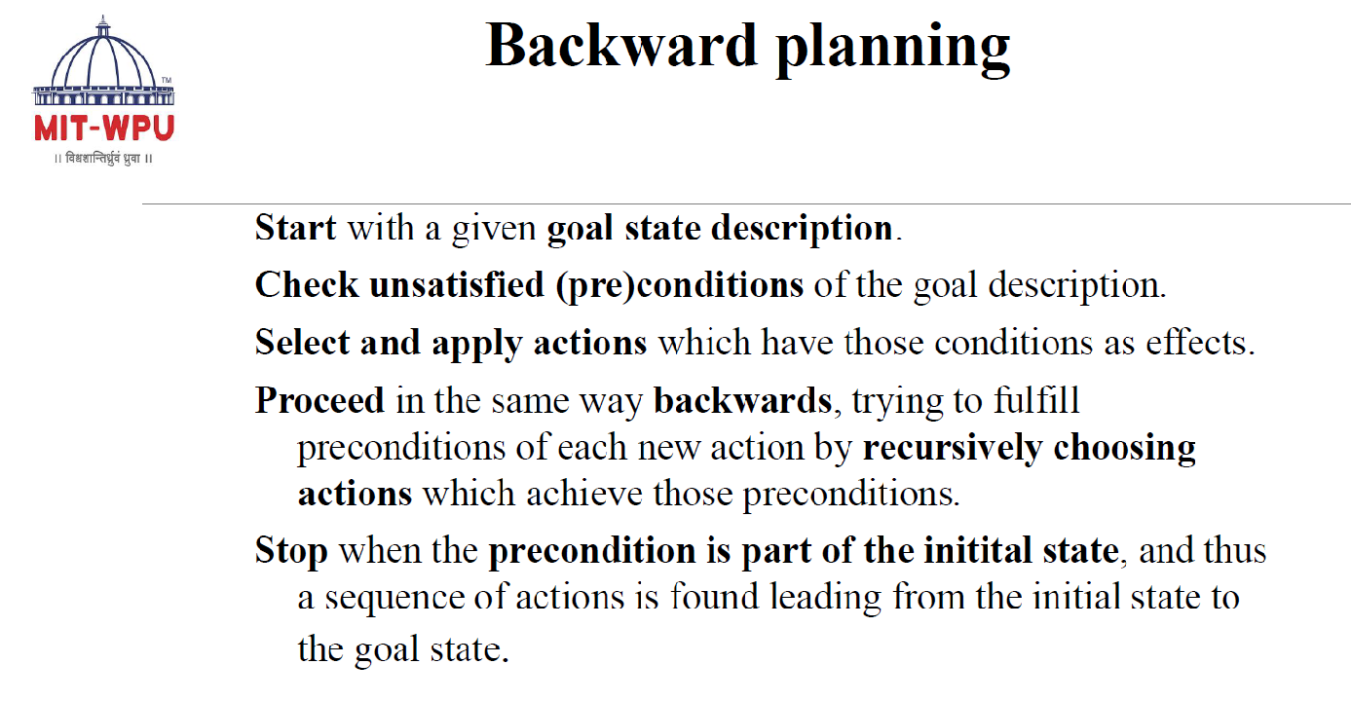

Slide 137
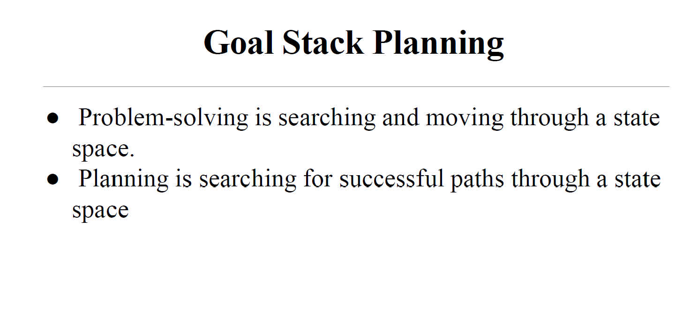

Slide 138


Slide 139


Slide 140


Slide 141


Slide 142


Slide 143


Slide 144


Slide 145


Slide 146


Slide 147


Slide 148


Slide 149


Slide 150
Non-linear planning
This planning is used to set a goal stack and is included in the search space of all possible subgoal orderings. It handles the goal interactions by interleaving method.
Advantage of non-Linear planning
Non-linear planning may be an optimal solution with respect to plan length (depending on search strategy used).
Disadvantages of Nonlinear planning
It takes larger search space, since all possible goal orderings are taken into consideration.
Complex algorithm to understand.

Slide 151
Algorithm
1. Choose a goal 'g' from the goalset
2. If 'g' does not match the state, thenChoose an operator 'o' whose add-list matches goal g
Push 'o' on the opstack
Add the preconditions of 'o' to the goalset
3. While all preconditions of operator on top of opstack are met in statePop operator o from top of opstack
state = apply(o, state)
plan = [plan; o]

Slide 152


