Slide 1
Knowledge Representation and Planning
Unit-2

Slide 2
Syllabus
Knowledge Representation and Planning
Propositional logic and predicate logic, Knowledge Representation structure such as frame, Conceptual dependencies, Semantic networks and script, Resolution in predicate logic, Unification algorithm, Forward and Backward chaining, Logic Programming
Planning: Forward and Backward planning, Goal Stack Planning, Hierarchical Planning.

Slide 3

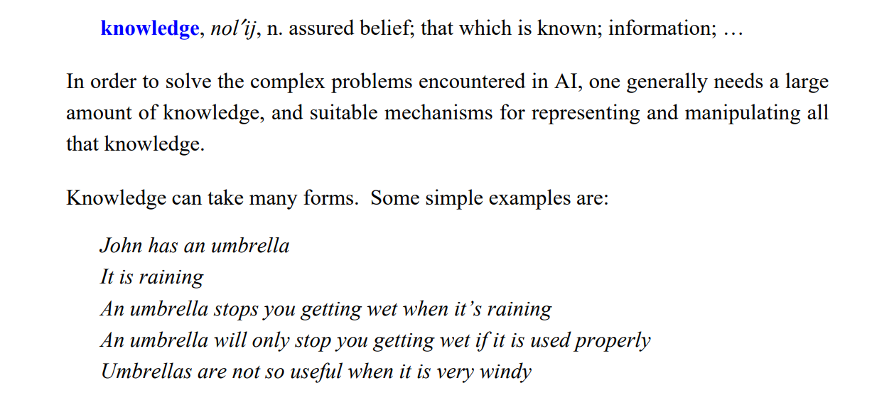

Slide 4
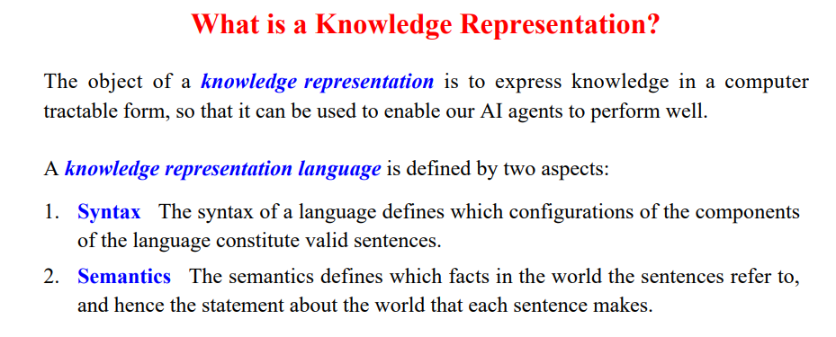
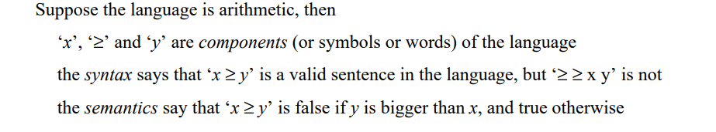

Slide 5
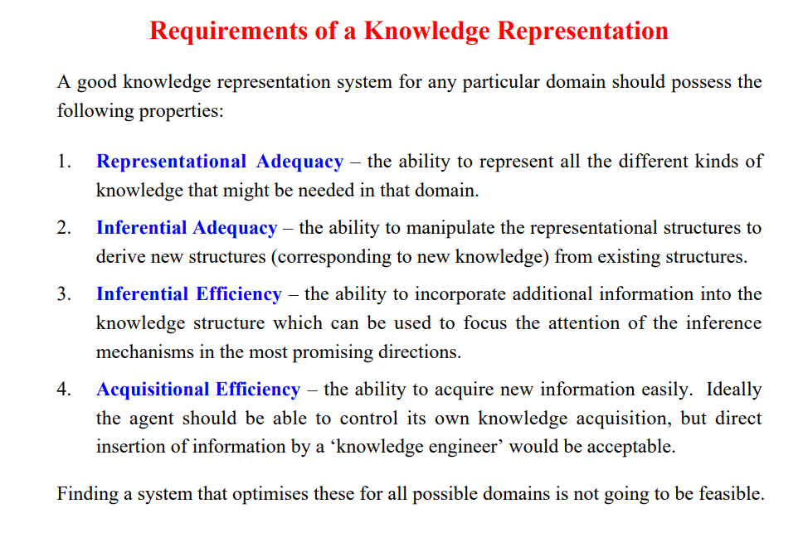

Slide 6
Techniques of knowledge Representation
Logical Representation
Semantic Networks
Frames
Scripts

Slide 7
Logic

Slide 8
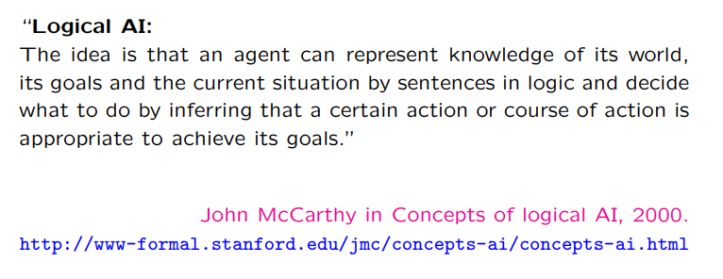

Slide 9
Knowledge Based Agent
Intelligent Agent : Perceiving, Knowledge Representation, Reasoning and Acting
The primary component of a knowledge-based agent is its knowledge-base
A knowledge-base is a set of sentences
Each sentence is expressed in a language called the knowledge representation language.
There must mechanisms to derive new sentences from old ones. This process is known as inferencing or reasoning

Slide 10
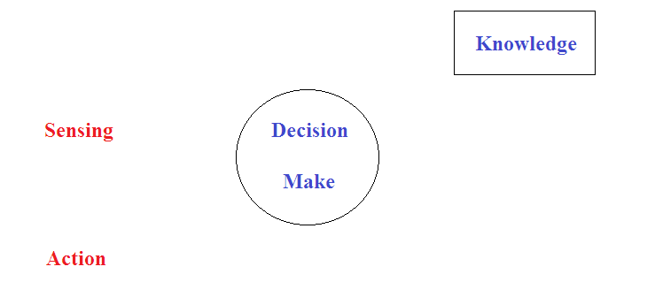
Knowledge and Intelligence
Does knowledge have any role in demonstrating Intelligent behavior.

Slide 11
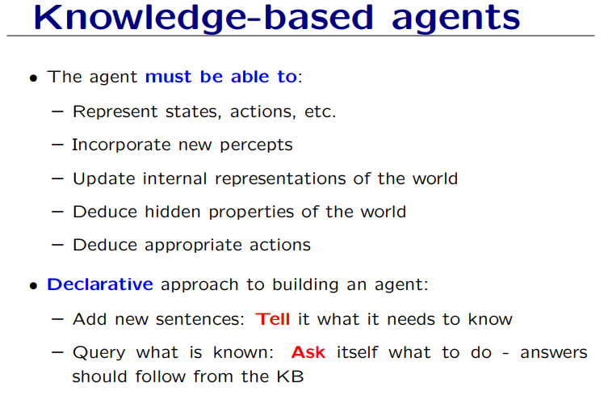

Slide 12
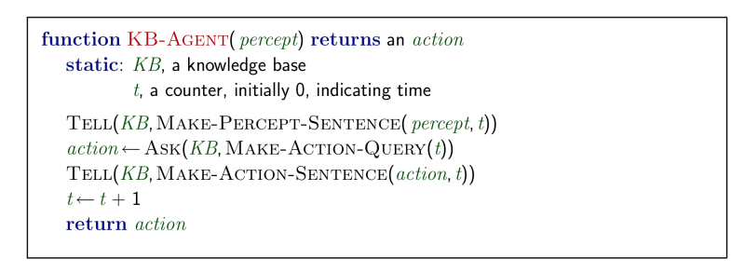
Knowledge Based Agent
There must be a way to add new sentences to the knowledge base, and a way to query what is known
The standard names for these tasks are TELL and ASK

Slide 13
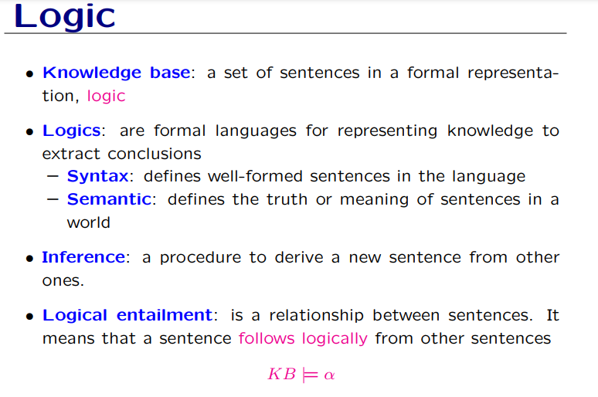

Slide 14
Types of Logic
There are a number of logical systems with different syntax and semantics.
Propositional logic
Predicate logic

Slide 15
Propositional Logic
Simplest form of logic where all the statements are made by propositions.
A proposition is a declarative statement which is either true or false
It is a technique of knowledge representation in logical and mathematical form
Examples -
a) It is Sunday.
b) The Sun rises from West (False proposition)
c) 3+3= 7(False proposition)
d) 5 is a prime number.

Slide 16
Propositional Logic
Propositional logic is a symbolic logic for manipulating propositions
Propositional logic is concerned with declarative sentences that can be classified as either true or false
Propositional logic is also called Boolean logic as it works on 0 and 1.
Use symbolic variables to represent the logic, and we can use any symbol for a representing a proposition, such A, B, C, P, Q, R, etc.
Propositions can be either true or false, but it cannot be both.

Slide 17
Propositional Logic
A sentence whose truth value can be determined is called a statement or proposition
A statement is also called a closed sentence because its truth value is not open to question
Statements that cannot be answered absolutely are called open sentences
A compound statement is formed by using logical connectives on individual statements
Statements which are questions, commands, or opinions are not propositions such as "Where is Rohini", "How are you", "What is your name", are not propositions.

Slide 18
Syntax of propositional logic
The syntax of propositional logic defines the allowable sentences for the knowledge representation. There are two types of Propositions:
Atomic Propositions
Compound propositions

Slide 19
Atomic Proposition: Atomic propositions are the simple propositions. It consists of a single proposition symbol. These are the sentences which must be either true or false.
“The Sun is cold” is also a proposition as it is a false fact.
Compound proposition: Compound propositions are constructed by combining simpler or atomic propositions, using parenthesis and logical connectives.
"It is raining today, and street is wet."

Slide 20
In propositional logic (PL) an user defines a set of propositional symbols, like P and Q. User defines the semantics of each of these symbols. For example :
P means "It is hot"
Q means "It is humid"
R means "It is raining"
A sentence (also called a formula or well-formed formula or wff) is defined as:
1. A symbol
2. If S is a sentence, then ~S is a sentence, where "~" is the "not" logical operator
3. If S and T are sentences, then (S v T), (S ^ T), (S => T), and (S <=> T) are sentences, where the four logical connectives correspond to "or," "and," "implies," and "if and only if," respectively

Slide 21
Propositional logic (PL)
For example,
  P means "It is hot"
  Q means "It is humid"
  R means "It is raining"
Examples of PL sentences:
o (P ^ Q) => R
(here meaning "If it is hot and humid, then it is raining")
o Q => P
(here meaning "If it is humid, then it is hot")
o Q
(here meaning "It is humid.")

Slide 22
Propositional logic (PL)
Propositional logic All objects described are fixed or unique
“John is a student" student(john)
Here John refers to one unique person.

Slide 23
Propositional Calculus Sentences
Every propositional symbol and truth symbol is a sentence.
Examples: true, P, Q, R.
The negation of a sentence is a sentence.
Examples: ¬P, ¬ false.
The conjunction, or and, of two sentences is a sentence.
Example: P ∧ ¬P

Slide 24
Propositional Calculus Sentences (cont’d)
The disjunction, or or, of two sentences is a sentence.
Example: P ∨ ¬P
The implication of one sentence from another is a sentence.
Example: P → Q
The equivalence of two sentences is a sentence.
Example: P ∨ Q ≡ R
Legal sentences are also called well-formed formulas or WFFs.

Slide 25
Properties of Operators:
Commutativity:
  P∧ Q= Q ∧ P, or
  P ∨ Q = Q ∨ P.
Associativity:
  (P ∧ Q) ∧ R= P ∧ (Q ∧ R),
  (P ∨ Q) ∨ R= P ∨ (Q ∨ R)
Identity element:
  P ∧ True = P,
  P ∨ True= True

Slide 26
Properties of Operators:
Distributive:
  P∧ (Q ∨ R) = (P ∧ Q) ∨ (P ∧ R).
  P ∨ (Q ∧ R) = (P ∨ Q) ∧ (P ∨ R).
DE Morgan's Law:
  ¬ (P ∧ Q) = (¬P) ∨ (¬Q)
  ¬ (P ∨ Q) = (¬ P) ∧ (¬Q).
Double-negation elimination:
  ¬ (¬P) = P.

Slide 27
Objectives
Infer truth value of proposition
Reason towards new facts, given set of propositions

Slide 28
Inference In Propositional Logic

Slide 29
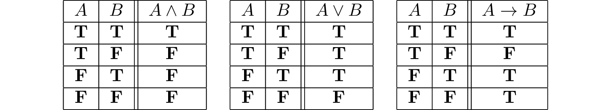
Procedure to derive Truth Value

Slide 30

1. Modus Ponens
The Modus Ponens rule is one of the most important rules of inference, and it states that if P and P → Q is true, then we can infer that Q will be true. It can be represented as:

Slide 31
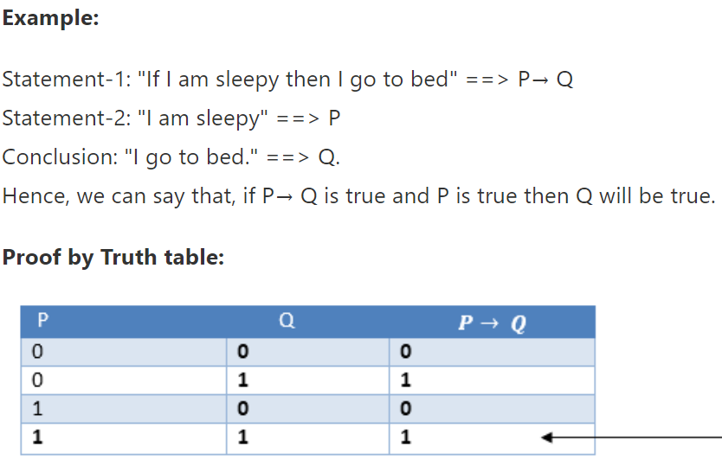

Slide 32

2. Modus Tollens
The Modus Tollens rule state that if P→ Q is true and ¬ Q is true, then ¬ P will also true. It can be represented as

Slide 33
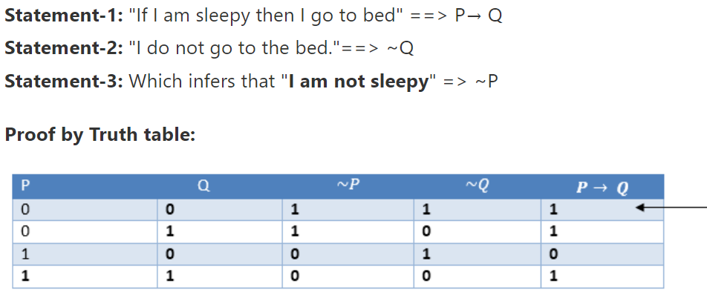

Slide 34
Limitation
We cannot represent relations like ALL, some, or none with propositional logic. Example:
  All the girls are intelligent.
  Some apples are sweet.
Propositional logic has limited expressive power.
In propositional logic, we cannot describe statements in terms of their properties or logical relationship

Slide 35
First Order Logic
OR
Predicate Logic

Slide 36
Limitation of Proposition Logic
Consider following arguments
All dogs are faithful
Tommy is a dog
Therefore, tommy is faithful
How to represent and infer this in propositional logic ?

Slide 37
Limitation of Proposition Logic
P is all dogs are faithful
q is Tommy is a dog
But p ^ q => Tommy is faithful ??
No ! We can not infer this in proposition Logic

Slide 38
More Scenarios
Tom is a hardworking : Hardworking (Tom)
Tom is intelligent : Intelligent (Tom)
Rule : If Tom is hardworking and intelligent then tom Scores high marks
Hardworking [Tom] ^ Intelligent [Tom] = > Scores_High_Marks[Tom]
What about john and Jill

Slide 39
The Problem of Infinite Model
In general, Proportional logic can deal with only a finite numbers of propositions.
If there are only three dogs Tommy, Jimmy and Leela the
T : Tommy is faithful
J : Jimmy is faithful
L : Leela is Faithful
All dogs are faithful : T ^ J ^ L

Slide 40
First Order Logic
Another way of knowledge representation
It is an extension to propositional logic
Predicate Logic deals with predicates, which are propositions, consist of variables
Also known as Predicate logic
Powerful language that develops information about the objects

Slide 41
Syntax for FOL
Defines in terms of
Terms
Predicates
Quantifiers

Slide 42
Terms
A term denotes some objects other than true or false
Tommy is a dog
Terms
All Men are mortal
Terms : Constants and Variables

Slide 43
Terms
A constant of type W is a name that denotes a particular objects in a set W
Example : 5, Tommy
A variable of type W is a name that can denote any element in the set W
Example : x € N denotes a natural number
d € M denotes the name of dog

Slide 44
Terms: Functions
A functional terms takes n objects of type W1 to Wn as input and returns an objects of type W.
F = ( W1,W2,………,Wn)
plus(3,4) = 7
Functional Term Constant Term

Slide 45
Predicates
Predicate are like functions except that their return type is true or false.
Example : greater(x, y) is true if x > y
Here greater is a predicate symbol that takes two arguments of type natural number
greater [2,4] – not valid
greater [3,-4] – valid

Slide 46
Types of Predicates
A predicates with no variable is a proposition
Tommy is a dog
A predicate with one variable is called a property
dog [x] is true if x is a dog
mortal [y] is true if y is mortal

Slide 47
Formulation of Predicates
Let P(x,y,….) and Q(x,y,…) are two predicates
Then so are
P v Q
P ^ Q
~ P
P =>Q

Slide 48
Predicates Examples
If x is a man then x is mortal
man(x) => mortal (x)
If n is a natural number, then n is either even or odd
natural(n) = > even (n) v odd(n)

Slide 49

Quantifiers
There are two basic quantifiers in FOL
“ For all “ – Universal quantifier
Ǝ “ There Exists” – Existential Quantifiers
Universal Quantifiers :
All dogs are faithful
faithful (x) : x is faithful
dog(x) : x is a dog
x (dog (x) => faithful (x ) )

Slide 50
All birds cannot fly
fly (x) : x can fly
birds(x) : x is a bird
~ [ x ( bird (x) => fly (x) ]

Slide 51
Existential Quantifiers
All birds can not fly : there exits a bird that can not fly
fly (x) : x can fly
birds(x) : x is a bird
Ǝ x [ bird (x) ^ ~ fly(x)]

Slide 52
Inference in First-Order Logic
Used to deduce new facts or sentences from existing sentences.
Some basic terminologies used in FOL

Slide 53
Inference in First-Order Logic
Substitution –
fundamental operation performed on terms and formulas.
It occurs in all inference systems
The substitution is complex in the presence of quantifiers in FOL.
F[a/x], so it refers to substitute a constant "a" in place of variable "x".

Slide 54
Inference in First-Order Logic
2. Equality
First-Order logic does not only use predicate and terms for making atomic sentences but also uses another way, which is equality in FOL.
we can use equality symbols which specify that the two terms refer to the same object.
Example - Brother (John) = Smith.
Also be used with negation to represent that two terms are not the same objects.
Example - ￢(x=y) which is equivalent to x ≠y.

Slide 55
FOL inference rules for quantifier
Universal Generalization
Universal Instantiation
Existential Instantiation
Existential introduction

Slide 56

Universal Generalization
.
Universal generalization is a valid inference rule which states that if premise P(c) is true for any arbitrary element c in the universe of discourse, then we can have a conclusion as ∀ x P(x).
It can be represented as
This rule can be used if we want to show that every element has a similar property.

Slide 57
Universal Generalization
  Example –
  P(c): "A byte contains 8 bits“
  so for ∀ x P(x) "All bytes contain 8 bits.",
  it will also be true.

Slide 58

Universal Instantiation
Also called as universal elimination
It can be applied multiple times to add new sentences.
It can be represented as
Example –
Every person like ice-cream=> ∀x P(x)
John likes ice-cream => P(c)

Slide 59

Existential Instantiation
Also called as Existential Elimination
It can be applied only once to replace the existential sentence.
This rule states that one can infer P(c) from the formula given in the form of ∃x P(x) for a new constant symbol c.
It can be represented as

Slide 60
Existential Instantiation
Example –
∃x Crown(x) ∧ OnHead(x, John)
So we can infer: Crown(K) ∧ OnHead( K, John), as long as K does not appear in the knowledge base.
The above used K is a constant symbol, which is called Skolem constant.
The Existential instantiation is a special case of Skolemization process.

Slide 61

Existential introduction
Also known as an existential generalization
This rule states that if there is some element c in the universe of discourse which has a property P, then we can infer that there exists something in the universe which has the property P.
It can be represented as
Example: Let's say that,
"Priyanka got good marks in English."
"Therefore, someone got good marks in English."

Slide 62
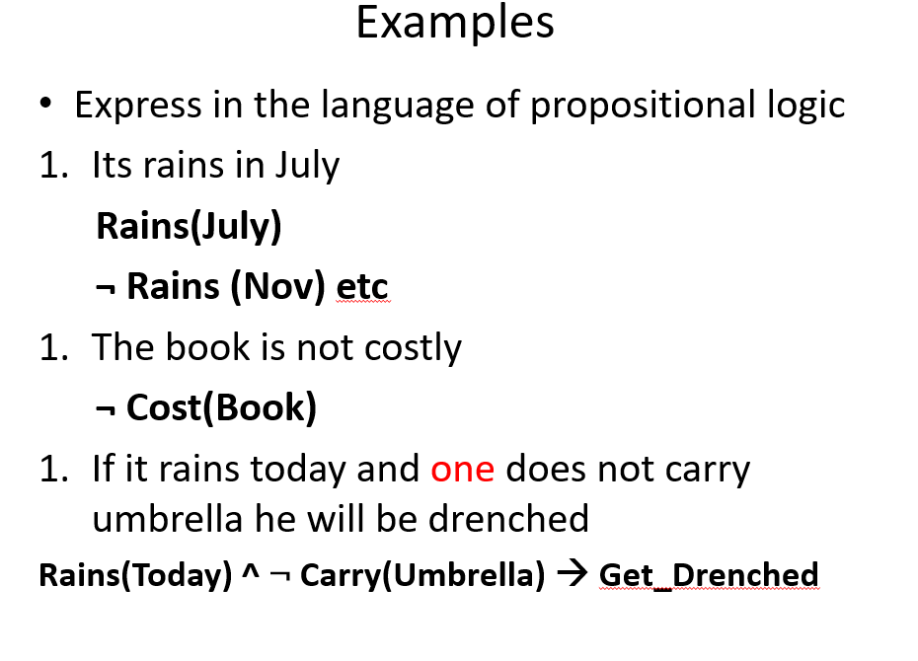

Slide 63
Examples
Express in the language of propositional logic
Its rains in July
Rains(July)
¬ Rains (Nov) etc
The book is not costly
¬ Cost(Book)
If it rains today and one does not carry umbrella he will be drenched
Rains(Today) ^ ¬ Carry(Umbrella) 🡪 Get_Drenched

Slide 64
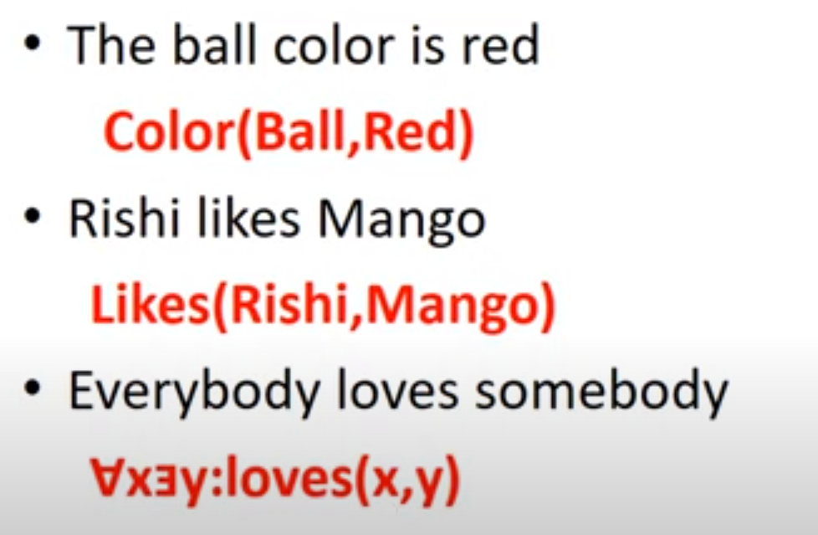

Slide 65
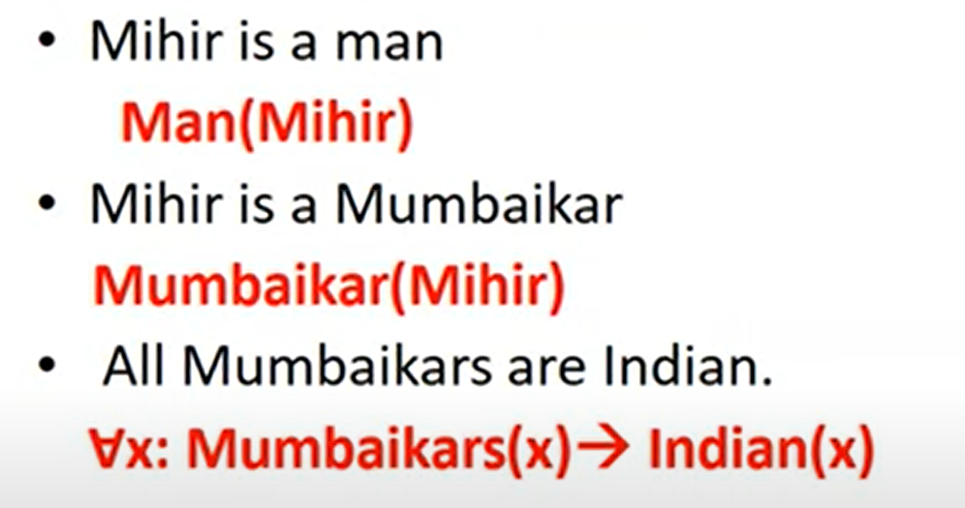

Slide 66
Examples
If P is true and Q is true , then are the following sentences are true or false?
P 🡪 Q
(¬ P v Q ) 🡪 Q
(¬ P v Q) 🡪 P
P v ¬P 🡪

Slide 67
Examples
Some dogs bark
All dogs have four legs
All barking dogs are irritating
No dogs purr
Fathers are male parents with children
Students are people who are enrolled in courses

Slide 68
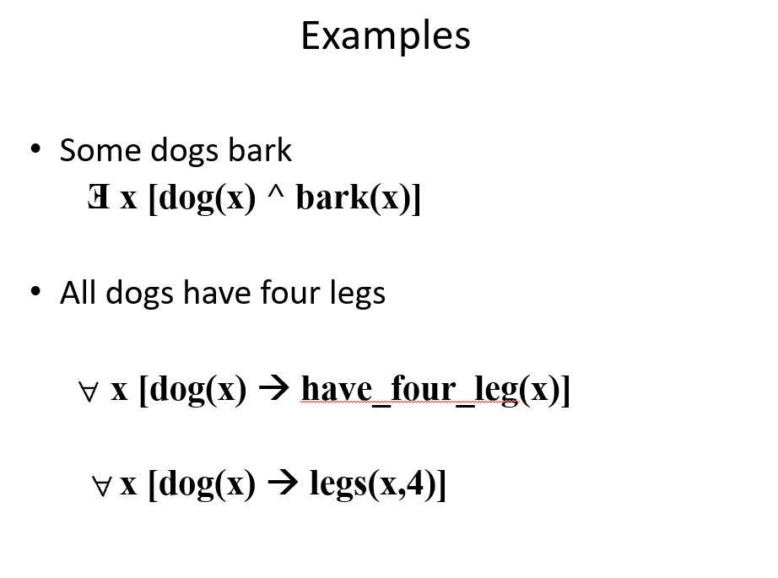

Slide 69
Examples
Some dogs bark
Ǝ x [dog(x) ^ bark(x)]
All dogs have four legs
x [dog(x) 🡪 have_four_leg(x)]
x [dog(x) 🡪 legs(x,4)]

Slide 70
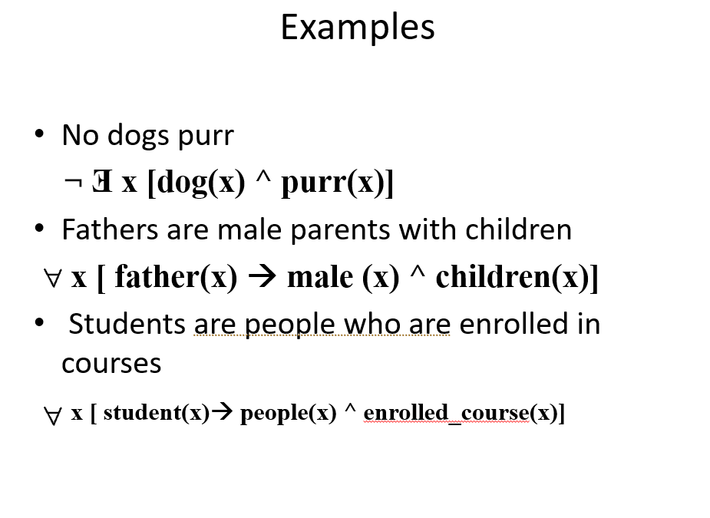

Slide 71
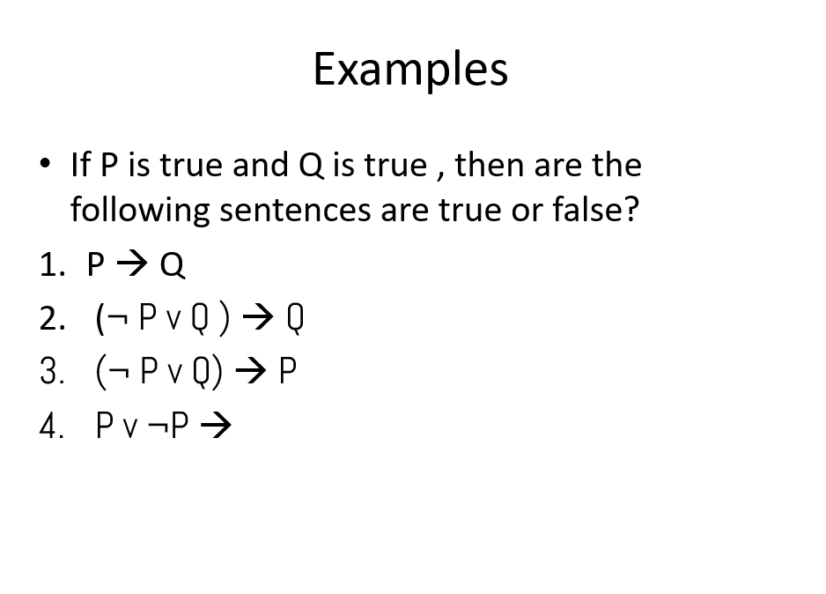

Slide 72
Solving Problems
All people who are graduating are happy
All happy people smile
Someone is graduating

Slide 73
Predicates
[x] [graduating [x] -> happy [x] ]
[x] [happy [x] -> smiling[x]]
Ǝ [x] [graduating [x]]

Slide 74
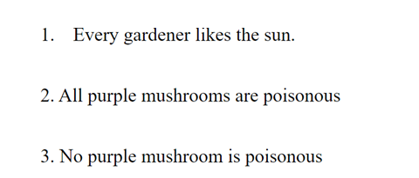

Slide 75
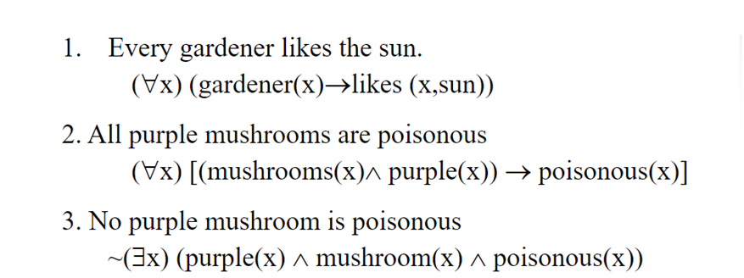
Predicates

Slide 76
Semantic Net

Slide 77
Semantic Networks
Alternative of predicate logic for knowledge representation.
Represent our knowledge in the form of graphical networks
This network consists of nodes representing objects and arcs which describe the relationship between those objects.
Categorize the object in different forms and can also link those objects.
Easy to understand and can be easily extended.

Slide 78
Semantic Networks
This representation consist of mainly two types of relations:
IS-A relation (Inheritance)
Kind-of-relation

Slide 79
Semantic Networks
Statements:
Jerry is a cat.
Jerry is a mammal.
Jerry is owned by Priya.
Jerry is white colored.
All Mammals are animal.

Slide 80
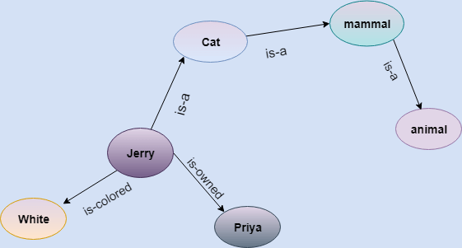

Slide 81
Drawbacks
More computational time
In practice, it is not possible to build such a vast semantic network.
These types of representations are inadequate as they do not have any equivalent quantifier, e.g., for all, for some, none, etc.
Semantic networks do not have any standard definition for the link names.
These networks are not intelligent and depend on the creator of the system.

Slide 82
Advantages
Semantic networks are a natural representation of knowledge.
Semantic networks convey meaning in a transparent manner.
These networks are simple and easily understandable.

Slide 83
Frames

Slide 84
Frame
By Marvin Minsky in 1970
Definition- A collection of attributes and associated values that describe some entity in the world
A frame represents a concept
Frames are organized into hierarchies or network of frames
Lower-level frames can inherit information from upper-level frames in network

Slide 85
Frame
A Frame system is a collection of objects.
Each object contains a number of slots.
A slot represents an attribute. Each slot has a value. The value of an attribute can be another object.
Each object is like a C struct. The struct has a name and contains a bunch of named values (which can be pointers)

Slide 86
Frame
A Frame system is a collection of objects.
Each object contains a number of slots.
A slot represents an attribute. Each slot has a value. The value of an attribute can be another object.
Each object is like a C struct. The struct has a name and contains a bunch of named values (which can be pointers)

Slide 87
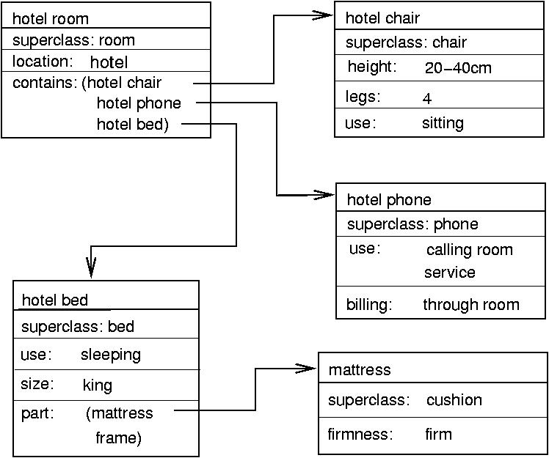

Slide 88
Advantages
Allowing complex object represented as a single frame
Provide easier framework to organize the information hierarchically
Frame support class inheritance

Slide 89
Script
Another knowledge representation technique
Frame like structures used to represent commonly occurring experiences (going to restaurant, visiting a doctor)
It is a structure that describes a stereotyped sequence of events in a particular context.
A script consist of a set of slots.
Associated with each slot may be some information

Slide 90
Script
Useful because in the real world, there are no patterns to the occurrence of events.
Patterns arise because of clausal relationships between events.
The events described in a script form a giant casual chain
The beginning of the chain is the set of entry conditions
The end of the chain is the set of results

Slide 91
Script
A script has various components like:
Entry condition: It must be true before the events described in the script can occur
Tracks: It specifies particular position of the script
Result: It must be satisfied or true after the events described in the script have occurred.
Probs: It describes the inactive or dead participants in the script
Roles: It specifies the various stages of the script.
Scenes : The sequence of events that occur.

Slide 92
Describing a script, special symbols of actions are used. These are:
Symbol | Meaning | Example
ATRANS | transfer a relationship | give
PTRANS | transfer physical location of an object | go
PROPEL | apply physical force to an object | push
MOVE | move body part by owner | kick
GRASP | grab an object by an actor | hold
INGEST | taking an object by an animal eat | drink
EXPEL | expel from animal’s body | cry
MTRANS | transfer mental information | tell
MBUILD | mentally make new information | decide
CONC | conceptualize or think about an idea | think
SPEAK | produce sound | say
ATTEND | focus sense organ | listen

Slide 93
Script Example
a) Script name : Movie
b) Track : CINEMA HALL
c) Roles : Customer(C), Ticket seller(TS), Ticket Checker(TC),
Snacks Sellers (SS)
d) Probes : Ticket, snacks, chair, money, Ticket, chart
e) Entry condition : The customer has money
The customer has interest to watch movie.
Scenes : The sequence of events that occur.

Slide 94
SCENE-1 (Entering into the cinema hall)
C PTRANS into the cinema hall
C ATTEND eyes towards the ticket counter
C PTRANS towards the ticket counters
C ATTEND eyes to the ticket chart
C MBUILD to take which class ticket
C MTRANS TS for ticket
C ATRANS money to TS
TS ATRANS ticket to C

Slide 95
SCENE-2 (Entering into the main ticket check gate)
C PTRANS into the queue of the gate C ATRANS ticket to TC
TC ATTEND eyes onto the ticket
TC MBUILD to give permission to C for entering into the hall
TC ATRANS ticket to C
C PTRANS C into the picture hall.

Slide 96
Script
Less general than frames.
May not be suitable to represent all kinds of knowledge
Advantages of Scripts
Ability to predict events.
A single coherent interpretation maybe builds up from a collection of observations.
Disadvantages of Scripts
Less general than frames.
May not be suitable to represent all kinds of knowledge

Slide 97
Sematic Network Example
Tom is an instance of dog.
Tom caught a cat
Tom is owned by rashan.
Tom is brown in colour.
Dogs like bones.
The dog sat on the mat.
A dog is a mammal.
A cat is an instance animal
All mammals are animals.
Mammals have fur.

Slide 98
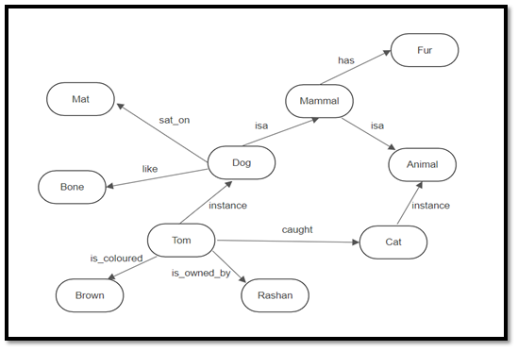
Sematic Network Example

Slide 99
Write a Script for going to the bank to withdraw money.

Slide 100
SCRIPT : Withdraw money
TRACK : Bank
PROPS : Money, Counter, Form, Token
Roles : P= Customer, E= Employee
C= Cashier
Entry conditions: P has no or less money.
The bank is open.
Results : P has more money.
Scene 1: Entering
P PTRANS P into the Bank
P ATTEND eyes to E
P MOVE P to E

Slide 101
Convert the following English statements to statements in first order logic
a. every boy or girl is a child
b. every child gets a doll or a train or a lump of coal
c. no boy gets any doll
d. no child who is good gets any lump of coal
e. Jack is a boy

Slide 102
The FOL statements are
a. forall x ((boy(x) or girl(x)) -> child(x))
b. forall y (child(y) -> (gets(y,doll) or gets(y,train) or gets(y,coal)))
c. forall w (boy(w) -> !gets(w,doll))
d. forall z ((child(z) and good(z)) -> !gets(z,coal))
e. boy(Jack)

Slide 103
Forward and Backward Chaining

Slide 104
Inference engine
It is a component of the intelligent system
Which applies logical rules to the knowledge base to infer new information from known facts
The first inference engine was part of the expert system
Commonly proceeds in two modes
Forward chaining
Backward chaining

Slide 105
Forward Chaining
It is also known as a forward deduction or forward reasoning method
It is a form of reasoning which start with atomic sentences in the knowledge base and applies inference rules (Modus Ponens) in the forward direction to extract more data until a goal is reached.
Starts from known facts, triggers all rules whose premises are satisfied, and add their conclusion to the known facts. This process repeats until the problem is solved.

Slide 106
Properties of Forward-Chaining
Down-up approach
Making a conclusion based on known facts or data
Data-driven as we reach to the goal using available data.
Commonly used in the expert system, such as CLIPS, business, and production rule systems.

Slide 107
Example Knowledge Base
The law says that it is a crime for an American to sell weapons to hostile nations. The country Nono, an enemy America, has some missiles, and all of its missiles were sold to it by Colonel West, who is an American.
Prove that Colonel West is a criminal.

Slide 108
Example Knowledge Base
It is a crime for an American to sell weapons to hostile nations
  American(x) ∧Weapon(y) ∧Sells(x,y,z) ∧Hostile(z) ⇒ Criminal(x)
  The country Nono, an enemy America
  Enemy(nono, America)
Nono…has some missiles
  Owns(Nono, M1)
  Missle(M1)
All of its missiles were sold to it by Colonel. West
  ∀x Missle(x) ∧ Owns(Nono, x) ⇒ Sells( Colonel, x, Nono)

Slide 109
Example Knowledge Base
Missiles are weapons
  Missle(x) ⇒ Weapon(x)
Col. West who is an American
  American( Col. West )
An enemy of America counts as “hostile”
  Enemy( x, America ) ⇒ Hostile(x)

Slide 110
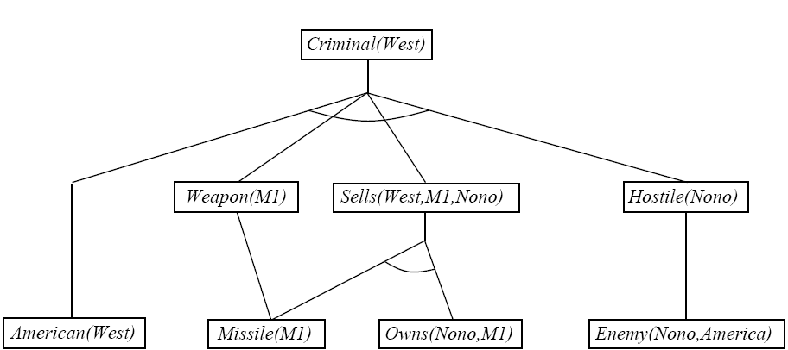
Example Knowledge Base
American(x) ∧Weapon(y) ∧Sells(x,y,z) ∧Hostile(z) ⇒ Criminal(x)
Enemy(nono, America)
Owns(Nono, M1)
Missle(M1)
∀x Missle(x) ∧ Owns(Nono, x) ⇒ Sells( Colonel, x, Nono)
Missle(x) ⇒ Weapon(x)
American( Col. West )
Enemy( x, America ) ⇒ Hostile(x)

Slide 111
Backward Chaining
It is also known as a backward deduction or backward reasoning method
It is a form of reasoning, which starts with the goal and works backward
Chaining through rules to find known facts that support the goal.

Slide 112
Properties of backward chaining
Top-down approach.
Based on modus ponens inference rule
The goal is broken into sub-goal or sub-goals to prove the facts true.
Goal-driven approach, as a list of goals decides which rules are selected and used.
Used in game theory, automated theorem proving tools, inference engines, proof assistants
mostly used a depth-first search strategy for proof.

Slide 113
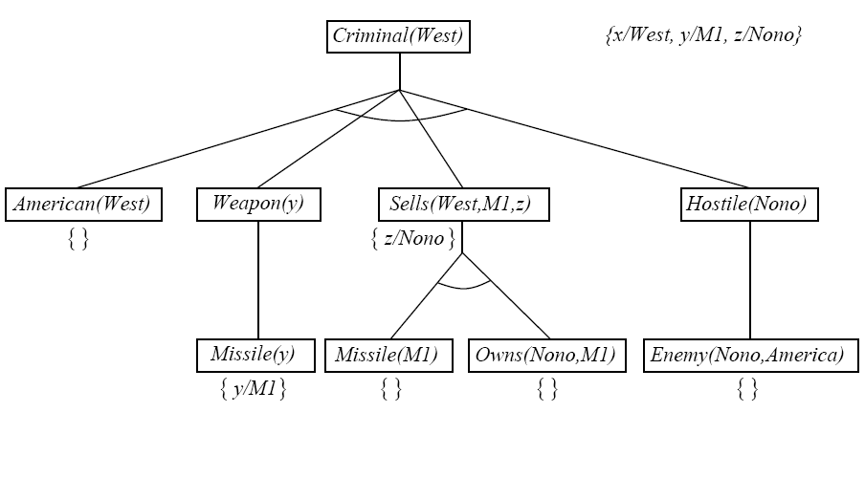
American(x) ∧Weapon(y) ∧Sells(x,y,z) ∧Hostile(z) ⇒ Criminal(x)
Enemy(nono, America)
Owns(Nono, M1)
Missle(M1)
∀x Missle(x) ∧ Owns(Nono, x) ⇒ Sells( Colonel, x, Nono)
Missle(x) ⇒ Weapon(x)
American( Col. West )
Enemy( x, America ) ⇒ Hostile(x)

Slide 114
Resolution in predicate logic
Theorem proving technique that proceeds by building refutation proofs i.e., proofs by contradictions.
Used, if there are various statements are given, and we need to prove a conclusion of those statements.
Resolution is a single inference rule which can efficiently operate on the conjunctive normal form or clausal form

Slide 115
Resolution in predicate logic
Clause: Disjunction of literals (an atomic sentence) is called a clause. It is also known as a unit clause.
Conjunctive Normal Form: A sentence represented as a conjunction of clauses is said to be conjunctive normal form or CNF.

Slide 116
Steps for Resolution
Conversion of facts into first-order logic.
Convert FOL statements into CNF
Negate the statement which needs to prove (proof by contradiction)
Draw resolution graph (unification).

Slide 117
Example
John likes all kind of food.
Apple and vegetable are food
Anything anyone eats and not killed is food.
Anil eats peanuts and still alive
Harry eats everything that Anil eats.
Prove by resolution that:
John likes peanuts.

Slide 118
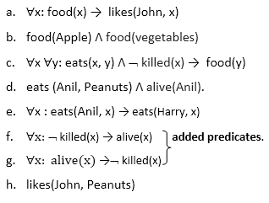
Step-1: Conversion of Facts into FOL

Slide 119
Step-2: Conversion of FOL into CNF
Eliminate all implication (→) and rewrite
∀x ¬ food(x) V likes(John, x)
food(Apple) Λ food(vegetables)
∀x ∀y ¬ [eats(x, y) Λ ¬ killed(x)] V food(y)
eats (Anil, Peanuts) Λ alive(Anil)
∀x ¬ eats(Anil, x) V eats(Harry, x)
∀x¬ [¬ killed(x) ] V alive(x)
∀x ¬ alive(x) V ¬ killed(x)
likes(John, Peanuts).

Slide 120
Step-2: Conversion of FOL into CNF
Move negation (¬)inwards and rewrite
∀x ¬ food(x) V likes(John, x)
food(Apple) Λ food(vegetables)
∀x ∀y ¬ eats(x, y) V killed(x) V food(y)
eats (Anil, Peanuts) Λ alive(Anil)
∀x ¬ eats(Anil, x) V eats(Harry, x)
∀x killed(x) V alive(x)
∀x ¬ alive(x) V ¬ killed(x)
likes(John, Peanuts).

Slide 121
Rename variables or standardize variables
∀x ¬ food(x) V likes(John, x)
food(Apple) Λ food(vegetables)
∀y ∀z ¬ eats(y, z) V killed(y) V food(z)
eats (Anil, Peanuts) Λ alive(Anil)
∀w¬ eats(Anil, w) V eats(Harry, w)
∀g ¬killed(g) ] V alive(g)
∀k ¬ alive(k) V ¬ killed(k)
likes(John, Peanuts).

Slide 122
Eliminate existential instantiation quantifier by elimination
Drop Universal quantifiers
¬ food(x) V likes(John, x)
food(Apple)
food(vegetables)
¬ eats(y, z) V killed(y) V food(z)
eats (Anil, Peanuts)
alive(Anil)
¬ eats(Anil, w) V eats(Harry, w)
killed(g) V alive(g)
¬ alive(k) V ¬ killed(k)
likes(John, Peanuts).

Slide 123
Step-3: Negate the statement to be proved
¬likes(John, Peanuts)

Slide 124
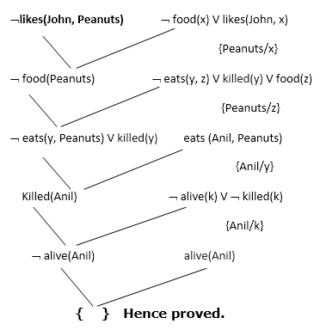
Step-4: Draw Resolution graph

Slide 125
Planning

Slide 126
Planning
The planning in AI is about the decision-making tasks performed by the robots or computer programs to achieve a specific goal.
The execution of planning is about choosing a sequence of actions
Planning is arranging sequence of actions to achieve a goal.

Slide 127
Forward State Space Planning (FSSP)
Like forward state space search
Start state S in any domain, we perform certain actions required and acquire a new state S’ (which includes some new conditions as well) which is called progress and this proceeds until we reach the goal state.
Disadvantage: Large branching factor
Advantage: The algorithm is Sound

Slide 128
Backward State Space Planning (BSSP)
Like backward state space search
In this, we move from the goal state g towards sub-goal g’ that is finding the previous action to be done to achieve that respective goal.
This process is called regression
These sub-goals have to be checked for consistency as well.
Disadvantages: not sound algorithm (sometimes inconsistency can be found)
Advantage: Small branching factor (much smaller than FSSP)

Slide 129
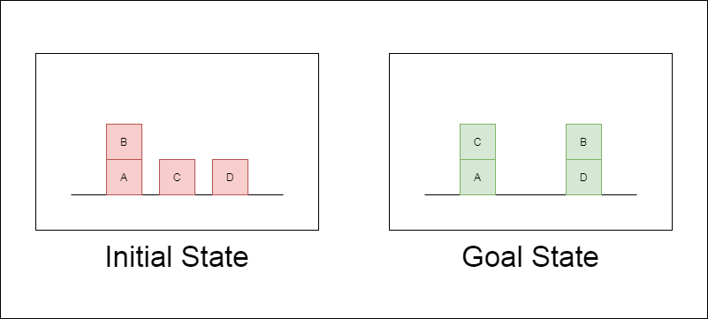
What is Blocks World Problem?
There is a table on which some blocks are placed.
Some blocks may or may not be stacked on other blocks.
We have a robot arm to pick up or put down the blocks.
The robot arm can move only one block at a time, and no other block should be stacked on top of the block which is to be moved by the robot arm.
AIM - change the configuration of the blocks from the Initial State to the Goal State

Slide 130
Goal Stack Planning
It work backwards from the goal state to the initial state.
start at the goal state and we try fulfilling the preconditions required to achieve the initial state
These preconditions in turn have their own set of preconditions, which are required to be satisfied first
Keep solving these “goals” and “sub-goals” until we finally arrive at the Initial State
Use of a stack to hold these goals as well the actions that we need to perform for the same.

Slide 131
Goal Stack Planning
Representing the configurations as a list of “predicates”
ON(A,B) : Block A is on B
ONTABLE(A) : A is on table
CLEAR(A) : Nothing is on top of A
HOLDING(A) : Arm is holding A.
ARMEMPTY : Arm is holding nothing
Using these predicates, we represent the Initial State and the Goal State

Slide 132
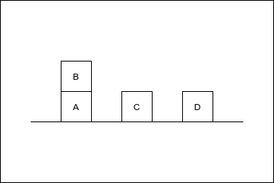
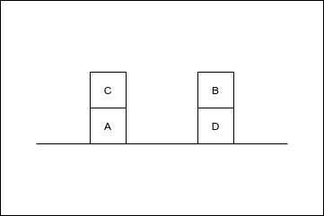
Initial State — ON(B,A) ∧ ONTABLE(A) ∧ ONTABLE(C) ∧ ONTABLE(D) ∧ CLEAR(B) ∧ CLEAR(C) ∧ CLEAR(D) ∧ ARMEMPTY
Goal State — ON(C,A) ∧ ON(B,D) ∧ ONTABLE(A) ∧ ONTABLE(D) ∧ CLEAR(B) ∧ CLEAR(C) ∧ ARMEMPTY

Slide 133
Goal Stack Planning
“Operations” performed by the robot arm
STACK(X,Y) : Stacking Block X on Block Y
UNSTACK(X,Y) : Picking up Block X which is on top of Block Y
PICKUP(X) : Picking up Block X which is on top of the table
PUTDOWN(X) : Put Block X on the table

Slide 134
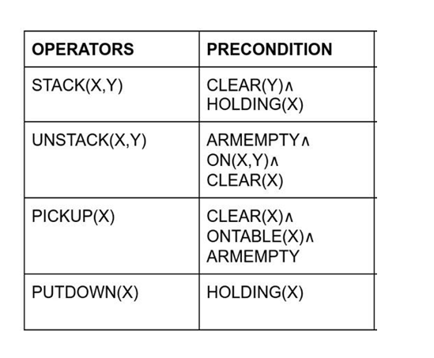

Slide 135
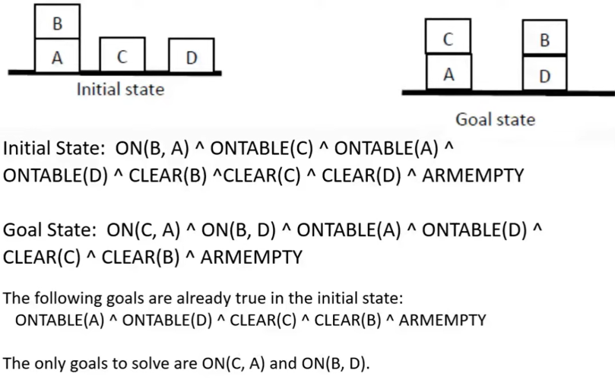

Slide 136
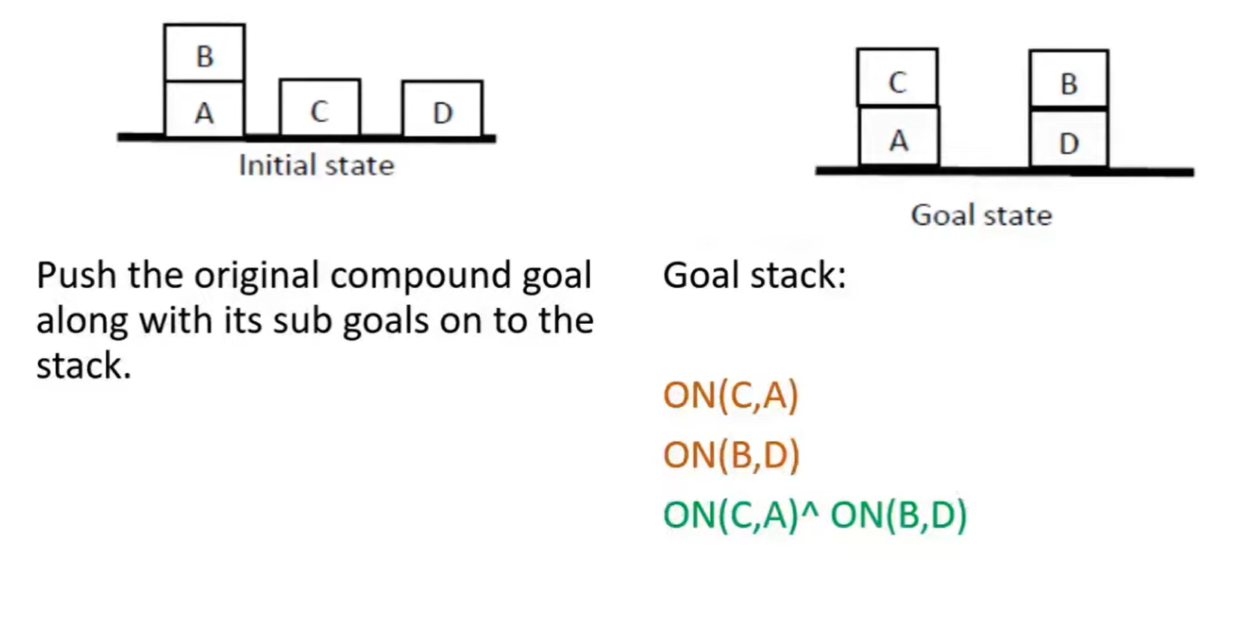

Slide 137
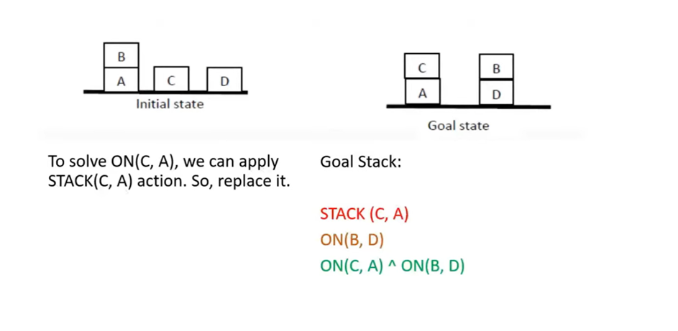

Slide 138
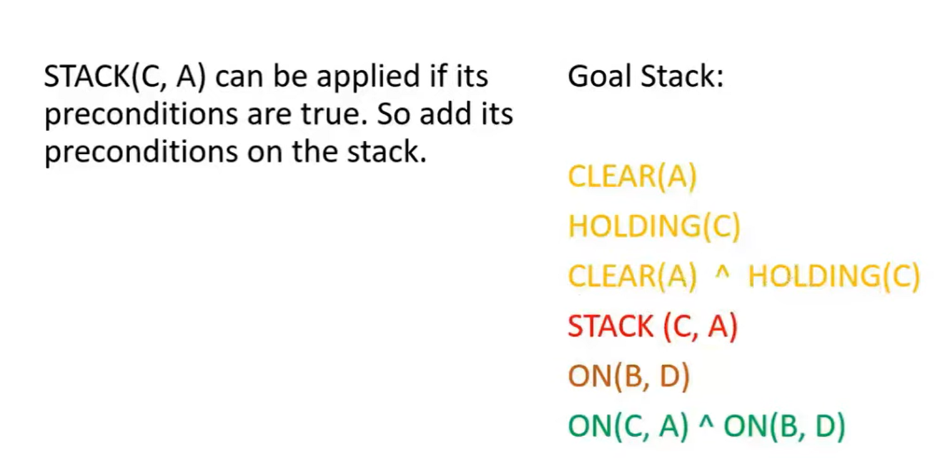

Slide 139
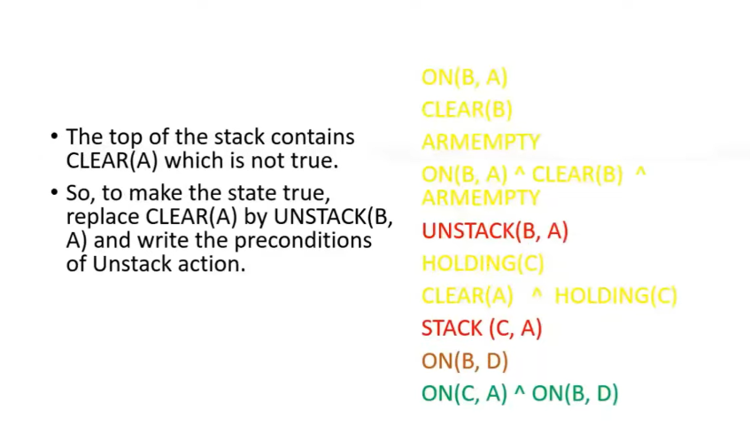

Slide 140
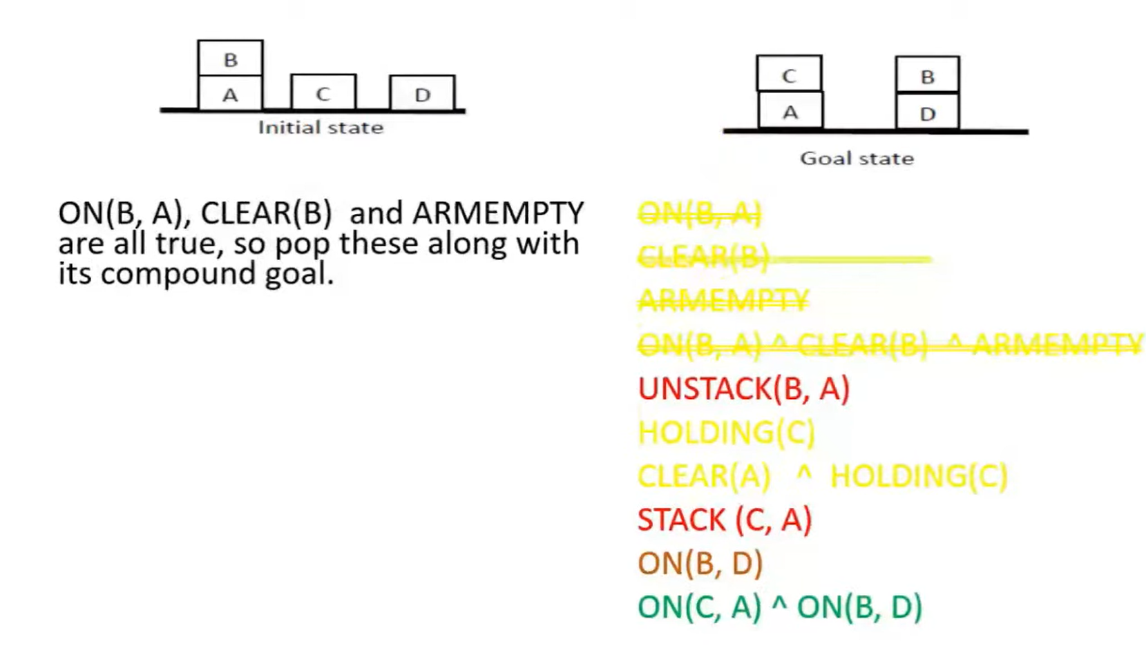

Slide 141
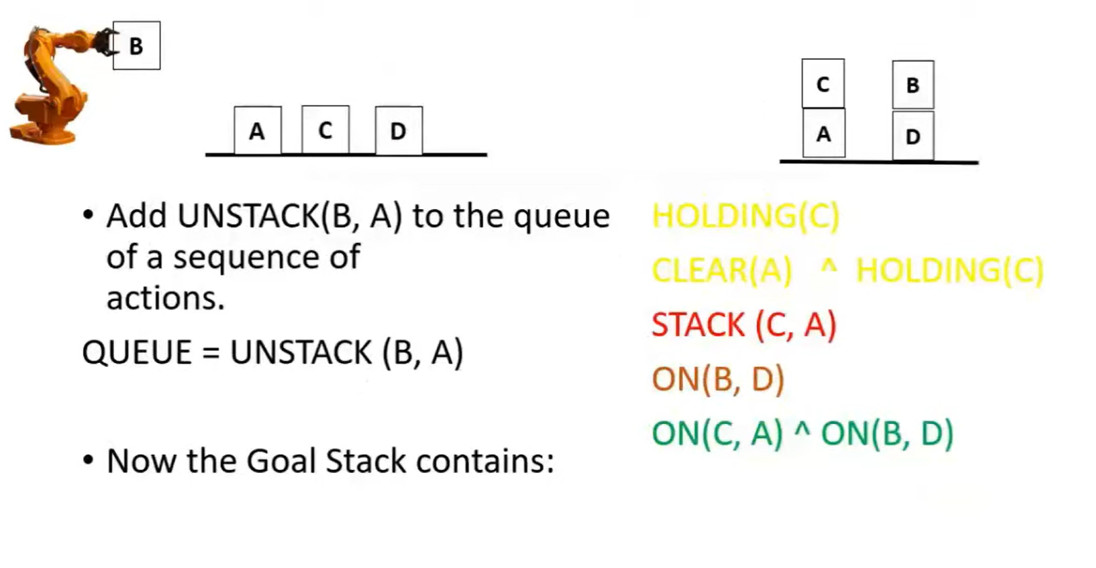

Slide 142
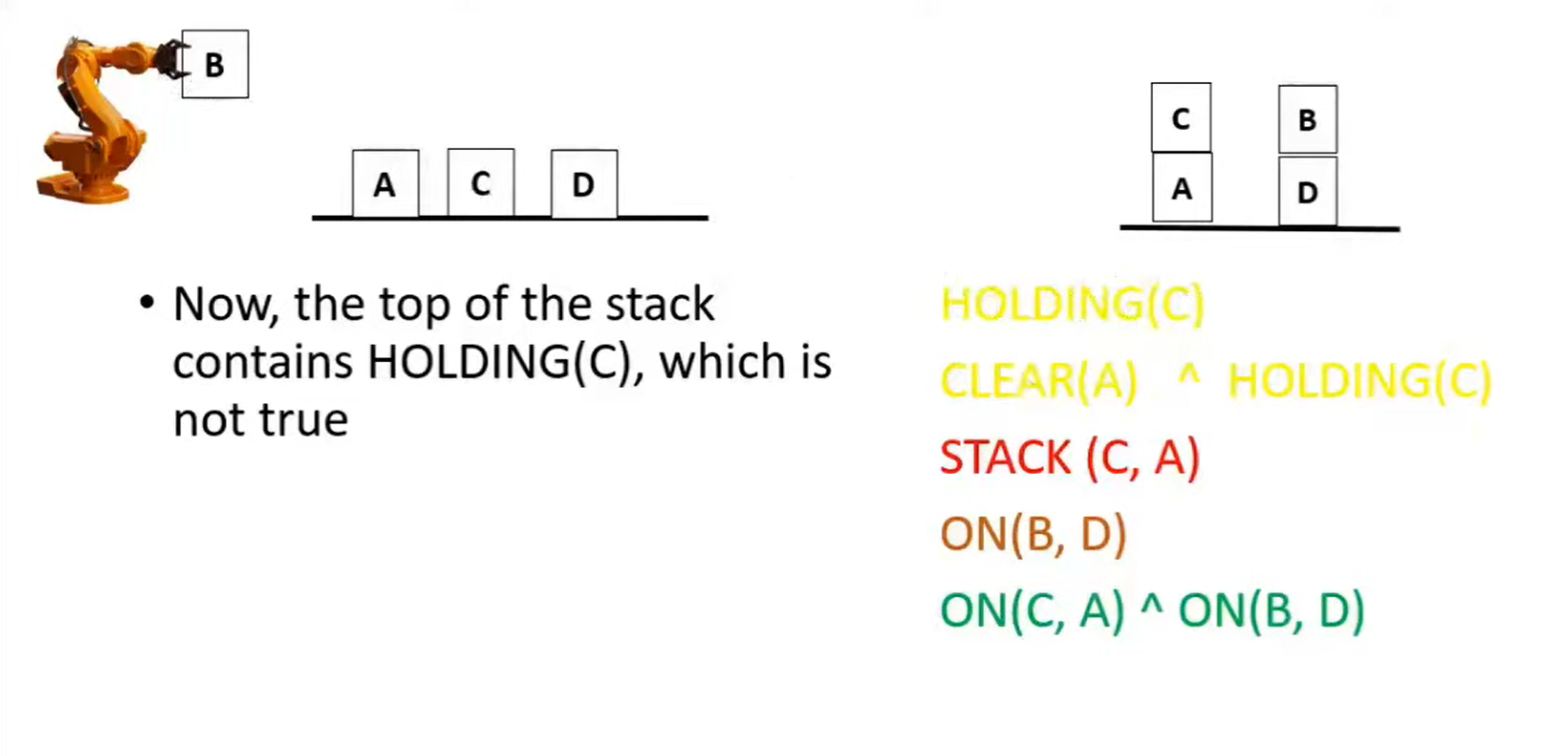

Slide 143
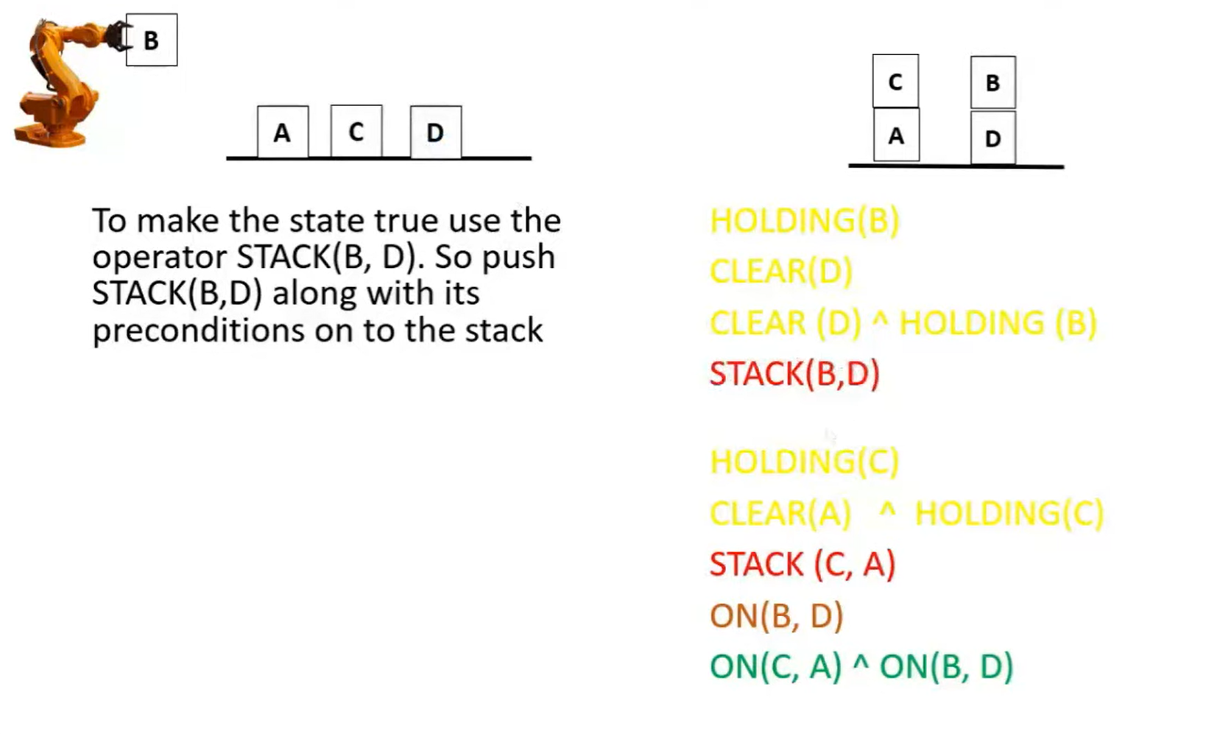

Slide 144
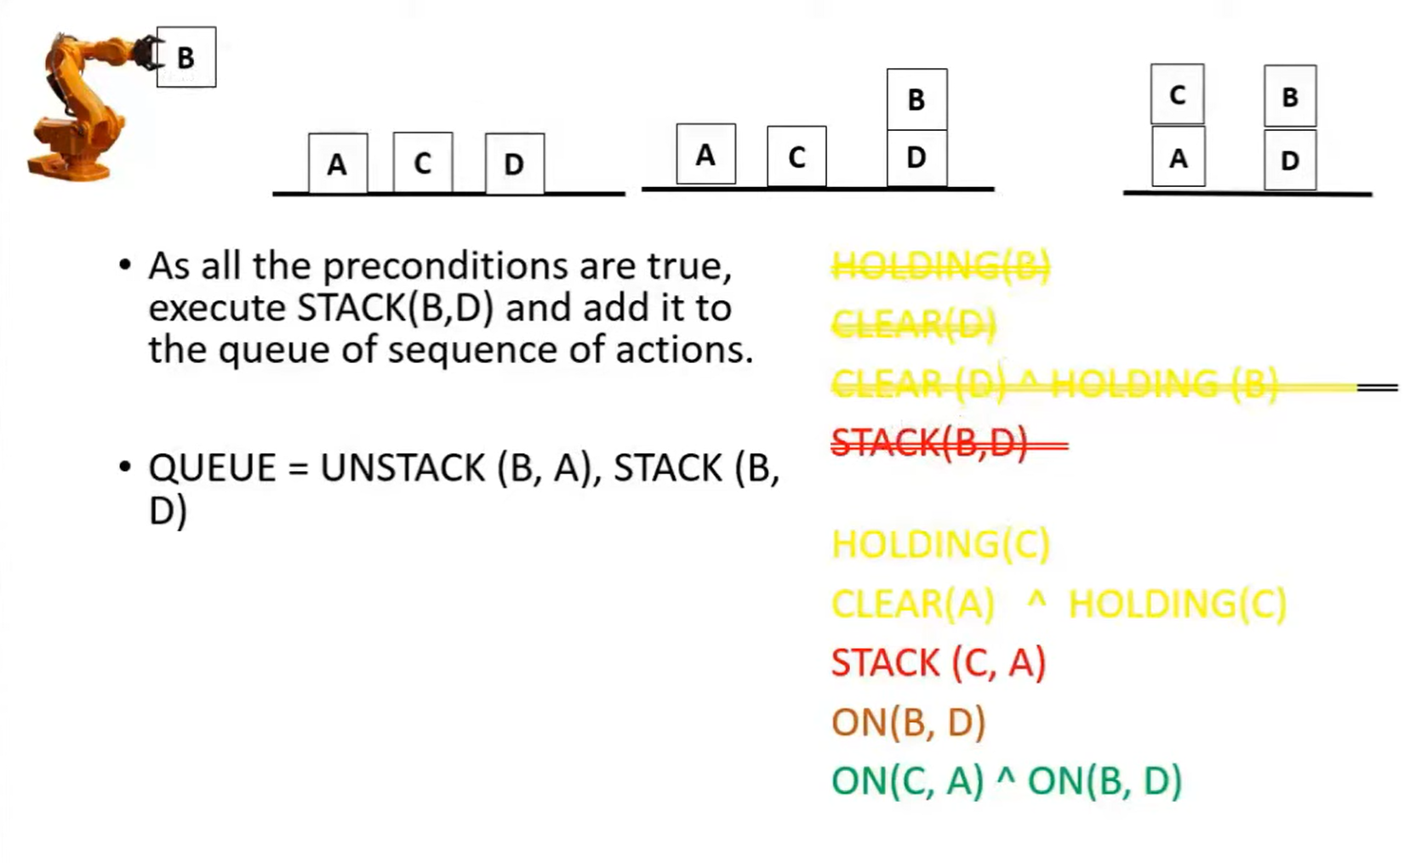

Slide 145
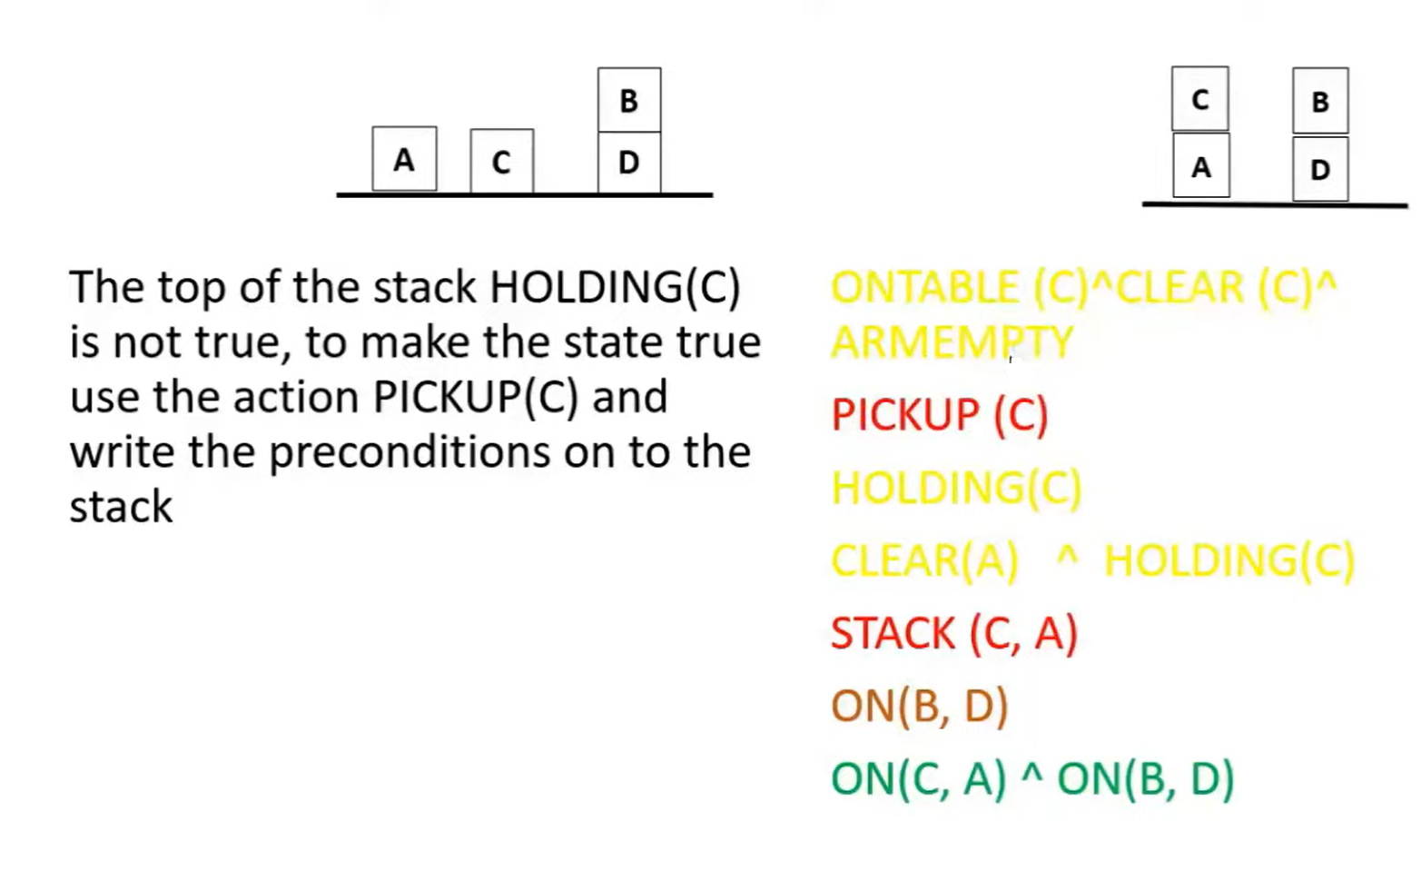

Slide 146
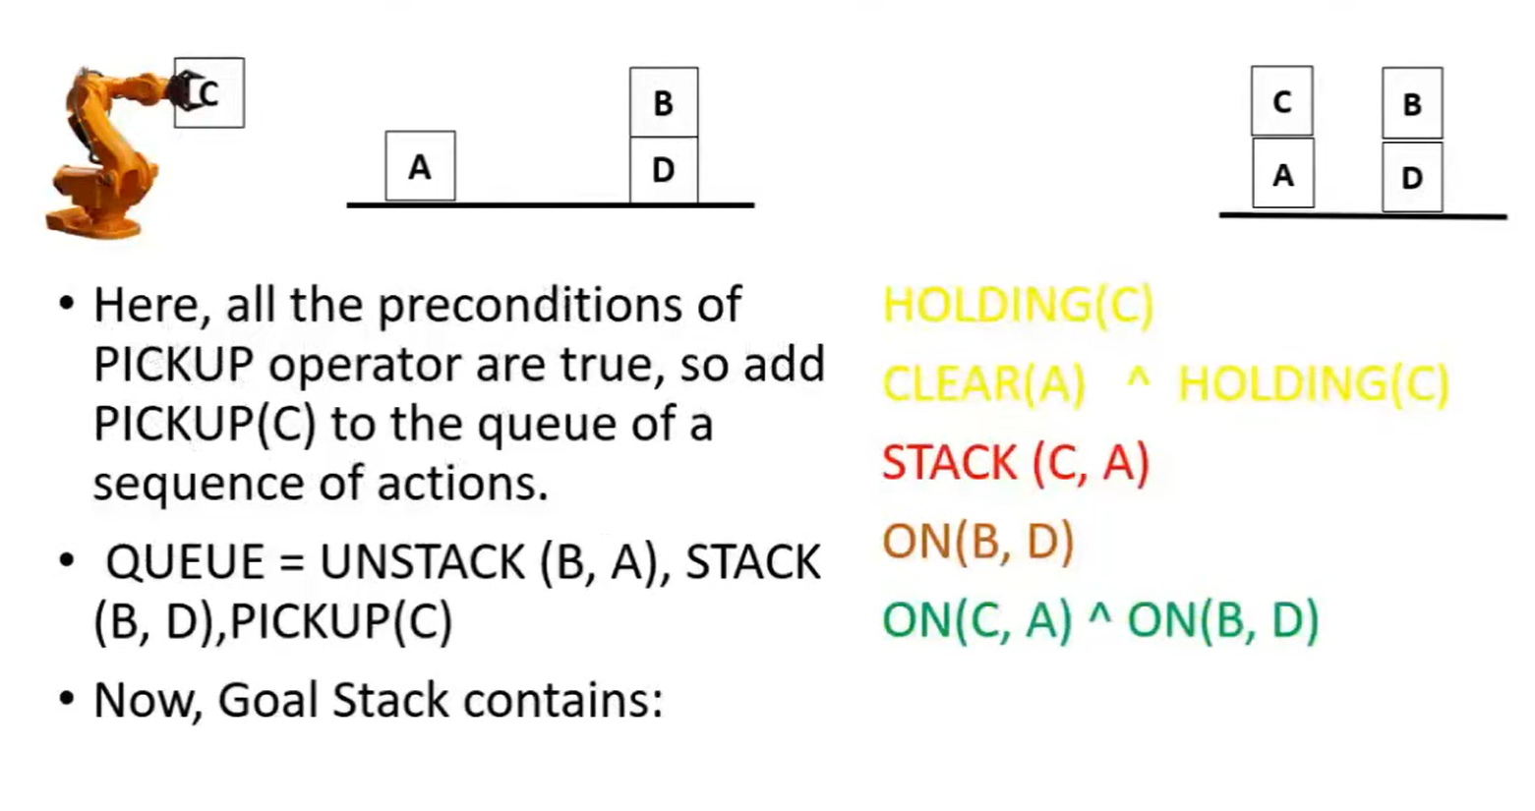

Slide 147
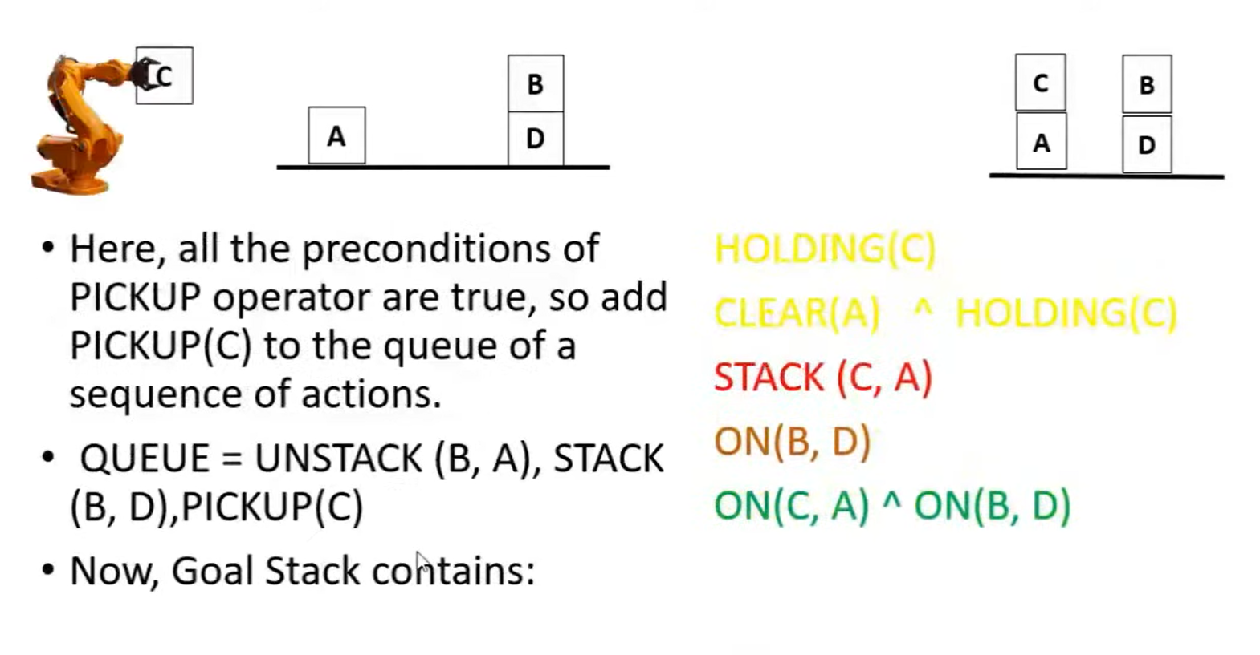

Slide 148
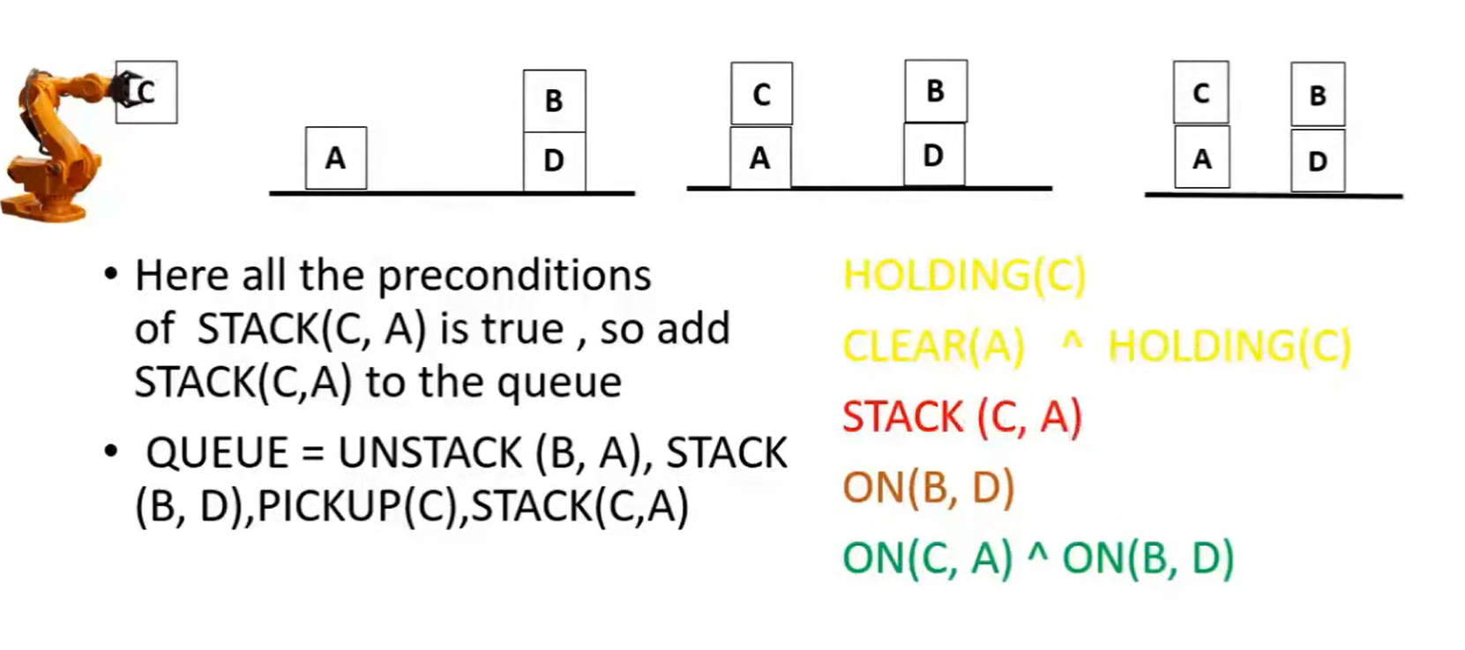

Slide 149
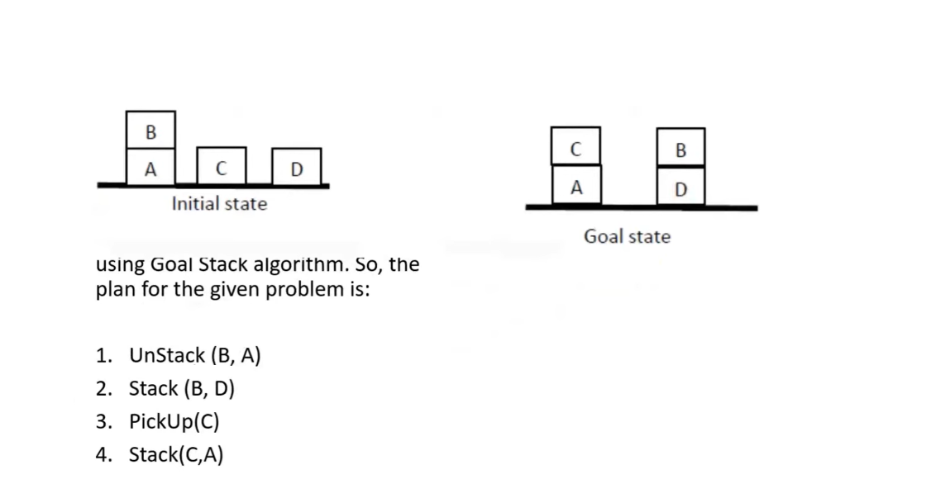

Slide 150
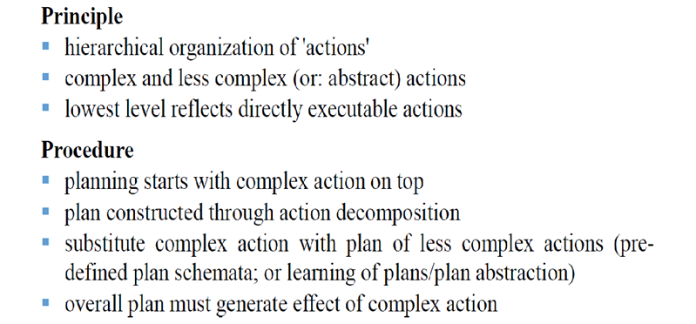
Hierarchical Planning

Slide 151
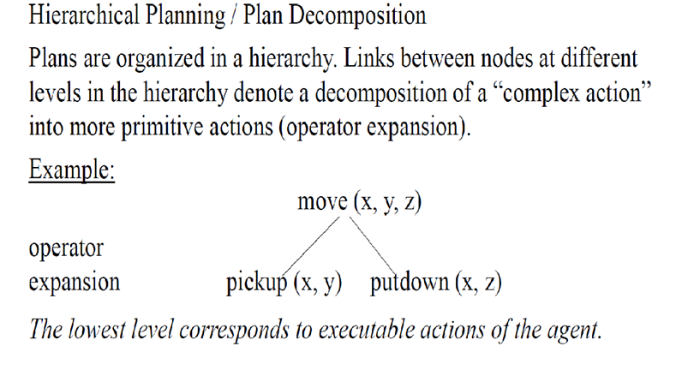
Hierarchical Planning

Slide 152
