Slide 1

(Computer Engineering and Technology)
(TYB.Tech)
‹#›

Slide 2
UNIT V- Data Mining_Classification and Clustering
Introduction to Data Mining, Data Mining Techniques, Supervised,Semi-Supervised, and Unsupervised Methods, Classification: Basic Concepts, Decision Tree Induction, Bayesian Classification
Clustering Techniques: Basic concepts, Partition based Clustering:k-Means
‹#›

Slide 3
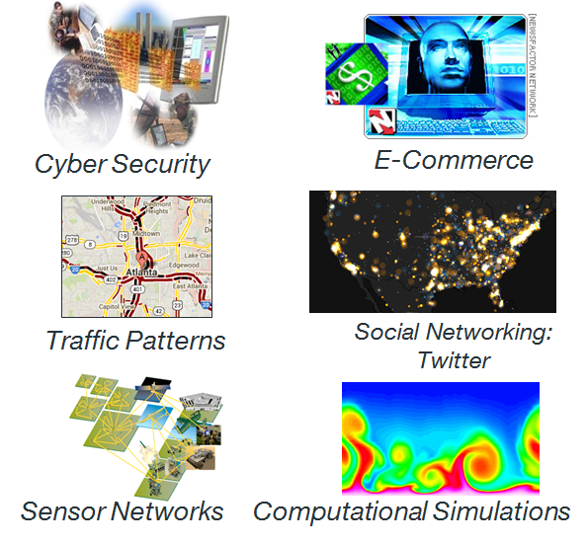
Large-scale Data is Everywhere!
There has been enormous data growth in both commercial and scientific databases due to advances in data generation and collection technologies
Gather whatever data you can whenever and wherever possible.
Gathered data will have value either for the purpose collected or for a purpose not envisioned.
Need of automated processing and identifying hidden knowledge from data

Slide 4
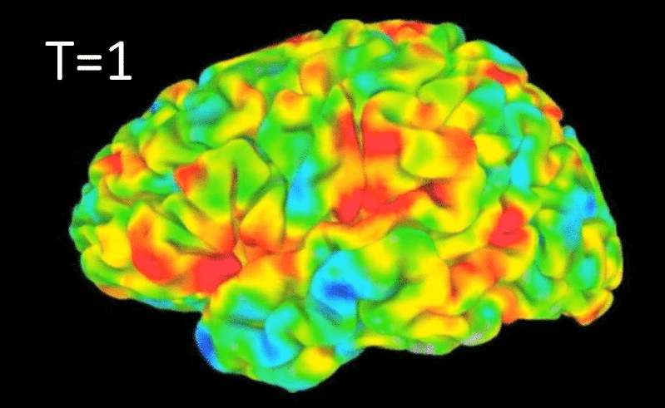
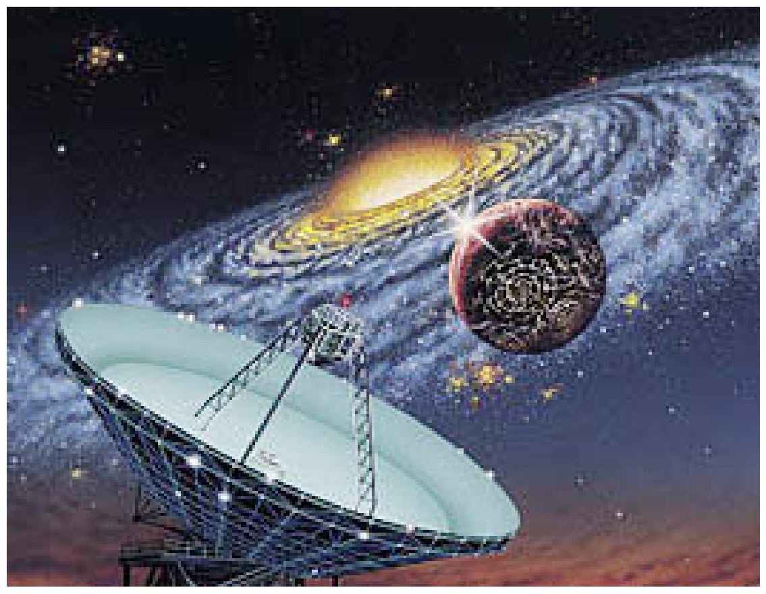
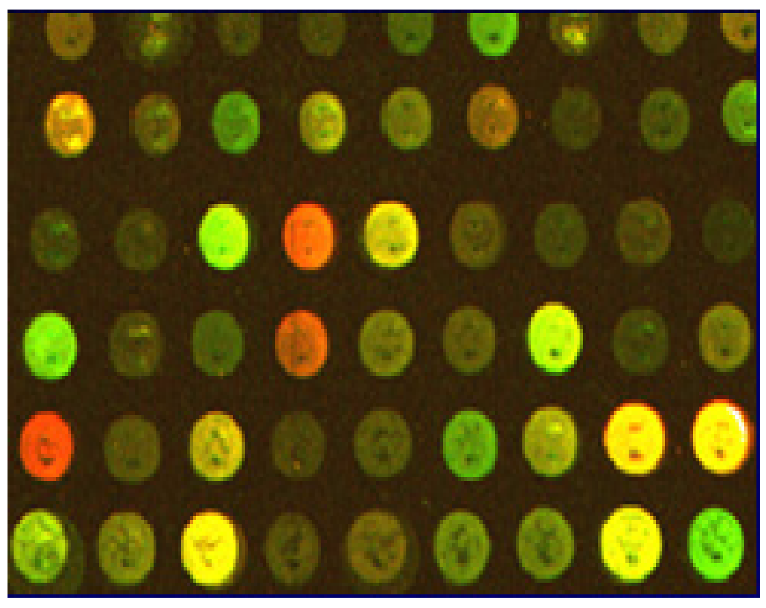
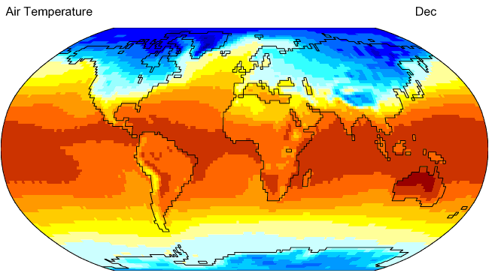
Why Data Mining? Scientific Viewpoint
Data collected and stored at enormous speeds
  remote sensors on a satellite
    NASA EOSDIS archives over petabytes of earth science data / year
  telescopes scanning the skies
    Sky survey data
  High-throughput biological data
  scientific simulations
    terabytes of data generated in a few hours
Data mining helps scientists
  in automated analysis of massive datasets
  In finding hidden knowledge and inferences from data
fMRI Data from Brain
Sky Survey Data
Gene Expression Data
Surface Temperature of Earth

Slide 5
Why Data Mining? Commercial Viewpoint
Lots of data is being collected and warehoused
  Web data
    Yahoo has Peta Bytes of web data
    Facebook has billions of active users
  purchases at department/ grocery stores, e-commerce
    Amazon handles millions of visits/day
  Bank/Credit Card transactions
Computers have become cheaper and more powerful
Competitive Pressure is Strong
  Need of Finding the inferences; likeliness, hidden knowledge from gathered data which Provide better, customized services for an edge (e.g. in Customer Relationship Management)

Slide 6
Need of Data Mining
The Explosive Growth of Data: from terabytes to petabytes
  Data collection and data availability
    Automated data collection tools, database systems, Web, computerized society
  Major sources of abundant data
    Business: Web, e-commerce, transactions, stocks, …
    Science: Remote sensing, bioinformatics, scientific simulation, …
    Society and everyone: news, digital cameras, YouTube
We are drowning in data, but starving for knowledge!
“Necessity is the mother of invention”—Data mining—Automated analysis of massive data sets

Slide 7
An example application
An emergency room in a hospital measures 17 variables (e.g., blood pressure, age, etc) of newly admitted patients.
A decision is needed: whether to put a new patient in an intensive-care unit.
Due to the high cost of ICU, those patients who may survive less than a month are given higher priority.
Problem: to predict high-risk patients and discriminate them from low-risk patients.
‹#›

Slide 8
Another application
A credit card company receives thousands of applications for new cards. Each application contains information about an applicant,
  age
  marital status
  annual salary
  outstanding debts
  credit rating
  etc.
Problem: to decide whether an application should approved, or to classify applications into two categories, approved and not approved.
‹#›

Slide 9
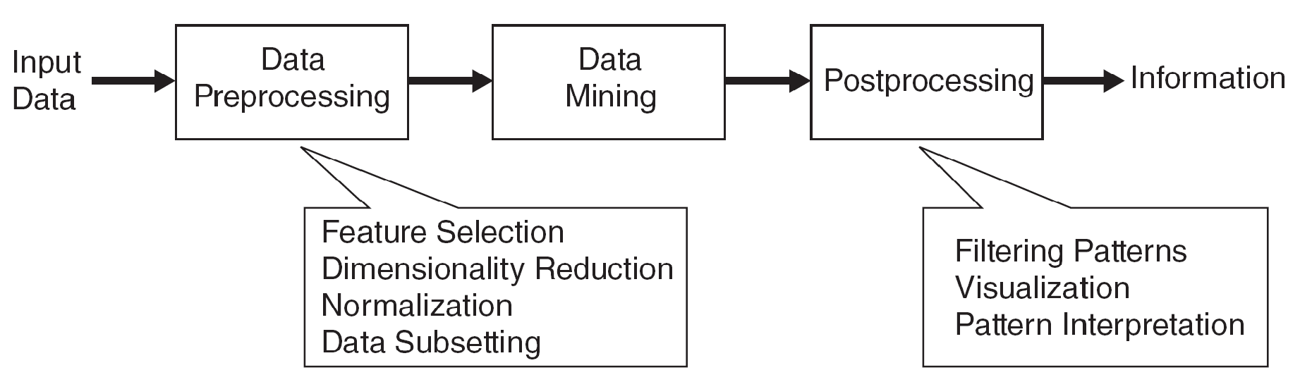
What is Data Mining
  Data Mining is Non-trivial extraction of implicit, previously unknown and potentially useful information from data
  Data Mining is Exploration & analysis, by automatic or semi-automatic means, of large quantities of data in order to discover meaningful patterns

Slide 10
Data Mining Task
Predictive Methods
  Use some variables to predict unknown or future values of other variables.
Descriptive Methods
  Find human-interpretable patterns that describe the data.

Slide 11
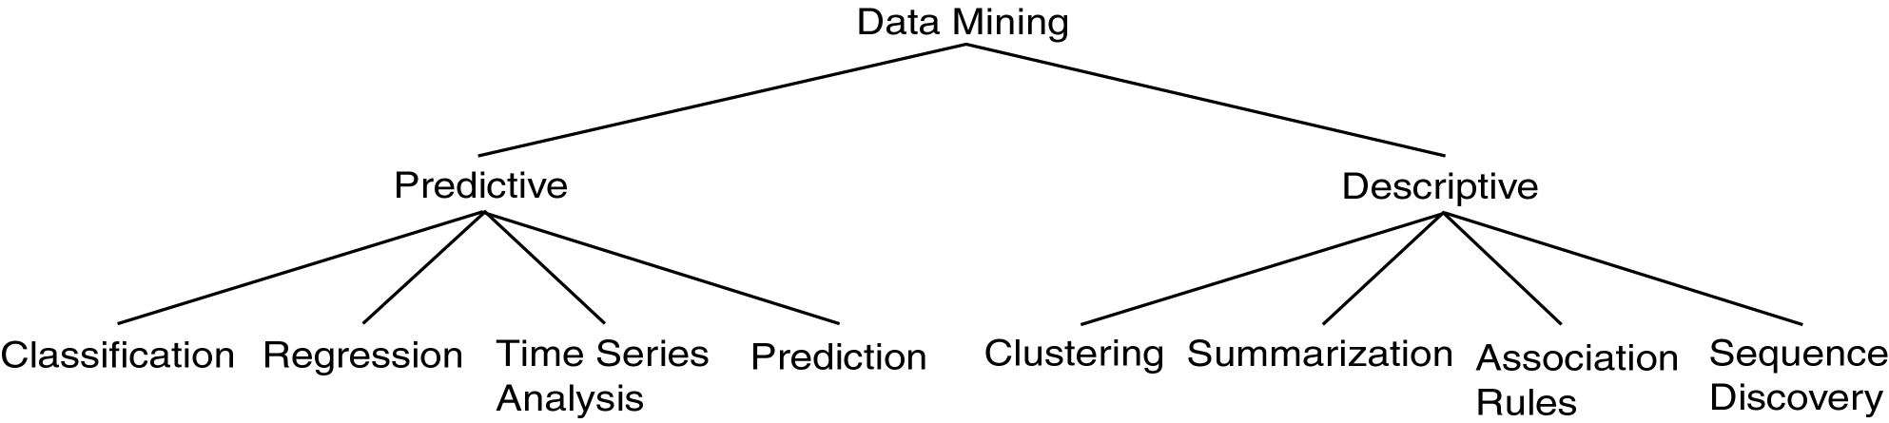
Data Mining Models and Tasks
‹#›

Slide 12
Supervised vs. Unsupervised Learning
Supervised learning (classification)
Supervision: The training data (observations, measurements, etc.) are accompanied by labels indicating the class of the observations
New data is classified based on the training set
Unsupervised learning (clustering)
The class labels of training data is unknown
Given a set of measurements, observations, etc. with the aim of establishing the existence of classes or clusters in the data
‹#›
Notes:
‹#›

Slide 13
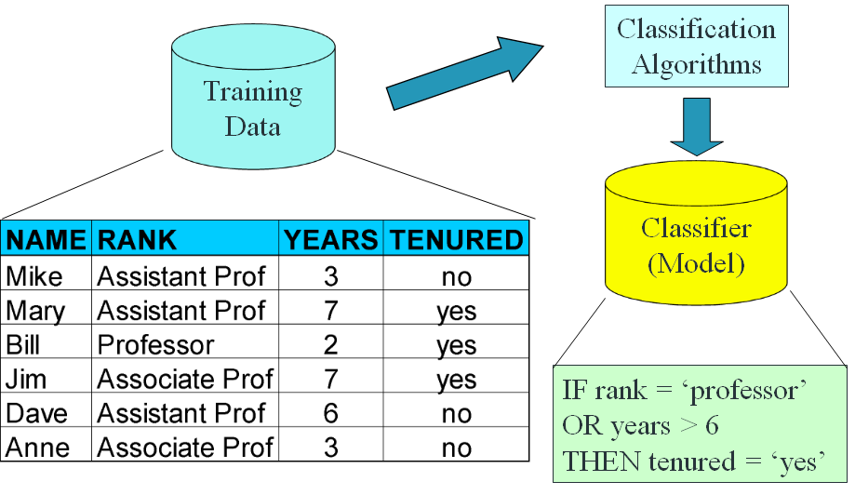
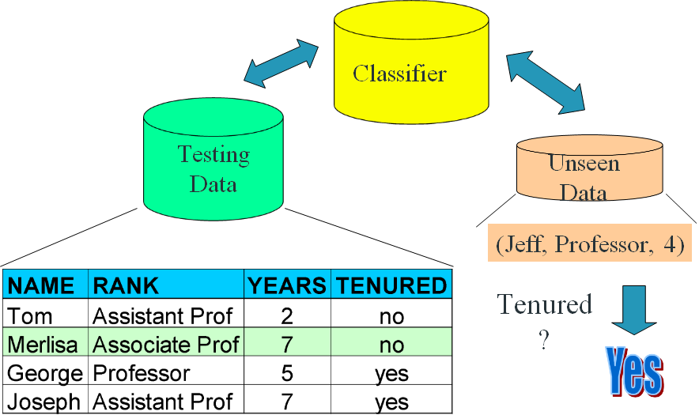
Supervised Learning
Prediction methods are commonly referred to as supervised learning.
Supervised methods are thought to attempt the discovery of the relationships between input attributes and a target attribute.
A training set is given and the objective is to form a description that can be used to predict unseen examples.
Methods:
  Classification
    The domain of the target attribute is finite and categorical.
    A classifier must assign a class to a unseen example.
  Regression
    The target attribute is formed by infinite values.
    To fit a model to learn the output target attribute as a function of input attributes.
  Time Series Analysis
    Making predictions in time.

Slide 14
Unsupervised Learning
There is no supervisor and only input data is available.
The aim is to find regularities, irregularities, relationships, similarities and associations in the input.
Methods:
  Clustering
  Association Rules
  Pattern Mining
    It is adopted as a more general term than frequent pattern mining or association mining.
  Outlier Detection
    Process of finding data examples with behaviours that are very different from the expectation (outliers or anomalies).

Slide 15
Semi Supervised Learning
Semi-supervised learning is a class of machine learning tasks and techniques that also make use of unlabeled data for training – typically a small amount of labeled data with a large amount of unlabeled data
Semi-supervised learning falls between unsupervised learning (without any labeled training data) and supervised learning (with completely labeled training data).
‹#›

Slide 16
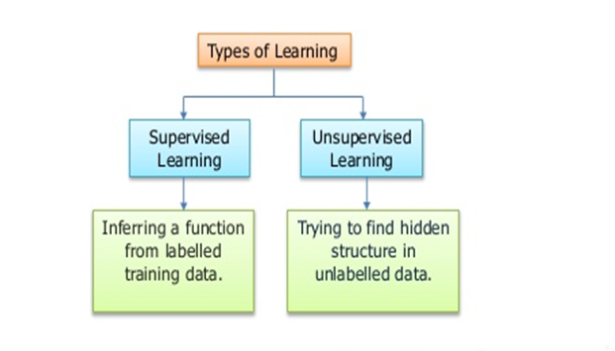
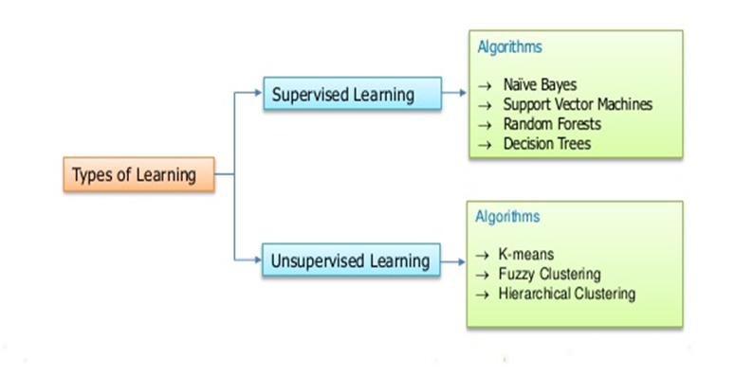
Supervised, Unsupervised Learning Algorithms
‹#›

Slide 17

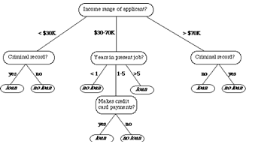
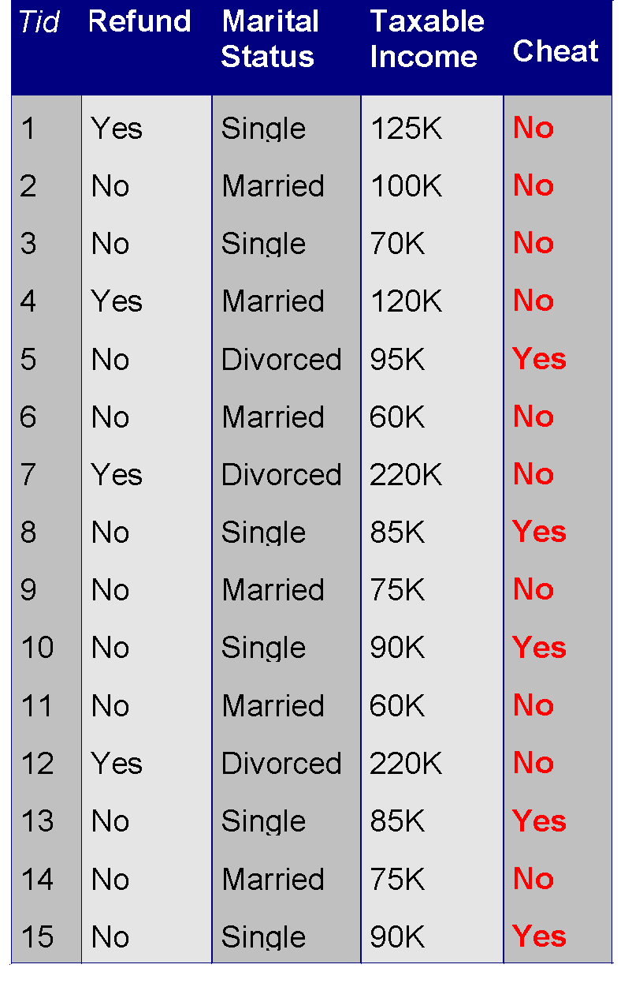
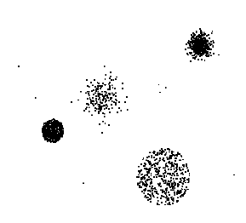


Data Mining Task..
Data
Clustering
Predictive Modeling
Association
Rules
Anomaly
Detection
Milk

Slide 18
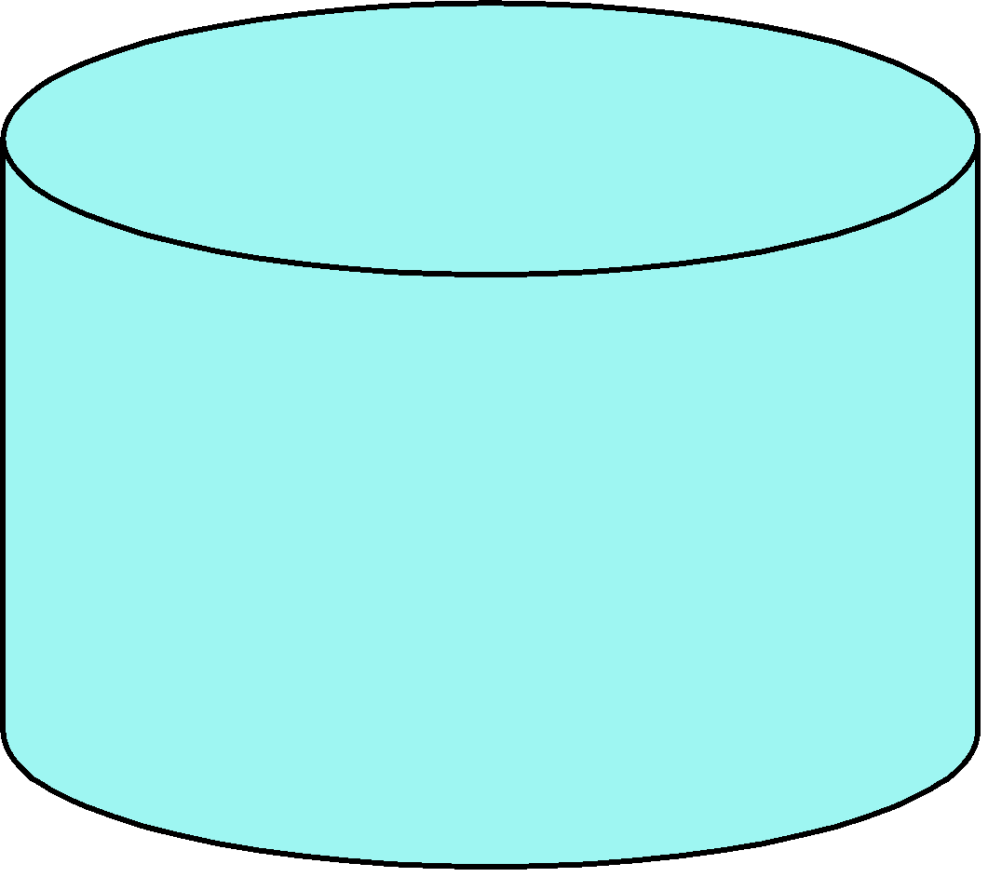
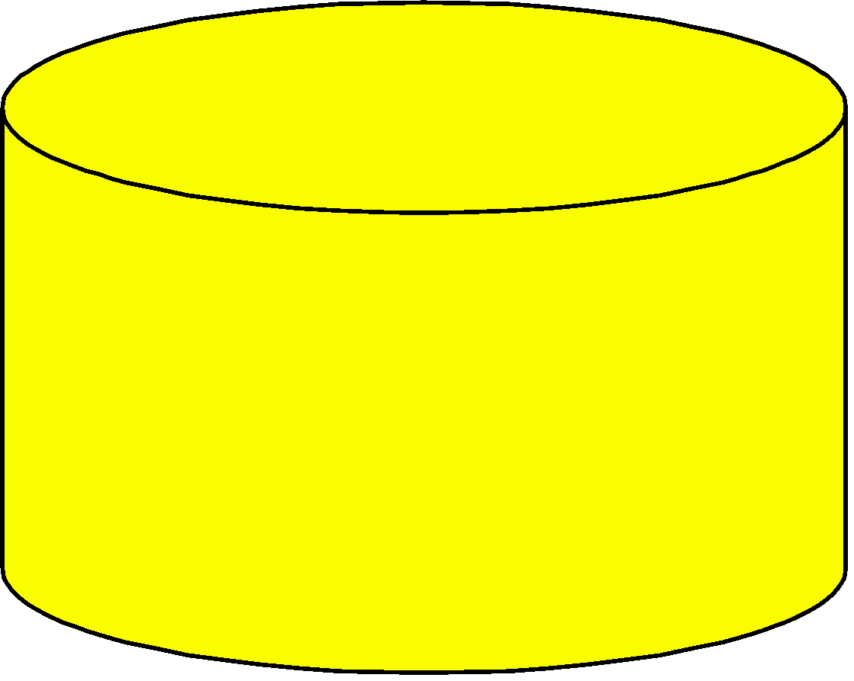
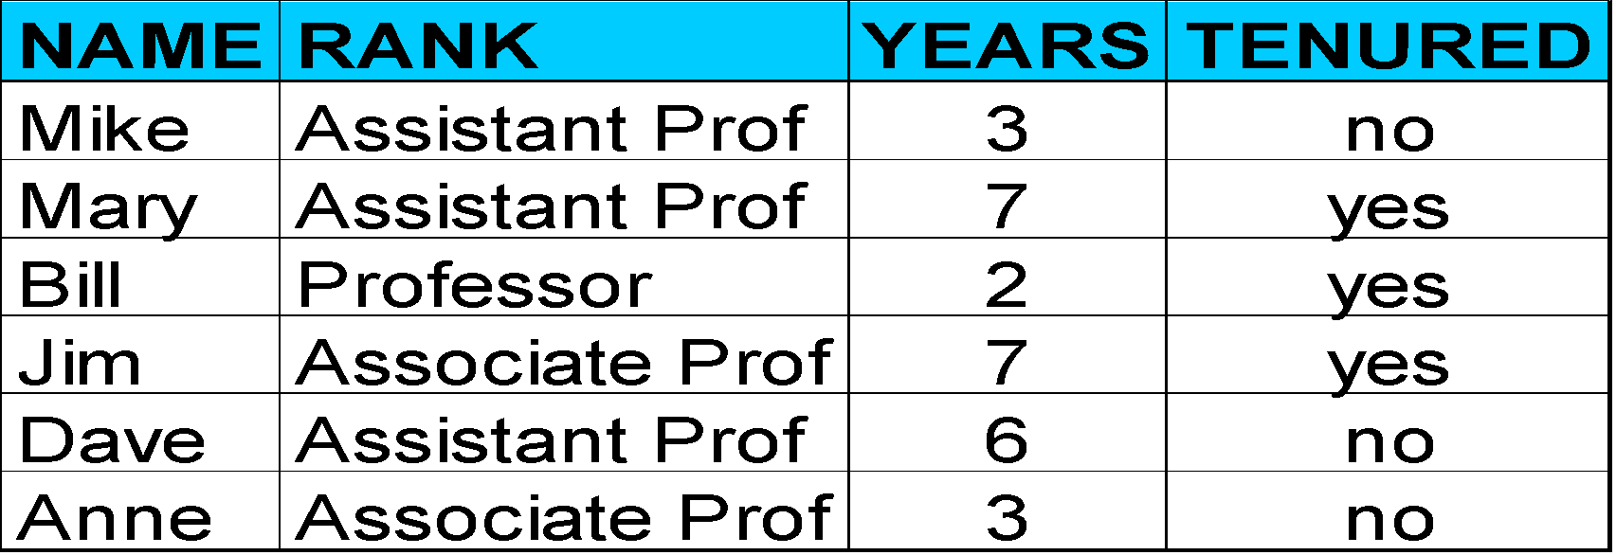
Process (1): Model Construction
Classification
Algorithms
Training
Data
Classifier
(Model)
IF rank = ‘professor’
OR years > 6
THEN tenured = ‘yes’
‹#›
Notes:
‹#›

Slide 19
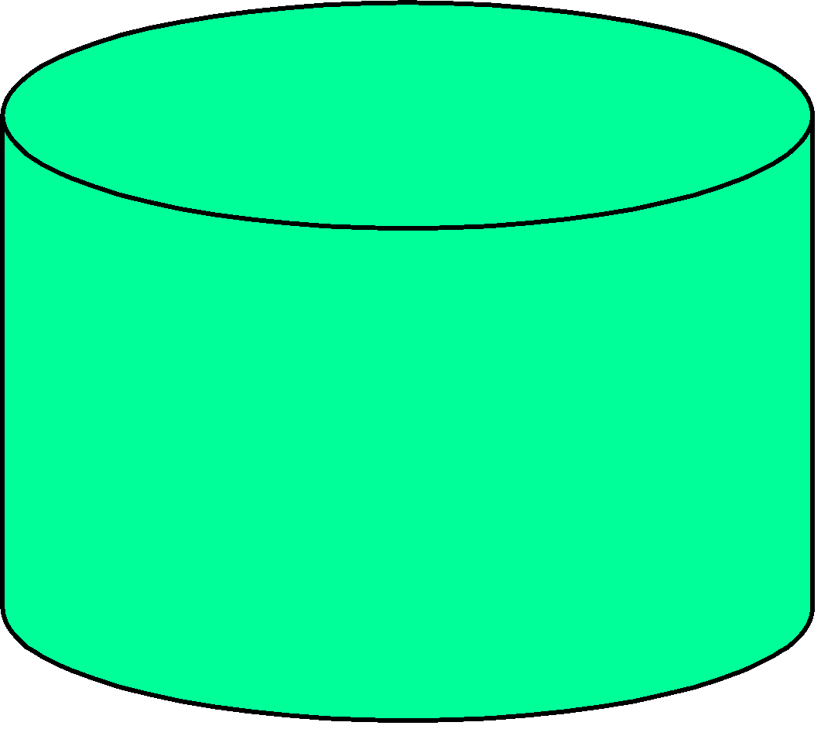
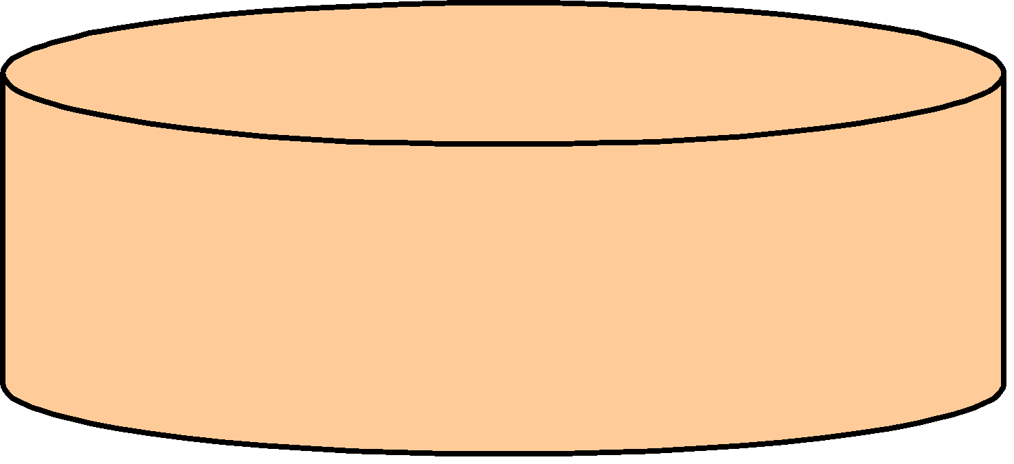
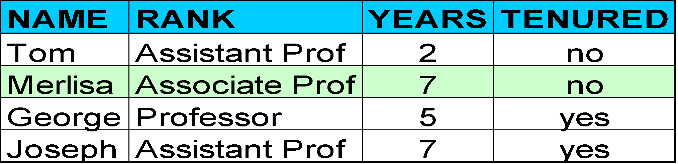

Process (2): Using the Model in Prediction
Classifier
Testing
Data
Unseen Data
(Jeff, Professor, 4)
Tenured?
‹#›
Notes:
‹#›

Slide 20
Classification
Classification maps data into predefined groups or classes
It is useful in
  Supervised learning
  Pattern recognition
  Prediction

Slide 21
Classification Vs Prediction
Classification
  Predicts categorical class labels (discrete or nominal)
  Classifies data (constructs a model) based on the training set and the values (class labels) in a classifying attribute and uses it in classifying new data
Prediction
  Models continuous-valued functions, i.e., Predicts unknown or missing values
Typical applications
  Credit approval
  Target marketing
  Medical diagnosis
  Fraud detection

Slide 22
Classification Process
Model construction: describing a set of predetermined classes
  Each tuple/sample is assumed to belong to a predefined class, as determined by the class label attribute.
  The set of tuples used for model construction is training set.
  The model is represented as classification rules, decision trees, or mathematical formulae.
Model usage: for classifying future or unknown objects
  Estimate accuracy of the model
    The known label of test sample is compared with the classified result from the model
    Accuracy rate is the percentage of test set samples that are correctly classified by the model.
    Test set is independent of training set, otherwise over-fitting will occur.
  If the accuracy is acceptable, use the model to classify data tuples whose class labels are not known

Slide 23

Step 1: Model Construction
Classification
Algorithms
Training
Data
Classifier
(Model)
IF rank = ‘professor’
OR years > 6
THEN tenured = ‘yes’

Slide 24


Step 2: Model Usage
Classifier
Testing
Data
Unseen Data
(Jeff, Professor, 4)
Tenured?

Slide 25
Bayesian Classification
A statistical classifier: performs probabilistic prediction, i.e., predicts class membership probabilities
Foundation: Based on Bayes’ Theorem.
Performance: A simple Bayesian classifier, naïve Bayesian classifier, has comparable performance with decision tree and selected neural network classifiers.
Incremental: Each training example can incrementally increase/decrease the probability that a hypothesis is correct — prior knowledge can be combined with observed data
Standard: Even when Bayesian methods are computationally intractable, they can provide a standard of optimal decision making against which other methods can be measured.

Slide 26
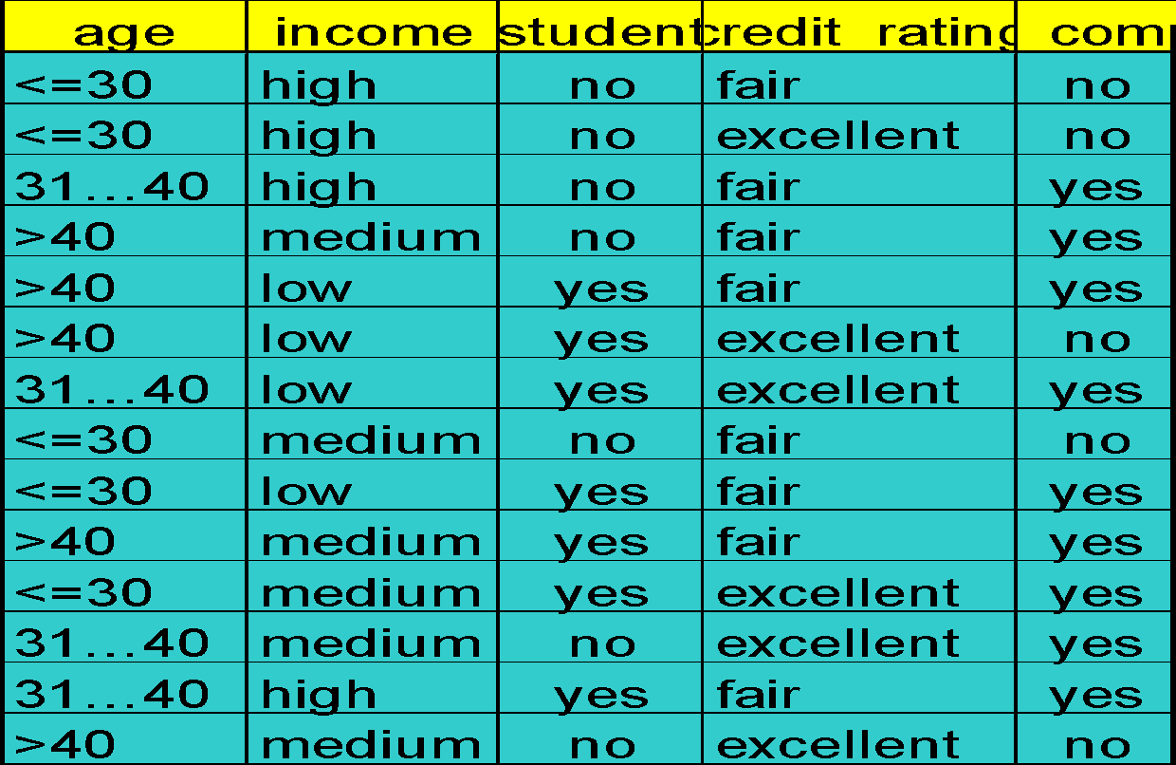
Bayesian Classification - Example

Slide 27
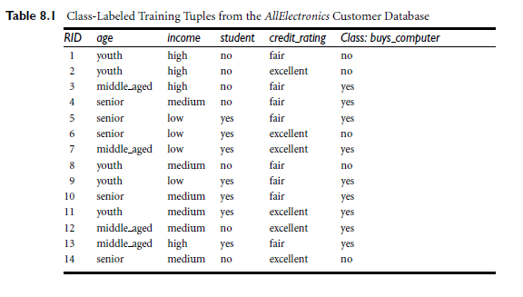
Bayesian Classification - Example

Slide 28
Bayesian Classification - Probability
Probability: How likely something is to happen
Probability of an event happening =
Number of ways it can happen
_________________________
Total number of outcomes

Slide 29
Bayesian Classification Theorem
Let X be a data sample (“evidence”): class label is unknown
Let H be a hypothesis that X belongs to class C
Classification is to determine P(H|X), the probability that the hypothesis holds given the observed data sample X
P(H) (prior probability), the initial probability
  E.g., X will buy computer, regardless of age, income, …
P(X): probability that sample data is observed
P(X|H) (posteriori probability), the probability of observing the sample X, given that the hypothesis holds
  E.g., Given that X will buy computer, the prob. that X is 31..40, medium income

Slide 30

Bayesian Classification Theorem
Given training data X, posteriori probability of a hypothesis H, P(H|X), follows the Bayes theorem
Informally, this can be written as
  posteriori = likelihood x prior/evidence
Predicts X belongs to C₂ iff the probability P(C_{i}|X) is the highest among all the P(C_{k}|X) for all the k classes
Practical difficulty: require initial knowledge of many probabilities, significant computational cost

Slide 31
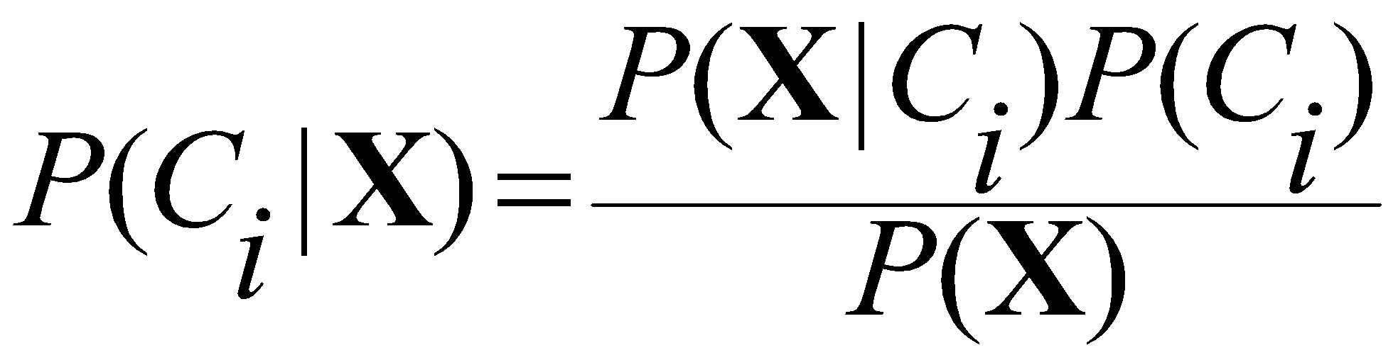
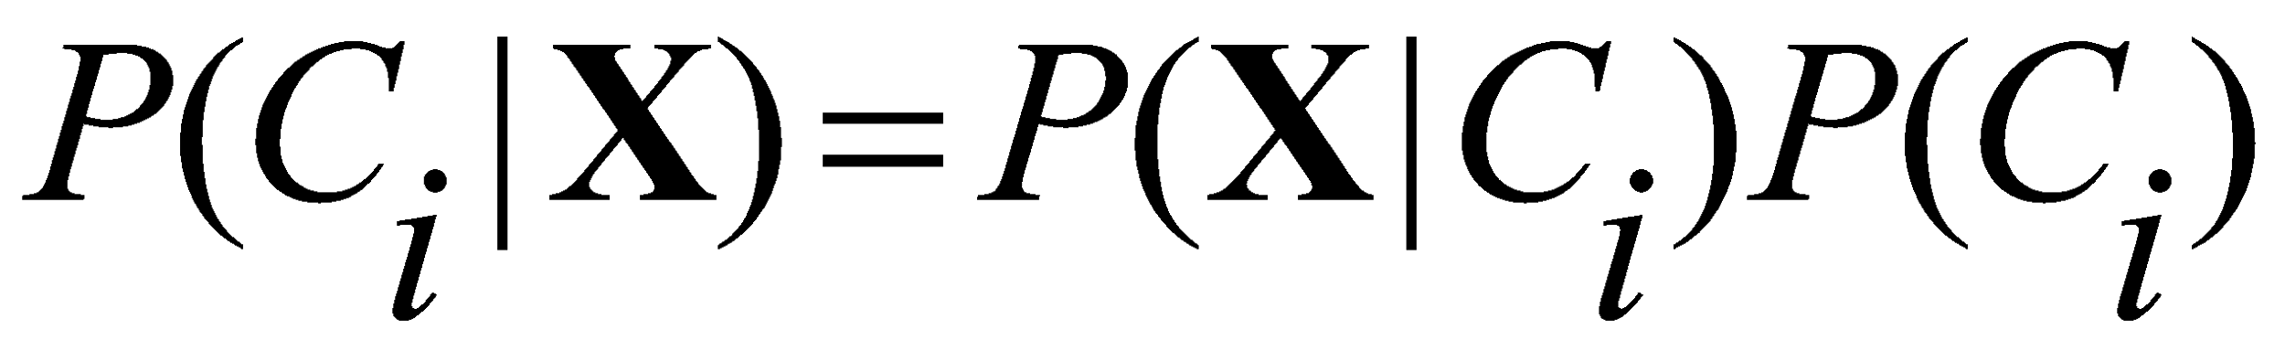
Naïve Bayesian Classification Theorem
Let D be a training set of tuples and their associated class labels, and each tuple is represented by an n-D attribute vector X = (x₁, x₂, …, x_{n})
Suppose there are m classes C₁, C₂, …, C_{m}.
Classification is to derive the maximum posteriori, i.e., the maximal P(C_{i}|X)
This can be derived from Bayes’ theorem
Since P(X) is constant for all classes, only
  needs to be maximized

Slide 32
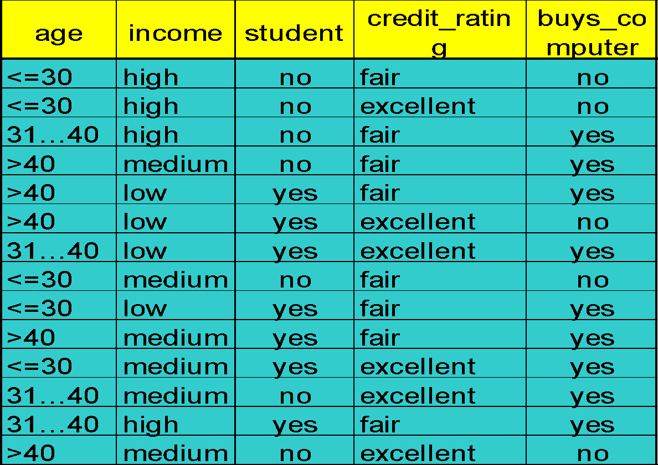
Naïve Bayesian Classification - Example
Class:
C1:buys_computer = ‘yes’
C2:buys_computer = ‘no’
Data sample
X = (age <=30,
Income = medium,
Student = yes
Credit_rating = Fair)

Slide 33
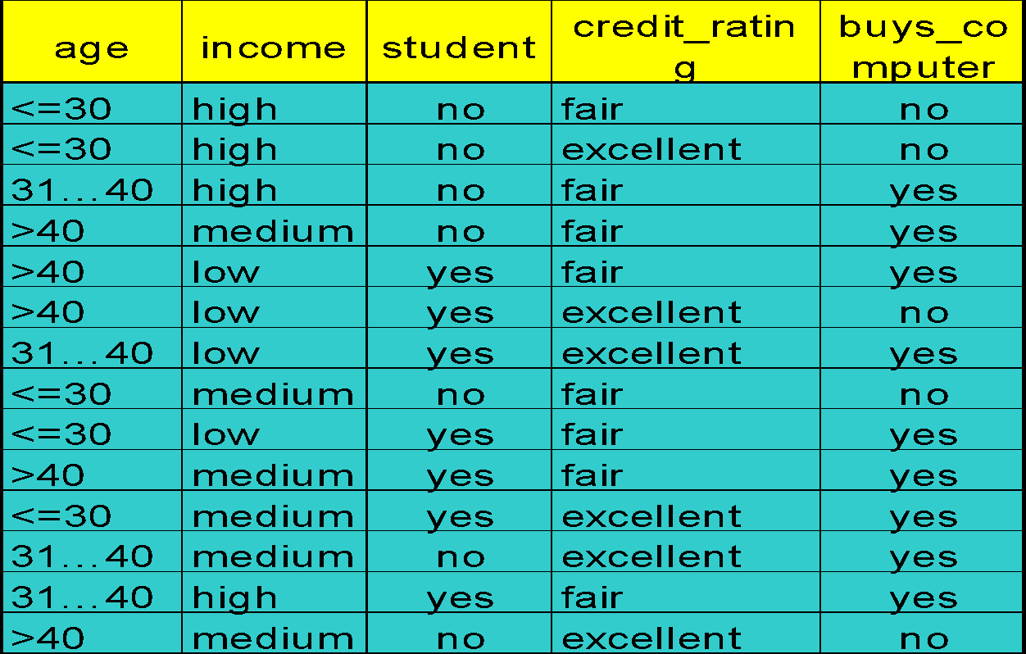
Naïve Bayesian Classification - Example
Test for X = (age <= 30 , income = medium, student = yes, credit_rating = fair)
P(C_{i}): P(buys_computer = “yes”) = 9/14 = 0.643 P(buys_computer = “no”) = 5/14= 0.357
Compute P(X|C_{i}) for each class
P(age = “<=30” | buys_computer = “yes”) = 2/9 = 0.222
P(age = “<= 30” | buys_computer = “no”) = 3/5 = 0.6
P(income = “medium” | buys_computer = “yes”) = 4/9 = 0.444
P(income = “medium” | buys_computer = “no”) = 2/5 = 0.4
P(student = “yes” | buys_computer = “yes) = 6/9 = 0.667
P(student = “yes” | buys_computer = “no”) = 1/5 = 0.2
P(credit_rating = “fair” | buys_computer = “yes”) = 6/9 = 0.667
P(credit_rating = “fair” | buys_computer = “no”) = 2/5 = 0.4
P(X|C_{i}) : P(X|buys_computer = “yes”) = 0.222 x 0.444 x 0.667 x 0.667 = 0.044
P(X|buys_computer = “no”) = 0.6 x 0.4 x 0.2 x 0.4 = 0.019
P(X|C_{i})*P(C_{i}) : P(X|buys_computer = “yes”) * P(buys_computer = “yes”) = 0.028
P(X|buys_computer = “no”) * P(buys_computer = “no”) = 0.007
0.028>0.007 ..
Therefore, X belongs to class (“buys_computer = yes”)

Slide 34
Comment on Naive Bayes Classification
Advantages
Easy to implement
Good results obtained in most of the cases
Disadvantages
Assumption: class conditional independence, therefore loss of accuracy
Notes:
‹#›

Slide 35
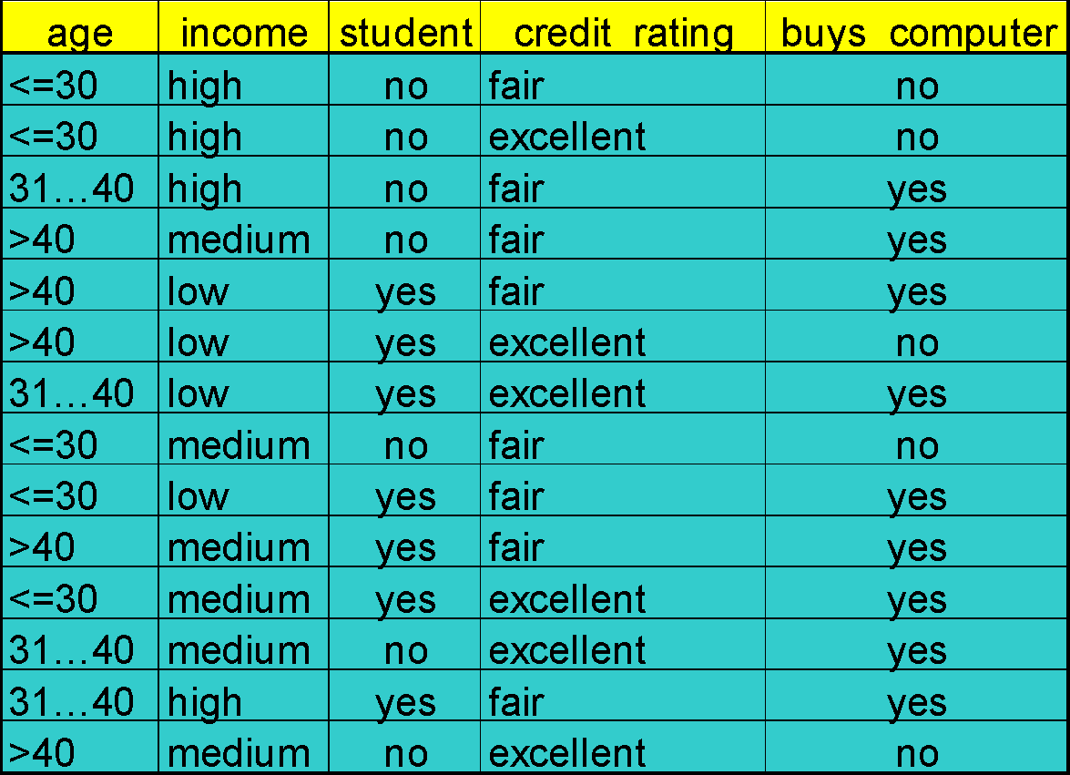
Decision Tree Classification
age?
age
<=30
31..40
>40
student?
yes
credit rating?
no
yes
excellent
fair
no
yes
no
yes

Slide 36
Decision Tree Terminologies
Decision tree may be n-ary, n ≥ 2.
There is a special node called root node.
Internal nodes are test attribute/decision attribute
leaf nodes are class labels
Edges of a node represent the outcome for a value of the test node.
In a path, a node with same label is never repeated.
Decision tree is not unique, as different ordering of internal nodes can give different decision tree
Notes:
‹#›

Slide 37
Rule Extraction From decision Tree
age?
age
Rules are easier to understand than large trees
One rule is created for each path from the root to a leaf
Each attribute-value pair along a path forms a conjunction: the leaf holds the class prediction
Rules are mutually exclusive and exhaustive
<=30
31..40
>40
student?
yes
credit rating?
no
yes
excellent
fair
no
yes
no
yes
Example: Rule extraction from our buys_computer decision-tree
IF age = young AND student = no THEN buys_computer = no
IF age = young AND student = yes THEN buys_computer = yes
IF age = mid-age THEN buys_computer = yes
IF age = old AND credit_rating = excellent THEN buys_computer = yes
IF age = young AND credit_rating = fair THEN buys_computer = no

Slide 38
Decision Tree Algorithm
Basic algorithm (a greedy algorithm)
  Tree is constructed in a top-down recursive divide-and-conquer manner
  At start, all the training examples are at the root
  Attributes are categorical (if continuous-valued, they are discretized in advance)
  Examples are partitioned recursively based on selected attributes
  Test attributes are selected on the basis of a heuristic or statistical measure (e.g., information gain)
Conditions for stopping partitioning
  All samples for a given node belong to the same class.
  There are no remaining attributes for further partitioning – majority voting is employed for classifying the leaf.
  There are no samples left

Slide 39
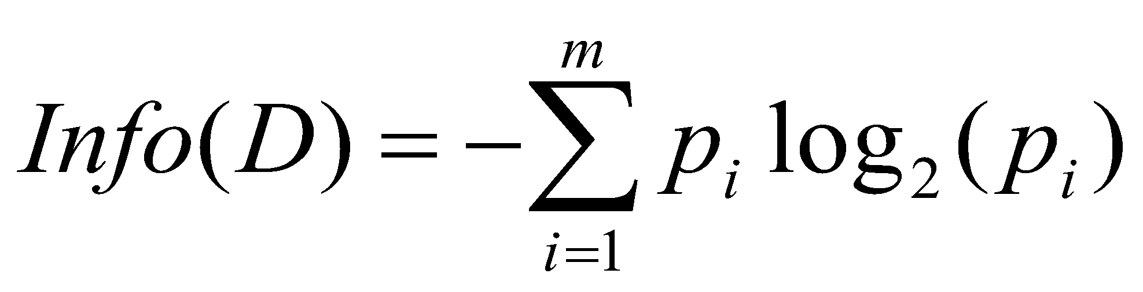
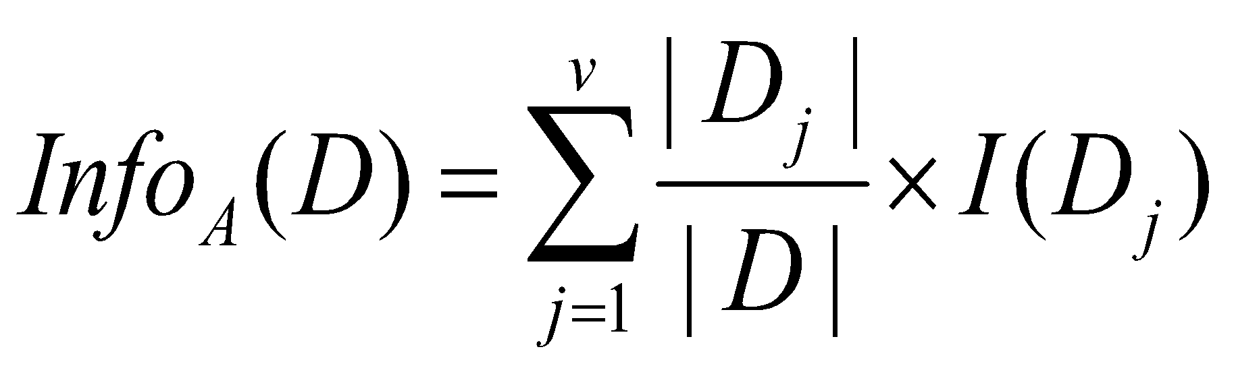
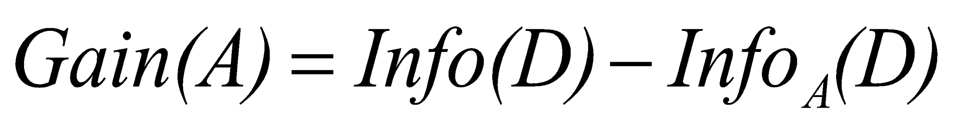
Decision Tree Algorithm
Test Attribute Selection
Select the attribute with the highest information gain
Let p_{i} be the probability that an arbitrary tuple in D belongs to class C_{i}, estimated by |C_{i, D}|/|D|
Expected information (entropy) needed to classify a tuple in D:
Information needed (after using A to split D into v partitions) to classify D:
Information gained by branching on attribute A

Slide 40
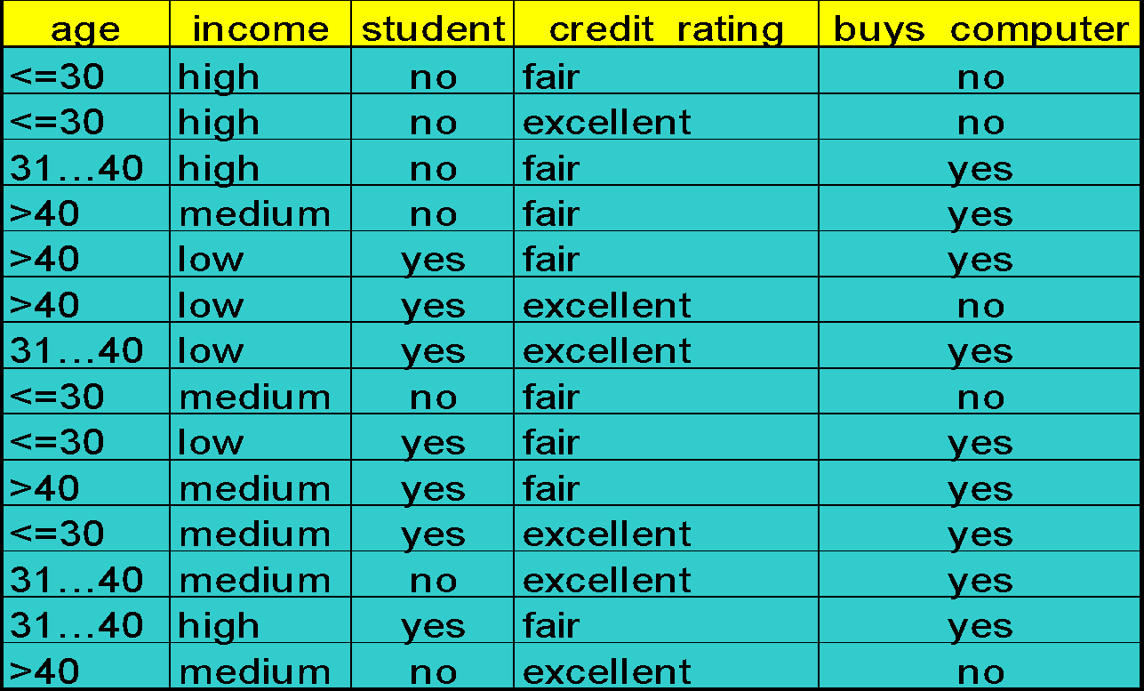
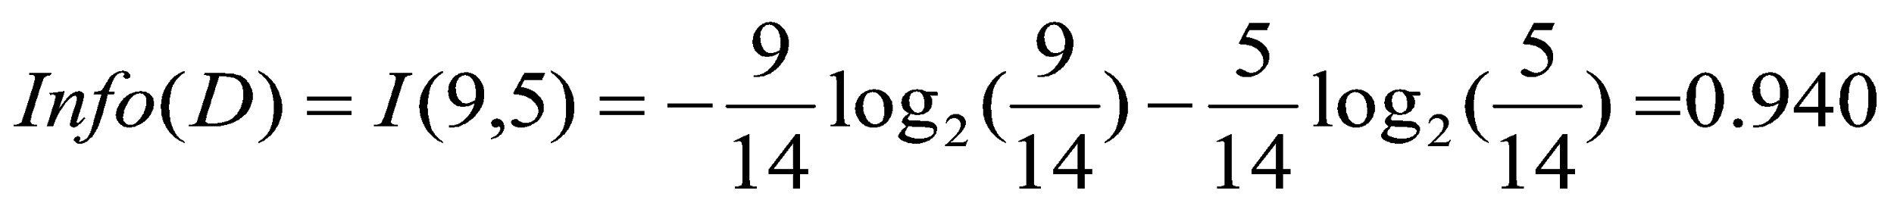
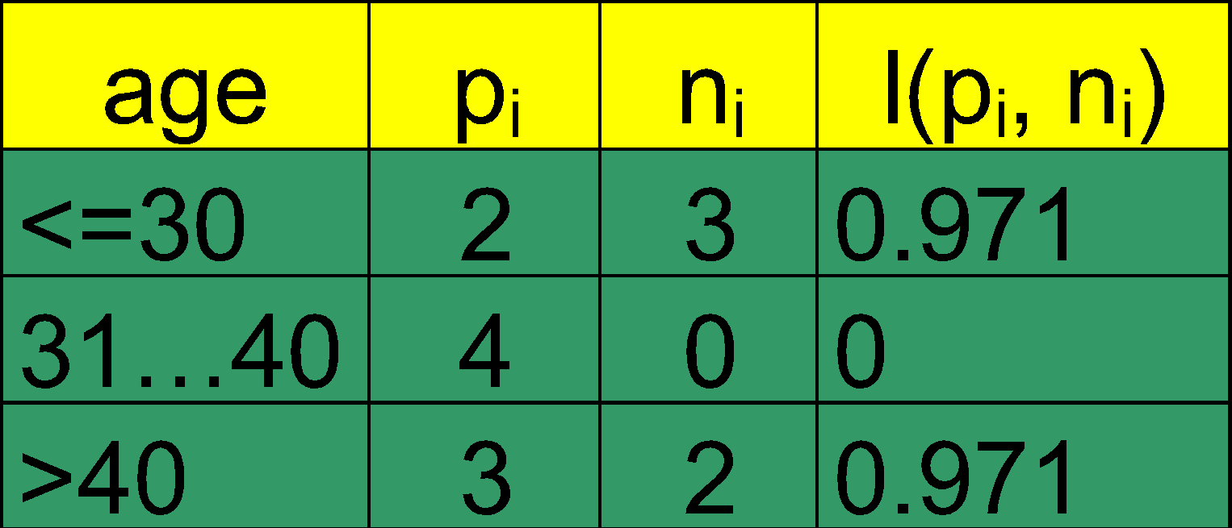
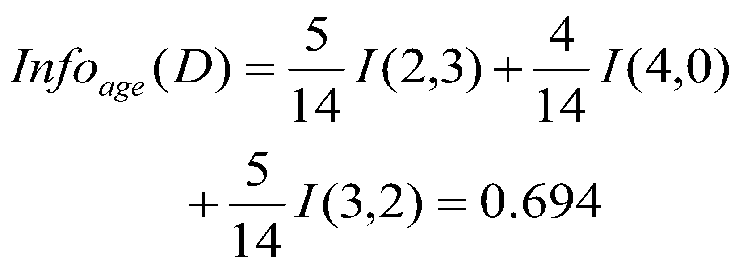
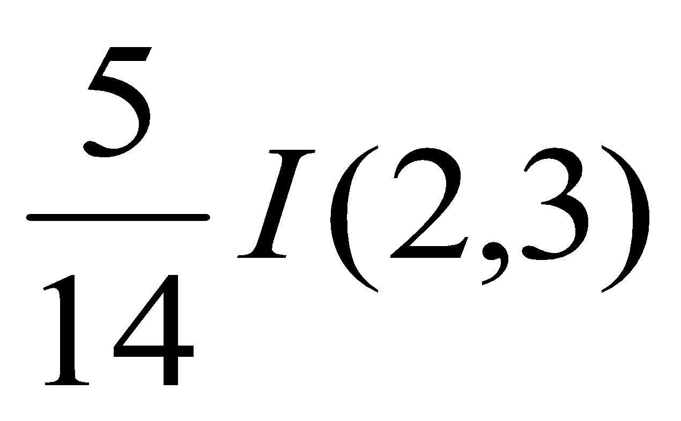
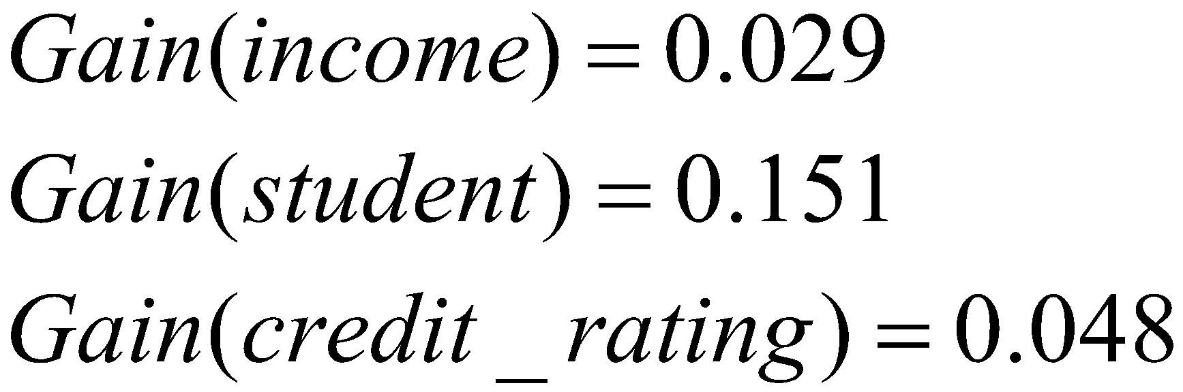
Attribute Selection : Information gain
Class P: buys_computer = “yes”
Class N: buys_computer = “no”
1 : Calculate Entropy for Class Labels
2 : Calculate Information of Each Attribute (one by one)
3 : Calculate Gain of Each Attribute (one by one)
means “age <=30” has 5 out of 14 samples, with 2 yes’es and 3 no’s.
4: Select Attribute with max gain as a root attribute
Gain(age)> any other gain. so age is selected as root node

Slide 41
Final DT of the buys_computer dataset
age?
age
<=30
31..40
>40
student?
yes
credit rating?
no
yes
excellent
fair
no
yes
no
yes
Notes:
‹#›

Slide 42
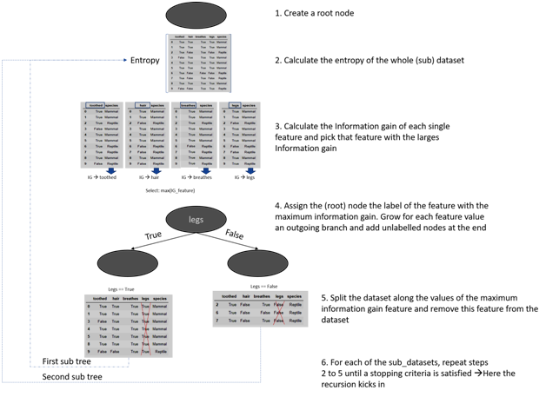
Example : Usage of Information Gain and Entropy in DT Creation
 | toothed | hair | breathes | legs | species
0 | True | True | True | True | Mammal
1 | True | True | True | True | Mammal
2 | True | False | True | False | Reptile
3 | False | True | True | True | Mammal
4 | True | True | True | True | Mammal
5 | True | True | True | True | Mammal
6 | True | False | False | False | Reptile
7 | True | False | True | False | Reptile
8 | True | True | True | True | Mammal
9 | False | False | True | True | Reptile
Notes:
‹#›

Slide 43
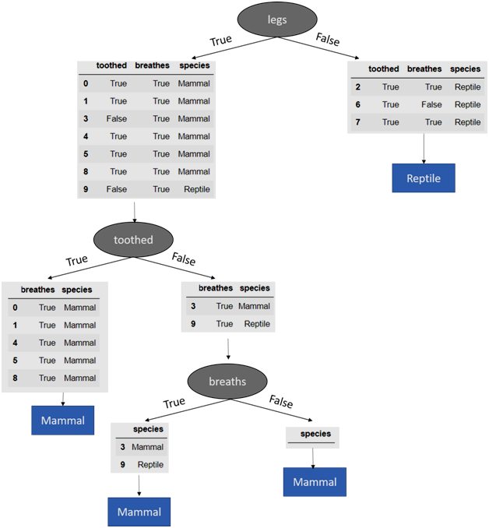
Decision Tree Algorithm- Example
Notes:
‹#›

Slide 44
Summary- Classification Algorithm
Classification is a form of data analysis that extracts models describing important data classes.
Effective and scalable methods have been developed for decision tree induction, Naive Bayesian classification, rule-based classification, and many other classification methods.
Notes:
‹#›

Slide 45
Clustering
Organizing data into classes such that there is
  high intra-class similarity
  low inter-class similarity
Finding the class labels and the number of classes directly from the data (in contrast to classification).
More informally, finding natural groupings among objects.
Also called unsupervised learning, sometimes called classification by statisticians and sorting by psychologists and segmentation by people in marketing
‹#›

Slide 46
Definition
Finding groups of objects such that the objects in a group will be similar (or related) to one another and different from (or unrelated to) the objects in other groups
Inter-cluster distances are maximized
Intra-cluster distances are minimized

Slide 47
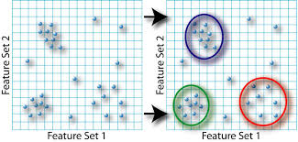
Clustering Example

Slide 48
Types of Clustering
Hierarchical clustering(BIRCH)
  A set of nested clusters organized as a hierarchical tree
Partitional Clustering(k-means,k-mediods)
  A division data objects into non-overlapping (distinct) subsets (i.e., clusters) such that each data object is in exactly one subset
Density – Based(DBSCAN)
  Based on density functions
Grid-Based(STING)
  Based on multiple-level granularity structure
Model-Based(SOM)
  Hypothesize a model for each of the clusters and find the best fit of the data to the given model

Slide 49











Two types of Clustering
Partitional algorithms: Construct various partitions and then evaluate them by some criterion (we will see an example called BIRCH)
Hierarchical algorithms: Create a hierarchical decomposition of the set of objects using some criterion
Hierarchical
Partitional
‹#›

Slide 50
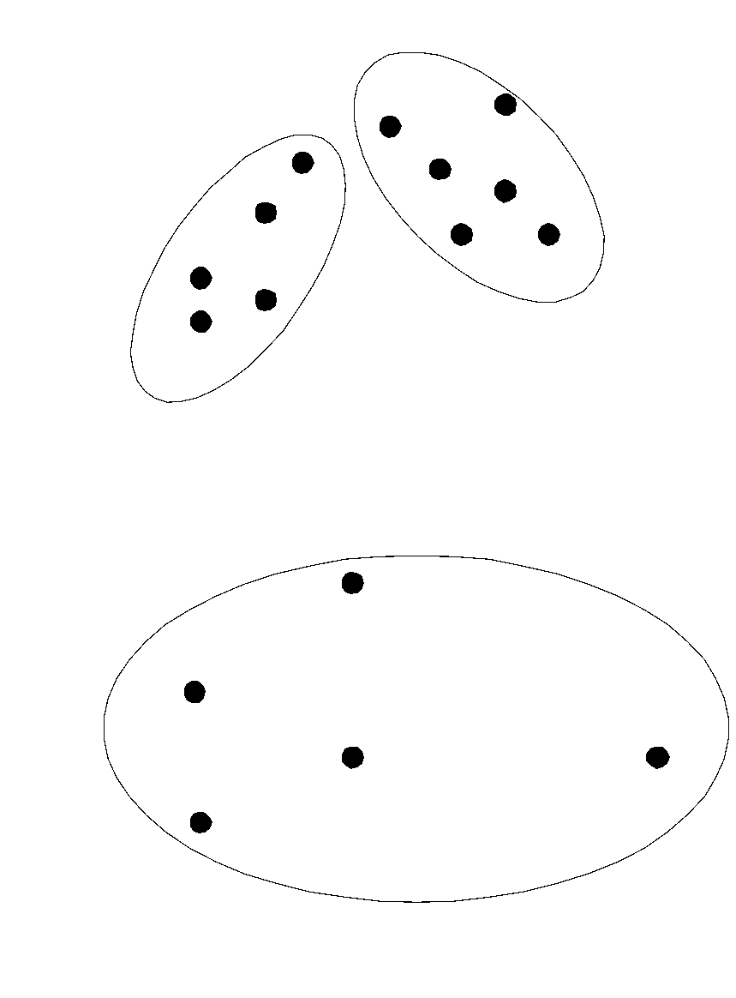
Partitional Clustering
Original Points
A Partitional Clustering

Slide 51
Clustering Algorithms
Partitional
  K-means

Slide 52
Desirable Properties of Clustering
Scalability (in terms of both time and space)
Ability to deal with different data types
Minimal requirements for domain knowledge to determine input parameters
Able to deal with noise and outliers
Insensitive to order of input records
Incorporation of user-specified constraints
Interpretability and usability

Slide 53

K-MEANS CLUSTERING
The k-means algorithm is an algorithm to cluster n objects based on attributes into k partitions, where k < n.
It assumes that the object attributes form a vector space.
An algorithm for partitioning (or clustering) N data points into K disjoint subsets S_{j} containing data points so as to minimize the sum-of-squares criterion
Where x_{n} is a vector representing the the n^{th} data point and u_{j} is the geometric centroid of the data points in S_{j}.

Slide 54
K-MEANS CLUSTERING
Simply speaking k-means clustering is an algorithm to classify or to group the objects based on attributes/features into K number of group.
K is positive integer number.
The grouping is done by minimizing the sum of squares of distances between data and the corresponding cluster centroid.

Slide 55
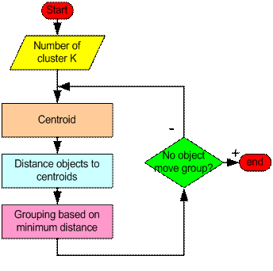
Working of K-MEANS CLUSTERING

Slide 56

Classical Partitioning Method- K mean
First, it randomly selects K of the objects, each of which initially means represents cluster mean or center.
For each of the remaining objects, an object is assigned to the cluster to which it is most similar, based on the distance between the object and the cluster mean.
It then computes the new mean for each cluster.
This process iterates until the criterion function converges.
Typically, the Square error criterion is used, defines as
E- Sum of square error for all objects in the data set
P is the point in space representing given object;
mi- is the mean of cluster Ci

Slide 57
Classical Partitioning Method- K mean
In other words, for each object in each cluster , the distance from the object to its cluster center is squared, and the distances are summed.
This criterion tries to make the resulting k clusters as compact and as separate as possible.

Slide 58
Working of K-MEANS CLUSTERING
Begin with a decision on the value of k = number of clusters
Arbitrarily assign k objects from D as the initial cluster centers
Each object is distributed to a cluster based on the cluster center to which it is the nearest.
Next, the cluster centers are updated i.e. mean valu of each cluster is recalculated based on the current objects in the cluster
Using the new cluster centers, the objects are redistributed to the clusters based on which cluster center is the nearest.
This process iterates
Eventually, no redistribution of the objects in any occurs , and so the process terminates
Resulting clusters are returned by the clustering process.

Slide 59
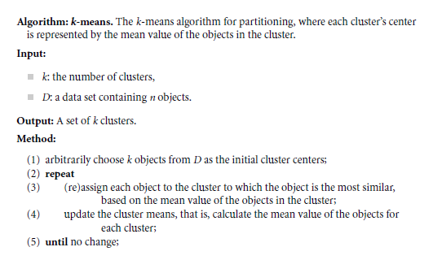
Algorithm of K-MEANS CLUSTERING

Slide 60
Example 1
Given: {2,3,6,8,9,12,15,18,22} Assume k=3.
Solution:
  Randomly partition given data set:
    K1 = 2,8,15 mean = 8.3
    K2 = 3,9,18 mean = 10
    K3 = 6,12,22 mean = 13.3
  Reassign
    K1 = 2,3,6,8,9 mean = 5.6
    K2 = mean = 0
    K3 = 12,15,18,22 mean = 16.75

Slide 61
Example 1
  Reassign
    K1 = 3,6,8,9 mean = 6.5
    K2 = 2 mean = 2
    K3 = 12,15,18,22 mean = 16.75
  Reassign
    K1 = 6,8,9 mean = 7.6
    K2 = 2,3 mean = 2.5
    K3 = 12,15,18,22 mean = 16.75
  Reassign
    K1 = 6,8,9 mean = 7.6
    K2 = 2,3 mean = 2.5
    K3 = 12,15,18,22 mean = 16.75
STOP

Slide 62
Example 1
Given {2,4,10,12,3,20,30,11,25}
Assume k=2.
Solution:
K1 = 2,3,4,10,11,12
K2 = 20, 25, 30

Slide 63
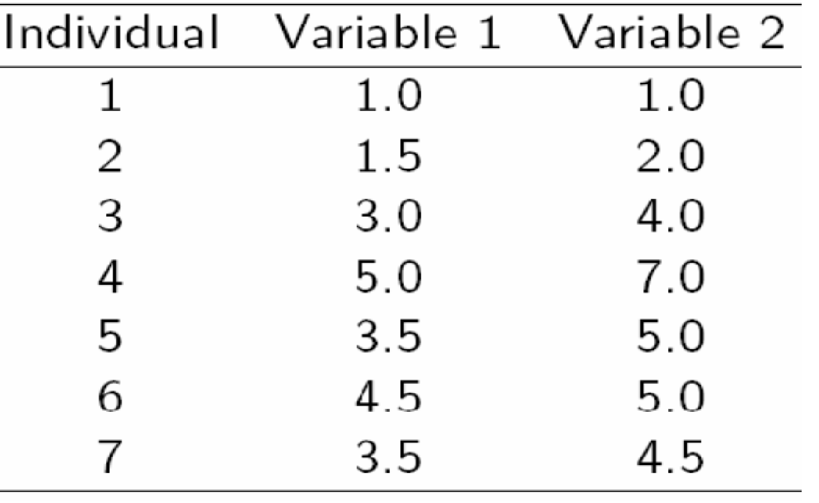
A Simple example
A Simple example showing the implementation of k-means algorithm
(using K=2)

Slide 64
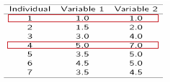
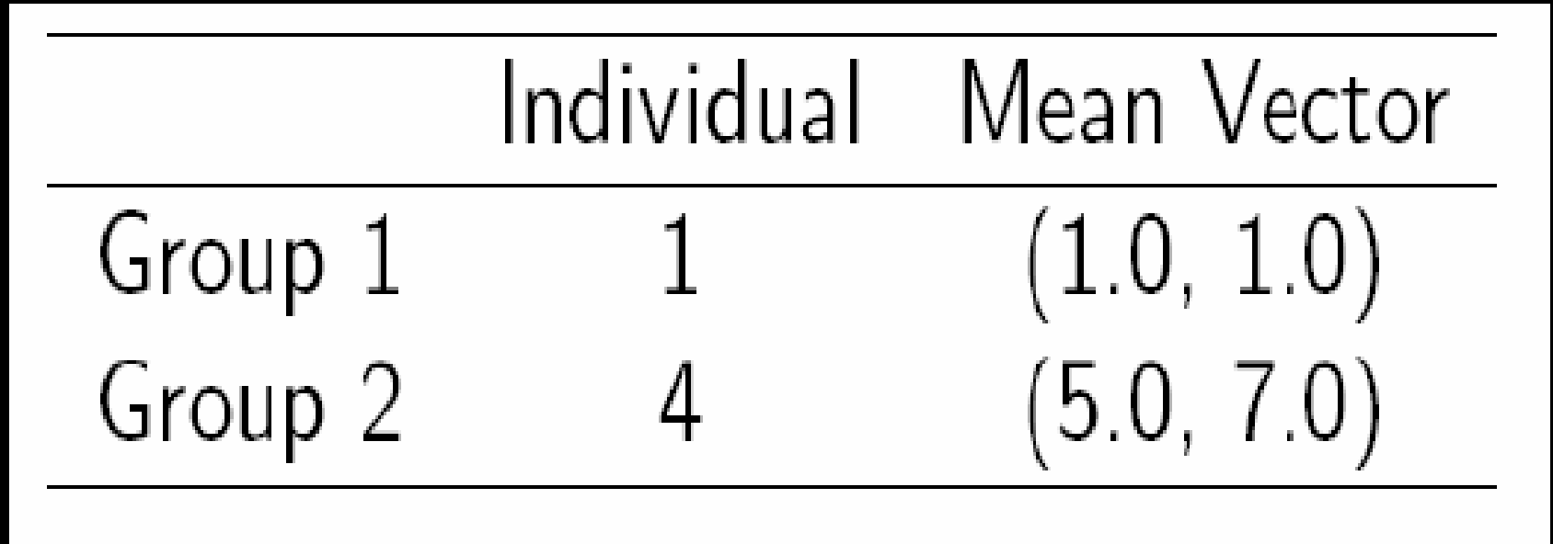
A Simple example
Step 1:
Initialization: Randomly we choose following two centroids (k=2) for two clusters.
In this case the 2 centroid are: m1=(1.0,1.0) and m2=(5.0,7.0).

Slide 65
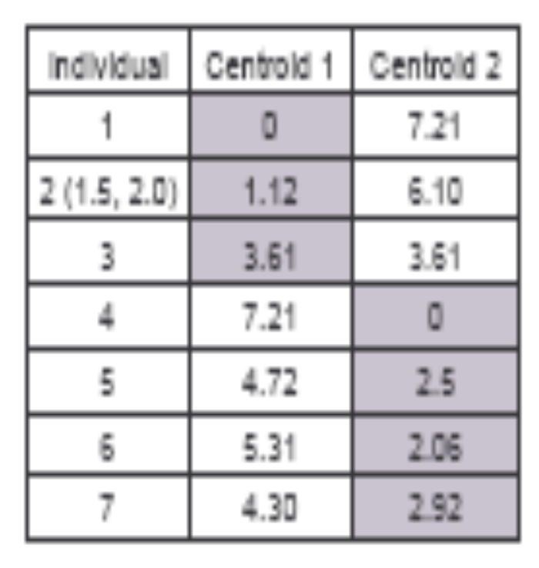



A Simple example
Step 2:
Thus, we obtain two clusters containing:
{1,2,3} and {4,5,6,7}.
Their new centroids are:

Slide 66
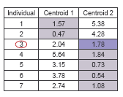
A Simple example
Step 3:
Now using these centroids we compute the Euclidean distance of each object, as shown in table.
Therefore, the new clusters are:
{1,2} and {3,4,5,6,7}
Next centroids are:
m1=(1.25,1.5) and m2 = (3.9,5.1)

Slide 67
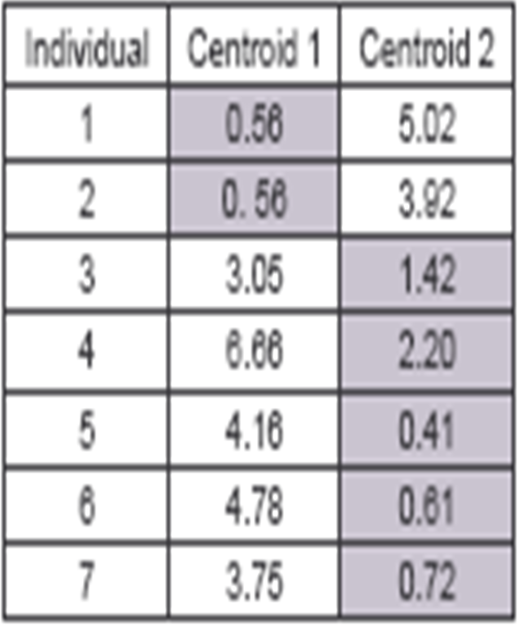
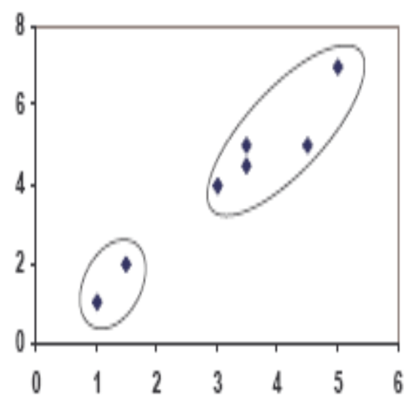
A Simple example
Step 4:
The clusters obtained are:
{1,2} and {3,4,5,6,7}
Therefore, there is no change in the cluster.
Thus, the algorithm comes to a halt here and final result consist of 2 clusters {1,2} and {3,4,5,6,7}.

Slide 68
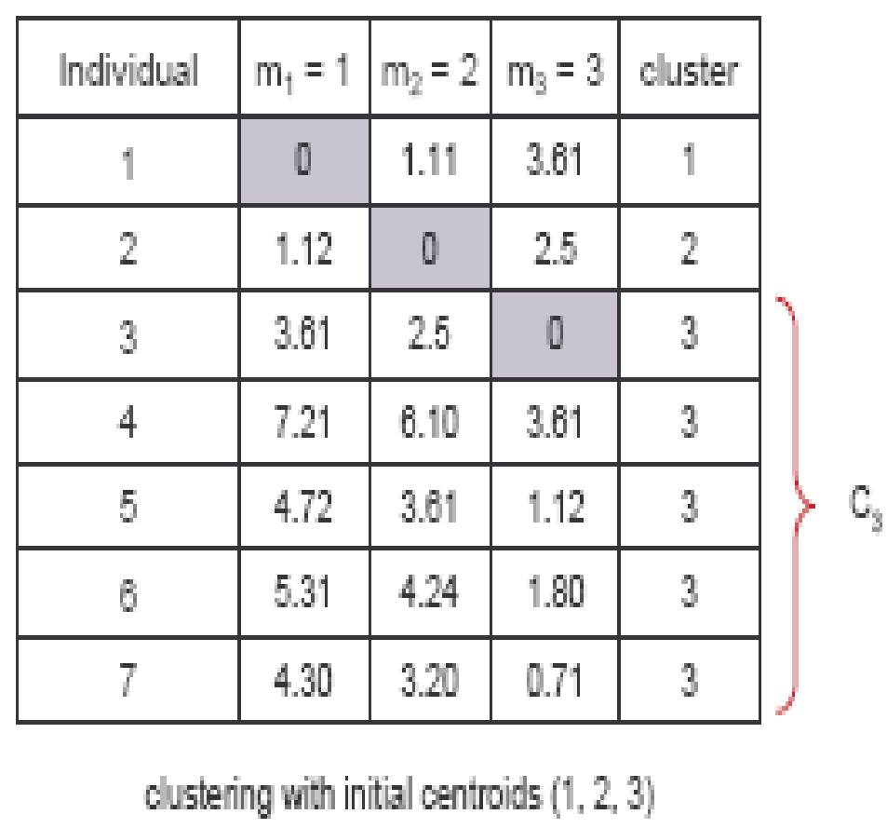


K=3
Step 1
Step 2

Slide 69
K=3

Slide 70
Applications of K-Mean Clustering
It is relatively efficient and fast. It computes result at O(tkn), where n is number of objects or points, k is number of clusters and t is number of iterations.
k-means clustering can be applied to machine learning or data mining
Used on acoustic data in speech understanding to convert waveforms into one of k categories (known as Vector Quantization or Image Segmentation).
Also used for choosing color palettes on old fashioned graphical display devices and Image Quantization.

Slide 71
Weaknesses of K-Mean Clustering
When the numbers of data are not so many, initial grouping will determine the cluster significantly.
The number of cluster, K, must be determined before hand. Its disadvantage is that it does not yield the same result with each run, since the resulting clusters depend on the initial random assignments.
We never know the real cluster, using the same data, because if it is inputted in a different order it may produce different cluster if the number of data is few.
It is sensitive to initial condition. Different initial condition may produce different result of cluster. The algorithm may be trapped in the local optimum.

Slide 72
Advantages & Disadvantage of K means-Clustering
Advantages
  K-means is relatively scalable and efficient in processing large data sets
  The computational complexity of the algorithm is O(nkt)
    n: the total number of objects
    k: the number of clusters
    t: the number of iterations
    Normally: k<<n and t<<n
Disadvantage
  Can be applied only when the mean of a cluster is defined
  Users need to specify k
  K-means is not suitable for discovering clusters with non convex
  Shapes or clusters of very different size
  It is sensitive to noise and outlier data points

Slide 73
Conclusion of Clustering
K-means algorithm is useful for undirected knowledge discovery and is relatively simple. K-means has found wide spread usage in lot of fields, ranging from unsupervised learning of neural network, Pattern recognitions, Classification analysis, Artificial intelligence, image processing, machine vision, and many others.

Slide 74
References
J. A. Hartigan (1975) "Clustering Algorithms". Wiley.
J. A. Hartigan and M. A. Wong (1979) "A K-Means Clustering Algorithm", Applied Statistics, Vol. 28, No. 1, p100-108.
www.wikipedia.com

