Slide 1


(Computer Engineering and Technology)
(TYB.Tech)
Subject : Data Engineering Concepts
Flagship University of MIT Group of Institutions
MIT-WPU is recognized by UGC and Approved by AICTE
M. Tech. (Computer Science & Engineering)
Notes:
© Copyright Showeet.com – Free PowerPoint Templates

Slide 2
Unit IV: Association Rules Mining
Market basket Analysis, Frequent item set, Closed item set, Association Rules, a-priori Algorithm, Generating Association Rules from Frequent Item sets, Improving the Efficiency of a-priori, Mining Frequent Item sets without Candidate Generation: FP Growth Algorithm; Mining ,Generating Rules

Slide 3

Introduction : Frequent Patterns
Frequent pattern: a pattern (a set of items, subsequences, substructures, etc.) that occurs frequently in a data set
First proposed by Agrawal, Imielinski, and Swami [AIS93] in the context of frequent item sets and association rule mining
Motivation: Finding inherent regularities in data
                What products were often purchased together?
                What are the subsequent purchases after buying a PC?
                What kinds of DNA are sensitive to this new drug?
Applications
  Market basket analysis, cross-marketing, catalog design, sales campaign analysis, Web log (click stream) analysis, and DNA sequence analysis

Slide 4


Market Basket Analysis
Consider shopping cart filled with several items
Market basket analysis tries to answer the following questions:
Who makes purchases?
What do customers buy together?
In what order do customers purchase items?

Slide 5



Introduction to Market Basket Analysis
Def: Market Basket Analysis (Association Analysis) is a mathematical modeling technique based upon the theory that if you buy a certain group of items, you are likely to buy another group of items.
It is used to analyze the customer purchasing behavior and helps in increasing the sales and maintain inventory by focusing on the point of sale transaction data.
Given a dataset, the Apriori Algorithm trains and identifies product baskets and product association rules

Slide 6
Definitions and Terminology
Transaction is a set of items (Itemset).
Confidence : It is the measure of uncertainty or trust worthiness associated with each discovered pattern.
Support : It is the measure of how often the collection of items in an association occur together as percentage of all transactions
Frequent itemset : If an itemset satisfies minimum support, then it is a frequent itemset.
Strong Association rules: Rules that satisfy both a minimum support threshold and a minimum confidence threshold
In Association rule mining, we first find all frequent itemsets and then generate strong association rules from the frequent itemsets

Slide 7
What Is Frequent Pattern Analysis?
Introduction
Frequent pattern: a pattern (a set of items, subsequences, substructures, etc.) that occurs frequently in a data set
First proposed by Agrawal, Imielinski, and Swami [AIS93] in the context of frequent itemsets and association rule mining
Motivation: Finding inherent regularities in data
  What products were often purchased together?— bread and butter?
  What are the subsequent purchases after buying a PC?
  What kinds of DNA are sensitive to this new drug?
  Can we automatically classify web documents?
Applications
  Basket data analysis, cross-marketing, catalog design, sale campaign analysis, Web log (click stream) analysis, and DNA sequence analysis.

Slide 8
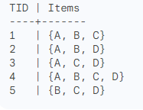
Closed itemset
It is a frequent itemset that has no proper superset with the same support. In other words,
a closed itemset is the largest itemset in a set of itemsets with the same support.
For example, consider the following transaction database:
The minimum support (minsup) is set to 3. The frequent itemsets in this database are:
{A}, {B}, {C}, {D}, {A, B}, {A, C}, {A, D}, {B, C}, {B, D}, {C, D}, and {A, B, C}, {A, B, D}, {A, C, D}, and {B, C, D}
However, only the following itemsets are closed:
{A}, {B}, {C}, {D}, {A, B}, {A, C}, {A, D}, {B, C}, and {B, D}
Closed itemsets are useful for association rule mining because they can be used to
generate all frequent itemsets and their supports. Additionally, closed itemsets are
often more concise and easier to interpret than frequent itemsets.
Here are some examples of closed itemsets in different industries:
Retail: {bread, milk}, {shirt, jeans}, {laptop, printer}
Healthcare: {fever, cough}, {diabetes, heart disease}, {cancer, chemotherapy}

Slide 9
Association rule mining
Proposed by Agrawal et al in 1993.
It is an important data mining model studied extensively by the database and data mining community.
Assume all data are categorical.
No good algorithm for numeric data.
Initially used for Market Basket Analysis to find how items purchased by customers are related.
Bread → Milk [sup = 5%, conf = 100%]

Slide 10
Why Is Freq. Pattern Mining Important?
Discloses an intrinsic and important property of data sets
Forms the foundation for many essential data mining tasks
  Association, correlation, and causality analysis
  Sequential, structural (e.g., sub-graph) patterns
  Pattern analysis in spatiotemporal, multimedia, time-series, and stream data
  Classification: associative classification
  Cluster analysis: frequent pattern-based clustering
  Data warehousing: iceberg cube and cube-gradient
  Semantic data compression: fascicles
  Broad applications

Slide 11
Market Basket Analysis General Concept: Measures
_____________________________
Measures:
  Suport
Suport = (containing the item combination) /( total number of record.)
Let the rule Is "If a customer purchases Cola, then they will purchase Frozen Pizza"
The support for this
= 2 (number of transaction that include both Cola and Frozen Pizza is) / 5(total records )
= 40%.
  Confidence:
Confidence of a rule = the support for the combination / the support for the condition.
For the rule "If a customer purchases Milk, then they will purchase Potato Chips"
confidence = support for the combination (Potato Chips + Milk) is 20%/ support for the condition (Milk) is 60%,
=33%
Support and confidence are used to select the association rules.

Slide 12


What Is Association Rule Mining?
Frequent patterns: patterns (set of items, sequence, etc.) that occur frequently in a database
Frequent pattern mining: finding regularities in data
What products were often purchased together?
What are the subsequent purchases after buying a car?
Can we automatically profile customers?

Slide 13


Association Rules
“An association algorithm creates rules that describe how often events have occurred together.”
Example: When a customer buys a hammer, then 90% of the time they will buy nails.

Slide 14
Apriori Introduction
Frequent pattern: a pattern (a set of items, subsequences, substructures, etc.) that occurs frequently in a data set
First proposed by Agrawal, Imielinski, and Swami [AIS93] in the context of frequent itemsets and association rule mining
Motivation: Finding inherent regularities in data
                What products were often purchased together?— Pen and Pencil?!
                What are the subsequent purchases after buying a PC?
                What kinds of DNA are sensitive to this new drug?
  Can we automatically classify web documents?
Applications
  Basket data analysis, cross-marketing, catalog design, sale campaign analysis, Web log (click stream) analysis, and DNA sequence analysis

Slide 15
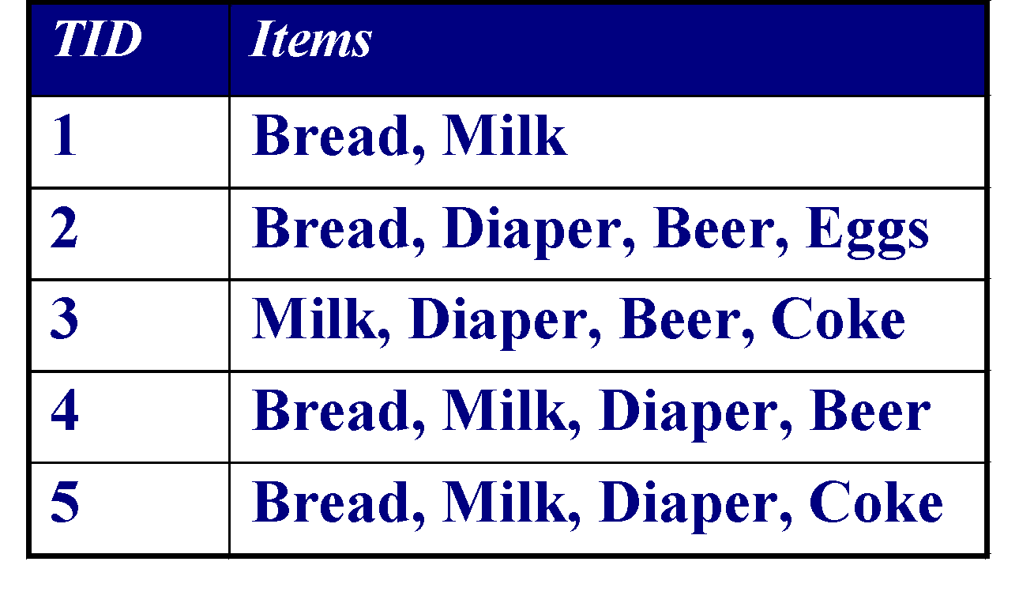
Examples: Association Rule Mining
Given a set of transactions, find rules that will predict the occurrence of an item based on the occurrences of other items in the transaction
Market-Basket transactions
Example of Association Rules
{Diaper} → {Beer},
{Beer, Bread} → {Diaper},
Implication means co-occurrence, not causality!

Slide 16
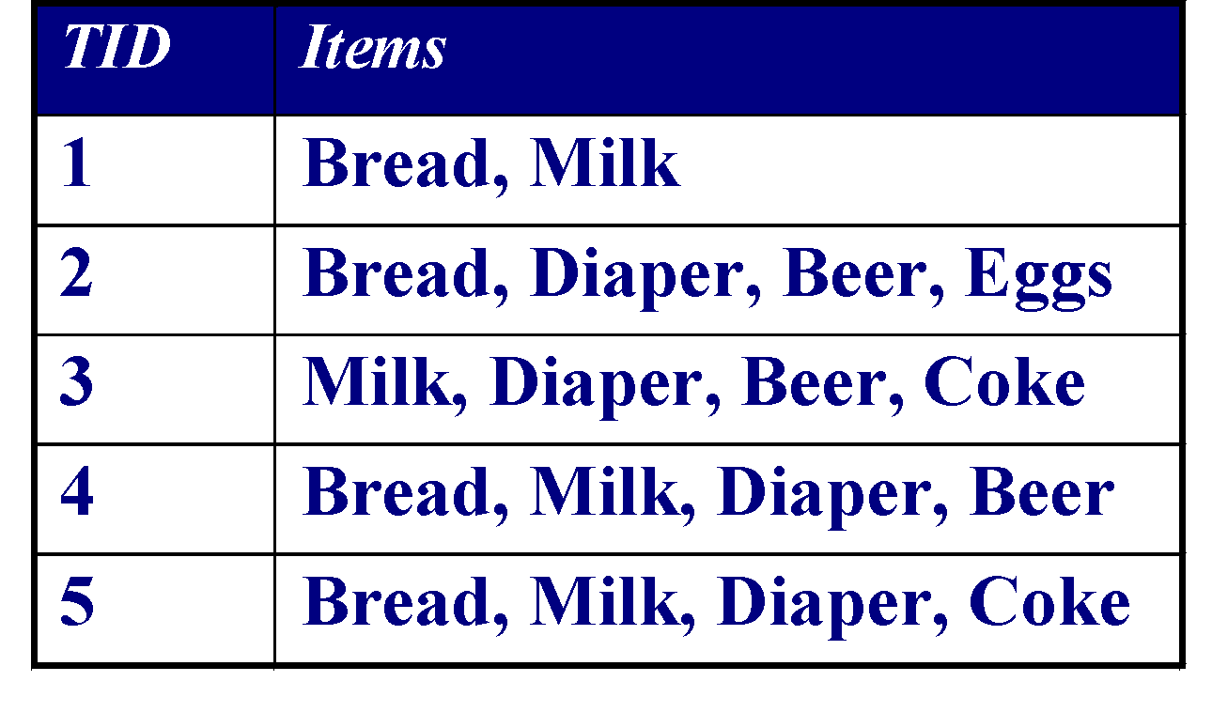
Terms & Definitions: Examples
Itemset
  A collection of one or more items
    Example: {Milk, Bread, Diaper}
  k-itemset
    An itemset that contains k items
Support count/count/frequency (σ)
  Frequency of occurrence of an itemset
  E.g. σ({Milk, Bread,Diaper}) = 2
Support
  Fraction of transactions that contain an itemset
  E.g. s({Milk, Bread, Diaper}) = 2/5
Frequent Itemset
  An itemset whose support is greater than or equal to a min_sup threshold

Slide 17
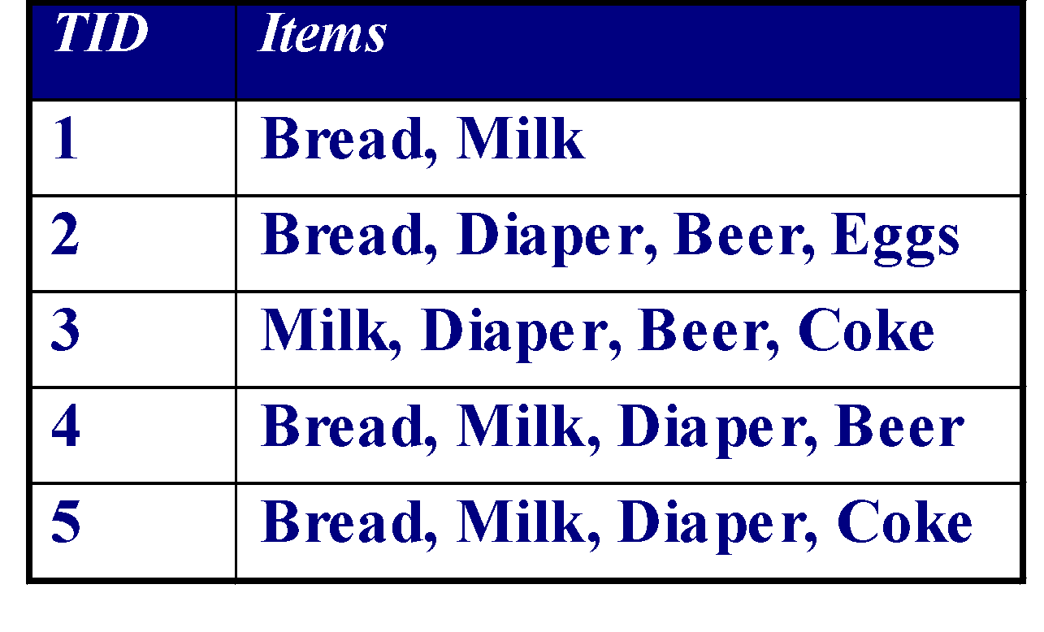
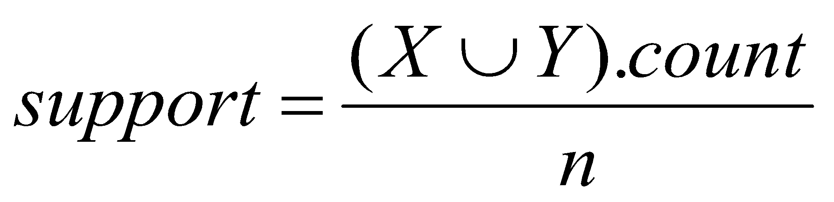
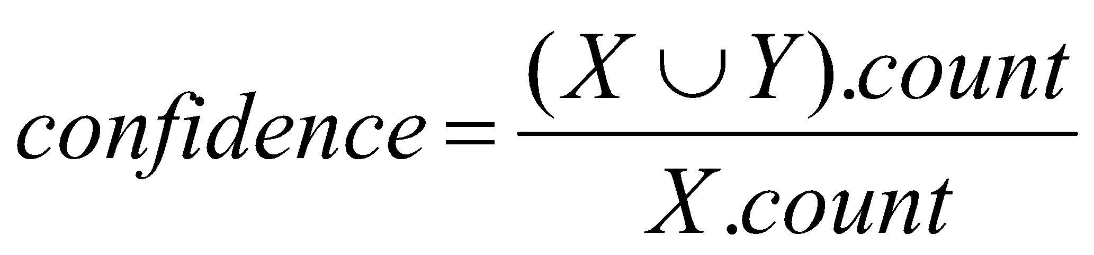

Definition: Association Rule Example
Association Rule
  An implication expression of the form X → Y, where X and Y are itemsets
  Example:
  {Milk, Diaper} → {Beer}
Rule Evaluation Metrics
  Support (s)
    Fraction of all transactions that contain both X and Y
  Confidence (c)
    Measures how often Y appears in transactions that contain X
Example:

Slide 18
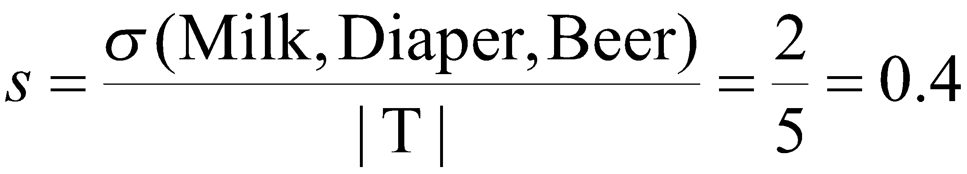
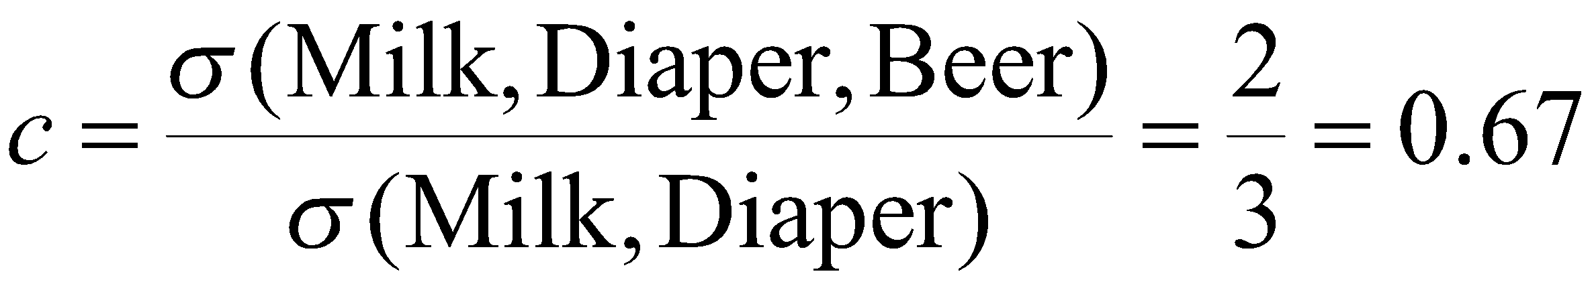
Definition: Association Rule Example
Association Rule
  An implication expression of the form X → Y, where X and Y are itemsets
  Example:
  {Milk, Diaper} → {Beer}
Rule Evaluation Metrics
  Support (s)
    Fraction of all transactions that contain both X and Y
  Confidence (c)
    Measures how often Y appears in transactions that contain X
Example:

Slide 19
Association Rules
Support: “is a measure of what fraction of the population satisfies both the antecedent and the consequent of the rule”.
Example:
  People who buy hotdog buns also buy hotdog sausages in 99% of cases. = High Support
  People who buy hotdog buns buy hangers in 0.005% of cases. = Low support
Situations where there is high support for the antecedent are worth careful attention
  E.g. Hotdog sausages should be placed in near hotdog buns in supermarkets if there is also high confidence.
support(X=>Y) = P(XUY)

Slide 20
Association Rules
Confidence: “is a measure of how often the consequent is true when the antecedent is true.”
Example:
  90% of Hotdog bun purchases are accompanied by hotdog sausages.
  High confidence is meaningful as we can derive rules.
Hotdog bun🡪 Hotdog sausage
2 rules may have different confidence levels and have the same support.
E.g. Hotdog sausage 🡪 Hotdog bun may have a much lower confidence than Hotdog bun 🡪 Hotdog sausage yet they both can have the same support.
Confidence(X=>Y)=P(Y|X)

Slide 21
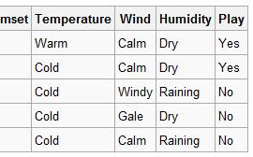
Full example
  Support: 2/5 = 40%
  Confidence: 2/2 = 100%
  => Good
{Cold, Raining} => No
  Support: 2/5 = 40%
  Confidence: 2/2 = 100%
  => Good
{Calm, Dry} => Yes
  Support: 3/5 = 60%
  Confidence: 1/3 = 33.3%
  => Bad
{Cold, Raining} => No
{Calm, Dry} => Yes
{Dry} => No
{Windy} => No
{Dry} => No
  Support: 1/5 = 20%
  Confidence: 1/1 = 100%
  =>Bad
{Windy} => No

Slide 22

Association Rule Mining Task
Given a set of transactions T, the goal of association rule mining is to find all rules having
    support ≥ minsup threshold
    confidence ≥ minconf threshold
Brute-force approach:
    List all possible association rules
    Compute the support and confidence for each rule
    Prune rules that fail the minsup and minconf thresholds

Slide 23
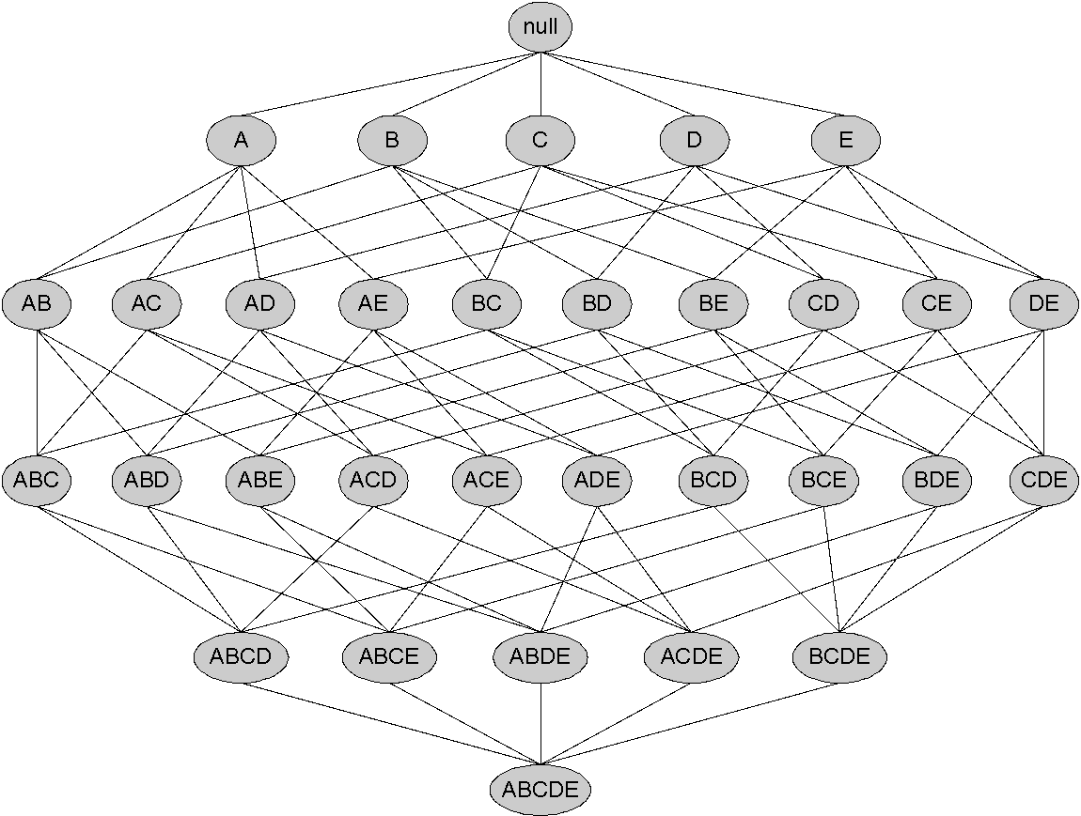
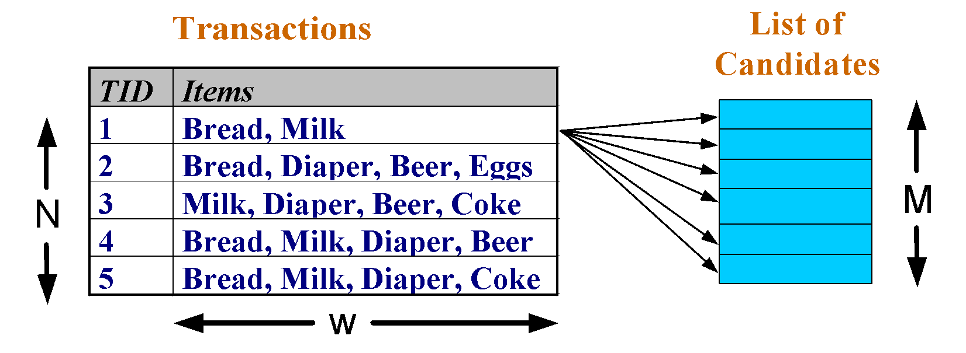
Frequent Itemset Generation
Brute-force approach:
  Each itemset in the lattice is a candidate frequent itemset
  Count the support of each candidate by scanning the database
  Match each transaction against every candidate
  Expensive !!!
Given d items, there are 2^{d} possible candidate itemsets

Slide 24

Mining Association Rules
Two-step approach:
  Frequent Itemset Generation
    Generate all itemsets whose support ≥ minsup
  Rule Generation
    Generate high confidence rules from each frequent itemset, where each rule is a binary partitioning of a frequent itemset
Frequent itemset generation is computationally expensive

Slide 25

Frequent Itemset Generation Strategies
To Reduce the number of candidates (M) Complete search: M=2^{d} use pruning techniques

Slide 26
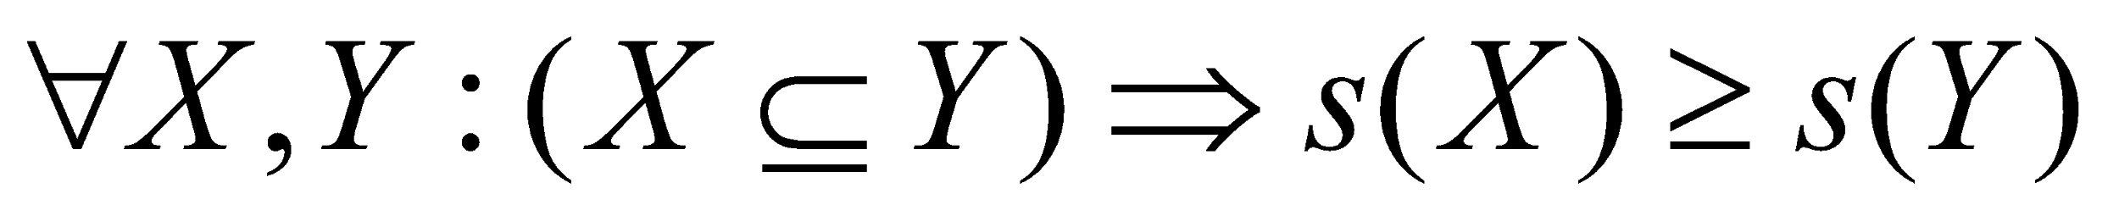
Reducing Number of Candidates
Apriori principle:
  If an itemset is frequent, then all of its subsets must also be frequent
  Apriori principle holds due to the following property of the support measure:
Support of an itemset never exceeds the support of its subsets.
This is known as the anti-monotone property of support.

Slide 27
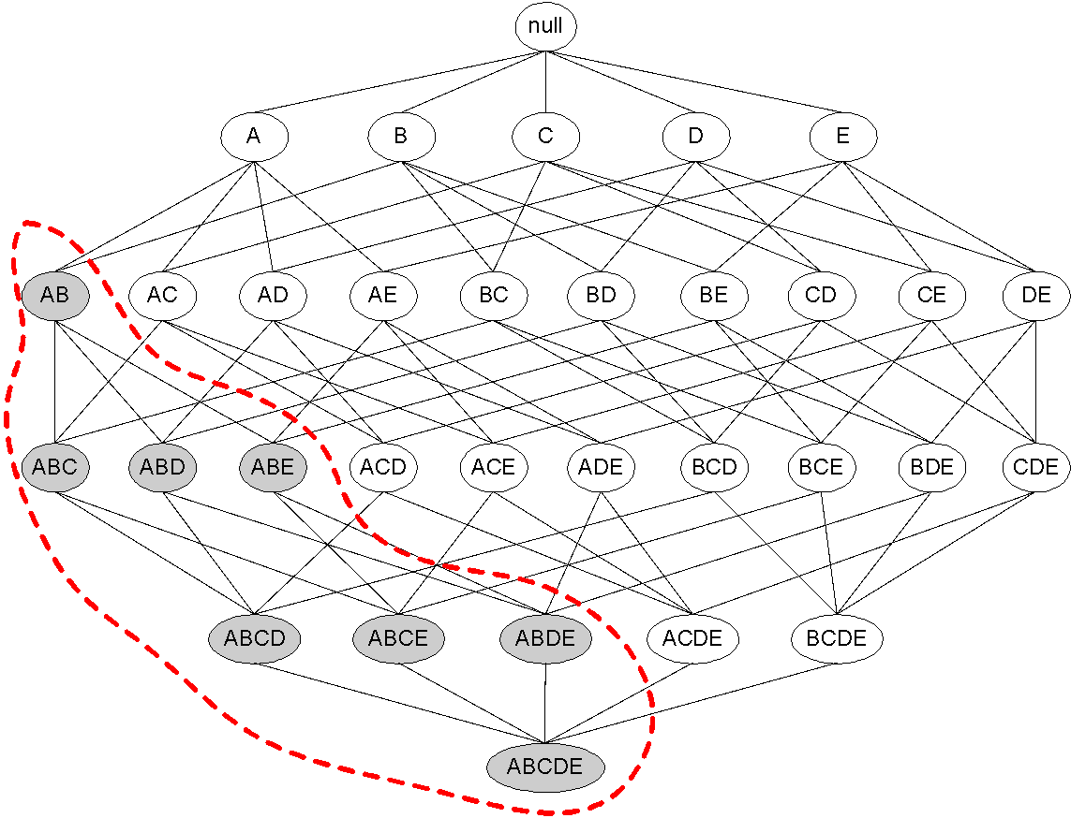
Illustrating Apriori Principle
Pruned supersets

Slide 28
Apriori Algorithm
  F_{k}: frequent k-itemsets
  L_{k}: candidate k-itemsets
Algorithm
  Let k=1
  Generate F₁ = {frequent 1-itemsets}
  Repeat until F_{k} is empty
    Candidate Generation: Generate L_{k+1} from F_{k}
    Support Counting: Count the support of each candidate in L_{k+1} by scanning the DB
    Candidate Pruning: Prune candidate itemsets in Lk+1 containing subsets of length k that are infrequent . Eliminate candidates in L_{k+1} that are infrequent, leaving only those that are frequent => F_{k+1}

Slide 29
Frequent itemset Generation Method
HINT : Merge two frequent itemsets with size n if their first n-1 items are identical
  F₃ = {ABC,ABD,ABE,ACD,BCD,BDE,CDE}
    Merge(ABC, ABD) = ABCD
    Merge(ABC, ABE) = ABCE
    Merge(ABD, ABE) = ABDE
    Do not merge(ABD,ACD) because they share only prefix of length 1 instead of length 2

Slide 30
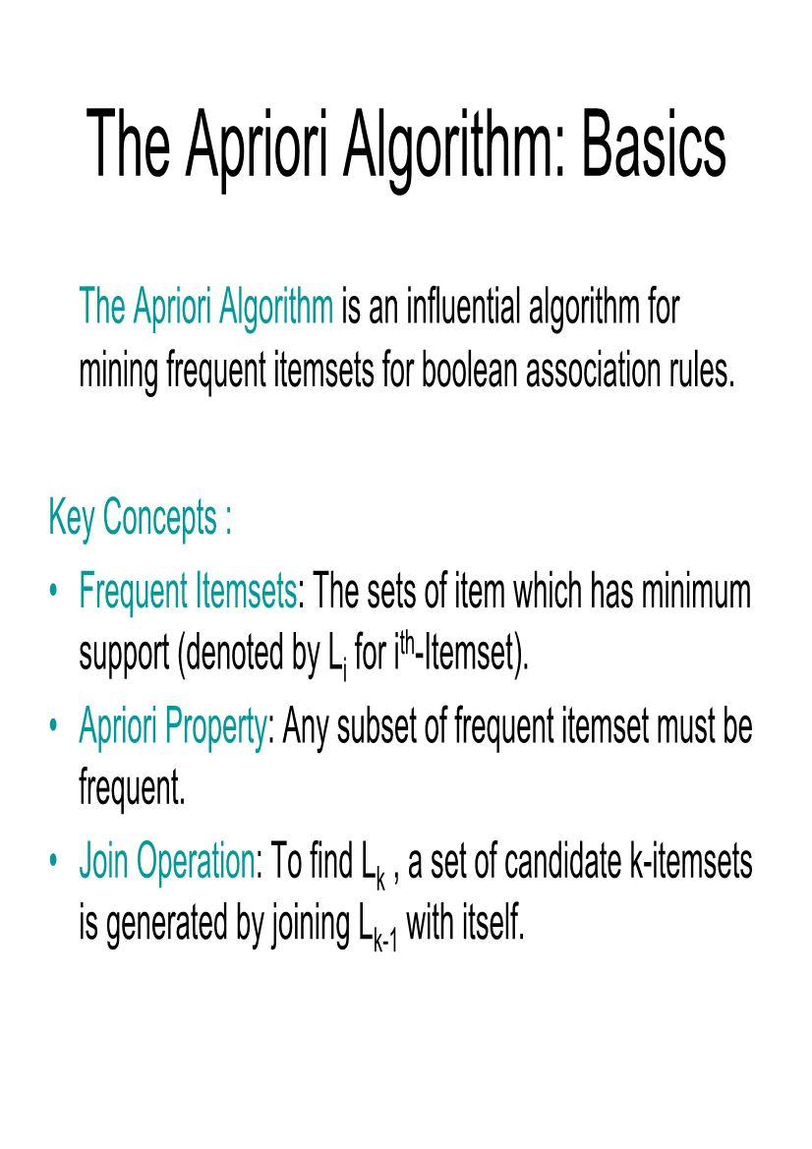
Apriori Algorithm

Slide 31
The Apriori Algorithm (Pseudo-Code)
C_{k}: Candidate itemset of size k
L_{k} : frequent itemset of size k
L₁ = {frequent items};
for (k = 1; L_{k} !=∅; k++) do begin
C_{k+1} = candidates generated from L_{k};
for each transaction t in database do
  increment the count of all candidates in C_{k+1} that are contained in t
L_{k+1} = candidates in C_{k+1} with min_support
end
return ∪_{k} L_{k};

Slide 32
Implementation of Apriori
How to generate candidates?
  Step 1: self-joining L_{k}
  Step 2: pruning
Example of Candidate-generation
  L₃={abc, abd, acd, ace, bcd}
  Self-joining: L₃*L₃
    abcd from abc and abd
    acde from acd and ace
  Pruning:
    acde is removed because ade is not in L₃
  C₄ = {abcd}

Slide 33
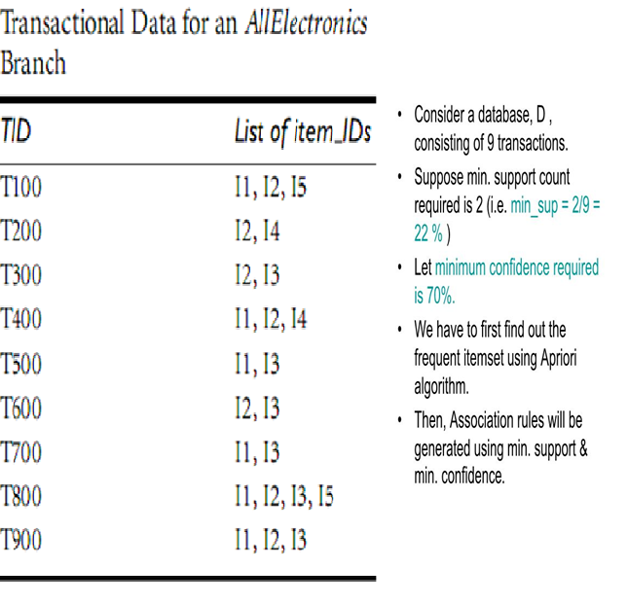
Apriori Example

Slide 34
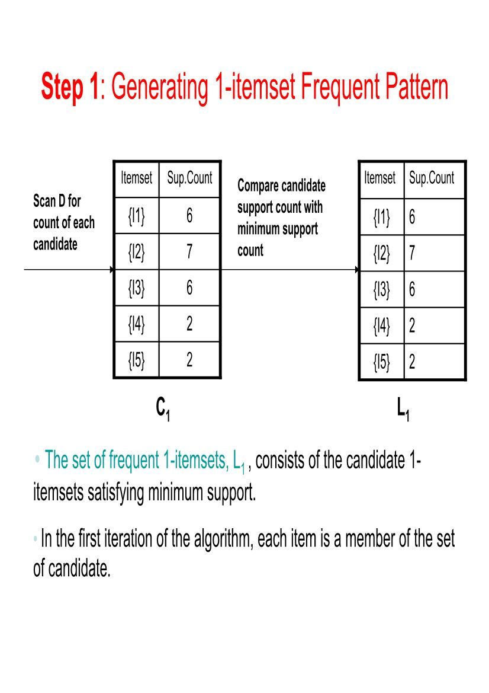
Example –Step 1

Slide 35
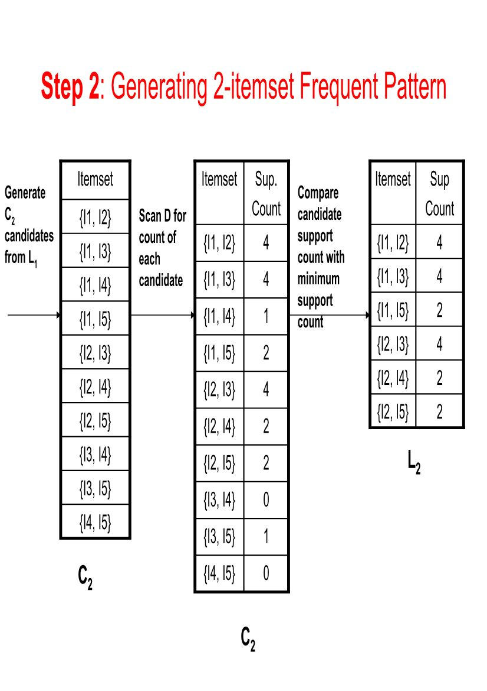
Example – Step 2

Slide 36
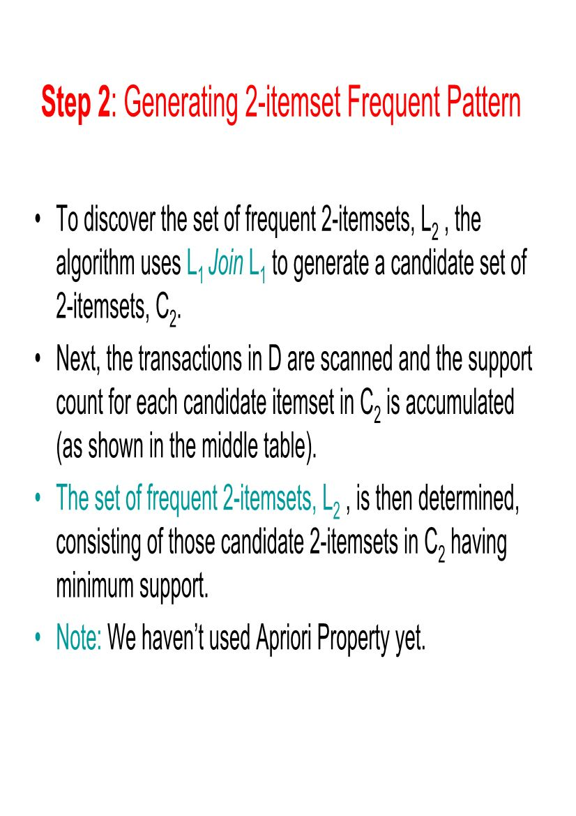
Example – Step 2

Slide 37
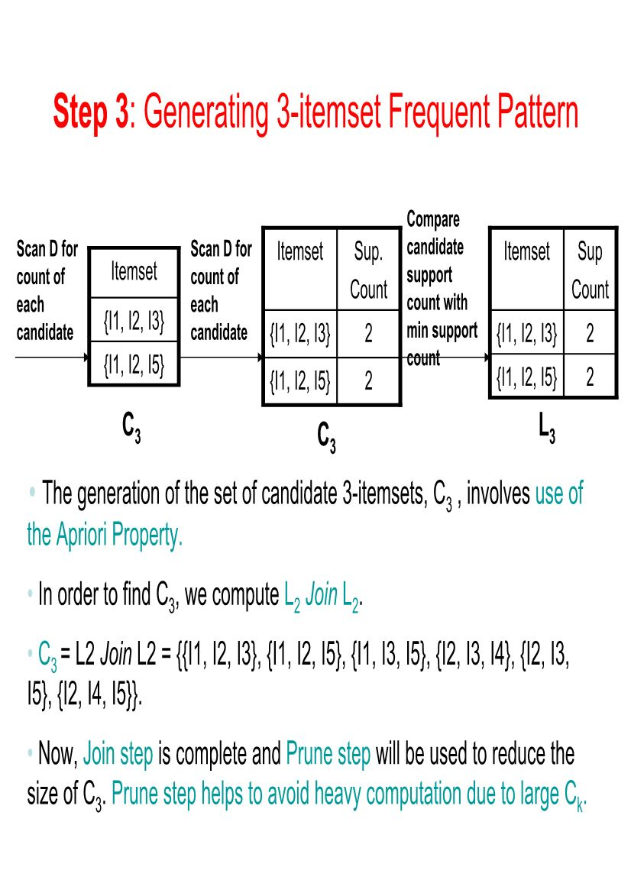
Example – Step 3

Slide 38
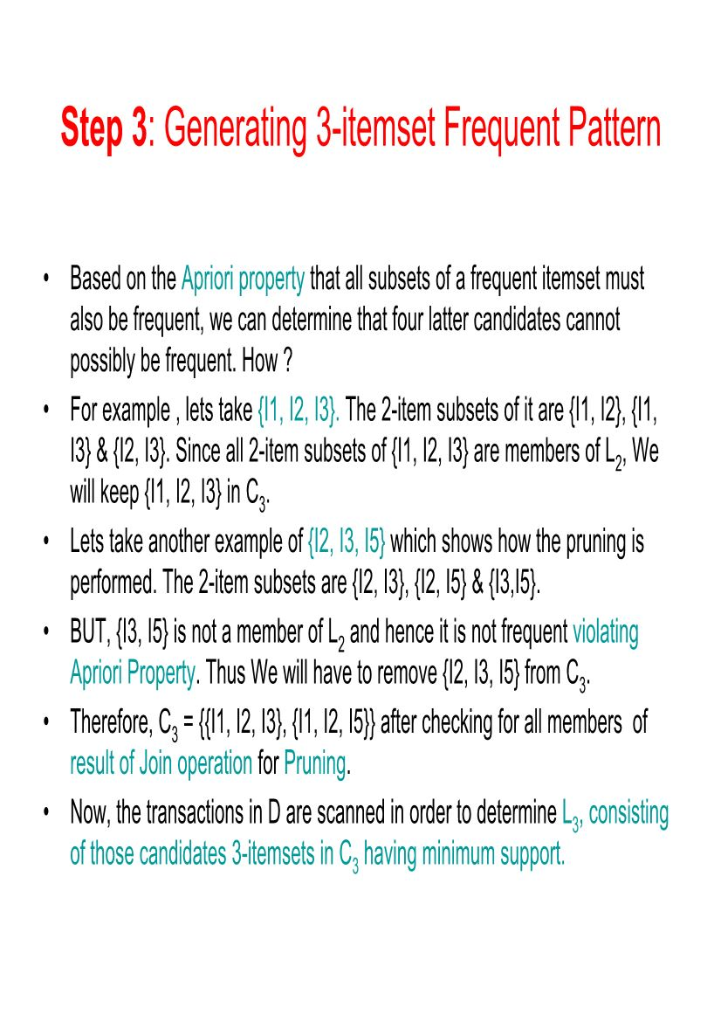

Slide 39
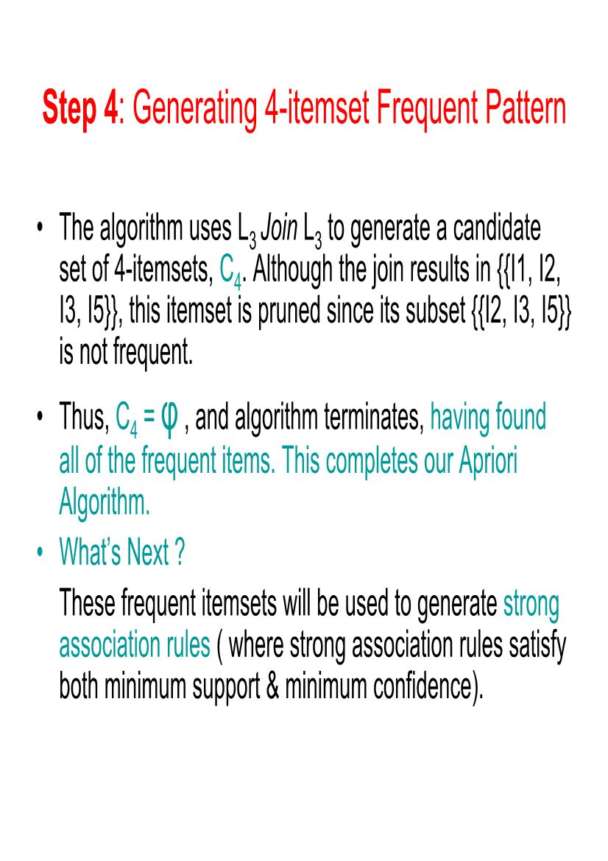
Example – Step 4

Slide 40
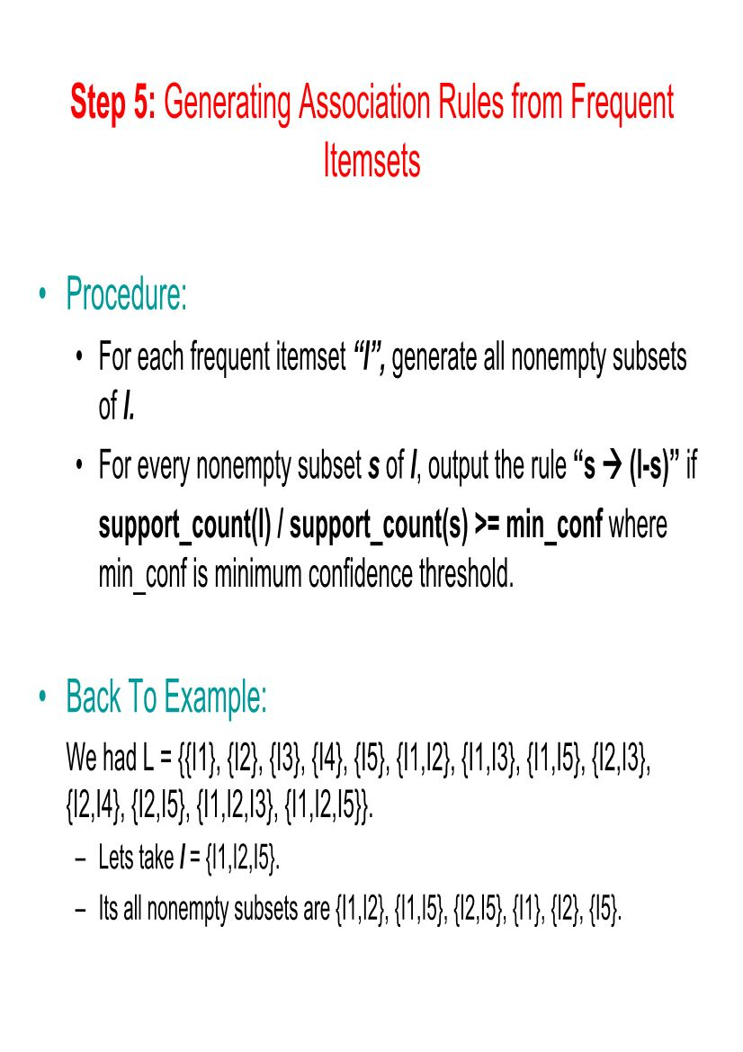
Example – Step 5

Slide 41
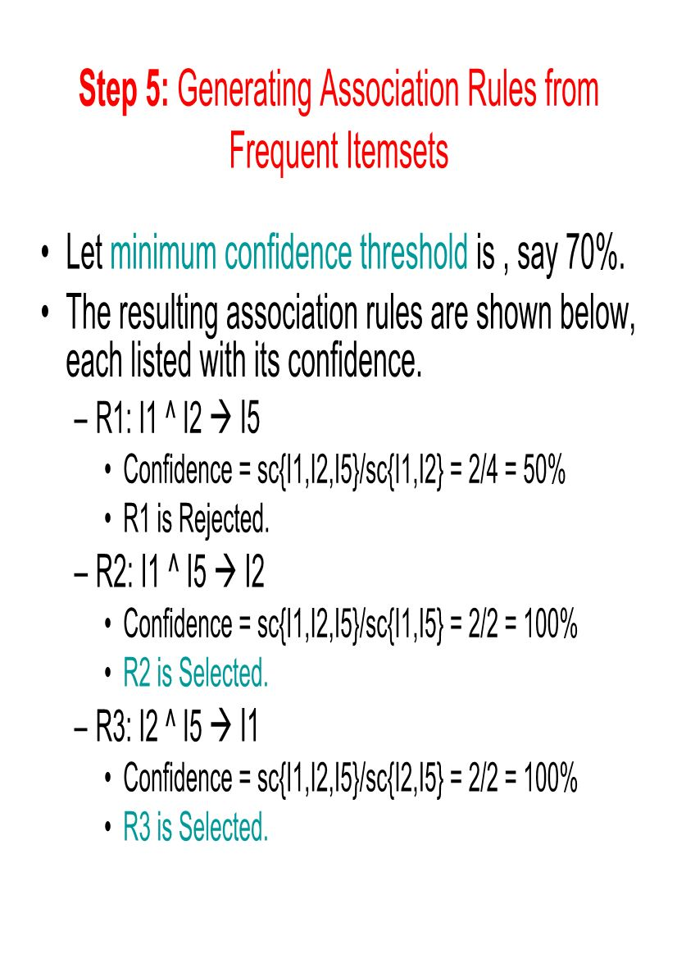

Slide 42
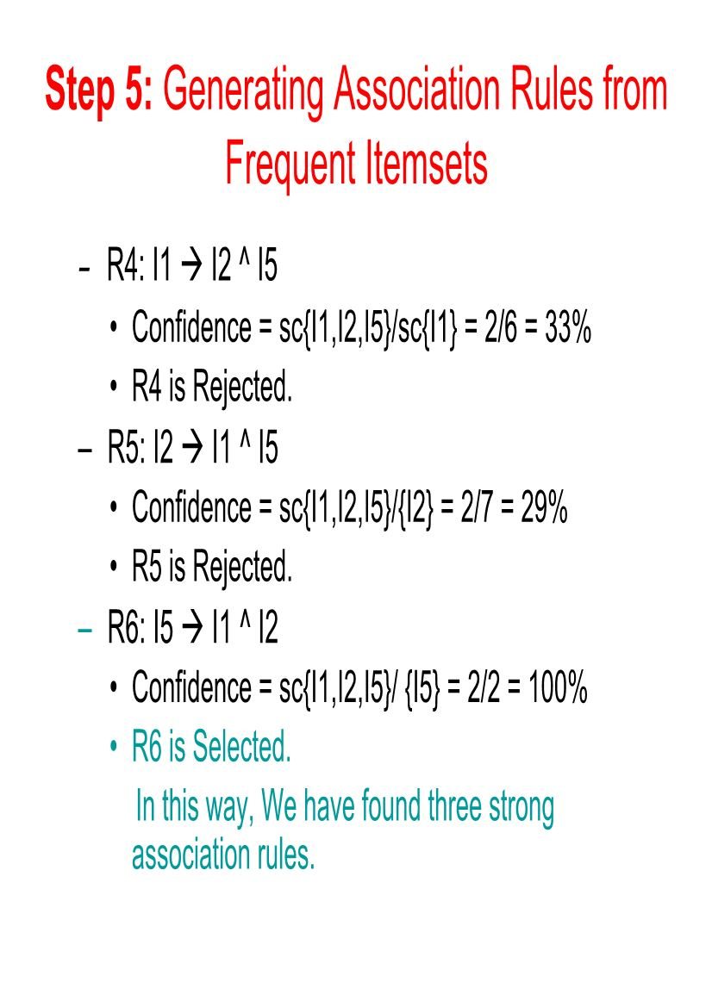

Slide 43
The following are the main steps of the apriori algorithm in data mining:
Set the minimum support threshold - min frequency required for an itemset to be "frequent".
Identify frequent individual items - count the occurence of each individual item.
Generate candidate itemsets of size 2 - create pairs of frequent items discovered.
Prune infrequent itemsets - eliminate itemsets that do no meet the threshold levels.
Generate itemsets of larger sizes - combine the frequent itemsets of size 3,4, and so on.
Repeat the pruning process - keep eliminating the itemsets that do not meet the threshold levels.
Iterate till no more frequent itemsets can be generated.
Generate association rules that express the relationship between them - calculate measures to evaluate the strength & significance of these rules.

Slide 44
Improve the Apriori Algorithm's efficiency
Many methods are available for improving the efficiency of apriori algorithm.
Hash-Based Technique: This method uses a hash-based structure called a hash table for generating the k-itemsets and their corresponding count. It uses a hash function for generating the table.
Transaction Reduction: This method reduces the number of transactions scanned in iterations. The transactions which do not contain frequent items are marked or removed.
Partitioning: This method requires only two database scans to mine the frequent itemsets. It says that for any itemset to be potentially frequent in the database, it should be frequent in at least one of the partitions of the database.
Sampling: This method picks a random sample S from Database D and then searches for frequent itemset in S. It may be possible to lose a global frequent itemset. This can be reduced by lowering the min_sup.
Dynamic Itemset Counting: This technique can add new candidate itemsets at any marked start point of the database during the scanning of the database.

Slide 45
Exercises & Solutions

Slide 46
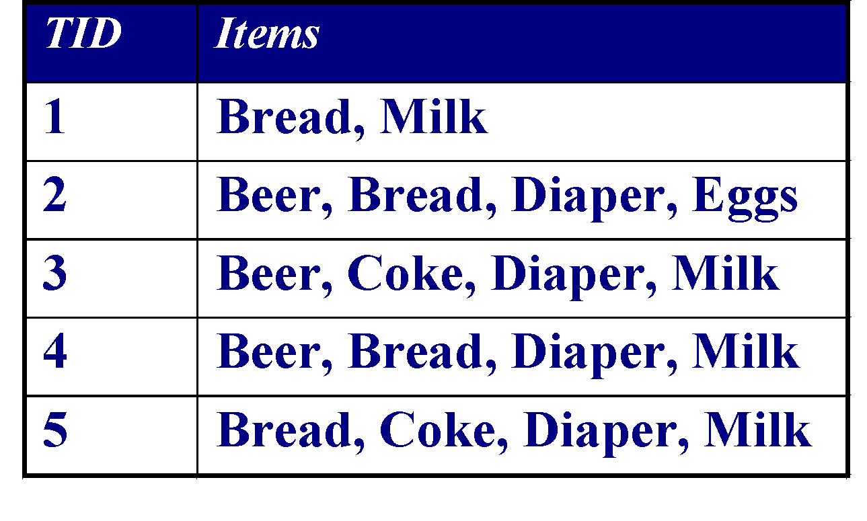
Exercise 01
Minimum Support = 3

Slide 47
Illustrating Apriori Principle : Candidate Generation for n=1
Minimum Support = 3
Items (1-itemsets)
Items
Bread
Coke
Milk
Beer
Diaper
Eggs

Slide 48
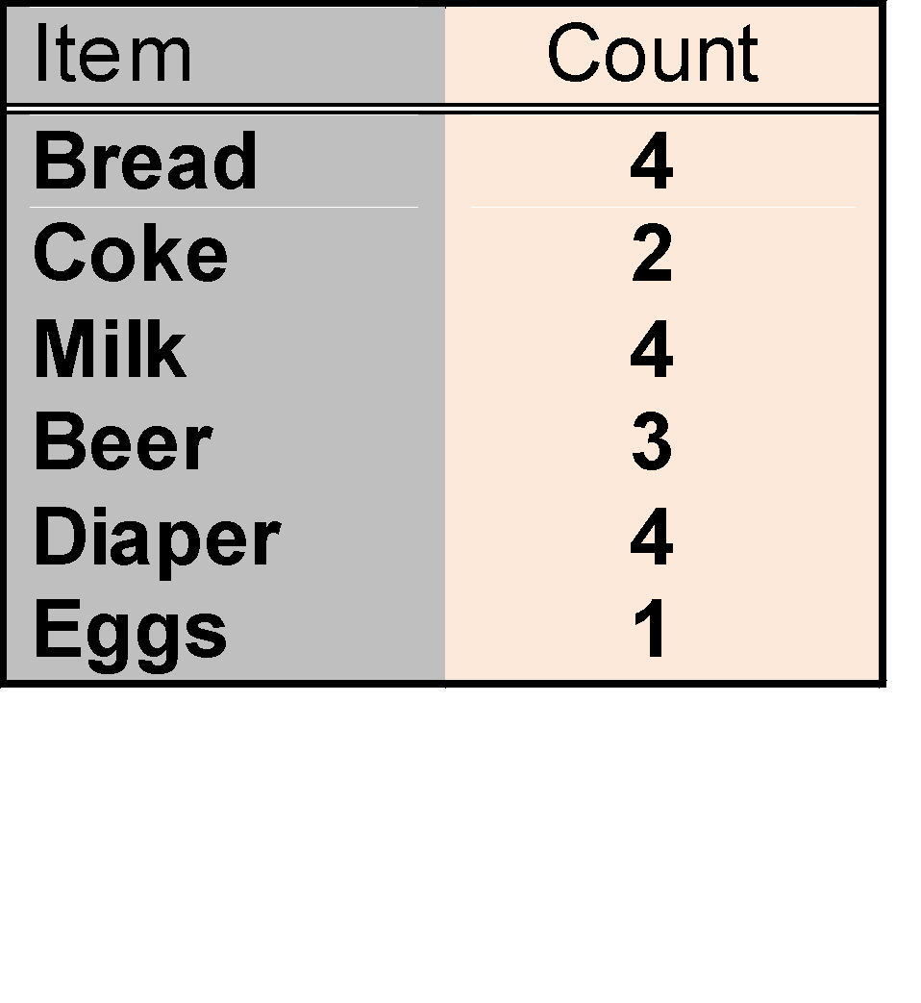
Illustrating Apriori Principle : Support Counting
Minimum Support = 3
Items (1-itemsets)

Slide 49
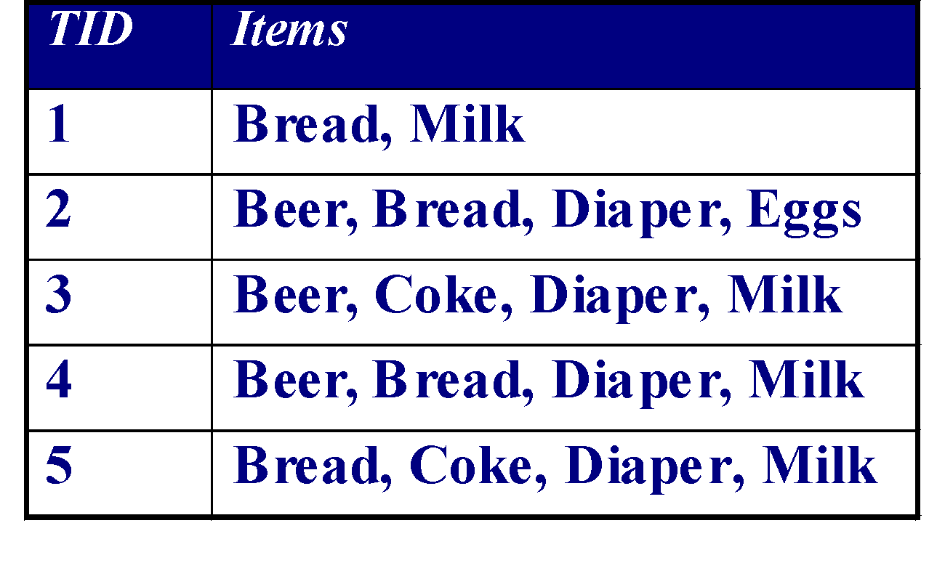
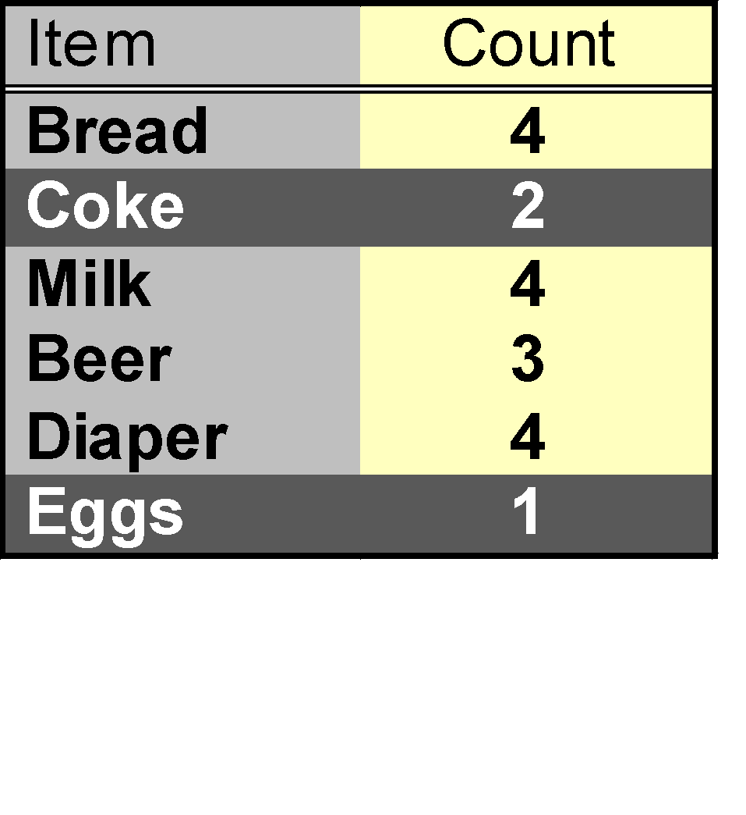
Illustrating Apriori Principle : Prune infrequent Candidate
Items (1-itemsets)
Minimum Support = 3

Slide 50
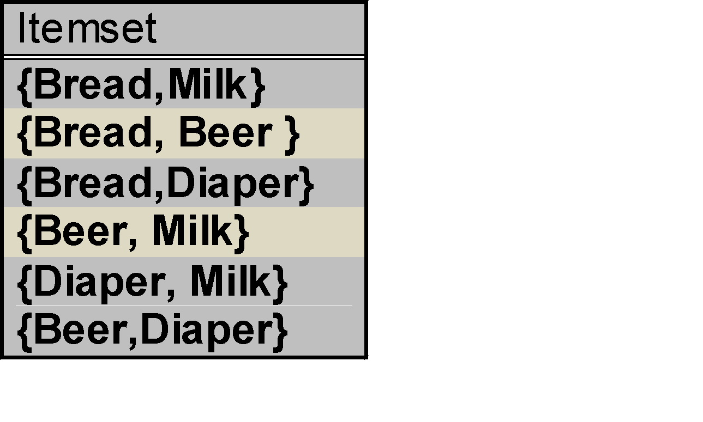
Candidate Generation(n=2)
Minimum Support = 3
Items (1-itemsets)
Pairs (2-itemsets)
(No need to generate
candidates involving Coke
or Eggs)
HINT : Merge two frequent itemsets with size n if their first n-1 items are identical

Slide 51
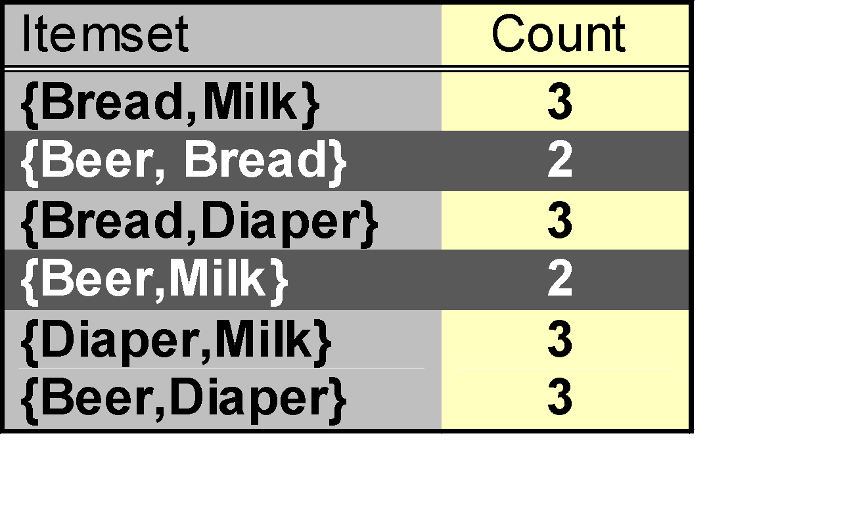
Support Counting
Minimum Support = 3
Items (1-itemsets)
Pairs (2-itemsets)
(No need to generate
candidates involving Coke
or Eggs)

Slide 52
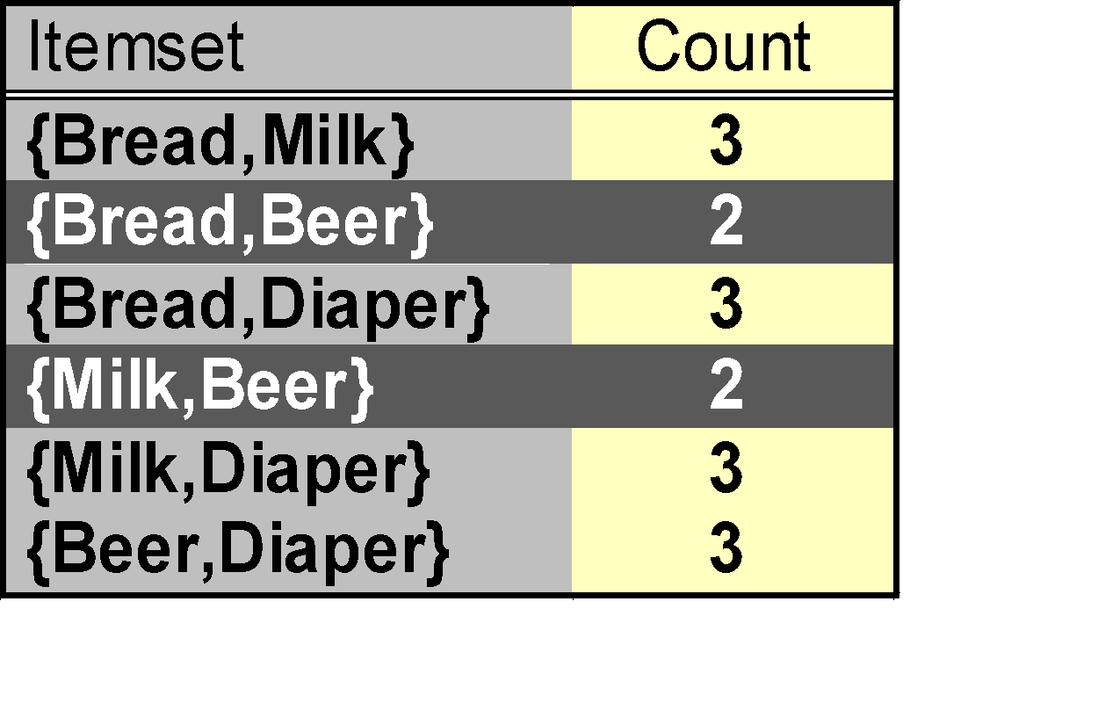
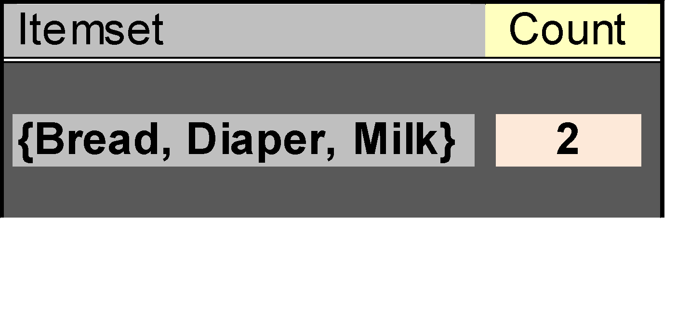
Prune infrequent Candidate and Candidate Generation for n=3
Items (1-itemsets)
Minimum Support = 3
Pairs (2-itemsets)
Triplets (3-itemsets)
HINT : Merge two frequent itemsets with size n if their first n-1 items are identical

Slide 53
Exercise 02
Sup_{min} = 2
Tid | Items
10 | A, C, D
20 | B, C, E
30 | A, B, C, E
40 | B, E

Slide 54
Example
Sup_{min} = 2
Itemset | sup
{A} | 2
{B} | 3
{C} | 3
{D} | 1
{E} | 3
Itemset | sup
{A} | 2
{B} | 3
{C} | 3
{E} | 3
L₁
Tid | Items
10 | A, C, D
20 | B, C, E
30 | A, B, C, E
40 | B, E
C₁
1st scan
C₂
Itemset | sup
{A, B} | 1
{A, C} | 2
{A, E} | 1
{B, C} | 2
{B, E} | 3
{C, E} | 2
C₂
L₂
Itemset
{A, B}
{A, C}
{A, E}
{B, C}
{B, E}
{C, E}
Itemset | sup
{A, C} | 2
{B, C} | 2
{B, E} | 3
{C, E} | 2
2nd scan
C₃
Itemset
{B, C, E}
3rd scan
L₃
Itemset | sup
{B, C, E} | 2

Slide 55
Generating rules: an example
Suppose {2,3,4} is frequent, with sup=50%
  Proper nonempty subsets: {2,3}, {2,4}, {3,4}, {2}, {3}, {4}, with sup=50%, 50%, 75%, 75%, 75%, 75% respectively
  These generate these association rules:
    2,3 → 4, confidence=100%
    2,4 → 3, confidence=100%
    3,4 → 2, confidence=67%
    2 → 3,4, confidence=67%
    3 → 2,4, confidence=67%
    4 → 2,3, confidence=67%
    All rules have support = 50%

Slide 56
Association Rule Generation
Given a frequent itemset L, find all non-empty subsets f ⊂ L such that f → L – f satisfies the minimum confidence requirement
  If {A,B,C,D} is a frequent itemset, then candidate rules:
    ABC →D, ABD →C, ACD →B, BCD →A,
    A →BCD, B →ACD, C →ABD, D →ABC
    AB →CD, AC → BD, AD → BC, BC →AD,
    BD →AC, CD →AB
If |L| = k, then there are 2^{k} – 2 candidate association rules (ignoring L → ∅ and ∅ → L)

Slide 57
What are the Association Rules for Below, calculate Confidence of Each Rule
Tid | Items
10 | A, C, D
20 | B, C, E
30 | A, B, C, E
40 | B, E
Itemset | sup
{B, C, E} | 2
BC--> E
B-->CE
CE-->B
E-->BC
BE-->C

Slide 58
FP Growth
In Data Mining, finding frequent patterns in large databases is very important and has been studied on a large scale.
The FP-Growth Algorithm is an alternative way to find frequent item sets without using candidate generations, thus improving performance.
For so much, it uses a divide-and-conquer strategy. The core of this method is the usage of a special data structure named frequent-pattern tree (FP-tree), which retains the item set association information.
FP Growth Allows frequent itemset discovery without candidate generation
Two step Process
  1.Build a compact data structure called the FP-tree : 2 passes over the database [ Only !!!]
  2.Extracts frequent itemset directly from the FP-tree: Traverse through FP-tree
Use a compressed representation of the database using an FP-tree
Once an FP-tree has been constructed, it uses a recursive divide-and-conquer approach to mine the frequent itemsets.
Building the FP-Tree
Scan data to determine the support count of each item.
  Infrequent items are discarded, while the frequent items are sorted in decreasing support counts.
Make a second pass over the data to construct the FP­tree.
  As the transactions are read, before being processed, their items are sorted according to the above order.

Slide 59
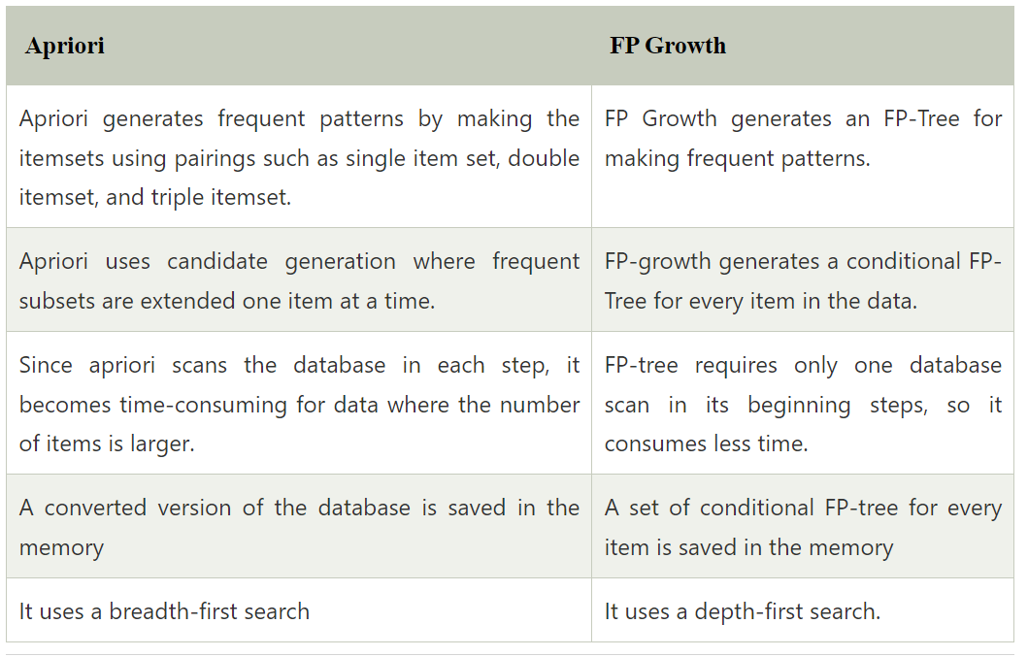
Difference of Apriori and FP Growth

Slide 60
FP-Tree Definition
FP-tree is a frequent pattern tree . Formally, FP-tree is a tree structure defined below:
1. One root labeled as “null", a set of item prefix sub-trees as the children of the root, and a frequent-item header table.
2. Each node in the item prefix sub-trees has three fields:
  item-name : register which item this node represents,
  count, the number of transactions represented by the portion of the path reaching this node,
  node-link that links to the next node in the FP-tree carrying the same item-name, or null if there is none.
3. Each entry in the frequent-item header table has two fields,
  item-name, and
  head of node-link that points to the first node in the FP-tree carrying the item-name.

Slide 61
Construct FP-tree
Two Steps:
Scan the transaction DB for the first time, find frequent items (single item patterns) and order them into a list L in frequency descending order.
e.g., L={f:4, c:4, a:3, b:3, m:3, p:3}
In the format of (item-name, support)
2. For each transaction, order its frequent items according to the order in L; Scan DB the second time, construct FP-tree by putting each frequency ordered transaction onto it.

Slide 62
FP-tree Example: step 1
FP-tree
L
Step 1: Scan DB for the first time to generate
L
TID Items bought
100 {f, a, c, d, g, i, m, p}
200 {a, b, c, f, l, m, o}
300 {b, f, h, j, o}
400 {b, c, k, s, p}
500 {a, f, c, e, l, p, m, n}
Item frequency
f 4
c 4
a 3
b 3
m 3
p 3
By-Product of First Scan of Database

Slide 63
FP-tree Example: step 2
Step 2: construct FP-tree
{}
{}
f:1
f:2
{f, c, a, m, p}
{f, c, a, b, m}
{}
c:1
c:2
a:1
a:2
m:1
m:1
b:1
NOTE: Each transaction corresponds to one path in the FP-tree
p:1
p:1
m:1

Slide 64
FP-tree Example: step 3
Step 3: construct FP-tree
{}
{}
{}
f:3
f:3
c:1
f:4
c:1
{f, b}
{c, b, p}
{f, c, a, m, p}
c:2
b:1
c:2
b:1
b:1
c:3
b:1
b:1
a:2
a:2
p:1
a:3
p:1
m:1
b:1
m:1
b:1
m:2
b:1
p:1
m:1
p:1
m:1
p:2
m:1
Node-Link

Slide 65
Construction Example
Final FP-tree
{}
Header Table
Item head
f
c
a
b
m
p
f:4
c:1
c:3
b:1
b:1
a:3
p:1
m:2
b:1
p:2
m:1

Slide 66
FP-growth:
Mining Frequent Patterns
Using FP-tree

Slide 67

Mining Frequent Patterns Using FP-tree
General idea (divide-and-conquer)
Recursively grow frequent patterns using the FP-tree: looking for shorter ones recursively and then concatenating the suffix:
  For each frequent item, construct its conditional pattern base, and then its conditional FP-tree;
  Repeat the process on each newly created conditional FP-tree until the resulting FP-tree is empty, or it contains only one path (single path will generate all the combinations of its sub-paths, each of which is a frequent pattern)

Slide 68
3 Major Steps
Starting the processing from the end of list L:
Step 1:
Construct conditional pattern base for each item in the header table
Step 2
Construct conditional FP-tree from each conditional pattern base
Step 3
Recursively mine conditional FP-trees and grow frequent patterns obtained so far. If the conditional FP-tree contains a single path, simply enumerate all the patterns

Slide 69
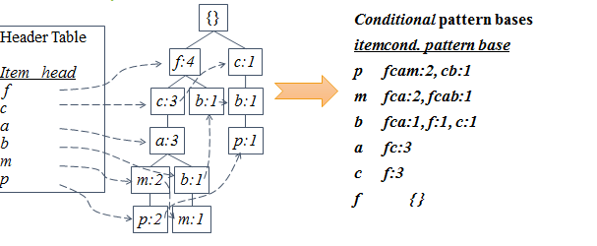
Step 1: Construct Conditional Pattern Base
Starting at the bottom of frequent-item header table in the FP-tree
Traverse the FP-tree by following the link of each frequent item
Accumulate all of transformed prefix paths of that item to form a conditional pattern base

Slide 70
Properties of FP-Tree
Node-link property
For any frequent item a_{i}, all the possible frequent patterns that contain a_{i} can be obtained by following a_{i}'s node-links, starting from a_{i}'s head in the FP-tree header.
Prefix path property
To calculate the frequent patterns for a node a_{i} in a path P, only the prefix sub-path of a_{i} in P need to be accumulated, and its frequency count should carry the same count as node a_{i}.

Slide 71
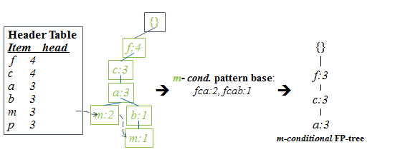
Step 2: Construct Conditional FP-tree
For each pattern base
  Accumulate the count for each item in the base
  Construct the conditional FP-tree for the frequent items of the pattern base

Slide 72
Step 3: Recursively mine the conditional FP-tree
conditional FP-tree of
“m”: (fca:3)
conditional FP-tree of
“am”: (fc:3)
conditional FP-tree of
“cam”: (f:3)
add
“c”
{}
{}
{}
add
“a”
Frequent Pattern
Frequent Pattern
Frequent Pattern
f:3
f:3
f:3
c:3
add
“f”
add
“c”
add
“f”
c:3
conditional FP-tree of
“cm”: (f:3)
conditional FP-tree of
of “fam”: 3
a:3
{}
add
“f”
Frequent Pattern
Frequent Pattern
add
“f”
f:3
conditional FP-tree of
“fcm”: 3
Frequent Pattern
Frequent Pattern
fcam
conditional FP-tree of “fm”: 3
Frequent Pattern

Slide 73
Principles of FP-Growth
Pattern growth property
  Let α be a frequent itemset in DB, B be α's conditional pattern base, and β be an itemset in B. Then α ∪ β is a frequent itemset in DB iff β is frequent in B.
Is “fcabm ” a frequent pattern?
  “fcab” is a branch of m's conditional pattern base
  “b” is NOT frequent in transactions containing “fcab ”
  “bm” is NOT a frequent itemset.

Slide 74
Conditional Pattern Bases and Conditional FP-Tree
Item
Conditional pattern base
Conditional FP-tree
p
{(fcam:2), (cb:1)}
{(c:3)}|p
m
{(fca:2), (fcab:1)}
{(f:3, c:3, a:3)}|m
b
{(fca:1), (f:1), (c:1)}
Empty
a
{(fc:3)}
{(f:3, c:3)}|a
c
{(f:3)}
{(f:3)}|c
f
Empty
Empty
order of L

Slide 75
Single FP-tree Path Generation
Suppose an FP-tree T has a single path P. The complete set of frequent pattern of T can be generated by enumeration of all the combinations of the sub-paths of P
{}
All frequent patterns concerning m: combination of {f, c, a} and m
m,
fm, cm, am,
fcm, fam, cam,
fcam
f:3
🡲
c:3
a:3
m-conditional FP-tree

Slide 76
Advantages of the FP-tree Structure
The most significant advantage of the FP-tree
  Scan the DB only twice and twice only.
Completeness:
  the FP-tree contains all the information related to mining frequent patterns (given the min-support threshold). Why?
Compactness:
  The size of the tree is bounded by the occurrences of frequent items
  The height of the tree is bounded by the maximum number of items in a transaction

Slide 77
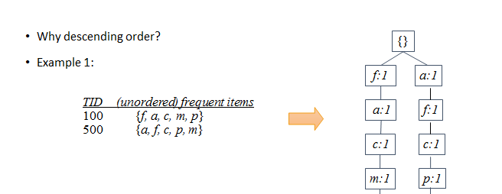
Question

Slide 78
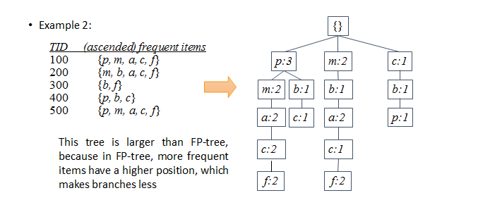
Question

Slide 79
Exercises

Slide 80
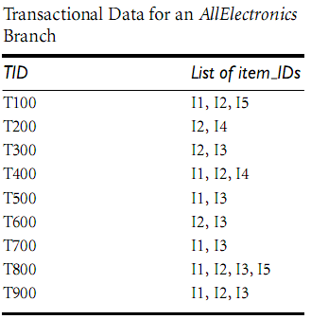
Exercise 01
Support=2

Slide 81
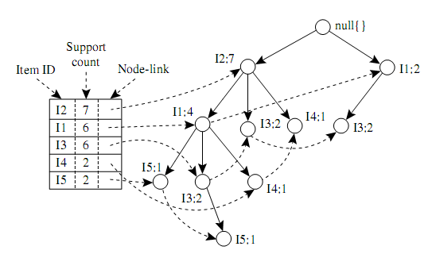
FP Growth: Solution

Slide 82
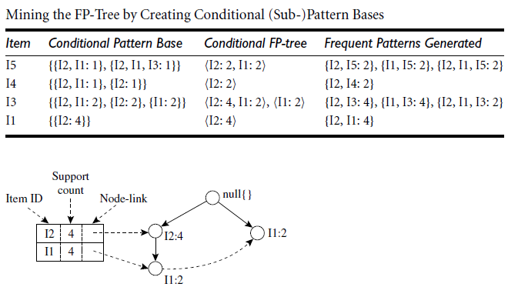
FP Growth: Solution

Slide 83
FP Exexrcise 02
Transactions
Freq. 1-Itemsets.
Supp. Count ≥2
Transactions with items sorted based on frequencies, and ignoring the infrequent items.
A B C E F O
A C G
E I
A C D E G
A C E G L
E J
A B C E F P
A C D
A C E G M
A C E G N
A C E B F
A C G
E
A C E G D
A C E G
E
A C E B F
A C D
A C E G
A C E G
A:8
C:8
E:8
G:5
B:2
D:2
F:2

Slide 84
FP-Tree after reading 1st transaction
A C E B F
A C G
E
A C E G D
A C E G
E
A C E B F
A C D
A C E G
A C E G
Header
null
A:8
C:8
E:8
G:5
B:2
D:2
F:2
A:1
C:1
E:1
B:1
F:1

Slide 85
FP-Tree after reading 2nd transaction
A C E B F
A C G
E
A C E G D
A C E G
E
A C E B F
A C D
A C E G
A C E G
Header
null
A:8
C:8
E:8
G:5
B:2
D:2
F:2
A:2
C:2
E:1
G:1
B:1
F:1

Slide 86
FP-Tree after reading 3rd transaction
A C E B F
A C G
E
A C E G D
A C E G
E
A C E B F
A C D
A C E G
A C E G
Header
null
A:8
C:8
E:8
G:5
B:2
D:2
F:2
A:2
E:1
C:2
E:1
G:1
B:1
F:1

Slide 87
FP-Tree after reading 4th transaction
A C E B F
A C G
E
A C E G D
A C E G
E
A C E B F
A C D
A C E G
A C E G
Header
null
A:8
C:8
E:8
G:5
B:2
D:2
F:2
A:3
E:1
C:3
E:2
G:1
G:1
B:1
F:1
D:1

Slide 88
FP-Tree after reading 5th transaction
A C E B F
A C G
E
A C E G D
A C E G
E
A C E B F
A C D
A C E G
A C E G
Header
null
A:8
C:8
E:8
G:5
B:2
D:2
F:2
A:4
E:1
C:4
E:3
G:1
G:2
B:1
F:1
D:1

Slide 89
FP-Tree after reading 6th transaction
A C E B F
A C G
E
A C E G D
A C E G
E
A C E B F
A C D
A C E G
A C E G
Header
null
A:8
C:8
E:8
G:5
B:2
D:2
F:2
A:4
E:2
C:4
E:3
G:1
G:2
B:1
F:1
D:1

Slide 90
FP-Tree after reading 7th transaction
A C E B F
A C G
E
A C E G D
A C E G
E
A C E B F
A C D
A C E G
A C E G
Header
null
A:8
C:8
E:8
G:5
B:2
D:2
F:2
A:5
E:2
C:5
E:4
G:1
G:2
B:2
F:2
D:1

Slide 91
FP-Tree after reading 8th transaction
A C E B F
A C G
E
A C E G D
A C E G
E
A C E B F
A C D
A C E G
A C E G
Header
null
A:8
C:8
E:8
G:5
B:2
D:2
F:2
A:6
E:2
C:6
E:4
G:1
D:1
G:2
B:2
F:2
D:1

Slide 92
FP-Tree after reading 9th transaction
A C E B F
A C G
E
A C E G D
A C E G
E
A C E B F
A C D
A C E G
A C E G
Header
null
A:8
C:8
E:8
G:5
B:2
D:2
F:2
A:7
E:2
C:7
E:5
G:1
D:1
G:3
B:2
F:2
D:1

Slide 93
FP-Tree after reading 10th transaction
A C E B F
A C G
E
A C E G D
A C E G
E
A C E B F
A C D
A C E G
A C E G
Header
null
A:8
C:8
E:8
G:5
B:2
D:2
F:2
A:8
E:2
C:8
E:6
G:1
D:1
G:4
B:2
F:2
D:1

Slide 94
null
Items Arranged in ascending order of support | Conditional Pattern Base | Conditional Frequent Pattern Tree | Frequent Pattern Generated
F | {A,C,E,B :2} | {A:2,C:2,E:2,B:2} | {A,F:2} , {C,F:2} ,{E,F :2} ,{B,F:2} {A,C,E,B,F:2}
D | {A,C:1} {A,C,E,G:1} | {A:2 ,C:2} | {A,D:2} , {C,D:2} {A,C,D:2}
B | {A, C,E:2} | {A:2,C:2,E:2} | {A,B:2} {C,B:2} {E,B:2} {A,C,E,B:2}
G | {A,C:1} {A,C,E:4} | {A,C:2} {E:4} | {A,G:2} {C,G:2} {A.C.G:2} {E,G:4}
E | {A,C:6} | {A,C:6} | {A,E:6} {C,E:6} {A,C.E:6}
C | {A:8} | {A:8} | {A,C:8}
A:8
C:8
E:8
G:5
B:2
D:2
F:2
A:8
E:2
C:8
E:6
G:1
D:1
G:4
B:2
F:2
D:1

Slide 95
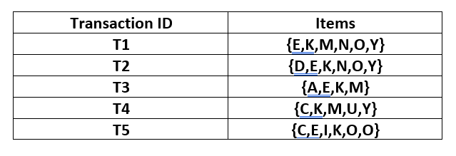
Exercise 03
min_sup:3

Slide 96
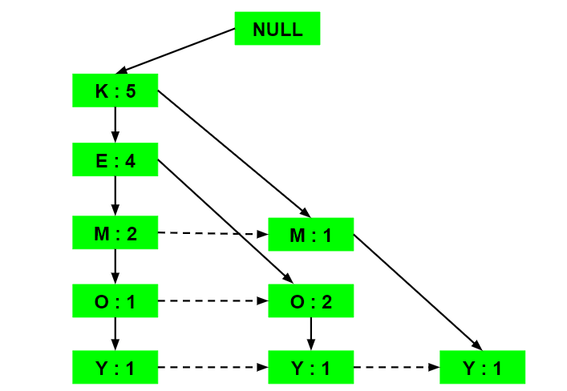
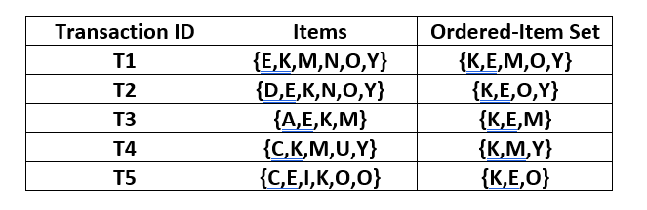
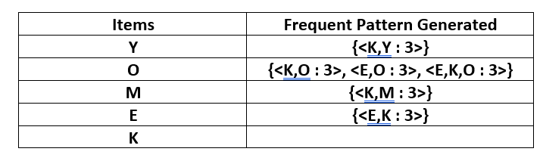
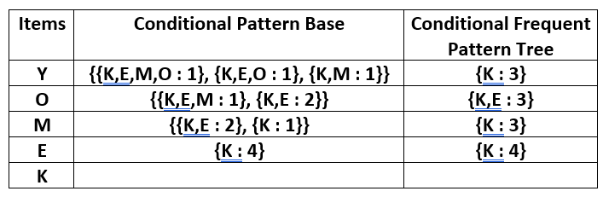
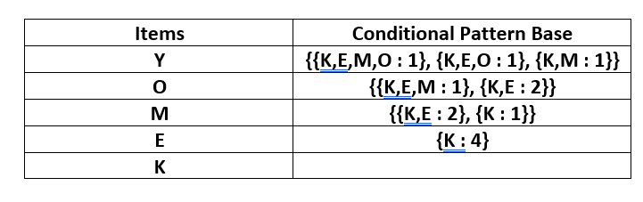
Solution
Original Set
Ordered Set as per Support Count
FP Tree
Item Set with min_sup:3 = {K : 5, E : 4, M : 3, O : 3, Y : 3}

Slide 97
Advantages Disadvantages of FP Growth
Advantages Of FP Growth Algorithm
This algorithm needs to scan the database only twice when compared to Apriori which scans the transactions for each iteration.
The pairing of items is not done in this algorithm and this makes it faster.
The database is stored in a compact version in memory.
It is efficient and scalable for mining both long and short frequent patterns.
Disadvantages Of FP-Growth Algorithm
FP Tree is more cumbersome and difficult to build than Apriori.
It may be expensive.
When the database is large, the algorithm may not fit in the shared memory.

Slide 98
Comparison of FP Growth with Apriori
FP Growth | Apriori
Pattern Generation
FP growth generates pattern by constructing a FP tree | Apriori generates pattern by pairing the items into singletons, pairs and triplets.
Candidate Generation
There is no candidate generation | Apriori uses candidate generation
Process
The process is faster as compared to Apriori. The runtime of process increases linearly with increase in number of itemsets. | The process is comparatively slower than FP Growth, the runtime increases exponentially with increase in number of itemsets
Memory Usage
A compact version of database is saved | The candidates combinations are saved in memory

Slide 99
FP Growth-Generating Rules
Generating rules in the FP algorithm is the process of identifying strong association rules from the frequent itemsets that have been mined. Association rules are a type of data mining rule that describes the relationship between two or more items. They are typically expressed in the form "if-then" statements, such as "if a customer buys diapers, then they are also likely to buy beer.“
It generates association rules by using the following steps:
Calculate the support and confidence of each frequent itemset. Support is the proportion of transactions in the database that contain the itemset. Confidence is the proportion of transactions that contain the itemset among those that also contain the antecedent item.
Filter the frequent itemsets based on minimum support and minimum confidence thresholds. This ensures that only rules that are both common and reliable are considered.
Generate association rules for each remaining frequent itemset. For each frequent itemset, generate an association rule for each subset of the itemset. The antecedent of the rule is the subset of the itemset, and the consequent is the remaining item in the itemset.

Slide 100
Evaluate the strength of each association rule using additional metrics, such as lift and conviction. Lift measures how much more likely the consequent is to occur when the antecedent is also present, compared to when the antecedent is not present. Conviction measures the extent to which the antecedent rules out the possibility of the consequent not occurring.
Select the strongest association rules based on the chosen metrics. This can be done manually or using automated rule selection techniques.
Steps:-
Find the minimum support of each item.
Order frequent itemset in descending order.
Draw an FP tree.
Minimum frequent pattern from the FP tree.

Slide 101
References
Data Mining. Concepts and Techniques, 3rd Edition, Han Kamber
https://www.cs.uic.edu/~liub/WebContentMining.html
http://dmr.cs.umn.edu/Papers/P2004_4.pdf

Slide 102
Thank you !!

