Slide 1
Fundamentals of Statistical Testing
Lecture 02
Martina Sladekova

Slide 2


Slide 3


PSAs
Register your Kahoot username:
https://canvas.sussex.ac.uk/courses/27531/quizzes
Make sure you can see all the channels on Discord:

Slide 4
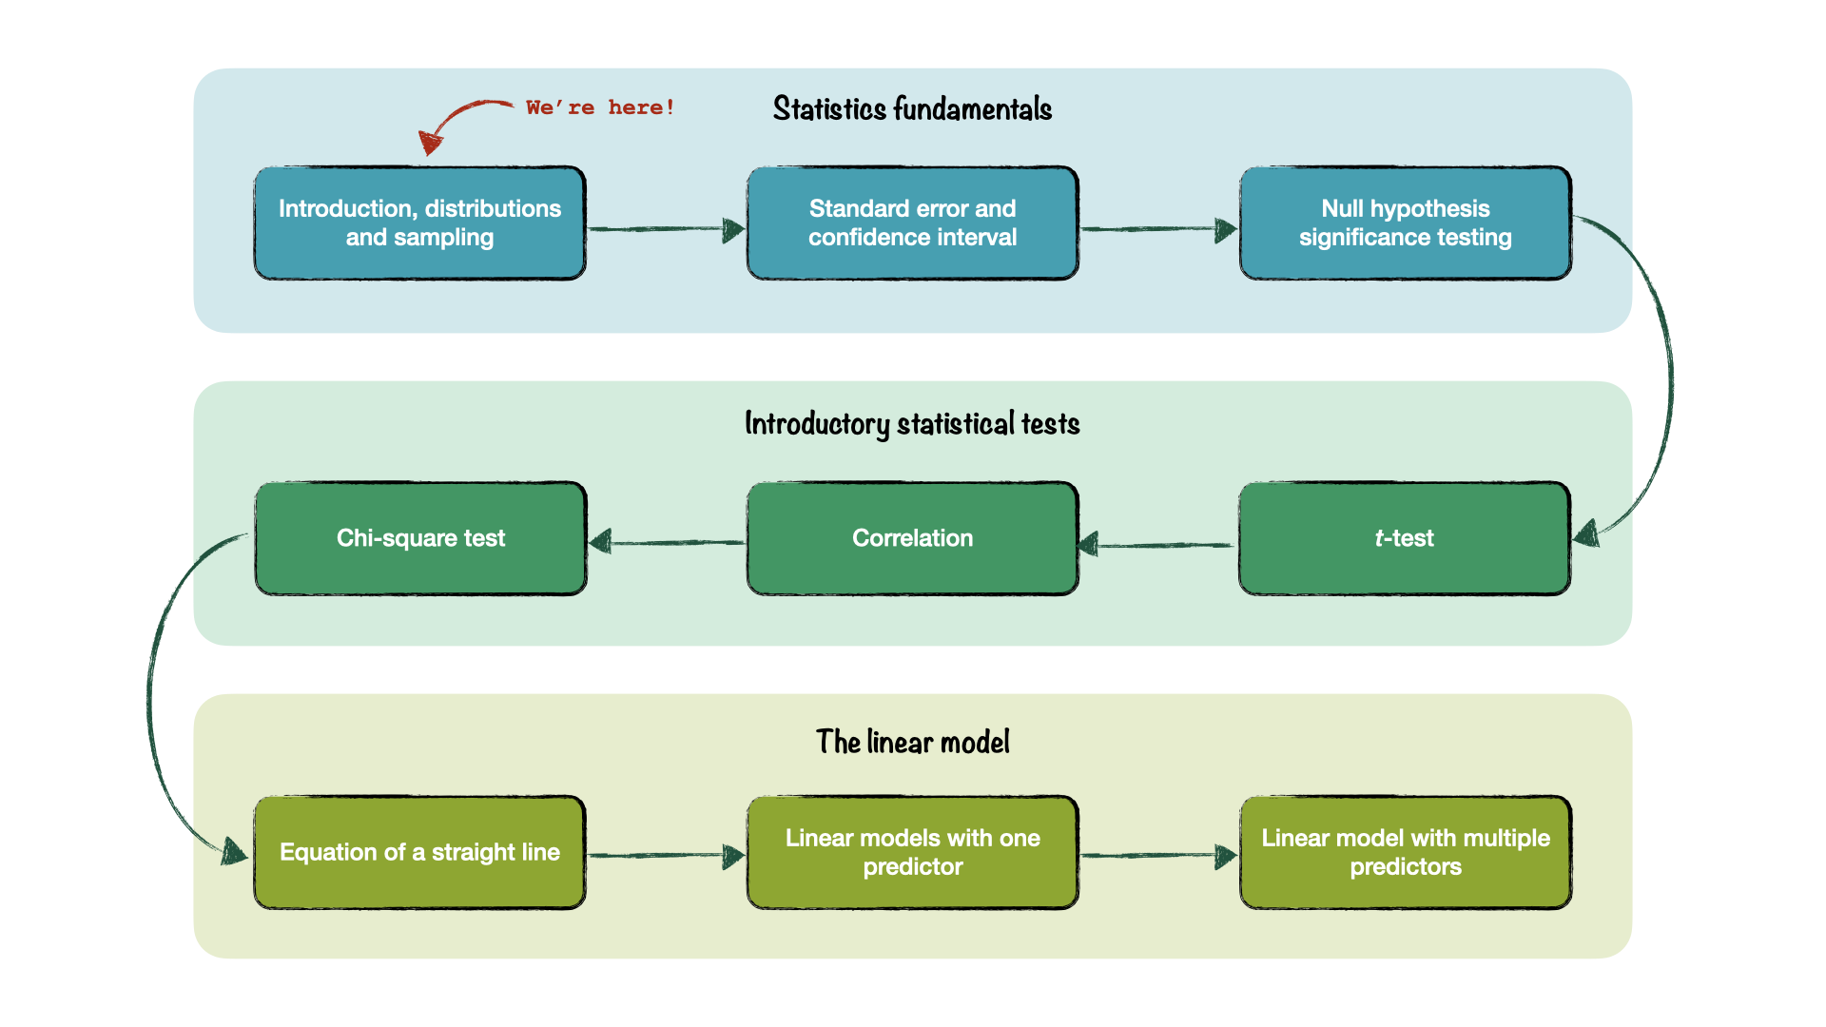
Analysing Data Roadmap

Slide 5
Today
Speaking stats
Distributions
  More about the normal distribution
Sampling
  Sampling distribution
  Central Limit Theorem

Slide 6
Speaking Stats

Slide 7
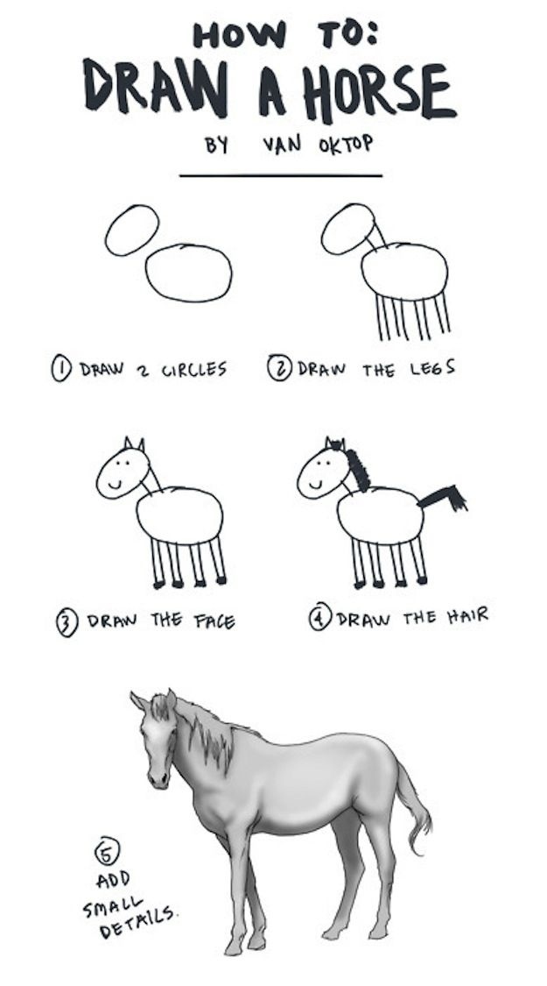
Speaking Stats
Learning to think in statistical terms is a skill just like:
Drawing/art/music
Weightlifting
Speaking a new language
You don’t need “innate talent” for any of these!
You do need (1) patience and (2) lots of practice (3) take things step by step

Slide 8

Speaking Stats

Slide 9
Speaking Stats
Skill | Language | Statistics | Year
Beginner | Learn vocabulary, basic sentences and grammar | Learn terminology, fundamental concepts | 1
Intermediate | Extend to more situations, how to deal with irregular forms | Extend to more types of tests/data, how to deal with bias | 2
Advanced | Create own sentences, have conversations | Create own study, apply to own data | 3

Slide 10

Speaking Stats
Treat stats (and R!) like you would learning a language
The core of generalising to new situations is grammar 😱
Generally: the rules for how to create new combinations in new situations
Not everyone’s favourite thing! But essential for fluency
Today’s lecture focuses on the “grammar” of statistics
It’s hard work, but essential for everything that follows

Slide 11
Recap and Distributions

Slide 12
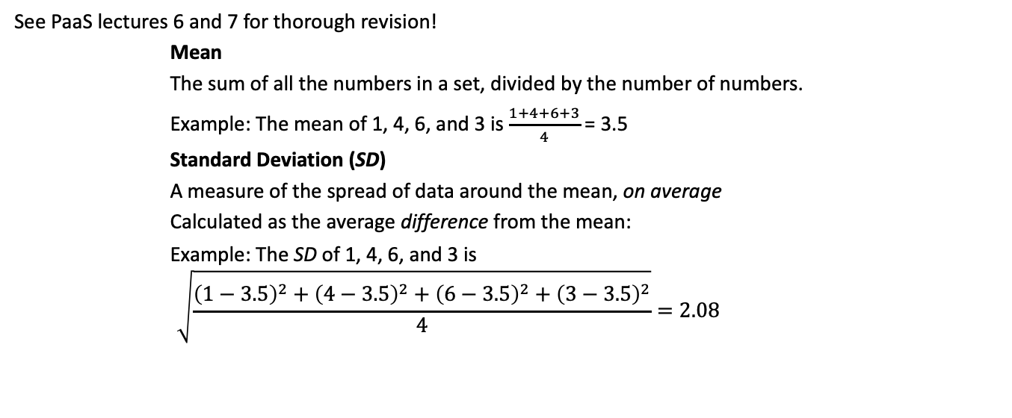
Quick recap: Means and SDs
See PaaS lectures 6 and 7 for thorough revision!
Mean
The sum of all the numbers in a set, divided by the number of numbers.
Example: The mean of 1, 4, 6, and 3 is $\frac{1+4+6+3}{4}$ = 3.5
Standard Deviation (SD)
A measure of the spread of data around the mean, on average
Calculated as the average difference from the mean:
Example: The SD of 1, 4, 6, and 3 is
$$\sqrt{\frac{{\left(1−3.5\right)}^{2}+{\left(4−3.5\right)}^{2}+{\left(6−3.5\right)}^{2}+{\left(3−3.5\right)}^{2}}{4}}=2.08$$

Slide 13
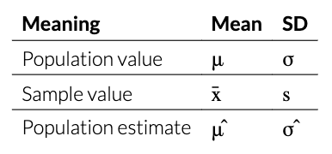
It’s all Greek to me!
Symbols
Greek is for populations, Latin is for samples, hat is for population estimates

Slide 14
Distributions
Distribution
Numerically speaking, the number of observations per each value of a variable
Shows us which values occur more often and which less often
The shape formed by the bars of a bar chart/histogram

Slide 15
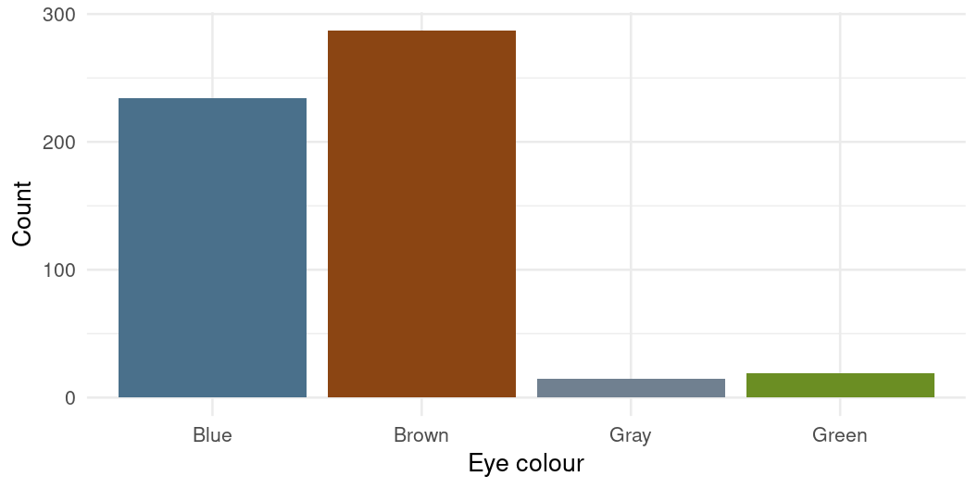
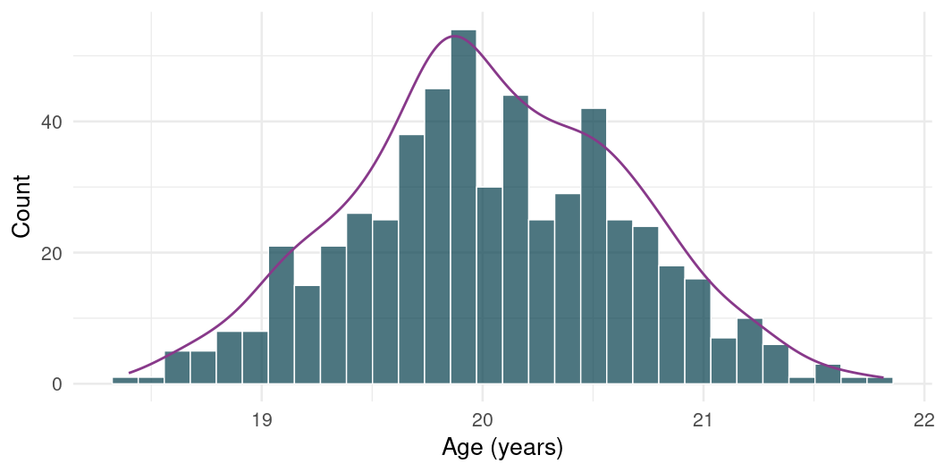
Distribution of Categorical Data
Distribution of Continuous Data

Slide 16
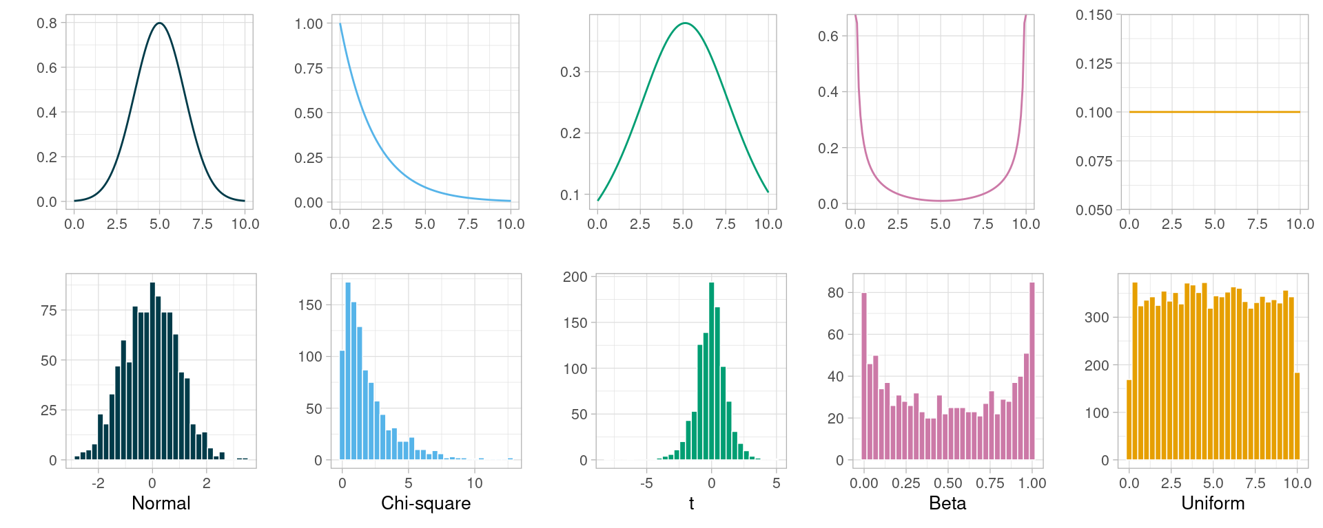
Known Distributions
Some shapes are “algebraically tractable”, i.e., there is a maths formula to draw the line
We can use them for statistics because they have particular known properties

Slide 17
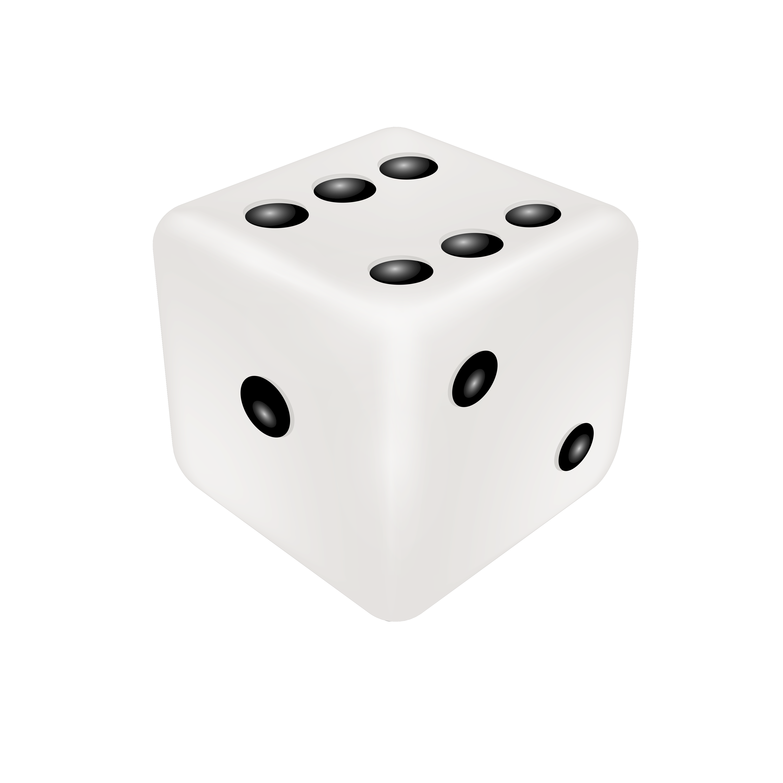
A dicey example
6-sided die (unbiased)
Each value is equally likely (e.g. the probability of getting a 6 is as likely as the probability of getting a 3)
Roll it 10 times, 50 times, and 1000 times - the more roll we throw it, the more the distributions of rolls resembles the shape of the probability function

Slide 18
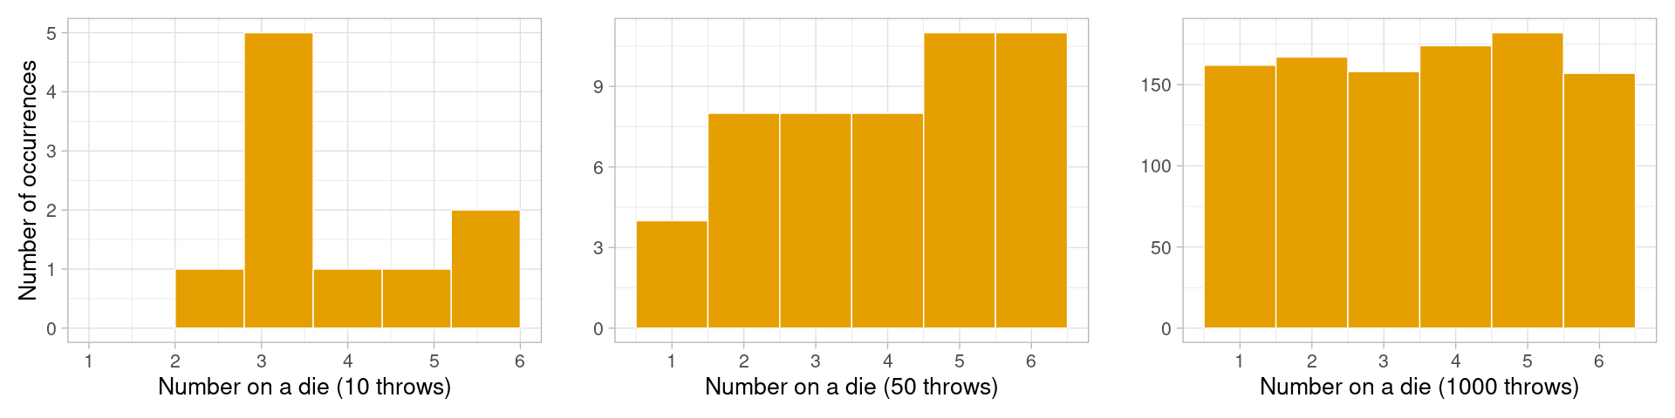

Slide 19
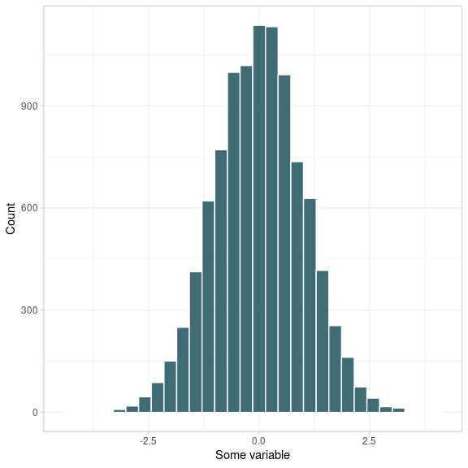
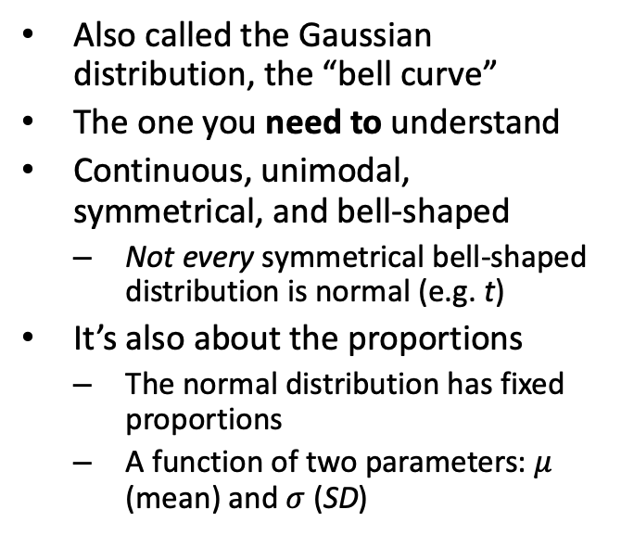
The normal distribution
Also called the Gaussian distribution, the “bell curve”
The one you need to understand
Continuous, unimodal, symmetrical, and bell-shaped
  Not every symmetrical bell-shaped distribution is normal (e.g. t)
It’s also about the proportions
  The normal distribution has fixed proportions
  A function of two parameters: $μ$ (mean) and $σ$ (SD)

Slide 20
Area below the normal curve
No matter the particular shape of the given normal distribution, the proportions with respect to SD are the same
Proportions of a Normal Distribution
∼68% of the area below the curve is within ±1 SD from the mean
95% of the area below the curve is within ±1.96 SD from the mean
99% of the area below the curve is within ±2.58 SD from the mean
These proportions make a continuous, unimodal, symmetrical, and bell-shaped distribution “normal”

Slide 21
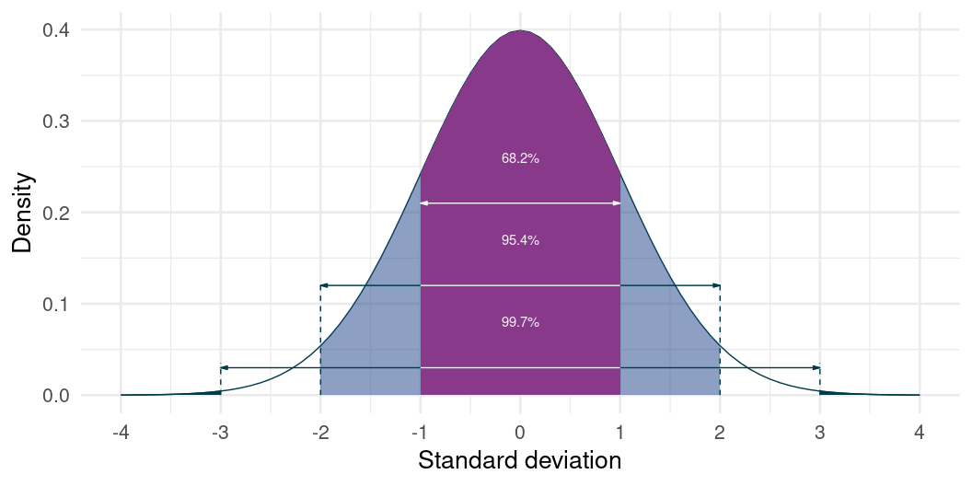
Area below the normal curve

Slide 22
Critical Values

Slide 23
Proportions to Probability
The proportions are always the same in a normal distribution
If we know that a particular quantity is normally distributed…
  We know something about the probability of observing a particular value!
This essentially allows us to (numerically) quantify whether something “unusual” or “surprising” given a particular baseline

Slide 24
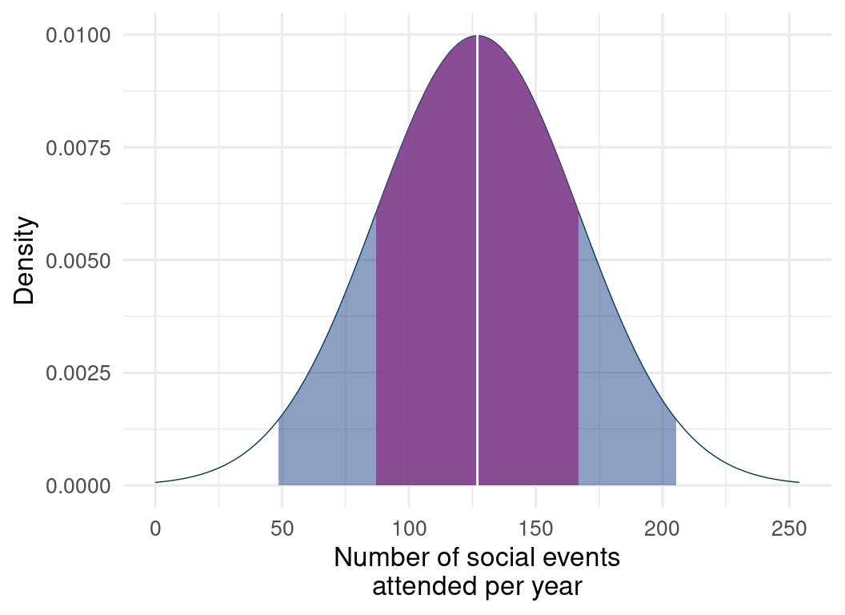
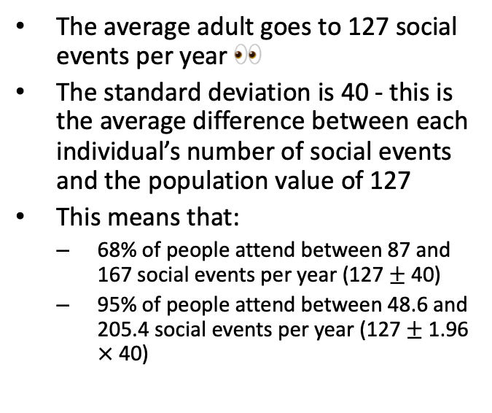
What’s “unusual”?
The average adult goes to 127 social events per year 👀
The standard deviation is 40 - this is the average difference between each individual’s number of social events and the population value of 127
This means that:
  68% of people attend between 87 and 167 social events per year (127 $±$ 40)
  95% of people attend between 48.6 and 205.4 social events per year (127 $±$ 1.96 $×$ 40)

Slide 25

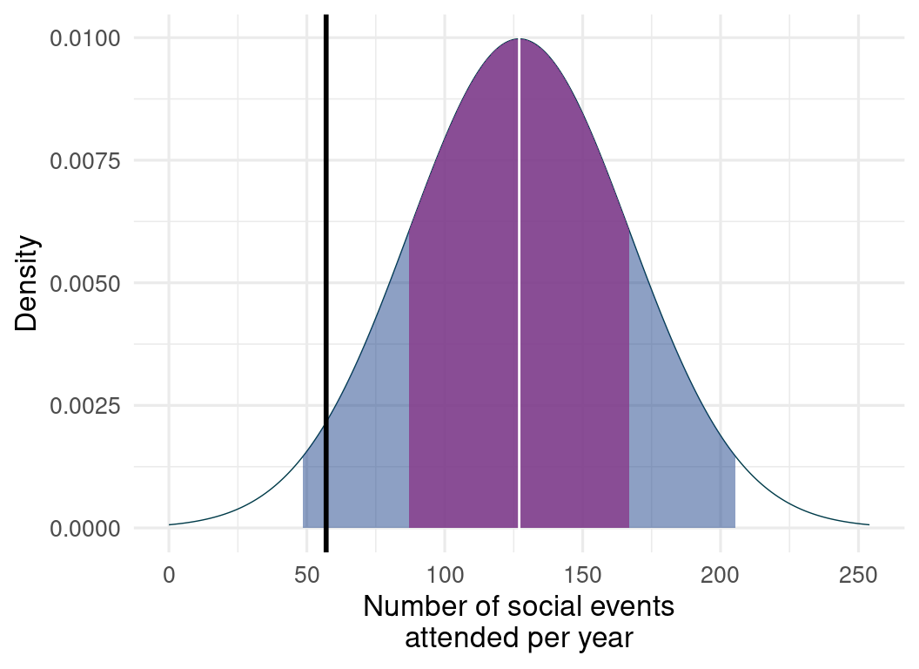
What’s “unusual”?
Meet Charlie
Charlie goes to 57 social events per year.
This is 70 events below the average
Is Charlie unusual?

Slide 26
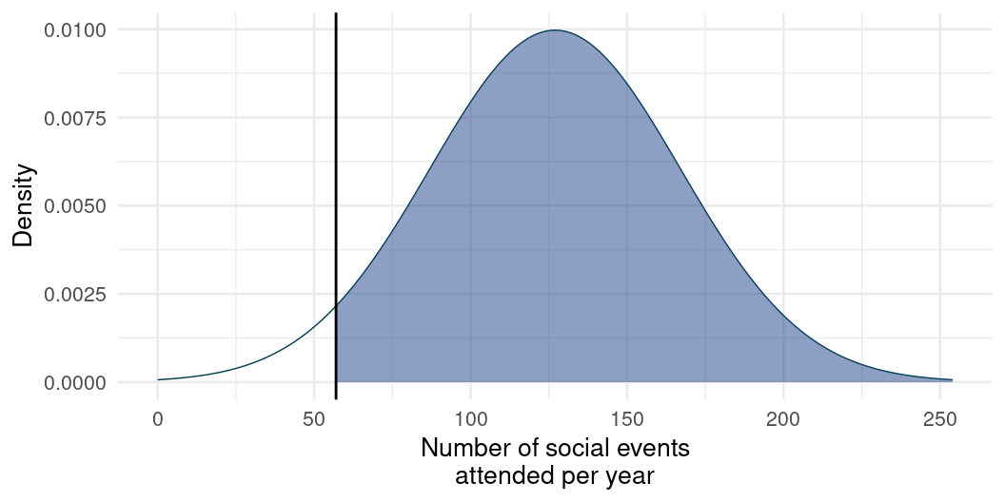
What’s “unusual”?
How common is Charlie’s score of 57 ?
Shaded area: proportion of the population that attends more social events than Charlie.
Non-shaded area: proportion of people who attend fewer events than Charlie

Slide 27
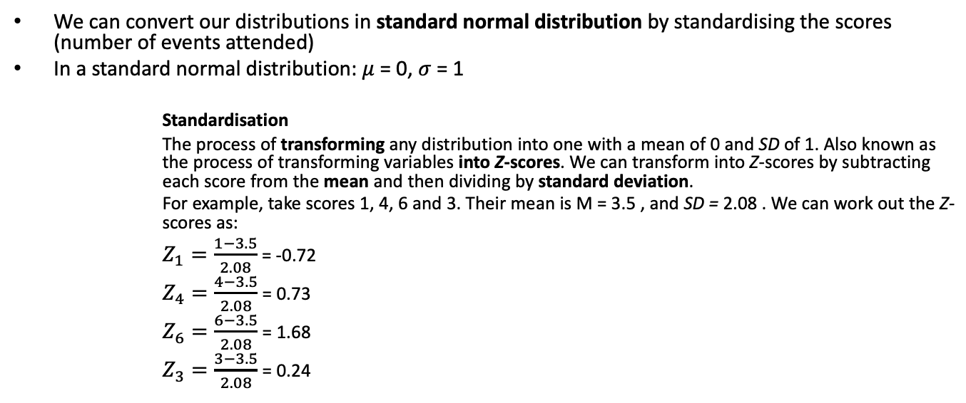
Working out proportions - the long way around
We can convert our distributions in standard normal distribution by standardising the scores (number of events attended)
In a standard normal distribution: $μ$ = 0, $σ$ = 1
Standardisation
The process of transforming any distribution into one with a mean of 0 and SD of 1. Also known as the process of transforming variables into Z-scores. We can transform into Z-scores by subtracting each score from the mean and then dividing by standard deviation.
For example, take scores 1, 4, 6 and 3. Their mean is M = 3.5 , and SD = 2.08 . We can work out the Z-scores as:
$Z_{1}=\frac{1−3.5}{2.08}$ = -0.72
$Z_{4}=\frac{4−3.5}{2.08}$ = 0.73
$Z_{6}=\frac{6−3.5}{2.08}$ = 1.68
$Z_{3}=\frac{3−3.5}{2.08}$ = 0.24

Slide 28
Working out proportions - the long way around
Let’s transform Charlie’s score of 57 into a Z-score:
M = 127
SD = 40
Z = (57 - 127) / 40 = -1.75

Slide 29
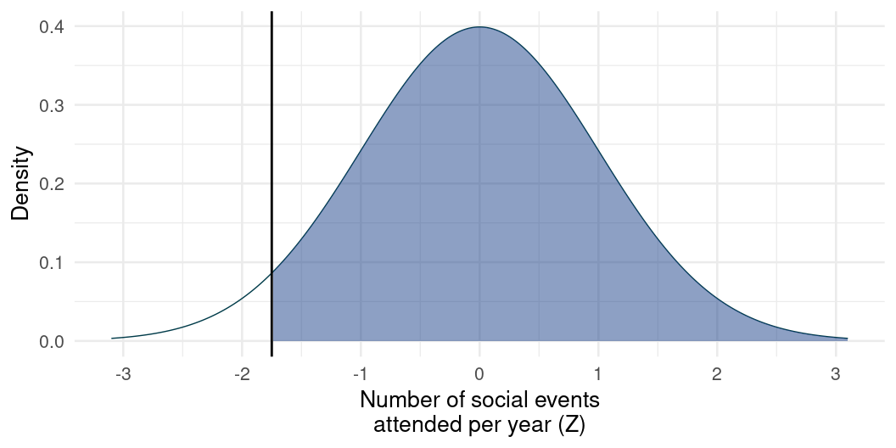

Slide 30
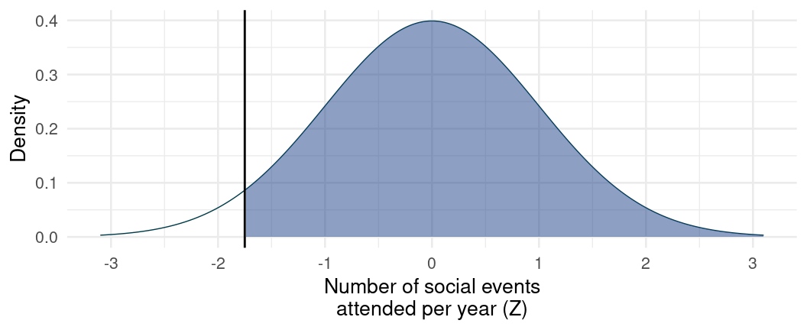
Working out proportions - the long way around
Perks of standardized scores - we know exactly how probable each Z-score is
Optional: Look up the probability of Z_{Charlie} = -1.75 in a Z-table - e.g. https://www.z-table.com/ (or use R)
The probability of obtaining a is around 0.04 - so only 4 % of people go to fewer social events than Charlie (non-shaded area)
The area under the curve is equal to 1 - so the remaning shaded area represents 1- 0.04 = 0.96 or 96 % (people who attend more social events per year than charlie)

Slide 31
Working out proportions - the quickR way
Using the Z-score and standard normal distribution:
charlie_z = -1.75
pnorm(charlie_z, mean = 0, sd = 1, lower.tail = FALSE)
[1] 0.9599408
Using the original scores and distributional properties:
charlie_events = 57
pnorm(charlie_events, mean = 127, sd = 40, lower.tail = FALSE)
[1] 0.9599408

Slide 32
Working out critical values
Sometimes we want to find a value in a distribution that defines a cut-off point - for example top 5%.
Critical Value
A value that cuts off a specific proportion of a distribution
How many events would Charlie need to go to, if he wanted to be among top 5% of social-event-goers on the planet?

Slide 33
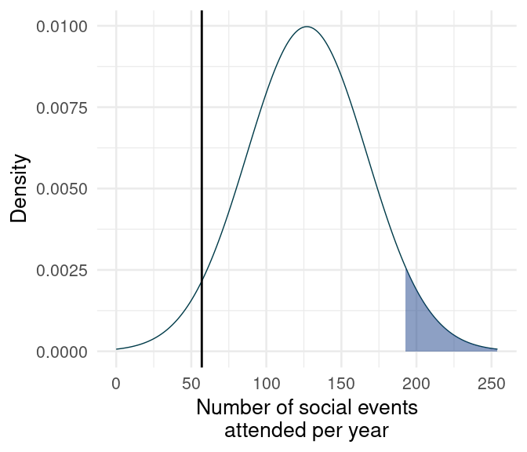
Working out critical values
qnorm(p = 0.95, mean = 127, sd = 40)
[1] 192.7941
We could work backwards through Z-scores: find a Z-score that corresponds to the probability of 0.95, then transform the Z-score into the original score.
  Or use R.
Charlie would need to attend 193 social events per year (that’s 3.7 events per week! 😱 ) if he wanted to be in the top 5% of event-goers.
This is 136 more events than he attends at the moment.

Slide 34
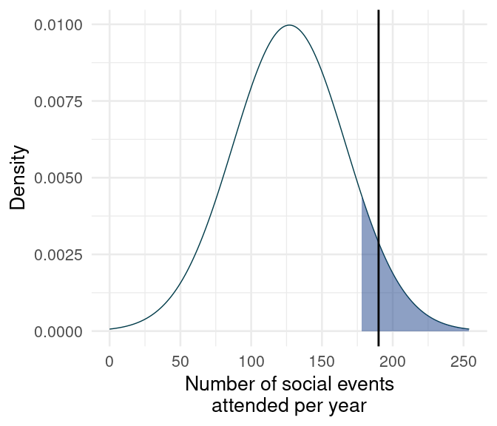
One more example
qnorm(p = 0.9, mean = 127, sd = 40)
[1] 178.2621
Patty attends 190 events per year. Is she in the top 10% of event goers?
In a normal distribution with M = 127 (social events attended per year) and SD = 40, an individual would have to attend 178 events or more to be in the top 10% of event goers.
Therefore, with 190 events attended per year Patty is in the top 10%.

Slide 35
So What?
This idea of the probability of encountering a certain value, given a specific distribution, is absolutely fundamental to everything we will do this term!
  If you feel a bit shaky on it now, don’t worry - we’ll practice it more
For now, focus on:
  Revising the logic above
  Learning the definitions

Slide 36
Sampling

Slide 37
From Values to Samples
We just saw the relationship between a value and its (known) distribution
Next let’s talk about the relationship between a sample statistic and its sampling distribution

Slide 38
Sampling from distributions
Collecting data on a variable = randomly sampling from distribution
Sample
A (usually randomly) selected subset of values of a particular size (e.g., 10, 50) taken from a larger pool of values, often the population
Many variables come from a normal distribution
Some variables might come from other distributions
  Reaction times: log-normal distribution
  Number of annual casualties due to horse kicks: Poisson distribution
  Passes/fails on an exam: binomial distribution

Slide 39
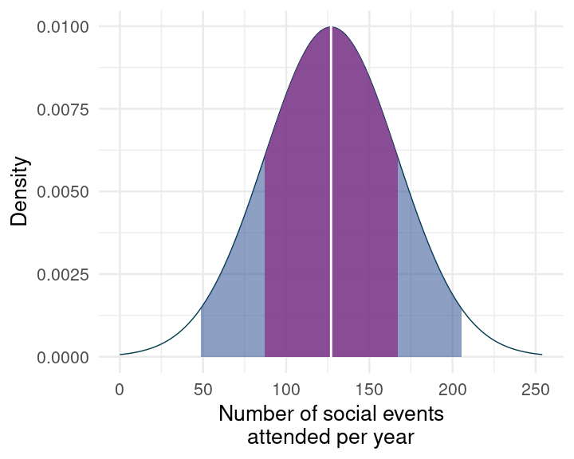
Sampling more humans
So far, we looked at a score of one (unsociable) individual
In research, we typically work with scores of many individuals - we collect a sample.
Samples from the same population will be different from one another
We can ask 6 people how many events they go to. Then ask 6 different people the next day - everyone’s score will be different.
# as 6 people about their event-going:
rnorm(n = 6, mean = 127, sd = 40)
[1] 94.72075 134.76754 125.31043 120.08560 232.28828 117.47832
# repeat
rnorm(n = 6, mean = 127, sd = 40)
[1] 142.32235 136.06493 118.61234 96.26304 90.73451 162.95180

Slide 40
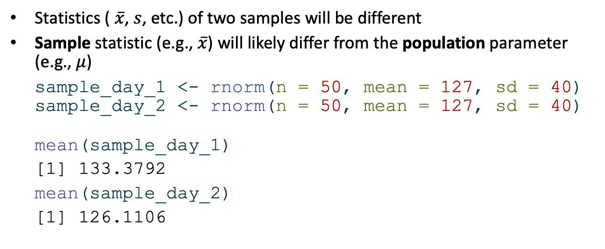
Sampling from distributions
Statistics ( $\overset{‾}{x}$, $s$, etc.) of two samples will be different
Sample statistic (e.g., $\overset{‾}{x}$) will likely differ from the population parameter (e.g., $μ$)
sample_day_1 <- rnorm(n = 50, mean = 127, sd = 40)
sample_day_2 <- rnorm(n = 50, mean = 127, sd = 40)
mean(sample_day_1)
[1] 133.3792
mean(sample_day_2)
[1] 126.1106

Slide 41
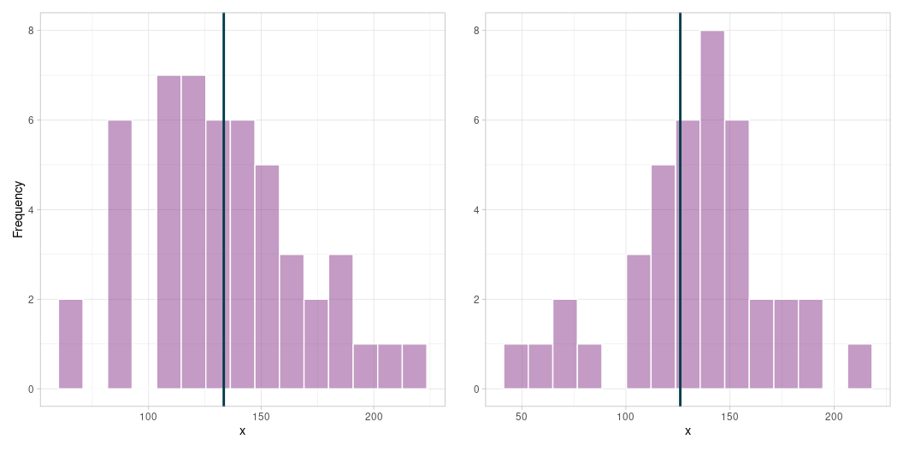
Sampling from distributions
Statistics ( $\overset{‾}{x}$, $s$, etc.) of two samples will be different
Sample statistic (e.g., $\overset{‾}{x}$) will likely differ from the population parameter (e.g., $μ$)

Slide 42
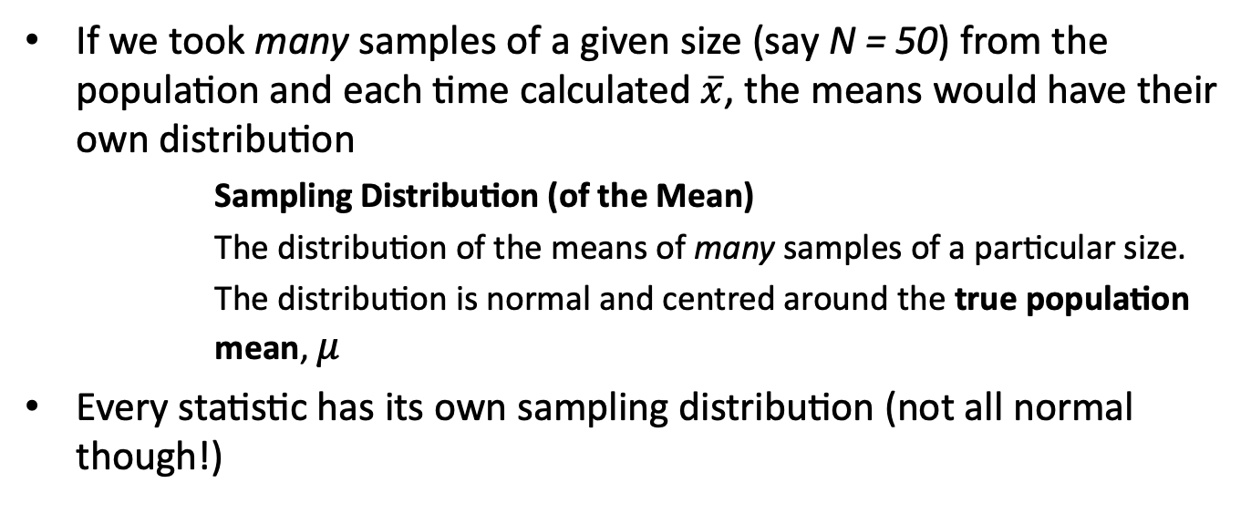
Sampling distribution
If we took many samples of a given size (say N = 50) from the population and each time calculated $\overset{‾}{x}$, the means would have their own distribution
Sampling Distribution (of the Mean)
The distribution of the means of many samples of a particular size.
The distribution is normal and centred around the true population mean, $μ$
Every statistic has its own sampling distribution (not all normal though!)

Slide 43
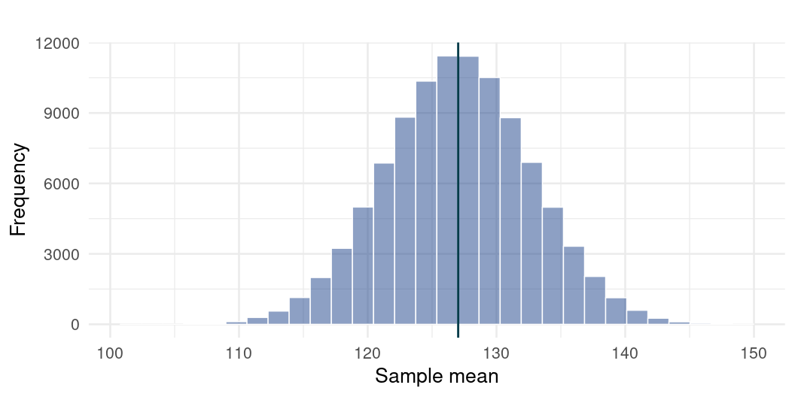
Sampling distribution
many_sample_means <- replicate(100000, mean(rnorm(50, mean = 127, sd = 40)))
mean(many_sample_means)
[1] 127.0259

Slide 44
The Central Limit Theorem
You’ve just seen the Central Limit Theorem in action.
As N gets larger, the sampling distribution of $\overset{‾}{x}$ tends towards a normal distribution with mean = $μ$
True no matter the shape of the population distribution!
  “Central” as in “really important” because, well, it is!

Slide 45
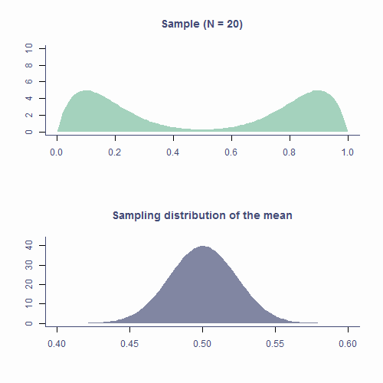
The Central Limit Theorem
Take a sample
Compute the mean
Put it on the plot below
Repeat

Slide 46
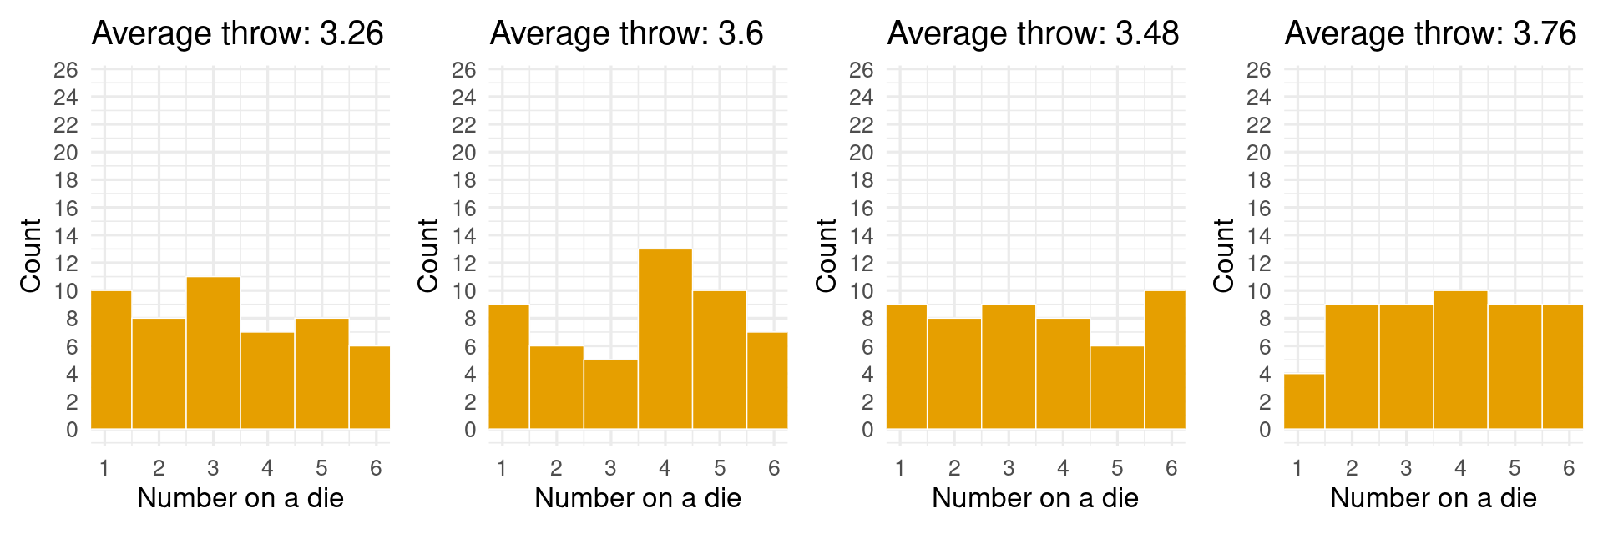
One more peek at the dice
We know that dice rolls are uniformly distributed - each number is equally likely
What if we calculate an average roll?

Slide 47
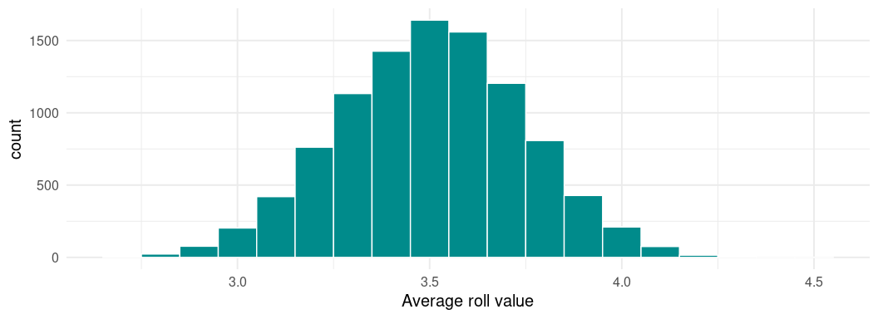
One more peek at the dice
dice_rolls_6 <- replicate(10000, mean(sample(50, x = 1:6, TRUE)))
ggplot2::ggplot() +
geom_histogram(aes(x = dice_rolls_6), binwidth = 0.1, fill = "darkcyan", colour = "white") +
labs(x = "Average roll value") +
theme_minimal(base_size = 15)

Slide 48
The CLT governs a lot of processes where randomness and sampling are involved.
This is extremely useful for research - our tests are not immediately doomed if we collect a messy sample

Slide 49
Take-home messages
There are many mathematically well-described distributions
Normal (Gaussian) distribution is one of them
  Continuous, unimodal, symmetrical, bell-shaped
  Must have the right proportions to be normal!
  We can use these proportions to work out critical values

Slide 50
Take-home messages
Statistics of random samples differ from parameters of a population
As N gets bigger, sample statistic approaches population parameters
Distribution of sample means (or other statistics) is the sampling distribution
Central Limit Theorem
  Really important!
  Sampling distribution of the mean tends to normal even if population distribution is not normal
Understanding distributions, sampling distributions and CLT it most of what you need to understand all the stats techniques we will cover.

Slide 51

NEXT WEEK
More sampling distributions
Quantifying uncertainty with standard errors and confidence intervals

