Slide 1
Questionable Research Practices
Week 11
Dr Jenny Terry & Dr Martina Sladekova

Slide 2
Part 1: How science got broken

Slide 3
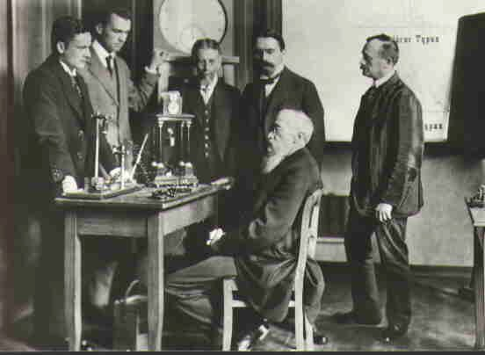
Long ago, Psychology scientists lived together in harmony
1879 - world’s psychology lab established by Wilhelm Wundt
Defining point for Psychology as a separate discipline Prior to that - part of philosophy
Use of experimental methods for the first time - smooth psychological science followed

Slide 4

…Everything changed when the Fire Nation Open Science Collaboration attacked
Open Science Collaboration (2015): Estimating the reproducibility of psychological science
Attempted to replicate findings published in high profile journals
Replicated effect sizes were half the size of the ones than originally reported 97% of original p-values were statistically significant (p < 0.05)
Only 36% of replicated p-values were statistically significant
Vocabulary
Replication: The process of repeating (re-running) the same study using identical methodology.

Slide 5
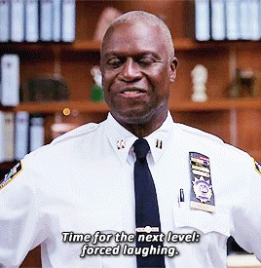
…Everything changed when the Fire Nation Open Science Collaboration attacked
Some famous findings that we can’t replicate:
Smiling will make you feel happier Power posing will make you act bolder
Self-control is a limited resource (ego-depletion)
Revising after your exams can improve your earlier performance (Daryl Bem’s “pre-cognition” experiments)
Babies are born with the ability to imitate
Read more here: https://www.bps.org.uk/research-digest/ten-famous-psychology-findings-have-been-difficult- replicate

Slide 6
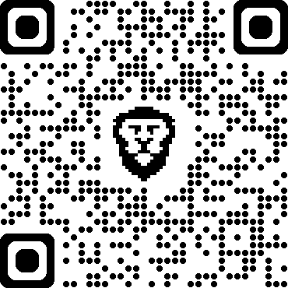
PollEverywhere
Two teams of researchers set out to study the effect of mindfulness meditation on well-being. Both teams apply the same intervention using identical protocol and each team collects 200 participants. The teams analyse their own data using the t-test, comparing the well-being of the intervention group against the control group.
Both teams write-up their reports as a scientific paper.
Which paper should get published?
linktr.ee/analysingdata
Team 1
Team 1 finds a statistically significant difference in well-being between the two groups (p = .034)
Team 2
Team 2 finds a non-significant difference in well-being between the two groups (p = .27)

Slide 7
Publication bias
Some results are more “interesting” to publish (more readers and citations = more money) The publication record is over-populated with statistically significant findings
Papers with significant p-values are 9 times more likely to get published Problem for evidence synthesis/meta-analysis
Weakness of statistical research: if there is no effect of mindfulness on well-being, we’ll still find a statistically significant result in 5% of replications because of random sampling (assuming alpha of 0.05)
Vocabulary
Publication bias or the “File drawer effect” - is the bias in the publication system where statistically significant results are favoured for publication over non- significant findings. Papers reporting non-significant findings often end up in researchers’ file-drawers, never to be seen again.

Slide 8

A day in the life of a scientist
Conduct research (requires funding)
Train research students (requires funding) Publish papers (requires funding)
Teach (it’s free! 🤩)
Secure funding (apply for grants)
Funding bodies look at researchers’ publication records (among other things) to decide who gets awarded a grant.
Failure to publish |> failure to secure funding |> failure to conduct further research |> job insecurity

Slide 9

Questionable Research Practices (QRPs)
Tight deadlines +
high pressure competitive environment + “publish or perish” +
lack of training +
personal investment -> QRPs
Vocabulary
Questionable research practices - a range of practices that distort (intentionally or unintentionally) the results (often) motivated by the desire to find support for hypotheses and make research more publishable.

Slide 10
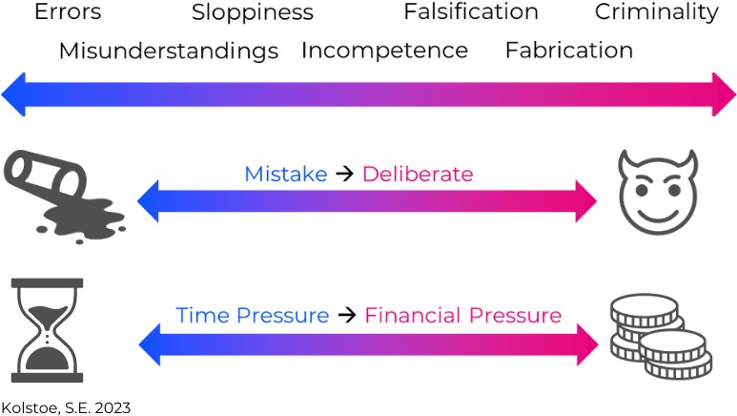
Questionable Research Practices (QRPs)
From UK Research Integrity Office:
Hanlon’s Razor: “Never attribute to malice that which is adequately explained by ignorance or incompetence.”

Slide 11

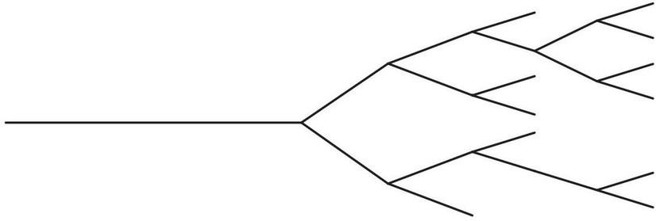
The Garden of Forking Paths
Each analysis has many decision points - which tests to run, which participants to exclude, which steps to take during data cleaning, etc..
Each decision results in a unique analysis “path”
Different analysts might not necessarily take the same path and arrive at the same conclusion (Silberzahn, 2018)
Some “paths” become can seem more sensible depending on your motivations

Slide 12

Some QRPs
p-hacking
Selective inclusion/removal of cases Subsetting/combining groups Variable dichotomisation
Data transformation
Collecting more data (“data peeking”)
NOTE: None of these are “questionable” in their own right. Motivation matters!
Vocabulary
p-hacking: taking specific analytic steps in order to achieve statistical significance rather than (pre-planned) steps that are more appropriate to answer the research question.

Slide 13
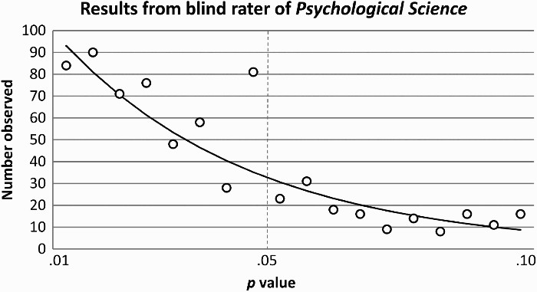
Some QRPs
p-hacking
Masicampo, E. J., & Lalande, D. R. (2012). A peculiar prevalence of p values just below .05:

Slide 14
Some QRPs
HARKing
NOT the same as exploratory research
NOT the same as discussing explanations for your (suprising) results
Vocabulary
HARKing: Hypothesizing After The Results are Known. Often involves collecting data without clear a hypothesis, deciding on a hypothesis based on what’s significant, and then presenting that hypothesis as if it was decided on before running any analyses.

Slide 15
Some QRPs
Selective reporting
Often goes hand-in-hand with HARKing
Collecting a lot of variables and only reporting statistically significant relationships (without making in clear that you’ve also collected other data)
Selective/inaccurate citing
Picking and choosing which papers to cite in a way that fit your narrative Citing papers as supporting a specific point when they don’t
Salami slicing
Splitting relevant analyses from a single dataset into multiple papers to increase publication count

Slide 16
Do Psychologists Engage in QRPs? (John et al. 2012)
Item
Self admission rate (%)
Failing to report all of study’s dependent measures
63.4
Deciding whether to collect more data after looking to see whether the results were significant
55.9
Failing to report all of a study’s conditions
27.7
Stopping collecting data earlier than planned because one found the result that one had been looking for
16.6
“Rounding off” a p value (e.g., reporting that a p value of .054 is less than .05)
22.2
Selectively reporting studies that “worked”
45.8
Deciding whether to exclude data after looking at the impact of doing so on the results
38.2
Reporting an unexpected finding as having been predicted from the start
27.0
Claiming that results are unaffected by demographic variables (e.g., gender) when one is actually unsure (or knows that they do)
3.0
Falsifying data
0.6

Slide 17
There is yet hope…
PhD Researchers’ beliefs about null results (Pownall et al., 2023):
Statement | Percent agree:
If someone does good scientific work, they produce significant results. | 7.98
I believe that null effects are generally caused by sloppy experimental work. | 1.60
A null effect tells me that I did not do good work. | 1.60
Whether I get positive feedback on my work depends on whether my results are significant. | 22.34
If my thesis does not produce significant results, I will get more negative feedback. | 25.00
I think my supervisor gives more positive feedback on significant results than non- significant ones. | 22.87

Slide 18
The future of QRPs?
Potential risks of AI for research integrity (Chen et al. 2024):
Generation of fictitious clinical trial data Data fabrication and falsification
Inappropriate application of statistical models
AI-assisted academic plagiarism and automatic content generation Lack of transparency and disclosure

Slide 19

Why should you care?
YOU are the future
researchers (academic or industry) practitioners
educators
Understanding how research works (and how the environment can affects the research process) allows you to:
Be critical when you’re reading about research and not fall every “Psychology says” or “Science says” click-bait and
Make science better!
How can we make science better?

Slide 20
Part 2: From “Replication Crisis” to “Credibility Revolution”

Slide 21

The Credibility Revolution
Simine Vazire (University of Melbourne)
Coined the term “Credibility Revolution” to describe a more optimistic move towards improving research, as opposed to just pointing out what was wrong with it
Co-Founder of the Society for the Improvement of Psychological Science (SIPS) in 2016
SIPS aims to “bring together scholars working to improve methods and practices in psychological science” and has played a key role in the development and proliferation of Open Science

Slide 22
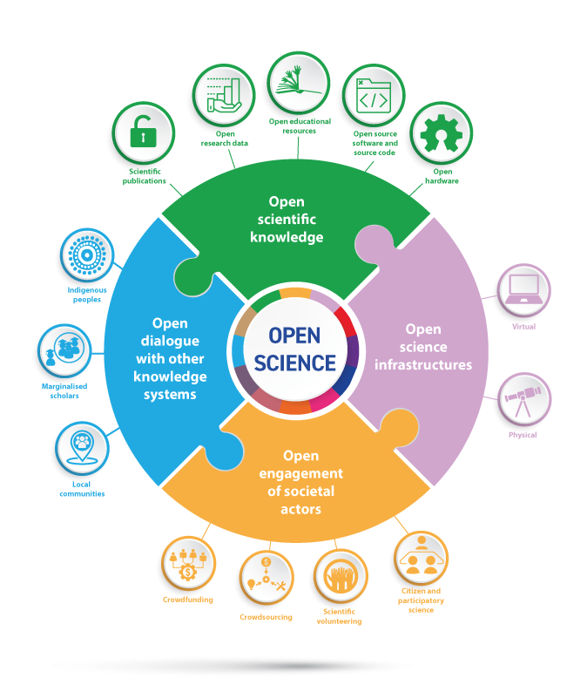
Open Science (OS)
Openness (transparency) prevents researchers from being able to hide their QRPs
The Open Science movement has inspired many innovations in transparent research, only a few of which we’ll explore today:
Preregistration Registered reports
Open materials/data/code

Slide 23
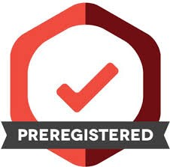
Preregistration
Preregistration involves publicly sharing a time- stamped research plan (e.g., on the OSF) that includes:
Precise hypotheses to prevent HARKing
Information about all your variables and how they’re operationalised to prevent selective reporting
A detailed data analysis plan to prevent p- hacking
Other benefits include making sure you are collecting data you can actually analyse and front-loading a lot of the work

Slide 24
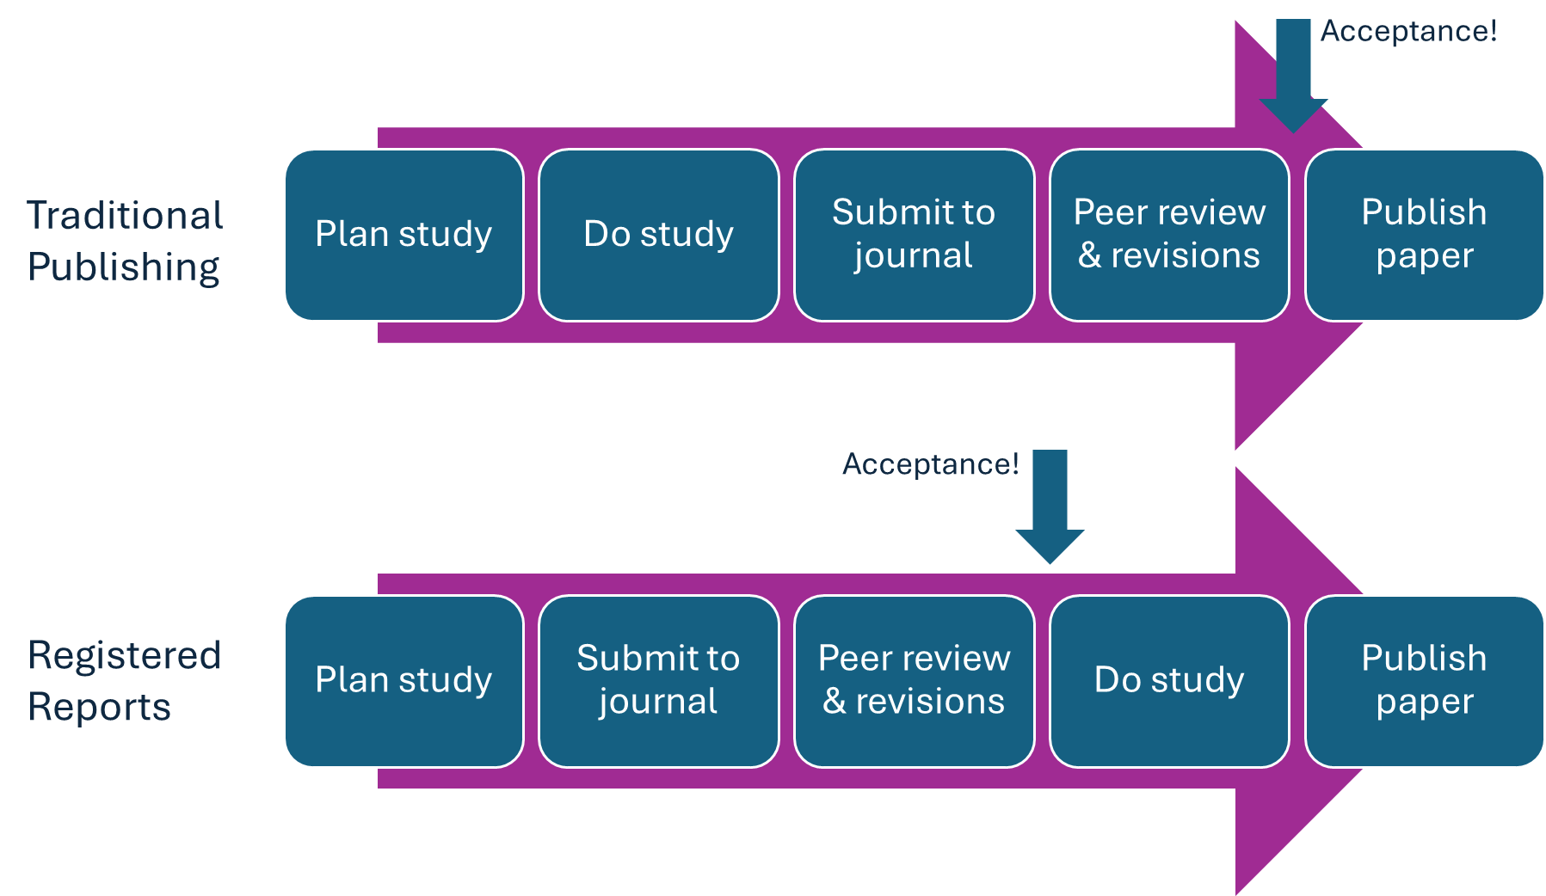
Registered Reports

Slide 25
Registered Reports
Registered Reports are like preregistration insomuch as you’re specifying what you’re going to do in advance, but they have additional benefits.
Like preregistration, they aim to reduce QRPs such as HARKing, p-hacking, and selective reporting
They also improve research quality more generally as the methods are reviewed by peers before data collection commences
They are also more likely to reduce publication bias as journals agree to publish the study based on the quality of the methods, regardless of the results

Slide 26
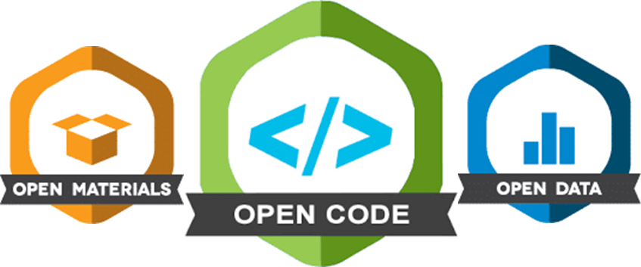
Sharing of Materials, Data, & Code
Open materials allow other researchers to inspect and more easily replicate your research study
Open code and data allow other researchers to inspect and reproduce your research findings
Open code is the main reason why we’re teaching you R!

Slide 27
So, has Open Science improved Psychology?

Slide 28
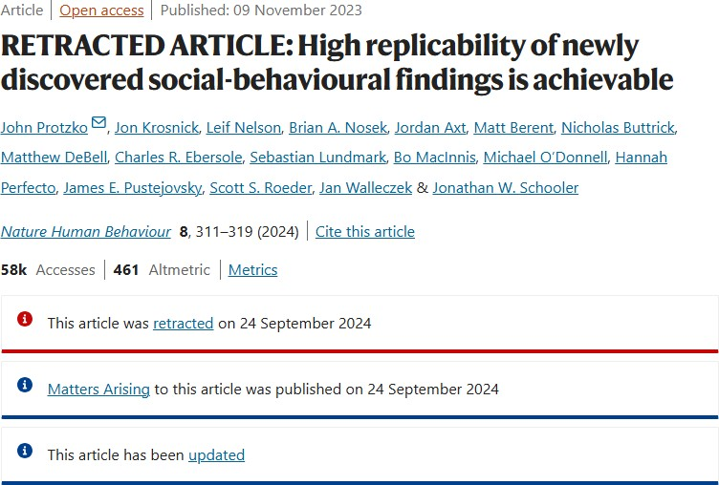
New Evidence that OS is Improving Psychological Science!
Protzko et al. (2023) claimed that OS efforts are improving replicability
Methods are complex, but essentially compared the replication rates of studies that had used OS practices with the replication rate of studies that hadn’t used OS practices
Concluded 86% replication rate in the OS sample was due to “rigor-enhancing practices” such as preregistration, methodological transparency, confirmatory tests, and large sample sizes.

Slide 29
Wait, what’s that Retraction Notice all about?

Slide 30

Bak-Coleman & Devezer (2023) wrote a response, arguing (amongst other things):
The definition of ‘replication’ was less conservative in the OS than the non-OS sample
The OS group of studies were chosen because they were more likely to replicate
The hypotheses and analyses in the study were not as preregistered
The story unfolds further in this blogpost.

Slide 31
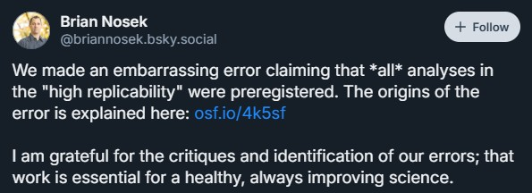
Wait, what’s that Retraction Notice all about?!

Slide 32
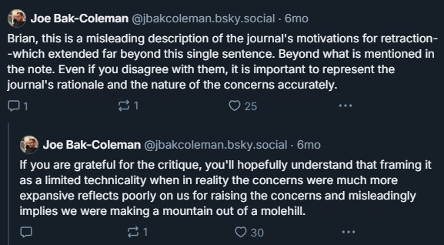
Wait, what’s that Retraction Notice all about?!

Slide 33
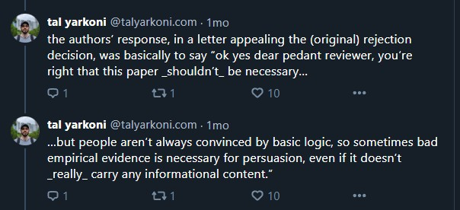
Metabias
Original reviewers also pointed out the flaws in this study
One of those reviewers spoke out on Twitter, saying the original authors’ response was that they were aware of the flaws, but thought the ends justified the means
In other words, it was okay to fudge the figures a bit to get more people on the OS bandwagon
This (meta)bias is the kind of QRP that OS set out to eradicate
Read the full thread here on Bluesky

Slide 34
Questionable Metascience Practices
Rubin (2023) argued that many OS proponents engage in questionable metascience practices, for example:
A lack of evidence of its efficacy
Metabias towards blaming researcher bias (QRPs) for the replication crisis, when there are other explanations (e.g., weak theory, poor measurement practice)
Rejecting, undermining, and ignoring criticisms of metascience and/or science reform
Quick, superficial, dismissive, and/or mocking style of criticising others, predominantly from those in positions of power and privilege (bropen science)

Slide 35

What do (most of) these OS proponents have in common?

Slide 36
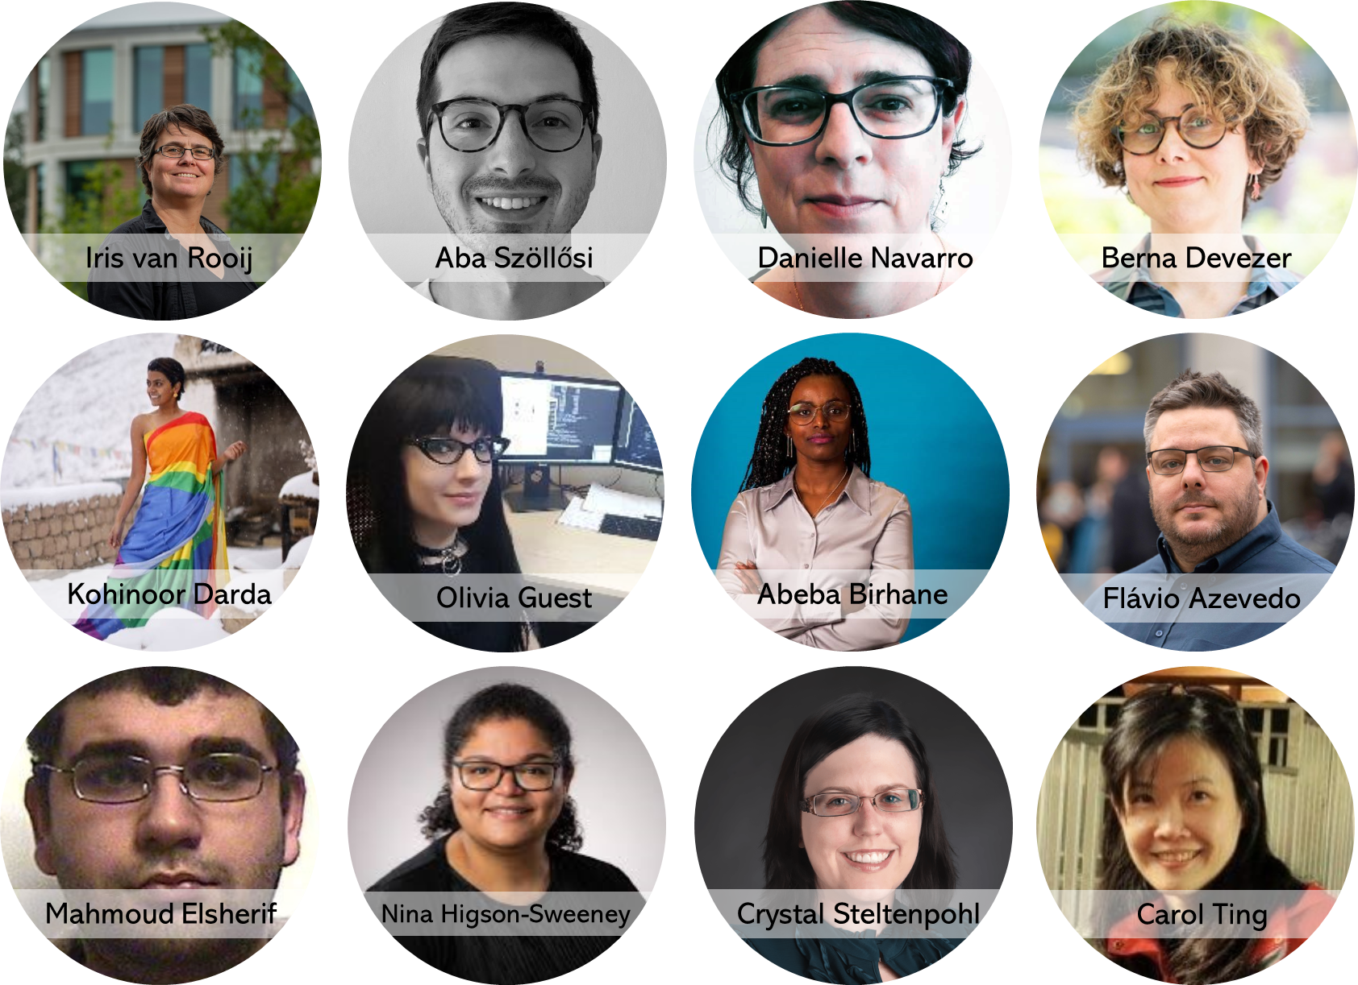
What do (most of) these OS critics have in common?

Slide 37
Bropen Science
Whitaker & Guest (2020)
“Not all bros are men… but they are more likely to be from one or more of the following dominant social groups: male, white, cisgender, heterosexual, able-bodied, neurotypical, high socioeconomic status, English-speaking. That’s because structural privileges exist that benefit certain groups of people.”
“#bropenscience is a tongue-in-cheek expression but also has a serious side, shedding light on the
narrow demographics and off-putting behavioural patterns seen in open science.”

Slide 38
Glimmers of Hope
The Society for the Improvement of Psychological Science’s Code of Conduct warns against behaviour typical of #bropenscience and is now (visibly) more committed to diversity and inclusion
The Center for Open Science’s Symposium: Critical Perspectives on the Metascience Reform Movement is an example of OS embracing criticism
Non-English speaking OS groups are being set up which challenge and dilute the dominant Western narrative, such as the Chinese Open Science Network

Slide 39
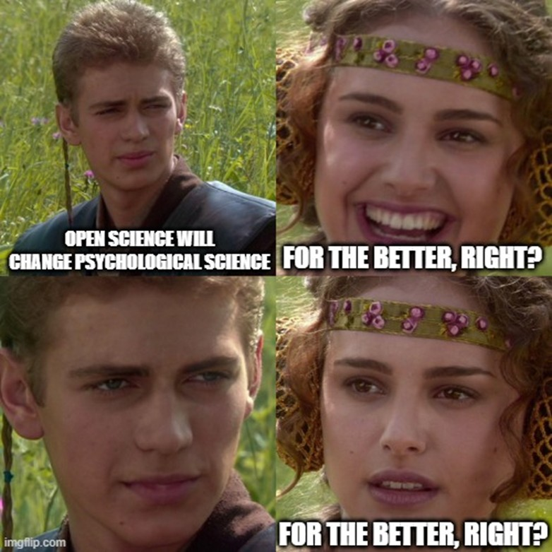
Lecture Summary
The Replication Crisis in Psychology triggered a chain of events, intended to improve Psychological Science
Initially, the discipline focused on identifying problems and a list of Questionable Research Practices emerged
In response, Open Science initiatives were developed that attempted to prevent QRPs
However, OS has been subject to Questionable Metascience Practices and must be held to the same standards as the research it is trying to improve
OS is showing signs of becoming more humble, more reflective, more inclusive, and will have no choice but to provide robust evidence of its effectiveness

Slide 40
Further Reading
FORRT (including the Open Science Glossary) Mark Rubin’s Critical Metascience Reading List
Mastodon/Bluesky (follow the folks cited in this lecture)
More references:
John, L. K., Loewenstein, G., & Prelec, D. (2012). Measuring the prevalence of questionable research practices with incentives for truth telling.
Psychological science, 23(5), 524-532.
Masicampo, E. J., & Lalande, D. R. (2012). A peculiar prevalence of p values just below .05. Quarterly Journal of Experimental Psychology, 65(11), 2271-2279. https://doi.org/10.1080/17470218.2012.711335
Pownall, M., Terry, J., Collins, E., Sladekova, M., & Jones, A. (2023). UK Psychology PhD researchers’ knowledge, perceptions, and experiences of open science. Cogent Psychology, 10(1), 2248765.
Silberzahn, R., Uhlmann, E. L., Martin, D. P., Anselmi, P., Aust, F., Awtrey, E., … & Nosek, B. A. (2018). Many analysts, one data set: Making transparent how variations in analytic choices affect results. Advances in Methods and Practices in Psychological Science, 1(3), 337-356.
Simon Kolstoe. Defining the Spectrum of Questionable Research
Practices (QRPs), UKRIO, 2023 https://doi.org/10.37672/UKRIO.2023.02.QRPs
Chen, Ziyu, Changye Chen, Guozhao Yang, Xiangpeng He, Xiaoxia Chi, Zhuoying Zeng, and Xuhong Chen. 2024. “Research Integrity in the Era of Artificial Intelligence: Challenges and Responses.” Medicine 103 (27): e38811. https://doi.org/10.1097/md.0000000000038811.

