Slide 1
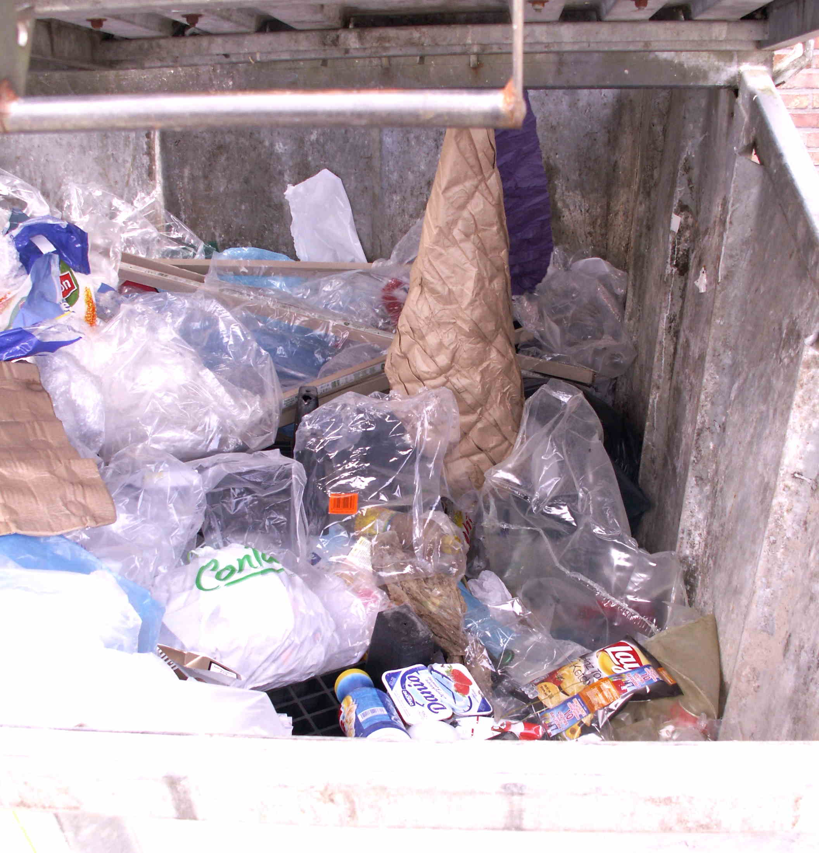

F
FRESHSAVER AI
AI BUILDERS HACKATHON 2026
Fresh today.
Expired tomorrow.
Wasted forever.
FreshSaver gives a grocer one more chance to protect margin and find a buyer before the expiry clock runs out.
THE COST OF WAITING
What was inventory
becomes avoidable waste.
LIVE DEMO →
SOURCE →
Public-domain image: KVDP / Wikimedia Commons
FRESHSAVER
The global waste problem appears as a local pricing decision
Notes:
Open as a story: food can move from sellable inventory to a supermarket waste container because the intervention came too late. FreshSaver gives the owner an evidence-based action while the product still has value. Image: “Supermarket dumpster” by KVDP, public domain, Wikimedia Commons: https://commons.wikimedia.org/wiki/File:Supermarket_dumpster.jpg

Slide 2
PROBLEM STATEMENT
The waste is global. The decision is local.
Every number below is sourced; not all global food waste is caused by expiry dates.
1.05B
~$1T
8–10%
tonnes
each year
of GHGs
food waste generated at retail, food service and household level in 2022
estimated global economic toll of food loss and waste
annual global emissions attributed to food loss and waste
12%
of 2022 food waste occurred at retail.
Up to 10%
of annual EU food waste is linked to date marking.
OUR WEDGE
Independent grocers making product-level decisions every day.
European Commission estimate — not a global expiry-waste estimate.
For one grocer, this becomes a recurring question: hold, markdown, or lose the stock?
Source: UNEP Food Waste Index Report 2024 (2022 data)
Source: European Commission date-marking study (2018)
FRESHSAVER
Problem statement · sourced global scale and local wedge
Notes:
Tell the story from global to local. UNEP reports 1.05 billion tonnes of food waste in 2022 across retail, food service and households; 12% occurred at retail. Food loss and waste cost roughly US$1 trillion and generate 8–10% of global greenhouse gas emissions. Separately, the European Commission estimates up to 10% of EU food waste is linked to date marking. Do not say all global food waste is caused by expiry dates. Bring the story back to the grocer choosing between holding, marking down, or losing stock.

Slide 3
SOLUTION OVERVIEW
From expiring stock to a customer’s inbox.
Both AI systems are part of one owner-controlled workflow, ending in an approved offer and measurable outcome.
01
02
03
04
05
06
07
I
X
O
G
O
M
E
INVENTORY
XGBOOST
OPTIMIZER
GEMINI
OWNER
MATCH
EMAIL
CSV + expiry + cost
Predict every price
Apply hard rules
Explain + recipe
Approve or reject
Store + category opt-in
Brevo sends campaign
APPROVED CAMPAIGN
Personalized deal + recipe idea → customer deal page → cart / pickup → order and outcome ledger
AI #1: PREDICT
AI #2: COMMUNICATE
HUMAN APPROVAL BEFORE SEND
FRESHSAVER
Inventory → AI prediction → guarded decision → email → shopper
Notes:
Walk left to right. XGBoost predicts sell-through for every candidate. The optimizer applies deterministic constraints. Gemini explains the fixed evidence and creates campaign and recipe copy. Nothing goes live until owner approval. Matching then selects opted-in customers and Brevo sends the campaign when configured.

Slide 4
TARGET USERS
Stores pay. Shoppers save. Food gets another chance.
FreshSaver is designed as B2B2C software: decision intelligence for retailers and a free marketplace for customers.
PAYING CUSTOMER
DAILY OPERATOR
FREE USER
1
2
3
Retailers & grocery owners
Store managers & staff
Students & budget shoppers
Need earlier expiry visibility, margin-aware pricing, and a workflow that starts with the CSV they already have.
Need a ranked queue, clear evidence, and final control over every price and customer campaign.
Want affordable, good local food without paying to use the app.
✓
Protect margin
✓
Review recommendations
✓
Discover nearby deals
✓
Reduce manual shelf checks
✓
Approve or reject
✓
Opt into relevant alerts
✓
Reach opted-in local demand
✓
Track orders and outcomes
✓
Get recipe ideas and pickup
BUSINESS MODEL
Customers use FreshSaver free • stores pay a proposed 10% of attributable campaign sales • no setup fee
FRESHSAVER
Target users and value exchange
Notes:
Name the users explicitly. Independent retailers and grocery owners are the paying customer. Store staff operate the workflow. Students and budget-conscious shoppers use the marketplace for free. The proposed model is 10% of attributable campaign sales, not a claim of incremental lift.

Slide 5
PRODUCT FEATURES
Everything needed to move from risk to pickup.
Three connected surfaces: owner operations, explainable decision intelligence, and a free shopper marketplace.
1
OWNER PORTAL
2
DECISION ENGINE
3
SHOPPER APP
Operate the store
Review the evidence
Find affordable food
✓
Dashboard and expiry KPIs
✓
Candidate prices and ranges
✓
Deals, stores, search, filters
✓
Manual products + CSV import
✓
Margin + clearance probability
✓
Maps and local store pages
✓
Store-specific subscribers
✓
Top XGBoost factors
✓
Store/category opt-in alerts
✓
Pricing Log + run history
✓
Recipe and campaign preview
✓
Single-store cart + pickup
✓
Orders and email logs
✓
Approve, reject, or override
✓
Account and order history
CREDENTIAL-FREE /DEMO
Synthetic decision, approval, matching and redemption story works even if external services fail.
FRESHSAVER
Key features and functionality
Notes:
Keep this feature slide concrete. Four owner pages, explainable pricing evidence, and the free shopper marketplace are the core product. Mention the offline judge demo as the reliable fallback.

Slide 6
AI TECHNOLOGIES USED — WHAT AND WHY
Two AIs. Two jobs. One controlled decision.
XGBoost handles numerical uncertainty. Gemini handles language. Neither gets unchecked authority.
1
AI #1 · PREDICTION
2
NOT AI · POLICY
3
AI #2 · LANGUAGE
4
HUMAN · AUTHORITY
XGBoost
Optimizer
Gemini
Store owner
WHAT
WHAT
WHAT
WHAT
Predicts sell-through at every candidate price.
Selects the strongest eligible contribution score.
Explains evidence, writes email copy and suggests a recipe.
Approves or rejects the pending recommendation.
WHY
WHY
WHY
WHY
Built for nonlinear tabular data: stock, price, expiry and sales velocity.
Keeps price floors, expiry blocks and overrides deterministic.
Natural language is its strength; it never calculates the price.
Pricing accountability remains with the merchant.
XGBOOST PREDICTS
→
POLICY CONSTRAINS
→
GEMINI COMMUNICATES
→
OWNER DECIDES
LIVE: XGBOOST
SYNTHETIC MAE 2.097 VS 6.332 BASELINE
SAFE TEMPLATE FALLBACK
FRESHSAVER
AI technologies used
Notes:
State the role split explicitly: XGBoost predicts because demand is tabular and nonlinear. Deterministic policy enforces hard rules. Gemini handles explanations, personalized campaign language and recipe ideas, never pricing. Customer PII stays out of Gemini. The owner decides. Synthetic metrics validate the pipeline, not real-world lift.

Slide 7
TECHNICAL ARCHITECTURE
Store-scoped from database row to customer email.
The browser is untrusted. Role, store ownership and recommendation state are resolved on the server.
EXPERIENCE
1
Shopper marketplace
2
Owner portal
3
Offline judge demo
STORE
ID
APPLICATION
1
Next.js 16 / Vercel
2
Scan + approval APIs
3
Brevo email adapter
INTELLIGENCE
1
XGBoost / FastAPI
2
Constrained optimizer
3
Gemini + recipe copy
AUDIT
TRAIL
DATA + OPS
1
Supabase Auth + RLS
2
PostgreSQL + Storage
3
Render + Vercel Cron
FRESHSAVER
Next.js · Supabase · XGBoost · Gemini · Brevo · Render · Vercel
Notes:
Explain trust boundaries. Public values stay in the browser; service role, model secret, Gemini key, Brevo key and cron secret stay server-side. store_id is the tenant key. The approval record connects model evidence to the published price and email campaign.

Slide 8
IMPACT AND VALUE PROPOSITION
Create value before food becomes waste.
FreshSaver aligns store economics, shopper savings and measurable waste prevention.
1
FOR STORES
2
FOR STUDENTS + SHOPPERS
3
FOR THE FOOD SYSTEM
Protect margin
Find good local deals
Keep food in use
Choose product-level markdowns instead of blanket discounts, reduce manual review and build an auditable decision trail.
Use the marketplace free, opt into relevant stores and categories, and receive recipe ideas for approved surplus offers.
Intervene before surplus, improve sell-through, and record pickups, waste, donation and adjustment outcomes.
PILOT IMPACT METRICS
kg / tonnes diverted • sell-through before expiry • gross margin • shopper savings • pickup rate
VALUE PROPOSITION
Prevent waste before it becomes surplus — while making approved food more affordable.
FRESHSAVER
Impact will be measured in a controlled merchant pilot
Notes:
Do not claim measured tonnes yet. Explain the intended value for three groups: store margin and efficiency, free savings for students and budget-conscious shoppers, and earlier food-waste prevention. State exactly what the pilot will measure.

Slide 9
FUTURE ROADMAP
Pilot, learn, integrate, then scale.
FreshSaver is live today and ready for shadow recommendations with independent grocers.
LIVE
PILOT
LEARN
INTEGRATE
SCALE
Deployed MVP
3–5 retailers
Store elasticity
POS + payments
Circular network
Owner portal, shopper app, XGBoost and approval workflow.
Shadow forecasts, capture overrides, measure waste and margin.
Retrain from real intervention response and calibrate ranges.
Transactional reservations, POS feeds and electronic shelf labels.
Donation routing, store transfers and multi-location policies.
Free for shoppers • stores pay 10% of attributable campaign sales • no setup fee
Would you pilot this?
PROPOSED BUSINESS MODEL
OPEN LIVE PRODUCT →
FRESHSAVER
FreshSaver AI · detect risk · protect margin · reach the right shopper
Notes:
Close with the roadmap and ask for a pilot. The MVP is live. The next claim comes from measured merchant outcomes. Shoppers use the app free; the proposed store model is 10% of attributable campaign sales with no setup fee.

