Slide 1

The ABAP strategy towards ABAP Cloud development accelerated by ABAP AI
Fabian Fellhauer SAP SE
Boris Gebhardt, SAP SE
June, 2025

Slide 2
Agenda
ABAP impact and strategy
ABAP Cloud
ABAP AI

Slide 3


ABAP impact and strategy

Slide 4
ABAP impact – 2024 SAP developer insight survey
Popular Programming Languages
“Which programming languages have you used in your development work over the past 12 months?”
ABAP
The 2024 Developer Insights Survey: The Report - SAP Community

Slide 5





ABAP as main technology provider for SAP S/4HANA
SAP solutions
SAP solutions
SAP solutions
Integrate
SAP BTP
SAP S/4HANA
SAP S/4HANA
Cloud
SAP S/4HANA
Cloud
SAP BTP
SAP BTP
Integrate
Classic SAP ERP
ABAP Cloud based
SAP BTP solutions
and extensions
Any premise
Private Edition
Public Edition
and SAP NetWeaver
products like
SAP BW, SAP PI, …
ABAP Platform
ABAP Platform Cloud
SAP NetWeaver
SAP BTP ABAP
Environment (Steampunk)
No new releases,
only patches
Every 2 years a new release
Half-yearly releases
Quarterly releases
Improvements
One common ABAP Platform innovation codeline

Slide 6




SAP BTP ABAP Environment (Steampunk)
Frontrunner for cloud and innovations
SAP BTP ABAP Environment (Steampunk)
ABAP Cloud
development model
Upgrade stable
ABAP Cloud development model
Optimized for cloud operations
Steampunk infrastructure
SAP S/4HANA optimized
Steampunk infrastructure
Scalable
Resilient
Automated operation
SAP BTP services
Gardener (K8S), SAP HANA Cloud

Slide 7
ABAP Cloud

Slide 8


ABAP Cloud combines
Cloud Technologies
ABAP Cloud Language, ABAP RESTful Application Programming Model (RAP), SAP Fiori UI Technology, Integration technologies, technical services, business services, ABAP Development Tools, Gen AI powered development,...
Clear Separation between SAP code and custom code
Public extension points, local APIs, remote APIs
Cloud-Ready and Clean Core by Default

Slide 9
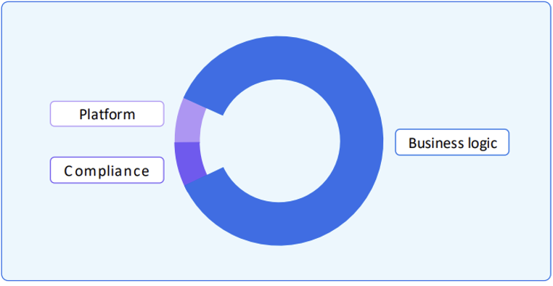
ABAP Cloud – Developers can focus on business logic
Example of Re-Use Services
E-Mail Service
Factory Calendar
E-Mail- and Form Templates
Forms processing via Forms Service by Adobe
Number Ranges
Document Management
Change Documents
Application Jobs
Application Logs
Cloud Printing
Units of Measurement
ABAP Cloud
ABAP Cloud comes with:
  Public SAP APIs and extensions points
  Cloud-optimized ABAP language
  ABAP Development Tools
  ABAP RESTful Application Programming Model

Slide 10





ABAP Cloud map
ABAP Cloud
SAP Fiori apps
Analytical apps
Generative AI
Joule for developers – ABAP AI capabilities⁹,
custom code migration⁸ and ABAP AI SDK⁹
Reuse services and libraries
Output management, jobs., XCO, ...
Built-in qualities
Cloud-readiness, IAM4, BC5, extensibility, security, ...
Lifecycle management
change and transport system (CTS), gCTS, abapGit
Tools
ADT⁶, BAS⁷, key user and monitoring tools
App
UI services
for SAP Fiori and analytical clients
(OData and InA¹)
Integration services
for process and data integration
(OData, business events, HTTP, SOAP, RFC, SQL)
Business service
exposure
Domain-specific models
CDS² entity, RAP³ Business Object, CDS analytical provider
Domain-specific implementation
Domain-specific logic
ABAP, CDS
SAP HANA
(SQL and SQLScript)
Integration services
for process and data integration
(OData, business events, HTTP, SOAP, RFC, SQL)
Database
Business service consumption
1 Information access / 2 Core Data Services / 3 ABAP RESTful application programming model / 4 Identity & Access Management / 5 Business Configuration / 6 ABAP Development Tools /
7 Business Application Studio / 8 Planned to be available in future releases / 9 Available for SAP S/4HANA Cloud Public Edition and SAP BTP ABAP environment

Slide 11
ABAP Cloud – One development model for SAP S/4HANA and SAP BTP
SAP S/4HANA¹
SAP S/4HANA
Cloud¹
SAP S/4HANA
Cloud²
SAP BTP
ABAP Environment
Any premise
Private Edition
Public Edition
ABAP Cloud development model
Classic ABAP development model
¹ SAP S/4HANA any premise or SAP S/4HANA Cloud, private edition release ≥ 2022
² SAP S/4HANA Cloud, public edition release ≥ 2208, 3-system landscape required

Slide 12


ABAP Cloud in SAP Build as essential part of SAP’s development portfolio
SAP Build
Low-code
Low-code applications
Workflows and automations
Digital workspaces
SAP Build Apps
SAP Build Process Automation
SAP Build Work Zone
Key user extensibility for SAP S/4HANA
Extensions for
SAP applications
Joule copilot
SAP S/4HANA
Cloud
SAP BTP
On-stack
extensibility
Side-by-side
extensibility
Cloud developer extensibility
for SAP S/4HANA
Full-stack applications
Integrations
Extensions for
SAP applications
Full-stack applications
Integrations
Partner multitenant
SaaS applications & add-ons
SAP Build Code
SAP BTP ABAP Environment
Pre-built content
and templates
Pro-code

Slide 13

ABAP Cloud establishes the industry standard for developing enterprise business applications
Increase Developer Productivity
with generators, upskilling, migration tools
We accompanion the journey.
Incorporate Emerging Technologies
like generative AI, Fiori, HANA
We ensure competitiveness.
Grant Cloud-Native Qualities Out-Of-The Box
like resilience, performance, observability, scalability, extensibility, testability
We are reliable.

Slide 14

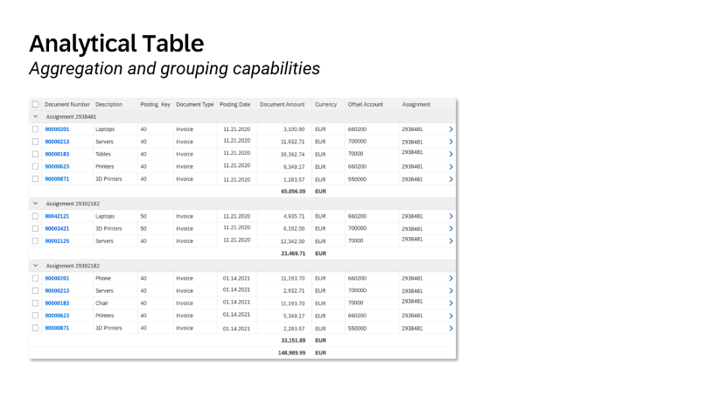
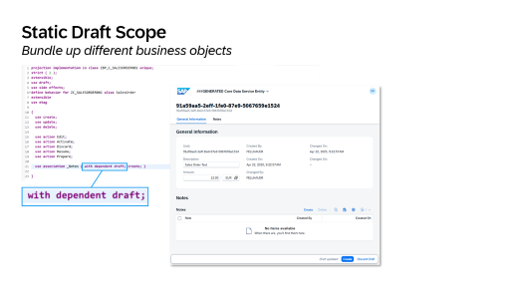

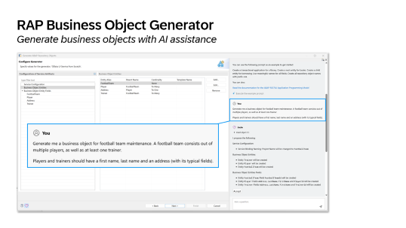
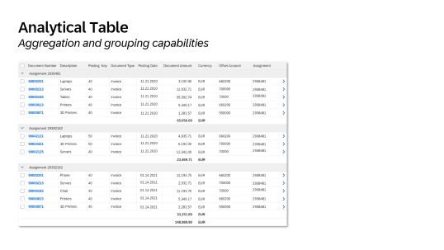
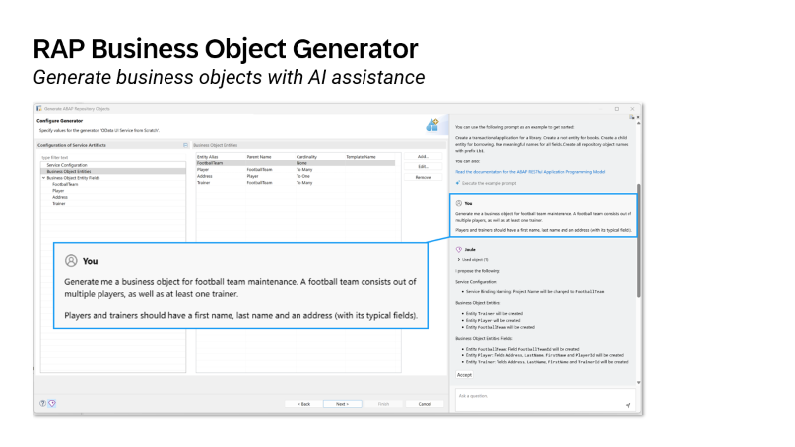
ABAP Cloud
Roadmap ¹
NOW
(2505)
NEXT
(2508)
SOON
(later)
INNOVATE YOUR ENTERPRISE
BOOST YOUR EFFICENCY
1 See https://help.sap.com/docs/abap-cross-product/roadmap-info/abap-cloud-roadmap-information for further details. Mentioned releases may be subjected to be changed without further notice.

Slide 15
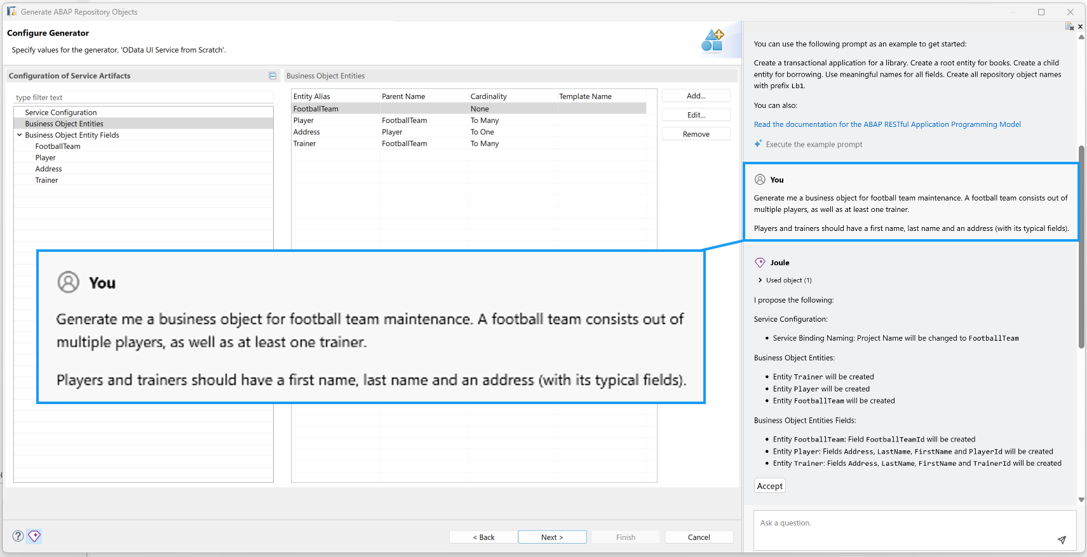
RAP Business Object Generator
Generate business objects with AI assistance

Slide 16
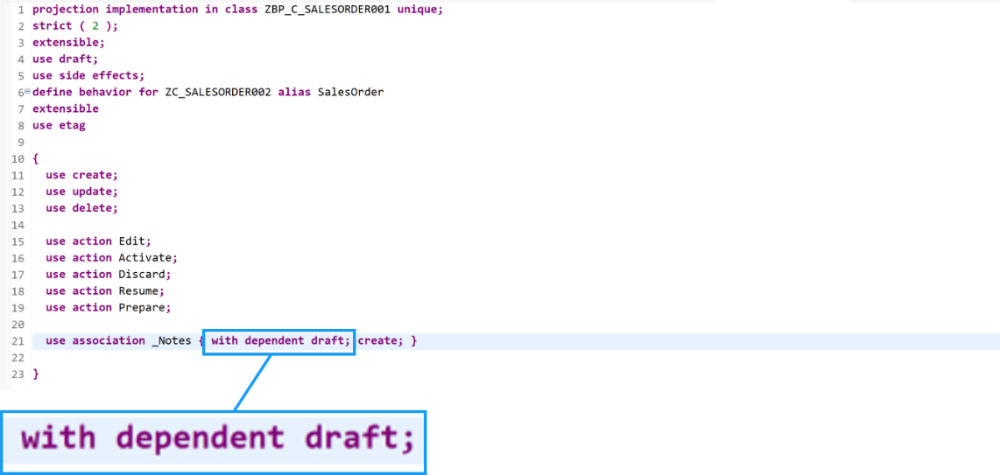
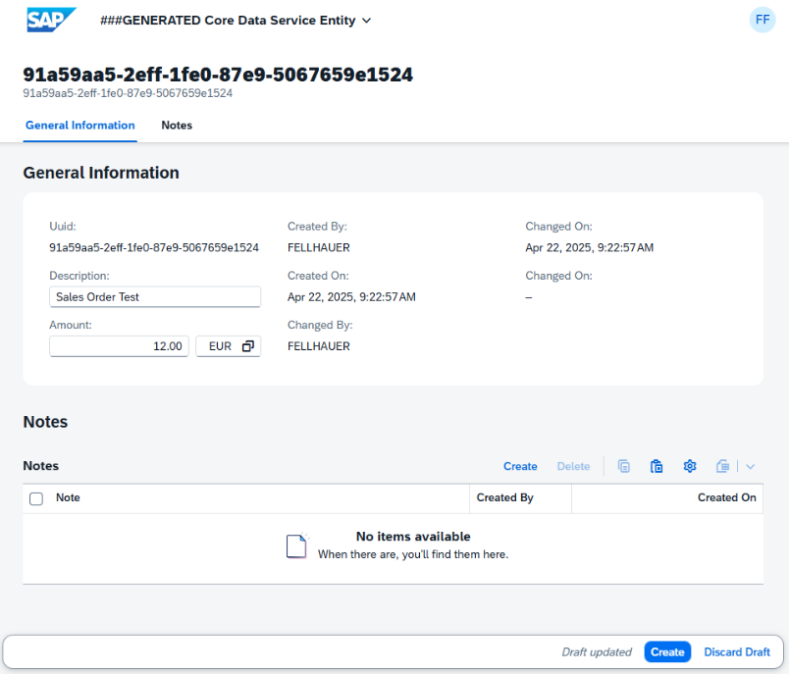
Static Draft Scope
Bundle up different business objects

Slide 17
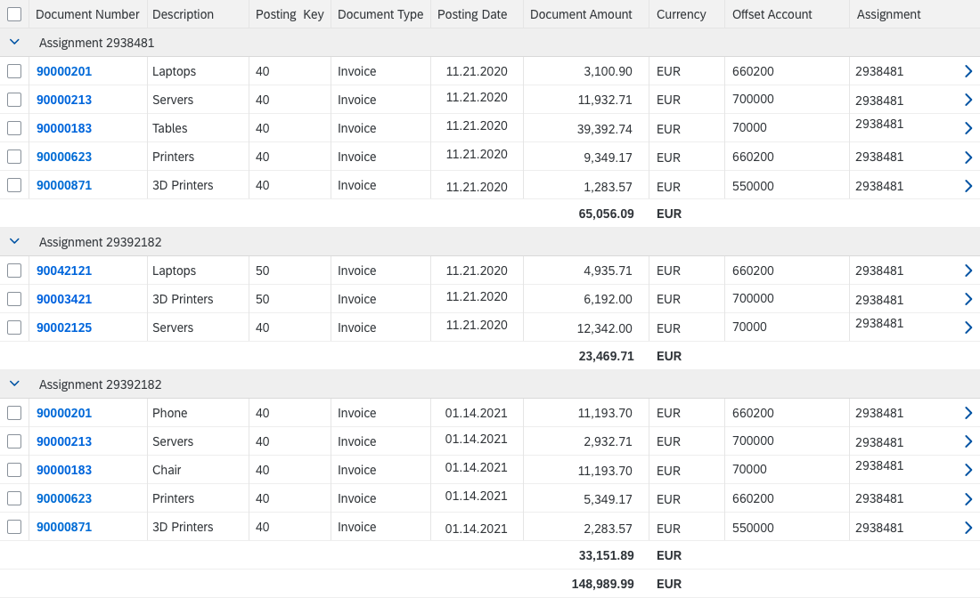
Analytical Table
Aggregation and grouping capabilities

Slide 18
ABAP Cloud
Roadmap ¹
NOW
(2505)
NEXT
(2508)
SOON
(later)
INNOVATE YOUR ENTERPRISE
BOOST YOUR EFFICENCY
1 See https://help.sap.com/docs/abap-cross-product/roadmap-info/abap-cloud-roadmap-information for further details. Mentioned releases may be subjected to be changed without further notice.

Slide 19
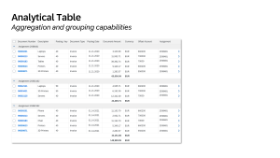
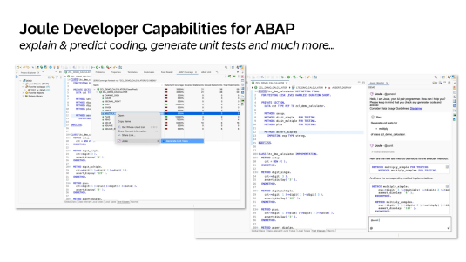
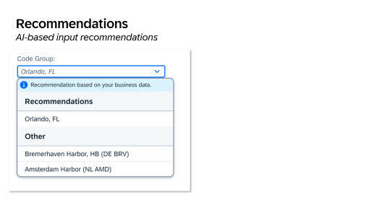

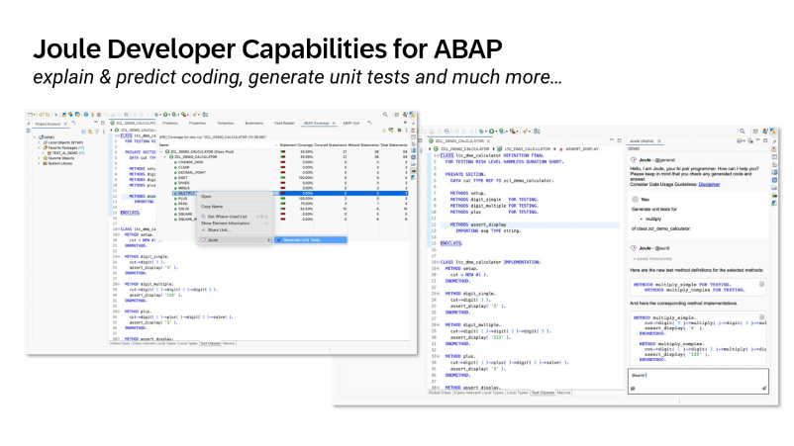
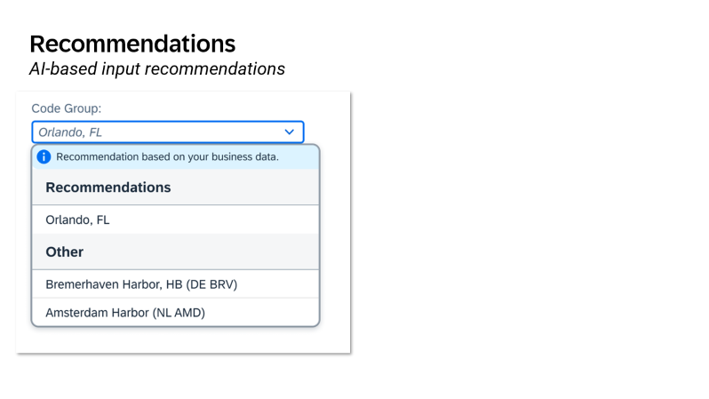

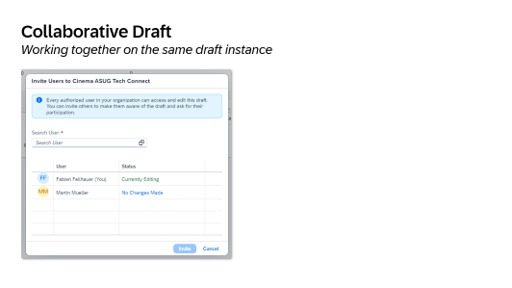




ABAP Cloud
Roadmap ¹
NOW
(2505)
NEXT
(2508)
SOON
(later)
INNOVATE YOUR ENTERPRISE
BOOST YOUR EFFICENCY
1 See https://help.sap.com/docs/abap-cross-product/roadmap-info/abap-cloud-roadmap-information for further details. Mentioned releases may be subjected to be changed without further notice.

Slide 20
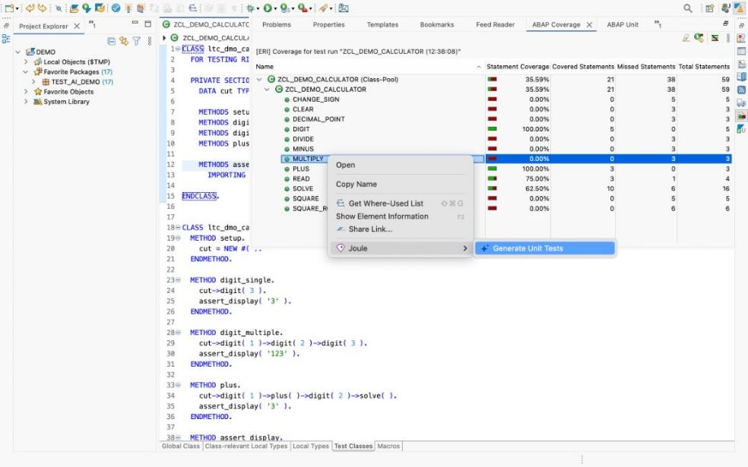
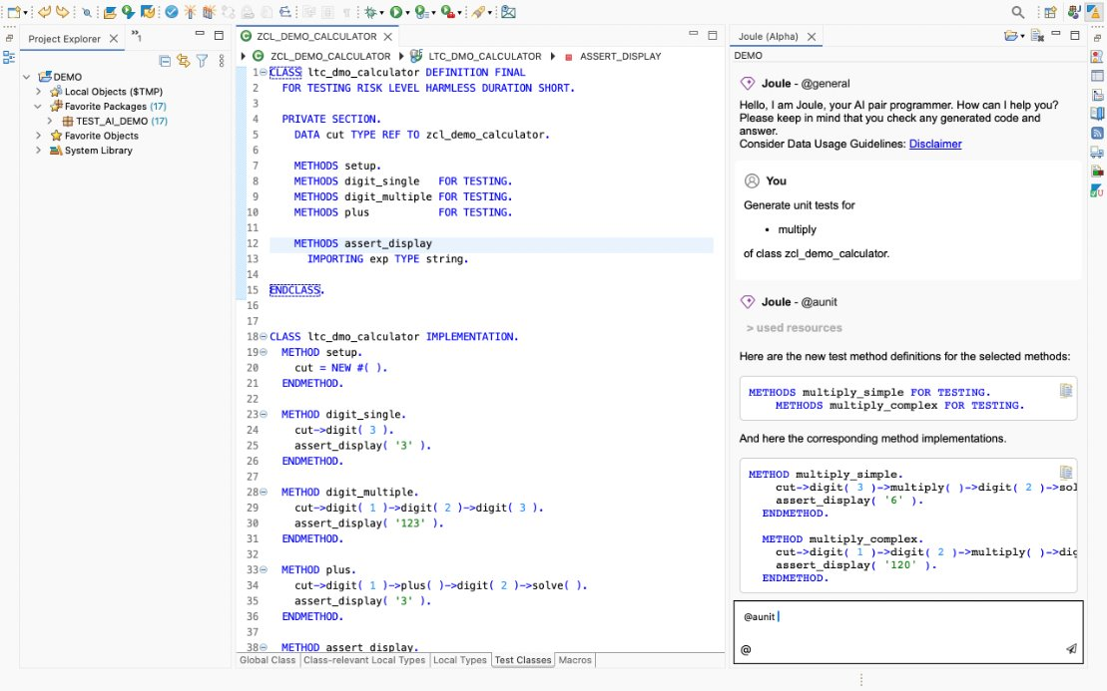
Joule Developer Capabilities for ABAP
explain & predict coding, generate unit tests and much more…

Slide 21
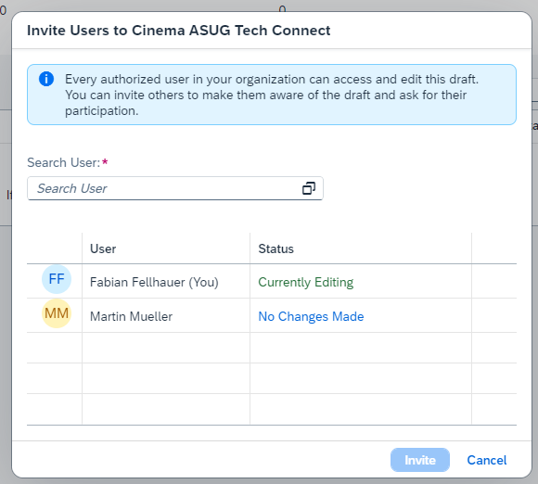
Collaborative Draft
Working together on the same draft instance

Slide 22
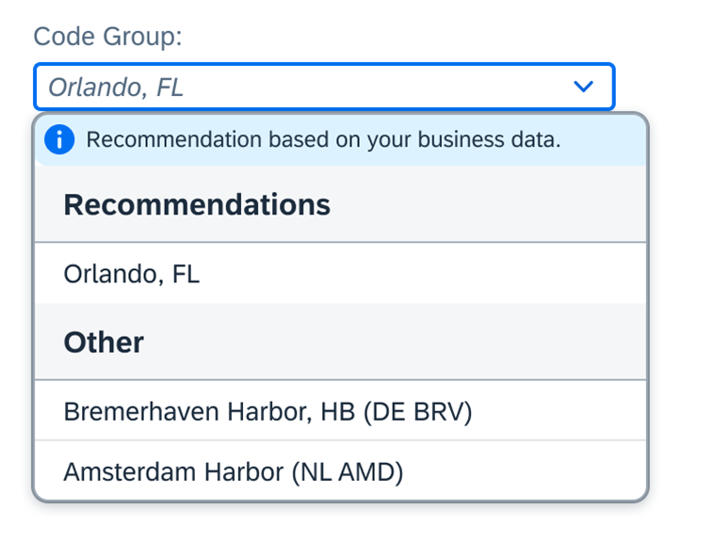
Recommendations
AI-based input recommendations

Slide 23

Video
File: Medien1.mp4
Recommendations
AI-based input recommendations
* This presentation and SAP‘s strategy and possible future developments are subject to change and may be changed by SAP at any time for any reason without notice.

Slide 24
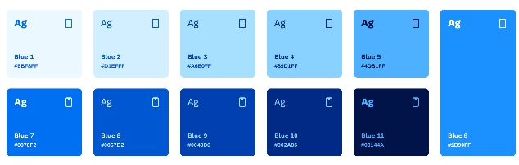
ABAP Cloud
Roadmap ¹
NOW
(2505)
NEXT
(2508)
SOON
(later)
INNOVATE YOUR ENTERPRISE
BOOST YOUR EFFICENCY
1 See https://help.sap.com/docs/abap-cross-product/roadmap-info/abap-cloud-roadmap-information for further details. Mentioned releases may be subjected to be changed without further notice.

Slide 25
ABAP AI strategy

Slide 26
ABAP Use Cases for Generative AI
Accelerate
Joule for developers
Integrated in ABAP Development Tools
Empower
ABAP AI SDK powered by ISLM
ABAP Client for SAP BTP GenAI Hub
Transform
ECC → SAP S/4HANA → Clean Core and ABAP Cloud
Integrated in the ABAP Test Cockpit and the Custom Code Migration App

Slide 27
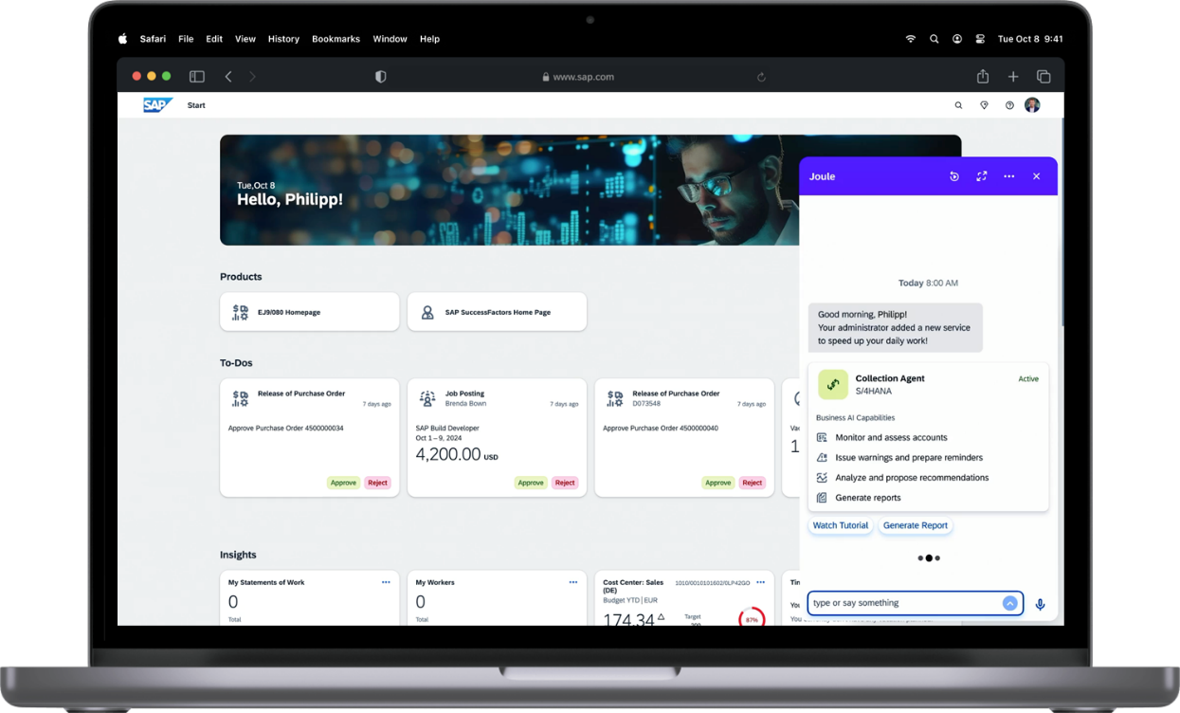
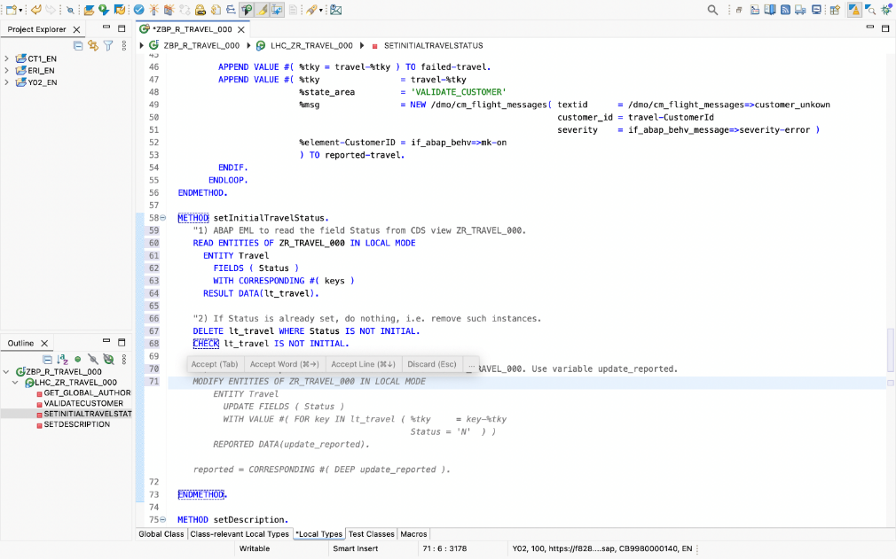


Use Case: Accelerate*
Joule for developers, ABAP AI capabilities
Accelerate
Scope for GA within 2502
Joule Copilot
Predictive Code Completion
ABAP Code Explain
ABAP CDS Explain
ABAP Unit Test Generation
CDS Unit Test Generation
Products*
SAP BTP ABAP Environment as of release 2502
SAP S/4HANA Cloud Public Edition as of release 2502
SAP S/4HANA Cloud Private Edition as of release 2025.
* This presentation and SAP‘s strategy and possible future developments are subject to change and may be changed by SAP at any time for any reason without notice.
ABAP Cloud Roadmap - GenAI

Slide 28
Early Feedback Joule for developers, ABAP AI capabilities
Internal developers + customer testing
UX
Ease of Use
How likely will you recommend it?

Slide 29
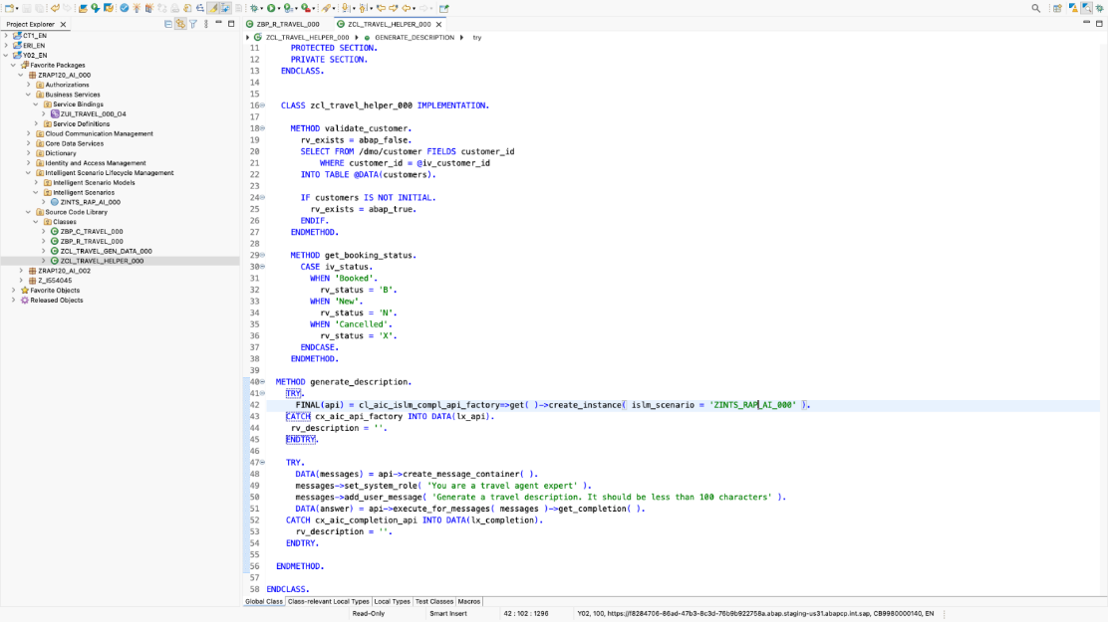
Use Case: Empower*
Empower
GA within 2502: ABAP AI SDK powered by Intelligent Scenario Lifecycle Management
Central, standardized access to generative AI hub in SAP AI Core
Used by SAP for ABAP AI functionality
Easy to configure, easy to consume
Products*
SAP BTP ABAP Environment as of release 2502
SAP S/4HANA Cloud Public Edition as of release 2502
SAP S/4HANA Cloud Private Edition and OnPrem as of release 2025
via standard delivery.**
** Lower releases of SAP S/4HANA Cloud Private Edition and OnPrem are supported
via Transport-based Correction Instructions (TCI), see details in SAP Note 3513374
* This presentation and SAP‘s strategy and possible future developments are subject to change and may be changed by SAP at any time for any reason without notice.

Slide 30
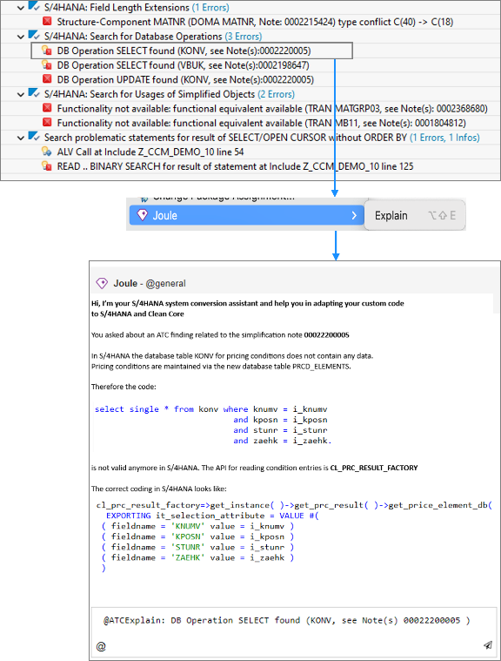
Use Case: Transform*
Labs Preview
Transform
Custom Code Migration to SAP S/4HANA
Embedded in ABAP development tools for Eclipse
Get AI-based explanation of legacy code
(also planned in Custom Code Migration app)
Get AI-bases explanation of SAP S/4HANA related ATC findings and Simplification Items
Get AI-based proposal for code adaptation
Example: Explain ATC finding and get AI code proposal for SAP S/4HANA adaptation
Custom Code Migration to ABAP Cloud
Embedded in ABAP Development Tools for Eclipse
Get AI-driven code suggestions for adaptation to usage of SAP APIs
* This presentation and SAP‘s strategy and possible future developments are subject to change and may be changed by SAP at any time for any reason without notice.

Slide 31

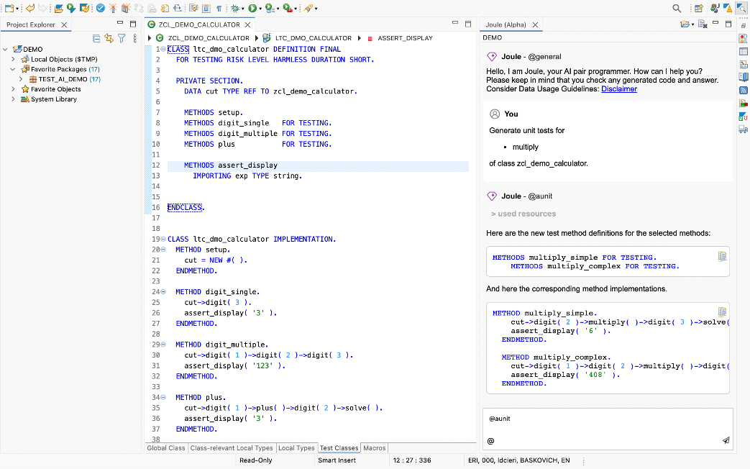


Demo
Joule capabilities in ABAP
+
Notes:
Demo: Showcase ABAP AI Feature in RAP Application context

Slide 32
RAP Business Object Generator*
* This presentation and SAP‘s strategy and possible future developments are subject to change and may be changed by SAP at any time for any reason without notice.

Slide 33
ABAP Cloud Generator – Transactional app from scratch*
Video
File: Medien2.mp4
* This presentation and SAP‘s strategy and possible future developments are subject to change and may be changed by SAP at any time for any reason without notice.

Slide 34
Predictive Code Completion*
Video
File: Medien3.mp4
* This presentation and SAP‘s strategy and possible future developments are subject to change and may be changed by SAP at any time for any reason without notice.
Notes:
RAP – Define and implement determination with Predictive Code Completion

Slide 35
ABAP Unit Test Capability*
Video
File: Medien4.mp4
* This presentation and SAP‘s strategy and possible future developments are subject to change and may be changed by SAP at any time for any reason without notice.
Notes:
ABAP Unit Test Double Framework – Isolate Database table

Slide 36
ABAP Explain Capability *
Video
File: Medien5.mp4
* This presentation and SAP‘s strategy and possible future developments are subject to change and may be changed by SAP at any time for any reason without notice.
Notes:
RAP → BO Implementation Class

Slide 37
CDS Unit Test Capability *
Video
File: Medien6.mp4
* This presentation and SAP‘s strategy and possible future developments are subject to change and may be changed by SAP at any time for any reason without notice.
Notes:
RAP → CDS Unit Test

Slide 38
CDS Explain Capability *
Video
File: Medien7.mp4
* This presentation and SAP‘s strategy and possible future developments are subject to change and may be changed by SAP at any time for any reason without notice.

Slide 39
ABAP AI SDK powered by ISLM *
Video
File: Medien8.mp4
* This presentation and SAP‘s strategy and possible future developments are subject to change and may be changed by SAP at any time for any reason without notice.
Notes:
RAP → ABAP AI SDK – Infuse AI in the Fiori Element App with the

Slide 40
ABAP extensibility strategy

Slide 41
Extensibility portfolio for SAP S/4HANA Cloud public edition
SAP S/4HANA Cloud
Key User
Extensibility
SAP Build Apps
SAP Build Process Automation
SAP Build Work Zone
Low Code
ABAP Cloud
SAP S/4HANA Cloud
SAP BTP
Seamless
integration
Side-by-Side
Extensibility
On-Stack
Extensibility
Pro Code
SAP S/4HANA Cloud
Developer
Extensibility
SAP Build Code
CAP ²
ABAP Cloud
NO CLASSIC ABAP!
SAP BTP ABAP environment
ABAP Cloud
SAP Build including ABAP Cloud
² SAP Cloud Application Programming Model

Slide 42
When to use which extensibility option?
Side-by-side extensibility on SAP BTP
On-stack
key user or developer extensibility
On-stack
key user or developer extensibility
Can or should be decoupled (loosely coupled) from SAP S/4HANA core
Is a hub scenario (i.e., integrates with SAP and Non-SAP solutions and services)
Part of a highly integrated business process of the
SAP S/4HANA core (e.g., a custom process extension)
Is a multi-tenant partner SaaS (partner-led)
Extends an existing SAP S/4HANA core app
(e.g., custom fields)
Enables mobile usage or to be used in offline scenarios
Depends on fast SQL access to SAP data, heavy data exchange
to BTP would increase TCO / performance
Enables process automation for SAP S/4HANA proc. or across multiple systems
Strong consistency with SAP transactions
(e.g., updates in the same logical unit of work).
Intended by users without access to SAP S/4HANA system
Enables scalability/elasticity in peak load scenarios
Custom Remote API to drive side-by-side extension
Benefits from frequent shipments and changes (CI/CD) of the extension
Benefits from a broad spectrum of developers with different skill sets

Slide 43
Extensibility portfolio for SAP S/4HANA Cloud private edition
SAP S/4HANA Cloud
Key User
Extensibility
SAP Build Apps
SAP Build Process Automation
SAP Build Work Zone
Low Code
ABAP Cloud
SAP S/4HANA Cloud
SAP BTP
Seamless
integration
Side-by-Side
Extensibility
On-Stack
Extensibility
Pro Code
SAP S/4HANA Cloud
Developer
Extensibility
SAP Build Code
CAP²
ABAP Cloud
Classic Extensibility¹
Classic ABAP
SAP BTP, ABAP environment
ABAP Cloud
¹ SAP S/4HANA Cloud Private Edition and on-premise only
² SAP Cloud Application Programming Model

Slide 44
Clean Core extensibility in SAP S/4HANA Cloud Private Edition and on-premise
Clean Core for custom extensions in SAP S/4HANA Cloud Private Edition is based on
ABAP Cloud and the 3-tier extensibility model, and governed by the ABAP Test Cockpit (ATC).
On-stack – tightly coupled
Side-by-side – loosely coupled
SAP S/4HANA Cloud
SAP Business Technology Platform
NEW EXTENSIONS
with SAP Build
TIER 1
ABAP Cloud
TIER 1
ABAP Cloud
CAP
Low-code / No-code
TIER 2
Cloud API enablement
Renovate
or innovate
GET LEGACY CODE
UNDER CONTROL
TIER 3
Classic ABAP development
Adapt
Retire
/ Check out: ABAP Extensibility Guide

Slide 45

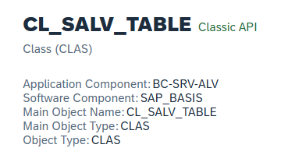
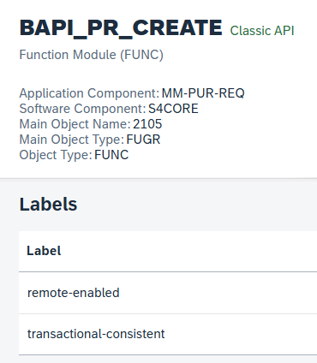
Enhanced guidance for custom development in tier 3
Classic APIs for tier 3 on
TIER 3
Classic ABAP development
Renovate
or innovate
Retire
ADAPT
  Recommended classic APIs for tier 3 (e.g., CL_GUI_ALV_GRID) provided as JSON file on GitHub
  New ATC check* available detecting the classic custom ABAP code which shall be adapted.
  (* New checks available with SAP Note 3565942)

Slide 46
Takeaways

Slide 47


Takeaways
ABAP Cloud
Combines cloud technologies and clear separation of SAP and customer/partner code
Default for any new ABAP development on SAP S/4HANA and on SAP BTP
Is a key pillar of the SAP S/4HANA Extensibility strategy
Used productively by customers and partners in SAP S/4HANA and on SAP BTP
Generative AI for ABAP
3 main scenarios: Accelerate, Empower, Transform
Accelerate: GA as of 2502 in
SAP BTP ABAP Environment
SAP S/4HANA Cloud Public Edition
Empower: GA as of 2502 in the cloud and downports until 2021 for SAP S/4HANA OnPrem and Private Cloud
Transform: Planned for 2025

Slide 48

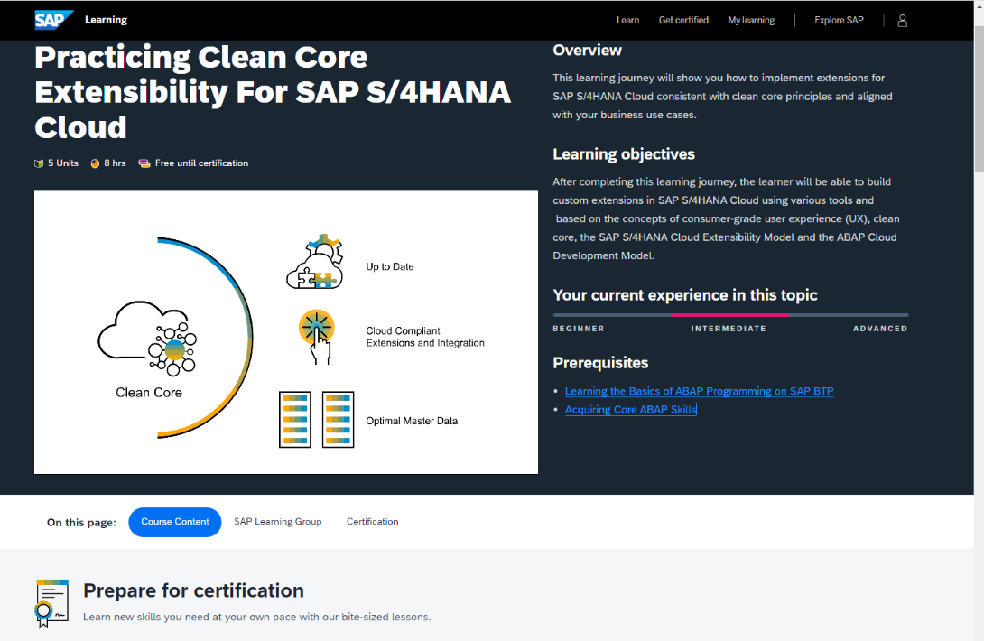

Become an ABAP Cloud certified developer
SAP Learning journeys valid for all SAP S/4HANA editions
👩‍🏫 SAP Learning Journey: Practicing Clean Core Extensibility for SAP S/4HANA Cloud
🥇 Become an SAP Certified Associate – ABAP Cloud Back-End Developer

Slide 49
Further information
• ABAP Extensibility Guide | SAP Community • ABAP Cloud Development Guide | SAP Help Portal
• ABAP RESTful Application Programming Model (RAP) | SAP Community, SAP Help Portal • ABAP Roadmap Information | For ABAP-based Products and ABAP Cloud • ABAP Cloud sessions at Devtoberfest by SAP TechEd in 2024 | ABAP Cloud sessions at SAP TechEd 2024 | Blog posts (incl. replays)
Public SAP Web sites
ABAP Development Community: www.sap.com/community/topic/abap ABAP Extensibility Community: https://pages.community.sap.com/topics/abap-extensibility ABAP Testing and Analysis Community: https://community.sap.com/topics/abap-testing-analysis SAP BTP ABAP Environment Community: https://community.sap.com/topics/btp-abap-environment SAP S/4HANA Cloud ABAP Environment Community: https://community.sap.com/topics/s4hana-cloud-abap-environment
SAP training and certification opportunities
www.sap.com/education – e.g. trainings S4D400, S4D430, S4D437, and HA400. https://learning.sap.com/ – e.g., search for ABAP or ABAP Cloud SAP Certified Associate – ABAP Cloud Back-End Developer

Slide 50
Thank you.
Boris Gebhardt

