Slide 1




ColumnKeeper: Efficient Solutions
to the ColumnDisturb Vulnerability
in DRAM-based Systems
Andreas Kosmas Kakolyris
F. Nisa Bostancı
Harsh Songara
Konstantinos Kanellopoulos
Ataberk Olgun
Konstantinos Marios Sgouras
A. Giray Yağlıkçı
İsmail Emir Yüksel
Umut Başer
Onur Mutlu
Notes:
Hi all, my name is Andreas and today I will be presenting our work titled ColumnKeeper Efficient Solutions
to the ColumnDisturb Vulnerability in DRAM-based Systems

Slide 2
Executive Summary
Problem: DRAM chips are vulnerable to ColumnDisturb, a new, column-based read disturbance phenomenon.
Naively mitigating ColumnDisturb incurs significant overheads.
Goal: Design mechanisms that mitigate ColumnDisturb bitflips with
low performance, energy and area overheads
Key Idea: Track row activations at subarray granularity.
Iteratively refresh all rows.
ColumnKeeper-D (Deterministic): Uses separate activation counters for odd and even bitlines of each subarray and issues a preventive refresh when either counter reaches a predetermined threshold
ColumnKeeper-P (Probabilistic): Probabilistically issues refreshes to one row in
three consecutive subarrays upon a row activation in the middle subarray
Evaluation
ColumnKeeper mitigates ColumnDisturb bitflips with low overheads
at current (1M) and “near-future” (128K) thresholds
ColumnKeeper can mitigate ColumnDisturb bitflips with low overheads
even at low thresholds (16K) with changes to DRAM microarchitecture
https://github.com/CMU-SAFARI/ColumnKeeper
Notes:
This is a high-level summary of my talk.
[CLICK] The problem that we tackle is that …
[CLICK] Our goal in this paper is to
[CLICK] To achieve this, our key idea is to
We propose two mechanisms. The first is
[CLICK] ColumnKeeper-D which …
The second is:
ColumnKeeper-P, which
Our evaluation shows that
[CLICK] …
And
[CLICK …]
[CLICK ]ColumnKeeper is open source and available at the link below

Slide 3
Outline
Background
Motivation
ColumnKeeper-D (Deterministic)
ColumnKeeper-P (Probabilistic)
Evaluation
Conclusion
Notes:
This is the outline of my talk.

Slide 4
Outline
Background
Motivation
ColumnKeeper-D (Deterministic)
ColumnKeeper-P (Probabilistic)
Evaluation
Conclusion
Notes:
I’ll start with a bit of background

Slide 5
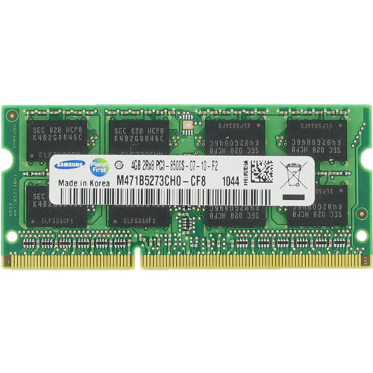
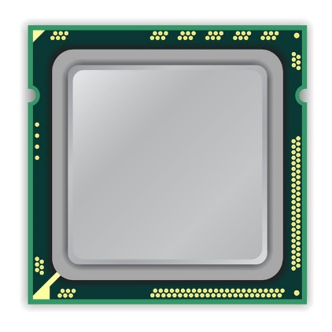
DRAM Organization
DRAM Chip
DRAM
Channel
CPU
DRAM Module
Notes:
This is a high-level view of a modern system where a CPU and a DRAM module communicate over a DRAM Channel.
[CLICK] The DRAM module is comprised of multiple DRAM chips.

Slide 6
DRAM Organization
DRAM
Chip
Sense Amplifiers
DRAM Row
Bank
DRAM Subarray 0
wordline
Bank
…
Bank
Sense Amplifiers
DRAM Subarray 1
SA
SA
…
SA
bitline
Chip I/O
Sense Amplifiers
capacitor
DRAM Subarray 2
DRAM Cell
…
SA
SA
…
SA
…
Bank
Bank
Bank
DRAM Subarray N
Sense Amplifiers
DRAM Chip
DRAM Bank
DRAM Subarrays
DRAM Column
Notes:
[CLICKx2] The DRAM chip is comprised of multiple DRAM banks.
[CLICK] Each bank is composed of multiple subarrays and sense amplifiers and
[CLICK] within each subarray, there is a two dimensional array of DRAM cells
[CLICK] The cells are organized into rows that are selected using wordlines
[CLICK] and columns that connect the dram cells to the sense amplifiers via bitlines

Slide 7
DRAM Organization
1
ACTIVATE: Fetch the row
into the sense amplifiers
SA
SA
1
0
2
READ/WRITE: Retrieve or
update data
1
1
0
1
1
1
SA
SA
3
PRECHARGE: Prepare the bank for a new ACTIVATE
to/from I/O
Notes:
To access DRAM one must first
[CLICK] Activate (also known as opening) a DRAM row which latches its data into the row buffer
[CLICK] And then retrieve or update data with a READ or WRITE command
[CLICK] To access data in a different row the DRAM bank must be precharged (also known as closing a row) which prepares it for a new ACTIVATE command

Slide 8

DRAM Read Disturbance: RowHammer
Read disturbance in DRAM breaks memory isolation
Prominent example: RowHammer
SA
SA
Victim Row
Aggressor Row
Victim Row
SA
SA
Notes:
Repeatedly opening and closing rows may cause read disturbance phenomena, which break memory isolation
One prominent example is RowHammer.
[CLICK] This is a picture of a DRAM bank
[CLICK] To induce RowHammer bitflips, we repeatedly open and close a DRAM row called an aggressor row
[CLICK] Too many activations cause bitflips in adjacent rows in the same subarray. Rows that experience bitflips are called victim rows

Slide 9
DRAM Read Disturbance: RowHammer
Read disturbance in DRAM breaks memory isolation
Prominent example: RowHammer
SA
SA
Victim Row
Aggressor Row
Victim Row
SA
SA
RowHammer causes bitflips in adjacent rows
in the same subarray
Notes:
The key point here is that RowHammer causes bitflips in adjacent rows in the same subarray

Slide 10
DRAM Read Disturbance: RowPress
Read disturbance in DRAM breaks memory isolation
Another prominent example: RowPress
SA
SA
keep
open
Victim Row
Aggressor Row
Victim Row
SA
SA
Notes:
Another Read Disturbance phenomenon, RowPress, induces bitflips by
[CLICK ] keeping rows open for long periods of time.

Slide 11
DRAM Read Disturbance: RowPress
Read disturbance in DRAM breaks memory isolation
Another prominent example: RowPress
SA
SA
keep
open
Victim Row
Aggressor Row
Victim Row
SA
SA
RowPress causes more bitflips in adjacent rows
in the same subarray
Notes:
Doing so causes even more bitflips in adjacent rows

Slide 12
DRAM Read Disturbance: ColumnDisturb
ColumnDisturb: Repeatedly hammering or pressing a DRAM row
disturbs many DRAM cells on the same DRAM column
Subarray
SA
SA
Open-bitline architecture:
columns of a single row
span multiple subarrays
Subarray
SA
SA
Subarray
Notes:
ColumnDisturb is a new and fundamentally different DRAM read disturbance phenomenon.
[CLICK] Repeatedly hammering or pressing a DRAM row disturbs many DRAM cells on the same DRAM column
[CLICK] Due to modern DRAM’s open-bitline architecture the columns span multiple subarrays

Slide 13
DRAM Read Disturbance: ColumnDisturb
ColumnDisturb: Repeatedly hammering or pressing a DRAM row
disturbs many DRAM cells on the same DRAM column
Cells on odd columns
Subarray
All cells
Subarray
Cells on even columns
Subarray
Notes:
ColumnDisturb affects all cells in the hammered subarray
[CLICK] But only cells in either the odd or the even columns in neighboring subarrays

Slide 14
DRAM Read Disturbance: ColumnDisturb
ColumnDisturb: Repeatedly hammering or pressing a DRAM row
disturbs many DRAM cells on the same DRAM column
ColumnDisturb affects DRAM cells across
three consecutive DRAM subarrays (up to 3072 DRAM rows)
Cells on odd columns
Subarray
ColumnDisturb induces bitflips within the DDR4 refresh window
All cells
Subarray
The number of activations required to
induce ColumnDisturb bitflips (N_{CD}) is currently $≈$ 1M
Cells on even columns
Subarray
Scaling studies show ColumnDisturb is getting worse in newer chips
Notes:
[CLICK] ColumnDisturb affects DRAM cells across three consecutive DRAM subarrays which is up to 3K rows
[CLICK] And it has been shown to induce bitflips within the DDR4 refresh window
[CLICK] The number of activations required to induce ColumnDisturb bitflips or N_CD is currently 1M
[CLICK] and scaling studies show that column disturb is getting worse in newer chips

Slide 15
Outline
Background
Motivation
ColumnKeeper-D (Deterministic)
ColumnKeeper-P (Probabilistic)
Evaluation
Conclusion
Notes:
Let me motivate the problem a bit more

Slide 16
Mitigating ColumnDisturb (I)
The easiest way of mitigating ColumnDisturb is to reduce the
DRAM refresh window so that all rows are refreshed before bitflips can occur
Significant performance overheads at near-future ColumnDisturb thresholds:
More than 50% for workloads with high memory intensity
Significant DRAM energy overheads at near-future ColumnDisturb thresholds:
More than 6x increase in energy consumption
Mitigating ColumnDisturb by increasing the DRAM refresh rate
incurs prohibitive overheads
Notes:
The easiest way of mitigating ColumnDisturb is to reduce the DRAM refresh window so that all rows are refreshed before bitflips can occur
However this comes at:
[CLICK] Significant performance overheads at what we consider near-future ColumnDisturb thresholds of 128K activations. For example we see a more than 50% drop in performance for workloads with high memory intensity.
[CLICK] We also see a more than 6x increase in DRAM energy consumption for the same workloads and thresholds
[CLICK] Overall, mitigating ColumnDisturb by increasing the DRAM refresh rate incurs prohibitive overheads

Slide 17
Mitigating ColumnDisturb (II)
Alternative method: Modifying RowHammer mitigation mechanisms
to protect against ColumnDisturb
RowHammer mitigations such as Per-Row Activation Counting (PRAC):
Track activations at the row granularity
Only refresh a few neighboring victim rows
Using PRAC to mitigate ColumnDisturb requires:
Aggressively configuring PRAC to fire at a low threshold
Refreshing all 3072 rows across three subarrays
Modified PRAC incurs prohibitive overheads
Notes:
An alternative method one would think of would be to modify existing RowHammer mitigation mechanisms to protect agains ColumnDisturb
[CLICK] However, RowHammer mitigation mechanisms such as Per-Row Activation Counting or PRAC track activations at the row granularity and only refresh a few neighboring victim rows
[CLICK] Using PRAC to mitigate ColumnDisturb requires aggressively configuring PRAC to fire at a low threshold and then refreshing all 3072 rows across three subarrays
[CLICK] As a result using a modified PRAC mitigation to protect against ColumnDIsturb also incurs prohibitive overheads.

Slide 18
Our Goal
Design mechanisms
that prevent ColumnDisturb bitflips
at low performance, energy, and area overheads
Notes:
Our Goal in this work is to:

Slide 19
Our Overarching Key Idea
Track activations at subarray granularity
Iteratively refresh all rows within each subarray
Notes:
Our overarching key idea is to track activations at the subarray granularity and
Iteratively refresh all rows within each affected subarray

Slide 20
Outline
Background
Motivation
ColumnKeeper-D (Deterministic)
ColumnKeeper-P (Probabilistic)
Evaluation
Conclusion
Notes:
We propose two mechanisms, the first of which, ColumnKeeper-D uses

Slide 21
Key Observation
Activations in one subarray affect all columns in that subarray but
either odd or even columns in neighboring subarrays
Notes:
The key observation that …

Slide 22
Key Observation
Activations in one subarray affect all columns in that subarray but
either odd or even columns in neighboring subarrays
N_{odd} = Χ
Total ACTs = Χ
Subarray A
N_{even} = Χ
Actual ACTs = Χ
Χ
SA
SA
SA
SA
N_{odd} = Υ
Total ACTs = Χ+Υ
Subarray B
Actual ACTs = max{Χ,Υ}
N_{even} = Χ
SA
SA
SA
SA
Υ
N_{odd} = Υ
Subarray C
Total ACTs = Υ
N_{even} = Υ
Actual ACTs = Υ
Notes:
Here is a picture of three consecutive subarrays A, B and C in a DRAM bank.
[CLICK] We hammer a row in subarray A X times [CLICK]
[CLICK] And we hammer a rows in subarray C Y times [CLICK]
As a result:
[CLICK ]The number of hammers in both the odd and even columns of subarray A is X.
[CLICK] The number of hammers both in the odd and even columns of subarray C is Y.
However,
[CLICK] in the middle subarray B, these differ, with Y hammers in the odd columns and X hammers in even columns.
The actual number of activations affecting the cells of A and C matches the total number of activations affecting the cells in those subarrays
[CLICK] However, in subarray B the total number of acts in the subarray is X+Y while the actual hammer count affecting any single cell in the subarray is the maximum of X and Y

Slide 23

Key Observation
Activations in one subarray affect all columns in that subarray but
either odd or even columns in neighboring subarrays
N_{odd} = Χ
Total ACTs = Χ
Subarray A
N_{even} = Χ
Actual ACTs = Χ
Χ
Naively counting the activations affecting a subarray
overestimates the activation count of cells and increases overheads
SA
SA
SA
SA
N_{odd} = Υ
Total ACTs = Χ+Υ
Subarray B
Actual ACTs = max{Χ,Υ}
N_{even} = Χ
In the worst case when Χ = Υ
Total ACTs = 2 $×$ Actual ACTs
SA
SA
SA
SA
Υ
N_{odd} = Υ
Subarray C
Total ACTs = Υ
N_{even} = Υ
Actual ACTs = Υ
Notes:
In the worst case were X = Y
the total number of activations affecting the middle subarray can be two times the actual number of activations affecting any cell in that subarray

Slide 24
ColumnKeeper-D Key Idea
Separately count activations in odd and even columns of each subarray to mitigate ColumnDisturb
at low performance and energy overheads
Notes:
To solve this is ColumnKeeper-D’s key idea is to:

Slide 25
ColumnKeeper-D Overview
ColumnKeeper-D consists of:
Counter Table – Even (CT-Even): Counts activations in even columns
Counter Table – Odd (CT-Odd): Counts activations in odd columns
Row Pointer Table (RPT): Points to the next row to be preventively refreshed
in each subarray
CT-Even
CT-Odd
RPT
5
3
8
2
4
9
N_{SUBARRAYS}
…
…
…
Memory Request Scheduler
Notes:
Here is an overview of ColumnKeeper-D.
ColumnKeeper-D consists of:
[CLICK] Counter Table – Even or CTE , which counts activations in the even columns of a subarray,
[CLICK] Counter Table – Odd or CTO, which counts activations in the odd columns of a subarray, and
[CLICK] the Row Pointer Table or RPT which always points to the next row to be preventively refreshed in each subarray
[CLICK] Let’s assume CTE and CTO contain some values
Do CT-Even and CT-Odd

Slide 26
ColumnKeeper-D Overview
Upon a row activation in subarray k, ColumnKeeper-D:
Increments both the CT-Even and CT-Odd entries for subarray k
Increments the CT-Even entry for the previous subarray
Increments the CT-Odd entry for the next subarray
CT-Even
CT-Odd
RPT
+1
5
3
5
6
+1
+1
8
2
9
3
8
2
+1
9
4
10
9
N_{SUBARRAYS}
…
…
…
Memory Request Scheduler
Notes:
When a row activation happens in a subarray k, ColumnKeeper-D:
[CLICK] increments both the CTE and CTO entries in subarray k but
[CLICK] increments only the CTE entry for the previous subarray
[CLICK] and the CTO entry in the next subarray
[CLICKx2]

Slide 27



ColumnKeeper-D Overview
Upon a row activation in subarray k, ColumnKeeper-D:
Calculates the maximum value of the two counters for the three subarrays
Compares the calculated value to a predetermined threshold (N_{PR})
CT-Even
CT-Odd
RPT
6
3
6
MAX
$$≥$$
9
3
MAX
9
$$≥$$
4
10
MAX
10
N_{SUBARRAYS}
$$≥$$
N_{PR} = 10
…
…
…
Memory Request Scheduler
Notes:
[CLICK] It then calculates the maximum value of the two counters in each of the three subarrays
[CLICK] and Compares the calculated value to a predetermined threshold which we call N_PR

Slide 28
ColumnKeeper-D Overview
Row activation in subarray k:
Calculates the maximum value of the two counters for the three subarrays
Compares the calculated value to a predetermined threshold (N_{PR})
CT-Even
CT-Odd
RPT
6
3
6
MAX
$$≥$$
9
3
MAX
9
$$≥$$
10
We set N_{PR} to N_{CD} divided by the subarray size
This ensures all rows are iteratively refreshed before reaching N_{CD}
4
10
MAX
$$≥$$
N_{SUBARRAYS}
N_{PR} = 10
…
…
…
Memory Request Scheduler
Notes:
[CLICK] we set N_PR to the column disturb threshold NCD divided by the subarray size .
[CLICK] This ensures all rows are iteratively refreshed before reaching NCD.

Slide 29
ColumnKeeper-D Overview
Row activation in subarray k:
Calculates the maximum value of the two counters for the three subarrays
Compares the calculated value to a predetermined threshold (N_{PR})
If the maximum counter value for a subarray exceeds N_{PR}
ColumnKeeper-D decides to issue a preventive refresh for that subarray
CT-Even
CT-Odd
RPT
6
N
6
3
MAX
$$≥$$
9
N
9
3
MAX
$$≥$$
10
Y
4
10
MAX
$$≥$$
N_{SUBARRAYS}
N_{PR} = 10
…
…
…
Memory Request Scheduler
Notes:
If the maximum counter value for a subarray exceeds NPR

Slide 30
ColumnKeeper-D Overview
ColumnKeeper-D:
Issues an ACT command followed by a PRE command to the Row Address pointed by the corresponding RPT entry
Increments the RPT entry to point to the next row in that subarray
Zeroes the CT-Even and CT-Odd entries for that subarray
CT-Even
CT-Odd
RPT
6
N
6
3
MAX
$$≥$$
9
N
9
3
MAX
$$≥$$
10
Y
4
10
+1
0
0
7
MAX
$$≥$$
6
N_{SUBARRAYS}
N_{PR} = 10
…
…
…
Row Address
Preventive Refresh
ACT+PRE
Memory Request Scheduler
Notes:
To do this it issues an ACT command followed by a PRE command to the Row Address pointed by the corresponding RPT entry.
[CLICK] it then increments the RPT entry to point to the next row in that subarray and finally
[CLICK] it zeroes the CTE and CTO entries for that subarray, restarting the counting process

Slide 31
Outline
Background
Motivation
ColumnKeeper-D (Deterministic)
ColumnKeeper-P (Probabilistic)
Evaluation
Conclusion
Notes:
We also propose a probabilistic variant of our ColumnKeeper mechanism called ColumnKeeper-P

Slide 32
ColumnKeeper-P Key Idea
Probabilistically issue preventive refreshes to
avoid activation counting and
mitigate ColumnDisturb at lower area overhead
Notes:
The key idea of ColumnKeeper is to:

Slide 33
ColumnKeeper-P Overview
ColumnKeeper-P substitutes ColumnKeeper-D’s deterministic activation counting mechanism with a probabilistic one
CT-Even
CT-Odd
RPT
6
N
6
3
MAX
$$≥$$
9
N
9
3
MAX
$$≥$$
10
Y
4
10
+1
0
0
6
MAX
$$≥$$
7
N_{SUBARRAYS}
N_{PR} = 10
…
…
…
Row Address
Preventive Refresh
ACT+PRE
Memory Request Scheduler
Notes:
ColumnKeeper-P substitutes …

Slide 34

ColumnKeeper-P Overview
Upon a row activation in one subarray:
ColumnKeeper-P flips a coin that lands heads up with a
predetermined probability (P_{PR})
Coin Flip w/
Probability P_{PR}
RPT
…
Memory Request Scheduler
Notes:
Upon a row activation in one subarray:
[CLICK] ColumnKeeper-P flips a coin that lands heads-up with a predetermined probability P_PR
Change coin

Slide 35
ColumnKeeper-P Overview
Upon a row activation in one subarray:
ColumnKeeper-P flips a coin that lands heads up with a
predetermined probability (P_{PR})
Coin Flip w/
Probability P_{PR}
RPT
$
P_{PR} is calculated to upper bound the probability of a ColumnDisturb bitflip occurring during a year of continuous ColumnDisturb attack
…
Preventive Refreshes
ACT+PRE
Memory Request Scheduler
Notes:
[CLICK] P_PR is calculated to …

Slide 36
ColumnKeeper-P Overview
Upon a row activation in one subarray:
ColumnKeeper-P flips a coin that lands heads up with a
predetermined probability (P_{PR})
If the coin lands heads up, ColumnKeeper-P issues preventive refreshes for that subarray and its neighbors and increments all three RPT entries
Coin Flip w/
Probability P_{PR}
RPT
+1
7
7
Heads up?
Y
+1
2
2
+1
9
9
…
Row Addresses
Preventive Refreshes
ACT+PRE
Memory Request Scheduler
Notes:
If the coin lands heads up, ColumnKeeper-P issues prefentive refreshes for that subarray and its neighbors and [CLICK] increments all three RPT entries

Slide 37
More Details in the Paper
Detailed calculation of N_{PR} for ColumnKeeper-D
Security analysis of ColumnKeeper-D
Detailed calculation of P_{PR} for ColumnKeeper-P
Monte-Carlo security analysis of ColumnKeeper-P
Notes:
We have a lot more details in the paper such as
[CLICK] Detailed calculation of N_{PR} for ColumnKeeper-D
[CLICK]Security analysis of ColumnKeeper-D
[CLICK] Detailed calculation of P_{PR} for ColumnKeeper-P
[CLICK] Monte-Carlo security analysis of ColumnKeeper-P
Extend terminology

Slide 38
Outline
Background
Motivation
ColumnKeeper-D (Deterministic)
ColumnKeeper-P (Probabilistic)
Evaluation
Conclusion
Notes:
I will now move to the evaluation section

Slide 39
Methodology
Performance and energy consumption evaluation: cycle-level simulations
using Ramulator2 [Luo+, CAL 2023] and DRAMPower [Chandrasekar+, DATE 2013]
System Configuration:
  Processor 1 or 4 cores, Last-Level Cache: 2 MiB/core
  DRAM 16GB DDR4, 1 channel, 2 rank/channel, 4 bank groups,
  4 banks/bank group, 64K rows/bank, 1K rows/subarray
  Mem. Ctrl. 64-entry read/write request queue,
  Scheduling policy: FR-FCFS, Open-Row Policy
  Address mapping: RoBaRaCoCh
  ColumnKeeper-D (Det) or
  ColumnKeeper-P w/ yearly failure probability of 10⁻³ (Pr-Perf) or 10⁻¹² (Pr-Cons)
Workloads:
62 single-core workloads from SPEC CPU2006, SPEC CPU2017, TPC, MediaBench, and YCSB categorized by Row Buffer Misses per-kilo-instructions (RBMPKI)
60 quad-core workload mixes synthesized from the resulting RBMPKI categories
Notes:
[CLICK] We evaluate ColumnKeeper using Ramulator2 integrated with DRAM power
[CLICK] This is the configuration of our system with 1 or 4 cores and 16GB of DDR4 memory
[CLICK] We evaluate ColumnKeeper-D or CKD for short and
ColumnKeeper-P configured for a yearly failure probability of 10 to the minus three and 10 to the minus 12 which we call CKP3 and CKP12, respectively.
[CLICK] We evaluate 62 single-core workloads from a variety of benchmark suites categorized by RowBuffer misses per Kilo instructions and
60 quad-core workload mixes from the result RBMPKI categories
Aggressively Optimize Legends

Slide 40
Evaluation: Single-Core Performance
Notes:
Let's start by evaluating single-core performance [CLICK ]

Slide 41
Evaluation: Single-Core Performance
Higher is better
More memory-intensive
Notes:
Let's start by evaluating single-core performance [CLICK ]
[CLICK] Here, the y-axis shows IPC normalized to the baseline system with no ColumnDisturb mitigation
[CLICK] the x-axis shows workloads organized by increasing RBMPKI which corresponds to more memory-intensive workloads.
[CLICK] For each RBMPKI category, different colored boxplots correspond to different ColumnKeeper mechanisms, with pink for CKD, blue for CKP3 and red for CKP12

Slide 42
Evaluation: Single-Core Performance
ColumnKeeper-D and –P incur low (<1%) average performance overheads
for current ColumnDisturb thresholds (1M)
Notes:
We observe that ColumnKeeper-D and ColumnKeeper-P incur low, that is under 1% average performance overheads for the current column disturb threshold of 1M

Slide 43
Evaluation: Single-Core Performance
Notes:
We repeat the same experiment for ColumnDisturb thresholds of 128K and 16K and we see that

Slide 44
Evaluation: Single-Core Performance
Performance overheads increase for more memory-intensive workloads
Notes:
[CLICK] For all thresholds, our performance overheads increase for more memory intensive workloads.

Slide 45
Evaluation: Single-Core Performance
Performance overheads increase for more memory-intensive workloads
All ColumnKeeper mechanisms incur significant performance overheads
at low ColumnDisturb thresholds of N_{CD}=16K
Notes:
[CLICK] We also see that all ColumnKeeper mechanisms incur …
Give example
3x Thin banners

Slide 46
Evaluation: DRAM Energy (Single-Core)
Notes:
This is our evaluation of ColumnKeeper’s impact on DRAM energy consumption for single-core workloads.

Slide 47
Evaluation: DRAM Energy (Single-Core)
Lower is better
More memory-intensive
Notes:
[CLICK] The y-axis shows DRAM energy consumption normalized to a system with no ColumnDisturb mitigation. Here, lower is better
[CLICK] Again, the x-axis is sorted in order of increasing memory-intensity

Slide 48
Evaluation: DRAM Energy (Single-Core)
Energy overheads increase for more memory-intensive workloads
Low energy overheads for current thresholds
Significant energy overheads for future low thresholds
Notes:
Our DRAM energy results largely mimic those for performance. Specifically, we see that
[CLICK] The energy overheads increase for more memory-intensive workloads and
[CLICK] that we have low energy overheads for current thresholds but
[CLICK] but significant energy overheads for future lower thresholds.

Slide 49
Evaluation: Multi-Core Performance
Notes:
Let’s move on to multi-core evaluation. [CLICK]
These are our results. [CLICK]
[CLICK] The Y axis shows weighted speedup normalized to the same system with no ColumnDisturb mitigation
[CLICK] The X axis shows different workloads mixes, organized from left to right by increasing memory intensity
[CLICK] Different colored boxplots correspond to different mechanisms.

Slide 50
Evaluation: Multi-Core Performance
Higher is better
More memory-intensive
Notes:
[CLICK] The Y axis shows weighted speedup normalized to the same system with no ColumnDisturb mitigation
[CLICK] The X axis shows different workloads mixes, organized from left to right by increasing memory intensity
[CLICK] Different colored boxplots correspond to different mechanisms.

Slide 51
Evaluation: Multi-Core Performance

Slide 52
Evaluation: Multi-Core Performance
Performance overheads increase for memory-intensive workload mixes
Low performance overheads for current thresholds
Significant performance overheads for future low thresholds

Slide 53
Evaluation: Multi-Core Performance
1.5%
More pronounced difference between CK-D an CK-P than single-core

Slide 54
Evaluation: Sensitivity to Subarray Size
Notes:
Το ColumnKeeper’s overheads we examine its sensitivity to the subarray size:
[CLICK] Here the x-axis shows the size of the subarray in terms of number of rows
[CLICK] The y axis shows IPC normalized to a baseline system with a subarray size of 1024 rows and no ColumnDisturb mitigation
[CLICK] Different colored boxplots correspond to different mechanisms.
[CLICK] These are our results and we observe that
[CLICK] Smaller subarrays, for example 128 rows, eliminate the overheads.

Slide 55
Evaluation: Sensitivity to Subarray Size
Higher is better
Smaller Subarrays
Notes:
Το ColumnKeeper’s overheads we examine its sensitivity to the subarray size:
[CLICK] Here the x-axis shows the size of the subarray in terms of number of rows
[CLICK] The y axis shows IPC normalized to a baseline system with a subarray size of 1024 rows and no ColumnDisturb mitigation
[CLICK] Different colored boxplots correspond to different mechanisms.
[CLICK] These are our results and we observe that
[CLICK] Smaller subarrays, for example 128 rows, eliminate the overheads.

Slide 56
Evaluation: Sensitivity to Subarray Size
Smaller subarrays (128 rows) eliminate the overheads of ColumnKeeper
for current ColumnDisturb thresholds (1M)
Notes:
Το ColumnKeeper’s overheads we examine its sensitivity to the subarray size:
[CLICK] Here the x-axis shows the size of the subarray in terms of number of rows
[CLICK] The y axis shows IPC normalized to a baseline system with a subarray size of 1024 rows and no ColumnDisturb mitigation
[CLICK] Different colored boxplots correspond to different mechanisms.
[CLICK] These are our results and we observe that
[CLICK] Smaller subarrays, for example 128 rows, eliminate the overheads.

Slide 57
Evaluation: Sensitivity to Subarray Size
Smaller subarrays reduce the overheads of ColumnKeeper
for all ColumnDisturb thresholds
Notes:
This applies in general for all the thresholds we evaluate

Slide 58
Evaluation: Sensitivity to Subarray Size
Notes:
Smaller subarrays significantly reduce the overheads of ColumnKeeper even at very low overheads

Slide 59
Evaluation: Sensitivity to Subarray Size
Smaller subarrays reduce the overheads of ColumnKeeper
even at very low thresholds
Notes:
[]
Smaller subarrays significantly reduce the overheads of ColumnKeeper even at very low overheads

Slide 60
Evaluation: Area and Power Overheads
ColumnKeeper requires:
7.5 KB of SRAM for ColumnKeeper-D
2.5 KB of SRAM for ColumnKeeper-P
Hardware Implementation & Synthesis:
ColumnKeeper implemented in Verilog
OpenRoad + NanGate 45nm Open-Source Cell Library
Area Overheads:
0.1 mm² for ColumnKeeper-D
0.03 mm² for ColumnKeeper-P
Power Overheads:
50 mW for ColumnKeeper-D
15 mW for ColumnKeeper-P
Notes:
Implementing ColumnKeeper requires:
[CLICK]
[CLICK]
We implement

Slide 61
More in the Paper
Evaluation of ColumnKeeper with
Subarray-level Parallelism [Kim+, ISCA 2012]
Impact of physical page allocation policy on
the performance overheads of ColumnKeeper
Performance evaluation of ColumnKeeper integrated with RowHammer mitigation mechanisms
Performance evaluation under adversarial workloads
An in-DRAM implementation of our design
Notes:
Color

Slide 62
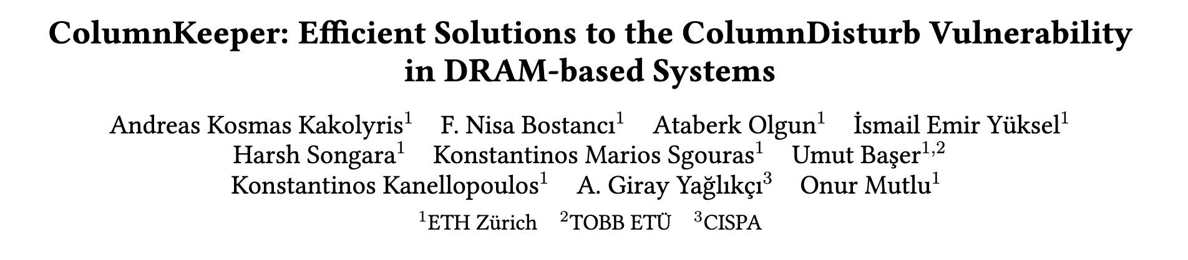
Available on arXiv
https://arxiv.org/pdf/2606.22632

Slide 63
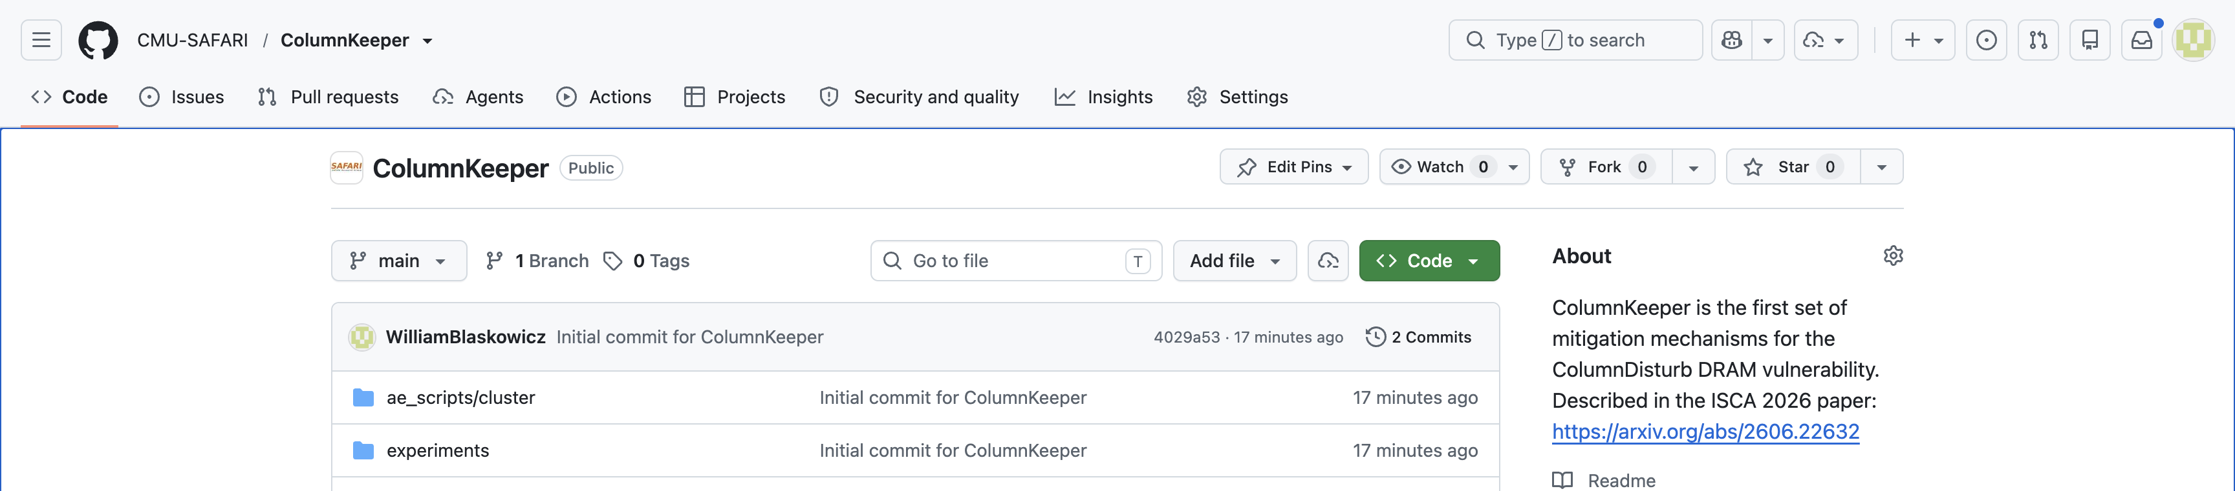
Artifact Evaluated & Open-Source
https://github.com/CMU-SAFARI/ColumnKeeper

Slide 64
Outline
Background
Motivation
ColumnKeeper-D (Deterministic)
ColumnKeeper-P (Probabilistic)
Evaluation
Conclusion
Notes:
This is the outline of my talk

Slide 65
Conclusion
Goal: Mitigate ColumnDisturb bitflips at low overhead
Key Idea: Track row activations at subarray granularity and iteratively refresh
all affected rows in a subarray
ColumnKeeper-D: Uses separate activation counters for odd and even columns of each subarray
ColumnKeeper-P: Probabilistically issues refreshes to one row in
three consecutive subarrays upon a row activation in the middle subarray
Key Results:
ColumnKeeper prevents ColumnDisturb bitflips with low overheads for current and near-future thresholds
ColumnKeeper can prevent ColumnDisturb bitflips at low overheads for low thresholds with changes to DRAM microarchitecture

Slide 66
ColumnKeeper: Efficient Solutions
to the ColumnDisturb Vulnerability
in DRAM-based Systems
Paper
Code

Slide 67
ColumnKeeper: Efficient Solutions
to the ColumnDisturb Vulnerability
in DRAM-based Systems
Backup Slides
Andreas Kosmas Kakolyris
F. Nisa Bostancı
Harsh Songara
Konstantinos Kanellopoulos
Ataberk Olgun
Konstantinos Marios Sgouras
A. Giray Yağlıkçı
İsmail Emir Yüksel
Umut Başer
Onur Mutlu

Slide 68
Evaluation: Detailed Single-Core Results

Slide 69
Evaluation: Sensitivity to Page Allocation
No significant difference in performance between the two allocators

Slide 70
Evaluation: In-DRAM Implementation
The in-DRAM implementation of ColumnKeeper-D
reduces its overheads at low ColumnDisturb thresholds

Slide 71
ColumnKeeper-P: P_{PR} Calculation
Methodology
Similar to the one proposed in HiRA [Yaglikci+, MICRO 2022]
Considers the maximum number of attacks that can happen
in a refresh window
At least one of these attacks has to succeed
To induce bitflips: The number of preventive issues issued to a subarray must be lower than the subarray size (S) when the ColumnDisturb threshold is reached
Total number of preventive refreshes issued after N activations (M_{N}):
Sum of Bernoulli random variables
M_{N} follows a binomial distribution
$$P\left(M_{N}≤k\right)=I_{q}\left(N−k,1+k\right), q=1−P_{PR}$$

Slide 72
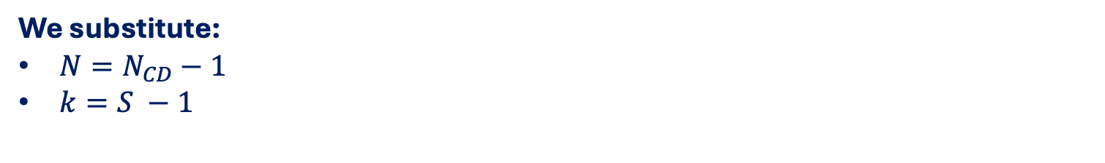


ColumnKeeper-P: P_{PR} Calculation
We substitute:
$N=N_{CD}−1$
$k=S −1$
A single ColumnDisturb attack succeeds with probability P₁:
$$P_{1}=P\left(M_{N_{CD}}< S \right)=P\left(M_{N_{CD}}≤S−1 \right)=I_{q}(N_{CD}−S,S)$$
Probability of a successful attack within a refresh window based on maximum number of attacks:
$$P_{REFW}=1 −{\left(1−P_{1}\right)}^{A}, A=\frac{t_{REFW}}{t_{F}}+1,t_{F}=\left(1+3S\right)⋅t_{RC}$$
Probability of a successful attack within a year (P_{Y}):
$$P_{Y}=1 −{\left(1−P_{REFW}\right)}^{492.7⋅{10}^{6}}$$

Slide 73
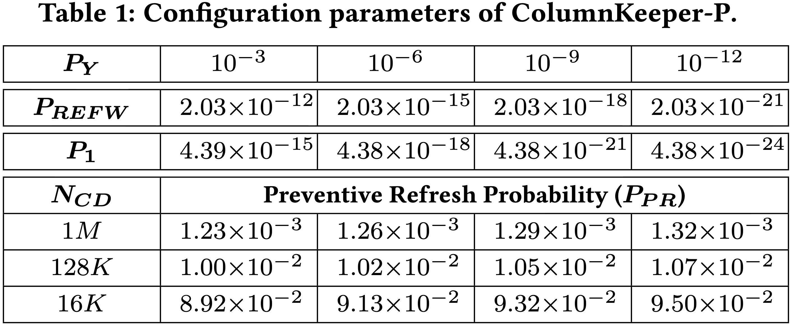
ColumnKeeper-P Configuration
Small increases in P_{PR} significantly increase security for the same N_{CD}

Slide 74
ColumnKeeper-P: Monte-Carlo Simulation
Lower P_{Y} leads to more preventive refreshes and a lower HC_{max}

Slide 75
Evaluation: Integration w/ RH Mitigations
ColumnKeeper issues ACT+PRE commands:
ACTs and PREs are transparent to RowHammer mitigation mechanisms
RowHammer mitigation mechanisms issue:
ACT + PRE commands
RFM commands
RFM commands accounted by
incrementing all activation counters in affected banks
ColumnKeeper operates transparently to
RowHammer mitigation mechanisms
RowHammer mitigation mechanisms operate
transparently to ColumnKeeper

Slide 76
Evaluation: Integration w/ RH Mitigations
N_{CD} = 128K, N_{RH} = 128
No destructive interference between
RowHammer mitigation mechanisms and ColumnKeeper

Slide 77
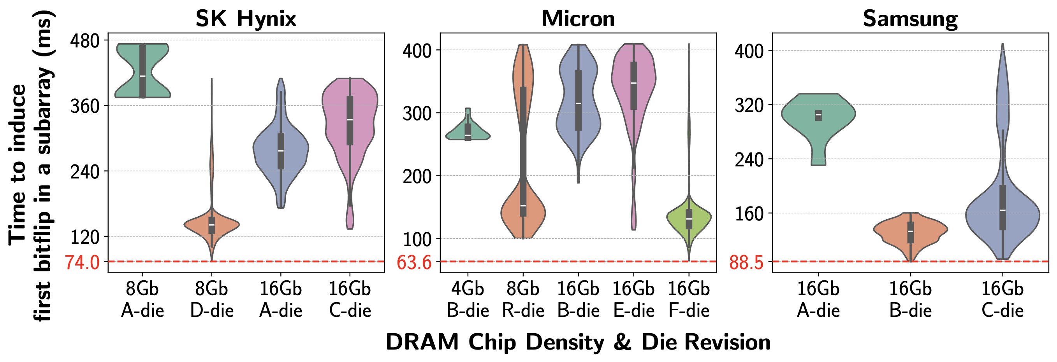
ColumnDisturb:
Newer Chips are More Vulnerable
5.1x
3x
2.5x
1.3x
Newer chips tend to be
more vulnerable to ColumnDisturb bitflips
This trend is consistent across all tested manufacturers

Slide 78
Evaluation: Adversarial Workloads
Low performance overheads for current and near-future thresholds
Significant performance overheads for future low thresholds
Notes:
We hammer rows across three consecutive subarrays
Normalize to the same workload with no CD mitigation

