Slide 1


CSCA08 Final Review
Seminar
Dec 7th, 2025 | 13:00 - 15:00
Course Reps:
Kevin Yu, Zohair Syed, Krisha Patel, Nathanael Kevin Sitepu, Nihar Samant
PRESENTED BY

Slide 2
Content Overview
Agenda / Topics for Today
Agenda / Topics for Today:
Lists
Review of tuples/dictionaries
Files
Testing
Sorting and Sorting Analysis
Past Exams and Questions
PRESENTED BY

Slide 3
Part 1: Quick Review - Lists, Tuples,
& Dictionaries

Slide 4
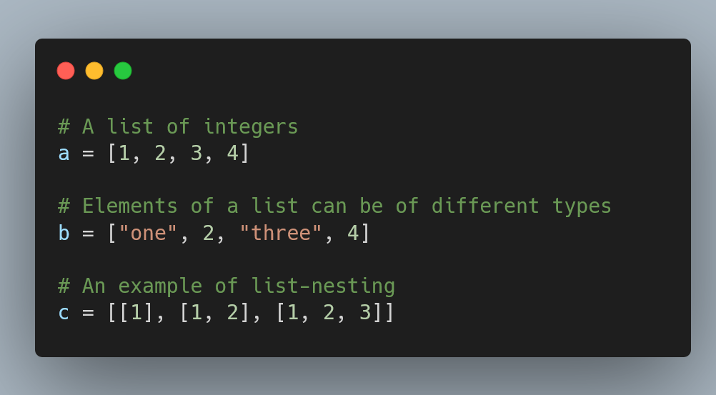
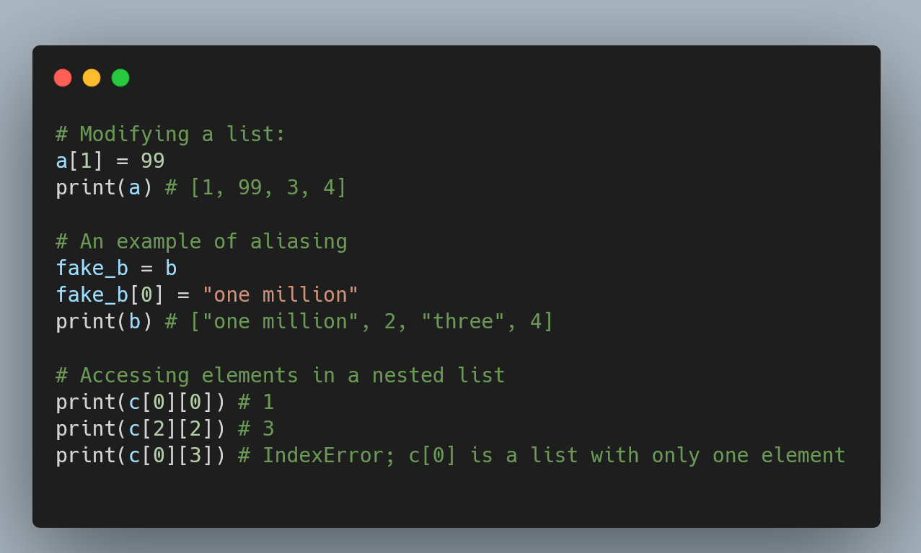
Lists
A data type that can store a collection of elements under one variable

Slide 5
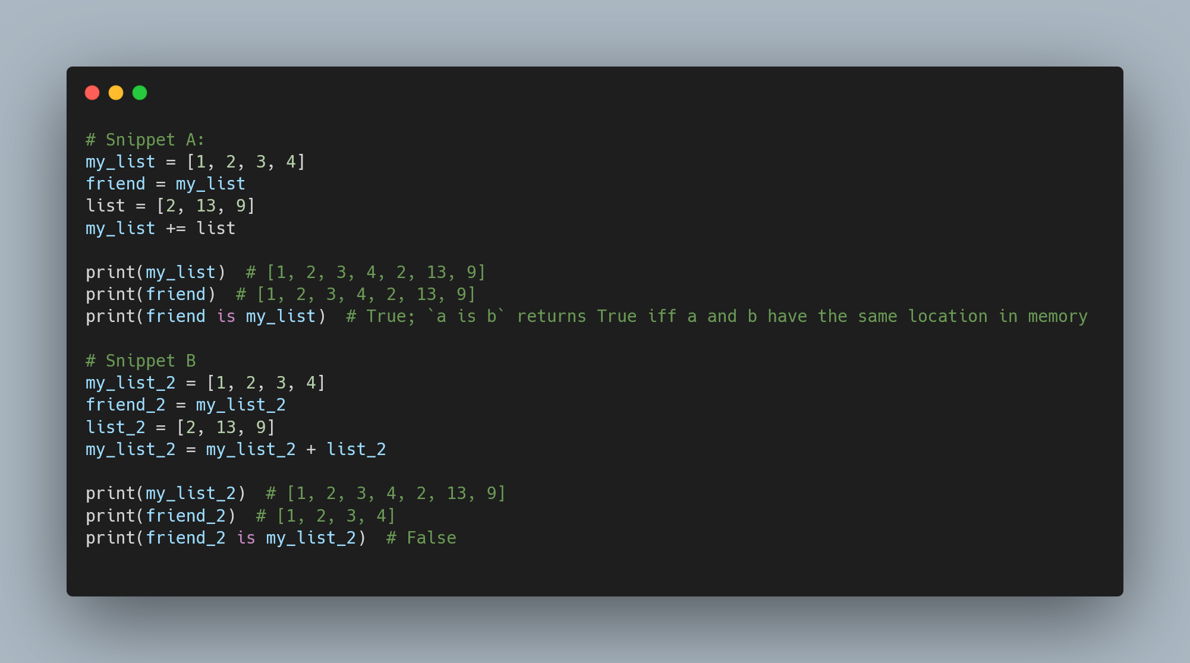
Lists - Continued
Some common stuff that trips a lot of people up:
Snippet A:
+= modifies the list. Since friend is an alias, we can see the change being reflected.
Snippet B:
my_list_2 + list_2 creates a new list in memory. Then, the assignment operator assigns this new list to my_list_2. friend_2 still points to the old object in memory.

Slide 6
Lists (Example From Last Slide)

Slide 7
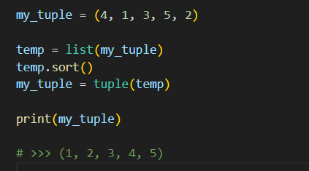
Tuples
An n-tuple is a grouped collection of n items, similar to a list, but:
They are immutable
Use my_tuple = (1, 2, 3, 4) syntax
Quick question: How do you sort the elements of a tuple?
A: Convert to a list first, then you can sort using the aforementioned list methods!

Slide 8
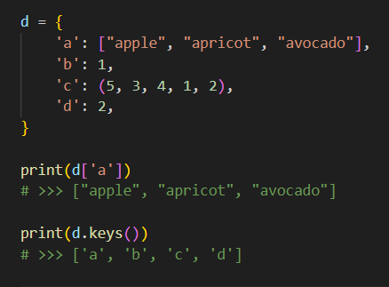
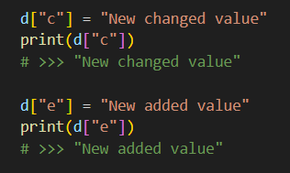
Dictionaries
A dictionary is a mapping of key-value pairs, with many helpful built-in methods

Slide 9
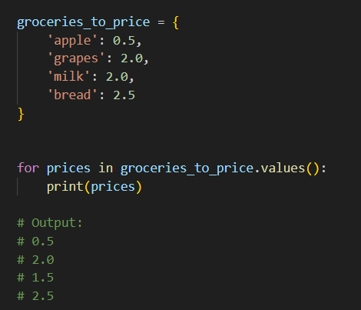
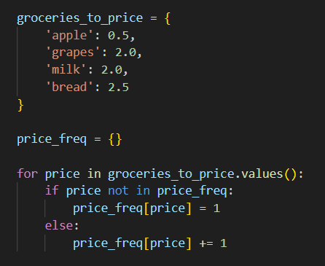
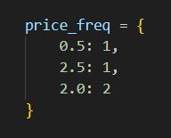
Common Dictionary Techniques
Iterate through values with .values()
Counting frequencies

Slide 10
Reminders
Dictionaries are unordered collections. Do not try to index them
‘+=’ and ‘+’ methods aren’t defined for Dictionaries(i.e you cannot add two dictionaries)
There are only two methods defined on tuples:
count() : Counts the number of occurrences of a particular element.
index() : Looks for the first occurence of an element. Throws an error if the element is not in the tuple.
A single element tuple is defined a little differently:
>>> a = (1,)
>>> b = (1)
‘a’ is a tuple and ‘b’ is not a tuple. Then what is the type of ‘b’ here?

Slide 11
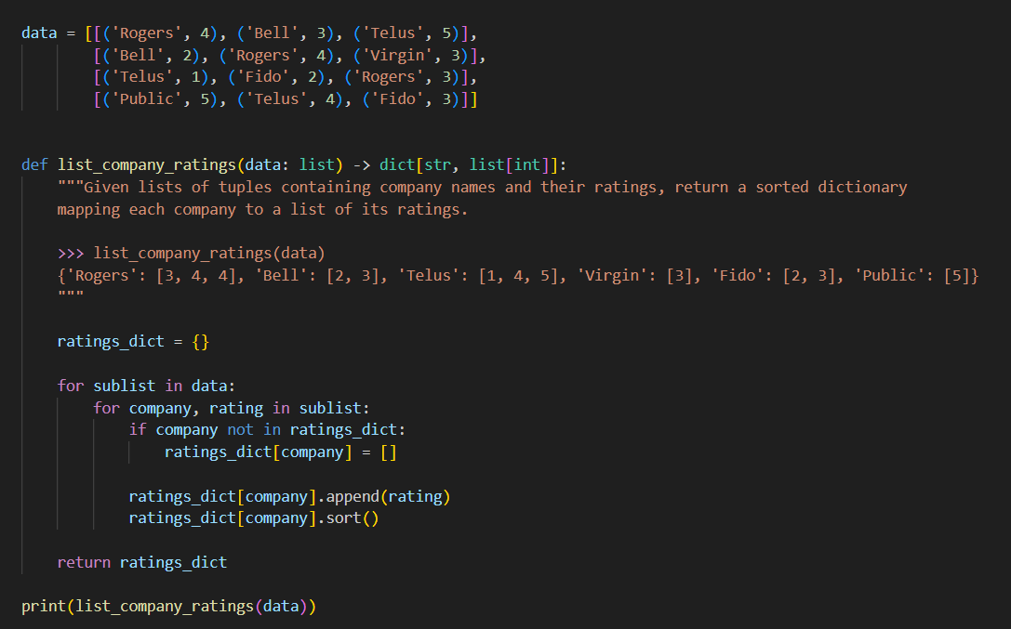

Slide 12
Part 2: Files

Slide 13
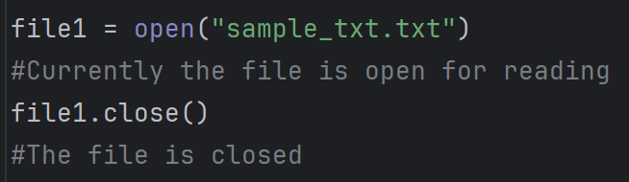
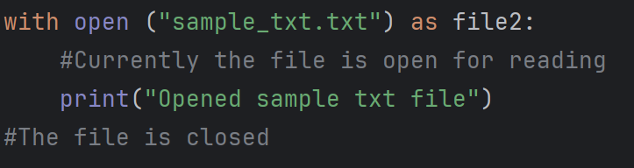
File Operations
open(file_location , mode)
Both file_location and mode are of type string
file_location can be specified by :
Absolute path or Relative path
The default value for mode is set to “r”
Which method would you prefer?

Slide 14
modes
r | read-only. Error if the file does not exist
r+ | read and write. Error if the file does not exist
w | Write-only. New file created if the file does not exist
w+ | read and write. New file created if the file does not exist
a | Append-only. New file created if the file does not exist
a+ | read and append. New created file if the file does not exist
If the file does not exist the error raised is
FileNotFoundError
If a new file has to be created, it is created in the same folder/directory as your python script
rb, rb+, wb, wb+, ab, ab+ perform the same tasks expect the file is opened for tasks in binary.
We will mostly work with r, w and a

Slide 15
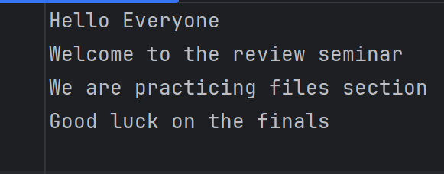
Reading a file : Readline
Returns the current line of the file as a string and file pointer is updated.
If at EOF it returns an empty string and leaves the file pointer unaffected.
with open(“sample_txt.txt”) as file1:
file1.readline()
file1.readline()
file1.readline()
file1.readline()
file1.readline()
file1.readline()

Slide 16
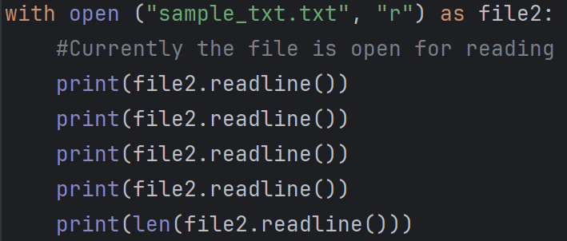
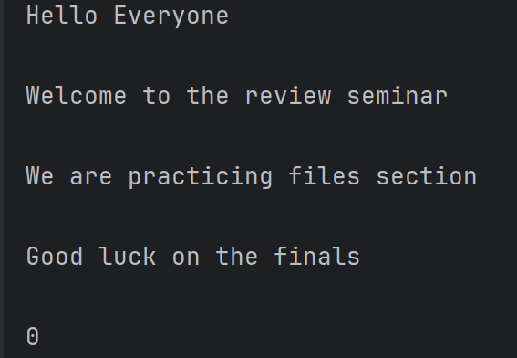
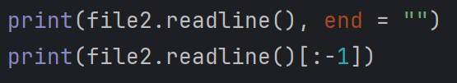
Readline continued
The readline also reads the ‘\n’ character at the end of each line.
The print line by default also adds a ‘\n’ to the string to be printed in the console.
Fixes:
Which is better and why?

Slide 17
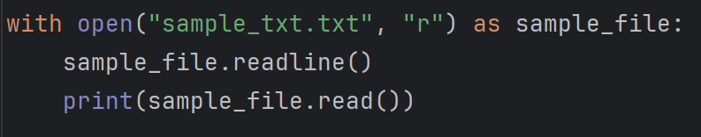
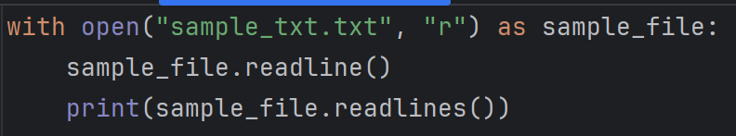
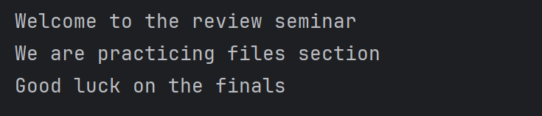
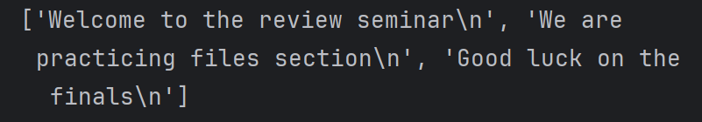
Other read operations
file_object.read()
Returns the entire file content starting from the current line as a single string.
file_object.readlines()
Returns a list of strings which are all the lines starting from the current line.

Slide 18
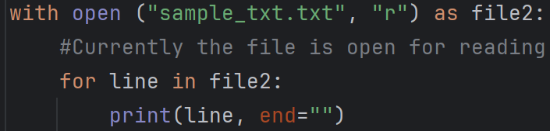
File Reading
Another way of reading a file :

Slide 19
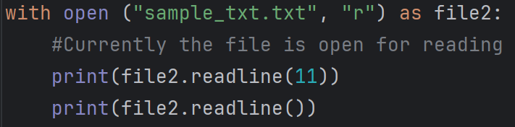


Fun fact
readline, readlines and read
takes an optional int argument ‘size’ to specify how many character/bytes you want to read. By default it is set to ‘-1’
1 11
Careful about how the file pointer is affected in your read operations
Output

Slide 20
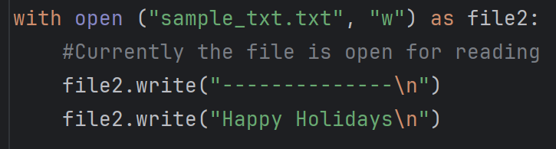
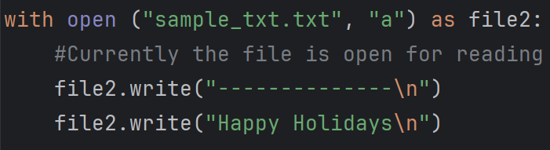
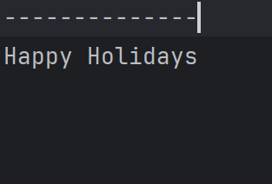
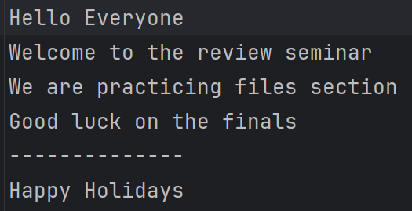
Writing to a file
file_obj.write(“str”) : Writes a string to the file opened by file_obj
You need to manually add the ‘\n’ to go to the next line

Slide 21
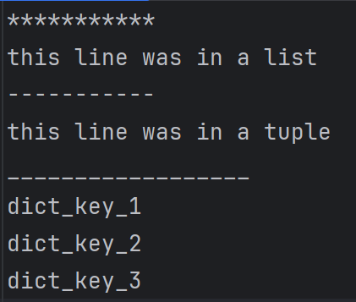
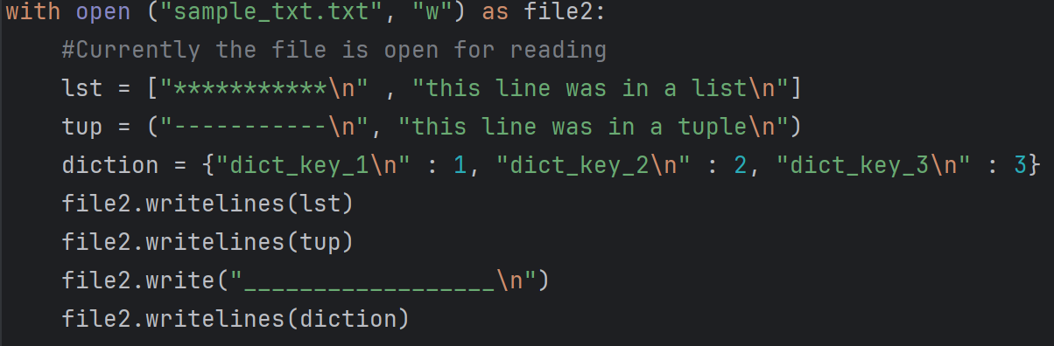
Writing to a file
file_obj.writelines(iterable) : Writes multiple lines by iterating over the iterable object specified.

Slide 22
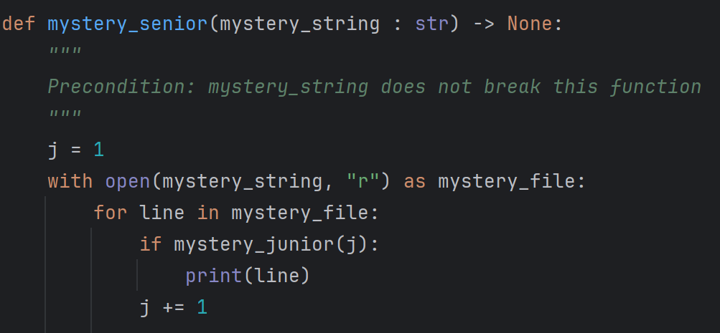
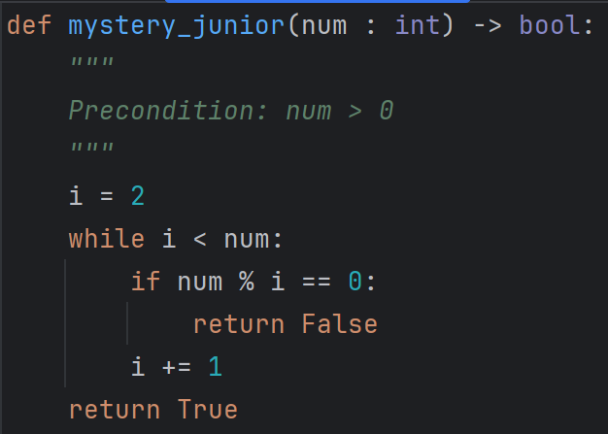
Practice Problem : Mystery Function
Prints all lines in the file ‘mystery_string’ for which the line number is not divisible by any integer smaller than ‘num’ and greater than 2.
Returns True iff ‘num’ is not divisible by any integer smaller than ‘num’ and greater than 2.
Returns True iff ‘num’ is a prime number or 1

Slide 23
Part 3: Algorithm Analysis

Slide 24
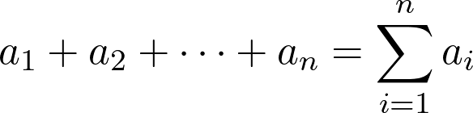
Useful Prereq: Summation Notation
You’ll need it in the future if you haven’t learnt it already … Not really needed for this course but makes things A LOT easier
Start at i = 1, stop exactly at i = n

Slide 25
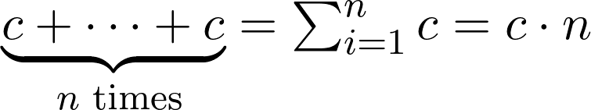
Useful Prereq: Arithmetic Series
Arithmetic sequence: a sequence of numbers where the difference between each term is constant
Arithmetic series: the total sum of all numbers in an arithmetic sequence
Very useful for counting iterations for programs
We give you the following formulas

Slide 26
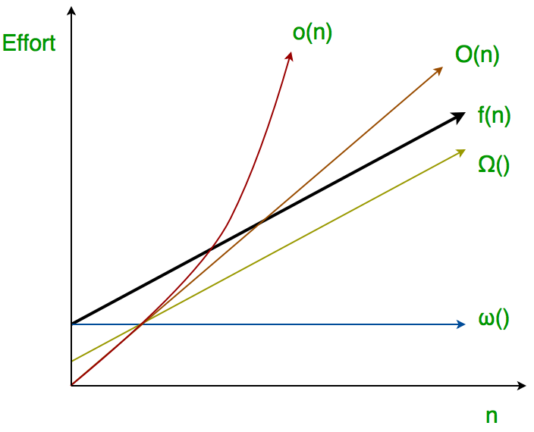
Analyzing Algorithms
When analyzing algorithms, you were taught to look at the runtime complexity of some functions.
How do we measure how efficient our program is?
  We count the # of operations or steps for a given input size
What are our operations or steps?
  Depends on the context
  Is specified during the exam
  I.e. #of arithmetic operations, #of iterations of a loop
What is the input size?
  Can be the size of a list, string, tuple, etc.

Slide 27
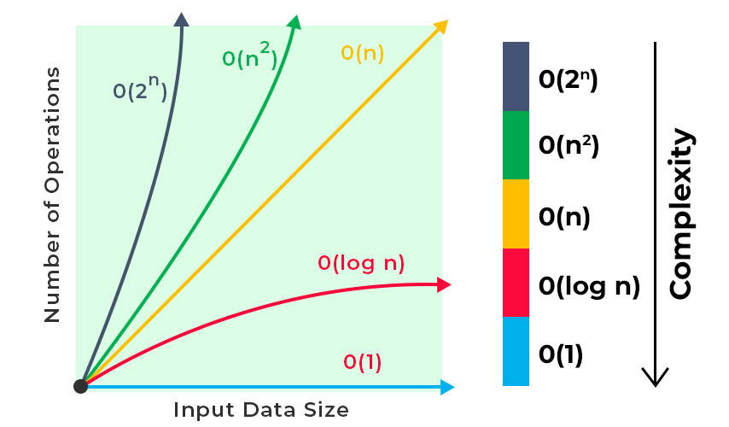
Common types of ‘growth’
NOTE: YOU ARE NOT REQUIRED TO KNOW ALL OF THESE! WE WILL POINT OUT THE ONES YOU SHOULD KNOW!
Linear O(n): The code ‘grows’ directly with input size.
Quadratic O(n^2): The code ‘grows’ with the square of the input.
Constant O(1): When the code doesn’t depend on input size.
Is ‘constant’ with respect to the size.

Slide 28
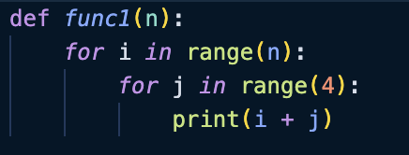
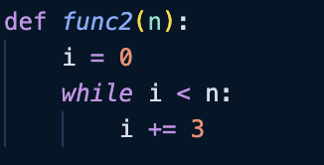
Try it out…
How many iterations of each loop is roughly preformed?
(A) 4n (B) n (C) 4 + n (D) none of above
(A) n/3 (B) 3n (C) log(n) (D) none of above

Slide 29
Some terms to know…
On your test, exam or worksheets, some common terms will pop up that you should know…
BEST RUNTIME CASE: The case with the ‘least’ #of steps.
WORST RUNTIME CASE: The case with the ‘greatest #of steps.

Slide 30
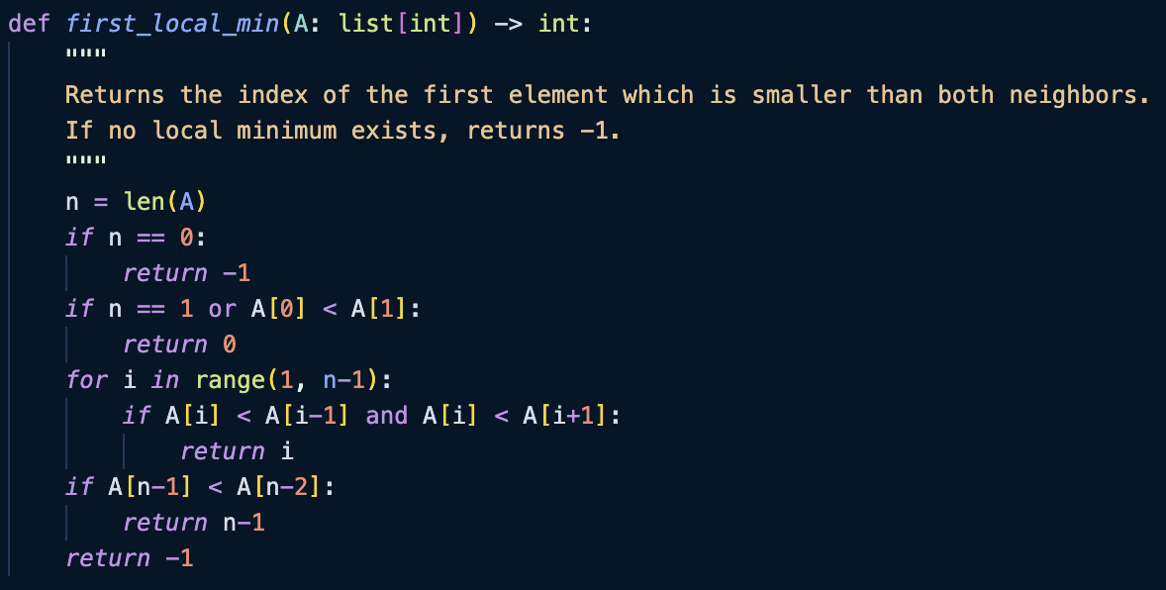
Try it out…
What is the best and worst case scenario of both functions, in terms of #conditional statements checked? [A IS NON EMPTY, len(A) >= 1]

Slide 31
Try it out…
What is the best and worst case scenario of both functions, in terms of #conditional statements checked? [A IS NON EMPTY, len(A) >= 1]
We consider in both cases, array of the same size, n.
BREAK DOWN THE ALGORITHM…
If the length of the array is zero, we return -1
  One check
If the zeroth element in the array is less than its neighbour, we return zero OR the length of the array is 1
  One to two checks
Else, we iterate and find the neighbour
  # checks varies per amount of iterations done

Slide 32
Try it out…
What is the best and worst case scenario of both functions, in terms of #conditional statements checked? [SUPPOSE A IS NOT EMPTY]
We consider in both cases, array of the same size, n.
BEST CASE…
  If n == 1
    We return early, giving 2 checks
  If n > 1…
    If we let A[0] < A[1], we return early, giving 3 checks

Slide 33
Try it out…
What is the best and worst case scenario of both functions, in terms of #conditional statements checked? [SUPPOSE A IS NOT EMPTY]
We consider in both cases, array of the same size, n.
WORST CASE… (consider n > 1)
  We let A = [ 100, 99 …. 1]
    Let A be a strictly decreasing sequence of numbers
  First two if statements are FALSE = 3 checks
  We iterate through the loop FULLY
    A total of [ (n-1) - 1 ] = n - 2 times
    We have two checks in each loop, giving 2(n-2) checks
  Our final if statement runs = 1 CHECK
TOTAL # CHECKS = 3 + 2(n-2) + 1 = 2n

Slide 34
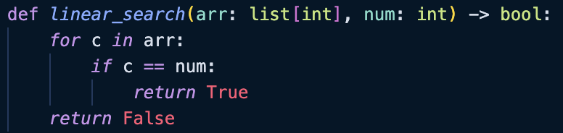
Linear Search
Linear search involves iterating through the entire array, arr until you find the element you want, num.
In terms of the # of iterations…
BEST CASE: When arr[0] == num, or arr is empty!
WORST CASE: When the last element in arr is num, or num is NOT in arr.

Slide 35
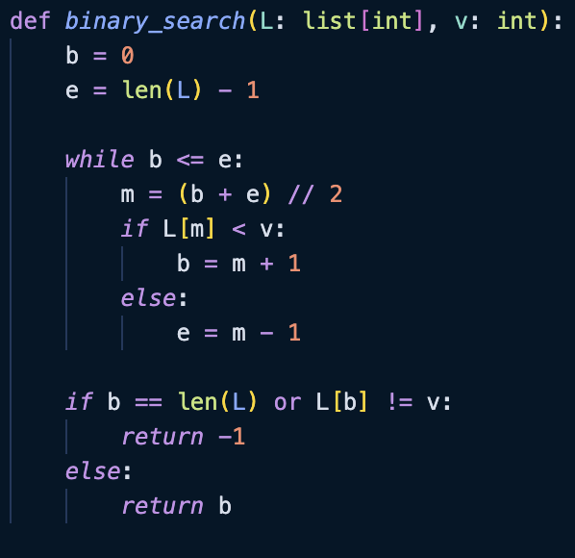
Binary Search
Binary search also searches for the element you want, but differently. REQUIREMENT: LIST MUST BE SORTED!!
We initialize b and e to be the starting and ending indexes of our list
  This is our search interval!
Compute the middle index of the interval m
  If L[m] < v…
    V must be to the right as the array is sorted
  Else…
    V could be at m, or to the left (so we move e down)
At the end, b is the smallest index which v will be found, or is invalid (out of bounds OR not v)
This version searches for the FIRST OCCURENCE of v.

Slide 36
Binary Search
I.e. Searching for v = 30
10 | 20 | 30 | 40 | 50 | 60 | 70 | 80
m = (0+7)//2 = 3
L[m] > v so e = m-1
0 1 2 3 4 5 6 7
10 | 20 | 30 | 40 | 50 | 60 | 70 | 80
m = (0+2)//2 = 1
L[m] < v so b = m+1
0 1 2 3 4 5 6 7
10 | 20 | 30 | 40 | 50 | 60 | 70 | 80
m = (2+2)//2 = 2
L[m] == v so e = m-1
0 1 2 3 4 5 6 7
We break out of the loop, and return b as L[b] == 30!

Slide 37
Selection Sort (REFRESHER)
Idea:
Divide list into sorted and unsorted portions – How?
Loop over each item in the list:
  For the item at index i, find min(L[i:])– the smallest item of L[i:]
  Swap min(L[i:])and L[i]
  After each iteration, L[:i + 1] will be unsorted and L[i+1:] will be sorted
Please don’t use the min function on the exam :)
Update after seminar: fixed unsorted vs. sorted portion

Slide 38
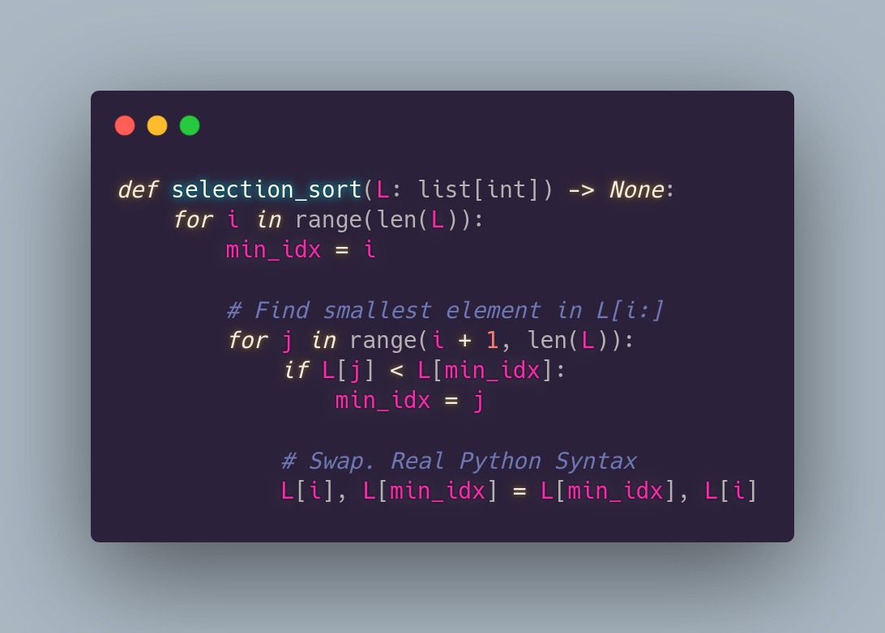
Selection Sort – Python Code

Slide 39
Selection Sort – Analysis
Suppose that len(L) = n. We would like to count the number iterations.
Observe that there are no early exits in the algorithm – Best Case, Worst Case, and Average Case are all the same.
Outer loop: one iteration for each element => runs n times
Inner loop: On the ^{i}th iteration of the outer loop, the inner loop runs n-1-(i+1)+1 = n-i-1 times. How? Calculate: “end index” - “start index” + 1
The end index is inclusive. e.g., if the range ends at n, the end index will be n-1

Slide 40
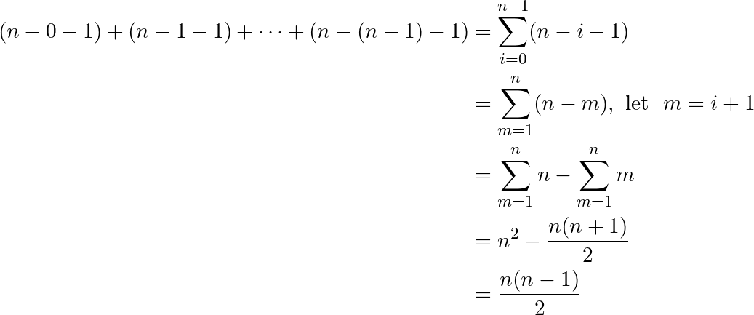
Selection Sort – Analysis (CONT.)
Note: Indices of outer loop start at 0 and end at n-1
Total iterations:
If m = i + 1, then
i = 0 => m = 0 + 1 = 1
i = n - 1 => m = (n - 1) + 1 = n
PLEASE ask if you are confused
Notice the n² term. Therefore, we have quadratic running time
Fix after seminar: note about indices only applies to outer loop

Slide 41
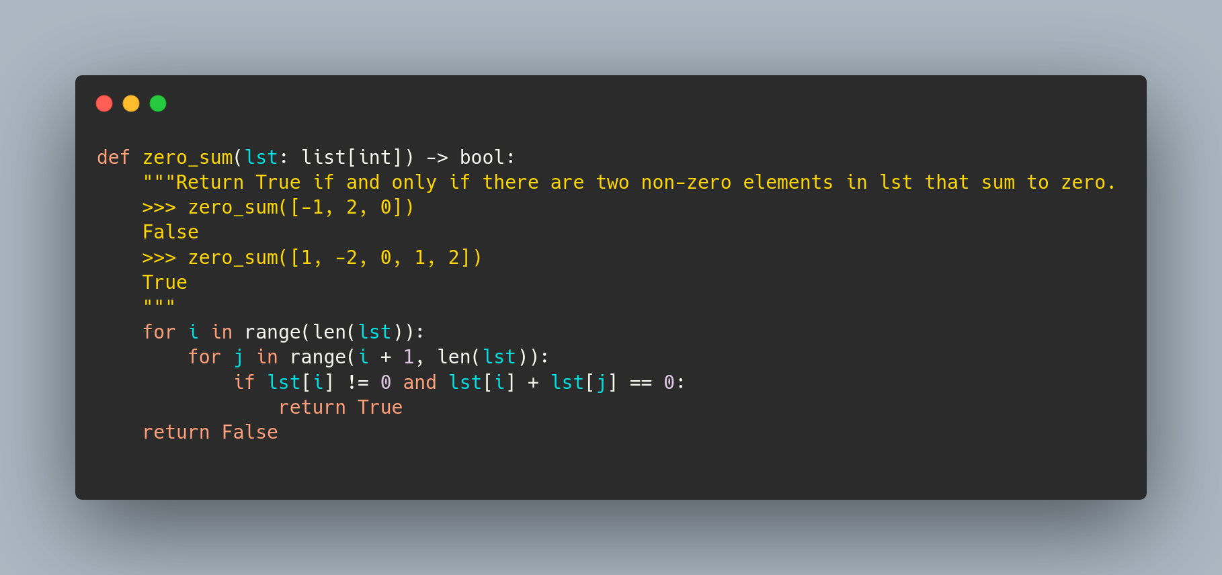
Past Exam Question (F23)
Count comparisons: != and ==
We want: # of comparisons in worst case given len(lst) = n

Slide 42

ANSWER
Worst case: no early exit, all code runs. No two nonzero elements sum to zero, or only last two elements are nonzero and sum to zero.
Outer for loop: will run with indices from 0 to n-1 (i.e., n times)
Inner loop: for ^{i}th iteration of the outer loop, inner loop runs (n-1)-(i+1)+1=n-1 times. The inner loop has 2 comparisons, namely != and ==.
Number of comparisons:
Quadratic run time!
Fix after seminar: added additional scenario for worst case

Slide 43
Past Exam Question (AGAIN) (F23)
Count comparisons: != and ==
We want: # of comparisons in best case given len(lst) = n

Slide 44
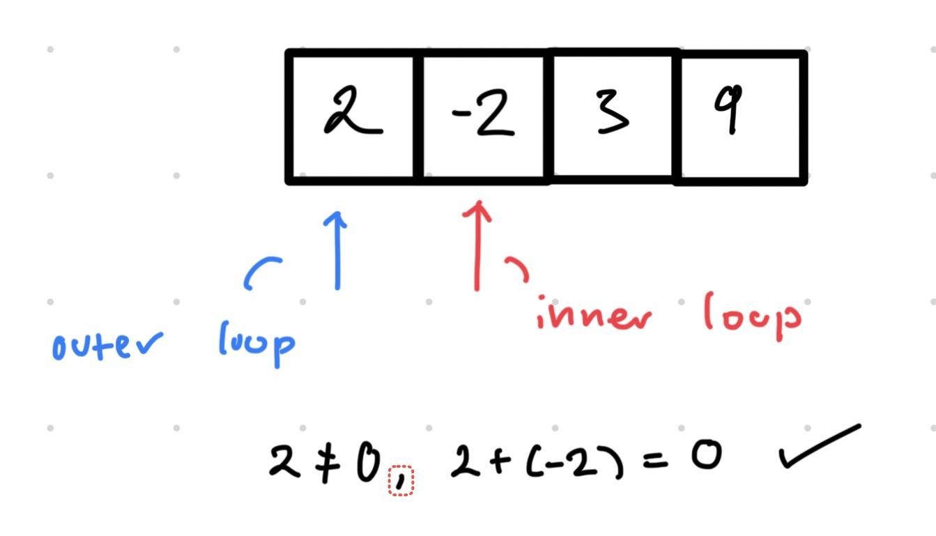
ANSWER
First two elements are nonzero and sum to zero. e.g.,
If-statement only needs to run once => 2 comparisons. Constant run time

Slide 45
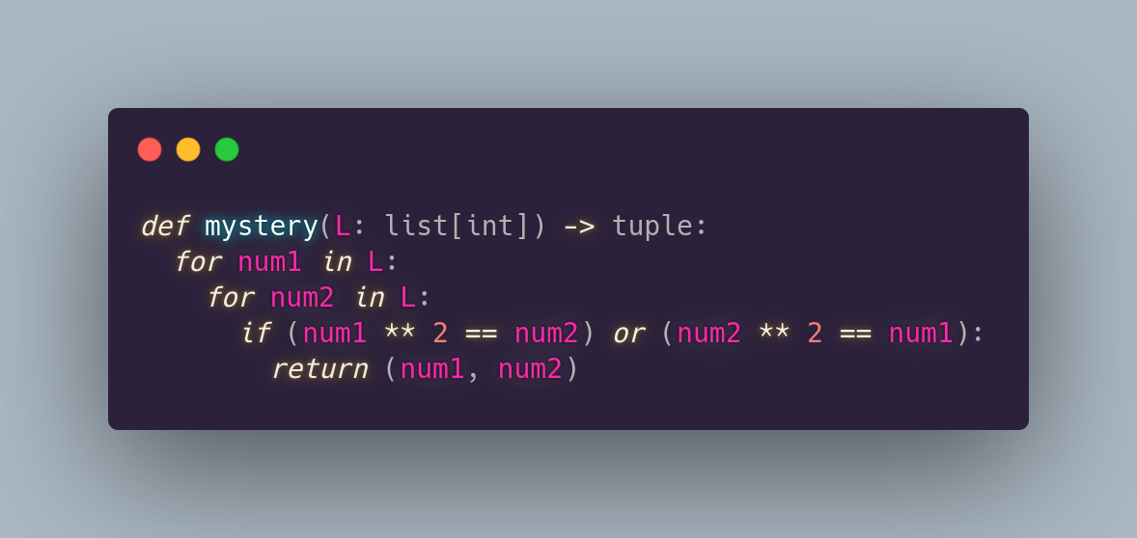
Past Exam Question (W 2024)
How many comparisons would be executed on one call to this function with an argument of length n that produces the worst-case? Explain and show all your work. Is the worst-case constant, linear,
or quadratic?
Note: 1 if statement is 1 comparison
Fix after seminar: clarified what a comparison was

Slide 46
Answer
Worst case: We are assuming the worst case scenario, meaning that there is no early exit. Hence, every line of code is executed.
Worst case happens when none of the elements is another elements square. (or last and only last element is the square of itself e.g., 0 or 1). – Early exit will happen at end

Slide 47
Answer
Outer loop: one iteration for each element in the list – since len(L) = n (as given in the question) we have n iterations of the outer loop
Inner loop: similarly, there are n iterations of the inner loop.

Slide 48
Answer
Total Comparisons: There is one comparison for each iteration of the inner loop. The inner loop runs n times for each iteration of the outer loop. The outer loop runs n times. Therefore, there are n x n x 1 = n² comparisons in the worst case.
Linear, Constant, or Quadratic? Quadratic – note the n² term in the n.o. Comparisons
Note: If we counted a == as a comparison, there would be 2n² comparisons. False values do not cause short-circuit evaluations with the or operator
Fix after seminar: clarified n² vs 2n² confusion. Removed redundant repetition

Slide 49
Part 4: Test Cases & Unit Testing

Slide 50
Intro to Testing
Testing is used to confirm the correctness of an application. There are many types of testing but we will focus on unit tests.
Unit Tests - used for testing in isolation
Doctest
  Mainly as an example
  Around 3-4 examples
Unit Testing (Preferred)
  Better Maintainability
  As many as needed/wanted
  Can test more conditions

Slide 51
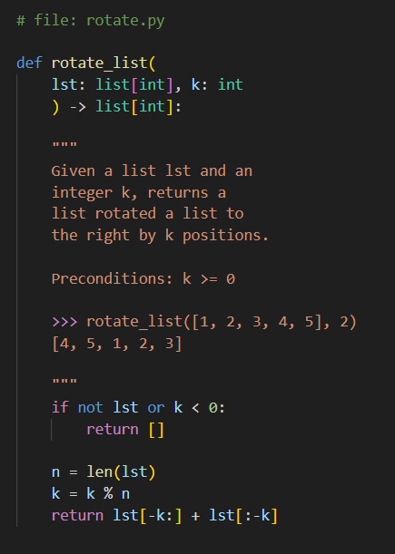
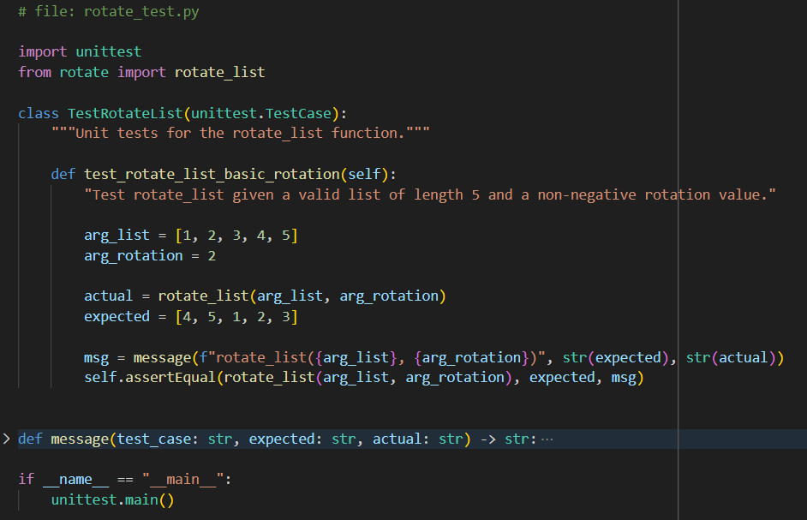
Unit Tests - UnitTest Module
UnitTest Summary
Import the unittest module
Test file in same folder (directory) as the function
Each function tested is its own TestCase class, with each function being a different test case
Modules vs Libraries vs Packages
if __name__ == “__main__”
Notes:
Going to highlight a bun

Slide 52
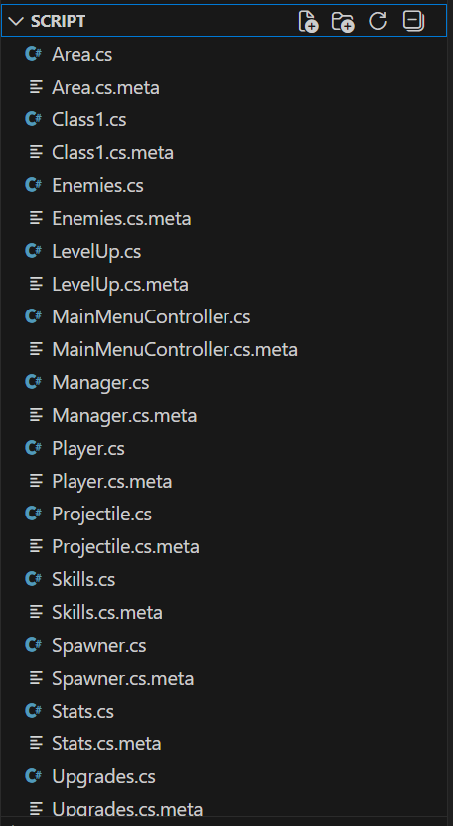
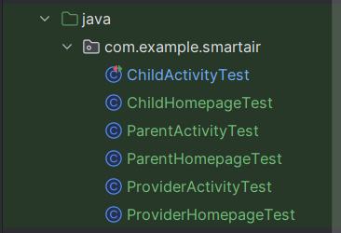
File Structure

Slide 53
Choosing Test Cases
Know what the function does
  Strings? Numbers? Floats? Lists?
  Mutation?
  Loops?
Forget how the function works
Test with valid inputs
One test for each test case
Write as many as you can think of

Slide 54
Input and Output of Functions
Strings
  Empty
  Single/Many
  Upper/lowercase/special characters
Numbers
  Zero
  Positive/negative/even/odd
  Decimals ( if allowed )

Slide 55
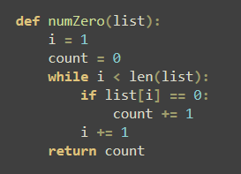
Input and Output of Functions
Mutation
  Check if original list is mutated
Lists/Dictionaries
  Empty
  Single/Many
  Combination of all allowed inputs
Loops
  Off by one errors

Slide 56
Test Case Examples
def containsElement(lst: List[int], item: int) -> boolean:
>>> returns whether the item appears in lst
Description | lst | item | Return

Slide 57
Test Case Examples
def containsElement(lst: List[int], item: int) -> boolean:
>>> returns whether the item appears in lst
Description | lst | item | Return
Empty list, any integer | [] | 5 | False
Element appears as the only item in the list | [5] | 5 | True
List has one element, but item does not appear | [5] | 4 | False
List has multiple elements, and item appears | [1, 2, 3, 4, 5] | 4 | True
List has multiple elements, but item doesn't appear | [1, 2, 3, 4, 6, 7] | 5 | False

Slide 58
Test Case Examples
def mergeSort(lst: List[int]) -> None:
>>> sorts the list ‘lst’ according to merge sort
Description | lst | Return

Slide 59
Test Case Examples
def mergeSort(lst: List[int]) -> None:
>>> sorts the list ‘lst’ according to merge sort
Note: Merge sort divides the list by two and arranges each half
Description | lst | Modified lst
Empty list | [] | []
Single element list | [2] | [2]
Many element list, all the same number, even length | [3, 3, 3, 3] | [3, 3, 3, 3]
Many element list, all negative, odd length | [-3, -5, -7, -1 -2] | [-7, -5, -3, -2, -1]
Many element list, mixed | [1, 4, 0, -5, 9, -2] | [-5. -2, 0, 1, 4, 9]
Many element list, already sorted | [1, 2, 3, 4, 5] | [1, 2, 3, 4, 5]

Slide 60

Acknowledgments
We would like to thank, Ben (AMACCS Director of CS) and Professor Purva Gawde for providing us lecture notes to use as a basis for the review seminar.

Slide 61

Feedback Form!
Please fill out the feedback form below:

