Slide 1
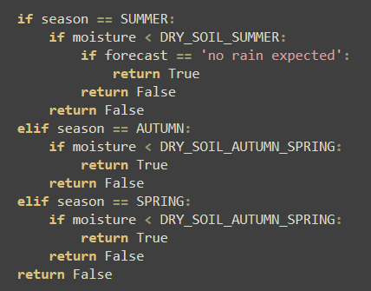
Explanation
Things to remove: Unnecessary else statements

Slide 2


CSCA08 Midterm Review
Seminar
Nov 4th, 2025
18:00 - 20:00
Course Reps: Kevin, Zohair Syed, Krisha Patel, Nathanael Kevin Sitepu
PRESENTED BY

Slide 3

What would you like us to cover first?
Please fill out this poll to rank the topics you want us to review.
You can scan the QR code to the right or go to this link:
https://www.menti.com/aln5t7odibcj
Or you can go to menti.com and enter to code 8660 7727

Slide 4
Part 1: Variables, Design Recipe
& Conditional Statements

Slide 5
Memory Model
A way of representing current execution of code. Think of it as a big ‘box’ with lockers, each containing a value and memory address.
Id1: int
10
id1
x = 10
y = 20.5
x = x + y
lst1 = [x, y]
id3
X
Y
lst1
Id2: float
20.5
id2
Id3: float
30.5
id4
Id4: list
id1
id3

Slide 7
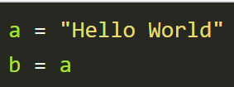
Aliasing
When multiple variables refer to the same object in your memory.
In these example ‘b’ is our Alias
What happens when we try to modify an alias(in this case ‘b’)?
A new object gets created if we are dealing with Immutable data types.
The same object gets modified dealing with mutable data types.
Some built-in methods might be an exception to this rule of thumb.
Refer to the helpsheet if you encounter an unfamiliar built-in method.

Slide 8
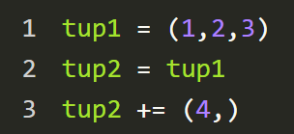
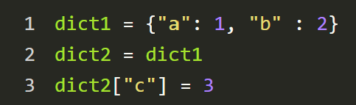
Aliasing in Immutable object
Aliasing in Mutable object
After executing line 3
After executing line 2
After executing line 2
After executing line 3
Id1: tuple
Id1: dict
tup1 : id1
dict1 : id1
Id2
1
Id3
2
Id4
3
Id2
“a”
Id4
“b”
Id6
“c”
tup2 : id1
tup2 : id6
dict2 : id1
Id3
1
Id5
2
Id7
3
Id6: tuple
Id2
1
Id3
2
Id4
3
Id5
4

Slide 9
Try it yourself!
What is true about the following piece of code?
x = 10
y = 20.5
y = x
lst1 = [x, y]
lst2 = [x, y]
lst3 = lst1
a) lst1 and lst2 refer to the same ID in memory
b) lst3 and lst2 refer to the same ID in memory
c) lst2[1] and lst3[1] refer to the same ID in memory
d) x and y refer to same ID in memory

Slide 10
Try it yourself!
What is true about the following piece of code?
X
Y
Lst1
Lst2
lst3
id1
Id1: int
Id2: int
x = 10
y = 20.5
y = x
lst1 = [x, y]
lst2 = [x, y]
lst3 = lst1
10
20.5
id1
Id3: list
id1
id1
id3
Id4: list
a) lst1 and lst2 refer to the same ID in memory
b) lst3 and lst2 refer to the same ID in memory
c) lst2[1] and lst3[1] refer to the same ID in memory
d) x and y refer to same ID in memory
id4
id1
id1
id3
Notes:
Double check ans - i believe that instantiating two diff lists even of same content, would give two diff ids

Slide 11
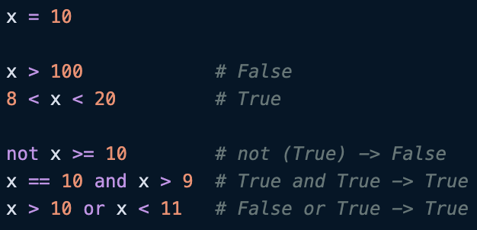
Boolean & Comparison Operators
Booleans hold a ‘True’ or ‘False’ value in Python (remember to capitalize!).
We can use operators, which evaluate to a boolean. This is useful in our conditional statements
Comparison Operators | <, >, ==, !=, >=, <=
Logical operators | keywords and, or, not
or and not
Order of precedence (low to high)

Slide 12
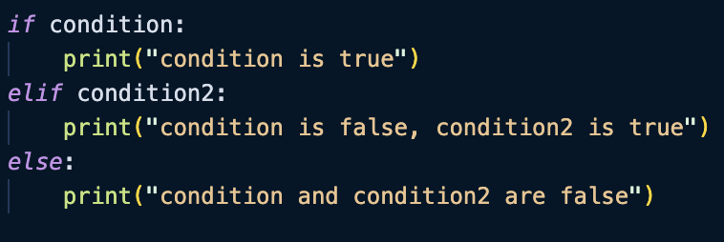
If Statements & Conditionals
If: checks the first condition. If it’s True, the code inside runs.
elif (else if): checks the next condition only if the previous ones were False.
else: runs only if all previous conditions were False.
We often use the if, elif, else sequence when amongst many conditions, we only want one statement/block to execute
It is best practice to reduce the #of if/elif/else blocks as we can for readability!

Slide 13
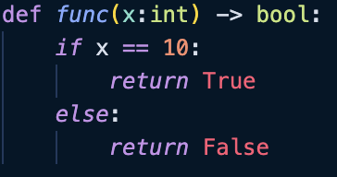
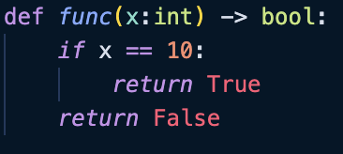
Proper usage of if, elif and else
Poor usage
Better usage
Improper use of if and else.
As we return early, we do not need the else statement at the end! We can write it in a more concise, and proper way.
This is a better way of using conditionals. Note, when x == 10, we return True and exit from function.
When x != 10, we return False, behaving the same as the block of code on the left.

Slide 14

Proper usage of if, elif and else
Optimal solution!
There’s even a better way to write our function without if!
We want to return TRUE iff x == 10
  Note that the statement x == 10 evaluates to a TRUE or FALSE value
  As we are returning a boolean, we can simply return that statement
It is best practice to reduce your conditional statements

Slide 15
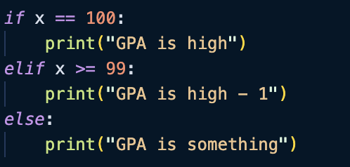
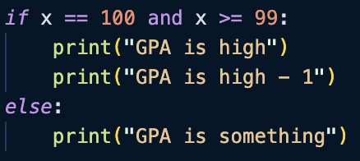
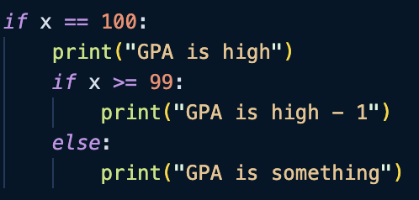
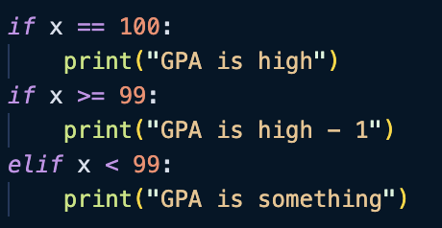
Example
Which pieces of code are equivalent? (i.e. produce same output for all values of x)
(1) and (4) B) (3) and (4) C) (1) and (2) D) None
1
3
2
4

Slide 16
Solution
Which pieces of code are equivalent?
(1) and (4) B) (3) and (4) C) (1) and (2) D) None
X | 1 | 2
101 | “GPA is something” | N/A
100 | “GPA is high” “GPA is high -1” | “GPA is high” “GPA is high -1”
99 | “GPA is high” “GPA is high -1” | “GPA is high” “GPA is high -1”
50 | “GPA is something” | N/A
1
2

Slide 17
Solution
Which pieces of code are equivalent?
(1) and (4) B) (3) and (4) C) (1) and (2) D) None
X | 3 | 4
101 | “GPA is something” | N/A
100 | “GPA is high” | “GPA is high” “GPA is high -1”
99 | “GPA is high” | “GPA is high” “GPA is high -1”
50 | “GPA is something” | “GPA is something”
3
4

Slide 18
Solution
Answer: None are equivalent!
X | 1 | 2 | 3 | 4
102 | “GPA is something” | N/A | “GPA is something” | N/A
100 | “GPA is high” “GPA is high -1” | “GPA is high” “GPA is high -1” | “GPA is high” | “GPA is high” “GPA is high -1”
99 | “GPA is high” “GPA is high -1” | “GPA is high” “GPA is high -1” | “GPA is high” | “GPA is high” “GPA is high -1”
50 | “GPA is something” | N/A | “GPA is something” | “GPA is something”

Slide 19
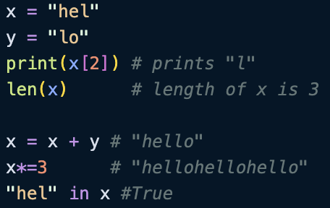
Strings and String Operations
Are IMMUTABLE!!!!! Please remember this; don’t be doing str[5] = ‘a’ !!!!!
Strings can be treated as a list of characters. This means you can access a character at a specific index (zero-indexed).
Operator | Description
str[i] | Access char at position i
len(x) | Length of string
x + y | Concatenate
x*y (y is integer) | Concat y copies of x
sub in str | Checks if sub is a substring in str

Slide 20
String Slicing
An important property is that you can slice strings…
Say I have a string x=”Hello world!”
-12 | -11 | -10 | -9 | -8 | -7 | -6 | -5 | -4 | -3 | -2 | -1
H | e | l | l | o |  | W | o | r | l | d | !
0 | 1 | 2 | 3 | 4 | 5 | 6 | 7 | 8 | 9 | 10 | 11
I can cut it using this…
‘Direction and step size’
(you’ll see what we mean :))
s[start:stop:stride]
Start index
Ending index (not inclusive)

Slide 21
String Slicing
s[start:stop:stride]
Start and stop are the starting and stopping indices (with ‘stop’ being EXCLUSIVE)
Stride refers to the step value used in slicing strings
  POSITIVE STRIDE: default values of start and stop are (start = 0, stop: len(s))
  NEGATIVE STRIDE: default values of start and stop are (start = -1, stop: -(1+len(s))
Negative stride…
  When stride is negative, you reverse the direction of ‘iteration’. You start from the end of the string!
**Think about it: what if stride is zero?

Slide 22
String Slicing
An important property is that you can slice strings…
Say I have a string x=”Hello World!”
-12 | -11 | -10 | -9 | -8 | -7 | -6 | -5 | -4 | -3 | -2 | -1
H | e | l | l | o |  | W | o | r | l | d | !
0 | 1 | 2 | 3 | 4 | 5 | 6 | 7 | 8 | 9 | 10 | 11
X =
x[0:5] # “Hello”
x[0:6] # “Hello “
x[-5:] # “orld!”
x[0:-1] # “Hello World”
x[::-1] # “!dlorW olleH”
x[::-2] # “!lo leH” #every two char
x[0:5:2] # “Hlo”
x[10:4:-1] # “dlroW ”

Slide 23
String Slicing
Let’s breakdown x[10:4:-1] # “dlroW”
-12 | -11 | -10 | -9 | -8 | -7 | -6 | -5 | -4 | -3 | -2 | -1
H | e | l | l | o |  | W | o | r | l | d | !
0 | 1 | 2 | 3 | 4 | 5 | 6 | 7 | 8 | 9 | 10 | 11
X =
Last index (4) exclusive
“ World” -> Reverse it -> “dlorW “

Slide 24
Try it yourself!
Given this string, produce the outputs with the given slices…
-12 | -11 | -10 | -9 | -8 | -7 | -6 | -5 | -4 | -3 | -2 | -1
A | M | A | C | S | S |  | 2 | K | 2 | 5 | !
0 | 1 | 2 | 3 | 4 | 5 | 6 | 7 | 8 | 9 | 10 | 11
This one
Is a bit
interesting!
x[0:len(x)] # “AMACSS 2K25!”
x[0:] # “AMACSS 2K25! “
x[0:200] # “AMACSS 2K25!”
x[-9:-8] # “C”
X[-9:-9] # “”
x[::2] # “AAS 25”
x[-1:-6:-1] # “!52K2”
x[3:6:0]

Slide 25
Try it yourself!
Given this string, produce the outputs with the given slices…
-12 | -11 | -10 | -9 | -8 | -7 | -6 | -5 | -4 | -3 | -2 | -1
A | M | A | C | S | S |  | 2 | K | 2 | 5 | !
0 | 1 | 2 | 3 | 4 | 5 | 6 | 7 | 8 | 9 | 10 | 11
This one
Is a bit
interesting!
x[0:len(x)] # “AMACSS 2K25!”
x[0:] # “AMACSS 2K25! “
x[0:200] # “AMACSS 2K25!”
x[-9:-8] # “C”
X[-9:-9] # “”
x[::2] # “AAS K5”
x[-1:-6:-1] # “!52K2”
X[3:6:0] VALUE ERROR!! (zero stride is not allowed!!!!)

Slide 26
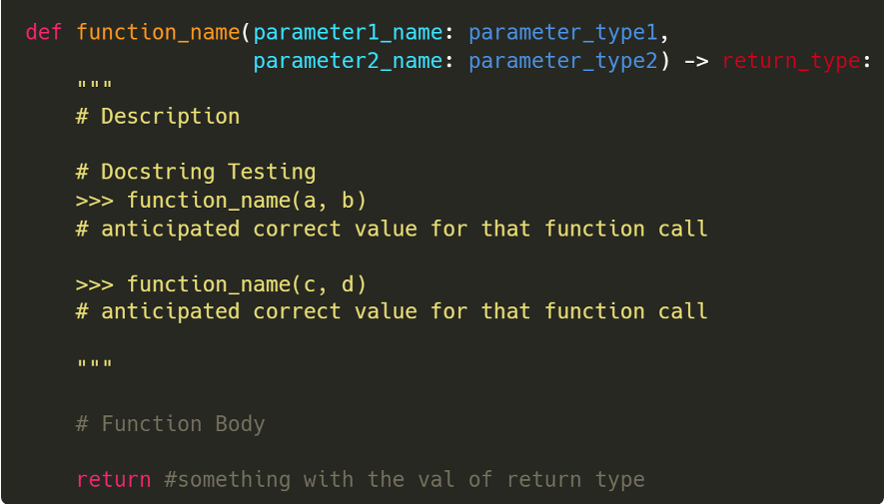
Design Recipe
Ensure to describe..
What is returned
Preconditions
What the function does
  Desc. should include parameter names
  Be detailed, yet concise
Tip: Try to start your description with ‘Return…’ and then continue your description. (Doesn’t always apply)

Slide 27
Design Recipe
DO NOT…
Describe how the function works
Be too long with your description.

Slide 28
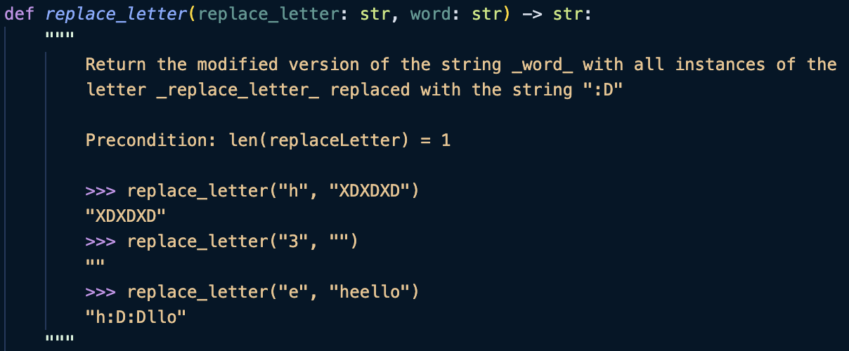
Example
TDLR: This function takes a string, replaces an instance of a given letter with “:D”

Slide 29
Example - Docstrings
When letter is not in string
String is empty
1 or more instance of letter in string
Your docstring tests should…
Have around 3~4 (or how many the question permits you to have)
Cover all cases; regular cases, edge cases
DO NOT BE REPETITIVE WITH CASES!!

Slide 30
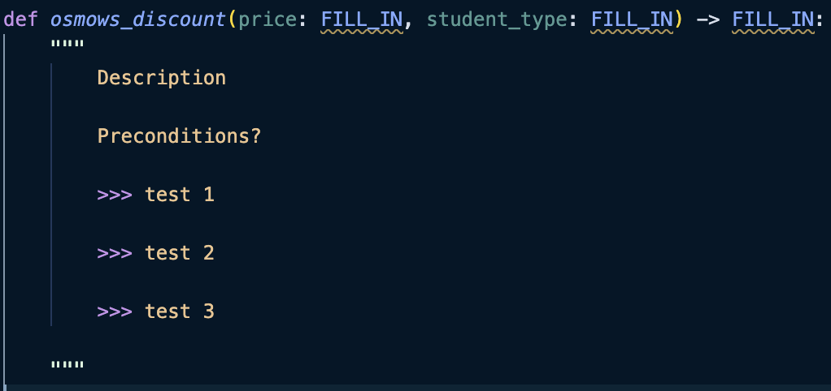
Try it yourself!
Problem Statement: Osmows UTSC is offering a discount!
UTSC-students (denoted as ‘UTSC’) can get a discount $3 off, while other UofT students (denoted ‘UofT’) can get a discount of $1 off. A non UofT student (denoted as ‘N/A’) gets no discount.
The following function below applies the discount to the price based on the student status (with the possible statuses being “UTSC”, “UofT” and “N/A”) and returns True IFF the discounted price is $5 or less, and the student goes to UofT.

Slide 31
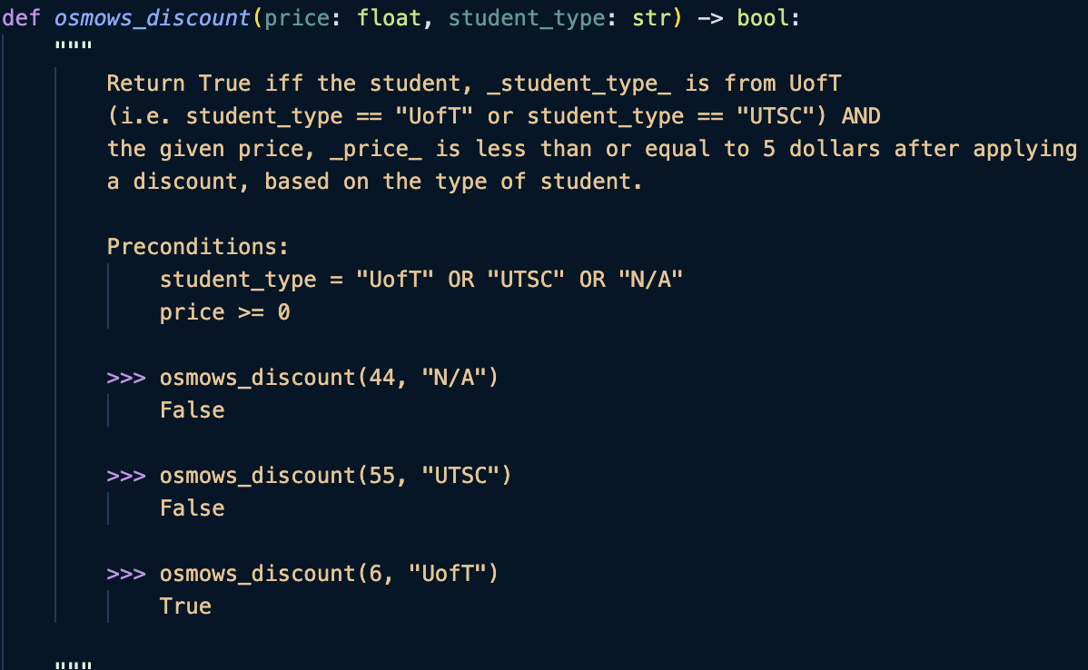
Sample Soln

Slide 32
Part 2: Lists, List and String Methods, Loops
Notes:
Loops:
For and while loops
Range function
Looping over a list
List methods
Showcase some examples of common list methods
Strings can be thought of as lists

Slide 33
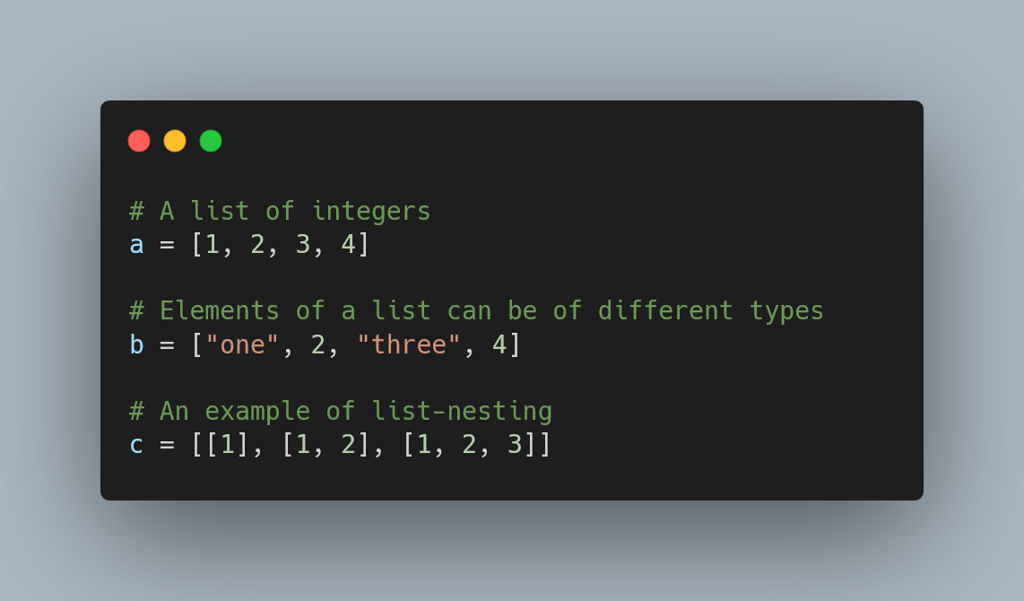
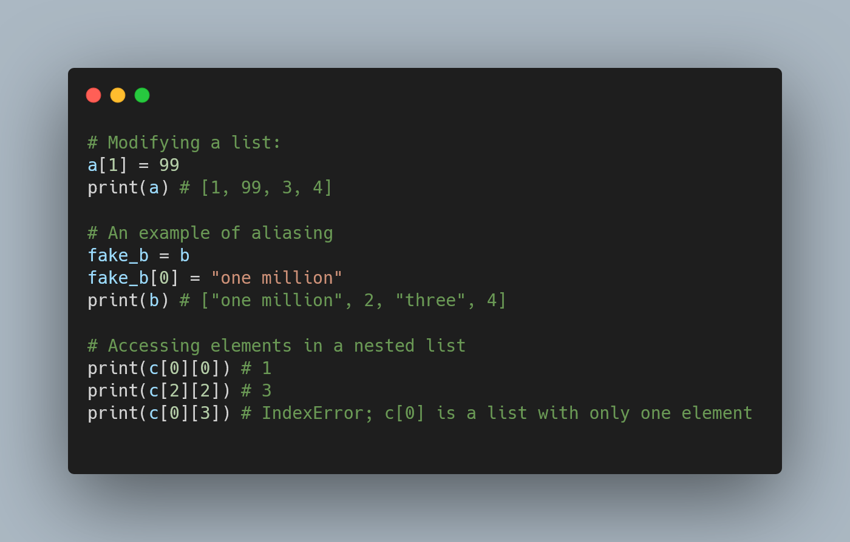
Lists
A data type that can store a collection of elements under one variable

Slide 34
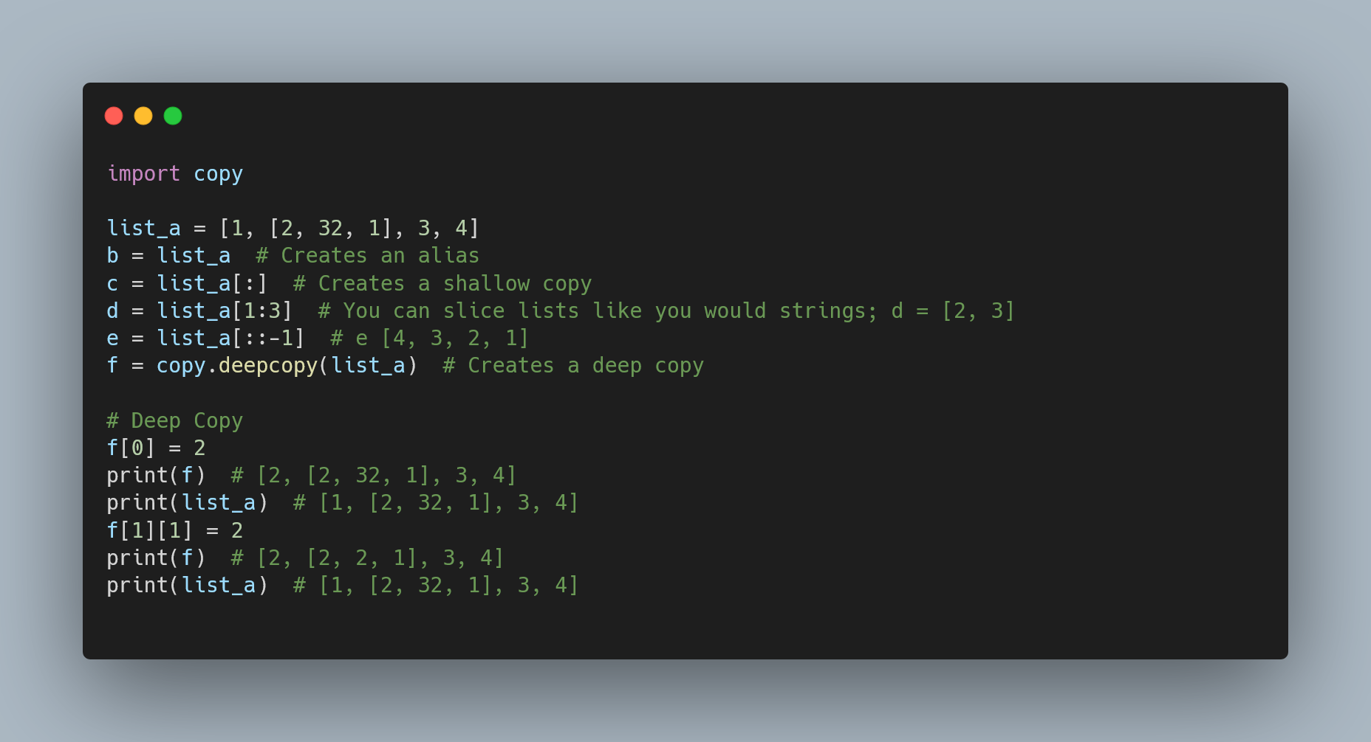
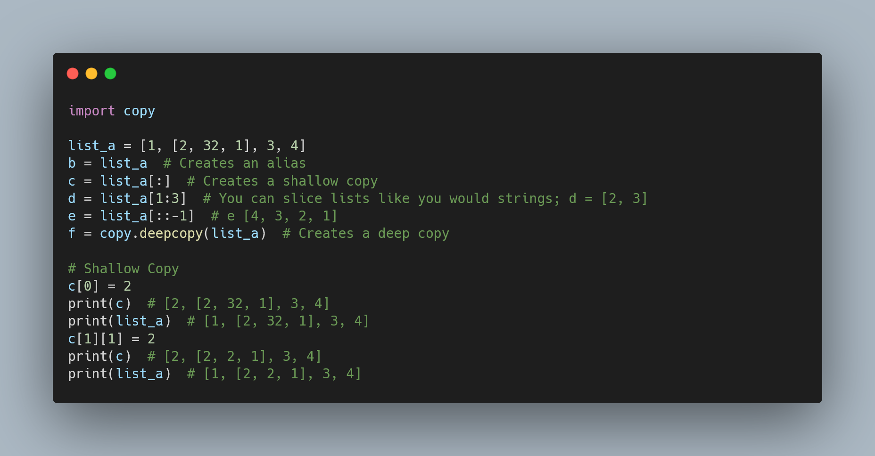
Lists - Continued
Shallow Copy: if b is a shallow copy of a, a and b are different objects in memory, but their elements refer to the same objects in memory.
Deep Copy: if b is a deep copy of a, and b are different objects in memory, and their elements refer to different objects in memory.

Slide 35
Lists - Deep Copy Example

Slide 36
Lists - Shallow Copy Example

Slide 37
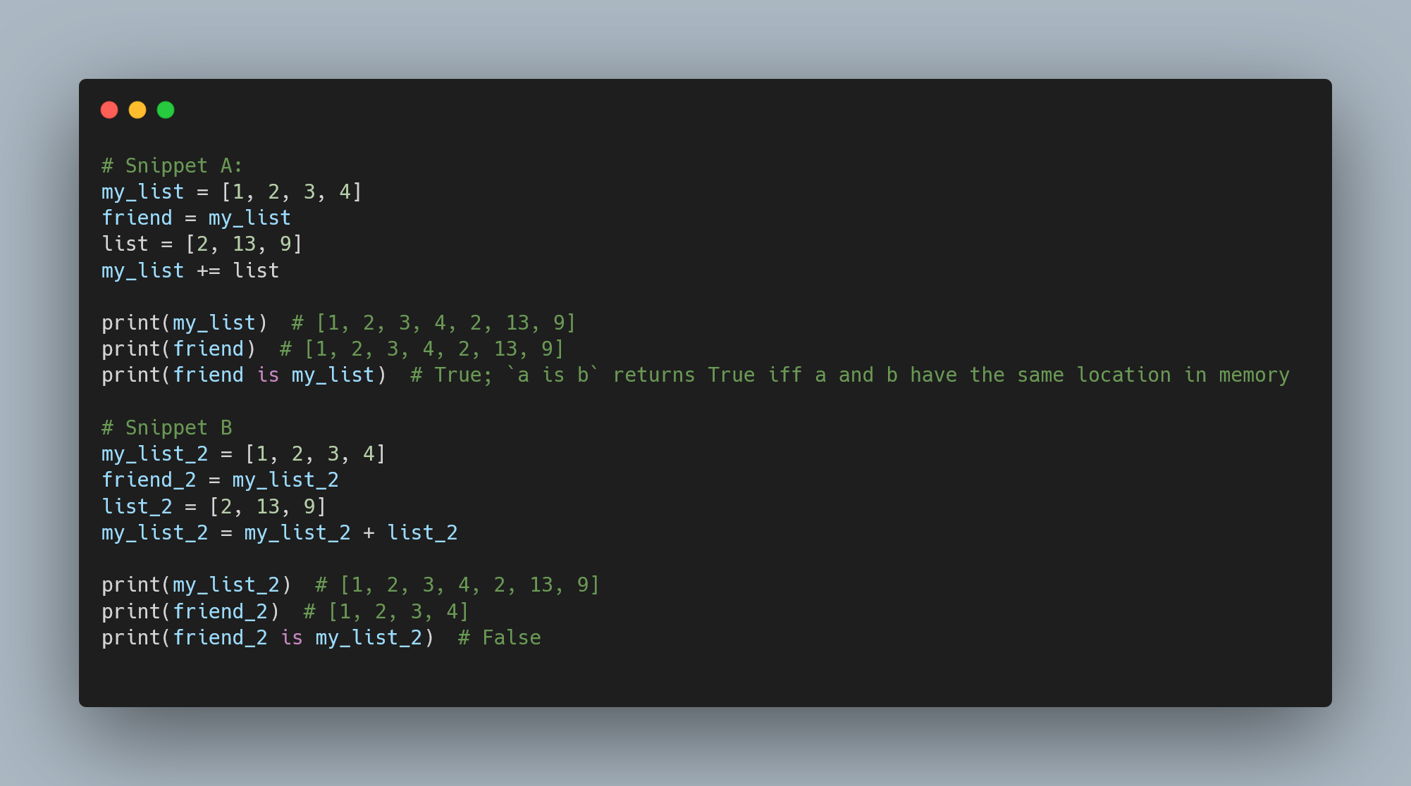
Lists - Continued
Some common stuff that trips a lot of people up:
Snippet A:
+= modifies the list. Since friend is an alias, we can see the change being reflected.
Snippet B:
my_list_2 + list_2 creates a new list in memory. Then, the assignment operator assigns this new list to my_list_2. friend_2 still points to the old object in memory.

Slide 38
Lists (Example From Last Slide)

Slide 39
Reading Documentation
One of the important parts of reading Python documentation is being able to understand the function signatures.
func_name(param_1: type_1)
func_name(param_0: type_0, param_1: type_1[, param_2: type_2])
Sometimes, you’ll get the same function defined with different parameters. This lets you call the function with different arguments. This concept is called function overloading. You’ll learn more about in CSCA48!
Bracketed [] parameters are optional.

Slide 40
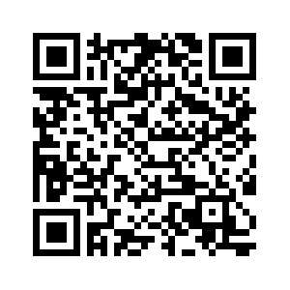
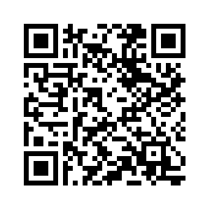
List and String Methods
Some common string methods can be found at:
https://docs.python.org/3/library/stdtypes.html#string-methods
Some common list methods can be found at:
https://docs.python.org/3/tutorial/datastructures.html
On last year’s (Fall 2024) exams, we were given a cheat sheet containing documentation for various functions and methods.

Slide 41
List and String Methods - Example
1) Past Midterm Question
Consider the following code:
text = "The quick brown fox jumps over the lazy dog"
result = text.replace('e', '3').replace('a', '@').replace('i', '_')
What will the value of result be after these replacements?
"Th3 qu_ck brown fox jumps ov3r th3 l@zy dog"
"Th3 qu1ck brown fox jumps ov3r th3 l@zy dog"
"Th3 quick brown fox jumps over the l@zy dog"
"Th3 qu_ck brown f0x jumps ov3r th3 l@zy dog"
Error

Slide 42
List and String Methods - Example
1) Past Midterm Question - Answer
"Th3 qu_ck brown fox jumps ov3r th3 l@zy dog"
"Th3 qu1ck brown fox jumps ov3r th3 l@zy dog"
"Th3 quick brown fox jumps over the l@zy dog"
"Th3 qu_ck brown f0x jumps ov3r th3 l@zy dog"
Error
Explanation
>>> "The quick brown fox jumps over the lazy dog".replace('e', '3')
'Th3 quick brown fox jumps ov3r th3 lazy dog'
>>> 'Th3 quick brown fox jumps ov3r th3 lazy dog'.replace('a', '@')
'Th3 quick brown fox jumps ov3r th3 l@zy dog'
>>> 'Th3 quick brown fox jumps ov3r th3 l@zy dog'.replace('i', '_')
'Th3 qu_ck brown fox jumps ov3r th3 l@zy dog'

Slide 43
List and String Methods - Example
2) Past Midterm Question
Consider the following code.
my_list = [1, 2, 3, 2, 4, 2]
my_list.remove(2)
my_list.reverse()
print(my_list)
What is the output in python shell after the code is executed?
[4, 2, 3, 2, 1]
[4, 3, 2, 1]
[1, 3, 4, 2, 2]
[2, 4, 2, 3, 1]
None of the above

Slide 44
List and String Methods - Example
2) Past Midterm Question - Answer
[4, 2, 3, 2, 1]
[4, 3, 2, 1]
[1, 3, 4, 2, 2]
[2, 4, 2, 3, 1]
None of the above
Explanation
>>> my_list = [1, 2, 3, 2, 4, 2]
>>> my_list.remove(2)
>>> my_list
[1, 3, 2, 4, 2]
>>> my_list.reverse()
>>> my_list
[2, 4, 2, 3, 1]

Slide 45
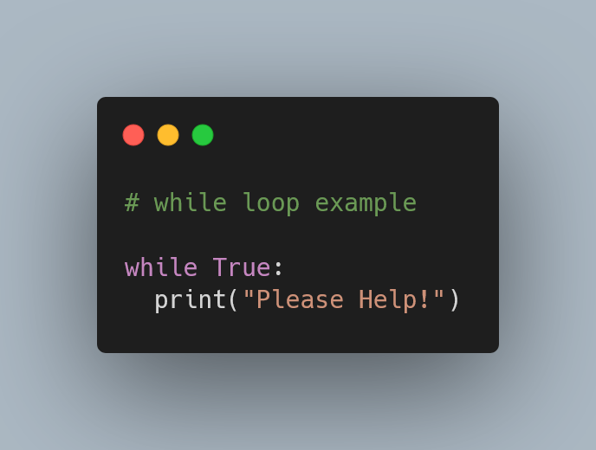
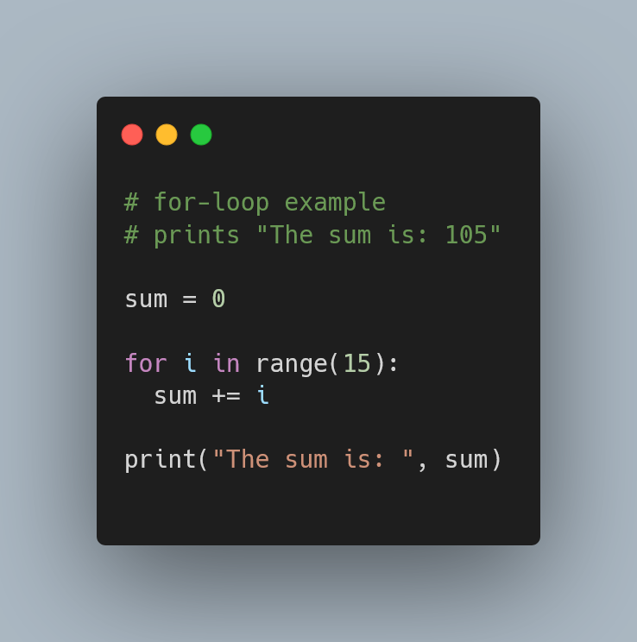
Loops
There are two main types of loops in Python: while loops and for loops
Some Terminology:
Loop body:
Code that gets executed during the loop
In Python, you must indent to indicate the loop body

Slide 46
For Loops
For loops let you iterate through each element in an iterable object using the for … in syntax.
The variable i denotes the element corresponding to the current iteration. The scope of i is limited to only within the loop body.
Iterable objects are objects with a finite number of elements; you can count the each element within an iterable object: lists, strings, and tuples are some examples.

Slide 47
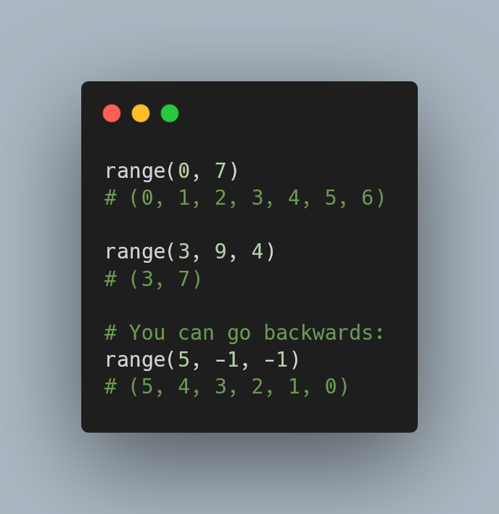
What’s range?
The range function lets you create a range object, which is an immutable sequence of numbers.
It has the following function signatures:
range(stop)
range(start, stop[, step])
The sequence starts at start, increments by step, and ends just before stop.
If start is omitted, the sequence starts at 0. If step is omitted, the sequence increments by 1.

Slide 48
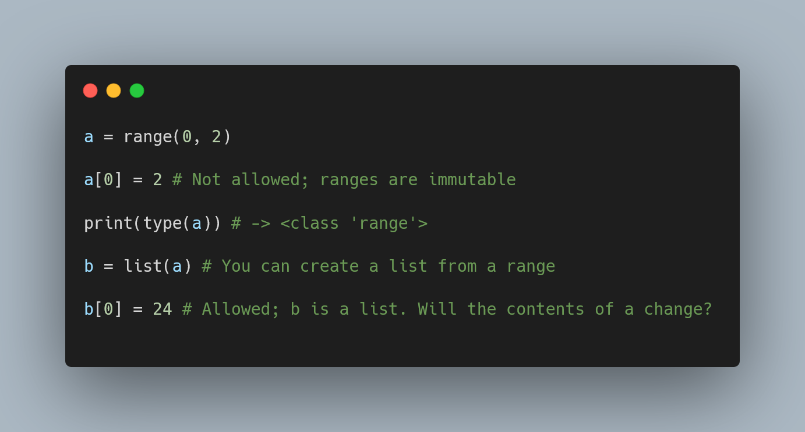
range - Continued
Gotcha:
A range is not a list
  Like mentioned before, a range is an iterable object. A list is an iterable object, but not all iterable objects are lists

Slide 49
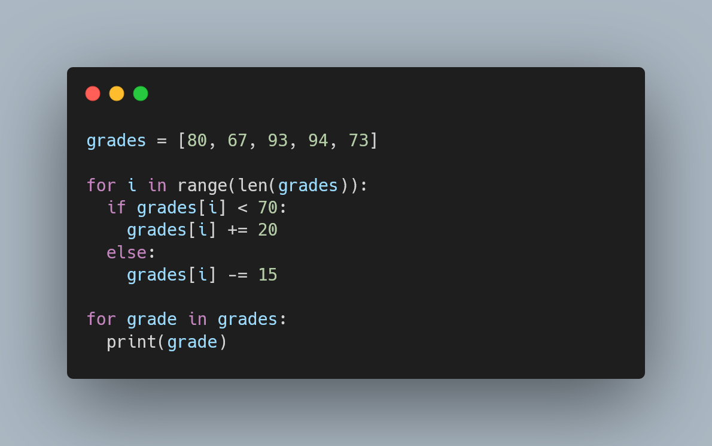
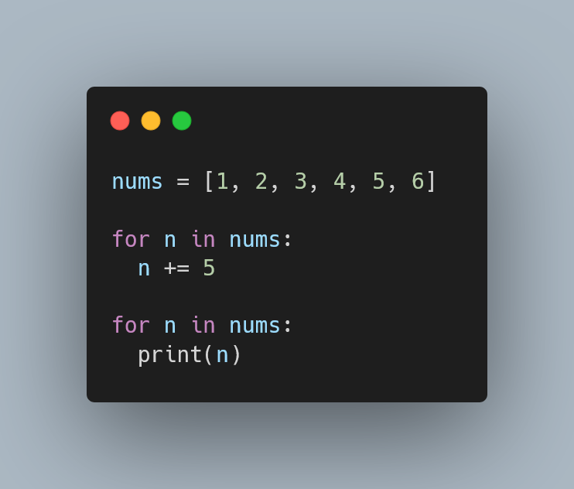
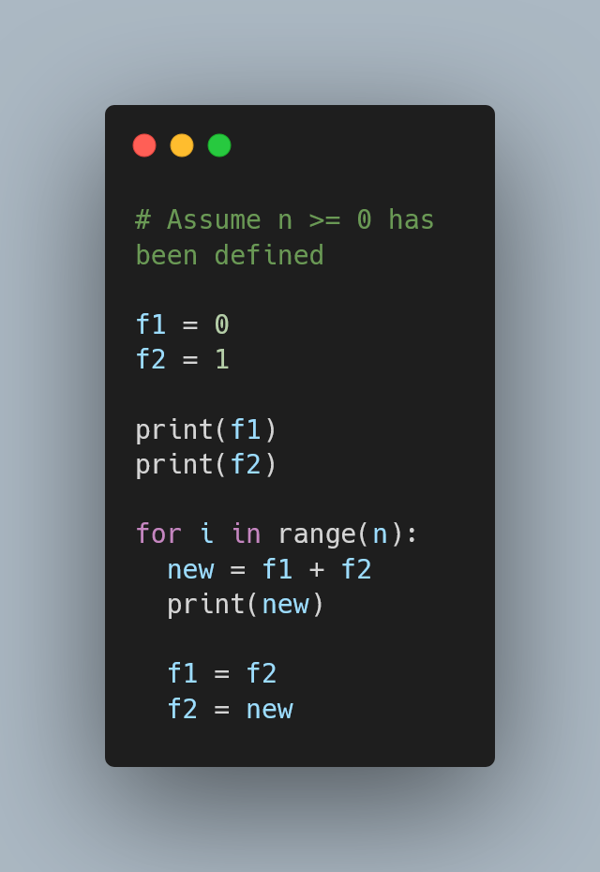
For Loops - Examples
What is the expected output of each program?
A)
B)
C)

Slide 50
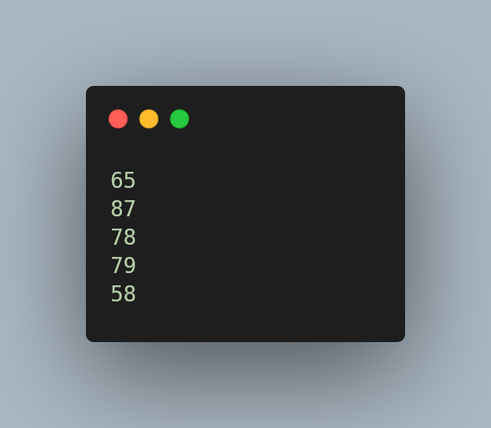
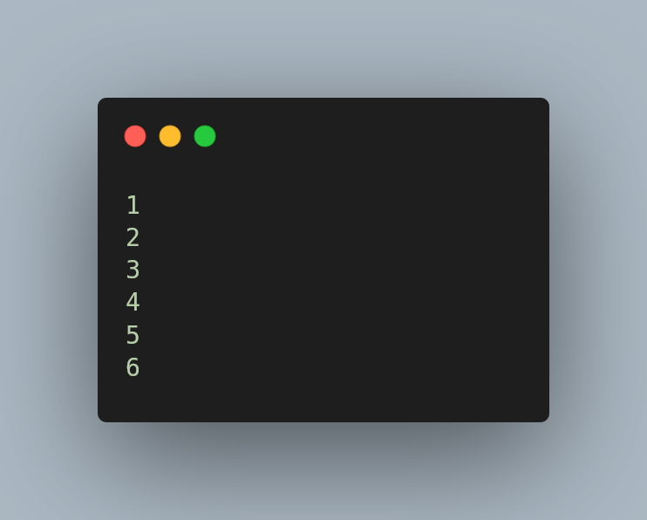
For Loops - Examples
Answers:
A)
B)
The for … in syntax creates a copy of each element; the original array doesn’t get modified.
If you are trying to mutate the list, use range to generate a sequence of indices, and use it to index into the list; see example A).
C)
The first n + 2 fibonacci numbers

Slide 51
While Loops
While loops let you run code so long as a certain condition is True.
When the condition is False, the loop terminates; it no longer runs.
This loop will never terminate. Can you see why?

Slide 52
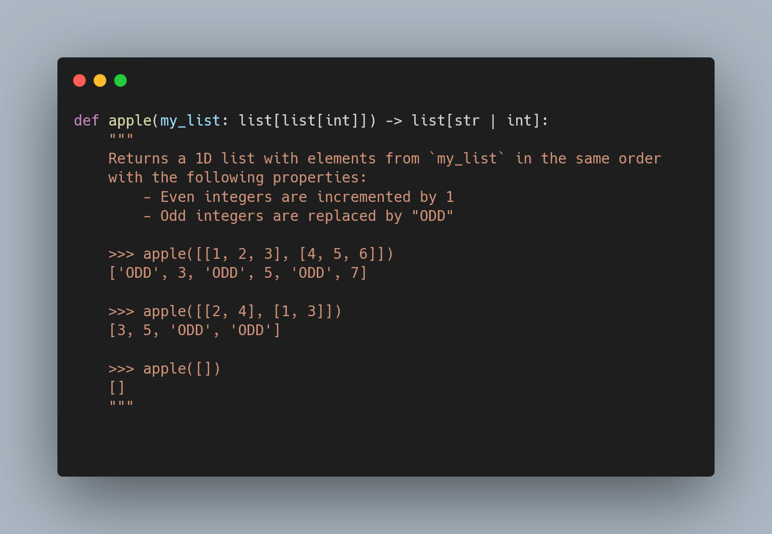
While Loops - Example
Given the following signature and docstring, implement the function. You must use a for loop and a while loop.

Slide 53
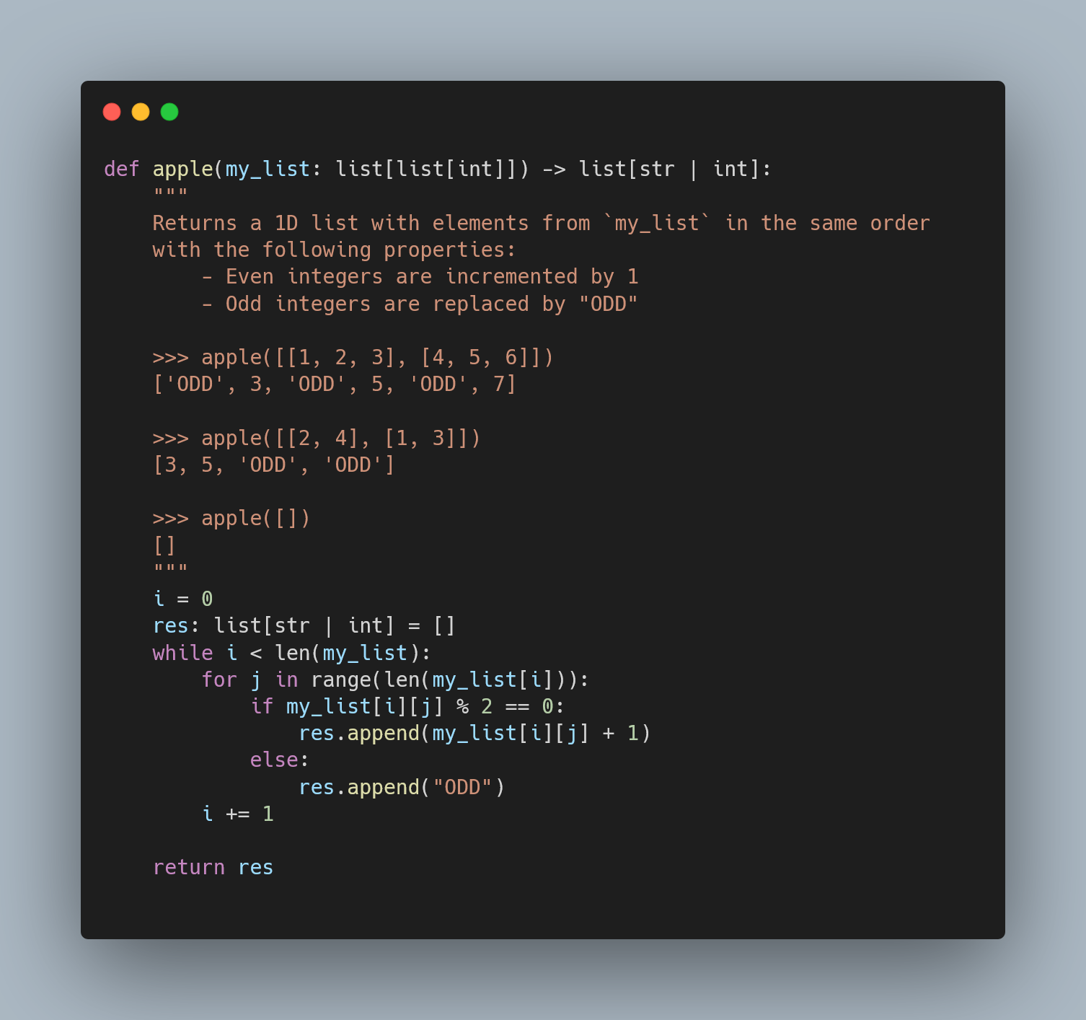
While Loops - Example
Answer:

Slide 54
Part 3: Understanding Tuples and Dictionaries
Notes:
Loops:
For and while loops
Range function
Looping over a list
List methods
Showcase some examples of common list methods
Strings can be thought of as lists

Slide 55
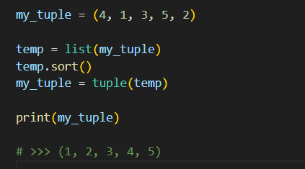
Introducing Tuples
An n-tuple is a grouped collection of n items, similar to a list, but:
They are immutable
Use my_tuple = (1, 2, 3, 4) syntax
Quick question: How do you sort the elements of a tuple?
A: Convert to a list first, then you can sort using the aforementioned list methods!

Slide 56
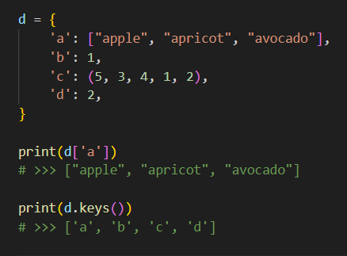
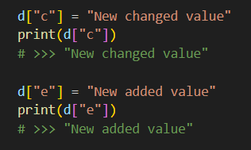
Introducing Dictionaries
A dictionary is a mapping of key-value pairs, with many helpful built-in methods

Slide 57
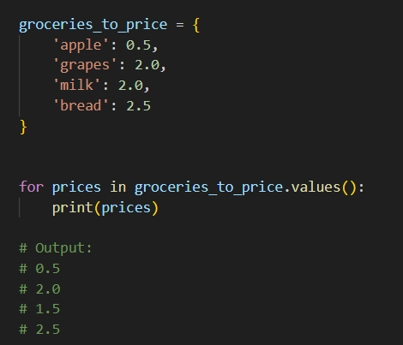
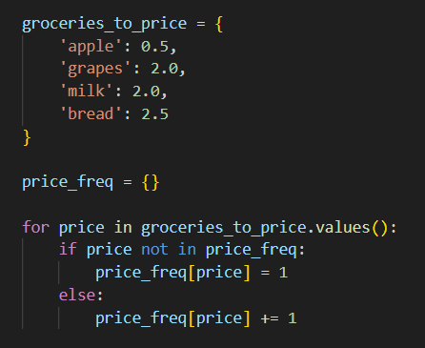
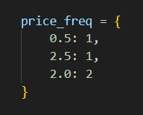
Common Dictionary Techniques
Iterate through values with .values()
Counting frequencies

Slide 58
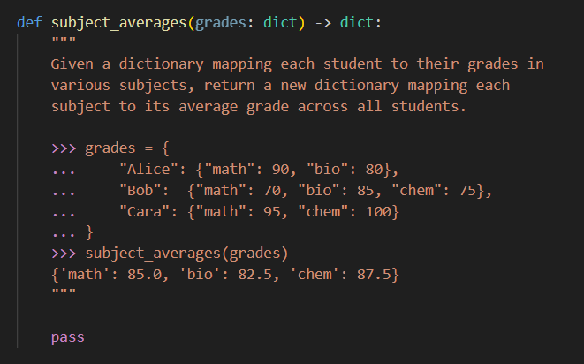
Dictionary
Question
Hints:
The keys (students) of grades aren’t needed, use .values() to loop over sub-dicts
We can use a similar counting approach as the last slide

Slide 59
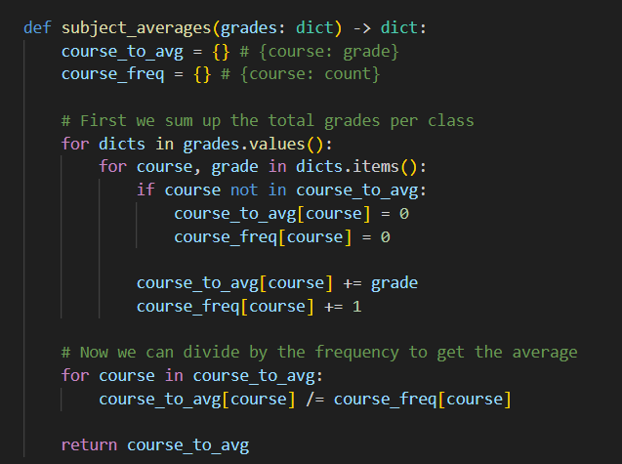
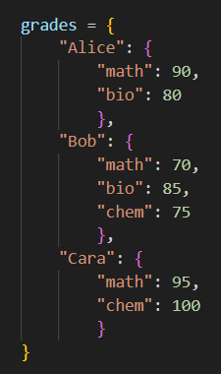
Solution

Slide 60
Reminders
Dictionaries are unordered collections. Do not try to index them
‘+=’ and ‘+’ methods aren’t defined for Dictionaries(i.e you cannot add two dictionaries)
There are only two methods defined on tuples:
count() : Counts the number of occurrences of a particular element.
index() : Looks for the first occurence of an element. Throws an error if the element is not in the tuple.
A single element tuple is defined a little differently:
>>> a = (1,)
>>> b = (1)
‘a’ is a tuple and ‘b’ is not a tuple. Then what is the type of ‘b’ here?

Slide 61
Part 4: Past Midterm Questions
Notes:
Loops:
For and while loops
Range function
Looping over a list
List methods
Showcase some examples of common list methods
Strings can be thought of as lists

Slide 62
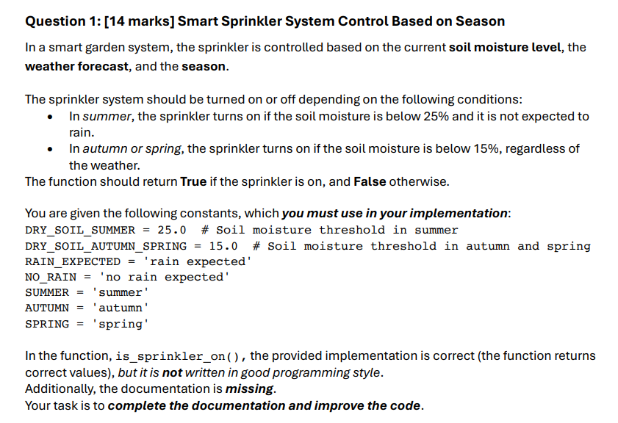
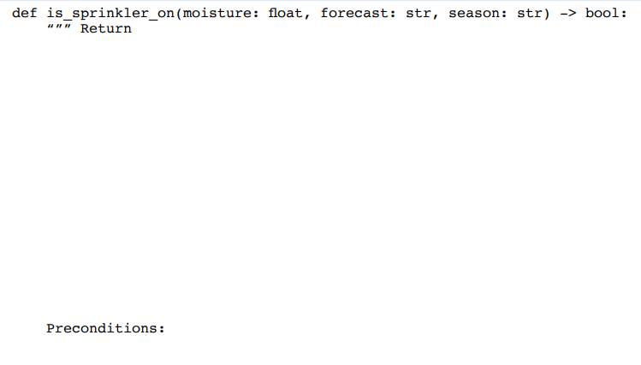

Past Midterm Question

Slide 63
Explanation
Description
What does the function return?
Explain how the return value changes according to the arguments
Include parameter names
Things to Remember for Docstrings:
Description
Preconditions
Tests
Return True when the sprinkler should be turned on and False when the sprinkler should be turned off.
Notes:
Text overlapping on purpose for animation
It describes two ways of explaining the same thing.
The text are,
Return True when the sprinkler should be turned on and False when the sprinkler should be turned off.
Returns True if and only if the sprinkler should be turned on.

Slide 64
Explanation
Description
What does the function return?
Explain how the return value changes according to the arguments
Include parameter names
Things to Remember for Docstrings:
Description
Preconditions
Tests
The sprinkler should be turned on or off based on ‘moisture’ that represents soil moisture level, ‘forecast’ that represents weather forecast and ‘season’.
Notes:
Text overlapping on purpose for animation
It describes two ways of explaining the same thing.
The text are,
Return True when the sprinkler should be turned on and False when the sprinkler should be turned off.
Returns True if and only if the sprinkler should be turned on.

Slide 65
Explanation
Preconditions
Explain any assumption that should be made to use the function
Not binding
Things to Remember for Docstrings:
Description
Preconditions
Tests
Assume the function works for valid moisture, forecast and season. Meaning, moisture is a non-negative float, forecast is either 'rain expected' or 'no rain expected' and season is one of 'summer', ‘autumn’, or 'spring'
moisture >= 0.0
The `forecast` is either RAIN_EXPECTED or NO_RAIN.
The `season` is one of SUMMER, AUTUMN or SPRING.

Slide 66
Explanation
Tests
Follow assumption/precondition
Test using different relevant arguments
Things to Remember for Docstrings:
Description
Preconditions
Tests
>>> is_sprinkler_on(20.0, NO_RAIN, SUMMER)
True
>>> is_sprinkler_on(21.0, NO_RAIN, SUMMER)
True
>>> is_sprinkler_on(22.0, NO_RAIN, SUMMER)
True
>>> is_sprinkler_on(23.0, NO_RAIN, SUMMER)
True
>>> is_sprinkler_on(20.0, NO_RAIN, SUMMER)
True
>>> is_sprinkler_on(10.0, RAIN_EXPECTED, SUMMER)
True
>>> is_sprinkler_on(20.0, NO_RAIN, AUTUMN)
True
>>> is_sprinkler_on(10.0, NO_RAIN, SPRING)
False
Notes:
Text overlapping on purpose for animation
Example of bad and good tests
>>> is_sprinkler_on(20.0, NO_RAIN, SUMMER)
True
>>> is_sprinkler_on(10.0, RAIN_EXPECTED, SUMMER)
True
>>> is_sprinkler_on(20.0, NO_RAIN, AUTUMN)
True
>>> is_sprinkler_on(10.0, NO_RAIN, SPRING)
False
>>> is_sprinkler_on(20.0, NO_RAIN, SUMMER)
True
>>> is_sprinkler_on(10.0, RAIN_EXPECTED, SUMMER)
True
>>> is_sprinkler_on(20.0, NO_RAIN, AUTUMN)
True
>>> is_sprinkler_on(10.0, NO_RAIN, SPRING)
False

Slide 67
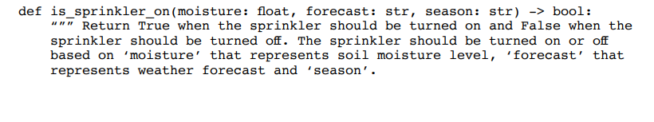
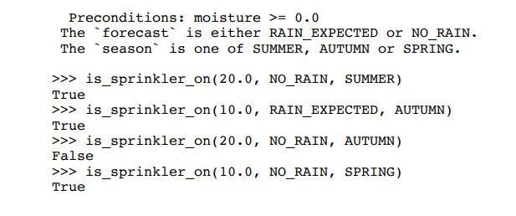
Soln

Slide 68
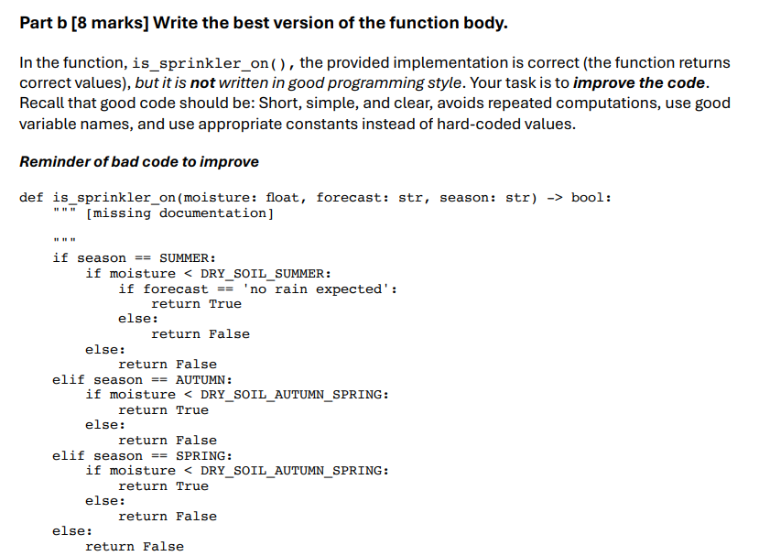
Past Midterm Question

Slide 69
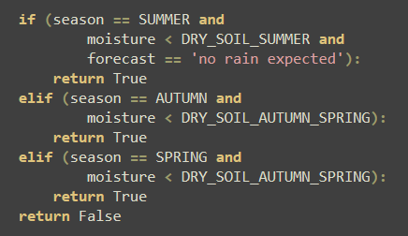
Explanation
Things to remove: Nested if statements

Slide 70

Explanation
Things to remove: Similar conditioning

Slide 71

Explanation
Return Type & Question Specific

Slide 72


Past Midterm

Slide 73

Explanation
Use a while loop, initiate variables, set return

Slide 74

Explanation
Build function logic according to question

Slide 75
Explanation
Build function logic according to question

Slide 76
Explanation
Build function logic according to question

Slide 77

Solution

Slide 78

Feedback Form!
Please fill out the feedback form below:

Slide 79
Acknowledgments
We would like to thank Professor Purva R. Gawde for providing us lecture notes to use as a basis for the review seminar.

