Slide 1
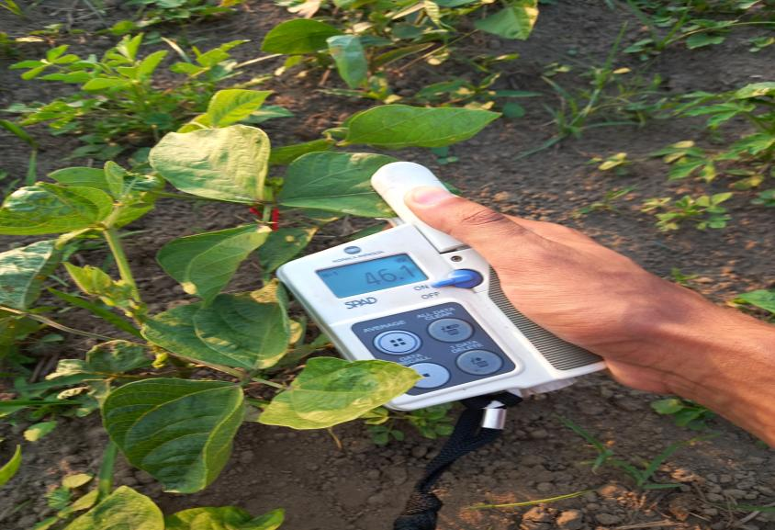
Genotypic variability Assessment, MTSI Modeling & Revealing the Effects of Phytohormone on Post-Fertility Traits of Mung-bean Genotypes under Rain-fed Condition in Chitwan, Nepal
Bikas Basnet
.Exam Roll no:1216
BSc.Ag 8th Sem
FOA, AFU, Rampur

Slide 2

SUPERVISING COMMITEE
MAJOR ADVISOR
Krishna Prasad Thapaliya
Assistant Professor
Department of Rural Sociology and Development Studies, AFU

Slide 3
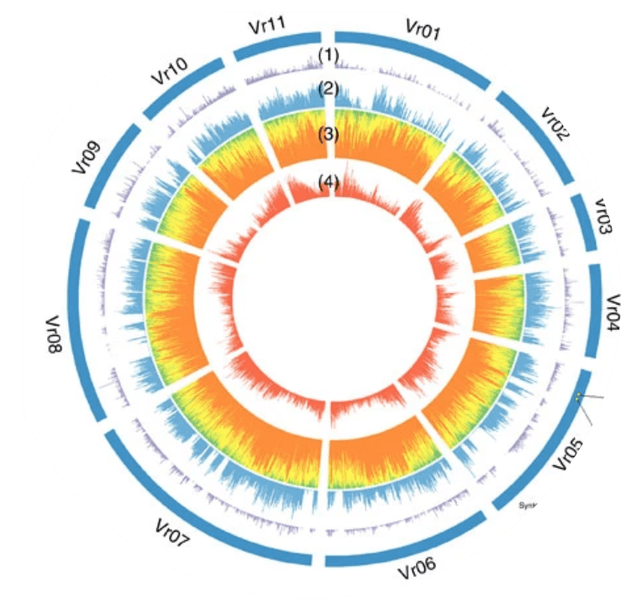
1.1. Background
Vigna radiates ,quickly (55-75 days(tropic &subtropic), pollinates itself
2n= 22(diploid), except V. reflexa pilosa, 2n= 44(Tetraploid).
V. radiata var. radiata (VC1973A) , draft genome size of 475-579.35 mbp (Ha et Al ,2020.; Kang et al., 2014 & Liu et al., 2022)
60-65% carbohydrates, 20.97-31.32% protein (20-30% in soy and kidney beans), 1-1.5% fat, iron and folate reviewed by (Sandhu & Singh, 2021)

Slide 4
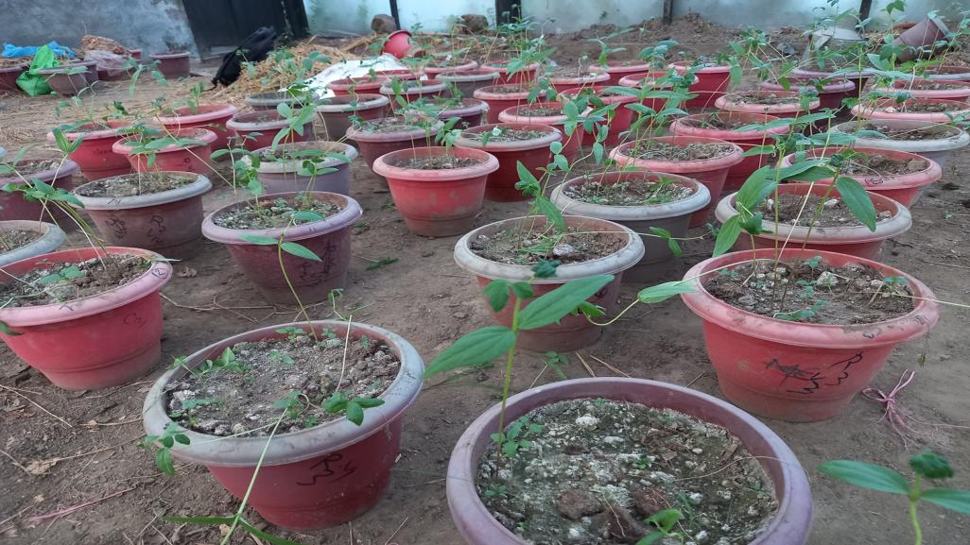
1.1. Background
Genetic diversity link with climate resilience of mung bean genotypes(Basnet et al., 2014)
Crosses between parents with the greatest genetic diversity leades to responsive to genetic improvement
PCA was used to identify and remove duplicate genotypes with similar trait
vulnerability to multicollinearity(MTSI)(Benakanahalli et al., 2021)
Phytohormones, that regulate many aspects of plant growth and development, FERONIA(post-fertility trait)(Ha et Al, 2021)

Slide 5
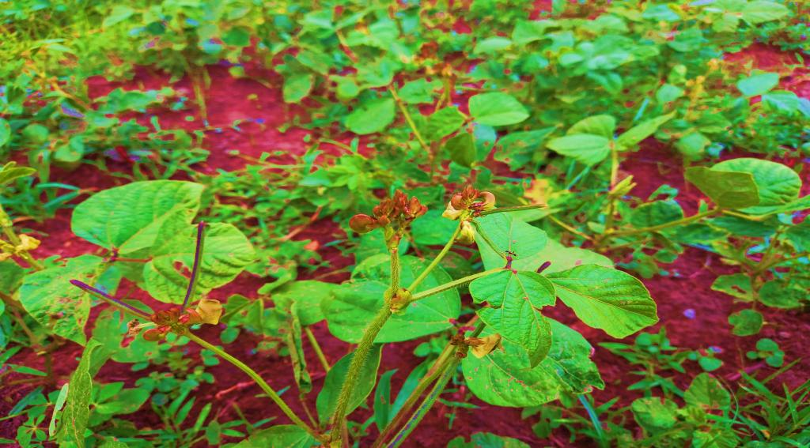
1.2. Statement of Problems
Tremendous production potential, but flower shedding and poor grain setting in pods. Exogenous application tested cucurbit crops, documented in Nepal, but the use of standard researched rates(GA3 (50 mg/L)+NAA (50 mg/L).(El Karamany et al., 2019)(Parveen et al., 2023)
Asynchronous maturation, influence of intricate genetics and Env
No used (FAI-BLUP), morphological characteristics of mung bean genotypes and pinpoint optimal elite lines(ideal genotype Ranking)

Slide 6
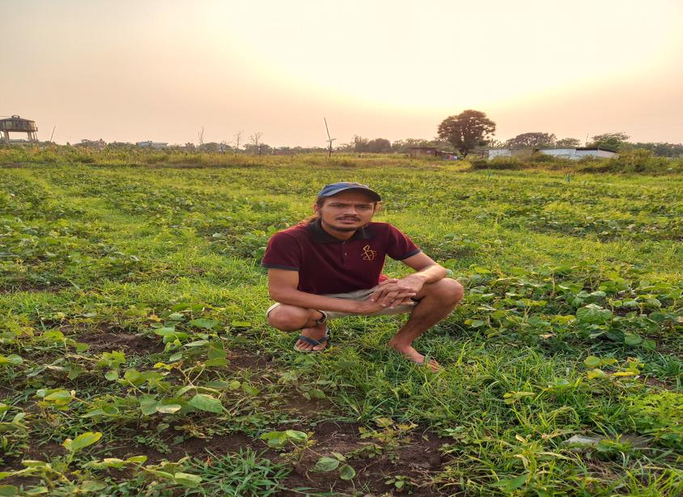
1.3. Rationale of the study
Tested exotic germplasm selection as standard check for Chitwan Condition
Selection of most phytohormones responsive genotypes for Yield attributes(phenotypic elsticity)
Simultaneous improvment of Promising cultivars for multiple traits(Pratigya, KPS1 & Samrat)
FA-BLUP measured the most stable and ideal candidate(chitwan condition) indcates scope in selection and Hybridization program

Slide 7
1.4.Objectives of the study
General objectives
•To study the significance of phytohormone foliar application ,ideal, stable genotype and diversity through multivariate analysis
Specific Objectives
•To assess the significance and impact of phytohormone foliar application on yield associated attributes
•To Study a Genetic Diversity(phenotypic markers) via. Principal Component Analysis, Cluster Graphics, and Best Linear Unbiased Prediction for Crop Ideotype Modeling, for stability analysis(mung germplasm)

Slide 8
2.Systematic Reviewed Topic
PCA analysis , PCA biplot analysis
Cluster analysis
BLUP and MTSI analysis
ANOVA analysis
DMRT TEST Selection
Flowering and Post Fertilization traits assessment
Impacts study of phytohormones on associated crops for Yield attributes.

Slide 9
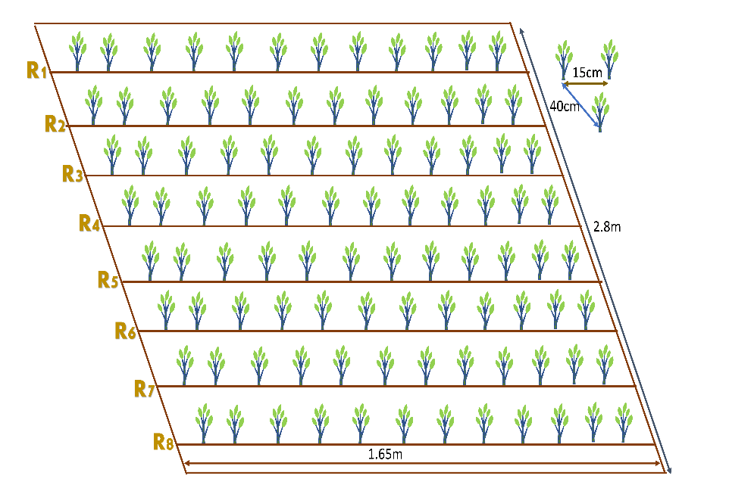
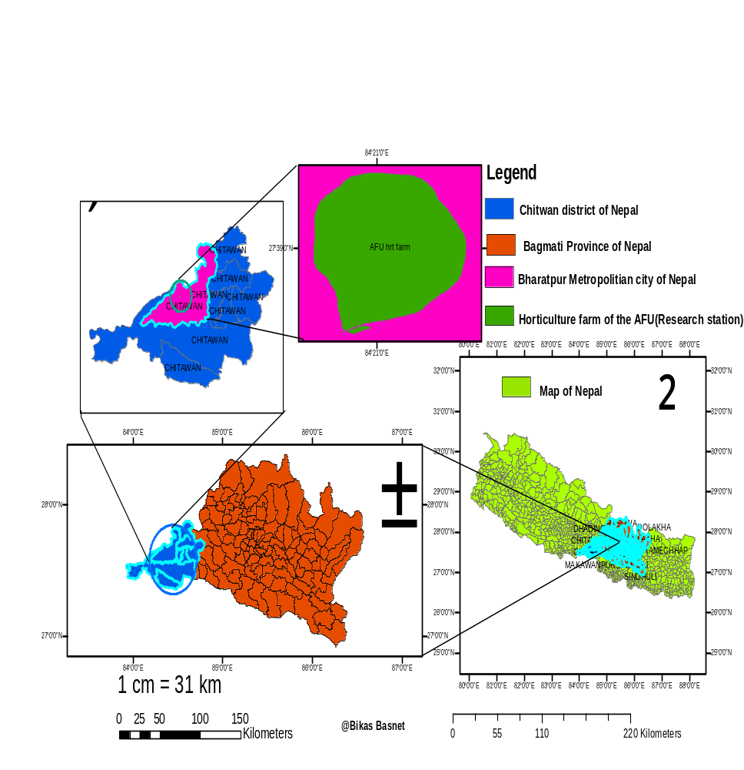
3.Materials and Methods
Figure 1 Representation of the Experimental demo plot and GIS map of the Research site

Slide 10
3.1. Materials & Methods…………
Figure 2 Evaluating Meteorological Data of Research Stations from Weather Stations

Slide 11
3.2.Materials & Methods…………(Basnet, 2023)
S.N | Soil Property | Value/Rating | Method of Extraction
1 | Sand% | 49.3 | The textural triangle of USDA
2 | Slit% | 34.9 | The textural triangle of USDA
3 | Clay% | 15.8 | The textural triangle of USDA
4 | Textural Class | Sandy Loam | Determined by Marshall’s triangular coordinates by USDA system
5 | PH | 5.52(Acidic Nature) | Digital pH Meter
6 | Organic Carbon% | 3.201 | 58% of OM = Organic Carbon
7 | Organic Matter | 3.42(medium) | (1-S/B)0.6810=3.42 because I have 11.6 and 23.4 value of S and B. (Walkley and Black method)
8 | Total N% | 0.20(Medium) | Micro-K-jeldal Method
9 | Total Phosphorous | 10.5 ppm(medium) | Modified Olsen's Bicarbonate Method
10 | Total Potassium | 5.5ppm(low) | Flame photometer method

Slide 12
3.3.Materials & Methods…………
foliar spray of 50 mg/l NAA + 50 mg/l GA3, gorkha stickermore(0.5ml/l), gorkha agrochemical pvt. ltd(30 and 55 das), 1:1 weight-to-volume ratio for six hours(priming)(shukla et al., 2018)
RCBD(single factorial), plot size= 4.62 sq.m, 3 rep, 16 genotypes(NGLRP), march 22(sowing time)(Neupane et al. ,2023).
correlation analysis(simple linear correlation)
Yield calculation model
Mixed model (Multivariates Techniques)
euclidean distance calculation and cluster analysis.
multi-trait genotype-ideotype distance index (MTGID)
FA (factor analysis) -BLUP(best linear unbiased prediction) index
PCA analysis, estimation of genetic parameters, anova with Duncan test. calculation

Slide 13
3.4. Materials & Methods…………
Statistical analysis:
Software: R version 4.3.1 (dated 2023-06-16)
"agricolae" for mean separation
Gvlma” Normal Distribution Testing
"variability" for estimating genetic parameters
"factoextra" and "factominer" for Principal Component Analysis
metan" for (Pearson r) and multi-trait genotype-ideotype distance indices for Crop Ideotype Modeling
"ggplot","circlize” and "reshape" heatmap and other Graphics, "NbClust" -optimal number of Clusters

Slide 14
4. Results………
Table 2 Representation of Flowering and Post-Flowering Associated Traits with Standard Formulation of Two Phytohormones
Genotypes | SPFDBAH ±SD | SPFDAAH± SD | Length of the Pod ± SD | Pod/Cluster ±SD | Diameter of Grain ± SD
VC6368(46-40-3) | 5.37±0.77 | 0.75±0.07 | 8.62 ± 1.09 | 10.5 ± 0.71 | 3.60 ± 0.44
NM-54 | 4.13±0.70 | 0.733±0.07 | 8.75 ± 0.97 | 4.93 ± 0.37 | 3.64 ± 0.16
VC6370A | 5.86±0.59 | 1.26^{ab}± 0.05 | 8.14 ±1.33 | 6.66± 0.98 | 3.92 ± 0.25
VC1973A(SC) | 6.13±0.56 | 0.80±0.06 | 7.99 ± 0.64 | 7.60± 0.64 | 4.06 ± 0.41
VC6173C | 5.20 ±0.99 | 0.53±0.05 | 6.98± 1.42 | 6.71± 0.55 | 3.75 ± 0.39
CN95 | 6.40 ±0.86 | 0.80±0.08 | 9.20 ± 0.81 | 7.00 ± 0.34 | 3.62± 0.33
VC6848 | 5.33±0.74 | 0.86±0.07 | 8.16 ± 1.36 | 5.46 ±0.55 | 3.86 ± 0.15
PRATIGYA | 8.13ª ±0.91 | 0.73± 0.07 | 9.02±0.84 | 5.73 ± 0.45 | 3.53 ±0.23
KPS-1 | 7.60 ±0.91 | 0.53±0.09 | 7.45 ± 0.90 | 2.8 ±0.73 | 3.87± 0.40
VC3890A | 5.06 ±0.74 | 0.53±0.07 | 8.34 ±0.93 | 4.20 ± 0.11 | 3.71± 0.29
VC6173A | 7.42 ±0.99 | 0.92±0.09 | 8.02 ± 0.88 | 6.71 ± 0.55 | 3.75± 0.28
SAMRAT | 6.53 ±0.63 | 0.46± 0.06 | 7.43 ± 1.19 | 3.60 ± 0.45 | 3.67± 0.32
PANT MUNG 2 | 7.60 ±0.91 | 0.60±0.09 | 8.16 ± 0.75 | 4.20 ± 0.16 | 3.59 ±0.28
MN92 | 7.466±0.75 | 1.0±0.07 | 8.84 ± 0.67 | 5.26 ± 0.90 | 3.73 ±0.18
VC6369 | 6.66 ±0.50 | 0.40±0.05 | 8.35 ± 1.46 | 5.80± 0.24 | 3.79 ±0.28
VC3960A-88 | 7.20 ±1.18 | 1.53ª±0.18 | 9.04 ±1.146 | 7.80± 0.93 | 3.96a ± 0.17
LSD(0.05) | 0.33 | 0.094 | 0.135 | 0.675 | 0.03
SE_{m} | 0.17 | 0.191 | 0.074 | 0.353 | 0.02
F-prob | <0.001 | <0.01 | <0.001 | <0.05 | <0.001
CV% | 14.96 | 9.90 | 12.63 | 9.82 | 8.162

Slide 15
Results………..
Table 3 Representation of Grain Characteristics and Variability Among Mung Bean Genotypes
Genotypes | Length of Grain± SD | Area of Grain± SD | Grains/Pod ± SD | Clusters/Plant± SD
VC6368(46-40-3) | 5.19± 0.39 | 18.68±2.66 | 8.68± 0.24 | 7.31±0.092
NM-54 | 5.19 ±0.39 | 17.81±1.76 | 6.20±0.74 | 6.60±0.32
VC6370A | 5.58± 0.62 | 21.96±3.27 | 8.96± 0.94 | 8.00±0.92
VC1973A-(SC) | 5.28± 0.64 | 21.50±3.85 | 7.93 ± 0.25 | 9.00±0.58
VC6173C | 5.60a± 0.40 | 20.98±2.24 | 8.20± 0.95 | 5.60±0.50
CN95 | 4.92 ±0.45 | 17.88±2.51 | 10.46± 0.16 | 8.20±0.8
VC6848 | 5.22 ±0.50 | 20.16±1.84 | 8.53±0.58 | 6.80±0.1
PRATIGYA | 5.07± 0.37 | 17.96±1.76 | 8.93± 0.21 | 7.00±0.4
KPS-1 | 4.86 ±0.48 | 18.08±2.59 | 5.13± 0.81 | 4.13±0.47
VC3890A | 5.07± 0.45 | 18.85±2.20 | 8.66± 0.28 | 5.60±0.22
VC6173A | 5.60± 0.64 | 20.98±3.12 | 7.42± 0.60 | 9.21±0.77
SAMRAT | 5.43± 0.37 | 19.98±2.55 | 8.00± 0.53 | 4.80±0.89
PANT MUNG 2 | 4.91 ±0.47 | 17.68±2.11 | 7.66±0.26 | 5.86±0.50
MN92 | 5.59± 0.35 | 20.94±2.14 | 4.40±0.01 | 9.20±1.00
VC6369 | 5.17± 0.42 | 19.65±2.04 | 6.40±0.88 | 7.00±0.6
VC3960A-88 | 5.37± 0.37 | 21.34±2.04 | 8.60±1.20 | 7.40±1.18
LSD(0.05) | 0.05 | 0.30 | 0.35 | 0.39
SE_{m} | 0.0339 | 0.18 | 0.20 | 1.03
F-prob | <0.001 | <0.001 | <0.001 | <0.001
CV% | 9.02 | 12.53 | 8.82 | 5.396

Slide 16
Results…………
Table 4 Evaluation of Mung Bean Genotypes for Key Yield-Related Characteristics and Their Phytohormone Responsiveness
Genotypes | 100 Grain grain weight± SD | Straw Yield/ha± SD | Biological Yield kg/Ha± SD | Harvesting Index± SD | Grain yield (Tons)/ha± SD
VC6368(46-40-3) | 5.15±0.0765 | 3197±0.00 | 5779.60±0.005 | 0.45 ±0.00 | 2.58±0.00
NM-54 | 5.41±0.00 | 3154±0.00 | 5678.20 ±0.005 | 0.44 ±0.00 | 2.52±0.00
VC6370A | 5.88±0.00 | 3126±0.00 | 5610.36±0.005 | 0.44 ±0.00 | 3.04ª ±0.00
VC1973A(SC) | 4.96±0.00 | 3207±0.00 | 5920.08±0.005 | 0.46 ±0.00 | 2.71±0.00
VC6173C | 5.39±0.00 | 3056±0.00 | 5035.12 ±0.005 | 0.41 ±0.00 | 2.085±0.00
CN95 | 5.26±0.00 | 3293±0.00 | 6133.08 ±0.005 | 0.48 ª ±0.00 | 2.84 ^{ab} ±0.00
VC6848 | 5.80±0.00 | 3013±0.00 | 5385.60 ±0.006 | 0.44 ±0.00 | 2.37±0.00
PRATIGYA | 5.46±0.00 | 3012±0.00 | 5322.534±0.005 | 0.43 ±0.00 | 2.31±0.00
KPS-1 | 6.66a±0.00 | 2360±0.00 | 3494.18 ±0.005 | 0.32 ±0.00 | 1.134± 0.00
VC3890A | 6.21±0.00 | 3120±0.00 | 5578.330±0.005 | 0.44 ±0.00 | 2.45±0.00
VC6173A | 4.87±0.00 | 3056±0.00 | 5545.172±0.005 | 0.45 ±0.00 | 2.48±0.00
SAMRAT | 5.40±0.00 | 2120±0.00 | 3378.120±0.005 | 0.37 ±0.00 | 1.25±0.00
PANT MUNG 2 | 4.75±0.00 | 2930±0.00 | 5178.700±0.005 | 0.43 ±0.00 | 2.24±0.00
MN92 | 4.85±0.00 | 3186±0.00 | 5684.88 ±0.005 | 0.44±0.00 | 2.49±0.00
VC6369 | 5.36±0.00 | 2993±0.00 | 5805.60 ±0.005 | 0.46^{b}±0.00 | 2.81±0.00
VC3960A-88 | 5.07±0.00 | 3267a±0.00 | 6316.657 ± 1729.933 | 0.46^{b} ±0.00 | 2.83^{ab}±0.072
LSD(0.05) | 0.002 | 1.24 | 54.97426 | 0.0024 | 0.054
SE_{m} | 0.032 | 19.97 | 111.58 | 0.003 | 0.042
F-prob | <0.001 | <0.001 | <0.001 | <0.001 | <0.001
CV% | 0.36 | 0.32 | 8.05 | 4.47 | 3.06

Slide 17
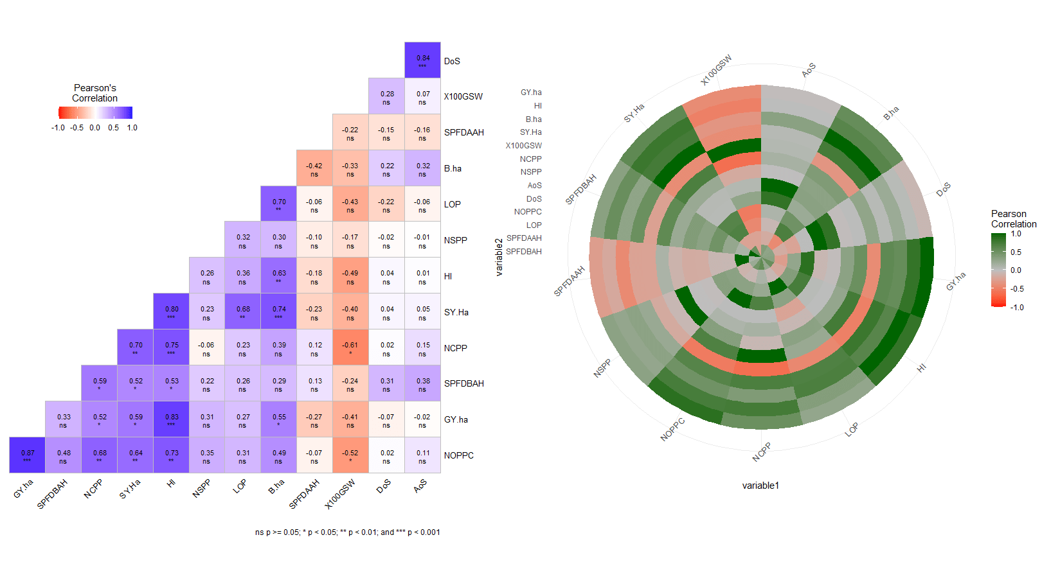
Results………..
Figure 3 Correlation Matrix Heat Map of the Post Fertility-Associated Traits of the Mung Bean Genotypes and Promising Cultivars

Slide 18
Results……….
Table 5 Average intra-cluster (main diagonal) and inter-cluster (off-diagonal) of 16 genotypes centroid linkage method(unit same)
Clusters | c1 | c2 | c3 | c4
c1 | 440.6875
c2 | 5959.402 | 164.8274
c3 | 2102.300 | 3901.142 | 409.9461
c4 | 3798.374 | 2228.011 | 1702.288 | 229.3632

Slide 19
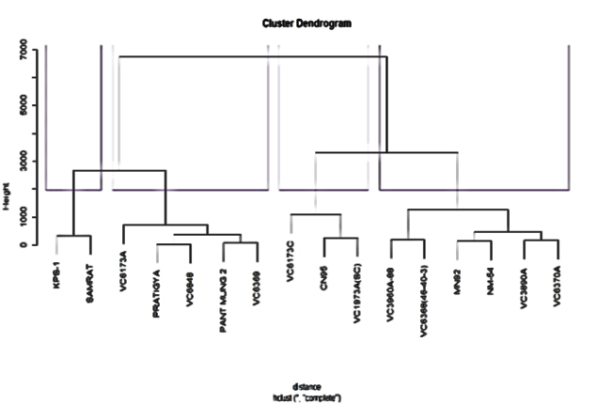
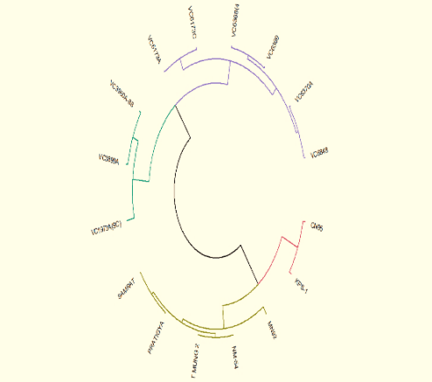
Results………………..
Figure 5 A dendrogram illustrating the degree of genetic similarity among various Mung Bean genotypes

Slide 20
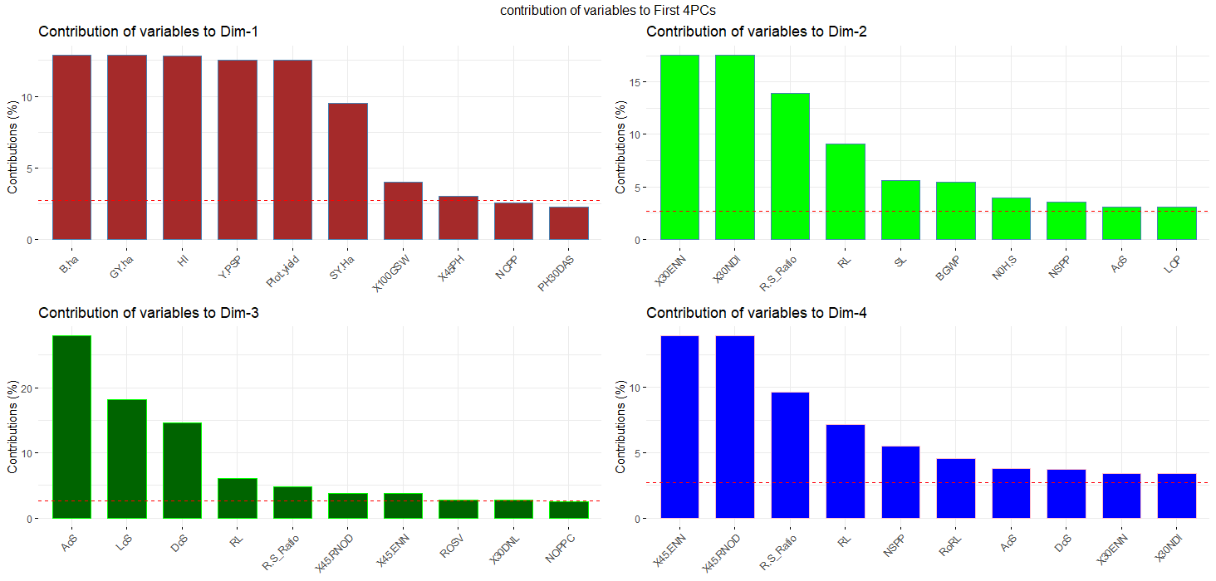
Results…………….
Figure 6 displays the percentage contributions of variables to the principal components (PCs) using distinct colors for each PC. The bars corresponding to PC1 are represented in brown, PC2 in light green, PC3 in dark green, and PC4 in blue. red dashed reference lines are overlaid across the bar plots. Variables with bars extending above these reference lines are considered significant contributors to their respective PCs.

Slide 21
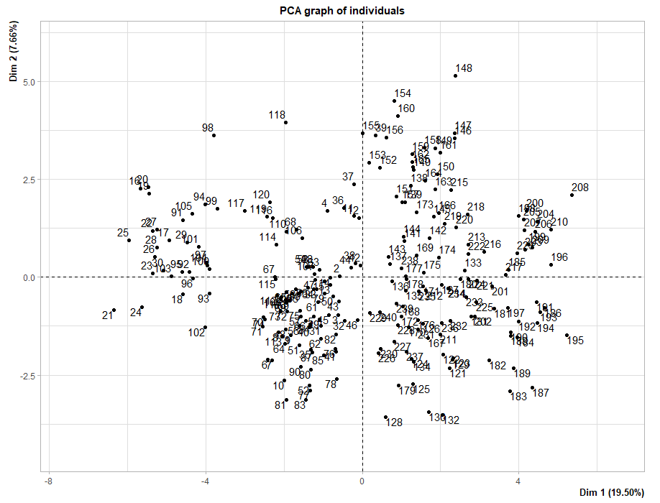
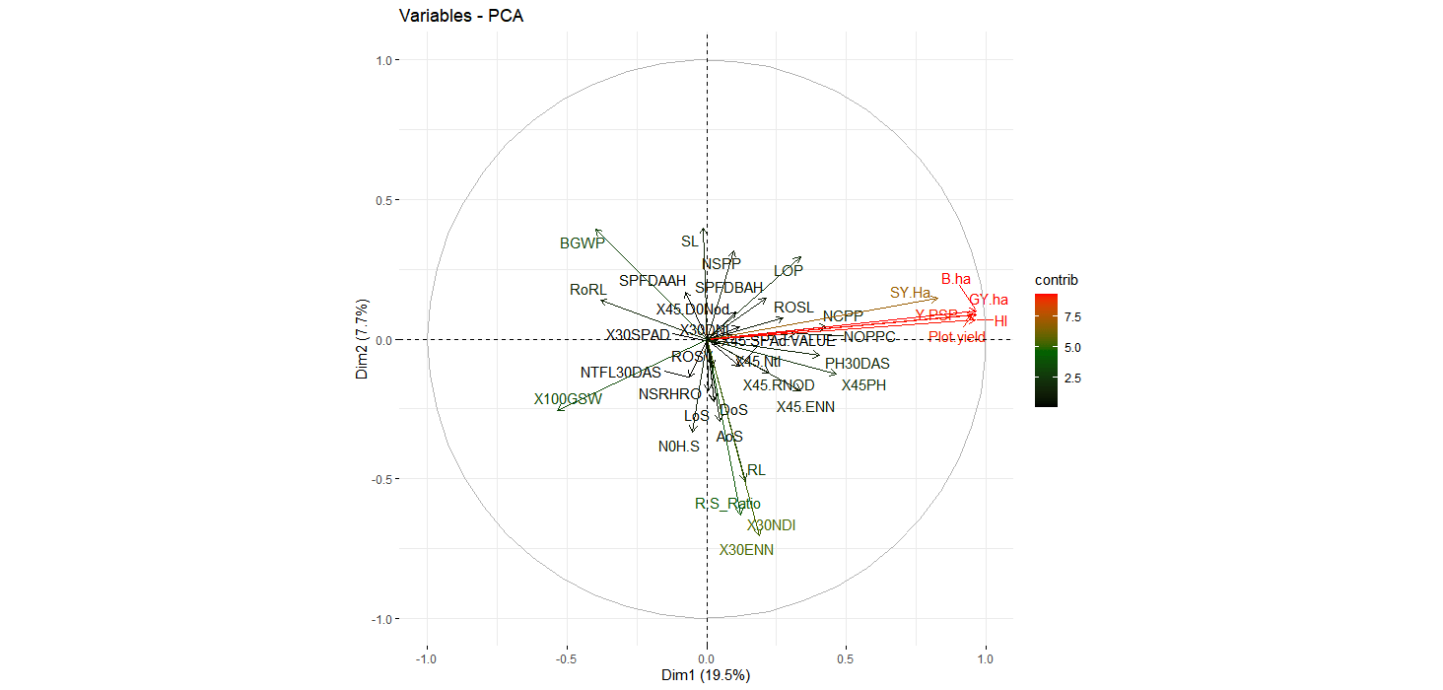
Results……………
Figure 7 Representation of PCA Score Plots for Genotype Relationships and Variable Distribution in Mung Bean Analysis. RL=Root Length, SL=Shoot Length, R.S Ratio=Root to Shoot Ratio,N0H.S=Number of Secondary Roots, BGWP= Below ground White Portion,PH30DAS and X45PH= Plant Height 30 and Days after sowing, NTFL30DAS& X45.Ntl =Number of Tri-foliates leaves 30 and 45 DAS ,X30NDl & X30DNL=Number and Diameter of 30 days nodules, X30ENN & X45.ENN =effective number of root nodules 30 AND 45DAS,X30SPAD & X45.SPAd.VALUE=30 and 45DAS SPAD value,X45.RNOD= Root Nodules 45DAS,X45.D0Nod=45 Days Diameter of Nodules, LOP=Length of the Pod, NOPPC=Pod/Cluster, DoS & AoS=Diameter and Area of grain, NSPP=grain/Pod, NCPP=Cluster/ plant,X100GSW=100 Grain weight, SY.Ha= straw yield/ha, B.ha=Biological yield/ha, HI=Harvestig Index, GY.ha =Grain Yield/ha are used as experimental variables, respectively

Slide 22
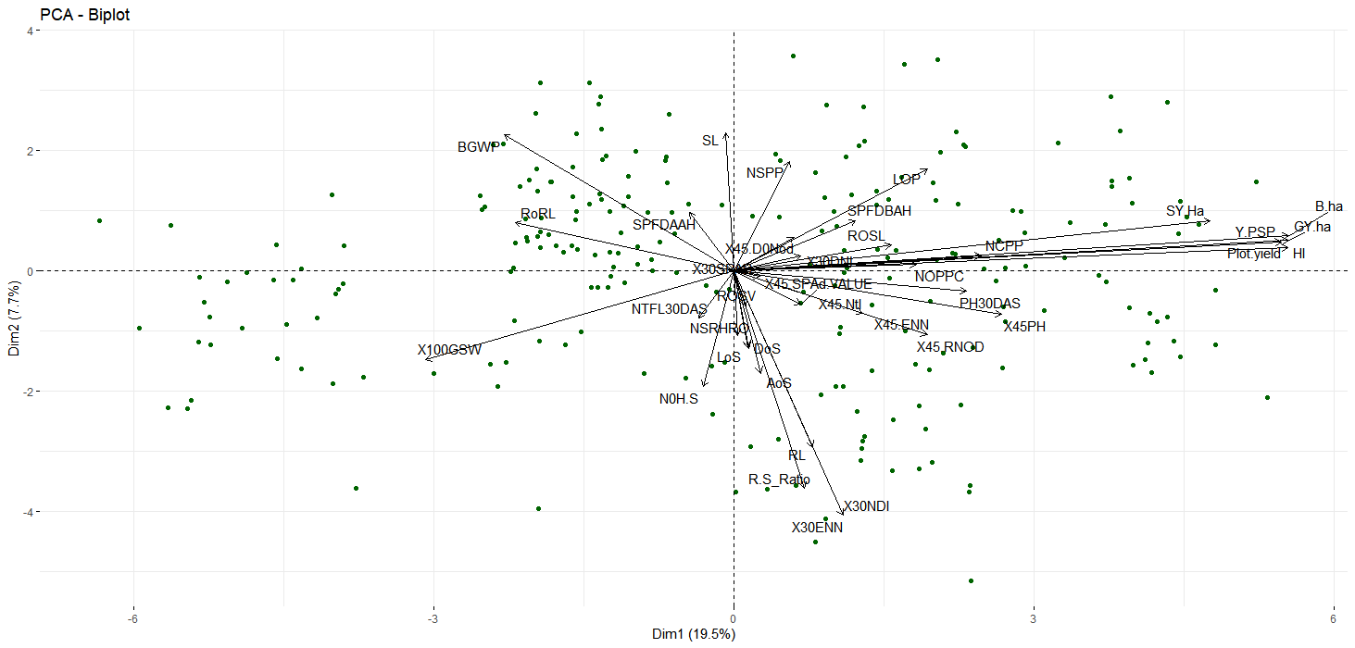
Results…………….
Figure 8 Graphical Representation of Relationships Among Experimental Attributes and Individual Data Points in the Top Two Principal Dimensions

Slide 23
Results……………
Table 6 Eigenvalue estimates by principal components analysis and the proportion of variance explained by them(Kaiser)
Principle Component | Eigenvalues | Variance (%) | Cum. variance (%)
PC1 | 12.019 | 32.483 | 32.483
PC2 | 5.020 | 13.568 | 46.051
PC3 | 4.467 | 12.072 | 58.123
PC4 | 2.997 | 8.100 | 66.223
PC5 | 2.896 | 7.828 | 74.051
PC6 | 2.136 | 5.772 | 79.822
PC7 | 1.778 | 4.806 | 84.629
PC8 | 1.418 | 3.832 | 88.461
PC9 | 1.358 | 3.670 | 92.131

Slide 24
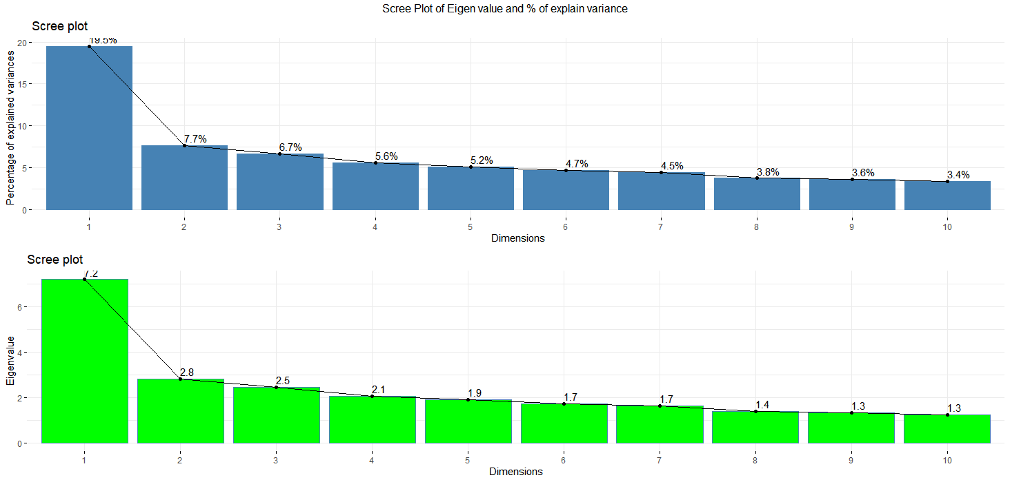
Results………………..
Figure 9 Scree Plot Illustrating Eigenvalues and Percentage of Explained Variance for the Top 10 Principal Components, with Labels Representing the Variance Explained in Phenotypic Diversity of Mung-bean Genotypes by Each Components

Slide 25
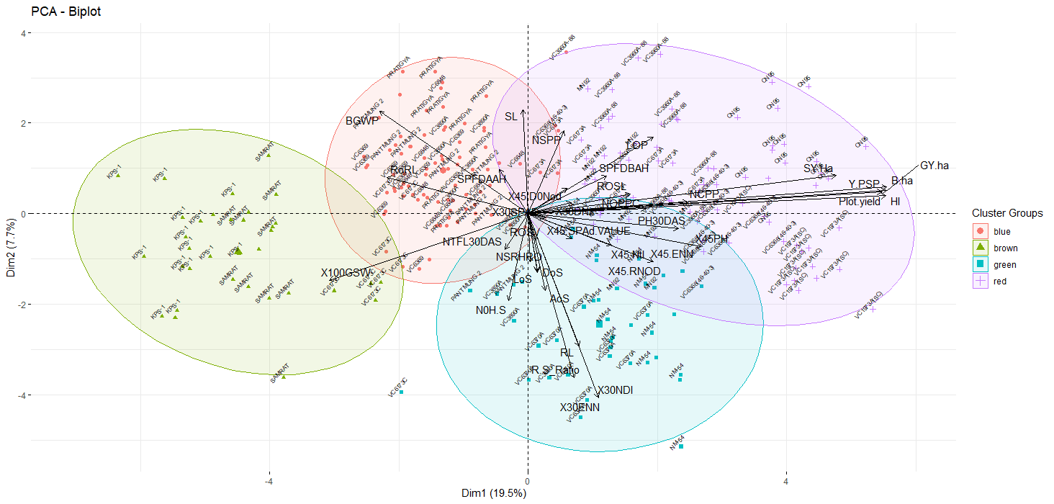
Results
Figure 10 Graphical Representation of PCA Biplot and Ellipse Cluster Plot with Experimental Variables

Slide 26
Results………….
Table 7 Summary of Selection Differential, Selection Gain, and Heritability Estimates Based on Multi-Trait Selection Index (MTSI)
Variables | Factor | Xo | Xs | SD | SD% | h2 | SG | SG% | sense
SPFDBAH | FA1 | 0.779 | 0.930 | 0.150 | 19.299 | 0.226 | 0.034 | 4.353 | decrease
LOP | FA1 | 7.303 | 7.479 | 0.176 | 2.416 | 0.357 | 0.063 | 0.862 | increase
NOPPC | FA1 | 5.750 | 5.794 | 0.044 | 0.765 | 0.157 | 0.007 | 0.120 | increase
NCPP | FA1 | 2.283 | 2.467 | 0.183 | 8.027 | 0.361 | 0.066 | 2.901 | increase
SY.Ha | FA1 | 2999.625 | 3210.077 | 210.452 | 7.016 | 1.000 | 210.386 | 7.014 | increase
B.ha | FA1 | 10406.339 | 13229.841 | 2823.502 | 27.133 | 0.999 | 2821.425 | 27.113 | increase
HI | FA1 | 0.697 | 0.750 | 0.052 | 7.519 | 1.000 | 0.052 | 7.516 | increase
GY.ha | FA1 | 7.407 | 10.020 | 2.613 | 35.280 | 0.999 | 2.611 | 35.253 | increase
DoS | FA2 | 3.738 | 3.767 | 0.030 | 0.790 | 0.424 | 0.013 | 0.335 | increase
LoS | FA2 | 5.189 | 5.241 | 0.052 | 0.997 | 0.447 | 0.023 | 0.446 | increase
AoS | FA2 | 19.428 | 19.856 | 0.428 | 2.203 | 0.536 | 0.229 | 1.181 | increase
NSPP | FA3 | 6.470 | 6.477 | 0.023 | 0.349 | 0.413 | 0.009 | 0.144 | increase
X100GSW | FA4 | 5.407 | 5.571 | 0.165 | 3.044 | 1.000 | 0.164 | 3.042 | increase
SPFDAAH | FA9 | 3.188 > | 3.107 | -0.080 | -2.522 | 0.271 | -0.022 | -0.683 | decrease
Xo: overall mean of genotypes; Xs: mean of the selected genotypes; SD: selection differential; SG: selection gain or impact; h2: heritability; SPFDBAH & SPFDAAH: sample plant flower drops before and after application of the hormone; LOP:length of pod; NOPPC: no of pod per cluster; SY.ha: straw yield/ha; B.ha: Biological yield/ha; HI:harvest index; DoS,AoS& LoS: Diameter, area and Length of grain; NSPP: no of grain per pod; X100GSW:100 grain grain weight.

Slide 27
Results………….
Table 8 Representation of the contribution factor rank of the selected genotypes. Exclusion of Genotypes FA5, FA6, FA7, and FA8 Due to Their Contribution to Pre-Fertilization Traits
FA1 | FA2 | FA3 | FA4 | FA5 | FA6 | FA7 | FA8 | FA9
CN95 | VC6370A | CN95 | CN95 | CN95 | VC6370A | CN95 | VC6370A | VC6370A
VC6370A | CN95 | VC6370A | VC6370A | VC6370A | CN95 | VC6370A | CN95 | CN95

Slide 28
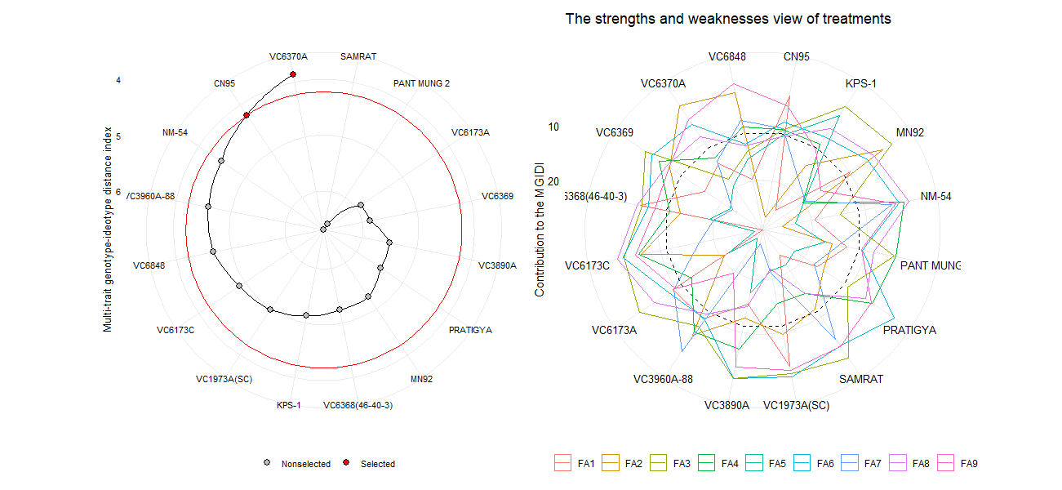
Results……………….
Figure 11 Graphics depicting the selected ideal and non-selected genotypes and the strength and weakness of MGIDI contributions to factor loading.

Slide 29
Results…………………..
Table 10 Estimation of genetic parameters for post-fertilization traits in different genotypes.
Parameters | Grand Mean | CD@ 5% | Ve | Vg | Vp | GCV | PCV | ECV | GA | GAPM
NOPPC | 5.75 | 8.49 | 27.81 | 8.58 | 36.39 | 50.94 | 104.92 | 91.72 | 2.93 | 50.95
DoS | 3.74 | 0.49 | 0.09 | 0.11 | 0.21 | 8.99 | 12.15 | 8.16 | 0.51 | 13.72
LoS | 5.19 | 0.99 | 0.22 | 0.29 | 0.51 | 10.44 | 13.81 | 9.03 | 0.84 | 16.28
NSPP | 7.61 | 4.49 | 7.78 | 9.57 | 17.35 | 40.64 | 54.72 | 36.63 | 4.73 | 62.19
X100GSW | 5.41 | 0.03 | 0.00 | 1.34 | 1.34 | 21.39 | 21.39 | 0.37 | 2.38 | 44.05
HI | 0.58 | 0.00 | 0.00 | 0.02 | 0.02 | 22.10 | 22.10 | 0.31 | 0.27 | 45.53
GY.ha | 4.43 | 0.09 | 0.00 | 9.56 | 9.57 | 69.74 | 69.75 | 1.30 | 6.37 | 143.64
Critical Difference (CD) 5%, Environmental Variance (EV); Genotypic Variance (GV); Phenotypic Variance (PV); Environmental Coefficient of Variance (ECV); Genotypic Coefficient of Variance (GCV) , Phenotypic Coefficient of Variance (PCV); Genetic Advance(GA); Genetic Advance as percentage of mean(GAPM). NOPPC: # of pod/cluster; DoS: Diameter of grain; AoS: area of grain; NSPP: # of grain/pod; x100GSW:100 grain grain weight; HI: harvesting index; GY.Ha: Grain Yield/ha

Slide 30
5. Discussion
Similar outcomes were observed in a study where the combined foliar application of Indole-3-acetic acid (IAA) and Gibberellic acid (GA3), referred to as IAA2 + GA2, exhibited a notably robust impact on various yield attributes. (Castro-Camba et al., 2022)(khattak et al., 2009)
All fertility-related traits, except for sample plant flower drops after application of hormone, need to be increased. Thus, Stable Genotypes have with improved morphological quantitative traits, such as clusters plant−1 , pods cluster−1 , grains pod−1 , branches plant−1(Benakanahalli et al., 2021)
A separate study of white Guinea yam genotypes found that the FAI-BLUP index technique could be used to identify genotypes that could be used as parents to breed new varieties with improved agronomic traits and end-product quality(Genta et al., 2022)

Slide 31
6. Conclusion
Trait Correlations and Breeding Strategy:
Effect of Plant Hormones on Yield Attributes:
Genotypic Diversity and Selection Criteria: PCA identified nine components contributing significantly to total diversity, and cluster analysis aided in the selection of superior genotypes. The FAI-BLUP index technique highlighted specific genotypes, with VC1973A and CN95 identified as the most stable and high-yielding (2.8 tons/ha) among the studied genotypes
Recommendation for Further Evaluation

Slide 32
Selected References
2021_Ha et al A near‐complete genome sequence of mungbean Vigna radiata L provides key insights into.pdf. (Nature Communications).
Azam, M. G., Hossain, M. A., Sarker, U., Alam, A. K. M. M., Nair, R. M., Roychowdhury, R., Ercisli, S., & Golokhvast, K. S. (2023). Genetic Analyses of Mungbean [Vigna radiata (L.) Wilczek] Breeding Traits for Selecting Superior Genotype(s) Using Multivariate and Multi-Traits Indexing Approaches. Plants, 12(10). https://doi.org/10.3390/plants12101984
Bam, R., Mishra, S. R., Khanal, S., Ghimire, P., & Bhattarai, S. (2022). Effect of biofertilizers and nutrient sources on the performance of mungbean at Rupandehi, Nepal. Journal of Agriculture and Food Research, 10(October), 100404. https://doi.org/10.1016/j.jafr.2022.100404
Basnet, K., Adhikari, N., & Pandey, M. (2014). Multivariate Analysis among the Nepalese and Exotic Mungbean (Vigna Radiata L. Wilczek) Genotypes Based on the Qualitative Parameters. Universal Journal of Agricultural Research, 2(5), 147–155. https://doi.org/10.13189/ujar.2014.020502
Benakanahalli, N. K., Sridhara, S., Ramesh, N., Olivoto, T., Sreekantappa, G., Tamam, N., Abdelbacki, A. M. M., Elansary, H. O., & Abdelmohsen, S. A. M. (2021). A Framework for Identification of Stable Genotypes Basedon MTSI and MGDII Indexes: An Example in Guar (Cymopsis tetragonoloba L.). Agronomy, 11(6), 1221. https://doi.org/10.3390/agronomy11061221

Slide 33
Acknowledgements
NGRP, Khajura Bake,
FoA, Rampur,
Major Advisor
LEE Home Campus Friends and Juniors
Prof Dr Madhav Prasad Neupane, Prof Surya Dhungana, Prof Sapana Ghimire
Beloved Parents

Slide 34
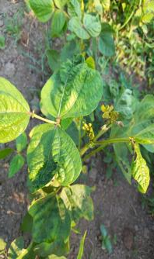
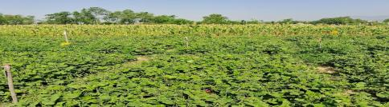
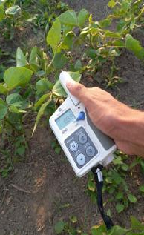
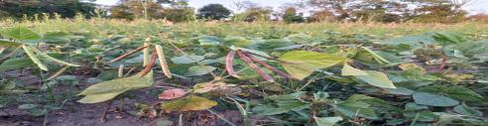
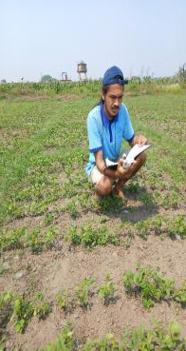
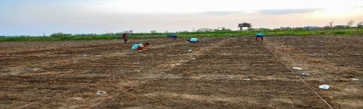
OVERVIEW OF RESEARCH ENDEAVORS
A
B
C
D
E
F
A) At flowering stage, B) At pod Setting stage. C) 80% pod maturity stage,D) SPAD measuring stage,E) Data taking,E) Layout

Slide 35
Constructive Comments are Highly welcome
Thanks

