Slide 1

Überblick Microsoft Cloud Adoption Framework
Strategy

Slide 2
Plan
An iterative process that supports your business … as it evolves
Govern
Manage
Define strategy
Adopt
Ready

Slide 3
Cloud adoption strategy evaluator

Slide 4
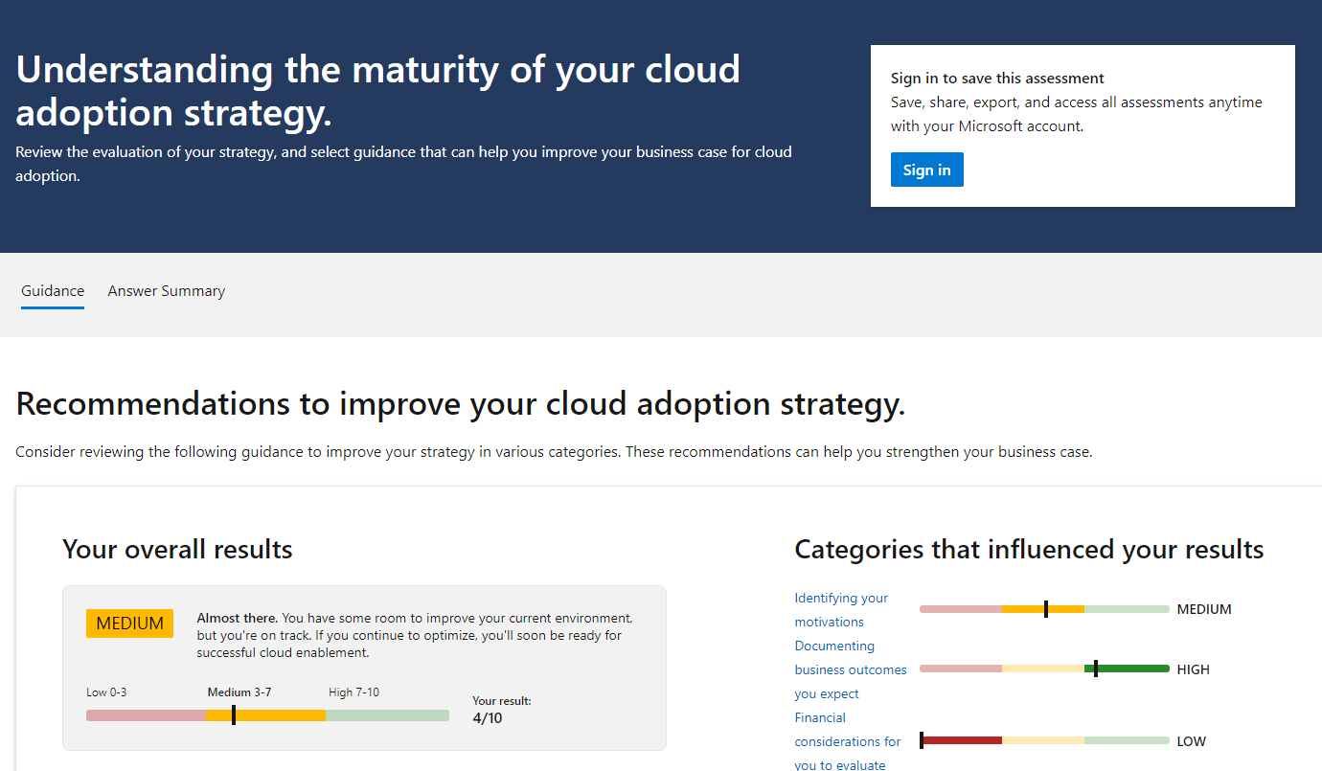
Cloud adoption strategy evaluator
The newly launched cloud adoption strategy evaluator provides customers with a framework to understand different areas needed to be considered when building a comprehensive business case.
The evaluation guides customers to appropriate cloud economics tools and content, while providing actionable next steps in building their business case.
https://aka.ms/adopt/assess/strategy

Slide 5
Strategy

Slide 6
Define strategy
Define strategy
Plan
Ready
Adopt
Documenting the cloud strategy will help business stakeholders and technicians understand the benefits the organization is pursuing by adopting the cloud.
Govern
Manage
Motivations
  Executive mandate
  DC Exit
  Merger and acquisitions
  Cost savings
  Optimization
  Agility
  Tech capabilities
  Market demands
  Geo expansion
  Migration
  Innovation
  Business outcomes
  Fiscal: revenue, cost, profit
  Agility: timer to market, provisioning,
  Reach: global access, sovereignty
  Customer engagement: cycle time, from request
  to release
  Performance: SLAs, Downtime, operations, reliability
  Business justification
  Business case: the cloud
  is not always cheaper, mirroring is not cloud, servers drive cost analysis
  Financial model: Capex/
  Opex, ROI, gain, cost avoidance/reduction
  Cloud accounting:
  cost center, procurement, profit center, revenue generating, chargeback
  First project
  Business criteria: workload supported by a BDM
  Technical criteria: minimum dependencies and test path, no governance
  Qualitative analysis: Current Team analysis

Slide 7

Why are you moving to the cloud?

Slide 8
Motivations for cloud adoption
Engage stakeholders across business and technology to—
define, document, and understand your motivations for cloud adoption
Critical business events
Datacenter exit
Mergers, acquisition or divestiture
Reductions in capital expenses
End of support for mission-critical technologies
Regulatory compliance, data sovereignty requirements
Reduce disruptions and improve IT stability
Migration motivations
  Cost savings
  Reduction in vendor or technical complexity
  Optimization of internal operations
  Increase business agility
  Prepare for new technical capabilities
  Scale to meet market demands
  Scale to meet geographic demands
Innovation motivations
  Prepare for new technical capabilities
  Build new technical capabilities
  Scale to meet market demands
  Scale to meet geographic demands
  Improve customer experiences / engagements
  Transform products or services
  Disrupt the market with new products or services

Slide 9
Define strategy
Define strategy
Plan
Ready
Adopt
Documenting the cloud strategy will help business stakeholders and technicians understand the benefits the organization is pursuing by adopting the cloud.
Govern
Manage
Motivations
  Executive mandate
  DC Exit
  Merger and acquisitions
  Cost savings
  Optimization
  Agility
  Tech capabilities
  Market demands
  Geo expansion
  Migration
  Innovation
  Business outcomes
  Fiscal: revenue, cost, profit
  Agility: timer to market, provisioning,
  Reach: global access, sovereignty
  Customer engagement: cycle time, from request
  to release
  Performance: SLAs, Downtime, operations, reliability
  Business justification
  Business case: the cloud
  is not always cheaper, mirroring is not cloud, servers drive cost analysis
  Financial model: Capex/
  Opex, ROI, gain, cost avoidance/reduction
  Cloud accounting:
  cost center, procurement, profit center, revenue generating, chargeback
  First project
  Business criteria: workload supported by a BDM
  Technical criteria: minimum dependencies and test path, no governance
  Qualitative analysis: Current Team analysis

Slide 10

Identify business outcomes
Engage stakeholders and discuss your desired outcomes
Define your organization's business outcomes—
to support transparency and develop cross-functional partnerships
Adopt cloud economics best practices and guidance to optimize your cloud investment
Plan conversations with various personas on business outcomes to trigger discussion on:
  Finance leadership
  Marketing
  Sales
  Human resources
  Executive leadership
Review business outcomes by category—define your organization's outcomes
Complete the business document template to identify your business outcomes

Slide 11
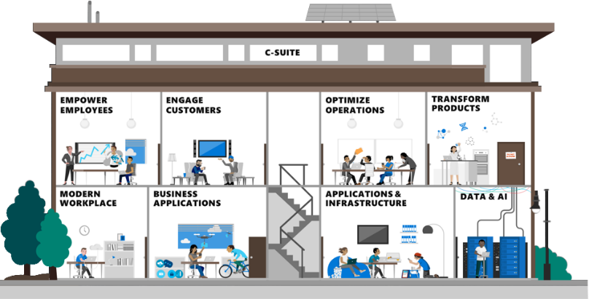


Document the expected business outcomes
1
2
Document them in the
strategy and plan template
Leverage our business outcome template
Stakeholders
Stakeholders (BDMs)
Capabilities
Business outcomes
Business outcomes, drivers, & KPIs
Capabilities = solutions and ecosystem
Business drivers
KPIs

Slide 12
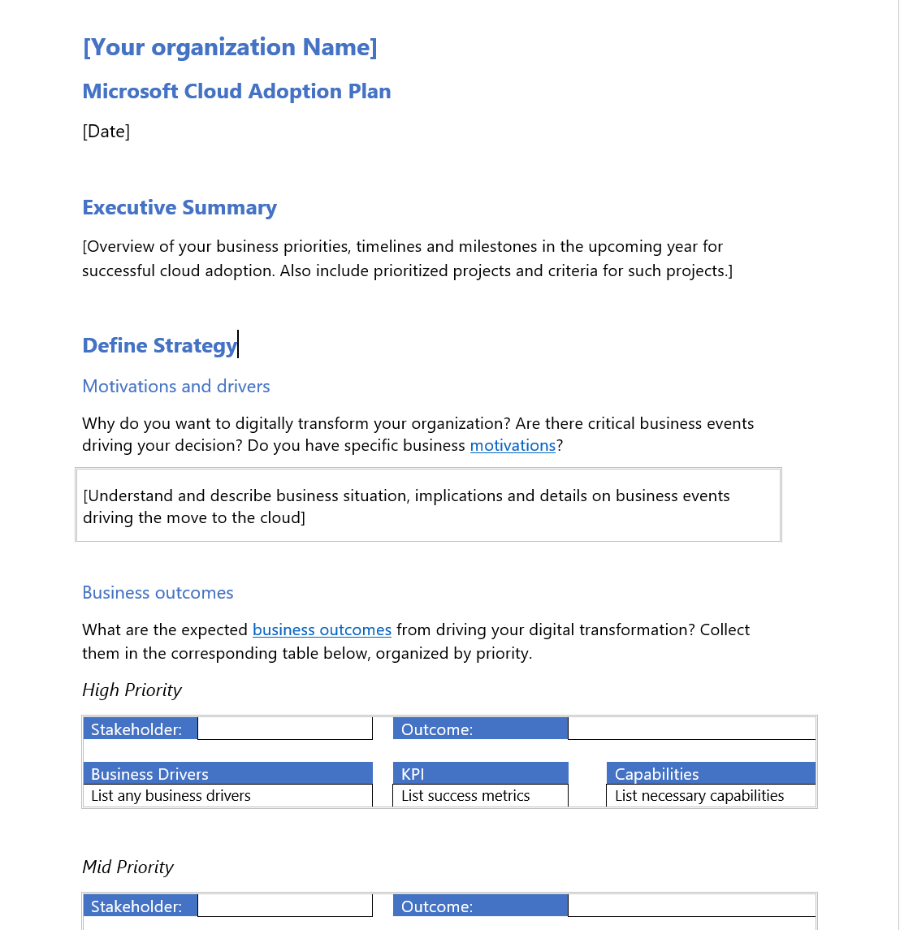

Start documenting the strategy results
Cloud adoption plan converts the aspirational goals of the cloud adoption strategy into an actionable plan
All the cloud teams leverage the cloud adoption plan to guide technical efforts, in alignment with business outcomes.
High Priority
Download the template
and get started with creating your plan
Stakeholder:
CFO
Outcome:
Reduce cost
Business drivers:
KPI:
Capabilities:
Lower OPEX
Payback – 36 months
List necessary capabilities
Cost saving in applications
15% range
5Rs: Rationalization, Right sizing, Autoscaling, & RIs
Retiring apps
5% of apps
No BO align and no customer function

Slide 13
Define strategy
Define strategy
Plan
Ready
Adopt
Documenting the cloud strategy will help business stakeholders and technicians understand the benefits the organization is pursuing by adopting the cloud.
Govern
Manage
Motivations
  Executive mandate
  DC Exit
  Merger and acquisitions
  Cost savings
  Optimization
  Agility
  Tech capabilities
  Market demands
  Geo expansion
  Migration
  Innovation
Business outcomes
  Fiscal: revenue, cost, profit
  Agility: timer to market, provisioning,
  Reach: global access, sovereignty
  Customer engagement: cycle time, from request
  to release
  Performance: SLAs, Downtime, operations, reliability
  Business justification
  Business case: the cloud
  is not always cheaper, mirroring is not cloud, servers drive cost analysis
  Financial model: Capex/
  Opex, ROI, gain, cost avoidance/reduction
  Cloud accounting:
  cost center, procurement, profit center, revenue generating, chargeback
  First project
  Business criteria: workload supported by a BDM
  Technical criteria: minimum dependencies and test path, no governance
  Qualitative analysis: Current Team analysis

Slide 14
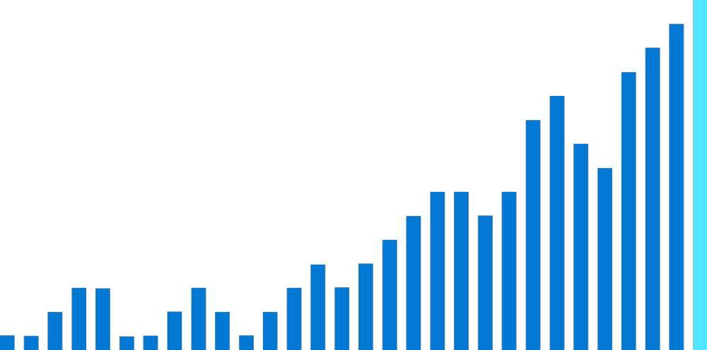
Financial considerations
OPEX pricing models
Reduced datacenter footprint
Staff productivity
Sustainability

Slide 15

Unlock your financial value—in the cloud
Digital transformation accompanies financial transformation
  When moving to the cloud, it is important to understand how Azure will impact:
  Financial position
  Accounting KPI
  Processes

Slide 16
Technical considerations
Scalability
Availability
Security and compliance
Capacity optimization

Slide 17
Basic differences between on-premises and cloud
  On-premises
  Cloud
  You buy servers typically for worst case, highest levels of usage
  Cloud shifts model towards dynamic allocation of capacity
IaaS
PaaS
SaaS
      Virtual machines
      Storage offerings – managed disks, blob storage
      Containerization and workload portability
      Databases
      Analytics
      Shifts on-premises infrastructure to direct SaaS offerings (O365 or other cloud SaaS offerings)

Slide 18
How your current workloads translate to the cloud
Spin up or deprovision resources to build your budgetary allocation
  Deploy and deprovision quickly—fail fast
  Leverage modular components across multiple applications
  Further optimize your investment with cloud billing models and offers
  Azure Hybrid Benefit
  Azure Dedicated Host
  Azure Reservations
  Azure spot pricing

Slide 19

How does cloud pricing work?
On-premises spend results in a fixed cost structure
  On-premises
  Cloud
On-prem
capacity
  On-premises IT costs
  are often upfront
  and require initial capital investment
  Regardless of underlying demand, you're committed to your initial fixed capacity
  Because of your growth expectations, you must
  pre-buy for expected demand and growth
  Cloud costs allow you to benefit from a variable cost model
  Elastic workloads can spin up pay-for-what you use
  For more fixed workloads, cloud also has reserved instance pricing to take advantage of lower price points for static workloads
IT demand
PAYG + Spot VMs
Reserved capacity
Year 1
Year 2
Year 3
Year 4
Year 5

Slide 20
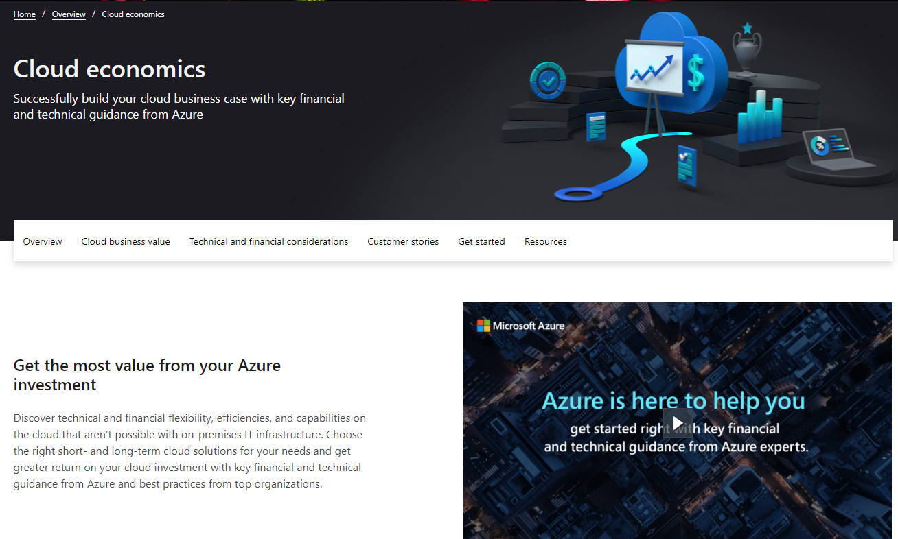

Cloud economics overview
Cloud economics—provides detailed technical and financial guidance from Azure experts—helping you to understand your cloud investment
Save time, budget, and resources—and maximize the benefits from your investment as you chart your cloud journey
Learn more https://www.azure.com/cloudeconomics

Slide 21
Azure Virtual Machine
Cost Estimator

Slide 22
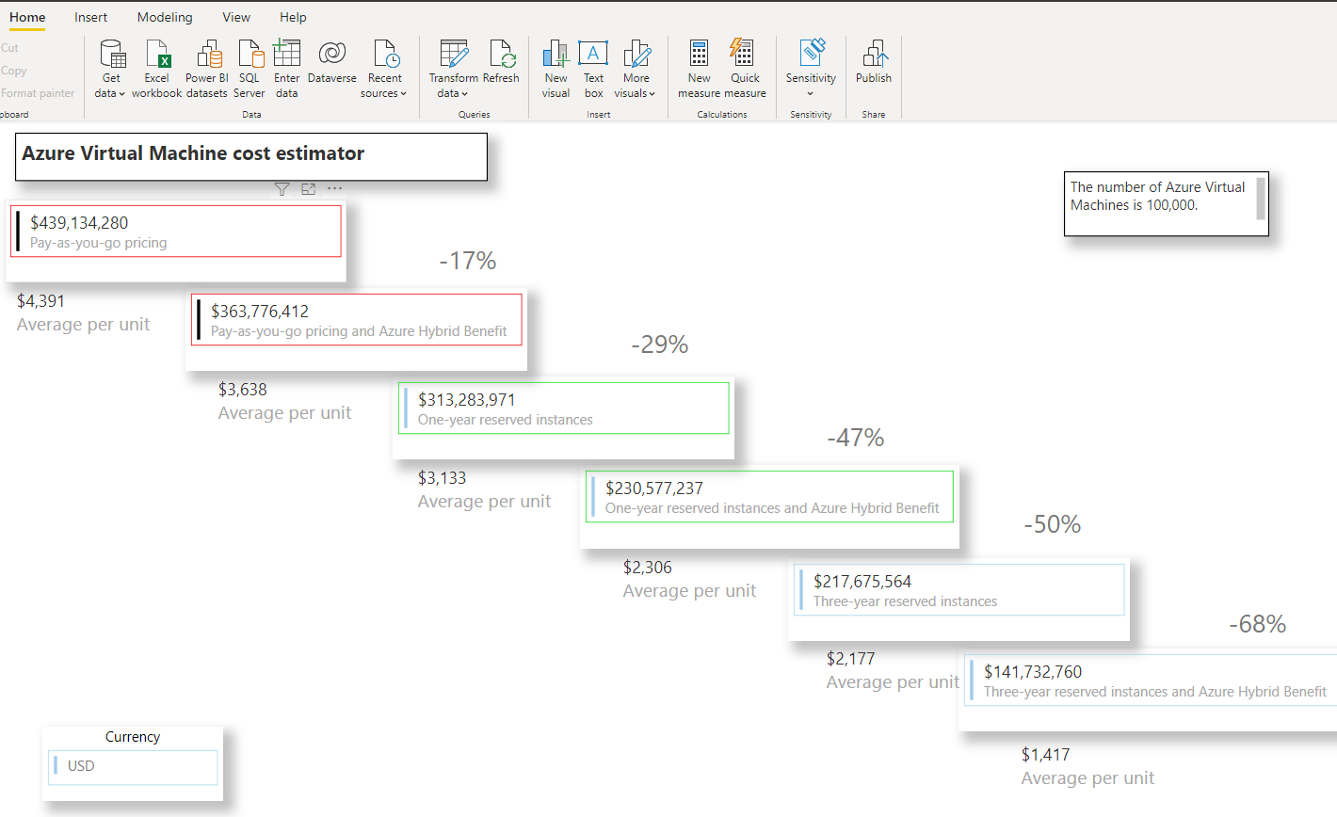
Introducing the Azure Virtual Machine Cost Estimator
How much can you save on Azure VMs by utilizing the Azure Hybrid Benefit and reserved instances?
Estimate and visualize the cost savings you can achieve against pay-as-you-go pricing by taking advantage of key Azure offers and benefits.
Import your own VM data at a massive scale
Leverage the real-time accuracy, speed, and flexibility of Azure pricing APIs.
Download both the Power BI template and Excel supporting file here to get started: https://aka.ms/VMcostestimator

Slide 23
Define strategy
Define strategy
Plan
Ready
Adopt
Documenting the cloud strategy will help business stakeholders and technicians understand the benefits the organization is pursuing by adopting the cloud.
Govern
Manage
Motivations
  Executive mandate
  DC Exit
  Merger and acquisitions
  Cost savings
  Optimization
  Agility
  Tech capabilities
  Market demands
  Geo expansion
  Migration
  Innovation
Business outcomes
  Fiscal: revenue, cost, profit
  Agility: timer to market, provisioning,
  Reach: global access, sovereignty
  Customer engagement: cycle time, from request
  to release
  Performance: SLAs, Downtime, operations, reliability
  Business justification
  Business case: the cloud
  is not always cheaper, mirroring is not cloud, servers drive cost analysis
  Financial model: Capex/
  Opex, ROI, gain, cost avoidance/reduction
  Cloud accounting:
  cost center, procurement, profit center, revenue generating, chargeback
  First project
  Business criteria: workload supported by a BDM
  Technical criteria: minimum dependencies and test path, no governance
  Qualitative analysis: Current Team analysis

