Slide 1

Überblick Microsoft Cloud Adoption Framework

Slide 2
Plan
An iterative process that supports your business … as it evolves
Govern
Manage
Define strategy
Adopt
Ready

Slide 3
Define strategy
Define strategy
Plan
Ready
Adopt
Documenting the cloud strategy will help business stakeholders and technicians understand the benefits the organization is pursuing by adopting the cloud.
Govern
Manage
Motivations
  Executive mandate
  DC Exit
  Merger and acquisitions
  Cost savings
  Optimization
  Agility
  Tech capabilities
  Market demands
  Geo expansion
  Migration
  Innovation
  Business outcomes
  Fiscal: revenue, cost, profit
  Agility: timer to market, provisioning,
  Reach: global access, sovereignty
  Customer engagement: cycle time, from request
  to release
  Performance: SLAs, Downtime, operations, reliability
  Business justification
  Business case: the cloud
  is not always cheaper, mirroring is not cloud, servers drive cost analysis
  Financial model: Capex/
  Opex, ROI, gain, cost avoidance/reduction
  Cloud accounting:
  cost center, procurement, profit center, revenue generating, chargeback
  First project
  Business criteria: workload supported by a BDM
  Technical criteria: minimum dependencies and test path, no governance
  Qualitative analysis: Current Team analysis

Slide 4
Plan
Define strategy
Plan
Ready
Adopt
Cloud adoption plans convert the aspirational goals of the cloud adoption strategy into actions. It will help guide technical efforts, in alignment with the business strategy.
Govern
Manage
Digital estate
  Rationalization: inventory
  Quantitative analysis:
  asset optimized and
  sized properly
  Qualitative analysis: operational process
  Initial organization alignment
  Cloud Strategy Team
    Business IT: requirements
    and needs
    IT management operations: traditional IT
    Governance: executive
    sponsor, finance, business leadership, legal,
    security, HR
    Cloud platform vendor: account success team
  Cost management
  IT-business alignment
  Governance MVP
  Skill readiness plan
  Organizational readiness
  Governance and security alignment
  Initial organization alignment
  Building technical skills: business/technical,
  and certifications
  Change management guidance
  Cloud adoption plan
  5R strategy: rehost, refactor, rearchitect, rebuild, replace
  Infrastructure migration: VM, server,
  database focus
  Application innovation: born in the cloud applications, APIs
  Data-driven innovation: Focus on data consolidation and analysis

Slide 5
Ready
Define strategy
Plan
Ready
Adopt
Ready establishes a cloud foundation or Adoption Target that can provide hosting for any adoption efforts. This should consist of common denominators across 80–90% of cloud adoption.
Govern
Manage
Azure
readiness guide
  Resource management:
  management groups, subscriptions, resource groups, resources tree hierarchy
  Naming Standards
  Resource tags
  Landing zone infrastructure
  Network design: Vnet, hybrid, firewall, hub, front door, endpoints
  Storage design: disk, file, blobs, CDN
  Compute design: VMs, containers, apps, serverless
  Data design: Structured/ unstructured
  Landing
  zone ID
  Identity and access
  Role-based access control RBAC
  Manage to least privilege
  Landing
  zone cost
  Costs and billing
  Analyze Cloud Costs
  Monitor with budgets
  Optimize with recommendations
  Manage invoices
  and payments
  Blueprints
  AI
  BigData
  Hybrid networks
  Identity management
  IoT
  Serverless
  SAP
  VMs
  WebApps
  DevOps

Slide 6
Adopt: Migrate
Define strategy
Plan
Ready
Adopt
Cloud adoption will include workloads which do not warrant significant investments in the creation of new business logic. These workloads are candidates for migration to the cloud.
Govern
Manage
Assess
  Evaluate assets and establish a plan
  Validate pre-requisites: landing zone, skilling
  Drivers: reducing capex, freeing up DC
  Quantitative factors: VMs, networking, compatibility
  Qualitative factors: process dependencies, critical business events
  Migrate: rehost
  Replicate (lift and shift)
  on-prem functionality using cloud native technology
  Leverage Azure
  Migration Guide
  Optimize
  Balance performance
  and price
  Deliver the right
  experience within budget
  Resize VM size, resize storage, resize database
  Secure and manage
  Prepare the migrated asset for ongoing operations: security, monitoring, configuration

Slide 7
Adopt: Innovate
Define strategy
Plan
Ready
Adopt
Older apps can take advantage of many of the same cloud-native benefits by modernizing the solution or components of the solution. Modern DevOps invites into the process to create shorter feedback loops and better customer experiences.
Govern
Manage
Infrastructure abstraction
  Cloud native applications built from the ground up optimized for cloud:
  Resiliency
  Global scale
  Agility
  Security
  Autoscaling
  Innovate: refactor
  Refactoring an application to fit a PaaS/Serverless-based model or refactoring code to deliver on new business opportunities.
  Drivers: faster and shorter updates,
  code portability, greater cloud efficiency (resources, speed, cost)
  Innovate: rearchitect
  Modify existing applications into managed containers to take advantage of cloud native benefits
  Drivers: application scale and agility, easier adoption of new cloud capabilities, mix of technology stacks
  Innovate:
  rebuild
  A new code base is created to align with a cloud-native approach. App Data and AI Services
  Drivers: accelerate innovation, build
  apps faster, reduce operational cost
  DevOps
  Culture
  Development
  Testing
  Release
  Monitoring
  Management

Slide 8
Govern
Define strategy
Plan
Ready
Adopt
Adopting the cloud is a journey, not a destination. Along the way, there are clear milestones and tangible business benefits. The final state of cloud adoption is unknown when a company begins the journey. Cloud governance creates guardrails that keep the company on a safe path throughout the journey.
Govern
Manage
Establish your methodology:
Establish a basic understanding of the methodology that drives cloud governance in the Cloud Adoption Framework to begin thinking through the end state solution.
  Use the governance benchmark tool:
  Assess your current state and future state to establish a vision for applying the framework.
  Establish an initial governance foundation:
  Begin your governance journey with a small, easily implemented set of governance tools. This initial governance foundation is called a minimum viable product (MVP).
  Improve your initial governance foundation:
  Throughout implementation of the cloud adoption plan, iteratively add governance controls to address tangible risks as you progress toward the end state.

Slide 9
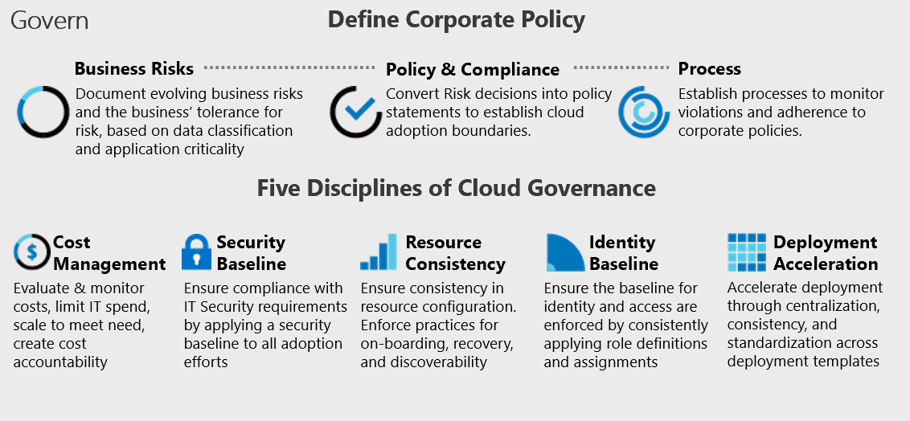
Cloud Adoption Framework’s Govern methodology

Slide 10
Manage and operations
Define strategy
Plan
Ready
Adopt
Manage and operations enumerates, implements, and iteratively reviews related to the expected operational behavior of the service.
Govern
Manage
Define business commitments
  Document supported workloads to establish operational commitments with the business and agree on cloud management investments for each workload.
  Establish a management baseline:
  Define the criticality classifications, cloud management tools, and processes required to deliver your minimum commitment to operations management.
  Expand the management baseline:
  Based on business commitments and operations decisions, make use of the included best practices to implement the required cloud management tooling.
  Advanced operations and design principles:
  Platforms or workloads that require a higher level of business commitment might require a deeper architecture review to deliver on resiliency and reliability commitments.

Slide 11
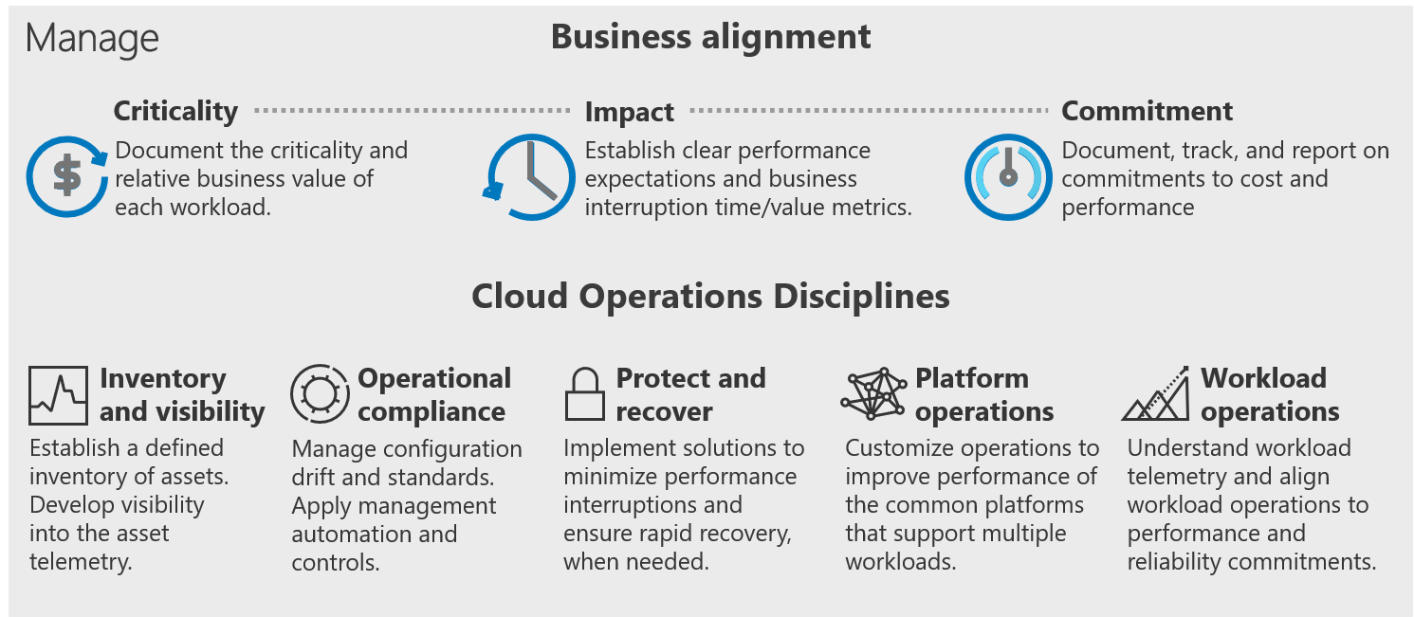
Cloud Adoption Framework's Manage methodology

Slide 12
Microsoft Cloud Adoption Framework for Azure
Adopt
Define Strategy
Understand motivations
Business outcomes
Business justification
Prioritize project
Plan
Digital estate
Initial organization alignment
Skills readiness plan
Cloud adoption plan
Ready
Azure readiness guide
First landing zone
Expand the blueprint
Best practice Validation
Migrate
• First workload migration
• Expanded scenarios
• Best practice validation
• Process improvements
Innovate
• Innovation guide
• Expanded scenarios
• Best practice validation
• Process improvements
Govern
Methodology • Benchmark
initial best practice • Governance maturity
Manage
Business commitments
operations baseline •
Ops maturity

Slide 13
Microsoft Cloud Adoption Framework for Azure
Security is a discipline you practice along your entire cloud adoption path
Define strategy
Define motivations, and create a business case leveraging cloud economics
Plan
Create actionable cloud adoption plan aligned to the strategy
Ready
Prepare cloud environments with Azure landing zones
Adopt
Migrate or Innovate
Design, build and deploy workloads to Azure
Ready
Prepare cloud environments with Azure landing zones
Security is a critical design area here
Govern
Automate governance baseline and empower delegated responsibility
Govern
Automate governance baseline and empower delegated responsibility
Manage
Build operations baseline and support enterprise operations
Manage
Build operations baseline and support enterprise operations
Secure
Establish security baseline and manage security posture
Security is a discipline of
governance & automated guardrails
Security drives your operations baseline implementation
All of which depend on sound security posture management

Slide 14


Cloud Adoption Framework – Secure methodology
End state for managing your overall security posture
Business alignment
Business alignment
Establish cross-org processes to scale cloud security throughout your business
Secure
Risk insights
Integrate security insights into risk management framework and digital initiatives.
Security integration
Integrate security insights and practices into business and IT processes
Operational resilience
Ensure organization can operate during attacks and rapidly regain full operational status.
Security disciplines
Security disciplines
Implement proven security processes
built on modern, cloud-based security tools
Access control
Establish Zero Trust
access model. Extend modern protection
to legacy assets.
Security operations
Detect, respond, and recover from attacks;
hunt for hidden threats; lead through
data-driven decision
Asset protection
Protect sensitive data and systems. Continuously discover, classify & secure assets.
Security governance
Continuously identify, measure, and manage security posture to correct deviation and reduce risk.
Innovation security
Integrate security into DevSecOps processes.
Align security, development, and operations practices.
Cloud security team
Establish team with expertise and experience for security and cloud. Often a cross-functional security team(s) that includes members of security team, cloud center of excellence (CCoE), Cloud operations, IT operations, and others.

