Slide 1
Hooks
Cui Xuesen

Slide 2
Motivation

Slide 3
It’s hard to reuse stateful logic between components
React doesn’t offer a way to “attach” reusable behavior to a component (for example, connecting it to a store).
Solutions: Mixins, render props, HOC
Let’s see how they work.

Slide 4
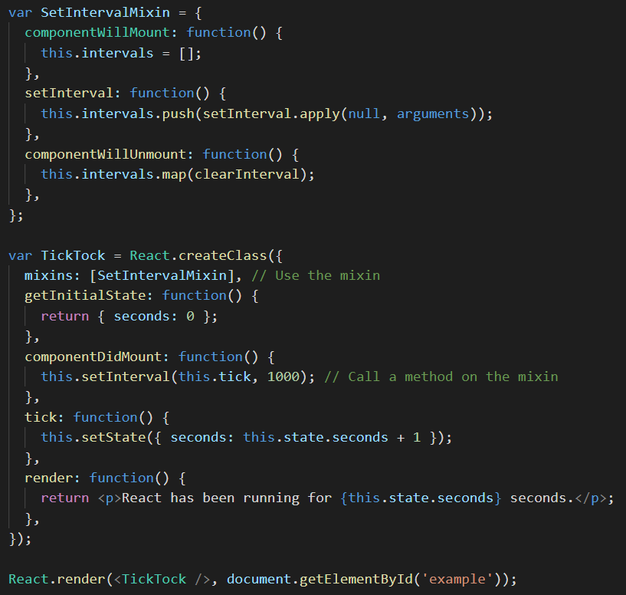
Mixins has been abandoned!!!
Mixins Considered Harmful

Slide 5
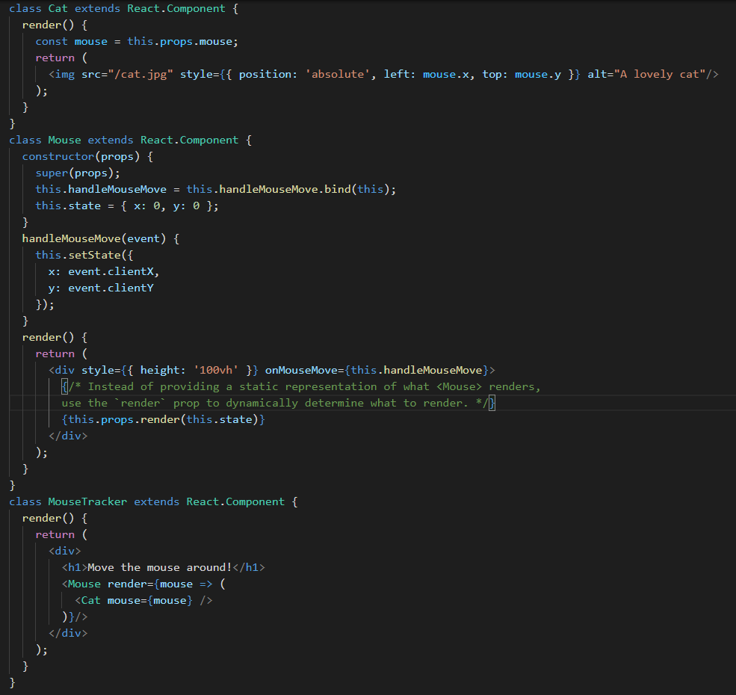
render props
It refers to a technique for sharing code between React components using a prop whose value is a function.

Slide 6
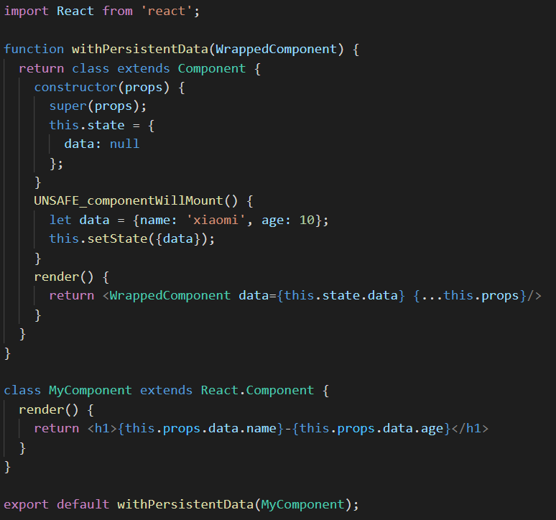
HOC
a function that takes a component and returns a new component
API❌
composition -> design pattern√

Slide 7
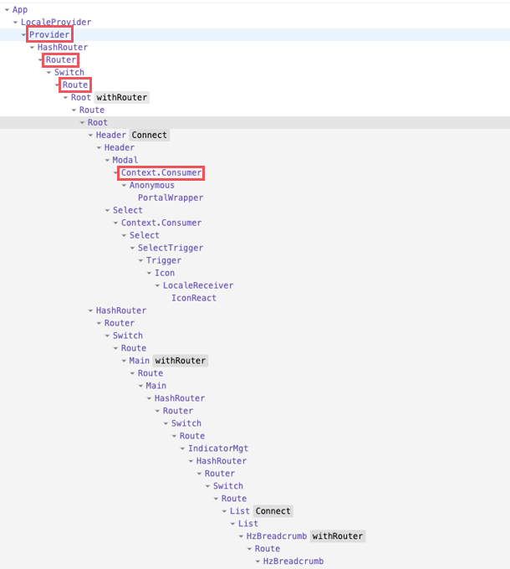
Redux
React Redux
React Router
wrapper hell
modify component structure -> reuse component logic
React needs a better primitive for sharing stateful logic.

Slide 8
Complex components become hard to understand

Slide 9
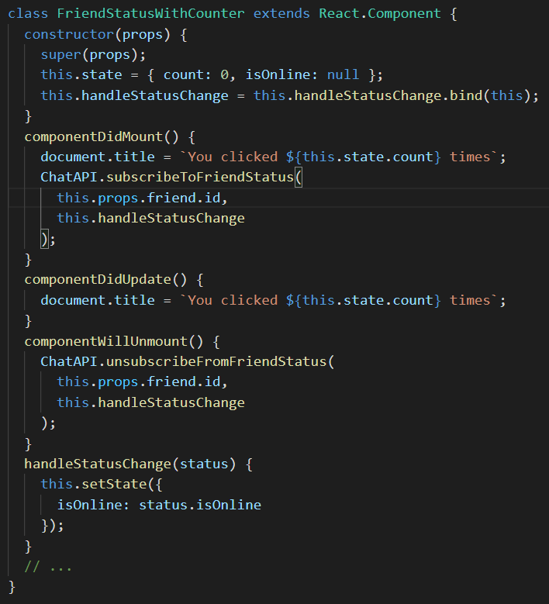

We have to duplicate the code between these two lifecycle methods in class.
In many cases we want to perform the same side effect regardless of whether the component just mounted, or if it has been updated.
Conceptually, we want it to happen after every render — but React class components don’t have a method like this.
We could extract a separate method but we would still have to call it in two places.

Slide 10
Notice that componentDidMount and componentWillUnmount need to mirror each other. Lifecycle methods force us to split this logic even though conceptually code in both of them is related to the same effect.

Slide 11
Complex components become hard to understand
Components: simple -> a mess of stateful logic and side effects
Each lifecycle method often contains a mix of unrelated logic.
componentDidMount and componentDidUpdate: fetch some data
componentDidMount: other logic(set up event listeners etc.)，componentWillUnMount: cleanup them
Mutually related code that changes together gets split apart, but completely unrelated code ends up combined in a single method.
force a split based on lifecycle methods => logic inconsistencies

Slide 12
Classes confuse both people and machines
class
this
bind the event handlers
Classes don’t minify very well, and they make hot reloading flaky and unreliable.

Slide 13
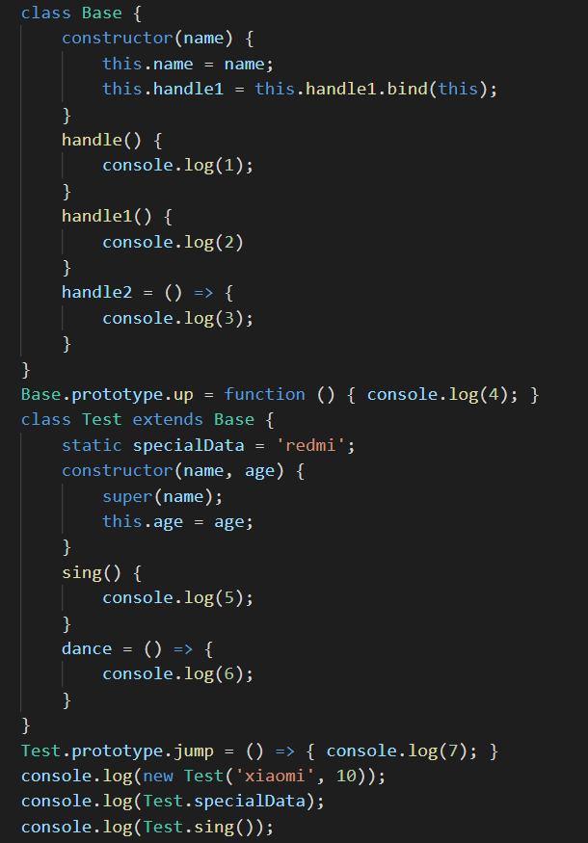
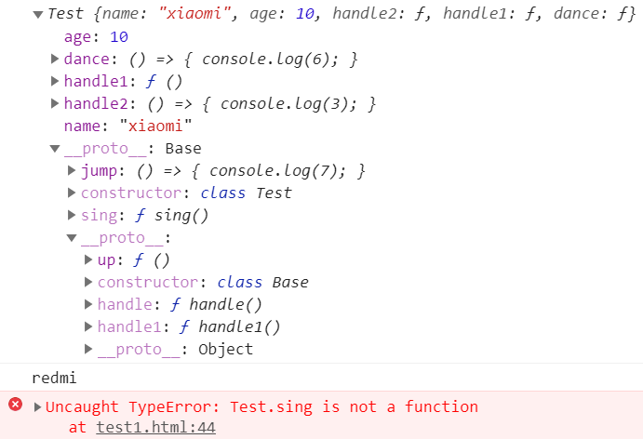

Slide 14
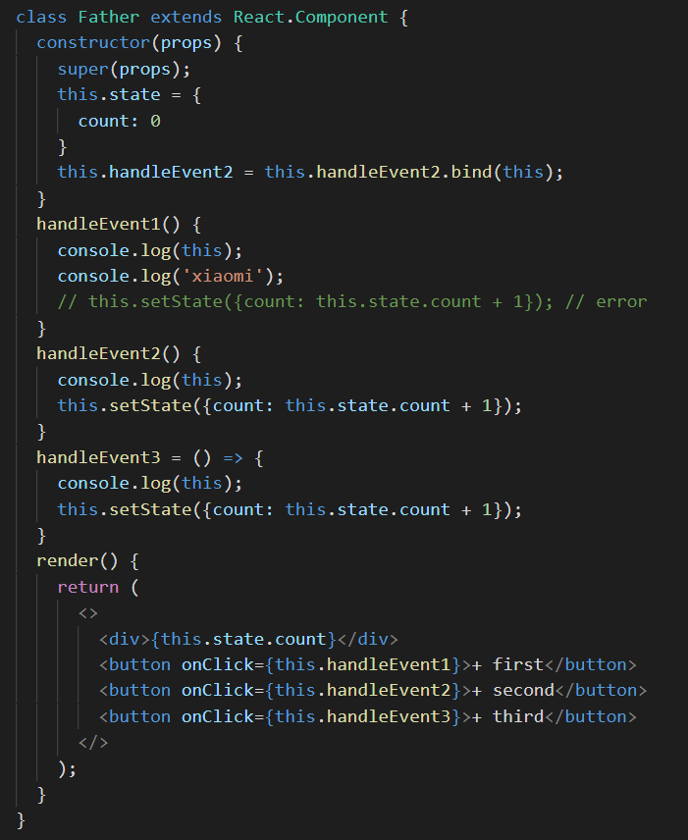
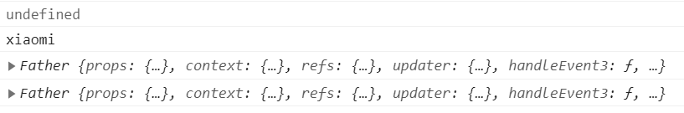
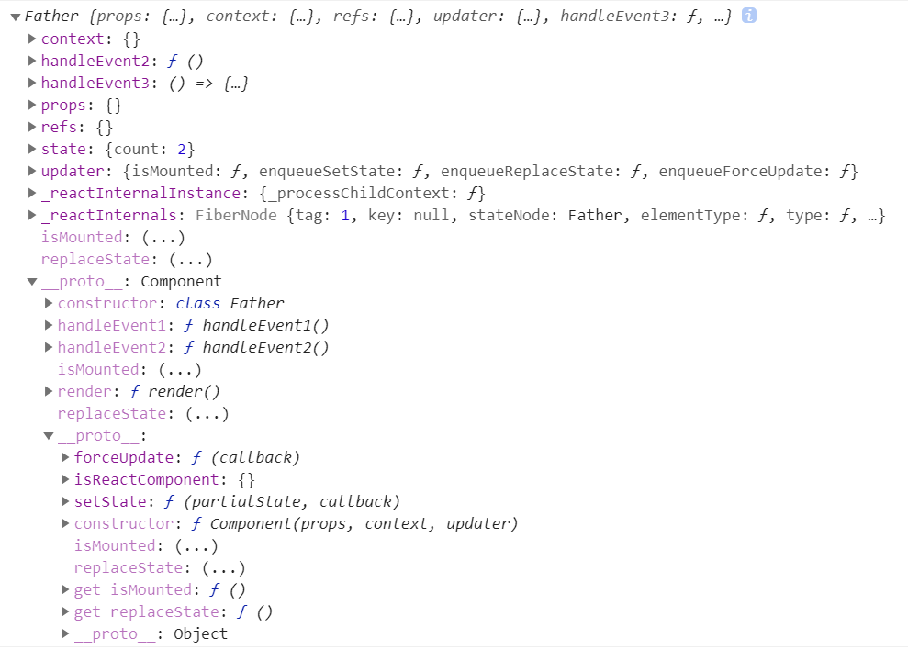
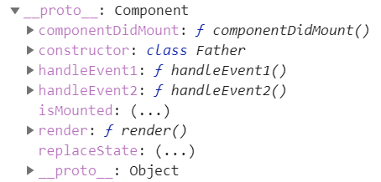

Slide 15
How do Hooks solve these problems?

Slide 16
React Conf 2018
Sophie Alpert:
Reusing logic
Giant components
Confusing classes
video
video
Dan Abramov:
Problems Today:
Wrapper hell
Huge components
Confusing classes
React doesn’t provide a stateful primitive simpler than a class component.

Slide 17
code reuse
Hooks allow you to reuse stateful logic without changing your component hierarchy.
code organization
Hooks let you split one component into smaller functions based on what pieces are related (such as setting up a subscription or fetching data).
class and this
Hooks let you use more of React’s features without classes.

Slide 18
What’s Hooks?

Slide 19
Hooks are a new addition in React 16.8. They let you use state and other React features without writing a class. React Native supports Hooks since the 0.59 release of React Native.
Hooks are functions that let you “hook into” React state and lifecycle features from function components.
Let’s us see what hooks are in React.

Slide 20
State Hook

Slide 21
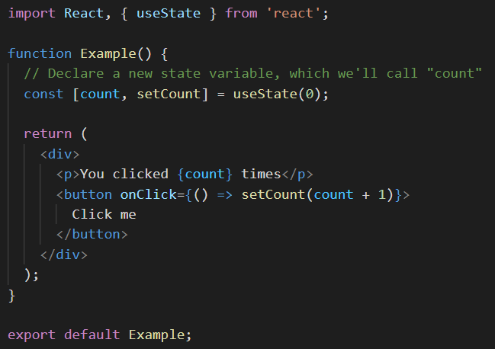

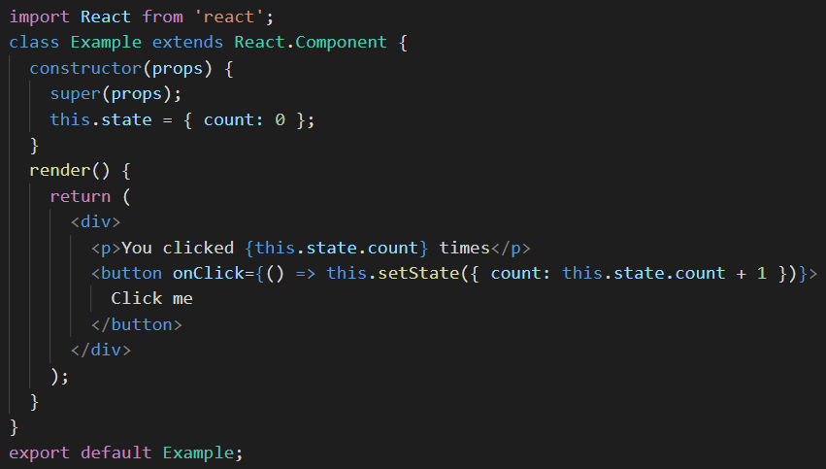
Of course, we can use ( ) => { }
init state
the current state and a function that updates it
array destructuring
update the count state
In a function, we already have setCount and count as variables so we don’t need this.
question

Slide 22
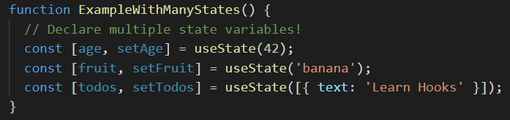
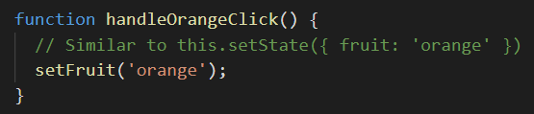
Using Multiple State Variables
const [something, setSomething] = useState(initialValue)
update individually

Slide 23
Effect Hook

Slide 24
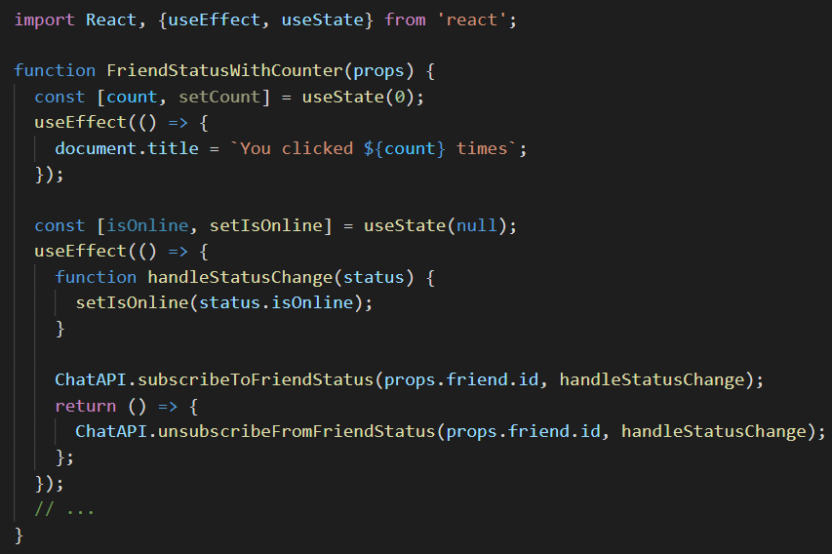
What does useEffect do?
do something after render
Use Multiple Effects to Separate Concerns
Hooks let us split the code based on what it is doing rather than a lifecycle method name. React will apply every effect used by the component, in the order they were specified.

Slide 25
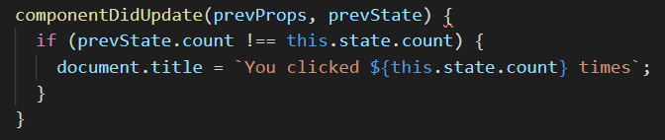

Optimizing Performance by Skipping Effects
In some cases, cleaning up or applying the effect after every render might create a performance problem.
[ ], run an effect and clean it up only once (on mount and unmount)

Slide 26
Context Hook

Slide 27
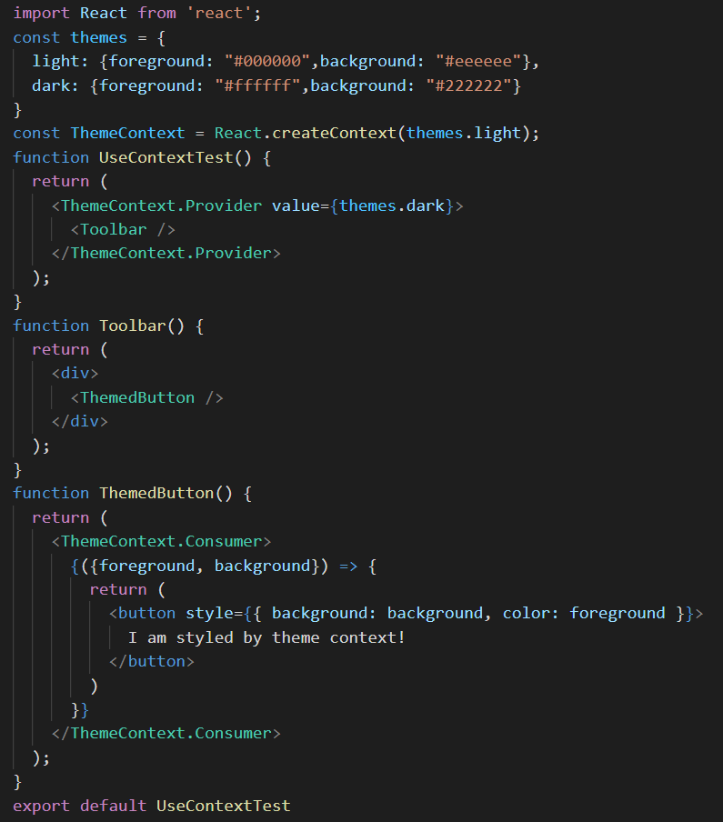
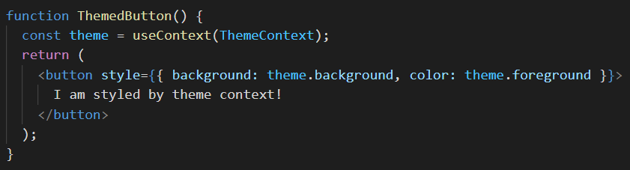
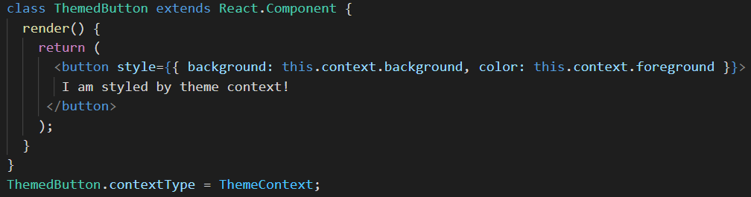
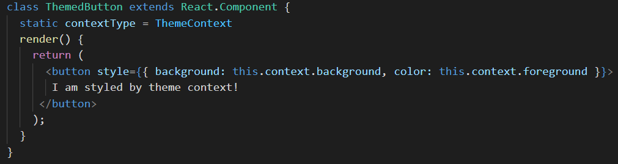

Slide 28
Reducer Hook

Slide 29
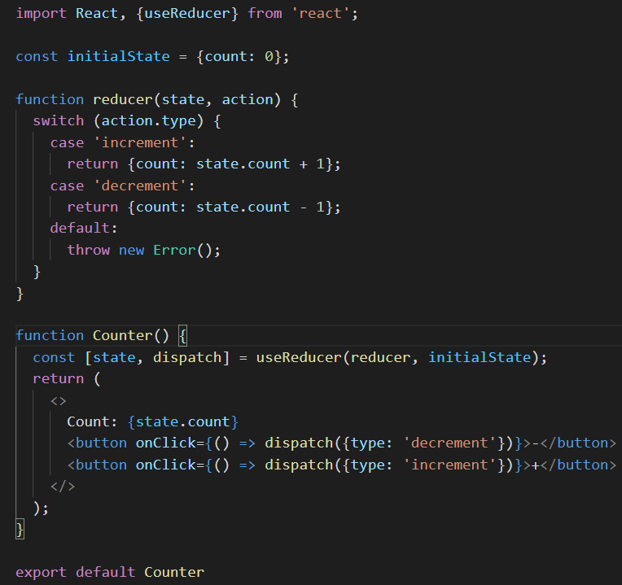
useReducer is usually preferable to useState when you have complex state logic that involves multiple sub-values or when the next state depends on the previous one.

Slide 30
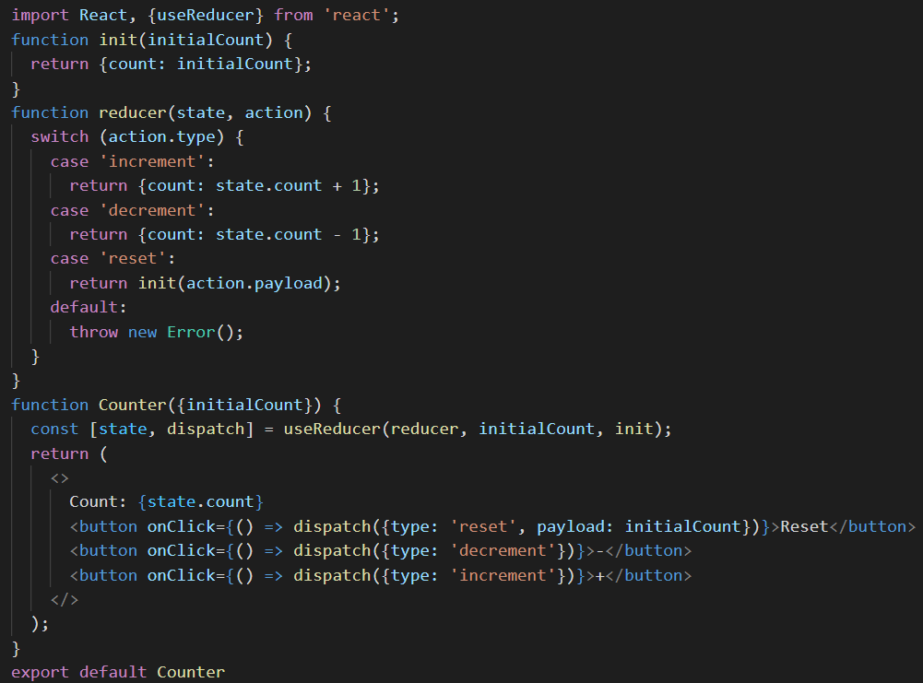
Lazy initialization

Slide 31
Callback Hook

Slide 32
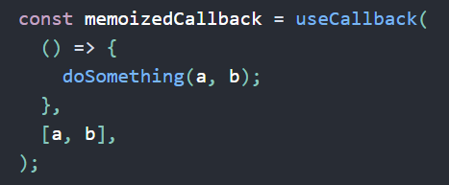
If the values of the variables in a and b remain the same, the reference to the memoizedCallback remains the same. That is, the first input function of the useCallback is cached for render performance optimization purposes.
example
PureComponent、shouldComponentUpdate、React.memo

Slide 33
Memo Hook

Slide 34
If the values of the variables a and b remain the same, the value of the memoizedValue remains the same. The first input function of the useMemo function is not executed, thus saving computation.
example
difference:
The useCallback is to cache the first argument(callback) according to the dependency, but the useMemo is to cache the value after the execution of the first argument(callback) according to the dependency.

Slide 35
Ref Hook

Slide 36
The useRef returns a mutable ref object whose .current property is initialized to the passed argument (initialValue). The returned object will persist for the full lifetime of the component.
example
So what’re the differences between the useRef and refs?
Let’us see how do refs work first.
example

Slide 37
useRef
save data “across render cycles”
The useRef doesn’t notify you when its content changes. Mutating the .current property doesn’t cause a re-render.

Slide 38
ImperativeHandle Hook

Slide 39
example
The official recommendation is to use both useImperativeHandle and forwardRef to customizes the instance value that is exposed to parent components(reduce the exposed attributes to parent components).

Slide 40
LayoutEffect Hook

Slide 41
In React Hooks, the useEffect is to replace the componentDidMount and componentDidUpdate, which the main function is to perform some side effects(such as accessing DOM, requesting data) after the page is rendered.
The signature is identical to useEffect, but it calls effect synchronously after all DOM mutations. Use this to read layout from the DOM and synchronously re-render. Updates scheduled inside useLayoutEffect will be flushed synchronously, before the browser has a chance to paint.
example

Slide 42
DebugValue Hook

Slide 43
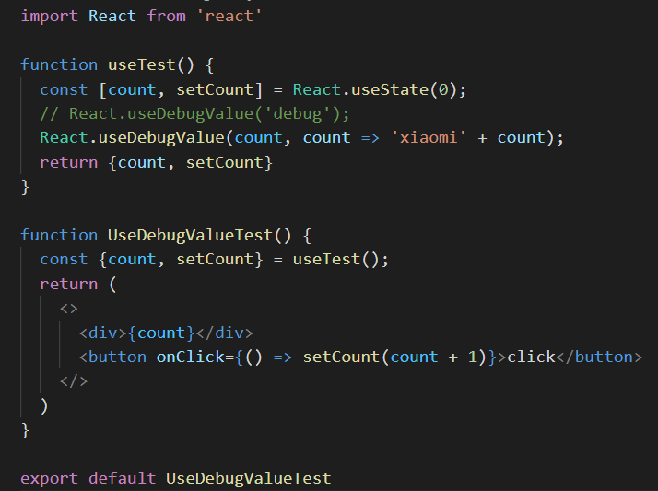

Slide 44
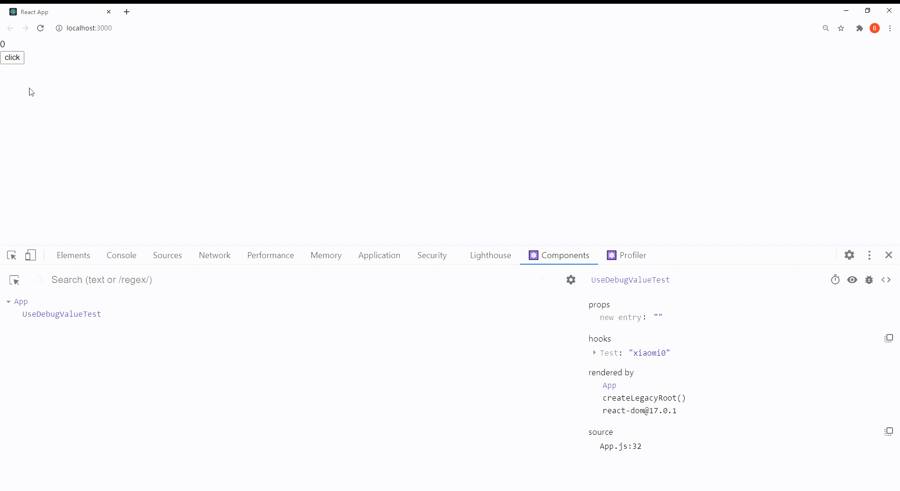

Slide 45
Bulid Your Own Hooks

Slide 46
Building your own Hooks lets you extract component logic into reusable functions.
example

Slide 47
Rules of Hooks

Slide 48
Only Call Hooks at the Top Level
Don’t call Hooks inside loops, conditions, or nested functions.
Only Call Hooks from React Functions
Don’t call Hooks from regular JavaScript functions.
example

Slide 49
Summary

Slide 50
No Breaking Changes
Completely opt-in.
100% backwards-compatible.
Available now.
There are no plans to remove classes from React.
Hooks don’t replace your knowledge of React concepts.

Slide 51
Information Support

Slide 52
React Official Chinese Document: https://zh-hans.reactjs.org/
React Official English Document: https://reactjs.org/
Codepen: https://codepen.io/cxs2018/pens/public

Slide 53
Q & A

Slide 54
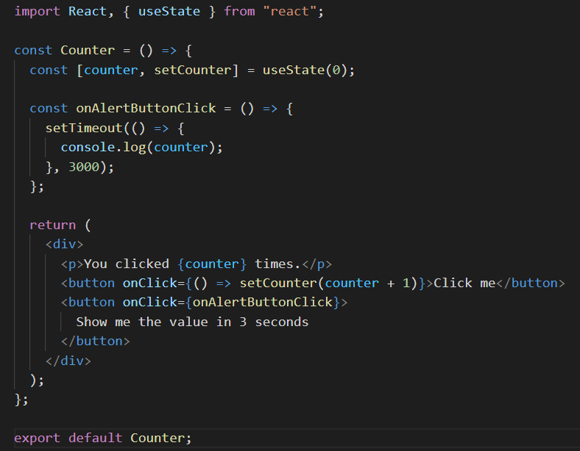
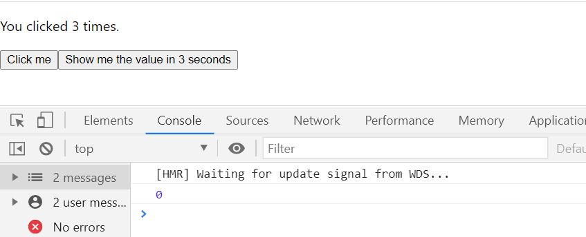

Slide 55
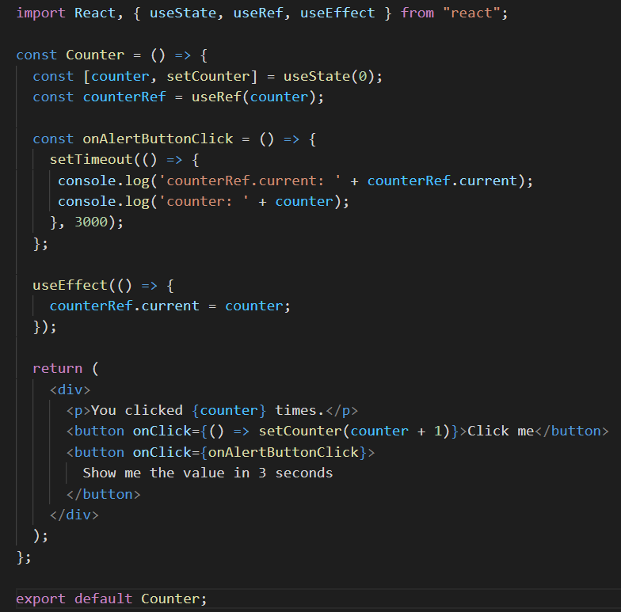
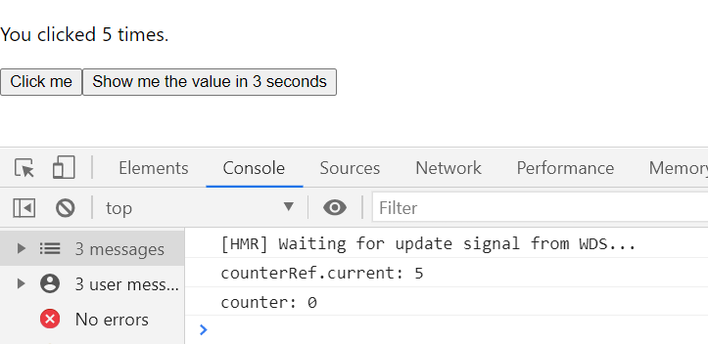

Slide 56
That’s all. Thank you!

