Slide 1
BIOM 201: Talkowski Seminar
Danny Antaki
Postdoctoral Scholar, Gleeson Lab UCSD
Nov. 8 2019
dantaki.github.io/presentations

Slide 2
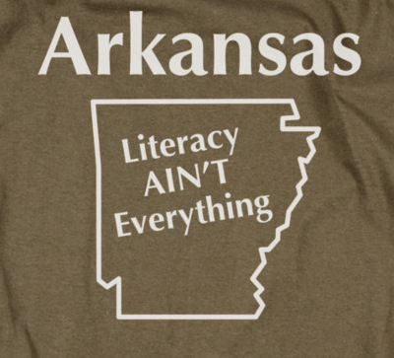
My Background
Raised in Arkansas (not fun)
Purdue as Bio major
BMS PhD in the Jonathan Sebat lab
  2013-2018
  *ok boomer*
Postdoc in the Joseph Gleeson lab

Slide 3
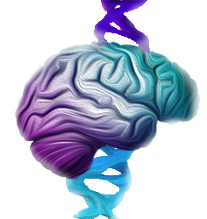
Research Interests
Genetics of Brain Development and Behavior
  How can DNA build a brain?
  Psychiatric Disorders (Autism & Schizophrenia)
Structural Variation

Slide 4
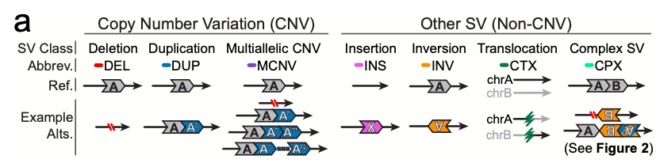
What is Structural Variation?
Classes of Sequence Mutations
SNP: 1bp
INDEL: 2bp-49bp
SV: >50bp
Reference
GATCGATC
GAGCGATC
GAT--CGATC
GAGAG-GATC
Mutation
Functional impact
Potentially more damaging
Collins 2019 biorxiv (gnomadSV manuscript)

Slide 5

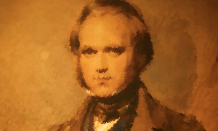
Structural Variation (SV): Bigger Picture
On the Origin of Species
On the Origin of Species
Mechanism?
SV can lead to radical changes in phenotype

Slide 6
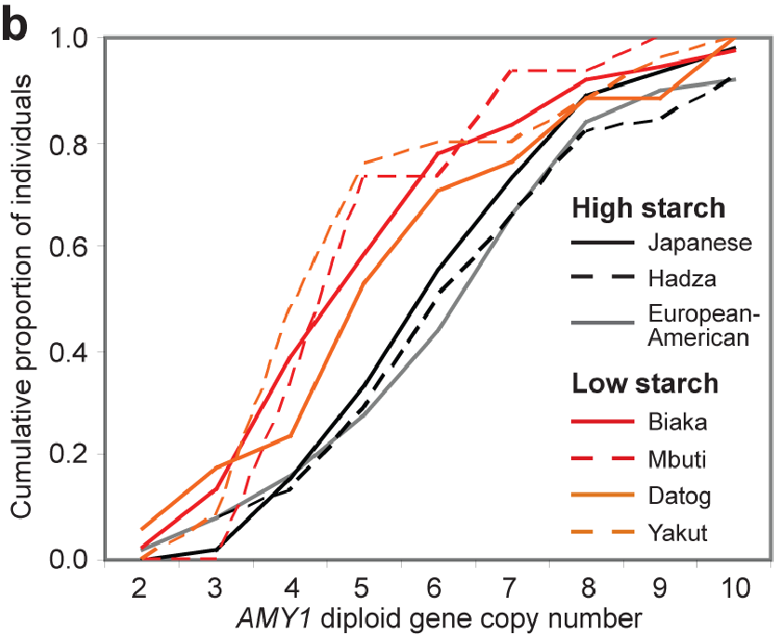
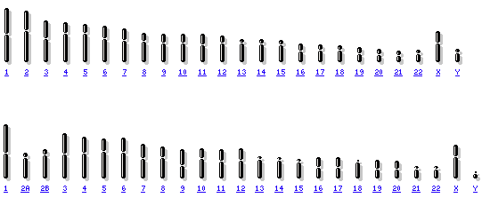

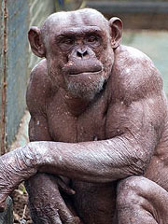
One small SNP for gradualism, one giant SV for discontinuous evolution
Leaps in Evolution
  Gene Duplications
  Gene fusions
Reproductive Barriers (Speciation)
  Chromosome number
  Translocations
  Inversions
Chromosome 2 fusion
Human
Chimp

Slide 7

SV: A force to be reckoned with
SVs are strongly associated with developmental disorders
  De novo mutation (new in child but not in parent)
  Autism
  Schizophrenia
  Down Syndrome
  Angelman / Prader-Willi
  Intellectual Disability
  Etc…
Cancer and SV go hand in hand
  Gene Fusions (BCR-ABL: Philadelphia Chromosome)
  Loss/Gain of genes/chromosomes
  Chromothripsis
Increased Fitness
Deleterious Mutations

Slide 8
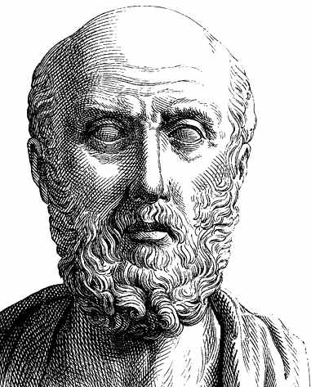
Talkowski’s Focus: Neurodevelopmental & Psychiatric Disorders
The cause of psychiatric disorders has been a mystery for 1000s of years
As long as the brain is at rest, the man enjoys his reason, but the depravement of the brain arises from phlegm and bile…
Those who are mad from phlegm are quiet, and do not cry out nor make a noise; but those from bile are vociferous, malignant, and will not be quiet, but are always doing something improper
– Hippocrates The Sacred Disease
History of Autism Genetics highlights how technology has improved our ability to attribute mutations to psychiatric disorders
Prof. Talkowski’s career developed in tandem with next generation sequencing, he applies new technology to characterize SV in diseases and healthy humans

Slide 9
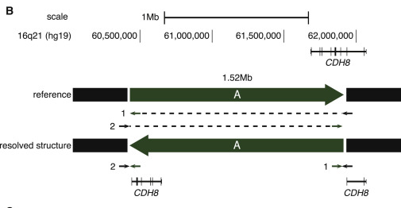
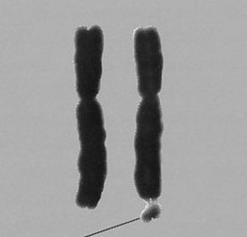
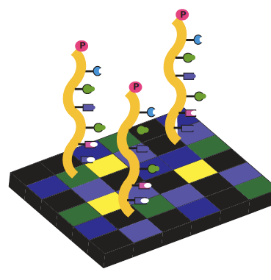
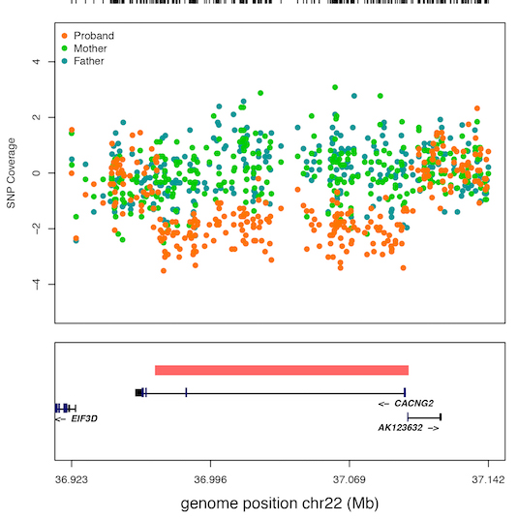
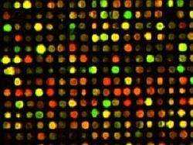
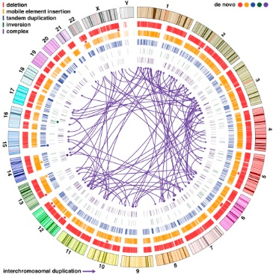
de novo inversion disrupts CDH8
Exome studies found loss of function and missense SNPs+INDELs (1-50bp)
First genetic associations were
microscopic structural changes
(>10Mb)
de novo deletion, spontaneous mutation in child
1960’S
1970’S
1980’S
1990’S
2000’S
2010’S
Microarrarys found sub-microscopic structural changes
(100kb-10Mb)
Whole genome sequencing resolved complex de novo structural changes (50bp-10Mb)
Notes:
How presentation will benefit audience: Adult learners are more interested in a subject if they know how or why it is important to them.
Presenter’s level of expertise in the subject: Briefly state your credentials in this area, or explain why participants should listen to you.

Slide 10
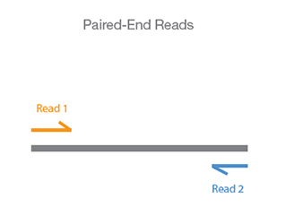
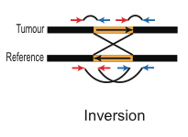
The (Current) New Wave: Next Gen. Sequencing
Balanced Chromosomal Alterations
  SV that do NOT change the copy number
  Inversions, Insertions, Translocations
Microarrays cannot detect them (except Loss of Heterozygosity events)
Whole Exome Sequencing rarely capture breakpoint sequences
Cytogenetics are limited to large Mb events
Whole Genome paired-end Sequencing (WGS) offers the best solution for nucleotide resolution of balanced SV
Balanced SV, those that do not alter the copy number, can be detected with paired-end sequencing

Slide 11
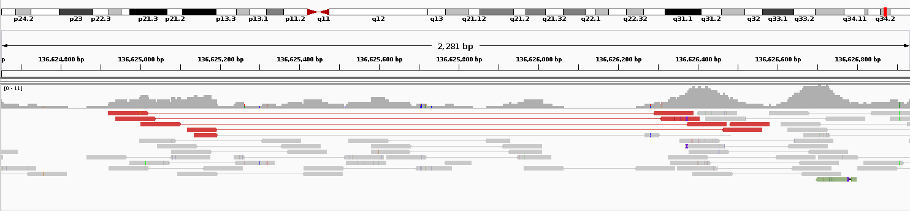
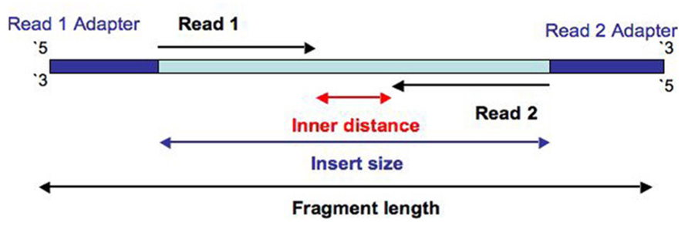
Paired-End (PE) Short Read Sequencing
Revolutionized genomics and structural variation calling
Heterozygous 1kb deletion in NA12878
Low coverage WGS: 100bp PE reads / 300bp “inner distance”
”Vanilla” Illumina Paired-End Short Reads
(not to scale)
100-150bp
~300bp
100-150bp

Slide 12
Jumping Libraries / Large Insert PE WGS
Prof. Talkowski is a huge advocate of this method
Strengths:
  Genome Assembly
  Greater physical coverage (”jump” across assembly gaps)
  Better balanced SV detection
Weaknesses:
  Shorter sequenced reads (25-50bp)
  Not as much bioinformatic support as vanilla PE-WGS
  Lower sequence coverage (lower sensitivity to detect CNVs by read-depth)
Schematic for jumping libraries
(not to scale)
25-50bp
3kbp-10kbp
25-50bp

Slide 13
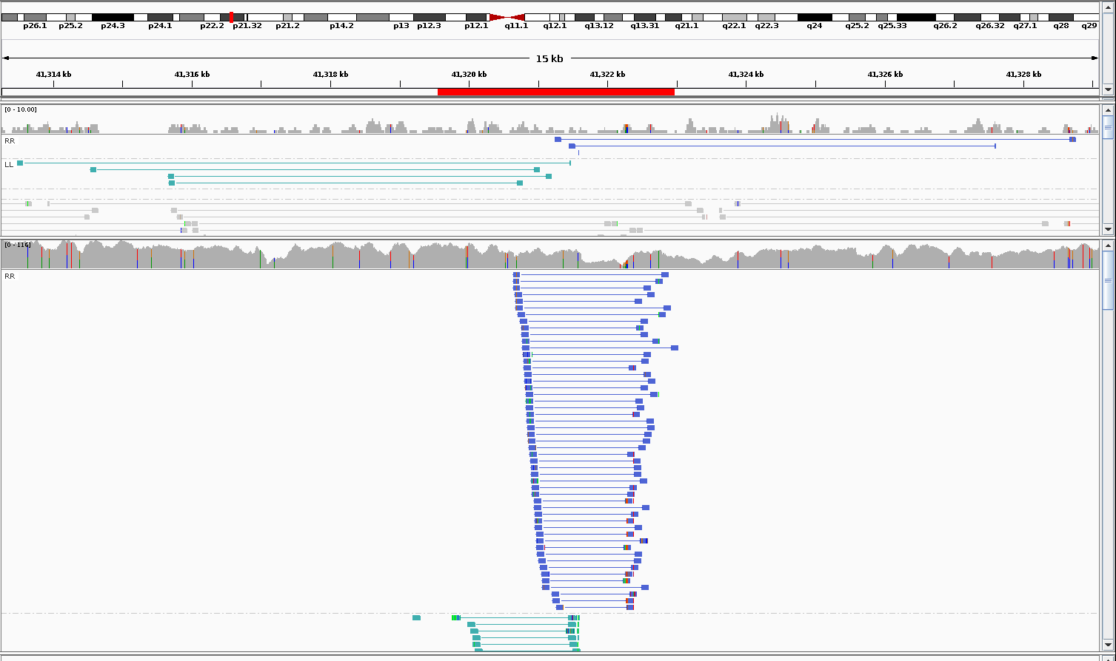
Jumping Libraries Visualized
3.4kb inversion in HG00733
7kb jumping insert WGS
Ambiguous Mapping
Vanilla PE-WGS
Repeat
Inversion
Repeat
80x Vanilla PE-WGS
Forward Strand
Reverse Strand
Jumping Library WGS

Slide 14
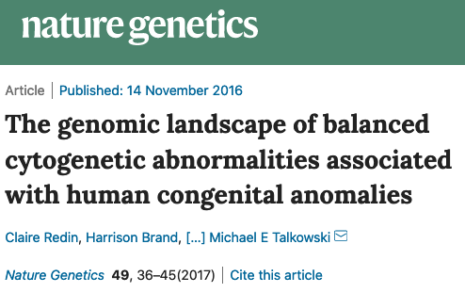
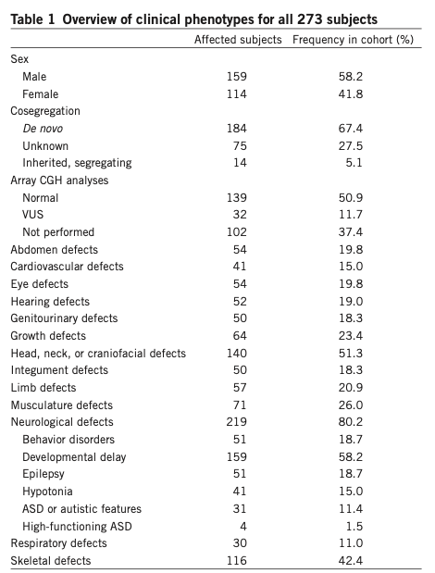
273 samples with developmental disorders (DD), karyotype was negative or hard to interpret
Applied jumping-insert WGS on majority of subjects.
Mapped balanced SV breakpoints to 91% of subjects.
8% of breakpoints could not have been resolved with vanilla WGS

Slide 15
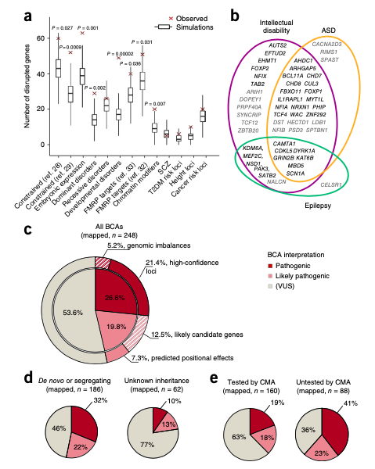
Disrupted Genes are enriched in specific gene sets & shared across DD

Slide 16
Many variants have uncertain functional effects

Slide 17
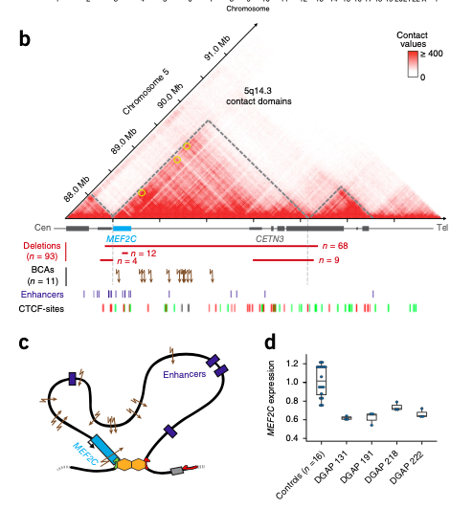
Balanced SV can alter topological domains and affect gene expression

Slide 18
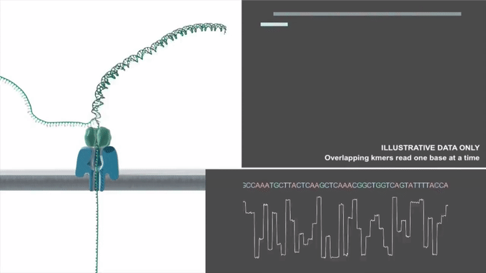
Future of jumping-insert WGS?
$: combination of jumping-insert and “vanilla” WGS for comprehensive SNP/INDEL/CNV/SV calling (potentially de novo assembly)
  Closing the gap of missing heritability in DD
$$$: 3rd Generation Sequencing: Single Molecule Long Read Sequencing
  PacBio / Oxford Nanopore
Also Optical Mapping (Bionano Genomics)
  NOT sequencing!

Slide 19
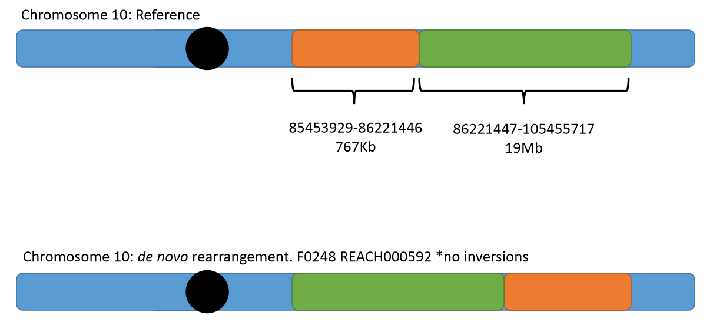
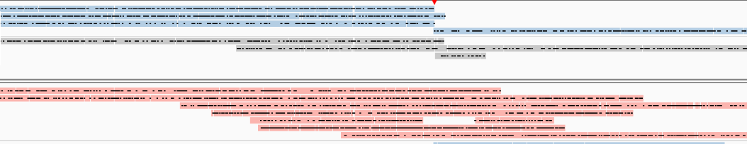
Single Molecule Long Read Sequencing
Advantages
  Longer reads (5kb – 100kb)
    better mapping in repeat regions
    Phasing of read
Disadvantages
  Very new with little tools for analysis
  Base calling has high error rates
    getting better with sacrifice for shorter (~5kb) reads
Long reads in blue are from the father’s haplotype for the first breakpoint. The mother’s haplotype is in red. The SV originated from the father

Slide 20
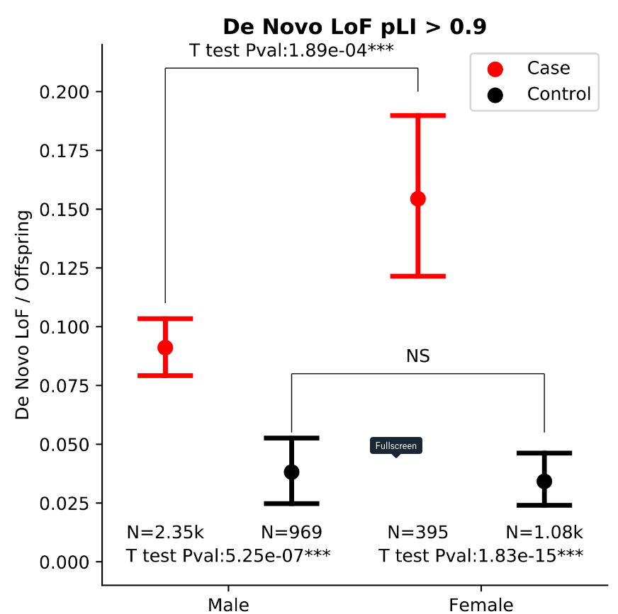
What’s Next for Developmental Disorders?
Leveraging new technologies
  De novo assemblies (likely long read + short read)
Comprehensive risk ascertainment
  Oligogenic (buzz word!)
    De novo mutations
    Rare inherited mutations
    Common variants )Polygenic Risk Scores i.e. scraping the bottom of the GWAS barrel when you can’t associate anything!)
  Machine Learning to incorporate all this
Question of Genetic Modifiers and Epigenetics
  Paternal origin effect of CRE-SVs
  Female protective effect (females can tolerate more damaging mutations)
Validation
  MOAR GENOMES! (UKBB + All of Us)
  iPSCs/Organoids and better functional work

Slide 21
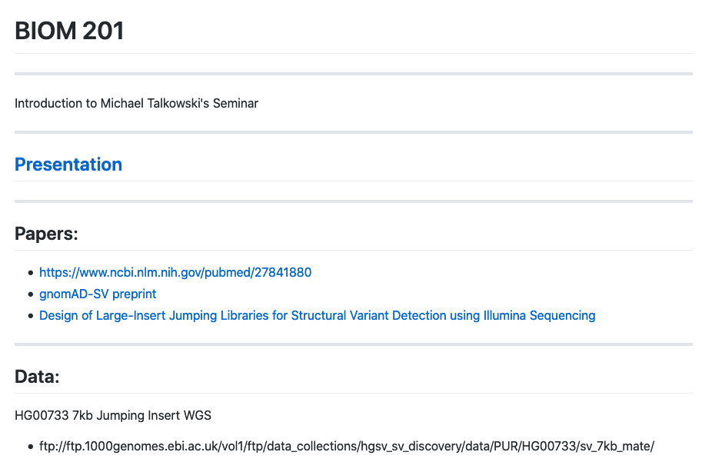
Questions?
Download this talk at
dantaki.github.io/presentations

