Slide 1
Chapter 3: Dynamic Routing
CCNA Routing and Switching
Routing and Switching Essentials v6.0
Notes:
Cisco Networking Academy Program
Routing and Switching Essentials v6.0
Chapter 3: Dynamic Routing

Slide 2
Chapter 3 - Sections & Objectives
3.1 Dynamic Routing Protocols
  Explain the function of dynamic routing protocols.
    Explain the purpose of dynamic routing protocols.
    Explain the use of dynamic routing and static routing.
3.2 RIPv2
  Implement RIPv2.
    Configure the RIPv2 routing protocol.
3.3 The Routing Table
  Determine the route source, administrative distance, and metric for a given route.
    Explain the components of an IPv4 routing table entry for a given route.
    Explain the parent/child relationship in a dynamically built routing table.
    Determine which route will be used to forward a IPv4 packet.
    Determine which route will be used to forward a IPv6 packet.
Notes:
2
Cisco Networking Academy Program
Routing and Switching Essentials v6.0
Chapter 3: Dynamic Routing

Slide 3
3.1 Dynamic Routing Protocols
Notes:
3 – Dynamic Routing
3.1 – Dynamic Routing Protocols

Slide 4
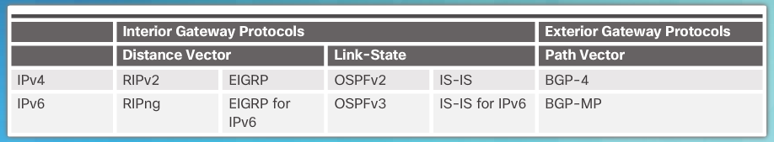
Dynamic Routing Protocol Overview
Dynamic Routing Protocol Overview
RIP protocol was updated to RIPv2 to accommodate growth in the network environment
  RIPv2 does not scale to current larger network implementations
Routing Protocols developed to meet the need of larger networks include:
  Open Shortest Path First (OSPF)
  Intermediate System-to-Intermediate System (IS-IS).
  Enhanced IGRP (EIGRP)
Border Gateway Protocol (BGP) is used between Internet service providers (ISPs)
.
Notes:
3.1 – Dynamic Routing Protocols
3.1.1 – Dynamic Routing Protocol Overview
3.1.1.1 – Dynamic Routing Protocol Overview

Slide 5
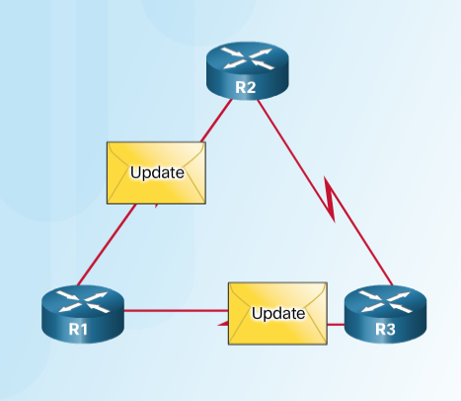

Dynamic Routing Protocol Overview
Dynamic Routing Protocol Components
Purpose of dynamic routing protocols includes:
  Discovery of remote networks
  Maintaining up-to-date routing information
  Choosing the best path to destination networks
  Ability to find a new best path if the current path is no longer available
The main components of dynamic routing protocols include:
  Data structures - tables or databases kept in RAM.
  Routing protocol messages - to discover neighboring routers, exchange routing information, and maintain accurate information about the network.
  Algorithms – to facilitate learning routing information and for best path determination.
Notes:
3.1 – Dynamic Routing Protocols
3.1.1 – Dynamic Routing Protocol Overview
3.1.1.2 – Dynamic Routing Protocol Components

Slide 6
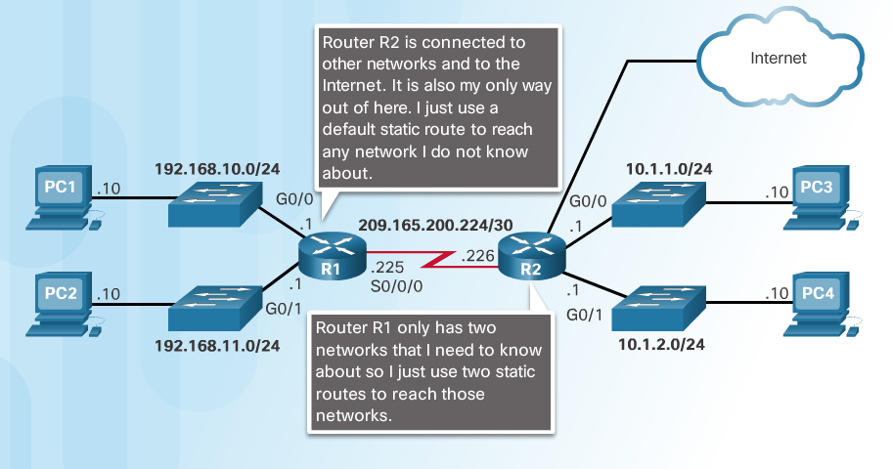
Dynamic versus Static Routing
Static Routing Uses
Networks often use both static and dynamic routing.
Static Routing is used as follows:
  For easy routing table maintenance in small networks.
  Routing to and from a stub network.
  Accessing a single default route.
Notes:
3.1 – Dynamic Routing Protocols
3.1.2 – Dynamic versus Static Routing
3.1.2.1 – Static Routing Uses

Slide 7
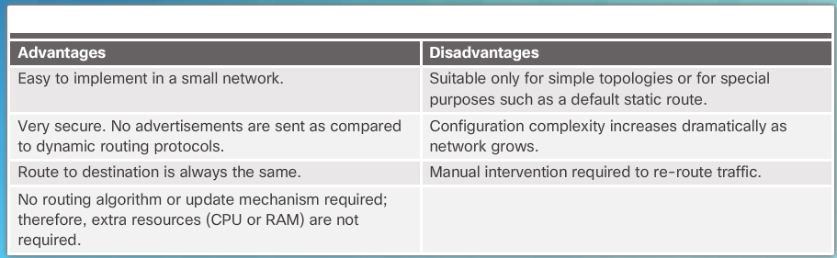
Dynamic versus Static Routing
Static Routing Advantages and Disadvantages
Notes:
3.1 – Dynamic Routing Protocols
3.1.2 – Dynamic versus Static Routing
3.1.2.2 – Static Routing Advantages and Disadvantages

Slide 8
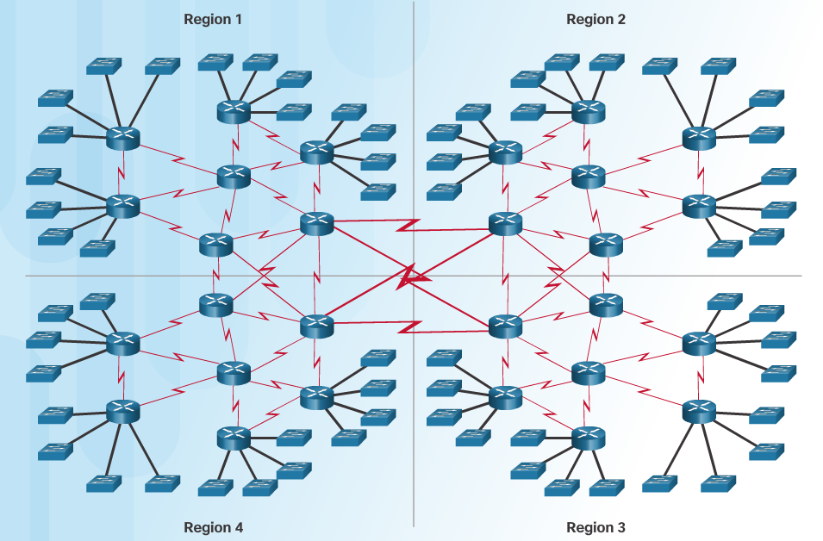
Dynamic versus Static Routing
Dynamic Routing Protocols Uses
Dynamic routing is the best choice for large networks
Dynamic routing protocols help the network administrator manage the network:
  Providing redundant paths
  Automatically implementing the alternate path when a link goes down.
Notes:
3.1 – Dynamic Routing Protocols
3.1.2 – Dynamic versus Static Routing
3.1.2.3 – Dynamic Routing Protocols Uses

Slide 9
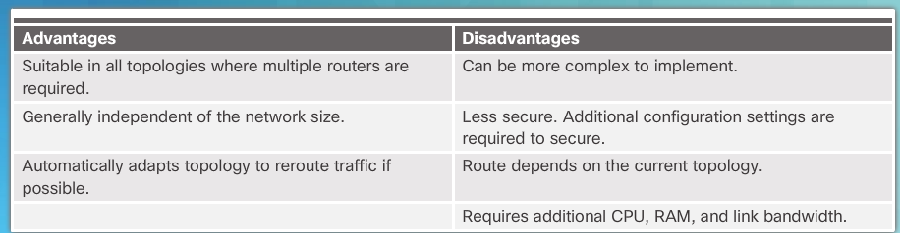
Dynamic versus Static Routing
Dynamic Routing Advantages and Disadvantages
Notes:
3.1 – Dynamic Routing Protocols
3.1.2 – Dynamic versus Static Routing
3.1.2.4 – Dynamic Routing Advantages and Disadvantages

Slide 10
3.2 RIPv2
Notes:
3 – Dynamic Routing
3.2 – RIPv2

Slide 11
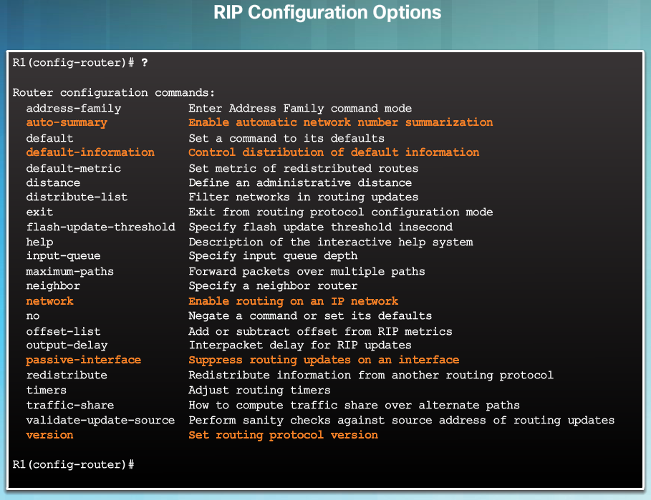
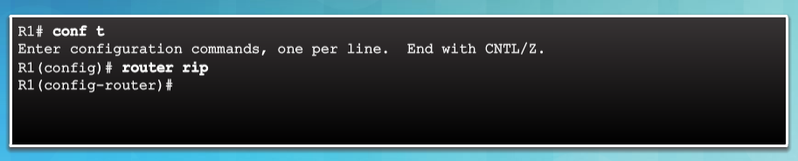
Dynamic versus Static Routing
Router RIP Configuration Mode
Use the router rip command to enable RIP v1
Use the no router rip command to disable RIP
Notes:
3.2 – RIPv2
3.2.1 – Configuring the RIP Protocol
3.2.1.1 – Router RIP Configuration Mode

Slide 12
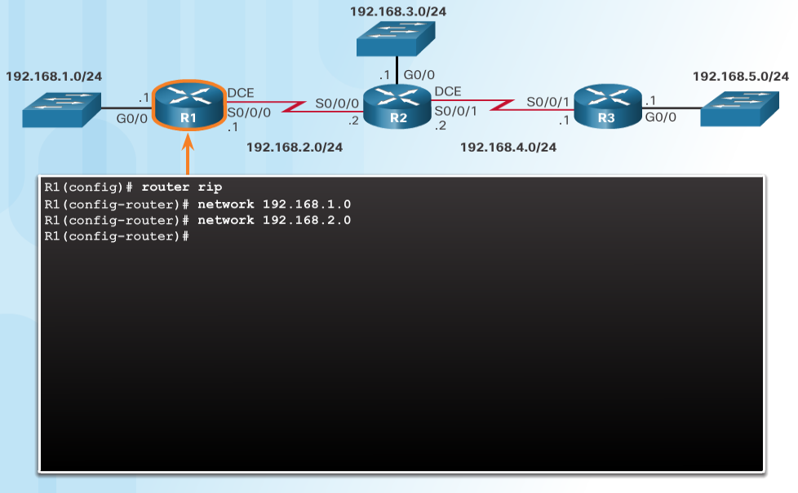
Configuring the RIP Protocol
Advertise Networks
The network network-address router configuration mode command:
  Enables RIP on all interfaces that belong to a specific network
  Advertises the network in RIP routing updates sent to other routers every 30 seconds.
  Note: RIPv1 is a classful routing protocol for IPv4.
Notes:
3.2 – RIPv2
3.2.1 – Configuring the RIP Protocol
3.2.1.2 – Advertise Networks

Slide 13
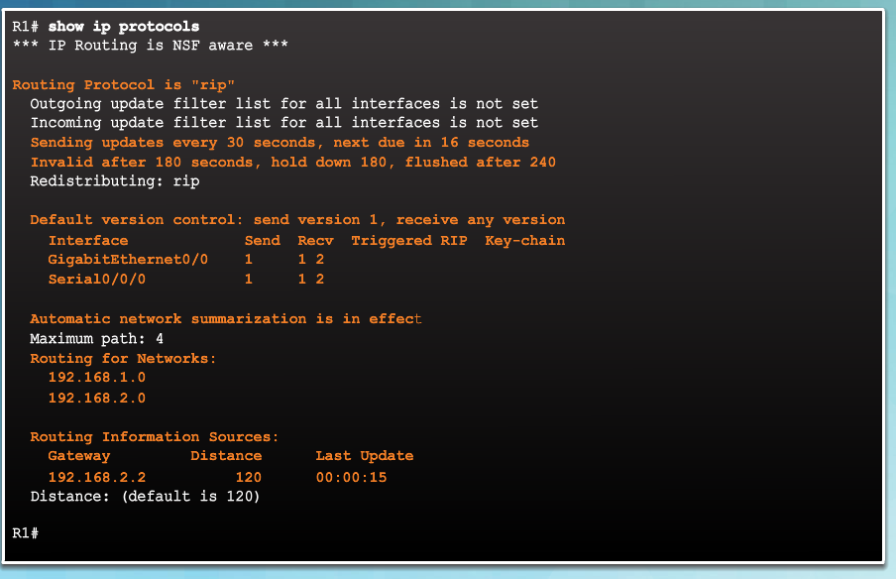
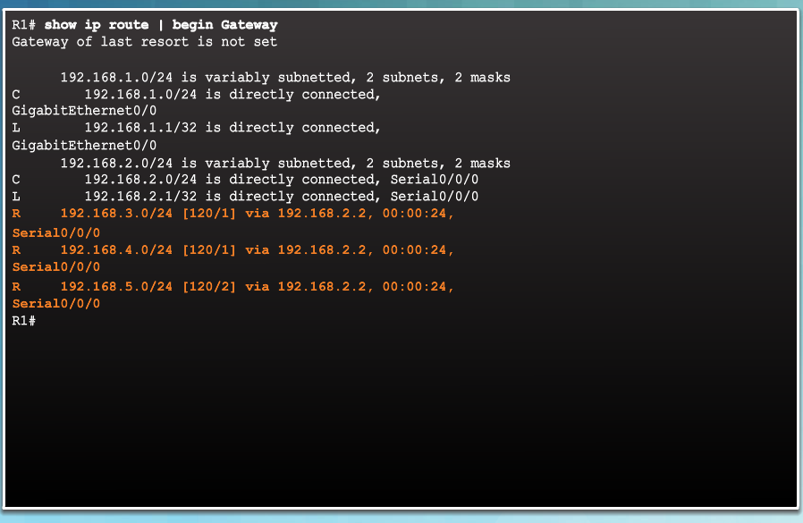
Configuring the RIP Protocol
Verify RIP Routing
show ip route – displays RIP routes installed in the routing table.
show ip protocols – displays IPv4 routing protocols configured on the router.
Notes:
3.2 – RIPv2
3.2.1 – Configuring the RIP Protocol
3.2.1.3 – Verify RIP Routing

Slide 14
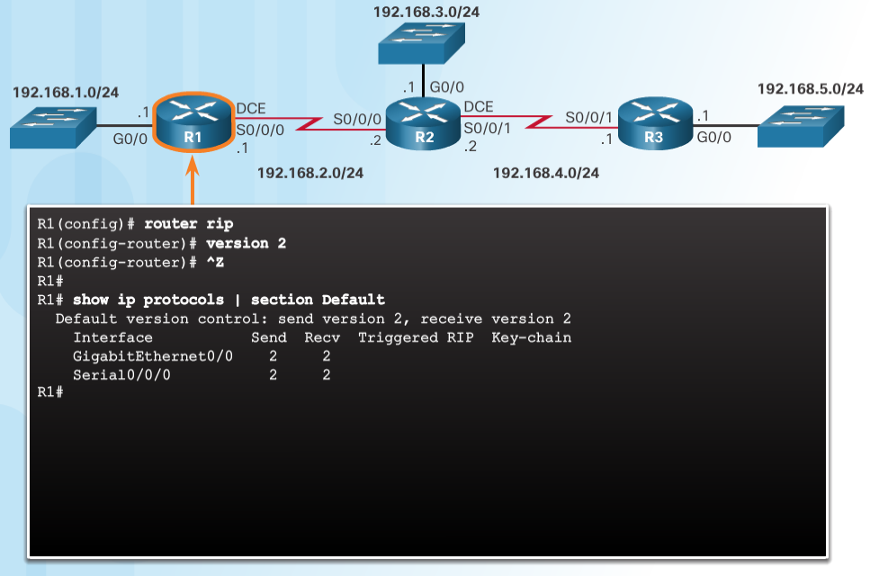
Configuring the RIP Protocol
Enable and Verify RIPv2
Use the version 2 router configuration mode command to enable RIPv2
Use the show ip protocols command to verify that RIPv2 is configured.
Use the show ip route command to verify the RIPv2 routes in the routing table.
Notes:
3.2 – RIPv2
3.2.1 – Configuring the RIP Protocol
3.2.1.4 – Enable and Verify RIPv2

Slide 15
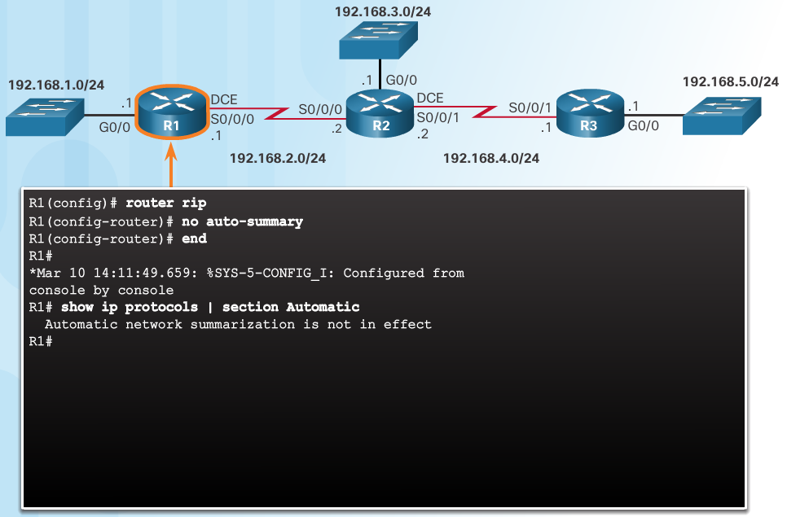
Configuring the RIP Protocol
Disable Auto Summarization
RIPv2 automatically summarizes networks at major network boundaries.
Use the no auto-summary router configuration mode command to disable auto summarization.
Use the show ip protocols command to verify that auto summarization is off.
Notes:
3.2 – RIPv2
3.2.1 – Configuring the RIP Protocol
3.2.1.5 – Disable Auto Summarization

Slide 16
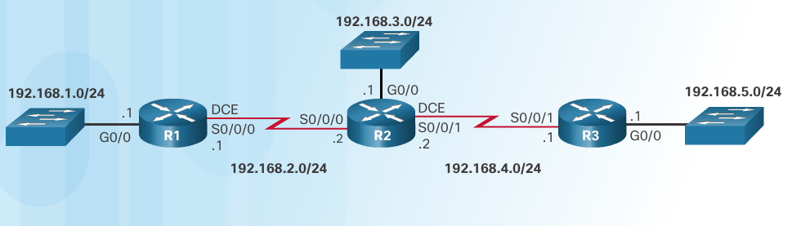
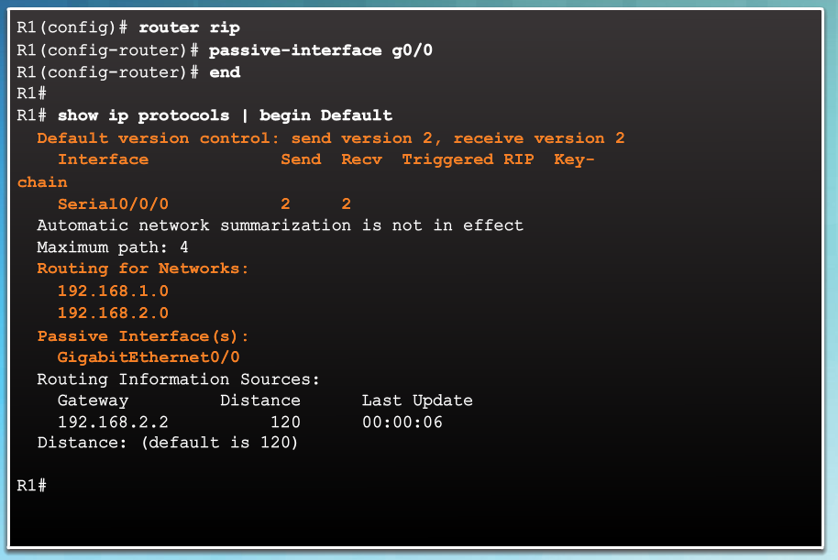
Configuring the RIP Protocol
Configure Passive Interfaces
RIP updates:
  Are forwarded out all RIP-enabled interfaces by default.
  Only need to be sent out interfaces that are connected to other RIP-enabled routers.
Sending RIP updates to LANs wastes bandwidth, wastes resources, and is a security risk.
Use the passive-interface router configuration command to stop routing updates out the interface. Still allows that network to be advertised to other routers.
Notes:
3.2 – RIPv2
3.2.1 – Configuring the RIP Protocol
3.2.1.6 – Configure Passive Interfaces

Slide 17
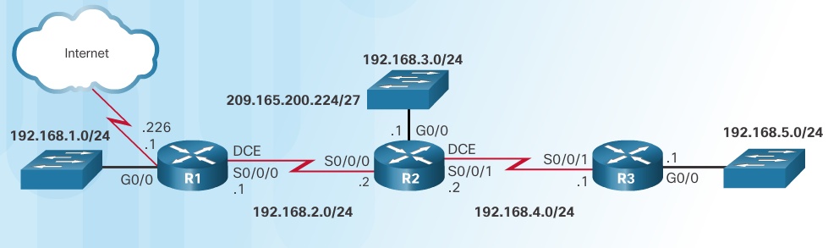
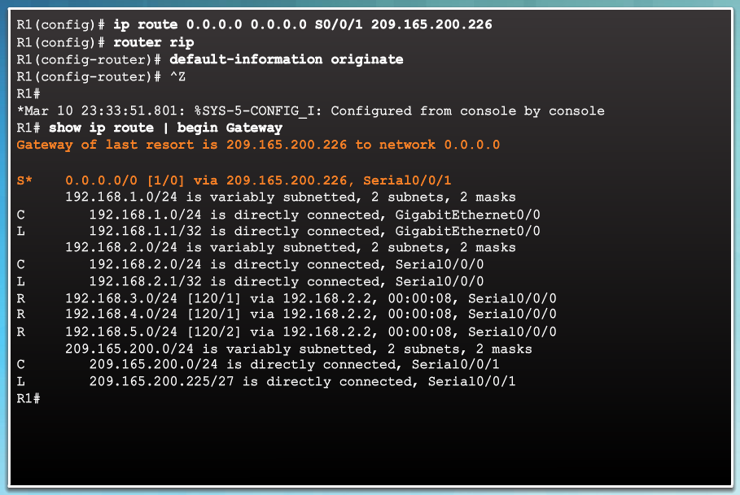
Configuring the RIP Protocol
Propagate a Default Route
In the diagram a default static route to the Internet is configured on R1.
The default-information originate router configuration command instructs R1 to send the default static route information in the RIP updates.
Notes:
3.2 – RIPv2
3.2.1 – Configuring the RIP Protocol
3.2.1.7 – Propagate a Default Route

Slide 18
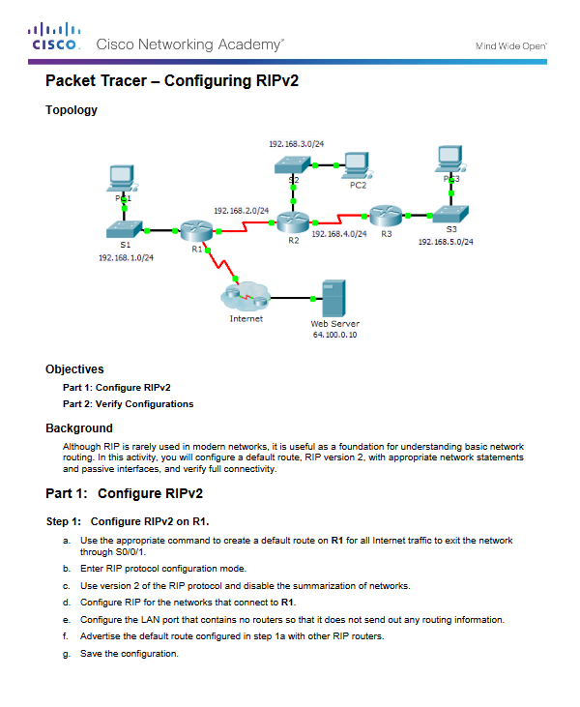
Configuring the RIP Protocol
Packet Tracer - Configuring RIPv2
Notes:
3.2 – RIPv2
3.2.1 – Configuring the RIP Protocol
3.2.1.8 – Packet Tracer - Configuring RIPv2

Slide 19
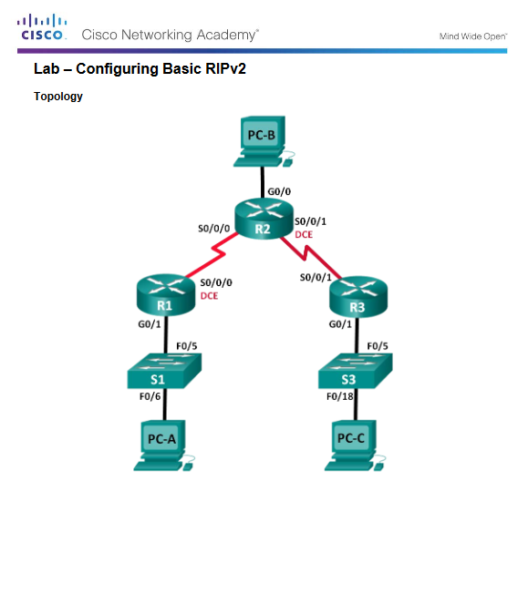
Configuring the RIP Protocol
Lab - Configuring Basic RIPv2
Notes:
3.2 – RIPv2
3.2.1 – Configuring the RIP Protocol
3.2.1.9 – Lab - Configuring Basic RIPv2

Slide 20
3.3 The Routing Table
Notes:
3 – Dynamic Routing
3.3 – The Routing Table

Slide 21
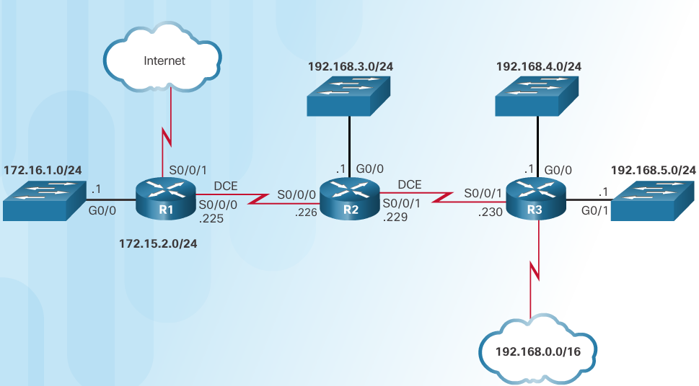
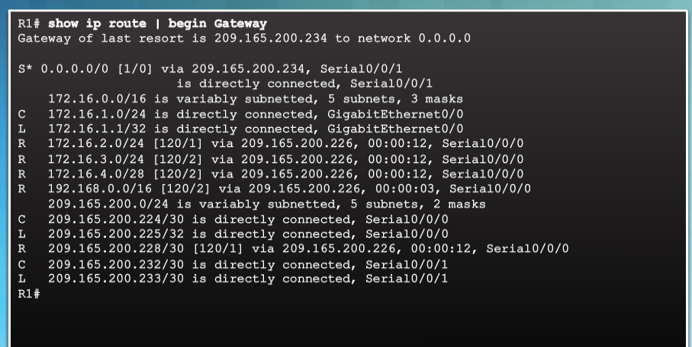
Parts of an IPv4 Route Entry
Routing Table Entries
Routing Table for R1
Notes:
3.3 – The Routing Table
3.3.1 – Parts of an IPv4 Route Entry
3.3.1.1 – Routing Table Entries

Slide 22
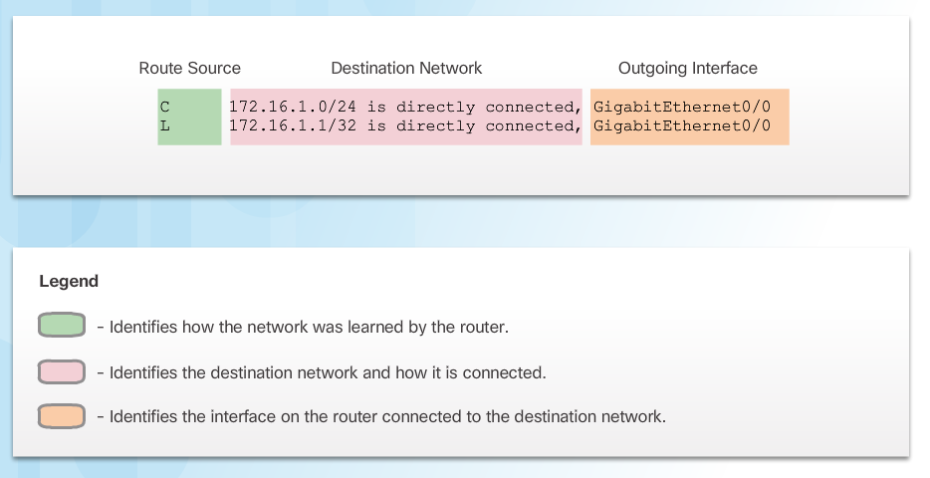
Parts of an IPv4 Route Entry
Directly Connected Entries
Directly Connected Networks (C) are automatically added to the routing table when the interface is configured and activated.
Entries contain the following information:
  Route source - how the route was learned.
  Destination network – remote network.
  Outgoing Interface – exit interface used to forward packets to destination.
Other route source entries include:
  S –Static Route
  D – EIGRP routing protocol
  O – OSPF routing protocol
  R - RIP routing protocol
Notes:
3.3 – The Routing Table
3.3.1 – Parts of an IPv4 Route Entry
3.3.1.2 - Directly Connected Entries

Slide 23
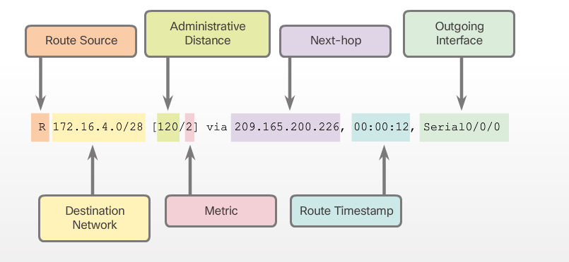
Parts of an IPv4 Route Entry
Remote Network Entries
Routes to remote networks contain the following information:
  Route source – how route was learned
  Destination network
  Administrative distance (AD) - trustworthiness of the route.
  Metric – value assigned to reach the remote network. Lower is better.
  Next hop – IPv4 address of the next router that the packet should be forwarded to.
  Route timestamp – time since the route was updated.
  Outgoing interface - the exit interface to use to forward the packet
Notes:
3.3 – The Routing Table
3.3.1 – Parts of an IPv4 Route Entry
3.3.1.3 - Remote Network Entries

Slide 24
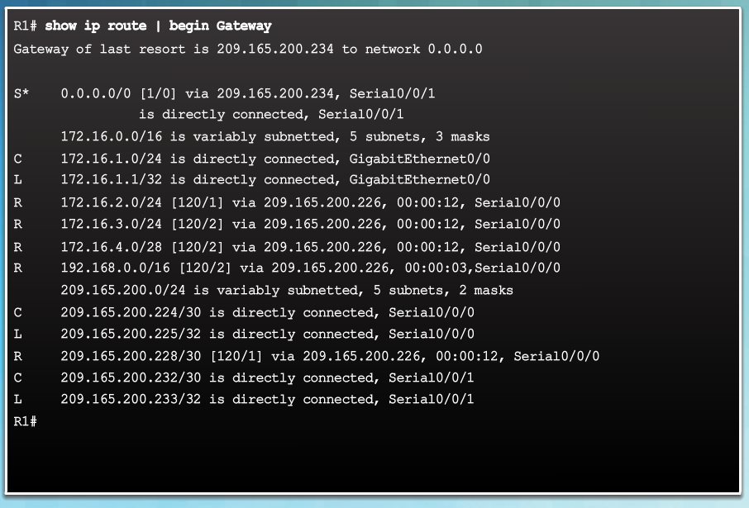
Dynamically Learned IPv4 Routes
Routing Table Terms
The routing table is a hierarchical structure that is used to speed up the lookup process when locating routes and forwarding packets.
The hierarchy includes:
  Ultimate Routes
  Level 1 routes
  Level 1 parent routes
  Level 2 child routes
Notes:
3.3 – The Routing Table
3.3.2 – Dynamically Learned IPv4 Routes
3.3.2.1 - Routing Table Terms

Slide 25
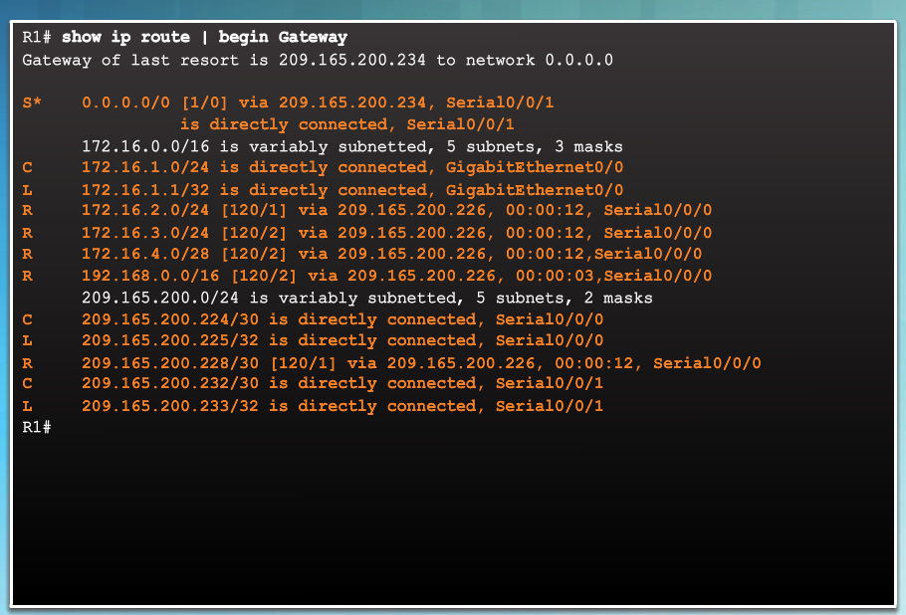
Dynamically Learned IPv4 Routes
Ultimate Route
An ultimate route is a routing table entry that contains either a next-hop IPv4 address or an exit interface.
Directly connected, dynamically learned, and local routes are ultimate routes.
Notes:
3.3 – The Routing Table
3.3.2 – Dynamically Learned IPv4 Routes
3.3.2.2 - Ultimate Route

Slide 26
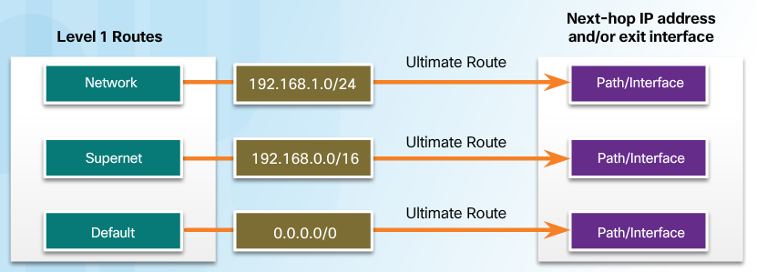
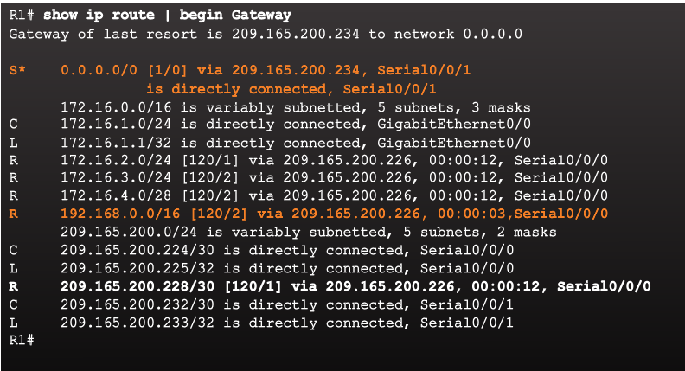
Dynamically Learned IPv4 Routes
Level 1 Route
A level 1 route can be a:
  Network route - a network route that has a subnet mask equal to that of the classful mask.
  Supernet route - a network address with a mask less than the classful mask, for example, a summary address.
  Default route - a static route with the address 0.0.0.0/0
Notes:
3.3 – The Routing Table
3.3.2 – Dynamically Learned IPv4 Routes
3.3.2.3 - Level 1 Route

Slide 27
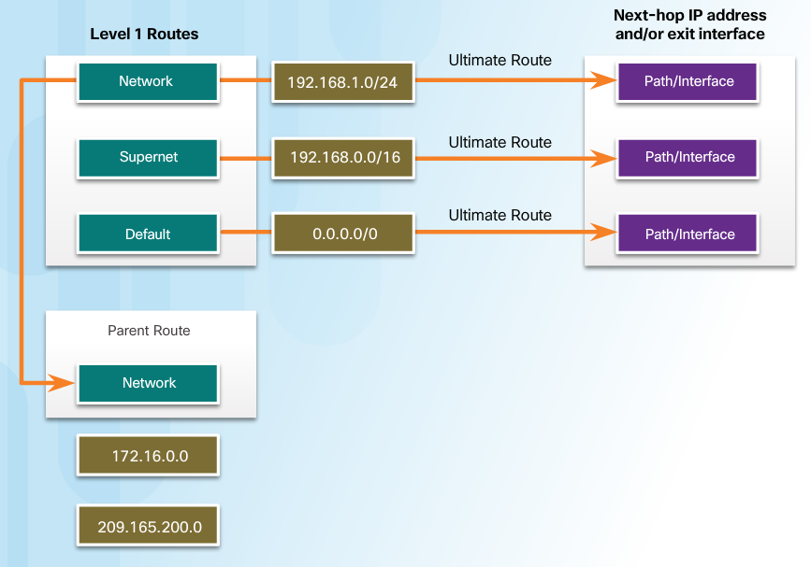
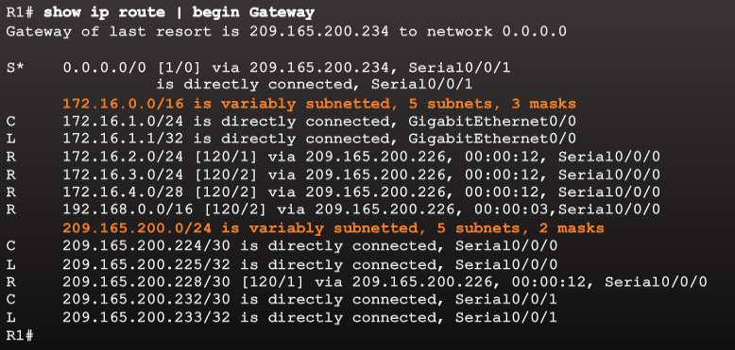
Dynamically Learned IPv4 Routes
Level 1 Parent Route
A parent route is a level 1 network route that is subnetted.
In the routing table, it basically provides a heading for the specific subnets it contains.
Notes:
3.3 – The Routing Table
3.3.2 – Dynamically Learned IPv4 Routes
3.3.2.4 - Level 1 Parent Route

Slide 28
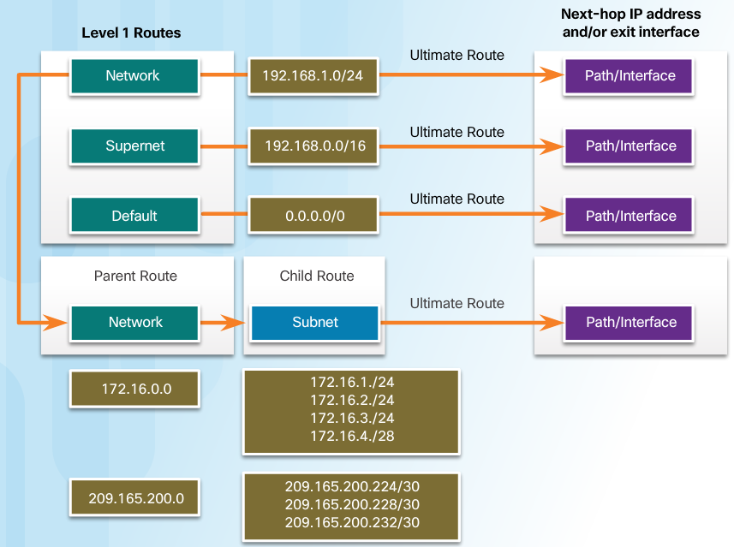
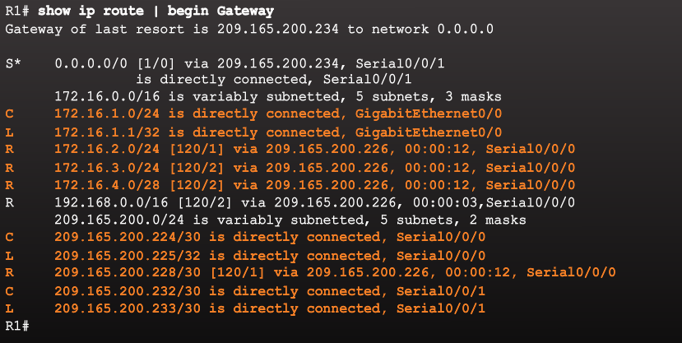
Dynamically Learned IPv4 Routes
Level 2 Child Route
A level 2 child route is a route that is a subnet of a classful network address.
Level 1 parent routes contain level 2 child routes.
Level 2 child routes are also ultimate routes.
Notes:
3.3 – The Routing Table
3.3.2 – Dynamically Learned IPv4 Routes
3.3.2.5 - Level 2 Child Route

Slide 29
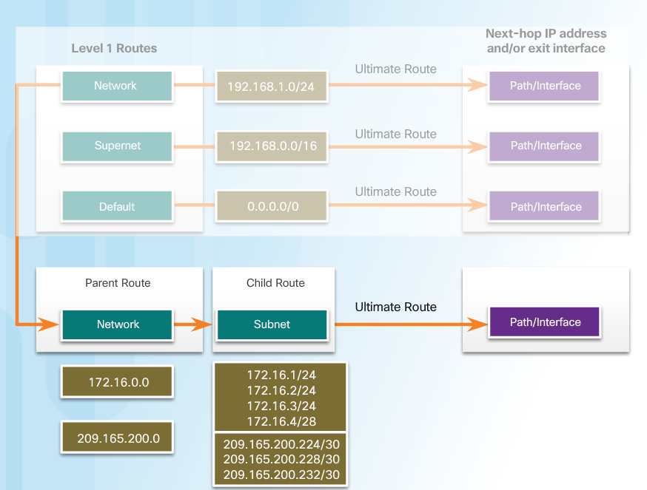
The IPv4 Route Lookup Process
Route Lookup Process
Router lookup process:
  If the best match is a level 1 ultimate route, then this route is used to forward the packet.
  If the best match is a level 1 parent route, the router then examines child routes (the subnet routes).
  If there is a match with a level 2 child route, that is used to forward the packet.
  If there is no match with level 2 child routes, the router searches level 1 supernet or default routes. If there is a match, that route is used.
  If there is no match found in the routing table the packet is dropped.
Notes:
3.3 – The Routing Table
3.3.3 – The IPv4 Route Lookup Process
3.3.3.1 - Route Lookup Process

Slide 30
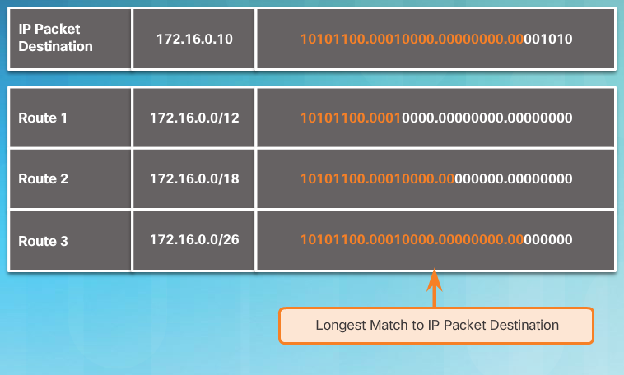
The IPv4 Route Lookup Process
Best Route = Longest Match
The best match is the route in the routing table that has the most number of far left matching bits with the destination IPv4 address of the packet.
The route with the greatest number of equivalent far left bits, or the longest match, is always the preferred route.
Notes:
3.3 – The Routing Table
3.3.3 – The IPv4 Route Lookup Process
3.3.3.2 - Best Route = Longest Match

Slide 31
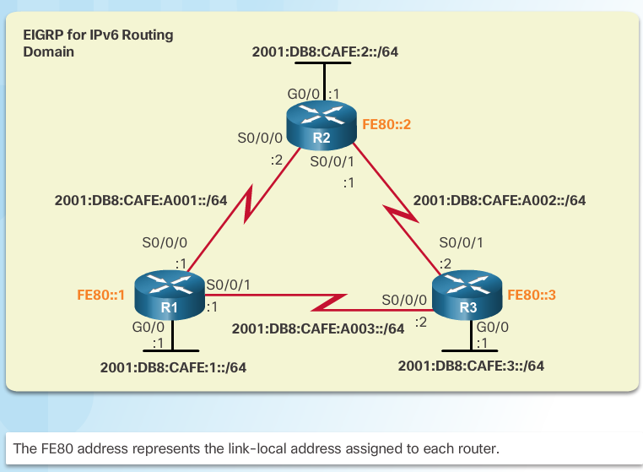
Analyze an IPv6 Routing Table
IPv6 Routing Table Entries
An IPv6 routing table includes directly connected, static and dynamically learned routes.
All IPv6 routes are level 1 ultimate routes.
Notes:
3.3 – The Routing Table
3.3.4 – Analyze an IPv6 Routing Table
3.3.4.1 - IPv6 Routing Table Entries

Slide 32
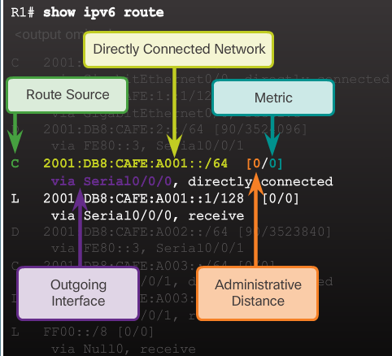
Analyze an IPv6 Routing Table
Directly Connected Entries
Use the show ipv6 route command to display the IPv6 routing table.
The directly connected route entries include the following:
  Route source – How the route was learned. Directly connected indicated with a C and L for local route.
  Directly connected network address.
  Administrative distance – Trustworthiness of the route (lower more trustworthy).
  Metric – Value assigned to reach the network (lower is preferred route).
  Outgoing interface – Exit interface used to forward packet.
Notes:
3.3 – The Routing Table
3.3.4 – Analyze an IPv6 Routing Table
3.3.4.2 - Directly Connected Entries

Slide 33
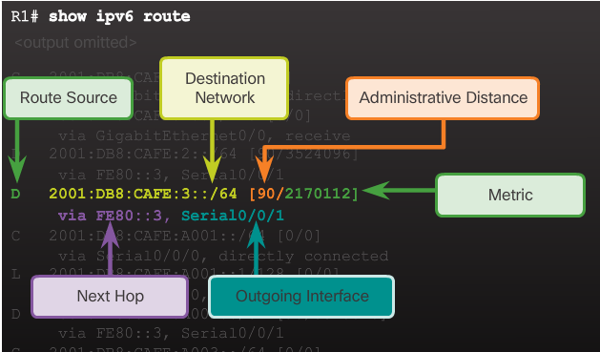
Analyze an IPv6 Routing Table
Remote IPv6 Network Entries
The remote IPv6 route entries also include the following:
  Route source – How the route was learned. Common codes include O (OSPF), D (EIGRP), R (RIP), and S (Static route).
  Next hop - Identifies the IPv6 address of the next router to forward the packet to.
The IPv6 router lookup process:
  Examines level 1 network routes for the best match.
  Longest match is the best match.
Notes:
3.3 – The Routing Table
3.3.4 – Analyze an IPv6 Routing Table
3.3.4.3 - Remote IPv6 Network Entries

Slide 34
3.4 Chapter Summary
Notes:
3 – Dynamic Routing
3.4 – Summary

Slide 35
Conclusion
Chapter 3: Dynamic Routing
Explain the function of dynamic routing protocols.
Implement RIPv2.
Determine the route source, administrative distance, and metric for a given route.
Notes:
3.4 – Summary
3.4.1 – Conclusion
3.4.1.2 – Chapter 3: Dynamic Routing

Slide 36
Chapter 3
New Terms and Commands
Routing Information Protocol (RIP)
RIPv1
RIPv2
Open Shortest Path First (OSPF)
Intermediate System-to-Intermediate System (IS-IS)
Interior Gateway Routing Protocol (IGRP)
Enhanced IGRP (EIGRP)
Border Gateway Protocol (BGP)
IPv4 addressing space
Data structures
Routing protocol messages
Algorithm
routing algorithm
classful routing protocol
classless routing protocol
automatic summarization
router rip
version 2
no router rip
network network-address
edge router
single-homed
propogate a default route
discontiguous networks
supernet
ultimate route
level 1 route
Network route
Supernet route
level 1 parent routes
level 2 child route
route lookup process
Notes:
Chapter 3: Dynamic Routing
New Terms and Commands

