Slide 1
Module 5: Dynamic Routing
CCNA Routing and Switching
Scaling Networks v6.0
Notes:
Cisco Networking Academy Program
Scaling Networks v6.0
Chapter 5: Dynamic Routing

Slide 2
Chapter 5 - Sections & Objectives
5.1 Dynamic Routing Protocols
  Explain the features and characteristics of dynamic routing protocols.
      Compare the different types of routing protocols.
5.2 Distance Vector Dynamic Routing
  Explain how distance vector routing protocols operate.
    Explain how dynamic routing protocols achieve convergence.
    Describe the algorithm used by distance vector routing protocols to determine the best path.
    Identify the types of distance-vector routing protocols.
5.3 Link-State Dynamic Routing
  Explain how link-state protocols operate.
    Describe the algorithm used by link-state routing protocols to determine the best path.
    Explain how the link-state routing protocol uses information sent in a link-state update.
    Explain the advantages and disadvantages of using link-state routing protocols.
Notes:
2
Cisco Networking Academy Program
Scaling Networks v6.0
Chapter 5: Dynamic Routing

Slide 3
5.1 Dynamic Routing Protocols
Notes:
5 – Dynamic Routing
5.1 – Dynamic Routing Protocols

Slide 4
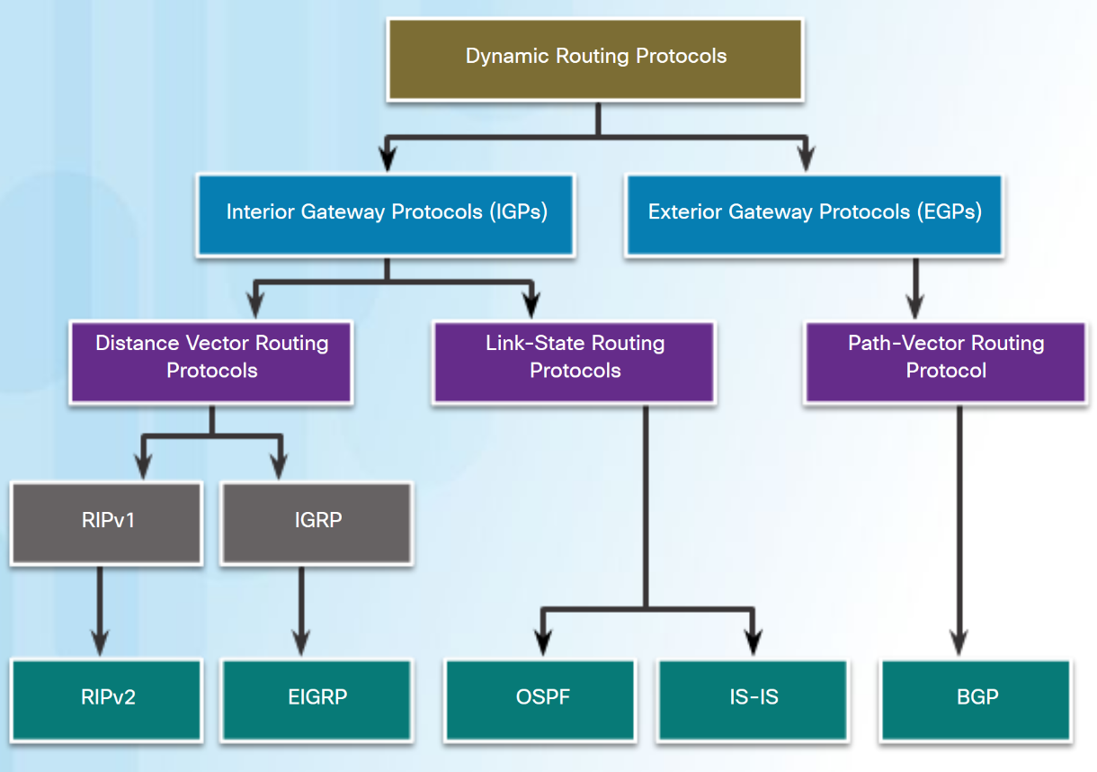
Types of Routing Protocols
Classifying Routing Protocols
The purpose of dynamic routing protocols includes:
  Discovery of remote networks.
  Maintaining up-to-date routing information.
  Choosing the best path to destination networks.
  Ability to find a new best path if current path is no longer available.
Notes:
5.1 – Dynamic Routing Protocols
5.1.1 – Types of Routing Protocols
5.1.1.1 – Classifying Routing Protocols

Slide 5
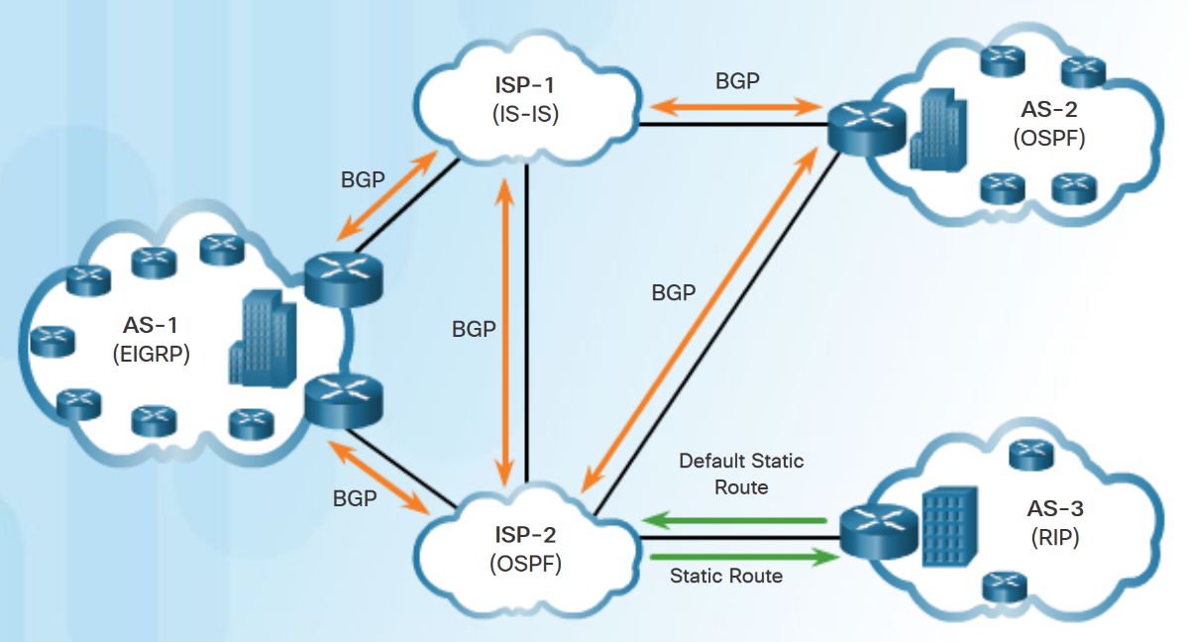
Types of Routing Protocols
IGP and EGP Routing Protocols
Interior Gateway Protocols (IGP) - Used for routing within an Autonomous System (AS).
  RIP, EIGRP, OSPF, and IS-IS.
Exterior Gateway Protocols (EGP) - Used for routing between Autonomous Systems.
  BGP
Notes:
5.1 – Dynamic Routing Protocols
5.1.1 – Types of Routing Protocols
5.1.1.2 – IGP and EGP Routing Protocols

Slide 6
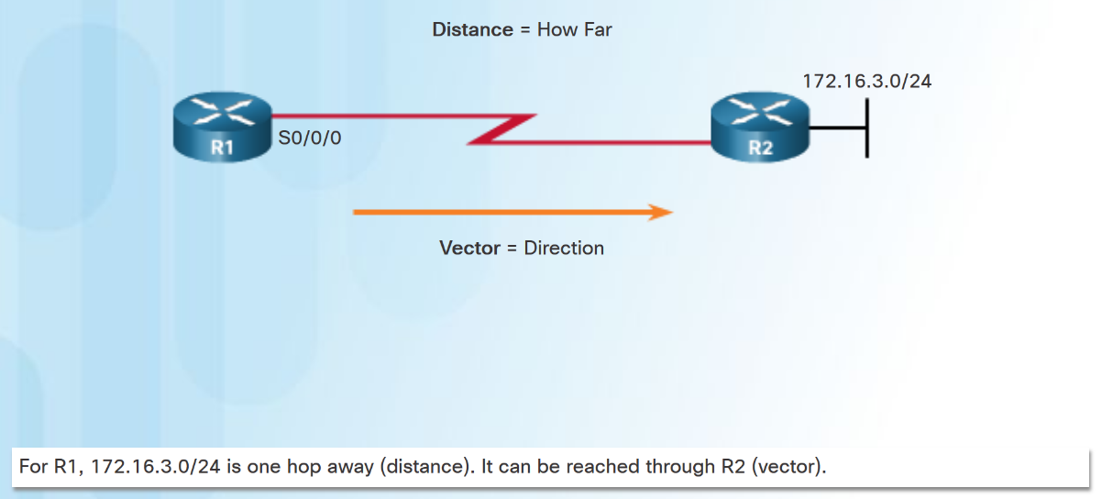
Types of Routing Protocols
Distance Vector Routing Protocols
Distance vector means that routes are advertised by providing two characteristics:
  Distance - Identifies how far it is to the destination network based on a metric such as hop count, cost, bandwidth, delay.
  Vector - Specifies the direction of the next-hop router or exit interface to reach the destination.
RIPv1 (legacy), RIPv2, IGRP Cisco proprietary (obsolete), EIGRP.
Notes:
5.1 – Dynamic Routing Protocols
5.1.1 – Types of Routing Protocols
5.1.1.3 – Distance Vector Routing Protocols

Slide 7
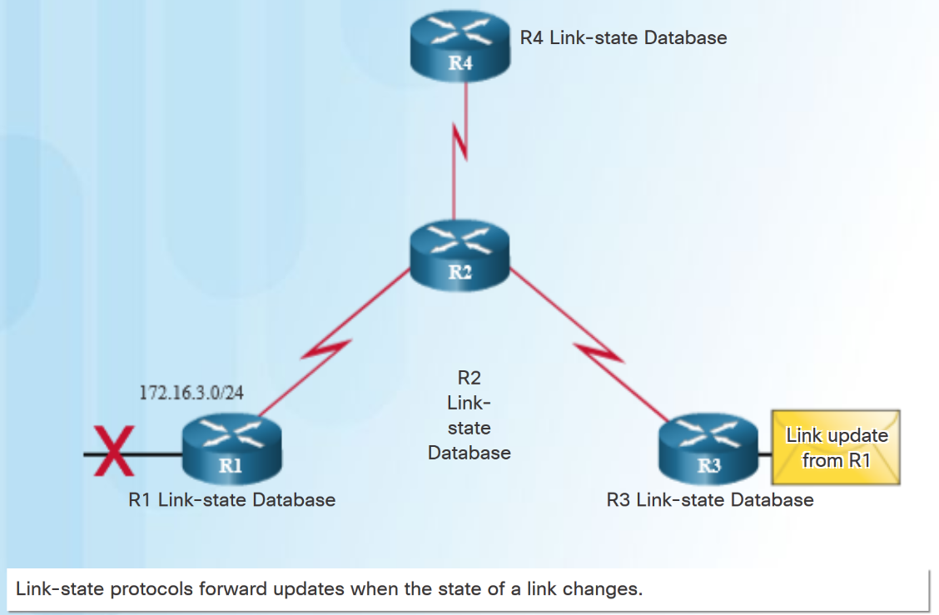
Types of Routing Protocols
Link-State Routing Protocols
A link-State router uses the link-state information received from other routers:
  to create a topology map.
  to select the best path to all destination networks in the topology.
Link-state routing protocols do not use periodic updates.
  updates are only sent when there is a change in the topology
OSPF and IS-IS
Notes:
5.1 – Dynamic Routing Protocols
5.1.1 – Types of Routing Protocols
5.1.1.4 – Link-State Routing Protocols

Slide 8
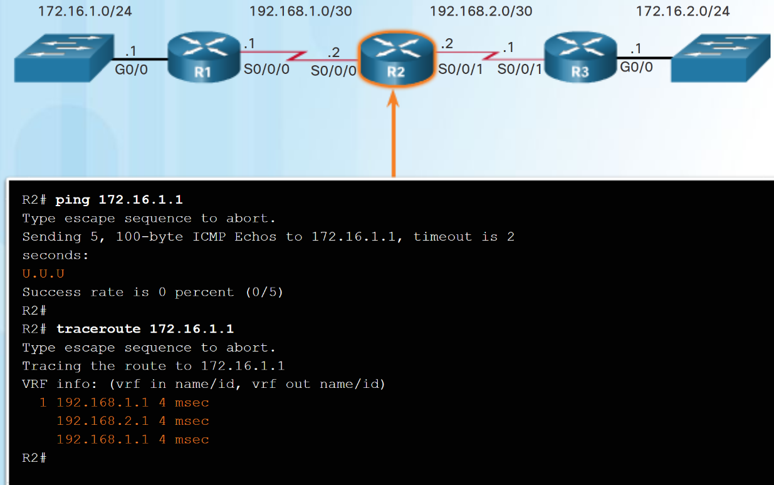
Types of Routing Protocols
Classful Routing Protocols
Classless routing protocols include subnet mask information in the routing updates.
Classful routing protocols do not send subnet mask information in routing updates.
Classful routing protocols cannot support variable-length subnet masks (VLSMs) and classless interdomain routing (CIDR).
Classful routing protocols also create problems in discontiguous networks.
Notes:
5.1 – Dynamic Routing Protocols
5.1.1 – Types of Routing Protocols
5.1.1.5 – Classful Routing Protocols

Slide 9
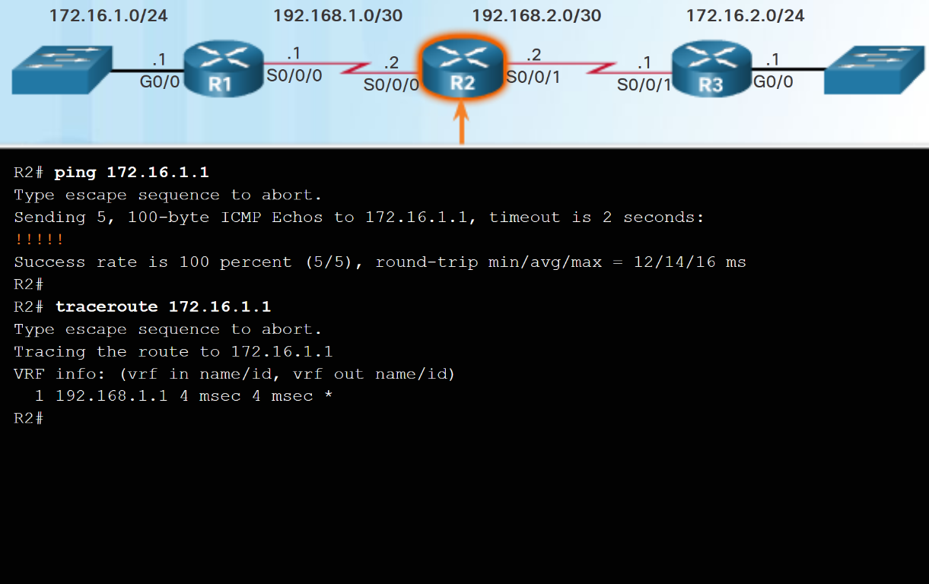
Types of Routing Protocols
Classless Routing Protocols
Classless IPv4 routing protocols (RIPv2, EIGRP, OSPF, and IS-IS) all include the subnet mask information in routing updates.
Classless routing protocols support VLSM and CIDR.
IPv6 routing protocols are classless.
Notes:
5.1 – Dynamic Routing Protocols
5.1.1 – Types of Routing Protocols
5.1.1.6 – Classless Routing Protocols

Slide 10
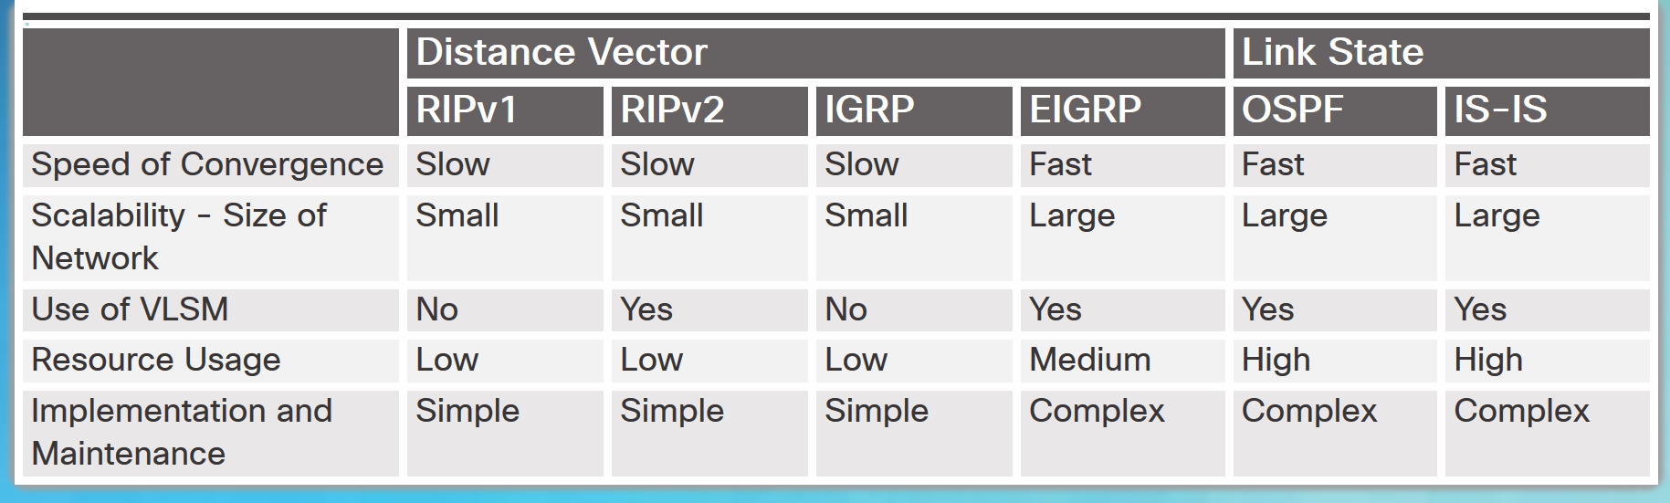
Types of Routing Protocols
Routing Protocol Characteristics
Routing protocols can be compared based on the characteristics in the chart.
Notes:
5.1 – Dynamic Routing Protocols
5.1.1 – Types of Routing Protocols
5.1.1.7 – Routing Protocol Characteristics

Slide 11
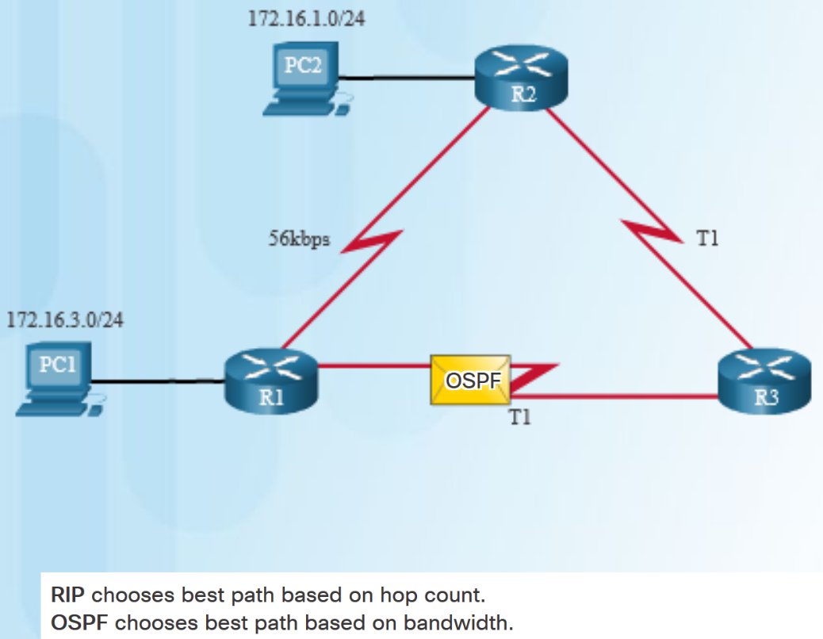
Types of Routing Protocols
Routing Protocol Metrics
A metric is a measurable value that is assigned by the routing protocol to different routes based on the usefulness of that route.
Routing metrics are used to determine the overall “cost” of a path from source to destination.
Best path is route with the lowest cost.
Metrics used by various dynamic protocols:
  RIP – Hop count
  OSPF – Cost based on cumulative bandwidth
  EIGRP - Bandwidth, delay, load, and reliability.
Notes:
5.1 – Dynamic Routing Protocols
5.1.1 – Types of Routing Protocols
5.1.1.8 – Routing Protocol Metrics

Slide 12
5.2 Distance Vector Dynamic Routing
Notes:
5 – Dynamic Routing
5.2 – Distance Vector Dynamic Routing

Slide 13
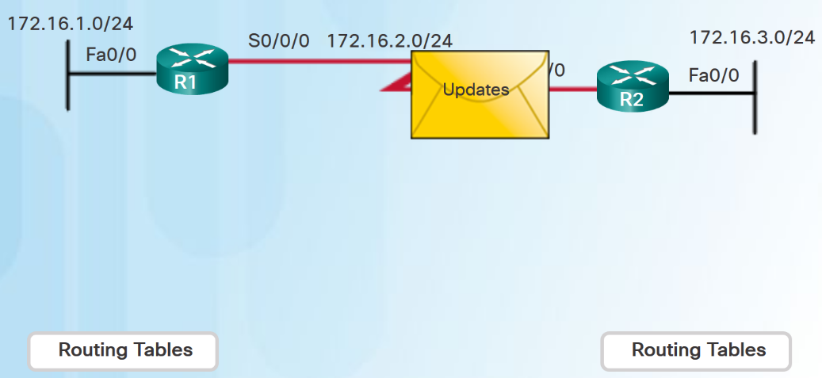
Distance Vector Fundamentals
Dynamic Routing Protocol Operation
Operation of a dynamic routing protocol can be described as follows:
  The router sends and receives routing messages on its interfaces.
  The router shares routing messages and routing information with other routers using the same routing protocol.
  Routers exchange routing information to learn about remote networks.
  When a router detects a topology change, the routing protocol can advertise this change to other routers.
Notes:
5.2 – Distance Vector Dynamic Routing
5.2.1 – Distance Vector Fundamentals
5.2.1.1 – Dynamic Routing Protocol Operation

Slide 14
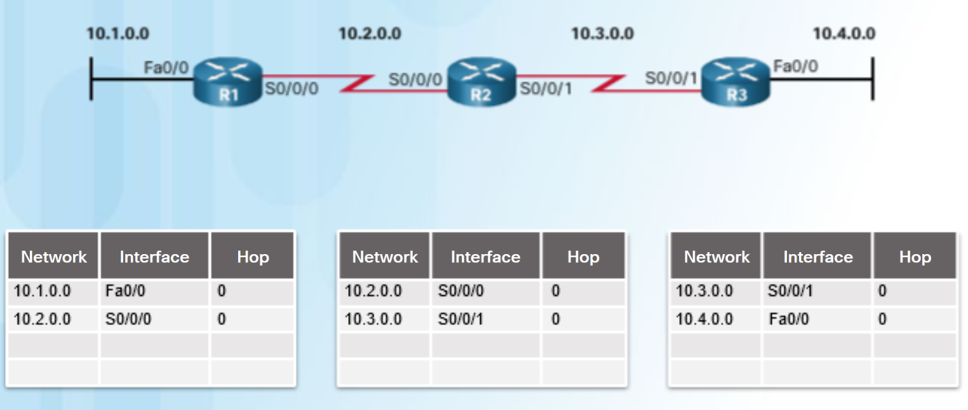
Distance Vector Fundamentals
Cold Start
After a router boots successfully it applies the saved configuration, then the router initially discovers its own directly connected networks.
  It adds those directly connected interface IP addresses to its routing table
Notes:
5.2 – Distance Vector Dynamic Routing
5.2.1 – Distance Vector Fundamentals
5.2.1.2 – Cold Start

Slide 15
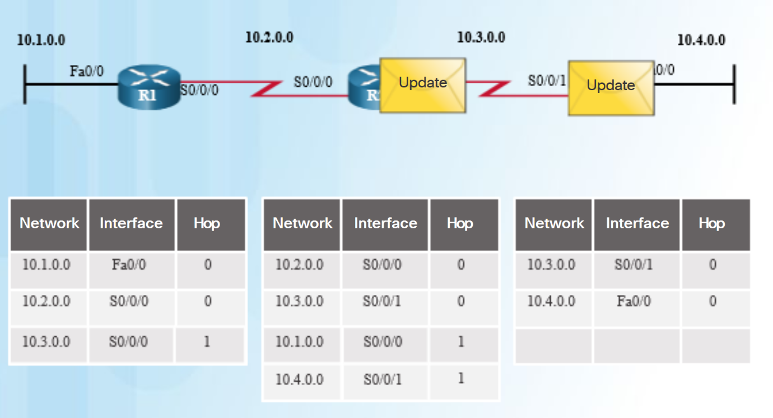
Distance Vector Fundamentals
Network Discovery
If a routing protocol is configured, the router exchanges routing updates to learn about any remote routes.
  The router sends an update packet with its routing table information out all interfaces.
  The router also receives updates from directly connected routers and adds new information to its routing table.
Notes:
5.2 – Distance Vector Dynamic Routing
5.2.1 – Distance Vector Fundamentals
5.2.1.3 – Network Discovery

Slide 16
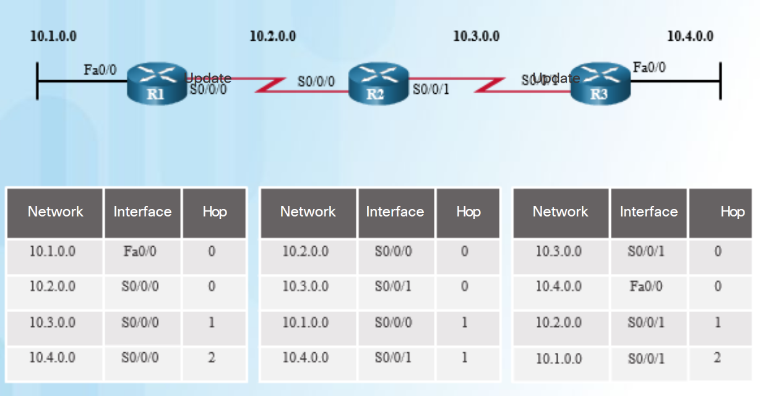
Distance Vector Fundamentals
Exchanging the Routing Information
Working toward convergence, the routers exchange the next round of periodic updates.
Distance vector routing protocols use split horizon to avoid loops.
Split horizon prevents information from being sent out the same interface from which it was received.
Notes:
5.2 – Distance Vector Dynamic Routing
5.2.1 – Distance Vector Fundamentals
5.2.1.4 – Exchanging the Routing Information

Slide 17
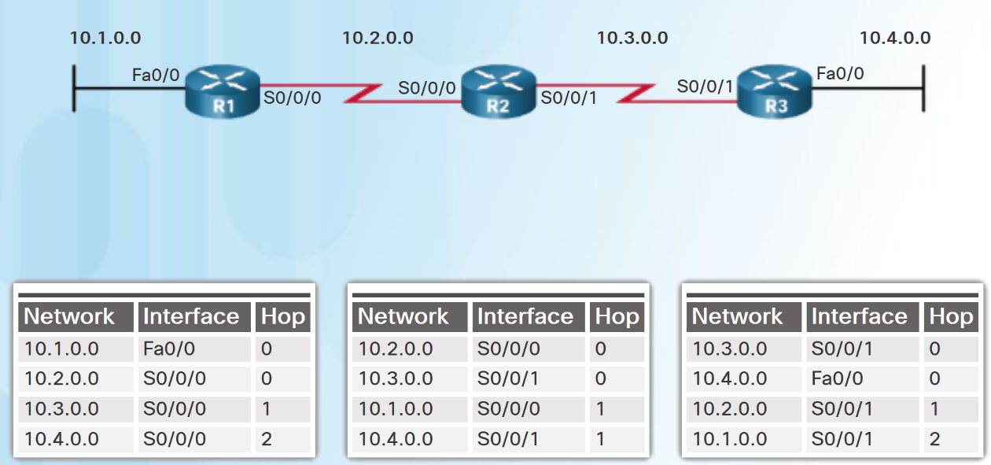
Distance Vector Fundamentals
Achieving Convergence
The network has converged when all routers have complete and accurate information about the entire network
Convergence time is the time it takes routers to share information, calculate best paths, and update routing tables.
Routing protocols can be rated based on the speed to convergence; the faster the convergence, the better the routing protocol.
Notes:
5.2 – Distance Vector Dynamic Routing
5.2.1 – Distance Vector Fundamentals
5.2.1.5 – Achieving Convergence

Slide 18
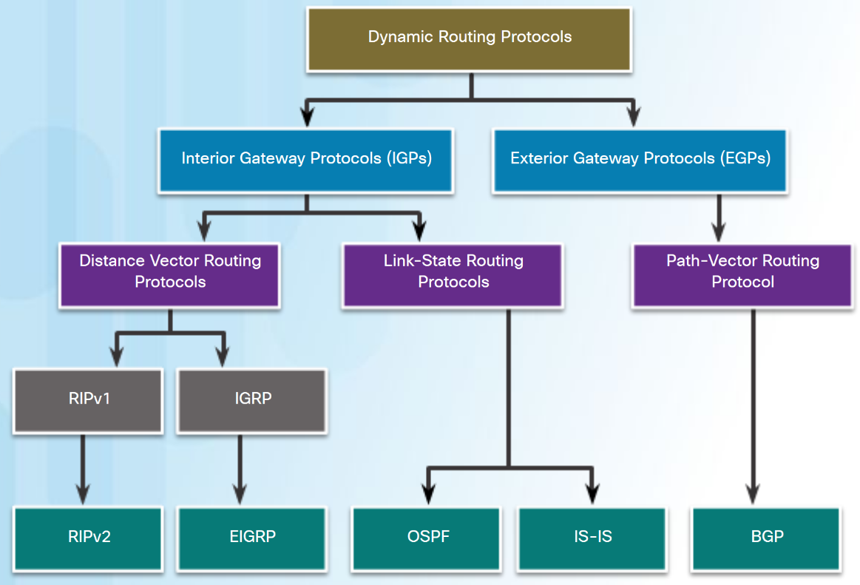
Distance Vector Routing Protocol Operation
Distance Vector Technologies
Distance vector routing protocols share updates between neighbors.
Routers using distance vector routing are not aware of the network topology.
Some distance vector routing protocols send periodic updates.
  RIPv1 sends updates as broadcasts 255.255.255.255.
  RIPv2 and EIGRP can use multicast addresses to reach only specific neighbor routers.
  EIGRP can use a unicast message to reach a specific neighbor router.
  EIGRP only sends updates when needed, not periodically.
Notes:
5.2 – Distance Vector Dynamic Routing
5.2.2 – Distance Vector Routing Protocol Operation
5.2.2.1 – Distance Vector Technologies

Slide 19
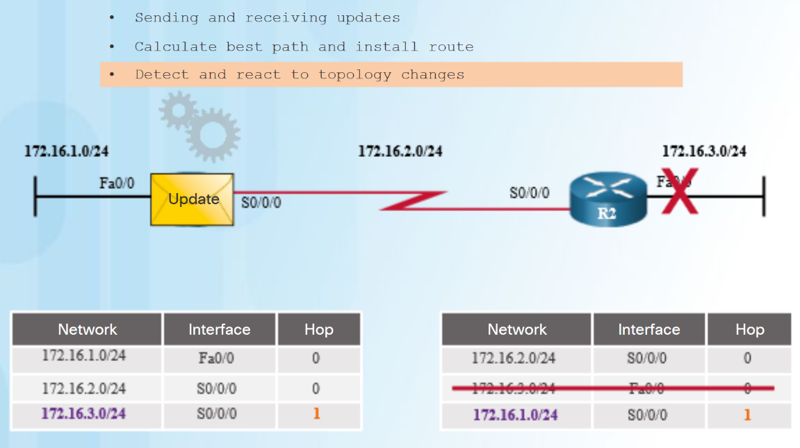
Distance Vector Routing Protocol Operation
Distance Vector Algorithm
The distance vector algorithm defines the following processes:
  Mechanism for sending and receiving routing information
  Mechanism for calculating the best paths and installing routes in the routing table
  Mechanism for detecting and reacting to topology changes
RIP uses the Bellman-Ford algorithm as its routing algorithm.
IGRP and EIGRP use the Diffusing Update Algorithm (DUAL) routing algorithm.
Notes:
5.2 – Distance Vector Dynamic Routing
5.2.2 – Distance Vector Routing Protocol Operation
5.2.2.2 – Distance Vector Algorithm

Slide 20
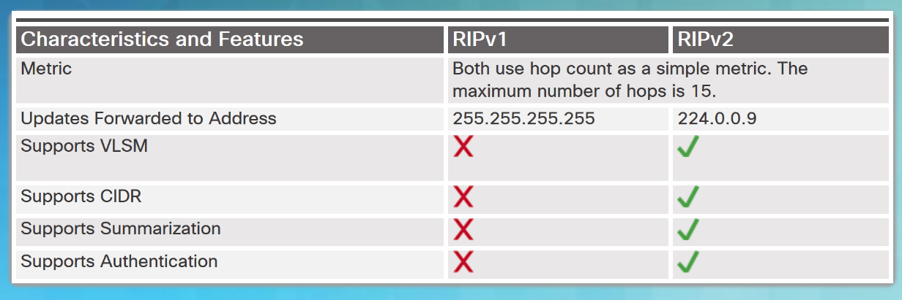
Types of Distance Vector Routing Protocols
Routing Information Protocol
The Routing Information Protocol (RIP)
  Easy to configure
  Routing updates broadcasted (255.255.255.255) every 30 seconds
  Metric is hop count
  15 hop limit
RIPv2
  Classless routing protocol - supports VLSM and CIDR
  Increased efficiency – sends updates to multicast address 224.0.0.9
  Reduced routing entries - supports manual route summarization
  Secure - supports authentication
RIPng
  IPv6 enabled version of RIP
  15 hop limit and administrative distance is 120
Notes:
5.2 – Distance Vector Dynamic Routing
5.2.3 – Types of Distance Vector Routing Protocols
5.2.3.1 – Routing Information Protocol

Slide 21
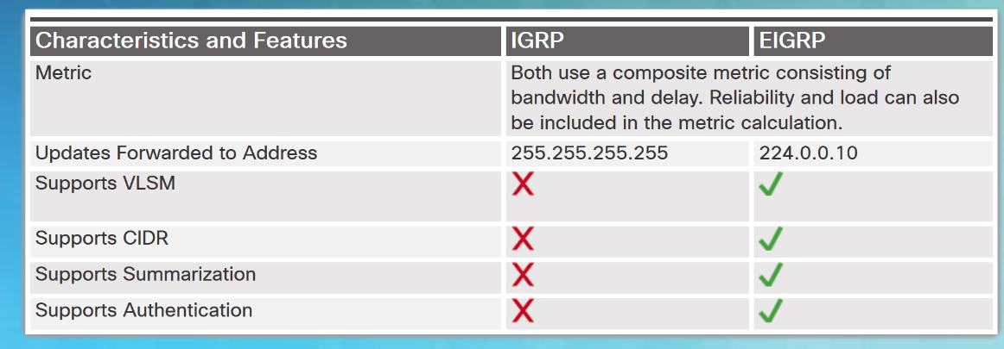
Types of Distance Vector Routing Protocols
Enhanced Interior-Gateway Routing Protocol
EIGRP replaced IGRP in 1992. It includes the following features:
  Bounded triggered updates – sends updates only to routers that need it.
  Hello keepalive mechanism - Hello messages are periodically exchanged to maintain adjacencies.
  Maintains a topology table - maintains all the routes received from neighbors (not only the best paths) in a topology table.
  Rapid convergence – because it maintains alternate routes.
  Multiple network layer protocol support – uses Protocol Dependent Modules (PDM) to support layer 3 protocols.
Notes:
5.2 – Distance Vector Dynamic Routing
5.2.3 – Types of Distance Vector Routing Protocols
5.2.3.2 – Enhanced Interior-Gateway Routing Protocol

Slide 22
5.3 Link-State Dynamic Routing
Notes:
5 – Dynamic Routing
5.3 – Link-State Dynamic Routing

Slide 23
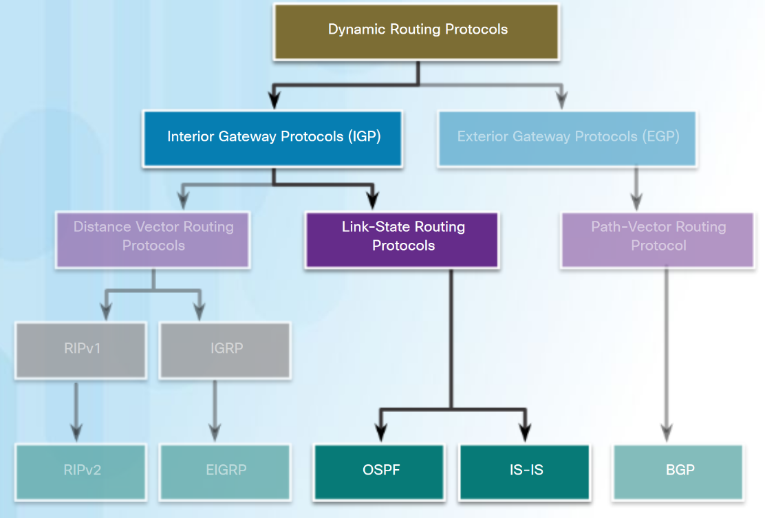
Link-State Routing Protocol Operation
Shortest Path First Protocols
Link-state routing protocols, also known as shortest path first protocols, are built around Edsger Dijkstra's shortest path first (SPF) algorithm.
IPv4 Link-State routing protocols:
  Open Shortest Path First (OSPF)
  Intermediate System-to-Intermediate System (IS-IS)
Notes:
5.3 – Link-State Routing Protocols
5.3.1 – Link-State Routing Protocol Operation
5.3.1.1 – Shortest Path First Protocols

Slide 24
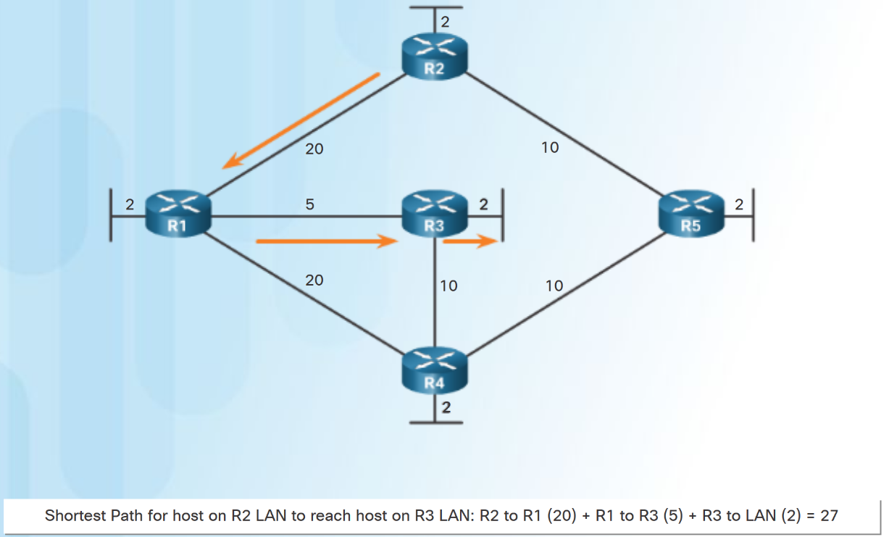
Link-State Routing Protocol Operation
Dijkstra's Algorithm
All link-state routing protocols apply Dijkstra’s algorithm (also known as shortest path first (SPF)) to calculate the best path route:
  Uses accumulated costs along each path, from source to destination.
  Each router determines its own cost to each destination in the topology.
Notes:
5.3 – Link-State Routing Protocols
5.3.1 – Link-State Routing Protocol Operation
5.3.1.2 – Dijkstra's Algorithm

Slide 25
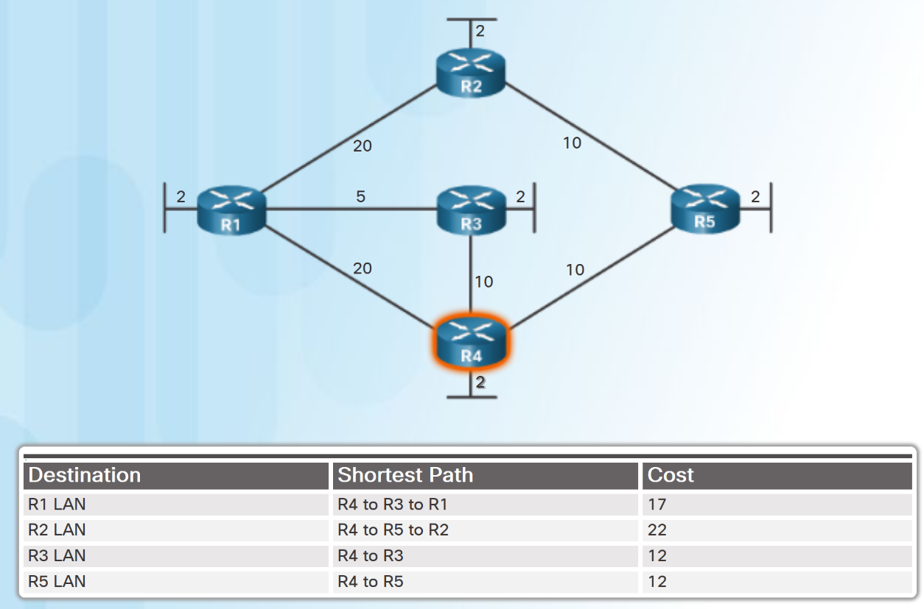
Link-State Routing Protocol Operation
SPF Example
The table displays the shortest path and the accumulated cost to reach the identified destination networks from the perspective of R4.
Notes:
5.3 – Link-State Routing Protocols
5.3.1 – Link-State Routing Protocol Operation
5.3.1.3 – SPF Example

Slide 26
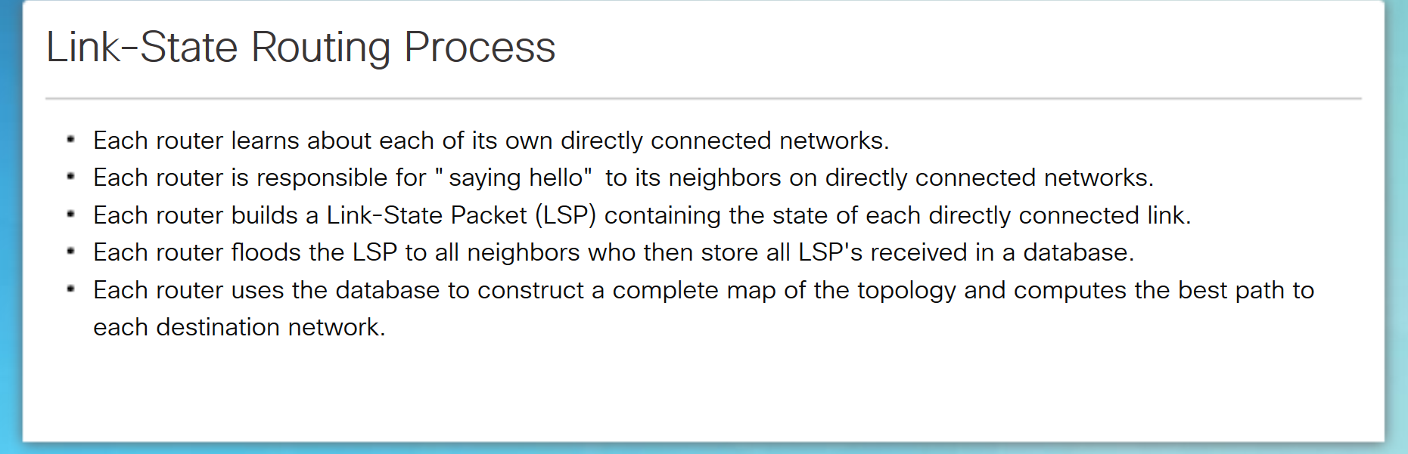
Link-State Updates
Link-State Routing Process
  Note: This process is the same for both OSPF for IPv4 and OSPF for IPv6.
Notes:
5.3 – Link-State Routing Protocols
5.3.2 – Link-State Updates
5.3.2.1 – Link-State Routing Process

Slide 27
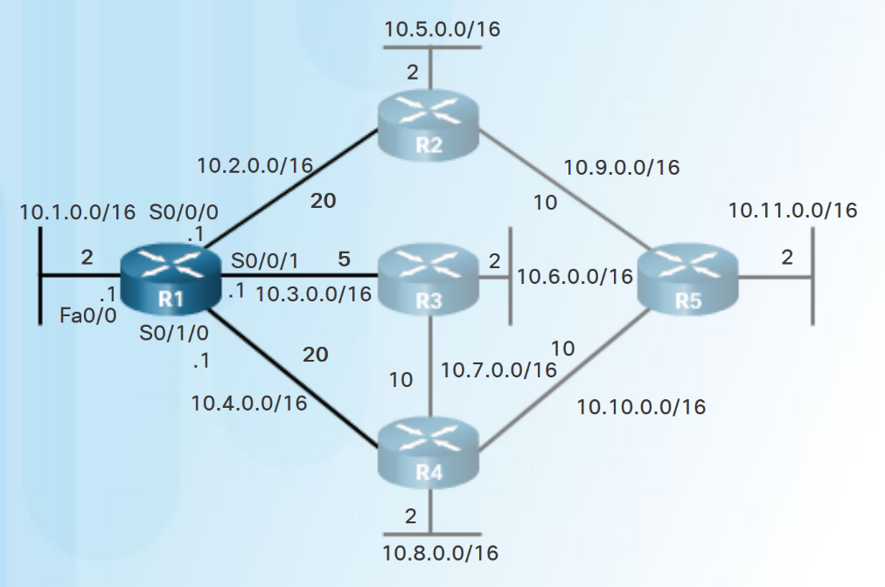
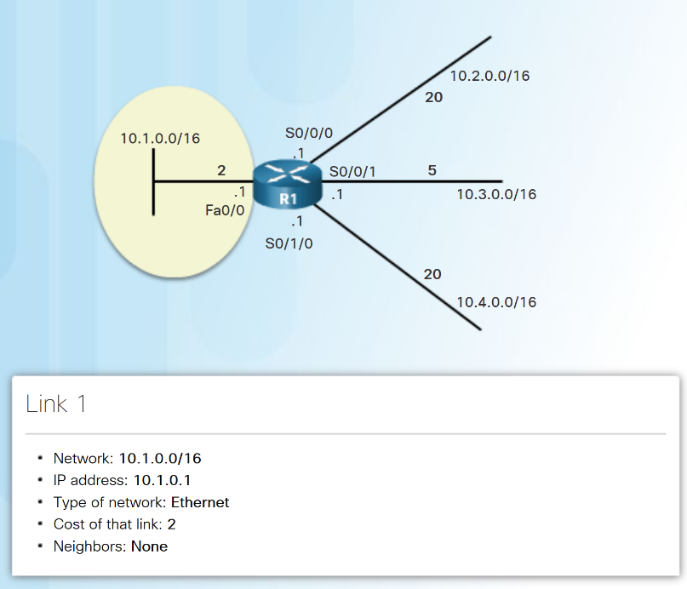
Link-State Updates
Link and Link-State
The first step in the link-state routing process is that each router learns its own directly connected networks.
Notes:
5.3 – Link-State Routing Protocols
5.3.2 – Link-State Updates
5.3.2.2 – Link and Link-State

Slide 28
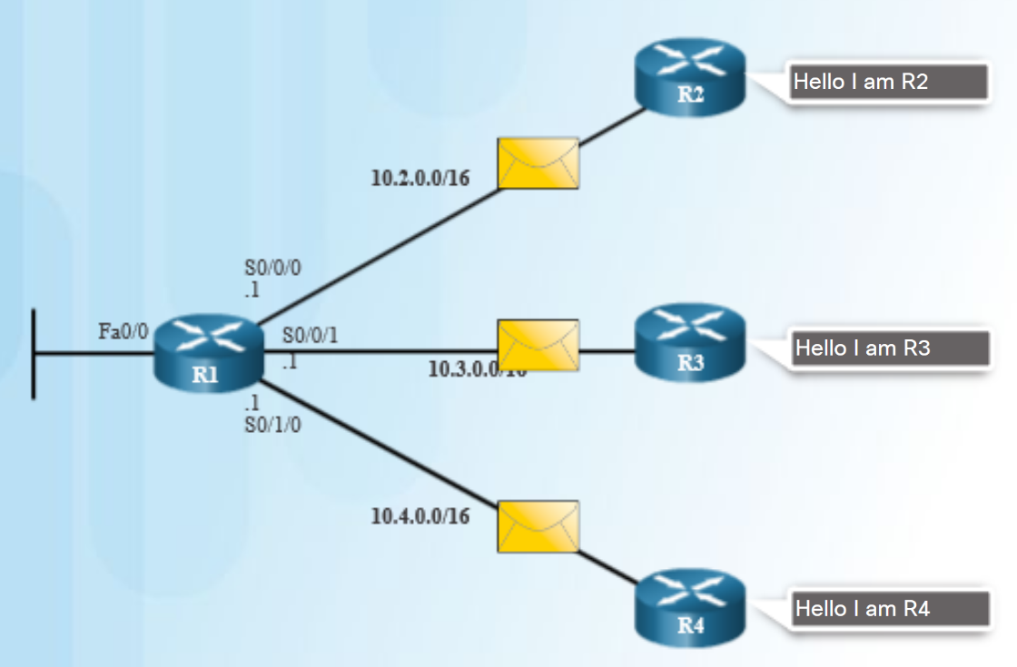
Link-State Updates
Say Hello
The second step in the link-state routing process is that each router uses a Hello protocol to discover any neighbors on its links.
When two link-state routers learn that they are neighbors, they form an adjacency.
If a router stops receiving Hello packets from a neighbor, that neighbor is considered unreachable.
Notes:
5.3 – Link-State Routing Protocols
5.3.2 – Link-State Updates
5.3.2.3 – Say Hello

Slide 29
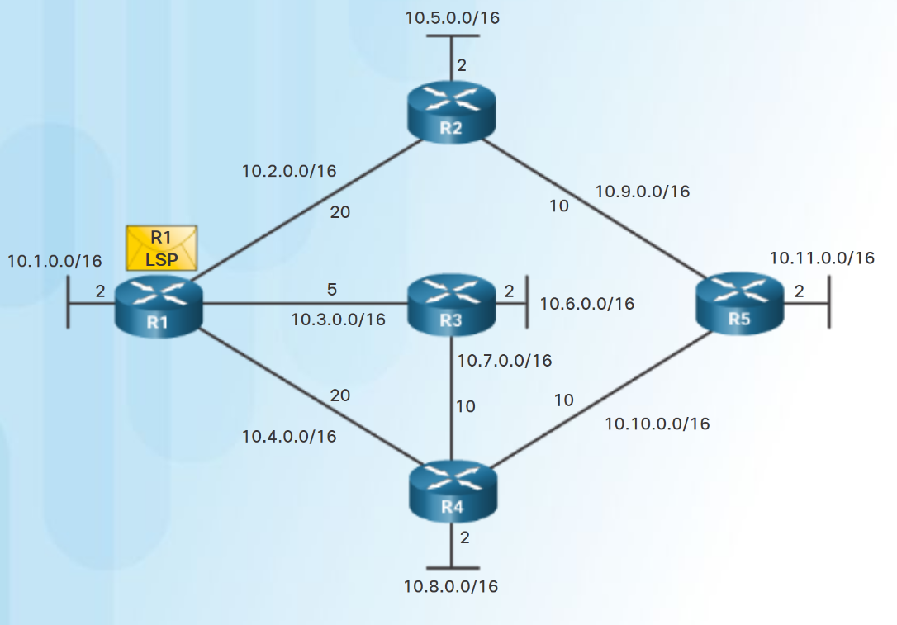
Link-State Updates
Building the Link-State Packet
The third step in the link-state routing process is that each router builds a link-state packet (LSP) that contains the link-state information about its links.
R1 LSP (in diagram) would contain:
  R1; Ethernet network 10.1.0.0/16; Cost 2
  R1 -> R2; Serial point-to-point network; 10.2.0.0/16; Cost 20
  R1 -> R3; Serial point-to-point network; 10.3.0.0/16; Cost 5
  R1 -> R4; Serial point-to-point network; 10.4.0.0/16; Cost 20
Notes:
5.3 – Link-State Routing Protocols
5.3.2 – Link-State Updates
5.3.2.4 – Building the Link-State Packet

Slide 30
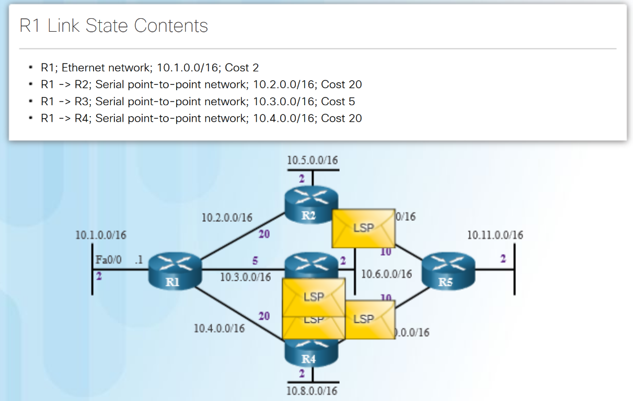
Link-State Updates
Flooding the LSP
The fourth step in the link-state routing process is that each router floods the LSP to all neighbors.
An LSP only needs to be sent:
  During initial startup of the routing protocol process on that router (e.g., router restart)
  Whenever there is a change in the topology (e.g., a link going down)
An LSP also includes sequence numbers and aging information:
  used by each router to determine if it has already received the LSP.
  used to determine if the LSP has newer information.
Notes:
5.3 – Link-State Routing Protocols
5.3.2 – Link-State Updates
5.3.2.5 – Flooding the LSP

Slide 31
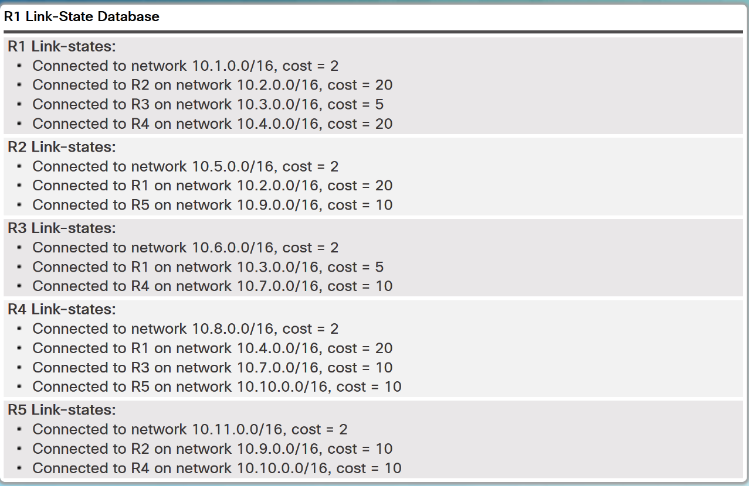
Link-State Updates
Building the Link-State Database
The final step in the link-state routing process is that each router uses the database to construct a complete map of the topology and computes the best path to each destination network.
Notes:
5.3 – Link-State Routing Protocols
5.3.2 – Link-State Updates
5.3.2.6 – Building the Link-State Database

Slide 32
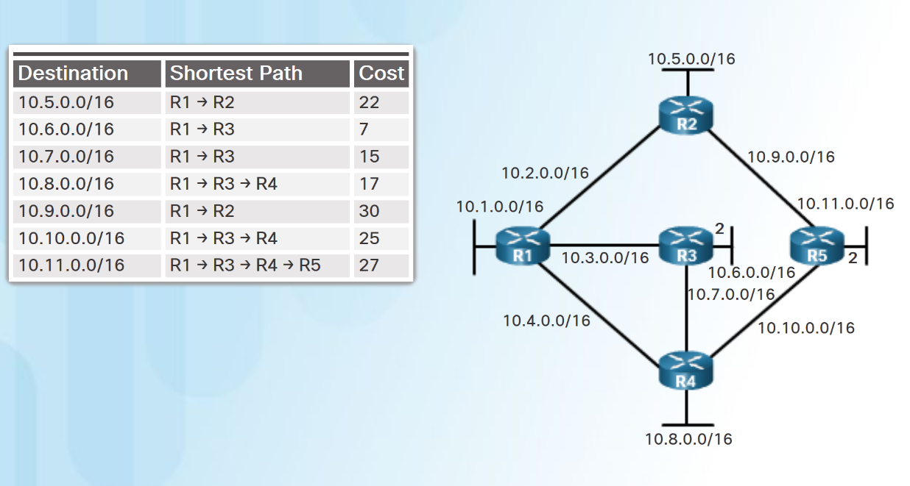
Link-State Updates
Building the SPF Tree
Each router uses the link-state database and SPF algorithm to construct the SPF tree.
    R1 identifies its directly connected networks and costs.
    R1 adds any unknown networks and associated costs.
    The SPF algorithm then calculates the shortest paths to reach each individual network resulting in the SPF tree shown in the diagram.
Each router constructs its own SPF tree independently from all other routers.
Notes:
5.3 – Link-State Routing Protocols
5.3.2 – Link-State Updates
5.3.2.7 – Building the SPF Tree

Slide 33
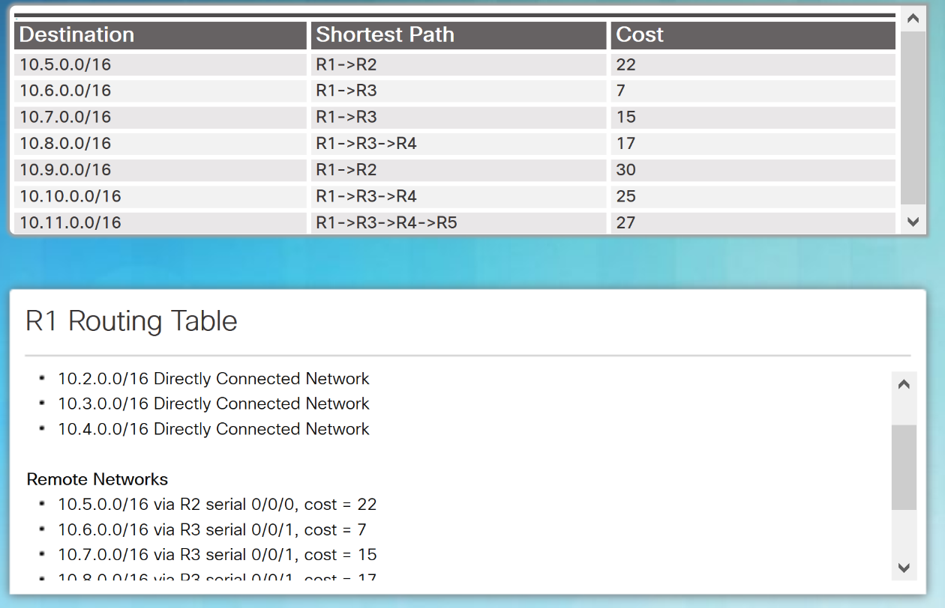
Link-State Updates
Adding OSPF Routes to the Routing Table
Using the shortest path information determined by the SPF algorithm, these best paths are then added to the routing table.
Directly connected routes and static routes are also included in the routing table.
Notes:
5.3 – Link-State Routing Protocols
5.3.2 – Link-State Updates
5.3.2.8 – Adding OSPF Routes to the Routing Table

Slide 34
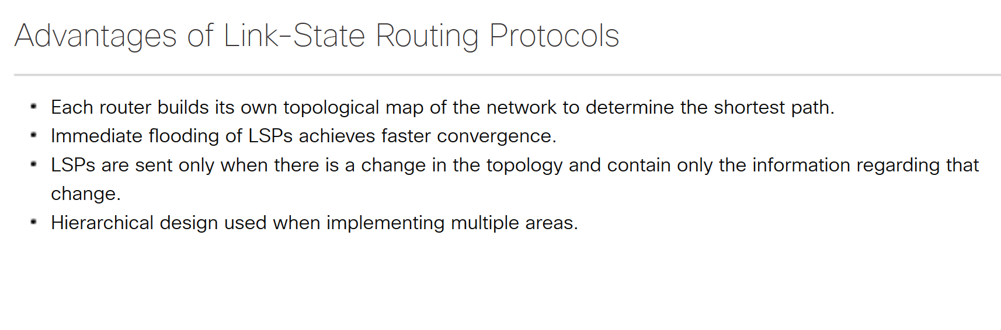
Link-State Routing Protocol Benefits
Why Use Link-State Protocols?
Notes:
5.3 – Link-State Routing Protocols
5.3.3 – Link-State Routing Protocol Benefits
5.3.3.1 – Why Use Link-State Protocols?

Slide 35
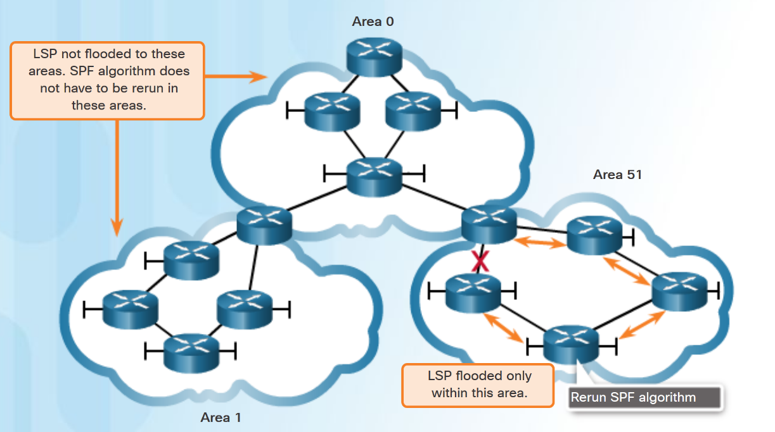
Link-State Routing Protocol Benefits
Disadvantages of Link-State Protocols
Disadvantages of Link-State protocols:
  Memory Requirements - Link-state protocols require additional memory.
  Processing Requirements - Link-state protocols can require more CPU processing.
  Bandwidth Requirements - The flooding of link-state packets can adversely affect bandwidth.
Using multiple areas can reduce the size of the link-state databases.
Multiple areas can limit the amount of link-state information flooding and send LSPs only to those routers that need them.
Notes:
5.3 – Link-State Routing Protocols
5.3.3 – Link-State Routing Protocol Benefits
5.3.3.2 – Disadvantages of Link-State Protocols

Slide 36
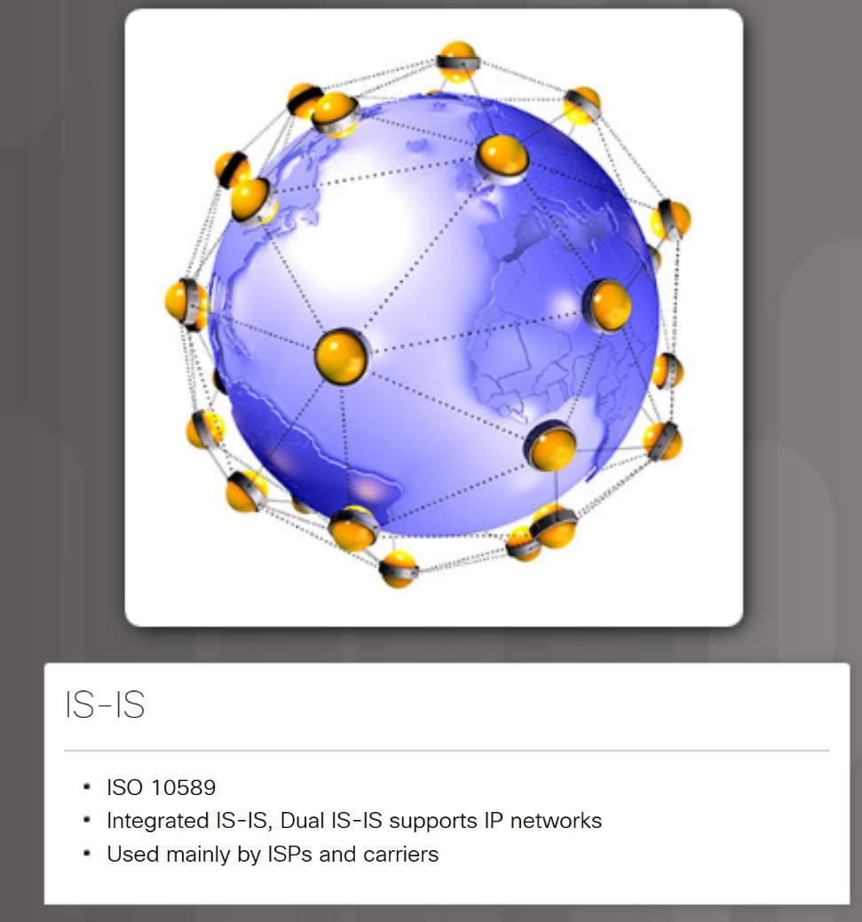
Link-State Routing Protocol Benefits
Protocols that Use Link-State
Two link-state routing protocols, OSPF and IS-IS.Open Shortest Path First (OSPF) - most popular implementation with two versions in use:
    OSPFv2- OSPF for IPv4 networks (RFC 1247 and RFC 2328)
    OSPFv3- OSPF for IPv6 networks (RFC 2740)
Integrated IS-IS, or Dual IS-IS, includes support for IP networks.
  used mainly by ISPs and carriers.
Notes:
5.3 – Link-State Routing Protocols
5.3.3 – Link-State Routing Protocol Benefits
5.3.3.3 – Protocols that Use Link-State

Slide 37
5.4 Chapter Summary
Notes:
5 – Dynamic Routing
5.4 – Summary

Slide 38
Conclusion
Chapter 5: Dynamic Routing
Explain the features and characteristics of dynamic routing protocols.
Explain how distance vector routing protocols operate.
Explain how link-state protocols operate.
Notes:
5.4 – Summary
5.4.1 – Conclusion
5.4.1.1 – Chapter 5: Dynamic Routing

