Slide 1
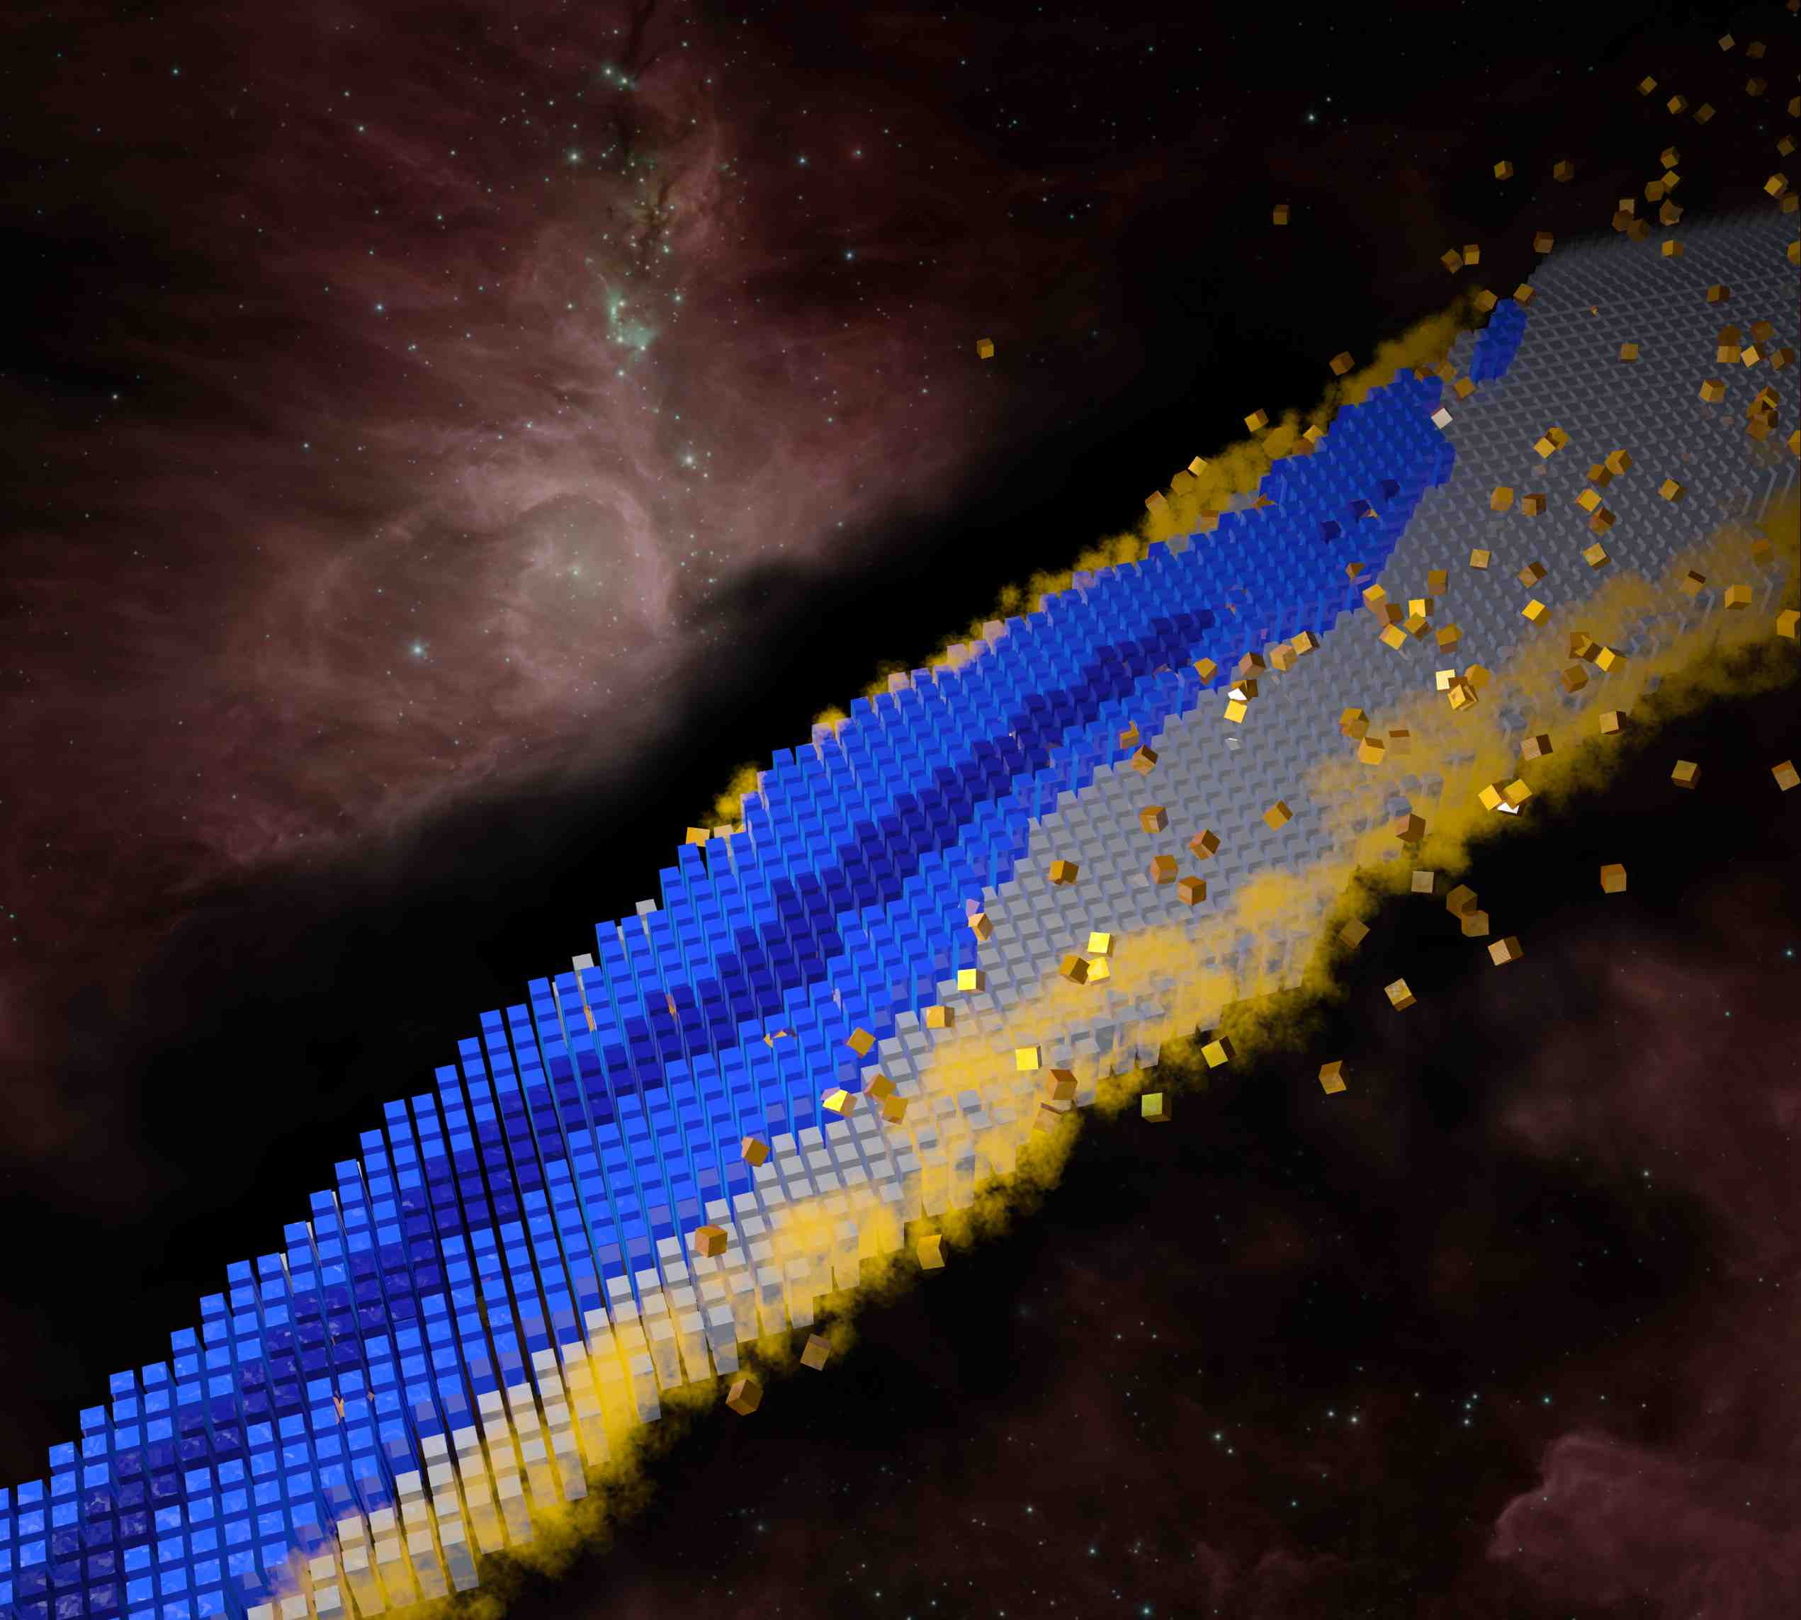

Introduction to the Science of Superheavy Nuclei
Tongji University, Nov. 15, 2024
Witold Nazarewicz (FRIB/MSU)
Menu
Introduction
Superheavy nuclei/atoms
Where is the end of the nuclear chart/periodic table?
Prospects

Slide 2
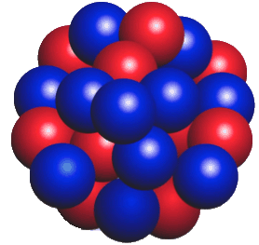
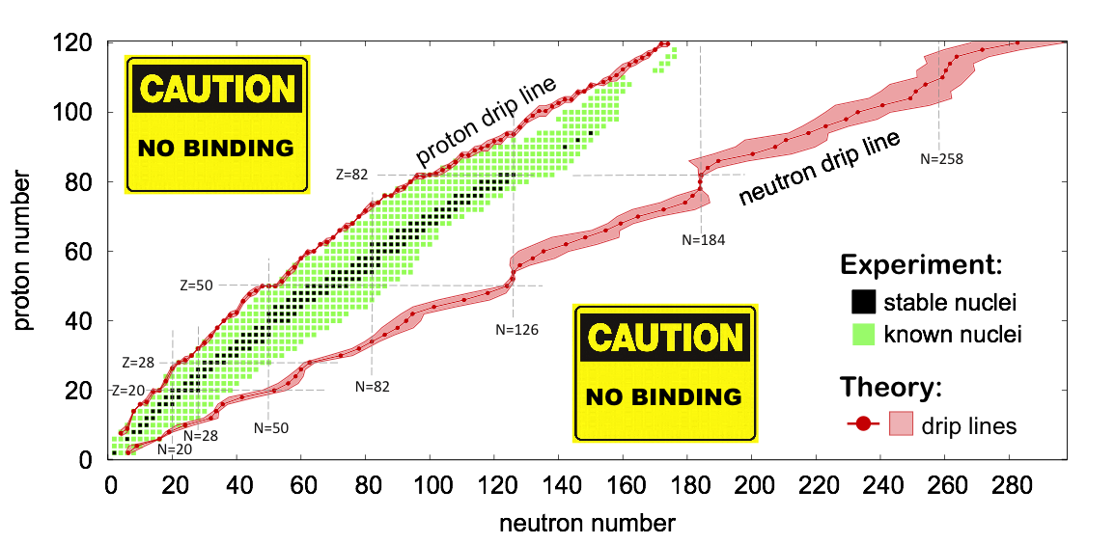
The Nuclear Landscape
superheavy
Nuclei
(all radioactive)
The term superheavy elements usually refers to transactinides − the chemical elements with atomic numbers Z≥104.

Slide 3
Historical introduction
Our quest for heavy elements can be divided into several periods. The first period (1896-1940) was characterized by the Curies' work and the discovery of polonium.
The Manhattan Project marked the second period (1940-1946), when plutonium became part of the periodic table.
The third period (1947-1974) witnessed a Cold War competition between Russian and American laboratories to discover new elements. For instance, einsteinium and fermium were discovered in 1952 in the debris from the thermonuclear explosion conducted at Eniwetok Atoll in the Pacific Ocean. The fermium nucleus was made through the capture of 17 neutrons by ²³⁸U followed by the subsequent beta decays. In nature, a similar process (the so-called r-process) is responsible for the synthesis of heavy elements.

Slide 4
Historical introduction (cont.)
During the fourth period, Isotopes of elements with the atomic number Z=110-113 were discovered at GSI (1994-1996; Z=110-113) and RIKEN (2004; Z=113) using “cold-fusion” heavy-ion reactions using lead or bismuth targets. Their lifetimes have been found to be very short. For instance, the isotope ^{A}Z=²⁷⁷112 turned out to have a half-life of the order of 300 μs. The production cross section was found to be rapidly decreasing with the atomic number (it is around 20 fb for Z=113).
The use of “hot-fusion” reactions in Dubna (Russia) by Oganessian et al. with the neutron-rich ⁴⁸Ca beam and actinide targets from ORNL has transformed the superheavy research. During this fifth period, measurements of over fifty isotopes of new elements with Z=114-118 were carried out during 1998-2008. The most significant result of these measurements is the observed increase of half-lives with increasing neutron numbers. The search for Z=119 and 120 is ongoing at RIKEN, Dubna, GSI, and Berkeley.

Slide 5
SHE/SHN: multi-science problem
Nuclear structure and reactions
Atomic physics and chemistry
Nuclear astrophysics
Many-body physics
  Many nucleons and many electrons; both are complex systems
  Open systems (fission, fusion, supercritical charges)
Relativity and QED

Slide 6
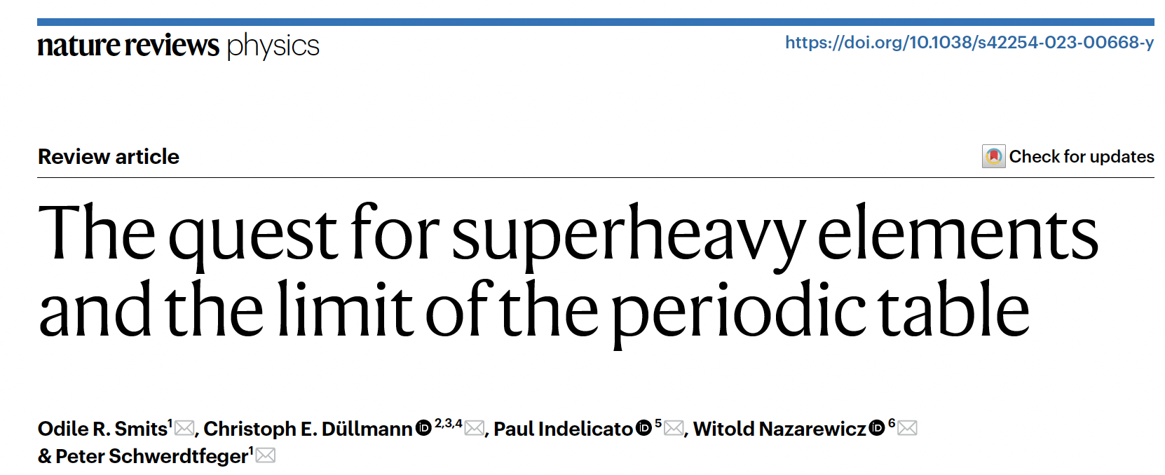
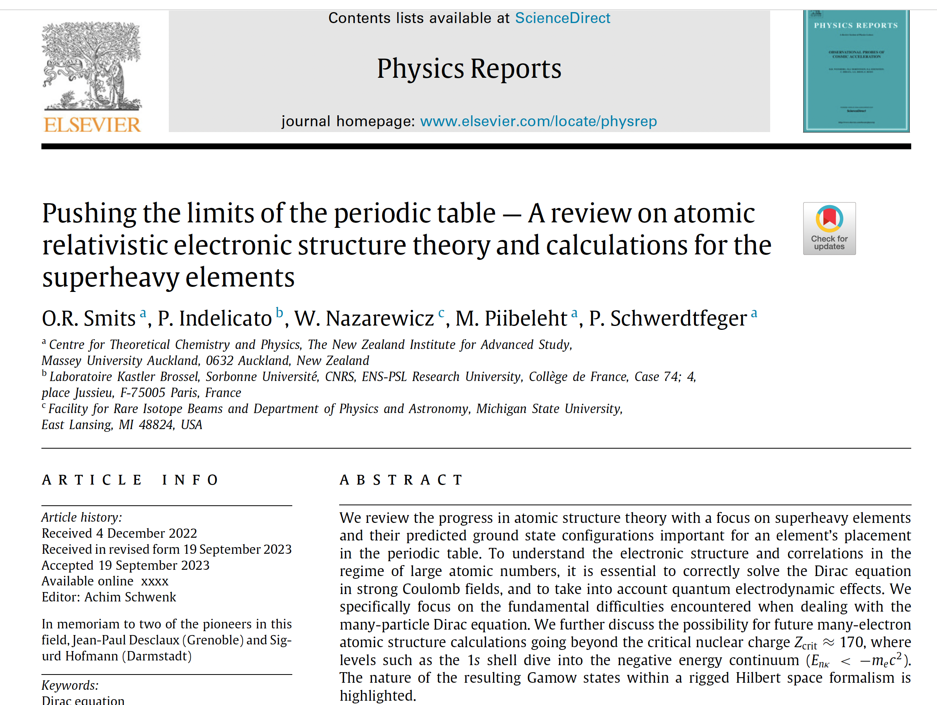

Recent reviews

Slide 7
Structure of SHN

Slide 8
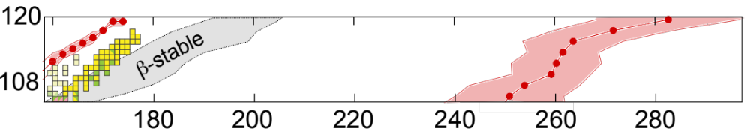
Superheavy territory
Nature Physics 14, 537 (2018)
proton drip line
N=170
beta stable
N≈192
neutron drip line
N≈270
≈100 isotopes of Og

Slide 9
Nuclear properties of Og (predicted)
(nucleons/fm³)
oblate
spherical
triaxial
Og is BIG!

Slide 10
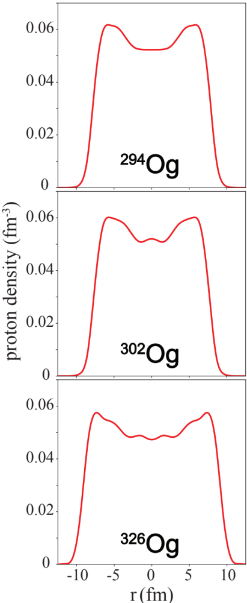

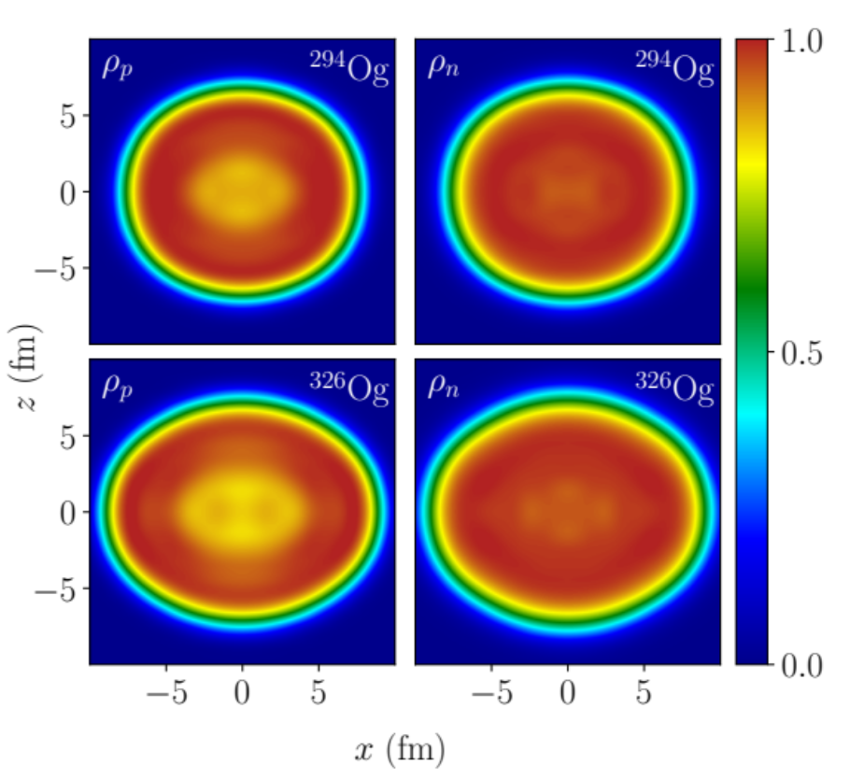
²⁹⁴Og is expected to be a deformed semi-bubble!
Phys. Rev. C 96, 024306 (2017)
protons
neutrons
nuclear
electrostatic
²⁹⁴Og
Og is a strongly frustrated system: a competition between long-range Coulomb and short-range nuclear interactions gives rise to exotic distributions of protons
³⁰²Og

Slide 11
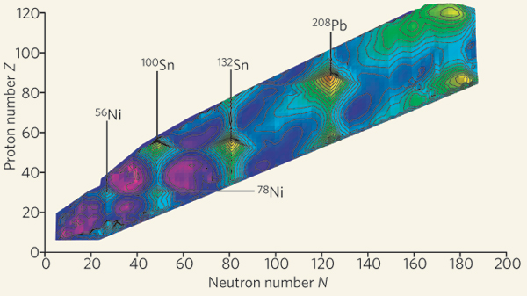
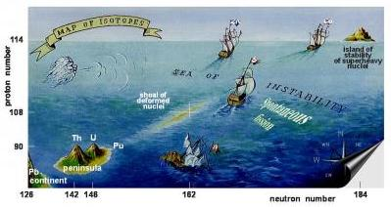

The existence of superheavy nuclei hangs on quantum effects!
Nature 449, 411 (2007)
Shell energy
Świątecki 1955
Strutinsky 1967
Warsaw/Lund 1969

Slide 12
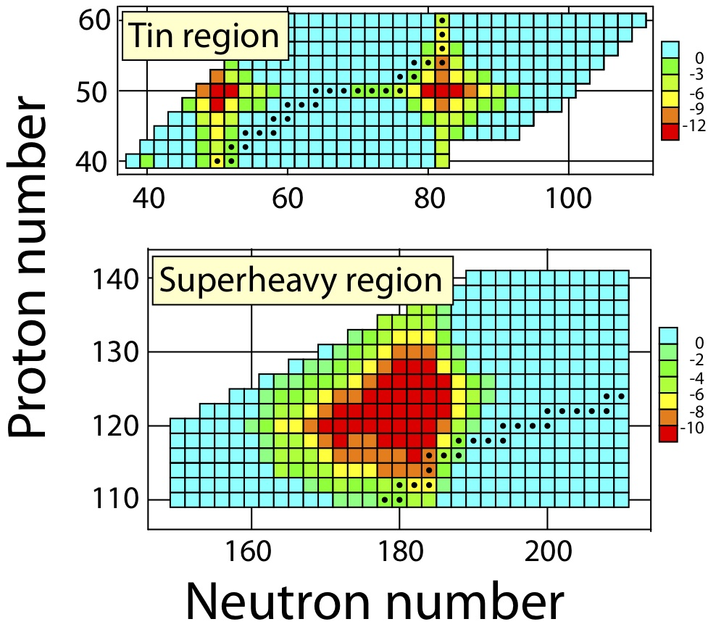
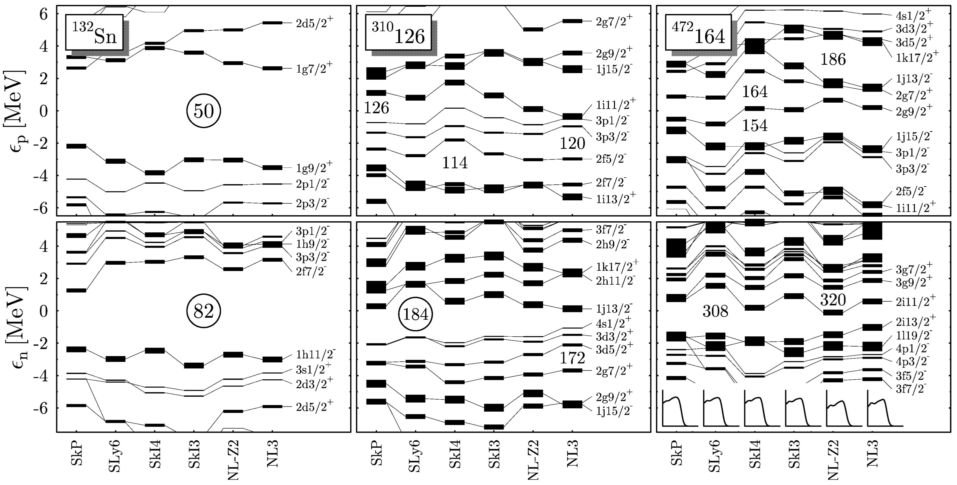
Diffused shell structure of superheavy nuclei
Spherical shell energy of SLy6
Phys. Lett. B 515, 42 (2001)
Yes, SHN are indeed shell-stabilized
But it makes little sense to argue about “the next magic gap in the SHN region”
The heaviest doubly-magic nucleus is probably ²⁰⁸Pb

Slide 13

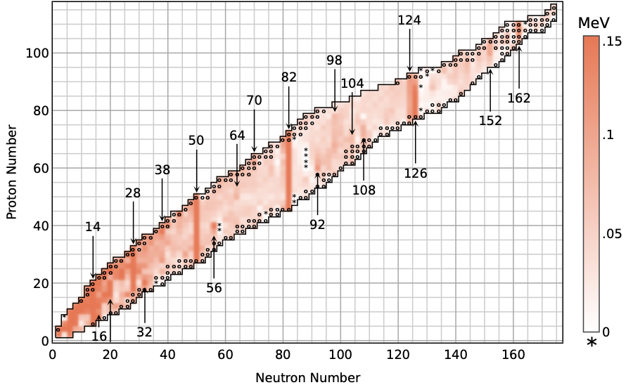


Nucleonic shells from nuclear masses
http://bmex.dev
L. Buskirk et al., Phys. Rev. C 109, 044311 (2024)

Slide 14
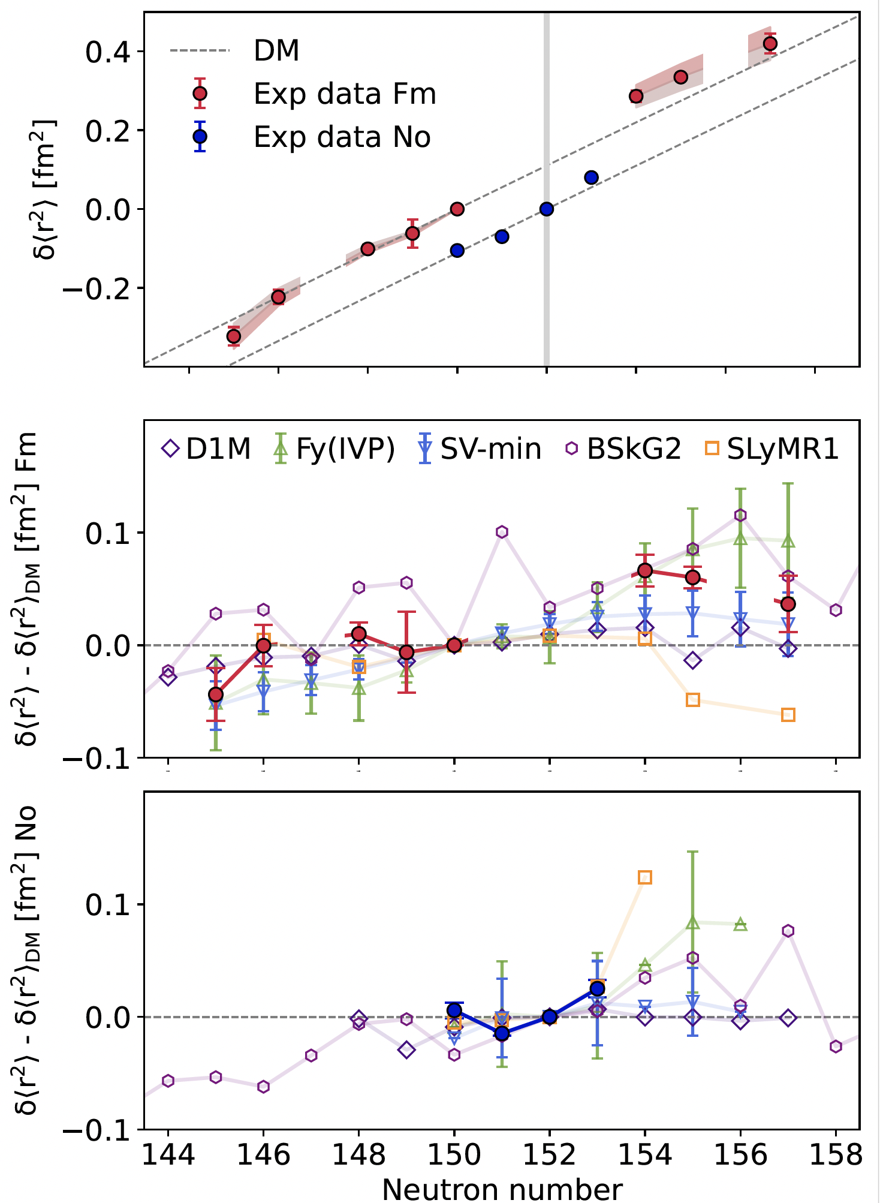
Laser spectroscopy of fermium isotopes: diffused shell effects in the heaviest nuclei
J. Warbinek et al., Nature 634, 1075–1079 (2024)
Superheavy nuclei are ~bulk systems (by nuclear standards). Macroscopic liquid-drop arguments based on leptodermous expansion and semi-classical arguments often apply.
But… their mere existence hangs on subtle quantum shell effects!
Challenge: more information on radii and EM moments of SHN

Slide 15
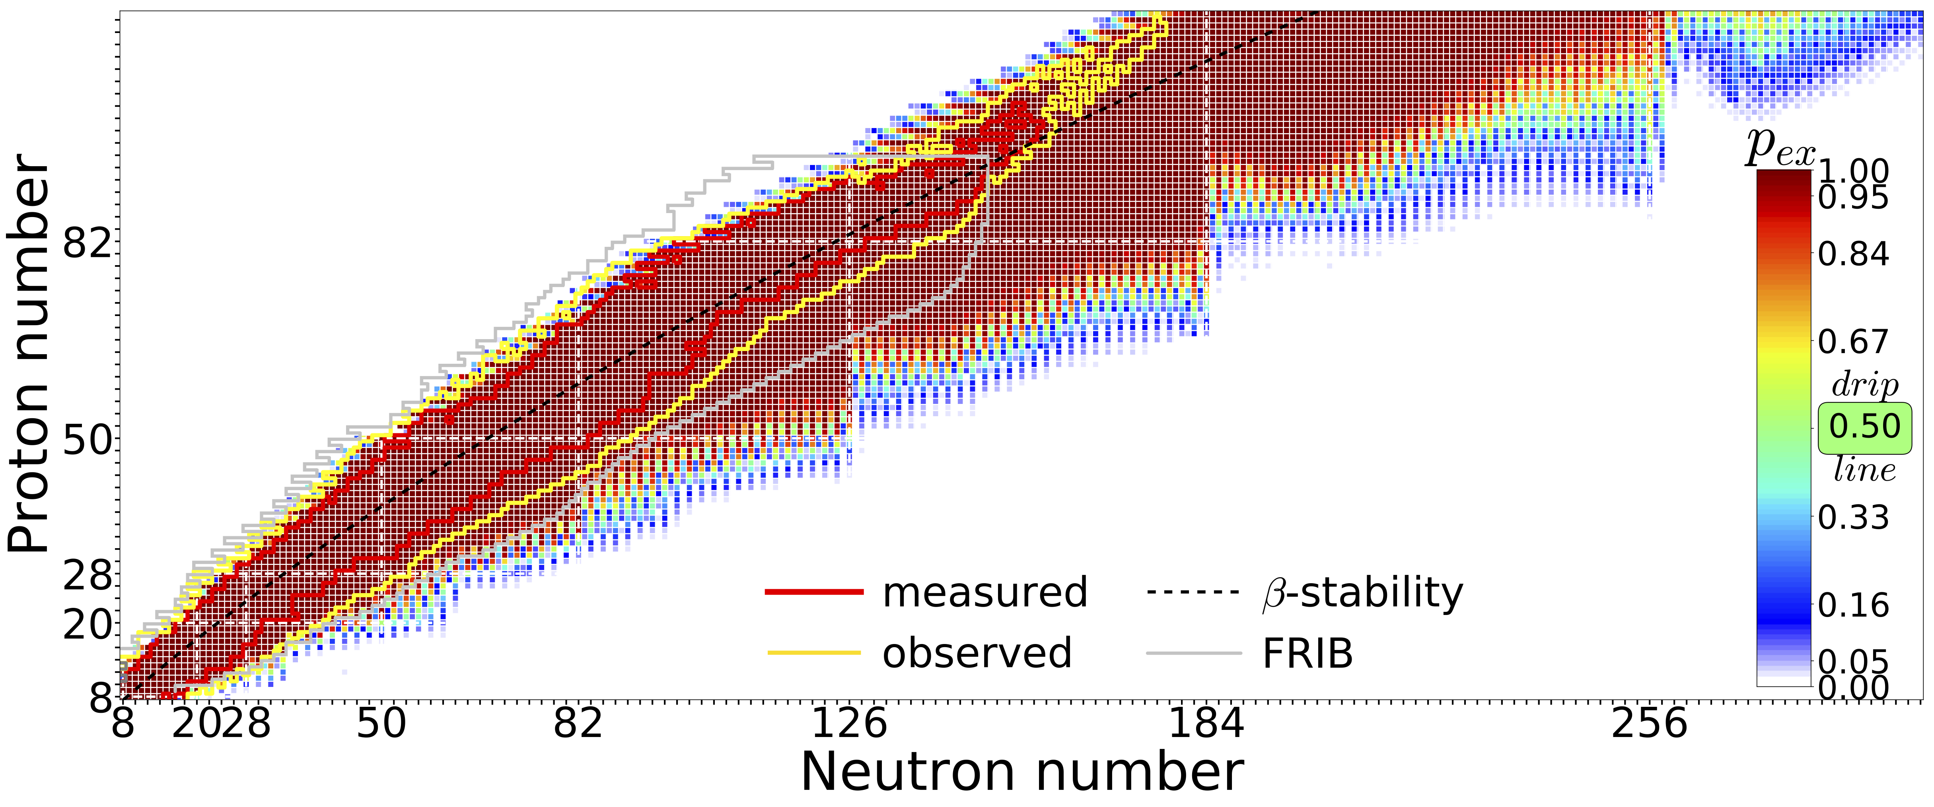
Theoretical predictions for SHN amount to extrapolations
Quantified predictions based on current data and current theoretical knowledge
? ? ? ? ? ? ? ? ? ? ? ?
Phys. Rev. C 101, 044307 (2020)
Predictions made with 11 global mass models and Bayesian model averaging
Challenge: quantified theoretical extrapolations: no single model can be trusted!
Notes:
286 primordial nuclides.

Slide 16
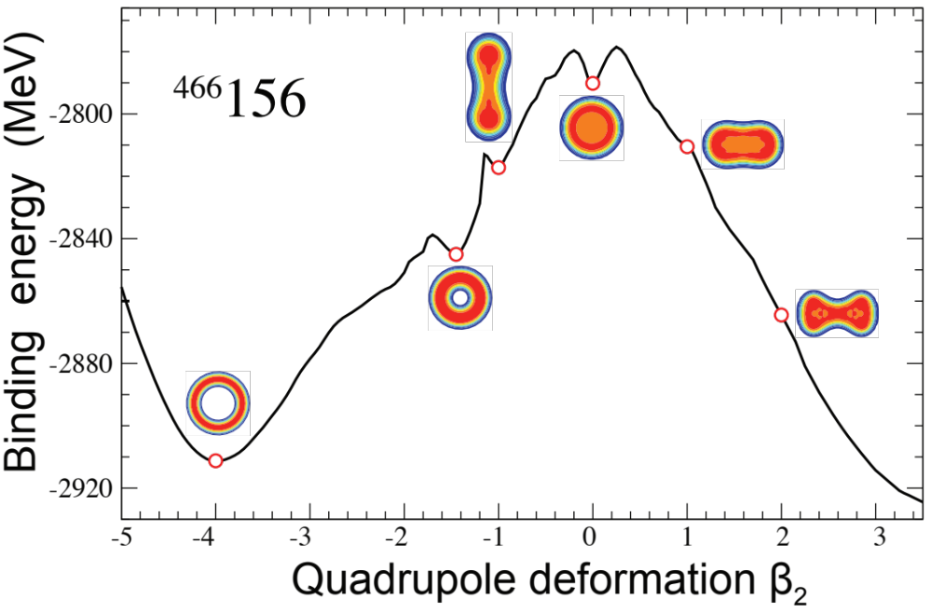
Coulomb frustration impacts shell structure
SHN are strongly frustrated systems: a competition between long-range Coulomb repulsion and short-range nuclear attraction gives rise to exotic distributions of protons
Phys. Rev. C 103, 034323,(2021)
Challenge: assess the stability of exotic topologies

Slide 17
Fission

Slide 18
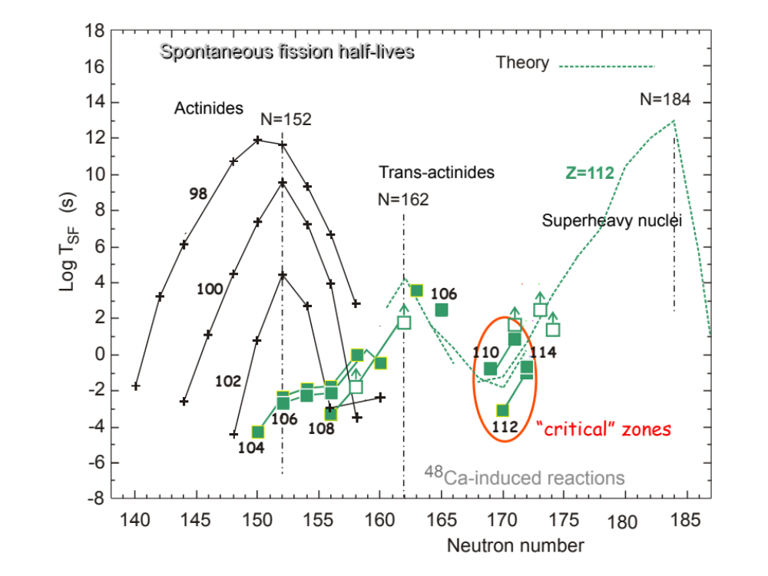
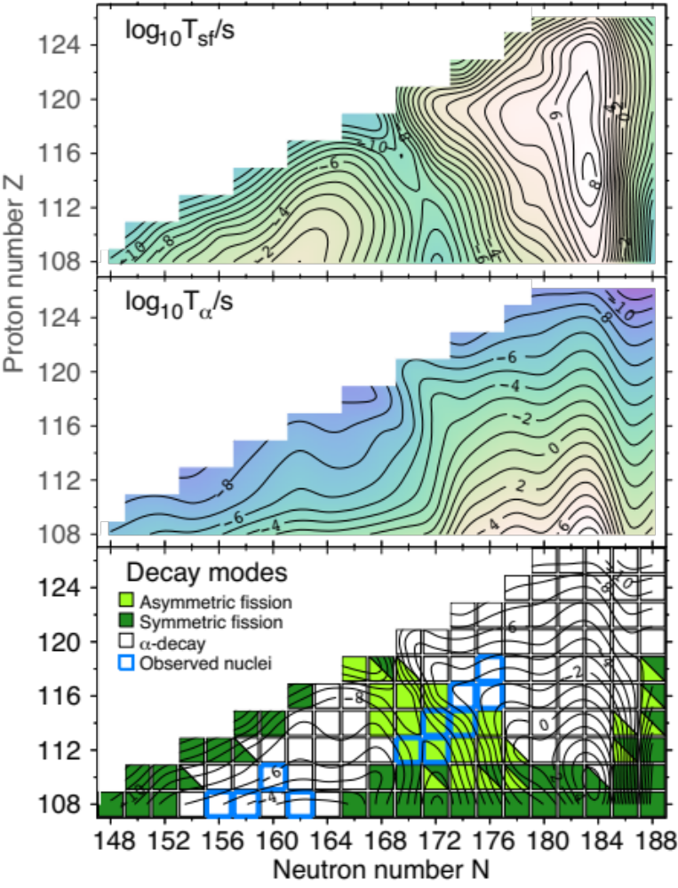
alpha decay and spontaneous fission
Oganessian et al.
No superhavy island of stability!
SF fission “Death Valley” around N=170
Phys. Rev. C 87, 024320 (2013)
SkM* model

Slide 19
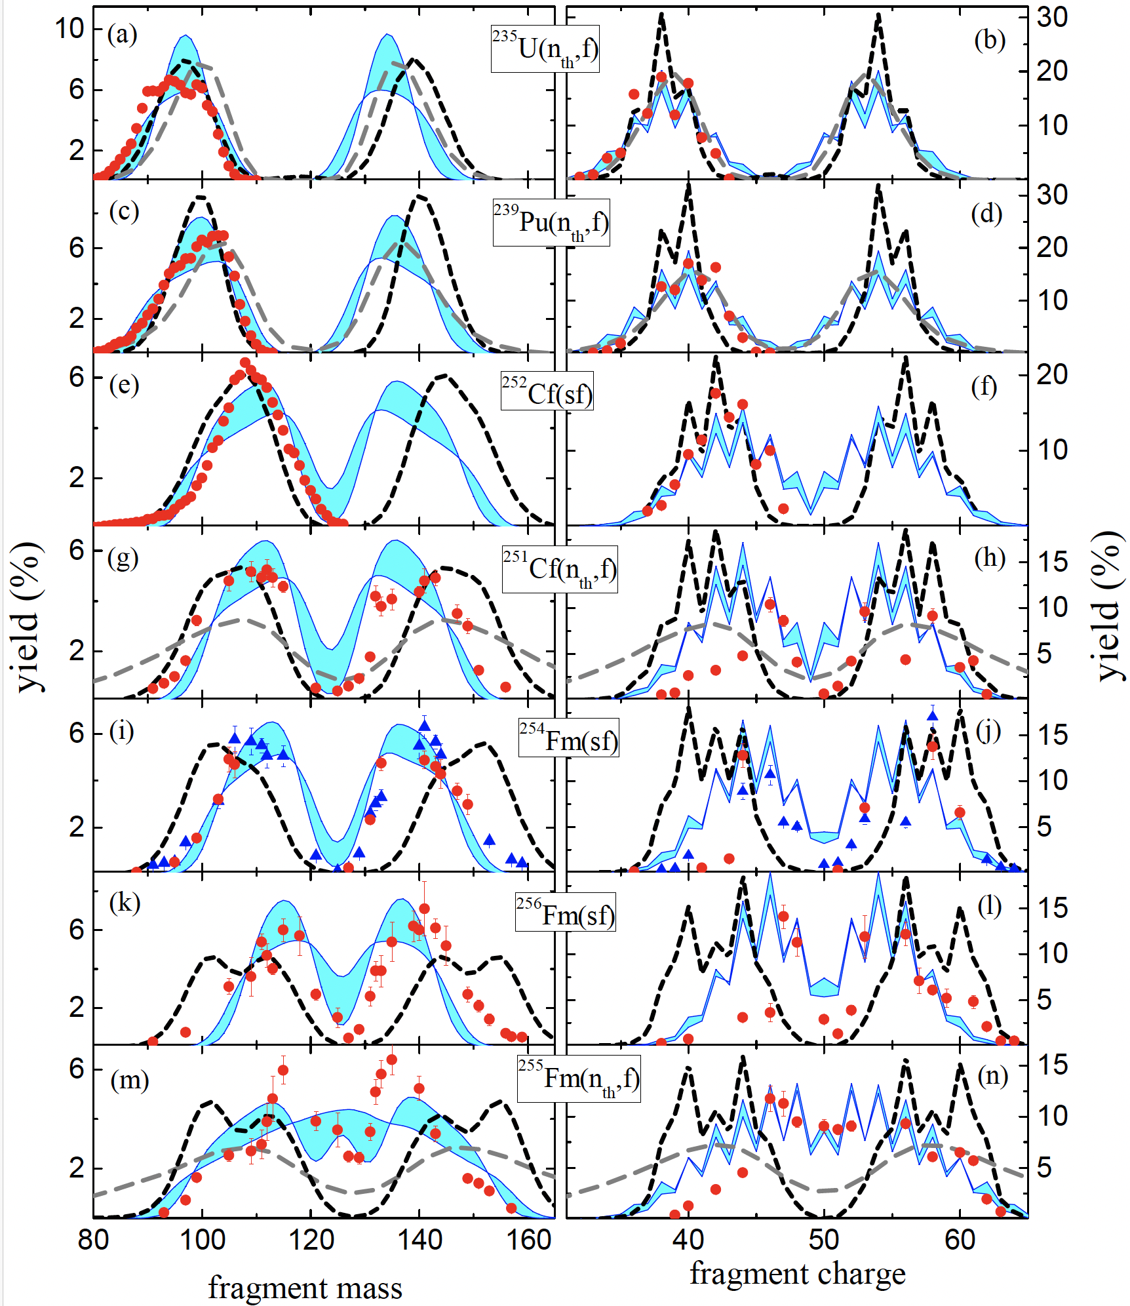
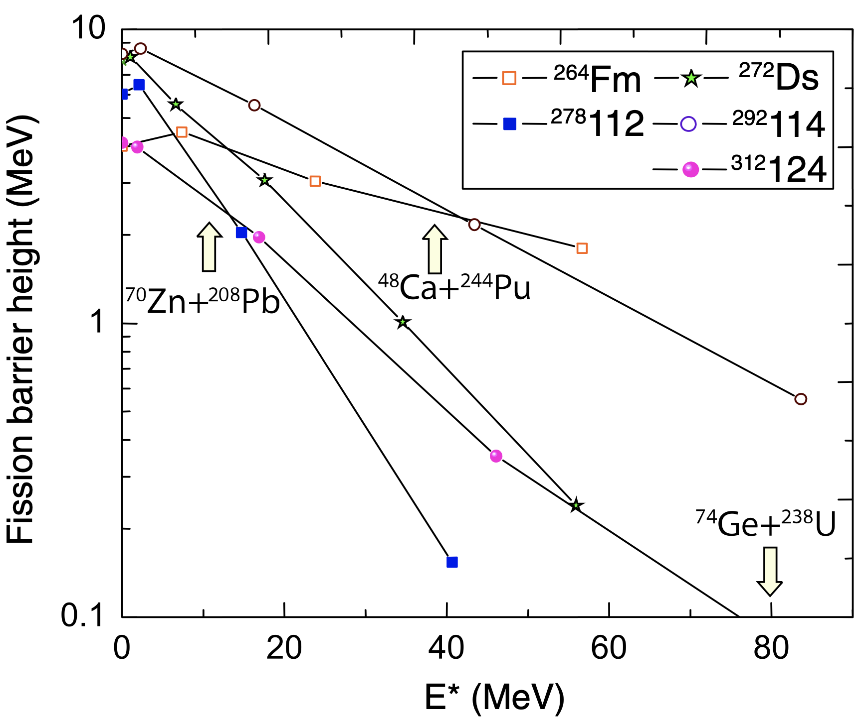
Theoretical description of fission yields: fast and efficient global model
J.Sadhukhan et al., Phys. Rev. C, 105, 014619 (2022)
Hybrid model (blue bands)
BSM (gray dashed lines)
SPM (black dashed lines)
J.Pei et al., Phys. Rev. Lett., 102, 192501 (2009)
Fission of synthesized SHN happens at high excitation energy: thermal aspects play a role!

Slide 20
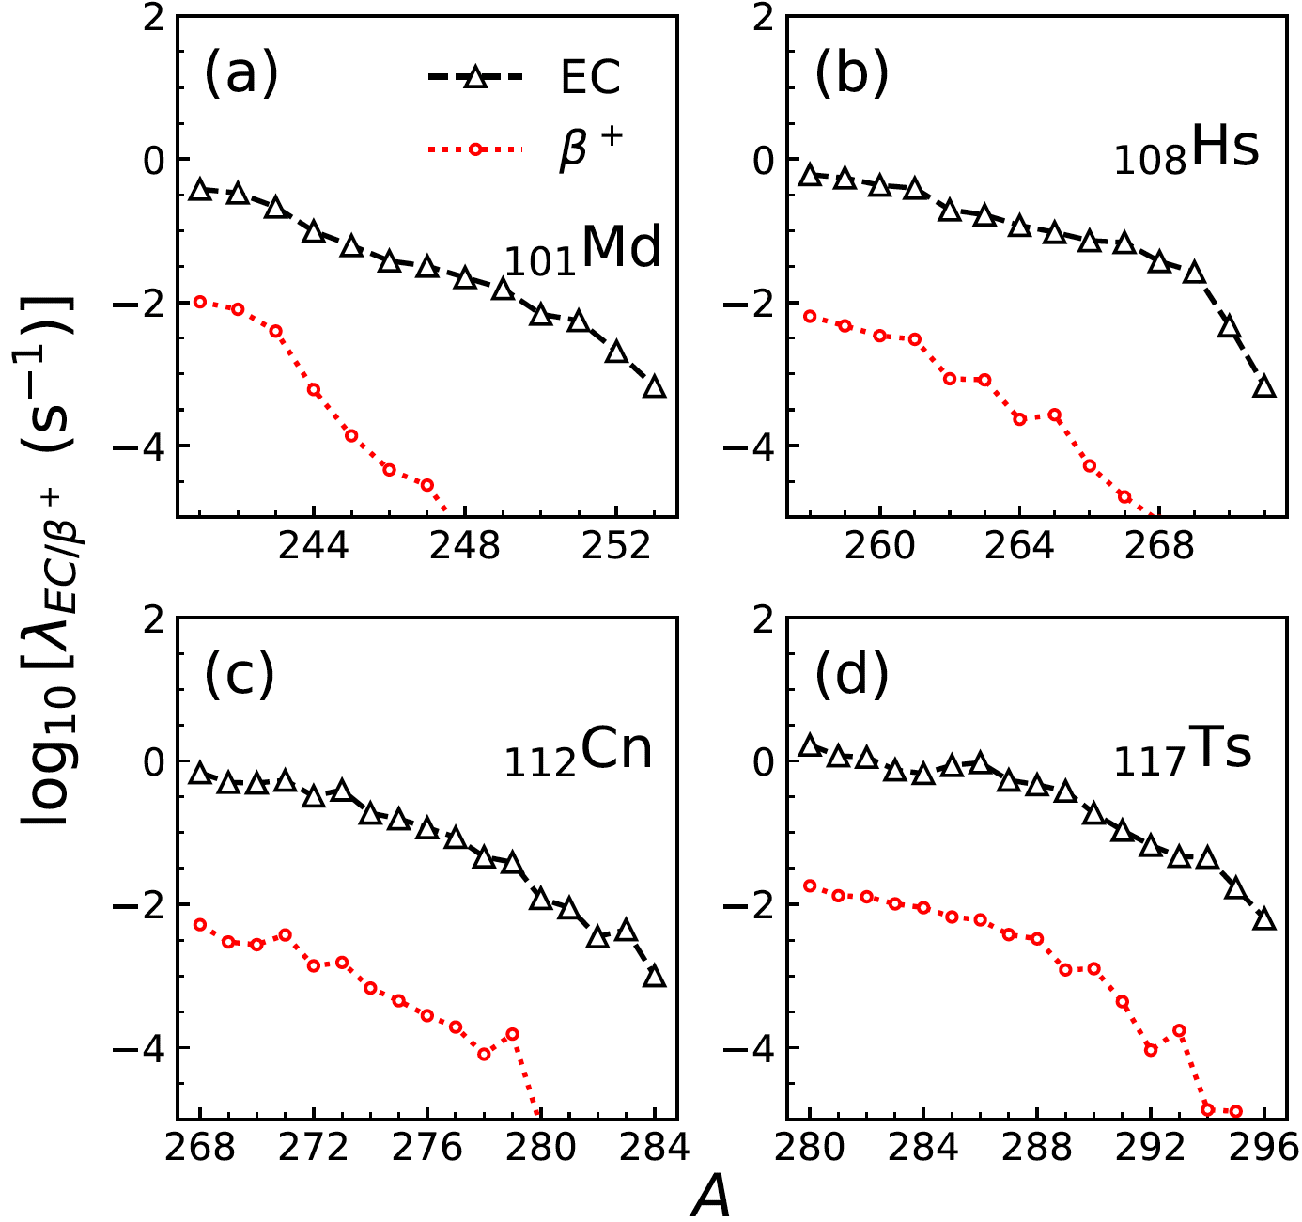
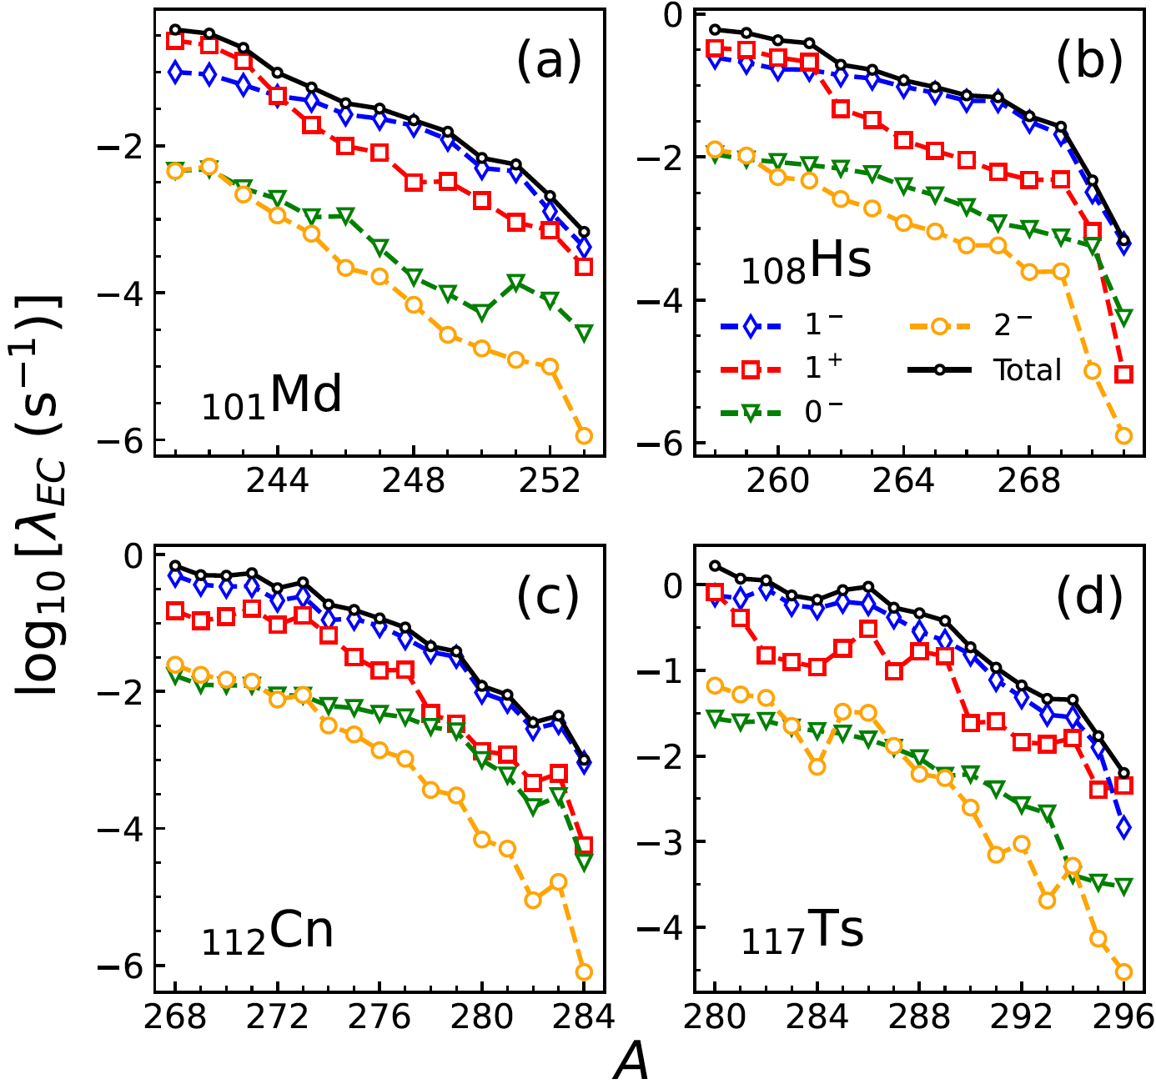
Weak decays in superheavy nuclei
A. Ravlić, WN, arXiv:2409.04620
EC dominates over β⁺
FF dominate

Slide 21
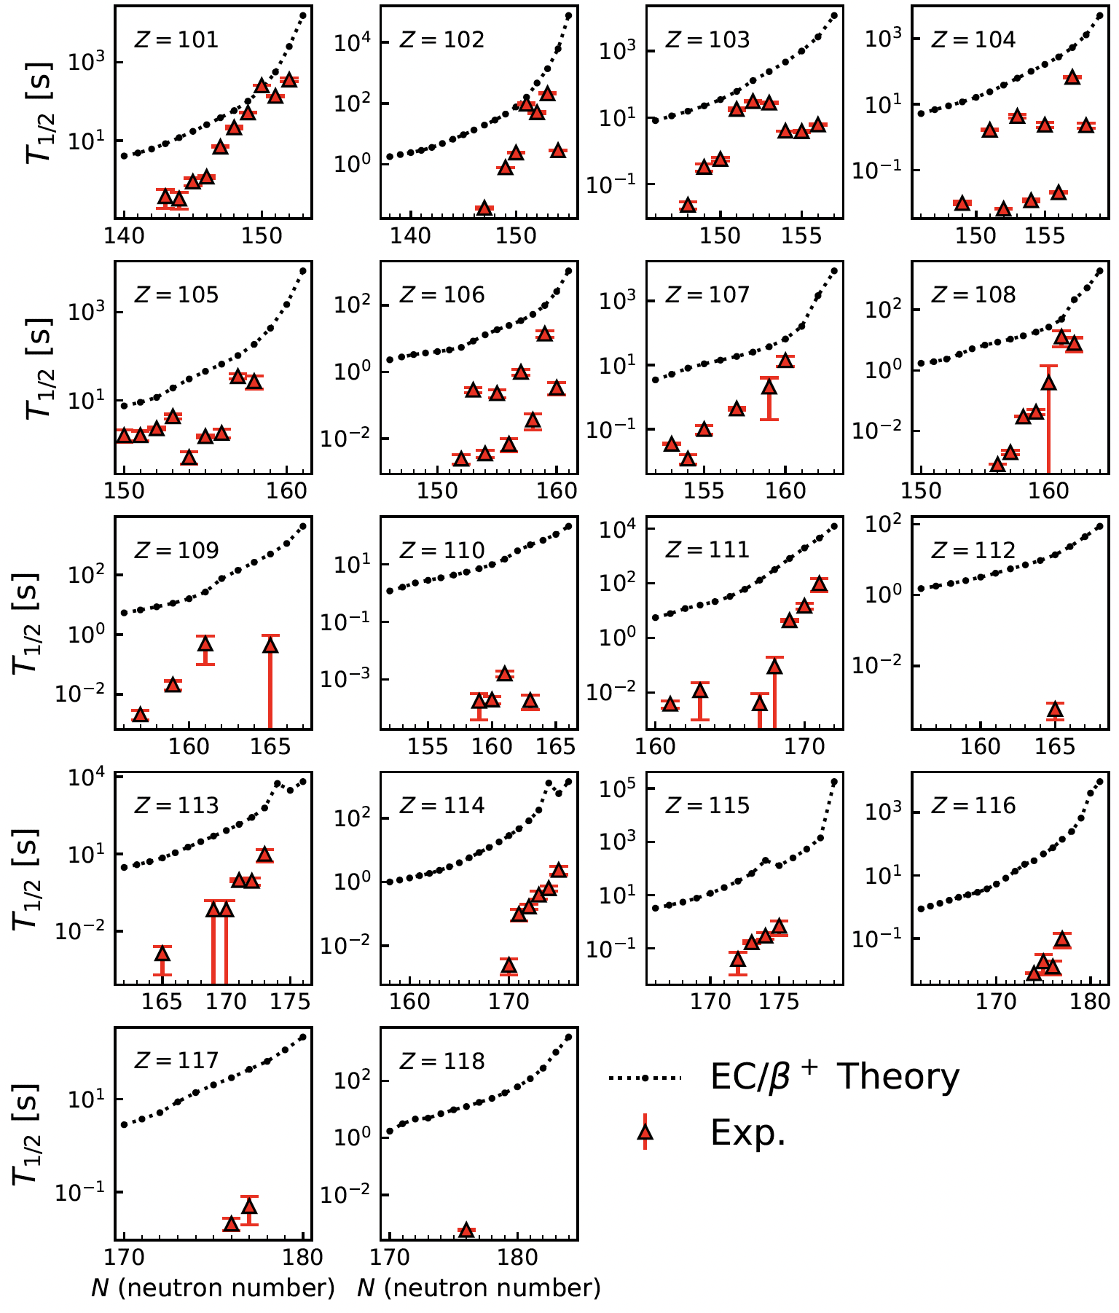
Weak decays
For proton-rich transfermium nuclei, EC dominates over beta decay
For heavy nuclei, forbidden transitions dominate
Challenge: quantified predictions of weak decays, including forbidden ones

Slide 22
Fusion
How to get there?
A quest for predictive theory of production cross-sections
Best reactions?
Multi-neutron transfer?
Exotic beams (far into the future)?
Notes:
Loss of Valeri Zagrebaev

Slide 23
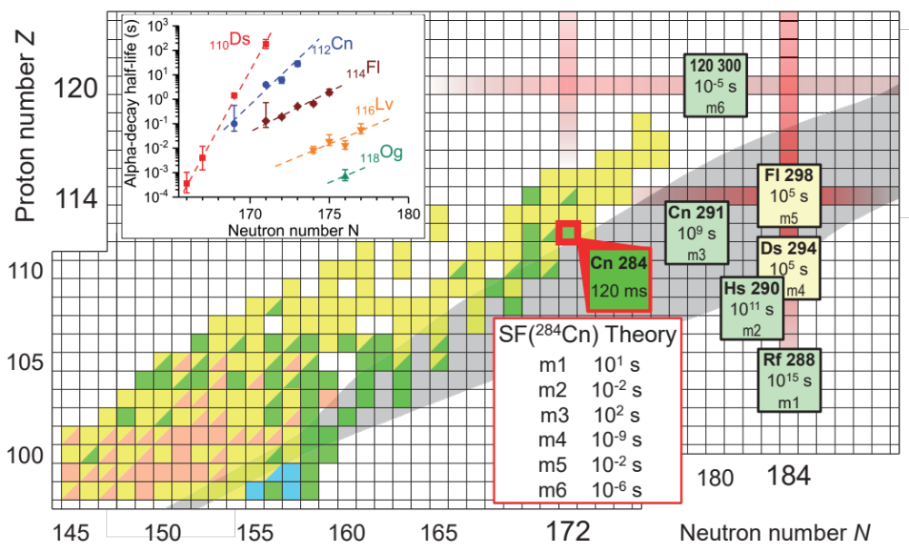

Fission of SHN is a major challenge for theory...

Slide 24
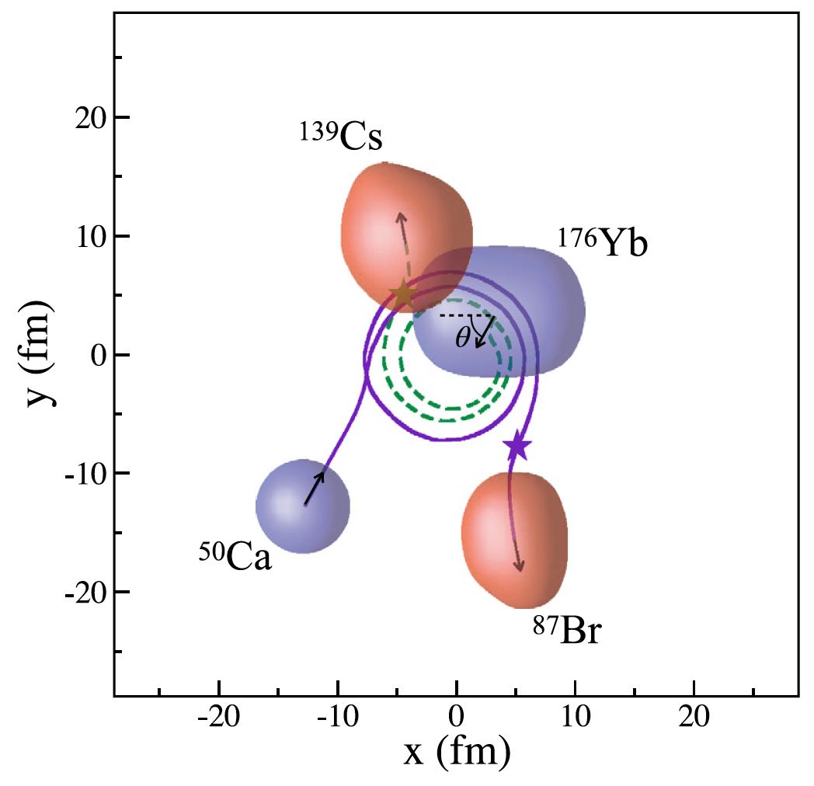
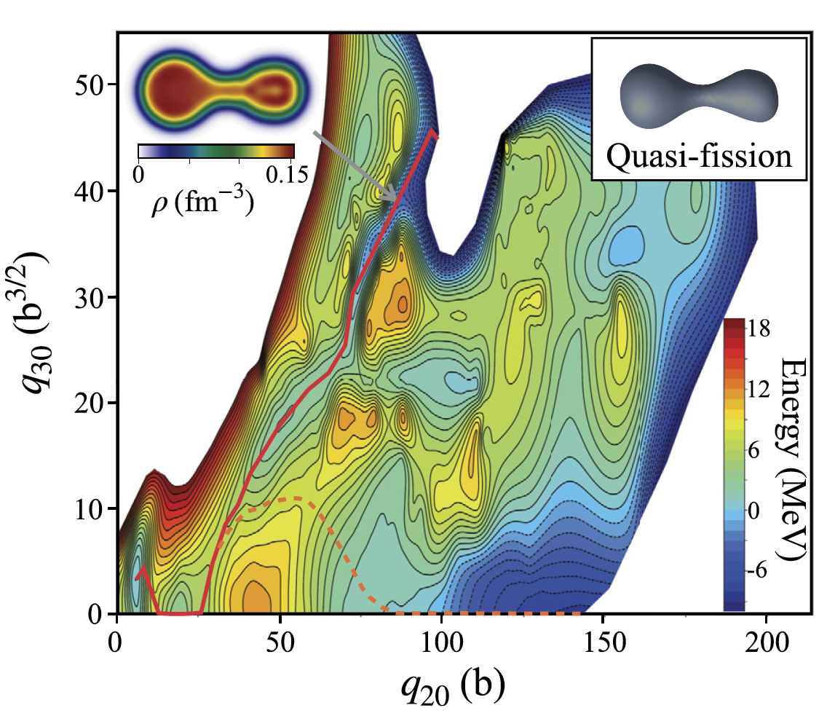
Comparison of fission and quasi-fission modes with TDDFT
Simenel et al. Phys. Lett. B 822, 136648 (2021)
McGlynn and C. Simenel, Phys. Rev. C 107, 054614 (2023)
Simulations of ⁵⁰Ca+¹⁷⁶Yb collisions show that the mass equilibration between the fragments in quasi-fission is stopped when they reach similar properties to those in the asymmetric fission mode of the ²²⁶Th compound nucleus.
Can quasifission trajectories be interpreted in terms of the underlying PES at low excitation energies?
Notes:
Loss of Valeri Zagrebaev

Slide 25
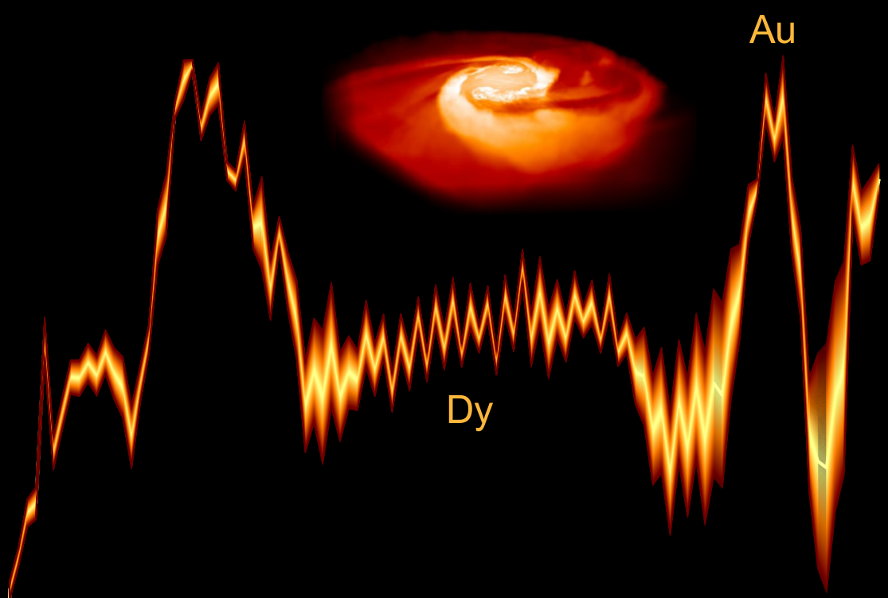
Cosmic origin of superheavy nuclei
Are superheavy nuclei created in stellar explosions? If so, how do they impact chemical evolution?
?
Neutron rich superheavy nuclei could impact the formation of heavy elements at the final stages of the astrophysical r-process through the fission recycling − believed to be of particular importance during neutron star mergers where free neutrons of high density are available.

Slide 26
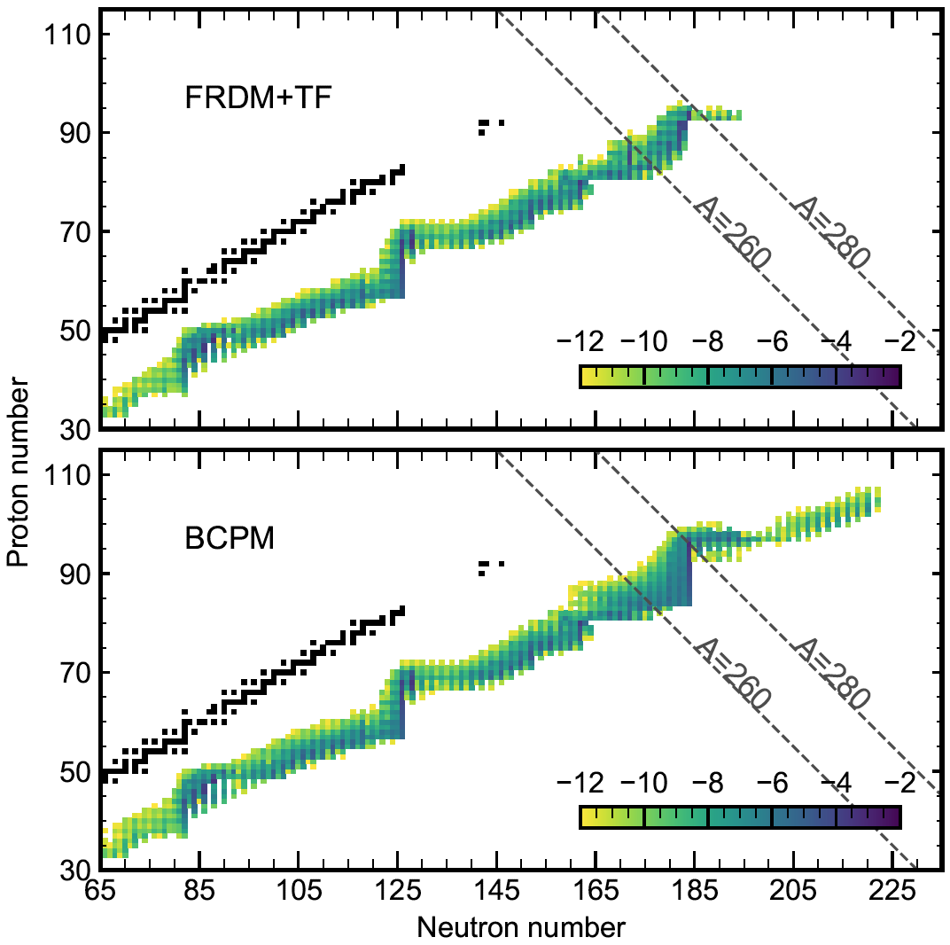
Fission yields of super-heavy nuclei be formed in the r-process strongly depend on predicted nuclear data
S. Giuliani et al. Phys. Rev. C 102, 045804 (2020)
Abundances (in log scale) at freeze-out in the hot dynamical ejecta of neutron star mergers. At N=184, the r-process path obtained with BCPM model can substantially populate nuclei up to ²⁸⁰Cm.

Slide 27
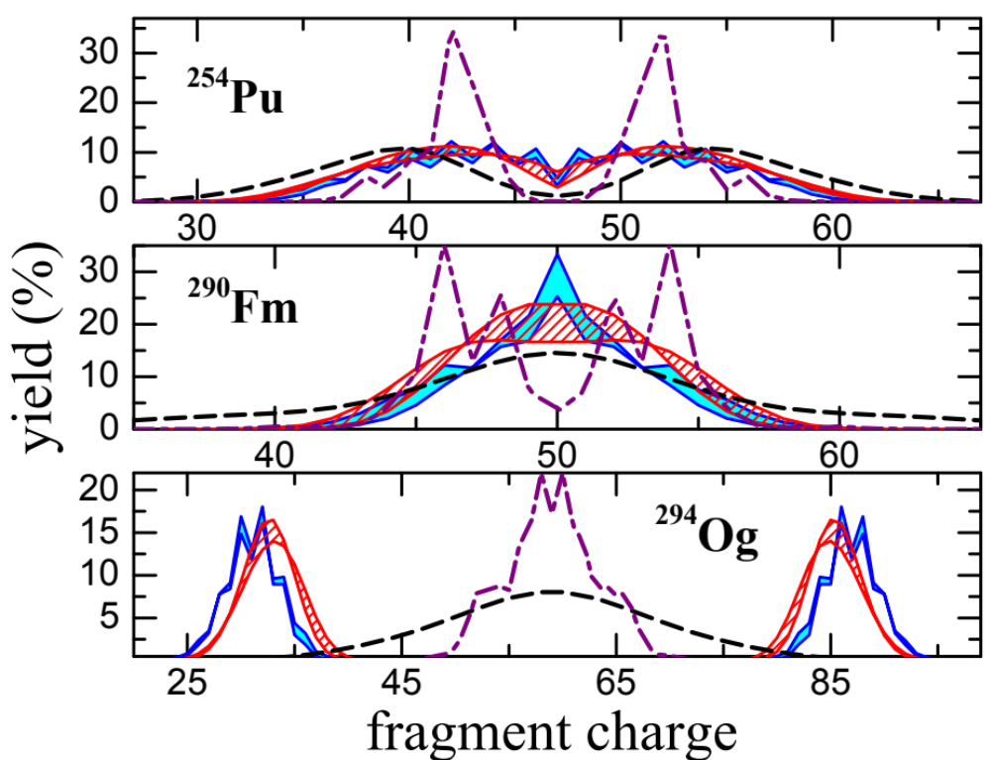
Fission in the r-process and superheavy nuclei
J.Sadhukhan et al., Phys. Rev. C 105, 014619 (2022)
Fragment charge distributions of ²⁵⁴Pu,²⁹⁰Fm, and ²⁹⁴Og obtained in DFT+stat work (blue bands) and predicted in previous work by neglecting odd-even staggering (red dashed bands). Predictions of BSM and SPM models are shown by dashed and dash-dotted lines, respectively.
²⁹⁴Og→ ²⁰⁸Pb+⁸⁶Kr₅₀

Slide 28

What are chemical properties of superheavy elements?

Slide 29
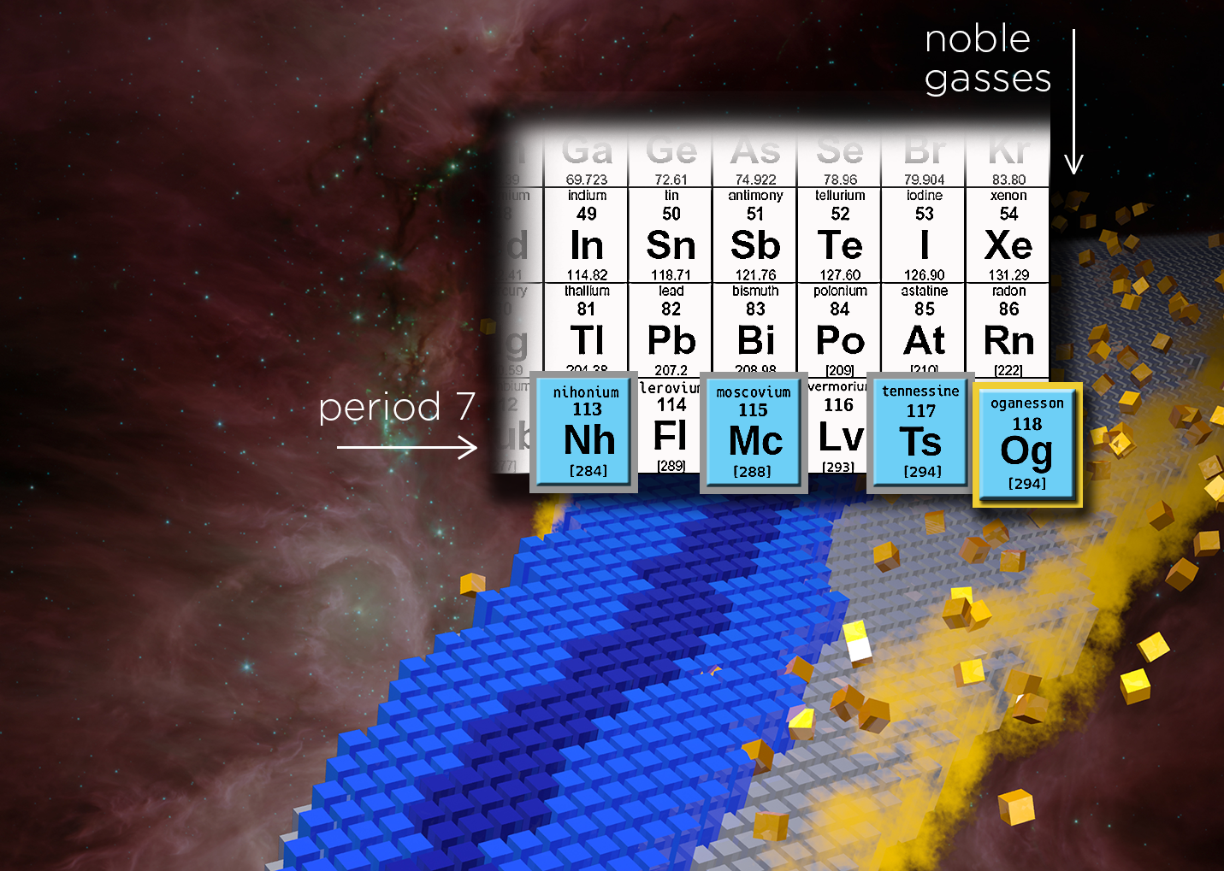
highly unreactive except when under particular extreme conditions
main group elements: s- and p- electrons in the outer valence shell

Slide 30

Z=173 catastrophy
α – fundamental physical (fine structure) constant
1/α = 137.035999173(35)
For Zα≥1 relativistic equation for atom becomes unstable ⇒ Z=137 catastrophe (antimatter produced spontaneously)
Would element 137 (feynmanium) really spell the end of the periodic table?
Not so fast!
137 → 173 (nucleus has finite radius!)
Zα = 0.86 for Og ⇒ relativistic effects huge!

Slide 31
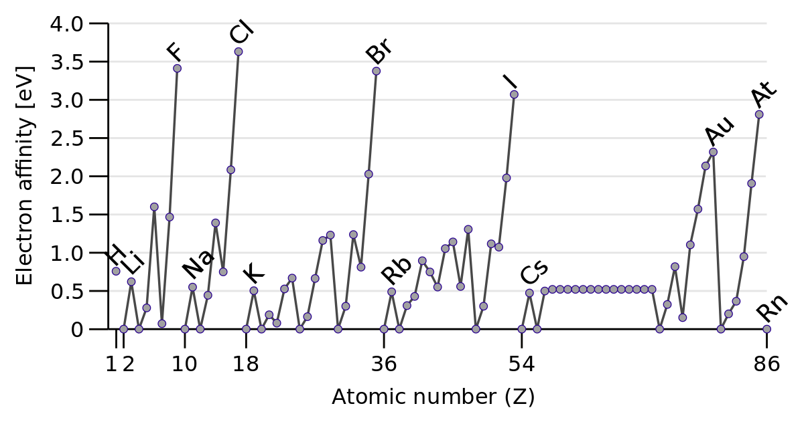
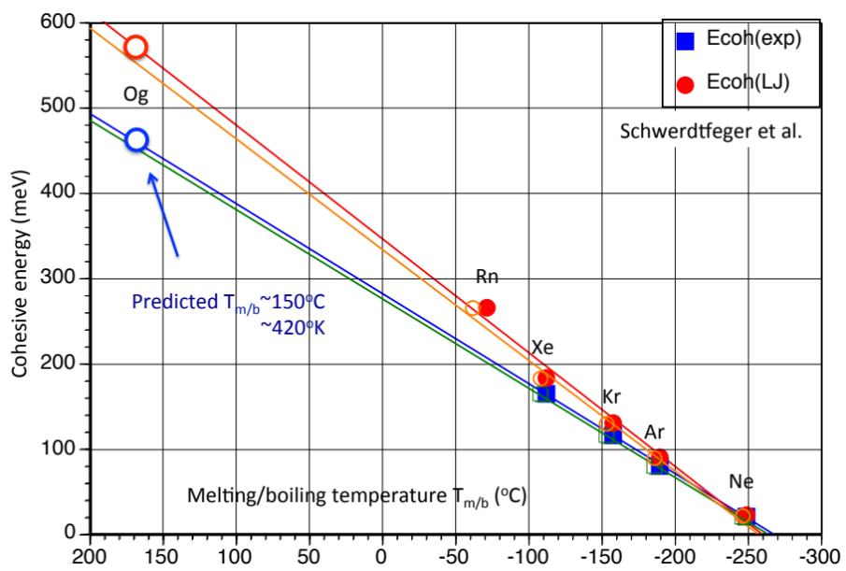
0.064(2) eV for Og!
Og is predicted to be the first rare gas with positive electron affinity
Og is not expected to be a gas at room temperature
(Schwerdtfeger et al.)

Slide 32
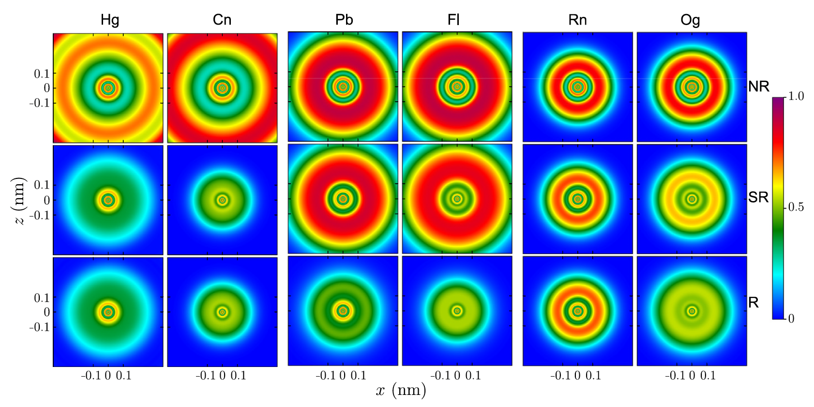
Electron localization from nonrelativistic (NR, top), scalar relativistic (SR, middle) and fully relativistic (R, bottom) DFT calculations for Hg and Cn (left), Pb and Fl (center), and Rn and Og (right).

Slide 33
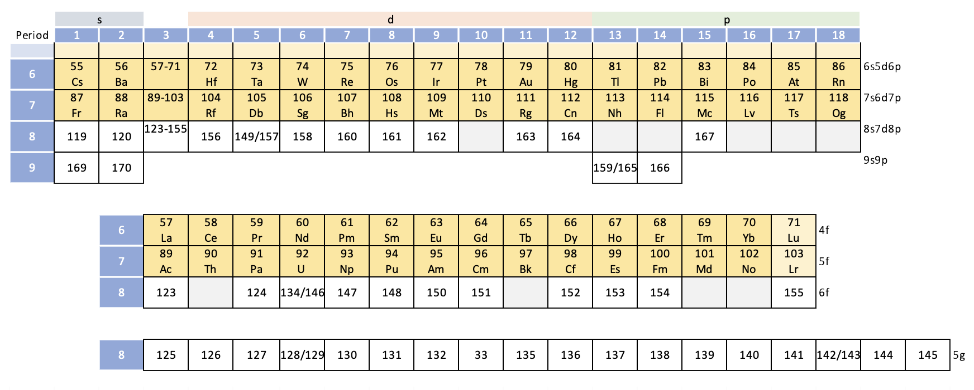
Extended Periodic Table
Ground state of superheavy elements with 120≤Z≤170: Systematic study of the electron-correlation, Breit, and QED effects, Savelyev et al. Phys. Rev. A 107, 042803 (2023).
Where is the end of the Periodic Table?
Atoms cannot exist without atomic nuclei!

Slide 34
Where is the end of the Periodic Table?
“The discovery of a chemical element is the experimental demonstration, beyond reasonable doubt, of the existence of a nuclide with an atomic number Z not identified before, existing for at least 10⁻¹⁴ s”. (IUPAC 1991)
To define a nuclide, its lifetime should be longer than the single-particle time scale 3⋅10⁻²² s corresponding to the time scale needed to create the nuclear mean field.
Because of fission, superheavy nuclei with N>184 are expected to be short-lived.
No chemistry for nuclides with lifetimes between 10−14 and 10−22 s! Gaps in the periodic table?
It is possible that the periodic table will end well before reaching Z_{crit} for purely nuclear reasons.

Slide 35
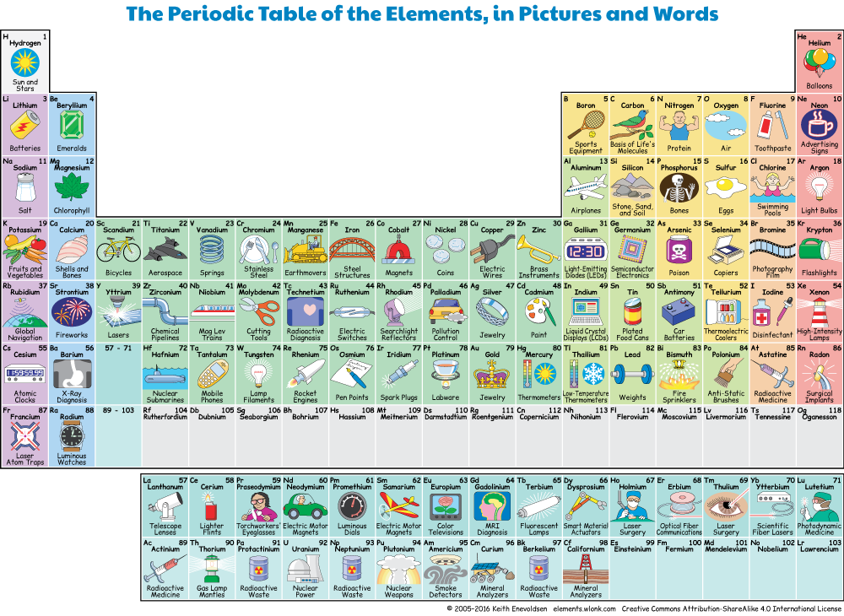

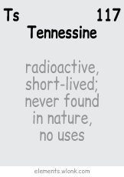
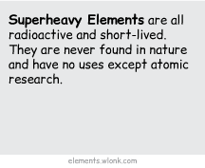
Applications?
https://elements.wlonk.com/ElementsTable.htm

Slide 36
What have we learned so far?
Elements up to Z=118 have been produced; the end of the nuclear chart has been extended to ²⁹⁴Og
The stability of superheavy nuclei is governed by alpha decay and spontaneous fission
Their half-lives increase with N – consistent with theoretical expectations
We are in the process of searching for new chemistry (one-atom-at-a-time studies)

Slide 37

by Simon Tschachtli

Slide 38
Great prospects
Search for elements beyond Z=118; expansion of the periodic table to the 8th period (ongoing)
Search for nuclides beyond ²⁹⁴Og; expansion of the chart of the nuclides in mass and charge (ongoing)
Excursion into the N=184 region of longer-lived superheavies
In search of new chemistry
Develop the predictive theory of excitation functions
Probing the transition to leptodermous regime: quantified extrapolations in A
Pinning down the stability of exotic topologies
Delineating the role of superheavy nuclei in the Cosmos
Exploring QED aspects in SHE

Slide 39
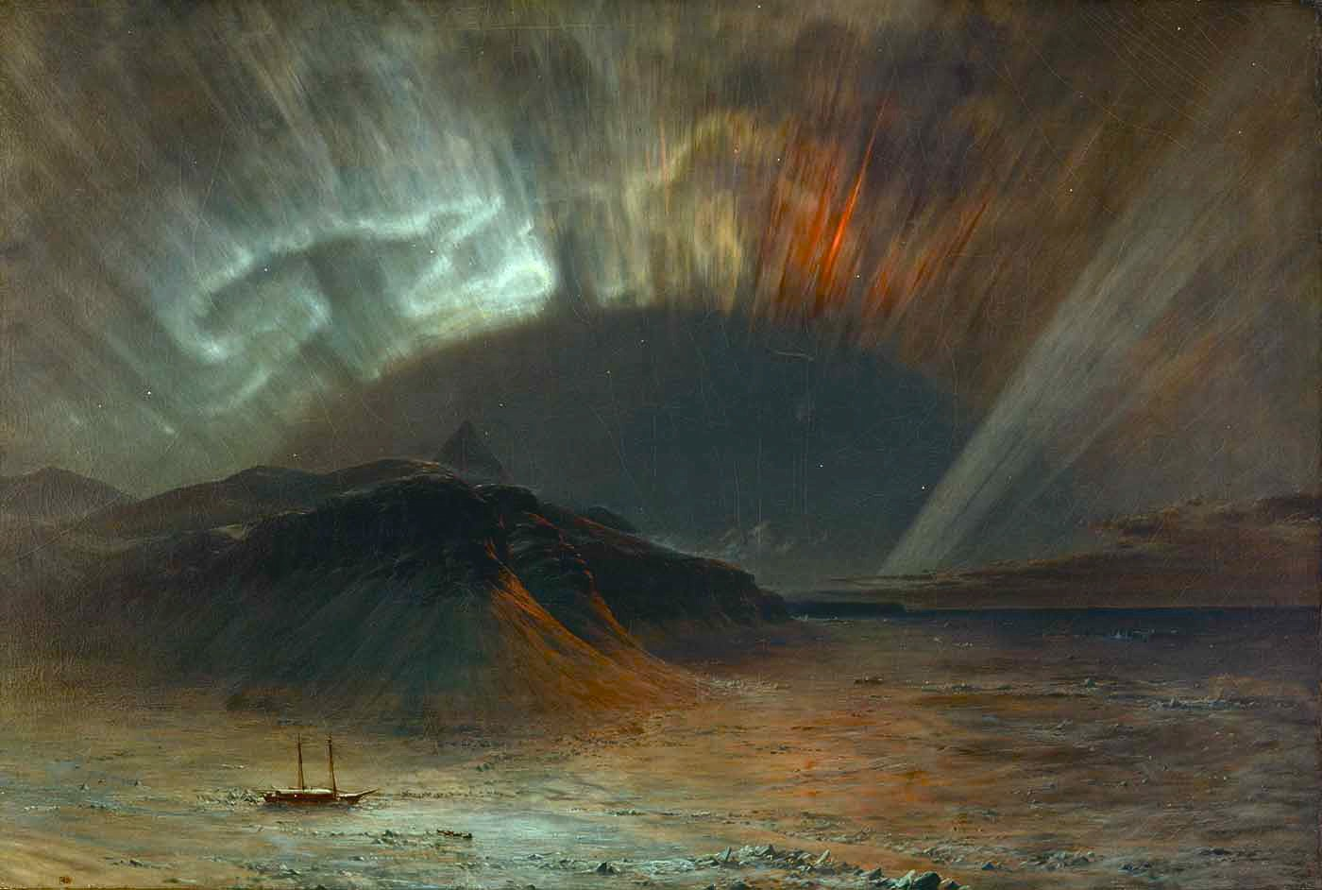
We’re a long way off from the end of the nuclear chart …The limiting factor right now seems to be human ingenuity. Based on the progress so far, we should be optimistic!
Thank you!
“Aurora Borealis” (1865) by Fredric Edwin Church
Notes:
“Aurora Borealis” (1865) by American painter Fredric Edwin Church.

Slide 40
Backup

