Slide 1

Notes:
- We have all been here
- We are excited to ship the next version
- What is in it?
- What problems have we solved?
- What bugs have we addressed?
- What features are we excited about shipping?
- How do we communicate these to our end users?

Slide 2
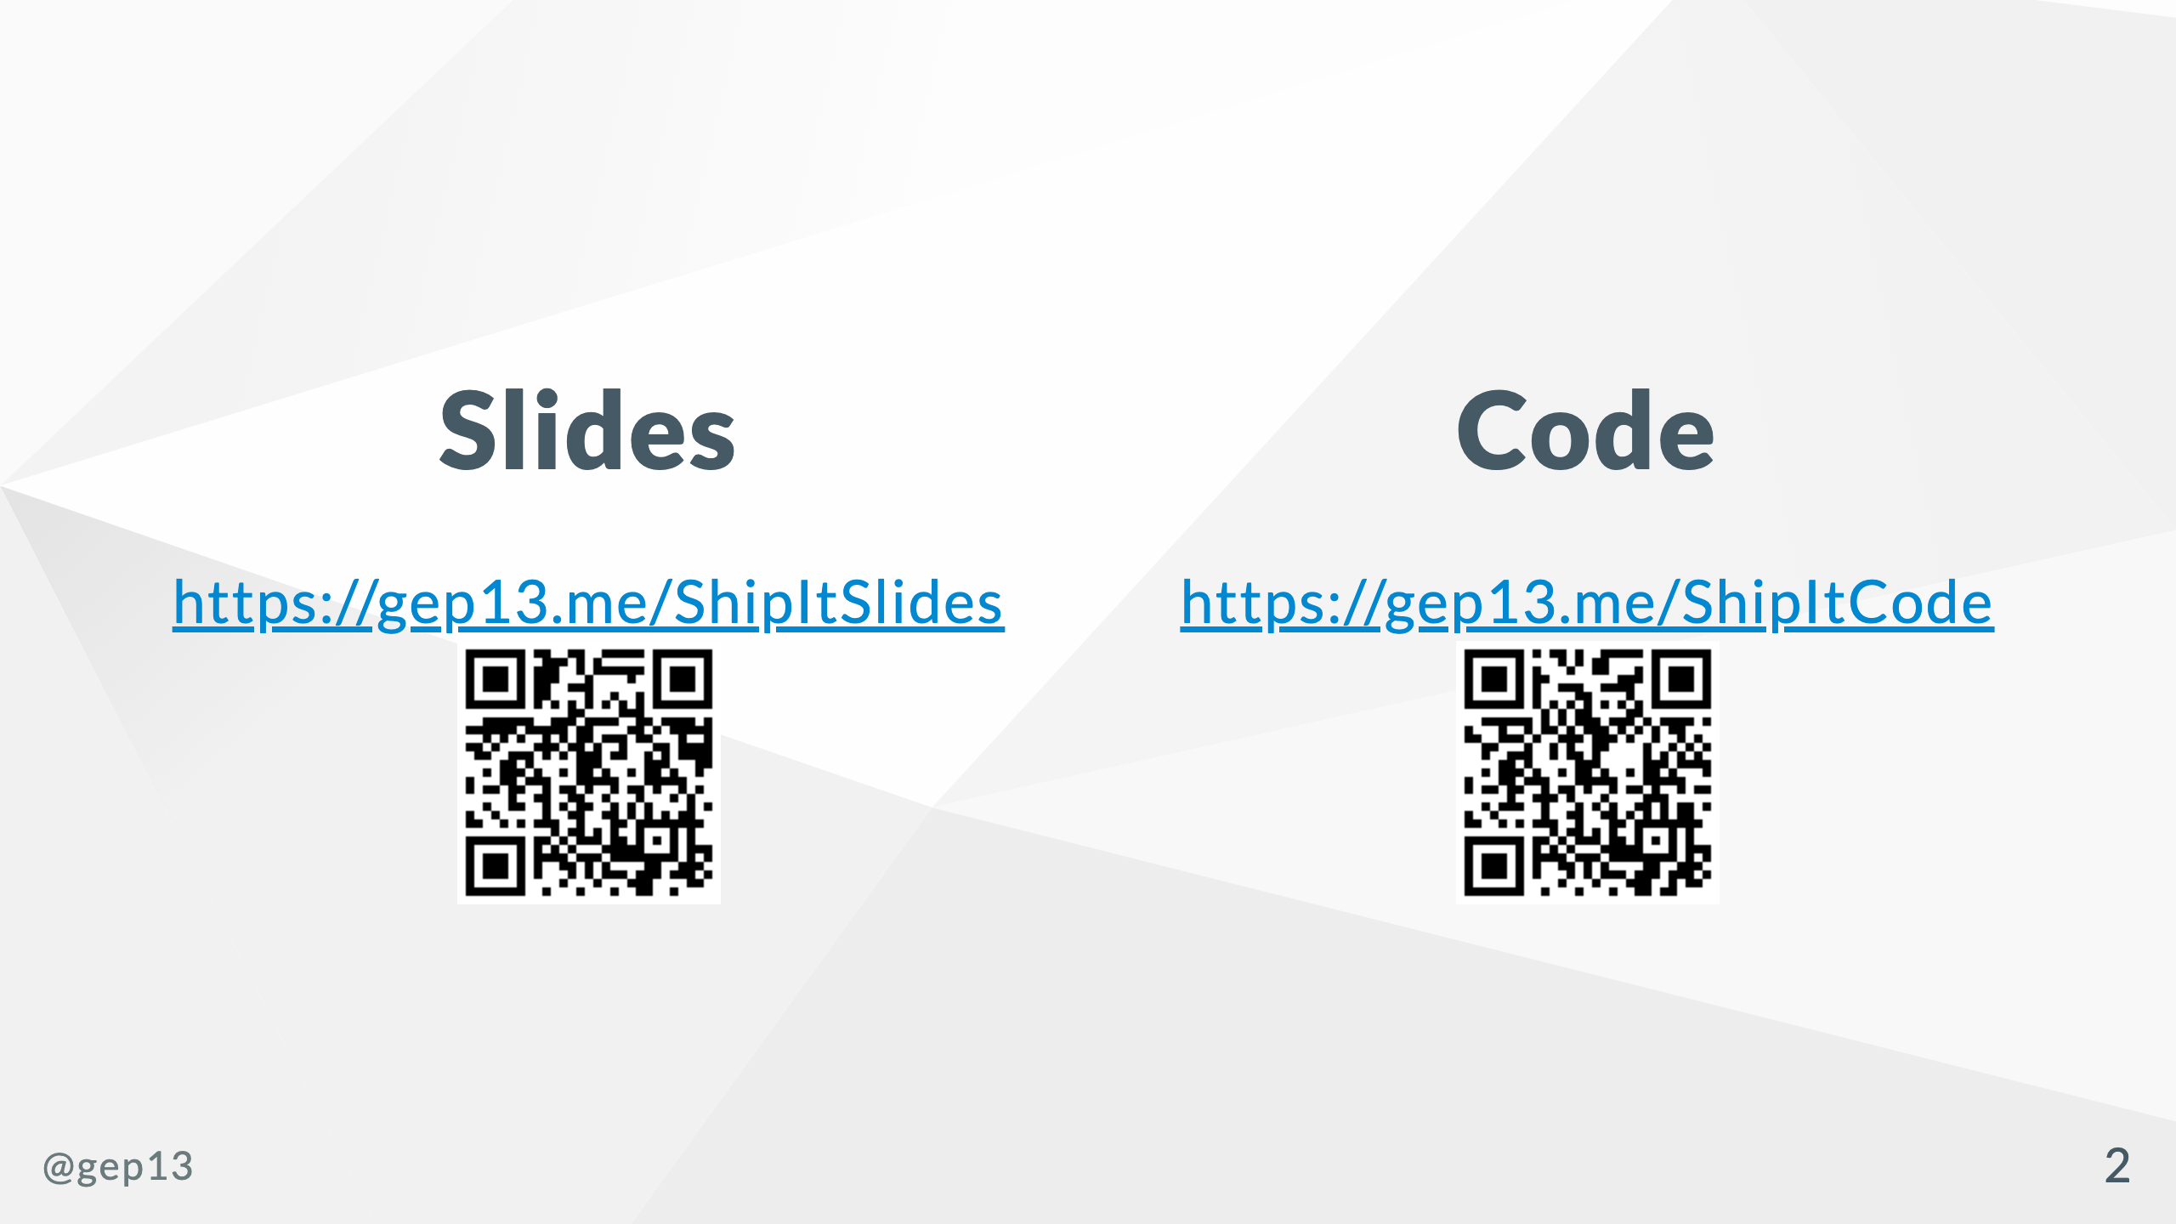
Notes:
- Cake build script sample for running GitVersion and GitReleaseManager is in the repository

Slide 3
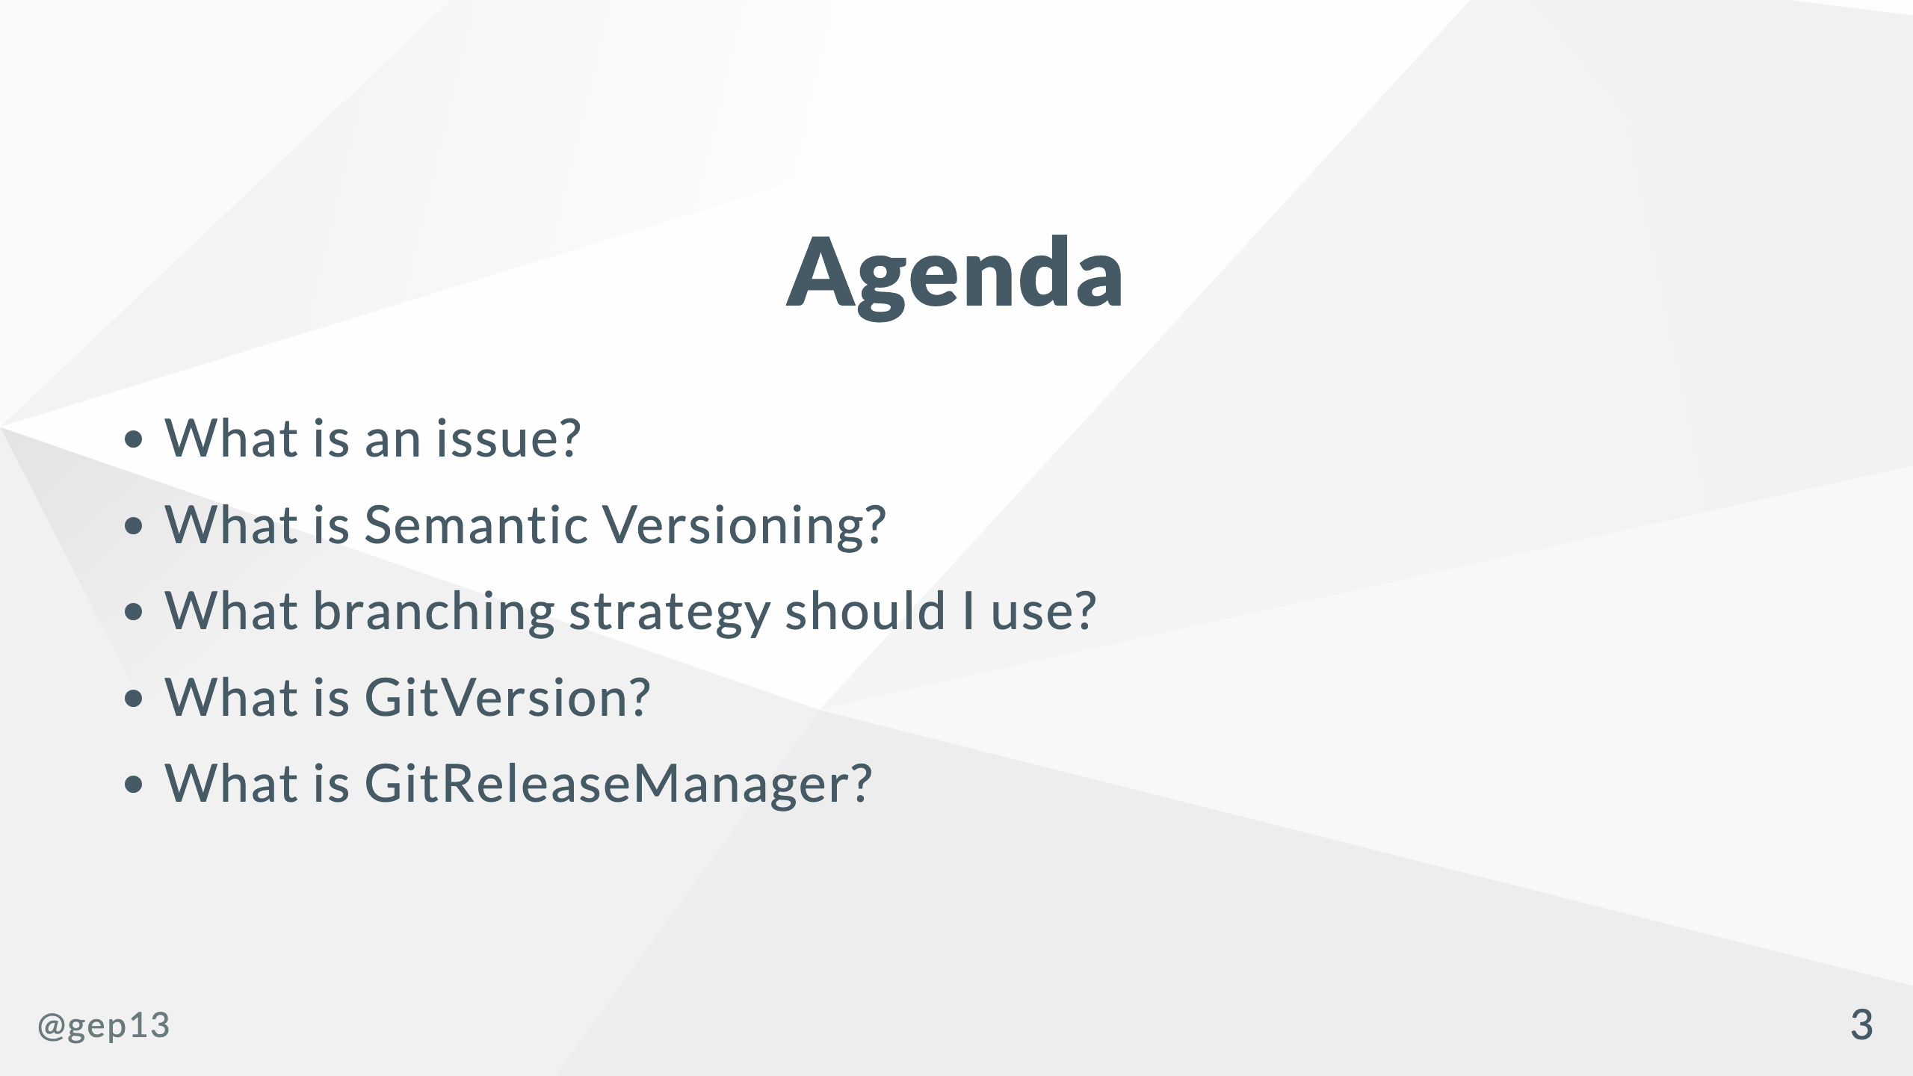
Notes:
- Fundamental principal - traceability and communication
- What version number does it have?
- What issues/pull requests are associated with it?

Slide 4


Slide 5

Notes:
- Single point of truth for information
- Both for developers and users
- Where we can trace changes associated with the issue
- Where we can communicate changes about the issue

Slide 6
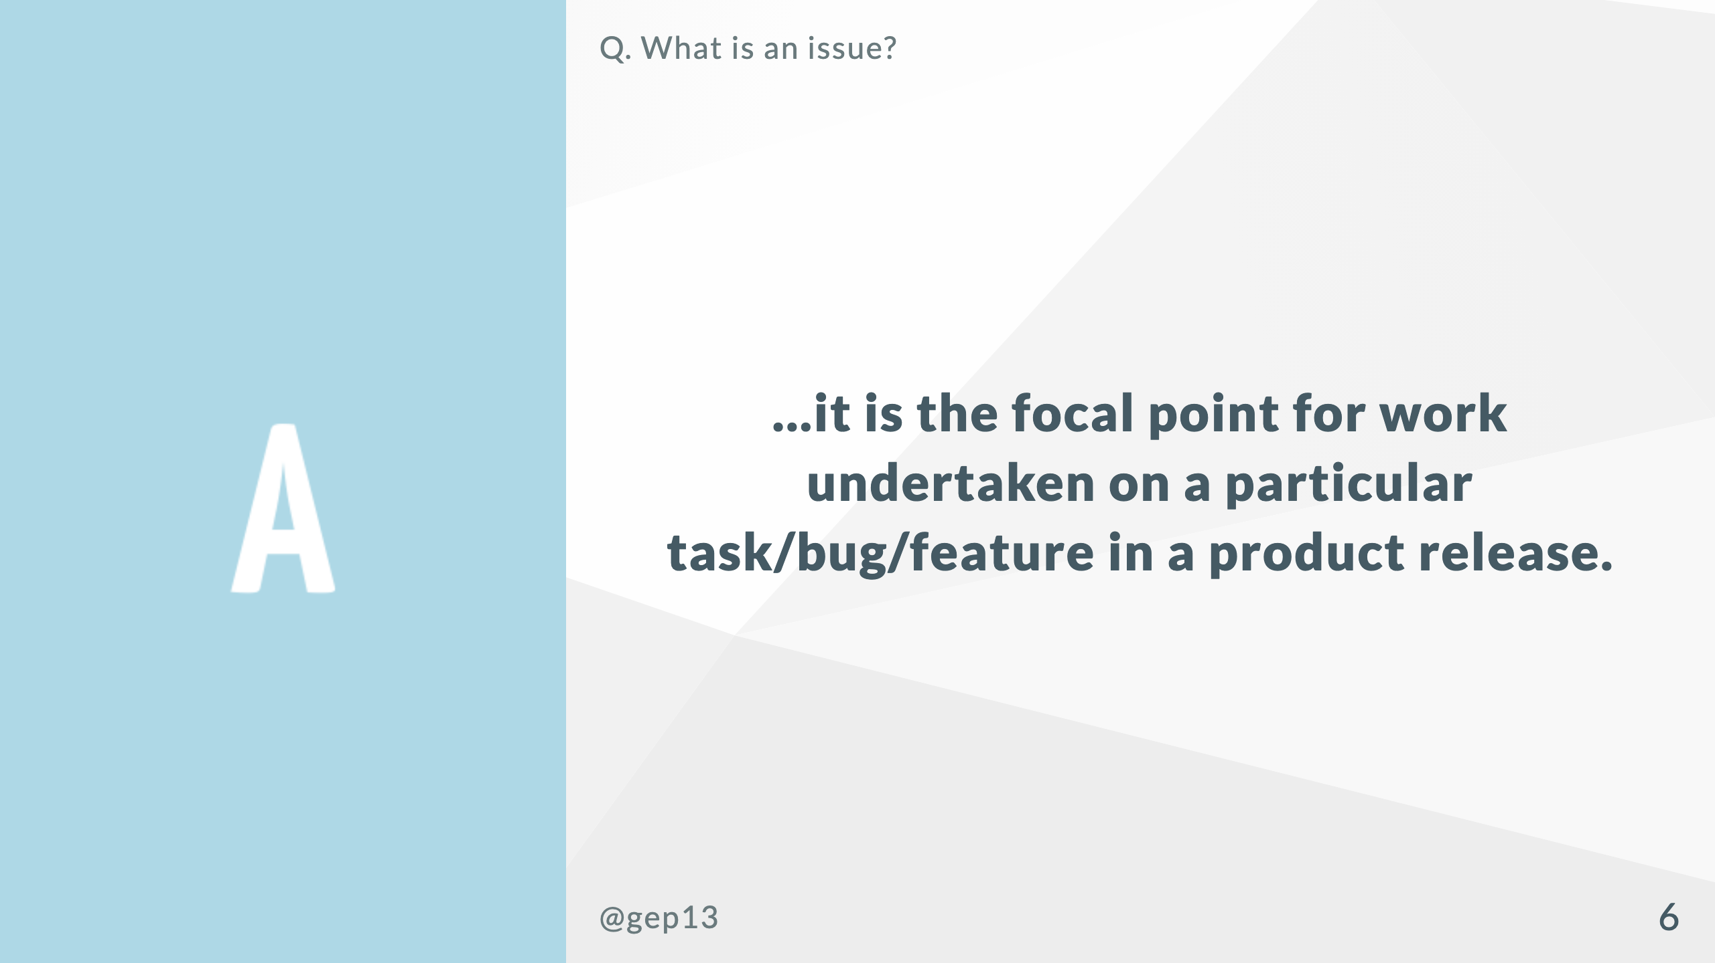

Slide 7
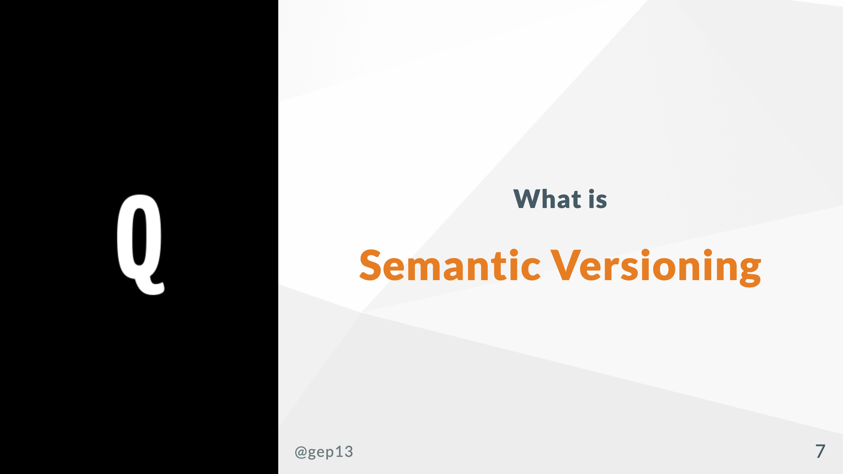

Slide 8
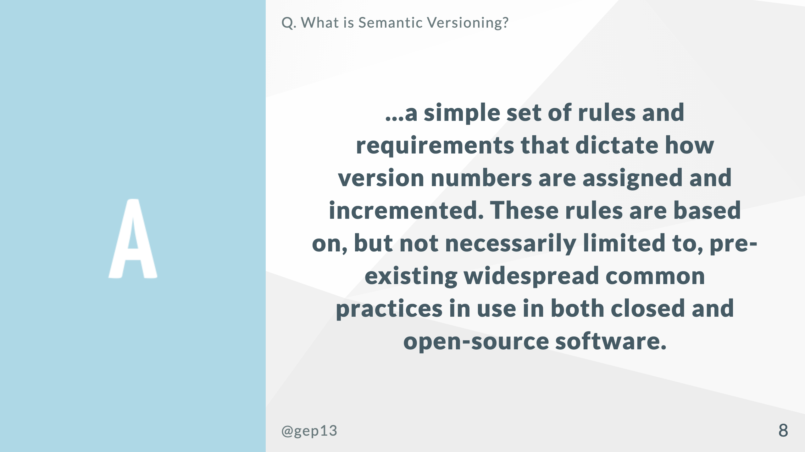
Notes:
- Loaded topic - large discussion
- Not going into the details

Slide 9
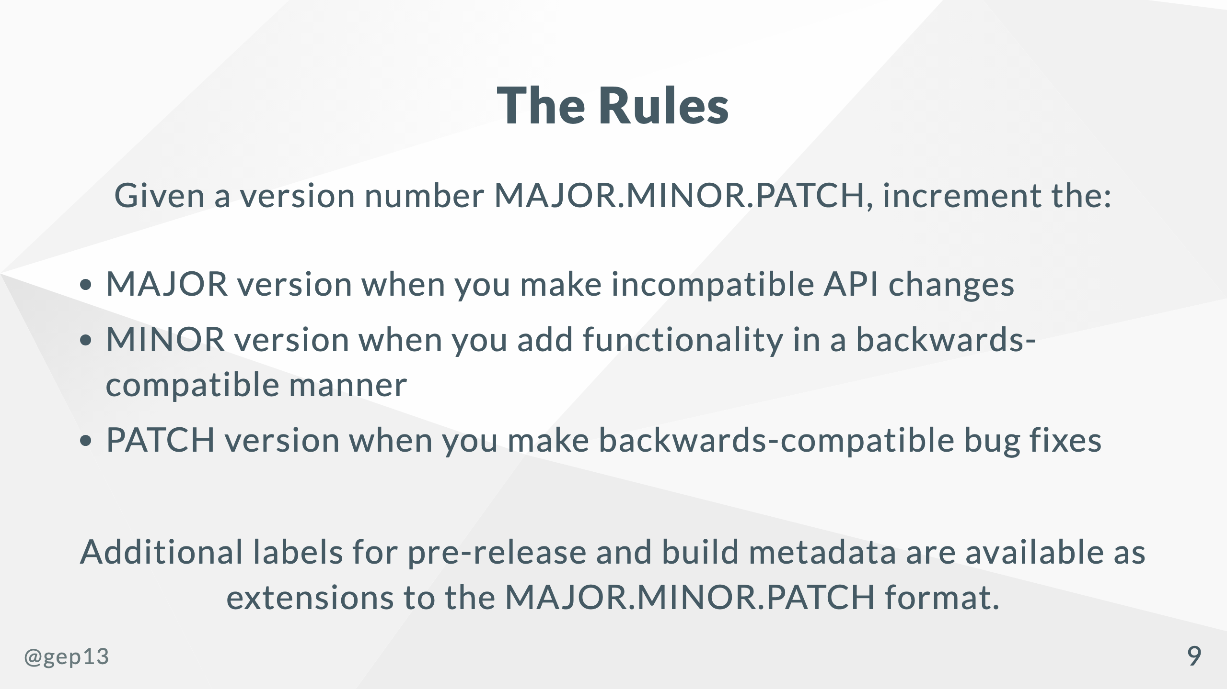
Notes:
- A semantic version number expresses the intention of the release
- What has changed since the last version

Slide 10
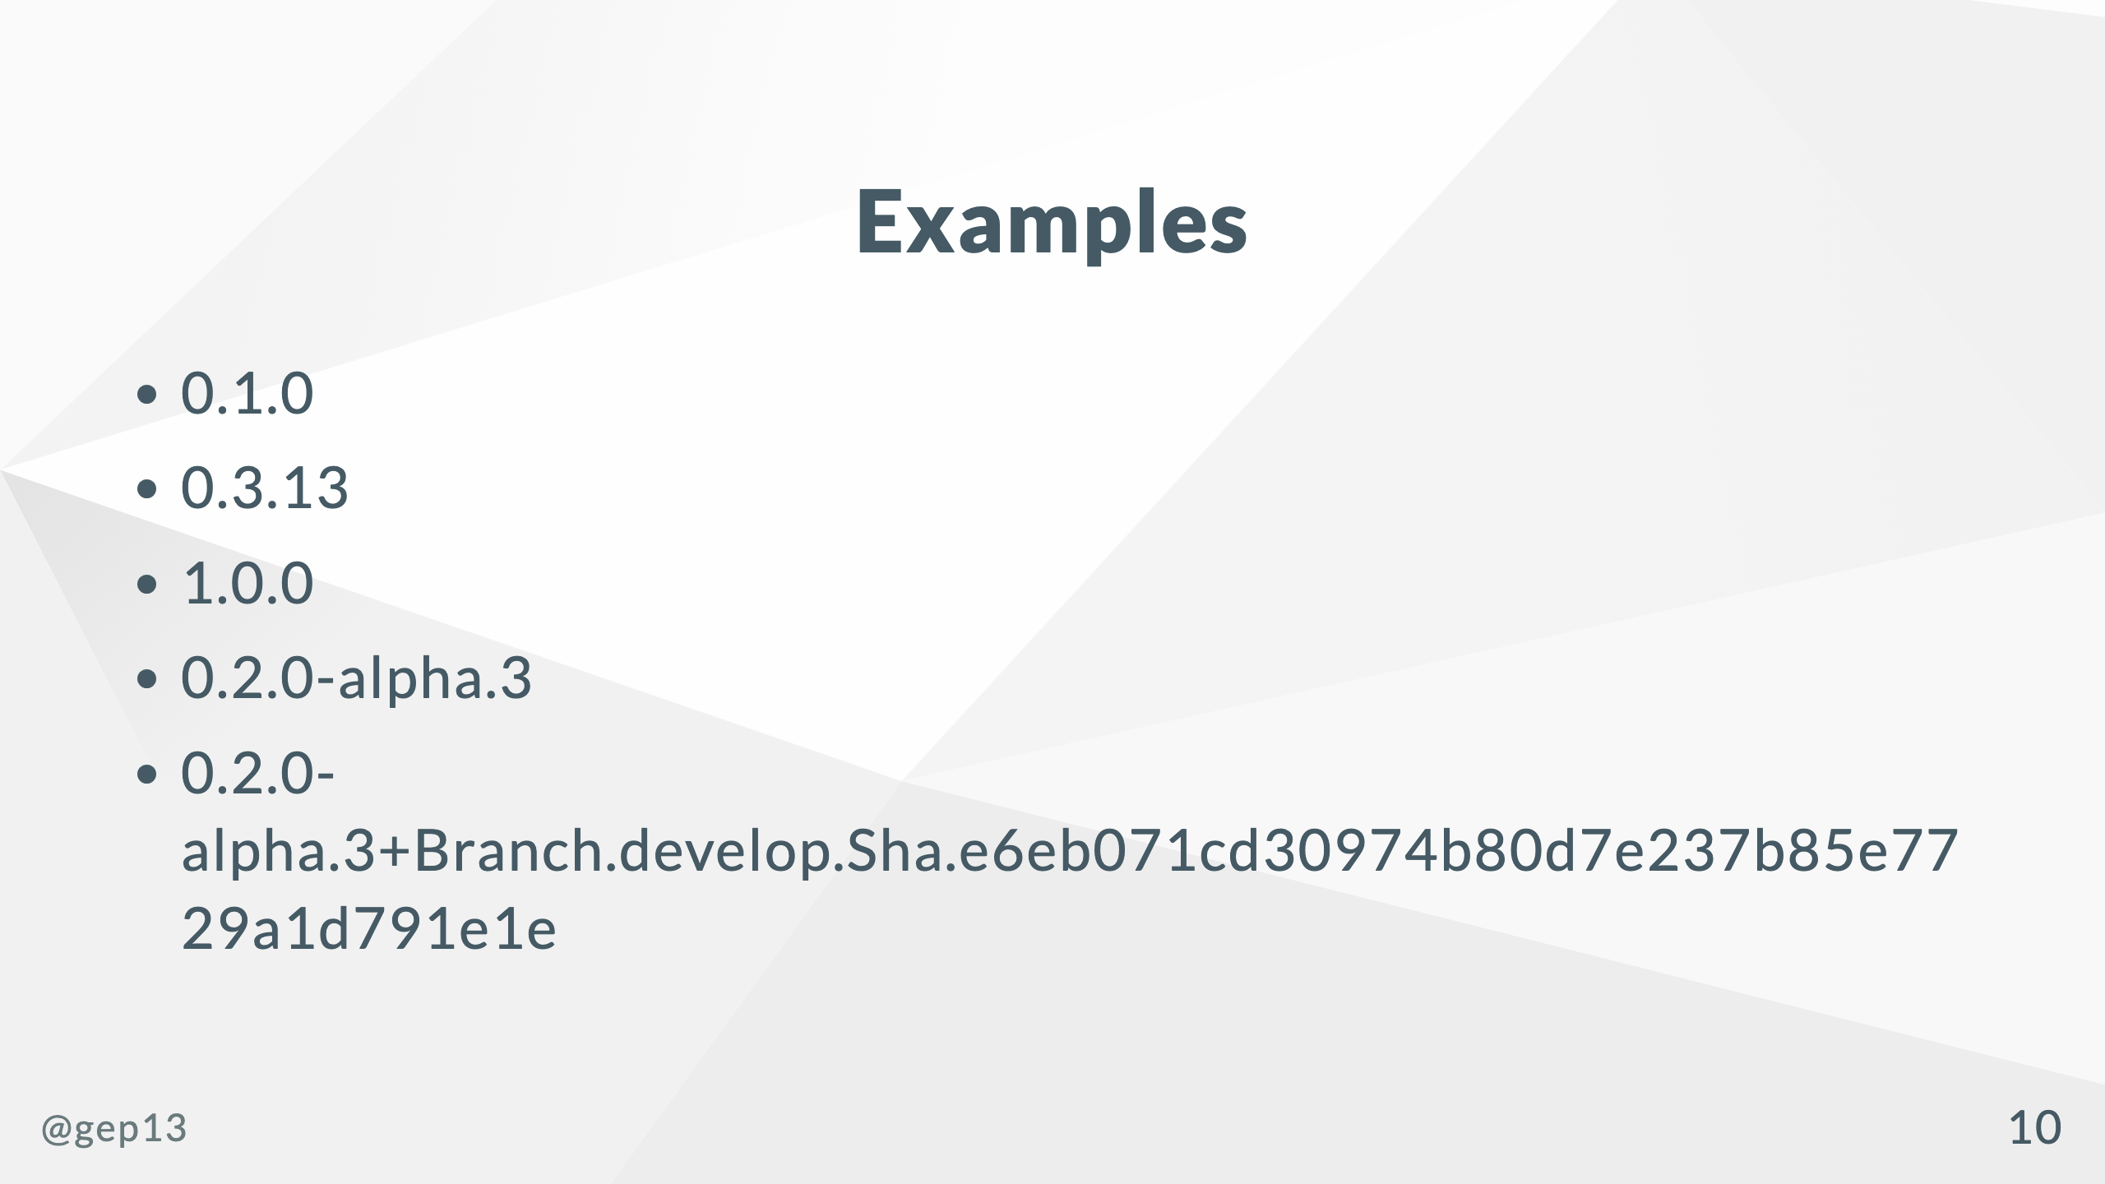
Notes:
- Final example here has ALL information needed for the purposes of traceability
- Most common to have both a "short" version for normal usage, and use the full version as an informational version

Slide 11


Slide 12
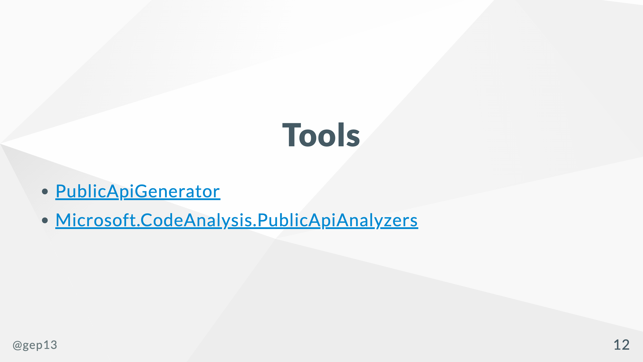
Notes:
- There is no magic bullet here
- These tools definitely help in keeping you "honest" about the changes going into a given release
- There may be marketing reasons why a certain version number is needed

Slide 13
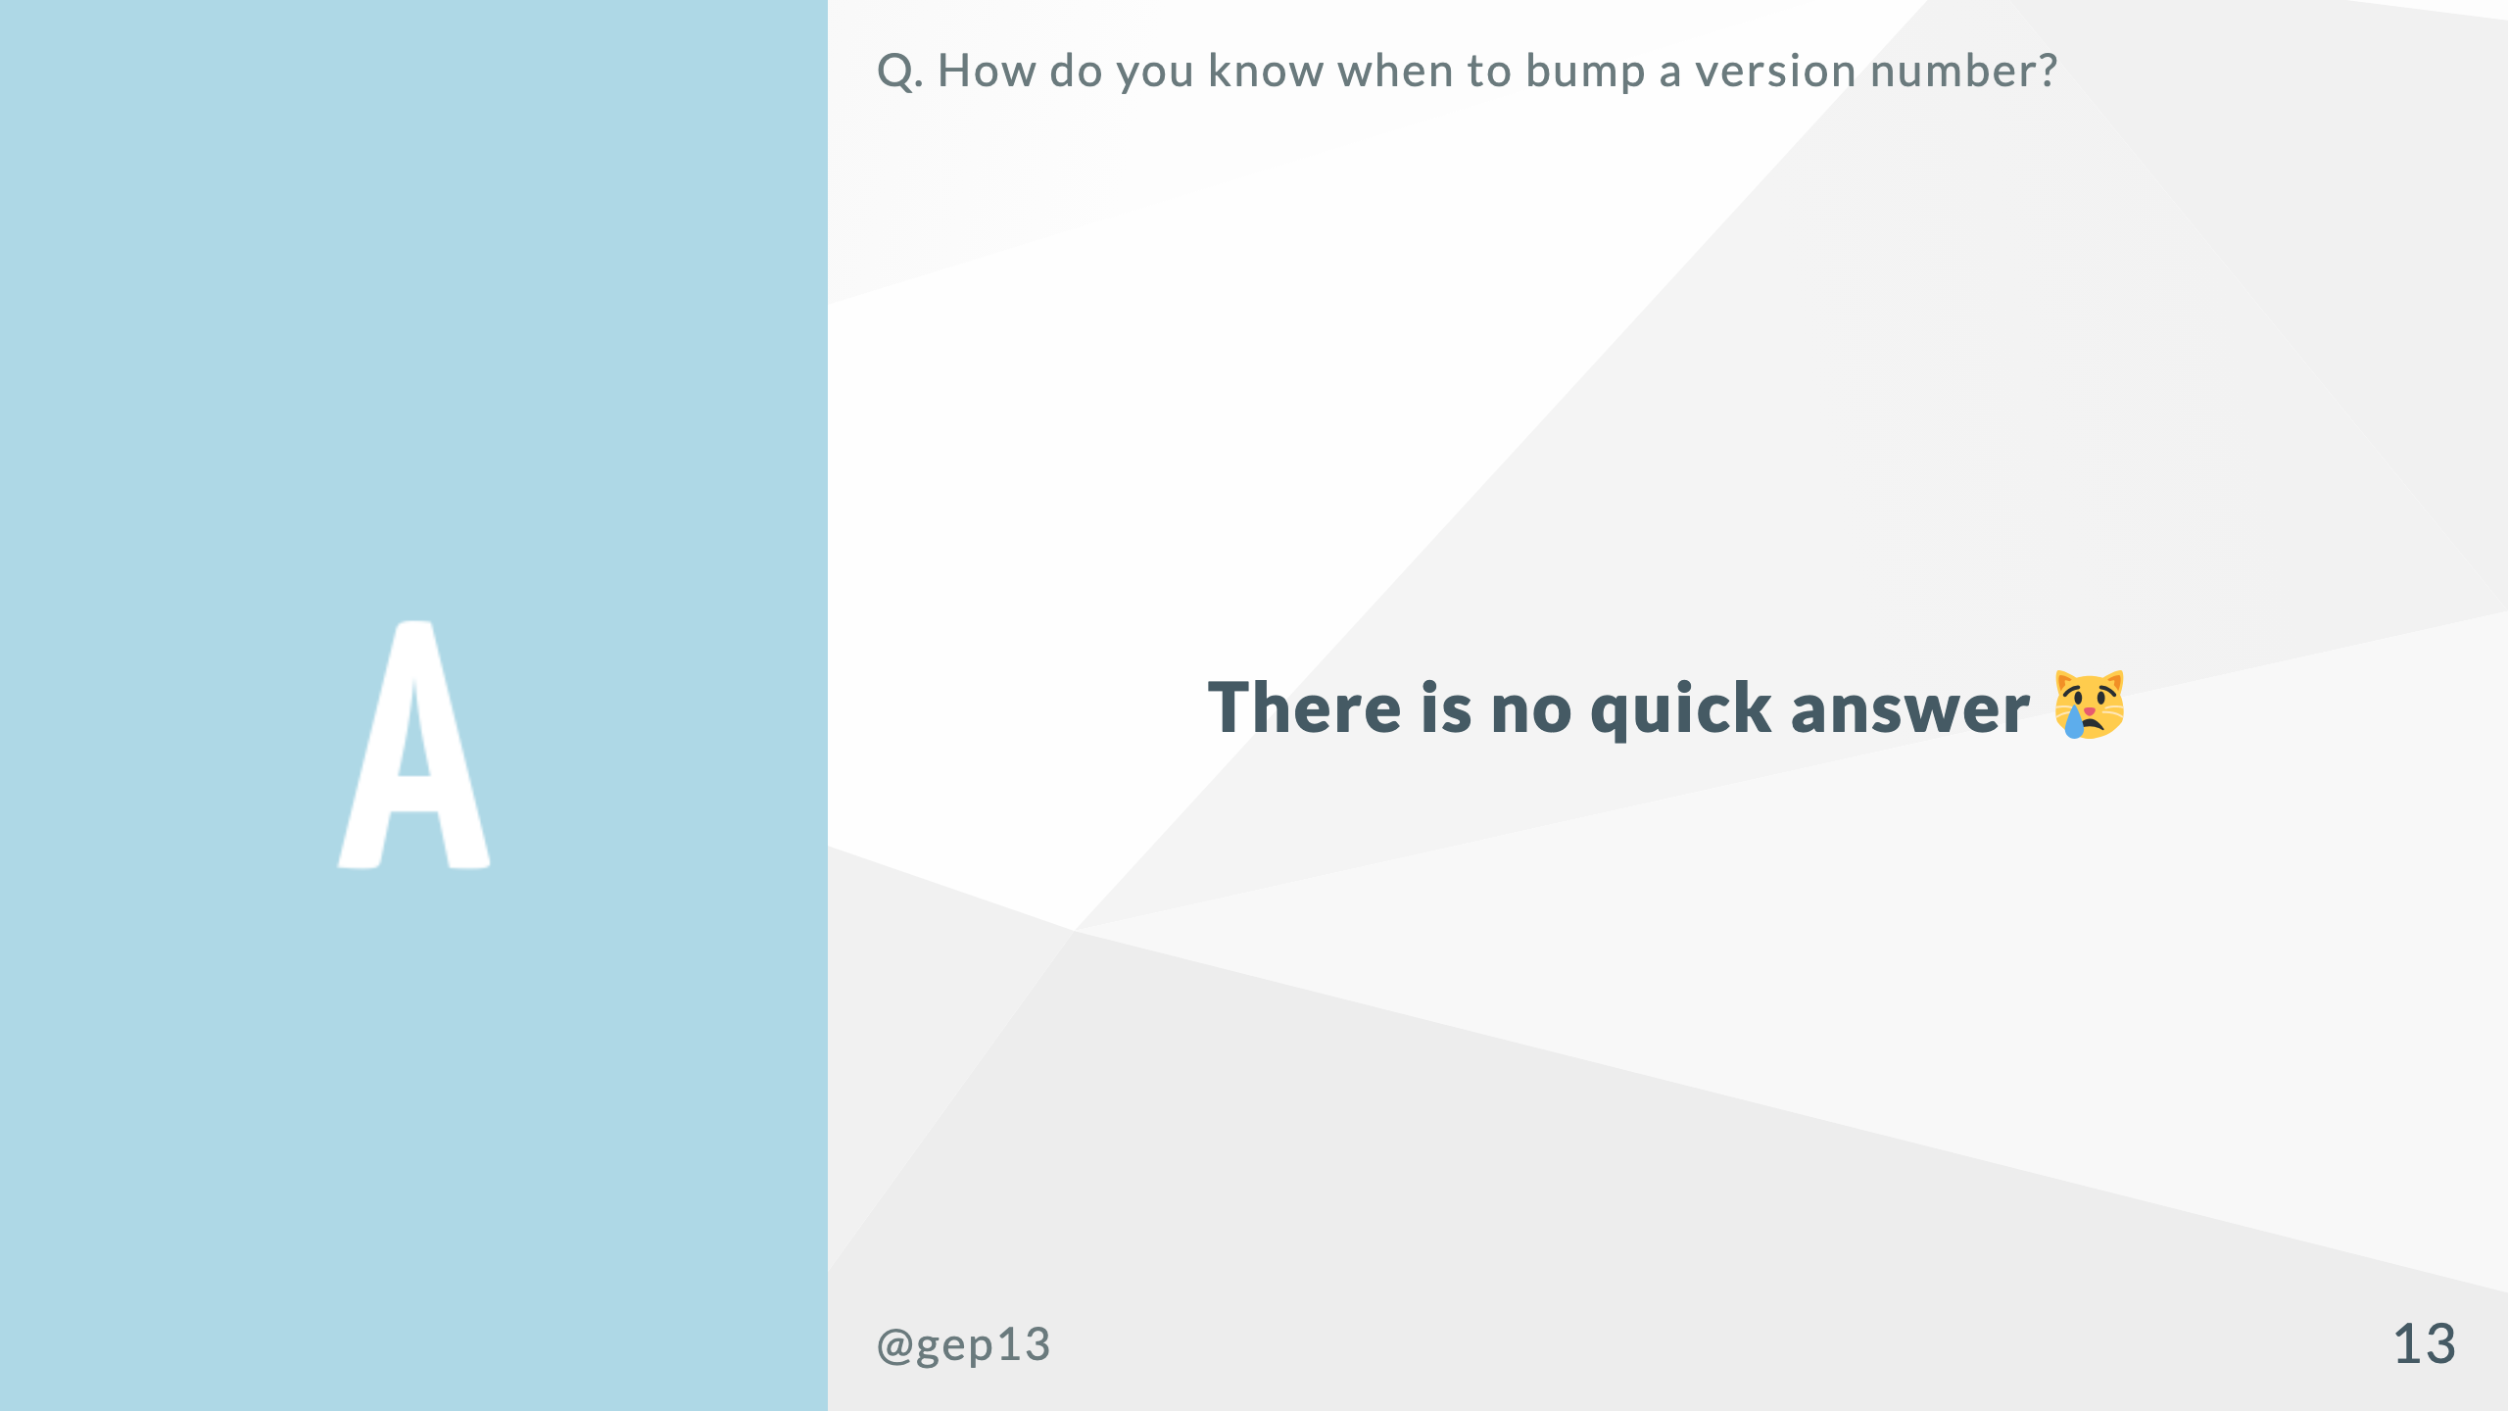

Slide 14

Notes:
- Again a loaded topic

Slide 15

Notes:
- This is the simpler of the two strategies that I am going to show

Slide 16
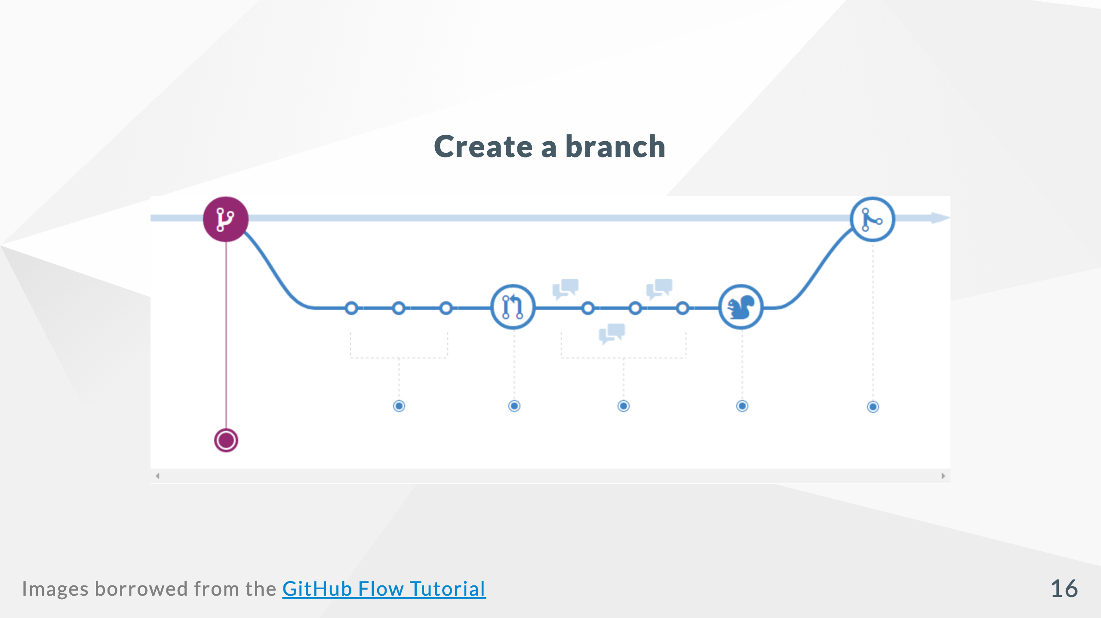

Slide 17
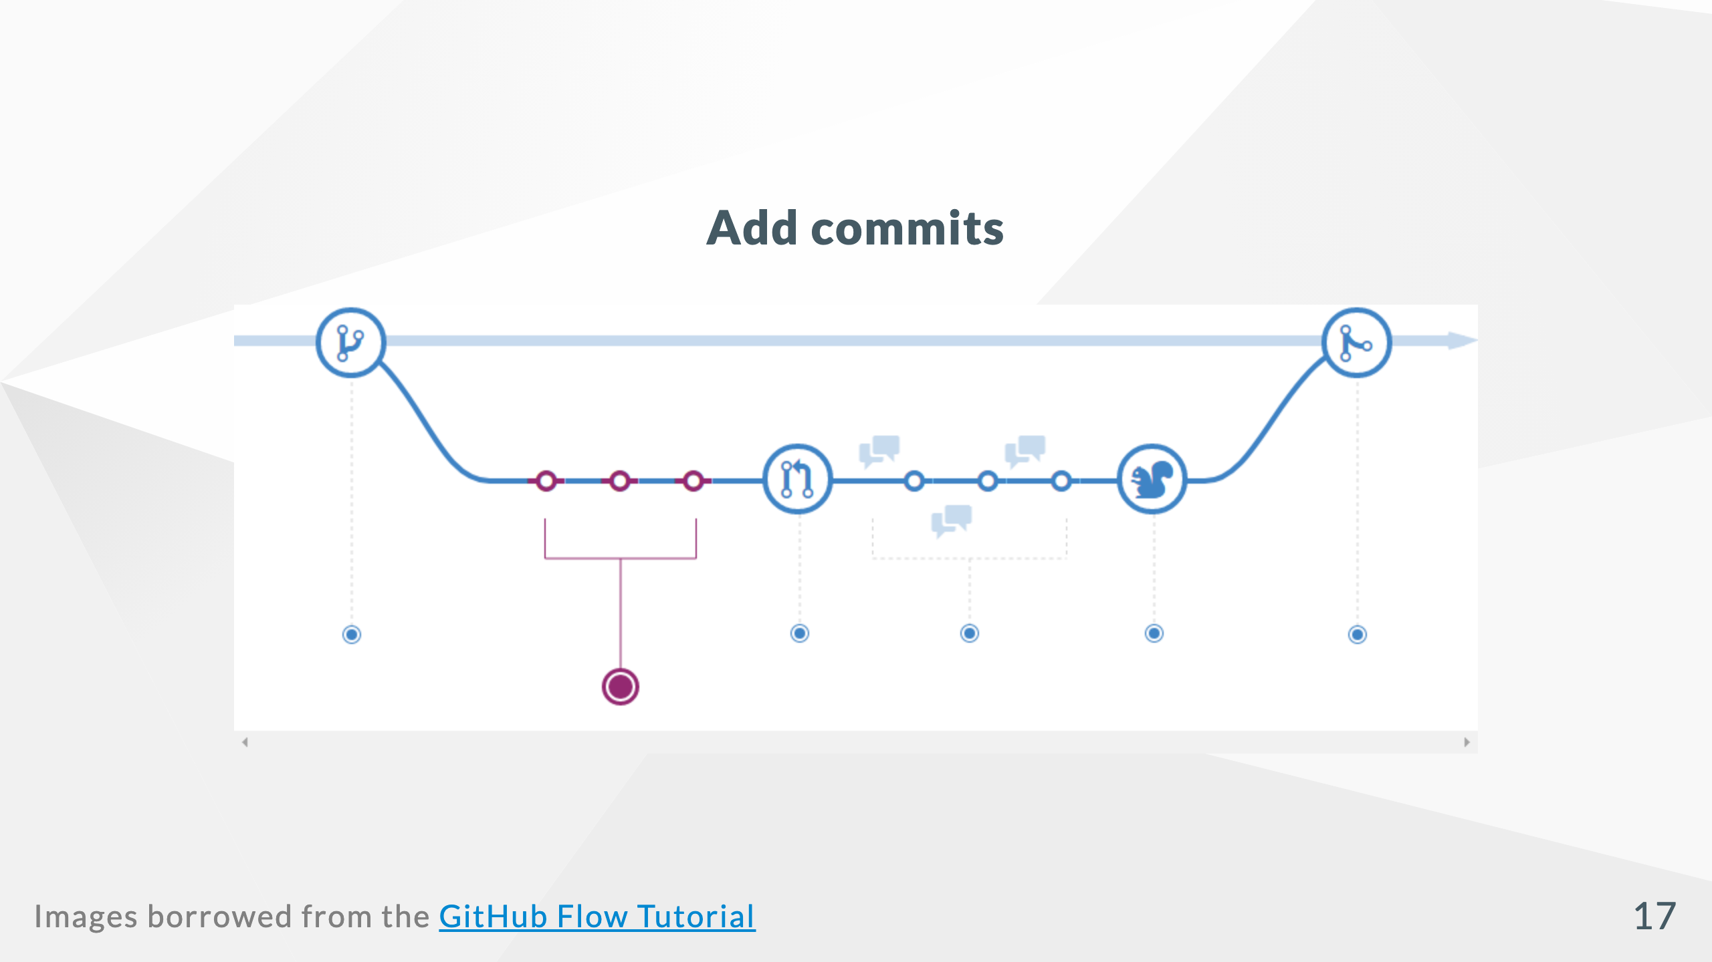

Slide 18
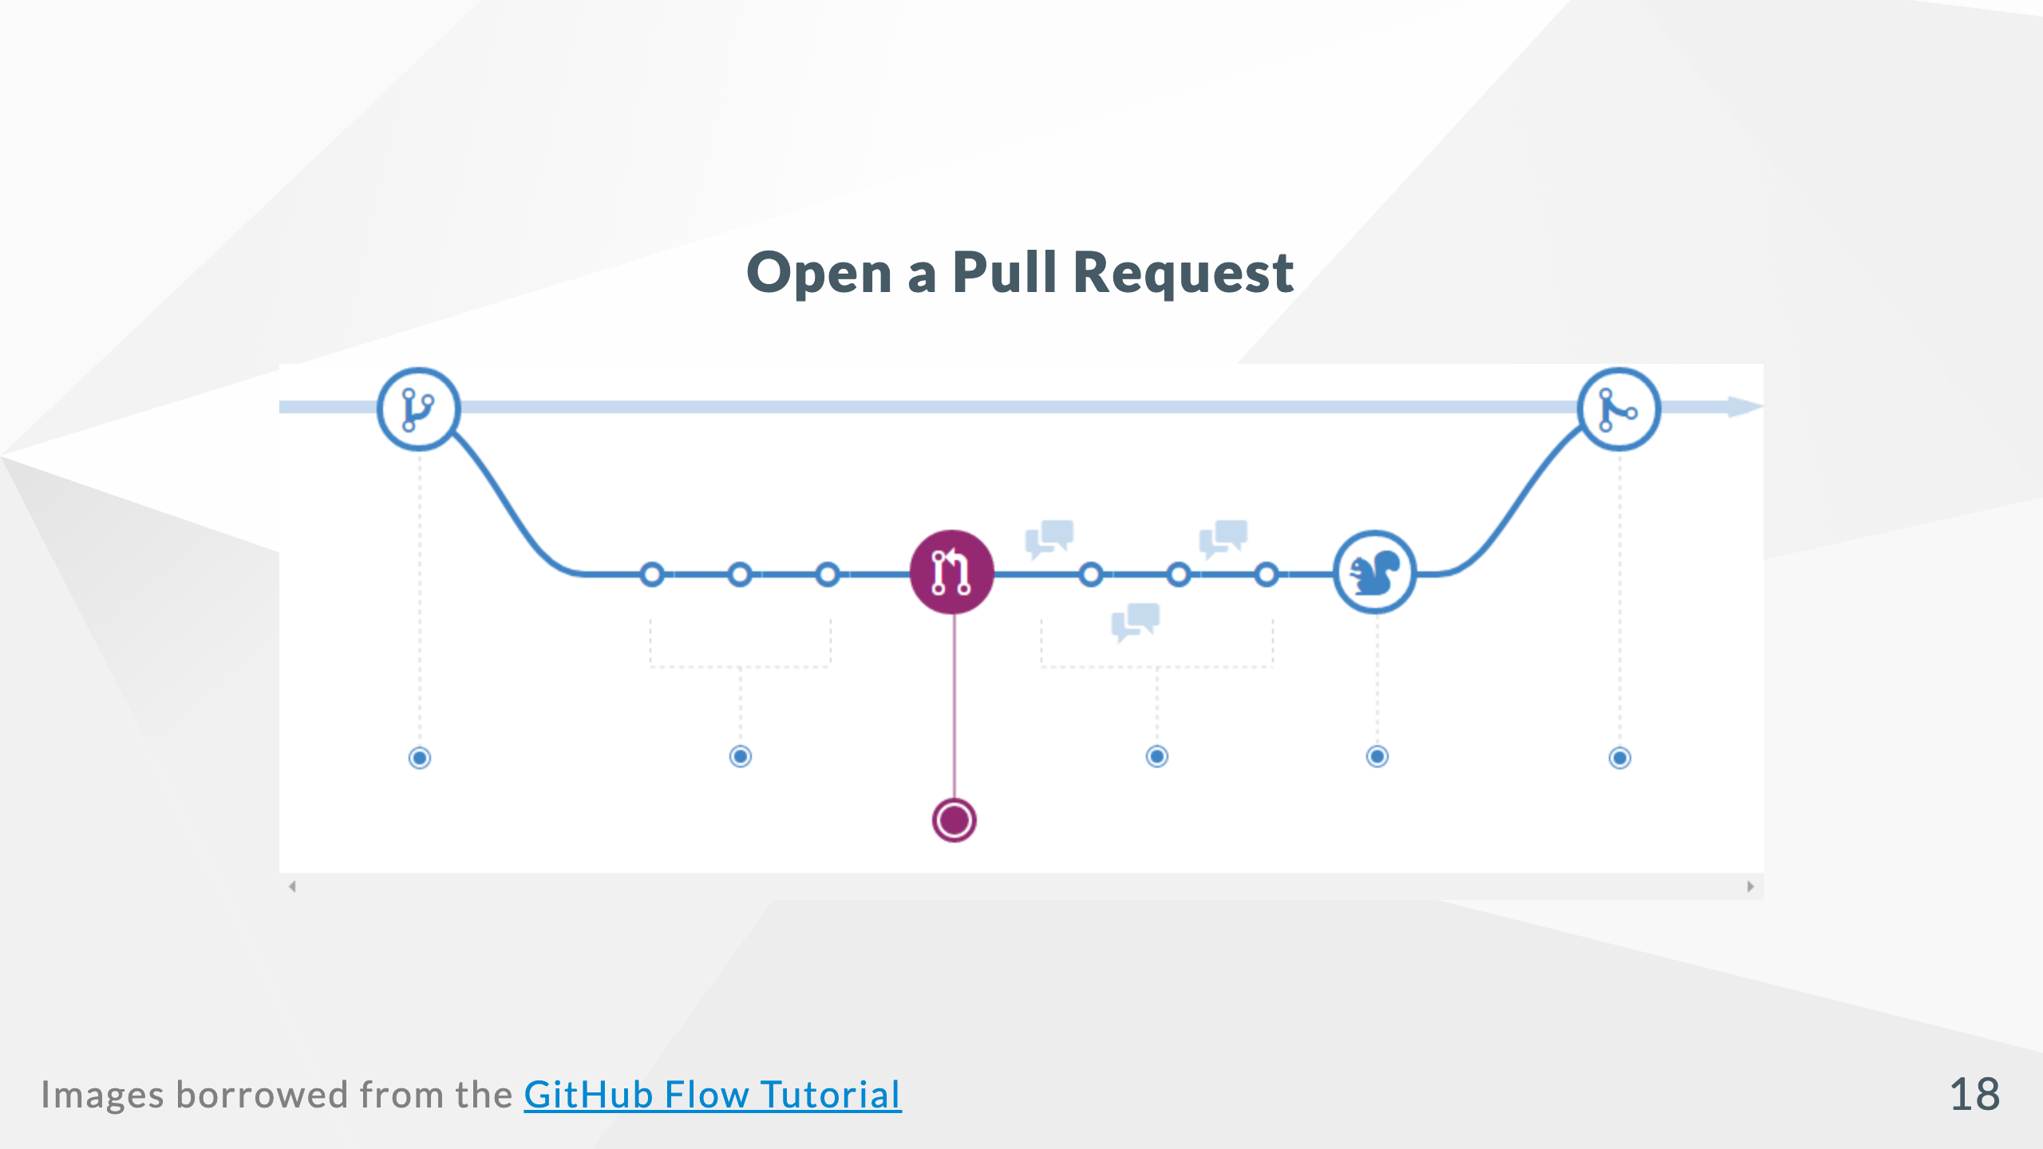

Slide 19
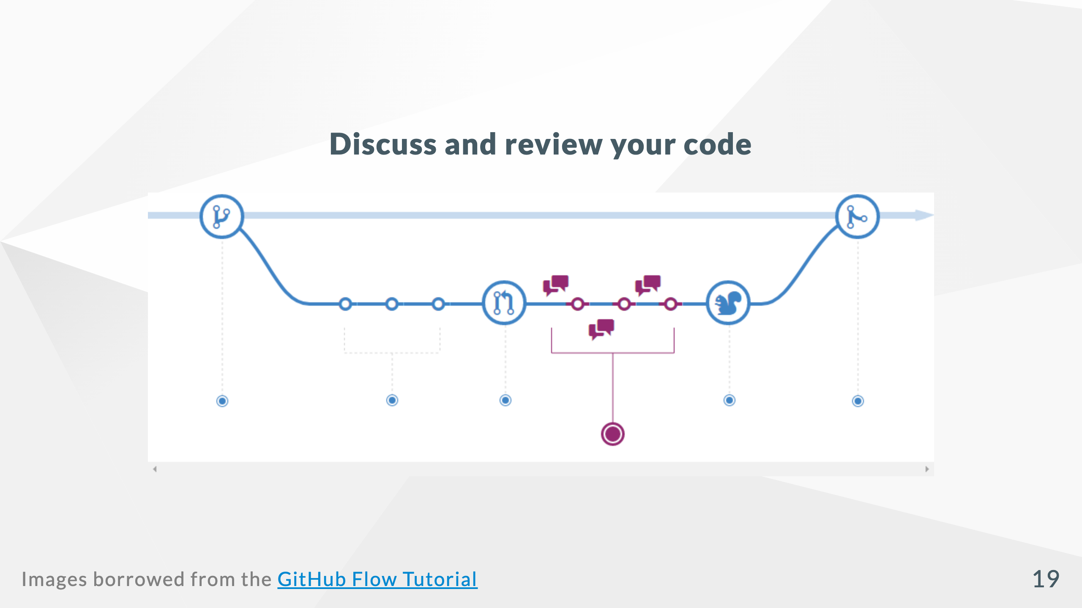

Slide 20
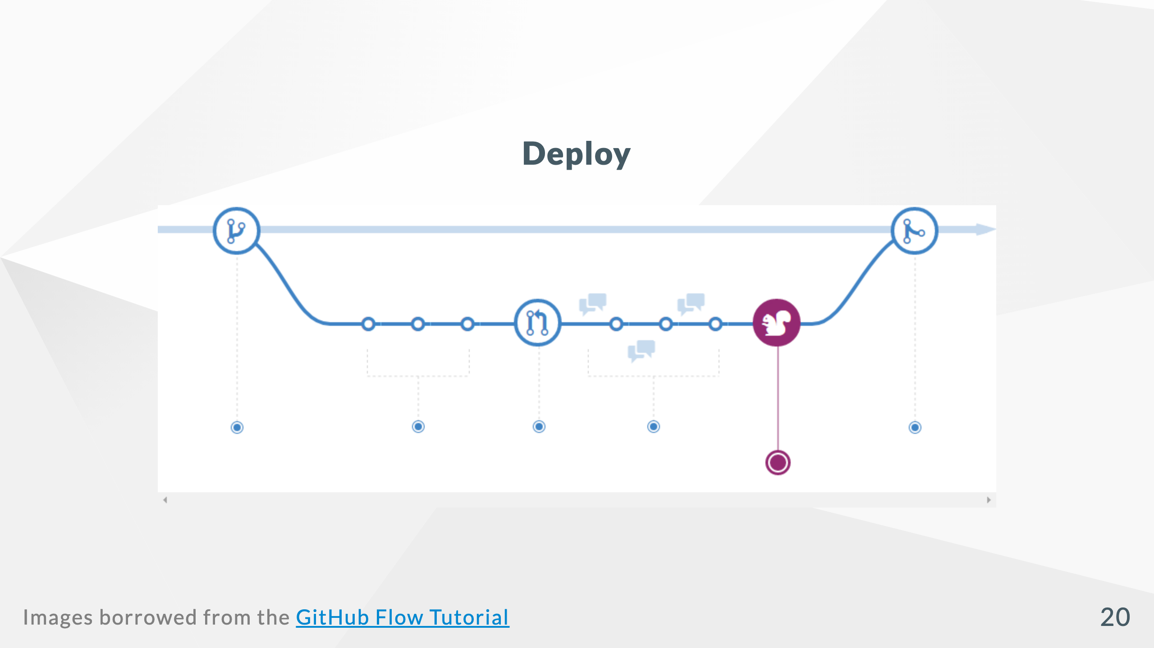

Slide 21
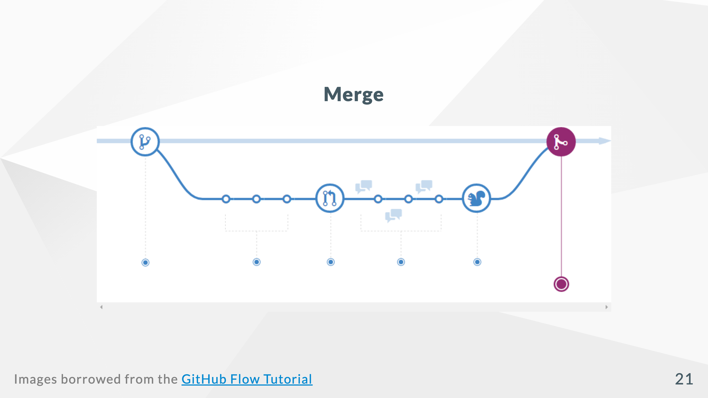

Slide 22

Notes:
- This is the more complicated strategy, but also the one that I prefer

Slide 23
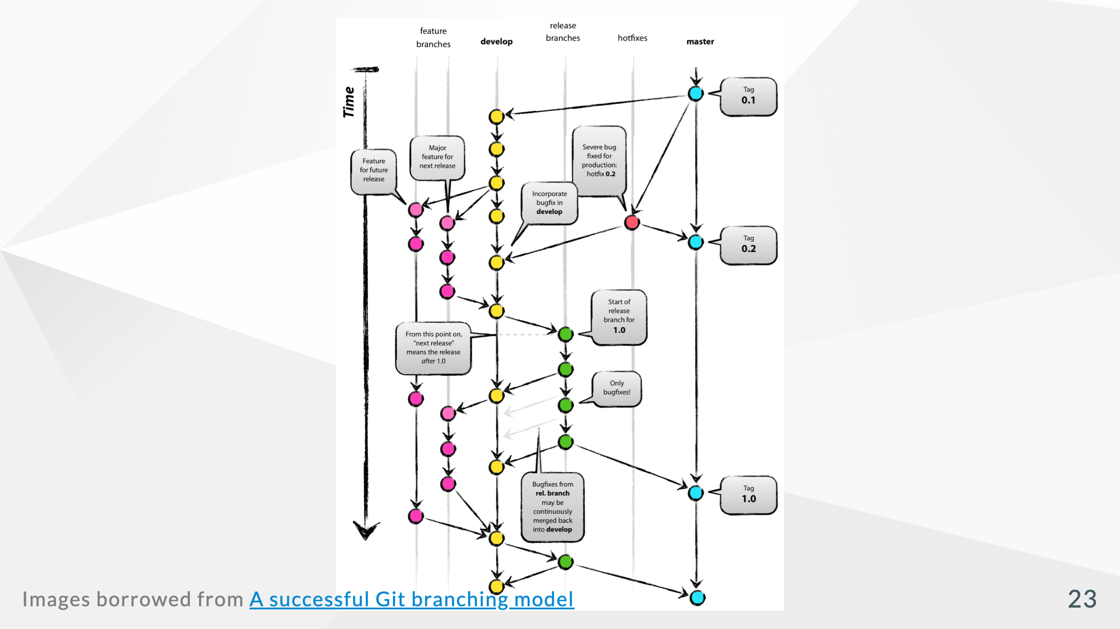

Slide 24
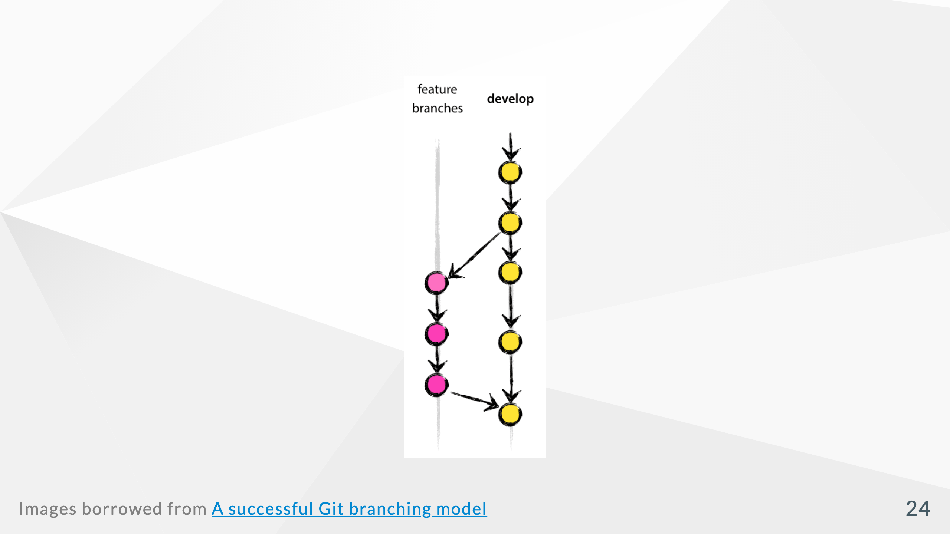
Notes:
- Even though it appears more complicated
- Once you break it down, the process is very similar to GitHub Flow
- If you squint your eyes a bit!

Slide 25
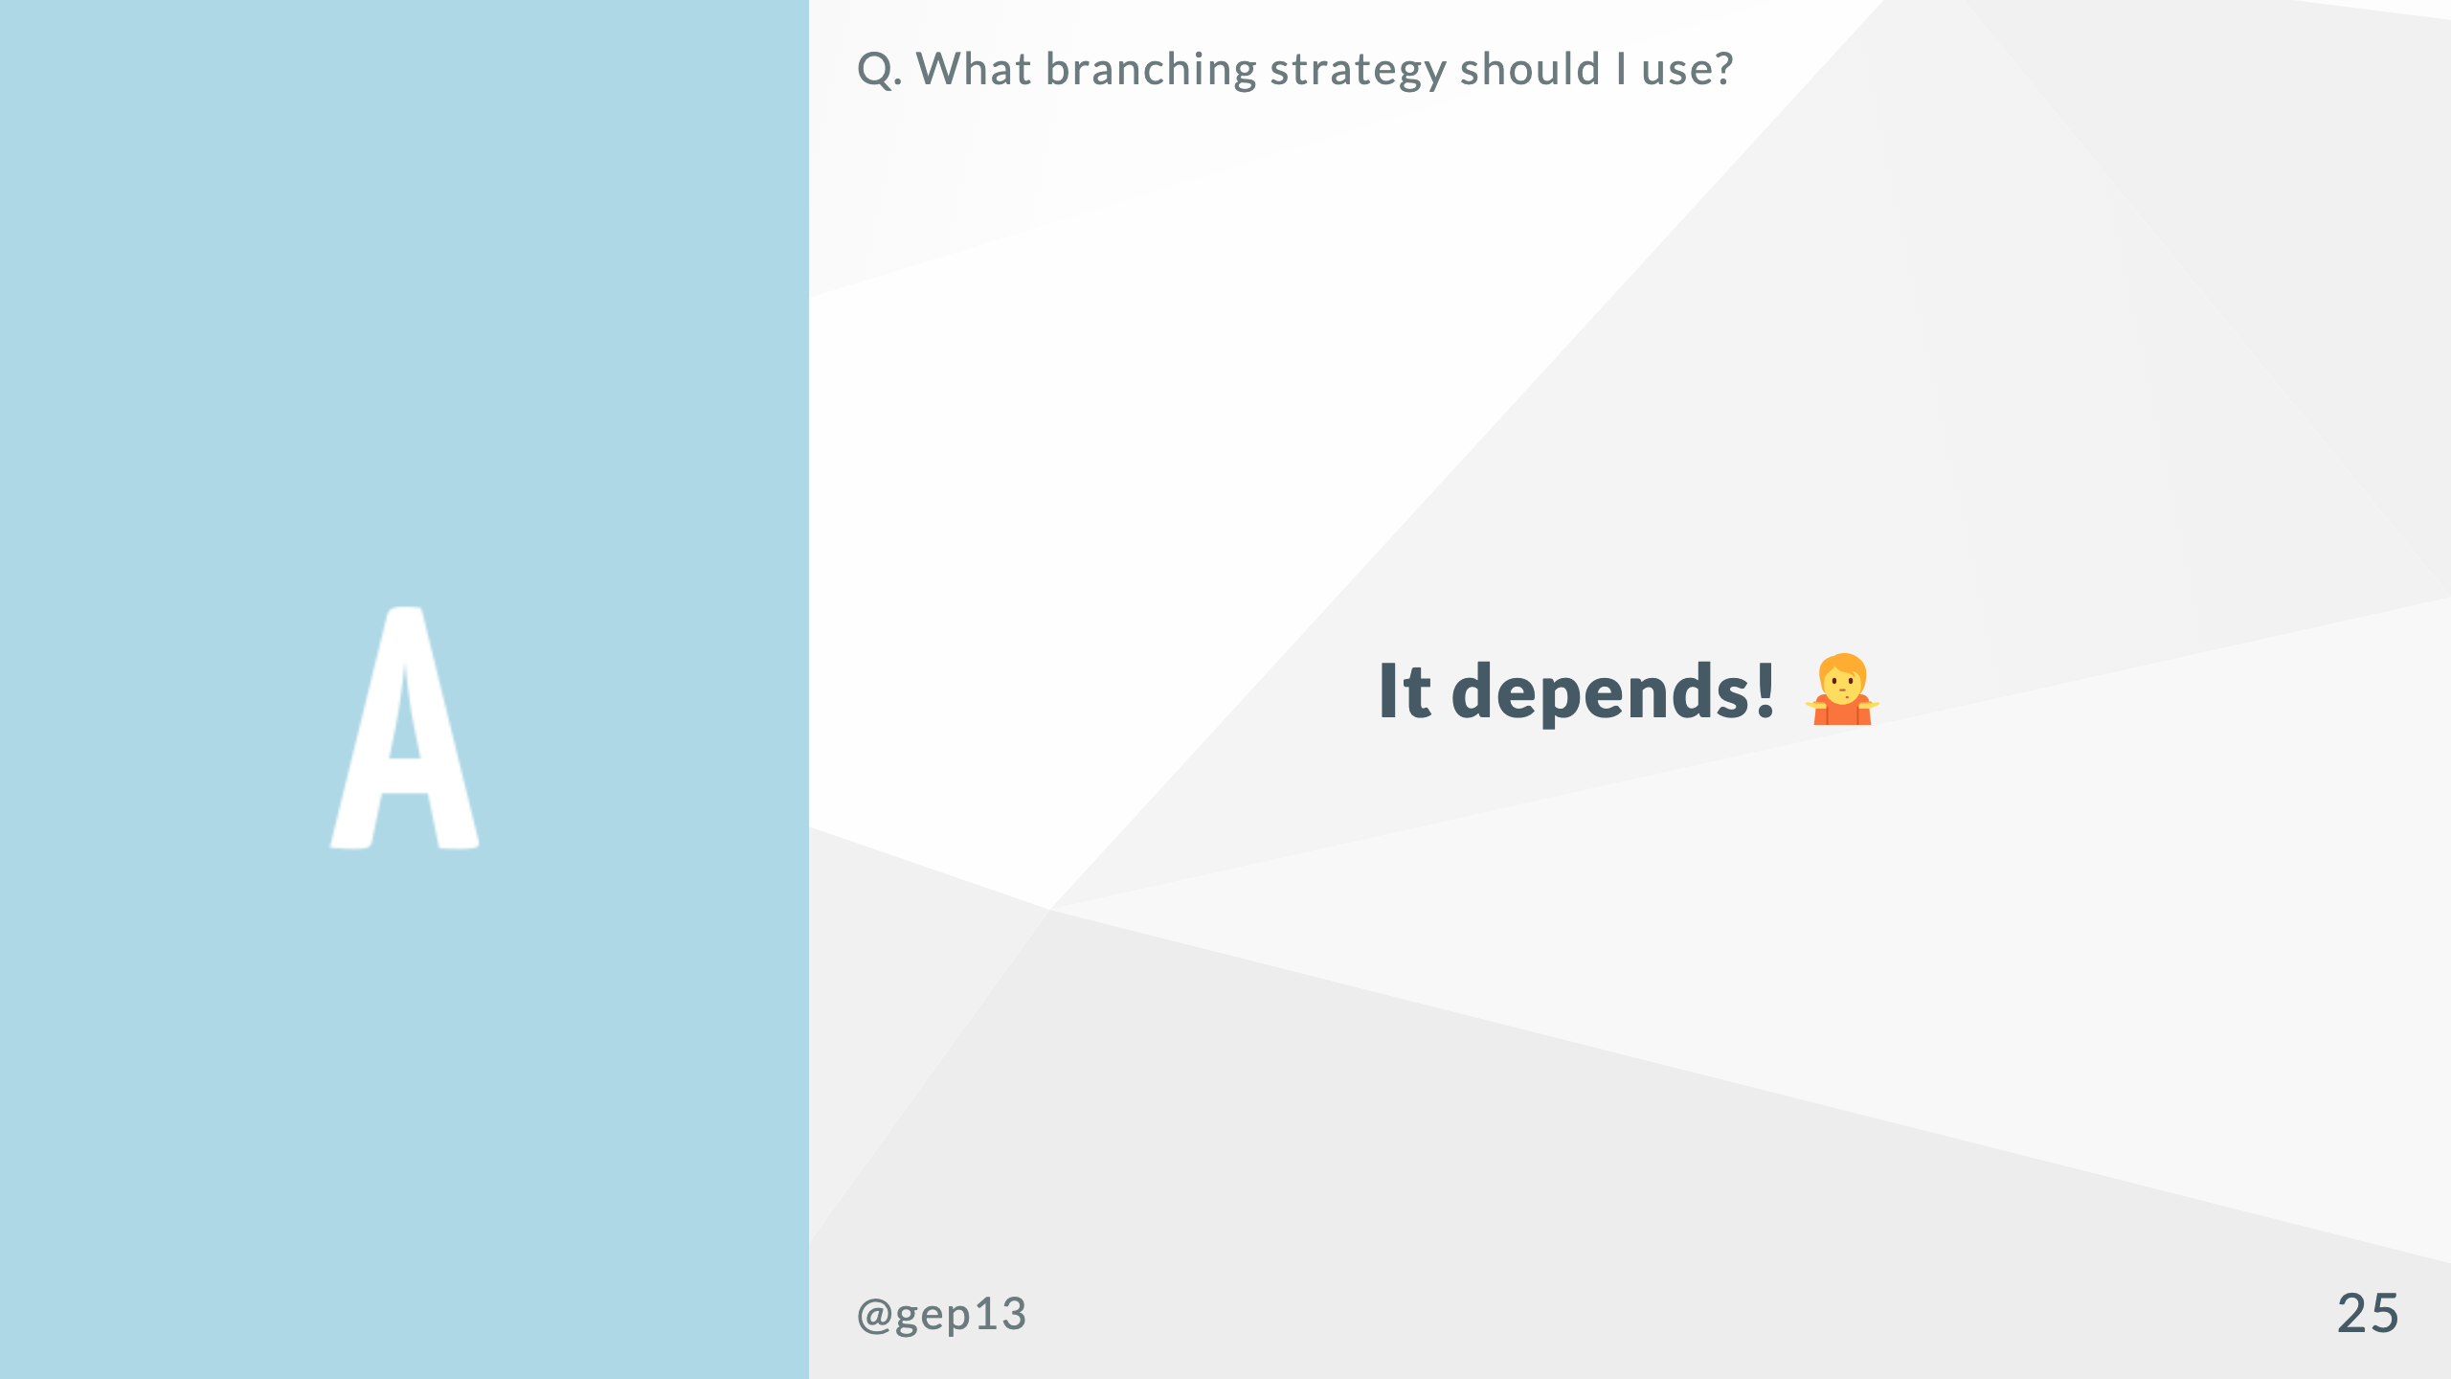
Notes:
- Again, there is no magic bullet
- Pick the workflow that works for your team
- Document it, so that everyone knows what to expect

Slide 26


Slide 27
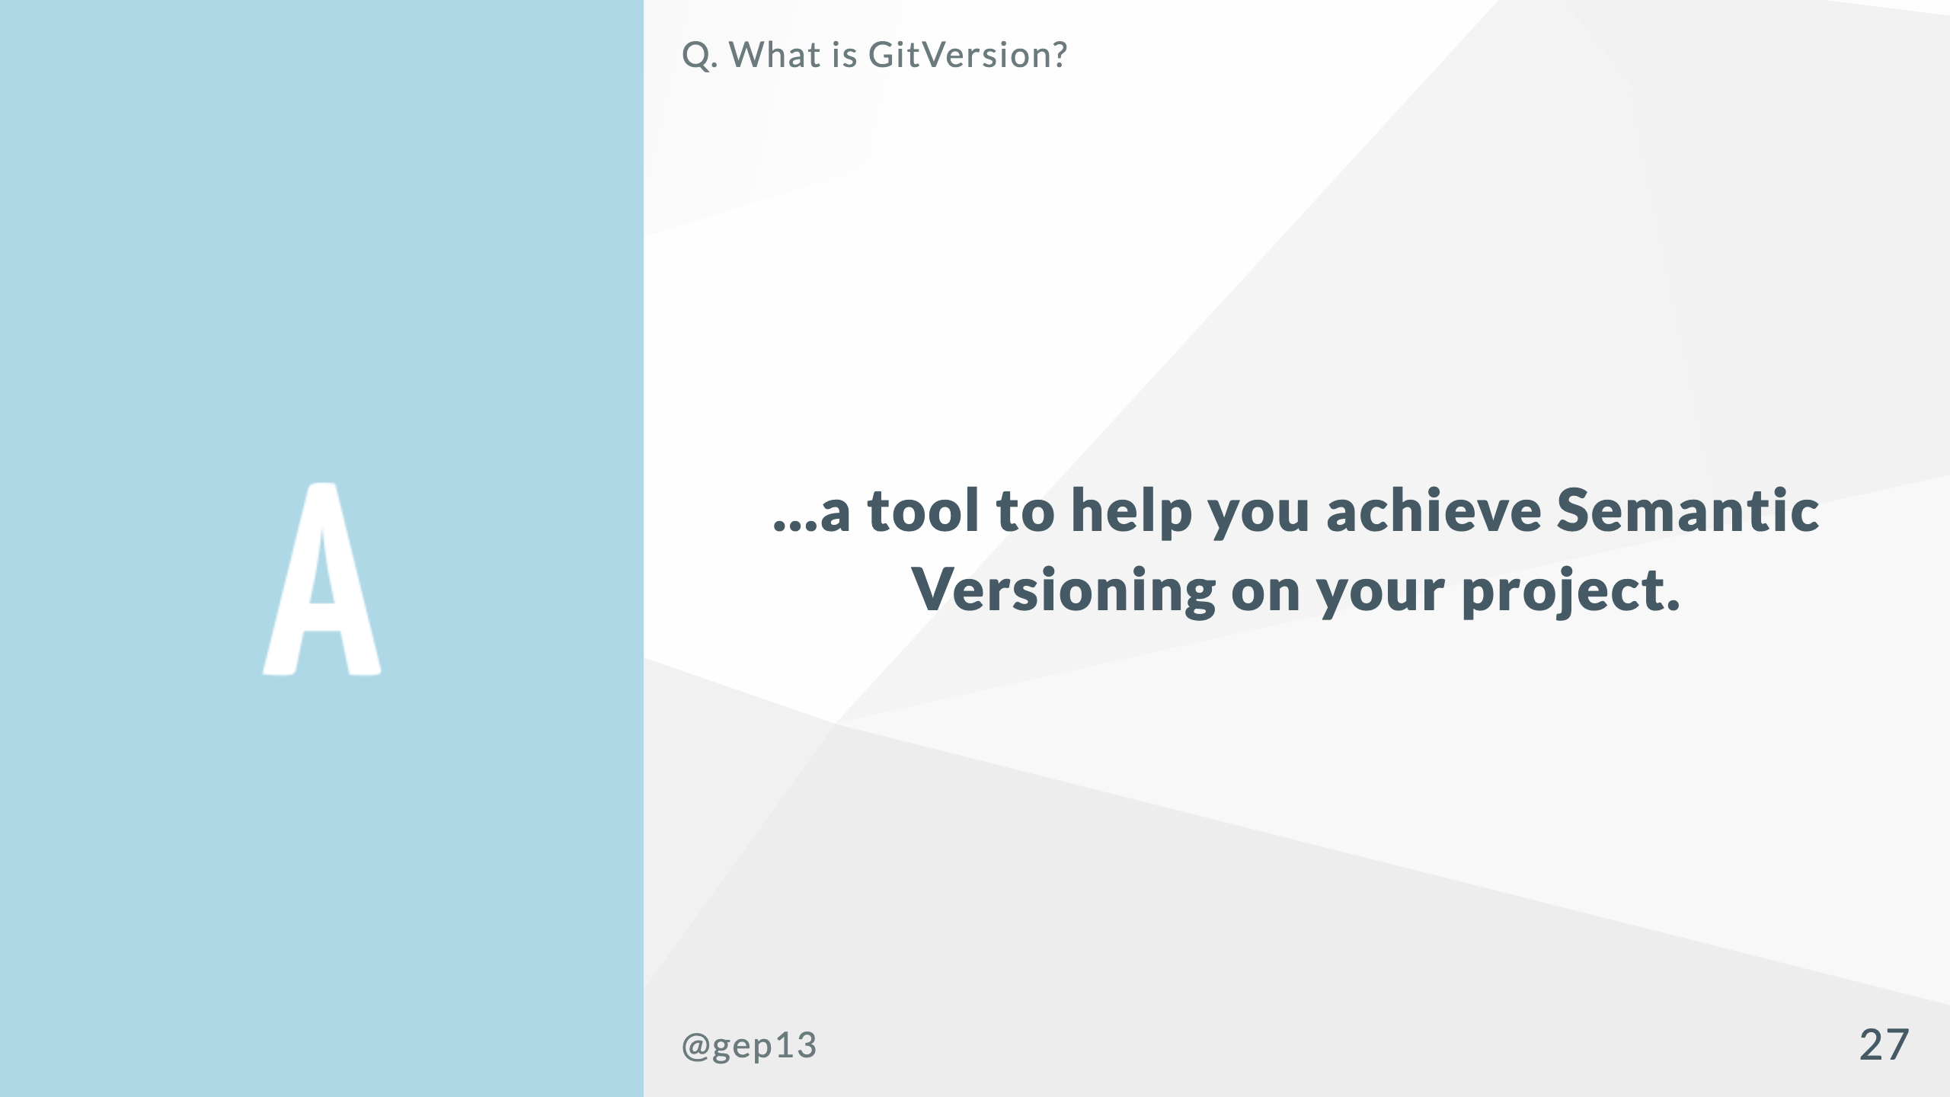
Notes:
- .Net Framework
- .Net Global Tool
- GitHub Action
- Doesn't help you decide when a version number need to change

Slide 28


Slide 29


Slide 30
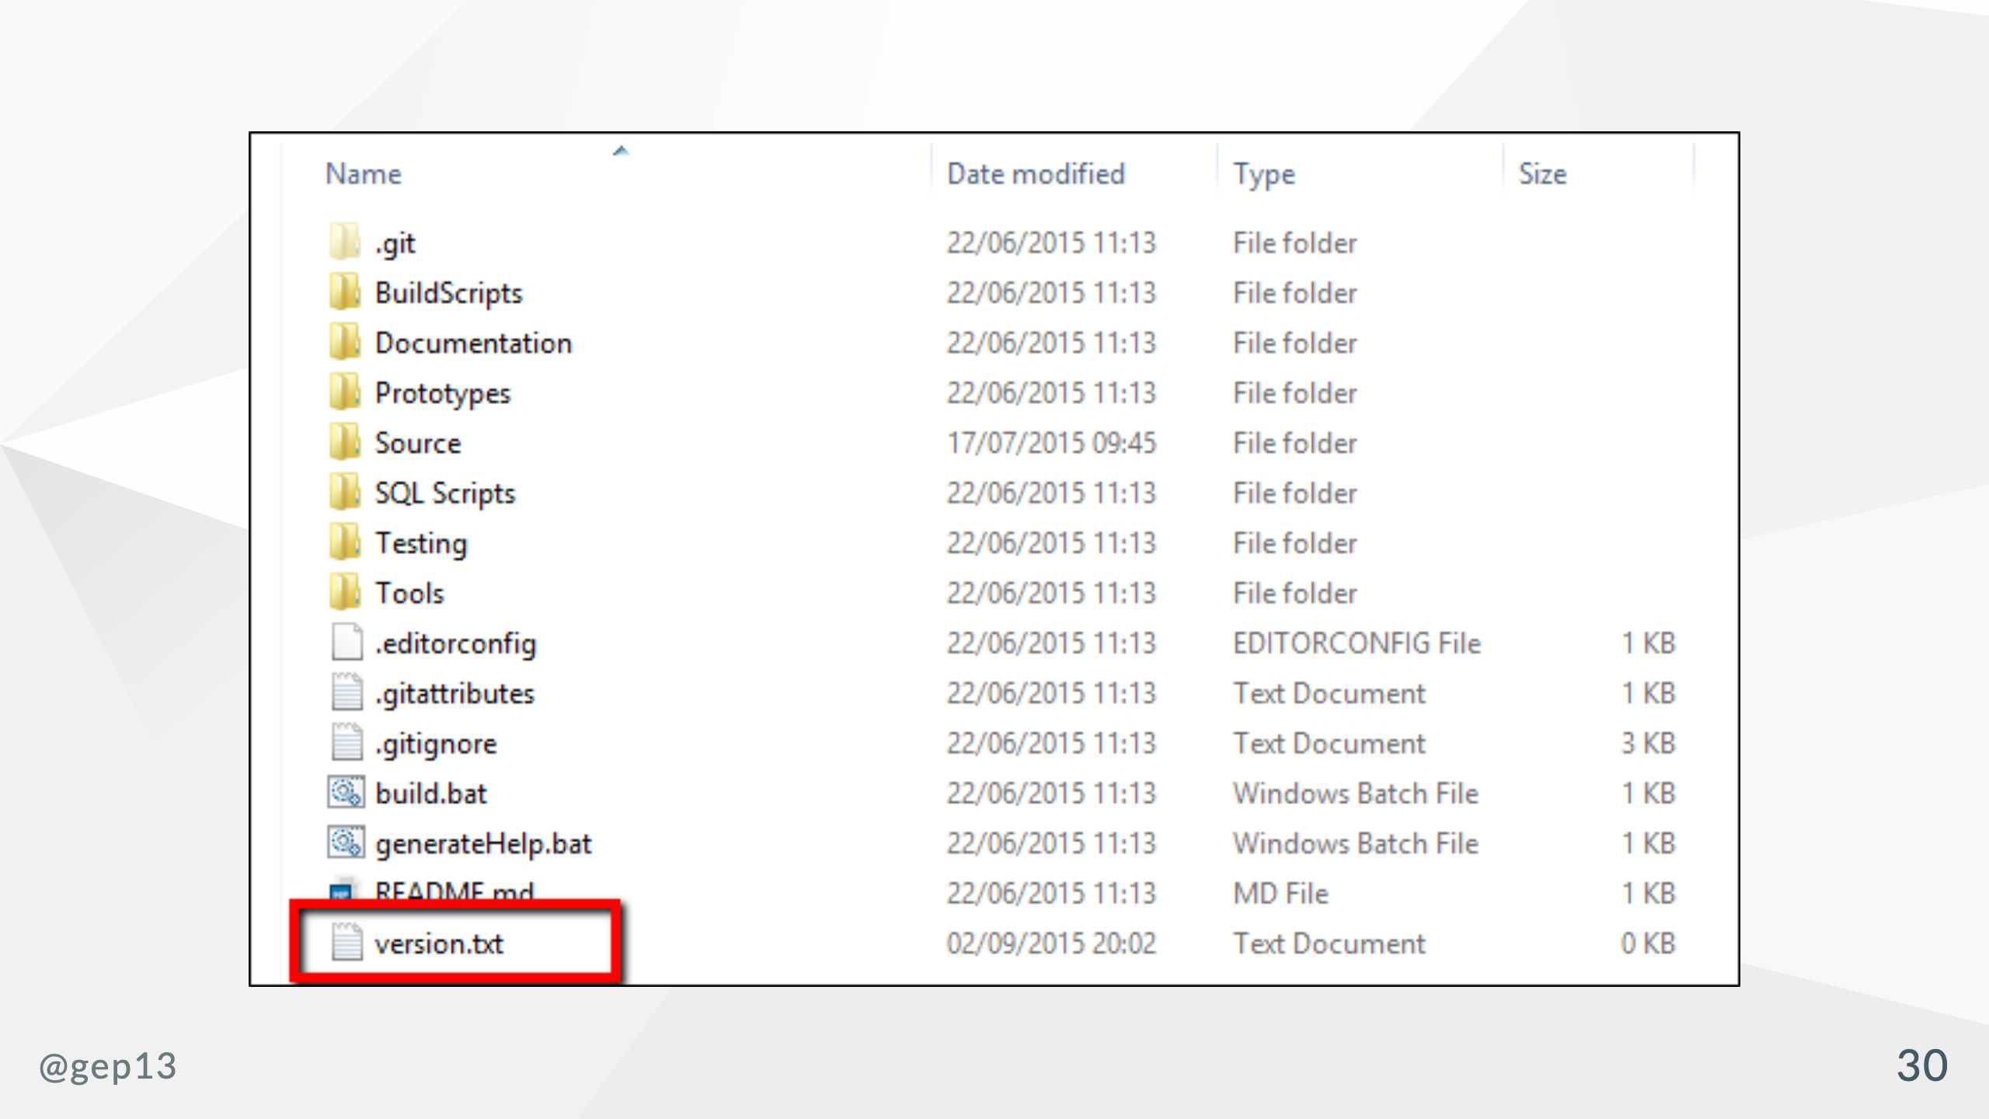

Slide 31
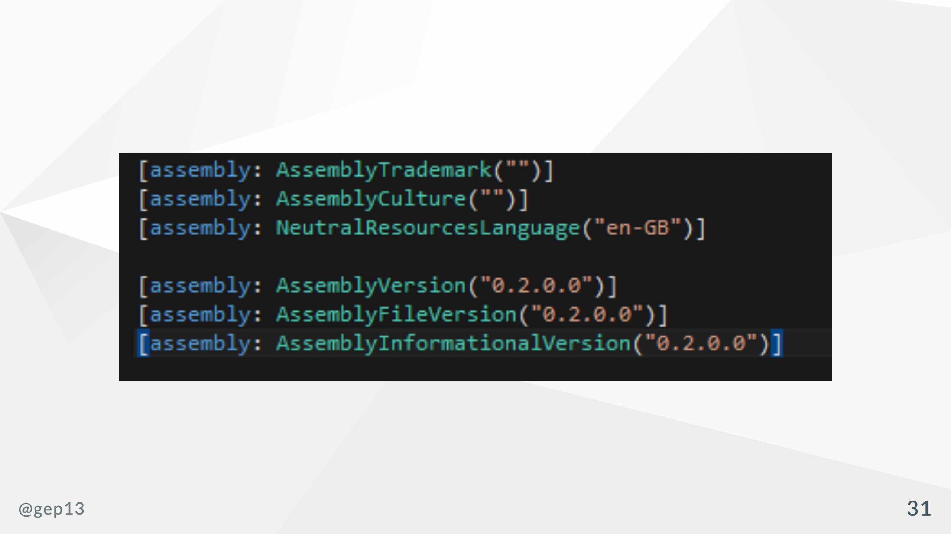

Slide 32
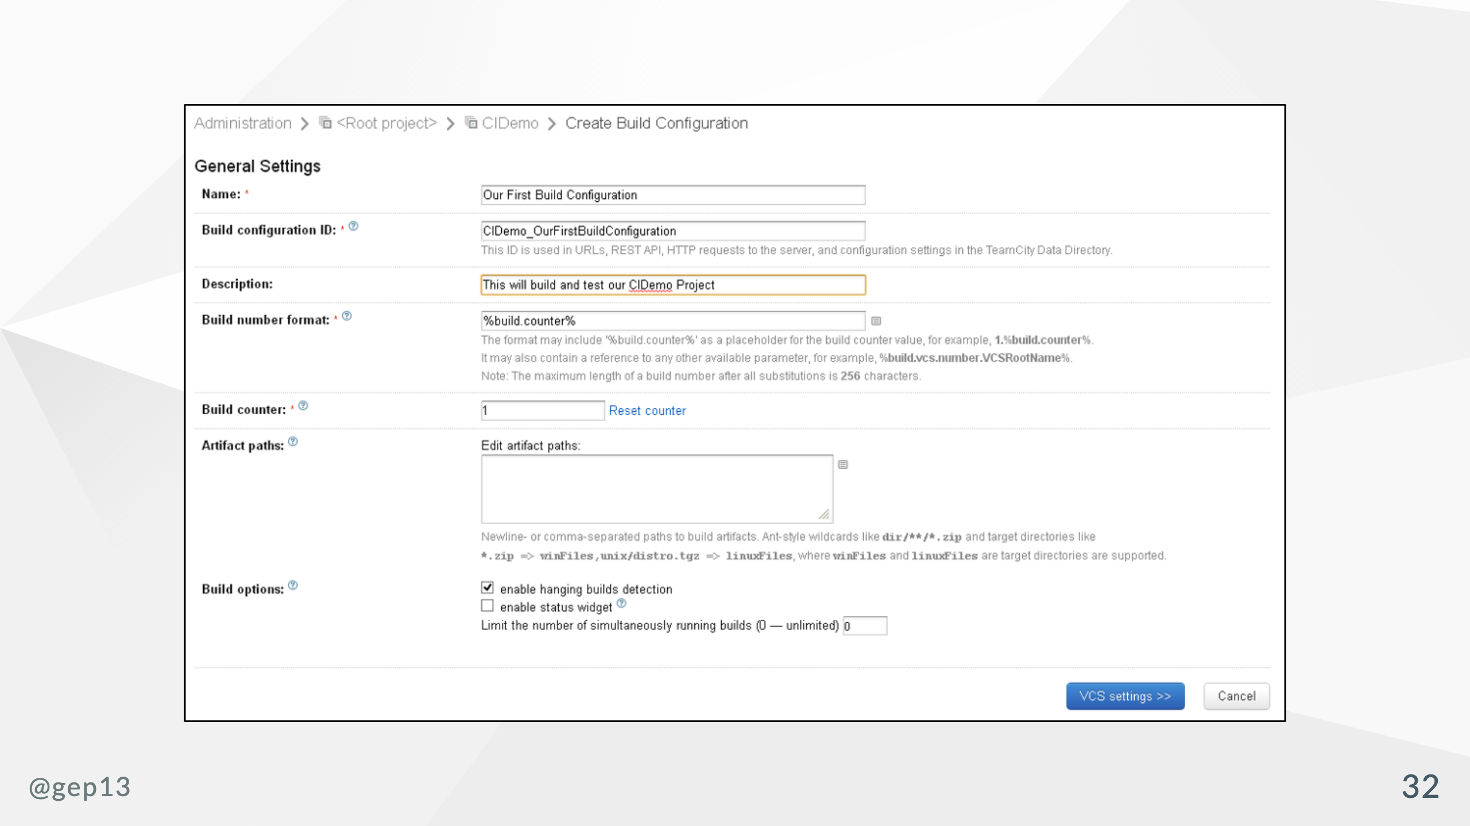
Notes:
- This couples you to a CI system

Slide 33

Notes:
- No idea what the version number is

Slide 34
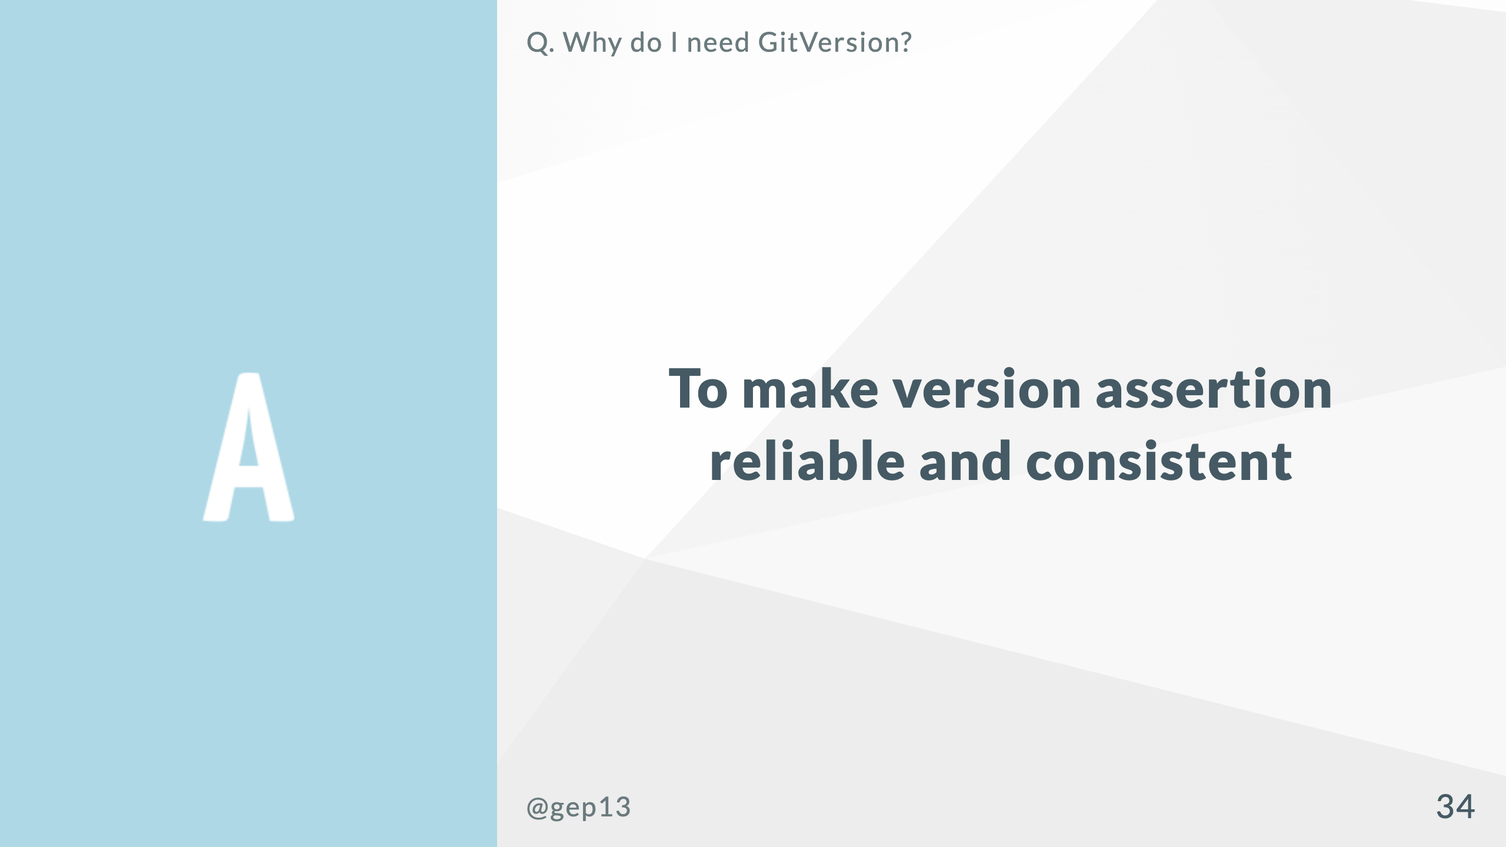

Slide 35


Slide 36
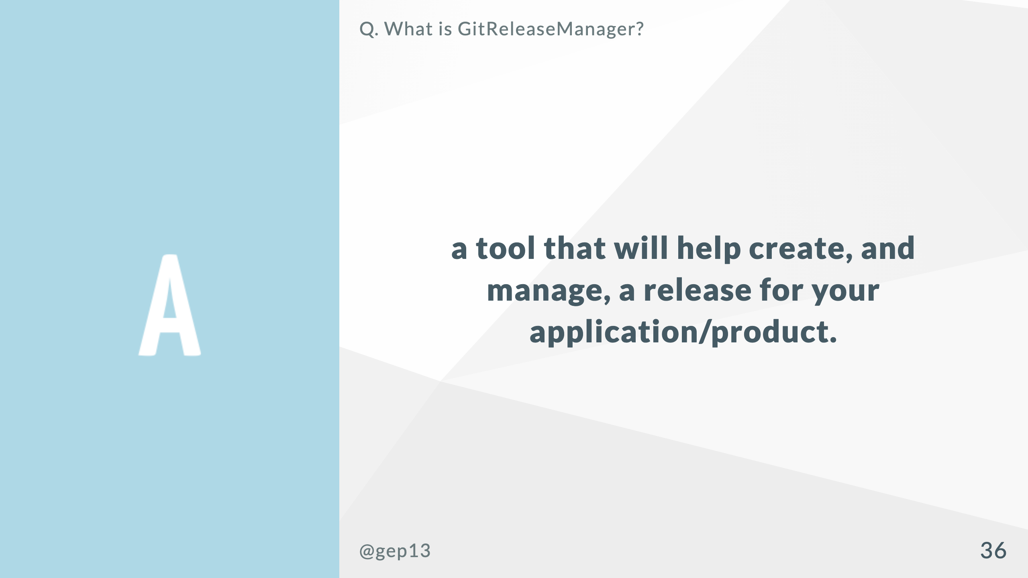
Notes:
- Started out as a tool from Particular
- .Net Framework
- .Net Global Tool
- GitHub Action

Slide 37


Slide 38


Slide 39


Slide 40
