Slide 1

Advanced Corporate Finance (LL4554V/LL5554V/LLJ5554V/LL6554V)
3. valuing bonds
Kenneth Khoo
kenneth.khoo@nus.edu.sg

Slide 2

Valuing bonds
Using the Present Value Formula to Value Bonds.
How Bond Prices Vary With Interest Rates.
The Term Structure of Interest Rates.
Explaining the Term Structure.
Real and Nominal Rates of Interest.
The Risk of Default.

Slide 3
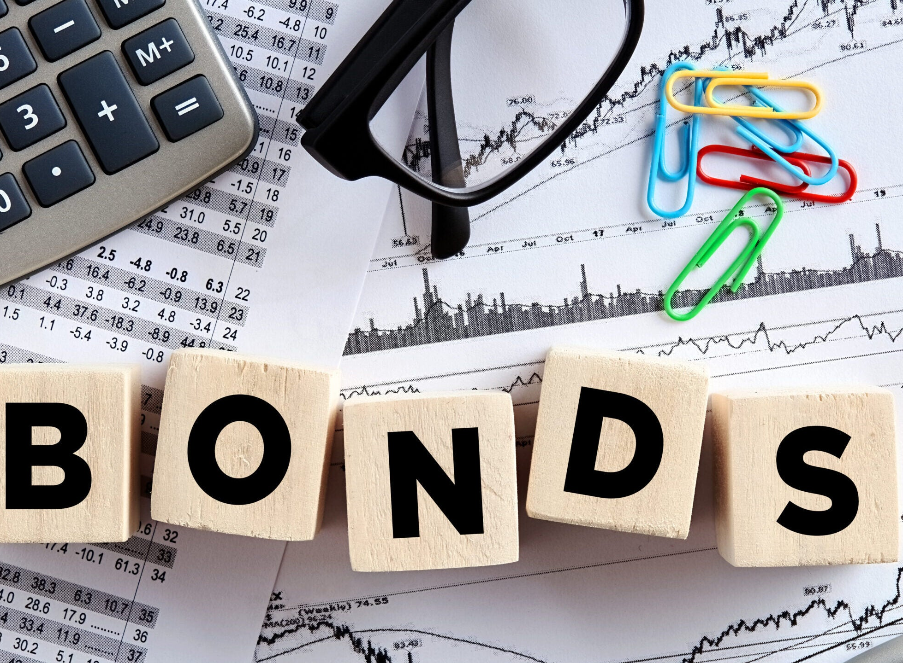
Terminology
Bond
  Security that obligates the issuer to make specified payments to the bondholder.
Face value (par value or principal value).
  Payment at the maturity of the bond.
Coupon
  The periodic interest payments made to the bondholder.
Coupon rate
  Annual interest payment, as a percentage of face value.
Impt: The coupon rate is not the “interest rate” of the bond!

Slide 4
PV Formula to Value a Bond
The price of a bond is the present value of all cash flows generated by the bond (that is, coupons and face value) discounted at the required rate of return.
Note: We use “cpn” here is an abbreviation for “coupon”, and “par” as an abbreviation for the principal which is repaid at the end of the bond’s maturity.

Slide 5
PV Formula to Value a Bond
Example: France
  In October 2025, you purchase 100 euros of bonds in France that pay a 4.25% coupon every year. If the bond matures in 2029 and the YTM (yield to maturity) is 0.15%, what is the value of the bond?

Slide 6
PV Formula to Value a Bond
Recall the formula for computing annuities.
  Coupons are paid every period, while the principal is only paid in the last period.
PV (bond) = PV (annuity of coupons) + PV (principal)

Slide 7
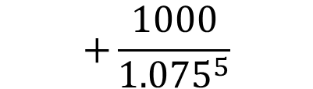
PV Formula to Value a Bond
Example: If today is October 1, 2025, what is the value of the following bond? An IBM bond pays $115 every September 30 for 5 years. In September 2030, it pays an additional $1,000 and retires the bond. The bond is rated AAA (WSJ AAA YTM is 7.5%).
$$+\frac{1000}{{1.075}^{5}}$$

Slide 8
PV Formula to Value a Bond
Example: What is the price of a 7.25% annual coupon bond with a $1,000 face value that matures in 3 years? Assume a required return of 0.35%.
Note: Bond prices are quoted as a percentage of the par/principal value.

Slide 9
PV Formula to Value a Bond
Example: In November 2025, you purchase a 3-year U.S government bond that has an annual coupon rate of 4.25%, paid semiannually. If investors demand an annualized 0.965% return, what is the price of the bond?
  Notes: Assume bond has face/par/principal value at $1000 unless otherwise specified.
  If bond is paid semiannually, then annual coupon rate is divided by half.
  If yields/rates are quoted in APR form, then the semi-annual rate is also divided by half.
  DCF is always based on the NUMBER OF PERIODS, so a 3-year semi-annual bond has 6 periods.

Slide 10
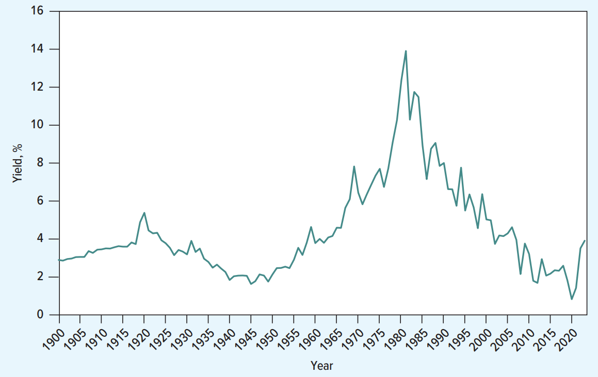
PV Formula to Value a Bond
In practice, yields are derived from the bond price and the coupon rates + par value. How so?

Slide 11
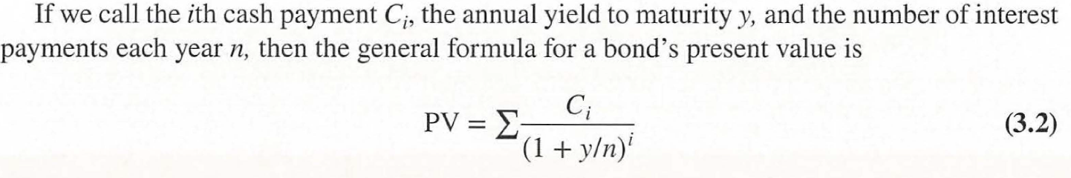
PV Formula to Value a Bond
More on how we derive yield $y$ later.

Slide 12
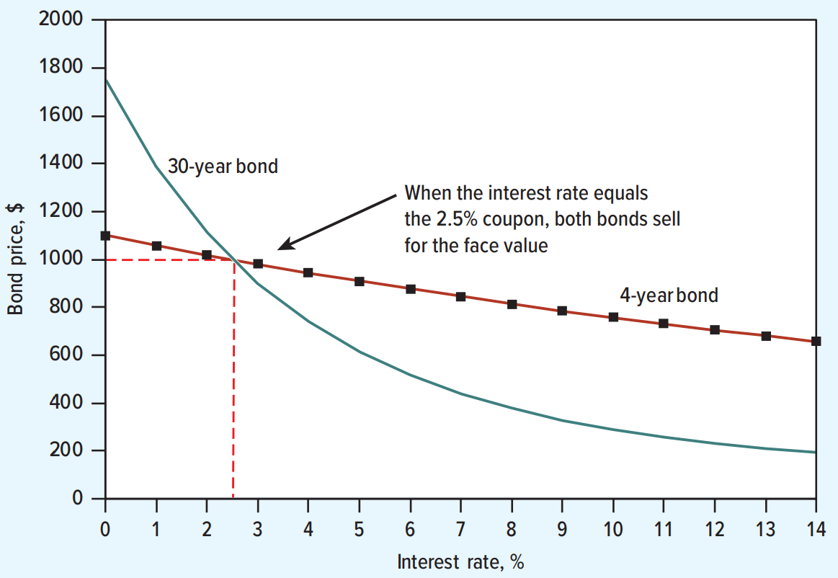
How Bond Prices Vary With Interest Rates
Yields are inversely related to bond prices. The yield is in the denominator, so if yield increases, bond prices decrease.
Yields (or YTM) are often used as “the (market) interest rate” for that bond, as it is the bond’s market-implied discount rate.
This figure plots bond prices as a function of the interest rate. The price of long-term bonds is more sensitive to changes in the interest rate than the price of short-term bonds.
Does maturity length determine “duration” for pricing? Not entirely.

Slide 13
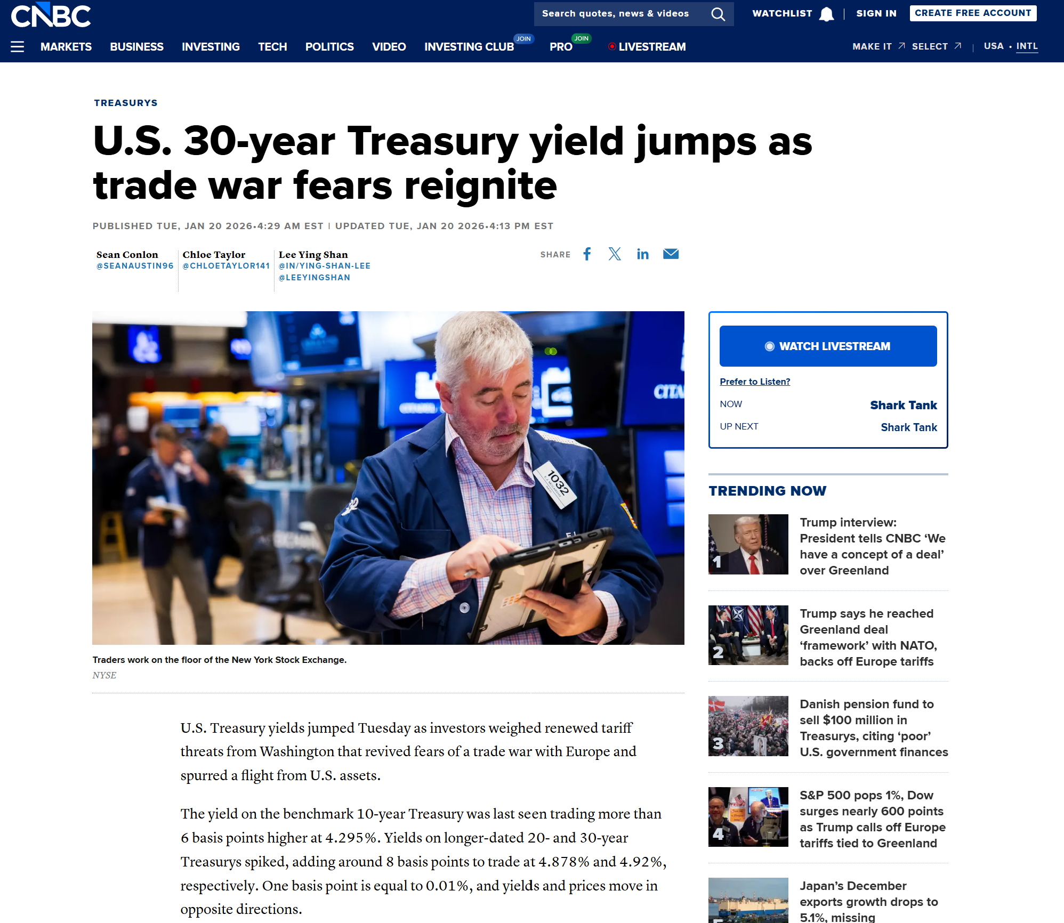
How Bond Prices Vary With Interest Rates

Slide 14
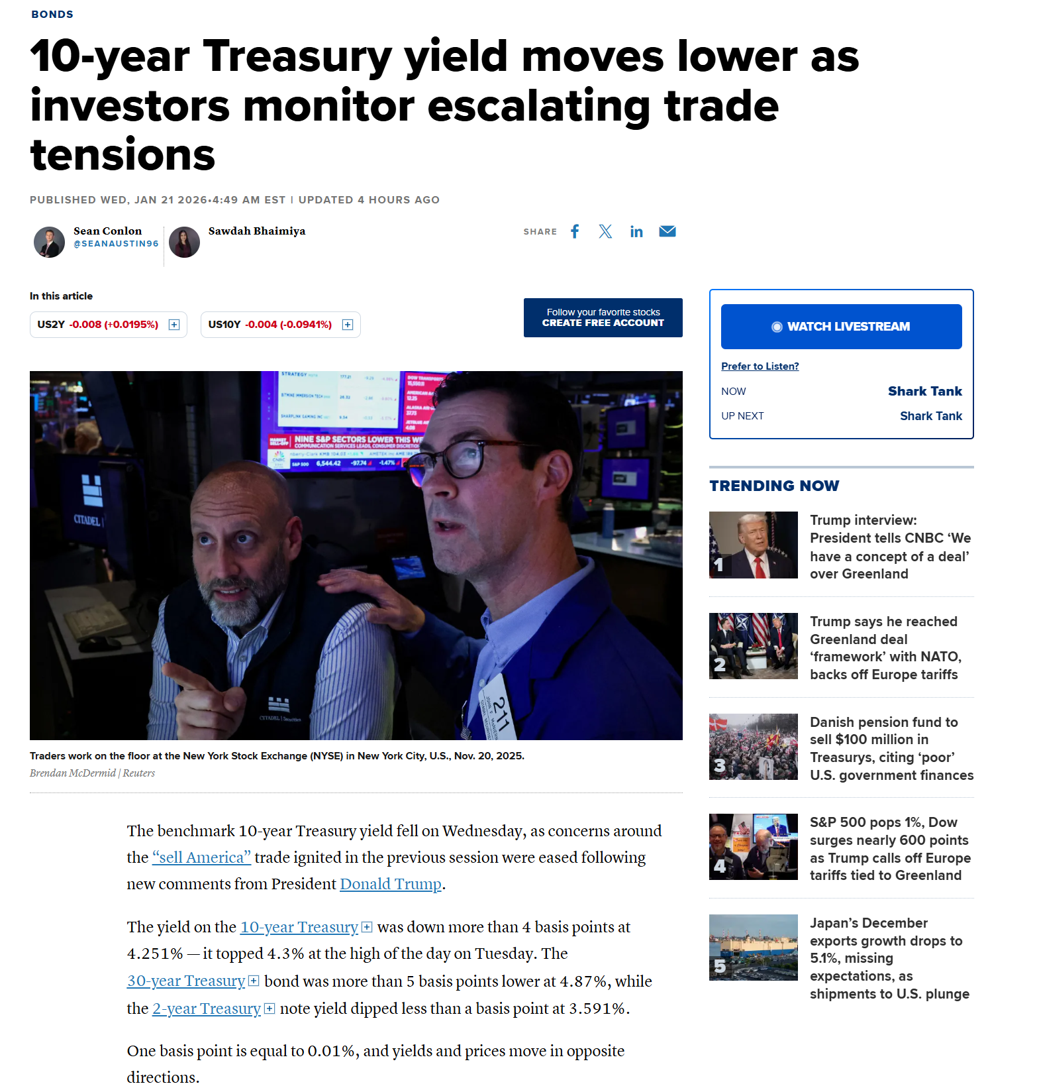
How Bond Prices Vary With Interest Rates

Slide 15
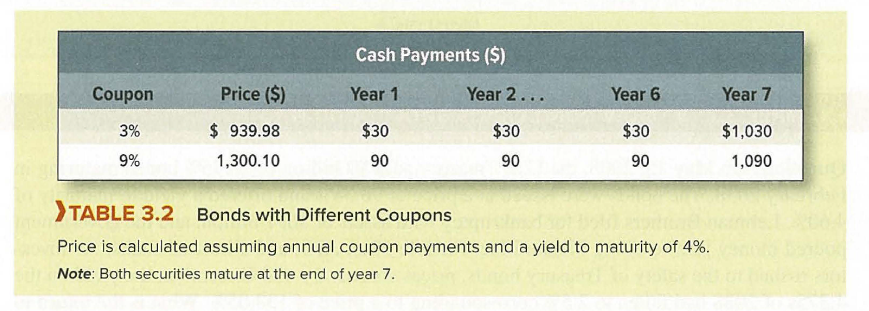
How Bond Prices Vary With Interest Rates
Q: Suppose the YTM on each bond falls to 3%. Which bond would you prefer to own?
Ans: If YTM falls (e.g., to 3%), both bonds’ prices rise — but the bond with higher duration rises more. Macaulay Duration (or Duration) measures price sensitivity to yield changes.
With the same maturity, the lower-coupon bond has the longer “effective life” (higher Macaulay duration) because more of its present value comes from the principal paid at maturity (cash flows are weighted later).
Therefore, prefer the low-coupon bond (“3s”): it benefits most from the fall in yields.

Slide 16
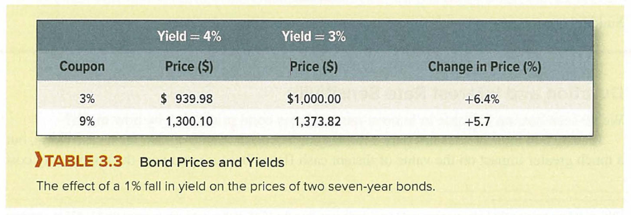
How Bond Prices Vary With Interest Rates

Slide 17
How Bond Prices Vary With Interest Rates
A bond’s “Duration” is also known as the Macaulay duration.
  Weighted average of the times (t) to each of the cash payments.
A bond’s “modified duration” is also termed the “Volatility” of the bond.
  It measures how bond prices change when the interest rates change. HW: Derive Volatility as a function of changes in bond price and interest rates (i.e., elasticity)

Slide 18
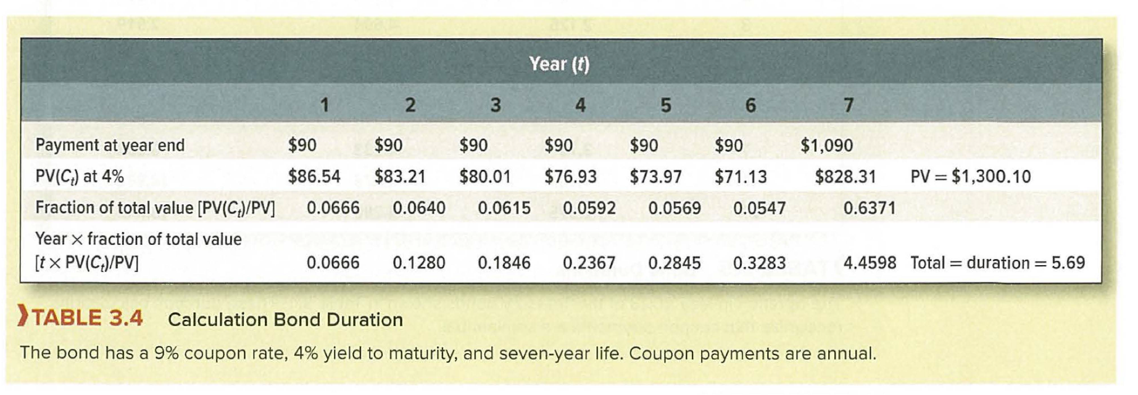
How Bond Prices Vary With Interest Rates

Slide 19
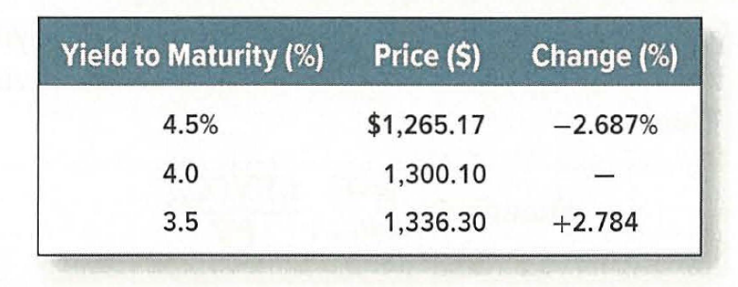
How Bond Prices Vary With Interest Rates
Example: Suppose the duration of the aforementioned bond is 5.69 years.
  Then the modified duration is duration/(1+yield) = 5.69/1.04 = 5.47
  1% change in yield should change bond price by 5.47%
  -2.687% + 2.784% = 5.47%

Slide 20
The term structure of interest rates
In the seminar on PV, we used the same discount rate to calculate the value of each period's cash flow.
  However, short-term interest rates may be different from long-term rates. In this case, it may be worth discounting each cash flow at a different rate.
The relationship between short- and long-term interest rates is called the term structure of interest rates.
  The term structure is also commonly known as the “yield curve”.

Slide 21
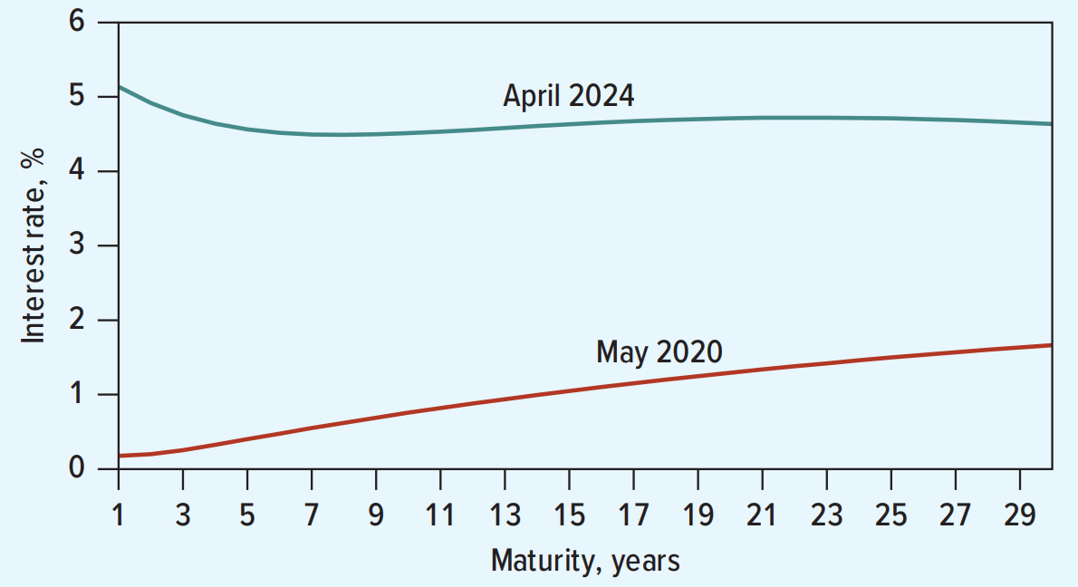
The term structure of interest rates
In April 2024, the term structure was mostly downward sloping; in May 2020, it was upward sloping.

Slide 22
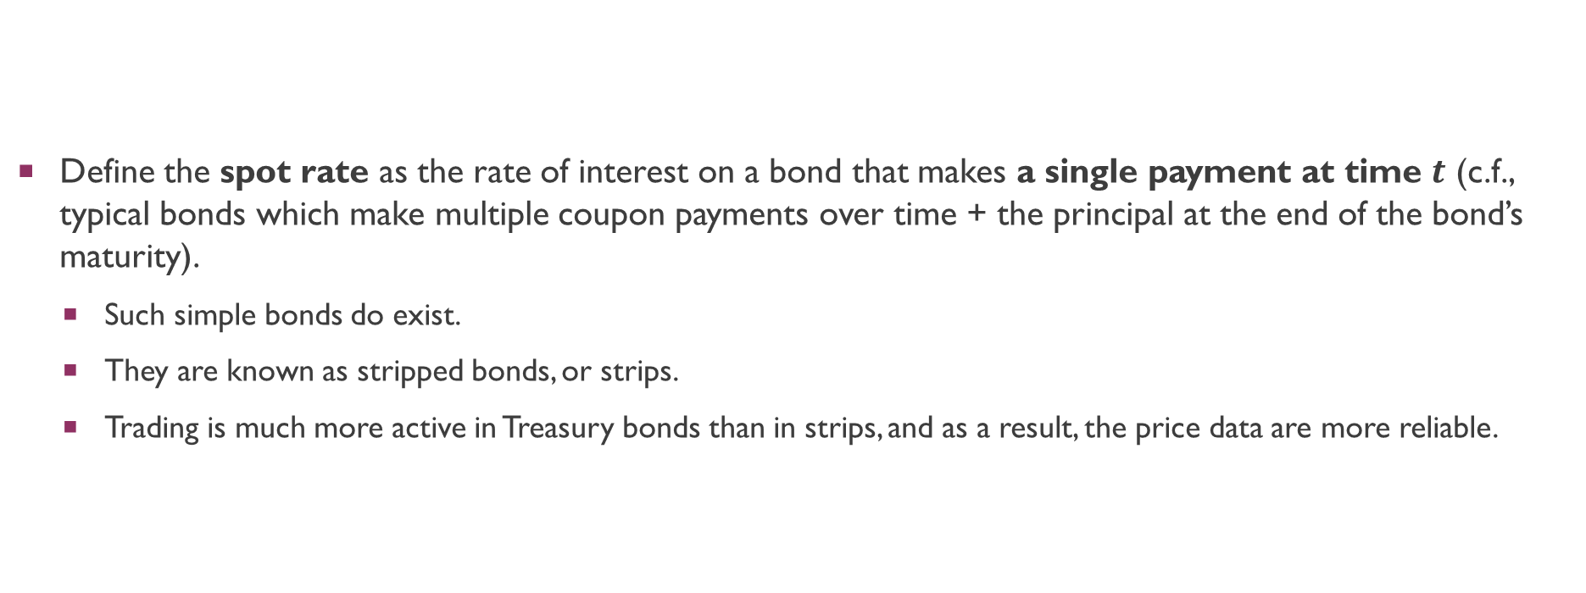
The term structure of interest rates
Define the spot rate as the rate of interest on a bond that makes a single payment at time $t$ (c.f., typical bonds which make multiple coupon payments over time + the principal at the end of the bond’s maturity).
  Such simple bonds do exist.
  They are known as stripped bonds, or strips.
  Trading is much more active in Treasury bonds than in strips, and as a result, the price data are more reliable.

Slide 23
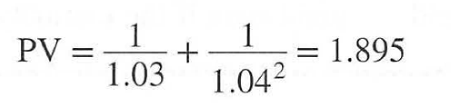
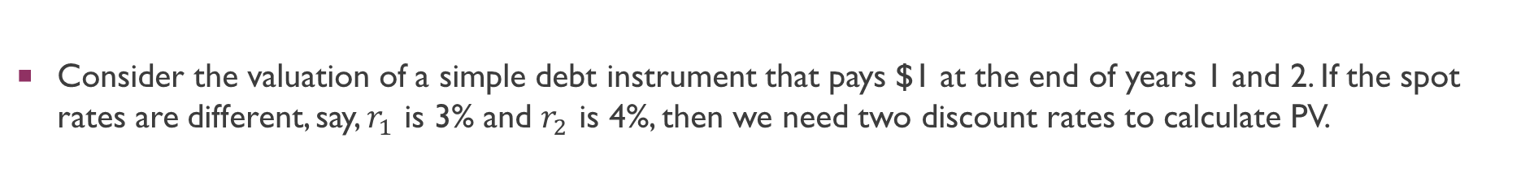
The term structure of interest rates
Consider the valuation of a simple debt instrument that pays $1 at the end of years 1 and 2. If the spot rates are different, say, $r_{1}$ is 3% and $r_{2}$ is 4%, then we need two discount rates to calculate PV.
When the term structure is not flat, so the spot rates vary across years, we need to use a different spot rate to discount each cash flow.

Slide 24
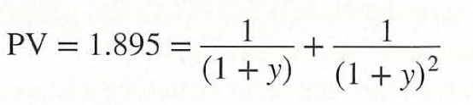
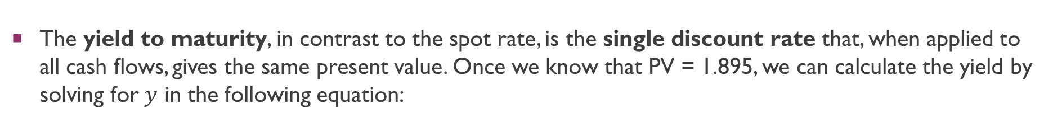
The term structure of interest rates
The yield to maturity, in contrast to the spot rate, is the single discount rate that, when applied to all cash flows, gives the same present value. Once we know that PV = 1.895, we can calculate the yield by solving for $y$ in the following equation:
This gives a YTM of 3.66%: in between the spot rates of 3% and 4%.
  YTM is a weighted average of the spot rates, where the weights depend on the size of the cash flows received in each year.

Slide 25
The term structure of interest rates
Notice the two steps we went through to calculate the yield:
  Use spot rates to calculate the bond price.
  Use the bond price to calculate the yield..
Important: Spot rates come first. Yields come later, after bond prices are set.
  Spot rates allow you to price any bond.
  The yield of a bond allows one to price a particular bond only.

Slide 26
Explaining the term structure
Yield-curves tend to be upward sloping, although sometimes they can change their form to be downward sloping as well.
  This presents an opportunity for arbitrage. If I can borrow at X% and then invest that amount for Y%, I can pocket the difference.
  Braeley et al (2025): “[In May 2020], long-term spot rates of interest were about 1.4%; short-term rates were close to zero. Why, then, didn't everyone rush to buy long-term bonds?”

Slide 27
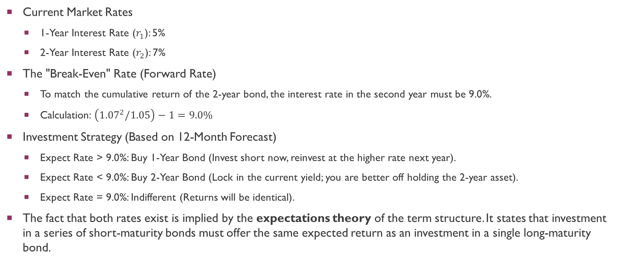
Explaining the term structure
Current Market Rates
  1-Year Interest Rate ($r_{1}$): 5%
  2-Year Interest Rate ($r_{2}$): 7%
The "Break-Even" Rate (Forward Rate)
  To match the cumulative return of the 2-year bond, the interest rate in the second year must be 9.0%.
  Calculation: $\left({1.07}^{2}/1.05\right)−1=9.0\%$
Investment Strategy (Based on 12-Month Forecast)
  Expect Rate > 9.0%: Buy 1-Year Bond (Invest short now, reinvest at the higher rate next year).
  Expect Rate < 9.0%: Buy 2-Year Bond (Lock in the current yield; you are better off holding the 2-year asset).
  Expect Rate = 9.0%: Indifferent (Returns will be identical).
The fact that both rates exist is implied by the expectations theory of the term structure. It states that investment in a series of short-maturity bonds must offer the same expected return as an investment in a single long-maturity bond.
Notes:
Suppose 10%. I buy 1-year bond now (lend), next year, I get my money back and reinvest at 10%.
Suppose 8%. I should lock in the 2-year bond now (lend). My alternative is to buy 1-year bond now, reinvest next year and get 8% (which would yield me lower returns than locking in now).

Slide 28
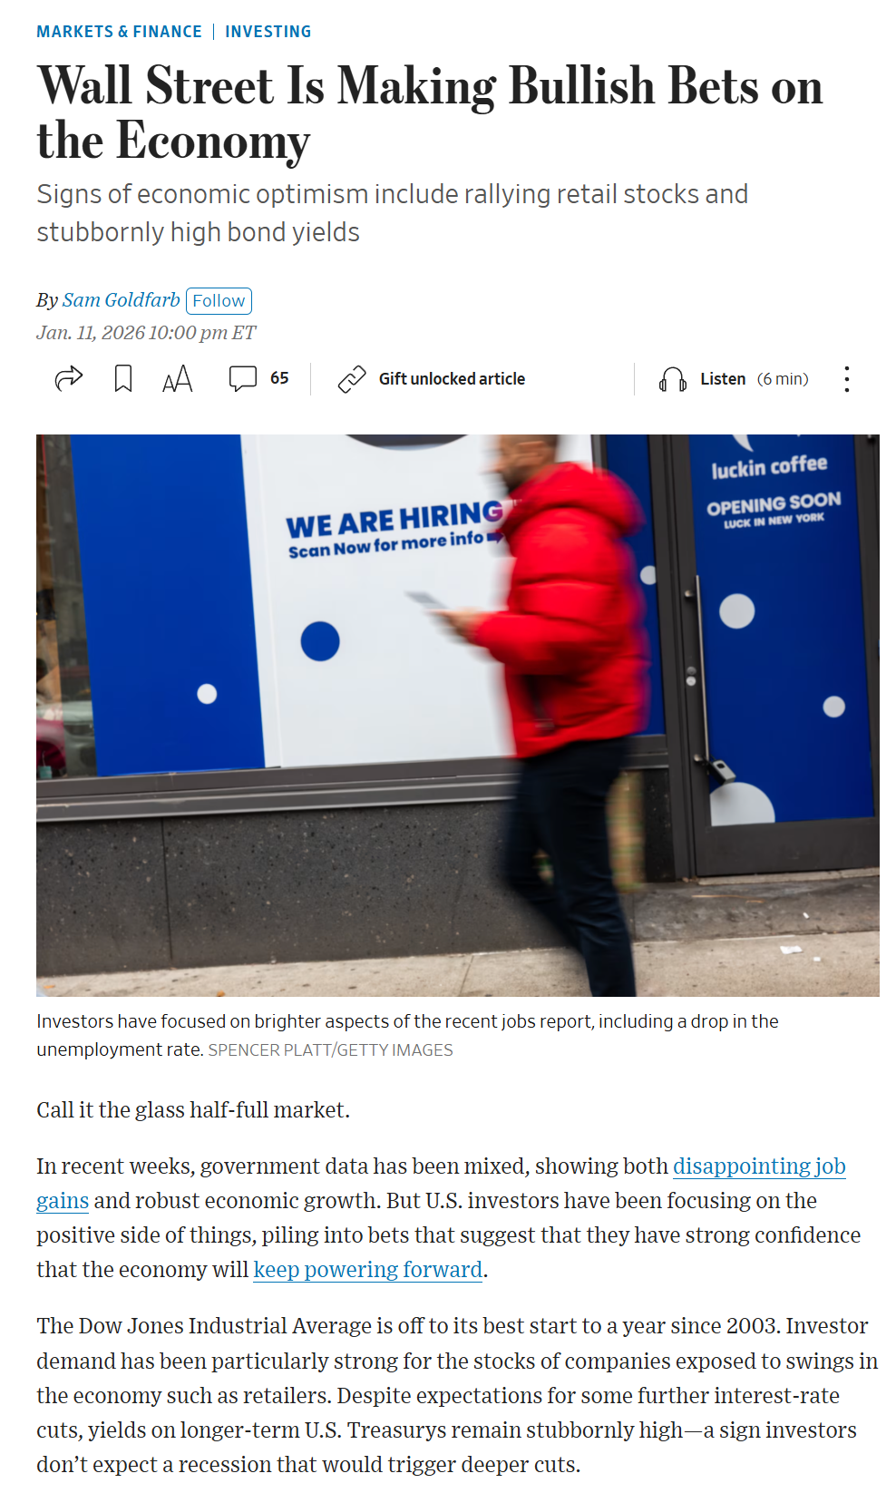
Explaining the term structure

Slide 29
Explaining the term structure
Interest rate risk
  Prices of long-duration bonds are significantly more volatile than short-duration bonds, with sharp interest rate increases potentially dropping long-term values by 30% to 40%.
  Investors without matching long-term obligations, such as those saving for a near-term purchase, typically require higher prospective returns to accept this volatility.
Inflation risk
  Predicting inflation over a 10 to 15-year horizon is highly uncertain, making it risky to lock in long-term interest rates.
  Investors can reduce exposure to inflation risk by investing in short-term assets and rolling them over, as future rates will likely adjust to match rising inflation.
  Because of this uncertainty, borrowers must offer incentives to induce long-term lending, which often results in a steeply upward-sloping yield curve.

Slide 30
Real and nominal rates of interest
Inflation measures the rate at which the prices of goods and services increase over time.
Nominal dollars represent the absolute monetary value in financial terms, such as the specific figure in a bank balance or net worth statement.
Real dollars reflect actual purchasing power, indicating the tangible volume of goods and services that can be purchased with that money.
In the presence of inflation, an investor’s real interest rate is always less than the nominal interest rate.
  Real rate of return:

Slide 31
Real and nominal rates of interest
Example: If you invest in a security that pays 10% interest annually and inflation is 6%, what is your real interest rate?
  Real interest rate = 0.03774 or 3.774%

Slide 32
Real and nominal rates of interest
  Treasury Inflation-Protected Securities (T I P S) have a lower yield but “protects” investors against inflation
Future Annual Inflation | Outcome Analysis | Better Investment
Higher than 2.3% | The inflation adjustment on TIPS exceeds the yield advantage of nominal bonds. | TIPS
Lower than 2.3% | The fixed rate on nominal bonds provides a better return than the inflation-adjusted TIPS. | Nominal Bonds
Exactly 2.3% | The returns on both investments are identical (the "break-even" inflation rate). | Indifferent

Slide 33
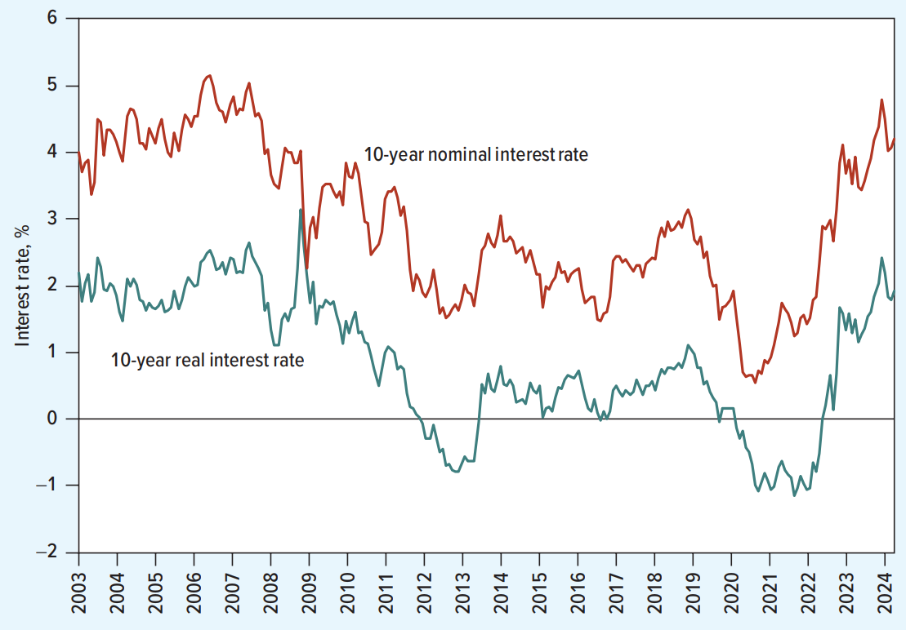
Real and nominal rates of interest
In practice, bonds are typically valued using nominal rates; not real interest rates.
  Real interest rates are “baked” into nominal rates because nominal rates tend to adjust upward when (expected) inflation increases.

Slide 34
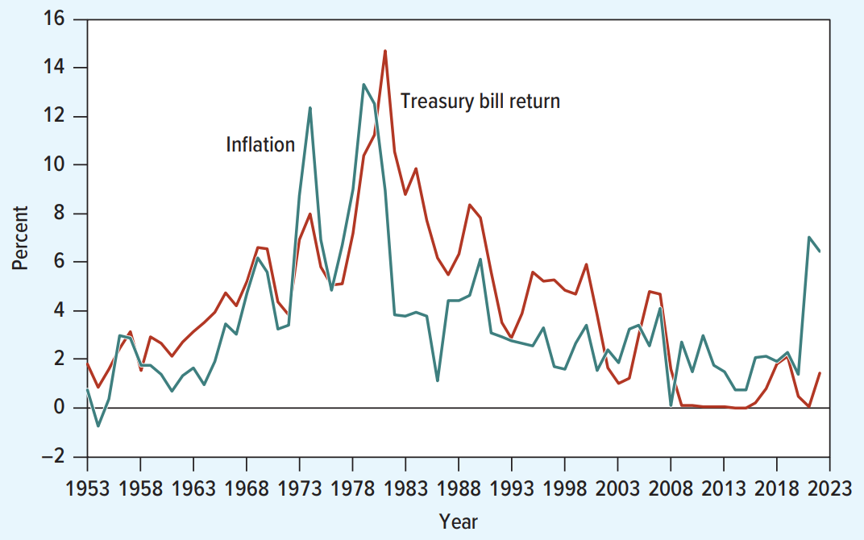
Real and nominal rates of interest
Fisher: Real rates are constant; if expected inflation increases, so do nominal interest rates.

Slide 35
The Risk of Default
Default or Credit Risk: The risk that a bond issuer may default on its bonds.
  Direct consequence from Limited Liability
Default premium: The additional yield on a bond that investors require for bearing credit risk.
Investment-grade bonds: Bonds rated Baa or above by Moody’s or BBB or above by Standard and Poor’s.
Junk bonds: Bonds with a rating below Baa or BBB.

Slide 36
The Risk of Default
Issuer Name | Coupon (%) | Maturity | S&P Rating | Price (%) | Yield (%)
Johnson & Johnson | 4.95 | 2033 | AAA | 105.09 | 4.26
ExxonMobil | 2.6 | 2030 | AA | 86.6 | 4.86
Bristol Myers | 2.95 | 2032 | A | 86.70 | 4.88
Hess | 7.125 | 2033 | BBB | 109.09 | 5.88
Qorvo | 3.75 | 2031 | BB | 81.47 | 6.50
Eldorado Gold | 6.5 | 2027 | B | 77.35 | 11.30
Telesat | 6.5 | 2027 | CCC | 50.0 | 37.49

Slide 37
The Risk of Default
Moody's | Standard and Poor's and Fitch
Investment-Grade Bonds
Aaa | AAA
Aa | AA
A | A
Baa | BBB
Junk Bonds
Ba | BB
B | B
Caa | CCC
Ca | CC
C | C

Slide 38
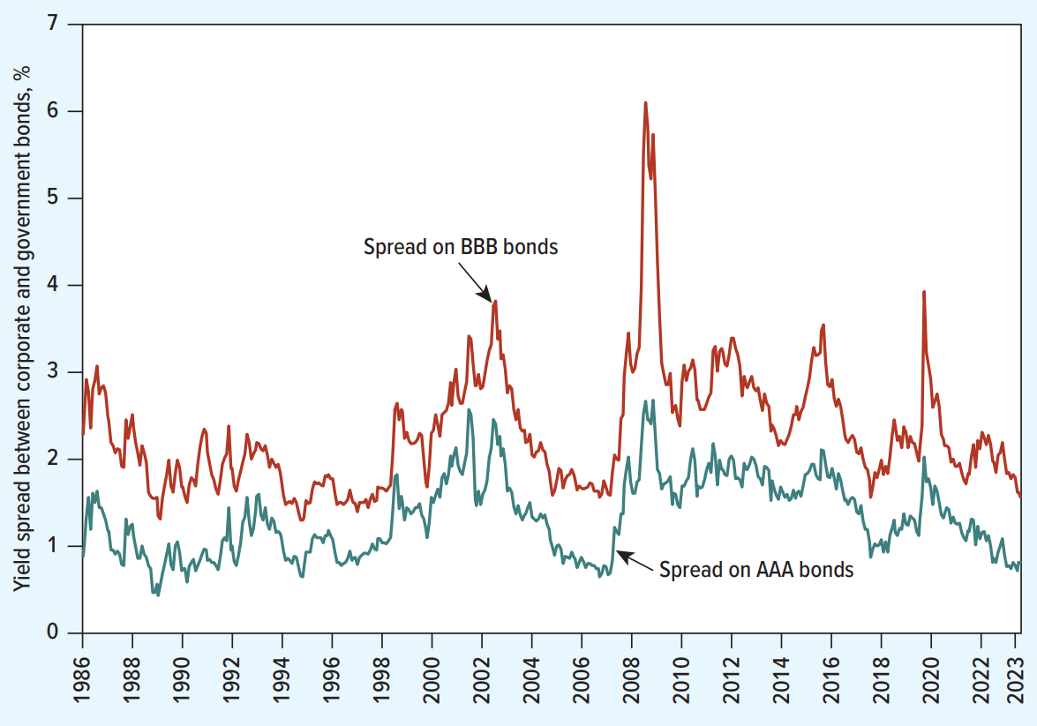
The Risk of Default

Slide 39
The Risk of Default
The Context of Pricing (Primary vs. Secondary) for Corporate Bonds
Valuation methodology differs significantly depending on whether the bond is similar to an existing asset trading on the exchange or a new security with no comparables being created.
In the Secondary Market, pricing is an analytical exercise based on interest rate math and relative value compared to other trading assets (what we have done so far).
In the Primary Market, pricing is a negotiation and discovery process driven by investor appetite and legal underwriting agreements.

Slide 40
The Risk of Default
Secondary Market Valuation (Analytical Pricing)
Bankers begin by analyzing the government term structure (the yield curve) to determine the baseline risk-free rate for the bond's specific maturity (e.g., 10-year Treasury rate).
To account for default risk, they add a credit spread to this baseline; this spread acts as a premium determined by the company’s specific credit rating (comparing a AAA benchmark vs. the company's actual rating, such as BBB).
Once the total discount rate (Risk-Free Rate + Credit Spread) is established, they use the Discounted Cash Flow (DCF) method to calculate the present value of all future coupon payments and the principal repayment.

Slide 41
The Risk of Default
Primary Market Pricing (Negotiation and Discovery)
Because a new bond has no trading history, bankers conduct a “price discovery” process known as book building, where they solicit indications of interest from institutional investors to see what yield they demand.
The pricing is finalized based on investor feedback; if demand is weak, the issuer may have to widen the spread (offer a higher yield) to clear the market.
In a “firm commitment” underwriting, if the auction fails to clear at the agreed price, the underwriter is legally obligated to guarantee the deal by purchasing the unsold bonds using their own capital.

Slide 42
Legal applications
Ethoz Capital Ltd v Im8ex Pte Ltd [2023] SGCA 3: “The classic statement of principle [relating to whether a provision is an unenforceable penalty] is that “[t]he essence of a penalty is a payment of money stipulated as in terrorem of the offending party” while “the essence of liquidated damages is a genuine covenanted pre-estimate of damage.”
  An acceleration clause demanded immediate payment of all future unearned interest upon breach.
  Court held that this clause was an unenforceable penalty: “in the face of the Facilities, the immediate and full payment of the Total Interest is clearly a payment of money that operates in terrorem of Im8ex, forcing it to comply with its primary obligation under the Facilities…”
The Valuation Flaw: Receiving $100 today is worth significantly more than receiving $100 in Year 10.
  By demanding the full nominal sum immediately (without a rebate), the lender demands more than their actual economic loss. This excess is the “Penalty.”
  To ensure enforceability, the clause should apply a Discount Rate (DCF). Promisee is legally entitled only to the Present Value (PV) of those future payments, not the nominal sum.

Slide 43
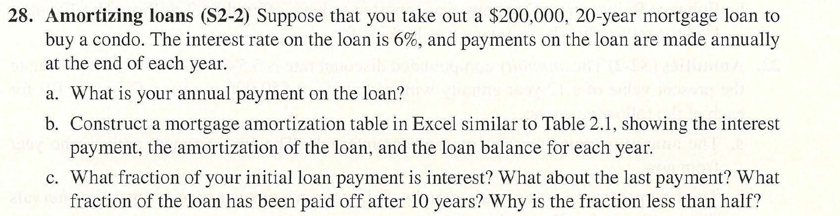
Seminar questions

Slide 44
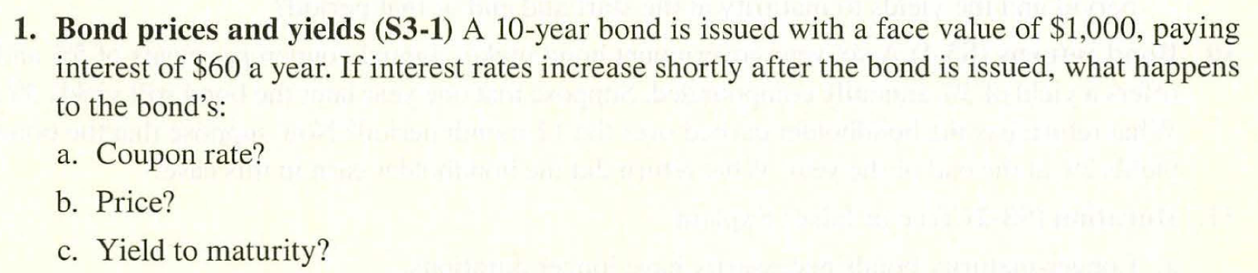
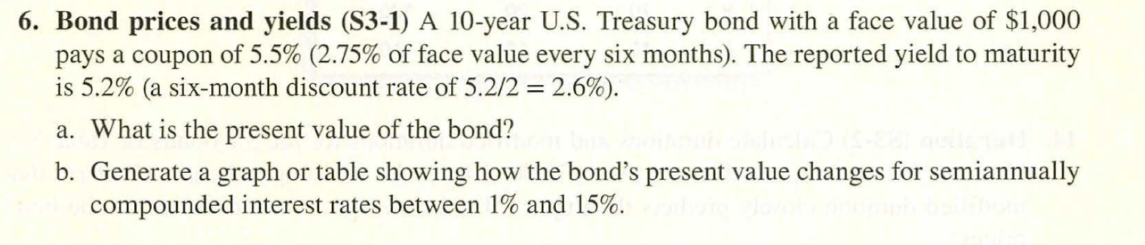
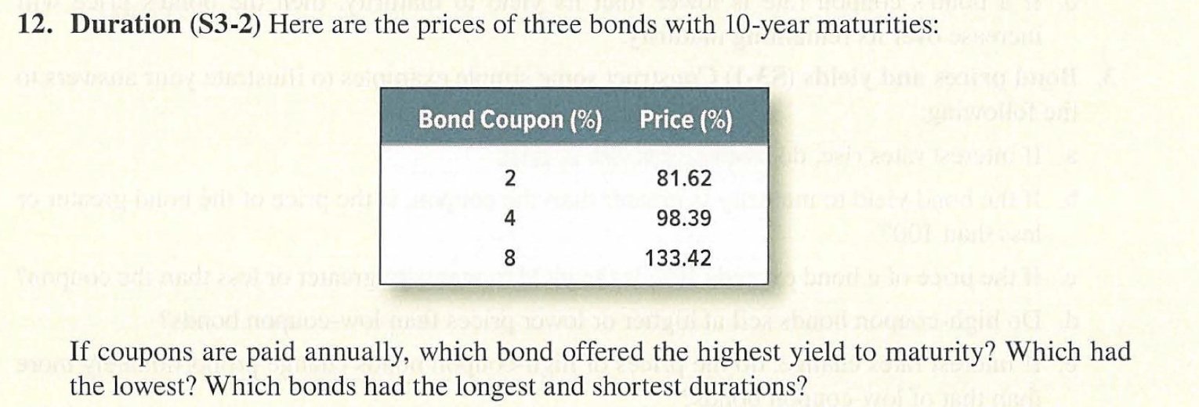
Seminar questions

Slide 45
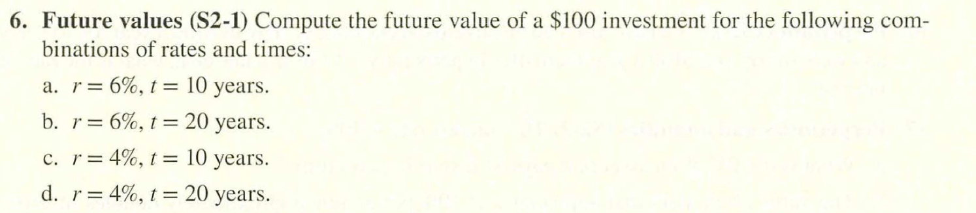
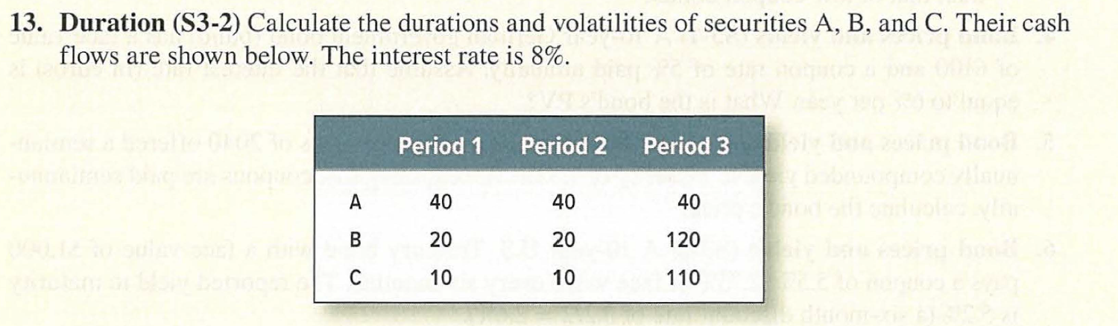
Seminar questions (optional)

Slide 46
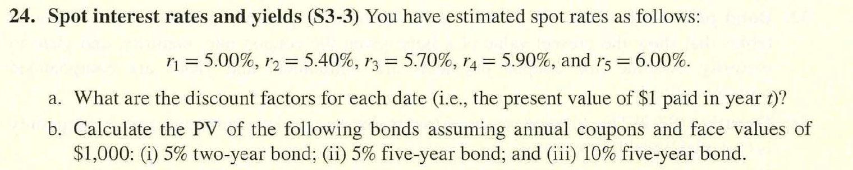
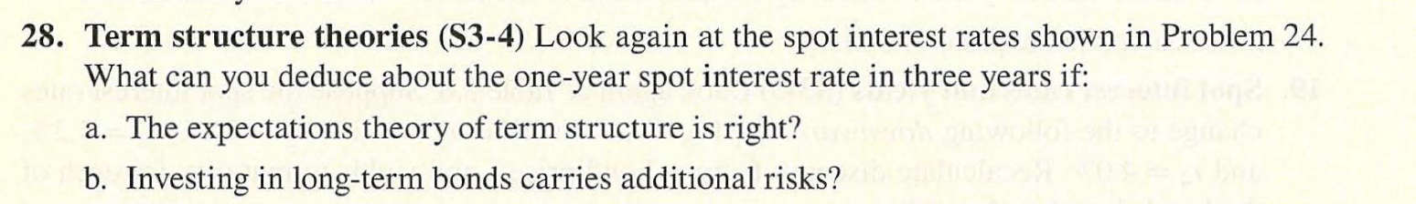
Seminar questions (optional)

Slide 47
Q&A
See you guys on Thurs.

