Slide 1

Advanced Corporate Finance (LL4554V/LL5554V/LLJ5554V/LL6554V)
4. valuing equity
Kenneth Khoo
kenneth.khoo@nus.edu.sg

Slide 2

Valuing equity
How Common Stocks Are Traded.
Valuation by Comparables.
Valuation by Fundamentals.
Valuation Based on Free Cash Flow.
Legal Applications.

Slide 3
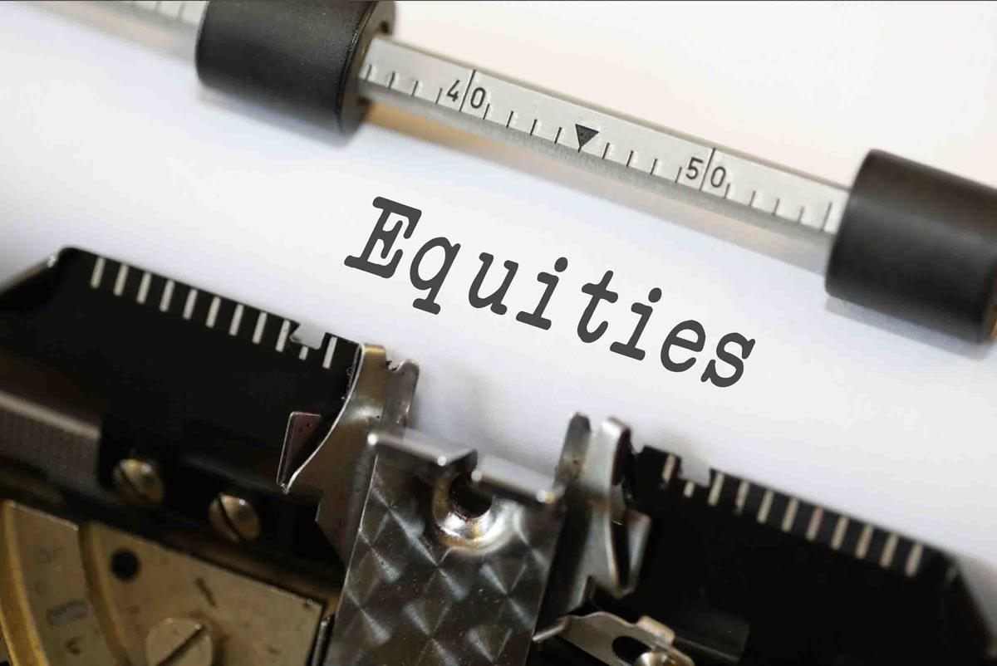
Terminology
Primary Market
  Market for the sale of new shares by corporations.
Secondary Market
  Market in which previously issued shares are traded among investors.
Common Stock
  Ownership shares in a publicly held corporation
  NB: Ignore dual-class variants/preference shares for now.
Exchange-Traded Funds (ETFs)
  Portfolios of stocks that can be bought or sold in a single trade.
This Photo by Unknown Author is licensed under CC BY-SA

Slide 4

Terminology
Earnings (The Flow)
  The net profit a company generates over a specific period (usually a year).
  Formula: Revenue - Expenses = Earnings (Net Income).
  Earnings represent new wealth creation. It is the speed at which the company is making money right now.
  Contrast with Cash Flow: Earnings are an accounting measure; they are not always the same as physical cash in the bank because they include non-cash items (like depreciation) and exclude capital expenditures.
This Photo by Unknown Author is licensed under CC BY-SA

Slide 5

Terminology
Book Value (The Stock)
  The net worth of the firm according to the accounting Balance Sheet.
  Formula: Total Assets - Total Liabilities = Book Value (Shareholder’s Equity).
  This is a snapshot of historical wealth. It represents what shareholders theoretically own if the company stopped operations and sold everything at its accounting value.
  NB: Book value is NOT market value. Why?
Dividend
  A periodic cash distribution sent directly from the firm to the shareholders.

Slide 6
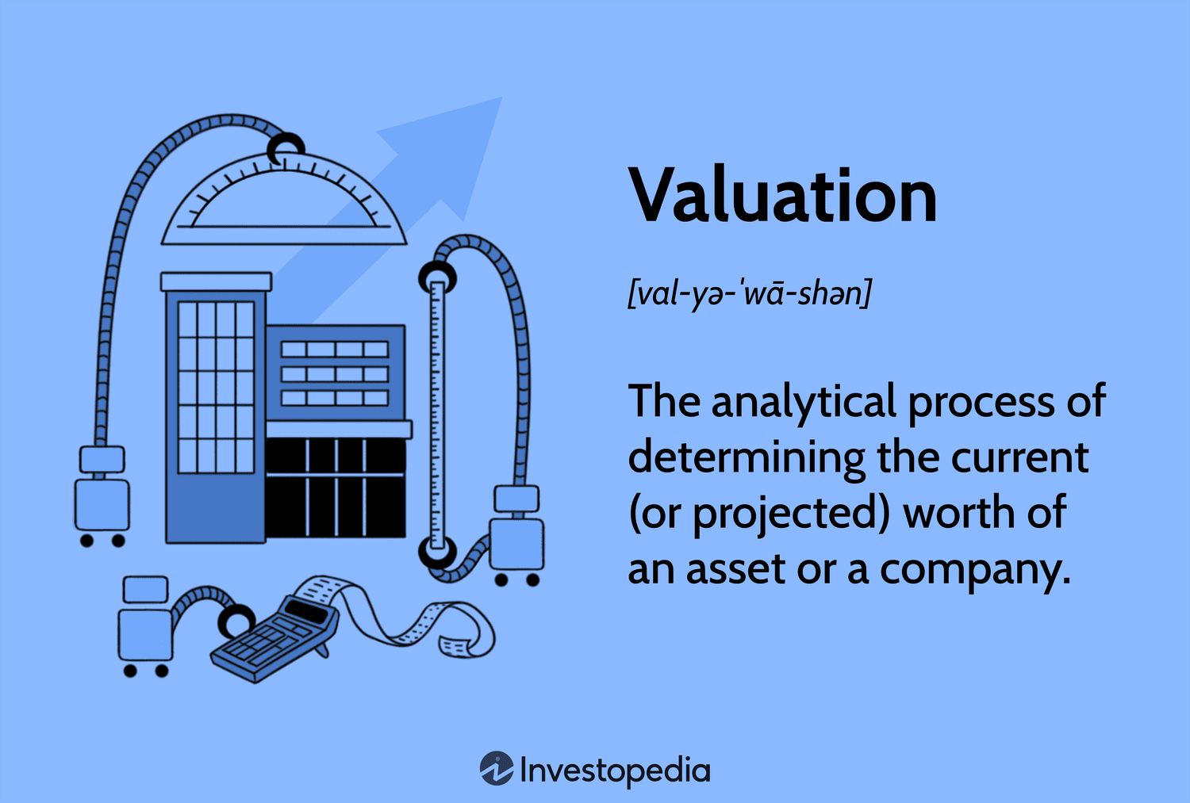
Terminology
Valuation by Comparables
  Identifying similar firms as potential comparables and then examining how much investors in these comparable companies pay per dollar of earnings or book value.
P/E Ratio
  Price per share divided by earnings per share.
  For valuation purposes, we almost always use the forward (i.e., projected) P/E Ratio.
P/B Ratio
  Price per share divided by book value per share.

Slide 7
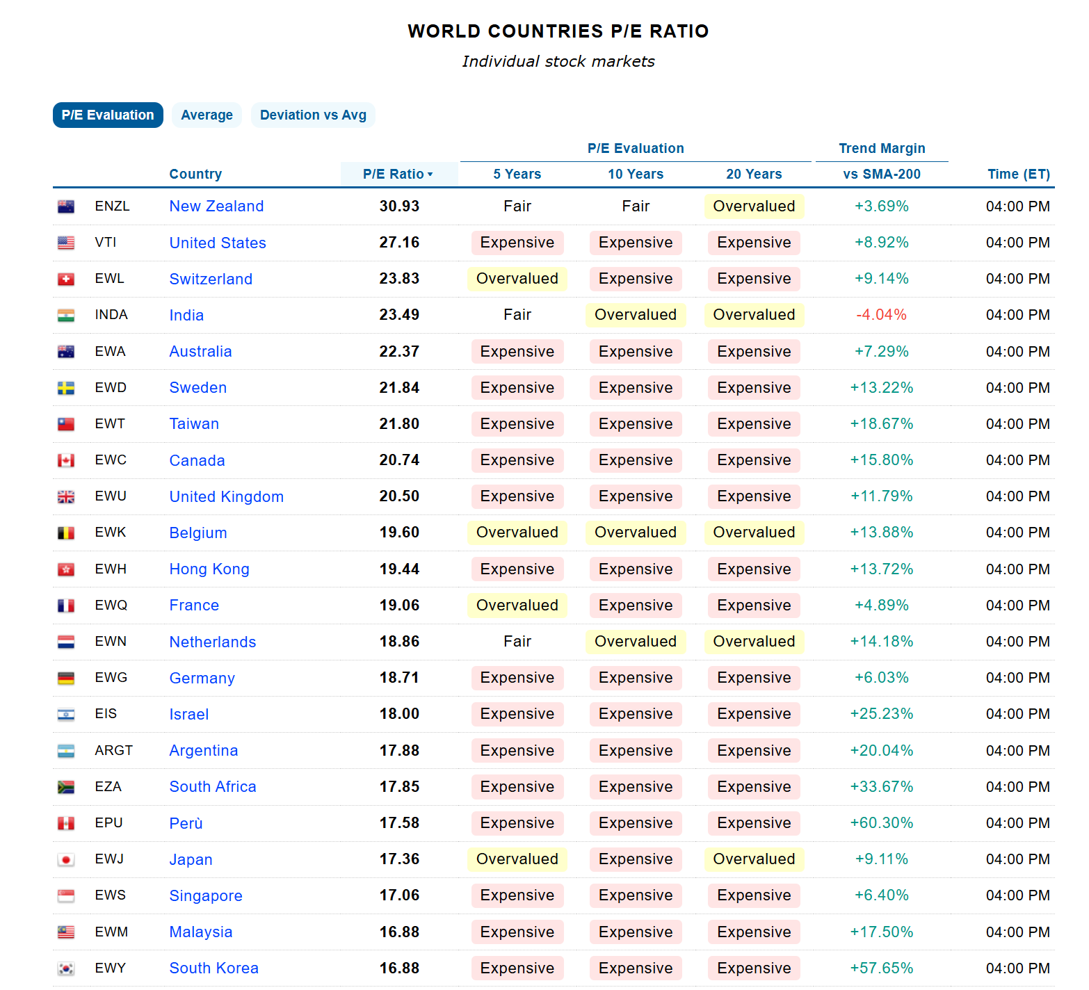
Terminology

Slide 8
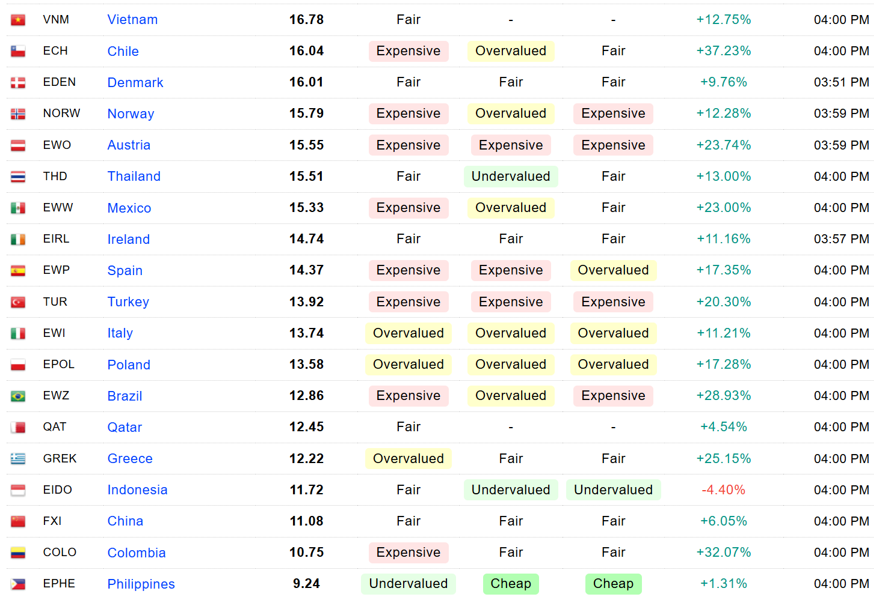
Terminology

Slide 9
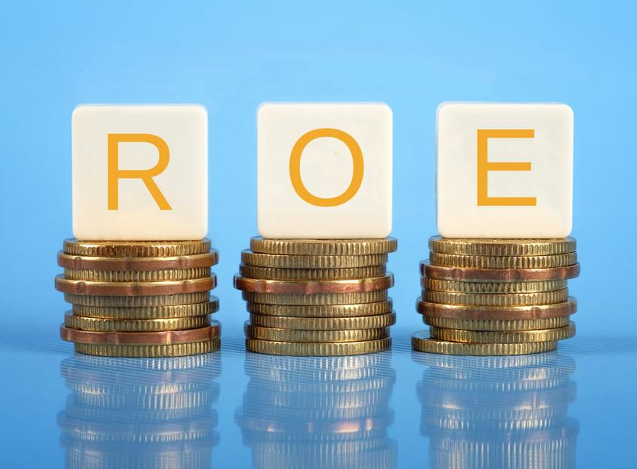
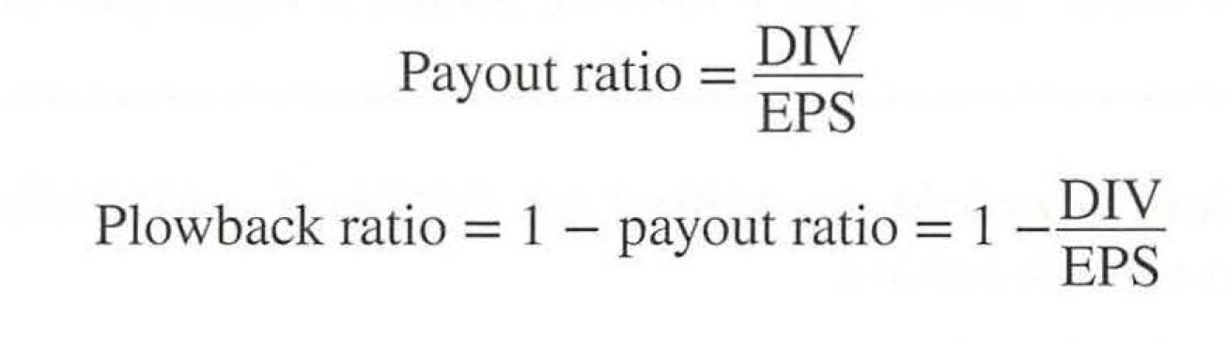
Terminology
Return on Equity (y, or ROE)
  Defined as the ratio of Net Income (i.e., earnings) to Book Equity (i.e., book value).
  ROE shows how much additional profit is generated for every dollar of cash reinvested inside the company.
Plowback Ratio (k)
  The fraction of earnings that the company keeps for internal reinvestment.
  It represents the portion of profits retained for growth rather than distributed to shareholders as dividends.
This Photo by Unknown Author is licensed under CC BY-NC

Slide 10
How stocks are traded
Nike, Inc. (NKE)
103.77 –0.02 (–0.02%) Feb. 8 4:00 pm ES T
Previous close | 103.79 | Market cap | 157.224 B
Open | 104.43 | EPS (TTM) | 3.43
Day’s range | 103.04 to 104.96 | EPS (2023A) | 3.23
52-week range | 88.66 to 128.68 | EPS (2024E) | 3.59
Volume | 6,324,489 | EPS (2025E) | 4.25
Average volume | 9,324,623 | P/E (TTM) | 30.25
Book value/share | 9.32 | Dividend (yld) | 1.48 (1.43%)
Price/book value | 11.11 | 1y Target Est | 123.23
Notes:
Current price: 103.77 (Feb 8 2024)
-0.02: The stock price has dropped by $0.02 (2 cents) compared to the Previous close.
–0.02% (Percentage Change): The stock price has dropped by 0.02% in value.
EPS (TTM): 3.43TTM stands for "Trailing Twelve Months." Nike earned $3.43 per share over the last year.
EPS (2023A): A stands for Actual historical earnings reported by the company, for fiscal year 2023.
EPS (2024E) & (2025E): 3.59 & 4.25E stands for "Estimated." Analysts expect earnings to grow from $3.23 (2023A) to $4.25 (2025E).
P/E (TTM): 30.25. This is the Trailing P/E Ratio.
Nike pays out $1.48 per share in cash every year.
Forward P/E = 103.77/3.59 = 28.9
Volume: The total number of shares that have changed hands (been bought or sold) during today's trading session.
Average Volume: The average number of shares traded daily over a specific past period (usually the last 30 or 90 days).
1y Target Est (123.23): "One-Year Target Estimate." This is the average price forecast from professional research analysts covering the stock.

Slide 11
How stocks are traded
Unlike the valuation of bonds, the valuation of equities is far more complicated.
Bonds
  The cash flows are strictly defined because coupons are contractual, fixed obligations that must be paid.
  The life of the investment is clear because the maturity date is a known and finite point in time.
  The discount rate is objective because it can be observed directly from current market yields for similar debt.
Equities
  The cash flows are difficult to predict because dividends and earnings are variable, uncertain, and theoretically infinite.
  The investment carries higher risk because there is no legal promise or contract guaranteeing any payment to the shareholder.

Slide 12
How stocks are traded
The Estimation Dilemma
  Unlike bond coupons, future earnings are driven by complex market dynamics, strategy, and competition that make precise forecasting impossible.
  Since stocks have no maturity date, analysts must estimate a “Terminal Value” to capture the distant future, which often makes up the majority of the stock’s value.
  As the textbook notes, analysts can generate various price estimates using different methods (such as P/E or DCF), but there is no single “best” method to rely on.

Slide 13
Valuation by comparables
 | Stock Price | P/E | P/B | Comparable | P/E | P/B
Coca-Cola (beverages) | $ 61.20 | 26.7 | 10.5 | PepsiCo | 38.7 | 16.0
Union Pacific (railroad) | $ 200.03 | 17.7 | 9.8 | CPKC | 26.3 | 2.5
 |  |  |  | CSX | 16.1 | 5.4
 |  |  |  | Norfolk Southern | 17.1 | 3.9
 |  |  |  | Average | 19.8 | 3.9
Bank of America (bank) | $28.14 | 8.5 | 0.9 | JPMorgan Chase | 10.2 | 1.5
 |  |  |  | Wells Fargo | 11.8 | 0.9
 |  |  |  | Citigroup | 6.4 | 0.5
 |  |  |  | Capital One | 6.7 | 0.7
 |  |  |  | PNC Financial | 8.5 | 1.0
 |  |  |  | US Bancorp | 8.6 | 1.1
 |  |  |  | Average | 8.7 | 1.0
Stock price, price–earnings (P/E), and market-book (P/B) in June 2023 for three companies and potential comparable companies.

Slide 14
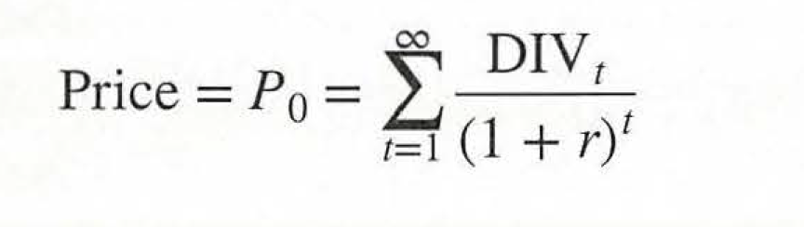
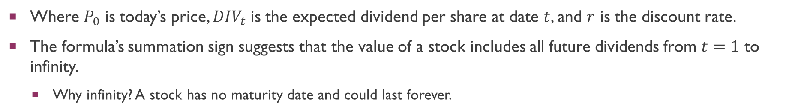
Valuation by fundamentals
The value of any stock is the present value of its future cash flows.
  This reflects the DCF formula. Dividends represent the future cash flows of the firm.
PV (Share of stock) = PV (Expected future dividends per share).
Thus, the price of a stock is thus given by:
Where $P_{0}$ is today’s price, $DIV_{t}$ is the expected dividend per share at date $t$, and $r$ is the discount rate.
The formula’s summation sign suggests that the value of a stock includes all future dividends from $t=1$ to infinity.
  Why infinity? A stock has no maturity date and could last forever.

Slide 15
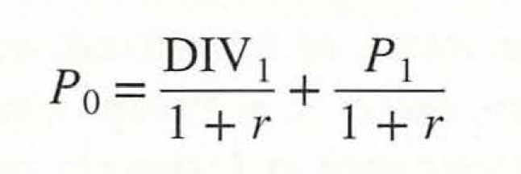
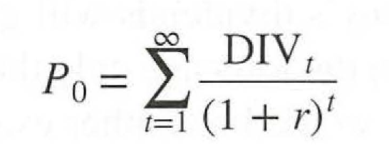
PV Formula to Value a Bond
It is important to note that the price of the stock, when sold, incorporates all future dividends.
In the example provided by the textbook, it is shown that the price of the stock to an investor who will sell the stock in 1 year’s time is:
The textbook illustrates that this is equivalent to:
In short, the seller explicitly receives the date 1 dividend, and he implicitly receives all dividends from date 2 onward, since they’ll affect the price he is paid for them in date 2.
In short, capital gains depend on expected future dividends.

Slide 16
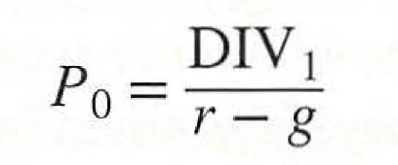
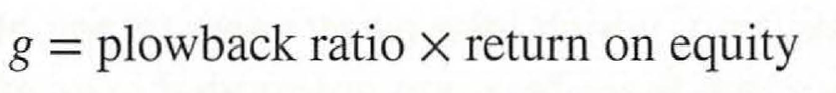
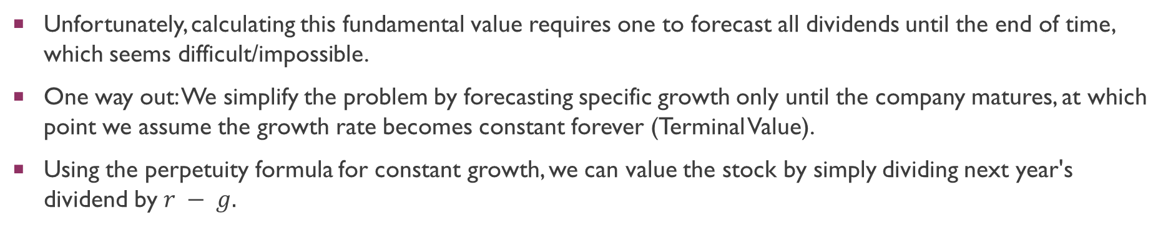

Valuation by fundamentals
Unfortunately, calculating this fundamental value requires one to forecast all dividends until the end of time, which seems difficult/impossible.
One way out: We simplify the problem by forecasting specific growth only until the company matures, at which point we assume the growth rate becomes constant forever (Terminal Value).
Using the perpetuity formula for constant growth, we can value the stock by simply dividing next year's dividend by $r − g.$
This is also known as the constant-growth DCF model.
Note that the dividend growth rate $g$ is usually estimated via $k × y$:

Slide 17
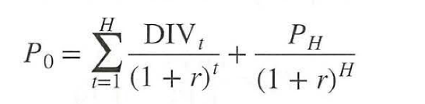
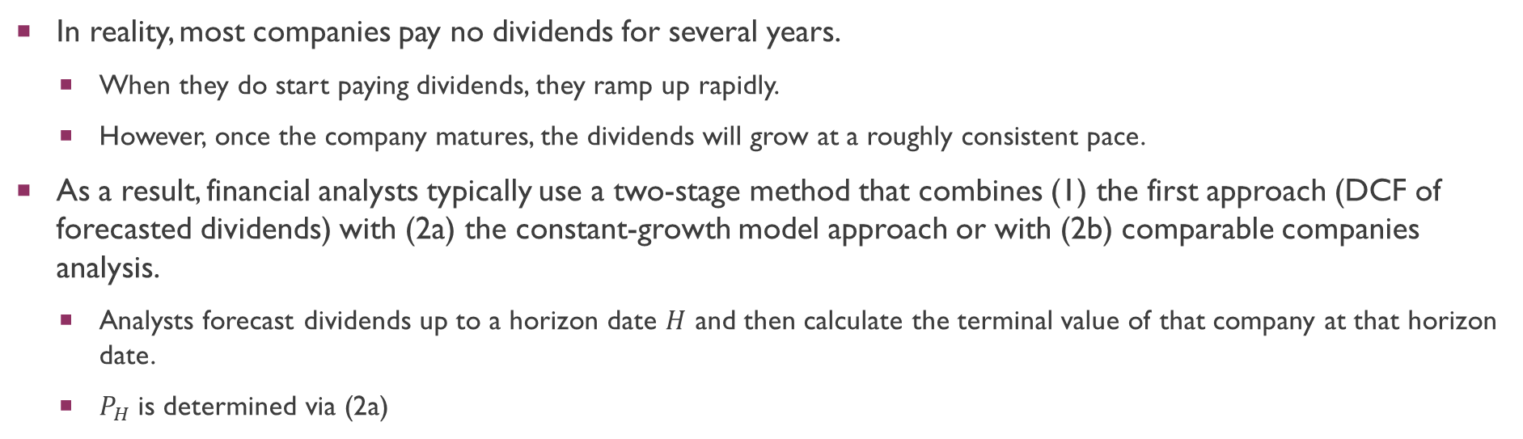
Valuation by fundamentals
In reality, most companies pay no dividends for several years.
  When they do start paying dividends, they ramp up rapidly.
  However, once the company matures, the dividends will grow at a roughly consistent pace.
As a result, financial analysts typically use a two-stage method that combines (1) the first approach (DCF of forecasted dividends) with (2a) the constant-growth model approach or with (2b) comparable companies analysis.
  Analysts forecast dividends up to a horizon date $H$ and then calculate the terminal value of that company at that horizon date.
  $P_{H}$is determined via (2a)

Slide 18
Valuation by fundamentals
Example:
  Phoenix produces dividends in 3 consecutive years of 0.00, 0.31, and 0.65, respectively. The dividend in Year 4 is estimated to be 0.67 and should grow in perpetuity at 4%. Given a discount rate of 10%, what is the price of the stock?

Slide 19
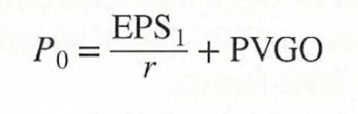
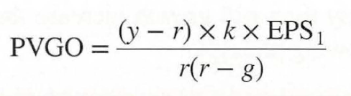
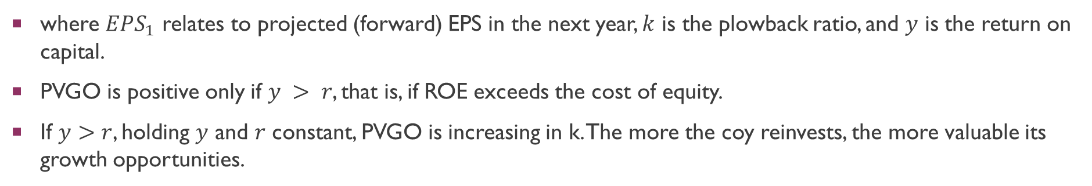
Valuation by fundamentals
Another way of thinking about the stock price is to decompose the stock price into two components, (1) the value of average earnings under a no-growth policy, and (2) PVGO, the present value of growth opportunities.
where $EPS_{1}$ relates to projected (forward) EPS in the next year, $k$ is the plowback ratio, and $y$ is the return on capital.
PVGO is positive only if $y > r$, that is, if ROE exceeds the cost of equity.
If $y>r$, holding $y$ and $r$ constant, PVGO is increasing in k. The more the coy reinvests, the more valuable its growth opportunities.
Notes:
DIV_1 = EPIS_1(1-k)

Slide 20
Valuation by fundamentals
Intuition behind PVGO: If a firm elects to pay a lower dividend and reinvest the funds, the stock price may increase because future dividends may be higher.
Example:
  Our company forecasts to pay an $8.33 dividend next year, which represents 100% of its earnings. This will provide investors with a 15% expected return. Instead, we decide to plow back 40% of the earnings at the firm’s current return on equity of 25%. What is the value of the stock before and after the plowback decision?
With Growth
No Growth
Notes:
DIV_1 = EPIS_1(1-k)

Slide 21
Valuation by fundamentals
Intuition behind PVGO: If a firm elects to pay a lower dividend and reinvest the funds, the stock price may increase because future dividends may be higher.
If the company did not plow back some earnings, the stock price would remain at $55.56. With the plowback, the price rose to $100.00.
The difference between these two numbers is called the present value of growth opportunities (PVGO).
PVGO = $100.00 − 55.56 = $44.44
Notes:
DIV_1 = EPIS_1(1-k)

Slide 22
Valuation by fundamentals
Growth Stocks
  These are stocks where the Present Value of Growth Opportunities (PVGO) is positive and accounts for a large fraction of the total stock price.
  Investors are primarily attracted to these companies by the potential for significant capital gains if the firm's expansion strategies succeed.
Income/Value Stocks
  These are stocks where PVGO makes up only a small fraction of the price, often because the company cannot reinvest capital at returns substantially above its cost of equity.
  The value of these stocks is derived mostly from the future earnings and dividends generated by the assets already in place.

Slide 23
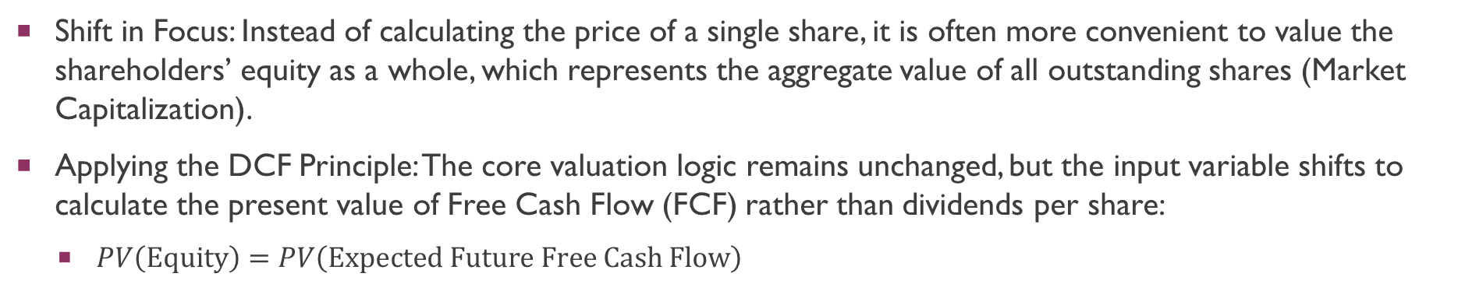
Valuation Based on Free Cash Flow
Shift in Focus: Instead of calculating the price of a single share, it is often more convenient to value the shareholders’ equity as a whole, which represents the aggregate value of all outstanding shares (Market Capitalization).
Applying the DCF Principle: The core valuation logic remains unchanged, but the input variable shifts to calculate the present value of Free Cash Flow (FCF) rather than dividends per share:
  $PV\left(\text{Equity}\right)=PV\left(\text{Expected} \text{Future} \text{Free} \text{Cash} \text{Flow}\right)$

Slide 24
Valuation Based on Free Cash Flow
Defining Free Cash Flow (FCF): FCF is the post-tax cash generated by the company’s operations after subtracting the investments required for growth. This distinction is critical because, just like stock valuation uses dividends rather than earnings, firm valuation uses the actual cash available for distribution rather than accounting profits.
While dividends per share represent the cash actually paid to a single unit of ownership, Free Cash Flow represents the total pool of cash available for payout to the entire group of shareholders.

Slide 25
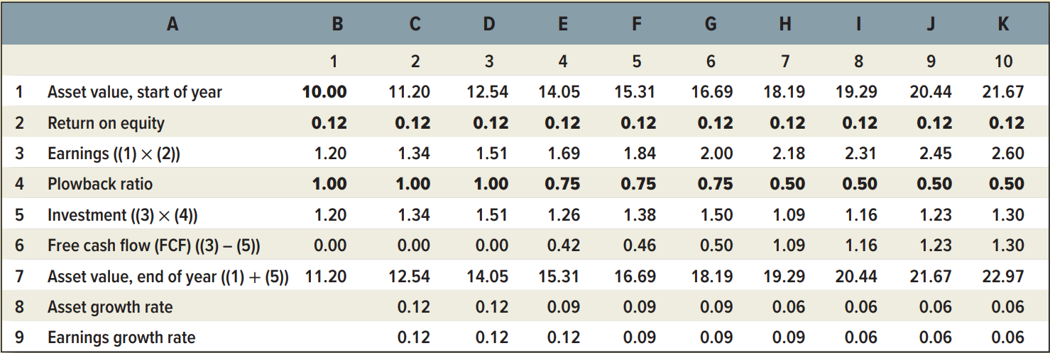
Valuation Based on Free Cash Flow
Example:
  Given the cash flows for Concatenator Manufacturing Division, calculate the PV of near-term cash flows (Years 1 to 6), PV (terminal value), and the total value of the firm when r = 10% and g = 6%.

Slide 26
Valuation Based on Free Cash Flow
Example:
  Given the cash flows for Concatenator Manufacturing Division, calculate the PV of near-term cash flows (Years 1 to 6), PV (terminal value), and the total value of the firm when r = 10% and g = 6%.

Slide 27
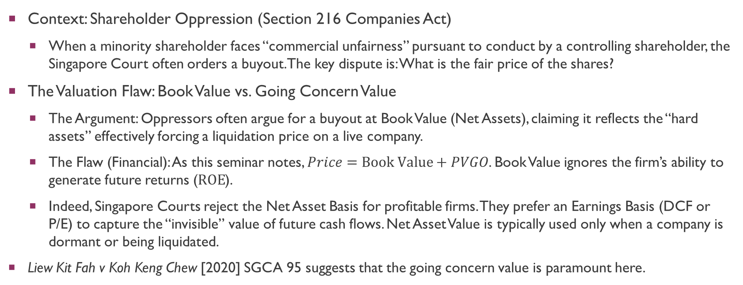
Legal applications
Context: Shareholder Oppression (Section 216 Companies Act)
  When a minority shareholder faces “commercial unfairness” pursuant to conduct by a controlling shareholder, the Singapore Court often orders a buyout. The key dispute is: What is the fair price of the shares?
The Valuation Flaw: Book Value vs. Going Concern Value
  The Argument: Oppressors often argue for a buyout at Book Value (Net Assets), claiming it reflects the “hard assets” effectively forcing a liquidation price on a live company.
  The Flaw (Financial): As this seminar notes, $Price=\text{Book} \text{Value}+PVGO$. Book Value ignores the firm’s ability to generate future returns ($ROE$).
  Indeed, Singapore Courts reject the Net Asset Basis for profitable firms. They prefer an Earnings Basis (DCF or P/E) to capture the “invisible” value of future cash flows. Net Asset Value is typically used only when a company is dormant or being liquidated.
Liew Kit Fah v Koh Keng Chew [2020] SGCA 95 suggests that the going concern value is paramount here.

Slide 28
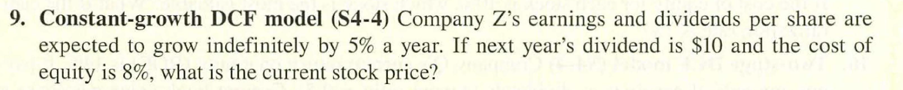
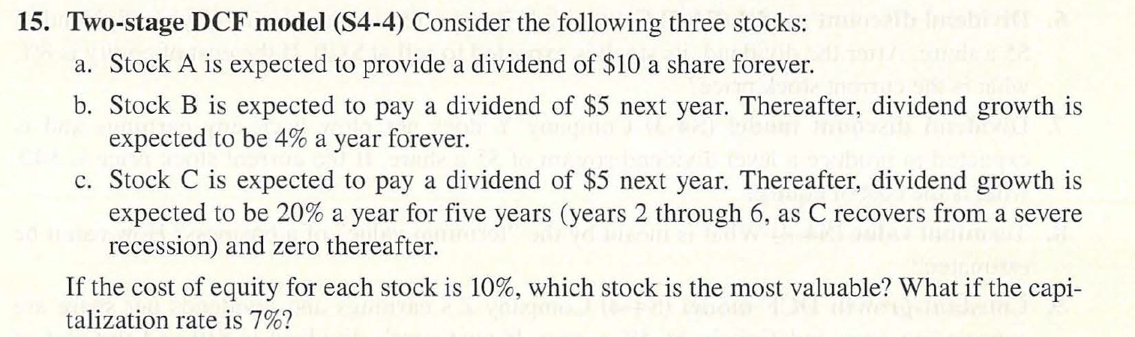
SEMINAR QUESTIONs

Slide 29
SEMINAR QUESTIONS

Slide 30
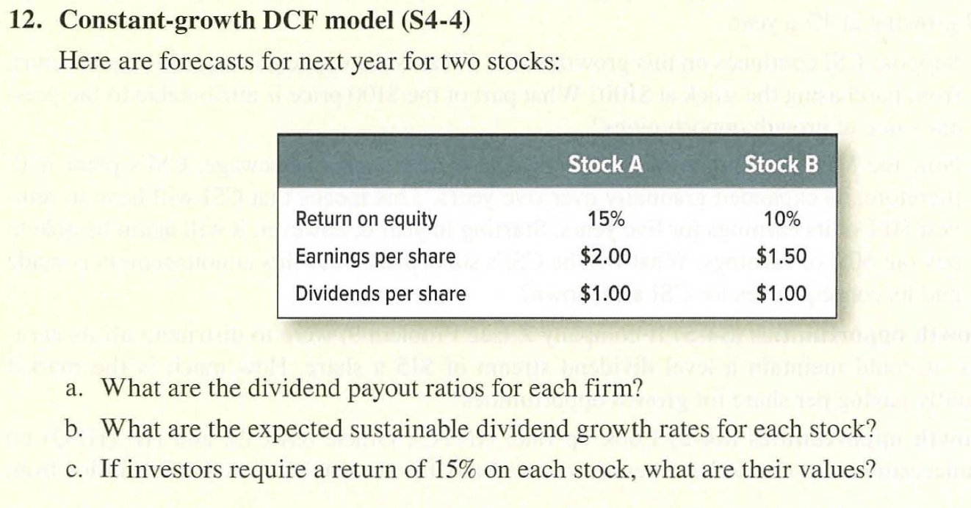
SEMINAR QUESTIONS (OPTIONAL)

Slide 31
SEMINAR QUESTIONS (OPTIONAL)

Slide 32
Q&A
See you guys on Thurs.

