Slide 1

Advanced Corporate Finance (LL4554V/LL5554V/LLJ5554V/LL6554V)
5. investment criteria
Kenneth Khoo
kenneth.khoo@nus.edu.sg

Slide 2

Investment criteria
A Review of the Net Present Value Rule.
The Payback and Accounting Rate of Return Rules.
The Internal Rate of Return Rule.
Choosing Projects When Resources Are Limited.

Slide 3
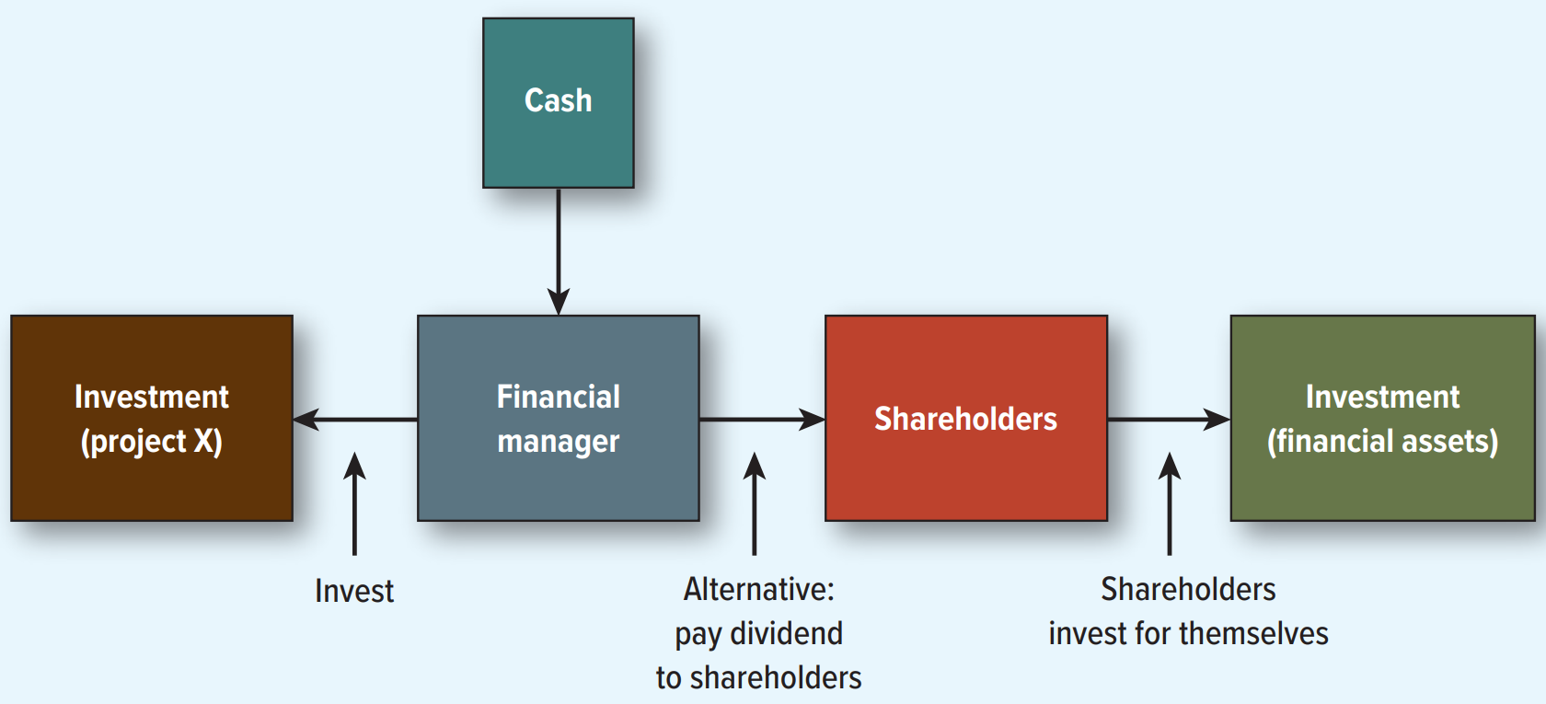
The opportunity cost of investment

Slide 4
Five points to remember about npv
The NPV rule offers a clear benchmark— accept projects with positive NPV.
NPV depends solely on all the cash flows, none are unaccounted for.
A dollar today is worth more than a dollar tomorrow.
Net present value ignores irrelevant factors. It depends solely on the forecasted cash flows from the project and the opportunity cost of capital.
Because present values are all measured in today’s dollars, you can add them up.

Slide 5
Investment criteria
In practice, however, firms often use investment criteria other than NPV to guide their decisions. This raises the question of how comparable these criteria are to one another.
 | Large Firms 2001 | Large Firms 2022 | Small Firms 2001 | Small Firms 2022
N P V | 85% | 77% | 68% | 40%
Internal Rate of Return | 84% | 75% | 69% | 40%
Payback | 46% | 64% | 64% | 66%
Accounting Rate of Return | 18% | 57% | 22% | 44%
Profitability Index | 8% | 39% | 15% | 31%
Source: J. Graham, “Presidential Address: Corporate Finance and Reality,” Journal of Finance 77 (2022), pp. 1975 to 2049.

Slide 6
Accounting rate of return
The accounting rate of return is also known as the “Book Rate of Return”
It is defined by dividing average income (i.e., earnings) by average book value over project life.
Managers rarely use this measurement to make decisions.
The components reflect tax and accounting figures, not market values or cash flows.
  Ignores time value of money
  No clear benchmark (e.g., what if it’s lower than the opportunity cost of capital)?

Slide 7
Payback rule
Payback period: The number of years it takes before the cumulative forecasted cash flow equals the initial outlay.
The payback rule says to only accept projects that “pay back” in the desired time frame.
This method is flawed:
  It ignores later-year cash flows.
  It ignores the present value of future cash flows.
  No clear benchmark—cutoff of “payback period” is arbitrary

Slide 8
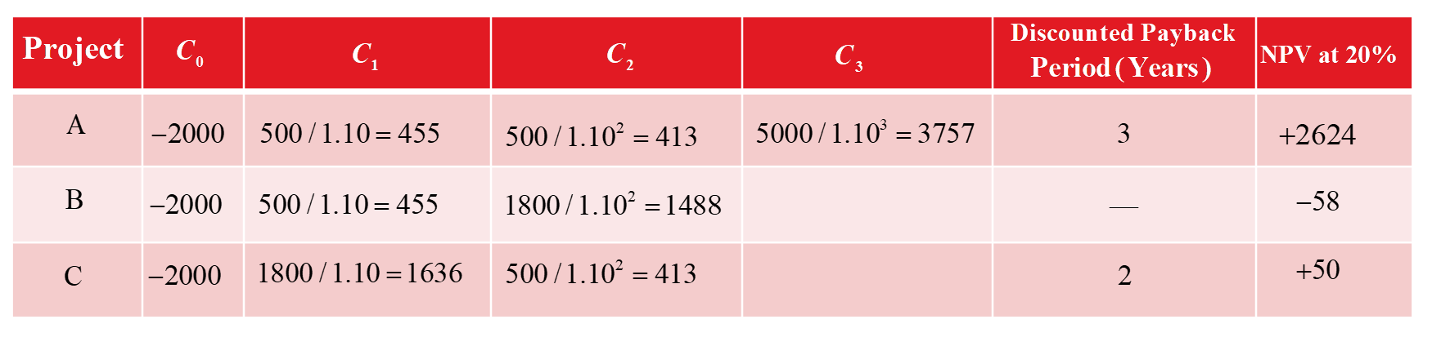
Payback rule
Example:
  Examine the three projects and note the mistake we would make if we insisted on only taking projects with a payback period of 2 years or less.
  We would forgo Project A, the most profitable project.

Slide 9
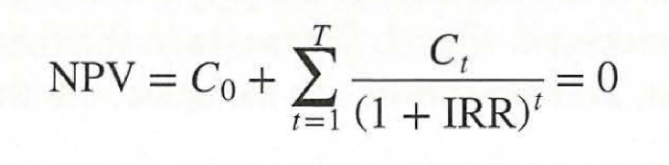
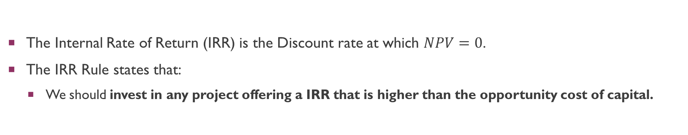
Internal rate of return
The Internal Rate of Return (IRR) is the Discount rate at which $NPV=0$.
The IRR Rule states that:
  We should invest in any project offering a IRR that is higher than the opportunity cost of capital.
Note that the internal rate of return is an internal profitability measure that depends solely on the amount and timing of the project cash flows.
In contrast, the opportunity cost of capital is an external benchmark against which we compare the profitability measure. The opportunity cost of capital is established in financial markets. It is the expected rate of return offered by other assets with the same risk as the project being evaluated.

Slide 10
Internal rate of return
Example:
  You can purchase a turbo-powered machine tool gadget for $4,000. The investment will generate $2,000 and $4,000 in cash flows for 2 years, respectively. What is the IRR on this investment?

Slide 11
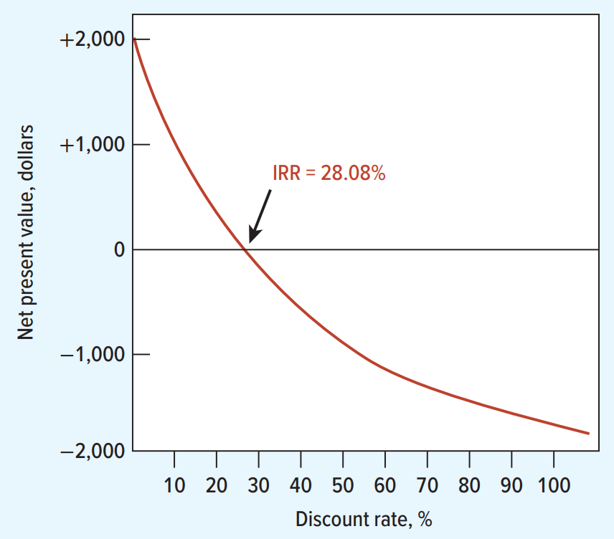
Internal rate of return

Slide 12
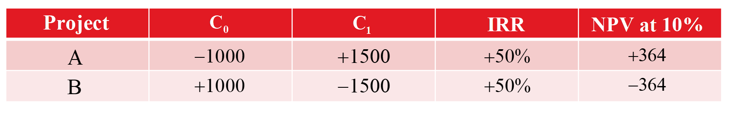
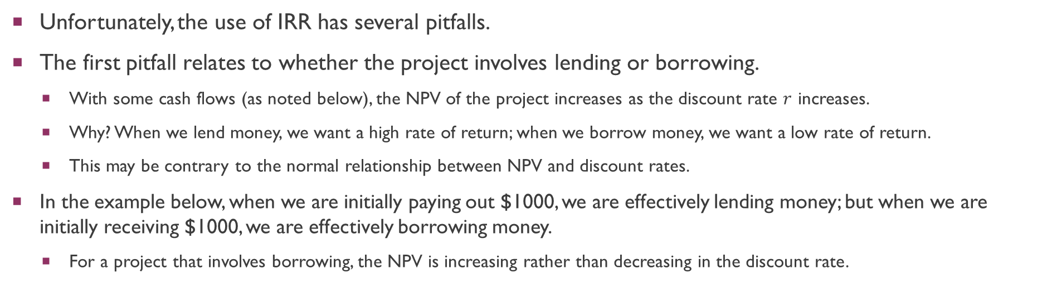
Internal rate of return
Unfortunately, the use of IRR has several pitfalls.
The first pitfall relates to whether the project involves lending or borrowing.
  With some cash flows (as noted below), the NPV of the project increases as the discount rate $r$ increases.
  Why? When we lend money, we want a high rate of return; when we borrow money, we want a low rate of return.
  This may be contrary to the normal relationship between NPV and discount rates.
In the example below, when we are initially paying out $1000, we are effectively lending money; but when we are initially receiving $1000, we are effectively borrowing money.
  For a project that involves borrowing, the NPV is increasing rather than decreasing in the discount rate.
Notes:
We will go through 4 pitfalls.

Slide 13
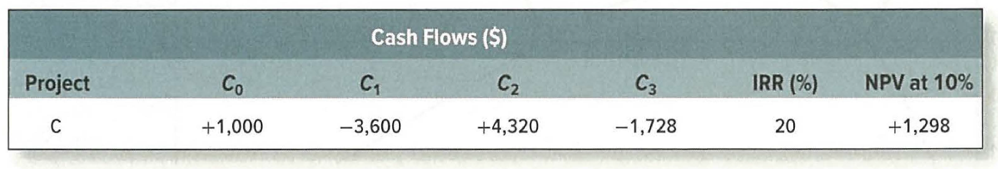
Internal rate of return
Not always clear whether we are borrowing or lending. In this example, the sign of cash flows changes several times. However, the project’s NPV is positive which makes it clear that it should be taken.

Slide 14
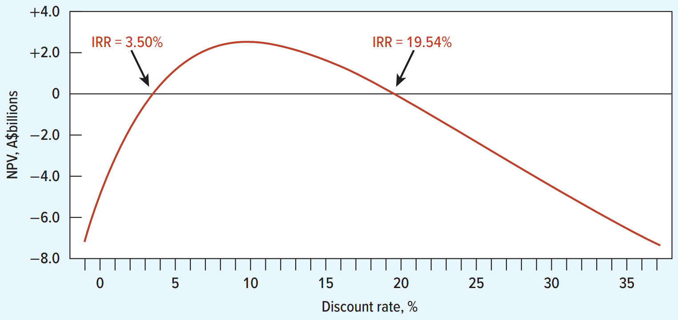
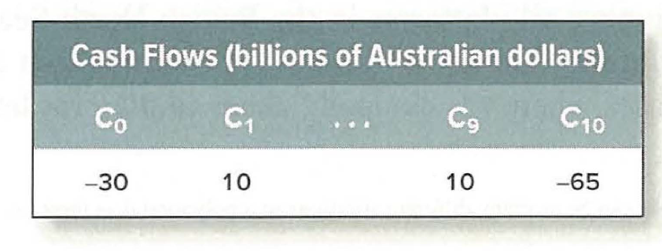

Internal rate of return
Unfortunately, the use of IRR has several pitfalls.
The second pitfall relates to multiple rates of return.
  Number of “IRRs” that satisfy the equation $≤$ the changes in the signs of the cash flow.
Example: The following investment has an IRR of both 3.50% and 19.54%.

Slide 15
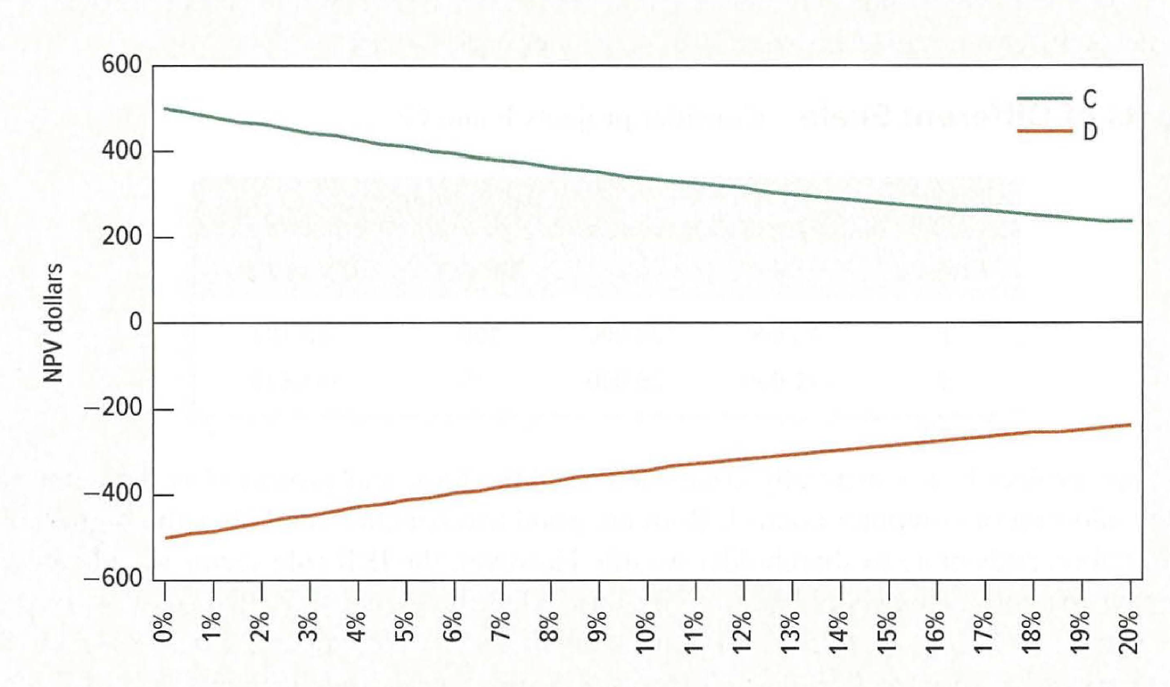
Internal rate of return
Cases also arise where no IRR exists.
  A project may have positive NPV for all (plausible) discount rates; while another may have negative NPV for all (plausible) discount rates.

Slide 16
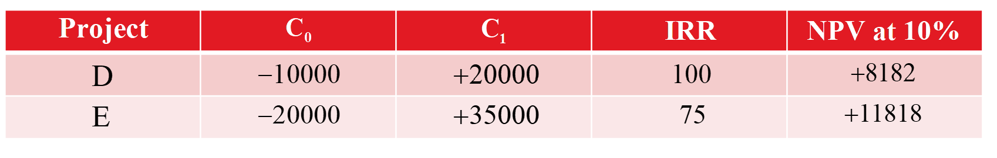
Internal rate of return
Unfortunately, the use of IRR has several pitfalls.
The third pitfall relates to mutually exclusive projects.
Consider the following projects:
One way out of the problem: Examine the incremental flows from undertaking the larger project (E) relative to the smaller project (D).

Slide 17
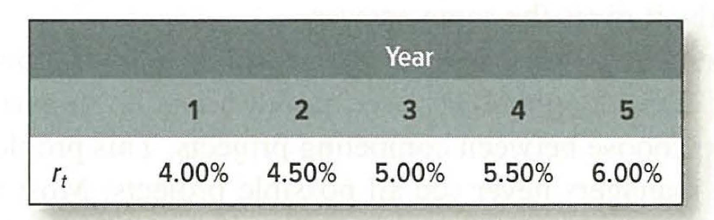
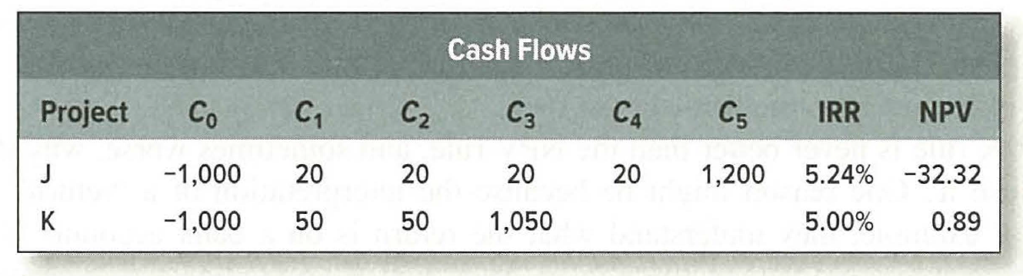
Internal rate of return
Unfortunately, the use of IRR has several pitfalls.
The fourth pitfall relates to multiple opportunity costs of capital.
In contrast to the term structure assumption, we have assumed that discount rates are stable during the term of the project.
  This is commonly a false assumption. Consider:

Slide 18
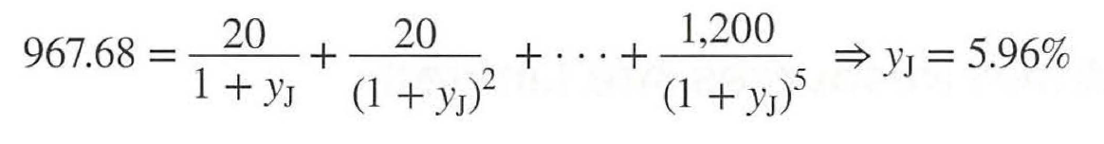
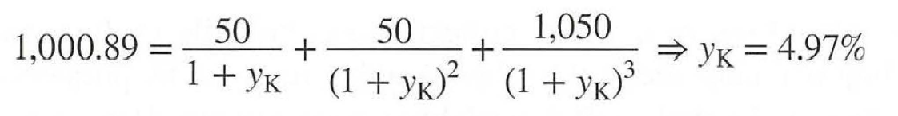
Internal rate of return
Why does project J have a higher IRR but a lower NPV?
  The reason is that IRR of J should be compared to a cutoff different from K.
IRR for J (5.24% from previous slide) needs to be compared with the yield of an equivalent bond calculated using the term structure in the previous slide. This is:
IRR for K (5.00% from previous slide) needs to be compared with the yield of an equivalent bond calculated using the term structure in the previous slide. This is:
Siince $IRR_{J}<y_{j}$, reject project J. Since $IRR_{K}>y_{k}$, accept project K. NPV formula avoids this mess.

Slide 19
Choosing projects when resources are limited
Soft Rationing.
  Limits on available funds imposed by management.
Hard Rationing
  Limits on available funds imposed by the unavailability of funds in the capital market.
When resources are limited, the profitability index (PI) provides a tool for selecting among various project combinations and alternatives.
  A set of limited resources and projects can yield various combinations.
  The highest weighted average PI can indicate which projects to select.

Slide 20

Choosing projects when resources are limited
Example: We only have $11 million to invest. Which do we select?
Project | Investment ($ millions) | N P V ($ millions) | Profitability Index
A | 10 | 33 | 3.3
B | 5 | 16.25 | 3.25
C | 6 | 19.2 | 3.2
$$Profitability Index = \frac{NPV}{Investment}$$

Slide 21
Choosing projects when resources are limited
Example: We only have $300,000 to invest, Which do we select?
  All of them are attractive with positive NPVs
  Ans: Invest the first $10 million in project A. It has the highest profitability index, so every $1 invested in it creates more shareholder value than the other two projects.
  Invest the final $1 million in a fifth of Project B-that is, a scaled-down version. Since B has the higher profitability index than C, it is the next best option.
Contrast: All-or-nothing investments
  May not be possible to make fractional investments—projects are all or nothing, such as either buying a machine or not.
  In that case, investing $10 million in A→ cannot invest into a fifth of project B.
  Instead you would have to put the remaining $1 million in the bank, for an NPV of 0, leading to a total NPV of $33 million.
  In contrast, investing in projects B and C together would generate NPV of $35.45 million

Slide 22
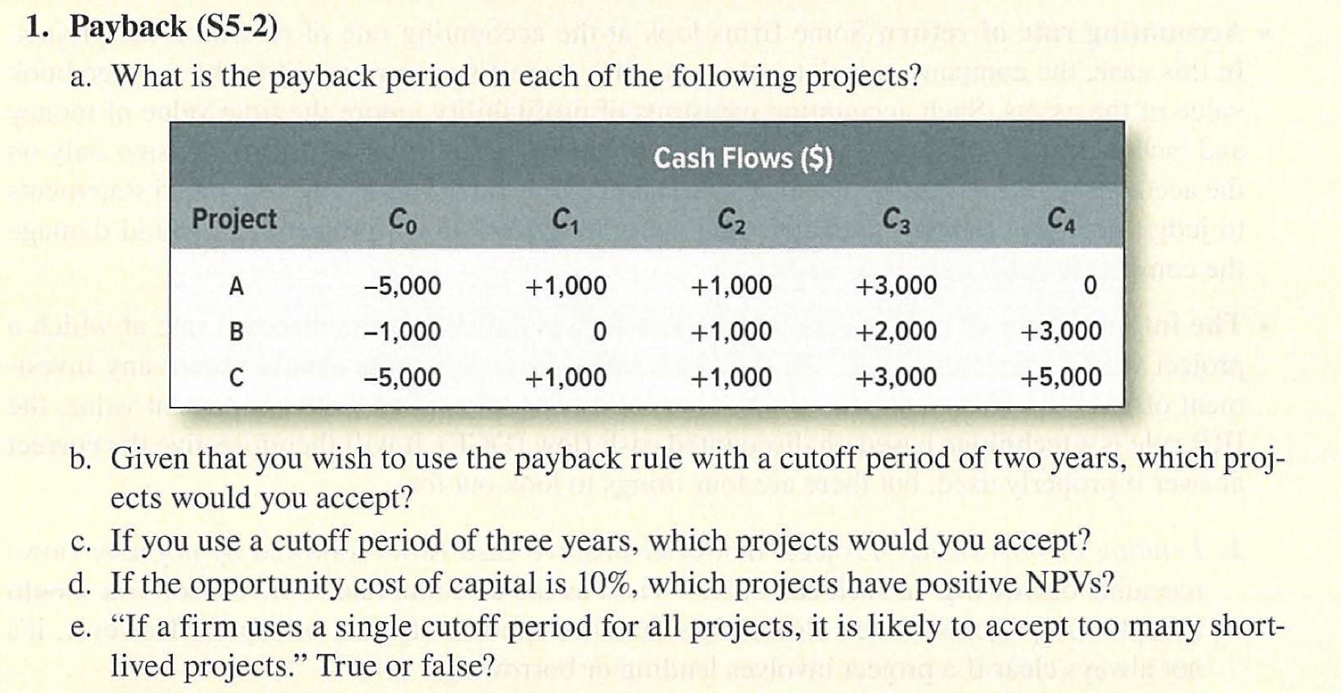
Seminar questions

Slide 23
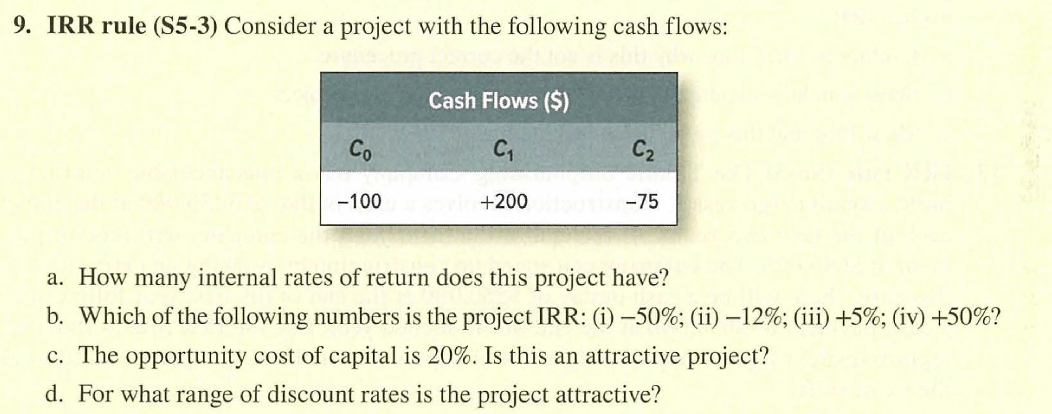
Seminar questions

Slide 24
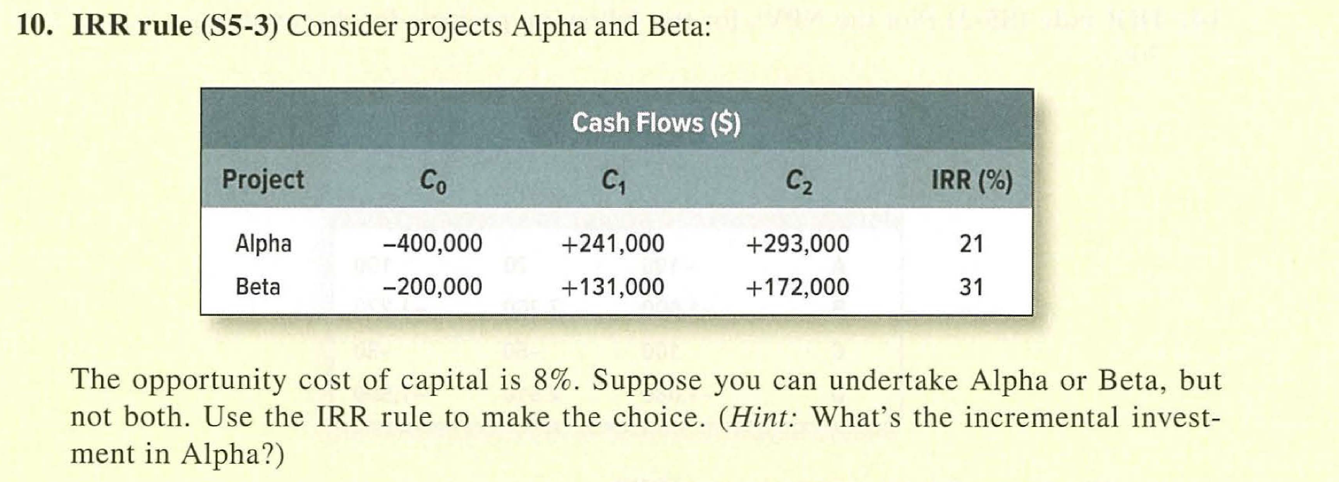
Seminar questions

Slide 25
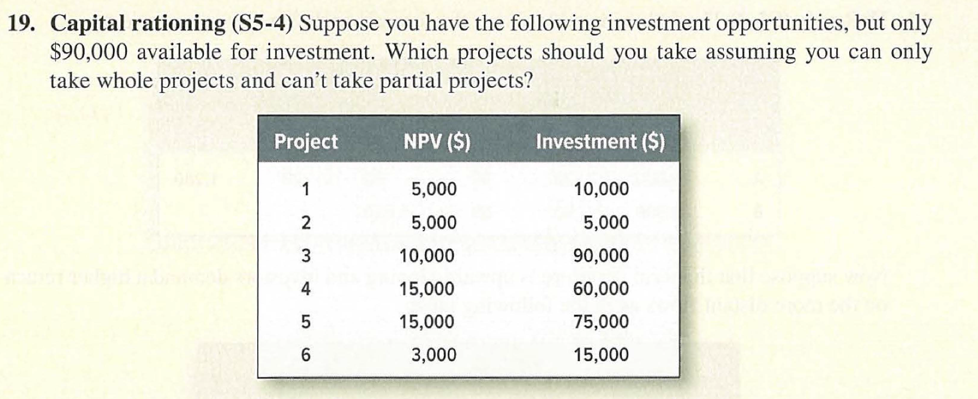
Seminar questions

Slide 26
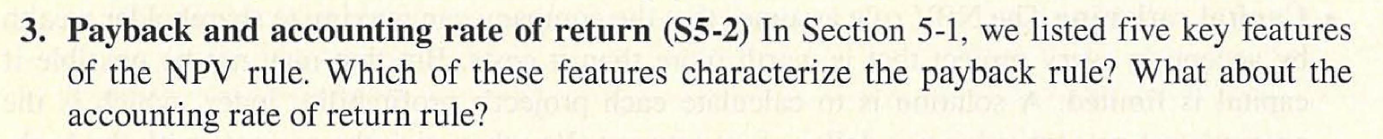
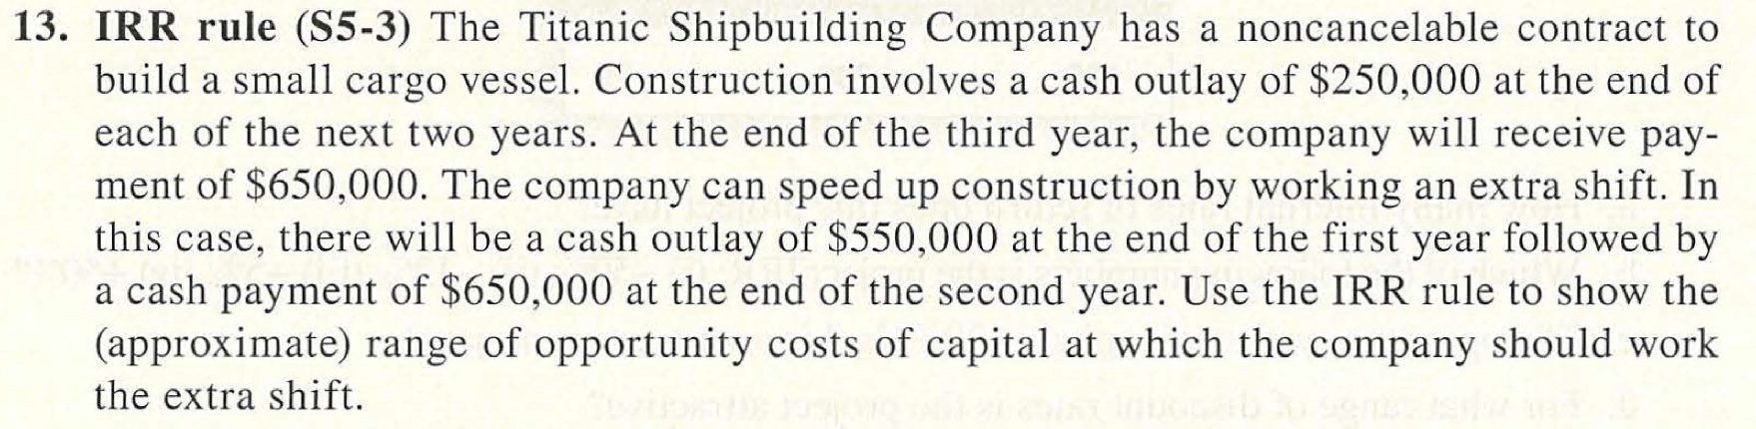
Seminar questions (optional)

Slide 27
Q&A
See you guys on Thurs.

