Slide 1

Company Law (LC2008C)
2. FOUNDATIONS OF COMPANY LAW
LC2008C
Kenneth Khoo
kenneth.khoo@nus.edu.sg

Slide 2

THE FOUNDATIONS OF COMPANY LAW
Motivation
The Company as an Organization
The Contractarian Approach
  The Contractarian Approach : Opportunism
  The Contractarian Approach : Information Asymmetry
  The Contractarian Approach: Reducing the Costs of Contracting
The Proprietary Approach:
  The Proprietary Approach: A Primer
  The Proprietary Approach: Separate Legal Personality
  The Proprietary Approach: Entity Shielding
  The Proprietary Approach: Owner Shielding
Conclusion

Slide 3

motivation
Suppose that you have a non-law friend who asks you the question:
  “Why does Company Law exist?”
  Other variants: “Why do we have Company Law?” “Why do we even need Company Law?”
There is no obvious answer to this question.
  Why? Because Company Law is generally non-intuitive for most laypeople.
  Contrast this with Criminal Law, where most laypeople understand why we need to have a Criminal Law regime.

Slide 4

motivation
Most people understand that we need rules to punish wrongdoing and deter harmful acts.
  But company law can feel a bit abstract.
  What is its real purpose?
At its heart, company law exists to help people do business together effectively and to solve problems that arise when they do.

Slide 5


motivation
A business is simply an organization that sells goods or services to make a profit.
  Even a simple chicken rice stall is a business. The hawker buys ingredients and combines them to sell a final product at a profit.
This buying and selling is all about trade. You trade your money for a plate of chicken rice. This works because of specialization—the hawker is much better at making chicken rice than you are.
To make all this trading reliable, we have contract law. If you pay a contractor SGD 20 million to build a hotel, you need a way to ensure they don’t just run off with the money. Contract law provides that security.

Slide 6

motivation
But modern business is rarely just one person trading with another. Think about the massive, coordinated effort it takes to produce and sell an iPhone. Thousands of engineers, factory workers, and marketing professionals are involved.
Could you manage all of this with simple, individual contracts? It would be incredibly complicated and inefficient. Why?
  Hint: Think about coordination problems in the context of building a house.
This is where the idea of a company comes in.
Notes:
With thousands of individual contracts, you run into impossible coordination problems:
Who's in Charge? If the contract with the engineer specifies a glass wall, but the contract with the window supplier is for a brick-sized window, which contract wins? There is no central authority to make a final decision. A company structure creates a board of directors with the legal authority to make these calls.
Decision-Making Paralysis: What if you want to change the color of the paint mid-project? You would have to find and renegotiate every single contract with every painter, supplier, and designer. The project would grind to a halt. A company allows for agile decision-making.
Conflicting Goals: Each person is only obligated to do what their specific contract says. They have no legal duty to cooperate with anyone else. This leads to conflicts and disputes that are difficult to resolve. Company law creates a unified structure where everyone is, in essence, on the same team, working from the same playbook (the company's goals).
Company law creates a single, coordinated entity, providing one set of rules, one decision-making body, and one legal identity (the company itself) that can enter into contracts, creating order out of chaos.

Slide 7
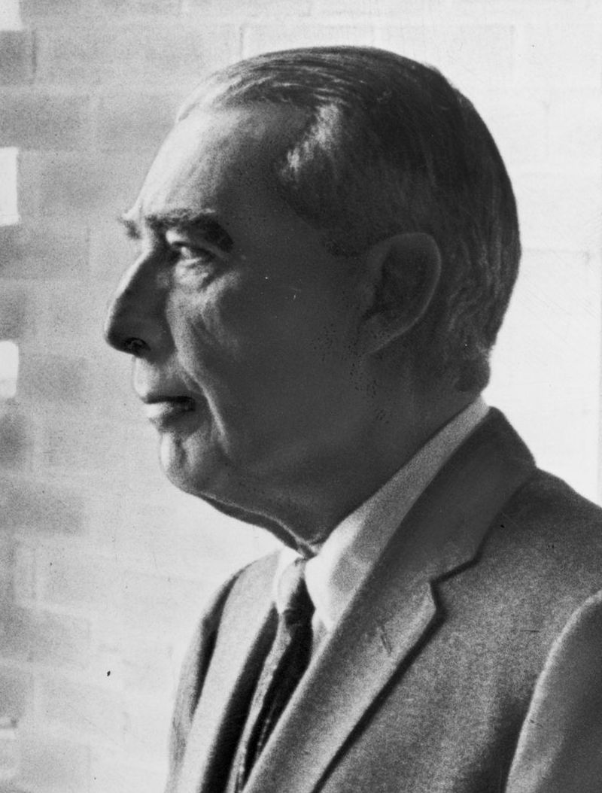
The company as an organization
A company is more than just a group of individuals; it’s a special structure that allows many people to work together towards a common business goal (almost like a sports team!). Company law provides the rules for this structure.
The two most important features of this “special structure” are:
  The Separation of Ownership and Control: The people who “own” the company (shareholders) are often different from the people who manage it day-to-day (directors and managers).
  The Company’s Separate Legal Personality: The company is treated as a separate legal “person” in the eyes of the law. This means it can own property, sign contracts, and be sued, all separate from the people who own or run it. When you buy an iPhone, your contract is with “Apple,” not with its thousands of employees.
Let’s focus on (1) (which relates to what scholars call the “contractarian approach”) before returning to (2) (the “proprietary approach”).

Slide 8
The Company as an Organization
Shareholders
Board of Directors
Managers & Employees
What exactly is the Separation of Ownership and Control? Let’s focus on two key constituents of the company: Shareholders and Directors.
  Shareholders provide the money (capital) to fund the business. Shareholders are often called “residual claimants” because they get the profits left over after all the bills are paid. Because they take on the biggest risk (they might get nothing if the company does poorly), they have the power to appoint or remove the people in charge.
  Directors are elected by the shareholders to run the company’s day-to-day business.
This separation is a form of beneficial trade: shareholders trade their capital for the potential of future profits (through the instrument of the shares they own), and managers trade their expertise and labor for a salary.

Slide 9
The Company as an Organization
Shareholders
Managers & Employees
Board of Directors
What about employees? Suppliers? Banks who finance the company?
  These are known as creditors—another major constituent of the company.
  Contract law + Insolvency law plays a major role in regulating the relationship between creditors and the company.
Note that in smaller (private) companies, the shareholders, board of directors and the managers of the company may not be distinct groups of persons.
Thus, there is no rule in company law that prevents persons from wearing “multiple hats” – you can always be a shareholder and a board member at the same time.

Slide 10
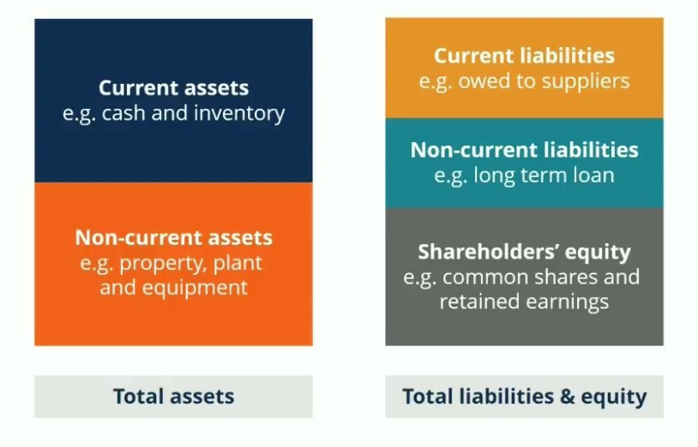
The Company as an Organization
When a company makes profits, who gets paid first? Creditors >> Shareholders. What about directors? Hint: See previous slide.
Equity = Assets – Liabilities

Slide 11
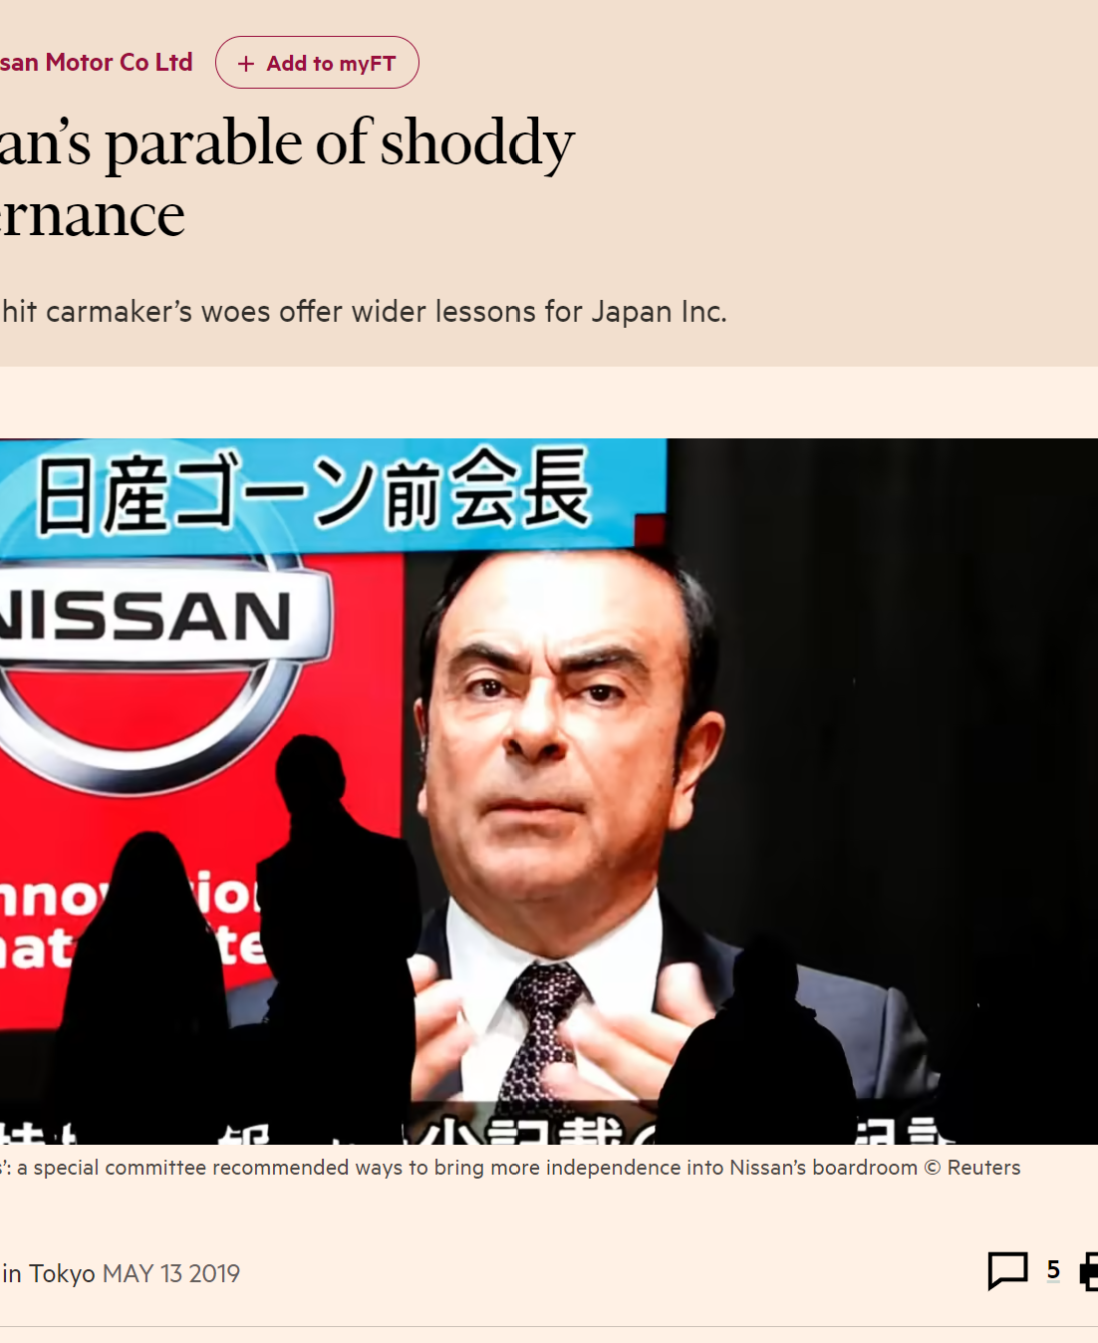
The contractarian approach: opportunism
In essence, due to the Separation of Ownership and Control, Corporate Law regulates a “very special type of contract” (Contractarian Approach).
First Problem (Opportunism): Once shareholders hand over their money and decision-making power, what stops managers from abusing that power for their own benefit?
  This is known as opportunism—acting in your own self-interest, sometimes deceitfully, at the expense of others.
  Example: A CEO (director) might use company money to buy a private jet for personal holidays instead of investing it back into the business.

Slide 12

The contractarian approach: opportunism
The CEO’s actions thereby create a conflict of interests.
  As we will learn in subsequent topics, Company Law addresses these conflicts of interests by imposing legal duties on directors to act in the best interests of the company.
Q (Difficult): Why not just rely on contract law to prevent opportunism?

Slide 13

The contractarian approach: information asymmetry
Second Problem (Information Asymmetry): Separation of Ownership and Control implies that directors (managers) are involved in the daily operations; shareholders are not.
  This means managers have a huge informational advantage.
  Example: An employee might take extra-long lunch breaks or take home office supplies for personal use. The employer isn't always watching and might never find out. This is a form of “moral hazard” which will induce losses for the business.

Slide 14

The contractarian approach: information asymmetry
Because shareholders can't see everything managers are doing, it's hard to know if they are always acting in the shareholders’ best interests. To solve this, shareholders can:
  Monitor: Install CCTVs (in the employee context), hire auditors, or conduct spot checks. But this is expensive.
  Bond (Align Interests): Give managers a share of the profits or tie their bonuses to performance. This encourages them to work harder for the company's success. Again, this is expensive.
The costs of monitoring and bonding, plus any remaining losses from misalignment, are called “agency costs.” Company law helps reduce these costs by setting out rules for transparency and accountability.

Slide 15

THE Contractarian Approach: Reducing the Costs of Contracting
Third Problem (Costly Contracting): Separation of Ownership and Control is endemic because it implies strong benefits. But do we really want to hire expensive lawyers to write a massive contract from scratch detailing every single rule for a new venture?
  Probably not. Here, company law can provide a default template/framework to reduce the costs of contracting.
  In Singapore, this is reflected in the company’s constitution, which acts as a contract binding the company and its members.
  Although modification is possible, many businesspeople stick to model constitutions which act as a set of default rules.
By providing this clear, predictable framework, company law reduces the costs and complexity of doing business.

Slide 16

The proprietary approach
Thus far, we have not discussed anything remotely related to the Company’s Separate Legal Personality.
Now, we'll look at the “Proprietary Approach”. This is about how a company deals with outsiders, like banks, lenders, and other creditors. This approach explains the most fundamental feature of a company: its status as a separate legal person.
This Photo by Unknown Author is licensed under CC BY

Slide 17
The proprietary approach: A PRIMER
Contractual Rights are in personam and tend to be bilateral – if I have a contractual right against X, I can only sue X, not a third party Y.
  Unless it falls under one or more exceptions to Privity of Contract (e.g. CRTPA Cap. 53B)
The case is similar for Tortious Right-holders.
Property Rights are in rem and tend to be impersonal – if I have a property right over X, I can enforce that right against anyone who infringes this right over X.
  Property rights are usually transferrable to third parties.
  If I sell the property right to a third-party Y, person Y will now have the same property right over X which I once had.
  Thus, property rights are said to be enforceable “against the world”.

Slide 18
The proprietary approach: A PRIMER
As opposed to in personam rights, Property Rights usually attach to “things” (whether tangible or intangible)
In company law, we are interested in two types of property rights.
  First, the attachment of property rights to the company’s assets.
    E.g. physical objects like machinery that the company owns, real estate, or intellectual property. These are known as “Choses in Possession”, a type of personal property. Land, in contrast, is a type of real property.
    In the absence of contracting, a company as a separate legal person has full property rights over its assets.
  Second, the attachment of property rights to ownership of the company as a separate legal person, embodied in shares. Shares are a type of “Chose in Action”, a type of personal property.
These property rights can then be transferred to other persons or organizations with separate legal personality.

Slide 19
The proprietary approach: A PRIMER
As discussed, shareholders have property rights in the company as a separate legal person. These property rights come in the form of shares.
  Shares are proprietary in nature. If person X steals person Y’s shares, that infringes on Y’s proprietary rights in the shares. Therefore, X would be (in addition to criminal liability) liable for the proprietary tort of conversion.
  The rights attached to these shares, however, are contractual. Anyone who owns a share (i.e. a shareholder) has a “contract” between himself/herself, the company, and some of its constituents. This was what we were referring to when we were talking about the “internal” contracting within the company.
  Thus, the shares themselves are proprietary, but the rights attached to them are contractual.
    Q: Is this possible with normal contracts?
  These contractual rights relate to (1) rights of control over the company (“control rights”) and (2) residual rights over the company’s profits (“cash-flow rights”).
Notes:
No, because you can only assign benefits but not obligations at common law.
Share = chose in action

Slide 20
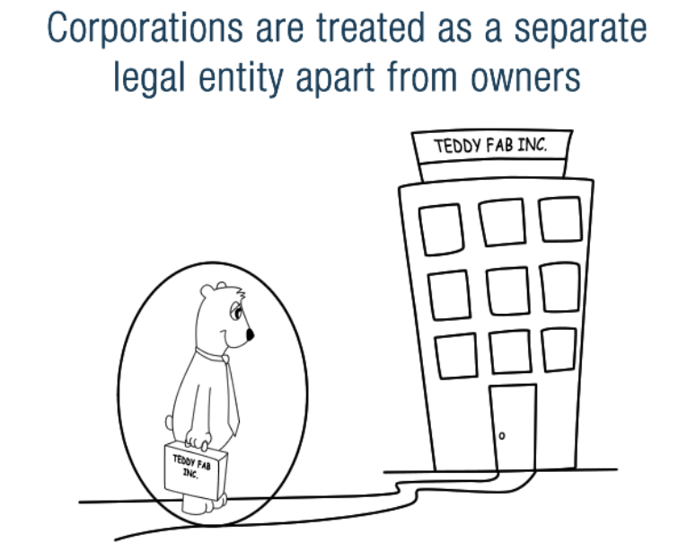
The proprietary approach: separate legal personality
Why is this important? The law does something that sounds strange: it treats a company as a legal entity separate from its owners. Think of it like creating a new person, “Teddy Fab Pte Ltd.”.
This legal “person” can:
  May sue and be sued in its own name
  Enjoys perpetual succession
  May enter into contracts in its own name
  May own property in its own name
  Is liable for taxes
See s 19(5) of the Companies Act.
Essentially, this creates property rights!

Slide 21

The proprietary approach: separate legal personality
The creation of a company’s SLP leads to a crucial separation of assets: Shareholders own shares in the company, but the company itself owns its assets. If you own shares in Toyota, you own a piece of the Toyota corporation, but you don’t own the tires on Toyota’s cars in their factories.
  This is often called a “bifurcated ownership structure”, or “Asset Partitioning”.
Asset partitioning essentially builds a legal wall between the personal assets of the owners (shareholders) and the assets of the business. This wall has two sides, creating two “shields” that protect different groups.
“Entity Shielding”
“Owner Shielding” (i.e., Limited Liability)

Slide 22

The proprietary approach: Entity shielding
The First Shield protects the Business, and is therefore termed “Entity Shielding”.
Entity shielding protects the company’s assets from the personal creditors of its shareholders.
Imagine you create two separate money jars:
  The Business Jar : Holds all the company’s money and assets.
  Your Personal Jar : Holds your personal savings and assets.
Entity shielding builds a “wall” around the Business Jar. If you, the owner, get into personal debt, your lenders cannot take money from the Business Jar. That money is reserved for the business. This works through two rules…

Slide 23

The proprietary approach: Entity shielding
Creditor Priority
Lenders to the business have first claim on the money in the Business Jar. Your personal creditors must wait in line and can't jump ahead of the business's own lenders. This makes lending to the company safer and, therefore, cheaper.
Liquidation Protection (“Capital Lock-in”)
As an owner, you cannot simply reach into the Business Jar and withdraw your initial investment whenever you want. This “locks in” the capital, ensuring the business has stable, long-term funding to operate and grow. It protects the business from being destroyed just because one owner faces personal financial difficulty.
This Photo by Unknown Author is licensed under CC BY-SA

Slide 24
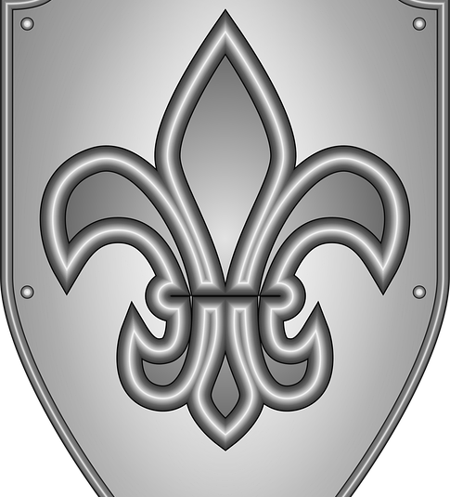
The proprietary approach: owner shielding
“Owner Shielding is the concept most people know as Limited Liability. It protects your Personal Jar from the debts of the Business Jar.
If the company borrows money and fails, the business's lenders can only take from the Business Jar. Once that jar is empty, they cannot come after your Personal Jar to cover the rest of the debt.
The most you, as a shareholder, can lose is the amount you invested in the company. Your personal car, house, and savings are safe.

Slide 25

The proprietary approach: owner shielding
Limited liability is important as it:
  Encourages Investment: People are more willing to risk investing in a business if they know their personal wealth is protected.
  Simplifies Risk: It allows you to invest in many different companies without needing to constantly monitor the wealth or actions of the other co-owners.
This Photo by Unknown Author is licensed under CC BY

Slide 26
THE PROPRIETARY APPROACH: ASSET PARTITIONING
Company’s Creditors
Shareholder’s Creditors
Owner Shielding: Limited Liability
Entity Shielding:
Creditor Priority
Company
Shareholder
Have a claim over the
Have a claim over the
Has ownership over
Has ownership over
Company’s Assets
Shareholder’s Assets
Entity Shielding:
Liquidation Protection
Has shares in the

Slide 27
Conclusion: Why Company Law Exists
Company law solves business problems from two different angles:
Inside the Company (The Contractarian Approach):
  It acts like a smart rulebook for business owners and managers.
  This reduces internal conflicts and the costs of managing people (Agency Costs).
Outside the Company (The Proprietary Approach):
  It creates a separate legal “person” with protective shields (like limited liability).
  This separates business risk from personal risk, making it cheaper to get funding—reducing the costs of capital.
Both approaches are consistent in reducing the overall costs of doing business, making it the most effective structure for enterprise.

