Slide 1

Corporate law and economics (LL4489V/5489V/6489V)
10. esg and stakeholderism II
LL4489V
Kenneth Khoo
kenneth.khoo@nus.edu.sg

Slide 2

Esg and stakeholderism
Motivation
Externalities on External Constituents
Shareholder and Managerial Preferences
ESG and Corporate Law
“Greenwashing” and Accountability

Slide 3
ESG and Corporate law
In our previous seminar (Slide Deck 9), our primary emphasis was on exploring the fundamental concepts and principles that underlie ESG.
  Much of this analysis involved voluntary initiatives taken by different stakeholders in connection with ESG.
  Q: If all of these initiatives are entirely voluntary, what justifies the need for corporate law? Why should corporate law be considered essential?
Impt: If corporate law were to impose mandatory rules upon corporate constituents to curb externalities, would the concept of “mandatory ESG/CSR” resemble regulation?

Slide 4
Esg and corporate law
To see how ESG objectives might be incorporated into corporate law, it is necessary to introduce the idea of what the debate on “corporate purpose” is.
This debate centers on the fundamental question of what the primary objectives of a corporation should be. In general, there is a stark divide between two “camps” of scholars:
  Advocates for “Shareholder Primacy/Shareholderism” promote the idea that a corporation’s primary responsibility is to maximize shareholder value – in other words, it’s primary purpose is to maximize profits for its shareholders.
  Advocates for “Stakeholderism” promote the idea that a corporation has a broader set of responsibilities beyond shareholders – instead, the corporation’s purpose is to maximize the broad interests of all its stakeholders, including employees, creditors, customers, suppliers, and the public at large (thus, via proxy, the environment).
This is not merely an academic debate…

Slide 5
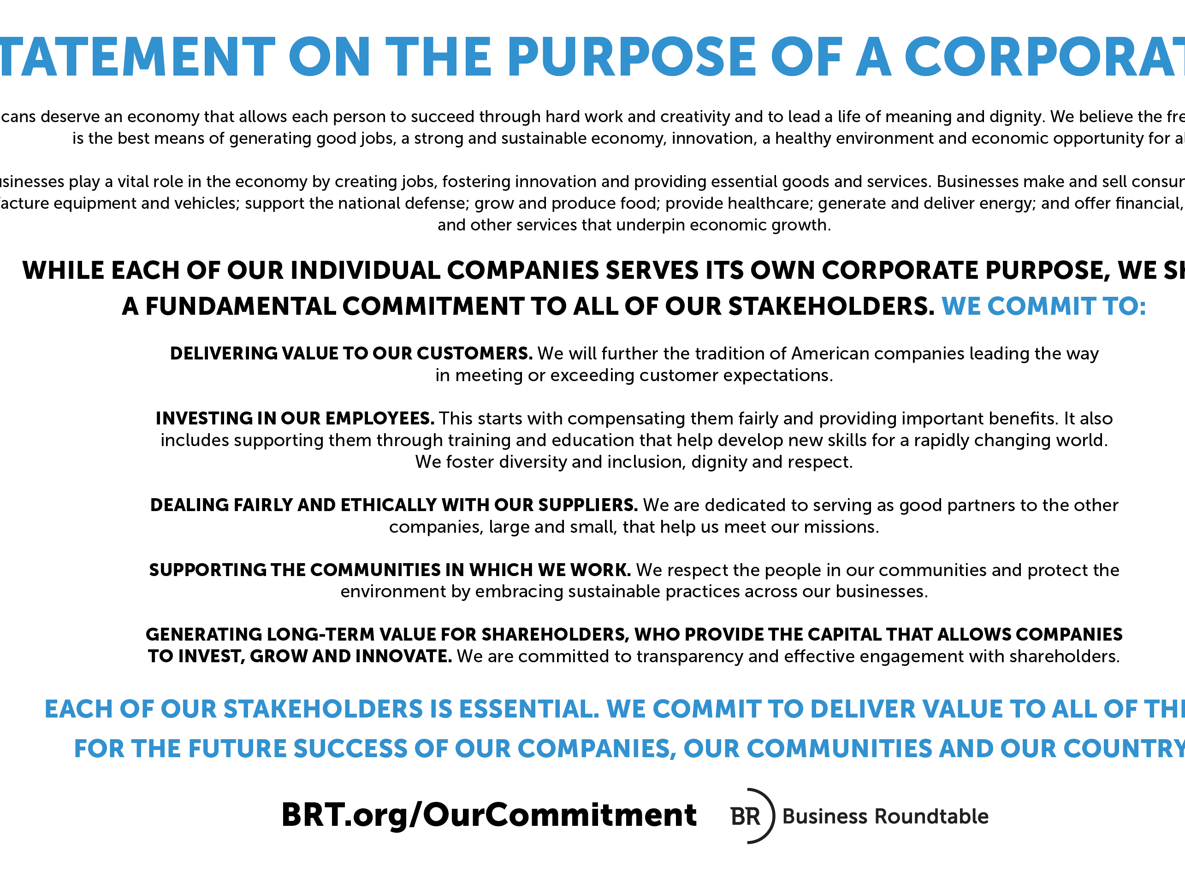
Esg and corporate law
Bebchuk and Tallarita (2020): “In the summer of 2019, with much fanfare and massive publicity, the Business Roundtable (BRT)—the influential association of corporate chief executive officers (CEOs)—announced a revision of its conception of corporate purpose. The BRT CEOs committed to “lead their companies for the benefit of all stakeholders.” Moving away from a long-standing statement that explicitly embraced shareholder primacy, the new BRT statement committed to “deliver value” not just to shareholders but also to employees, customers, suppliers, and communities. The BRT statement was presented by its authors, and characterized by many commentators, as a major milestone in the evolution of the modern corporation… Following the issuance of the BRT statement, the World Economic Forum published in December 2019 a manifesto that urged companies to move from the traditional model of “shareholder capitalism” to the model of ‘stakeholder capitalism.’”

Slide 6
Esg and corporate law
Recall our doctrinal course on Company Law: At common law, directors’ duties are owed to the company as a separate legal person – not the shareholders, creditors, employees, or any other corporate stakeholders (Percival v Wright [1902] 2 Ch 421).
Thus, when directors breach their duties, it is the company (and the company alone) that has the right to sue on this breach (Foss v Harbottle [1843] 67 ER 189).
  How might shareholders acquire standing to sue on behalf of the company?
But this raises the thorny question of how the company’s interests are to be ascertained.
  Traditional answer in Company Law: Barring “special” circumstances, the interests of the company are generally to be regarded as the members as a whole (see e.g., Raffles Town Club Pte Ltd v Lim Eng Hock Peter [2013] 1 SLR 374).
  Q: Is this “Shareholderism”?

Slide 7
Esg and corporate law
However, insofar as the question of “who is the company” is concerned, corporate law has also exhibited some reluctance to exclude the interests of other stakeholders.
S 172 CA 2006 in the United Kingdom: “A director of a company must act in the way he considers, in good faith, would be most likely to promote the success of the company for the benefit of its members as a whole, and in doing so have regard (amongst other matters) to
  (a) the likely consequences of any decision in the long term,
  (b) the interests of the company's employees,
  (c) the need to foster the company's business relationships with suppliers, customers and others,
  (d) the impact of the company's operations on the community and the environment,
  (e) the desirability of the company maintaining a reputation for high standards of business conduct, and
  (f) the need to act fairly as between members of the company.”
See also s 159(a) of Singapore’s Companies Act: “159. The matters to which the directors of a company are entitled to have regard in exercising their powers include the interests of the company’s employees generally, as well as the interests of its members…”

Slide 8
Esg and corporate law
Since the company is the locus of fiduciary duties owed to the company, it is not surprising that most legal debates around corporate purpose focus on the content/scope of these duties.
  NB: Fiduciary duties are legal directives as to how directors (and possibly senior managers) are supposed to exercise their discretion left by external regulation (Spamann and Fisher, 2022).
  Within shareholder primacy, a distinction is sometimes made between furthering shareholders’ financial payoffs (“shareholder value”) or their overall wellbeing, which would include the ethical concerns discussed above (“shareholder welfare”). (Hart and Zingales, 2022)
Do directors possess greater or reduced discretion in decision-making under a stakeholder-oriented system compared to a shareholder-oriented system? Recall Blair and Stout (1999).
  What are the potential costs associated with a stakeholder-oriented system?

Slide 9
Esg and corporate law
Spamann and Fisher (2022): “[The debate is often led by the] fear that a pure norm of shareholder value maximization would force managers and directors to sacrifice potentially unlimited social welfare for infinitesimal shareholder wealth gains. This emphasis and fear are misplaced. The primary reason is that fiduciary duties are not enforceable with this level of precision, i.e., the shareholder/stakeholder distinction makes no practical legal difference. Moreover, even the nominal content of existing fiduciary duties—that might matter to conscientious fiduciaries irrespective of enforcement—is far less shareholder-centric than the grotesque shareholder value norm sketched above. “Shareholder value” can have the feared nefarious effect only through a vulgar version that may have crept into managerial culture.”
“In corporate law, there is not a single case of managers or directors being held personally liable for furthering stakeholder interests over shareholder interests—ever, anywhere… Indeed, we are not aware of a single lawsuit or prosecution even attempting this in recent decades. This is hugely revealing because (a) companies take pro-stakeholder actions without rhetorically tying them to shareholder returns all the time and (b) directors and managers are sued all the time for different reasons in the U.S. If it were possible to sue managers and directors for being “too social,” somebody would have done so.”

Slide 10
Esg and corporate law
Spamann and Fisher (2022): “[Distinguishing between shareholders and stakeholders] is not possible, and for good reason. It is a general principle of corporate law that business decisions are not subject to judicial review (except in cases of pecuniary self-interest, which do not concern us here). In the U.S., this is explicit in the “business judgment rule”; elsewhere, it is often implicit in insurmountable procedural hurdles, even though duties may nominally be strict and capacious. This is uncontroversial; even shareholders voluntarily agree to it. As one of us has explained at length elsewhere, judicial review is simply not worth its cost given the tremendous difficulties courts would have in reconstructing the decision environment. With respect to potential conflicts between profits and stakeholders in particular, the line is usually blurred to the point of being invisible: which social action could not be justified by long-term reputational concerns? Besides, how would a judge trade off ex post costs to one constituency with the need (to make ex ante promises) to give an “adequate” return to another constituency? (In a second-best world, ex ante efficient arrangements often entail ex post inefficiencies.) From a psychological and institutional point of view, it seems difficult to imagine that a judge would come down hard on a manager or director for furthering the social interest.”
What is the core essence of Spamann and Fisher’s argument? Do you agree/disagree with their position?

Slide 11
Esg and corporate law
Are there are other problems associated with stakeholderism?
Bebchuk and Tallarita (2020): “The first difficulty in the implementation of pluralistic stakeholderism is the determination of the stakeholder groups whose interests should be taken into account. Without first making such a determination, directors cannot proceed to aggregate and balance the relevant interests. [To see how difficult this is, we examine a list of constituents considered by state laws.] All statutes list employees and customers as stakeholders, and most include suppliers as well. As for other groups, however, the statutes vary significantly. Many states mention creditors and local communities, but many do not. Some states allow directors to consider the effect of their decisions on society in general or on the economy of the state or the nation, but most do not. And some provisions are especially idiosyncratic; the New York statute, for example, allows directors to consider “the corporation’s retired employees and other beneficiaries receiving or entitled to receive” benefits sponsored by the corporation.”
What is the core essence of Bebchuk and Tallarita’s argument here? Are these statutes over-inclusive, or are they under-inclusive?

Slide 12
Esg and corporate law
Are there are other problems associated with stakeholderism?
Bebchuk and Tallarita (2020): “Once the relevant stakeholders are identified, stakeholderism requires that their interests be weighed and balanced. Such an exercise raises very difficult questions regarding conflicts between groups of stakeholders and between stakeholders and shareholders, which stakeholderists have largely avoided by leaving their solution, again, to the discretion of corporate leaders... [However], potential trade-offs between shareholders and stakeholders are ubiquitous. Even after adopting all the stakeholder-friendly policies that are expected to improve long-term shareholder value (that is, after carrying out instrumental stakeholderism to its fullest extent), companies will commonly face many opportunities to provide some stakeholders with benefits that will come at the expense of shareholders.”
“Consider a company that provides its employees with compensation and benefits at levels that fully enable it to attract and retain talented and productive employees. And suppose that this company has, as many major public companies do, a significant stream of profits that enables it to fund all necessary investments and to also pay dividends. In this common situation, if the directors were to follow pluralistic stakeholderism, they would face a trade-off. Financing an increase in employee compensation by reducing dividends would make employees somewhat better off and shareholders somewhat worse off. Trade-offs and conflicts of this kind are likely to be very common.”

Slide 13
Esg and corporate law
Bebchuk and Tallarita (2020): “How are directors supposed to assess the effects of their decisions on their various stakeholders? Should all stakeholder effects be converted into a monetary equivalent to enable comparison? If so, how should directors monetarize nonfinancial effects such as employees’ psychological well-being, the effects of increased employment on local crime rates, or the expected effects of the company’s emissions on global warming? Furthermore, how should directors do the balancing? Should they seek to maximize the aggregate welfare of the different groups regardless of where the gains and losses from decisions fall? Or should they try to ensure that value is distributed among various constituencies in a certain way?”
  Multi-dimensional nature of ESG issues makes “balancing” tradeoffs very difficult. Is there a non-arbitrary way to trade-off these concerns?
  Does a deontological framework exacerbate/ameliorate these “tradeoffs”?

Slide 14
Esg and corporate law
But see Mayer (2020): “Does that give directors carte blanche to do whatever they like? No, not a bit of it. They act according to the reasons for the company’s creation and the purposes of its continued existence. These reasons and purposes are the guiding stars of the board, not the rigid rules of shareholder rights or primacy that trump all else. It is against those purposes and their associated values that the board’s actions and performance should be judged. As [Bebchuk and Tallarita (“BT”)] themselves acknowledge, directors have the right to act with judgment—business judgment—and they should exercise that judgment in a form that they believe to be appropriate to the circumstances. What shareholder primacy and the type of thesis advocated by BT do is transform directors into automatons programmed according to rules maximizing shareholder value. Directors have discretion to act as they will so long as their will is consistent with the rule. This is free will at a price—the price of a share.”
“The implications of the opposite position are illustrated by a simple comparison of one corporate policy that delivers enormous benefits to employees, communities, or the environment at home or abroad, and the other that delivers no benefits or only detriments to those parties but a dollar more profit to shareholders. According to shareholder governance, directors must without hesitation adopt the latter policy, notwithstanding that a loss of one dollar in shareholder value in the former would yield substantial benefits for other parties…”

Slide 15
Esg and corporate law
Mayer (2020): “The answer to the question of how to monetize non-monetary costs and benefits is simple: don’t do it. One should measure non-monetary costs and benefits in their own terms. In our daily lives, we do not choose to help our family or friends clean up after dinner because we have attached a monetary value to this help and concluded that helping is most efficient. Instead, we act according to values of care, consideration and concern for others. It is these values, not monetary values, that determine the vast proportion of our actions and intentions. Likewise, companies have purposes that determine what values they attach to their non-monetary as well as monetary costs.”
  Q: Is Mayer’s argument one that is based on an “Law and Econ” framework? If not, why? Do you find Mayer’s reasoning persuasive?
  See Tjio (2023) (https://papers.ssrn.com/sol3/papers.cfm?abstract_id=4465647) for a similar argument.

Slide 16
Esg and corporate law
Beyond the imposition fiduciary duties, the role of Corporate Law/Securities Regulations is a lot less clear.
  Perhaps the most salient role of Corporate Law/Securities Regulations here relates to (possible) mandatory disclosure requirements: A key leader in this area is led by the European Union (“EU”) (Quare if this is “corporate” law or climate-oriented regulation!).
See https://finance.ec.europa.eu/capital-markets-union-and-financial-markets/company-reporting-and-auditing/company-reporting/corporate-sustainability-reporting_en
  “EU law requires all large companies and all listed companies (except listed micro-enterprises) to disclose information on what they see as the risks and opportunities arising from social and environmental issues, and on the impact of their activities on people and the environment.”
The main legislative initiative relates to the “Corporate Sustainability Reporting Directive” (CSRD), which amends and expands the previous reporting regulation, the Non-Financial Reporting Directive (NFRD) concerning the aforementioned risks and opportunities (and their related impact) in relation to social and environmental issues.

Slide 17
Esg and corporate law
CSRD (which will have a staggered adoption spanning 2024-2026) requires in-scope companies to report on sustainability matters (defined as environmental, social, and human rights), and governance factors. In most instances the obligation to disclose will turn on whether the sustainability matter is material to the business. Companies must include a dedicated section in their management report that sets out the information necessary to understand both the company’s impacts on sustainability matters and how sustainability matters affect the company’s development, performance, and position.
  Details provided by guidelines provided in the European Sustainability Reporting Standards (“ESRS”).
Since the obligations relate to disclosure requirements, the standard adopted is that of “comply or explain” – that is, companies must either disclosure the requested ESG information or provide an explanation of why they are not able to do so (if they fail to do either, this would be a breach of EU Law that induces penalties).
  Is this likely to be effective in advancing ESG goals? What are the factors that can make disclosures either impactful or ineffectual?

Slide 18
Esg and corporate law
Dharmapala and Khanna (2018): “[We] analyze CSR activity using quasi-experimental variation created by Section 135 of India’s Companies Act of 2013, which requires (on a “comply-or-explain” basis) that firms satisfying specific size or profit thresholds spend a minimum of 2% of their net profit on CSR. We examine effects on CSR spending and related outcomes, as well as exploring broader theoretical implications… Using a difference-in-difference approach, we find significant increases in CSR activity among firms affected by Section 135, especially along the extensive margin (i.e. in the fraction of firms engaging in CSR spending). The fraction of firms subject to Section 135 that engage in advertising expenditures declines, consistent with substitution between advertising and CSR. For a subset of large firms, we hand-collect comprehensive CSR data and find that while firms initially spending less than 2% increased their CSR activity, large firms initially spending more than 2% reduced their CSR expenditures after Section 135 came into effect. “

Slide 19
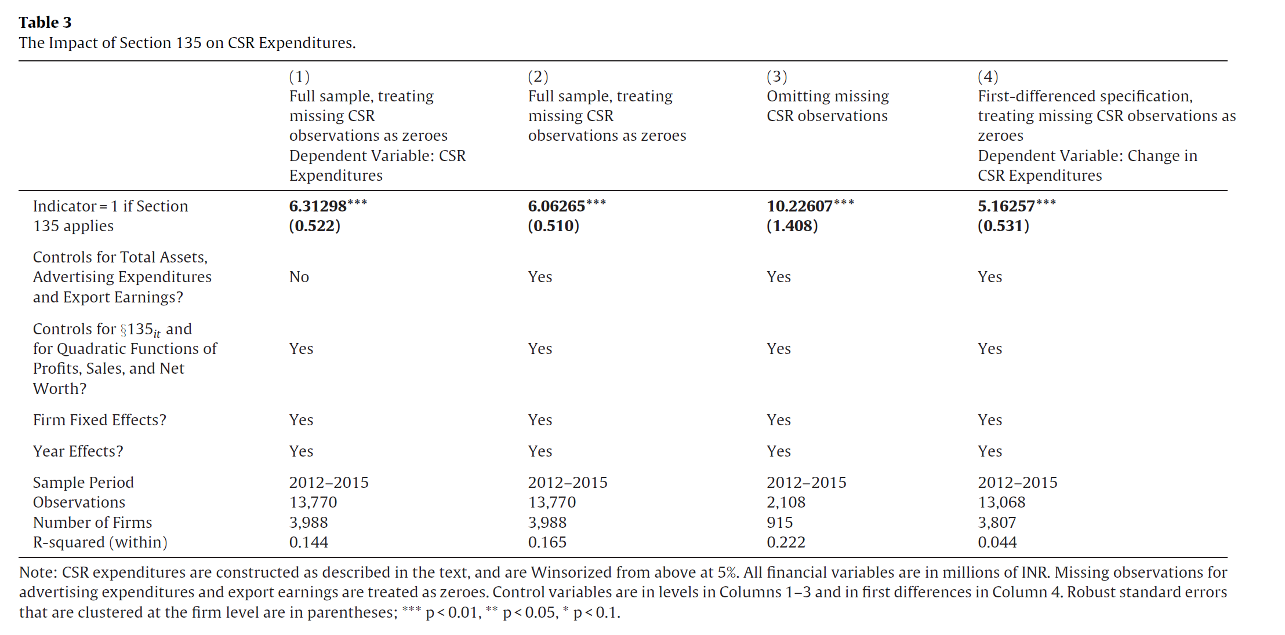
Esg and corporate law

Slide 20
Esg and corporate law
Dharmapala and Khanna (2018): “Although the sample size is quite small (consisting of the subset of the top 100 firms with usable data), it is apparent that firms initially spending less than 2% of their profits on CSR increased their CSR activity, while those that were initially spending more than 2% reduced their CSR expenditures towards 2% after Section 135 came into effect. On balance, however, the former effect was larger than the latter, so that aggregate CSR spending increased in this sample... We explore various explanations for this presumably unintended consequence of Section 135.”
“One explanation is that the firms (and their controllers) might consider the primary benefit of CSR to be the goodwill it generates for the firm (or its controlling group), which might be negatively impacted by mandated CSR spending. For instance, imagine that prior to Section 135, a separating equilibrium existed in which “good” firms engaged in 4% CSR (and thereby signaled their type), while “bad” firms did no CSR activity. After Section 135, “good” firms must increase their CSR – e.g. to 8% – to remain distinguishable from the “bad” firms (which now spend 2%). This may not be worth the cost, in which case the “good” firms will settle for a pooling equilibrium in which all firms spend 2%.”

Slide 21
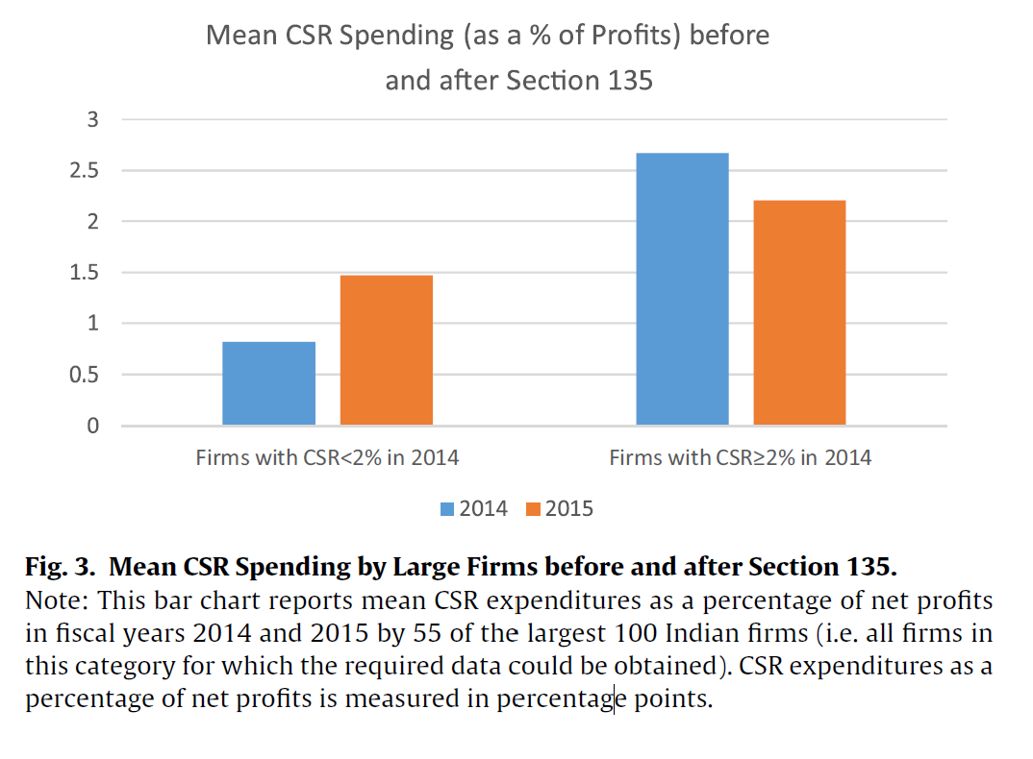
Esg and corporate law

Slide 22
Esg and corporate law
But see Ben-Shahar and Schneider (2011): “Although mandated disclosure addresses a real problem and rests on a plausible assumption, it chronically fails to accomplish its purpose. Even where it seems to succeed, its costs in money, effort, and time generally swamp its benefits. And mandated disclosure has unintended and undesirable consequences, like driving out better regulation and hurting the people it purports to help. Not only does the empirical evidence show that mandated disclosure regularly fails in practice, but its failure is inevitable. First, mandated disclosure rests on false assumptions about how people live, think, and make decisions. Second, it rests on false assumptions about the decisions it intends to improve. Third, its success requires an impossibly long series of unlikely achievements by lawmakers, disclosers, and disclosees. That is, the prerequisites of successful mandated disclosure are so numerous and so onerous that they are rarely met.”
  Ben-Shahar and Schneider argue that tailored solutions are crucial – “We are not saying that information never helps people make decisions… Our argument is directed at a regulatory technique in which a lawmaker requires a discloser to give a disclosee a standard disclosure—prepackaged information that the lawmaker thinks the disclosee needs in order to choose wisely.”

Slide 23
Esg and corporate law
Beyond these ideas, it is possible that corporate law may play a more important role in facilitating ESG-oriented norms (Jebe, 2019).
Consider the idea of “Corporate Purpose” – instead of subjecting directors to “hard law” (Q: what is this?), perhaps it would be better to subject them to “soft law” instead?
  Indeed, Dharmapala and Khanna (2018) show how a “comply or explain” regime may have very real effects.
  In previous seminars, we have already examined the influence of reputation. What other factors could also be at play?

Slide 24
Greenwashing and accountability
Recall our earlier discussion (in Slide Deck 9) on the relationship between ESG metrics and the notion of verifiability.
  Do we actually know whether a company claiming to be environmentally conscious is actually following through with its actions?
Greenwashing: A deceptive practice where a company exaggerates or falsely claims to be more environmentally friendly or socially responsible than it actually is.
  Recall also our earlier discussion on the relationship between ESG and Corporate Law. As Bebchuk and Tallarita (2020) have argued, trying to achieve ESG objectives through legal means could pose significant challenges.
  Why would companies try to engage in “greenwashing”? Why are they (generally) able to avoid consequences for such behaviour?

Slide 25
Greenwashing and accountability
It is important to note that “greenwashing” may occur at “multiple levels” in any corporate hierarchy.
  For instance, fund-managers may engage in “greenwashing” by voting against environmentally-friendly proposals despite public declarations that they are pursuing an “ESG-friendly” investment strategy.
  More importantly, corporate managers (i.e., the board of directors) might employ “greenwashing” tactics by promoting the company's environmentally-friendly image while allowing significant carbon emissions within the organization.
A related problem which facilitates “greenwashing” relates to the incommensurability of ESG-oriented metrics. We will turn to this shortly.

Slide 26
Greenwashing and accountability
Berg et al. (2022): “Environmental, social, and governance (ESG) rating provider have become influential institutions. A total of 3,038 investors representing over $100 trillion in combined assets have signed a commitment to integrate ESG information into their investment decisions (PRI, 2020). Sustainable investing is growing quickly and mutual funds that invest according to ESG ratings experience sizable inflows (Hartzmark and Sussman, 2019). Due to these trends, more and more investors rely on ESG ratings to obtain a third-party assessment of corporations’ ESG performance. A growing number of academic studies rely on ESG ratings for their empirical analysis (see, e.g., Servaes and Tamayo, 2013; Flammer, 2015; Liang and Renneboog, 2017; Lins, Servaes, and Tamayo, 2017; Albuquerque, Koskinen, and Zhang, 2019). As a result, ESG ratings increasingly influence decisions, with potentially far-reaching effects on asset prices and corporate policies.”
“However, ESG ratings from different providers disagree substantially, as previously shown in Chatterji et al. (2016). We confirm this finding in our data set, where the correlations between ESG ratings range from 0.38 to 0.71. This is based on ESG ratings from six different raters: KLD, Sustainalytics, Moody’s ESG (previously Vigeo-Eiris), S&P Global (previously RobecoSAM), Refinitiv (previously Asset4), and MSCI. This disagreement has several important consequences.”

Slide 27
Greenwashing and accountability
Berg et al. (2022): “This disagreement has several important consequences. First, it makes it difficult to evaluate the ESG performance of companies, funds, and portfolios, which is the primary purpose of ESG ratings. Second, ESG rating divergence decreases companies’ incentives to improve their ESG performance. Companies receive mixed signals from rating agencies about which actions are expected and will be valued by the market. This might lead to underinvestment in ESG improvement activities ex ante. Third, markets are less likely to price firms’ ESG performance ex post. ESG performance may be fundamentally value-relevant or affect asset prices through investor tastes (Heinkel, Kraus, and Zechner, 2001). However, in both cases, the divergence of the ratings disperses the effect of ESG performance on asset prices. Fourth, the disagreement shows that it is difficult to link CEO compensation to ESG performance. Contracts are likely to be incomplete and CEOs may optimize for one particular rating while underperforming in other important ESG issues—that is, CEOs might “hit the target” set by the rating but “miss the point” of improving the firm’s ESG performance more broadly.”
  Re points (2) and (3): Recall the mechanisms of Voice vs Exit in Slide Deck 6.

Slide 28
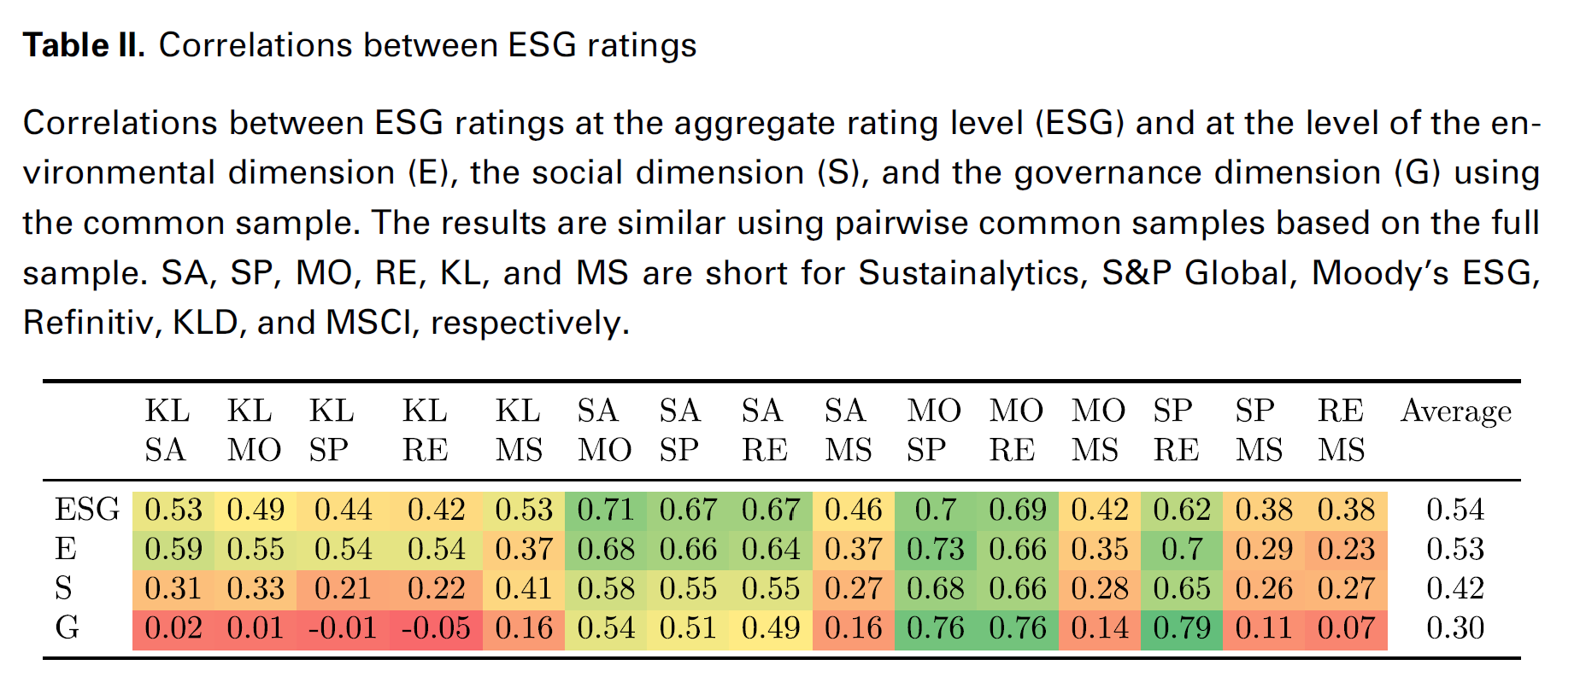
Greenwashing and accountability
Berg et al. (2022)

Slide 29
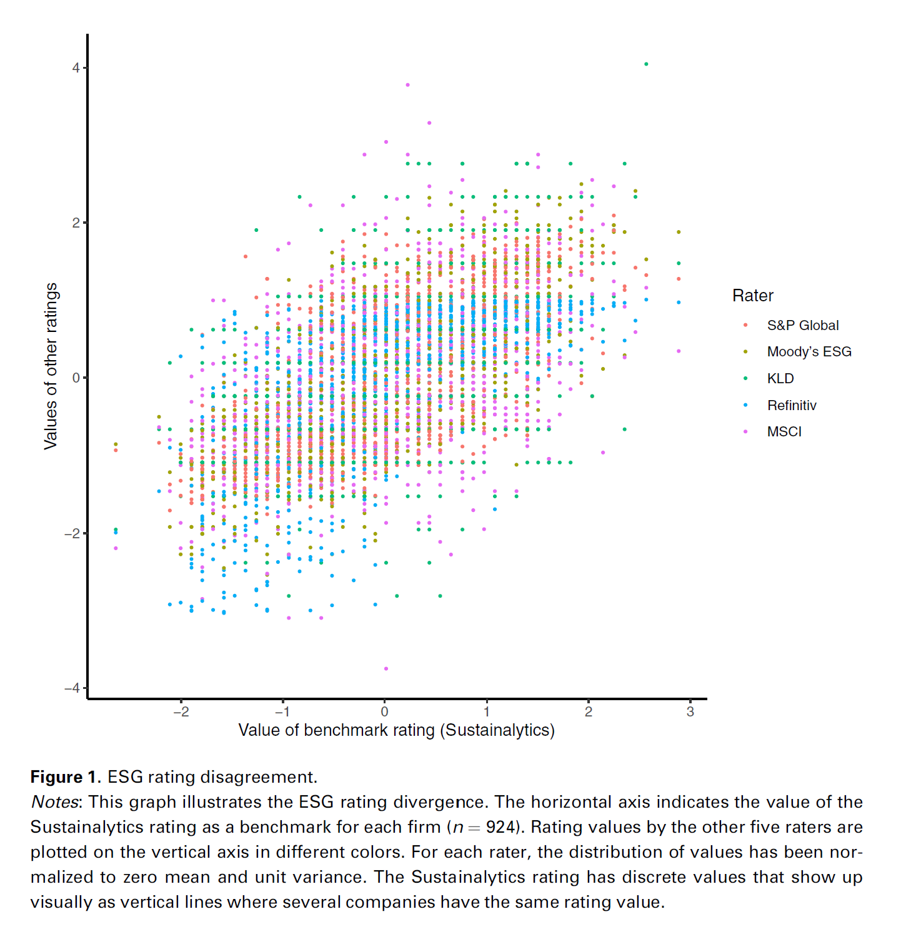
Berg et al. (2022)

Slide 30
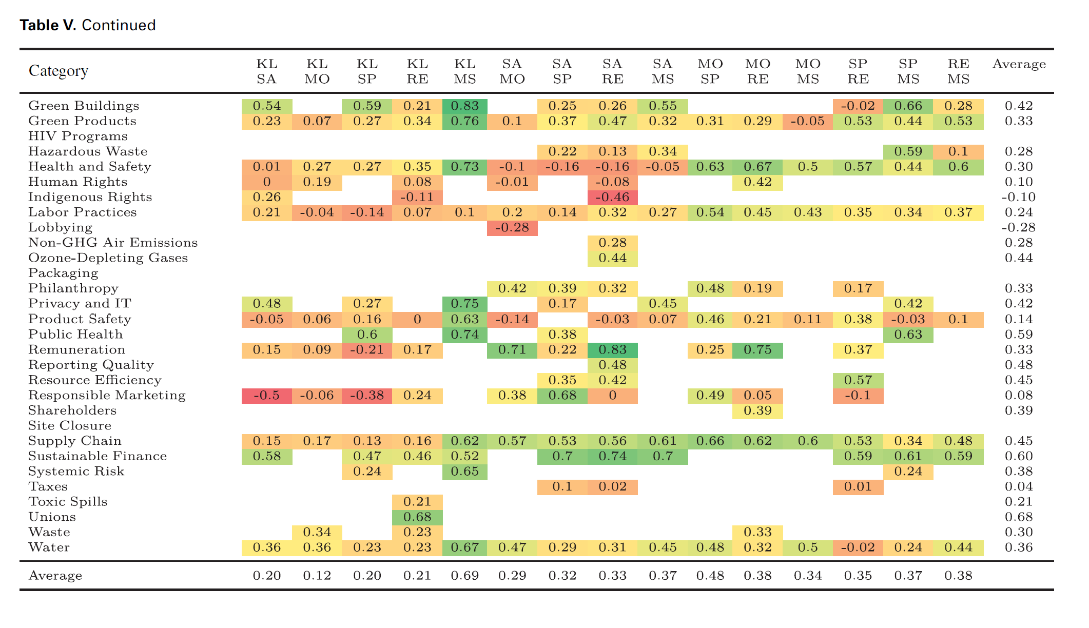
Shareholder and board preferences
Berg et al. (2022)
See category of “sustainable finance” vs “labour practices”. What does this suggest?

Slide 31
Greenwashing and accountability
Moving on to evidence of “Greenwashing” practices, recall our suggestion that “fund-managers may engage in “greenwashing” by voting against environmentally-friendly proposals despite public declarations that they are pursuing an “ESG-friendly” investment strategy.”
Curtis et al. (2021): “are [ESG] funds giving investors what they promise? Combining comprehensive data on mutual funds with proprietary data from the several of the most significant ESG ratings firms, we provide a unique picture of the current ESG environment with an eye to informing regulatory policy. We evaluate a number of criticisms of ESG funds made by academics and policymakers and find them lacking. We find that ESG funds offer their investors increased ESG exposure. They also vote their shares differently from non-ESG funds and are more supportive of ESG principles. Our analysis shows that they do so without increasing costs or reducing returns. We conclude that ESG funds generally offer investors a differentiated and competitive investment product that is consistent with their labeling. In short, we see no reason to single out ESG funds for special regulation.”
Notes:
Greenwashing at the fund-level.

Slide 32
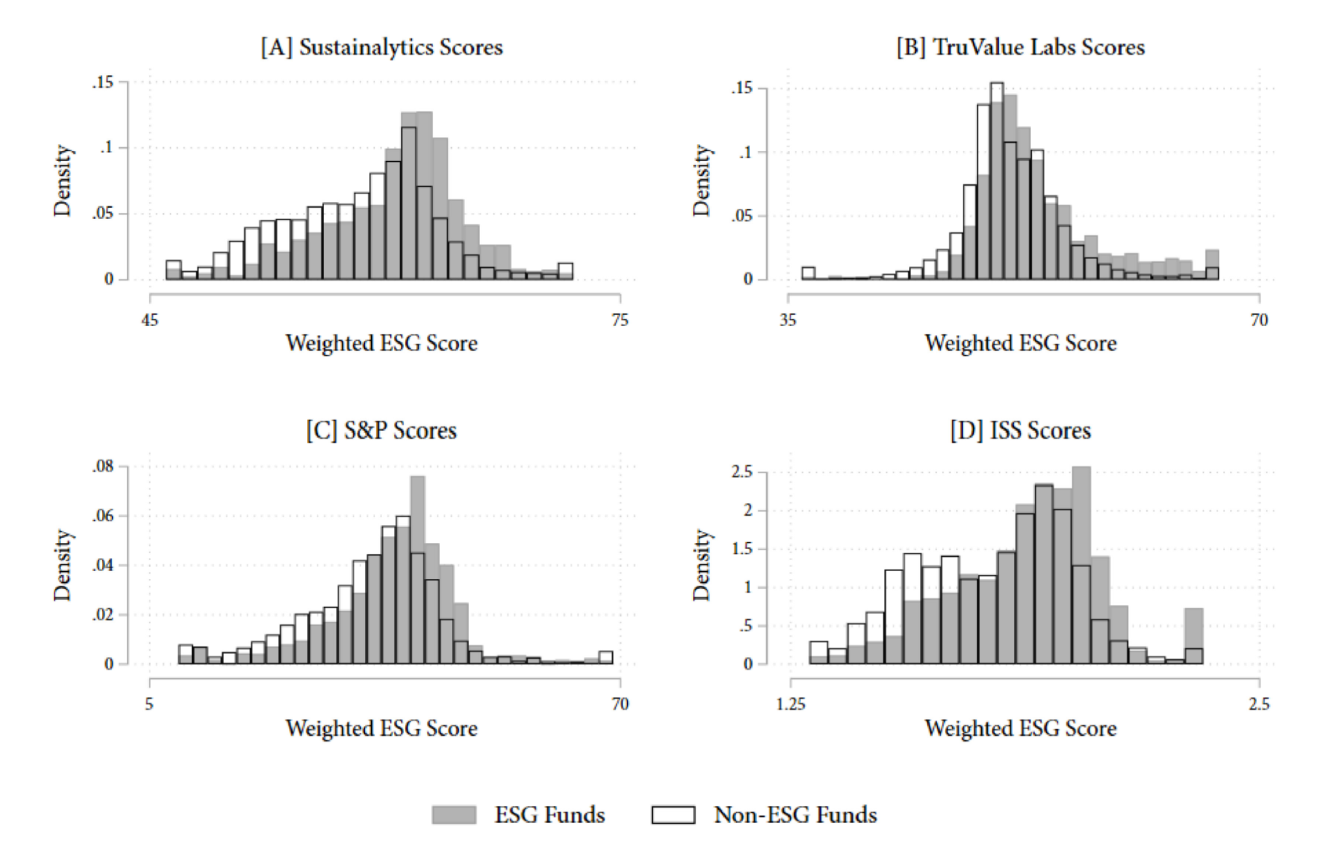
Greenwashing and accountability
Curtis et al. (2021)

Slide 33
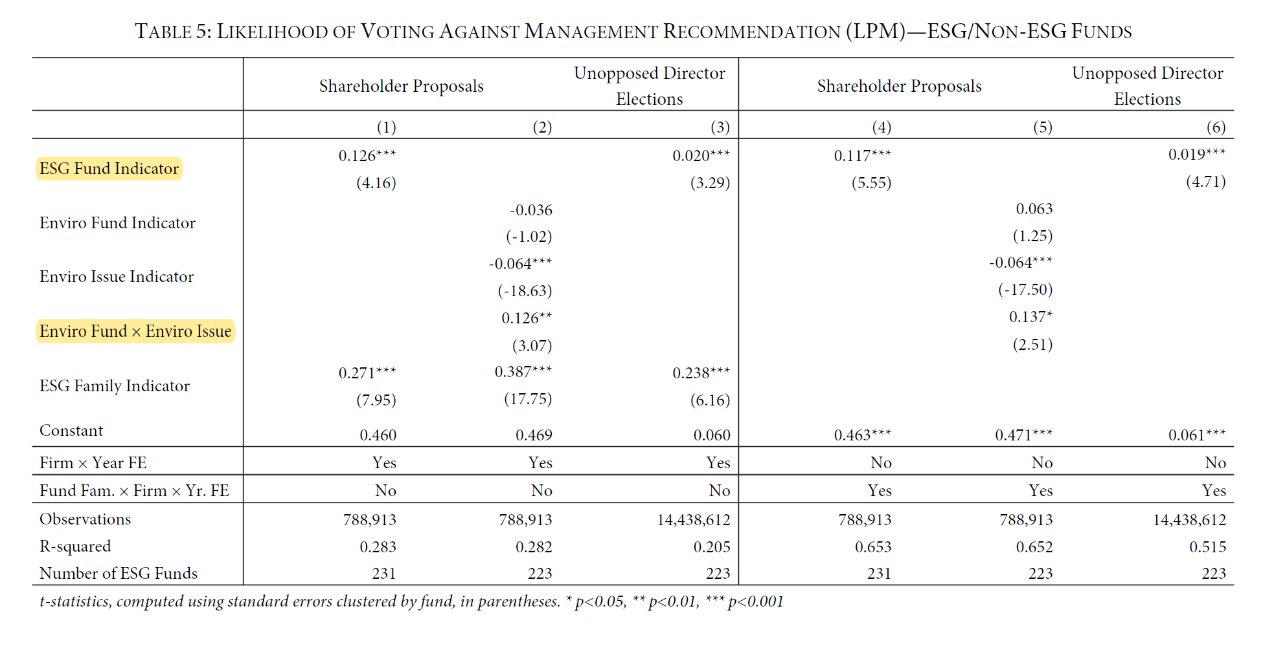
Greenwashing and accountability
Curtis et al. (2021)

Slide 34
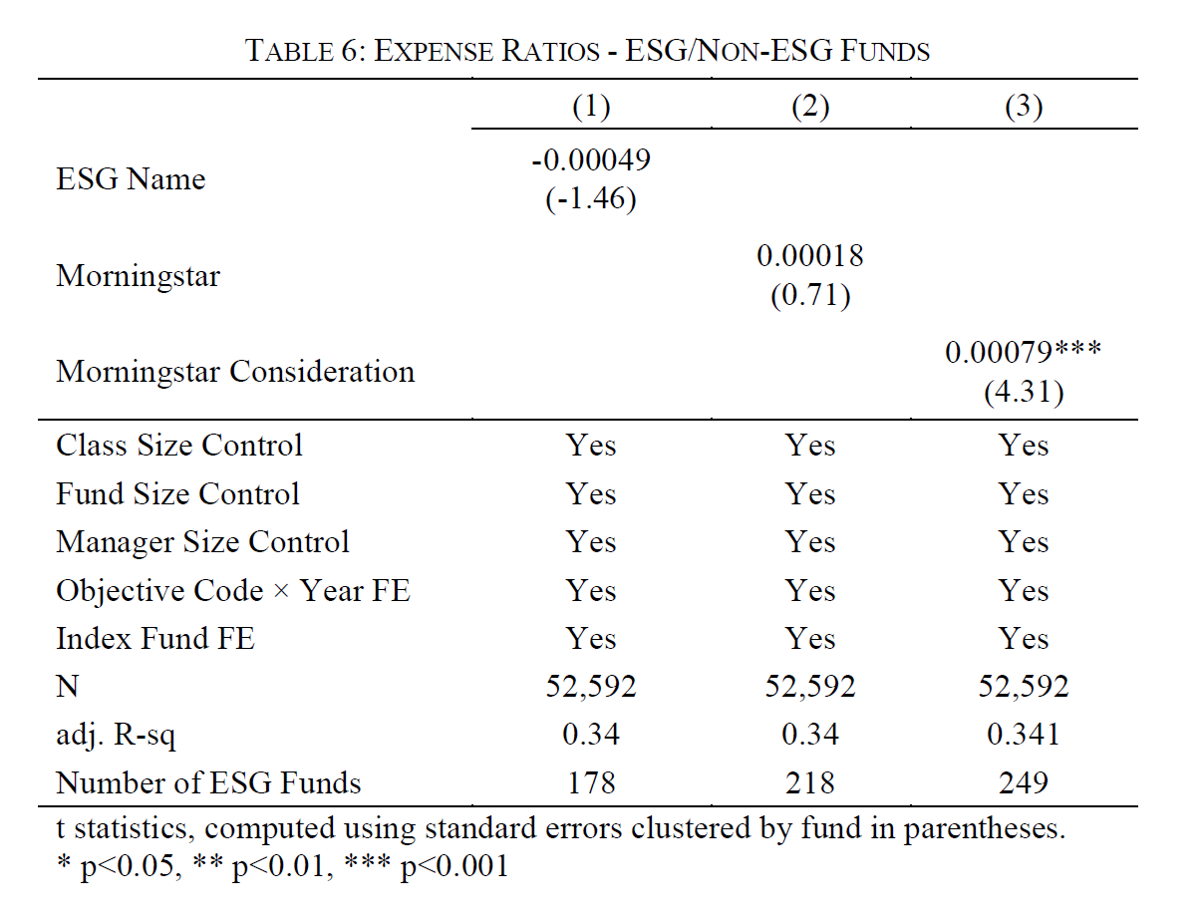
Greenwashing and accountability
Curtis et al. (2021)

Slide 35
Greenwashing and accountability
On the other hand, other papers posit an entirely different narrative…
Khoo and Tallarita (2024): “In this Article, we examine whether this recent decline is linked to a 2021 shift in the SEC’s policy, which expanded the ability of shareholders to influence E&S corporate decisions. We suggest that this regulatory shift has led to an increase in “prescriptive” E&S proposals, which typically call for the adoption of more specific E&S policies by companies, but are costlier to implement. [We]… find that these proposals generally receive less voter support and seem to be driving a substantial part of the decline in support for E&S proposals.”
“Our results support arguments that many institutional investors do not “walk the talk” when faced with E&S issues that conflict with pecuniary maximization objectives (Goshen and Hamdani (2023); Michaely et al. (2021); Heath et al. (2021)). Indeed, while much emphasis has been placed on the importance of pro-social prefer- ences in ameliorating environmental and social externalities (Hart and Zingales (2017); Hart and Zingales (2022); Broccardo et al. (2022); Barber et al. (2021); Hirst et al. (2023); Hart et al. (2024)), our findings reveal that the financial costs of prescriptive proposals often outweigh the intensity of E&S preferences for the vast majority of funds.”
Notes:
Greenwashing at the fund-level.

Slide 36
Greenwashing and accountability
On the other hand, other papers posit an entirely different narrative…
Heath et al. (2021): “Using novel micro-level data, we examine the impact of socially responsible investment (SRI) funds on corporate behavior. SRI funds select firms that pollute less, have greater board diversity, higher employee satisfaction, and higher workplace safety. Yet, both in the broad cross-section and using an exogenous shock to SRI capital, we find no evidence that SRI funds improve firm behavior. The results suggest SRI funds operate through a selection effect, not a treatment effect: SRI funds invest in a portfolio consistent with the fund’s objective, but they do not significantly improve corporate conduct.”
Notes:
Greenwashing at the fund-level.

Slide 37
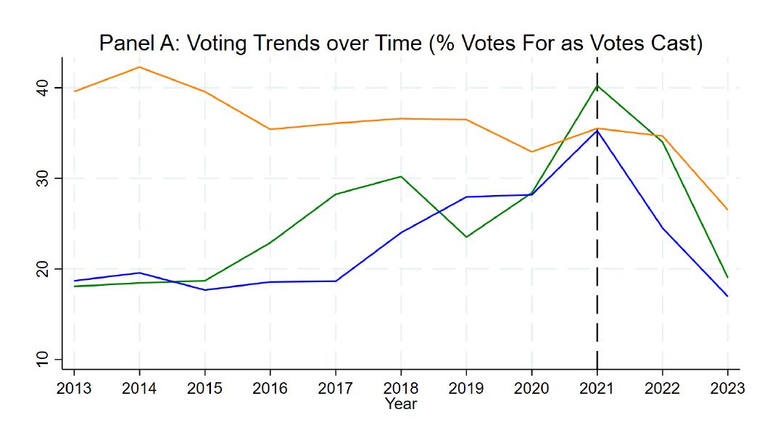
Greenwashing and accountability
Khoo and Tallarita (2024)

Slide 38
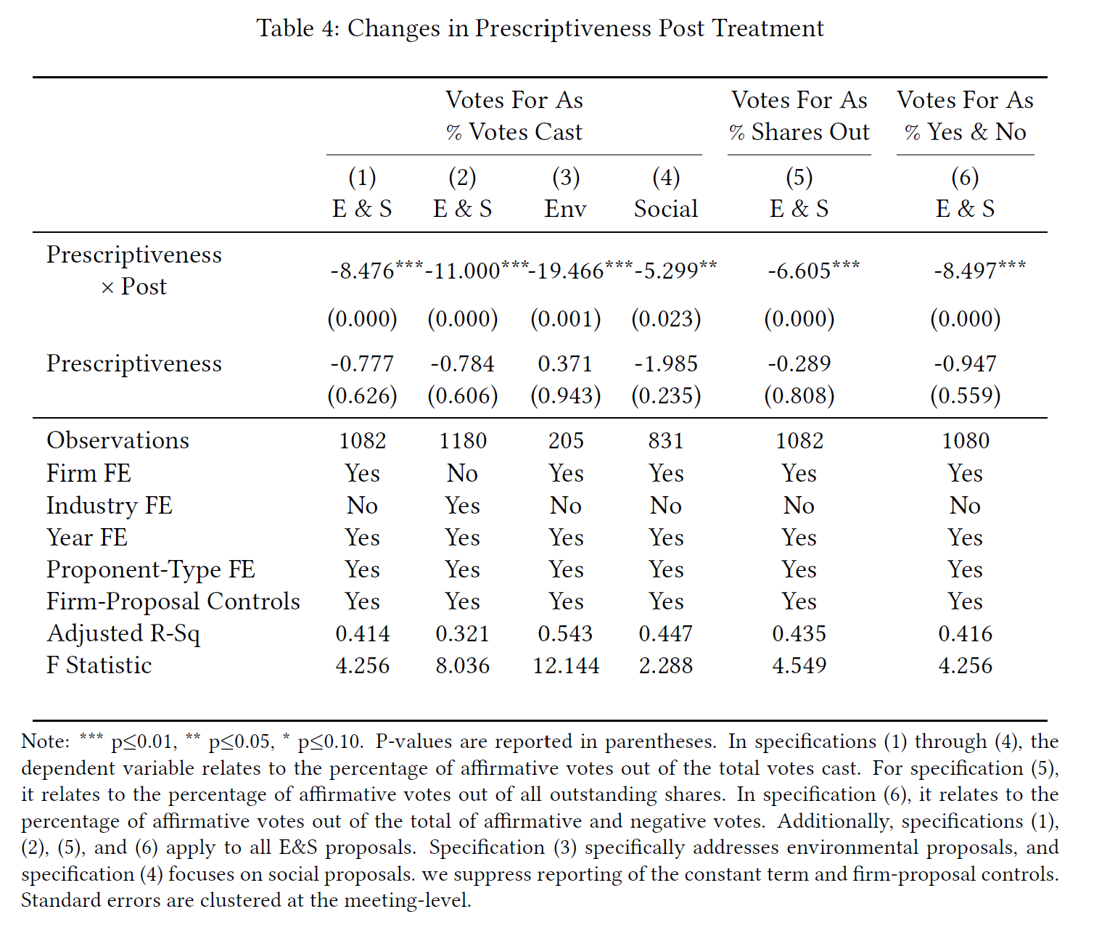
Khoo and Tallarita (2024)

Slide 39
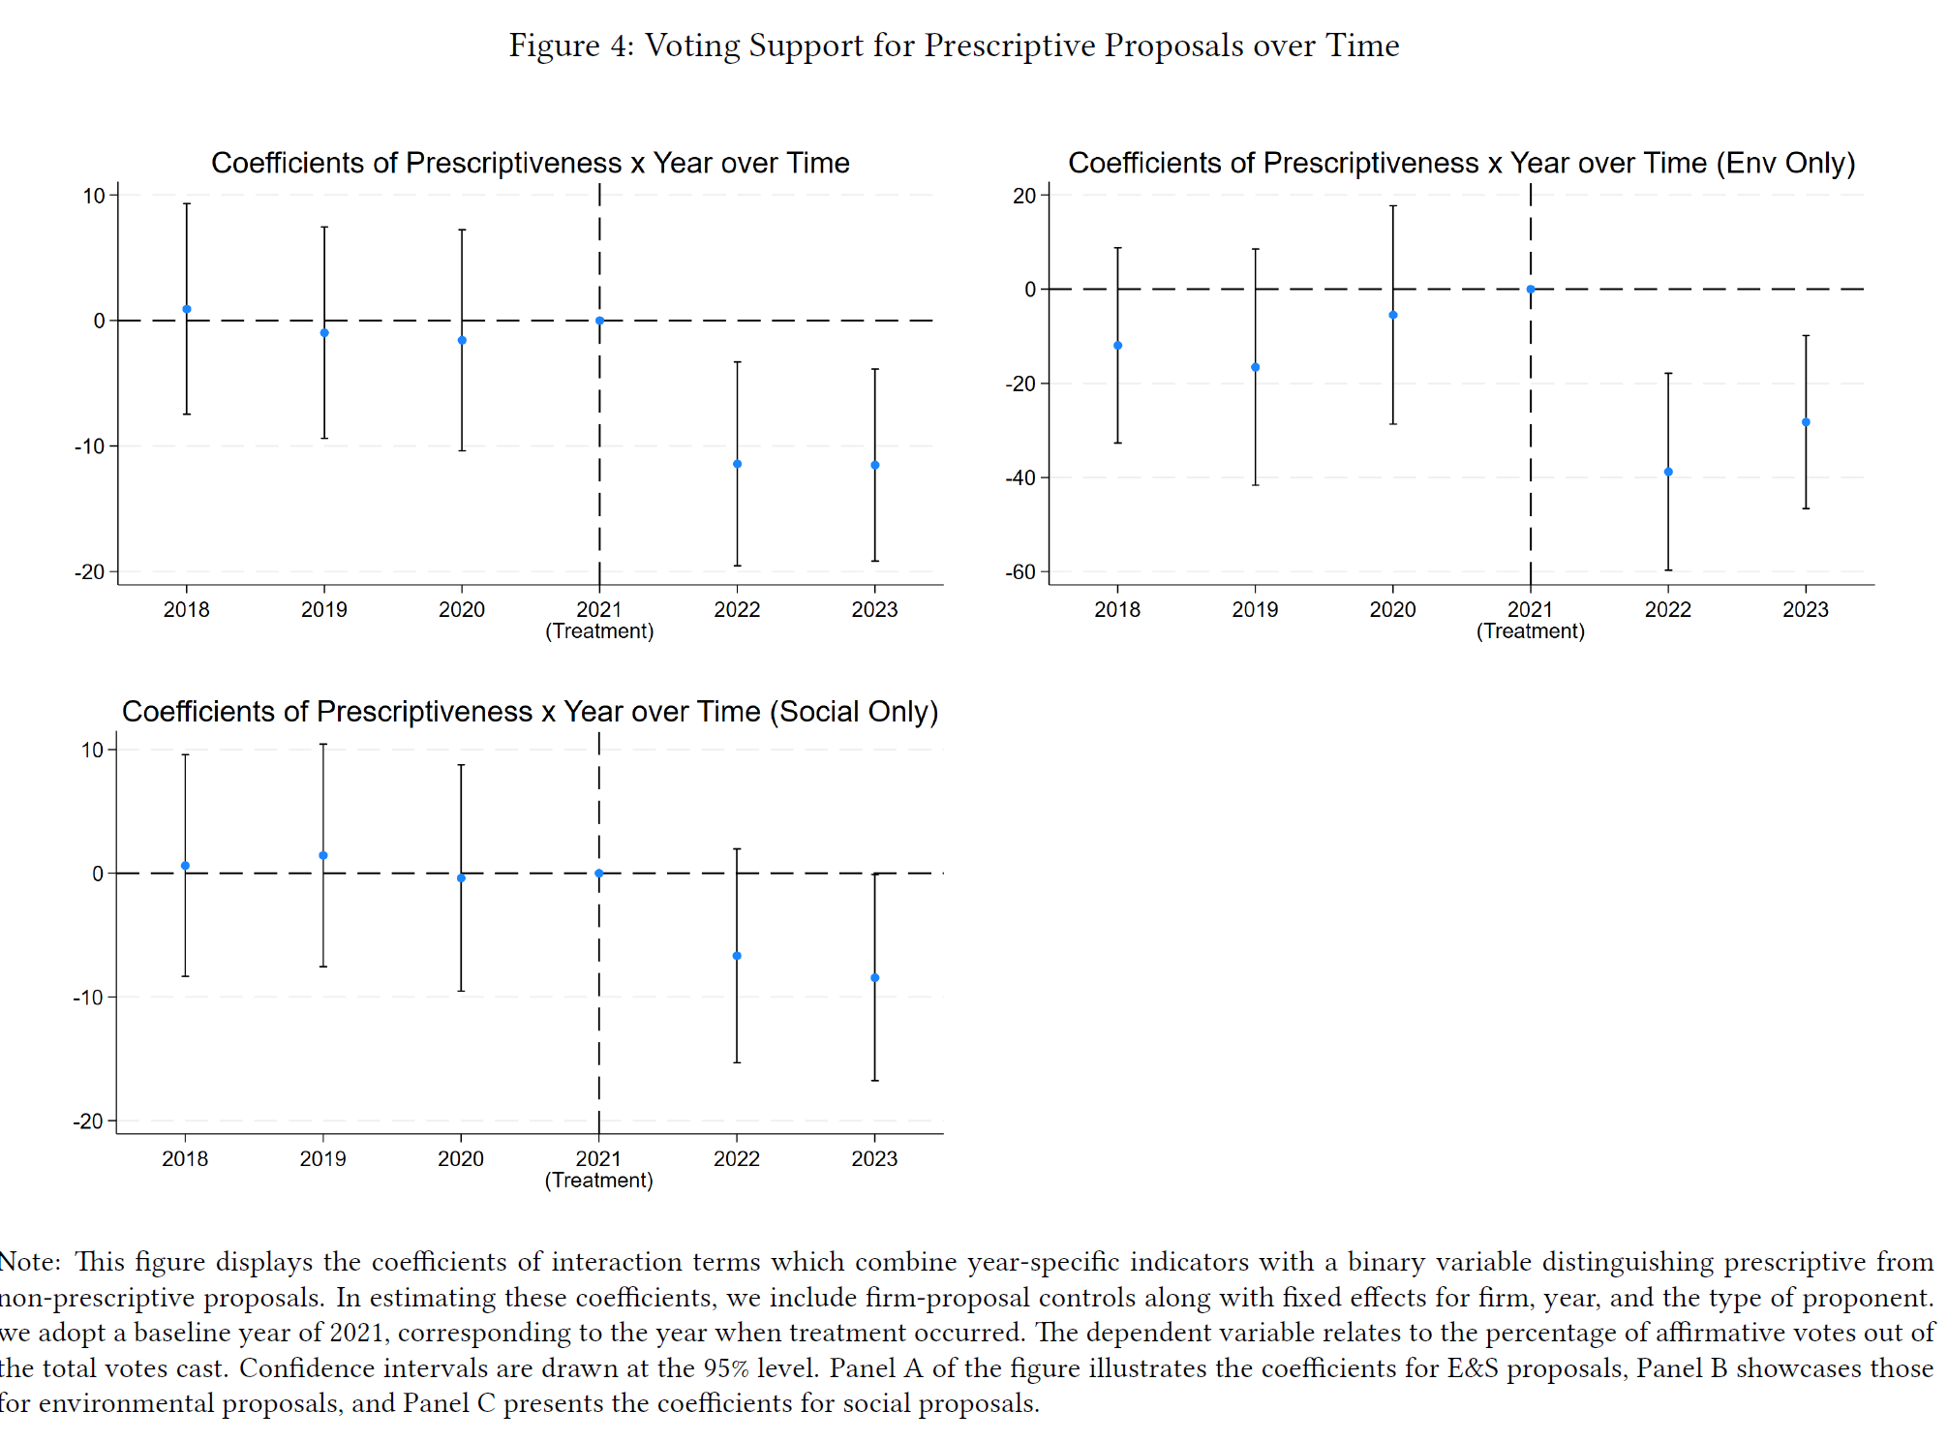
Khoo and Tallarita (2024)

Slide 40
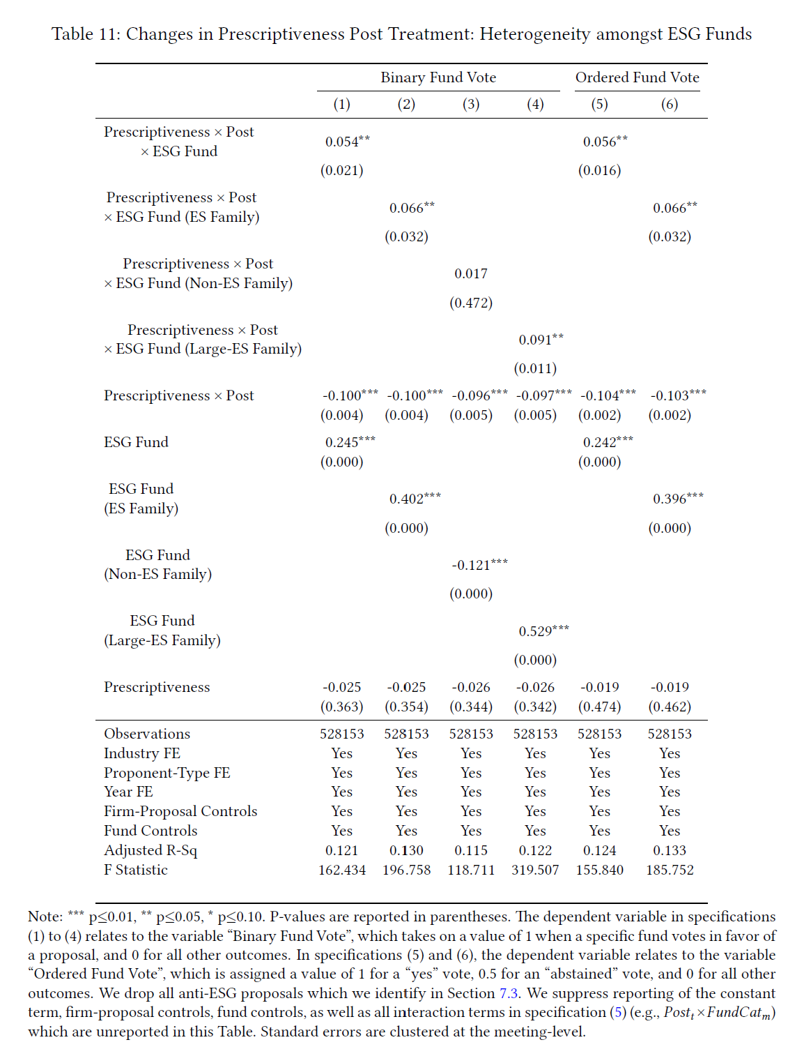
Khoo and Tallarita (2024)

Slide 41
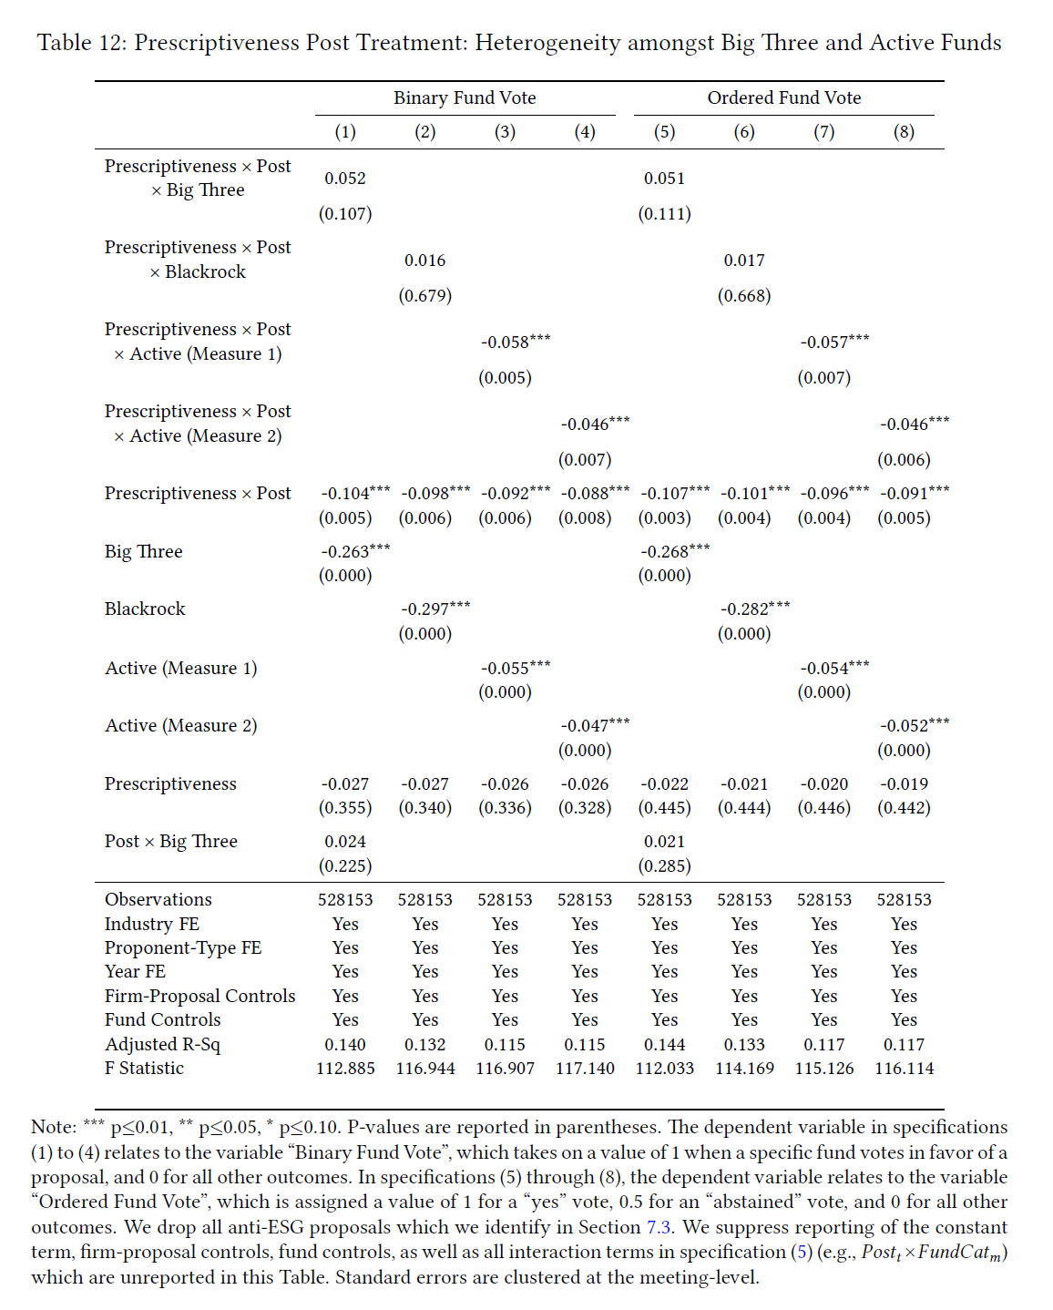
Khoo and Tallarita (2024)

Slide 42
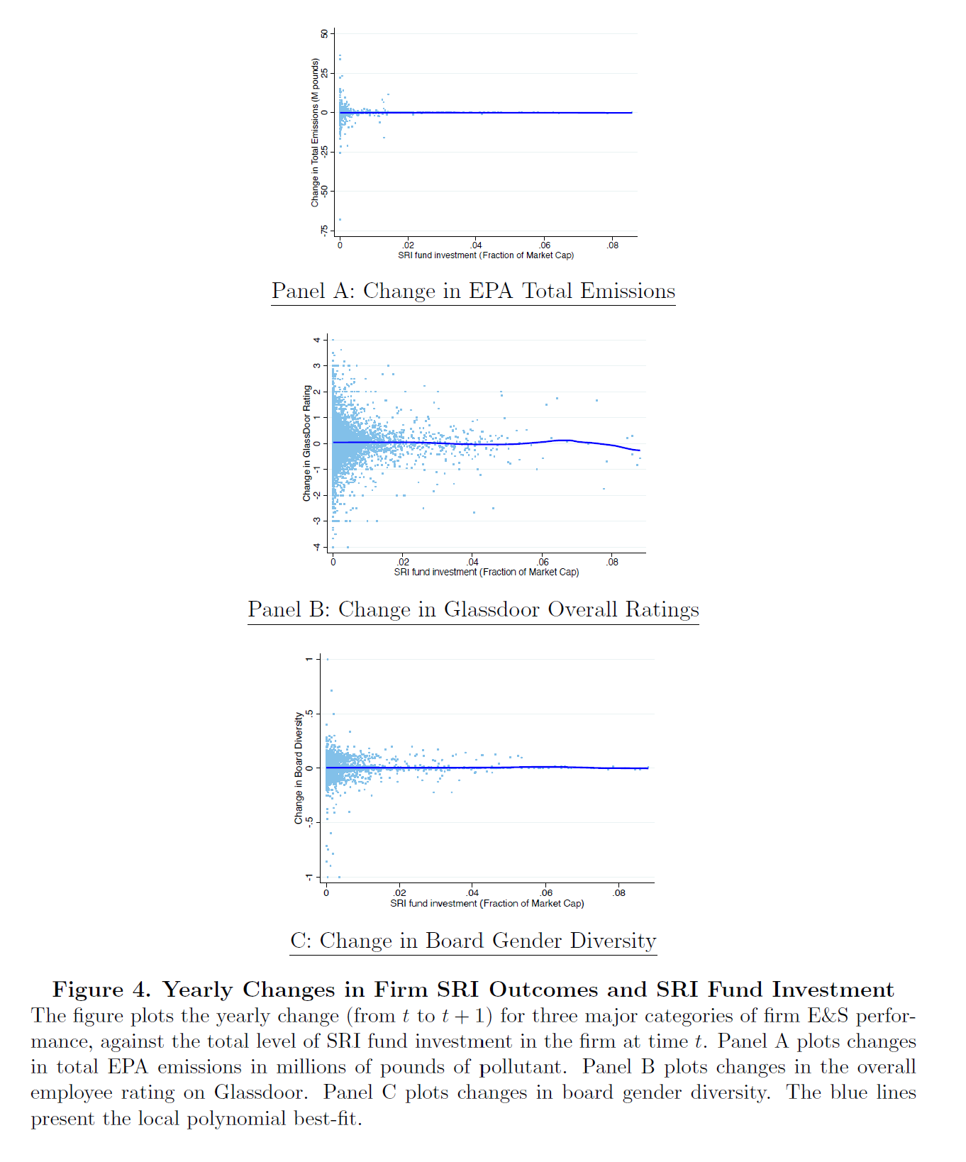
Heath et al. (2021)

Slide 43
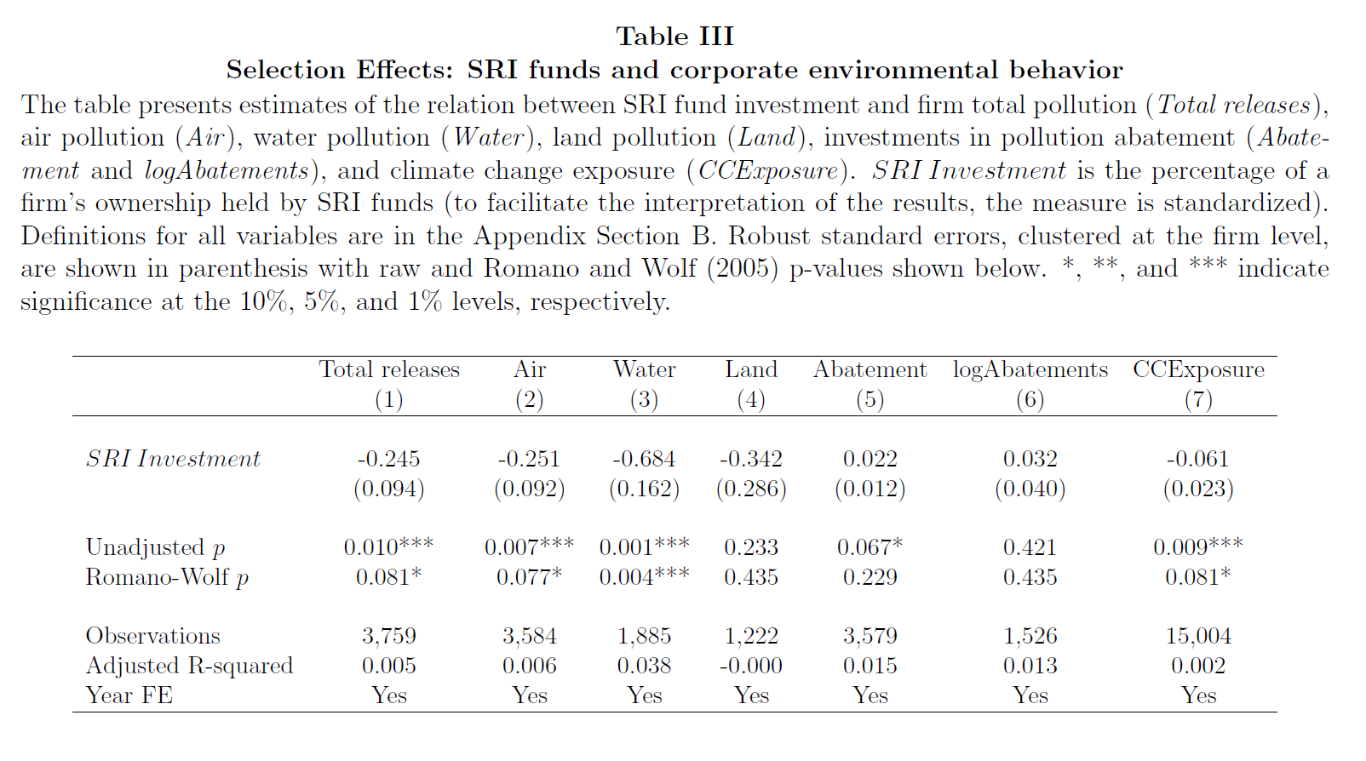
Greenwashing and accountability
Heath et al. (2021)

Slide 44
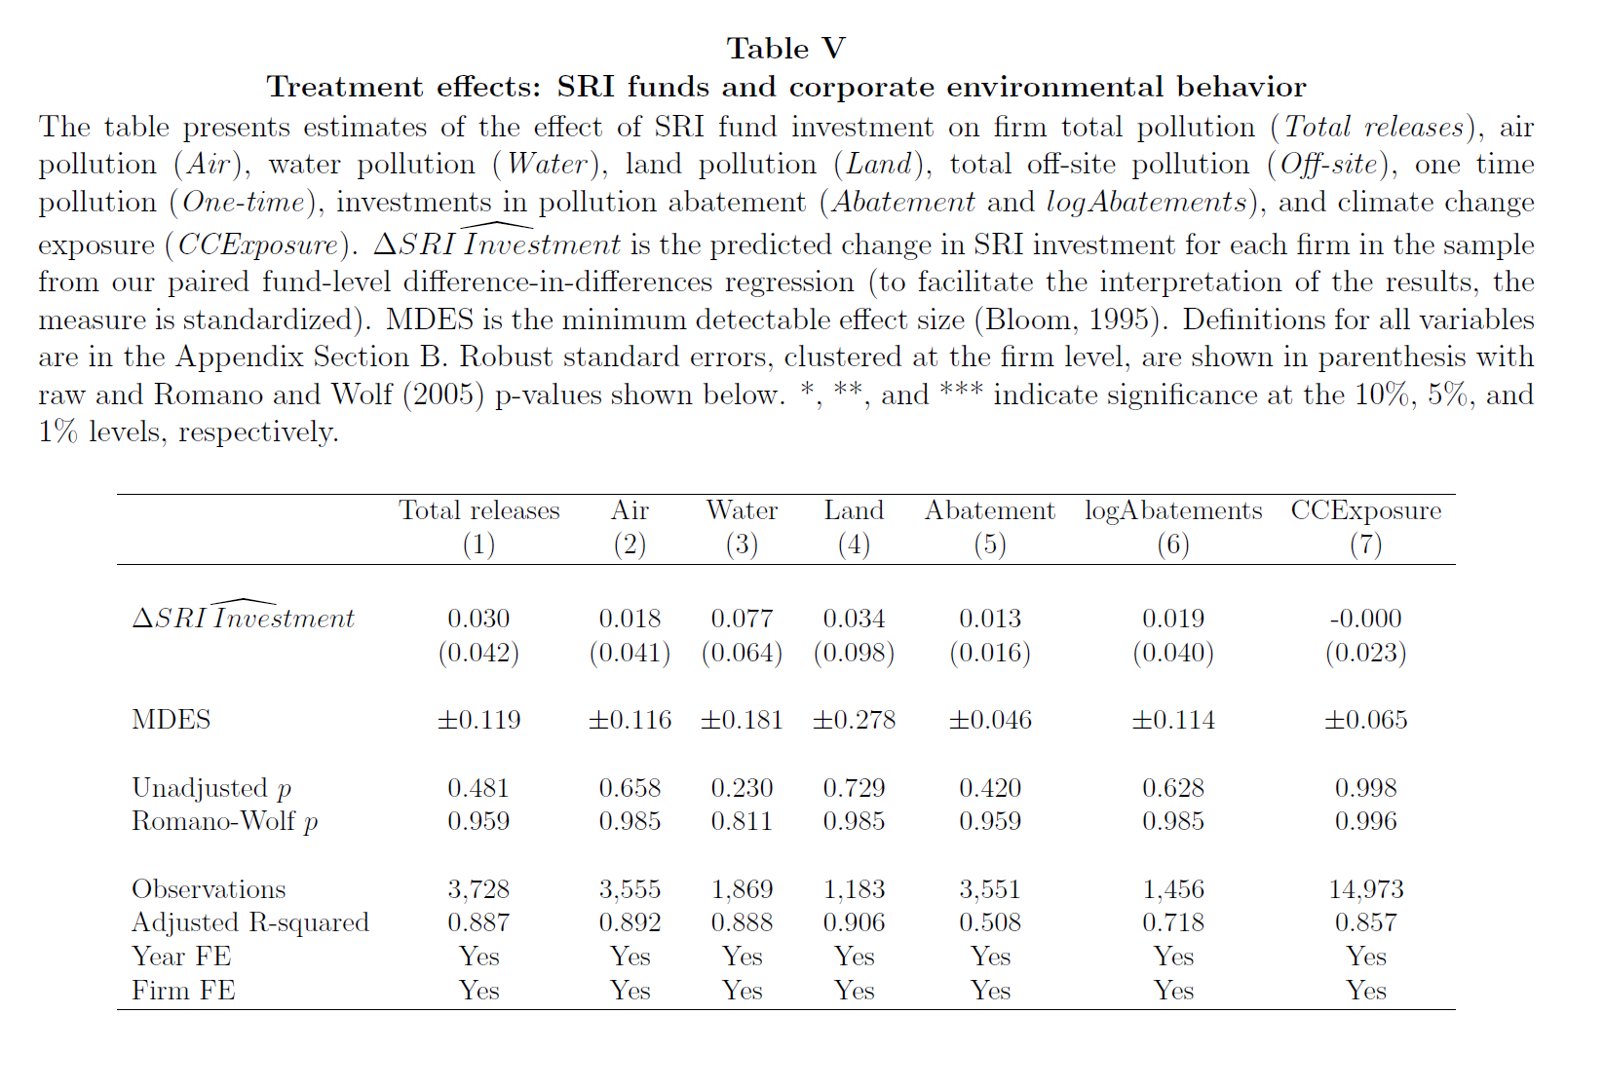
Heath et al. (2021)

Slide 45
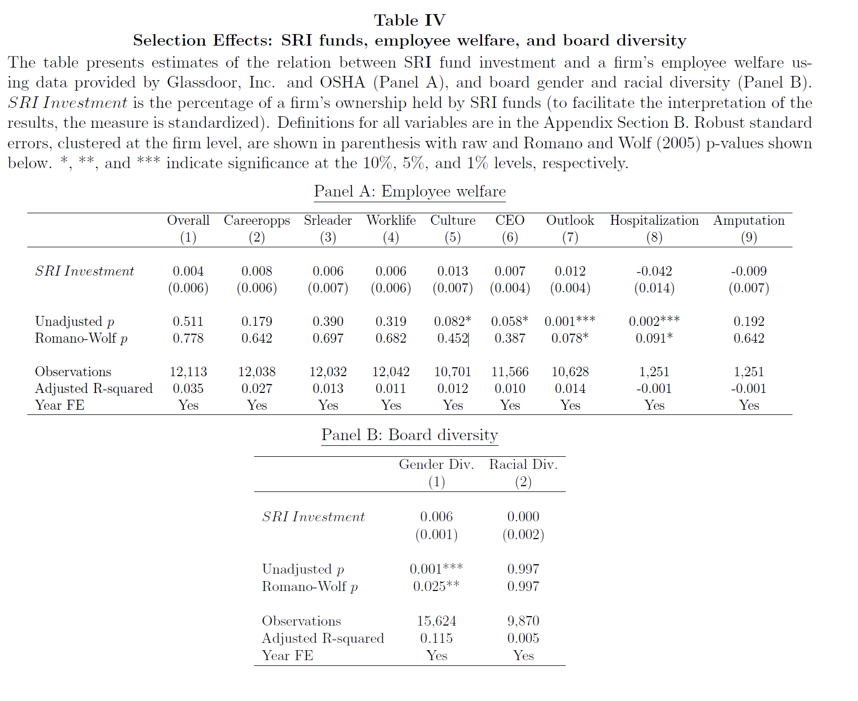
Heath et al. (2021)

Slide 46
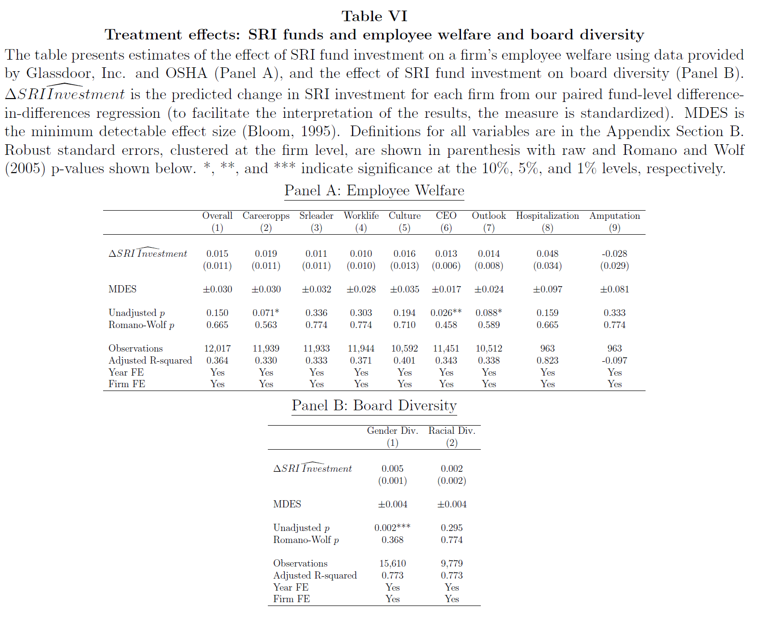
Heath et al. (2021)

Slide 47
Greenwashing and accountability
What about larger institutional investors?
Azar et al. (2021): “[We examine] the role of the “Big Three”(i.e., BlackRock, Vanguard, and State Street Global Advisors) on the reduction of corporate carbon emissions around the world. Using novel data on engagements of the Big Three with individual firms, we find evidence that the Big Three focus their engagement effort on large firms with high CO 2 emissions in which these investors hold a significant stake. Consistent with this engagement influence being effective, we observe a strong and robust negative association between Big Three ownership and subsequent carbon emissions among MSCI index constituents, a pattern that becomes stronger in the later years of the sample period as the three institutions publicly commit to tackle Environmental, Social, and Governance (ESG) issues
Notes:
Greenwashing at the fund-level.

Slide 48
Greenwashing and accountability
Azar et al. (2021): “To gauge whether the Big Three can induce companies to reduce carbon emissions, we start by analyzing these large investors’ engagements with the firms in their portfolios. The Big Three have recently started to disclose comparable detailed data on private engagements with their portfolio firms in investment stewardship reports (ISR). According to the narrative in the ISRs, most engagements go beyond sending a letter to the firm. For example, BlackRock’s ISR states that the fund’s investment stewardship department had “substantive dialogue with the companies listed as engaged firms.” The ISR also states that the fund “engages companies for the following reasons: (1) to ensure that BlackRock can make well-informed voting decisions; (2) to explain its voting and governance guidelines; (3) to convey its thinking on long-term value creation and sound governance practices… We disregard engagements by letters and include only comprehensive engagements via calls and in-person meetings.”
Notes:
Greenwashing at the fund-level.

Slide 49
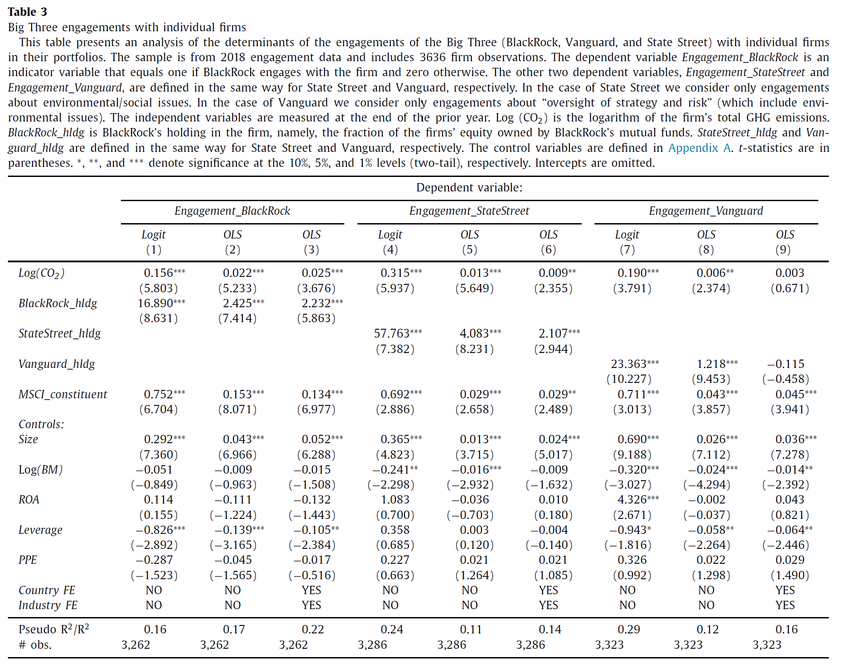
Azar et al. (2021)

Slide 50
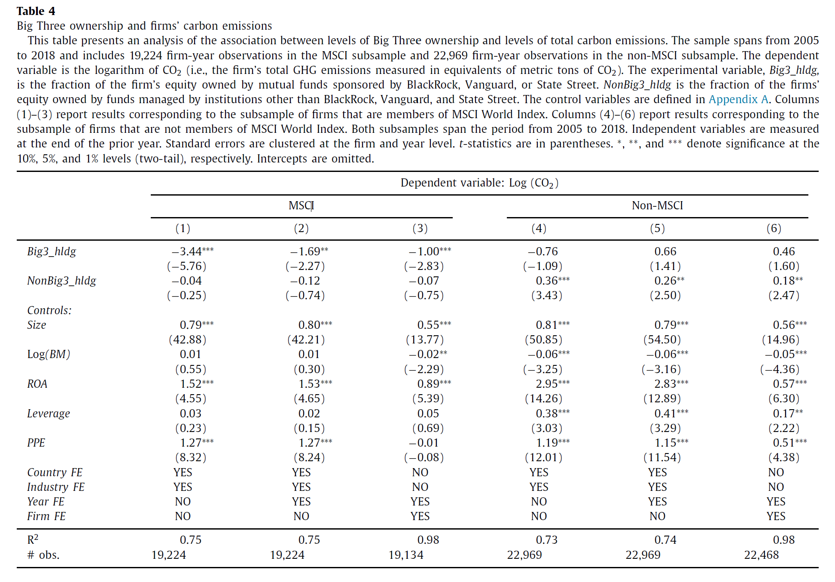
Azar et al. (2021)

Slide 51
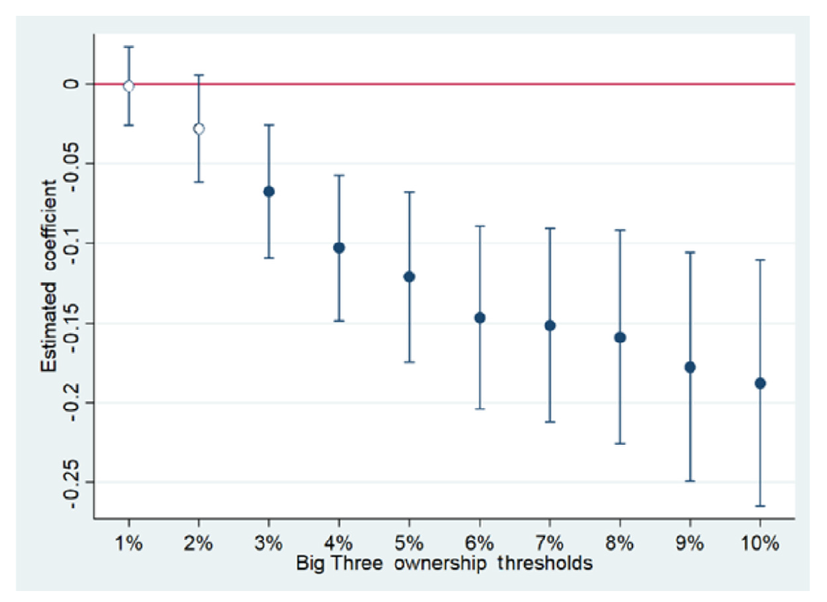
Greenwashing and accountability
Azar et al. (2021)

Slide 52
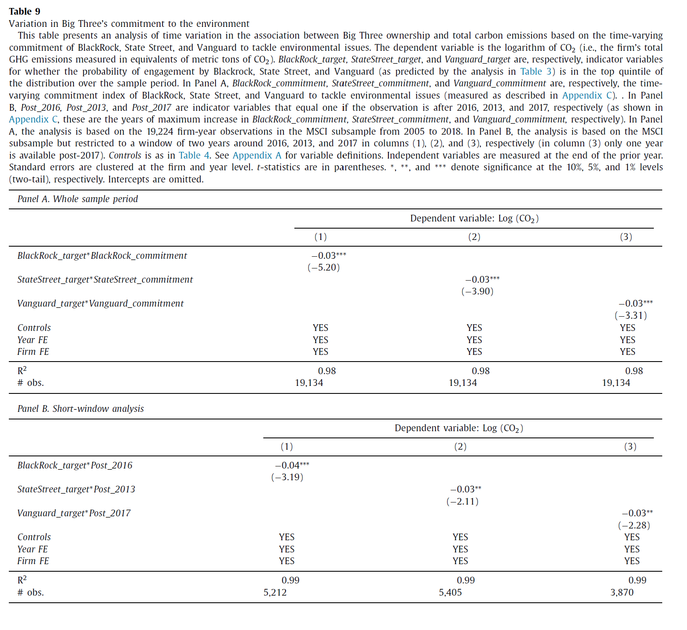
Azar et al. (2021)

Slide 53
Q&A
See you next Tuesday.

