Slide 1

Corporate law and economics (LL4489V/5489V/6489V)
11. board vs shareholder power
LL4489V
Kenneth Khoo
kenneth.khoo@nus.edu.sg

Slide 2

Board vs shareholder power
General Principles
  Overview
  Voice and Incomplete Contracting
  Formal vs Real Authority
Theoretical Foundations
Empirical Evidence

Slide 3
General principles: overview
Recall: In Slide Deck 4, we discussed the notion that the corporate “contract” is one which is characterized by the separation of ownership and control… which in turn gave rise to a “contract” which was associated with:
Massive information asymmetries between corporate managers and shareholders.
Costly monitoring + bonding by shareholders.
Extremely “incomplete” terms, which had to be “gap-filled” ex post.
Furthermore, we also spoke of the “corporate contract” as a “contract” between multiple shareholders and directors/managers. This was a heuristic device to abstract away from the nature of the corporation of a complex nexus of contracts between multiple parties (Coase, 1937).
  It turns out that these complications will be crucial re informing our understanding of the relationship between directors, managers, and shareholders.
Notes:
Unlike spot contracts, most issues in corporate law and governance are decided ex post many years after the corporation was first incorporated.

Slide 4
General principles: overview
At a very fundamental level, the tension between board power and shareholder power is one that involves the balancing of:
The benefits associated with the credible separation of ownership and control (Berle and Means, 1932) and…
  Recall Slide Deck 4’s discussion regarding gains from trade arising from specialization.
The agency costs associated with managerial opportunism in the presence of such a separation (Jensen and Meckling, 1976).
  Note that the use of the term “agency costs” in this context would include all of the opportunity costs associated with the reduction of such agency costs (e.g., the costly monitoring of managers, etc.), as well as the costs associated with opportunism in the presence of incomplete contracting.

Slide 5

General principles: overview
With multiple owners, the relevant benefits associated with no separation of ownership and control are further attenuated by the costs of collective-decision making where shareholders have conflicts of interests (Hansmann, 1996).
  Why even have multiple “owners”? One reason: Similar to (1) in Slide 5, having multiple owners reduces the issues associated with costly wealth constraints (Iacobucci and Triantis, 2007).
This is important when one considers the relevant counterfactual in relation to an “efficiency” analysis.
  For instance, delegating more power (from the board) to a large body of shareholders may be inefficient in comparison to a situation where power is delegated to one/a few shareholders (Anabtawi, 2005).

Slide 6
General principles: overview
While the balance of powers between the board and shareholders might seem “obvious” in theory, the normative inquiry as to how this “balance” should be struck is very complex. Why?
  Measuring the incentives that shareholders or the board may face when they are delegated more power (in relation to one or more issues) is often very difficult.
    For instance, directors/managers may be induced to increase their relationship-specific investments in the corporation when they are given more power. While this might be theoretically plausible, how should we go about measuring this?
    Directors/managers might be motivated to act in the best interests of the company pursuant to non-pecuniary incentives rather than mere pecuniary incentives. How should we ascertain what these non-pecuniary incentives are?
  There may be no limit to the number of ex-post issues which may arise for the board/shareholders’ consideration. Since the incentives of the board/shareholders will depend on the type of issue involved, how should the law allocate power in relation to identifiable issues? What about unidentifiable issues?
    In most jurisdictions, shareholders have the power to vote on the amendment of constitutional/charter amendments, where the conflict of interests between management and shareholders may be particularly sharp. But what about other issues? See discussion later on executive compensation.

Slide 7
General principles: overview
While the balance of powers between the board and shareholders might seem “obvious” in theory, the normative inquiry as to how this “balance” should be struck is very complex. Why?
  The choice of mechanism as to how power should be allocated between the board and shareholders is non-trivial.
    Corporate law has an enormous variety of devices to allocate power between the board and shareholders. For instance, it may allow shareholders to advance a binding/non-binding vote on certain issues; it may allow shareholders to “put up” certain issues for a vote; or it may allow shareholders to sue directors pursuant to the breach of certain (fiduciary) duties. Is one mechanism better than another? Why, or why not?
  Even if the law were to allocate decision-making power to the board or the shareholders, that does not necessarily entail that these powers will be used.
    While this is a direct corollary from the Coase Theorem, determining the “transaction costs” involved in bargaining (between the board and its shareholders) is going to be very context-specific.
These complications have spawned a vast literature on how the law should regulate the tension between the board and its shareholders. We will focus on (1), (3), and (4), leaving most of (2) to a future topic on Voting.

Slide 8

General principles: voice and incomplete contracting
In our last lecture (Slide Deck 6), we discussed the notion of voice. This related to the collective rights of shareholders to:
  Use his/her voting rights to effect certain changes in the corporation (“Voting”).
    This may include using votes to replace the board of directors.
  Use his/her informational rights to engage managers of the corporation, aiming to convince them to follow a specific direction (“Engagement”).
  Use his/her control rights to sue the managers of the corporation for a breach of duties, if such a breach were to exist (“Enforcement”).
As detailed in that deck of slides, we discussed how voice may be superior to exit in many situations.

Slide 9
General principles: voice and incomplete contracting
As detailed in that deck of slides, we discussed how voice may be superior to exit in many situations.
  For instance, diversified shareholders may find exit to be very costly insofar as it would increase the risk-profile of their portfolios (due to the lack of diversification following exit).
  Separately, exit may be difficult or even impossible without the existence of a liquid secondary market for shares.
    In Singapore, most corporations are privately incorporated companies which are unlisted on a secondary exchange (https://www.straitstimes.com/business/companies-markets/the-incredible-shrinking-singapore-stock-market).
  Voting and engagement remain important mechanisms to express shareholder preferences even in jurisdictions where shareholding is diffuse in nature (i.e., where ownership is dispersed) (see Brav et al. (2020) and Azar et al. (2021)).

Slide 10
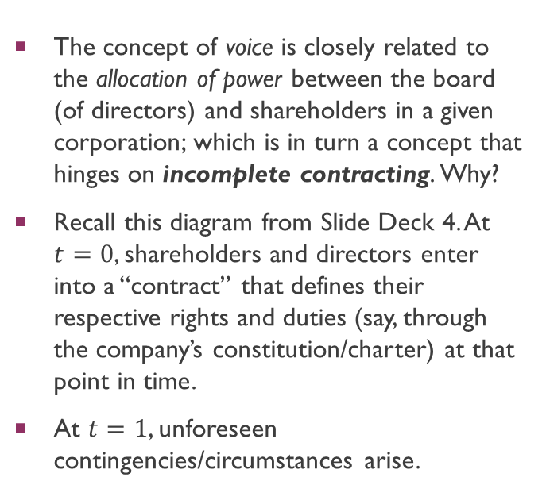
General principles: voice and incomplete contracting
The concept of voice is closely related to the allocation of power between the board (of directors) and shareholders in a given corporation; which is in turn a concept that hinges on incomplete contracting. Why?
Recall this diagram from Slide Deck 4. At $t=0$, shareholders and directors enter into a “contract” that defines their respective rights and duties (say, through the company’s constitution/charter) at that point in time.
At $t=1$, unforeseen contingencies/circumstances arise.
Ex Ante Contract
Ex Post “Gap Filling”
time
0
1

Slide 11
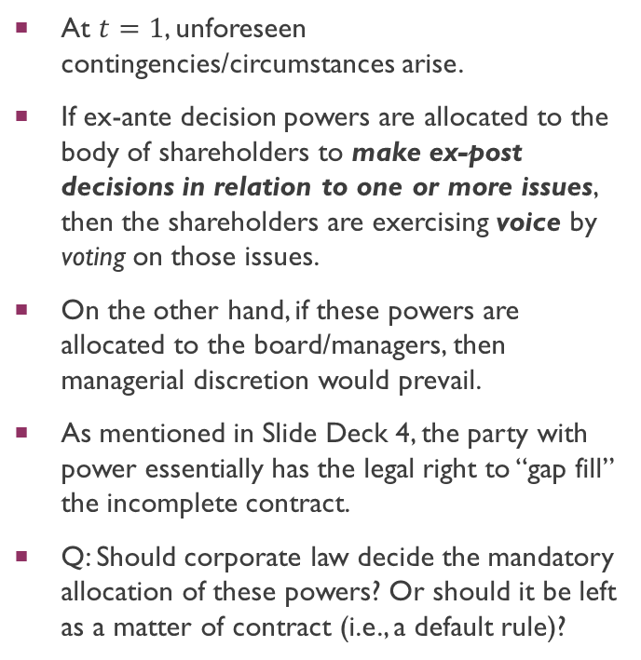
General principles: voice and incomplete contracting
At $t=1$, unforeseen contingencies/circumstances arise.
If ex-ante decision powers are allocated to the body of shareholders to make ex-post decisions in relation to one or more issues, then the shareholders are exercising voice by voting on those issues.
On the other hand, if these powers are allocated to the board/managers, then managerial discretion would prevail.
As mentioned in Slide Deck 4, the party with power essentially has the legal right to “gap fill” the incomplete contract.
Q: Should corporate law decide the mandatory allocation of these powers? Or should it be left as a matter of contract (i.e., a default rule)?
Ex Ante Contract
Ex Post “Gap Filling”
time
0
1

Slide 12
General principles: voice and incomplete contracting
A similar analogy applies to the concept of “enforcement”. Why?
  Even if the board has the ostensible power to “gap-fill” the incomplete contract ex post, doing so in a manner which breaches the board members’ (fiduciary) duties to the corporation would allow the shareholders to compel the rescission of these decisions.
  Arrow (1974): “Ultimately, the power to review is the power to decide… If every decision of A is to be reviewed by B, then all we have really is a shift in the locus of authority from A to B”.
  While costly, the (successful) enforcement of an action against a director’s breach of fiduciary duties owed to the company is thus analogous to the concept of “voting” (Hart, 1993).
What about “engagements”?
  Under an economic framework, successful engagements are conditioned on the credible threat of voting and/or enforcement.
    “Without these control rights “operating in the background”, engagement would be meaningless.” Would you agree with such a statement?

Slide 13
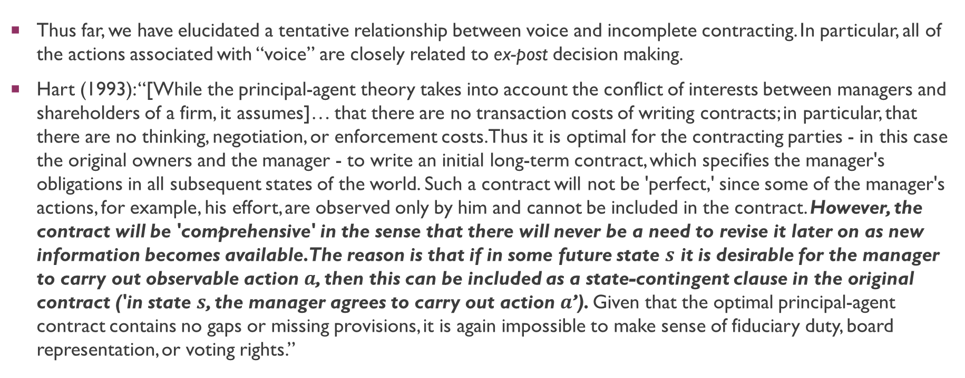
General principles: voice and incomplete contracting
Thus far, we have elucidated a tentative relationship between voice and incomplete contracting. In particular, all of the actions associated with “voice” are closely related to ex-post decision making.
Hart (1993): “[While the principal-agent theory takes into account the conflict of interests between managers and shareholders of a firm, it assumes]… that there are no transaction costs of writing contracts; in particular, that there are no thinking, negotiation, or enforcement costs. Thus it is optimal for the contracting parties - in this case the original owners and the manager - to write an initial long-term contract, which specifies the manager's obligations in all subsequent states of the world. Such a contract will not be 'perfect,' since some of the manager's actions, for example, his effort, are observed only by him and cannot be included in the contract. However, the contract will be 'comprehensive' in the sense that there will never be a need to revise it later on as new information becomes available. The reason is that if in some future state $s$ it is desirable for the manager to carry out observable action $a$, then this can be included as a state-contingent clause in the original contract ('in state $s$, the manager agrees to carry out action $a$’). Given that the optimal principal-agent contract contains no gaps or missing provisions, it is again impossible to make sense of fiduciary duty, board representation, or voting rights.”

Slide 14
General principles: voice and incomplete contracting
Hart (1993): “Take fiduciary duty. A leading example of breach of fiduciary duty or loyalty is where management engages in a self-dealing transaction; it arranges, say, to sell a division of the firm to another company in which it has an ownership interest at a below-market price. Shareholders might sue management and/or the firm to stop the transaction, and a court would then have to decide whether or not management's action is legitimate or whether it constitutes a breach of trust. However, such a case would never arise in a comprehensive contracting world. The reason is that, if the firm's initial owners and manager have unlimited foresight, then they can decide in advance whether the sale of the division under the particular conditions in question is desirable or not, and either allow or disallow this sale explicitly in the initial contract. In other words, it is only possible to make sense of fiduciary duty in a world where the initial contract is incomplete for some reason.”
…“The same difficulty arises when we try to analyze voting rights. A vote is meaningful in a situation where some action has not been specified in advance and the parties must decide on how to choose it ex post. In a comprehensive contracting world, however, where all actions have been specified, nothing is left out of the contract, and so there is never anything to vote on.”

Slide 15
General principles: voice and incomplete contracting
What about ex-ante decision making in corporations? Insofar as foreseeable issues are concerned, they may be contractually determined in a corporation’s constitution/charter. Shareholders are in principle free to “pick and choose” the contractual terms which they think would fit their needs.
  Thus, where complete contracting is concerned, a primary role of corporate law is to provide a set of default rules from which corporate stakeholders can opt out if they decide to do so.
  Note the distinction between the allocation of contractual powers to “gap-fill” the contract ex post, as compared to a corporate decision that has already been determined ex ante via the company’s constitution. As detailed in Slide Deck 4, the allocation of powers to “gap-fill” the contract is contractible ex ante, but the “gap-filling” decision itself is not.
Indeed, we suggested in Slide Deck 4 that rational shareholders will expect managers to behave opportunistically, and would internalize this possibility by bonding + monitoring managers, perhaps via incentives tied to the managers’ executive compensation. Unfortunately, this was a simplification of modern corporations as they stand today.

Slide 16
General principles: voice and incomplete contracting
There are three (among other) major problems associated with ex-ante contracting in corporations:
  Life Cycle of the Firm (Aghion and Bolton, 1992; Rajan and Zingales, 1998)
  Network Externalities (Klausner, 1995)
  Delegation of Term-Revisions to the State (Hansmann, 2006)
We will go through each of these arguments in turn. In any case, these theories (with substantial empirical evidence to back them) explain why ex-post decision-making is especially crucial in the modern corporation.
  These arguments also provide important context for why shareholders in many corporations may not have control rights over the executive compensation of managers/directors.
  They also provide context for why many scholars have argued for mandatory rules that would regulate the allocation of decision-making powers between shareholders and the board.
Notes:
However, we will only discuss mandatory rules in greater detail when discussing the topic “ESG, Shareholderism, and Corporate Stakeholders”

Slide 17
General principles: voice and incomplete contracting
The first problem concerns the “life cycle of a firm” – a term used to describe how the optimal allocation of power within the firm may shift over time.
In a seminal paper, Aghion and Bolton (1992) show that the optimal arrangement for “early-stage” firms may often be one that involves contingent control.
  Contingent control involves the allocation of control such that one or the other party may be in control depending on the verifiable realization of a random variable. According to Aghion and Bolton (1992), debt-financing in corporations resembles contingent control since the entrepreneur retains control of the firm only if he does not default on his debt obligations, otherwise the investor gets some or all of the control rights.
  See also the venture capitalist scenario (“VC”) where the VC often has explicit contractual rights to “take over” the firm if certain events (e.g., poor financial performance) occur.
  Idea behind why contingent control may be optimal: “It allows the entrepreneur to reap some private benefits and at the same time it gives adequate protection to the investor. By giving control to the investor when s = 0 (e.g.., when the firm is doing poorly), the debt contract can limit the extent of rent extraction through expost renegotiation. At the same time, when s = 1 (when the firm is doing well), the investor cannot prevent the entrepreneur from obtaining his private benefits.”
Notes:
More on private benefits of control later.

Slide 18
General principles: voice and incomplete contracting
However, contingent control between the board and shareholders is very rare in practice, especially in public corporations. Why?
One problem is that the nature of the relationship between an early-stage VC investor and an entrepreneur may be very different from that of a mature company which is considering an IPO (initial public offering).
Rajan and Zingales (1998): “where ownership of assets should optimally lie may change over time. When an inventor or entrepreneur starts out, there is little value to speak of (and, thus, little for others to appropriate through opportunistic investment). Since the expected payoff from appropriate investment is large relative to the payoffs from opportunism, ownership typically enhances the incentives to make specific investments. At this stage the most crucial investments are made by the inventor/entrepreneur, so he should own the start-up company. But once the enterprise becomes larger, two new issues arise. First, the specific investments of others such as professional managers become important. Second, the amount of future rents up for grabs is generally much larger. On the one hand, it may be unwise to give ownership to managers, since they may attempt to reduce the implicit claims the entrepreneur has by overly changing the direction of the firm. On the other hand, the entrepreneur may inefficiently attempt to capture even more surplus by maintaining the firm too long on a path that preserves his usefulness. The notorious focus of inventors on continuing R&D rather than on developing products for commercial production is a case in point. At this point, our work would suggest that cooperation is best achieved if the firm is owned by third parties…”

Slide 19

General principles: voice and incomplete contracting
In other words, in contrast to a firm’s “startup” stage where VC funding/seed funding is crucial, shareholders who “enter into the corporate contract” often take existing corporate contractual arrangements as given.
  Shareholders here act as “price takers” in relation to existing contractual terms. Almost all corporate reform must be done ex-post.
  We will discuss hedge-fund activism in a subsequent topic on shareholder activism and voting.
  NB: How is this distinct from the scenario where VCs are actively involved, as per the scenario painted in Aghion and Bolton (1992)?
  What about private companies? Quasi-partnerships (recall how quasi-partnerships are relevant to a s 216 analysis)?

Slide 20
General principles: voice and incomplete contracting
The second problem concerns network externalities associated with corporate law.
Stylized facts provided by Hansmann (2006): “the extraordinary freedom that is now available to the drafters of corporate charters is exploited in remarkably small degree. While closely held business firms commonly have detailed, specifically tailored charters, the charters of publicly traded corporations are remarkably empty. They are commonly just a few pages long and contain very little of interest. They effectively defer to the default terms of the state corporation law in virtually all matters of significance. If they contain anything else at all, it generally involves one or more of a few simple standardized deviations of a general character – such as provision for a staggered board or for dual class stock that entail choosing well-established alternatives from the statutory menu. We do not see corporate charters trying out any of the big reforms that are routinely pressed today, such as takeover rules along the lines of the British City Code, or expanded shareholder nomination rights, or constraints on the structure and disclosure of executive compensation.”
Klausner (1995) has argued that the default rules of corporate law gain much of their force from the need from network effects.

Slide 21
General principles: voice and incomplete contracting
What are network effects?
  A network effect/externality arises when the utility gained by party A from doing X increases with the number of parties also doing X.
  Example: Social media platforms derive most of their scaling efficiencies from network externalities/effects. Intuition: The “value” derived from using Facebook increases as more people join Facebook. Would people use Facebook if it just had a few users?
Additional Stylized Fact: More than 50% of all publicly incorporated companies are incorporated in the state of Delaware (see Daines, 2001).
As more and more companies choose to incorporate in Delaware, Klausner (1995) argues that is:
  a greater certainty that derives from judicial interpretation of similar terms in other firms' charters,
  a reduced cost of legal services resulting from a focus by lawyers on a narrower range of terms,
  lower costs to prospective investors in evaluating already familiar terms.
Notes:
What is “doing X” in our context?

Slide 22
General principles: voice and incomplete contracting
The third problem concerns the optimal delegation of term revisions.
Recall from Slide Deck 4 that the “corporate contract” is extremely dynamic (i.e., long-term) and incomplete.
Hansmann (2006): “By adopting default rules of law rather than using explicit contracting, parties allow for the constant readjustment of their relationship over the long period of time that it may last. The provisions of corporate law are essentially contract terms that can be repeatedly reformed by a third party – the state – to adapt them to changing circumstances.”

Slide 23
General principles: voice and incomplete contracting
Why the state?
  According to Hansmann (2006), reliance on corporations themselves to adjust their charters over time may give rise to even greater problems. What are some of these problems?
  Listokin (2005) and statutory fair price provisions (a species of antitakeover rule that impedes two-tier takeovers in which the price paid in the first-step tender offer is higher than the price paid in the second-step freeze-out merger). 27 states provided no default rule regarding these provisions, 23 states allowed for an “opt-out” default, while 1 state (Georgia) provided for an “opt-in” default.
    56.4% of all companies adopted “fair price provisions” in Georgia, but out of the 27 states where no default rule was operative, only 20.4% of these companies adopted such “fair price provisions”. Why?
  Hansmann (2006): A specially crafted charter provision is locked in until the charter is again amended to remove or alter it, whereas a provision in the state's corporation statute can be altered as necessary over time by the state's legislature and judiciary to keep it consistent with changes in circumstances and in other aspects of the state's corporation law.
    Q: Which of the two “routes” is more costly for parties?
Notes:
Boilerplate discussion

Slide 24

General principles: formal vs real authority
Given the aforementioned discussion, let us suppose that ex-post decision making is crucial in the corporate context.
In the usual L&E approach to resolving ex-post disputes, the residual power to “gap-fill” contracts is allocated to one or more parties ex-ante, at the start of the relationship (Grossman and Hart, 1983).
In economics, the power to engage in ex-post decision-making is also known as one’s authority to make the relevant decisions.
  This is a legal concept. Without law, the power of the board to act on behalf of the company (even if some of the shareholders were to dissent) would not be enforceable.
  Meridian Global Funds Management Asia Ltd v Securities Commission [1995] 2 AC 500: Rules of attribution exist to determine which actions of natural persons may be attributed to the company as a persona ficta.
However, the existence of legal authority does not necessarily entail the use of it (see Slide 8).

Slide 25
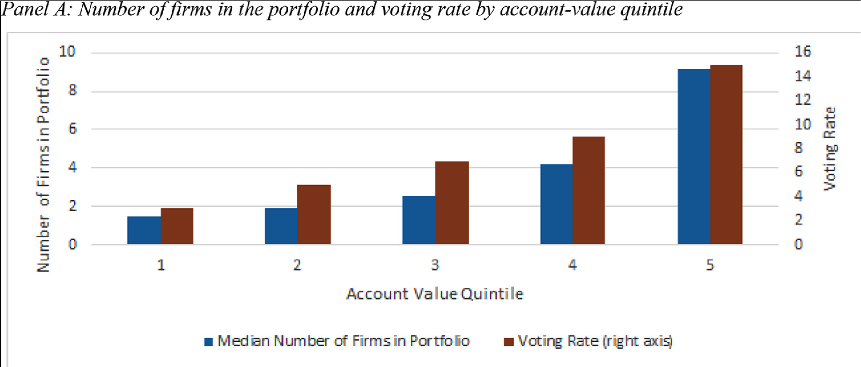
General principles: formal vs real authority
However, the existence of legal authority does not necessarily entail the use of it.
  Typical example: Shareholders have the legal authority/power to vote on certain issues. In practice, most shareholders do not turn up at shareholder meetings to vote. Only 3-15% of retail shareholders turn up to vote (Brav et al. 2022).
  This is known as the distinction between formal (i.e., legal) and real authority (Aghion and Tirole, 1997).
    Real authority: “effective control over decision-making”.

Slide 26
General principles: formal vs real authority
Recall Slide Deck 2. In Law and Economics, we were concerned about the law’s impact on human conduct.
  While many legal scholars simply assume that the law will change the incentives of persons subject to legal jurisdiction, most L&E scholars understand that the legal position might simply be irrelevant. Why so?
Aghion and Tirole (1997): “… For example, it is commonplace to observe that shareholders have limited control over their board of directors, which itself may be subject to the domination of the top executives, who in turn often rubber-stamp the divisions' projects, and so forth.”
  Why would a party with legal power allow another party without legal power to have real authority? According to Aghion and Tirole (1997), this is driven by the idea that the party with real authority might have a private benefit from decision-making, and that this party will exert more effort (i.e., shows initiative) so as to capture these private benefits.
  The notion of there being “private benefits from control” is an important concept which we will return to later, as well as in subsequent topics.

Slide 27
theoretical/conceptual foundations
Why the distinction between the board and body of shareholders?
  Pursuant to the primary rules of attribution (Meridian Global Funds), the primary rules of attribution attribute the acts of the company’s organs (either the board or the shareholders in a general meeting) to the company.
Should the law allocate legal power to the board of directors, or the body of shareholders?
  As motivated earlier, the answer to this question is complex. Why?
  Nevertheless, the allocation of powers to the board and/or the shareholders is not binary – it is a matter of degree. What does this mean?
The academic literature is broadly split into two camps:
  Scholars who believe that relatively more power should be vested in the board are known as advocates for “director primacy”.
  In contrast, scholars who believe that relatively more power should be vested in shareholders are known as advocates for “shareholder primacy”.
Notes:
Do not confuse this with stakeholderism.

Slide 28
theoretical/conceptual foundations: director primacy
Recall Slide Deck 4. In that Slide Deck, we discussed how separating ownership and control gave rise to gains from trade – a mutually beneficial arrangement for both the board and the corporation’s shareholders.
Problem: Separating ownership from control may not require any legal intervention. Even if shareholders were to retain legal power over their managers, they could simply task managers to run the day-to-day affairs of the corporation without actually invoking their legal authority/powers.
  See discussion on formal vs real authority.
  Bebchuk (2005): “Granting shareholders the power to intervene hardly implies that whatever superior information management might have will not influence the choice of governance arrangements. Management will be able to use the information as a basis for its recommendations to shareholders. Shareholders will then decide how much deference to give to management's recommendation, taking into account both that management might be better informed and that it might have self-serving reasons for opposing a value-enhancing proposal. After balancing the considerations for and against deference, rational shareholders might often conclude that deference would be best on an expected-value basis. Other times, however, they might reach the opposite conclusion. Although shareholders cannot be expected to get it right in every case, it is their money that is on the line, and they thus naturally have incentives to reach decisions that would best serve their interests.”
Rather, the issue concerns whether management should be credibly vested with the legal authority to make decisions on a particular issue, even if that decision would be opposed by shareholders. Can you think of an example?

Slide 29
theoretical/conceptual foundations: director primacy
As noted earlier, scholars who argue that directors should be credibly vested with the legal authority to act on behalf of the corporation are known as scholars who advocate for “director primacy”.
Intuition as per Bebchuk (2005): Shareholders are “tying their own hands” ex ante, vesting legal authority in the board to make decisions on their behalf.
Thus, if there is any ex-post dispute between the board and the shareholders in relation to a given issue, the board’s decision will prevail as a default rule.
  Shareholders will not get to supersede the board’s decision on the matter, even if they disagree with it.
    See Automatic Self-Cleansing Filter Syndicate Co Ltd v Cuninghame [1906] Ch 34: “it is not competent for the majority of the shareholders at an ordinary meeting to affect or alter the mandate originally given to the directors, by the articles of association”.
Scholars associated with “director primacy” argue that the benefits of credibly vesting decision-making power in the board largely outweigh the costs of doing so.

Slide 30
theoretical/conceptual foundations: director primacy
There are three central (among other) arguments associated with the literature on “director primacy”:
Information Asymmetry and Diversification
Private Benefits and the Incentives to acquire Information
Team Production and the Reduction of Inter-Shareholder Opportunism
We will go through each of the arguments in turn.
  How do proponents of “director primacy” address the issues of managerial self-interest and the associated agency costs?

Slide 31
theoretical/conceptual foundations: director primacy
Information Asymmetry and Diversification
The first argument is simple: It relates to the massive information advantage that directors have over shareholders due to the voluntary separation of ownership and control.
Directors are likely to have more payoff-relevant information simply due to their positions – they are put in charge of running the day-to-day business affairs of a corporation.
  One might contend that shareholders would simply allow directors to have real authority over corporate decision-making, notwithstanding their legal authority. But shareholder resolution outcomes are determined in accordance with the number of voting shareholders who are present.
  Thus, one might anticipate voting pathologies to arise if a subset of shareholders simply do not turn up for meetings (see Brav et al. 2022 in Slide 26). Can you think of an example?
One scholar who argues for a governance regime with director primacy is Bainbridge (2006).

Slide 32
theoretical/conceptual foundations: director primacy
Information Asymmetry and Diversification
Bainbridge (2006): “…shareholders lack incentives to gather the information necessary to participate actively in decision-making. A rational shareholder will expend the effort necessary to make informed decisions only if the expected benefits outweigh the costs. Given the length and complexity of corporate disclosure documents, the opportunity cost entailed in making informed decisions is significant. In contrast, the expected benefits of becoming informed are quite low, as most shareholders' holdings are too small to have significant effects on the vote's outcome. Accordingly, corporate shareholders are rationally apathetic.”
Time + Effort involved in Corporate Governance = Costs entailed in making informed decisions. These problems are exacerbated by:
  “Free-riding” problems in corporate governance. Note how shareholder participation in decision-making is endogenously determined. What does this mean?
  Diversified shareholdings. For a given shareholder, what does a diversification strategy entail?
Notes:
“Weakest argument”
Explain what free-riding problems are. What type of ownership structure is likely to invoke free-riding problems?

Slide 33
theoretical/conceptual foundations: director primacy
Information Asymmetry and Diversification
Bainbridge (2006): “Given these conditions, it would be surprising if a modern public corporation's governance arrangements attempted to make use of consensus-based decision-making anywhere except perhaps within the central decision-making body. Instead, it is "cheaper and more efficient to transmit all the pieces of information once to a central place" and to have the central office "make the collective decision and transmit it rather than retransmit all the information on which the decision is based.”
“Where then is the corporation's central office located? The Delaware Code, like the corporate law of virtually every other state, gives us a clear answer: the corporation's "business and affairs ... shall be managed by or under the direction of a board of directors." Hence, as an early New York decision put it, the board's powers are "original and undelegated…”
“The chief economic virtue of the public corporation… [is that] it provides a hierarchical decision-making structure well-suited to the problem of operating a large business enterprise with numerous employees, managers, shareholders, creditors, and other constituencies. In such an enterprise, someone must be in charge: Under conditions of widely dispersed information and the need for speed in decisions, authoritative control at the tactical level is essential for success.”
What are the weaknesses of Bainbridge’s arguments?

Slide 34
theoretical/conceptual foundations: director primacy
Private Benefits and the Incentives to acquire Information
The second argument relates to the private benefits which directors receive when legal authority/powers of decision-making are vested in them (Aghion and Tirole, 1992).
  This argument is focused on the incentives of directors, rather than the absence of incentives of corporate stakeholders.
Crucially, these benefits may incentivize directors to increase their (ex-ante) acquisition of relevant information, which in turn increases the corporation’s value.
  These benefits may also incentivize directors to participate in the “corporate contract” (Aghion and Tirole, 1992).
  Note that information acquisition is assumed to be costly here.
Given the aforementioned, it may be reasonable for shareholders to believe that it would be in their best interest to credibly vest the board with decision-making authority.
  This applies even if there is an ex-post dispute between the board and the shareholders. Why? NB: Trade-off between ex-post and ex-ante efficiency arises here.

Slide 35
theoretical/conceptual foundations: director primacy
Private Benefits and the Incentives to acquire Information
What is a “private benefit”?
  In our context, a “private benefit” is a benefit which is realized by the economic actor when he/she is granted decision-making autonomy over a given issue (Aghion and Tirole, 1992).
  Pecuniary private benefits are not particularly salient for economic-analysis. Like any other gain from trade, parties can bargain over the share of benefits realized by the actor with decision-making powers (Gilson, 2006).
  However, non-pecuniary private benefits cannot be easily transferred to other contracting parties (Gilson, 2006). Economists like to term these benefits as “non-contractible/non-verifiable” (see Hermalin et al. (2007)).
The idea that non-pecuniary private benefits are non-contractible is crucial, as it cannot be “unbundled” from the allocation of power to the party who would enjoy the private benefit.

Slide 36
theoretical/conceptual foundations: director primacy
Private Benefits and the Incentives to acquire Information
Example of such non-pecuniary private benefits, quoting Gilson (2006): “[A form of] psychic/other benefit that, without more, involve no transfer of real company resources… [and do not] dilute the value of the company’s stock to a diversified investor. For example, control of a large company in a small economy may provide a desirable social status for the controlling family.”
Aghion and Tirole (1992): “Private benefit[s] include perks on the job, acquisition of human capital, the possibility of signaling ability, or (minus) the disutility of implementing the [principal’s chosen] project.”
NB: Even if legal powers were to be credibly vested in the board, controlling shareholders can appoint themselves to the board and thus capture these non-pecuniary private benefits of control.
  We will turn to this in our next topic on “Minority Shareholder Protection”.

Slide 37
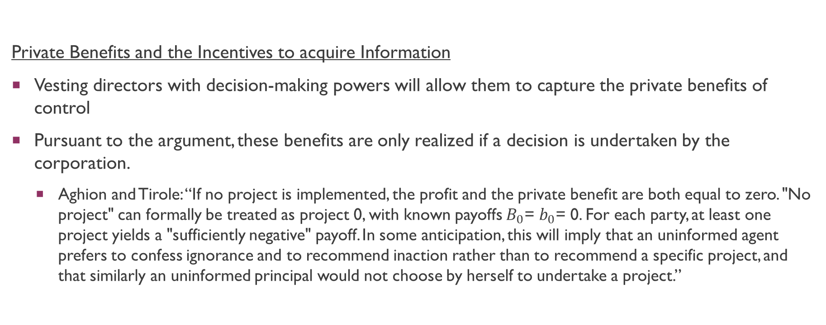
theoretical/conceptual foundations: director primacy
Private Benefits and the Incentives to acquire Information
Vesting directors with decision-making powers will allow them to capture the private benefits of control
Pursuant to the argument, these benefits are only realized if a decision is undertaken by the corporation.
  Aghion and Tirole: “If no project is implemented, the profit and the private benefit are both equal to zero. "No project" can formally be treated as project 0, with known payoffs $B_{0}$= $b_{0}$= 0. For each party, at least one project yields a "sufficiently negative" payoff. In some anticipation, this will imply that an uninformed agent prefers to confess ignorance and to recommend inaction rather than to recommend a specific project, and that similarly an uninformed principal would not choose by herself to undertake a project.”

Slide 38
theoretical/conceptual foundations: director primacy
Team Production and the Reduction of Inter-Shareholder Opportunism
The third (and possibly most persuasive) argument relates to the idea that director-primacy would promote relationship-specific investments by various (non-director) stakeholders of the company, including shareholders, managers, employees, and other creditors.
  These relationship-specific investments are assumed to have a significant positive impact on the corporation’s value.
  This argument is focused on the absence of incentives of corporate stakeholders, in contrast to the incentives of directors (see above).
The relationship-specific investments are promoted due to the fact that the stakeholders of the company are precluded from using “the power of ownership against each other” (Rajan and Zingales, 1998). In other words, director-primacy may reduce inter-shareholder opportunism.
  NB: Who has the “powers of ownership” in this context?
The aforementioned argument is often termed the “team production theory”, after Blair and Stout (1999).

Slide 39
theoretical/conceptual foundations: director primacy
Team Production and the Reduction of Inter-Shareholder Opportunism
What is a “relationship-specific investment”?
  Recall Slide Deck 4. A relationship-specific investment is an investment whose returns depend on the relationship’s continuation, and which has little to no value outside of the relationship.
Idea of “investment” in economics: Time, effort, pecuniary investments.
Firm-specific training is often very valuable to the firm (i.e., company) but not outside of it.
  Examples: If a McDonald’s employee invests effort into learning how to operate a (proprietary) French-fries fryer at McDonald’s, such investments no longer have value in the event where the employee no longer works for McDonald’s.
  Learning how to use “in-house” accounting software/proprietary machinery – are highly skilled employees “locked-in”?
  C.f. General skills acquired in the course of projects. Is training in Python development a type of relationship-specific investment?

Slide 40
theoretical/conceptual foundations: director primacy
Team Production and the Reduction of Inter-Shareholder Opportunism
Blair and Stout (1999): “In the economic literature, team production problems are said to arise in situations where a productive activity requires the combined investment and coordinated effort of two or more individuals or groups. If the team members' investments are firm-specific (that is, difficult to recover once committed to the project), and if output from the enterprise is nonseparable (meaning that it is difficult to attribute any particular portion of the joint output to any particular member's contribution), serious problems can arise in determining how any economic surpluses generated by team production- any "rents"-should be divided.
  Ex ante sharing rules invite shirking (why is this ex ante inefficient?),
  … while ex post attempts to divvy up rewards create incentives for opportunistic rent-seeking (which is this ex post inefficient?) that can erode and even destroy the economic gains that flow from team production.”

Slide 41
theoretical/conceptual foundations: director primacy
Team Production and the Reduction of Inter-Shareholder Opportunism
Blair and Stout (1999): “where it is impossible to draft explicit contracts that deter shirking and rent-seeking among these various corporate "team members" by preallocating rewards and responsibilities, we suggest that the problem may be better left to an institutional substitute for explicit contracts: the law of public corporations. We argue that public corporation law can offer a second-best solution to team production problems because it allows rational individuals who hope to profit from team production to overcome shirking and rent-seeking by opting into an internal governance structure we call the "mediating hierarchy." In essence, the mediating hierarchy solution requires team members to give up important rights (including property rights over the team's joint output and over team inputs such as financial capital and firm-specific human capital) to a legal entity created by the act of incorporation. In other words, corporate assets belong not to shareholders but to the corporation itself.
“Within the corporation, control over those assets is exercised by an internal hierarchy whose job is to coordinate the activities of the team members, allocate the resulting production, and mediate disputes among team members over that allocation. At the peak of this hierarchy sits a board of directors whose authority over the use of corporate assets is virtually absolute and whose independence from individual team members-as we demonstrate later in this Article-is protected by law.”

Slide 42
theoretical/conceptual foundations: shareholder primacy
On the other side of the coin, scholars who argue that shareholders should be vested with more legal authority to act on behalf of the corporation are known as scholars who advocate for “shareholder primacy”.
The starting point of the analysis stems from the idea that directors/managers may act opportunistically vis-à-vis shareholders when they are granted decision-making powers over the corporation (Jesen and Meckling, 1976).
  Efficiency losses from both moral hazard + agency costs + incomplete contracting affecting ex ante investments by shareholders (see Slide Deck 4).
Proponents of "shareholder primacy" also encounter an ostensible paradox in arguing why shareholders ought to have more powers.
  Why? Hint: If shareholders held complete control over a corporation's business decisions, what might we sacrifice?
To navigate this contradiction, proponents of shareholder primacy tend to focus on specific issues where there is a heightened conflict of interest between the board and shareholder.
  A leading advocate for “shareholder primacy” is Bebchuk (2005).

Slide 43
theoretical/conceptual foundations: shareholder primacy
What is an “issue” in this context?
  It is a point of contention which different corporate stakeholders may have differing opinions on.
  Also known as “agenda items”, or “matters” or “types of decisions” in the literature.
    More on this in the next Topic on “Minority Shareholder Protection”.
  In the U.S., shareholders are unable to initiate a vote on many issues at hand. Bebchuk (2005): “A central and well-settled principle of U.S. corporate law is that all major corporate decisions must be initiated by the board. Shareholders may not initiate any such decisions.”
    C.f. The position in UK and Singapore.
  Q: Why is the type of issue so important for the allocation of powers between the board and the shareholders? Explain this in terms of agency costs (broadly defined).

Slide 44
theoretical/conceptual foundations: shareholder primacy
Bebchuk (2005) argues that shareholders should have the power to not only elect and replace directors, but also to :
Initiate and adopt “rules-of-the-game” decisions to amend the corporate the corporate charter or to reincorporate in another jurisdiction and…
Initiate and adopt decisions to supersede management decisions regarding “game-ending decisions” such as:
  Sales, dissolutions, cash or in-kind distributions, and:
  Management remuneration (i.e., executive compensation)
The vibrant debates concerning 2(b) relate to the notion that shareholders should have a “say on pay”. We will turn to this in our next Slide Deck.

Slide 45
theoretical/conceptual foundations: shareholder primacy
“Rules-of-the-game” decisions concern the choice of the rules by which corporate actors play.
  Bebchuk (2005): “Both the charter and the state of incorporation can be changed, but such changes generally require initiation by management. Under the Delaware Code and the MBCA, charter amendments must be initiated and brought to a shareholder vote of approval by the board. Regardless of how many shareholders want a given charter amendment and of how long they have supported the amendment, shareholders may not vote on it unless the board first elects to have such a vote.”
  “It is worth noting that the Delaware Code and the MBCA grant shareholders the concurrent authority with the board to amend the company's bylaws, which can regulate some aspects of the company's governance. The bylaws, however, are subordinate to the charter and cannot alter any of the charter's arrangements. Furthermore, only the charter may opt out of various provisions of the Delaware Code and the MBCA.”
  Notice how this is not an issue in UK/SG law, see s 182 CA where shareholders may amend the corporate constitution pursuant to a special resolution. Indeed, Bebchuk draws on UK Law to support his arguments regarding shareholder primacy.

Slide 46
theoretical/conceptual foundations: shareholder primacy
“Game-ending” decisions concern decisions to merge, sell all assets, dissolve the company, or to “scale-down” the business by ordering a cash or in-kind distribution
  Bebchuk (2005): “Under the Delaware Code and the MBCA, mergers, consolidations, sales of all assets, and dissolutions - the various types of game-ending decisions - require approval by a majority of the outstanding shares. But the power granted to shareholders is only a veto power; shareholders lack the power to initiate such decisions. Only the board may bring to a shareholder vote a proposal to have a merger, consolidation, sale of all assets, or dissolution. Indeed, the Delaware Code even explicitly authorizes the board to abandon a proposed merger or sale of assets that received prior approval from the shareholders.”
  Scaling-down decisions are subject to even stricter requirements, since this is seen as the exclusive domain of the board.
  Again, notice how agenda-setting is not an “unbundled” issue in UK/SG law: Note how shareholders in SG have the power to initiate and approve such issues if the power lies with the general meeting (see Credit Development Pte Ltd v IMO Pte Ltd [1993] 1 SLR(R) 68).

Slide 47
theoretical/conceptual foundations: shareholder primacy
What might be more intriguing are the reasons Bebchuk (2005) presents in favor of these legal positions (and how we can learn from them).
First, Bebchuk (2005) argues why the shareholders’ power to replace directors (notice how this is also an issue at stake) cannot secure rules-of-the-game decisions that would be value-increasing.
  In the U.S., a corporate challenge to incumbent management – seeking to replace the entire/part of the board of directors – is known as a “proxy fight”.
  Bebchuk argues that challengers who commence a proxy fight face a disadvantage: “Challengers do not have the access to the corporate ballot and to the corporation's proxy machinery that incumbents enjoy. Unlike incumbents, who have their campaign costs fully borne by the company, challengers have to bear their campaign costs themselves – even though they will share the benefits from improved corporate governance with their fellow shareholders… Among thousands of public companies, there were on average only eleven such challenges a year, with less than two a year for firms with market capitalization exceeding $200 million”.

Slide 48
theoretical/conceptual foundations: shareholder primacy
First, Bebchuk (2005) argues why the shareholders’ power to replace directors (notice how this is also an issue at stake) cannot secure rules-of-the-game decisions that would be value-increasing.
  Separately, Bebchuk argues that shareholder voting on this particular issue is deeply problematic: “A vote to replace directors with a rival team that promises to initiate a given rules-of-the-game change is a highly imperfect instrument for achieving the desired change. Such a vote to replace directors bundles together (1) the given change in rules and (2) another significant change - the replacement of incumbent directors with the rival team. This bundling problem might prevent the adoption of value-increasing rule changes that shareholders would support by themselves.”
  “First-best” solution: Charter amendment may attract majority of shareholder support given that it may be value-increasing for the company as a whole. But an incumbent manager can defeat any challenger so long as the efficiency gains under the amendment are less than the costs of initiating and succeeding in a proxy fight.

Slide 49
theoretical/conceptual foundations: shareholder primacy
Second, Bebchuk (2005) suggests that the power of the Board to determine the agenda (i.e., have powers of agenda-setting) allows management to manipulate the voting process to capture economic rents from shareholders.
  Bebchuk: “Consider a situation in which there are three possible charter amendments - A, B, and C - that would each render both shareholders and management better off compared with the status quo. Suppose further that, in terms of shareholder value, amendment A is best, followed by B and then C, but that in terms of management interests the ranking is in the opposite order, with C being the best, followed by B and then A. Clearly, the veto power that shareholders have over changes does not enable them to ensure that the value-maximizing arrangement, A, will be selected.”

Slide 50
theoretical/conceptual foundations: shareholder primacy
Second, Bebchuk (2005) suggests that the power of the Board to determine the agenda (i.e., have powers of agenda-setting) allows management to manipulate the voting process to capture economic rents from shareholders.
  Bebchuk: “In the example under consideration, management might be able to get arrangement C, which is most favored by management but least value-increasing for shareholders. If management proposes arrangement C, shareholders might approve C rather than vote it down and thereby incur the risk of staying with the inferior status quo. Moreover, shareholders may face uncertainty as to whether management prefers any arrangement other than C over the status quo, and thus whether management would be willing to propose any other charter amendments if C is voted down. Such uncertainty will increase shareholders' willingness to approve C.”
  In this example, management has preferences over various arrangements, while the body of shareholders [also has] collective preferences over the same. Are you persuaded by these assumptions? Why, or why not?

Slide 51
theoretical/conceptual foundations: shareholder primacy
What about the actual mechanics of raising issues before the board and/or shareholders?
Lipton and Rosenblum (2003): “It might still be argued… that granting shareholders the power to intervene would result in the initiation of many proposals that would have little chance of being adopted but that would impose costs on companies and their shareholders. According to this view, many shareholders might bring proposals that are unlikely to obtain majority support because they are farfetched, ill-considered, or motivated by considerations other than shareholder wealth. Although these proposals would ultimately be defeated, dealing with them would be costly: shareholders would be burdened by the need to vote against the proposals, and management would have to devote time, attention, and company resources to campaign against them.”
Bebchuk (2005): Design of the proposed intervention regime would have to keep the costs of contests over "nuisance proposals" to an acceptable minimum, perhaps through ownership requirements or by allowing for proposals to be “struck out” if they did not receive adequate support in previous years.
  More on this in Topic on Voting and Proxy Access.

Slide 52
Empirical evidence
Gompers, Ishii and Metrick (2003): “We combine a large set of governance provisions into an index which proxies for the strength of shareholder rights, and then study the empirical relationship between this index and corporate performance. Our analysis should be thought of as a "long-run event study": we have democracies and dictatorships, the rules stayed mostly the same for a decade-how did each type do? Our main results are to demonstrate that, in the 1990s, democracies earned significantly higher returns, were valued more highly, and had better operating performance. Our analysis is not a test of market efficiency. Because theory provides no clear prediction, there is no reason that investors in 1990 should have foreseen the outcome of this novel experiment.”
“Our index construction is straightforward: for every firm we add one point for every provision that reduces shareholder rights. This reduction of rights is obvious in most cases; the few ambiguous cases are discussed. Firms in the highest decile of the index are placed in the "Dictatorship Portfolio" and are referred to as having the "highest management power" or the ''weakest shareholder rights"; firms in the lowest decile of the index are placed in the "Democracy Portfolio" and are described as having the "lowest management power" or the "strongest shareholder rights.“”

Slide 53
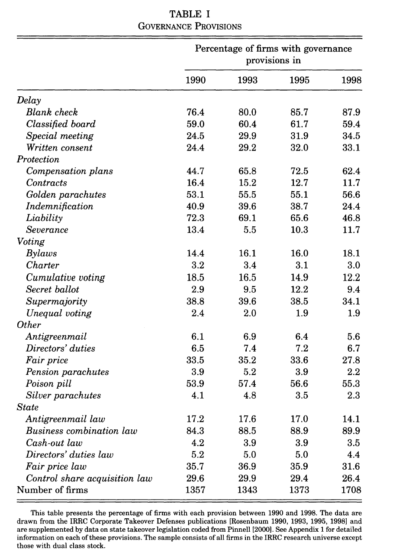
Empirical evidence

Slide 54
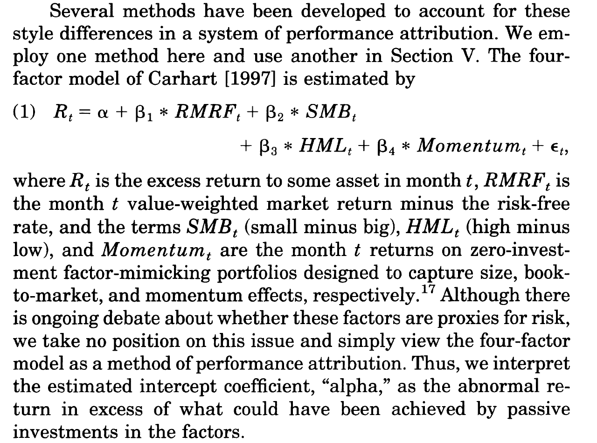
Empirical evidence

Slide 55
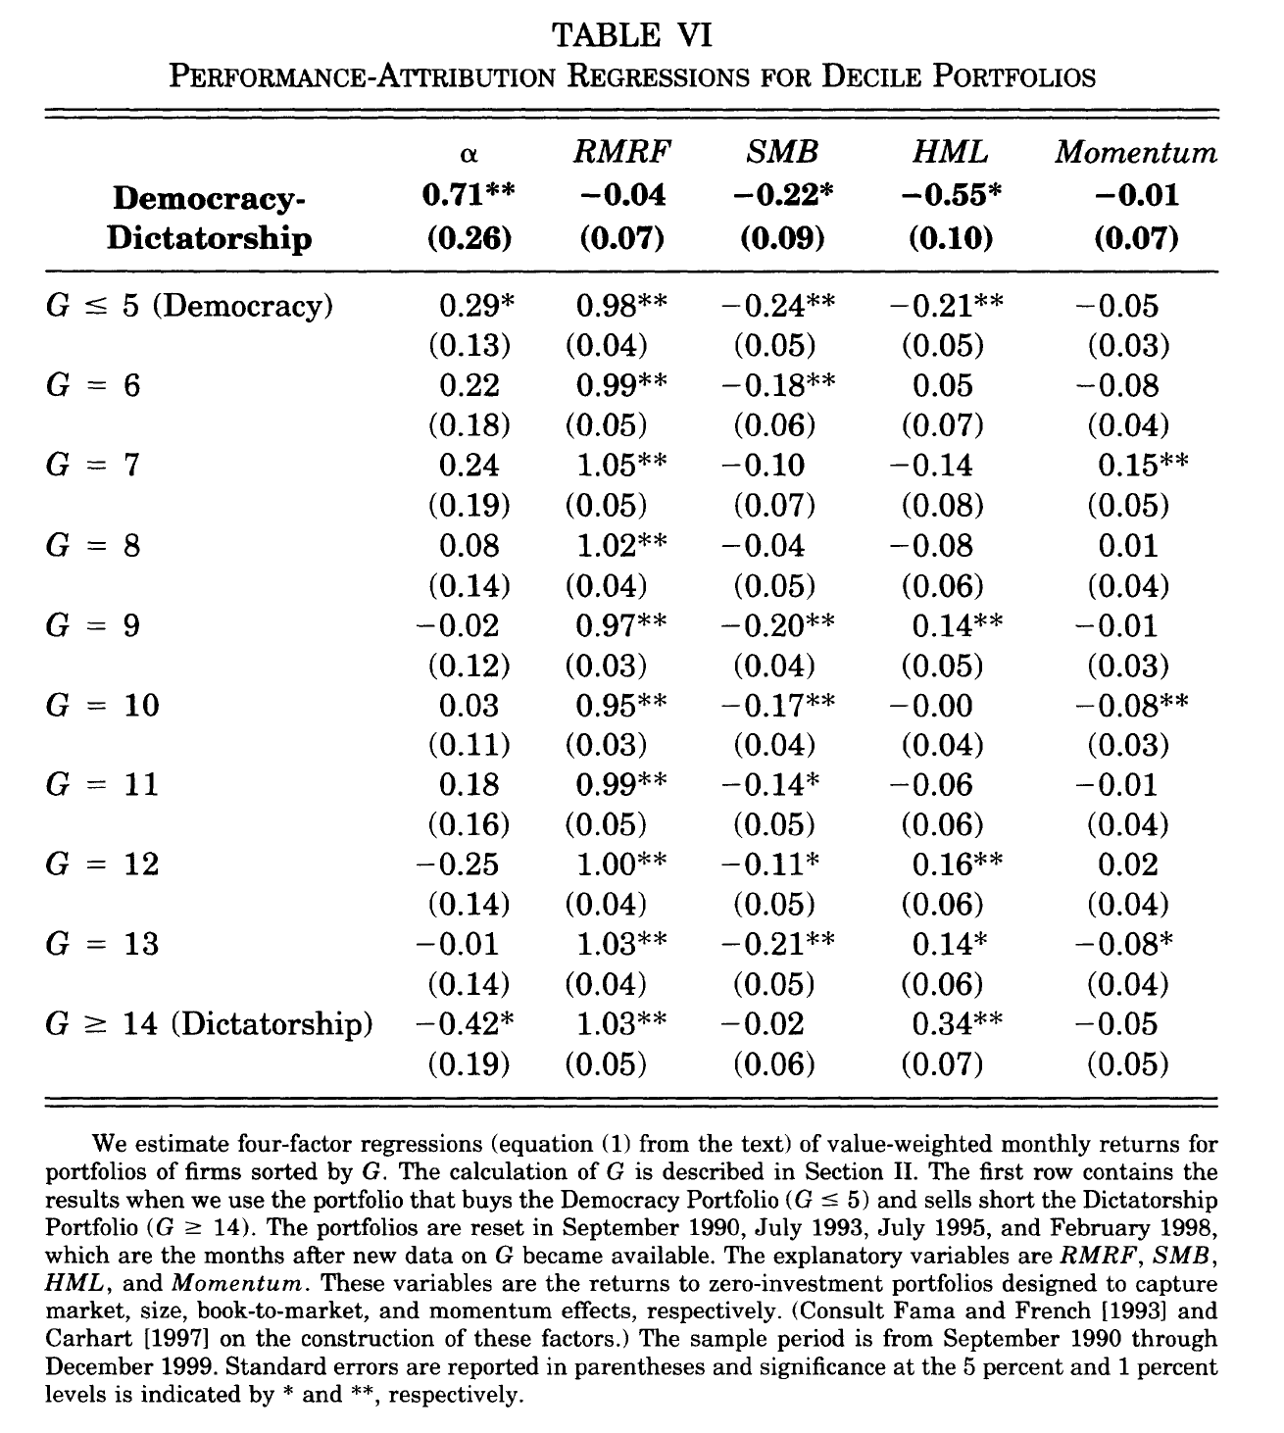
Empirical evidence
Notes:
The results also show that alpha decreases as G increases. The Democracy Portfolio earns the highest alpha of all the deciles, and the next two highest alphas, 24 and 22 hp, are earned by the third ( G = 7) and second ( G = 6) deciles, respectively. The Dictatorship Portfolio earns the lowest alpha, and the second lowest alpha is earned by the eighth (G = 12) decile. Furthermore, the four lowest G deciles earn positive alphas, while the three highest G deciles earn negative alphas. More formally, a Spearman rank-correlation test of the null hypothesis of no correlation between G-decile rankings and alpha rankings yields a test statistic of 0.842, and is rejected at the 1 percent level.

Slide 56
Empirical evidence
Bebchuk, Cohen, and Ferrell (2009): “Following [GIM], there is no a priori reason, of course, to expect that all the twenty-four IRRC provisions contribute to the documented correlation between the IRRC provisions in the aggregate and Tobin’s Q, as well as stock returns in the 1990s. Some provisions might have little relevance, and some provisions might even be positively correlated with firm value. Among those provisions that are negatively correlated with firm value or stock returns, some might be more so than others. Furthermore, some provisions might be at least partly the endogenous product of the allocation of power between shareholders and managers set by other provisions. In this article, we look inside the box of the IRRC provisions to identify which of them are responsible for the correlation between these provisions in the aggregate and firm value… We begin our investigation by identifying a hypothesis for testing. In particular, we hypothesize that six provisions among the twenty-four provisions tracked by IRRC play a significant role in driving the documented correlation between IRRC provisions and firm valuation. We include in this list of six provisions all the provisions among the IRRC provisions that have systematically drawn substantial opposition from institutional investors voting on precatory resolutions.”

Slide 57
Empirical evidence
Bebchuk, Cohen, and Ferrell (2009): “Of the six provisions, four set constitutional limits on shareholder voting power, which is the primary power shareholders have. These four arrangements—staggered boards, limits to shareholder amendments of the bylaws, supermajority requirements for mergers, and supermajority requirements for charter amendments—limit the extent to which a majority of shareholders can impose their will on management. Two other provisions are the most well known and salient measures taken in preparation for a hostile offer: poison pills and golden parachute arrangements.”
“We construct an index, which we label the entrenchment index (E index), based on these six provisions. Each company in our database is given a score, from 0 to 6, based on the number of these provisions that the company has in the given year or month... We find that, controlling for the rest of the IRRC provisions, the entrenching provisions—both individually and in the aggregate—are negatively correlated with Tobin’s Q. Increases in our E index are correlated, in a monotonic and economically significant way, with lower Tobin’s Q values. Moreover, the provisions in the E index appear to be largely driving the correlation that the IRRC provisions in the aggregate have with Tobin’s Q. We find no evidence that the eighteen provisions not in the E index are negatively correlated, either in the aggregate or individually, with Tobin’s Q.”

Slide 58
Empirical evidence
Bebchuk, Cohen, and Ferrell (2009): “documenting that entrenching provisions are negatively correlated with lower firm valuation, like the earlier finding that the IRRC provisions in the aggregate are correlated with lower firm valuation, does not establish that the entrenching provisions, or that the IRRC provisions in general, cause lower firm valuation. The identified correlation could be at least partly the product of the tendency of managers of low-value firms to adopt entrenching provisions… A high entrenchment level might protect low-Q firms from being taken over or forced to make changes that would raise their Tobin’s Q. Indeed, such an effect is presumably why low-Q firms might wish to adopt and retain a high level of entrenchment. Thus, a mere serial correlation in firms’ Tobin’s Qs does not indicate that causality runs primarily from low Q to high entrenchment, rather than in the opposite direction…”
“In any event, to explore this issue, we examine how firm valuation during the last five years of our sample (1998-2002) period is correlated with firms’ entrenchment scores as of 1990.We find that, even after controlling for firm valuation in 1990, high entrenchment scores in 1990 are negatively correlated with firm valuation at the end of our sample period. In addition, in firm fixed effects regressions controlling for the unobserved time-invariant characteristics of firms, we find that increases in the E index during our sample period are associated with decreases in Tobin’s Q.”

Slide 59
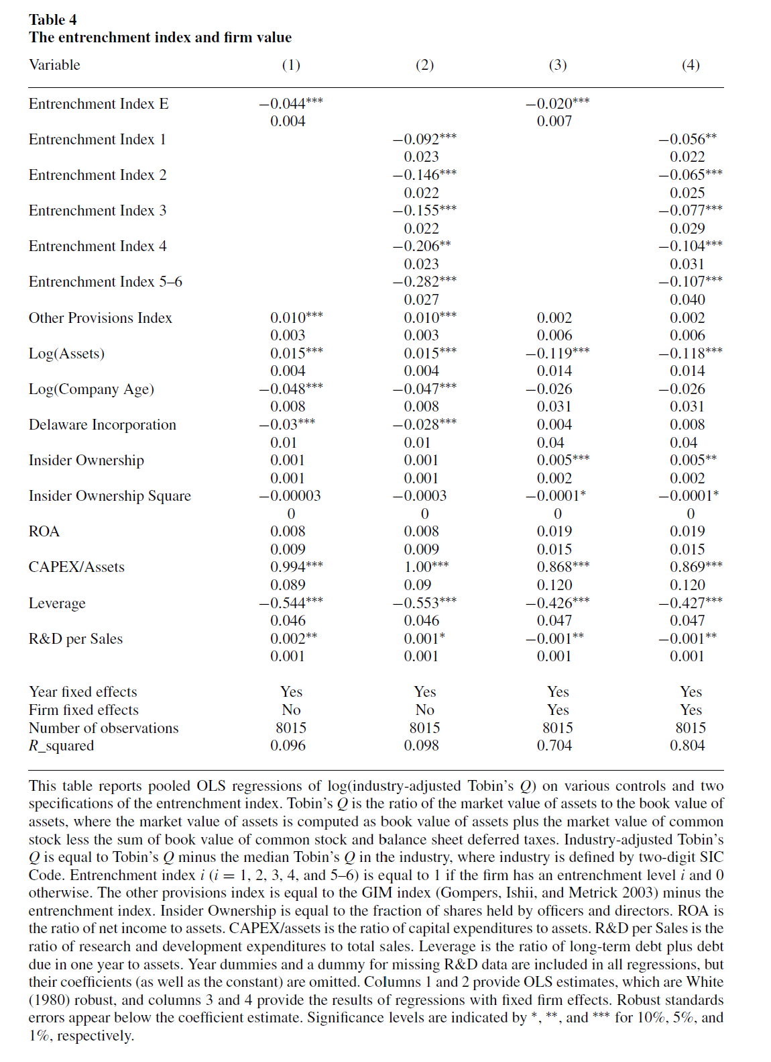
Empirical evidence

Slide 60
Empirical evidence
Frankenreiter et al. (2022): “Although empirical scholarship dominates the field of law and finance, much of it shares a common vulnerability: an abiding faith in the accuracy and integrity of a small, specialized collection of corporate governance data. In this paper, we unveil a novel collection of three decades’ worth of corporate charters for thousands of public companies, which shows that this faith is misplaced… We label our corpus for a variety of firm- and state-level governance features. Doing so reveals significant infirmities within the most well-known corporate governance datasets, including an error rate exceeding eighty percent in the G-Index, the most widely used proxy for “good governance” in law and finance. Correcting these errors substantially weakens one of the most well-known results in law and finance, which associates good governance with higher investment returns... our analysis exposes cautionary tales about the critical role of lawyers in empirical research.”

Slide 61
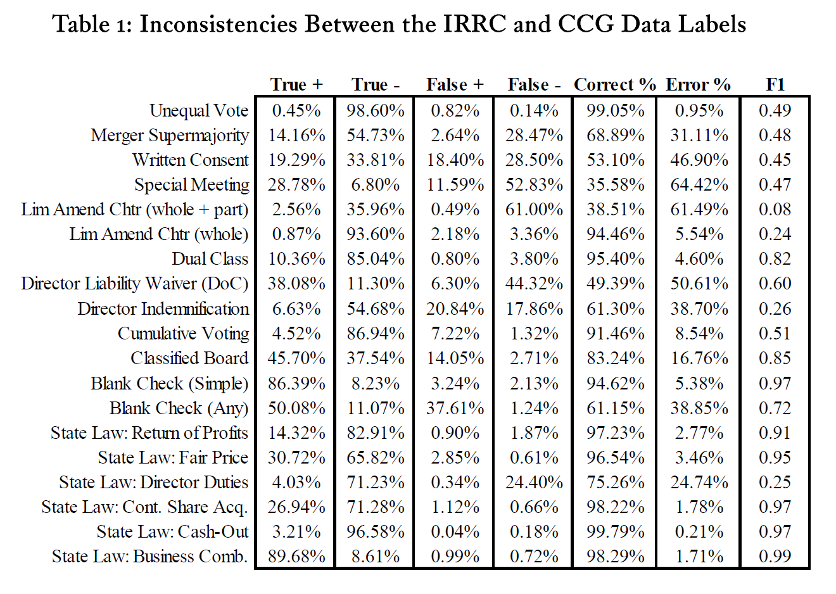
Empirical evidence

Slide 62
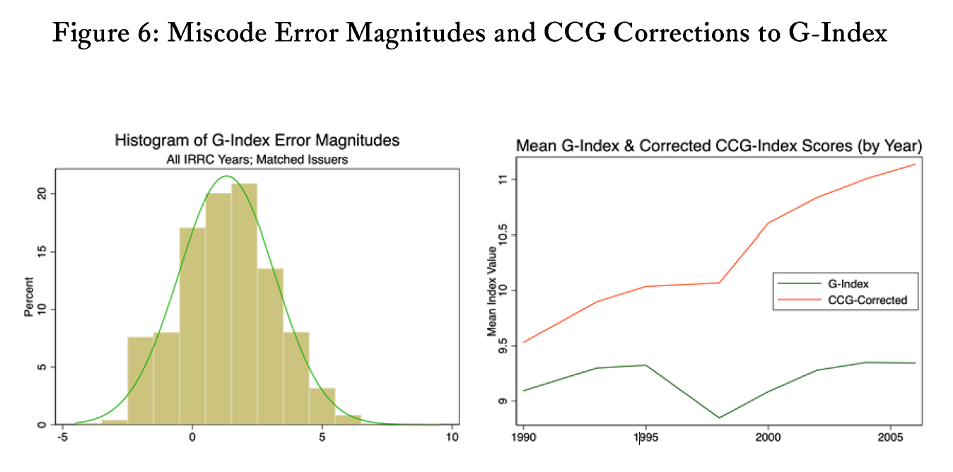
Empirical evidence

Slide 63
Empirical evidence
Frankenreiter et al. (2022): “All told, our results strongly suggest that not only do the errors in the G-Index affect results, but that they do so in a disconcerting way. In each of the reported replications that use our corrected CCG-lndex, the estimated abnormal return grows weaker-exactly the opposite movement from what one would expect had the G-Index merely been hamstrung by garden-variety measurement errors. Rather, each replication drives appreciably downward the estimated extent to which "good governance" predicts abnormally good returns to investors. Averaging across the columns, approximately a quarter of the 8.9% premium reported by GIM dissolves in the presence of corrected data.”
“It is worth noting that even with our corrections, the GIM arbitrage result does not "go away" completely. And accordingly, one could entertain the possibility that the original result-albeit reliant on imperfectly coded data merely generated a result that was still "real" but just a little too rosy. While we cannot rule out this possibility, we are skeptical. The fact that the attenuation effect is discernible after correcting only the matched firm-years (42%) with a deliberately conservative rubric raises serious concerns that Table 3 vastly understates the effect of the problem. And, reiterating our point above, the directionality of the change is particularly concerning, since it moves counter to what one would expect to see with classical measurement error adding just mere noise to the effect.”

Slide 64
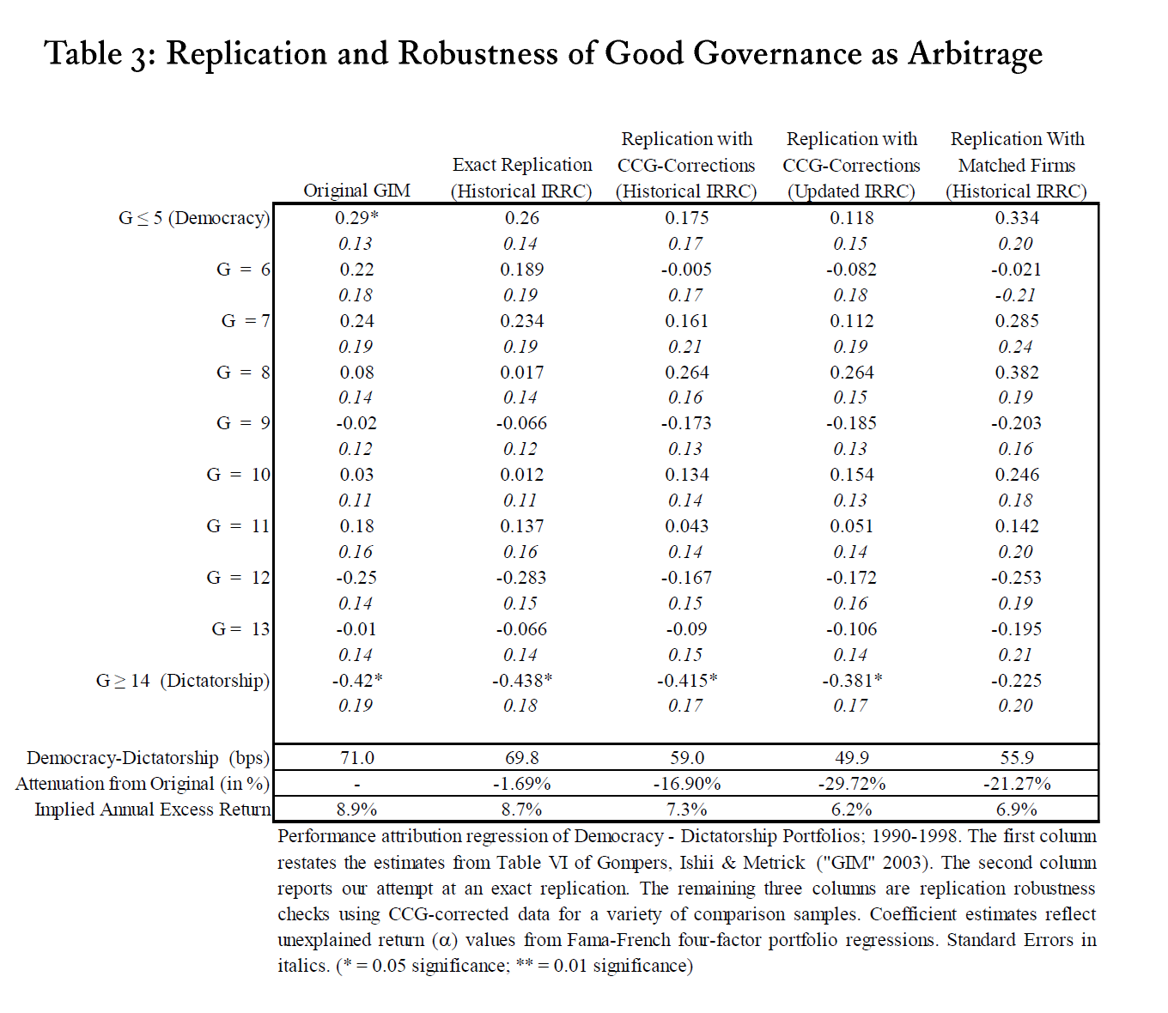
Empirical evidence

Slide 65
Q&A
See you guys on Tue.

