Slide 1

Corporate law and economics (LL4489V/5489V/6489V)
3. CONTRACTARIAN VS PROPRIETARY APPROACHES
LL4489V
Kenneth Khoo
kenneth.khoo@nus.edu.sg

Slide 2

CONTRACTARIAN AND PROPRIETARY APPROACHES
Sidenote on Friedman’s “The Methodology of Positive Economics” (1953)
Motivation
The Contractarian Approach to Corporate Law
  Departures from the Coase Theorem
    Agency Costs and Information Asymmetry: Moral Hazard and Adverse Selection
    Incomplete Contracting and “Unforseeability”
    Multiple Parties to a “Contract”

Slide 3

motivation
Recall: In our last lecture, we discussed:
  The fundamental assumptions which drive economic analysis
  Why exchange/trade is normatively desirable
  How the legal framework may or may not support exchange
  How the existence of property and contract law may facilitate mutually beneficial exchange
We now possess the tools to examine the underlying principles of company law.
In simple terms, just as with contract and property law, the economic rationale behind corporate law is to enable mutually advantageous exchanges.
  However, the Q arises as to why contract and property law are insufficient to protect business interests.
  To do that, let us expand a little more re the concept of “gains from trade”…

Slide 4

motivation
We already know that the act of trading, or exchange, is fundamental to the foundation of a viable business.
  Recall: Trading goods and services benefits both parties to the trade. Economists term these benefits the “gains from trade”.
  Recall: In our stylized examples in earlier slides (e.g., trading of the car between Adam and Blair), these gains from trade were exogenously determined by Adam and Blair’s subjective preferences.
    Q: What does this mean?
    Is this satisfactory? Ideally, we would like to motivate why these gains from trade arise in the first place.

Slide 5

motivation
As it turns out, there is a key reason why gains from trade are so endemic across the commercial world.
Specialization and the Division of Labor: The phenomenon of individuals/organizations concentrating their productive efforts on a limited range of tasks.
  When parties to trade specialize, each party tends to have a comparative advantage at the tasks which they specialize in.
  Comparative advantage: a party’s ability to produce a particular good or service at a lower opportunity cost than its trading partners.
Specialization leads to a phenomenon known as “Economies of Scale”:
  When more units of a good or service can be produced on a larger scale, yet with fewer input costs, economies of scale are said to be achieved.
  Rough intuition: As a business gets larger, it is able to spread out its fixed costs (e.g., manufacturing equipment, cost of land) across a larger number of units. The cost of producing each item falls.
  A business which specializes in steel production can concentrate on acquiring manufacturing equipment, such as furnaces, specifically tailored for steel manufacturing, rather than for coal or other material production.

Slide 6

motivation
An example from Investopedia: The key to understanding comparative advantage is a solid grasp of opportunity cost. Put simply, an opportunity cost is a potential benefit that someone loses out on when selecting a particular option over another...
Consider a famous athlete like Michael Jordan. As a renowned basketball and baseball star, Michael Jordan is an exceptional athlete whose physical abilities surpass those of most other individuals. Michael Jordan would likely be able to, say, paint his house quickly, owing to his abilities as well as his impressive height.
  Hypothetically, say that Michael Jordan could paint his house in eight hours. In those same eight hours, though, he could also take part in the filming of a television commercial which would earn him $50,000. By contrast, Jordan's neighbor Joe could paint the house in 10 hours. In that same period of time, he could work at a fast food restaurant and earn $100.
  In this example, Joe has a comparative advantage, even though Michael Jordan could paint the house faster and better. The best trade would be for Michael Jordan to film a television commercial and pay Joe to paint his house. So long as Michael Jordan makes the expected $50,000 and Joe earns more than $100, the trade is a “winner”. Owing to their diversity of skills, Michael Jordan and Joe would likely find this to be the best arrangement for their mutual benefit.

Slide 7

motivation
Easterbrook and Fischel (1991): “The extended conflict among selfish people produces prices that allocate resources to their best uses. This is an old story, and Adam Smith's The Wealth of Nations (1776) remains the best exposition. A series of short-term dealings in a market may be more useful for trading than for producing goods, however. The firm – an aggregation of people banded together for a longer period-permits greater use of specialization. People can organize as teams with the functions of each member identified, so that each member's specialization makes the team as a whole more productive than it would otherwise be.”

Slide 8
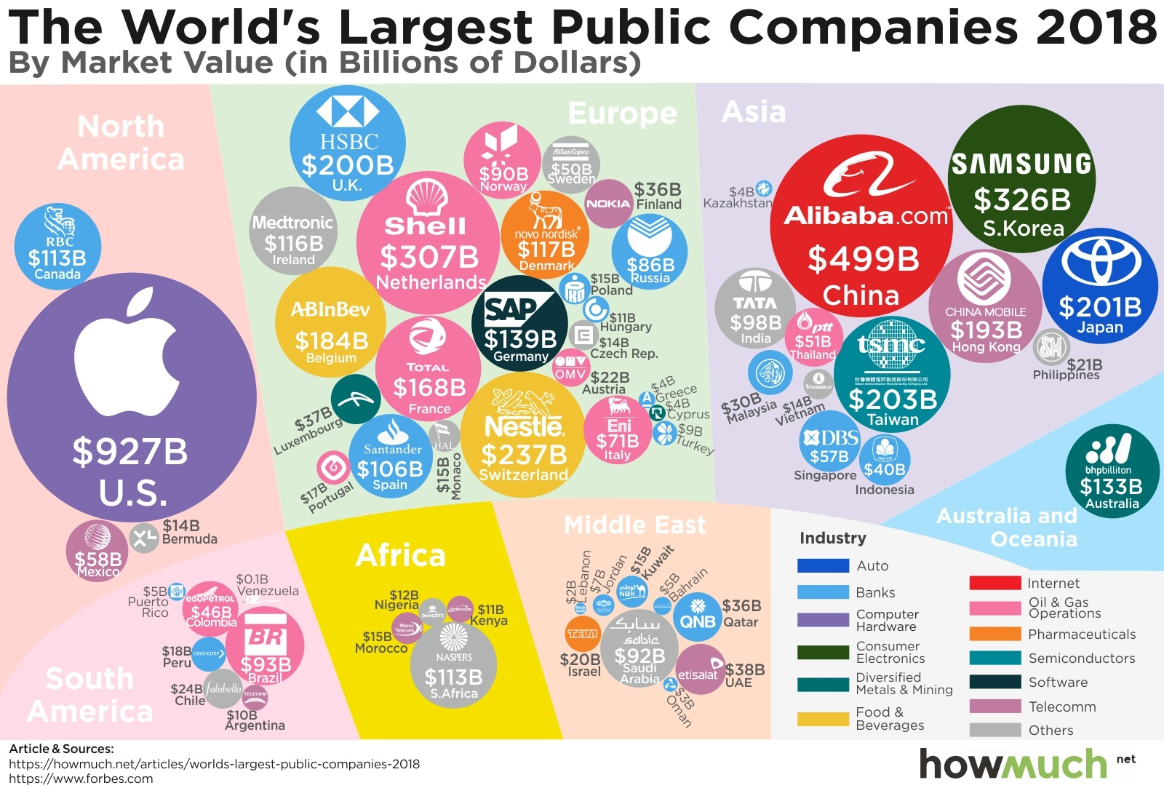
Motivation
Now that we have motivated why gains from trade are endemic across commerce, let us begin to examine some stylized facts.
  Dictionary definition of a business: “The activity of buying goods and services”. This is a form of trade.
  Despite the ubiquity of contracts (governed by contract law) in modern commerce, the vast majority of business today is conducted through corporations (a species of organizations), not individuals.
    Is your laptop manufactured by a company, or a person?
  Tjio et al. (2015): “Although it is an unruly horse, the company has created enormous wealth and for various reasons, other types of business vehicles have not done so well.”

Slide 9
Motivation
Large corporations may consist of individuals, but it is the corporation that ultimately represents the business.
When you buy an iPhone from an Apple Store, the counterparty to the contract is Apple South Asia Pte. Ltd., not the Apple employee who sold you the phone.
Consider what it takes to manufacture and distribute an iPhone. Thousands of individuals are involved:
  A large team of engineers designed and implemented all the features in the iPhone
  A huge team of production-line workers and machines were involved in manufacturing
  A large sales and marketing team launched the product.
  A tremendous amount of capital ($$$) was involved to fund all of these operations.
In essence, we can see that businesses run by corporations involve multiple individuals working in teams. In contrast, consider the bilateral nature of contracts and contract law.
Is it possible to run Apple’s business via ordinary contracts between the employees of Apple? Why or why not?

Slide 10
Motivation
Given the vast number of individuals involved in large-scale businesses, there's a necessity for “something beyond” just having contract law. Why?
I will break the key rationale down into two simple but fundamental reasons:
Corporate Law regulates a “very special type of contract” (Contractarian Approach).
Corporate Law regulates “conflicting contracts” (Proprietary Approach).

Slide 11
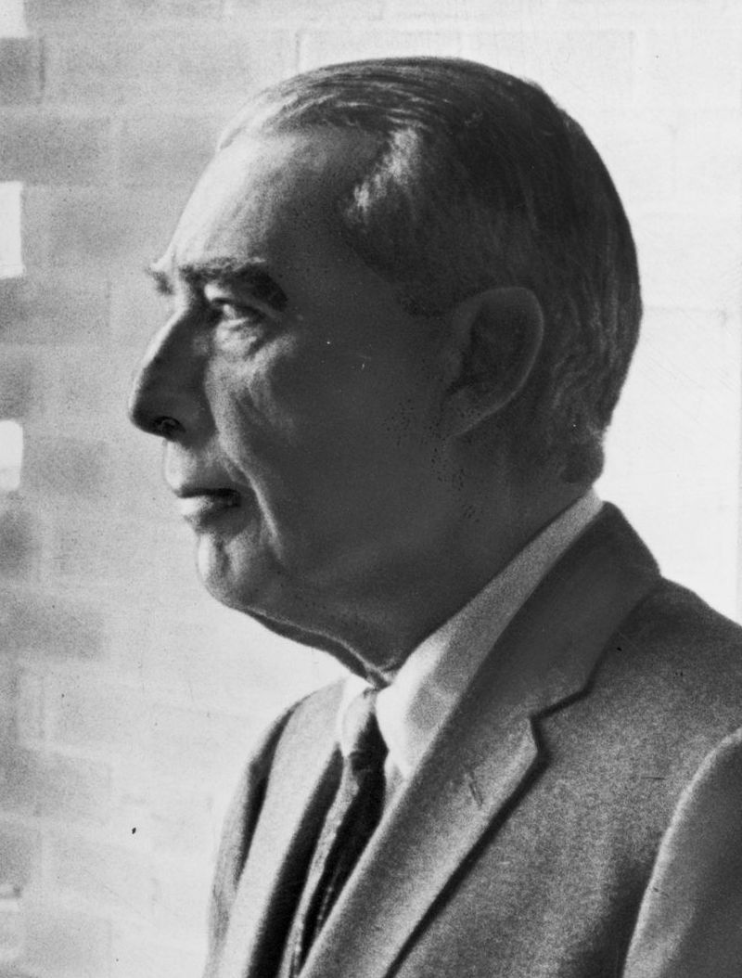
The contractarian approach to corporate law
Before we discuss why the corporate contract is so “special” that it requires a separate branch of law (that is distinct from contract law), let us examine how contemporary corporations are organized.
One of the central features of companies around the world is the widespread adoption of delegated management with a board structure (Kraakman et.al, 2017)
  All but the most fundamental [business] decisions are generally delegated to a board of directors that has four basic features:
  Formal separation between board and employees
  Board is elected by the firm’s shareholders
  Board formally distinct from firm’s shareholders
  Board has multiple members
Assume the company’s separate legal personality for now (TBD in detail in the next set of slides).

Slide 12
The contractarian approach to corporate law
Shareholders
Board of Directors
Managers & Employees
In larger (public) companies, the shareholders, board of directors and the managers of the company are usually distinct groups of persons.
Shareholders provide pecuniary capital for the organization’s use. These funds are used to purchase assets that are then used for business (e.g. machinery for production of goods).
The board of directors are persons elected by the shareholders to run the business of the company.
  In smaller companies, shareholders tend to retain significant control rights.
The board of directors can then delegate some (but not all) decision-making authority to the managers and employees of the company.
This is known as the separation of ownership and control (Berle and Means, 1932).

Slide 13
The contractarian approach to corporate law
Shareholders
Board of Directors
Managers & Employees
The separation of ownership and control in corporations is really just another instance of trade. Why?
  The shareholders are trading their capital input ($$$) for an expected return beyond the expected costs of paying the directors, managers, and employees.
  The directors and managers are trading their labour (time + effort) for salaries/fees which are in part funded by the shareholders’ capital.
    NB: A “functional approach” is taken here.
Typically, this setup is mutually beneficial to both parties involved.

Slide 14
The contractarian approach to corporate law
What about other relationships between and amongst different corporate stakeholders?
  E.g., Creditor-Company relationships, Employee-Company Relationships, Shareholder-Shareholder Relationships.
    A supplier provides goods or services to a Company (as a separate legal entity) in consideration for funding ($$$), as it inherently prefers the payment to its subjective valuation of the good or service. Why must this be the case?
    A minority shareholder invests in a Company even when they are aware that a controlling shareholder (i.e., a shareholder who owns more than 50% of the shares in the company) might act against their own interests. What is the minority shareholder expecting in return?
    A shareholder enters into a formal agreement (via the constitution/shareholder agreement) with a controlling shareholder that he/she would retain a right to appoint three directors on the board.
  Again, all of these relationships are instances of exchange/trade, and tend to be mutually beneficial for all parties involved.
Nevertheless, in the relationships expounded above, things can go awfully wrong…
Company
Supplier
Contractual Relationship

Slide 15
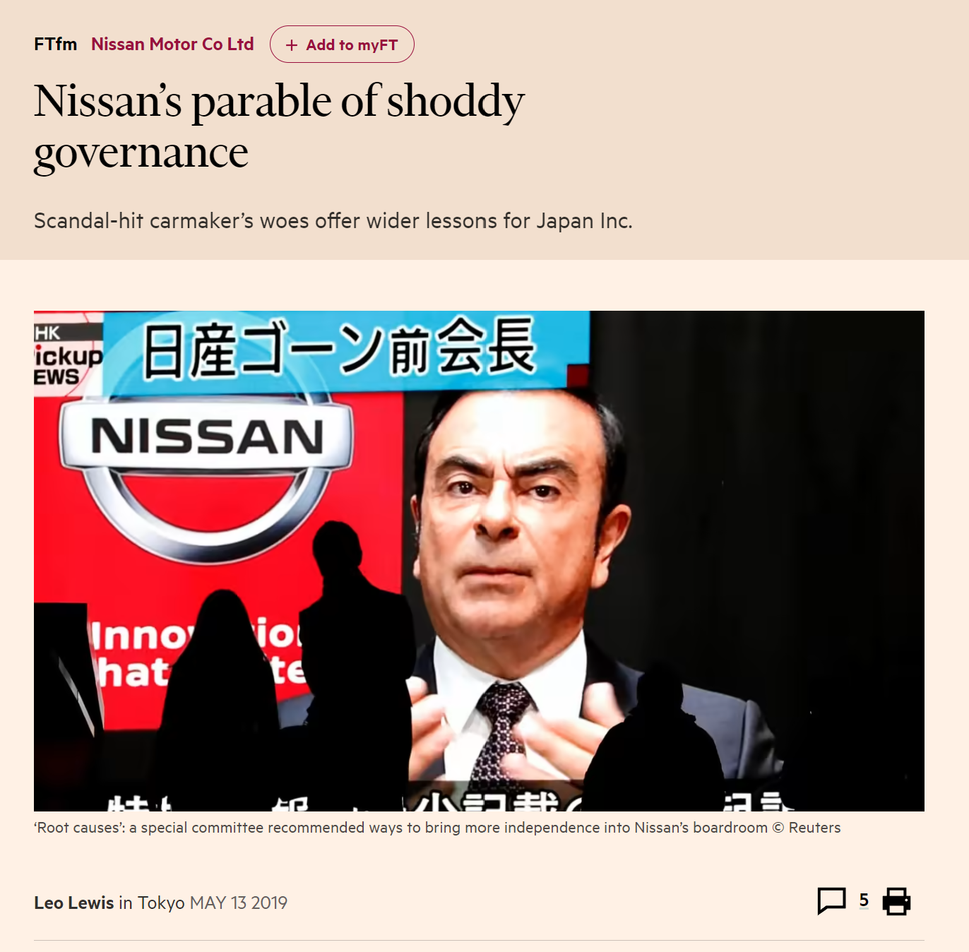
The contractarian approach to corporate law
“Just hours after Carlos Ghosn was led away by prosecutors from a private company jet at Tokyo’s Haneda airport last November, Nissan was already characterising the fiasco — at least in part — as a crisis of corporate governance.
At a fraught press conference that evening, Hiroto Saikawa, Mr Ghosn’s handpicked successor as Nissan chief executive, declared his “indignation and despair” at the overall situation in which Nissan’s chairman had been arrested on suspicion of financial misconduct. But he quickly homed in on the structural problems created by his mentor’s 19-year “regime”.
Nissan came under heavy fire for its own corporate role in allegations that included Mr Ghosn submitting accounts that understated his pay — and within three days the company had announced it would set up an independent panel to probe its governance shortcomings.”
https://www.ft.com/content/d6aca7b8-39d9-11e9-9988-28303f70fcff

Slide 16
The contractarian approach to corporate law
Recall our suggestion that Corporate Law regulates a “very special type of contract” (Contractarian Approach).
Recall also what we have learnt in our previous lecture regarding the Coase Theorem:
  When transaction costs are high enough to prevent bargaining, the efficient use of resources will depend on how legal rights are assigned.
  In other words, “the law matters”.
In all of the examples provided in Slides 12-13, is Coasean bargaining amongst the corporate stakeholders possible? Why, or why not?
The basic intuition behind the “contractarian approach to corporate law” is that the optimal (i.e., socially-desirable) corporate law regime needs to:
  Consider the massive transaction costs amongst all of the different corporate stakeholders
  Attempt to reduce the transaction costs determined in (1).

Slide 17
The contractarian approach to corporate law
Problem: What precisely are the "transaction costs" that emerge within the corporation, among its stakeholders, and in the wider business landscape?
  Despite his seminal articles in 1937 and 1960, Coase did not elaborate on the exact nature of these transaction costs.
To motivate the nature of these transaction costs from “first principles”, we must first delve into the core attributes of the typical transactions that take place within a corporation.

Slide 18
The contractarian approach to corporate law
Let us begin with the separation of ownership from control (between shareholders and managers). More formally, defined by Easterbrook and Fischel (1999):
  A corporation is characterized by a statement of capital contributions as formal claims against the firm's income that are distinct from participation in the firm's productive activities. The corporation issues "stock" in exchange for an investment; stock need not be held by the firm's employees. Investors bear the risk of failure (sometimes we call them "risk-bearers") and receive the marginal rewards of success. Equity investors are paid last, after debt investors, employees, and other investors with (relatively) "fixed" claims. These equity investors have the "residual" claim in the sense that they get only what is left over-but they get all of what is left over.
  The separation of risk bearing from employment is a form of the division of labor. Those who have wealth can employ it productively even if they are not good managers; those who can manage but lack wealth can hire capital in the market; and the existence of claims that can be traded separately from employment allows investors to diversify their investment interests.
One can clearly see the potential gains from trade which arise from this exchange/transaction.

Slide 19
The contractarian approach to corporate law
Given this separation of ownership from control, shareholders (especially diffuse shareholders in public corporations) are often “ignorant and passive” (Easterbrook and Fischel, 1999).
  In other words, many shareholders do not participate in any of the business’s operations.
Who runs the business activities? It is the board of directors and managers (who are delegated legal authority to act on behalf of the board) who effectively run these business operations.
Problem: What is to stop the managers from abusing the decision-making powers granted to them by the shareholders? Recall that the managers are supposed to maximize the profits of the corporation’s business!
  Can they act in their own self-interest at the expense of the shareholders?
  Is there the potential for a conflict of interests?
Kraakman et al. (2017): Managers may act opportunistically vis-à-vis shareholders.
  Opportunism relates to “self-interested behavior that involves some element of guile, deception, misrepresentation, or bad faith.”

Slide 20
Agency Costs and Information Asymmetry: Moral Hazard and Adverse Selection
Recall that under the voluntary agreement leading to the “separation of ownership and control”, the directors and managers (for simplicity, let's call them "managers“) of a company are motivated by their own self-interest, rather than the combined interests of all shareholders.
  This follows directly from the principle of rational utility-maximization. As individuals, managers will maximize their own utility, not the collective utilities of shareholders (or firm-level profits for that matter).
However, as rational utility-maximizing agents, shareholders of a company are also motivated by their own self-interest.
  Since shareholders know that managers will act in their own interests as opposed to the shareholders’ interests, they can design the terms of exchange (alternatively, we can think of this as the relevant “contract”) to attenuate managerial opportunism.
  The extent to which shareholders of a company are able to do so is a major issue in corporate law and governance.
  Q: Do the shareholders need “law” to do so? Are shareholders able to attenuate managerial opportunism in the absence of law?

Slide 21
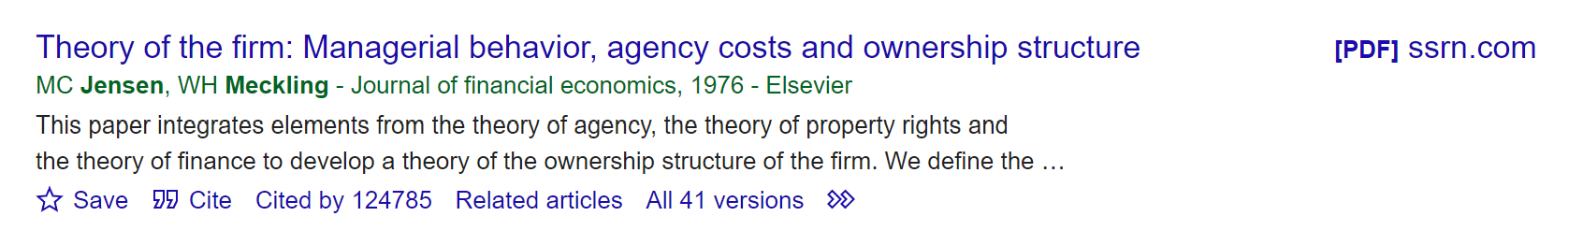
Agency Costs and Information Asymmetry: Moral Hazard and Adverse Selection
The sum of all costs (including opportunity costs) involved in attenuating this type of opportunism are termed as agency costs (Jensen and Meckling, 1976).
  Jensen and Meckling’s article is possibly the most cited article in all of the social sciences + humanities.
  Idea has evolved over the years to include interactions between different stakeholders, not merely the owner-manager.
  Taxonomizing the term “agency costs” is non-trivial, as multiple types of frictions are involved (see Khoo, 2022).

Slide 22
Agency Costs and Information Asymmetry: Moral Hazard and Adverse Selection
Kraakman et al. (2017): “Corporate law attempts to control conflicts of interest among corporate constituents… These conflicts all have the character of what economists refer to as “agency problems” or “principal-agent” problems. For readers unfamiliar with the jargon of economists, an “agency problem”— in the most general sense of the term— arises whenever one party, termed the “principal,” relies upon actions taken by another party, termed the “agent,” which will affect the principal’s welfare. The problem lies in motivating the agent to act in the principal’s interest rather than simply in the agent’s own interest. Viewed in these broad terms, agency problems arise in a broad range of contexts that go well beyond those that would formally be classified as agency relationships by lawyers.
“almost any contractual relationship, in which one party (the “agent”) promises performance to another (the “principal”), is potentially subject to an agency problem. The core of the difficulty is that, because the agent commonly has better information than does the principal about the relevant facts, the principal cannot easily assure himself that the agent’s performance is precisely what was promised. As a consequence, the agent has an incentive to act opportunistically, skimping on the quality of his performance, or even diverting to himself some of what was promised to the principal.”
NB: The use of the terms “agent” and “principal” here are distinct from what lawyers term “agents” and “principals” in agency law.

Slide 23
Agency Costs and Information Asymmetry: Moral Hazard and Adverse Selection
Kraakman et al. (2017): “… This means, in turn, that the value of the agent’s performance to the principal will be reduced, either directly or because, to assure the quality of the agent’s performance, the principal must engage in costly monitoring [or bonding] of the agent. The greater the complexity of the tasks undertaken by the agent, and the greater the discretion the agent must be given, the larger these “agency costs” are likely to be.”
  Q: When the “value of the agent’s performance” is reduced, is the resulting state of affairs efficient? Why, or why not?
    Is a strict definition of “pareto efficiency” always useful here? Why, or why not? Hint: What is the agent doing when he/she acts in her own self interest?
    Kaldor-Hicks Efficiency: “A Pareto efficiency arises when at least one person is made better off and no one is made worse off. In practice, however, it is extremely difficult to make any change without making at least one person worse off. Under the Kaldor-Hicks efficiency test, an outcome is efficient if those who are made better off could in theory compensate those who are made worse off and so produce a Pareto efficient outcome.”
  In the corporate context, what is the relevant counterfactual here?

Slide 24
Agency Costs and Information Asymmetry: Moral Hazard and Adverse Selection
Most legal scholars tend to gloss over how agency-cost theories remain useful for a theory of corporate law, complicating the task of clearly defining what agency costs entail.
One taxonomy which I like involves taxonomizing agency costs pursuant to three (or four, depending on your view) sub-components:
Information Asymmetry
  Moral Hazard
  Adverse Selection
Monitoring Costs
Bonding Costs
Opportunism in Incomplete Contracting (possibly not an agency cost…?)
We will go through each in turn.

Slide 25
Agency Costs and Information Asymmetry: Moral Hazard and Adverse Selection
Recall: Given that shareholders understand managers might prioritize their own interests over those of the shareholders, we suggested that rational shareholders will often design the terms of exchange to attenuate managerial opportunism.
In our previous lecture, we discussed the example of Adam and Blair where neither party to the proposed exchange had an information advantage over the other.
  By assumption, Adam knew that Blair’s willingness to pay for the car was $4000.
  Similarly, Blair knew that Adam’s willingness to sell the car was valued at $3000.
  As Ulen and Cooter (2016) noted, “private information impedes bargaining because much of it must be converted into public information before computing reasonable terms for cooperation… [Each party may be] reluctant to divulge [this information], since [their individual] share of the cooperative surplus depends, in part, on keeping some information private. But concluding the bargain requires making some information public. Balancing these conflicting pulls is difficult and potentially costly.”
However, the separation of ownership and control introduces information asymmetry by design, since managers are likely to have a tremendous informational advantage over the shareholders.

Slide 26
Agency Costs and Information Asymmetry: Moral Hazard and Adverse Selection
Recall: Managers run the day-to-day business operations of the corporation, not the shareholders.
  During the course of these business operations, do shareholders have access to the information that managers obtain?
Example: Employer-Employee relationship.
  Employer wants employee to work as hard as possible to maximize the business’ profits. But:
    Employee takes some of the stationary from work back home for personal use. Is an employer likely to discover this?
    Employee takes a long lunch break of several hours. Is an employer likely to discover this?
  Intuition: The employee “shirks” or “slacks” due to the inherent unobservability of the employee’s actions.
Q: Are there still gains from trade in this “exchange” notwithstanding the employee’s conduct?

Slide 27

Agency Costs and Information Asymmetry: Moral Hazard and Adverse Selection
In the aforementioned example, the employer may be able to design the employment contract with the objective of attenuating the employee’s incentives to shirk.
  This is known in economics as a “contracting problem”, and has led to an entire field of economics known as “contract theory”.
  In 2016, Oliver Hart and Bengt Holmström were honored with the Nobel Prize in Economics for their pioneering work in this field.
Q (Challenging): How can the employer possibly design the employment contract so as to reduce the level of employee shirking?

Slide 28
Agency Costs and Information Asymmetry: Moral Hazard and Adverse Selection
Economists divide these issues of information asymmetry into two main categories:
  Moral Hazard: Moral Hazard arises in the principal-agent relationship when the agent undertakes a hidden action which is of value to the principal.
    Example of a hidden action: the amount of effort that the employee undertakes in discharging his/her duties of employment.
    In most cases, this hidden action is costly to the agent and requires the principal to compensate him/her for choosing the action which would maximize the principal’s payoff. However, as the hidden action is unobservable to the principal, the principal can only offer contracts which contain observable and verifiable measures that are noisy signals of the agent’s action (Holmstrom, 1982).
  Q: Is the level of “effort” a valid term in contract law? Why, or why not?

Slide 29
Agency Costs and Information Asymmetry: Moral Hazard and Adverse Selection
Consider a typical instance of moral hazard in corporate governance, where a chief executive officer (“CEO”) has to decide how much effort to exert when working for a corporation.
As managerial effort is clearly unobservable to the corporation’s shareholders, the shareholders can only offer executive compensation contracts which contain contractible measures that are imperfect proxies of the CEO’s managerial effort.
Here, the shareholders may offer a contract to the CEO that probabilistically conditions the CEO’s compensation quantum on the corporation’s financial performance – say, its profits for the financial year.
  Q: Is such a term (e.g., you will be paid a bonus if the company’s annual profits exceed SGD 30 mil) enforceable? Why, or why not?
  Under what circumstances will the CEO enjoy the bonus while exerting little to no managerial effort?
  Similarly, under what circumstances will the CEO not enjoy the bonus while exerting considerable managerial effort?
  Would the CEO be willing to accept such contractual term in his/her employment contract? What about ordinary employees?

Slide 30
Agency Costs and Information Asymmetry: Moral Hazard and Adverse Selection
Economists divide these issues of information asymmetry into two main categories:
  Adverse Selection: Adverse Selection arises in the principal-agent relationship when the agent has a hidden characteristic which is of value to the principal.
    Example of a hidden characteristic: the inherent ability that a prospective employee has in performing a particular task required for employment.
    The employer aims to select the most capable candidate from a pool of potential employees. However, during interviews, every candidate will claim to be highly skilled, making it challenging for the employer to differentiate between those who are genuinely skilled and those who are not.
    Following (b), high-skilled employees will exit the employment market in the “worst-case scenario”. This is known as the “market for lemons”, after George Akerlof’s seminal work in 1970.
  Q: Why would high-skilled employees refuse to participate in such an employment market? Explain the underlying intuition here.

Slide 31

Agency Costs and Information Asymmetry: Moral Hazard and Adverse Selection
Issues of adverse selection tend to arise when quality is a key consideration in decision-making.
For instance, a CEO might have long-term plans for the company that are ostensibly more expensive (e.g., a plan to shift the company’s energy needs to renewables), but lacking this information on long-term profitability, shareholders may simply want to go for the cheapest option (e.g., fossil fuels).
  The CEO needs to convey this information in a credible way. This can be very costly. Q: In the aforementioned example, what would this involve?
  When the informed party has to address an adverse selection problem, economists term this phenomenon signaling.

Slide 32

Agency Costs and Information Asymmetry: Moral Hazard and Adverse Selection
In other situations, the uninformed party has to address an adverse selection problem. For instance, shareholders may need to decide which set of directors to vote for in a proxy contest.
  Like an employer attempting to hire a high-skilled employee, a controlling shareholder might wish to design contractual terms so that only skilled directors are attracted to apply.
  Economists term this phenomenon screening.
Q: Is signaling or screening “efficient” (say, in a pareto sense)? Why, or why not?
Notes:
## Screening inefficiency (adverse selection): “efficiency at the top”
* **Idea:** Firm can’t observe “type” (e.g., CEO ability), so it offers a **MENU of contracts** to make types self-select.
* **Benchmark (full info):** Give each type its efficient deal.
* **With hidden type:** To make separation work, the firm must leave the **top type an INFORMATION RENT** and usually **distort the lower-type contract downward** (make it less attractive / lower responsibility / lower power) so the **low type doesn’t want to pretend to be high type**.
→ **Efficiency at the top; inefficiency in the lower contract(s)**.
* **CEO framing:** “We slightly ‘damage’ the safe/low-responsibility track so it’s not too good; otherwise weaker candidates would claim the high-type package. The cost is under-utilizing the lower type; the benefit is truth-telling.”
---
## Signalling/adverse selection in financing (Myers–Majluf): equity vs debt
* **Setup:** CEO/management knows more about firm value/project quality than investors.
* **Equity issue logic:** If the firm **issues equity**, investors worry it’s because the stock is **overvalued** (or prospects are weaker). So they **mark down the price**. Good firms hate issuing equity at that discounted price because it **dilutes existing shareholders**. * **Key inefficiency:** Some **undervalued good firms may PASS on positive-NPV projects** rather than raise equity on bad terms (classic **underinvestment** result).
* **Debt contrast:** Relative to equity, debt (especially safer debt) is typically **less sensitive to this adverse-selection discount**, so firms try to avoid equity if they can (use internal funds / safer borrowing first).

Slide 33
Agency Costs and Information Asymmetry: Moral Hazard and Adverse Selection
Recall Jensen and Meckling (1976)’s suggestion that the sum of all costs (including opportunity costs) involved in attenuating agent opportunism may be termed as “agency costs”.
In their paper, Jensen and Meckling assume that “individuals [have] solve[d] [optimal contracting problems] and given that only stocks and bonds can be issued as claims, [they] investigate the incentives faced by each of the parties… characterizing the relationship between the manager (i.e., agent) of the firm and the [shareholders] and debt holders (i.e., principals)”.
  In other words, Jensen and Meckling assume in their paper that the principal has already “tried their best” to resolve all of the aforementioned problems associated with the agent’s information advantage, by designing contractual terms so as to maximize the principal’s utility.
Jensen and Meckling raise a further question: Can shareholders do more?
  Ans: Yes, by monitoring or bonding the corporation’s managers. One can conceive of monitoring and bonding costs as costly actions which the principal can undertake to reduce the information asymmetry between the principal and her agent.
  What exactly do these terms mean?

Slide 34
Agency Costs and Information Asymmetry: Moral Hazard and Adverse Selection
Monitoring: Measuring + Observing the actions of managers which may influence firm value.
  Simple Example: Employer installing CCTVs to “monitor” factory workers while they are working on the production line.
  Intuition: Monitoring involves the costly collection of information.
  Thus, some managerial activities that are usually unobserved would now be observed!
Jensen and Meckling (1976): Monitoring activities could include “auditing, formal control systems and budget restrictions… which serve to more closely identify the manager’s interests with [shareholders]”…
Other examples by Tirole (2006):
  An active (shareholder) monitor may collect and process information concerning a management policy which they believe would influence firm value – backed by the implicit threat that the monitor would be willing to exercise their control rights to replace current management should the policy result in a large decrease in firm value.
  A speculative (shareholder) monitor may collect and process historical information on the firm’s historical value pursuant to an array of financial benchmarks. If an adverse inference is drawn, the shareholder could exit the firm by selling her shares on a secondary market.
Q: What is the relevant counterfactual here in relation to efficiency?

Slide 35
Agency Costs and Information Asymmetry: Moral Hazard and Adverse Selection
Bonding: The expenditure of resources to guarantee shareholders that the managers will limit their activities.
  Simple Example: Manager might promise to pay contractual damages if he/she were to act beyond the powers granted to him/her via contract/corporate constitution (if he/she were a member).
  Intuition: Bonding involves credible commitments (recall last seminar) by managers that are costly. Why?
    Jensen and Meckling (1976): “[Bonding]… impost costs on the firm because they limit [managers’] ability to take full advantage of some profitable opportunities as well as limiting his ability to harm the stockholders while making [themselves] better off)”.
    Can you think of an example in Corporate Law (LC2008)?
Jensen and Meckling (1976): Bonding costs would “take such forms as contractual guarantees to have the financial accounts audited by a public account, explicit bonding against malfeasance on the part of the manager, and contractual limitations on the manager’s decision- making power.”
Q: Again, what is the counterfactual here in relation to efficiency?

Slide 36
Agency Costs and Information Asymmetry: Moral Hazard and Adverse Selection
Jensen and Meckling (1976): “In most agency relationships the principal and the agent will incur positive monitoring and bonding costs (non-pecuniary as well as pecuniary), and in addition there will be some divergence between the agent’s decisions and those decisions which would maximize the welfare of the principal. The dollar equivalent of the reduction in welfare experienced by the principal due to this divergence is also a cost of the agency relationship, and we refer to this latter cost as the “residual loss”. We define agency costs as the sum of:
  the monitoring expenditures by the principal,
  the bonding expenditures by the agent,
  the residual loss.
NB: Note how any efficiency losses arising from information asymmetry are subsumed within the category of “residual losses”.

Slide 37
Incomplete Contracting and “Unforseeability”
In the taxonomy advanced on Slide 9, we suggested that agency costs may be taxonomized pursuant to three (or four, depending on your view) sub-components:
Information Asymmetry
  Moral Hazard
  Adverse Selection
Monitoring Costs
Bonding Costs

Slide 38
Incomplete Contracting and “Unforseeability”
Nevertheless, in 1976, when Jensen and Meckling's foundational article was published, the concept of incomplete contracting had not yet evolved in contract theory. This idea arguably provides a more accurate depiction of the relationship between shareholders and managers compared to the prevailing agency cost theories at the time.
  Seminal article on the aforementioned by Grossman and Hart (1986).
Bolton and Dewatripont (2006): “The introduction of incomplete contracting involves a “substantive and methodological” break from the principal-agent paradigm.”
How then should we understand the concept of “Opportunism in Incomplete Contracting”? What does an “incomplete contract mean”?

Slide 39
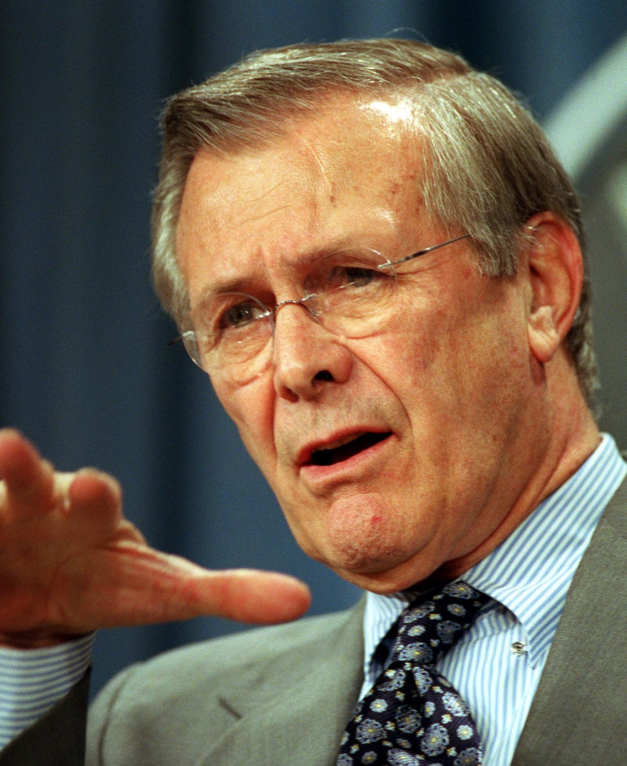
Incomplete Contracting and “Unforseeability”
Hint: https://en.wikipedia.org/wiki/There_are_unknown_unknowns
  Rumsfeld in 2002: “Reports that say that something hasn't happened are always interesting to me, because as we know, there are known knowns; there are things we know we know. We also know there are known unknowns; that is to say we know there are some things we do not know. But there are also unknown unknowns—the ones we don't know we don't know. And if one looks throughout the history of our country and other free countries, it is the latter category that tends to be the difficult ones.”
Let’s motivate this idea using an example.

Slide 40
Incomplete Contracting and “Unforseeability”
Consider a situation where two parties enter into an ostensibly mutually beneficial transaction.
In commerce, the parties may attempt to describe all of the terms that may be relevant to that transaction.
For instance, in a contract for a sale of goods (e.g., pecuniary consideration for socks), the contract between a supplier and a distributor may stipulate terms concerning:
  The price of the goods
  Certain characteristics of the goods (e.g., the socks must be blue in color, the socks must be made of wool, etc.)
  The time and venue of delivery, etc.
The parties may also attempt to contract on events that may or may not happen (in other terms, probabilistic events).
  For instance, the parties may contract to determine how losses should be allocated if the socks are seized by customs officials.
  In most commercial transactions, one party may be willing to bear these contingent losses if they are able to insure these losses are a lower cost when compared to their counterparty.

Slide 41
Incomplete Contracting and “Unforseeability”
Despite their best attempts, most commercial parties will inevitably fail to describe all of the events that will affect their eventual payoffs/profits/utilities.
  In other terms, some events (even those which could be highly significant to the parties involved) are simply unforeseeable at the time when the contract was initially established.
  While the events may be unforeseeable before they happen, they are often easily recognized after they occur. Q: Can you think of an example?
  Economists refer to the existence of vague or poorly defined trade terms at the beginning of a contractual relationship (that is, ex ante) as “incomplete contracting.”
Where incomplete contracting occurs, the contracting parties must determine how to address the “gaps” in the contract as unforeseen circumstances arise (i.e., ex post).
  Law and legal institutions play a central role in determining how incomplete contracts are “gap-filled” ex post.
Notes:
Chandler v Webster

Slide 42
Incomplete Contracting and “Unforseeability”
The nature of contracting within the corporation happens to be extremely incomplete and dynamic when compared to typical spot contracts.
Recall our last seminar: “Spot contracts” involve “exchanges occur instantly and simultaneously, as when a shopper pays cash for goods in the grocery store.” (Ulen and Cooter, 2016).
What about deferred exchanges as per our last seminar?
  When parties are aware of these payoff-relevant terms, they will include these terms in the contract governing their relationship (“known knowns”).
  When parties are aware of payoff-relevant terms which involve actions that are unobservable, they will attempt to mitigate them as per our discussion on agency costs and information asymmetry (“known unknowns”).
  Q: What about a situation where parties are unaware of the existence of payoff-relevant terms which may surface in the future (“unknown unknowns”)? What can they do?

Slide 43
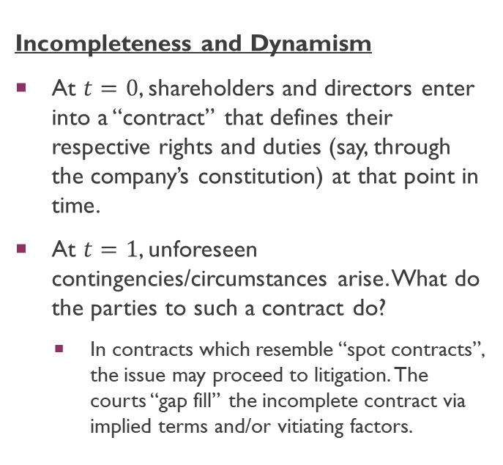
Incomplete Contracting and “Unforseeability”
Incompleteness and Dynamism
At $t=0$, shareholders and directors enter into a “contract” that defines their respective rights and duties (say, through the company’s constitution) at that point in time.
At $t=1$, unforeseen contingencies/circumstances arise. What do the parties to such a contract do?
  In contracts which resemble “spot contracts”, the issue may proceed to litigation. The courts “gap fill” the incomplete contract via implied terms and/or vitiating factors.
Ex Ante Contract
Ex Post “Gap Filling”
time
0
1

Slide 44
Incomplete Contracting and “Unforseeability”
Incompleteness and Dynamism
In the corporate context, resorting to litigation to resolve these issues every time they arise would be close to impossible, given how endemic unforeseen circumstances are.
  Bakery example: Hundreds, if not thousands of business decisions to make everyday.
What corporate law does is to give ex-ante decision powers to one or more parties to make ex-post decisions.
Party with power essentially has the legal right to “gap fill” incomplete contracts: that is, they have the legal rights to determine all unforeseen circumstances
Ex Ante Contract
Ex Post “Gap Filling”
time
0
1

Slide 45
Incomplete Contracting and “Unforseeability”
Incompleteness and Dynamism
Topic: Board Power vs Shareholder Power.
See s 157A(1) CA: “The business of a company shall be managed by, or under the direction or supervision of, the directors.”
Corporate Law has a crucial role to play in deciding who is vested with decision-making powers to make decisions on behalf of the company that are not inconsistent with prior contracts (like the company’s constitution).
  When it is vested in the board, the board of directors vote to determine an issue.
  When it is vested in the shareholders, a general meeting of shareholders vote to determine an issue.
Ex Ante Contract
Ex Post “Gap Filling”
time
0
1

Slide 46
Incomplete Contracting and “Unforseeability”
In theory, shareholders could vest decision-making powers to “gap-fill” the corporate contract in an array of different parties – not merely the courts and the board of directors.
  Q: Can you think of some examples? Consider the landscape of corporate governance in Singapore.
In Grossman and Hart (1986), the learned authors suggest that residual rights of control (i.e., the power to “gap-fill” incomplete contracts) should lie with the party whose ex-ante relationship-specific/asset-specific investments are most valuable to the firm.
  We will discuss this notion of a “relationship-specific investment” in great detail when we cover the topic on “Board vs Shareholder Power”.
  Basic intuition: A relationship-specific investment is an investment whose returns depend on the relationship’s continuation. These investments tend to have little to no value outside of the relationship.
    Investment: Time, Effort, Money (NB: We can think of these as costs that a party has to expend), etc.
    Example of a r/s-specific investment: If a McDonald’s employee invests effort into learning how to operate a (proprietary) French-fries fryer at McDonald’s, such investments no longer have value in the event where the employee no longer works for McDonald’s.

Slide 47
Multiple parties to a firm
Beyond the core “frictions” elucidated on Slide 9, there are further problems when collective decision-making is required for “gap-filling” incomplete contracts.
In a bilateral scenario, one party to a contract may have the residual power to “gap-fill” the contract where unforeseen events arise ex post, after the contract was first formed.
In a multilateral scenario, complexities arise. For instance, if multiple shareholders have this residual power to “gap-fill” the corporate contract, we need a mechanism to aggregate individual shareholder preferences to a single decision that represents the shareholders as a collective whole.
  This is most commonly done through the mechanism of a voting rule.
    Where a voting rule is majoritarian in nature, “differences of opinion” amongst the shareholder base are resolved via majority vote. The “winning issue” in a corporate election is determined by the issue which receives more than 50% of the total votes.
    Hansmann (1996) refers to the inefficiencies arising from voting rules as the "costs of collective decision-making," highlighting them as a distinct source of frictions. We will discuss these frictions in detail when we cover the topic “Shareholder Activism, Voting, and Proxy Access”.

Slide 48
Multiple parties to a firm
Hansmann (1996) describes the “costs of collective decision-making” as the costs that result from the heterogeneity of interests amongst the owners of a firm.
Q: Which party will always be outvoted under a majoritarian voting rule? Why?
  Some inefficiencies which could arise here:
    Rent-seeking
    Reduction in Ex-Ante Investments
More on this in topic: “Minority Shareholder Protection”.
A and B can vote to have the org choose this point
Amount spent on R&D
A
B
C

Slide 49
Multiple parties to a firm
Amount spent on CEO compensation
A and B can vote to have the org choose this point
B
A
C
Amount spent on R&D

Slide 50
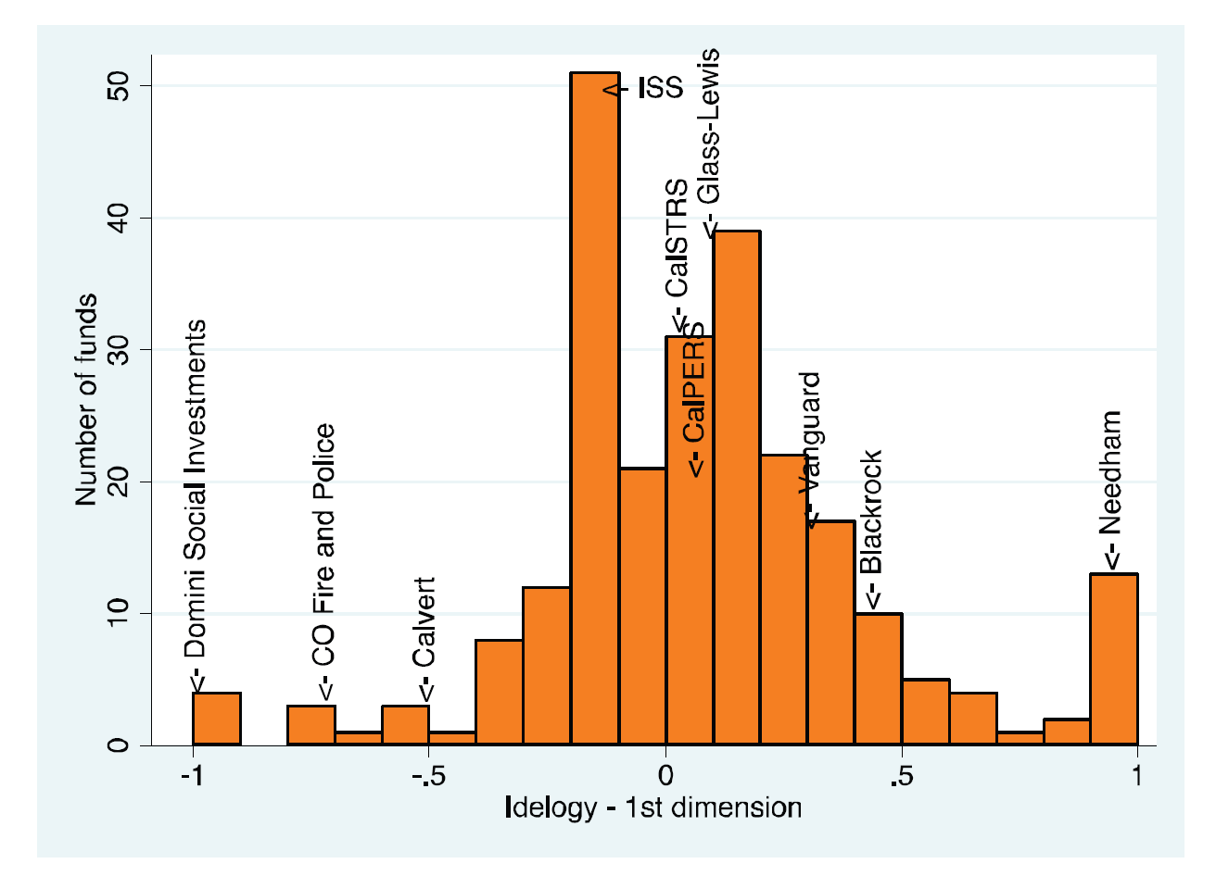
Multiple parties to a firm
Bolton et. al (2020) on “Investor Ideology”:

Slide 51
THE Contractarian Approach: Reducing the Costs of Contracting
Finally, the simplest justification arising from the contractarian approach to Company Law is to “reduce the cost that users of the law would have incurred in bargaining for such a legal structure”.
Company Law then acts as a set of default (contractual) rules.
Parties can elect to decide whether they want to retain these default rules, or deviate from them via contract in accordance with their preferences.
  We will discuss the extensive literature on default vs mandatory rules in our topic on “Board vs Shareholder Power”.
NB: If company law is only there to provide default rules, the default rules of Company Law should be set up in a way that reflects the majoritarian preferences of businessmen/businesswomen.

Slide 52
The contractarian approach to corporate law
To summarize, in this lecture, we have discussed:
  The Motivation for why Corporate Law may simply reflect the regulation of a “very special contract”.
  The array of “frictions” which arise in the “Corporate Contract”.
  How a “Contractarian Approach” to Corporate Law explains substantially more than what detractors of the theory suggests.
Note that we have not discussed anything remotely related to the Company’s Separate Legal Personality. This requires a discussion of the “proprietary approach” to Corporate Law, which we will turn to next week.

Slide 53
Q&A
See you guys on Tue.

