Slide 1

Corporate law and economics (LL4489V/5489V/6489V)
5. CONTRACTARIAN VS PROPRIETARY APPROACHES II
LL4489V
Kenneth Khoo
kenneth.khoo@nus.edu.sg

Slide 2

CONTRACTARIAN AND PROPRIETARY APPROACHES
Motivation
The Proprietary Approach to Corporate Law
  A Refresher on Property Rights
  The Company's Separate Legal Personality and the Bifurcation of the Company’s Ownership Structure
  Asset Partitioning

Slide 3

motivation
Recall: In our last lecture, we discussed:
  The Motivation for why Corporate Law may simply reflect the regulation of a “very special contract”.
  The array of “frictions” which arise in the “Corporate Contract”.
  How a “Contractarian Approach” to Corporate Law explains substantially more than what detractors of the theory suggests.
Nevertheless, we have not discussed anything remotely related to the Company’s Separate Legal Personality. We will turn to this today.

Slide 4
Motivation
A merely contractual perspective on business organizations explains much of what corporate law is, but fails to explain how corporate law regulates claims on firm assets.
  To see why this is crucial, consider the following notes by Dari-Mattiacci (2017): “Without organizational law, firm assets would be owned (possibly, jointly) by the firm owners, they would be seizable by their personal creditors and give raise to liabilities that would be guaranteed by the owners’ personal assets. Moreover, the owners, rather than the firm, would acquire property, enter into contracts and stand in court to bring or defend against lawsuits…”
  “…Organizing businesses of the scale we know today would be impossible, but this was the western world before the invention of organizational law. It took centuries to develop the set of rules that allow us to say that firms have their own assets, clearly separated from the personal assets of the owners, and can enter into contracts, own property and stand in court in their own name through (human) agents. Those rules do not establish default contractual rights; they create mandatory proprietary rights”
Q: Intuitively, why would it be difficult for businesses to gain economies of scale without organizational law?
Notes:
Ans: Without organizational law, a large number of capital providers would be subject to massive (and potentially) unlimited liability. This would seem to reduce the incentives to invest in large businesses; only small businesses with identified partners would be economically viable. Anonymized investing not possible.

Slide 5

motivation
Recall the “Contractarian Approach” to Corporate Law in our last lecture
  As detailed there, contracting amongst the various stakeholders of the corporation may be considerably involved.
  For instance, we know that rational, utility-maximizing shareholders will internalize the possibility that managers will act opportunistically against their interests.
    Similarly, rational, utility-maximizing managers understand the incentives of shareholders to curb their opportunism and will react accordingly.
Notes:
Caveat: Incomplete contracting

Slide 6

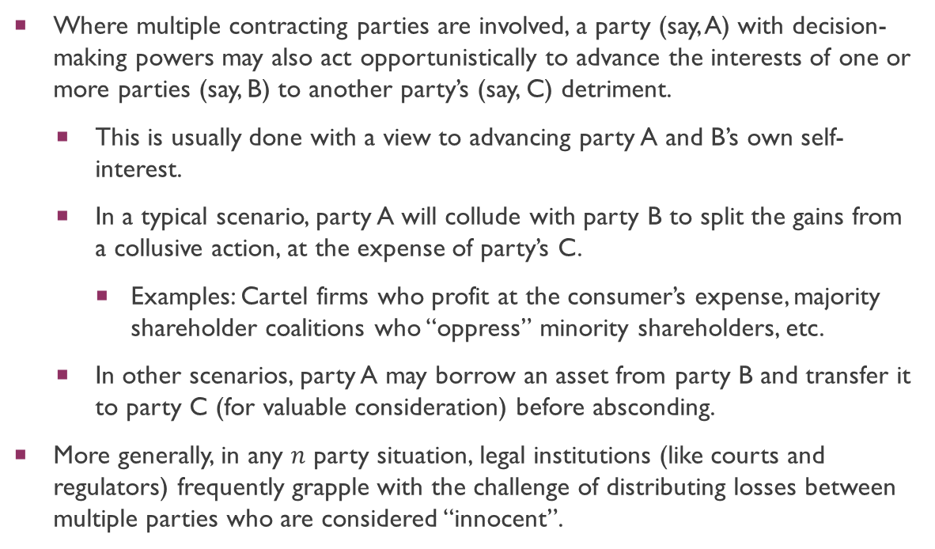
motivation
Where multiple contracting parties are involved, a party (say, A) with decision-making powers may also act opportunistically to advance the interests of one or more parties (say, B) to another party’s (say, C) detriment.
  This is usually done with a view to advancing party A and B’s own self-interest.
  In a typical scenario, party A will collude with party B to split the gains from a collusive action, at the expense of party’s C.
    Examples: Cartel firms who profit at the consumer’s expense, majority shareholder coalitions who “oppress” minority shareholders, etc.
  In other scenarios, party A may borrow an asset from party B and transfer it to party C (for valuable consideration) before absconding.
More generally, in any $n$ party situation, legal institutions (like courts and regulators) frequently grapple with the challenge of distributing losses between multiple parties who are considered “innocent”.
Notes:
Economists term this “contracting with externalities”.

Slide 7
Motivation
Dari-Mattiacci (2017): “The theory of the firm (Grossman and Hart, 1986; Hart and Moore, 1990) stresses the importance of property rights as characterized by residual control rights on assets, which solve problems arising from incomplete contracts. At a very fundamental level, this notion of property is orthogonal to the notion of property in legal scholarship…”
“…In the latter, the problem that property solves is not one of incomplete contracts; it is one of incompatible contracts. Since contracts are usually bilateral affairs, a contract between A and B might create claims that are in contrast with the claims generated by another contract between A and C. For instance, A might pledge the same security to both B and C. The problem arises because A, B and C cannot typically sit at the contracting table together, so that property rules are required to decide which of the contracts prevails (Merrill and Smith, 2000; Hansmann and Kraakman, 2002; Ayotte and Bolton, 2011). While in the theory of the firm property is required because a fully complete contract is unachievable at reasonable costs, in the theory of business organizations property is necessary because a grand multilateral contract is impractical.”

Slide 8
Motivation
Thus, property rules essentially determine who obtains priority in the presence of incompatible contracts.
In the example provided by Dari-Mattiacci (2017) where A pledges the same security to both B and C, a set of property rules determine whether B or C obtains the security.
In other words, property rules create a subordination regime where some interests of one or more parties are subordinated to the interests of one or more parties.
  We will argue that the Separate Legal Personality of a corporation provides one such subordination regime:
    Where corporate assets are involved, the interests of the shareholder’s creditors are subordinated to the interests of the company’s creditors.
    Similarly, where personal assets are involved, the interests of the company’s creditors are subordinated to the interests of the shareholder’s creditors.
In the L&E scholarship, the company’s separate legal persona is said to partition assets. But “security interests” as defined by Eldar and Verstein (2019) can partition assets as well.
  Q: Can you think of an example?
Notes:
Consider a situation where a property owner uses the same asset, such as a piece of real estate, to secure multiple loans from different lenders. In this case, asset partitioning occurs through the creation of security interests. The property may have a first mortgage, granting one lender priority over another lender who holds a second mortgage. If the property owner defaults, the first lender has priority in claims, subordinating the second lender's interest

Slide 9
A refresher on property rights
Contractual Rights are in personam and tend to be bilateral – if I have a contractual right against X, I can only sue X, not a third party Y.
  Unless it falls under one or more exceptions to Privity of Contract (e.g. CRTPA Cap. 53B)
The case is similar for Tortious Right-holders.
Property Rights are in rem and tend to be impersonal – if I have a property right over X, I can enforce that right against anyone who infringes this right over X.
  Property rights are usually transferrable to third parties.
  If I sell the property right to a third-party Y, person Y will now have the same property right over X which I once had.
  Thus, property rights are said to be enforceable “against the world”.
Recall the tension in 3-party problems, where the law has to allocate losses between B and C in A’s absence. If B has a property right in relation to the asset but C does not, then B’s claim to the asset will take priority over C’s claim.

Slide 10
A refresher on property rights
As opposed to in personam rights, Property Rights usually attach to “things” (whether tangible or intangible)
In company law, we are interested in two types of property rights.
  First, the attachment of property rights to the company’s assets.
    E.g. physical objects like machinery that the company owns, real estate, or intellectual property.
    In the absence of contracting, a company as a separate legal person has full property rights over its assets.
  Second, the attachment of property rights to ownership of the company as a separate legal person, embodied in shares.
These property rights can then be transferred to other persons or organizations with separate legal personality.

Slide 11
A refresher on property rights
Insofar as (1) is concerned, property rights are useful for companies because by giving up some of these rights, they make the company’s contracting more credible. This lowers the costs of trade.
  If person A contracts with company B and company B breaches the contract, owing A a debt, A has a default right (contractual lien/pledge) to seize company B’s assets to satisfy B’s contractual debt without more.
  Creditors can protect themselves further by explicitly contracting for security/collateral.
  This right (contractual lien/pledge) of person A is a property right, or equivalently a “proprietary right”. Other forms of collateral/security include mortgages and charges (see Practice Note).
  Note: The same concept applies for the shareholders and their personal creditors.
Kraakman et al. (2017) refer to this vesting of property rights as “bonding the firm’s contractual commitments”:
  “[the] firm’s assets are, as a default rule of law, automatically made available for the enforcement of contractual liabilities entered into in the name of the firm. By thus bonding the firm’s contractual commitments, the rule makes these commitments credible.”

Slide 12
A refresher on property rights
Shareholder’s Assets
have property rights in
as “collateral/security”
have property rights in
Shareholder’s Creditors
can transfer property rights to
Shareholders
can transfer company shares to
Third Parties
have property rights in
Company’s Creditors
can transfer property rights to
Company
have property rights in
have property rights in
has property rights in
as “collateral/security”
Company’s Assets
Notes:
“Collateral/Security” is an encumberence.

Slide 13
The Company's Separate Legal Personality and the Bifurcation of the Company’s Ownership Structure
Recall our last lecture on the functions/justifications of corporate law.
  We discussed the nature of the “internal aspect of company law” via the contractarian approach, without any reference to “non-contractual” rights or “proprietary rights”.
But earlier, we just spoke about the company as a separate legal person having property rights over its own assets.
We also noted how the company can transfer some of these property rights to its contractual counterparties.

Slide 14
The Company's Separate Legal Personality and the Bifurcation of the Company’s Ownership Structure
It turns out that shareholders also have property rights in the company as a separate legal person. These property rights come in the form of shares.
  Shares are proprietary in nature. If person X steals person Y’s shares, that infringes on Y’s proprietary rights in the shares. Therefore, X would be (in addition to criminal liability) liable for the proprietary tort of conversion.
  The rights attached to these shares, however, are contractual. Anyone who owns a share (i.e. a shareholder) has a “contract” between himself/herself, the company, and its constituents. This was what we were referring to when we were talking about the “internal” contracting within the company.
  Thus, the shares themselves are proprietary, but the rights attached to them are contractual.
    Q: Is this possible with normal contracts?
  These contractual rights relate to (1) rights of control over the company (“control rights”) and (2) residual rights over the company’s profits (“cash-flow rights”) (Hansmann, 1996).

Slide 15
The Company's Separate Legal Personality and the Bifurcation of the Company’s Ownership Structure
Cash flow rights
Some types of preference shares
“One-share-one-vote”
1
Dual class shares
0
45º
Control rights
1
Notes:
Horizontal Axis: Empty Voting
Vertical Axis: Creditors of the company.

Slide 16

The Company's Separate Legal Personality and the Bifurcation of the Company’s Ownership Structure
Where do these proprietary rights come from?
  Surely not by explicit agreement, since those rights would be contractual
  One Answer: One of the most important roles of Organizational Law (including Corporate Law) is the creation of property rights.
  Let’s use the corporate context from now on.

Slide 17
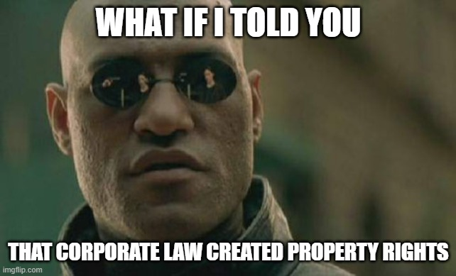
The Company's Separate Legal Personality and the Bifurcation of the Company’s Ownership Structure
This might sound very perplexing
  After all, if I opened a bakery alone without creating any legal entity, all property that I acquired in the course of business would be held under my name.
  If I bought an oven or some ingredients, then I would hold property rights over those chattels
    If my business went well, nothing would change with my failure to incorporate (create) a company

Slide 18
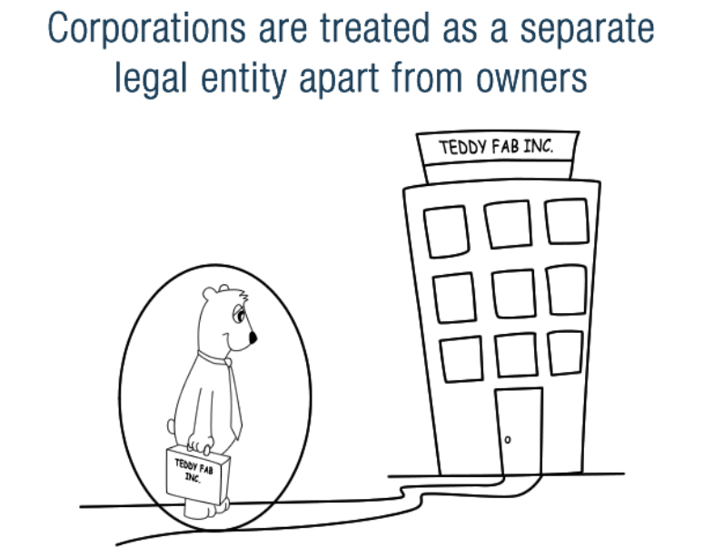
The Company's Separate Legal Personality and the Bifurcation of the Company’s Ownership Structure
The key to this puzzle lies partly in the principle that a Company is a Separate Legal Person
  What does this mean?
    At Law, it is seen as a separate being, distinct from its owners!
  The Company:
    May sue and be sued in its own name
    Enjoys perpetual succession
    May enter into contracts in its own name
    May own property in its own name
    Is liable for taxes
  See s 19(5) CA.

Slide 19

The Company's Separate Legal Personality and the Bifurcation of the Company’s Ownership Structure
Let’s think of a crazy example.
  Let’s say I go out to the store to buy a pencil.
  The law provides me with property rights over that pencil.
    For example, if someone steals it, they would not only be subject to criminal prosecution for theft, but also the (proprietary) tort of conversion
  But what if I incorporated a company (complying with all formalities) and transferred that pencil to the company?
    Because of the company’s separate legal personality, the company now has property rights over that pencil
    What I have is not the property right over the pencil, but shares (which are proprietary) in the company that owns the pencil.
  In effect, Corporate Law has just created Property Rights!

Slide 20
The Company's Separate Legal Personality and the Bifurcation of the Company’s Ownership Structure
The Bifurcation of the Company’s Ownership Structure
This subtle distinction is fundamental
  Tjio et.al (2015) at p 5: The Company is… “a segregated fund comprising the corporate assets and business that are quite distinct from the shares owned by the shareholders…”
  Tjio et.al (2015) at p 5: “the shareholders’ property interest is really an intangible chose in action in seeing to the proper administration of the company, a spes, rather than direct ownership rights in a fund…”
The segregation/separation of ownership rights over the company and ownership rights over the company’s assets is known as the bifurcated ownership structure of the company
  See Tjio et.al (2015) at p 12, 30 and 38.
The key intuition? Shareholders own shares, they do not (directly) own the assets of the company.
It is the company as a separate legal person who owns its own assets.

Slide 21
The Company's Separate Legal Personality and the Bifurcation of the Company’s Ownership Structure
Parent Company
Subsidiary 1
Subsidiary 2
The Bifurcation of the Company’s Ownership Structure
As the company is a separate legal person who can own property rights (assets), it can also own shares.
  As discussed above, shares are also proprietary in nature.
Thus, a company may own shares in another company. This is known as a “parent-subsidiary” relationship.
In the diagram on the right, the parent company owns 100% of the shares in subsidiary company 1 and 100% of the shares in subsidiary company 2.
Many issues in company law arise in the setting where artificial legal persons (i.e. companies) have ownership stakes in one another.
100%
100%

Slide 22
The Company's Separate Legal Personality and the Bifurcation of the Company’s Ownership Structure
“The first and most important contribution of corporate law, as of other forms of organizational law, is to permit a firm to serve [the coordinating role as a nexus for contracts] by operating as a single contracting party that is distinct from the various individuals who own or manage the firm”
Kraakman et. al (2017), The Anatomy of Corporate Law: A Comparative and Functional Approach.

Slide 23
ASSET PARTITIONING
So far, we have discussed the notion that a shareholder’s shares in a company are distinct from the company’s assets.
Logically, it follows that the shareholder’s personal assets (other than the shares of the company) should also be distinct from the company’s assets.
  This separation of assets is known as Asset Partitioning
  The stronger the degree of Asset Partitioning, the more conceptually distinct the shareholder’s assets are from the organization’s assets.
  Asset Partitioning does not arise organically, it is a creature of Corporate Law (or more generally, organizational law)

Slide 24
ASSET PARTITIONING
Logically, it follows that the shareholder’s personal assets (other than the shares of the company) should also be distinct from the company’s assets.
  The shareholder’s “connection” to the Company is by way of his/her rights associated with his/her shares. He/she has no direct interest in the Company’s assets.
  Asset Partitioning is not categorical, it is a matter of degree. Other organizational forms, like Partnerships, have weaker forms of Asset Partitioning when compared to companies.
  The strongest form of Asset Partitioning does not arise in companies. Rather it arises in organizations where beneficiaries have almost no control over the organization’s assets (usually nonprofits or non-charitable purpose trusts).

Slide 25
ASSET PARTITIONING
Food for thought. Say I have an expensive car and a company which I wholly own (100% equity stake).
Suppose the company owns title to the car. If I go bankrupt, is it “fair” that my creditors are unable to foreclose (that is, seize the car and put it up for sale to satisfy the debt) on the car given that it is held under the company’s name?
Suppose that I own title to the car. Likewise, if my company goes bankrupt, is it “fair” that the company’s creditors are unable to foreclose on the car given that it is held under my name?
Note that my (the shareholder’s) creditors are conceptually distinct from my company’s creditors.
Notes:
“Fair”: Some food for thought – no right answer.

Slide 26

ASSET PARTITIONING
In order to achieve Asset Partitioning, corporate law needs to do two things:
  First, it needs to shield the assets of the company from the creditors of the company’s owner (shareholder).
    This is known as “entity shielding”.
  Second, it needs to shield the assets of the shareholder from the creditors of the company.
    This is known as “owner shielding”.
“Shielding”: making assets unavailable for attachment (even if the underlying claim (say in contract) is valid)

Slide 27
ASSET PARTITIONING: entity shielding
Entity Shielding
Objective: shield the assets of the company from the creditors of the company’s owner (shareholder).
Involves two distinct rules
  “Creditor Priority”: Creditors of the company have a claim on the company’s assets that is prior to the claims of the personal creditors of the shareholders.
  “Liquidation Protection”: Individual owners of the company cannot unilaterally withdraw their share of the company’s assets at will + personal creditors of shareholders cannot foreclose on company’s assets.

Slide 28
ASSET PARTITIONING: entity shielding
Creditor Priority
After working for Mary for a few years, Peter has decided to start his own Bakery.
Peter marks the new career change by incorporating the new company “Peter’s Delights Pte Ltd”.
Due to his many years of experience in the industry, business is brisk, and Peter wants to expand his business by setting up a new branch
  This is costly: The new shophouse has to be rented, renovations have to be made, etc.
  Expanding is also risky – Peter has no idea whether the expansion will pay off.
Peter approaches his friend, Amy, for a loan.

Slide 29
ASSET PARTITIONING: entity shielding
Creditor Priority
Amy: I’ll lend the money to you for X% interest.
Peter: OK, would you like to contract with me or Peter’s Delights Pte. Ltd?
*Amy thinks about Creditor Priority*
Amy: I’ll lend it to your company, Peter’s Delights Pte Ltd. Can I have a look at its assets?
Peter: OK. The company owns a few machines, the physical premises of its headquarters, as well as intellectual property rights over a special manufacturing process.
Amy: Great!

Slide 30
ASSET PARTITIONING: entity shielding
Creditor Priority
*A few years pass and Peter commences a bad habit, gambling. He incurs substantial personal debt.*
*The casino starts to take legal action against Peter, suing to recover whatever they can*
*Amy hears of this and is alarmed. Peter is personally insolvent!*
She files suit against Peter’s Delights Pte Ltd and gets her money back, as the company still has substantial assets.
Amy is protected because of Creditor Priority!
  Her claim against Peter’s Delights Pte Ltd is unaffected by Peter’s personal issues
Notes:
Her claim takes priority over the casino’s claim.

Slide 31
ASSET PARTITIONING: entity shielding
Benefits of Creditor Priority
What does Creditor Priority do? What are its benefits?
It makes the company’s contractual commitments more credible
  As a default rule of law, the company’s assets are automatically made available for the enforcement of contractual liabilities entered into in the name of the firm (Kraakman et al. 2017)
  Decreases the risks of the company’s creditors facing corporate insolvency. If the firm goes insolvent, they may be able to foreclose on corporate assets prior to the shareholder’s creditors.
  This lowers the cost of providing capital via debt.

Slide 32
ASSET PARTITIONING: entity shielding
Benefits of Creditor Priority
What does Creditor Priority do? What are its benefits?
It controls the extent of negative externalities that a shareholder and his/her personal creditors can impose on the company’s creditors and (other) shareholders.
  Creditor priority focuses on preventing the shareholders’ creditors from displacing the company’s assets.
  In the example above, Amy doesn’t have to worry about Peter’s financial position.
  The extent of negative externalities that Peter and his personal creditors can impose on Amy is limited, because Peter and the Casino cannot contract around Amy’s priority on corporate assets.
  Because the Company is a SLP, she only needs to decide whether to make the loan on the basis of Peter’s Delights Pte Ltd’s financial position.
  Peter’s own financial position is largely irrelevant.
  The Casino could acquire Peter’s shares, but Amy’s claim is unaffected because debt holder claims are prioritized over equity holder claims!

Slide 33
ASSET PARTITIONING: entity shielding
Benefits of Creditor Priority
More intuition on (2): Here we see the utility of property rights.
Because property rights are enforceable “against the world”, they are very useful in controlling contracts with negative externalities (detrimental third-party effects). How so?
  Suppose that A and B write a contract that is detrimental to C’s financial interests. If the law vests C with property rights, C can enforce these rights against both A and B (because these rights are enforceable “against the world”).
  In a world without asset partitioning, the shareholder creditors (e.g. Casino) and the shareholders (Peter) can contract in a way that harms the company’s creditors’ (Amy) interests by reducing the amount of the company’s bonding assets. If company law vests the company creditors’ interests (Amy) with property rights, these creditors can enforce the property rights against the company and the shareholder’s creditors (Casino + Peter).

Slide 34
ASSET PARTITIONING: entity shielding
Benefits of Creditor Priority
Here, the rule of creditor priority is a property rule that protects company assets from the shareholder’s creditors.
Gives effect to “entity shielding”, also known as “affirmative asset partitioning”.
Can the rule creditor priority be recreated by contract? No! “To establish the priority of business creditors by contract [creditor priority], a firm’s owners would have to contract with its business creditors to include subordination provisions, with respect to business assets, in all contracts between individual owners and individual creditors. Not only would such provisions be cumbersome to draft and costly to monitor, but they would be subject to a high degree of moral hazard – an individual owner could breach her promise to subordinate the claims of her personal creditors on the firm’s assets with impunity, since this promise would be unenforceable against personal creditors who were not party to the bargain [due to privity of contract]” – Kraakman et. al (2016), The Anatomy of Corporate Law: A Comparative and Functional Approach on “entity shielding”.

Slide 35
ASSET PARTITIONING: entity shielding
Benefits of Creditor Priority
Without asset partitioning, a shareholder could in principle agree (vis-a-vis the company’s creditor) to subordinate all personal debt to the company creditor’s claims.
This would not bind a 3P personal creditor due to rules concerning the privity of contract.
Only a property rule like that of creditor priority can perform this function.
Shareholder
Not Bound due to Privity of Contract
Shareholder’s
Creditor
Contract between
Company’s
Creditor

Slide 36
ASSET PARTITIONING: entity shielding
Costs of Creditor Priority
    Increases cost of capital for Peter’s personal loans by reducing overall amount of assets available for bonding.
    If shareholders only have limited wealth, the creation of an artificial entity with legal personhood will not solve collateral problems.

Slide 37
ASSET PARTITIONING: entity shielding
Liquidation Protection
Mary’s Bakery business is doing well, and Peter is playing a major contribution to that end.
After a while, she (as a 100% equity holder) decides to make Peter a co-owner
Mary: Peter, would you like to be co-owner? I’ll sell you 40% of my company for $X. But this company is almost a “child” of sorts, I am in it for the long-haul.
Peter: Sure, that would be great!
*Peter and Mary are now “co-owners” of the company*

Slide 38
ASSET PARTITIONING: entity shielding
Liquidation Protection
*A few years pass and Peter commences a bad habit, gambling. He incurs substantial personal debt.*
Peter: Mary, I’m having personal difficulties right now. Would you be so kind as to return me my capital investment of $X?
Mary: I don’t have the cash to do so right now, and in any case you said that you would be in this business for the long run!
*Because of Liquidation Protection, Peter cannot withdraw his capital from the Company*
*After a few more months of struggling, the casino starts to take legal action against Peter, suing to recover whatever they can*
*The casino tries to foreclose on Peter’s shares in the company, but cannot do so because of Liquidation Protection*
Mary’s Bakery business continues to flourish...

Slide 39
ASSET PARTITIONING: entity shielding
Benefits of Liquidation Protection
What does Liquidation Protection do? What are its benefits?
  It protects the going concern value of the firm against destruction by individual shareholders or their creditors
    Most firms/businesses are worth more when they are operating, rather than when they are liquidated.
    This enables long-term investment, because investors cannot withdraw their money at will.
    Hence, liquidation protection is also known as “capital lock-in”

Slide 40
ASSET PARTITIONING: entity shielding
Benefits of Liquidation Protection
What does Liquidation Protection do? What are its benefits?
  It controls the extent of negative externalities that a shareholder and his/her creditors can impose on the company’s shareholders and creditors.
    Liquidation Protection focuses on preventing shareholders from displacing the company’s assets (except for a winding up of the company).
    Again, Mary doesn’t have to worry about Peter’s financial position.
    The extent of negative externalities that Peter can impose on Mary and other shareholders is limited, because he cannot withdraw his capital (except where provided by corporate law)
    Controls the extent of negative externalities that Peter and his creditors can impose on Mary and other shareholders
    Unlike many partnerships, Mary can keep her company running even if Peter is insolvent.
      Even if Peter’s estate or Official Assignee takes over his shares, the company is largely unaffected.
    Peter’s own financial position is also largely irrelevant.

Slide 41
ASSET PARTITIONING: entity shielding
Costs of Liquidation Protection
    In some cases, minority shareholders have no exit rights available to them, making them vulnerable to majority-shareholder opportunism
    Increases cost of capital for Peter’s personal loans by reducing amount of assets available for bonding.

Slide 42
ASSET PARTITIONING: entity shielding
“Strong” vs “Weak” form Entity Shielding
“Strong” form Entity Shielding: Creditor Priority + Liquidation Protection
“Weak” form Entity Shielding: Creditor Priority only
“Strong” form entity shielding is a key distinguishing characteristic of Companies when compared to their organizational counterparts like Partnerships
  In many partnerships (such as the General Partnership), death or bankruptcy of one partner can force the partnership to be dissolved

Slide 43
ASSET PARTITIONING: OWNER SHIELDING
Owner Shielding
Objective: shield the assets of the shareholder from the creditors of the company.
Limited Liability: The company’s creditors are limited to making claims against assets that are held in the company’s name itself, and have no claim against assets that the company’s shareholders hold in their own names

Slide 44
ASSET PARTITIONING: OWNER SHIELDING
Limited Liability
Mary (60% equity stake) and Peter (40% equity stake) are co-owners of Mary’s Delights Pte Ltd
  When founding the company, Mary put in $240 of her own money and Peter $160.
  The business is doing well, and Mary and Peter take a corporate loan from a bank to open another Bakery.
COVID-19 hits and “Circuit Breaker” measures have a tremendous (negative) impact on their business. Sales are almost non-existent.
Mary’s Delights Pte Ltd cannot pay its debts, and the bank sues the company, trying to recover whatever it can.
Can Mary lose more than $240 (her initial investment)? Can Peter lose more than $160?
  No. Limited liability places a limit on their losses to whatever their capital investment once was.

Slide 45
ASSET PARTITIONING: OWNER SHIELDING
Benefits of Limited Liability
What are the benefits of Limited Liability?
Facilitates Diversification
Reduces the Costs of Monitoring Other Shareholders
Promotes Free Transferability of Shares and so Constrains Agency costs

Slide 46
ASSET PARTITIONING: OWNER SHIELDING
Facilitates Diversification
  What is diversification?
    Formal definition: “Diversification is a risk management strategy that mixes a wide variety of investments within a portfolio. A diversified portfolio contains a mix of distinct asset types and investment vehicles in an attempt at limiting exposure to any single asset or risk. The rationale behind this technique is that a portfolio constructed of different kinds of assets will, on average, yield higher long-term returns and lower the risk of any individual holding or security.”
    Rough intuition – “Even if one firm in my portfolio does badly, another will do well”
    Mathematical intuition – “Returns on any one stock may be negatively correlated with another”
      Example: Airline stock and Crude Oil Producer stock

Slide 47

ASSET PARTITIONING: OWNER SHIELDING
Facilitates Diversification
  Should I invest all my savings in one company?
    Business is an inherently risky venture
    What if I put all my wealth in SIA?
      If things go badly, large portion of my savings would be wiped out
    Key here: Invest in something else that does well when SIA does poorly
      Crude Oil Stock? If crude oil prices are high, SIA likely to suffer…
      Strategy of 50% investment in SIA and 50% investment in ExxonMobil would lower risk as compared to 100% investment in SIA
  How do I still accrue gains over the long run?
    If the economy is doing well, all stock prices are likely to increase

Slide 48
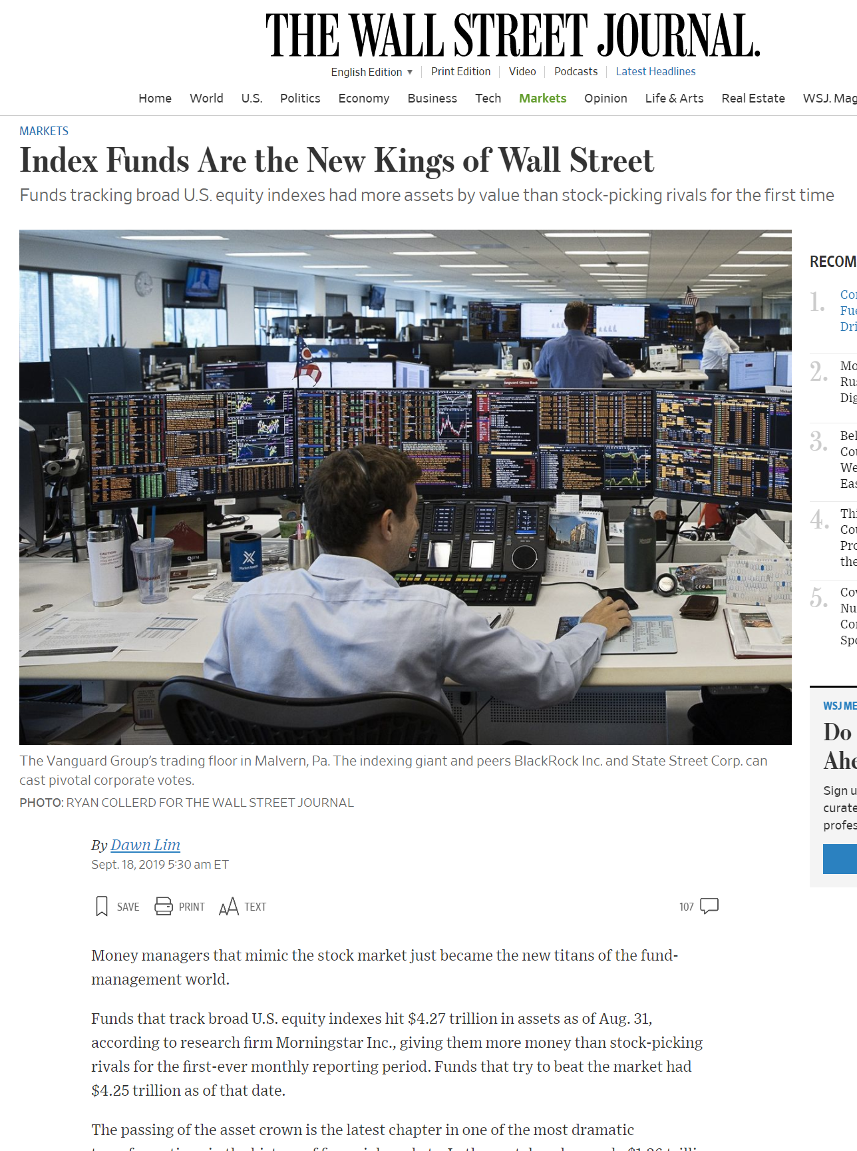
ASSET PARTITIONING: OWNER SHIELDING

Slide 49
ASSET PARTITIONING: OWNER SHIELDING
Facilitates Diversification
  How does limited liability facilitate diversification?
    With unlimited liability, the downside risk borne by the shareholders depends on the way the business is carried out
    They would want to be actively involved in the running of the business so as to keep this risk under control
    LL imposes a finite cap on downside losses, making it feasible for shareholders to diversify.

Slide 50
ASSET PARTITIONING: OWNER SHIELDING
Reducing Costs of Monitoring Other Shareholders
  Under a rule of unlimited liability, the greater the wealth of other shareholders, the lower the probability that any one shareholder’s assets will be needed to pay a judgement.
  Why? Consider the General Partnership that lacks LL. Partners are jointly liable for the debts of the Partnership.
    This means that if one partner dies, disappears or becomes insolvent, the other remains fully liable.
    So each partner has a strong incentive to engage in costly monitoring of other shareholders to ensure that they do not transfer assets to others or sell their shares to others with less wealth
  With LL, the wealth level of other shareholders becomes irrelevant.

Slide 51
ASSET PARTITIONING: OWNER SHIELDING
Promotes Free Transferability of Shares and so Constrains Agency Costs
Because the wealth level of other shareholders becomes irrelevant under LL, LL facilitates transferability of shares
Recall that under a rule of unlimited liability, each equity owner has a strong incentive to ensure that their co-owners do not transfer their shares to others with less wealth
This restriction of transferability prevents shareholders from “punishing” errant directors who act in their own self interest.
  In the absence of transferability, they could exercise their residual rights of control (e.g. voting to remove directors, or by suing them for a breach of fiduciary duties). This is costly.
  With free transferability, shareholders can simply sell their shares on a secondary market.
    New investors can take over the company and install new directors.
    This prevents directors from acting opportunistically in the first place, reducing agency costs.
    Takeovers play a large role in constraining Agency Costs (see Khoo and Tjio, 2020).

Slide 52
ASSET PARTITIONING: OWNER SHIELDING
Costs of Limited Liability
What are the costs of Limited Liability?
  Involuntary Creditors: If a company’s employee engages in a tort, the company is usually held vicariously liable. However, because of limited liability, the injured party may be left without compensation.
  Undercapitalization: Agency Relationship between Shareholders and Creditors
    Insolvency Law
The area of corporate law concerning “Veil Piercing” essentially deals with the difficult issue of whether there should be exceptions to Limited Liability (“Owner Shielding”) and Affirmative Asset Partitioning (“Entity Shielding”).

Slide 53
ASSET PARTITIONING
Summary so far
Asset Partitioning: Legal separation of shareholder’s assets from the company’s assets.
Series of Legal Rules that create this separation:
  “Entity Shielding”: Creditor Priority and Liquidation Protection
  “Owner Shielding”: Limited Liability
Common consensus that benefits of asset partitioning outweigh the costs. Why?
  Limits creditor-shareholder opportunism (vis-à-vis other creditors)
  Even though fewer assets are available for each type of creditor (company and personal), each type of creditor finds it far easier to evaluate and monitor the assets of the respective legal person under a regime of asset partitioning as compared to one without. (Hansmann and Kraakman, 2000)
    Each creditor has a “comparative advantage” in evaluation and monitoring assets of its “type”.
  This dramatically lowers the cost of capital
    Cheaper loans with lower interest rates!

Slide 54
ASSET PARTITIONING
Company’s Creditors
Shareholder’s Creditors
Owner Shielding: Limited Liability
Entity Shielding:
Creditor Priority
Company
Shareholder
Have a claim over the
Have a claim over the
Has ownership over
Has ownership over
Company’s Assets
Shareholder’s Assets
Entity Shielding:
Liquidation Protection
Has shares in the

