Slide 1

Corporate law and economics (LL4489V/5489V/6489V)
7. institutional investors and stewardship
LL4489V
Kenneth Khoo
kenneth.khoo@nus.edu.sg

Slide 2

Institutional investors and stewardship
General Principles
Fund Structure
Common Ownership
Stewardship

Slide 3
General principles
In Slide Deck 5, we discussed the idea that shares are a form of property (a “chose in action”), and that the corporation is a separate legal person at law.
  The company’s separate legal personality allows it to own property in its own name. Thus, a company can own shares in another company. That company can, in turn, own shares in yet another company, etc.
  E.g., Coy A can own 51% of the shares in Coy B, which can in turn own 51% of the shares in Coy C.
    These structures are known as “pyramid” structures (see Morck et al. 2005), and can lead to an extreme separation of ownership from control. Q: Why?
When an artificial legal entity is a shareholder of a company (say, Company A), the incentives of that artificial legal entity might be distinct from the incentives of shareholders who are natural persons. Why?
Notes:
Acts of natural persons attributed to acts of the company.

Slide 4

General principles
In this Seminar, we are going to examine the incentives of a special type of shareholder, commonly known as “institutional investors”.
An institutional investor is a shareholder of a company which [itself] buys, sells, or manages stocks, bonds, and other investment securities on behalf of its clients, customers, members, or shareholders.
Problem: Institutional Investors are not monolithic – different types of institutional investors will have different types of incentives.
  For instance, a mutual fund will often be driven by very different incentives as compared to a public pension fund.
Bebchuk et al. (2017): “Like all organizations with multiple employees, investment managers have their own internal agency problems.”
  As we will discover later, these agency problems are shaped by both economics incentives as well as the law – primarily, securities regulations which govern investment vehicles.

Slide 5
General principles
A non-exclusive taxonomy of institutional investors:
  Endowment funds
  Commercial banks
  Mutual funds
  Hedge funds
  Pension funds
  And Insurance companies.
We will focus on (3) and (4). Why? Most of the major institutional investors are mutual funds, while hedge funds play an important role in the “ecosystem” of corporate governance (at least in major public equity markets like the NYSE and LSE).
  In 2015, 40l(k) assets under management totaled $4.7 trillion, with 60 percent held in mutual funds (Collins, Holden, Duvall, and Chism, 2016).
Notes:
Endowment fund = non-profit funds e.g., NUS endowment fund.

Slide 6
General principles
Stylized Fact from Khoo (2023): “In 1950, institutional investors owned about 7% of public companies in the United States. Today, they hold almost 70% of the U.S. market. When combined, three firms alone—Vanguard, Blackrock, and State Street—constitute the largest shareholder in 88% of the S&P 500. In European markets, institutional investing is also on the rise: Blackrock, for example, is already the largest shareholder of a third of the largest companies in the UK and the German public-exchange markets. In 2015, institutional investors held more than 60% of the entire German chemical industry; in 2016, pension funds in Iceland had acquired shareholdings in most of the local companies, including 50% of telecommunication firm shares.”
  Similar phenomenon in Asia, with institutional investing on the rise (see Inderst, 2016).
Understanding the incentives of institutional investors is also crucial for understanding the incentives of other types of investors in Asia, such as sovereign wealth funds. We will turn to this next week.
Notes:
10-15% of Asian stock, with increasing trend.

Slide 7
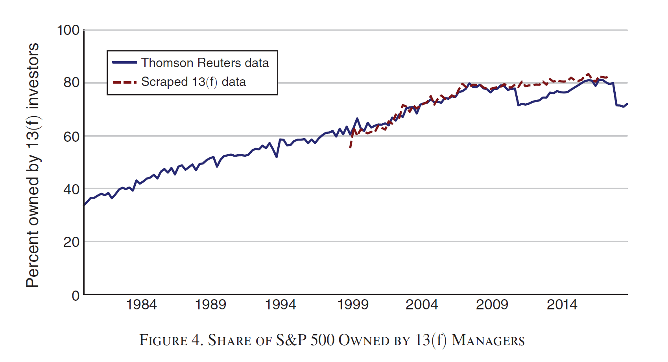
General principles
Backus et al. (2021)

Slide 8
General principles
The rise of institutional investing is one of the most important topics in corporate governance today, as it fundamentally changes our normative position on the central “frictions” amongst corporate constituents.
Gilson and Gordon (2013): “The canonical account of U.S. corporate governance, which stresses the tension between dispersed shareholders and company managers in large public firms, has become factually obsolete and now provides a misleading framework for contemporary corporate governance theorizing. In this account… shareholders individually own too few shares to monitor management's performance and confront coordination costs that make collective monitoring difficult… The Berle-Means premise of dispersed share ownership is now wrong. In 2011, for example, institutional investors owned over 70% of the outstanding stock of the thousand largest U.S. public corporations. This shift from the Berle-Means archetype of widely distributed ownership to concentrated institutional ownership gives rise to what we call "agency capitalism," an ownership structure in which agents hold shares for beneficial owners. The consequence is a double set of agency relationships: between shareholders and managers and between beneficial owners and record holders.”

Slide 9
General principles
Dasgupta et al. (2021): “Institutional investors are – by definition – asset managers, that is, they manage other people’s money. This endows their role in corporate governance with a unique set of characteristics. When institutional investors hold equity blocks they participate in a dual-layered agency relationship. On the one hand, as equity holders in the firms in which they hold blocks, institutional investors act as principals who must monitor the actions of their agents (corporate executives). On the other, institutional investors are themselves agents, acting on behalf of their own clients (fund investors) and are monitored by them. Thus, institutional blockholders are simultaneously principals and agents.”
One problem: “Retail-facing, large, long-only asset managers such as mutual funds tend to have very little ‘skin in the game’. According to Khorana et al. (2007) over half of mutual funds have zero managerial ownership.”
  Can you think of why a high-net-worth individual holding 20% of a Company would have different incentives vis-à-vis an asset manager who was managing the same blockholding of shares?

Slide 10
General principles
In Slide 5, we noted our focus on mutual funds and hedge funds. But what is a “mutual fund” and a “hedge fund”?
A mutual fund is a financial vehicle that pools assets from members of the public/firms to invest in securities like stocks, bonds, money market instruments, and other assets.
  Because mutual funds sell their shares widely to the general public, they are ordinarily subject to stringent securities regulations. In the U.S., the primary legislation is known as the “Investment Companies Act of 1940”.
Morley (2013): “A key feature of mutual funds is that they allow their shareholders to "redeem" their shares. In other words, shareholders can return their shares to the funds in exchange for the cash value of their shares. This value equals the value of the portion of a fund's net assets that corresponds to each share. Mutual funds typically allow their shareholders to redeem every day. "Exchange-traded" funds (ETFs), which have received a great deal of attention in recent years, are a special kind of mutual fund [which allows for constant redemption throughout the trading day].”
Notes:
How is a mutual fund distinct from an ordinary company, given that shareholders can return their shares in exchange for the cash value of their shares? (ask on next slide)

Slide 11
General principles
Morley (2013): “Mutual funds are sometimes called “open-end” funds to distinguish them from “closed-end” funds. The primary difference is that closed-end funds do not allow shareholders to redeem. Rather than redeeming, closed-end fund shareholders dispose of their shares by selling them on stock exchanges, just as they might do with the shares of operating companies.”
  NB: The distinction between “open-end” and “closed-end” funds relates to a key feature of companies in Slide Deck 5. What is that feature?
  NB: Why are “closed-end” funds similar to ordinary public corporations traded on a liquid stock exchange? What do they have in common?
  Do mutual funds assume the corporate organizational form? Why, or why not?
Notes:
Closed end shares have liquidation protection.

Slide 12
General principles
There are [broadly] two types of mutual funds: “Index funds” and “active funds”.
  An index fund is a type of mutual fund or exchange-traded fund (ETF) with a portfolio constructed to match or track the components of a financial market index, like the Standard & Poor’s 500 Index (S&P 500).
    Index funds are often associated with quasi-exogenous ownership, as they cannot engage in “exit”. Why?
  An active mutual fund is a type of mutual fund with managers who engage in decisions to buy, hold, or sell the assets in that fund.
    Thus, active mutual funds are associated with endogenous ownership by construction, as “exit” is a common strategy used by these funds.
Both funds can engage in “voice”, although they might choose not to do so. More on this later.
Notes:
Commitment to tracking the index.

Slide 13
General principles
Morley (2013): “Hedge funds are pools of investment assets similar to mutual funds. But unlike mutual funds, hedge funds issue securities only to limited numbers of institutional investors and wealthy individuals. Hedge funds therefore do not have to register with the [Securities and Exchange Commission] or comply with the [Investment Companies Act of 1940]. Like mutual funds, hedge funds allow their shareholders to redeem their shares. However, hedge funds typically allow redemptions only once per month or once per quarter, rather than daily as mutual funds do.”
  Thus, a hedge fund is an “open-end” fund. Hedge funds tend to be active funds.
Morley (2013): “Private equity funds are similar to hedge funds in the sense that they sell only to wealthy individuals and institutions and therefore do not register with the SEC or comply with the ICA. But private equity funds do not offer redemption rights. Instead, they exist for terms of years – usually around five to ten years – after which they wind up by distributing their assets or by selling their assets and distributing the proceeds.”
  Most PE funds are thus “closed-end” funds.

Slide 14
Fund structure
Before discussing the incentives of institutional investors and the problems associated with those incentives, we ought to discuss how investment funds are organized as legal entities.
Morley (2013) suggests that “every type of investment fund adopts a pattern of organization” that corresponds to the “separation of funds and managers”. What does this mean?
  “A management company [like Blackrock or Goldman Sachs] establishes a fund by taking several steps… First, the management company organizes the fund as a legal entity distinct from the management company. Next, the management company causes the new entity to sign a contract with the management company. Under the terms of the contract, the management company agrees to [exclusively] supply all of the operational and administrative services the fund requires. The fund thus has no employees or other operational assets and may even be prohibited from having them.”
  “Once the agreements and entities are in place, the management company solicits investments from outsiders. Note that the management company and its employees might invest some of their own money alongside the outsiders. However, [the] funds and management companies must deal with one another at arm's length and may be said to have separate ownership.”

Slide 15
Fund structure
Morley (2013): The largest management companies operate thousands of funds. Management companies often market their many funds under a single brand name, such as Fidelity or BlackRock,, and funds that share a common management company are often said to be part of the same “family”.
  “Once the management company has established the fund and its contracts, the fund will own what I am calling "investment" assets and liabilities, and the management company will own what I am calling "management" assets and liabilities. Investment assets typically (though not always) consist of things like securities, currency, real estate, and assorted financial instruments, and investment liabilities consist of things such as outstanding loans and unperformed derivative obligations. Management assets include the written and unwritten contracts that entitle management companies to the services of workers (such as portfolio managers, accountants, and secretaries), as well as physical assets such as office space and computers and intellectual property such as corporate logos. Management liabilities include obligations under office leases, employment contracts, and other commitments. In management companies that operate inside of larger financial conglomerates, such as Goldman Sachs, the management assets may be far-flung, highly complex, and only loosely related to the management of investment funds.”

Slide 16
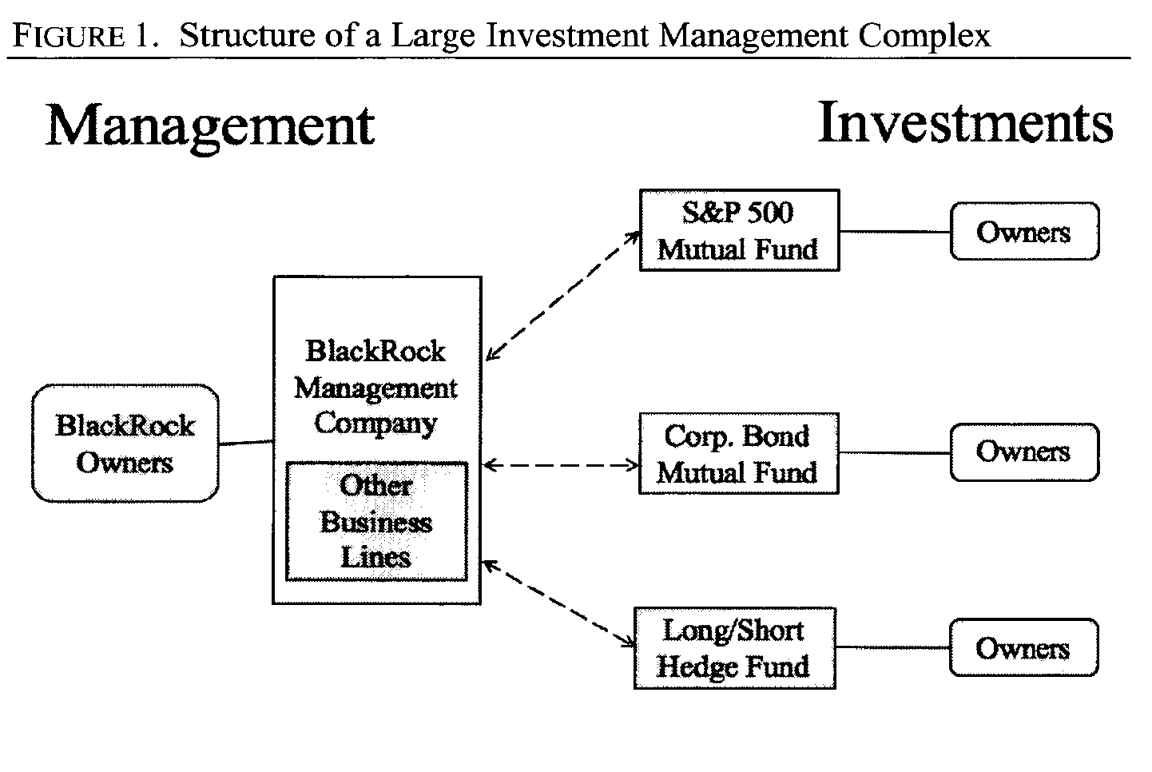
Fund structure
Morley (2018)

Slide 17
Fund structure
Morley (2013):The use of separate entities limits the exposure of fund assets to management companies' liabilities and creditors. In other words, the use of separate entities achieves "asset partitioning. By virtue of the fact that funds and management companies are separate entities, any creditors who contract with a management company have no claims against the assets of the funds.
The second limit is a product of the construction of separate ownership for funds and management companies. Separate ownership limits fund investors' rights to claim management companies' residual earnings or "profits." Because funds and management companies have separate owners, it is the management companies' equity holders, and not the funds' equity holders, who possess the rights to claim the management companies' residual earnings. As a consequence of these limits, fund investors experience neither the benefits nor the burdens of management companies' profitability.
The third limit is also a product of separate ownership. Separate ownership prevents fund investors from exercising residual control over management companies. Because funds and management companies are separately owned, it is the management companies' equity holders, and not the funds' equity holders, who exercise residual control over management companies and their assets.

Slide 18
Fund structure
Notice how this is a familiar problem: Asset partitioning (as per Hansmann and Kraakman (2000)) and the allocation of control rights in any organization (Iacobucci and Triantis (2007)) are associated with both costs and benefits.
  In the corporate context (Slide Deck 5), we suggested how the benefits of asset partitioning are likely to outweigh the associated costs – resulting in the dominance of the corporate business vehicle today.
Morley (2013) provides several reasons for why this structure is dominant amongst investment funds:
  Fund investors have unusually strong exit rights when funds are “open-ended”. Here, the net benefits of “exit” are much larger than the net benefits of “voice”. NB: Why?
  Investment managers have powerful performance incentives, since managers’ fees are tied to fund performance (more on this later and how other scholars disagree with Morley).
  Fund investors place an unusually high value on precision in the tailoring of risk (investors in the S&P 500 do not want to be exposed to the risks of other securities).

Slide 19
Fund structure
Now that we have discussed the legal organization of funds, we can turn to the incentives of fund managers.
Recall that fund managers typically work as employees of investment management firms (e.g., Blackrock Management Company) and may not possess ownership stakes in the funds they oversee and make investment decisions for.
  NB: How do fund managers have the authority to make investment decisions for these funds?
Fund managers wield considerable “power” – In theory, a BlackRock activist hedge fund could, in theory at least, become the world's most powerful corporate governance juggernaut by relying on the support of the plethora of BlackRock index funds (Morley, 2018).
  This does not happen in practice. Why? We will turn to this discussion shortly.
Notes:
Via contract.

Slide 20
Fund structure
As a starting position, most scholars tend to view mutual fund managers as having very weak incentives to engage in corporate governance.
Gilson and Gordon (2013): “a significant percentage of these institutional fiduciaries have business models that limit their incentives and capacity to monitor the business choices of their portfolio companies except through assessing stock market performance. The combination of limited institutional investor incentives and limited capacity establishes strong reasons to sell the stock of underperformers rather than to undertake a governance intervention. Record owners prefer exit to the exercise of governance rights even when a governance approach is more valuable to the beneficial owners.”
“What accounts for the missed gains that would come with the full exercise of governance rights? The answer, we think, stems from the agency costs of agency capitalism, rooted in the institutions' desire to deliver competitively superior performance for their beneficiaries (pension funds) or shareholders (mutual funds) while minimizing costs. This competitive pressure will lead institutions to focus externally and internally on relative performance. Such performance metrics do not readily accommodate much shareholder activism, especially performance activism, even though it would be in the beneficiaries' (shareholders') interest for the institutions to pursue value generation in this way.”
Notes:
Why does this phenomenon in Gilson and Gordon arise? (next slide)

Slide 21
Fund structure
Gilson and Gordon (2013): “A successful intervention will produce benefits enjoyed by all shareholders, including the mutual fund's competitors. But a shared gain, unlike the private gain of a successful trade, provides little competitive advantage to the proactive investment manager whose portfolio products and services are chosen in comparison to competitors offering similar products or services. In an environment in which fund managers are evaluated in relative terms, absolute performance will play a secondary role. Investment managers thus have little private incentive to address proactively strategy and performance problems at portfolio companies and therefore do not develop the expertise to engage in that activity, even if such activity would benefit their beneficiaries”.
Intuition: Competition amongst funds drives down the incentives to engage in “voice” as compared to “exit”, as exit provides greater benefits (in terms of relative performance metrics) for the individual fund manager when compared to voice.
Notes:
Why does this phenomenon in Gilson and Gordon arise?
Thus, the main decision is about picking stocks, rather than “helping” the stock of the companies which you already own.

Slide 22
Fund structure
This might be contrasted with the role of activist hedge funds, who play a complementary role vis-à-vis these passive funds.
Gilson and Gordon (2013): “We argue that the disinterest of these institutions in serving as active monitors of portfolio companies is an endogenous response to the particular agency relationships that arise from reconcentrated record ownership in investment intermediaries. In turn, the appearance of activist shareholders, such as hedge funds, who acquire a significant but noncontrolling stake in a corporation and then try to alter the company's business strategy initially through persuasion but sometimes through a follow-on proxy contest, should be seen as an endogenous response to the monitoring shortfall that follows from ownership reconcentration in intermediary institutions.”
Notes:
Complementary roles of activist hedge funds.

Slide 23
Fund structure
Gilson and Gordon (2013): “In this analysis, the activist shareholders are governance intermediaries: They function to monitor company performance and then to present to companies and institutional shareholders concrete proposals for business strategy through mechanisms less drastic than takeovers. These activists gain their power not because of their equity stakes, which are not controlling, but because of their capacity to present convincing plans to institutional shareholders, who ultimately will decide whether the activists' proposed plan should be followed... The role for activist shareholders is to potentiate institutional voice; specialists in monitoring combine through the capital markets with specialists in low-cost diversification to provide a form of market-based stewardship.”
“Rather than insist that institutions remodel themselves in a fashion that is inconsistent with their business model and therefore unlikely to succeed, we have suggested that the downside of specialization may be best addressed by fostering the development of a complementary set of specialists, in this case, activist shareholders, a species of hedge funds.”
  NB: How do both parties gain from “trade”?
  See subsequent discussion on the failure of the “Stewardship Code” in the UK.
Notes:
Gains from specialization.

Slide 24
Fund structure
Gilson and Gordon’s (2013) point may be taken further: The incentive structure for fund managers is centered around fees that are based on the total amount of assets under management (“AUM”).
  Why is this so? How else can we verify that Fund A (with a portfolio in S&P 500 firms) provides a superior product relative to Fund B?
Bebchuk et al. (2017): “Potential investors in equity mutual funds can be expected to judge the investment manager's performance relative to an equity index, or relative to other comparable equity mutual funds. As a result, in many cases, the consideration of improving relative performance would not provide any incentives to improve stewardship decisions. In particular, this is the situation in the important case of the investment managers of passively managed index mutual funds. If the investment manager of a certain mutual fund that invests according to a given index increases its spending on stewardship at a particular portfolio company and thereby increases the value of its investment in that company, it will also increase the value of the index, so its expenditure would not lead to any increase in the performance of the mutual fund relative to the index.”
Notes:
Tracking error, fees, etc.

Slide 25
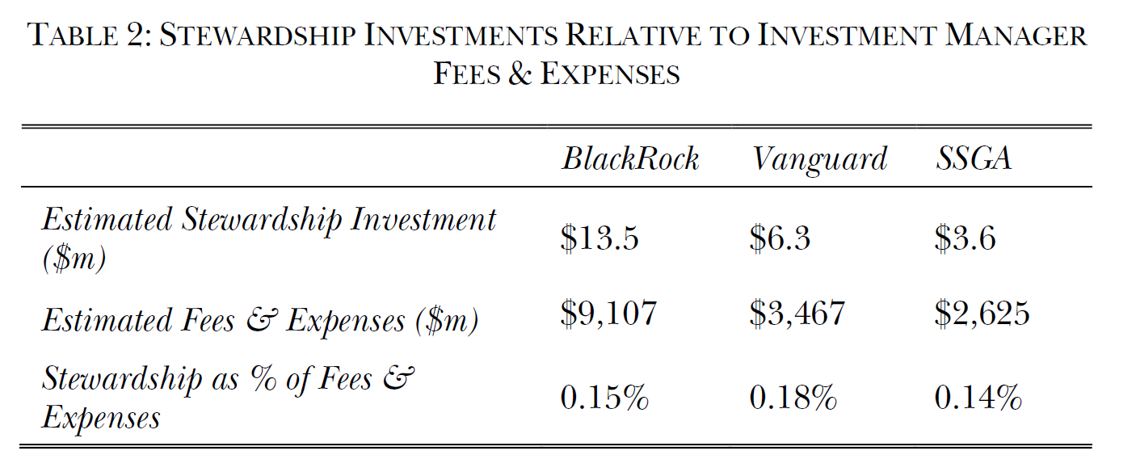
Fund structure
Bebchuk and Hirst (2019)

Slide 26
Fund structure
Bebchuk and Hirst (2018): “Table 2 shows the estimated cost of each of the Big Three’s stewardship departments and that cost as a proportion of the estimated fees from managing these assets. As the Table shows, the estimated investment in stewardship by BlackRock is below $15 million, that of Vanguard is below $10 million, and that of SSGA is below $5 million. Importantly, all three stewardship budgets are less than one-fifth of 1% — only 0.2% — of the estimated fees that each of the Big Three charge for managing equity assets. Thus, although the Big Three stress the importance of stewardship, their stewardship budgets are economically insignificant relative to the fees that they charge.”

Slide 27
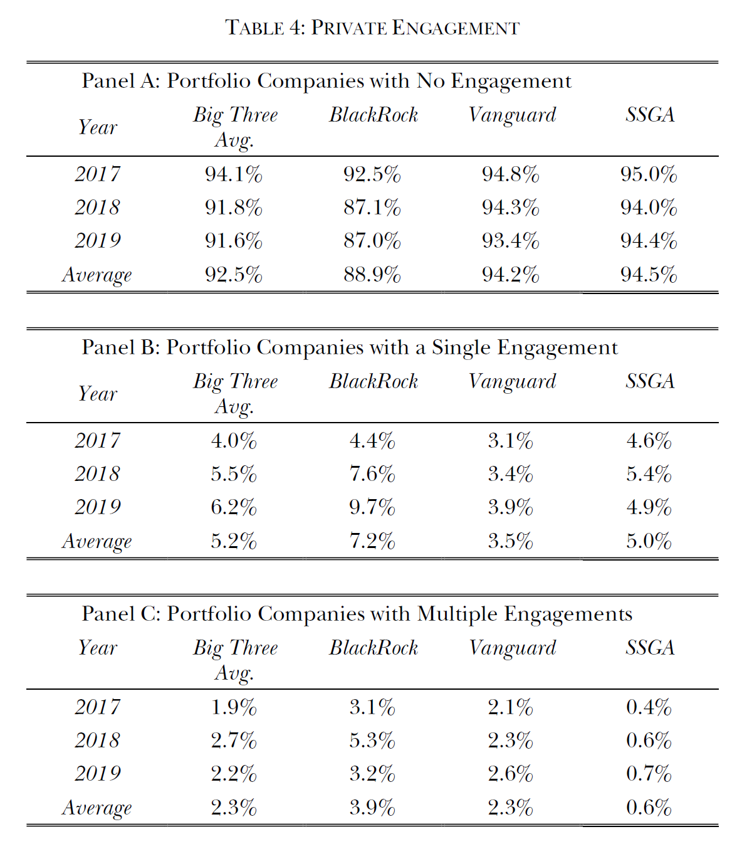
Fund structure
Bebchuk and Hirst (2019)

Slide 28
Fund structure
Bebchuk and Hirst (2018): “Table 4 reports our findings regarding the proportion of their portfolio companies with which each of the Big Three companies had engagements for each of the last three years, and the average for each of the Big Three over that period. Panel A of Table 4 shows the proportion of each of the Big Three’s portfolio companies with which it had no engagement in each of the last three years. From 2017 through 2019, the average proportion of portfolio companies with no engagement were 88.9% for BlackRock, 94.2% for Vanguard, and 94.5% for SSGA. Thus, on average, the Big Three had no engagement with 92.5% of their portfolio companies during the period from 2017 through 2019. Panel B of Table 4 reports the proportion of each of the Big Three’s portfolio companies in each year in with which it had a single engagement. During the period from 2017 through 2019, BlackRock had single engagements with an average of 7.2% of its portfolio companies, Vanguard 3.5%, and SSGA 5.0%. On average, over this period, the Big Three held single engagements in a given year with 5.2% of their portfolio companies on average. Panel C of Table 4 shows the proportion of companies in the portfolios of each of the Big Three with which they had multiple engagements in a particular year. From 2017 through2019, BlackRock had multiple engagements with an average of 3.9% of its portfolio companies, Vanguard 2.3%, and SSGA0.6%.On average, the Big Three had multiple engagements with only 2.3% of their portfolio companies over this period. Thus, the Big Three engage with only a small minority of their portfolio companies, and have multiple engagements in a given year with an even smaller minority of companies in their portfolios. “

Slide 29
Fund structure
Beyond the intuition provided by these scholars corporate and securities laws also impose obligations on funds managers to act/not act in certain ways:
The investment adviser to a mutual fund is a fiduciary that owes the fund a duty of "utmost good faith, and full and fair disclosure." This fiduciary duty extends to all functions undertaken on the fund's behalf, including the voting of proxies relating to the fund's portfolio securities.
Most investment funds are required to vote at shareholder meetings on director elections and management and shareholder proposals, and to have an internal process for making voting decisions. Thus, not voting, or voting in a patently uninformed manner, is not an option for investment managers (c.f. Retail Investing as per Brav et al. (2022)).
Due to these reasons, Morley (2018) has argued that fund managers have incentives to engage in passive behaviour. In other words, they are “too big to be activist”.

Slide 30
Fund structure
Morley (2018): “The basic claim of this Article is that this fragmentation of ownership inside an investment management complex creates intense conflicts of interest over shareholder activism. Because a manager and each of its various funds have separate owners, the manager and each of its funds are separate sites of fiduciary duty. Activism can thus place a manager in an extremely difficult position. Activism often brings a manager's various funds into conflict with one another, damaging some of a manager's funds even as it helps others. Some of the conflicts over activism are economic. If a BlackRock hedge fund invests in a company's equity at the same time that a BlackRock mutual fund invests in the company's debt, then any attempt by either fund to influence the company's affairs will damage the interests of the other fund. Other conflicts are legal. Many legal rules have a tendency to combine an investment manager and its various funds into a single unit for purposes of the law. Those kinds of rules include... section 13(d) of the Securities Exchange Act... Activism by one fund can thus do grave legal damage to the other funds, even if the other funds remain passive.”

Slide 31
Fund structure
Example: section 13(d) [of the SEA] requires anyone who "beneficially own[s]" more than 5 percent of any class of a company's equity securities to file a report with the Securities and Exchange Commission within ten days after the acquirer crosses the 5 percent line.
  A 13(d) disclosure essentially shuts down "quiet acquisitions". Why?
  Morley (2018): "What makes a quiet acquisition so useful is that it offers an activist its best opportunity to buy shares at a low price before the public learns about the activist's plan and the price moves upward. Once the public knows the activism campaign is coming, the activist's opportunity to buy at a low price will disappear.”
  “The small investment managers who operate activist hedge funds often do things that count as control within this convoluted definition... Bigger managers, by contrast, almost never cross the threshold into 13d-1 control. Though they often vote in support of smaller managers' efforts at "control," they will almost never engage in control themselves.”

Slide 32
Common ownership
Up until now, we've presented some literature indicating that fund managers, particularly in the context of mutual funds, are motivated to maintain a passive approach.
  NB: There are a few scholars who disagree with these arguments – see Fisch et al. (2019)
The primary body of literature that articulates how institutional investors may retain significant incentives to participate in corporate governance originates from the research on common ownership.
What is common ownership?
  Khoo (2023): “Common Ownership, or “Horizontal Shareholding,” arises where shareholders hold substantial stakes in competing firms. a common owner has an incentive to modify a portfolio firm’s conduct so that the firm maximizes its portfolio profits as opposed to the firm’s individual profits. Essentially, a common owner has the unilateral incentive to internalize the pecuniary externality of a portfolio firm’s actions on rival firm profits within its portfolio, even in the absence of any collusion or communication between firms inter se.”

Slide 33
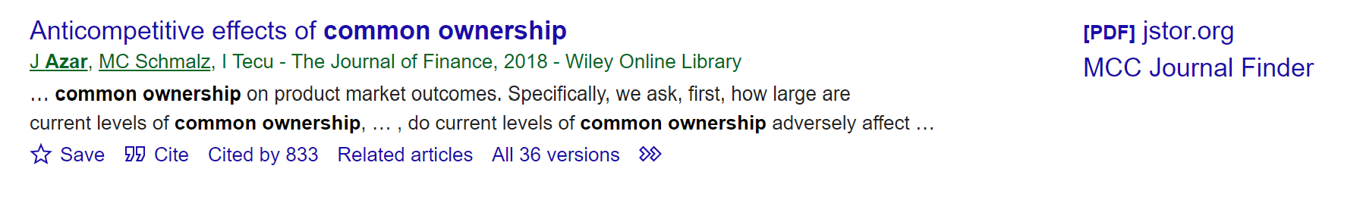
Common ownership
The common ownership hypothesis has attracted substantial debate. A seminal paper by Azar et al. (2018) noted how increases in common ownership concentration was associated with higher airline route-level prices.
  Since that time, the body of literature has considerably expanded, with numerous contributions from scholars across the world.

Slide 34
Common ownership
Azar et al. (2018)’s paper did not show how an increase in the level of common ownership (associated with the rise in institutional investing) would lead to an increase in product-level prices.
  Notably, the legal authority to determine prices is vested in the board of directors, not the body of shareholders (institutional or not).
  Khoo (2023): “there is generally no a priori reason why [the common ownership hypothesis] should be true. Indeed, a corporate governance scholar would be hard pressed to agree with such an assumption. Rather, she would point out that the managers (or the board of directors) of [the firm] would be ordinarily in charge of firm the firm’s day-to-day affairs. These issues would include, inter alia, the firm’s competitive conduct and strategy vis-à-vis its product market rivals. Any attempt at such a direct intervention by an activist shareholder would run into a board-friendly legal presumption of the “Business Judgement Rule.” On a related note, courts have struck down even modest attempts at including issues “significantly related to the company’s business” onto the management’s proxy statement for annual shareholder meetings”.
  What do you think?

Slide 35
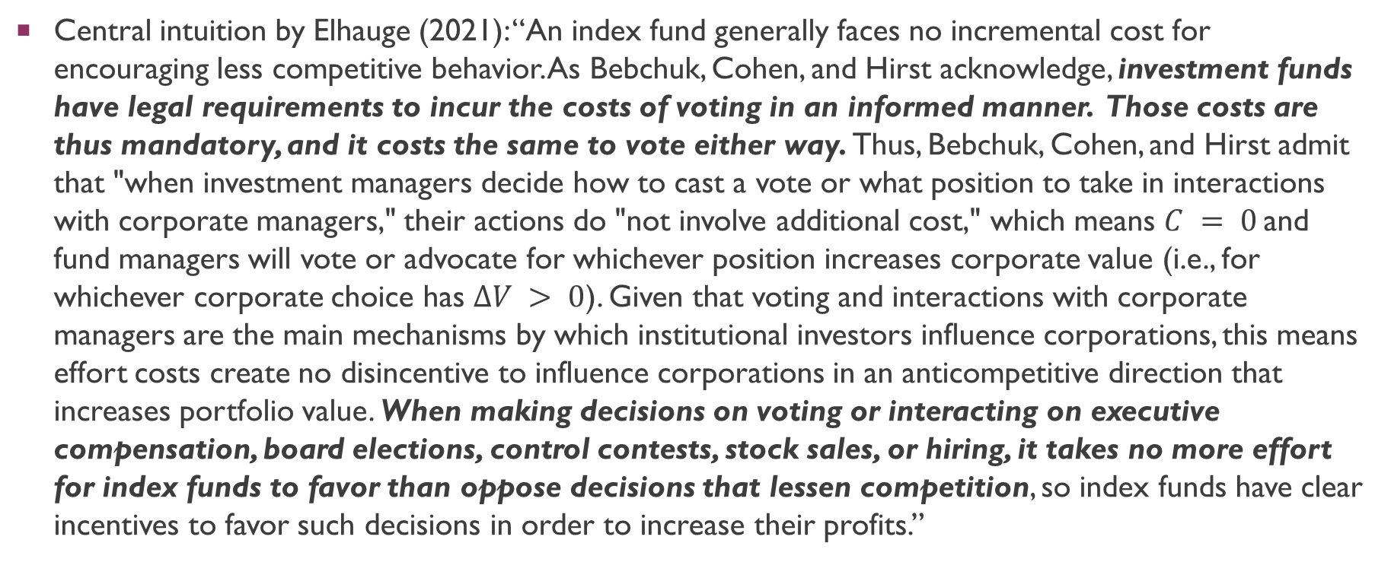
Common ownership
Central intuition by Elhauge (2021): “An index fund generally faces no incremental cost for encouraging less competitive behavior. As Bebchuk, Cohen, and Hirst acknowledge, investment funds have legal requirements to incur the costs of voting in an informed manner. Those costs are thus mandatory, and it costs the same to vote either way. Thus, Bebchuk, Cohen, and Hirst admit that "when investment managers decide how to cast a vote or what position to take in interactions with corporate managers," their actions do "not involve additional cost," which means $C = 0$and fund managers will vote or advocate for whichever position increases corporate value (i.e., for whichever corporate choice has $∆V > 0$). Given that voting and interactions with corporate managers are the main mechanisms by which institutional investors influence corporations, this means effort costs create no disincentive to influence corporations in an anticompetitive direction that increases portfolio value. When making decisions on voting or interacting on executive compensation, board elections, control contests, stock sales, or hiring, it takes no more effort for index funds to favor than oppose decisions that lessen competition, so index funds have clear incentives to favor such decisions in order to increase their profits.”

Slide 36
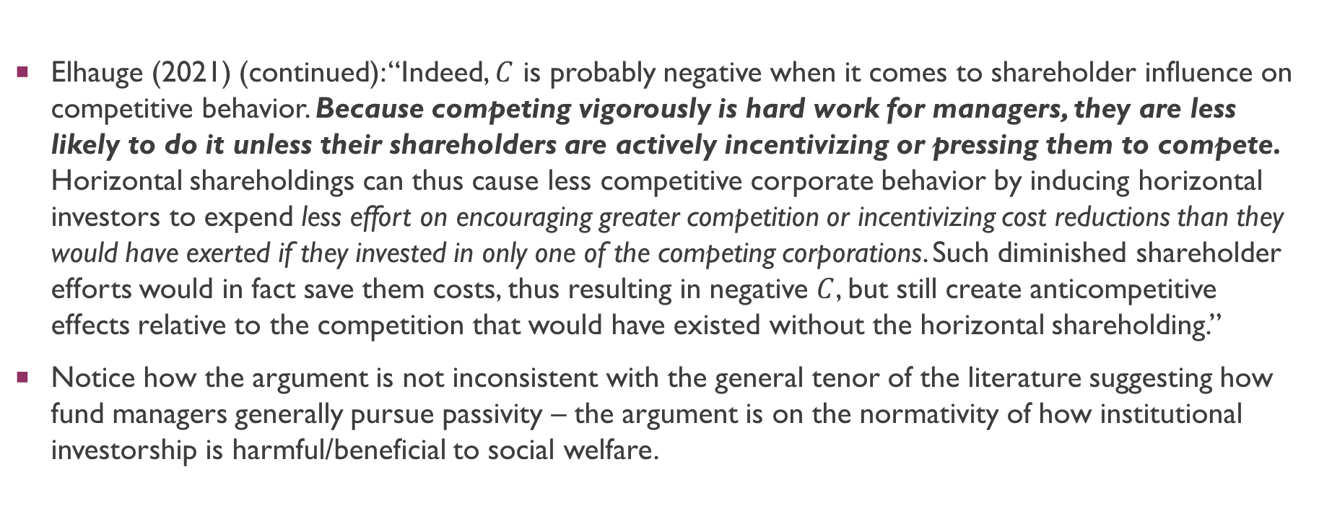
Common ownership
Elhauge (2021) (continued): “Indeed, $C$ is probably negative when it comes to shareholder influence on competitive behavior. Because competing vigorously is hard work for managers, they are less likely to do it unless their shareholders are actively incentivizing or pressing them to compete. Horizontal shareholdings can thus cause less competitive corporate behavior by inducing horizontal investors to expend less effort on encouraging greater competition or incentivizing cost reductions than they would have exerted if they invested in only one of the competing corporations. Such diminished shareholder efforts would in fact save them costs, thus resulting in negative $C$, but still create anticompetitive effects relative to the competition that would have existed without the horizontal shareholding.”
Notice how the argument is not inconsistent with the general tenor of the literature suggesting how fund managers generally pursue passivity – the argument is on the normativity of how institutional investorship is harmful/beneficial to social welfare.
Notes:
Note: Elhauge arguing negative C for institutional investors who aren’t forced to vote.

Slide 37
Common ownership
Anton et al. (2022): “Common owners are therefore more willing to tolerate managerial slack and productive inefficiency at their portfolio firms. The model thus predicts a negative relationship between common ownership and the sensitivity of top management incentives to firm performance. It also provides an explanation for the passivity of common owners who allow top managers to enjoy the quiet life.”

Slide 38
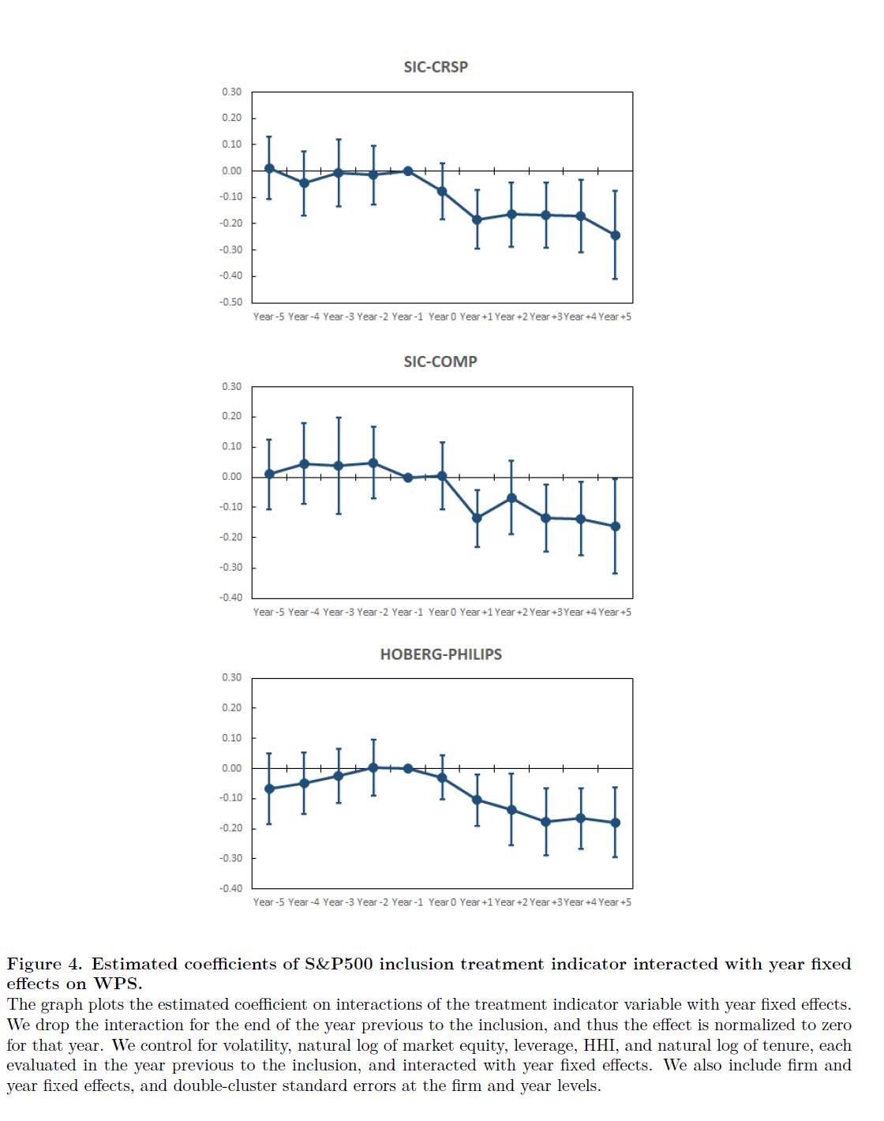
Common ownership
Anton et al. (2022)
Notes:
WPS: Wealth-Performance sensitivity: How sensitive is executive compensation of managers in relation to the performance/profitability of the firm.

Slide 39
stewardship
Katelouzou and Puchniak (2022): “In 2010, the United Kingdom hastily released the world’s first stewardship code (UK Code 2010) in response to the 2008 Global Financial Crisis (GFC).1 The UK Code 2010 was designed to cure what was perceived to be the UK’s primary corporate governance malady: rationally passive institutional investors in a country characterized by a dispersed ownership structure. It sought to achieve this by using a ‘soft’ law code to incentivize institutional investors – who own most of the shares in UK listed companies – to become actively engaged shareholder ‘stewards’.”
“In the 2010s, this bespoke solution to the UK’s ‘ownerless corporations’ problem went global. UK-style stewardship codes (in the broad sense) now exist in twenty jurisdictions, on six continents, and are embedded in a panoply of legal systems, shareholder markets and corporate cultures. In addition, stewardship codes have been developed at international and regional levels, making shareholder stewardship an international corporate law phenomenon”
Notes:
“Soft law” = comply or explain.

Slide 40
stewardship
Davies (2022): “The first version of the UK Code can be seen best as an adjunct to the [Corporate Governance Code]. Since its introduction in the wake of the Cadbury Committee Report of 1992, the CGC had been based on the model of a ‘monitoring’ board, as shown by the increasing emphasis over the various versions of that code on the role and functions of independent non-executive directors (NEDs). Their role was to ensure the loyalty of the executive management of the company to the shareholders’ interests, not only in the obvious sense of handling overt conflicts of interest but across the general management of the company. However, the Walker Review concluded in 2009 that, in the run-up to the GFC, NEDs had failed. Their performance was assessed as ‘seriously inadequate’. The Walker Review identified ‘above all the failure of individuals or of NEDs as a group to challenge the executive’.”

Slide 41
stewardship
Two subsequent versions on the Stewardship Code in the UK:
  First Version: Focused very much on engagement. “Engagement was clearly expected to be more than a reaction to problems which were already well developed, and would require continuous, close monitoring of the company’s development, at least at a high strategic level”
  Second Version: “Techniques of stewardship are now defined in a more expansive way, so that, although engagement is still given emphasis, it is only one among a number of available techniques: ‘Stewardship activities include investment decision-making, monitoring assets and service providers, engaging with issuers and holding them to account on material issues, collaborating with others, and exercising rights and responsibilities. In particular, buy and sell decisions (‘investment decisions’) are given apparently equal weight with engagement, so that monitoring may be done as much for this purpose as for engagement’”
NB: Notice the focus on exit vs voice.
Why would such “comply or explain” codes of “soft law” incentivize institutional investors to conduct themselves in a certain way?

Slide 42
stewardship
Why did the first version of the [Stewardship] Code fail?
Davies (2022): “the UK Code was concerned with changing behaviour directly, not via structural changes in the governance system. It aimed at both the behaviour of institutional investors as against investee companies and the behaviour of investee companies, for example in relation to their business strategies. However, the appropriate behavioural changes were inherently firm specific and fact-dependent, since the business models and environments of investee companies were many and various. Certainly, Principle 4 of the UK Code 2012 listed the tools available for engagement, for example voting on resolutions put forward by management at shareholder meetings, participating in private meetings with corporate management or the chair of the board, or proposing shareholder motions at general meetings to change policy or remove directors, and it required a commitment from shareholders and asset managers to use these tools, as and when appropriate. But the UK Code had little to say about the identification of the ‘as and when’. The appropriate occasions and the appropriate tools for particular occasions were not, and could not be, identified ex ante in the UK Code itself. The UK Code contained only high-level engagement recommendations, not specific ones equivalent to the structural recommendations of the CGC.”
Notes:
Not tailored/specific enough.

Slide 43
stewardship
Davies argues that “reputational incentives will operate more strongly in relation to the second version of the UK Code”.
  Details in the chapter uploaded on Canvas.
Davies (2022): “Will the second version of the UK Code be more successful than the first? It has been argued in this chapter that it is possible to construct a plausible argument in favour of a positive answer to this question, despite the bolder goals contained in the second version. This argument turns on the identification of a new and more forceful set of incentives for asset owners and managers to comply with the second version, together with a greater capacity to do so. The first version failed because engagement was not well aligned with the financial incentives and capacities generated by the business models of asset managers and asset owners. The second version, in addition to placing capital allocation decisions on par with engagement, creates a new set of incentives for compliance with the UK Code. Asset owners and managers, it is argued, will want to keep regulation at bay in order to protect their business models, and that will require doing enough in relation to ESG considerations to keep the government happy.”
  NB: Note the lengthy discussion on the various incentives of funds and fund managers involved.
Notes:
Political economy story here

Slide 44
Q&A
See you guys on Tue.

