Slide 1

Corporate law and economics (LL4489V/5489V/6489V)
8. ownership structures
LL4489V
Kenneth Khoo
kenneth.khoo@nus.edu.sg

Slide 2
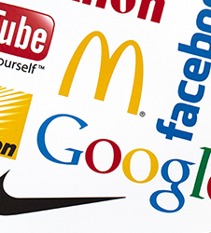
Institutional investors and stewardship
General Principles
Dual-Class Shares
State-Owned Enterprises
Family-Owned Firms

Slide 3
General principles
In Slide Deck 7, we discussed the idea that institutional investors might have distinct incentives when compared to the same incentives for shareholders who are natural persons.
In this seminar, we will examine two other types of unique investors who might also have incentives which are sui generis in nature: State-Owned Enterprises and Family-Owned Firms.
  Why would these investors have incentives which are distinct from institutional investors?
Furthermore, we will also discuss the incentives of shareholders in situations where there is an extreme separation of ownership from control.
  This is commonly implemented through the mechanism of dual-class shares, although pyramid structures are also used (Morck et al., 2005)
  NB: “Ownership” in this sense relates to the pecuniary ownership – i.e., the share capital contributed to the company by the controlling shareholder.
Notes:
What does “share capital” mean?

Slide 4
General principles
Recall Slide Decks 4 and 5 – shares are both contractual and proprietary in nature.
  Cambridge Gas Transport Corp v. Official Committee of Unsecured Creditors [2006] UKPC 26: “A share is the measure of the shareholder's interest in the company: a bundle of rights against the company and the other shareholders. As against the outside world, that bundle of rights is an item of property, a chose in action. But as between the shareholder and the company itself, the shareholder's rights may be varied or extinguished by the mechanisms provided by the articles of association or the Companies Act.”
Insofar as a shareholder’s contractual rights are concerned, most of them relate to the shareholder’s rights of control.
  What about a shareholder’s cash flow rights? Do they have a right to repayment of their share capital like that of (ordinary) debt holders?
  How are shareholders able to protect their returns on invested share capital?

Slide 5
General principles
Cash flow rights
Some types of preference shares
“One-share-one-vote”
1
Dual class shares
0
45º
Control rights
1
Notes:
Recall this diagram from Slide Deck 5.
One share one vote: proportionate control.

Slide 6
General principles
In a company with a dual-class share structure, one or more controlling shareholders can harness shares endowed with “special” voting privileges to secure a disproportionate level of control over the company.
  Example: Suppose that a company has 5,000 outstanding shares, and that the shares are issued at $100 each. Each ordinary share is associated with one vote, so a shareholder who wanted to gain control would have to invest at least $250,000 in the company. In contrast, a company with a dual-class share structure may issue up to 200 (additional) “special” shares at $100 each, but each share may be associated with 100 votes. Thus, a mere investment of $5000 (50 x $100) in 50 “special” shares is all that is required to gain control.
By design, the issuance of dual-class shares must be discriminatory in nature. How so?
  Why is the potential for controlling shareholder opportunism so salient here?

Slide 7
Dual class shares
Some stylized facts by Choi (2018): “In 2004, when Google was proposing to sell its stock to the public for the first time, the company adopted an unconventional ownership structure. The founders, Sergey Brin and Larry Page, together with CEO Eric Schmidt, would own Class B shares, which had ten votes per share, but the public was being offered to purchase Class A shares, which had only one vote per share. Given the number of Class A shares being offered, the effect was to give Brin, Page, and Schmidt, more than 66% of the voting rights even though they would own less than 32% of the outstanding stock.”
“Google's initial public offering seems to have changed the market's perception of dual class stock. Since 2004, other companies began to follow Google's footsteps and, by 2015, about 14 percent of all companies that went public have done so with a dual class structure. The list includes well-known companies, such as Facebook, Fitbit, Groupon, Linkedln, Shake Shack, Yelp, and Zynga. Most recently, in early 2017, Snap Inc., the parent company of a popular disappearing message application company Snapchat, has taken a step further by offering to sell to the public common stock with no votes, allowing the company's two founders to have complete control over the company”

Slide 8
Dual class shares
Some stylized facts by Choi (2018): “In 2004, when Google was proposing to sell its stock to the public for the first time, the company adopted an unconventional ownership structure. The founders, Sergey Brin and Larry Page, together with CEO Eric Schmidt, would own Class B shares, which had ten votes per share, but the public was being offered to purchase Class A shares, which had only one vote per share. Given the number of Class A shares being offered, the effect was to give Brin, Page, and Schmidt, more than 66% of the voting rights even though they would own less than 32% of the outstanding stock.”
“Google's initial public offering seems to have changed the market's perception of dual class stock. Since 2004, other companies began to follow Google's footsteps and, by 2015, about 14 percent of all companies that went public have done so with a dual class structure. The list includes well-known companies, such as Facebook, Fitbit, Groupon, Linkedln, Shake Shack, Yelp, and Zynga. Most recently, in early 2017, Snap Inc., the parent company of a popular disappearing message application company Snapchat, has taken a step further by offering to sell to the public common stock with no votes, allowing the company's two founders to have complete control over the company”

Slide 9
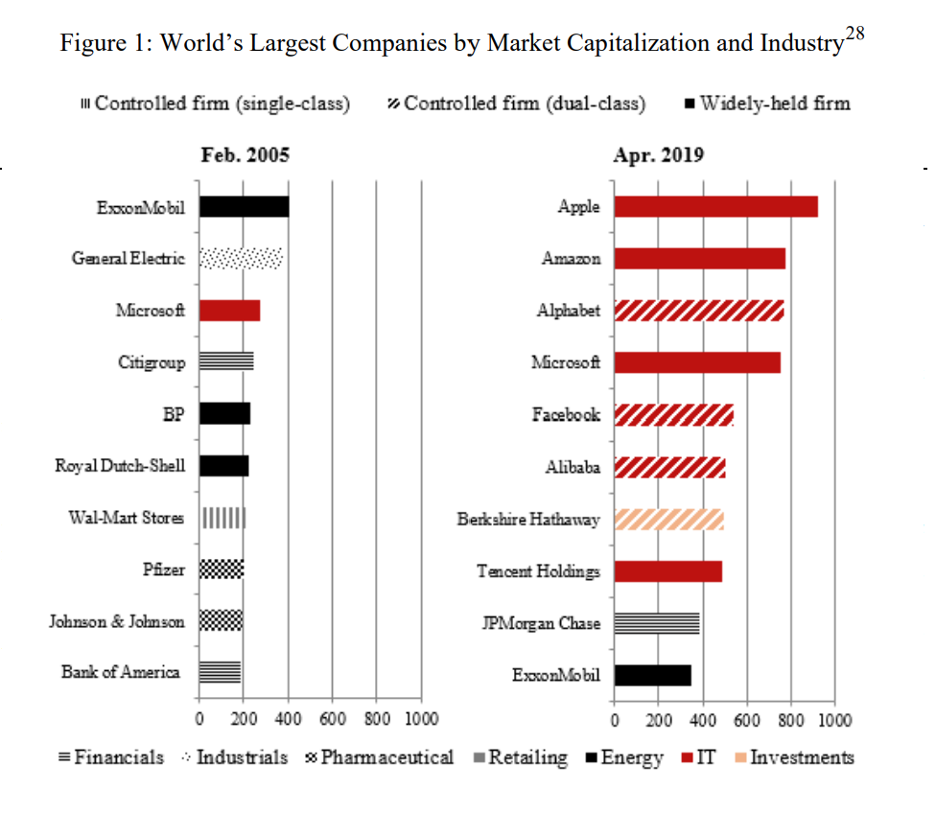
Dual class shares
Pargendler (2020): “While the largest companies of yesterday mostly had dispersed ownership structures, they now frequently boast controlling shareholders. In fact, these are often controlling minority shareholders through the use of dual-class structures, which amplify agency costs. As portrayed in [the Figure], the list of the world’s largest firms by market capitalization in 2005 included only one tech company (Microsoft) and one controlled company under a single-class structure (Walmart). By 2019, seven of the world’s largest firms were in the tech sector (Apple, Amazon, Alphabet, Microsoft, Facebook, Alibaba, and Tencent Holdings) and four were controlled companies with dual-class shares (Alphabet, Facebook, Alibaba, and Berkshire Hathaway). Moreover, Amazon is a borderline case, with founder Jeff Bezos holding a sizable equity stake and outsize influence in the company…”

Slide 10
Dual class shares
What about Singapore?
Lee (2019): “Historically, the principle of [one-share-one-vote] was firmly entrenched in Singapore. Section 64 of the Companies Act made clear that a public company and its subsidiaries (other than a newspaper company) may only issue equity shares that confer upon its holder one vote per share.”
“In 2003, this rule was relaxed to allow private companies that are subsidiaries of public companies to issue shares with multiple, limited, or no voting rights... However, the same extension was deemed inappropriate for public companies. Allowing a public company to issue shares with multiple or no voting rights would result in the concentration of control in the hands of a few without commensurate economic investments. Such an outcome would run counter to the fundamental precept of shareholder democracy, the cornerstone of good governance…”

Slide 11
Dual class shares
What about Singapore?
Lee (2018): “By 2011, however, regulatory attitude had shifted owing to concerns that insistence on the one share per vote principle might render Singapore uncompetitive as a destination for IPOs. The trigger for this turnaround is often traced to Manchester United’s aborted plans to list on the Singapore Exchange (“SGX”) on account of the latter’s ban of dual class share structures. In a report issued by the Steering Committee for the Review of the Companies Act, the committee recommended abolishing the one-share-one-vote structure to allow public companies greater flexibility in capital management. Acting on this recommendation, the Singapore Parliament amended s 64 of the Act in 2014 to clarify that the one-share-one-vote principle is only a default rule which may be displaced by contrary provisions in the company’s constitution. Following this amendment, public companies became free to adopt dual class share structures.”
In 2018/2019: SGX adopted listing framework for DCS structures. See https://rulebook.sgx.com/sites/default/files/net_file_store/SGX_Mainboard_Rules_June_26_2018.pdf

Slide 12

Dual class shares
Why the paradigm shift? Like almost every other area of corporate law/governance, dual-class share structures are associated with both benefits and costs.
  Costs: Dual-class share structures exacerbate the effects of controlling shareholder opportunism, and all of the deleterious effects associated with such opportunism (will be revisited in Slide Deck 12).
  Benefits: Dual-class share structures may incentivize:
    More firm-specific investments by the controlling shareholder (Rajan and Zingales, 1999), and
    Allows the controlling shareholder to commit to long-term profitability, in contrast to yielding to short-term market pressures (Choi, 2018).
There are many other (plausible) reasons, but we will focus on these two forms of benefits.

Slide 13
Dual class shares
More on (1) (i.e., the costs): Recall Slide Deck 7. Like institutional investors, one can observe that in contrast to the the typical controlling shareholder, a controller with dual-class shares has very little “skin in the game”. Why so?
  This raises all of the problems we discussed with the controller’s low-powered incentives: because the controller is largely relying on “other peoples’ monies”, there is always the strong temptation to engage in opportunism vis-à-vis other minority shareholders.
  This provides one possible explanation for why dual-class share structures are seen in certain types of industries (e.g., the tech industry) where the “long-term vision and control” of the entrepreneurial founders is particularly important. In these special circumstances, the benefits of a DCS structure outweighs its costs.
  Beyond the related benefits (see Slide 12), these entrepreneurs may also be motivated by intrinsic incentives (see Kraakman et al. 2017) rather than extrinsic/pecuniary based incentives.

Slide 14

Dual class shares
Back to our Google Example by Choi (2018): “When the potential investors expressed concern over giving so little control right to the public, the founders wrote and circulated a lengthy letter, titled "Letter from the Founders."' The letter emphasized that giving uncontested control to the founders under the dual class structure would allow the company to focus on the "long-term" goals and to maximize the "long-term" interests of the shareholders. While it is unclear how much effect the letter had in assuaging the investors' concerns, the company successfully sold its Class A shares and raised more than $1.67 billion.”
But how can we be certain that these were not mere hollow promises?
  Choi (2018): “It turns out that companies with controlling shareholders are often quite successful. Companies such as BMW, Ikea, Fiat, Lego, LVMH, and Samsung as well as companies like Amazon, Facebook, and Google excel in offering products and services that are well-received by consumers and generate healthy cash flows and profits for their shareholders. All of these companies have a shareholder (or a small group of shareholders) with de facto or de jure control.”
  What is happening here? Recall that the DCS regime is a voluntary enterprise.

Slide 15
Dual class shares
From the minority shareholder’s perspective, the DCS structure might be optimal if the controlling shareholder’s relationship/firm-specific investments are particularly important (Rajan and Zingales, 1999), or if the controlling shareholder is able to credibly commit to not act opportunistically vis-à-vis the minority shareholders given his/her disproportionate control (Choi, 2018).
One way by which the minority shareholder might be able to discern this credible commitment is via an observation of whether the controlling shareholder’s incentives are aligned with that of the company’s long-term success.
  If this is indeed the case, then it may be optimal for the minority shareholders to accept the DCS structure since the controlling shareholder would lack incentives to act opportunistically.

Slide 16
Dual class shares
Choi (2018): “There are two incentive challenges that the controlling shareholder and the firm face: short-term incentive alignment and long-term commitment. In terms of incentive alignment, a controlling shareholder must retain enough ownership shares (or enough "skin in the game") to have the necessary incentive to maximize the firm's bottom line. A strong incentive alignment also leads to a reduction in private benefits of control. If a substantial fraction of a controlling shareholder's return is based on private benefits that are insensitive to the firm's earnings, she will care less about improving the firm's performance. On the flip side, however, when the controlling shareholder's return comprises consists mostly of financial returns and little or no private benefits, it becomes easier for her to sever her relationship with the firm by either liquidating her position through the financial market or by selling her control block to a third party, possibly for a handsome profit. Such exit options reduce the controlling shareholder's incentive to stay with the firm and invest for the long-term. When more of her return is based on non-transferrable private benefits of control, severing her relationship with the firm implies losing all future private benefits. Unless she receives a large premium for her control block… , she will be unable to capture the value of future private benefits. In short, the larger the private benefits of control, the more likely that the controller will be locked in with the firm for the long-term and care about the firm's long-run performance… When these two challenges point in opposite directions, there will often be an optimal level of ownership share and amount of private benefits of control that the controlling shareholder extracts in maximizing the long-term value of the firm.”

Slide 17
Dual class shares
Choi (2018): “Foremost, the tradeoff between monetary incentive alignment and long-term commitment will be most relevant in industries where investment is not easily observable, the realized quality is difficult to verify, or legal enforcement mechanisms, particularly in the product market, are weak. This roughly corresponds foremost to new industries where the underlying technology and the relevant investment are not readily visible to the investors and the consumers, and the final product or service quality is difficult to gauge. For instance, when a computer software company comes up with a new computer algorithm, it will be difficult for the consumers to understand whether the company is making the right type of investment in improving the software program or to verify the quality of the product. With the lack of visibility, if the controlling shareholder lacks the long-term commitment, it may be tempting for the controlling shareholder to deviate by reducing short-term investment and liquidating her position through the market or third-party sale. Similarly, in developing economies with weak legal protection for consumers, reputational sanctions will play an important role. This will, in turn, heighten the importance of binding the controlling shareholder to the firm for the long-run.”
Rough intuition: If we are investing in a high-risk “growth” company with a highly opaque “road to profitability”, we want to ensure that the controlling shareholder is bonded to the firm for the long-run – an incentive structure promoted by relatively strong control rights and weak cash flow rights (essentially what DCS replicates).

Slide 18
Dual class shares
As the DCS structure relies heavily on the nature of the controlling shareholders’ non-transferable private benefits of control, one might question what these “private benefits of control” are.
Goshen and Hamdani (2016): “In our framework, both investors and entrepreneurs value control, but for different reasons. The entrepreneur wants to retain control over management decisions to pursue her idiosyncratic vision for producing above market returns. That is, control enables entrepreneurs to capture the value that they attach to the execution of their idiosyncratic vision. Investors, by contrast, value control because it allows them to minimize agency costs.”
  Q: Why is this distinction crucial, and why is the notion of “idiosyncratic vision” closely tied to the concept of “private benefits of control”?

Slide 19
Dual class shares
Example provided by Goshen and Hamdani (2016): “Henry Ford’s story illustrates our theory well. Ford did not invent the automobile, nor did he own any valuable intellectual property in the technology. He was competing with hundreds of other entrepreneurs attempting to create a “horseless carriage.” Ford, however, had a unique vision regarding car production. The Detroit Automobile Company, the first firm that he founded, was controlled by investors. While investors demanded that cars be immediately produced and sold, Ford insisted on perfecting the design prior to production, leading to delays and frustration on both sides. The tension eventually led investors to shut down the firm. Ford’s second attempt, the Henry Ford Company, was also controlled by investors. Again, after designing a car, Ford resisted the investors’ pressure to move directly into production. Ultimately, Ford’s obstinacy prompted investors to replace him with Henry Leland, who changed the company’s name to the Cadillac Automobile Company and successfully produced the car that Ford had designed. In Ford’s third attempt—the Ford Motor Company—he insisted on retaining control. This time, with no outside-investor interference, Ford transformed his innovative ideas for car design and production into one of the greatest corporate success stories of all time.”

Slide 20

Dual class shares

Slide 21
Dual class shares
While one might see how voluntary DCS structures might be suitable for certain corporations, questions remain as to whether the DCS capital structure is an efficient one for all time.
  Recall that unlike natural persons, corporations survive in perpetuity!
Bebchuk and Kastiel (2017): “Our analysis demonstrates that the potential advantages of dual-class structures (such as those resulting from founders' superior leadership skills) tend to recede, and the potential costs tend to rise, as time passes from the IPO. Furthermore, we show that controllers have perverse incentives to retain dual-class structures even when those structures become inefficient over time. Accordingly, even those who believe that dual-class structures are in many cases efficient at the time of the IPO should recognize the substantial risk that their efficiency may decline and disappear over time. Going forward, the debate should focus on the permissibility of finite-term dual-class structures – that is, structures that sunset after a fixed period of time (such as ten or fifteen years) unless their extension is approved by shareholders unaffiliated with the controller.”
  Finite dual-class structures are thus known in the literature as “sunset provisions”.

Slide 22
Dual class shares
Bebchuk and Kastiel (2017): “Public investors may be content with having Spiegel and Murphy securely at the helm in the years following Snap's initial public offering ("IPO"). After all, Spiegel and Murphy might be viewed by investors as responsible for the creation and success of a company that went public at a valuation of nearly $24 billion. However, even if the Snap cofounders have unique talents and vision that make them by far the best individuals to lead the company in 2017 and the subsequent several years, it is hardly certain that they would continue to be fitting leaders down the road. The tech environment is highly dynamic, with disruptive innovations and a quick pace of change, and once-successful founders could well lose their golden touch after many years of leading their companies. Thus, an individual who is an excellent leader in 2017 might become an ill-fitting or even disastrous choice for making key decisions in 2037, 2047, or 2057. Accordingly, as the time since Snap's IPO grows, so does the risk that Snap' s capital structure, and the cofounders' resulting lock on control, will generate costly governance problems.”
“…we disfavor the use of dual-class structures altogether. However, to the extent that companies are permitted to go public with a dual-class structure, our analysis calls for including an adequate sunset provision. Absent a sunset provision, the lifecycle of a dual-class structure is perpetual, and this infinite duration is likely to create growing risks and costs over time.”

Slide 23

Dual class shares
Different forms of “sunset-provisions”: Fixed-time sunsets, triggering-event sunsets, and ownership-percentage sunsets.
  Bebchuk and Kastiel (2017): “Some companies, including Linkedln and Zynga, have recently adopted a sunset clause triggered by crossing a certain ownership percentage. An ownership-percentage sunset converts the high-vote shares held by the founders into common stock when they represent less than a certain predetermined percentage of the total number of all common shares outstanding.”

Slide 24
Dual class shares
What about their implementation? See Fisch and Solomon (2019): “There is nothing inherently problematic about issuer-specific variation in the sunset length. Theoretically, each firm should be picking the time period best suited to its founder. But there is no evidence that this is the case. Rather, the sunset lengths chosen by individual firms do not appear to be tied to characteristics of the firms and their founders. For example, Workday went public in 2012 with a twenty-year sunset provision. At the time of its IPO, its founders were seventy-one and forty-six years old, meaning that they will be ninety-one and sixty-six when the sunset is triggered. More problematic than the variation is the fact that the length of the sunset period appears to be arbitrary and does not seem to correlate with any theory about the length of time necessary for a founder to implement his or her vision. If a founder’s strategic vision is flawed or the founder is otherwise inclined to exploit private benefits, the insulation conferred by even a relatively short sunset may be unwarranted. Commentators have noted, for example, that many dual class issuers struggle financially even in the first few years after their IPO, suggesting that, at least for these companies, a five or seven year sunset is much too long. On the other hand, the benefits from the founder’s innovative vision need not be limited to the initial years following the IPO.”
  I.e., Are fixed-time sunsets are both over and under-inclusive?

Slide 25

Dual class shares
Kim and Michaely (2019) provide evidence for Bebchuk and Kastiel (2017)’s thesis: “Using a new dataset of corporate voting-rights from 1971 to 2015, we find that young dual-class firms trade at a premium and operate at least as efficiently as young single-class firms. As dual-class firms mature, their valuation declines, and they become less efficient in their margins, innovation, and labor productivity compared to their single-class counterparts…”

Slide 26
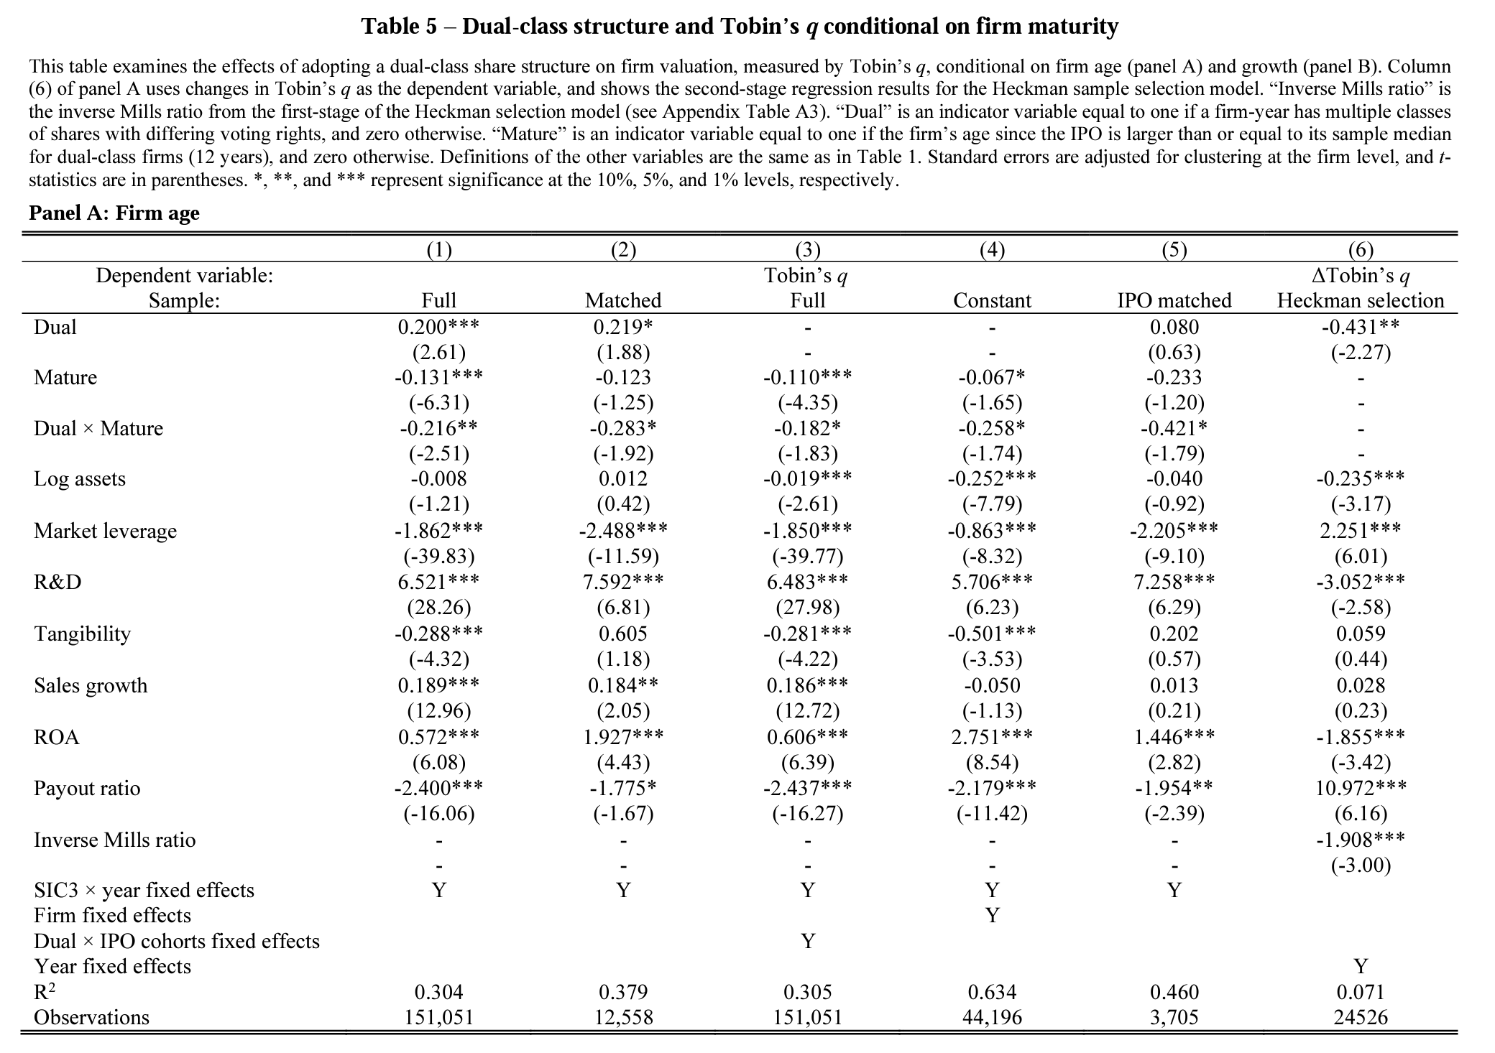
Dual class shares

Slide 27
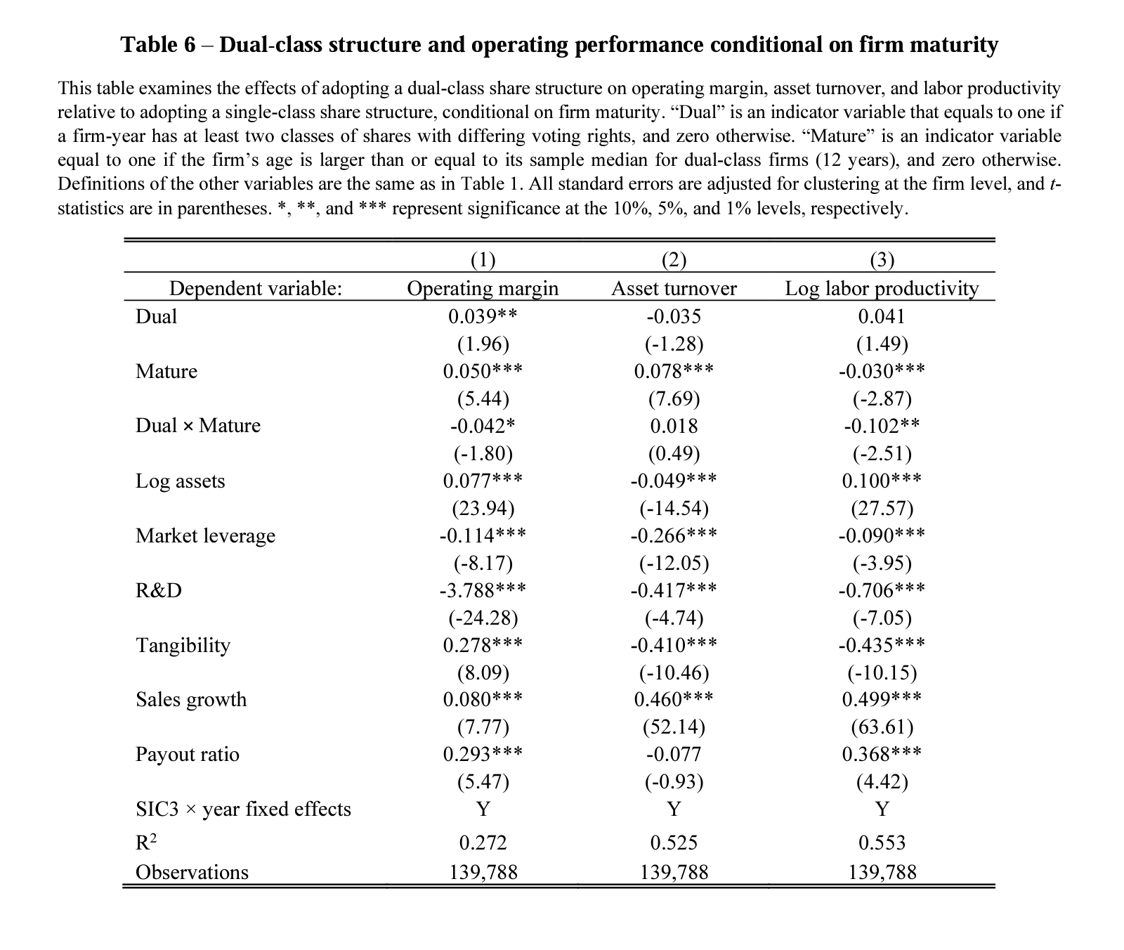
Dual class shares

Slide 28
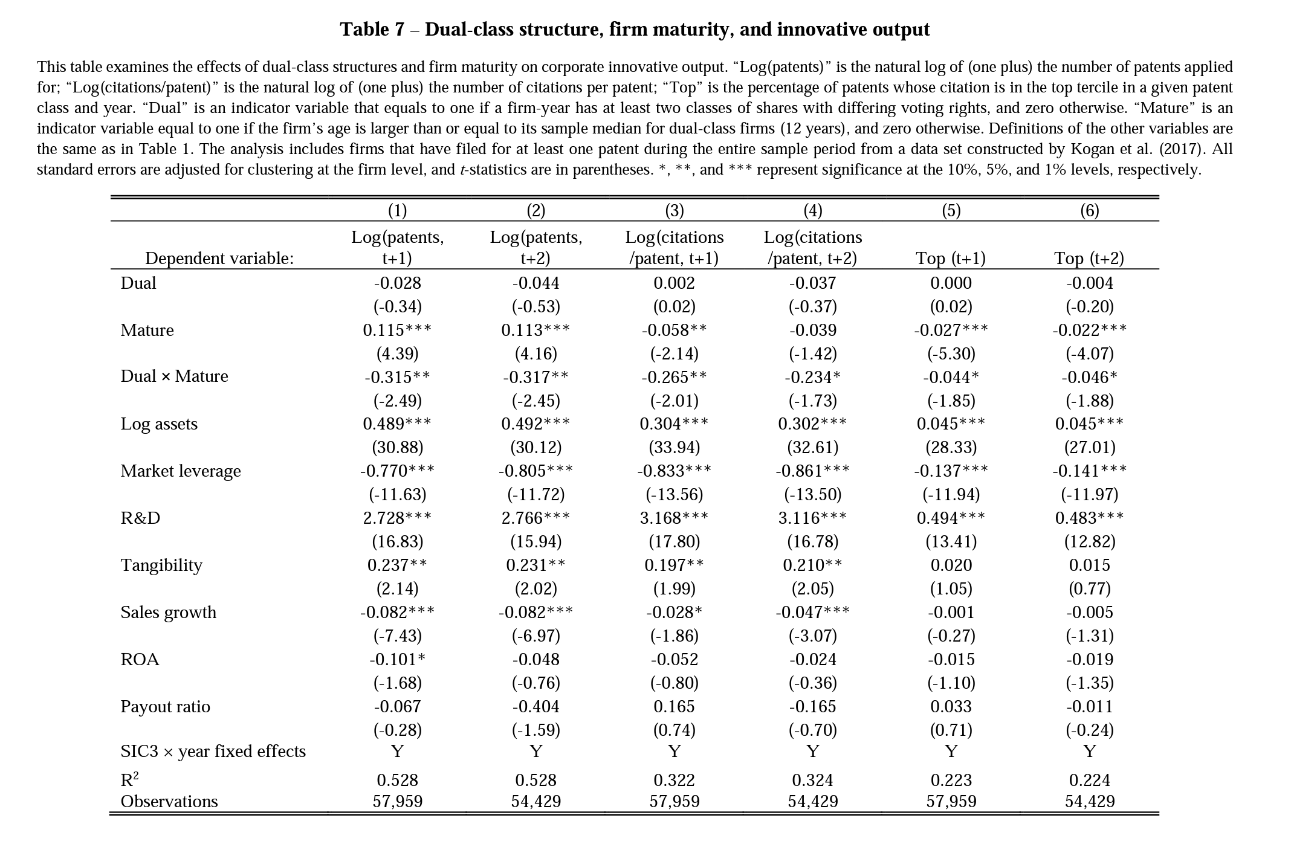
Dual class shares

Slide 29
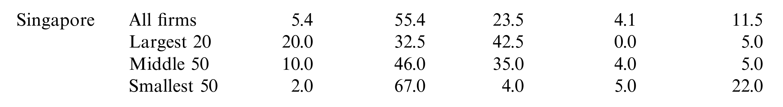
State-owned enterprises
Next, we will turn our attention to State-Owned Enterprises (“SOEs”), where the state is a major or controlling shareholder.
  Why are SOEs special? Milhaupt and Pargendler (2017): ““The state” is a distinctive type of owner. State ownership creates its own agency problems, which are caused by the separation of the politicians and bureaucrats who oversee SOEs from “the citizens” on whose behalf the enterprises are ostensibly owned.”
  Some stylized facts: As of 2010, SOEs accounted for about 20% of world market capitalization.
  SOEs play a major role in Singapore’s larger economy – about 23.5% of all firms are SOEs (Claessens et al., 2000 – see 3rd column in Figure below).

Slide 30
State owned enterprises
Kraakman et al. (2017): “[Where] state-owned enterprises (SOEs) embrace the corporate form, [they permit] the government to share ownership with private investors. Because the state is seldom, if ever, a typical financial investor, state ownership entails a degree of heterogeneity in the shareholder base that exceeds that of the typical investor-owned firm, with potential for unique conflicts of interest.”
  Although we have referred to the heterogenous objectives of various shareholders, the traditional view of shareholders is one which considers them to have relatively homogenous objectives. Why would this be the case? In contrast, what would the objective of the state be?
“By exercising appointment and voting rights through its role as shareholder, the state may steer the firm to achieve political objectives, even at the expense of financial returns. State-owned enterprises (SOEs) are usually subject to the same corporate law regime applicable to private firms, which generally affords the state as controlling shareholder wide discretion to pursue public goals.”
  How might these political objectives be distinct from that the goals of investor-owned companies?

Slide 31
State owned enterprises
Mueller (2003) [on the objectives of political bureaucrats]: “In the modern corporation, the information gatherers and processors of information are the managers. They are the possessors of power. A major difference between the business corporation and the public bureau is that the power of managers can be monetarized. The business of corporations is making profits, and managers as information gatherers are its main recipients. Legally, however, corporations belong to the stockholders [Q: is this correct?], and the custom persists that they are the rightful recipients of corporate profits. Thus, managers are unable to pay themselves all the profits they create. They are forced to claim corporate profits in less conspicuous ways than simply salaries and cash bonuses. Numerous substitute goals have been put forward: on-the-job consumption, excess staff and emoluments (Williamson, 1964), security (Fisher and Hall, 1969; Amihud and Lev, 1981), and a host of nonpecuniary goals… Many of the nonpecuniary goals of managers are likely to be correlated with the size or growth in size of the corporation (Baumol, 1959; Marris, 1964, ch. 2). The pursuit of profits is not the perceived legitimate goal of public bureaus, and thus it is even more difficult for public bureaucrats to convert the power they have into income. The nonpecuniary goals of management become the logical objectives of the public bureaucrat. Among these, size and risk aversion have received the most attention.”

Slide 32
State owned enterprises
Pargendler (2011): “[The] government control of business corporations can have unintended consequences well beyond potential firm mismanagement if the state pursues political goals inconsistent with shareholder wealth maximization—the concern that dominates the large literature on the relative merits of public and private ownership. An important, but so far overlooked, byproduct of government ownership stems from the conflict of interest inherent in the state’s dual role as shareholder and corporate governance regulator. There is now a vast body of empirical literature underscoring the importance of legal investor protection to the development of capital markets around the world. In particular, these works show a strong correlation among low levels of protection for minority shareholders, highly concentrated corporate control in the hands of the state and wealthy families, and underdeveloped capital markets. That is, where the state is a controlling shareholder of major business corporations, its interests as controller may come to dictate the content of general corporate laws to the detriment of both outside investor protection and efficiency.”
  Since the state supplies the rules concerning corporate governance, does it also have the incentives to shape the rules in a certain way so as to favour itself? “Rules for thee, but not for me” intuition!

Slide 33
State owned enterprises
Pargendler (2011): “Various factors render the political economy of corporate law reforms particularly favorable to the interests of the government as controlling shareholder. Not only does the state have a natural and unmatched proximity to the lawmaking process—and is hence uniquely positioned to influence its outcomes—but legal rules that favor the interests of the state as a shareholder over those of outside investors are often politically popular. For example, even the most financially developed jurisdictions have far more taxpayers than shareholders in publicly traded firms. If ordinary citizens are often sympathetic to the state’s interests as a shareholder, controlling families are even more so. In a system of concentrated corporate ownership, collective action problems allow controlling families to exercise disproportionate influence on legislative outcomes, stifling the enactment of investor protection laws. As a result, many citizens may come to favor legal rules that privilege the interests of the state as a controlling shareholder over those of minority (and often foreign) investors.”
  Q: In democracies, who dictates/shapes the state’s interests? Do these minority (and often foreign) investors play a role in shaping the state’s interests? Why is this a problem for corporate governance?

Slide 34
State owned enterprises
Some food for thought: Thus far, we have discussed the inherent conflicts of interests between the state as a supplier of corporate governance and a consumer of it (as shareholder) (Pargendler, 2011; Lim, 2022).
Furthermore, “influence-peddling” bureaucrats might be driven by the incentives to maximize their power/influence, instead of the purported objectives of state officials with political legitimacy (Mueller, 2003).
  In the political science/public choice literature, it is often said that bureaucrats face “soft budget constraints”. This is not a desirable phenomenon!

Slide 35
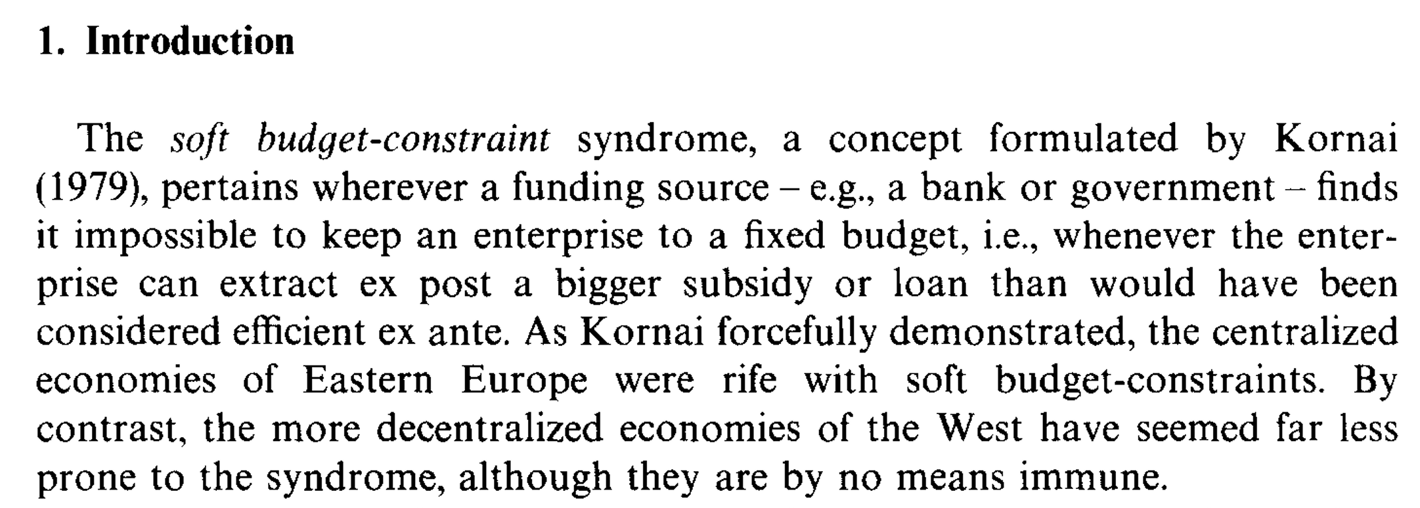
State owned enterprises
Maskin (1996)

Slide 36
State owned enterprises
However, the state is not a monolithic entity – it is an amalgamation of a plethora of stakeholders with (very) diverse interests and values.
  Hence, insofar as external stakeholders are concerned, the state can play a crucial role in steering the corporation toward a more pluralistic, diverse and inclusive outcome (Kraakman et al, 2017), in contrast to investor-led firms where the shareholder base tends to focus on pecuniary motivations. Is this desirable? We will turn to this in our discussion on “ESG and Stakeholderism” next week.
  Furthermore, the state does not seem to suffer the endemic free-riding problems which we have observed in our earlier seminars (e.g., in Seminars 4 and 7). Why is this so?
Before we turn to some applications, let us consider why private investors would countenance the presence of a SOE as a major/controlling shareholder. Such an ownership structure is often termed a structure of “mixed ownership”.

Slide 37
State owned enterprises
Pargendler et al. (2013): “The coexistence of government and private stockholdings in business corporations is puzzling and has long baffled observers. The potential for conflicts of interest between private and government shareholders is evident: while private investors presumably seek to maximize the financial returns on their stock, the government also has political objectives to fulfill—be they either benign (serving the public good) or malign (the product of rent-seeking). This tension has at times seemed intractable. In the mid-twentieth century, prominent French jurist George Ripert expressed a somber view of the conflicts inherent in mixed enterprises; the law, he argued, could not possibly manage to reconcile what is irreconcilable.”
“Yet, defying predictions, this strange combination of state and private capital has not only persisted but also appears to thrive. China’s blueprint for economic modernization has included the massive floating of minority stock in government-owned firms on local and foreign stock exchanges. In 2008, following a combination of the global financial crisis and high oil prices, listed state-owned firms from emerging markets came to account for five out of the top ten firms in the world by market value. Just four years before, SOEs were missing entirely from that list, which then was comprised solely of private firms headquartered in the U.S. and Europe.”
Pargendler et al. (2013) argue that the presence of “mixed-ownership” arguably offers “the best of both worlds”…

Slide 38
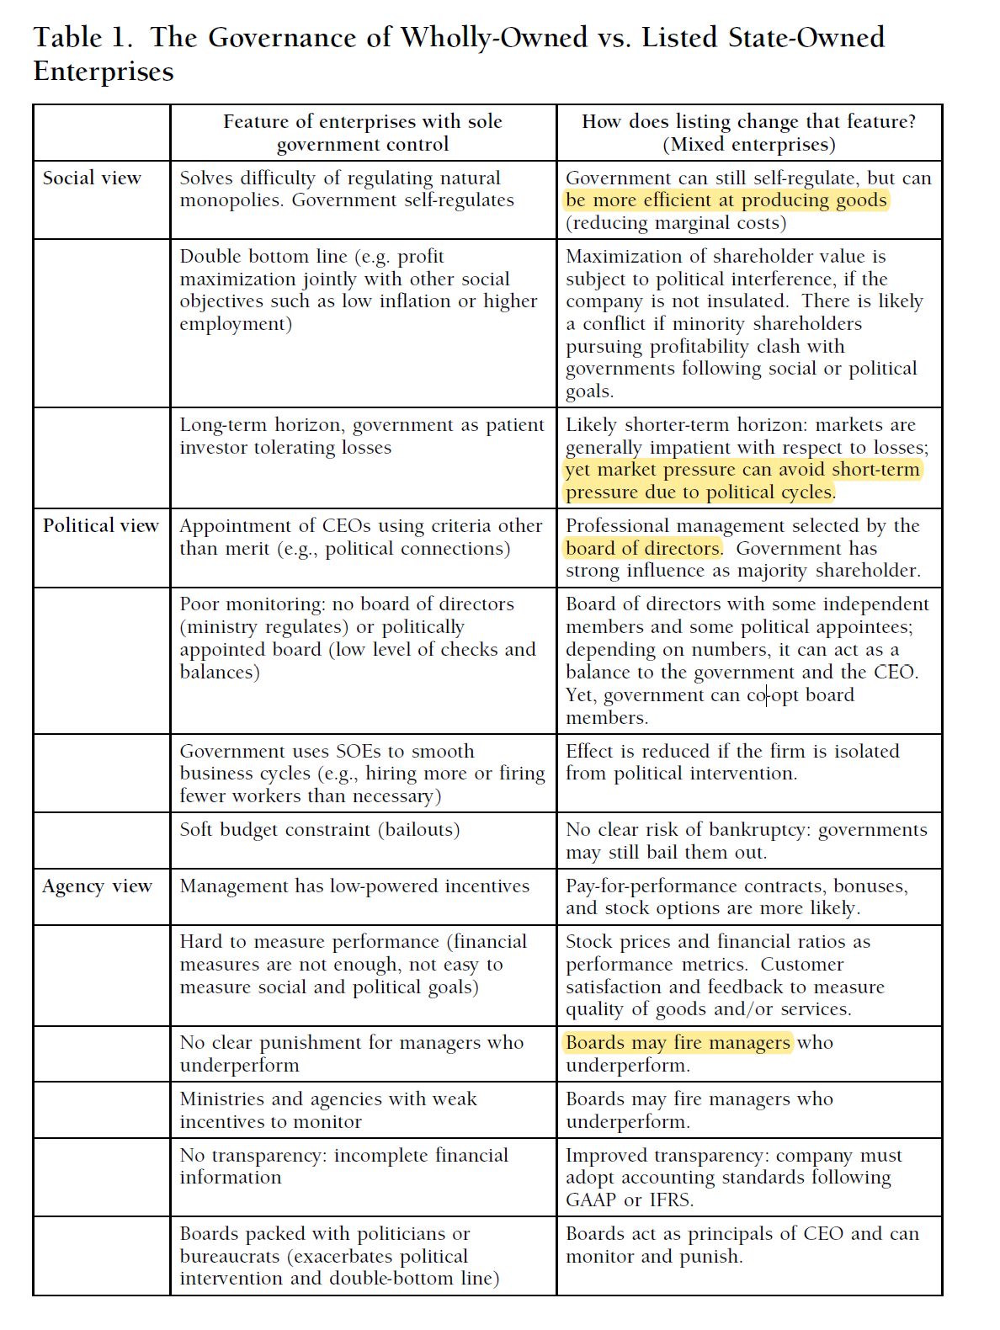
State owned enterprises

Slide 39
State owned enterprises
It turns out that Singapore’s SOEs are the “poster child” for SOE corporate governance, especially in relation to “mixed ownership” regimes!
Milhaupt and Pargendler (2017) (see also Tan et al. (2020)): “The GLC-centered strategy, developed in the 1960s, grew out of “the ruling PAP [People’s Action Party] government’s perceived need to support the transformation of the Singapore economy,” based on the conclusion that “control over key domestic markets and institutions [was] the most effective way to . . . meet the main planning objectives of absorbing surplus labour and promoting economic growth.” As has been the case in China for the past several decades, the political legitimacy of the PAP ruling in Singapore is strongly tied to successful economic development.”
“To mitigate the risk that the GLCs will be politically rather than commercially driven, the Singapore government has “constructed a highly visible and well-tailored regulatory regime, which aims to prevent the government from abusing its position as the ultimate controlling shareholder” of the GLCs. This regulatory regime has multiple, complementary components.”

Slide 40
State owned enterprises
First, a variety of legal constraints are imposed on MOF’s rights as a shareholder. For example, the Singapore Constitution provides that MOF’s appointment, reappointment, or removal of Temasek directors must be approved by the President of Singapore. Moreover, Temasek’s Articles of Incorporation provide that its board of directors, not MOF as the controlling shareholder, has authority to determine the amount of dividends to be paid to the government.”
Second, restrictions are placed on Temasek’s board to minimize the potential for politically motivated intervention. Temasek, as a Fifth Schedule entity—a constitutional designation signifying that it is a key government company—is accountable to the President of Singapore to demonstrate that the disposition of an investment is done at fair market value, and the President must approve of a drawdown of accumulated reserves. In addition, the Temasek Charter, a public corporate governance policy statement, places voluntary restrictions on Temasek’s involvement in portfolio companies...
Finally, although Temasek is legally exempt from public reporting requirements, it has chosen to publish detailed disclosures of its portfolio and performance, and subjects its financial statements to annual audits by an international audit firm. As a result, Temasek is often viewed as setting the “gold standard” for transparency by a government-owned investment fund, receiving the highest possible rating in the Linaburg-Maduell Transparency Index.

Slide 41
State owned enterprises
Milhaupt and Pargendler (2017): “An additional form of protection for the commercial orientation and political independence of Singapore’s GLC infrastructure is extensive reliance upon independent directors. The listed GLCs in Temasek’s portfolio are subject to Singapore’s Code of Corporate Governance, which sets out best practices for public companies on a “comply or explain” basis. The Code provides that at least one-third of the board of a listed company should be independent, increasing to one-half in companies where the chairman is not independent of management. As… noted, a majority of Temasek’s board is comprised of independent directors. In addition, Temasek splits the positions of CEO and Chairman, with the Chairman being a non-executive director independent of Temasek’s management.”
The result? “… the remarkable overall success of the Singapore approach on almost any measure— financial performance, transparency, lack of corruption, and protection of minority shareholder interests. Singapore appears to have achieved the “best of both worlds” with its GLC strategy. The government, acting through Temasek, achieves the monitoring benefits of being the controlling shareholder of its portfolio companies. At the same time, due to a host of institutional constraints and what might be called an “ethos of cleanliness” pervading the state sector, it has avoided the problem of minority shareholder exploitation found in most controlling shareholder regimes.”
  Intuition: Credible commitments toward insulating the board from the state’s (inherent) conflicted position can go a long way!

Slide 42
Family-owned firms
Finally, we will turn our attention to Family-Owned Firms (FOFs), where a family is a major/controlling shareholder.
  Unlike institutional investors and/or SOEs, families are natural persons, and so face most of the incentives we discussed in Slide Deck 7 (keep in mind, to be revisited in Slide Deck 12).
  Some stylized facts: FOFs play an even more important role in Singapore’s larger economy – about 55.4% of all firms are FOFs (Claessens et al., 2000 – see 2nd column in Figure below).

Slide 43
Family-owned firms
FOFs form the quintessential “type” of controlling shareholders in most jurisdictions where controlling shareholders dominate the corporate governance landscape.
Q: Why might this be the case? Recall that a controlling stake is often associated with a controlling premium…
  Pargendler (2011): “[When] robust capital markets fail to emerge… only the state and wealthy families possess enough capital to invest in large-scale productive activity.”
  This often explains why family and state control appears in tandem (but not always – as we shall see in Gilson’s work in Slide Deck 12).

Slide 44
Family-owned firms
Gilson (2007): “In Asia, for example, some two thirds of public corporations have one, most of whom represent family ownership… [In this Article], I posit that the presence of a controlling shareholder, particularly a family controlling shareholder, allows the corporation to better conduct its business, but in a way quite different than the potential for a controlling shareholder to more effectively police the agency conflict between management and shareholders, the productive advantage typically ascribed to a controlling shareholder structure.”
Why so? “In an environment of bad commercial law, a corporation's basic business depends on its capacity to engage in self-enforcing exchange – that is, commercial transactions where the parties perform their contractual obligations because it is in their self-interest to perform, not because of the threat of legal sanction. With bad commercial law, exchange must be self-enforcing because there are neither authoritative rules nor an effective judicial system to enforce those obligations. Transactions in this circumstance take place in a reputation market, which substitutes for law (or law's shadow) as a means to assure that parties perform their contractual obligations.”

Slide 45
Family-owned firms
Gilson (2007): “Framing the problem as one of commercial contracting in a bad law environment suggests a very different function for shareholder distribution than that contemplated by the law and finance literature. When commerce must take place in a reputation market, in which a corporation's business must be effected through self-enforcing transactions, the distribution of shareholdings, and particularly the presence of family ownership, facilitates the development and maintenance of the reputation necessary for a corporation's commercial success. More speculatively, the role of reputation in the product market may help explain why we observe publicly held minority shares in the capital market even though poor shareholder protection does not impose a formal limit on the amount of private benefits that a controlling shareholder can extract. If bad behavior toward minority shareholders can affect the corporation's reputation in the product market as well as the capital market, then self-imposed limits on controlling shareholders' extraction of private benefits may derive from their concern over success in the product market.”
  NB: Gilson’s argument is that FOFs are associated with strong reputational norms. Why do you think this is a plausible hypothesis?

Slide 46
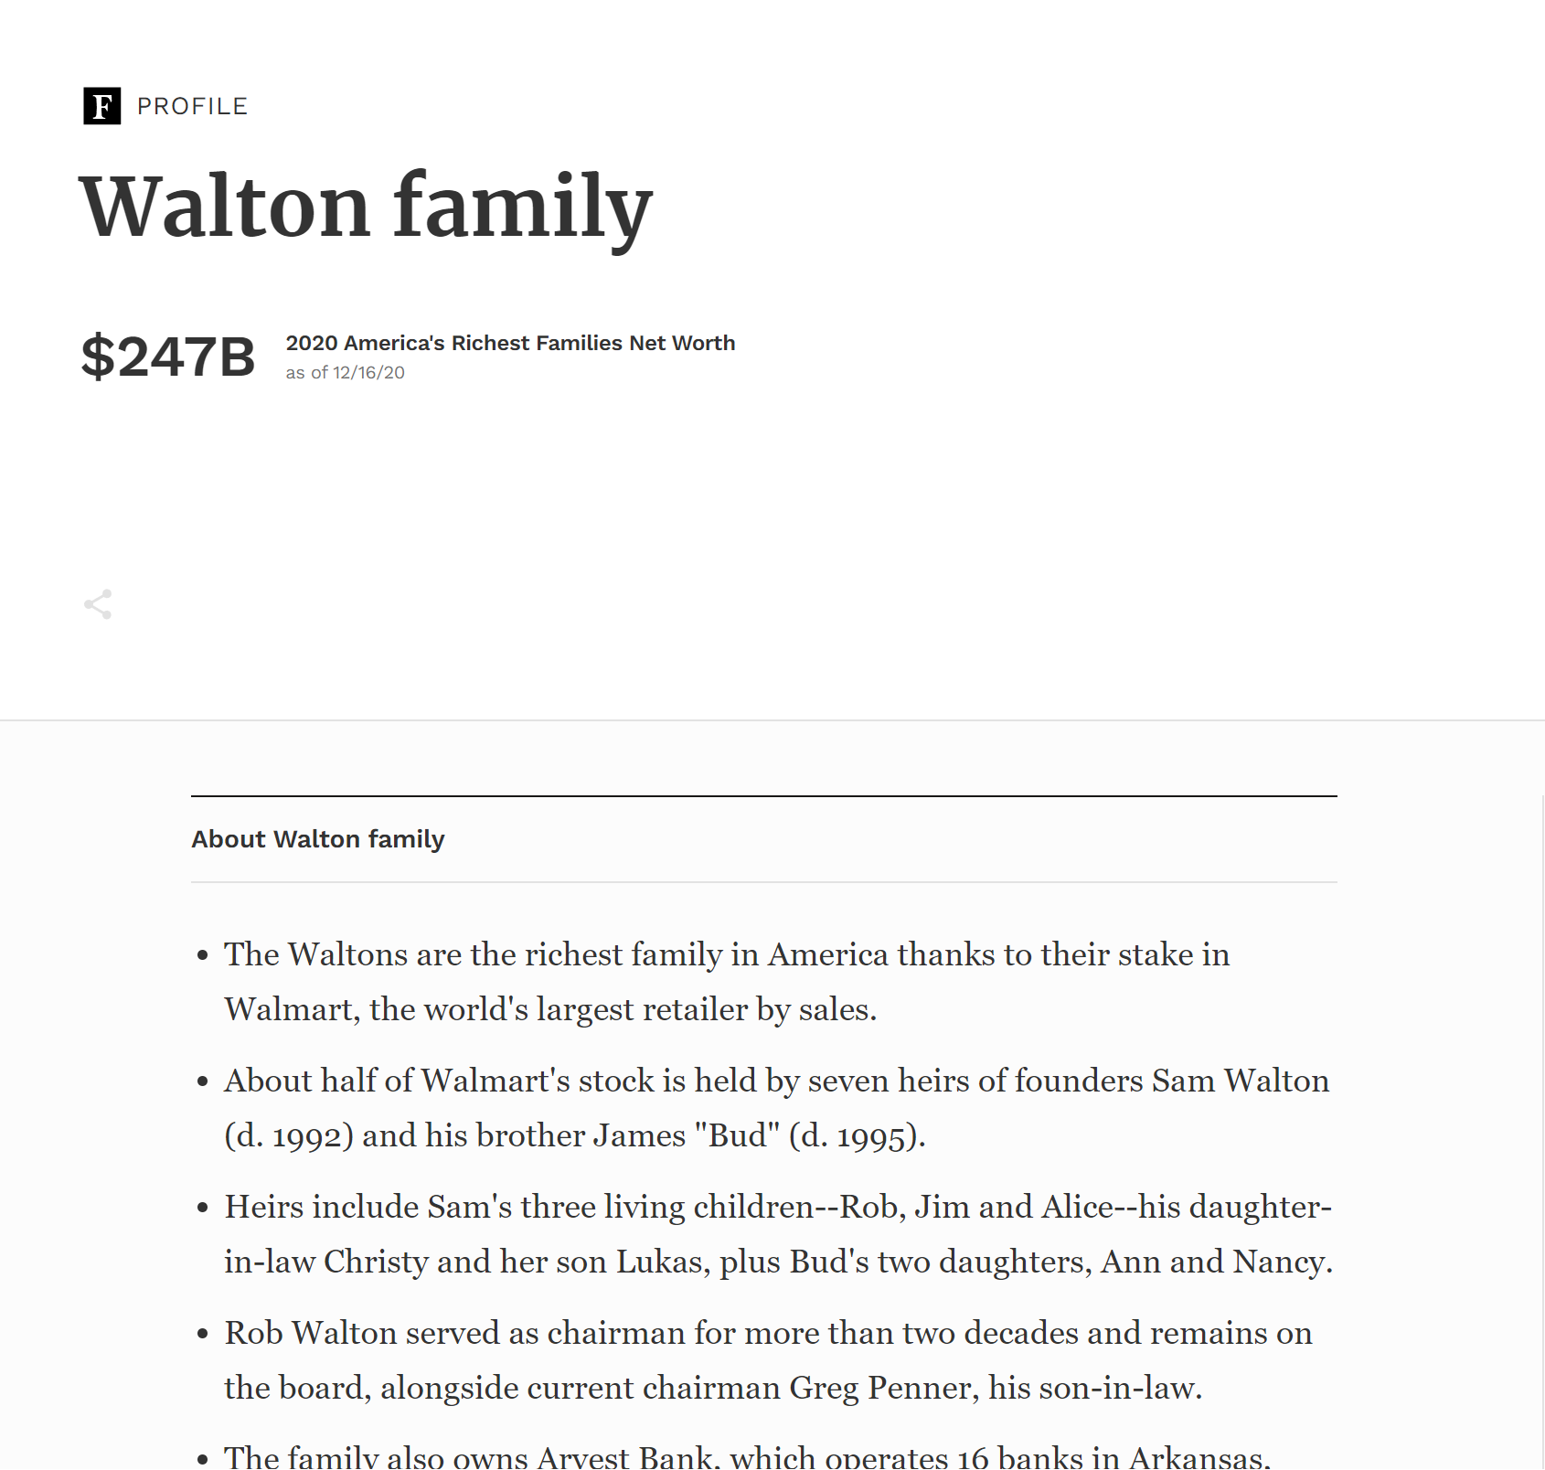
Family-owned firms

Slide 47
Family-owned firms
Maliath and Samuelson (2013): “The word ‘reputation’ appears throughout discussions of everyday interactions. Firms are said to have reputations for providing good service, professionals for working hard, people for being honest, newspapers for being unbiased, governments for being free from corruption, and so on. Reputations establish links between past behavior and expectations of future behavior. One expects good service because good service has been provided in the past, or expects fair treatment because one has been treated fairly in the past. These reputation affects are so familiar as to be taken for granted. One is instinctively skeptical of a watch offered for sale by a stranger on a subway platform, but more confident of a special deal on a watch from an established jeweler. Firms proudly advertise that they are fixtures in their communities, while few customers would be attracted by a slogan of “here today, gone tomorrow.” Repeated games allow for a clean description of both the myopic incentives that agents have to behave opportunistically and, via appropriate specifications of future behavior (and so rewards and punishments), the incentives that deter opportunistic behavior. As a consequence, strategic interactions within long-run relationships have often been studied using repeated games. For the same reason, the study of reputations has been particularly fruitful in the context of repeated games, the topic of this chapter.”
  Q: Why would family-firms be associated with repeated interactions? With customers? With stakeholders? What about non FOFs?

Slide 48
Family-owned firms
FOFs provide an interesting contrast to foundation-owned firms, which are companies controlled by nonprofit organizations (of which charities are an example).
Hansmann and Steen (2021): [Notwithstanding the literature in corporate governance devoted to the agency costs of delegated management], “It is… striking to encounter a large number of well-established and highly successful companies that have long been under the complete control of a self-appointing board of directors whose compensation is completely divorced from the profitability of the company and who cannot be removed or replaced by anyone except themselves.”
“…in [these] industrial foundations the nonprofit form is evidently chosen as protection for the company’s one largest patron—its founder. An entrepreneur who passes control of his company, at the end of his life, to a specially created industrial foundation is evidently seeking a degree of immortality. He wishes to assure, as far as possible, that the company he built will live on in perpetuity as a form of monument—commonly with his name on it. In short, he wants to perpetuate his control over the company beyond the grave…”

Slide 49
Family-owned firms
“One familiar approach that entrepreneurs take to this end is to pass ownership of their company to their descendants. But even if an entrepreneur has children he trusts to fulfill his wishes, leaving ownership of his company to the family involves placing much faith in generations yet unborn. And there is good evidence that such faith is often unjustified (Bertrand and Schoar 2006). It is therefore unsurprising that many entrepreneurs, given the opportunity, instead pass control of their company to a specially created foundation controlled by a board of directors comprising trustworthy persons pledged to maintain the company as the entrepreneur would have maintained it, and pledged as well to pass their control on to succeeding directors who can be trusted to do the same. The foundation’s nonprofit form largely removes pecuniary incentives to betray that trust.”
Hansmann and Steen (2021) suggest that ROE indicators are roughly the same amongst dispersed investor ownership, FOFs and foundation-owned firms.
  NB: See Villalonga and Amit (2020) for a comprehensive literature review for FOF performance.

Slide 50
Q&A
See you guys on Tue.

