Slide 1

Corporate law and economics (LL4489V/5489V/6489V)
9. esg and stakeholderism I
LL4489V
Kenneth Khoo
kenneth.khoo@nus.edu.sg

Slide 2

Esg and stakeholderism
Motivation
Externalities on External Constituents
Shareholder and Managerial Preferences
ESG and Corporate Law
“Greenwashing” and Accountability

Slide 3
motivation
In our previous seminars, we have largely focused on the pecuniary incentives of the corporation and its contractual constituents.
  These stakeholders include not merely the shareholders, but also managers (i.e., the board of directors), creditors, and employees.
  Even when we deliberated the concept of common ownership, our primary emphasis remained on maximizing profits at the portfolio level.
This was logical to the extent that the corporation's conventional purpose as a business entity was focused on profit maximization.
  However, there is little doubt that the corporation’s economic relevance and impact go well beyond its relationships with contractual counterparties.
  Left unchecked, corporations may engage in socially harmful behavior, such as environmental degradation, violations of human rights, anticompetitive behavior, or practices that pose systemic risk to the economy (Kraakman et al. 2017).

Slide 4

motivation
BBC (2015): “In September, the Environmental Protection Agency (EPA) found that many VW cars being sold in America had a "defeat device" - or software - in diesel engines that could detect when they were being tested, changing the performance accordingly to improve results. The German car giant has since admitted cheating emissions tests in the US.”
Kraakman et al. (2017): “The company’s relentless pursuit of growth, which initially benefited both shareholders and workers, encouraged managerial choices that clearly conflicted with the wider interests of society.”
Obviously, corporations are not the sole entities responsible for engaging in socially harmful activities; individuals and other types of organizations also partake in such actions.
  However, due to their capacity for large-scale operations, corporations can cause significant societal harm on a much larger scale compared to other forms of entities.
  Limited liability compounds the problem, as shareholders only bear only a fraction of the costs their companies’ activities cause for third parties.

Slide 5
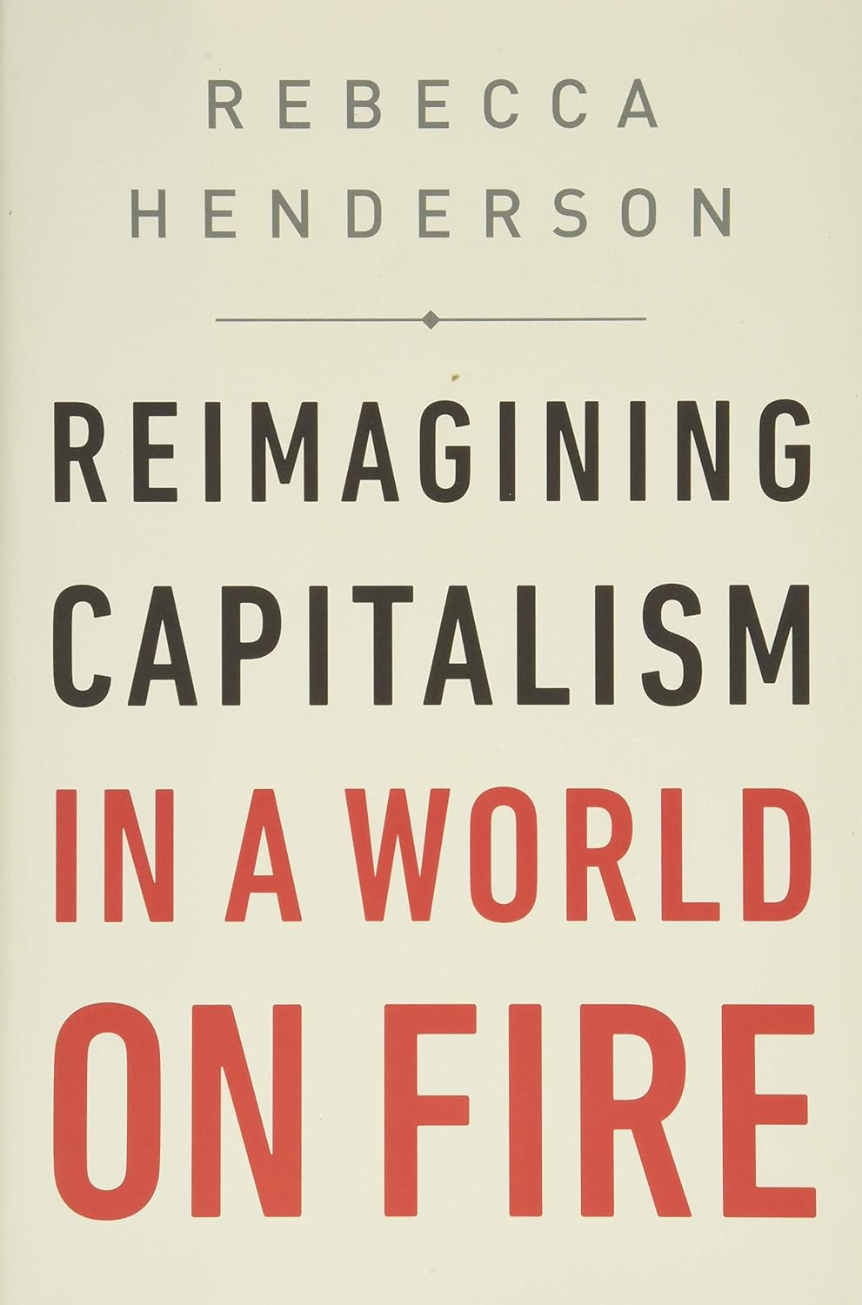
motivation
These concerns have been growing by the day. Even prominent advocates of “shareholderism” (more on this later) such as Bebchuk and Tallarita (2020), have acknowledged that “With growing inequality, large-scale losses of jobs and dislocations in the labor markets, rising climate change risks, and increasingly concentrated markets, capitalism is operating, as one prominent observer recently put it, in ‘a world on fire’.”
Kraakman et al. (2017): [Indeed, it may be likely that] “non-contractual stakeholders have a greater need for legal protection than do its contractual constituencies.”
  Q: Why is this persuasive? Consider what we have learnt so far in our course.
  What about contractual stakeholders? Why might they need additional legal protections as well?
Notes:
1. Cannot contract to protect themselves
2. Incomplete contracting

Slide 6
motivation
Kraakman et al. (2017): “The crucial question is not whether the corporation’s non-contractual stakeholders deserve legal protection of some sort— they clearly do— but whether corporate law is the proper channel through which to deliver this.”
  We will return to this later.
Putting aside our normative concerns, there are many stylized facts which suggest how shareholders and managers are increasingly prioritizing the safeguarding of these non-contractual stakeholders.
  One of the key “stakeholders” implicitly refers to the public at large, especially where environmental concerns are at stake.
Pollman (2022): “ESG (environmental, social, and governance [concerns]) [are] at the center of global dialogue on corporate governance, management, and investment. Remarkably, it has risen from an obscure and niche concept to a widely used term around the world.”

Slide 7
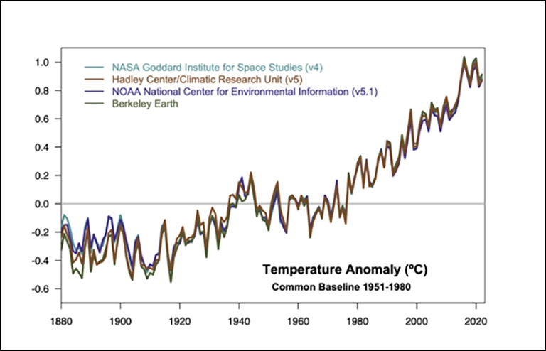
motivation
One of the reasons for the soaring popularity of the “ESG agenda” is the increasing recognition that climate change poses an existential crisis.

Slide 8
motivation
Hannes et al. (2022): “Total investments in businesses with an ESG orientation is estimated to be around $35 trillion, and is expected to reach $50 trillion by 2025. Investments in ESG-oriented mutual funds (green funds), rose globally by 53% in 2021 to $2.7 trillion, with an annual increase of $596 billion. In 2022, over half of investors invest in ESG products, which is almost double the amount of 2019.”
Tallarita (2022): “Throughout the 1980s, social proposals obtained very low support on average; in the 1990s, the highest vote category of social proposals received on average only 12.4% of the votes; and in the period between 2000 and 2003, the average support for the most voted social proposals (those on climate change and renewable energies) was 13%... However, the picture emerging… is significantly different from the old pictures from the 1970s throughout the early 2000s. Indeed, despite the systematic opposition of management, shareholder support for social proposals has been increasing dramatically... Shareholder support for proposals on climate change rose from 20.3% in the first half of the sample period (2010–2015) to 32.2% in the second half (2016–2021); shareholder support for proposals on political spending and activity rose from 24.7% (2010–2015) to 30.3% (2016–2021).”

Slide 9
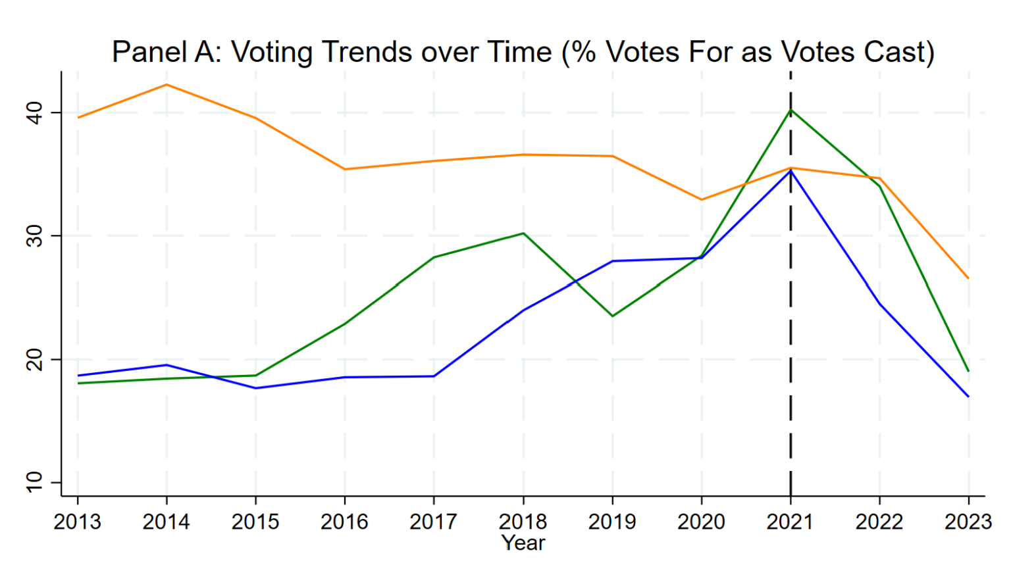
motivation
Khoo and Tallarita (2024)

Slide 10
motivation
Some terminology before we get into the weeds:
  “ESG” refers to Environmental, Social, and Governance agendas or concerns. Can you think of some environmental concerns? What about social concerns?
  What about “governance” concerns? Why are they so different from environmental and social concerns? See Pollman (2022)
“CSR” refers to “Corporate Social Responsibility”. One definition: It is the idea that “corporations have a moral responsibility to voluntarily integrate environmental, social, and governance improvements into their business operations for the benefit of shareholders, other stakeholders, society as a whole, and the environment” (LoPucki, 2021).
How is “ESG” distinct from “CSR”?
  Hint – Pollman (2022): “ESG was coined to describe a set of issues to be integrated into enhanced financial or investment analysis, and has taken on meanings related to risk management…”

Slide 11
motivation
Another buzzword which is commonly used relates to the notion of “sustainability”.
  Like “CSR”, the notion of “sustainability” encompasses notions of moralistic or ethical value. It is a “normative (values-based) argument” to “inject social consciousness into both corporate and individual investment decisions.” (Larcker et al. 2021).
  Are these distinctions (between ESG, CSR, and sustainability) meaningful?
Some studies have illustrated the importance of these distinctions.
  Bonnefon et al. (2022): “We characterize investors’ moral preferences in a parsimonious experimental setting, where we auction stocks with various ethical features. We find strong evidence that investors seek to align their investments with their social values (“value alignment”), and find no evidence of behavior driven by the social impact of investment decisions (“impact-seeking preferences”).”

Slide 12
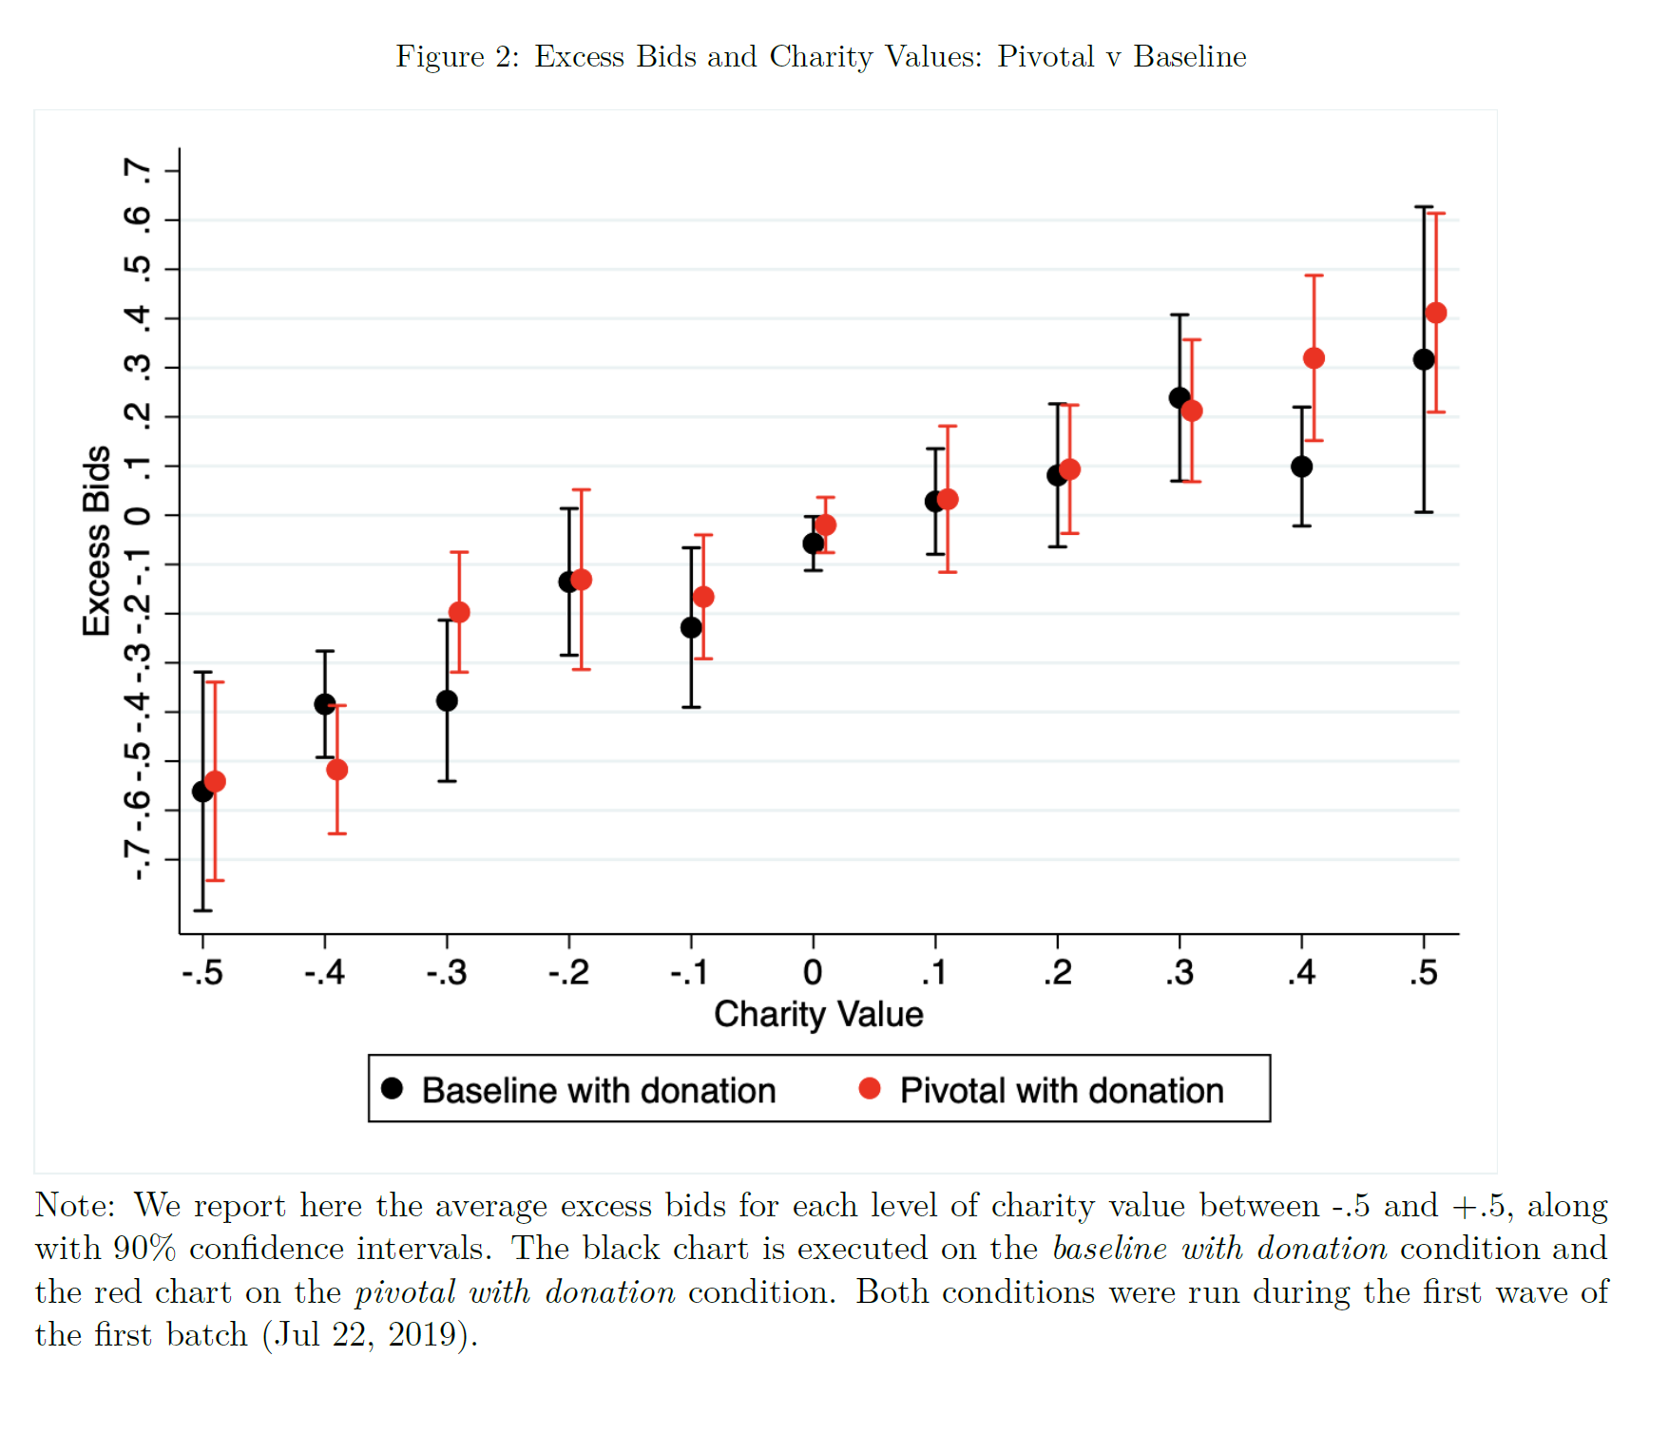
motivation
Bonnefon et al. (2020)
Notes:
Pivotal with donation = consequentialist.
Baseline with donation = deontologist.

Slide 13
Externalities on corporate constituents
Let’s go back to the point that was made earlier concerning how the corporation’s non-contractual stakeholders [would] deserve legal protection of some sort.
  Broad consensus that individuals harmed by wrongful acts committed by a company and/or its representatives should receive compensation (Hansmann and Kraakman, 1990).
As detailed earlier, the crucial question… is whether corporate law is the proper channel through which to deliver these protections.
Kraakman et al. (2017): “A simple answer is that protection of interests extraneous to the firm should come from other areas of law, such as environmental law, human rights law, antitrust law, or financial regulation. Indeed, the use of legal rules and standards— the constraints strategy— to promote interests extraneous to the corporate form is, almost by definition, not corporate law, but the application to corporations— as legal persons— of norms from other fields of law.”

Slide 14
Externalities on corporate constituents
Prior to the rise of the “ESG” agenda, this position has long been the orthodox position regarding the protection of constituents external to the corporation.
Since these constituents are “external” to the corporation, insofar as the corporation engages in actions which might harm one or more such constituents, the resulting harm is known as an externality.
  Dictionary definition of externality: “a consequence of an activity which affects other parties without this being reflected in market prices”. Example: A corporation engages in the dumping of waste in an adjacent water, inducing water pollution.
  Who might be affected by this activity? Why is this activity not “reflected in market prices”? What about the “Coase Theorem” discussed in Seminar 2? Why don't standard “contractual” corporate constituents encounter this issue?
Orthodox view: It should be the role of environmental law to address environmental externalities, not corporate law.

Slide 15
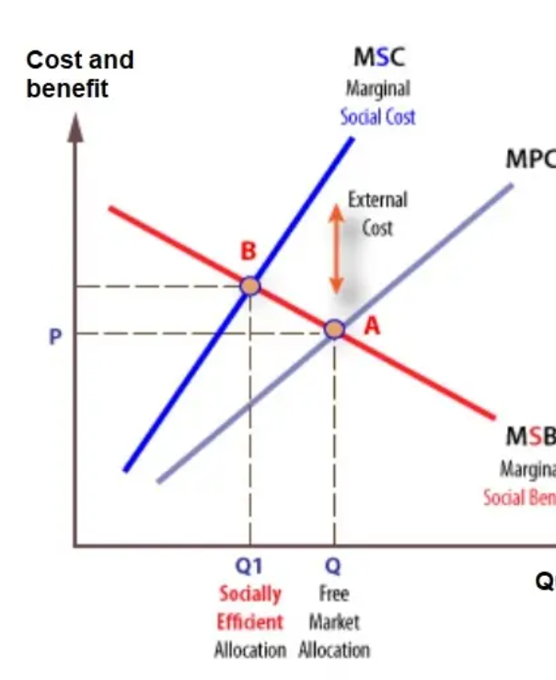
Externalities on corporate constituents
Externalities are known as market failures. Consider the example where a corporation engages in the dumping of waste in an adjacent water, inducing water pollution. Why does the “free market” fail here? Why is this externality known as a “negative externality”, as opposed to a “positive externality”?
How can state regulation address negative externalities? What can environmental regulations do to curb firm behavior in relation to the dumping of wastewater?

Slide 16
Externalities on corporate constituents
Let’s turn to some motivations for why the orthodox position might be on shaky ground.
Hart and Zingales (2022): “Corporations are larger, more complex, and more powerful than they were in the 1970s and early 1980s when the traditional paradigm became established. In a more populous and interdependent world, the importance of externalities has also greatly increased, and many feel that governments are not dealing with them.”
Kraakman et al. (2017): “[This ‘indirect’ approach to addressing corporate externalities] may be necessitated when—owing to regulators’ information gaps or to successful industry lobbying— more direct regulatory responses to externalities and other social problems are not feasible.”
  Can you think of some examples regarding the ostensible “failure” of regulation in addressing externalities?

Slide 17
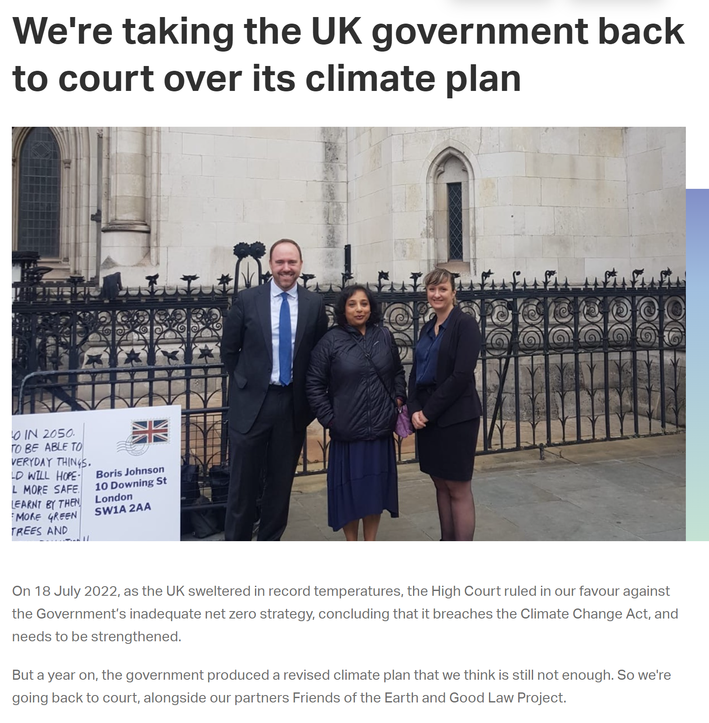
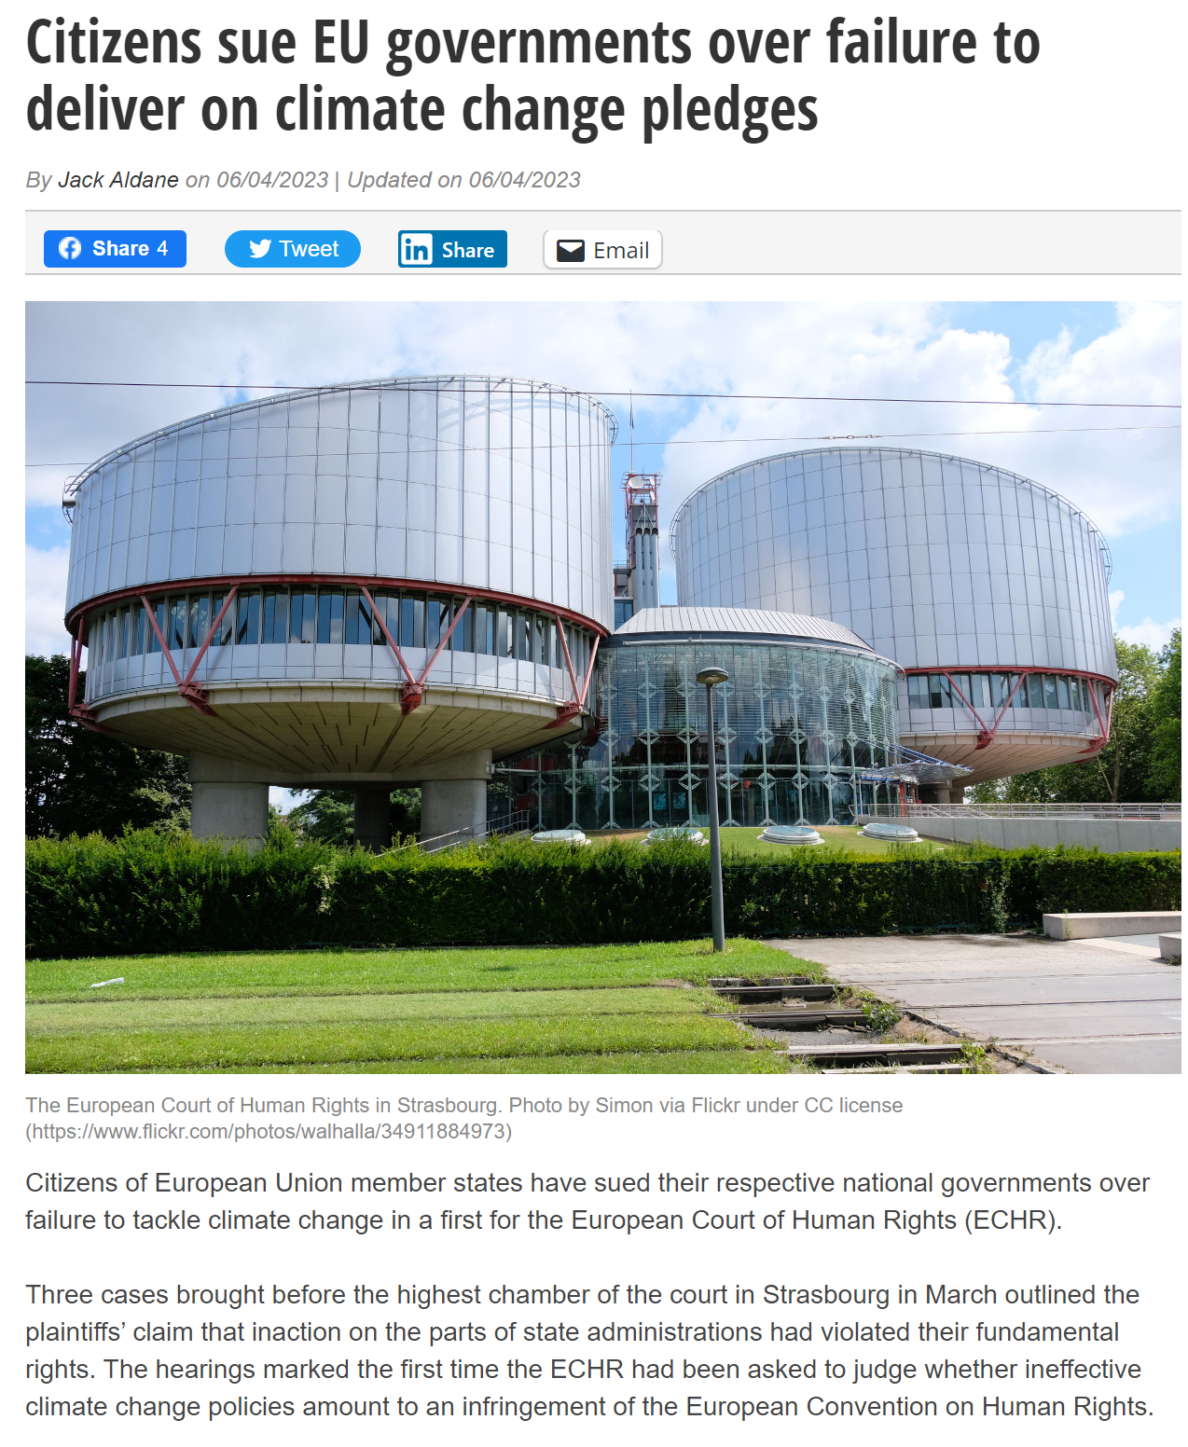
Externalities on corporate constituents

Slide 18

Externalities on corporate constituents
Figueres et al. (2022): “At the end of February this year, the world’s governments signed on to a statement that was startling in its strength and clarity. “The cumulative scientific evidence is unequivocal: Climate change is a threat to human wellbeing and planetary health,” reads the Intergovernmental Panel on Climate Change report. “Any further delay in concerted anticipatory global action on adaptation and mitigation will miss a brief and rapidly closing window of opportunity to secure a liveable and sustainable future for all.’” You might think that political leaders could have no higher priority than securing a “liveable and sustainable future”. Is that not what all of us, in every country, need and want for ourselves and for future generations?... The United Nations Framework Convention on Climate Change was adopted 30 years ago. In our time leading its secretariat, we have witnessed commitments and pledges that have not been fully honoured. While developed countries accepted the convention’s principle of equity and thus their responsibility to lead climate action, their performance has been disappointing, not least in reducing their emissions of greenhouse gases and in mobilising financial support for developing countries that need it. In the 2015 Paris agreement, all governments agreed to “pursue efforts” to limit global warming to 1.5C (2.7F)… But the sum total of policies in place now will take us to a world hotter by 2.7C and perhaps a catastrophic 3.6C above pre-industrial levels.”

Slide 19
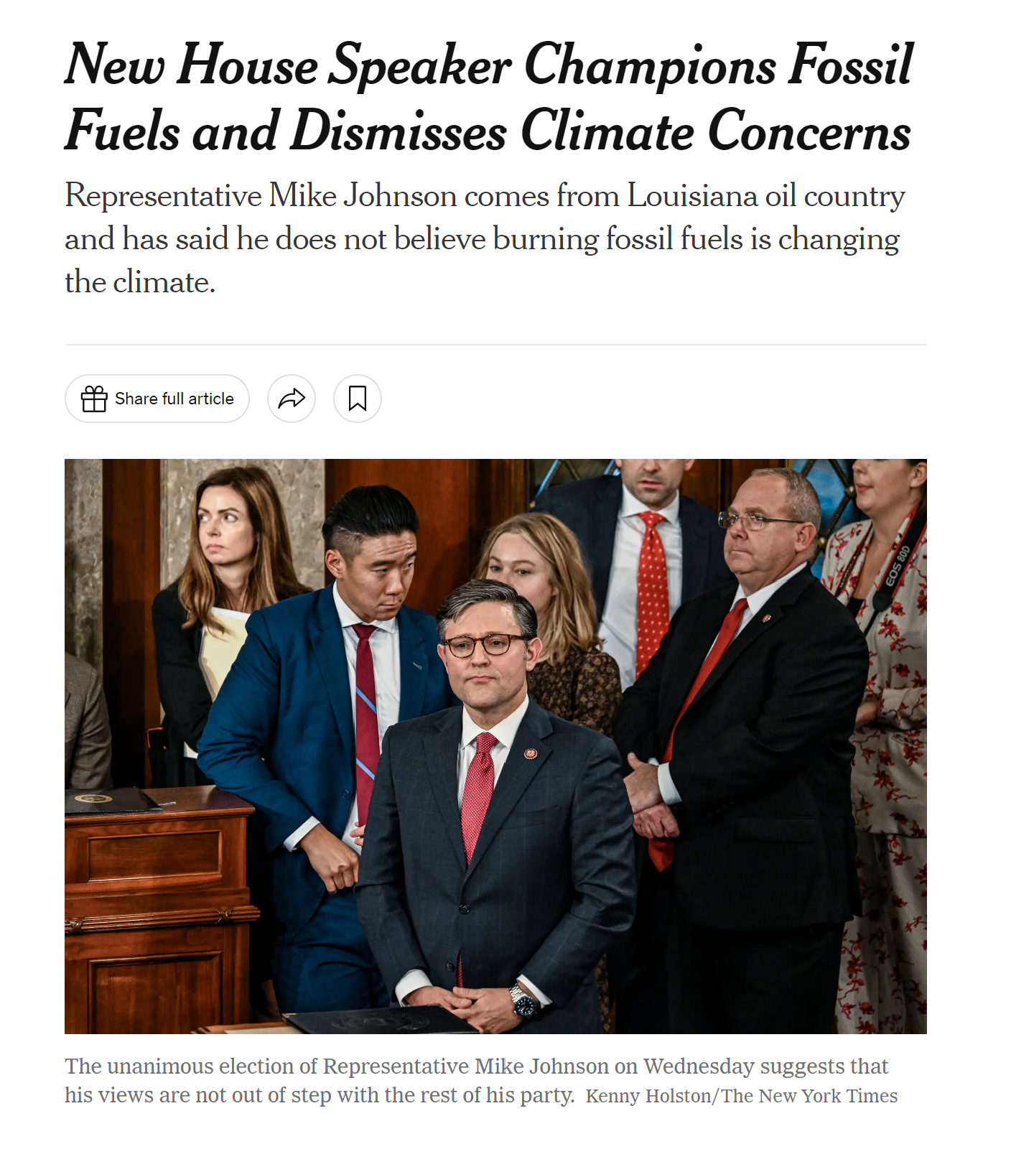
Externalities on corporate constituents

Slide 20
Externalities on corporate constituents
Beyond the political failures associated with the regulation of externalities, there has also been a swift evolution in investor sentiment regarding the purpose of corporations in recent times.
Hart and Zingales (2022): “The preferences of investors have changed too. Investors, especially younger ones, are more sensitive to environmental and social issues. As a result, we think that the paradigm needs to change. This is true even if one accepts, as we do, the idea of shareholder primacy, that is, that companies should act on behalf of shareholders.”
  In other words, investors might be socially responsible. Q: How does this change the paradigm of “utility-maximization” in economics? Do we have to abandon the framework altogether?
Even then, many scholars have argued that the presence of political failures + pro-social preferences should not alter the normative principle that corporations should be organized to maximize financial profits. Why is this the case?

Slide 21

Externalities on corporate constituents
This view, first advanced by Milton Friedman (1970), is often termed the “Friedman separation theorem”.
Hart and Zingales (2022): “To understand the argument, suppose that, in the absence of an optimal tax policy, the Sierra Club [a non-profit advocating for the protection of the environment] is doing valuable work to preserve the environment. Assume that the shareholders of a firm care about the environment either because environmental harm affects them directly or because they are socially responsible and care about the harm to others. Might the shareholders want their firm to reduce dividend payments and make a charitable contribution to the Sierra Club? The answer, at least according to Friedman, is no. The same outcome— a contribution to the Sierra Club—can be achieved if the firm pays out the higher dividend and each shareholder makes their own contribution to the Sierra Club. Given that individual shareholders can do anything the firm can do, it still makes sense for the firm to maximize profit, and for individual shareholders to engage in public welfare activities themselves.”

Slide 22
Externalities on corporate constituents
Hart and Zingales (2022): “Unfortunately, the Friedman separation theorem is not general. Charitable contributions are a very special case. Charitable contributions are separable from a firm’s other activities and a firm has no comparative advantage in making them relative to individuals. But in many cases a firm’s damage-inducing (or benefit-generating) activities are inseparable from its production activities, and under these conditions the separation theorem no longer holds.”
Example: DuPont generates large quantities of plastic waste. Reducing the waste would improve the environment but reduce profit... [but] shareholders cannot easily replicate (or undo) the firm’s decision. It would be very costly for individual shareholders to clean up the plastic waste produced by DuPont.
  Furthermore, there is no reason to suppose that shareholders will unanimously agree on this “two stage” procedure. Why? Hint: Think of the heterogeneity of shareholder preferences in Dupont.

Slide 23
Externalities on corporate constituents
The plot thickens when social objectives are concerned, as it may be questioned whether many of these social objectives even involve externalities.
Example: Violations of human rights, escalating income disparities, and shifts in labor demographics due to technological change are all critical issues that have the potential to undermine the overall 'social fabric' of society.
  Social objectives often concern redistribution issues (i.e., transfers). Why? Do transfers involve externalities? Why are economists reluctant to comment on issues concerning redistribution?
  Why does the state play a crucial role in redistributing wealth?
IMF (2017): “Labor’s share of income declines when wages grow more slowly than productivity, or the amount of output per hour of work. The result is that a growing fraction of productivity gains has been going to capital. And since capital tends to be concentrated in the upper ends of the income distribution, falling labor income shares are likely to raise income inequality.”

Slide 24
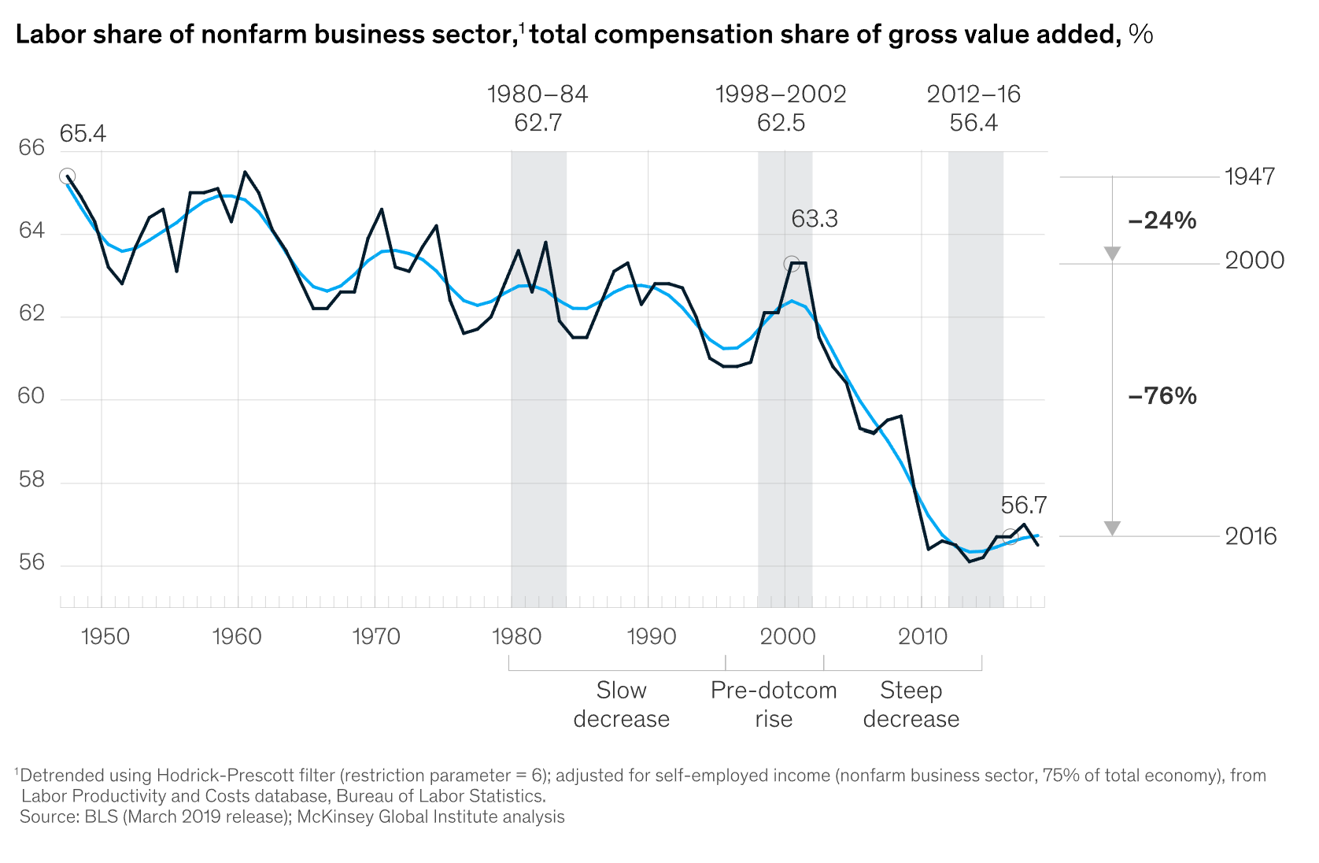
Externalities on corporate constituents

Slide 25
Externalities on corporate constituents
Note: None of the preceding discourse excludes the state's role in mitigating corporate externalities. In fact, most scholars still regard [direct] regulation as providing the most optimal approach for addressing issues related to climate change, income inequality, worker well-being and rights, and consumer protection.
Thus, the ESG movement is really a “second-best” solution to addressing some of the most critical issues within capitalism.
  One question arises as to whether this “second-best” solution may actually induce more social costs than benefits (more on this later).
  Bebchuk and Tallarita (2020): “by raising illusory and distracting hopes that corporate leaders would on their own provide substantial protection to stakeholders, acceptance of stakeholderism would impede or delay legal, regulatory, and policy reforms that could provide real, meaningful protection to stakeholders. In this way, acceptance of stakeholderism would be contrary to the goal of stakeholder protection that stakeholderism purports to serve.” Q: Can you think of how this would apply to legislative reforms?

Slide 26
Shareholder and board preferences
One of the most intractable issues concerning “ESG” issues lies with its complex relationship with (firm-level) profit-maximization.
  For instance, it might well be in the interests of a company to advance environmental or social goals as a means to profit-maximization.
  Indeed, Pollman (2022) argues that ESG was originally coined as a “risk management” issue, before assuming a life of its own, “as value-laden notions of “conscious” versus “woke” capitalism give way to perceptions of ESG as ideological, political, and subject to backlash.”
Furthermore, while certain companies may experience adverse effects due to heightened awareness of “E or S” (environmental or social) issues among their customer base, others are likely to emerge as beneficiaries.
  Can you think of some [obvious] examples?
That being the case, the question of whether corporate law should serve as a means to promote “ESG” objectives is an exceedingly intricate matter.
Notes:
What are some of these risks?

Slide 27
Shareholder and board preferences
Beyond problems of redistribution (i.e., creating ‘winners’ and ‘losers’ through laws that facilitate ESG), there are also fundamental problems associated with the “cheap talk” associated with “pro-ESG” policies.
  This challenge is especially relevant when it comes to “E & S” (Environmental and Social) concerns, as they are closely linked to ethical principles of “doing what is morally right”.
  Recall Bonnefon et al. (2022): Investors might be averse to owning companies that do not have a business model in line with their own moral values.
“Cheap Talk” is communication which is (1) costless to transmit and receive, (2) non-binding, and (3) non-verifiable (Crawford and Sobel, 1982).
  What do the terms “non-binding” and “non-verifiable” mean in the Law and Econ context? NB: This is an important context.
Most business patrons have very strong incentives to engage in “cheap talk” on ESG matters – a concept closely related to the notion of “greenwashing”.

Slide 28
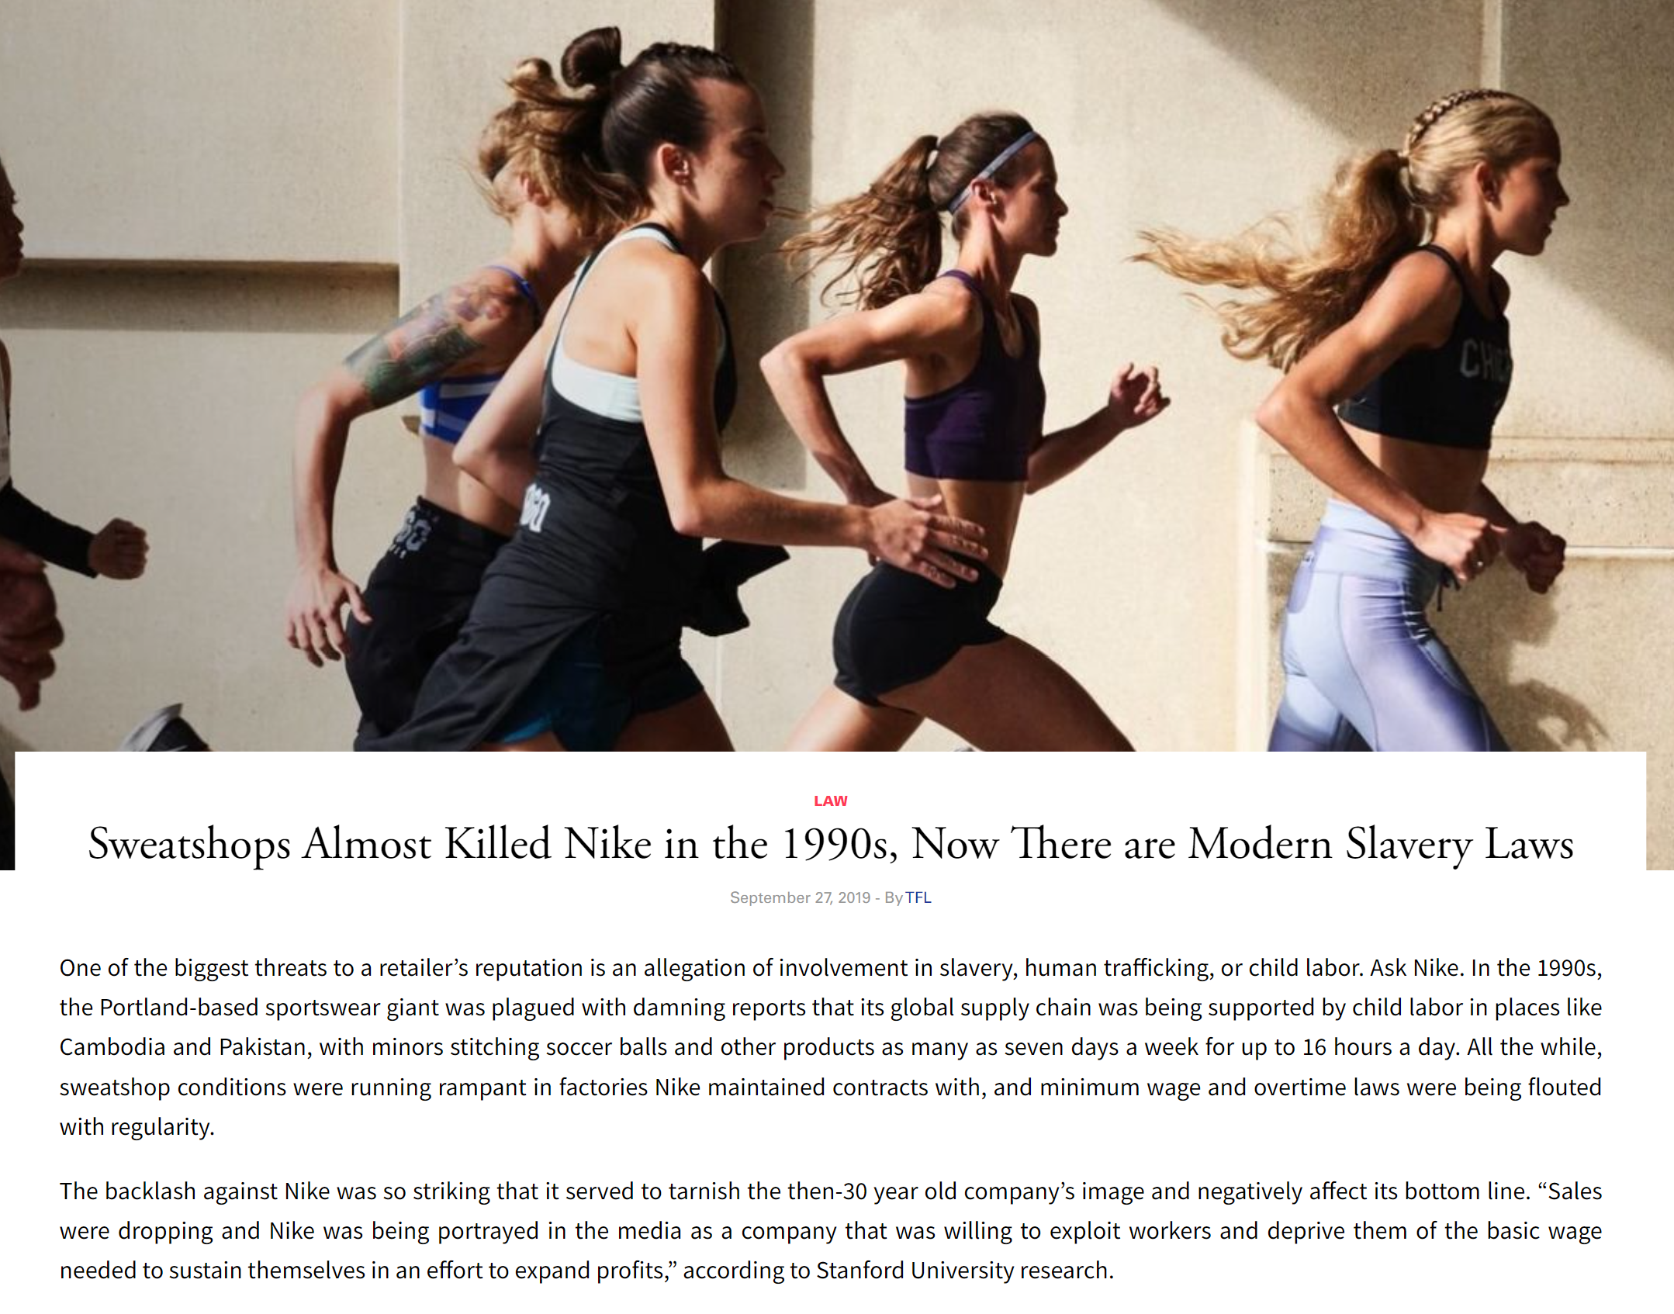
Shareholder and board preferences

Slide 29

Shareholder and board preferences
Blackrock CEO Larry Fink’s (2021) letter to (Portfolio) CEOs: “In 2018, I wrote urging every company to articulate its purpose and how it benefits all stakeholders, including shareholders, employees, customers, and the communities in which they operate. Over the course of 2020, we have seen how purposeful companies, with better environmental, social, and governance (ESG) profiles, have outperformed their peers. During 2020, 81% of a globally-representative selection of sustainable indexes outperformed their parent benchmarks…”
“While the transition [to net zero carbon emissions] will inevitably be complex and difficult, it is essential to building a more resilient economy that benefits more people. I have great optimism about the future of capitalism and the future health of the economy – not in spite of the energy transition, but because of it.”

Slide 30
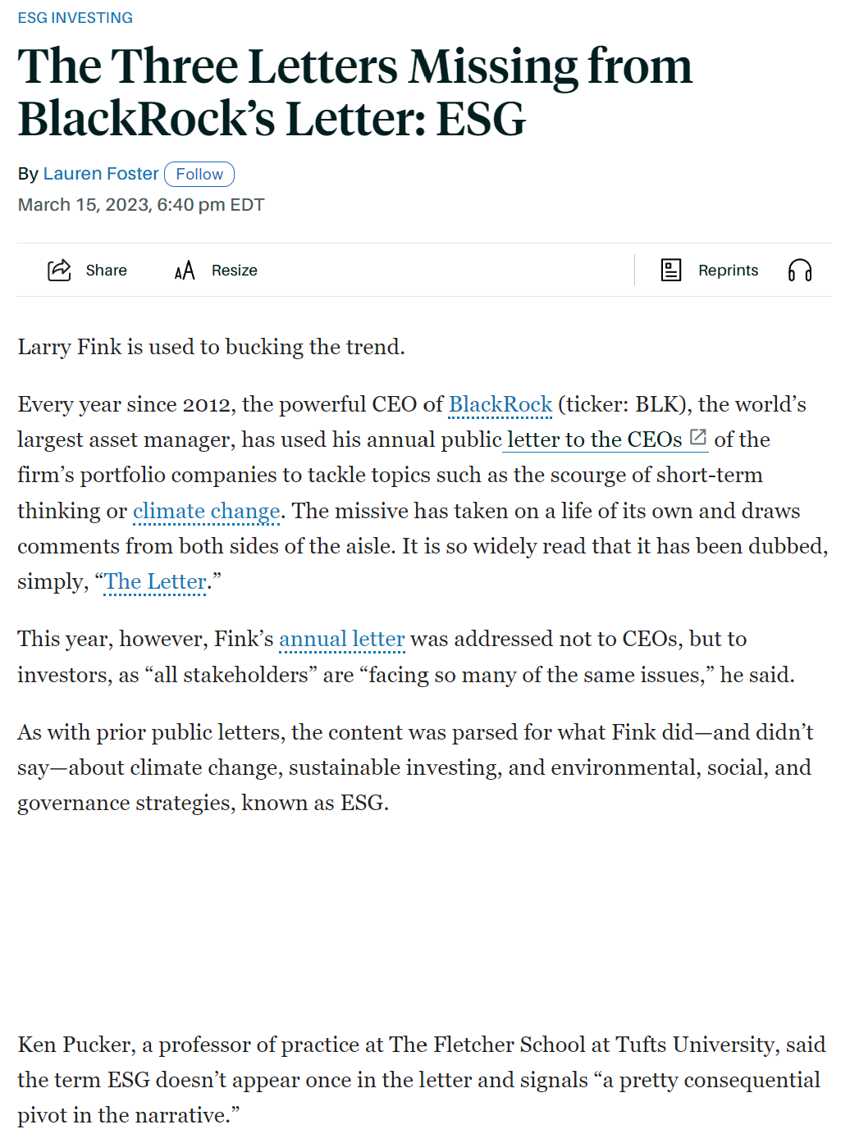
Shareholder and board preferences

Slide 31
Shareholder and board preferences
Recall our discussion of how ESG was conceptualized as a “risk management” issue.
  This begs the question of what these “risks” are: Do they relate to business risks associated with climate change? Do they relate to similar risks associated with social/political instability in regimes? Do they relate to the risks of future regulation on environmental or social issues?
Krueger et al. (2020): “According to our survey about climate risk perceptions, institutional investors believe climate risks have financial implications for their portfolio firms and that these risks, particularly regulatory risks, already have begun to materialize. Many of the investors, especially the long-term, larger, and ESG-oriented ones, consider risk management and engagement, rather than divestment, to be the better approach for addressing climate risks.”

Slide 32
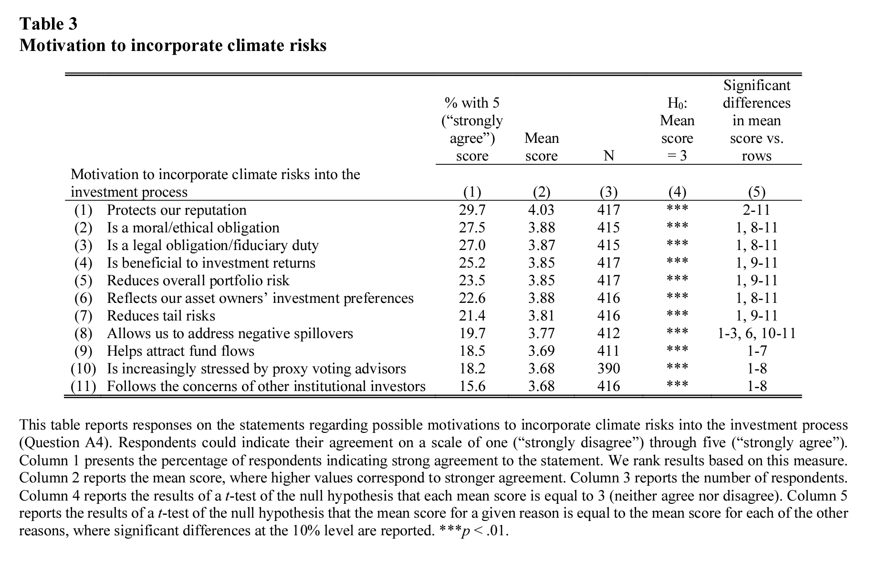
Shareholder and board preferences
Krueger et al. (2020)

Slide 33
Shareholder and board preferences
Krueger et al. (2020): “To understand expectations of the financial effects of climate risks for portfolio firms, we asked our participants in Question A2 to rate the financial materiality of three sources of climate risks: physical risks (changes in the climate), regulatory risks (changes in regulation), and technological risks (climate-related technological disruption). Respondents were asked to rate each of these climate risks on a scale of one (“very important”) to five (“not at all important”). Table 2, panel B, shows that the respondents on average rate the financial consequences of all three climate risks between 2.2 and 2.5, which means that the respondents regard the financial materiality of climate risks to be somewhere between “important” and “fairly important.” The effects of regulatory and technological risks are seen as somewhat more important overall than those of physical risks (the differences are statistically significant at the 1% level but relatively small in magnitude).”
NB: Recall our earlier discussion – if regulation is going to produce both “winners” and “losers”, the “losers” will have a strong incentive to engage in self-regulation. Why? See Armour and Skeel (2007):
  “Given that using litigation to resolve such matters involves a structural bias in favor of the directors, it should not be surprising that U.K. institutional investors chose to “privatize” the matter by instituting the Takeover Code in the late 60s...[In contrast, their US counterparts did not due to federal legislation which prevented institution investors from developing close links to make collective action possible].”

Slide 34
Shareholder and board preferences
What about other risks? Gordon (2022) argues that managers of a broadly diversified investment vehicle could improve the portfolio’s risk-adjusted returns (and thus improve the welfare of their beneficiaries) by mitigating systematic risk.
  Importantly, this mitigation effort can be operationalized within the existing framework of asset pricing which institutional investors are already familiar with.
“Many elements of social policy may have economy-wide effects and likely improve expected returns across the portfolio. For example, investments in education and infrastructure historically have been associated with substantial economic gains. But these investments typically reflect choices made by government actors, not portfolio companies; nor do they reflect systematic risk factors of the kind that an asset manager of a conventional financial product is readily in a position to evaluate. On the other hand, regulatory interventions that directly bear on systemic risk-taking by portfolio companies could well be within the asset manager’s domain because of the foreseeable impact on portfolio values.”

Slide 35
Shareholder and board preferences
Gordon (2022): “[One] particularly strong candidate for systematic stewardship is the risk associated with climate change associated with increasing levels of atmospheric CO2. Diverse analysts describe first-order economic effects associated with the resulting temperature rises. A 2017 report in Science, for example, estimates a loss of 1.2% of GDP for each degree centigrade rise; without intervention, analysts predict up to a 4-degree increase; the GDP impact would exceed the recession associated with the Great Financial Crisis... There are multiple channels through which massive economic harms could result from unmitigated climate change risk. There is, of course, the physical damage from extreme weather events, damage from rising sea levels, agricultural losses from shrinking arable landmass, and all the disruptions that would result from these physical manifestations. Postponement of firm-specific adaptations necessary to eliminate CO2 emissions and reverse atmospheric CO2 would only increase the eventual transition costs; the “stranded assets” would pile up. As the physical disruption from climate change becomes manifest, firms that significantly added to CO2 emissions through fossil fuel production or consumption (like public utilities or even automobile manufacturers) could face liability risk…”
See similar argument for social risks (pgs 655 to 658).

Slide 36
Shareholder and board preferences
How are these preferences (if they exist) implemented vis-à-vis the board?
  On investor preferences, see also Bolton et al. (2019) in “Minority Shareholder Protection”.
In Seminar 6 (Voice vs Exit), we proposed that socially responsible shareholders would prefer to employ “voice” strategies rather than “exit” strategies when it comes to decisions with a significant social impact.
  The intuition there (as per Broccado et al. (2021)) was that while well-diversified shareholders would face a negligible capital loss in inducing the firm to adopt “clean” technologies, the net social benefit from such an adoption would induce them to exercise their “voice” rights. In contrast, selfish-agents would offset the effects of divestment via their increased investment in companies shunned by socially responsible agents.
Krueger et al. (2020) provide some evidence for this hypothesis.
  Note how the least “costly” option (engagement) is always adopted first.

Slide 37
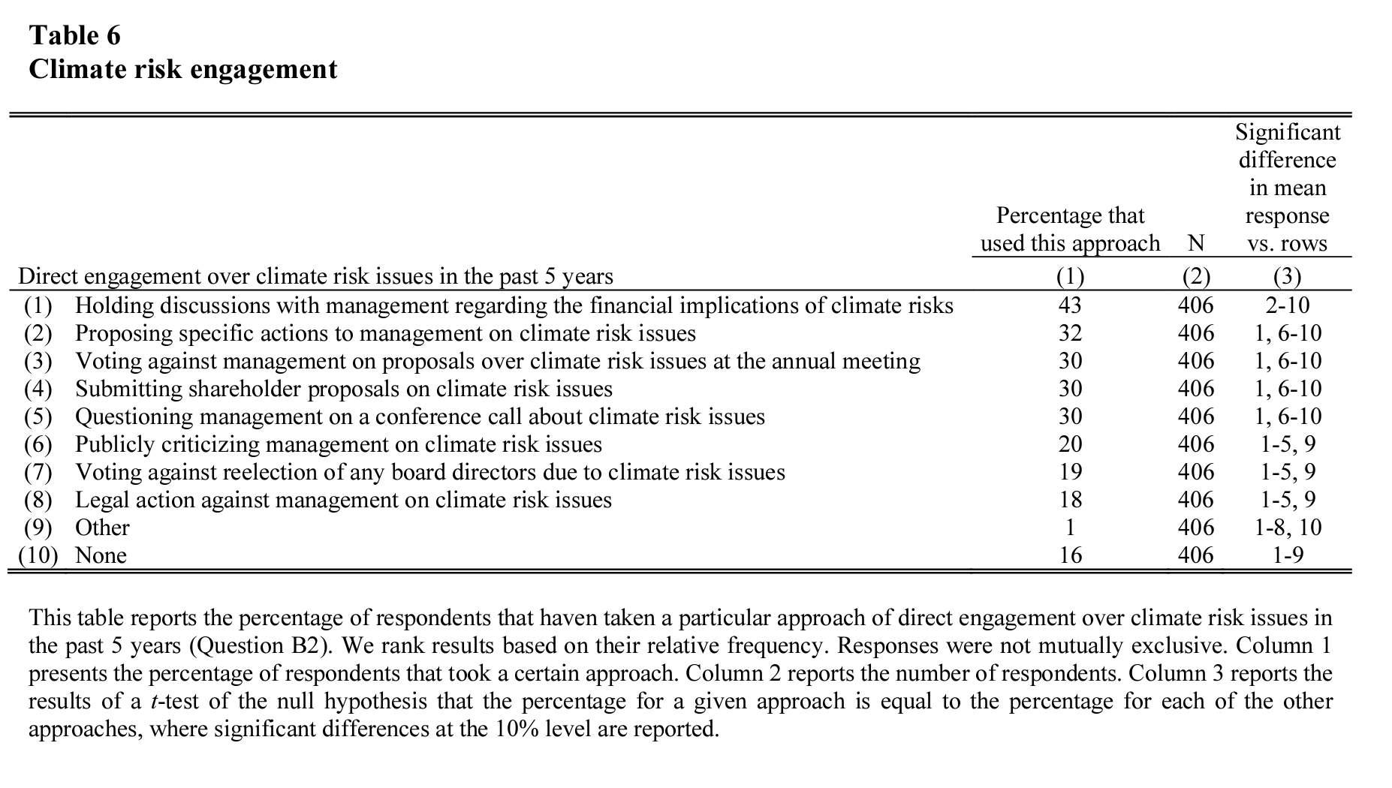
Shareholder and board preferences
Krueger et al. (2020)

Slide 38
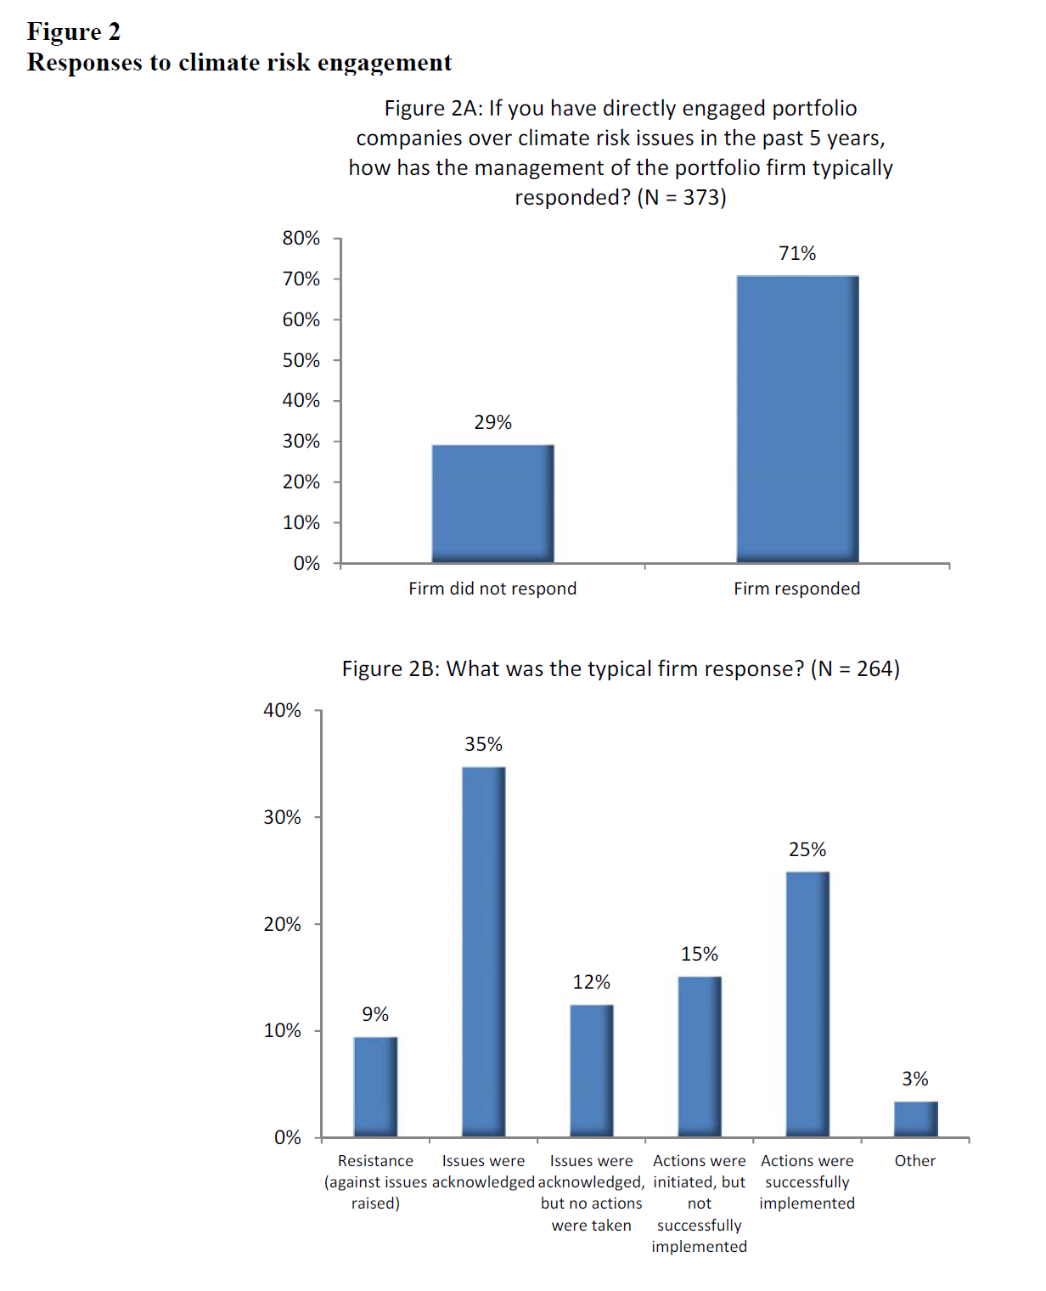
Krueger et al. (2020)

Slide 39
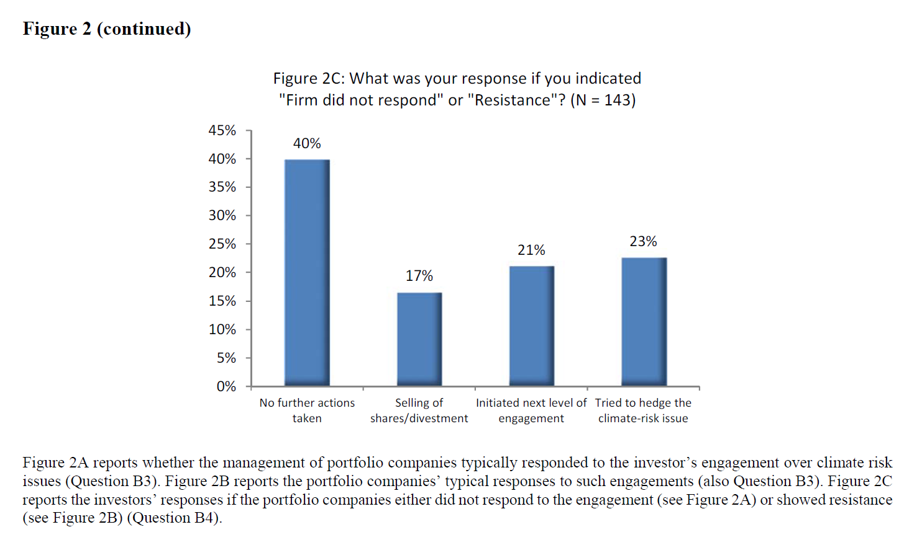
Shareholder and board preferences
Krueger et al. (2020)

Slide 40
Shareholder and board preferences
Beyond these self-reported preferences, many studies also show a positive relationship between financial performance and “ESG” metrics (however amorphous/ambiguous these metrics might be).
Some meta studies:
  Atz et al. (2021): After surveying 1,141 primary peer-reviewed papers and 27 meta-reviews published between 2015 and 2020, the authors find evidence of a positive association between sustainability and financial performance at the firm level and risk-mitigating effects at the portfolio level.
  Friede et al. (2015): After aggregating nearly 2,200 studies, the authors concluded that the majority found positive correlations between corporate financial and ESG performance but portfolio-level studies had more mixed results.
  Whelan et al. (2021): After examining the relationship between ESG and financial performance in more than 1,000 research papers from 2015-2020, the authors found a positive relationship for 58% of the “corporate” studies focused on operational metrics and 33% positive performance for investment studies typically focused on risk-adjusted attributes.
  Plagge and Grim (2020): The return and risk differences of ESG funds can be significant but appear to be mainly driven by fund-specific criteria rather than by a homogeneous ESG factor.
BUT: Correlation is NOT causation. Why could ESG factors exhibit a correlation with financial performance even if ESG initiatives did not directly lead to improved performance?

Slide 41
Q&A
See you guys on Tue.

