Slide 1
Monto Carlo Tree Search for SMT Strategy Synthesis with Applications to String Constraints
John Lu
PhD Student
University of Waterloo

Slide 2
Agenda
Background & Related Work
  Handcrafted strategy
  Algorithm selection
Z3alpha: SMT Strategy Synthesis using MCTS
Future Work
  A learning theoretical prospective

Slide 3
Background
String constraint solving is hard
Many algorithms & solvers
Complementary strengths

Slide 4
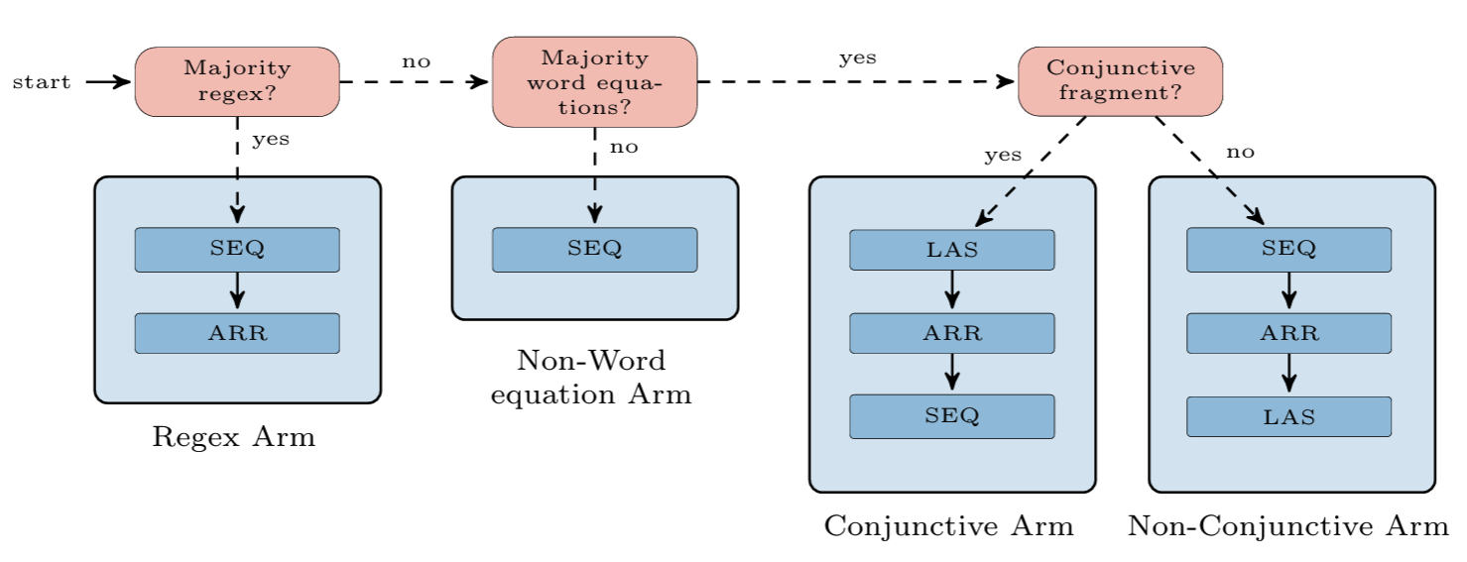
Z3str4: A Multi-armed String Solver [FM 2021]
Federico Mora, Murphy Berzish, Mitja Kulczynski, Dirk Nowotka, Vijay Ganesh
Notes:
Handcrafted strategy

Slide 5
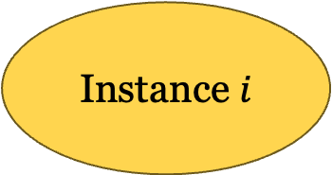
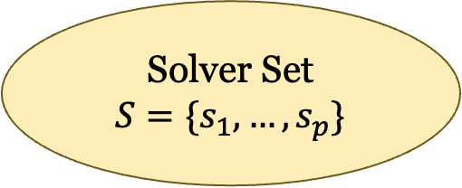
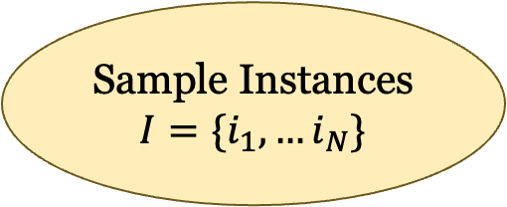
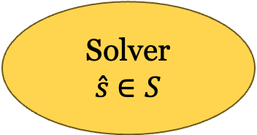
MachSMT: A Machine Learning-based Algorithm Selector for SMT Solvers [TACAS 2021]
Joseph Scott, Aina Niemetz, Mathias Preiner, Saeed Nejati, Vijay Ganesh
Feature Representation
ML Models
Instance $i$
Algorithm
Selector
Solver
$\hat{s}$ $∈S$
Training
ML training
Sample Instances
$$I=\{i_{1},…i_{N}\}$$
Performance Dataset
Solver Set
$$S=\{s_{1},…,s_{p}\}$$

Slide 6
MachSMT: A Machine Learning-based Algorithm Selector for SMT Solvers
Feature Representation
Syntactic features, mostly frequency of domain-specific keywords
Machine Learning Paradigm
Prediction: Predict given an instance and a solver, what is the expected solving time
Classification: Predict given an instance, which is the expected best solver

Slide 7
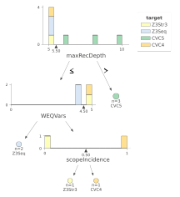
SMTQuery: Analysing SMT-LIB String Benchmarks [SBMF 2024]
Mitja Kulczynski, Kevin Lotz, Florin Manea, Danny Bøgsted Poulsen & Paul Sarnighausen-Cahn
21 string-specific structure features
Random forest for algorithm selection
Solved 1.14% more instances than CVC5 from a comprehensive string benchmark suite¹
10.61% more on a challenging subset
1. Kulczynski, M., Manea, F., Nowotka, D., & Poulsen, D. B. (2023). ZaligVinder: A generic test framework for string solvers. Journal of Software: Evolution and Process, 35(4).
Notes:
maxRecDepth: the maximal depth of an AST of an instance
WEQVars: the maximal number of variables that are connected via a word equation
scopeIncedence: the largest scope coincidence degree.

Slide 8
Z3alpha: Monte Carlo Tree Search for SMT Strategy Synthesis^{1, 2} [IJCAI 2024, Acta Informatica]
John Lu, Joel Day, Piyush Jha, Paul Sarnighausen-Cahn, Stefan Siemer, Florin Manea, Vijay Ganesh
Not limited to selecting from a set of standalone solvers…
Synthesize an optimized SMT strategy from a richer space!
1. Lu, Z., Siemer S., Jha P., Day J., Manea F., & Ganesh, V. (2024). Layered and staged Monte Carlo Tree Search for SMT strategy synthesis. IJCAI 2024.
2. Lu, Z., Day J., Jha P., Sarnighausen-Cahn, P., Siemer S., Manea F., & Ganesh, V. (2025) Novel tree-search method for synthesizing SMT strategies. Acta Informatica (to appear).

Slide 9
User-Controllable SMT Strategy¹
 | Definition | Z3 Examples
Strategy | An algorithmic recipe for selecting, sequencing, and parameterizing tactics. | (then simplify solve-eqs smt) (if (> num-consts 467) (then simplify sat) sat) (then (using-params simplify :elim_and true) smt)
Tactic | A well-defined reasoning/rewriting step, which either preprocesses, transforms, or solves the given formula. | simplify: The tactic performs simplifications on formulas ctx-simplify: The tactic performs simplifies sub-formulas using context built up by walking assertions and sub-formulas. bit-blast: Apply bit-blasting to a given goal. sat: Try to solve goal using a SAT solver. smt: Try to solve goal using the main DPLL(T) solver.
1. De Moura, L., & Passmore, G. O. (2013). The strategy challenge in SMT solving. Automated Reasoning and Mathematics: Essays in Memory of William W. McCune.

Slide 10
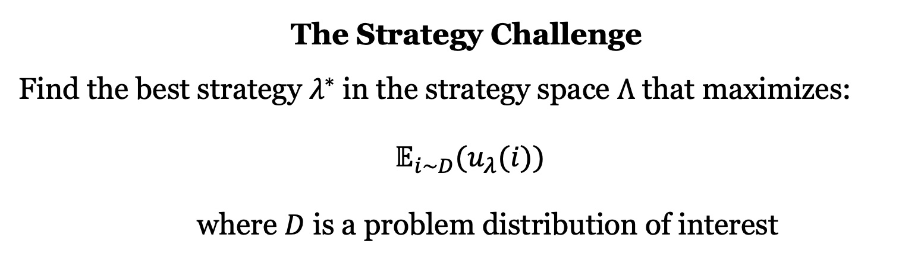
Objective
The Strategy Challenge
Find the best strategy $λ^{∗}$ in the strategy space $Λ$ that maximizes:
$𝔼_{i\sim D}(u_{λ}(i))$
where $D$ is a problem distribution of interest

Slide 11
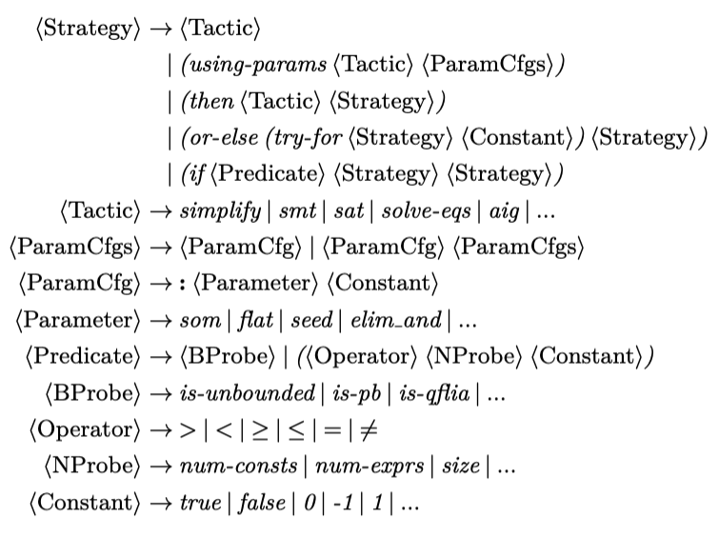
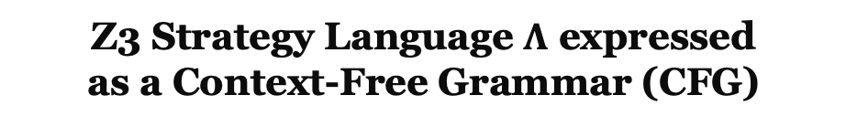
Problem Modelling
Z3 Strategy Language $Λ$ expressed
as a Context-Free Grammar (CFG)

Slide 12
Problem Modelling
MDP Modelling of
Strategy Synthesis
A simplified illustrative CFG
<S> → <T> <S>
<S> → smt
<T> → simplify
<T> → aig
<S>
<T> <S>
simplify <S>
simplify smt
R =eval(simplify smt) = 0.6
e.g., 60% of sample instances
are solved by this strategy

Slide 13
Problem Modelling
Search 1
Search 2
Search 3
<S>
<S>
<S>
<T> <S>
<T> <S>
smt
simply <S>
aig <S>
R = 0.4
……
simplify smt
aig smt
Infinite space, we want to search “smartly”
R = 0.6
R = 0.7✓

Slide 14
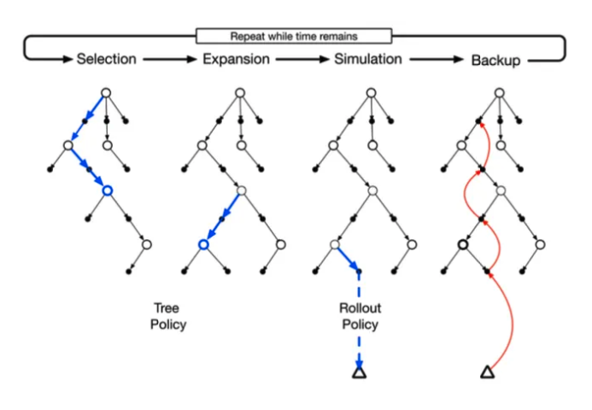
Monte Carlo Tree Search (MCTS)
A Best-First Search technique
The search tries to keep a balance between exploiting Previously Rewarding Trajectories and exploring Less-Visited Paths.

Slide 15
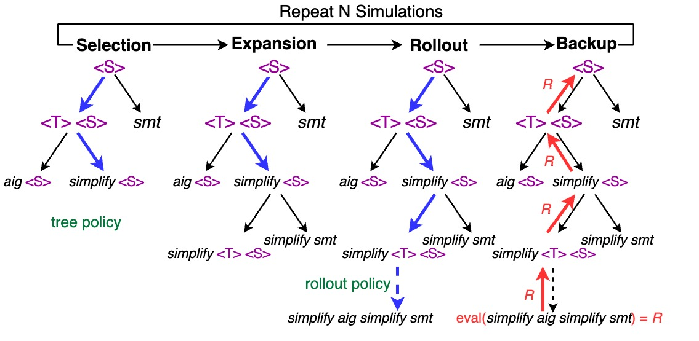
MCTS for Strategy Synthesis: One search

Slide 16
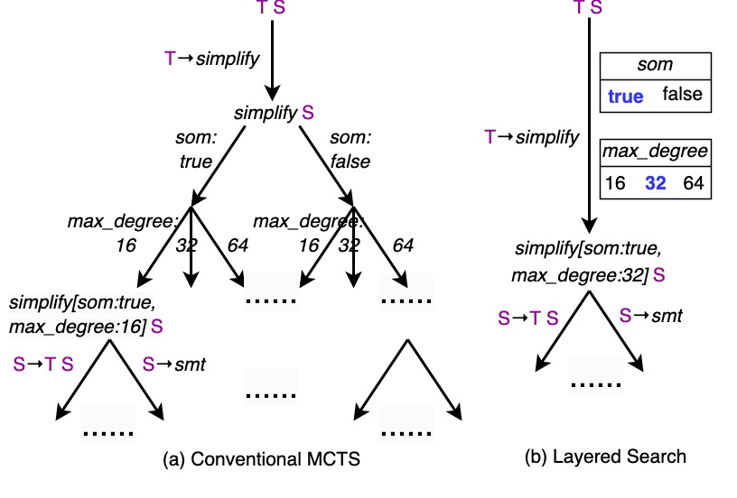
Layered Search for Parameter Configuration
Consider two parameters, i.e., som and max_degree
for the tactic simplify
Treat the parameter tuning as a separate optimization problem aside the main MCTS
The parameter tuning is optimized by Multi-Armed Bandit (MAB)
These MABs DO NOT expand the main MCTS search tree
Notes:
If we consider selecting each value for a parameter as a production rule, the conventional MCTS expands the search tree exponentially for configuring multiple parameters

Slide 17
Staged Search for Branching
Stage 1: Linear Strategy Selection
Stage 2: Branched Strategy Synthesis
Restrict the action space so that each path in AST
is a selected linear strategy from Stage 1
Ln Strat 1
Ln Strat 2
Ln Strat 3
false
true
is-pb
simplify
simplify
sat
simplify
sat
solve-eqs
qfnra-nlsat
Ln Strat 3
10 sec
else
try-for
smt
solve-eqs
qfnra-nlsat
Ln Strat 2
smt
Ln Strat 1
Evaluation: Retrieved from
cached linear strategy results
Evaluation: Interaction with SMT Solver

Slide 18
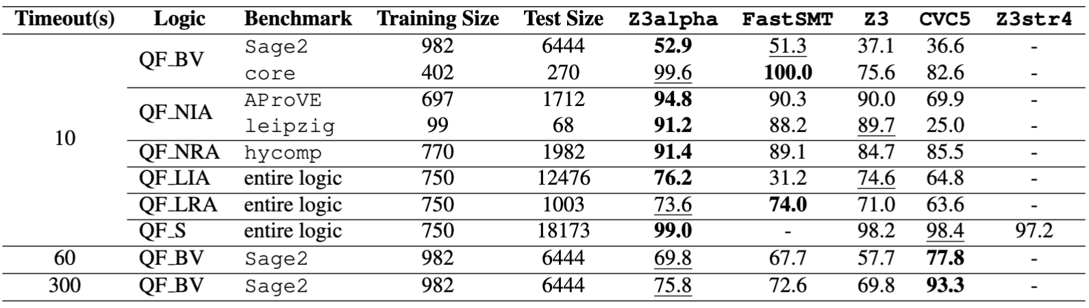
Experiment Results
%Instances Solved (10s time limit)
1
1. Balunovic, M., Bielik, P., & Vechev, M. (2018). Learning to solve SMT formulas. NeurIPS 2018.

Slide 19
Experiment Results – Sample Synthesized Strategy for QF_S
num-exprs > 44
Y
N
try-for
8s
str2regex*
simplify…
solve-eqs
simplify
str2regex*
elim_uncnstr
solve-eqs
ctx-simplify
arr
str2we
str-simplify*
ctx-simplify
smt
smt
* These tactics were in introduced in z3str4, z3str3RE, etc., and are not available as built-in Z3 tactics

Slide 20
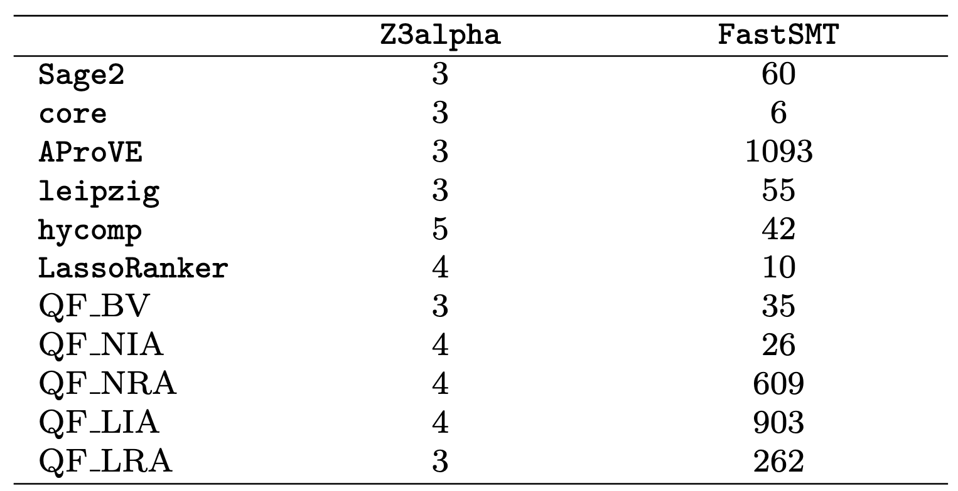
Experiment Results – #Branches in Synthesized Strategies

Slide 21
Z3alpha: a data-driven approach to
automatically search for the best strategy within a large space
of tactics, parameters, and combinations

Slide 22
Future Work
Parallel strategy
A learning theoretical perspective

Slide 23
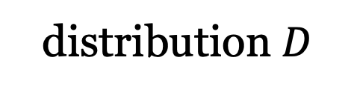
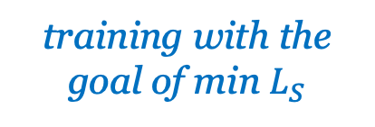
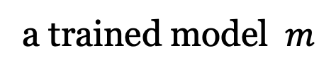
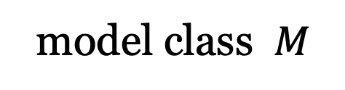
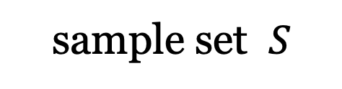
A Foundational Theoretical Machine Learning Question
distribution $D$
model class $M$
sampling
training with the goal of min $L_{S}$
sample set $S$
a trained model $m$
Is $M$Learnable : regardless of $D$, there exist a $|S|$ that guarantees $m$ is good enough with high confidence through learning

Slide 24
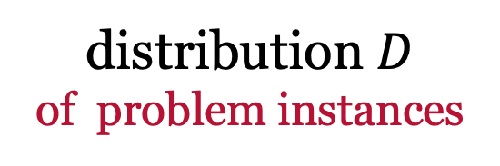
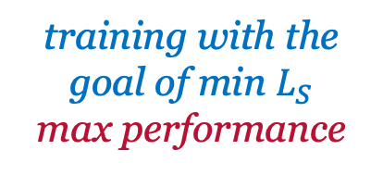
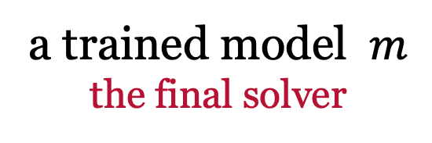
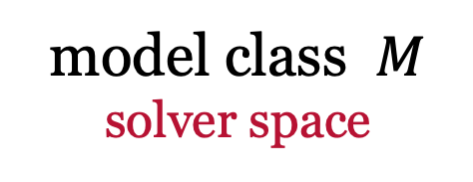
Data-Driven Solver Design: A Theoretical ML Perspectuve^{1,2}
distribution $D$
of problem instances
model class $M$
solver space
sampling
training with the goal of min $L_{S}$
max performance
a trained model $m$
the final solver
sample set $S$
Is $M$learnable – algorithm selection, strategy language, parallel portfolio…
What is the required sampling instance size
1. Gupta, R., & Roughgarden, T. (2016). A PAC approach to application-specific algorithm selection. SIAM J. Comput.
2. Balcan, M. F., Deblasio, D., Dick, T., Kingsford, C., Sandholm, T., & Vitercik, E. (2024). How Much Data Is Sufficient to Learn High-Performing Algorithms?. Journal of the ACM.

Slide 25
Thank You!

