Slide 1
Indexing
Prof. X

Slide 2
Outline
Primary / Secondary Indices
Index-sequential (ISAM)
B - trees, B+ - trees, B* - trees

Slide 3
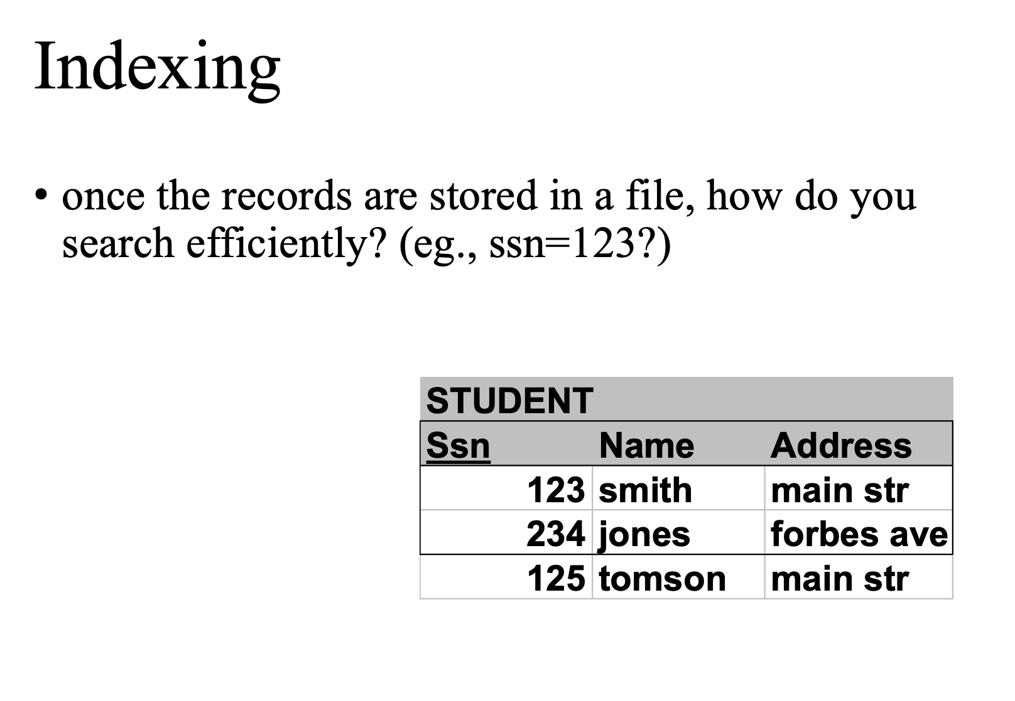

Slide 4
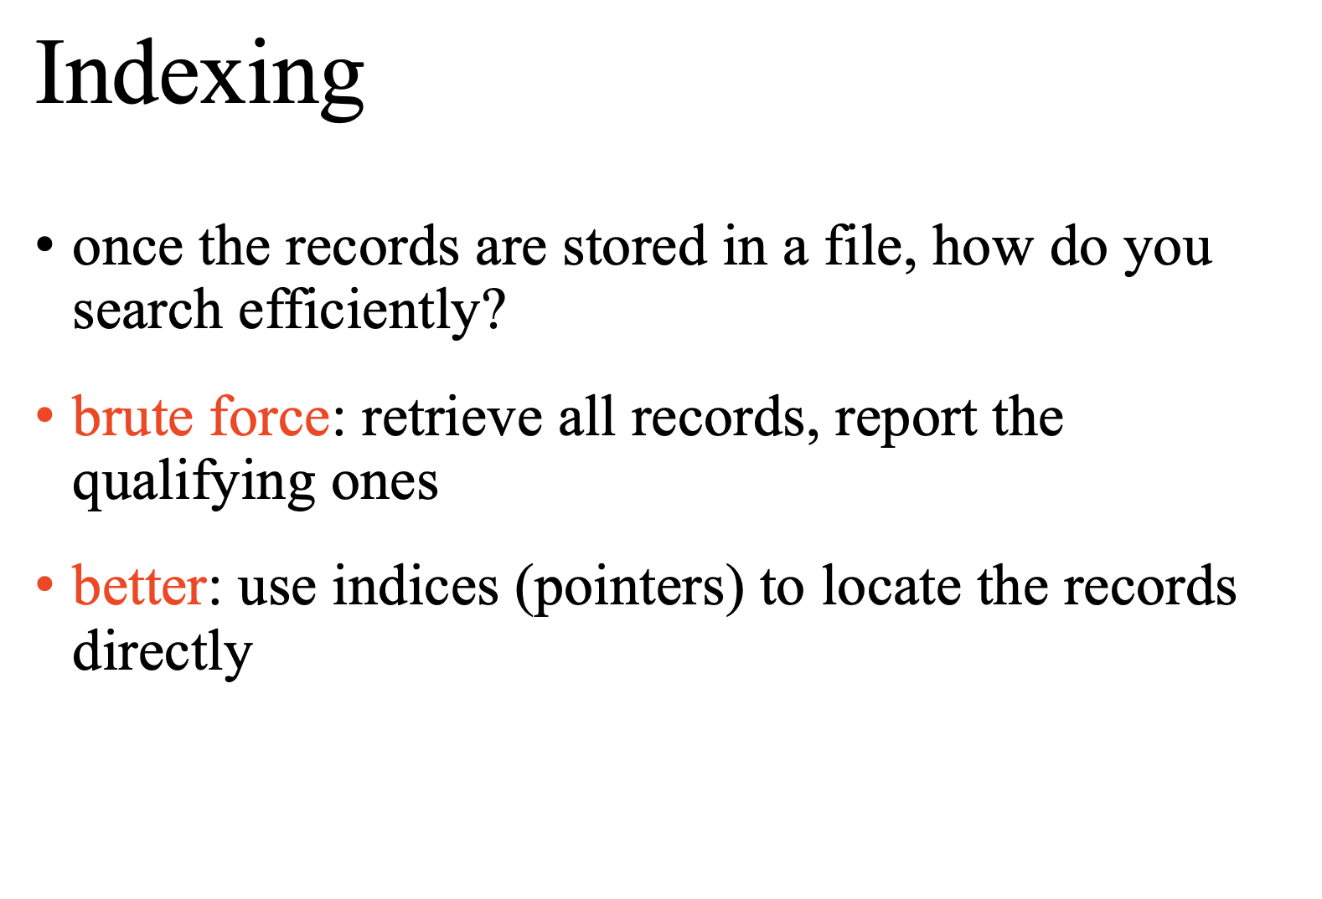

Slide 5
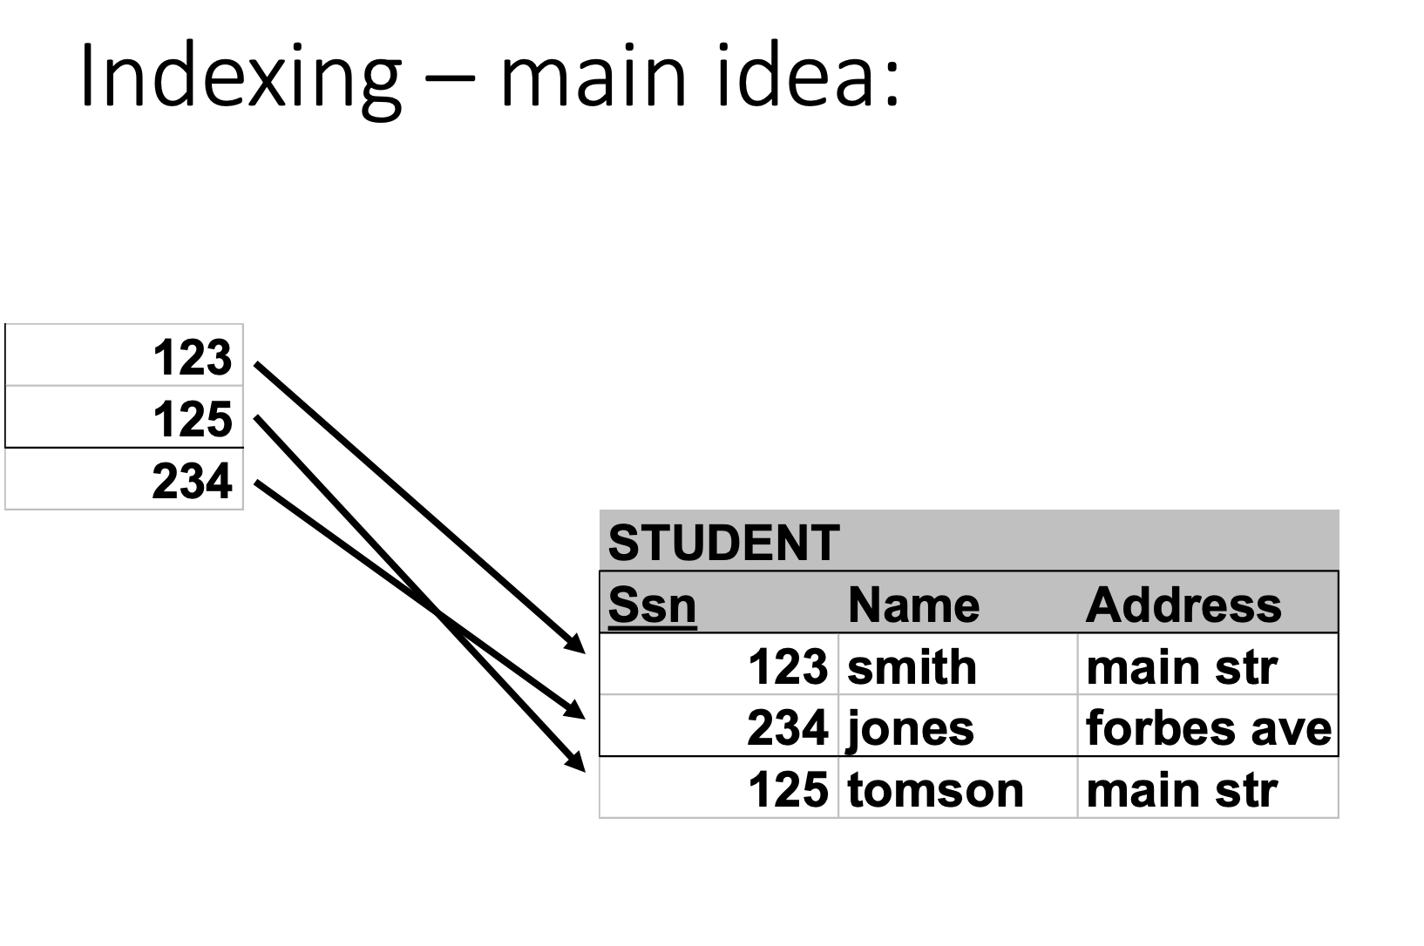

Slide 6
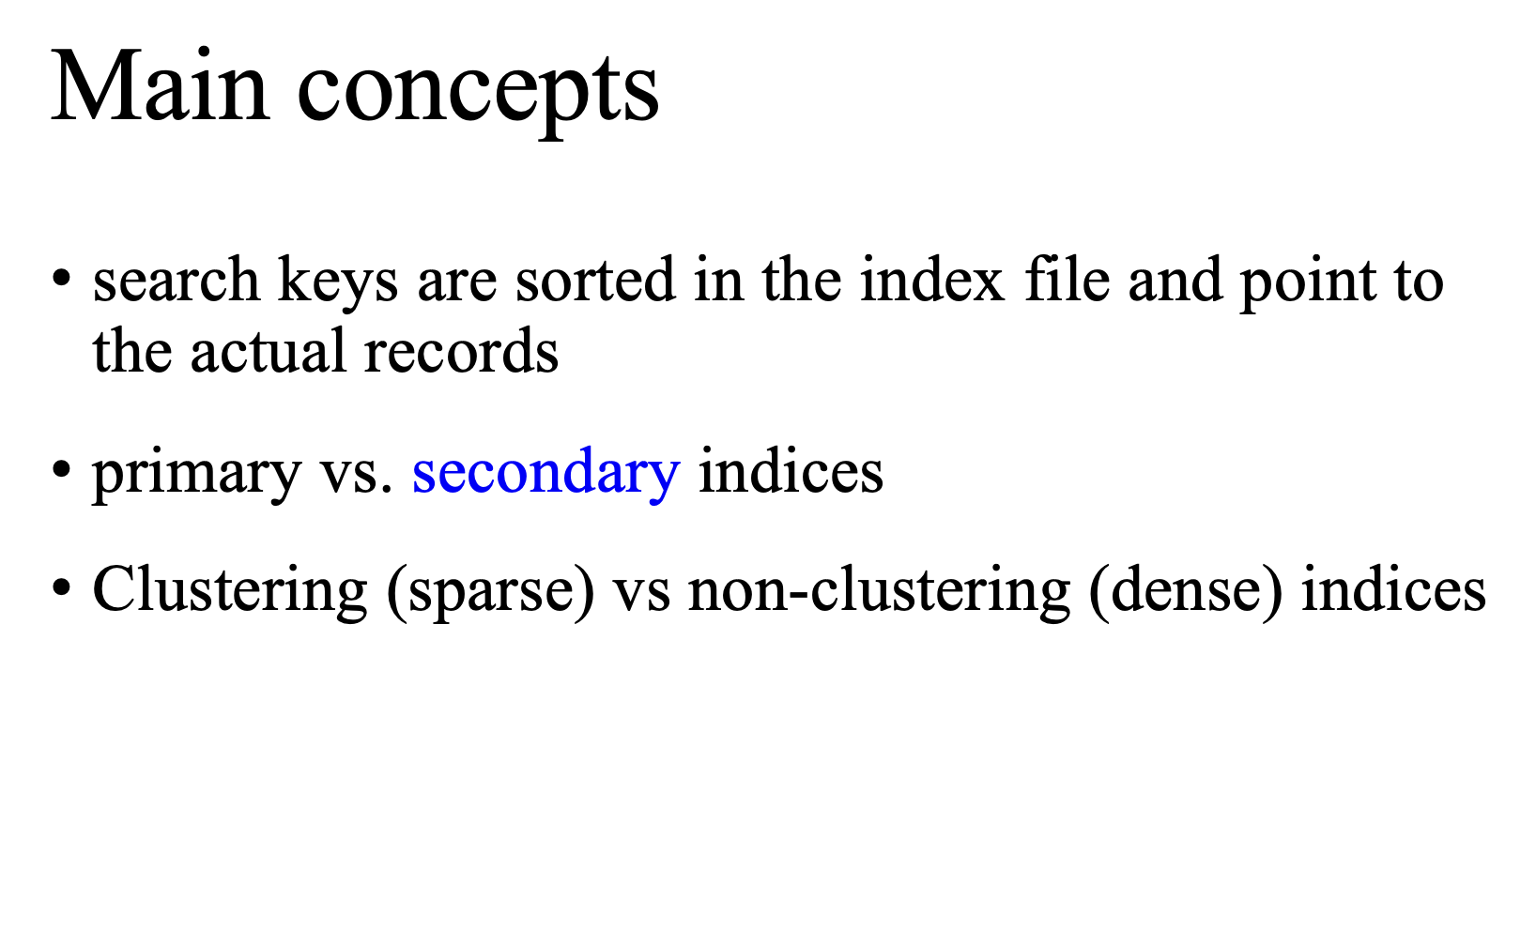

Slide 7
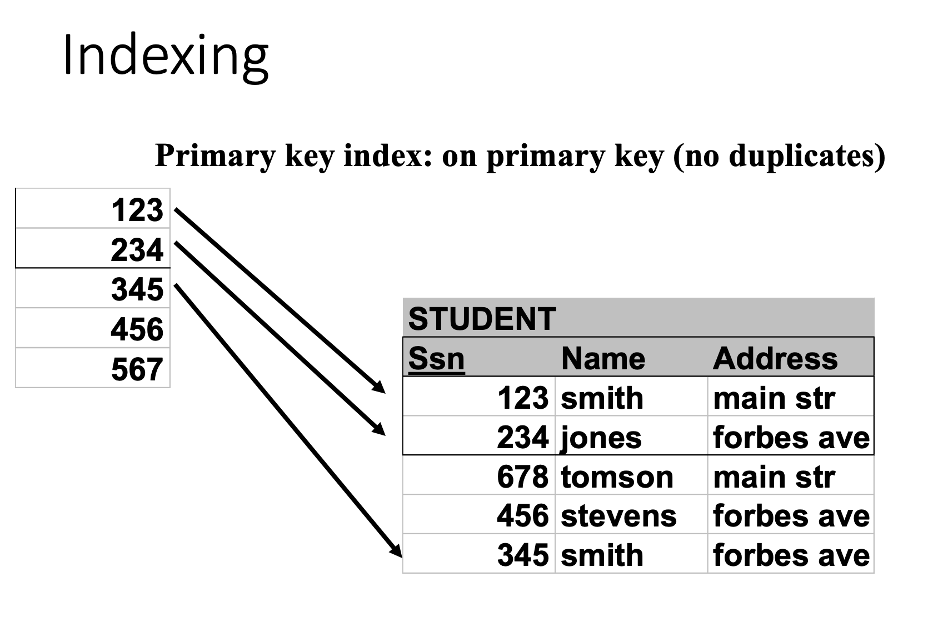

Slide 8
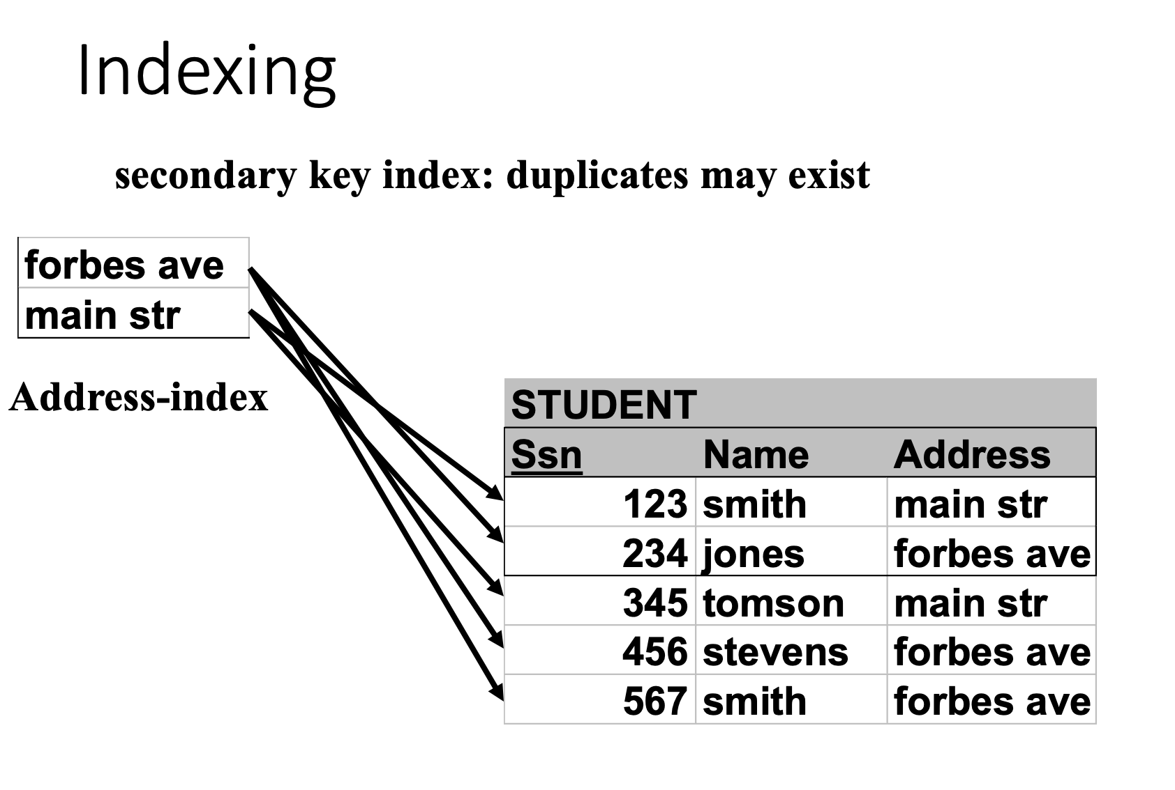

Slide 9
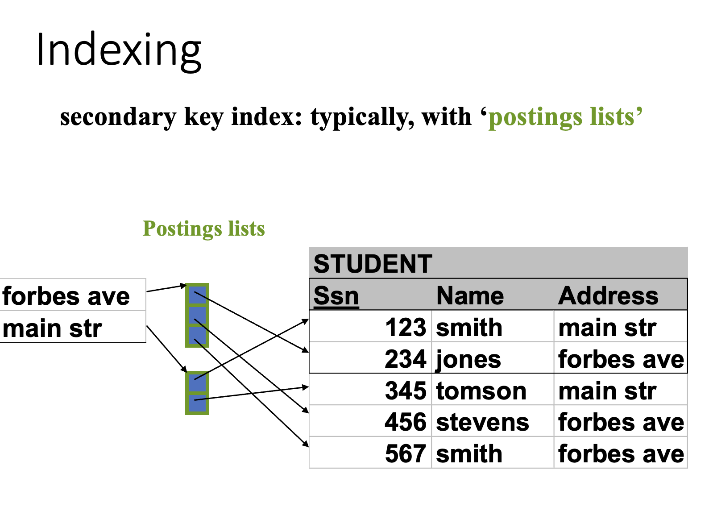
Notes:
Postings lists: theoretically, can be viewed as linked lists But in practice, real-world systems use a combination of Dynamic Arrays, Compressed Blocks, Skip list

Slide 10
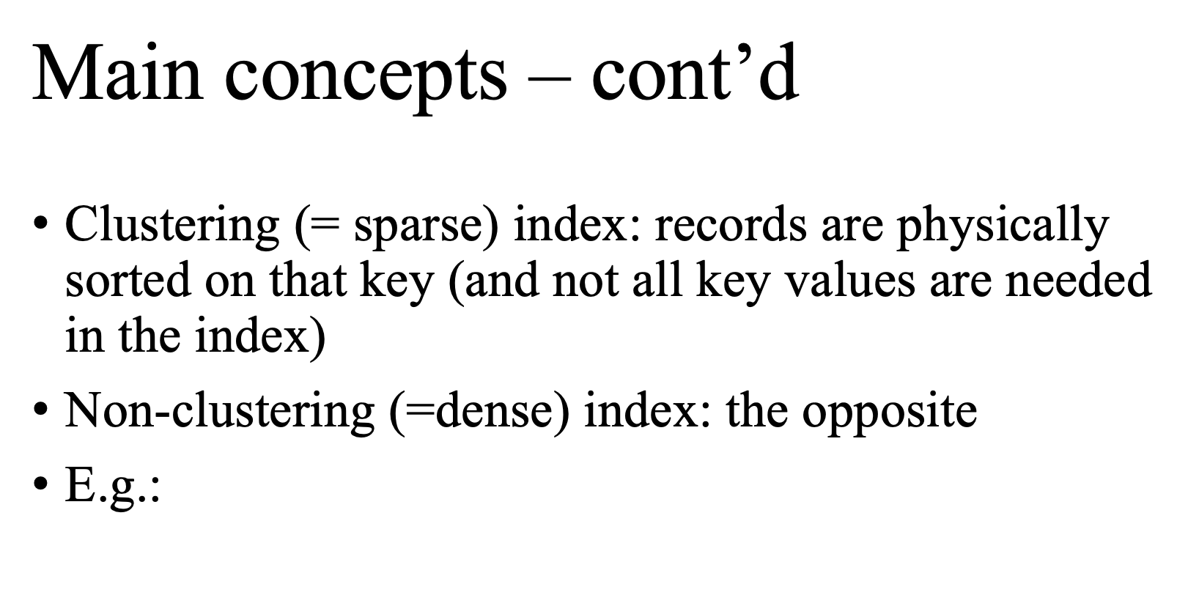

Slide 11
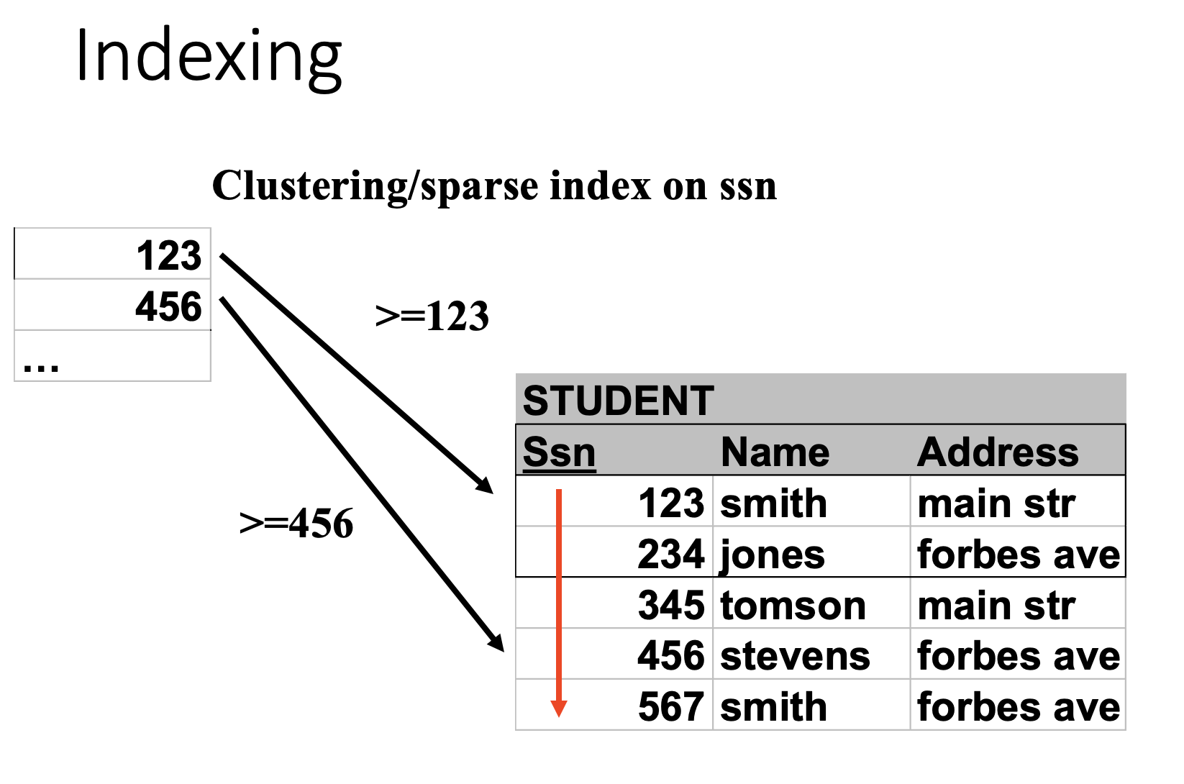

Slide 12
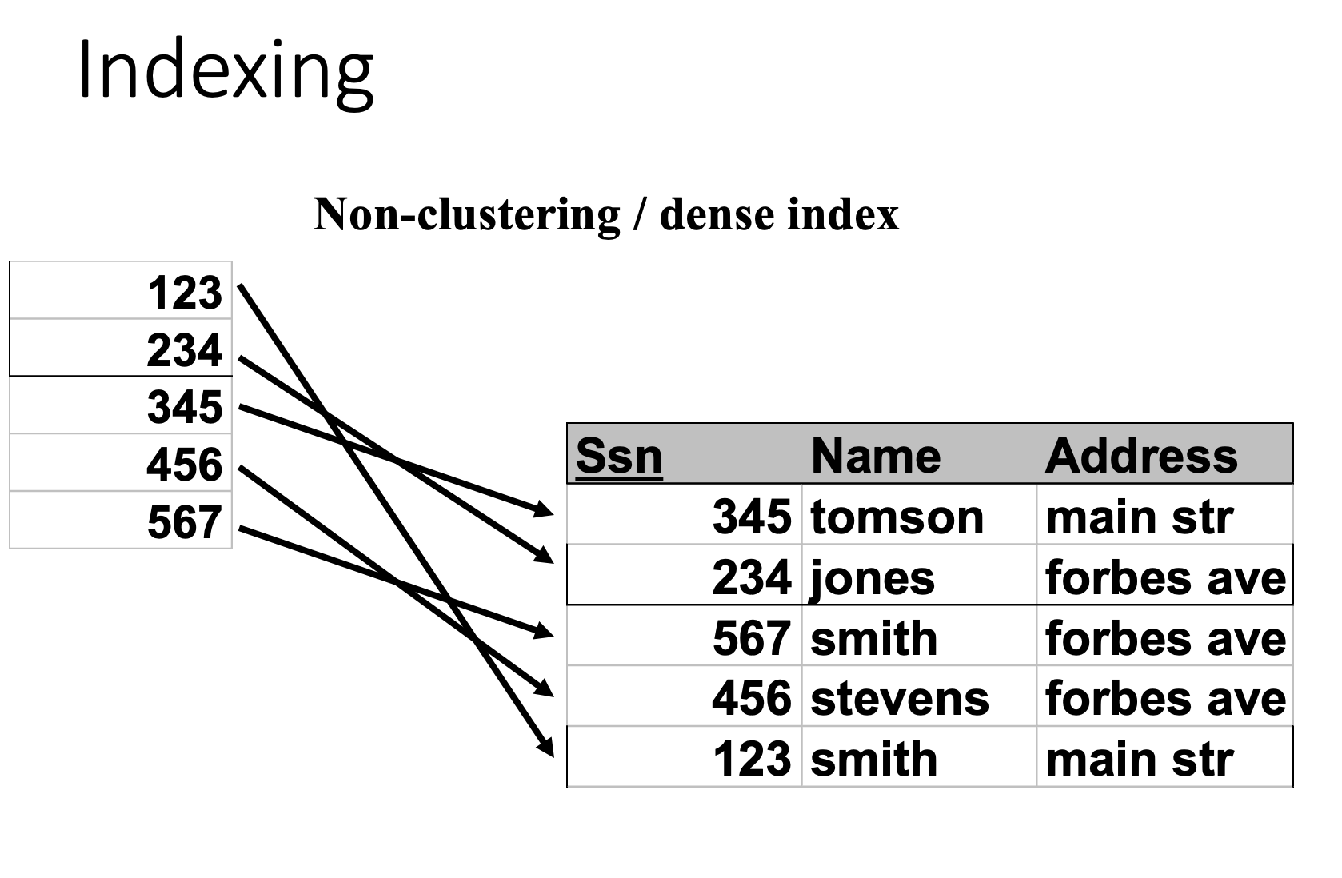

Slide 13
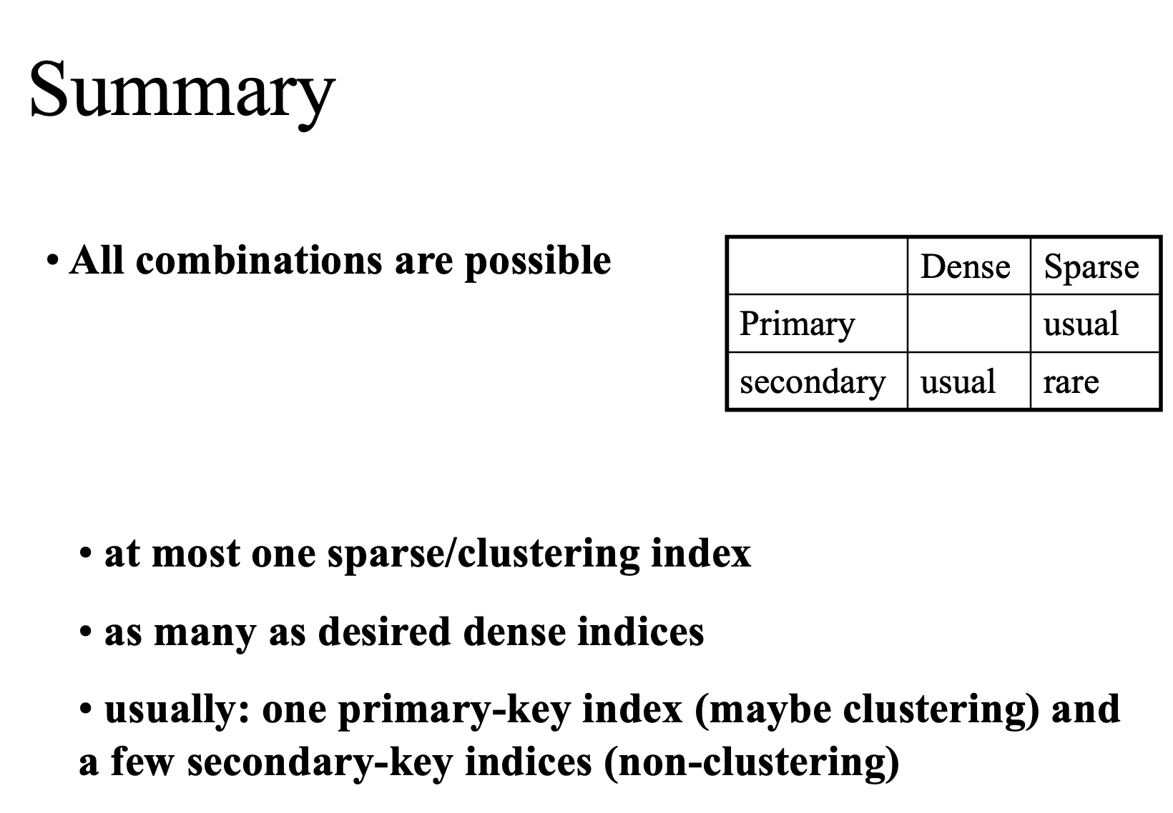

Slide 14
Index-Sequential (ISAM)
ISAM is a file organization method that combines sequential storage with a separate index structure to enable efficient data retrieval.
Data records are stored in sorted order on disk
A primary index maps key ranges → disk blocks
Enables both:
Fast random access (via index)
Efficient sequential access (ordered data)
Search Process
Use index to locate the correct block
Scan block sequentially to find the record
Notes:
Disk I/O is block-based (this is the key reason)
A disk read fetches a whole block (page) at once
Reading one record vs 100 records in the same block costs almost the same

Slide 15
Issues with ISAM
Static Indexing
New records (insertion) often don’t fit in place
Deleted records (deletion) leave holes
So ISAM is not good for frequent insertion or deletion
If index is too large, store it on disk and keep index-on-the-index
Usually two levels of indices, one first- level entry per disk block

Slide 16
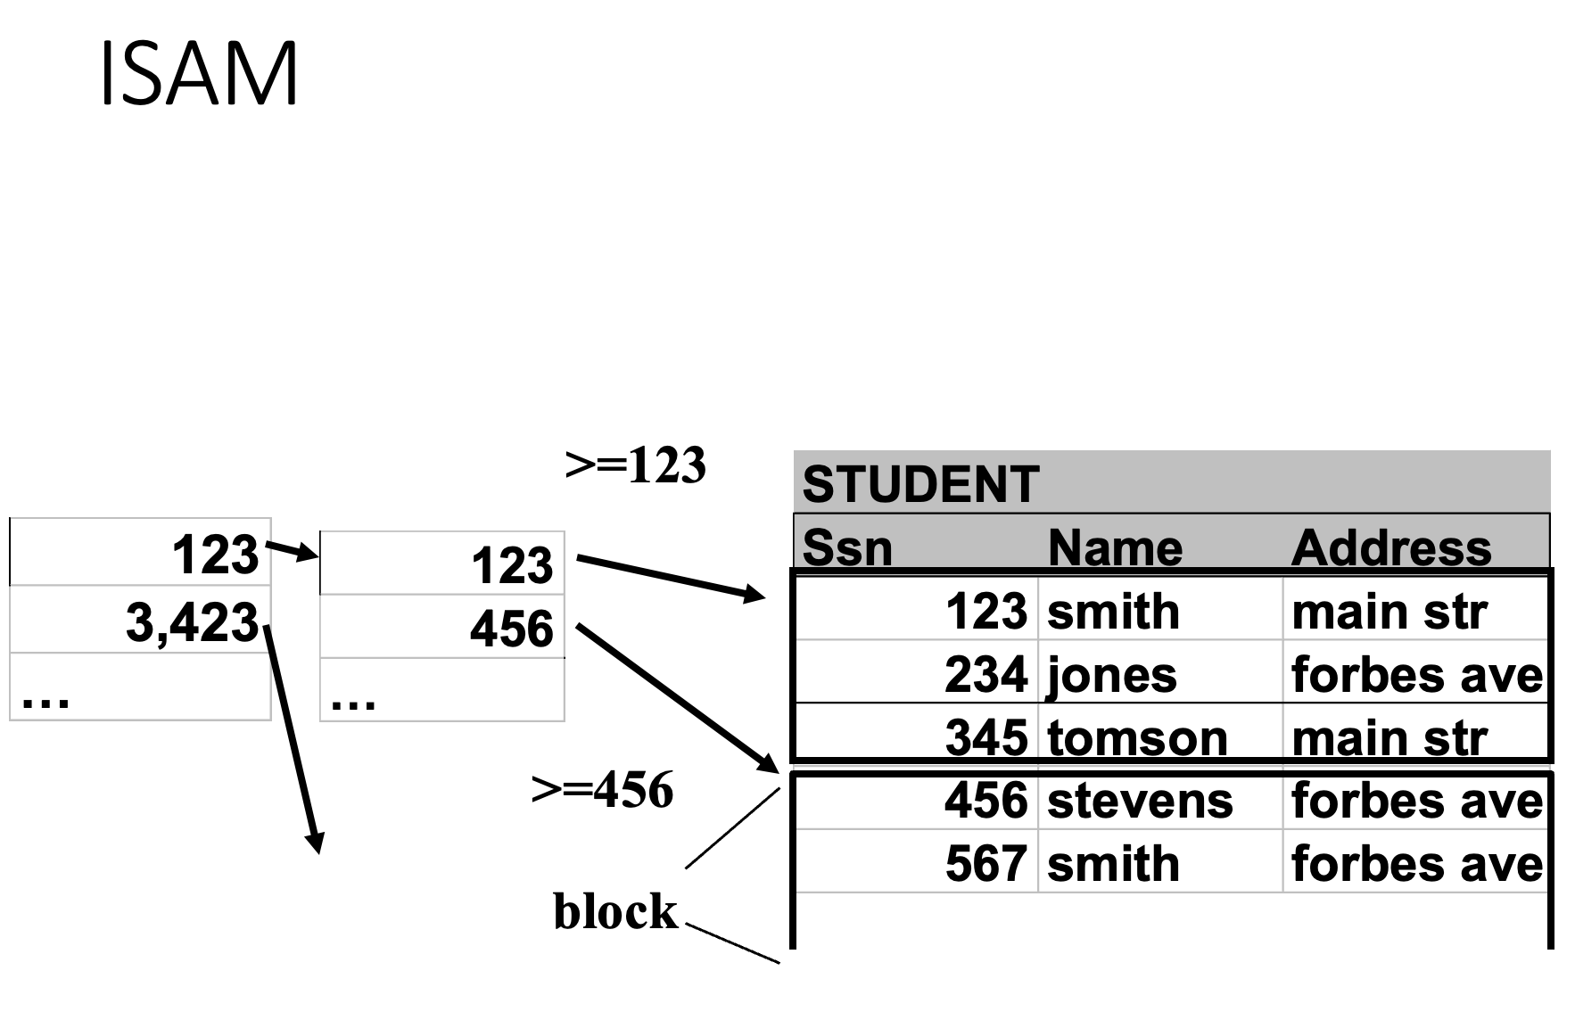

Slide 17
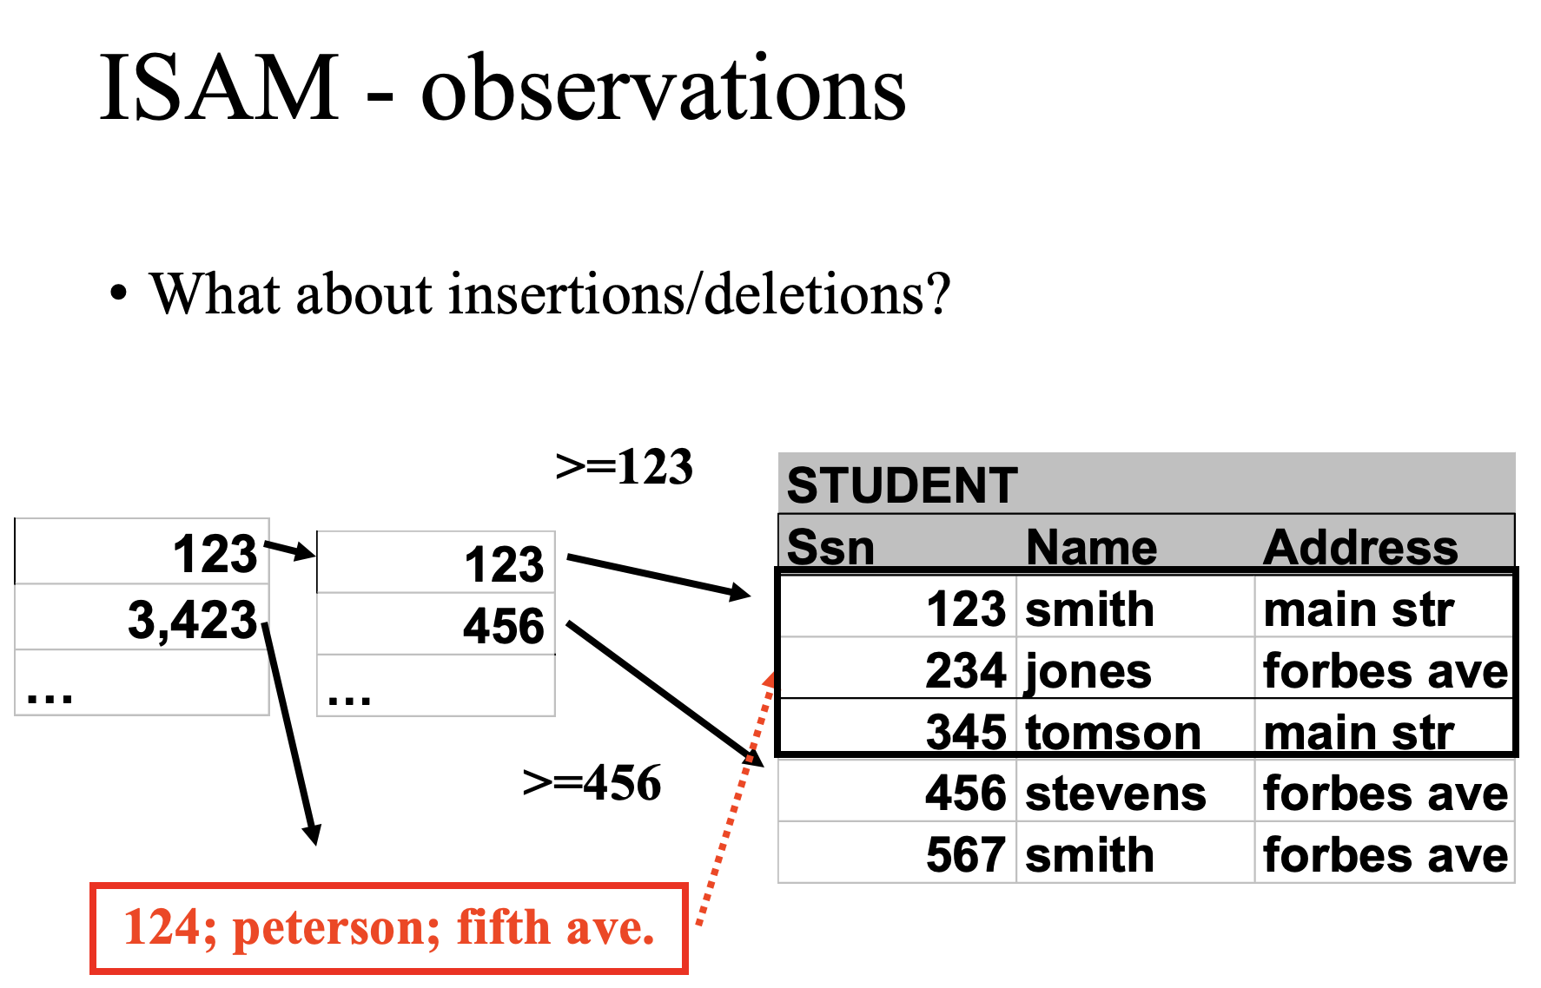

Slide 18
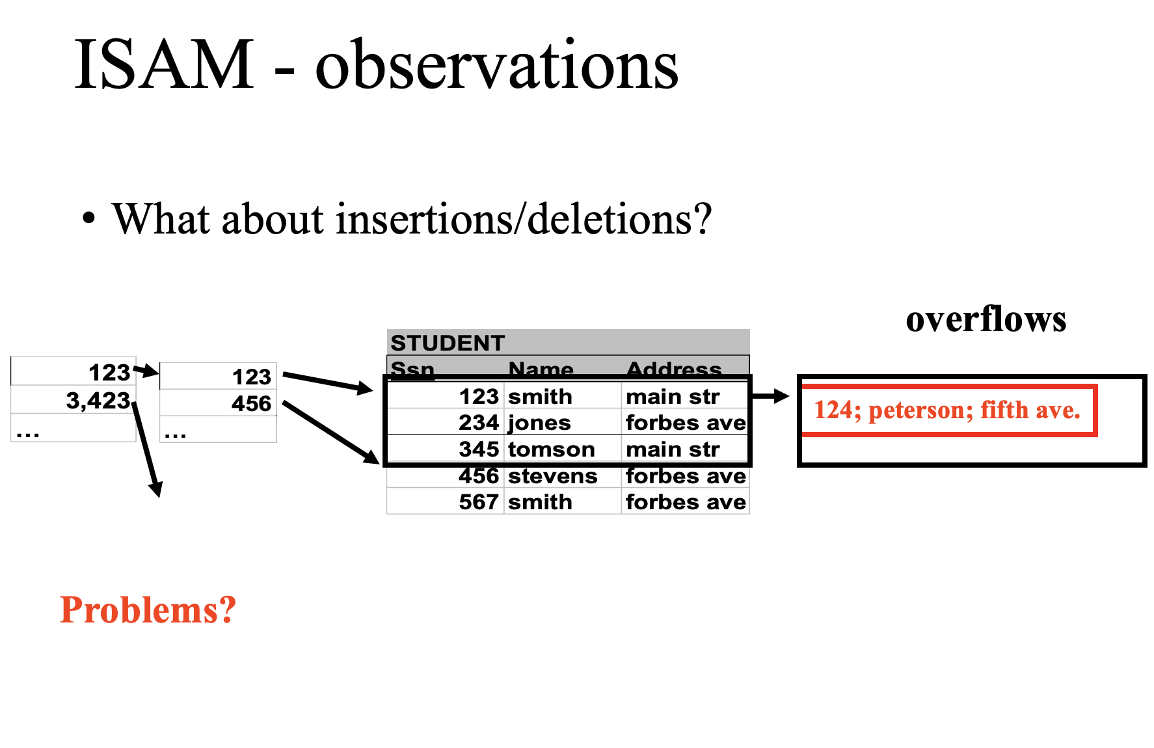

Slide 19
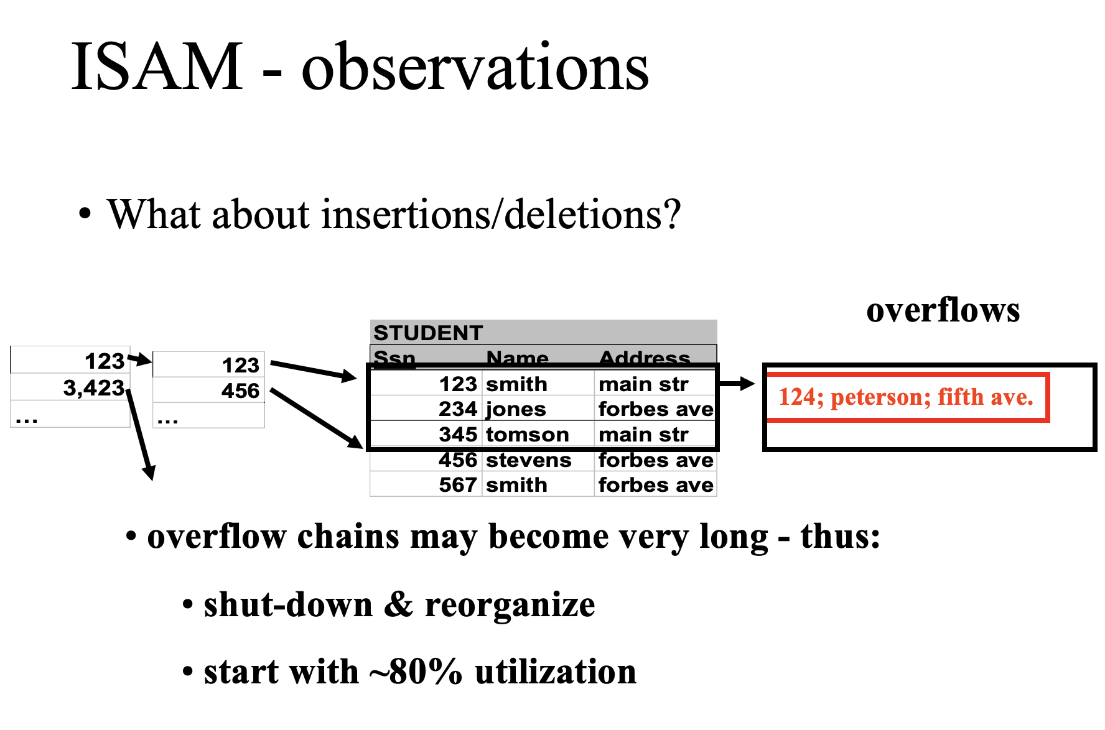

Slide 20
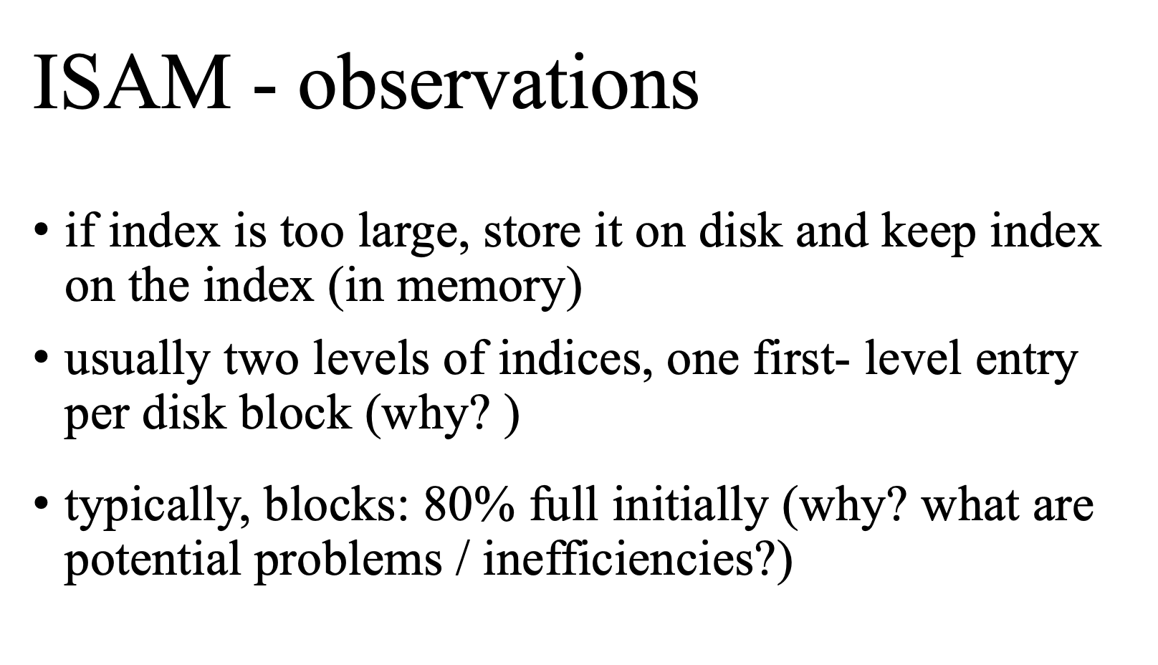

Slide 21
Indices (like ISAM) suffer in the presence of frequent updates
Alternative indexing structure: B – tree Families (dynamic indexing)

Slide 22
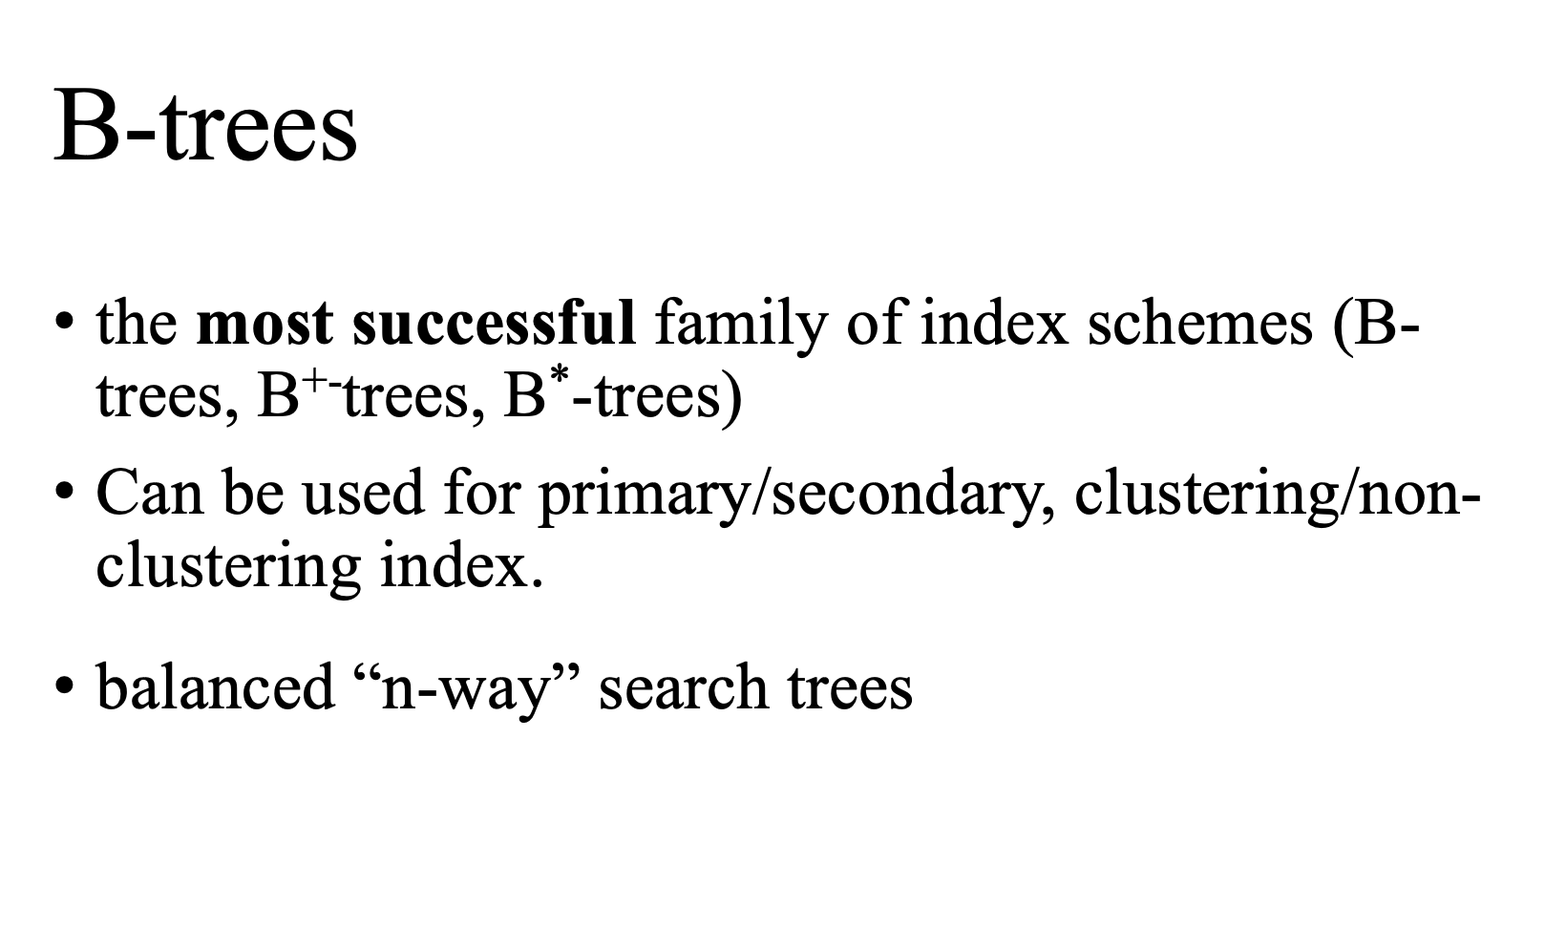

Slide 23
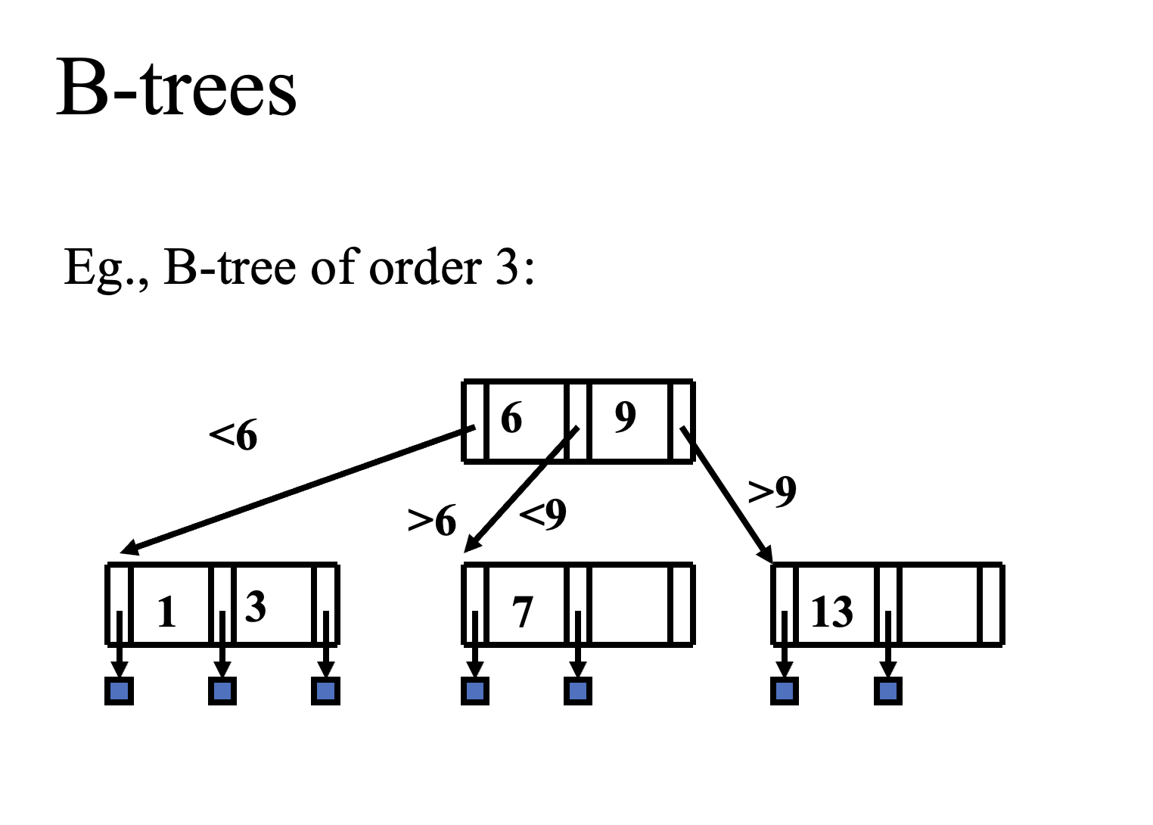

Slide 24
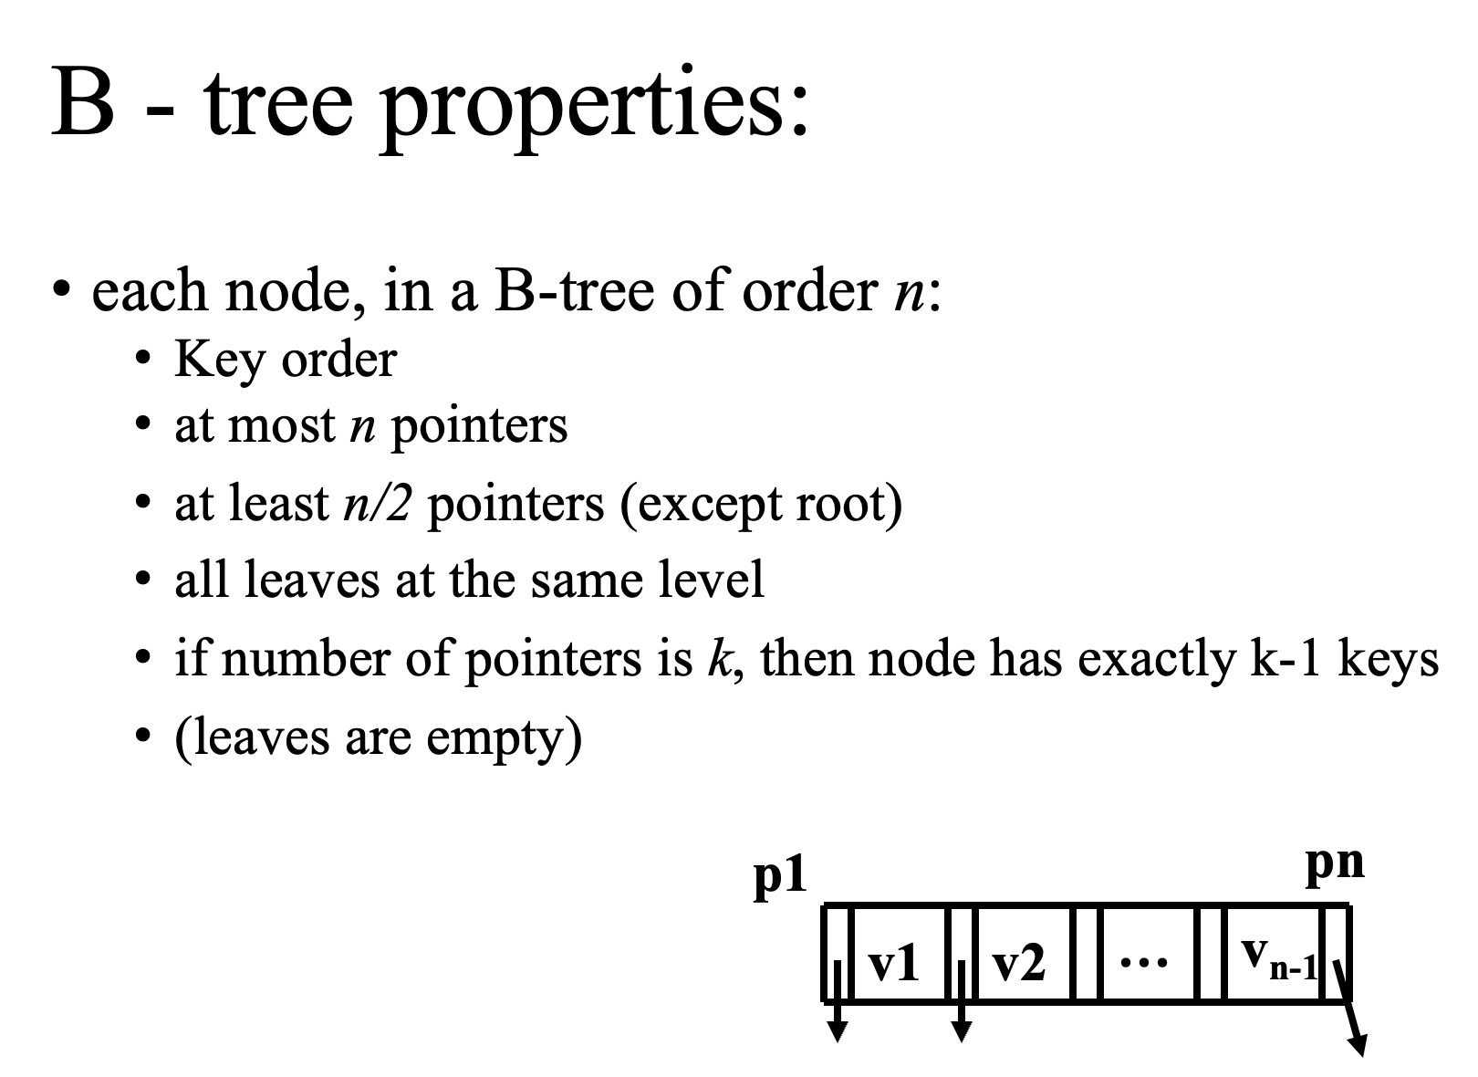

Slide 25
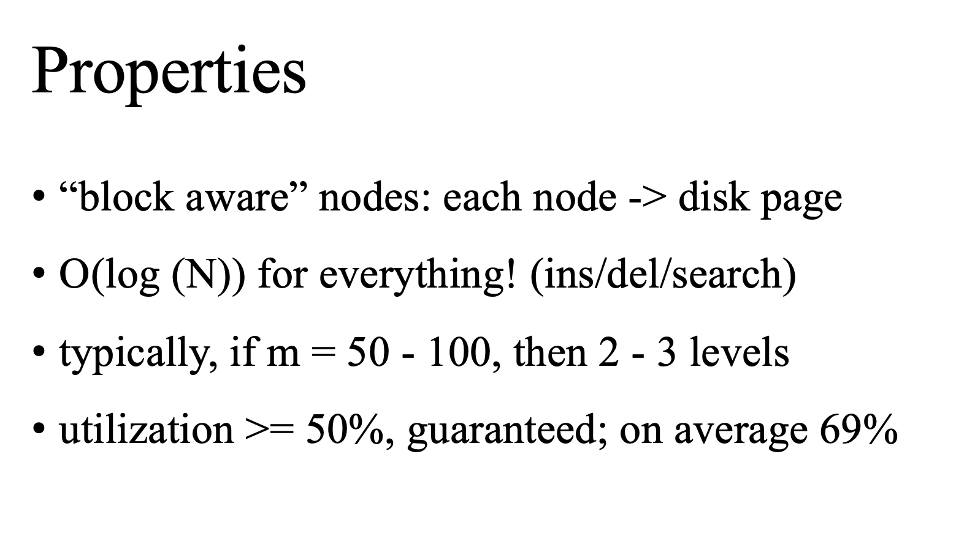

Slide 26
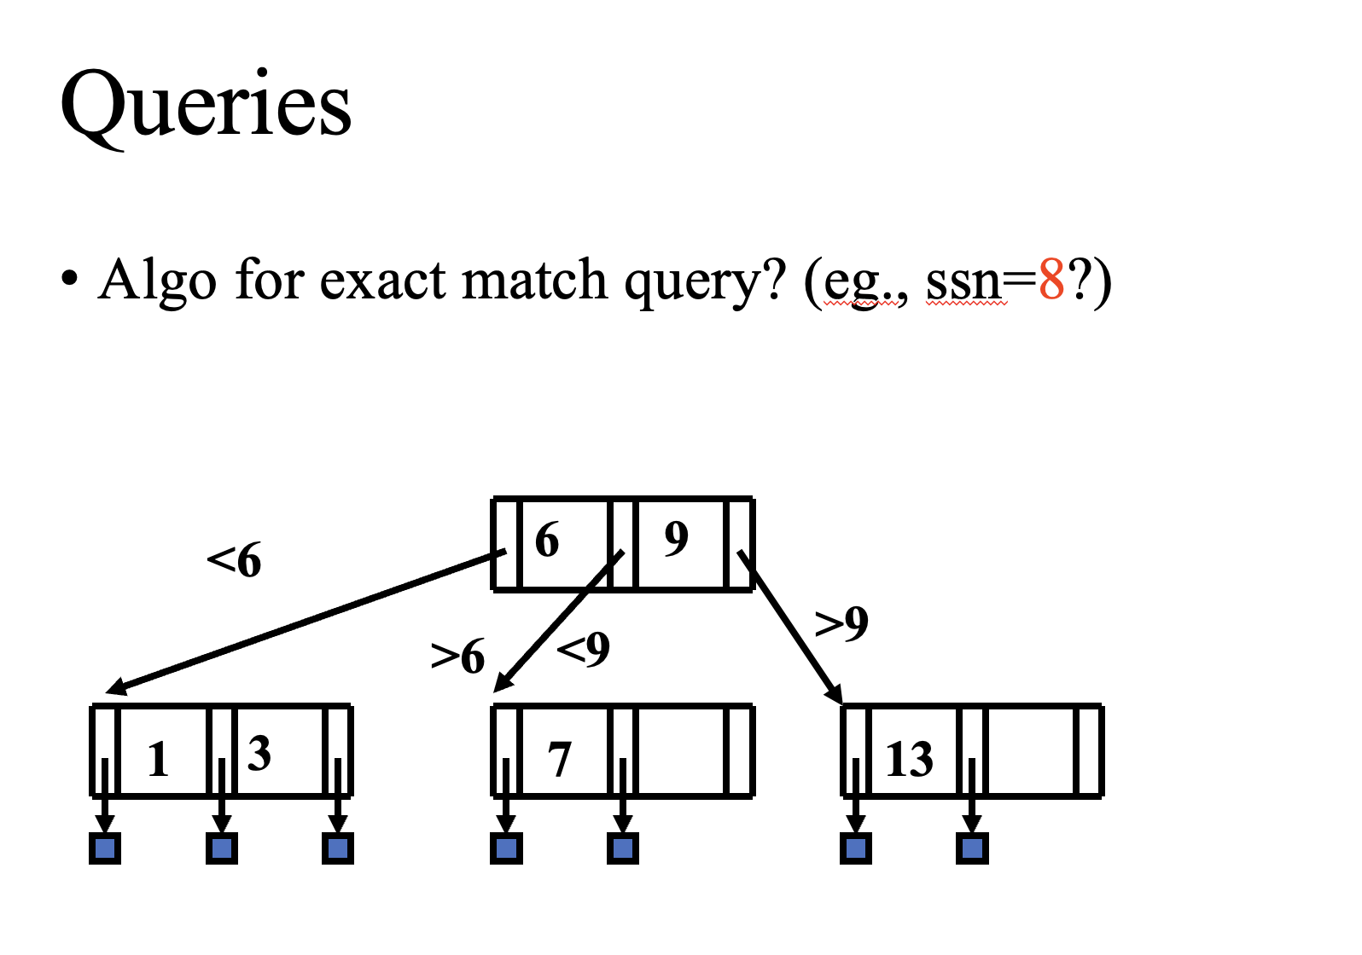

Slide 27
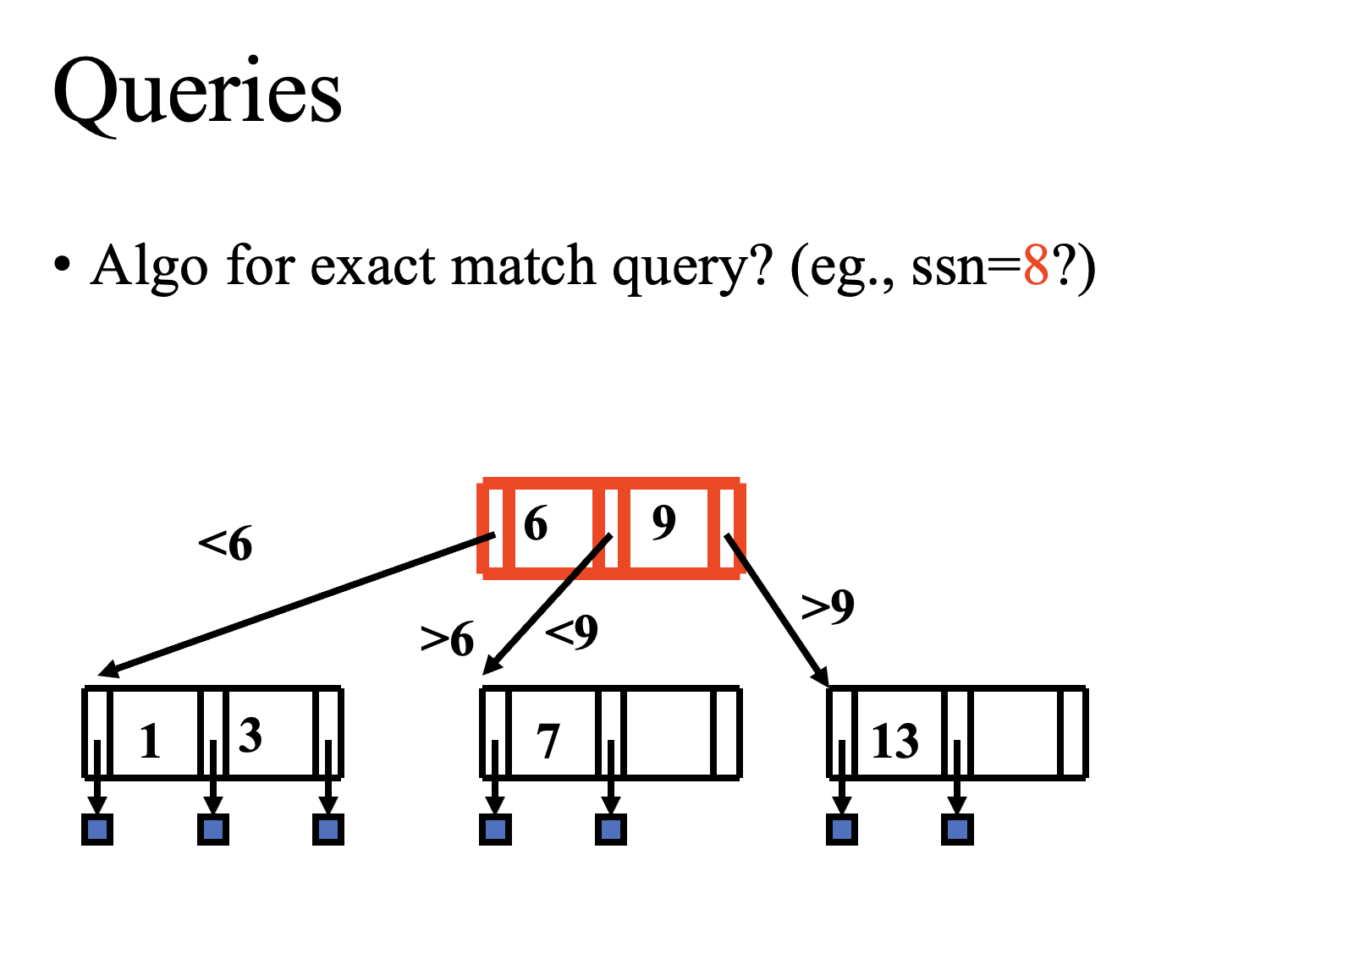

Slide 28
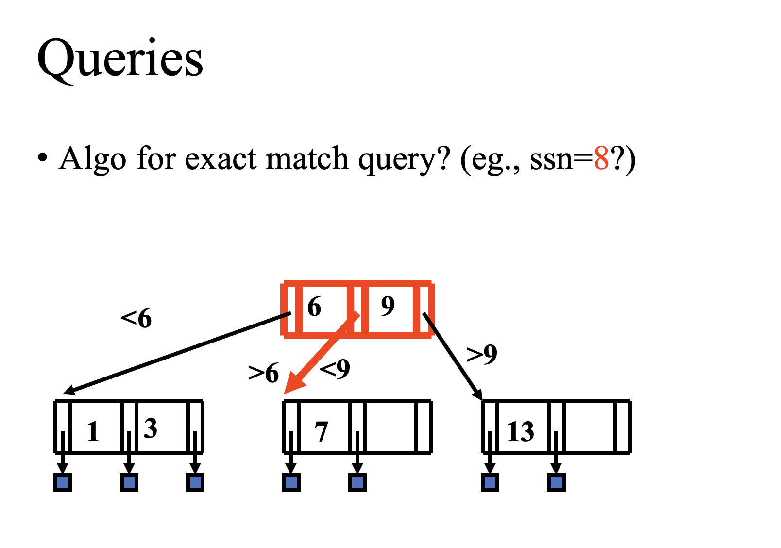

Slide 29
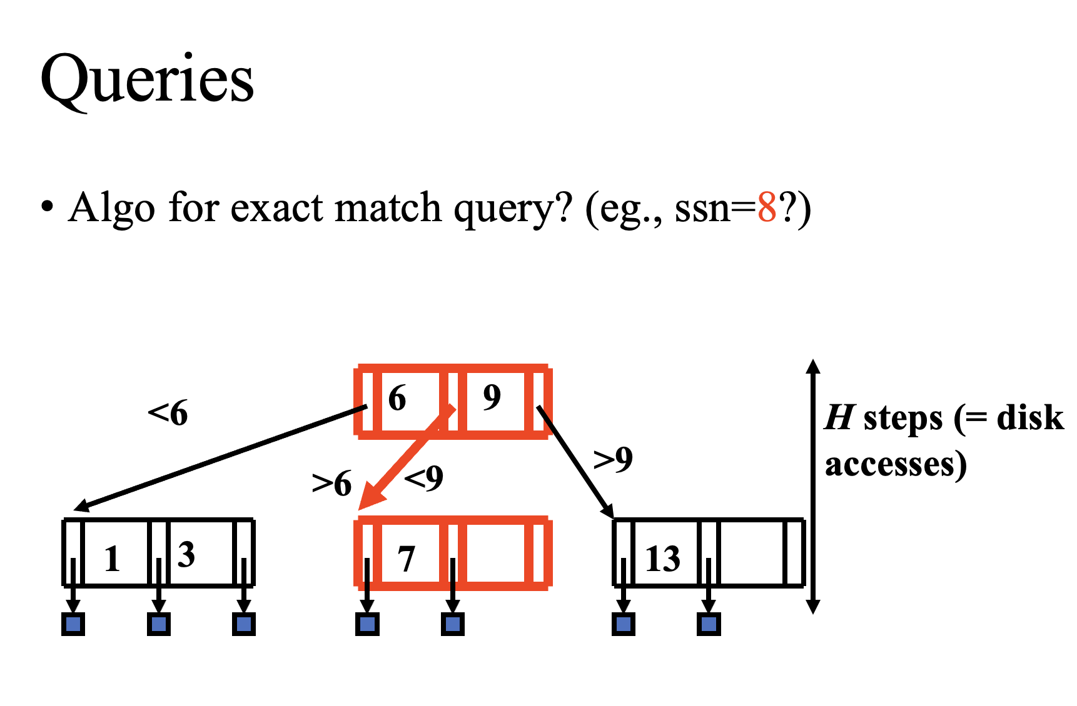

Slide 30
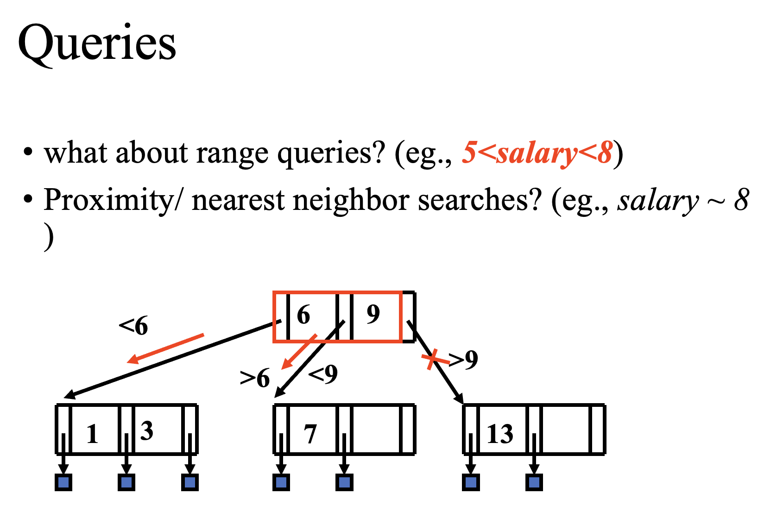

Slide 31
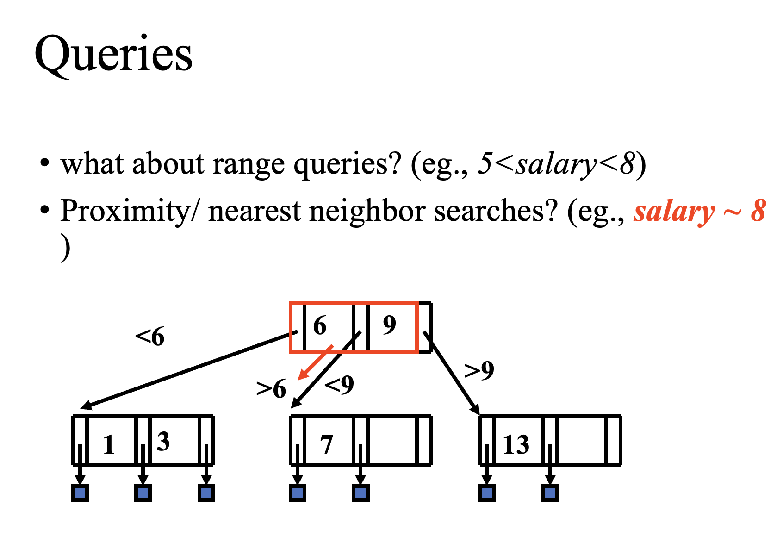

Slide 32
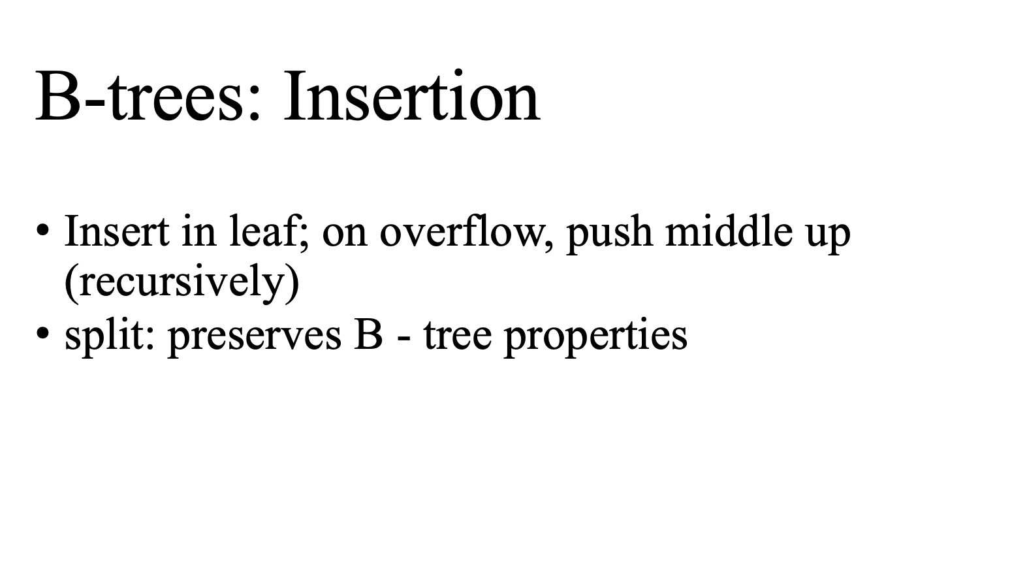

Slide 33
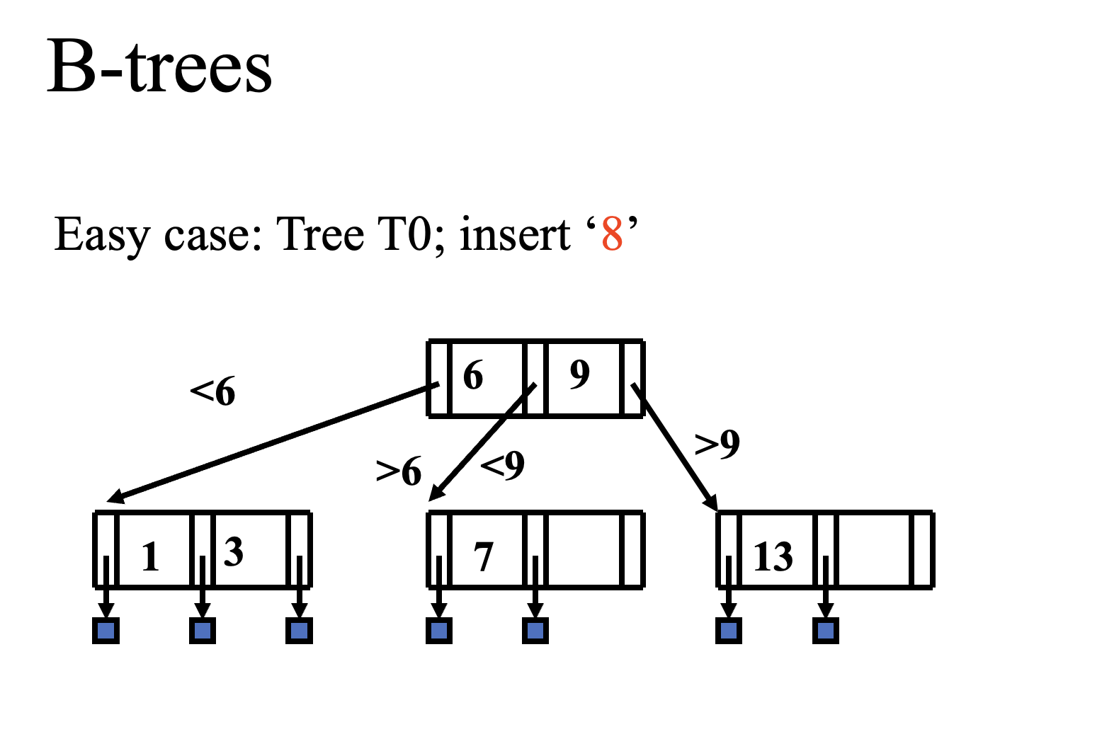

Slide 34
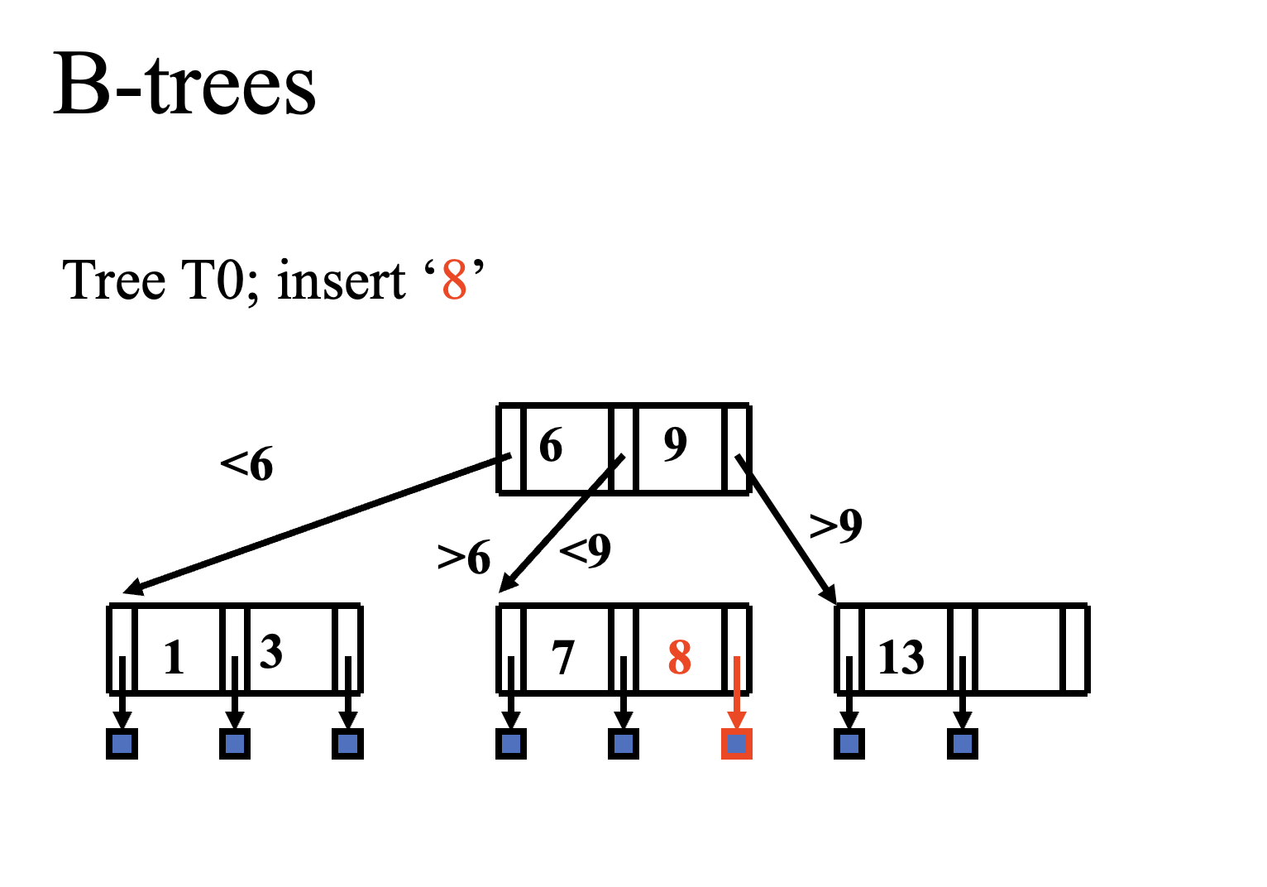

Slide 35
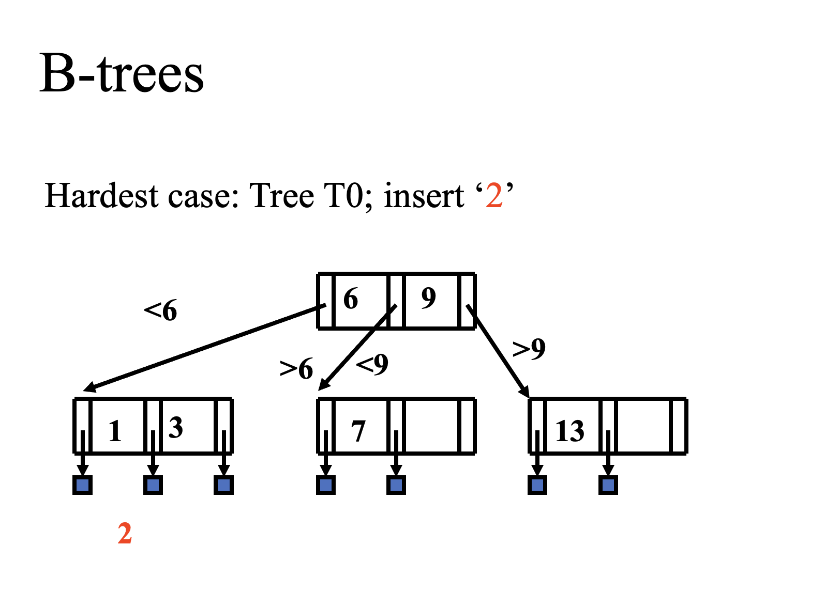

Slide 36
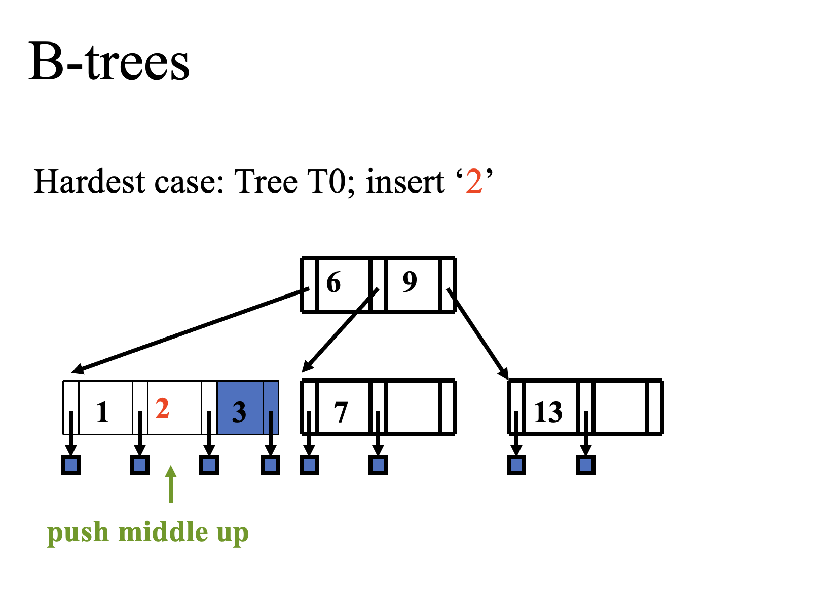

Slide 37
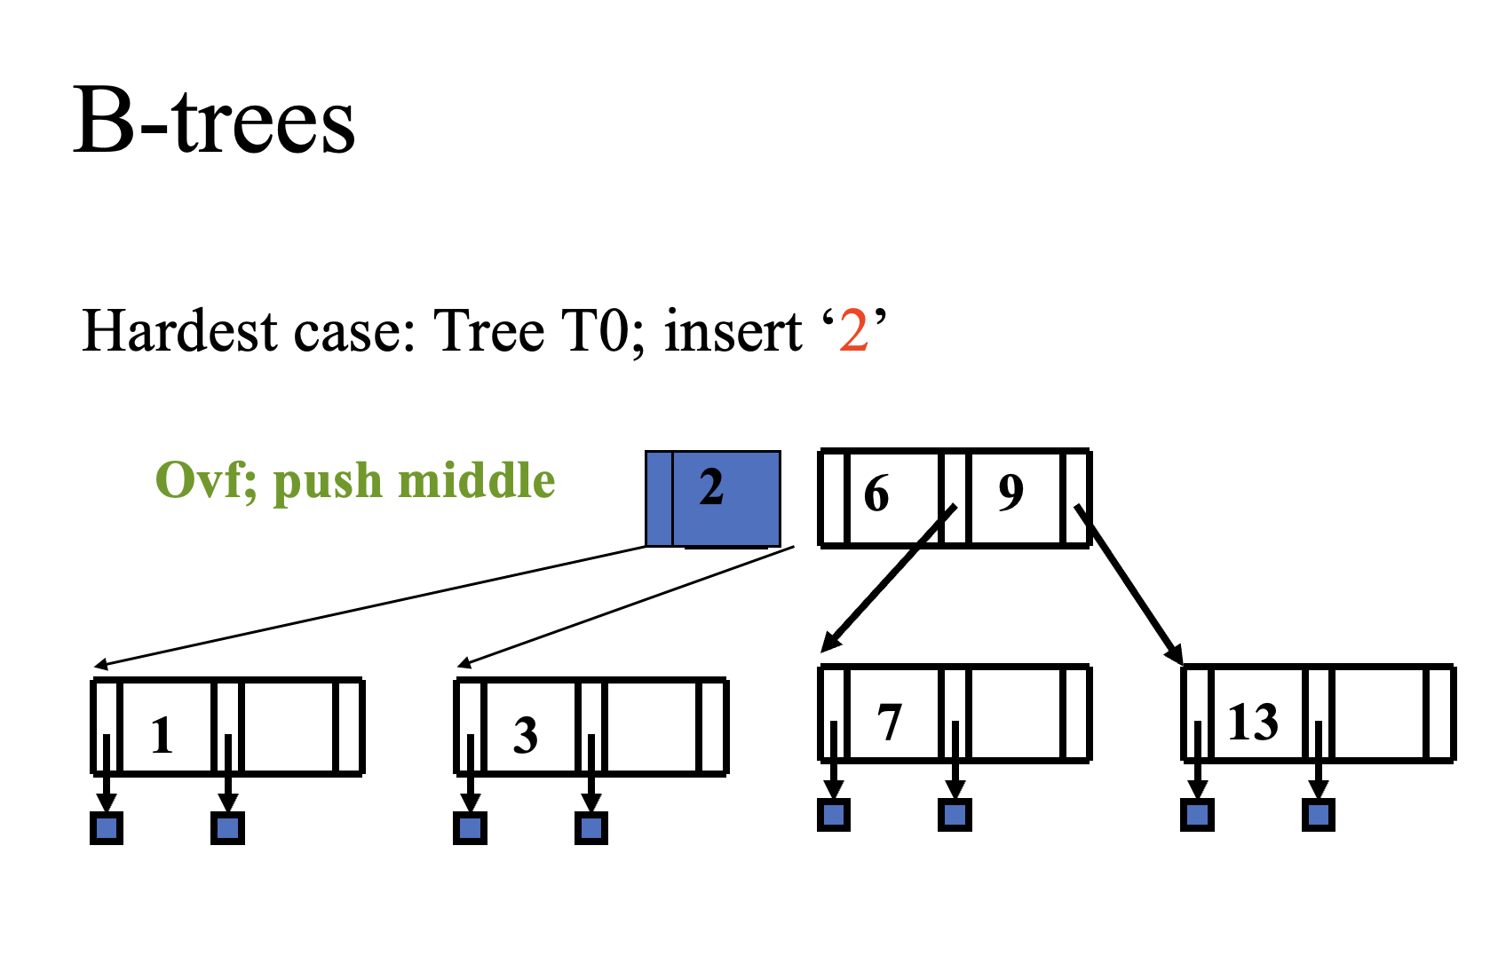

Slide 38
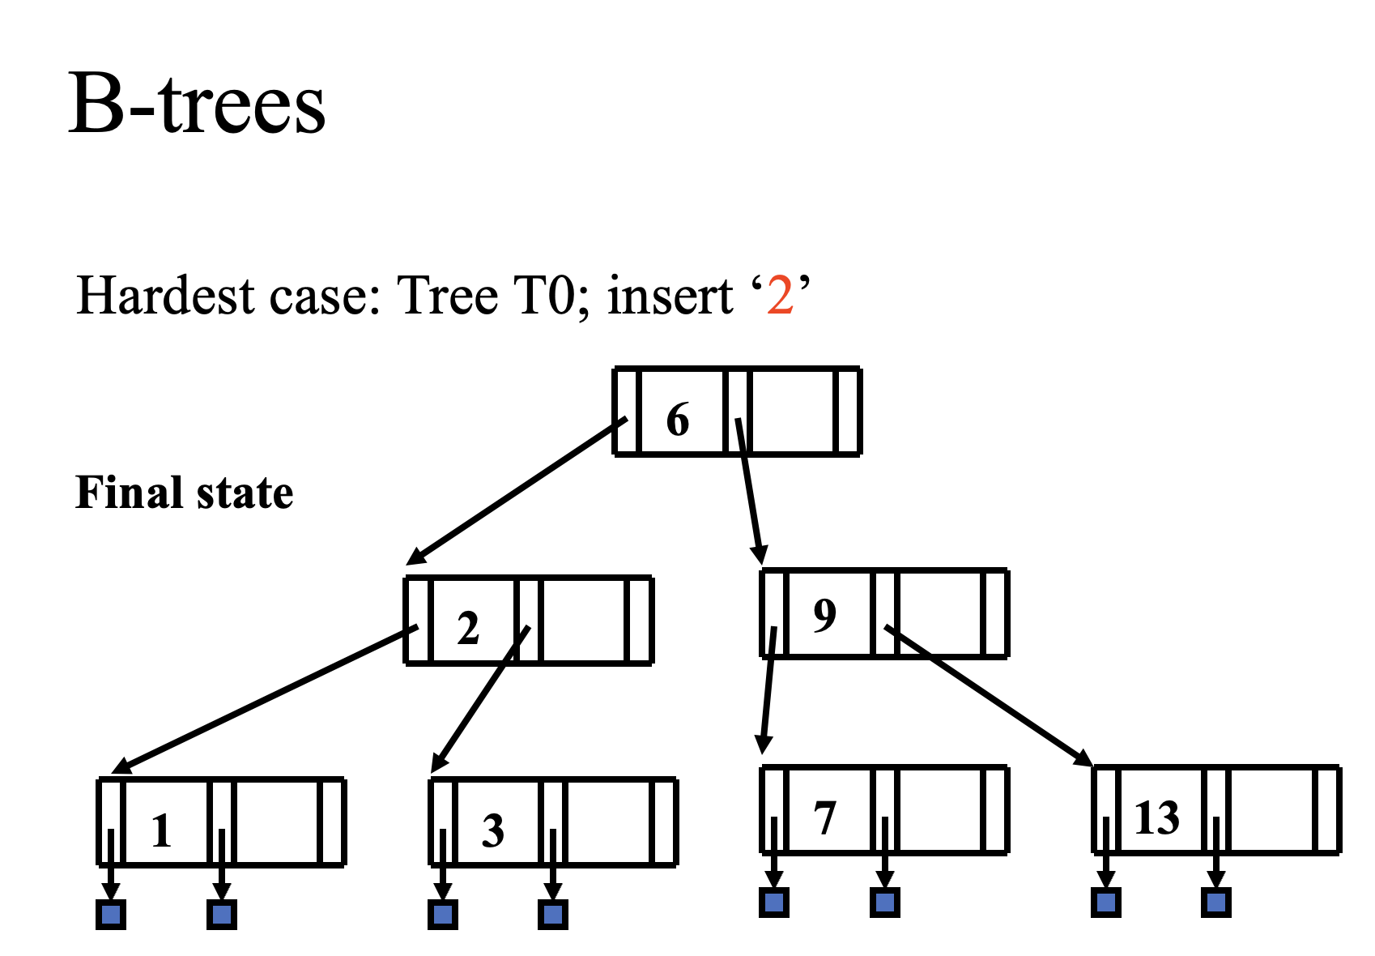
Notes:
Only 50% of the tree is used

Slide 39
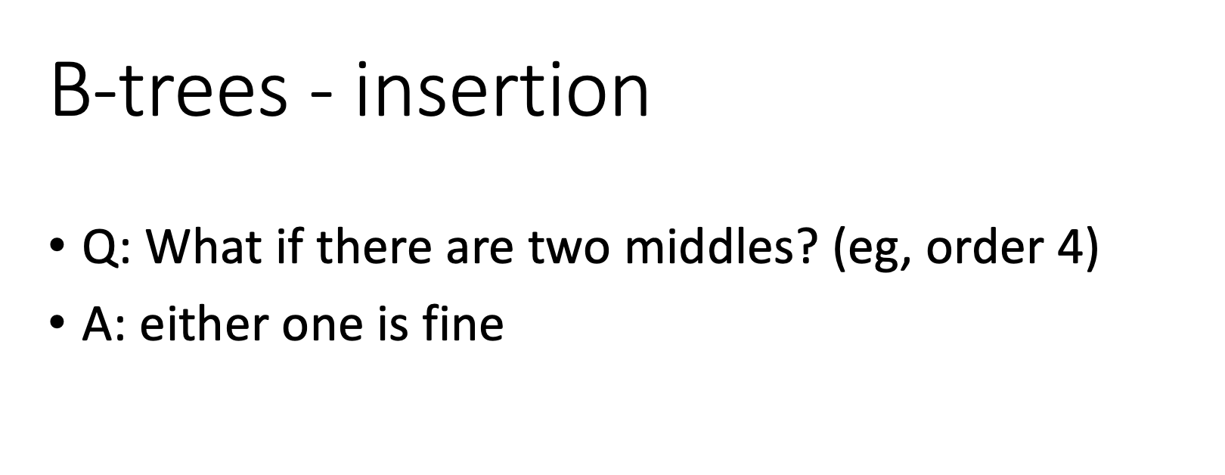

Slide 40
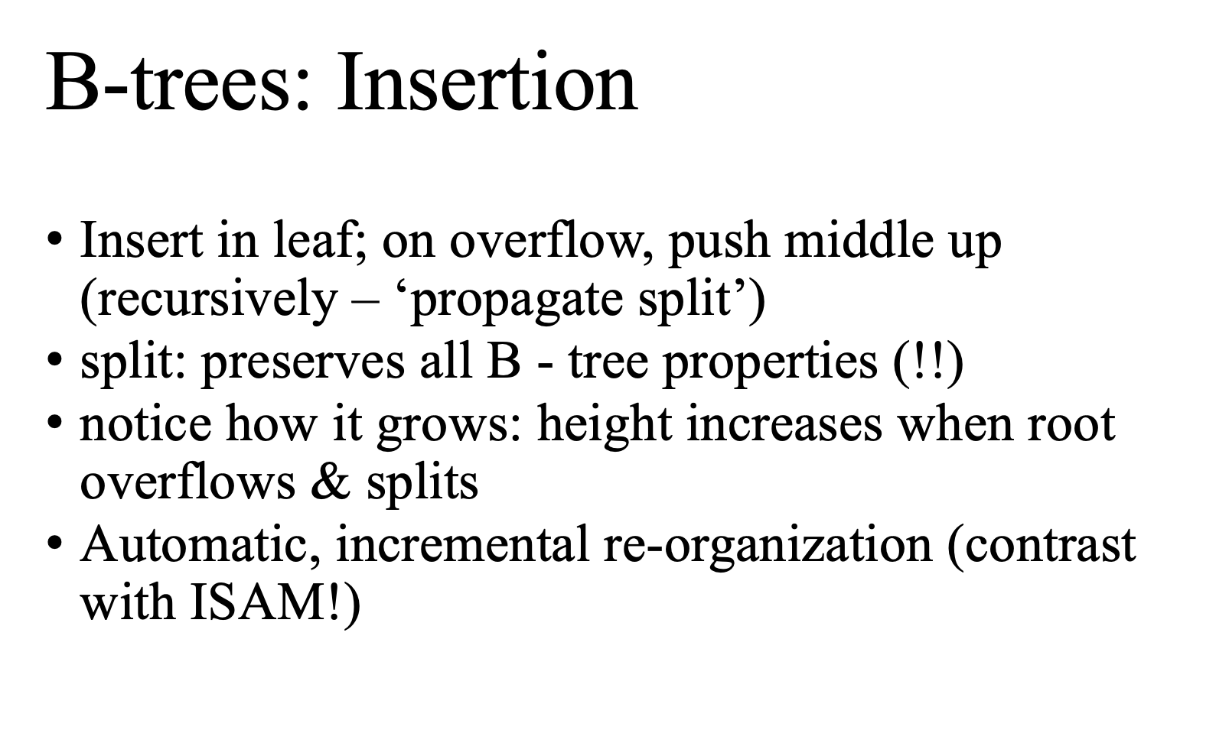

Slide 41
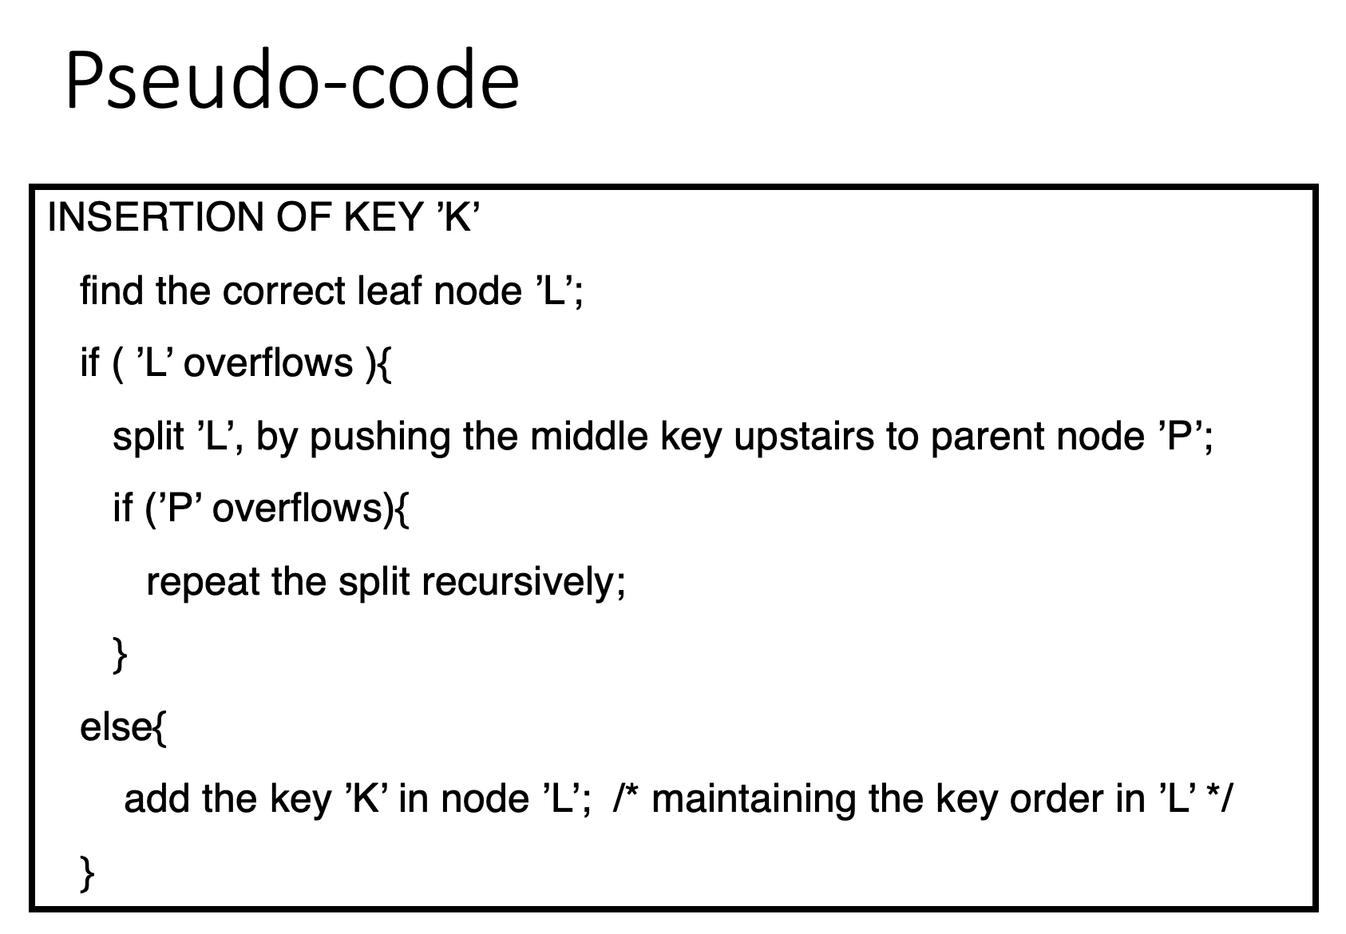

Slide 42
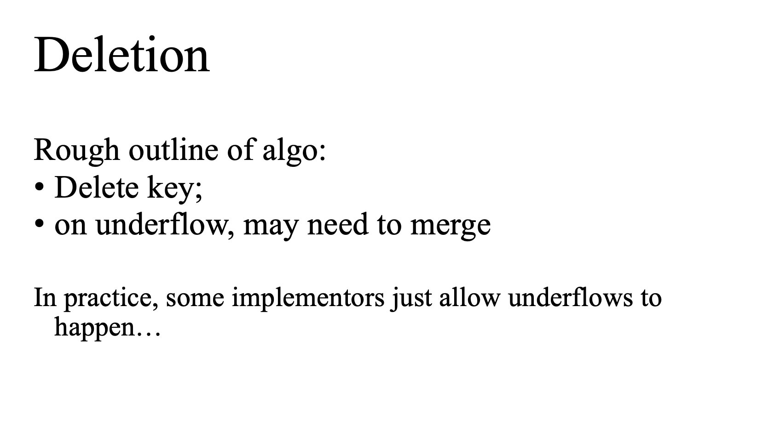

Slide 43
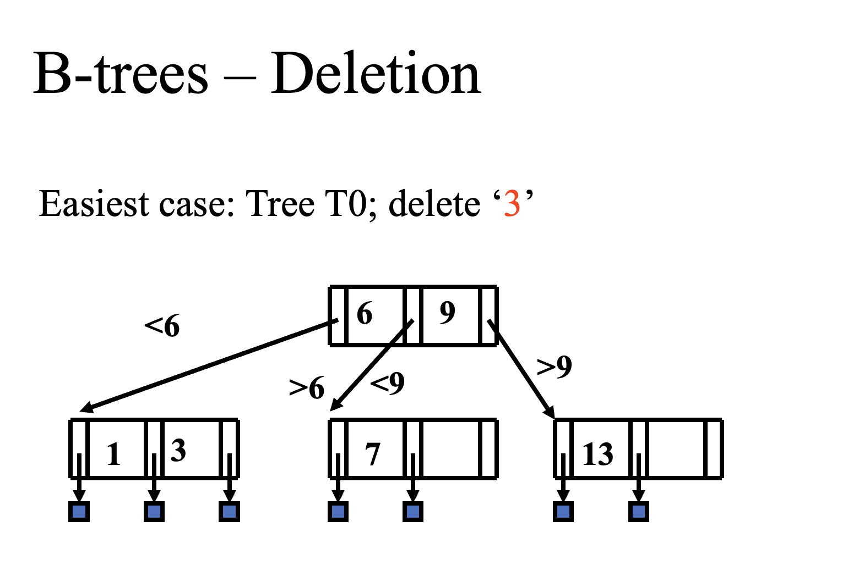

Slide 44
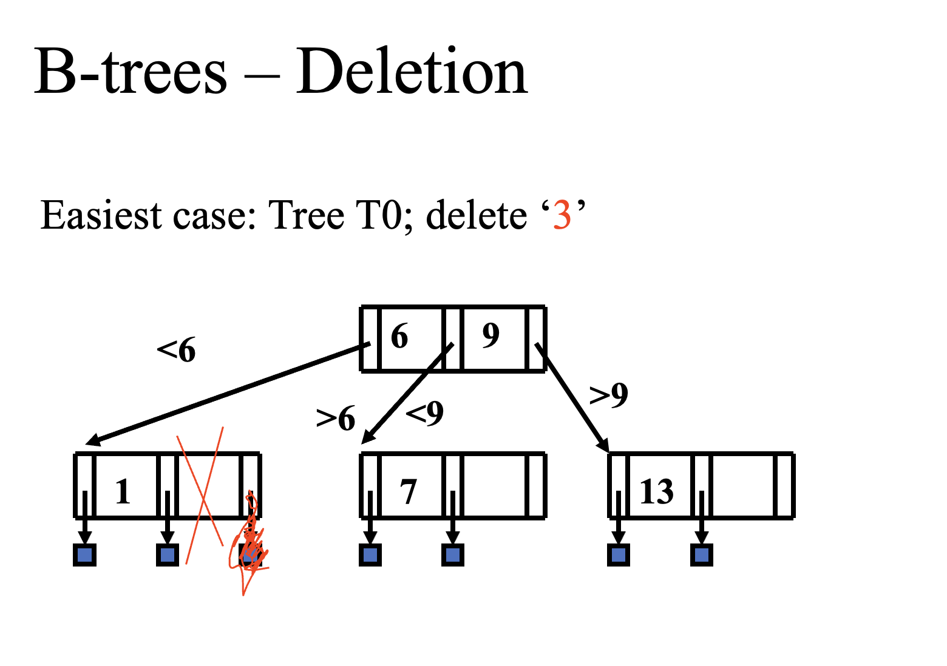

Slide 45
B-trees – Deletion
Case1: delete a key at a leaf – no underflow
Case2: delete non-leaf key – find a ‘scapegoat’, reduce to leaf deletion
Case3: delete leaf-key; underflow, and ‘rich sibling’
Case4: delete leaf-key; underflow, and ‘poor sibling’
Scapegoat: predecessor or successor of the non-leaf being deleted

Slide 46
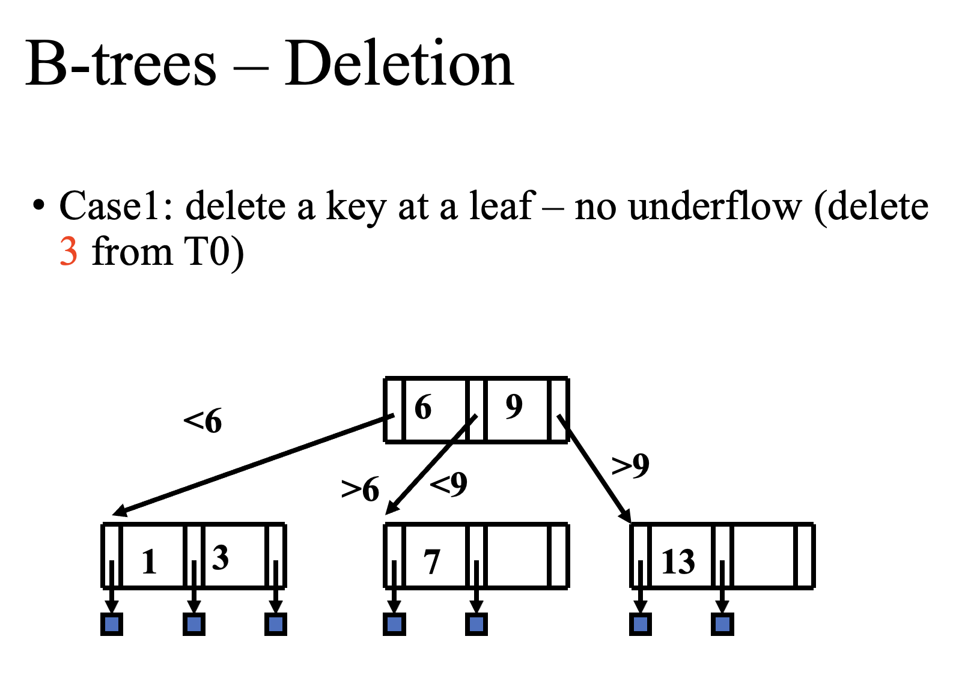

Slide 47
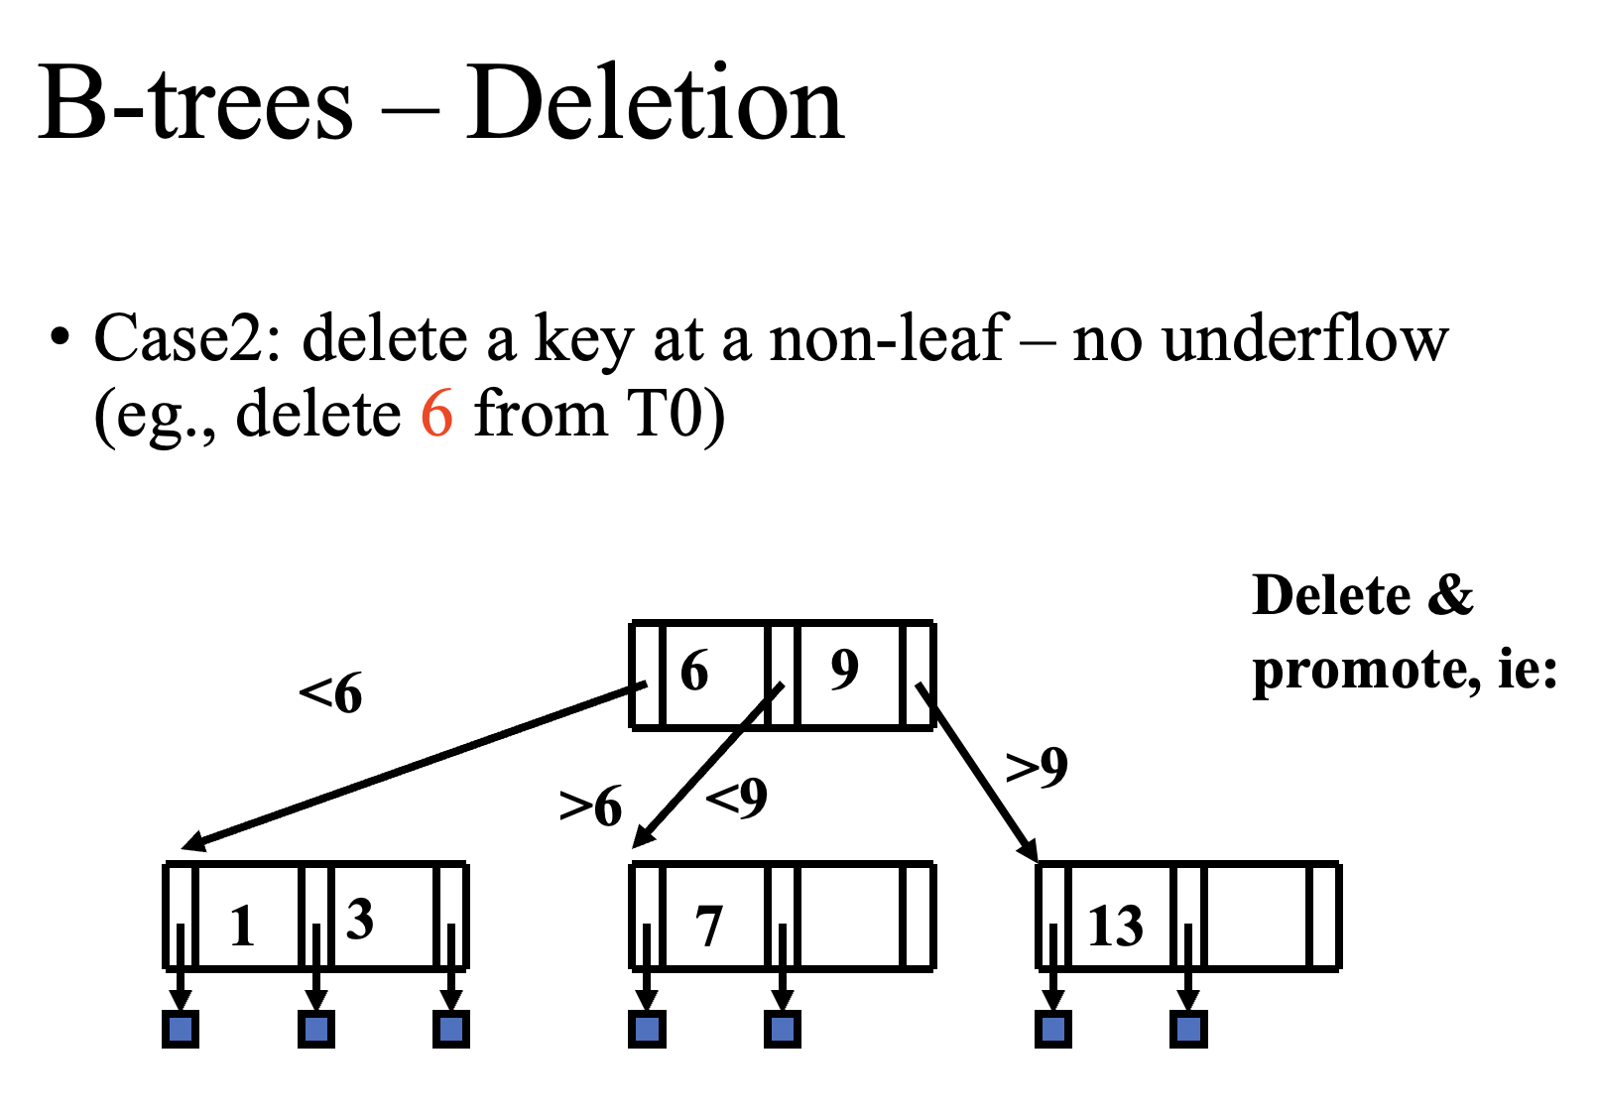

Slide 48
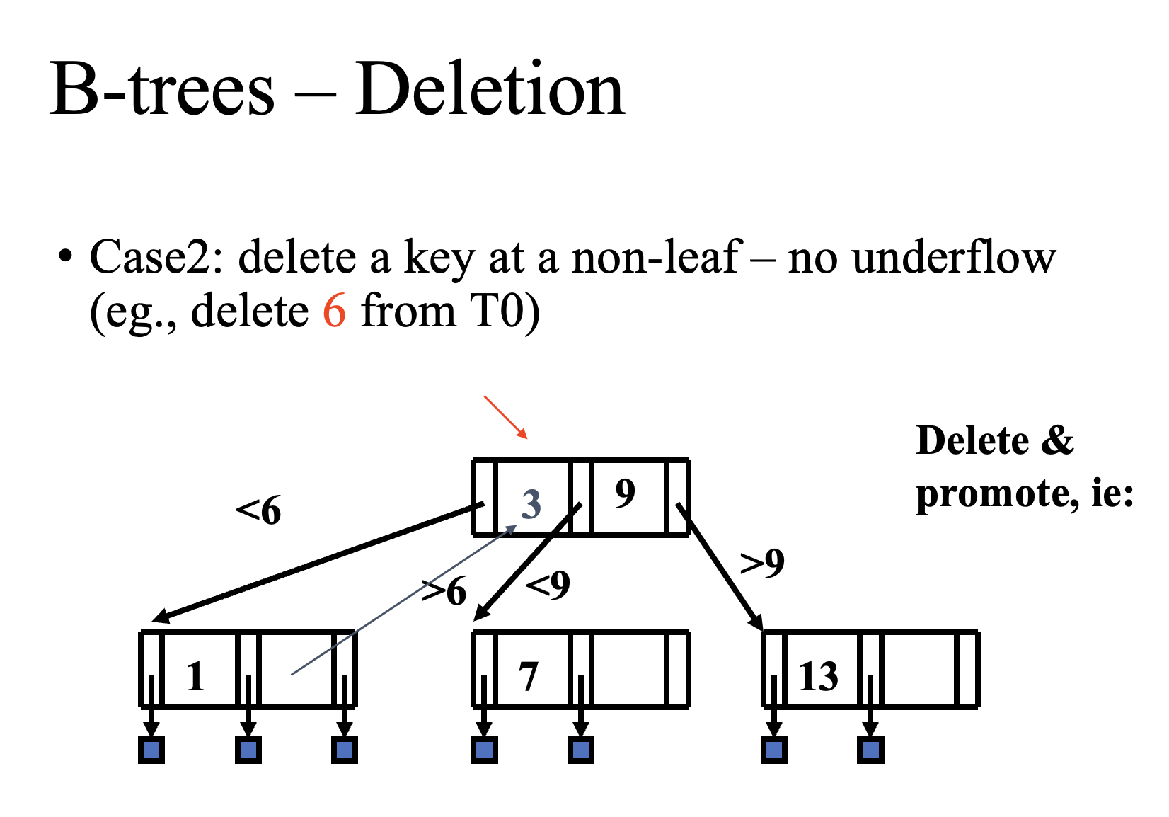

Slide 49
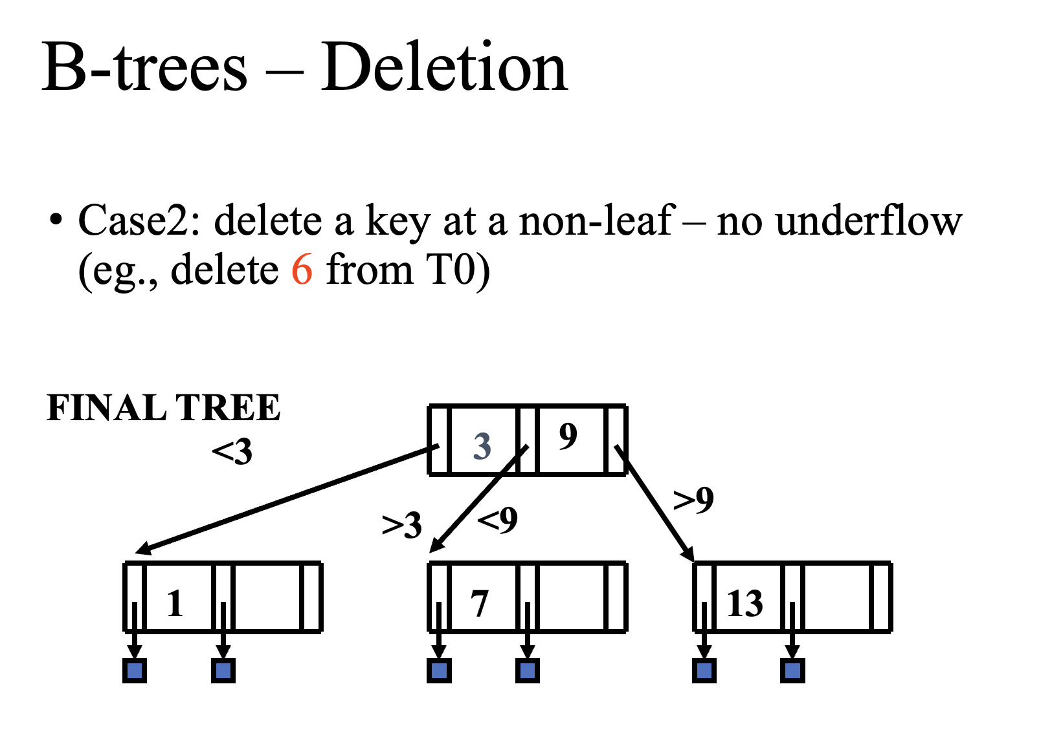

Slide 50
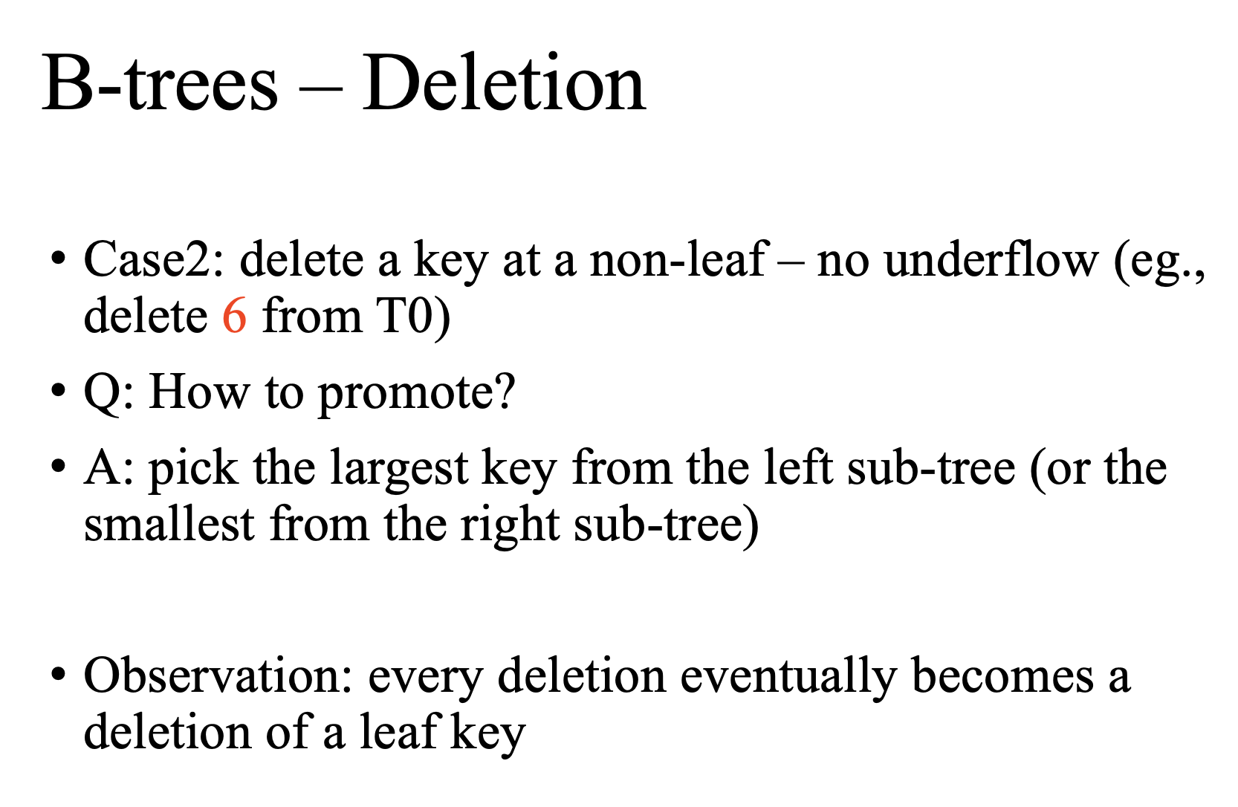

Slide 51
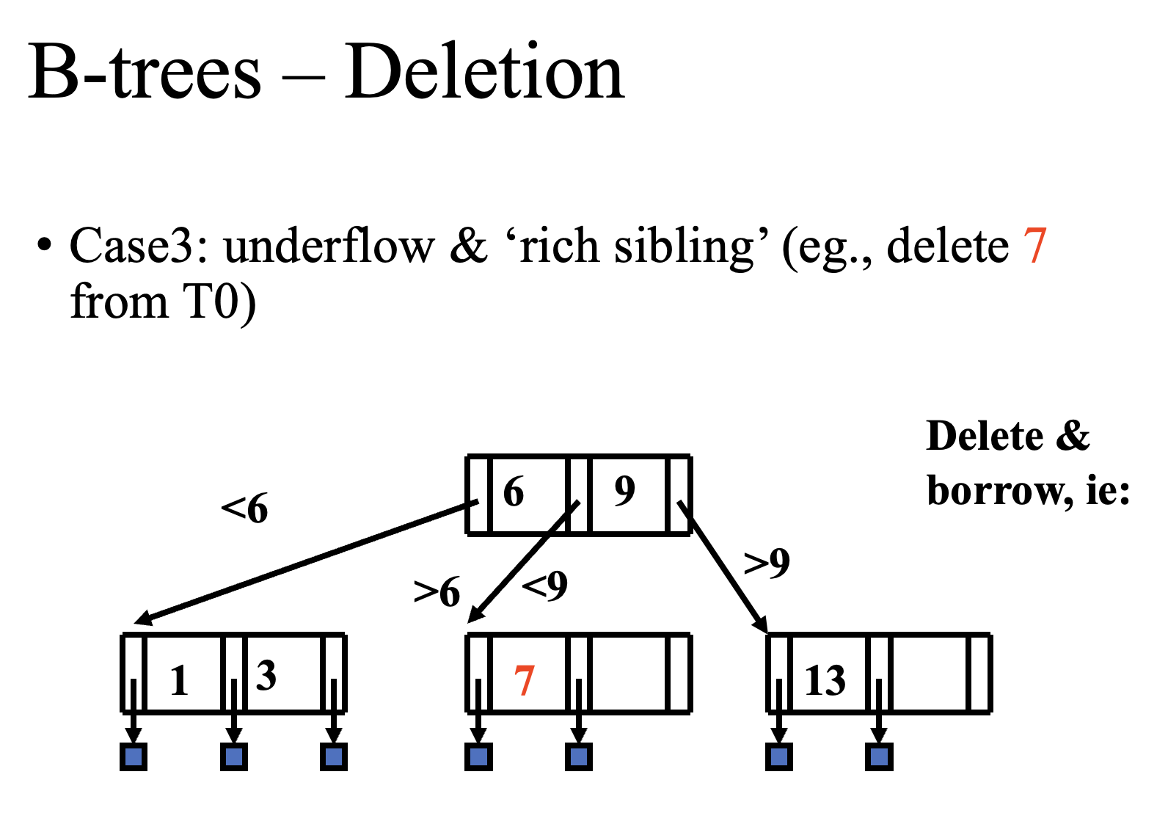

Slide 52
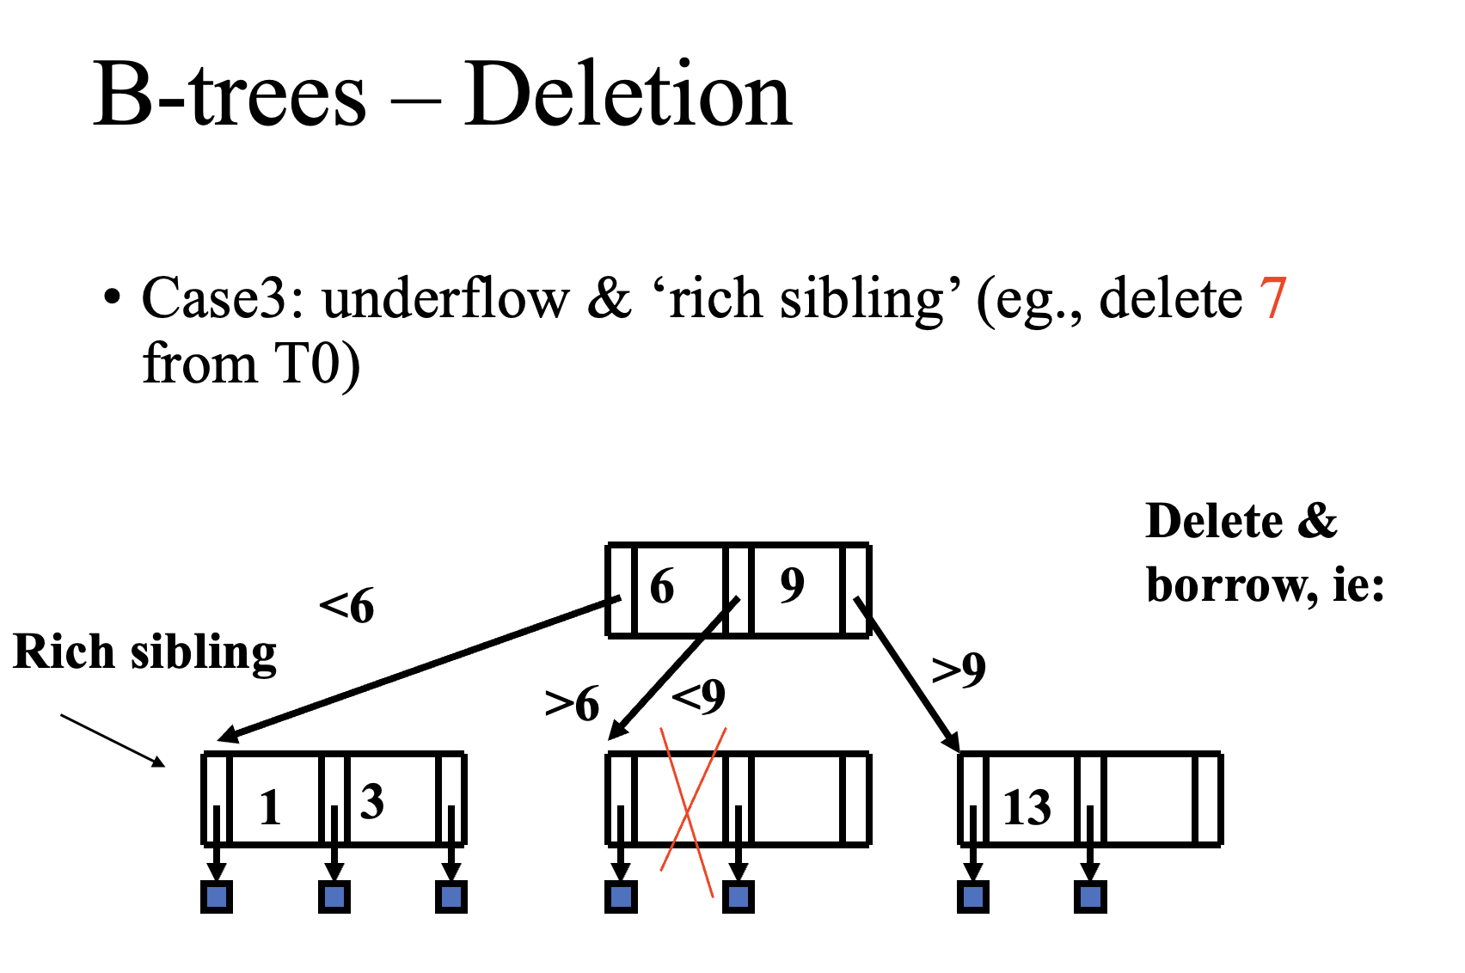

Slide 53
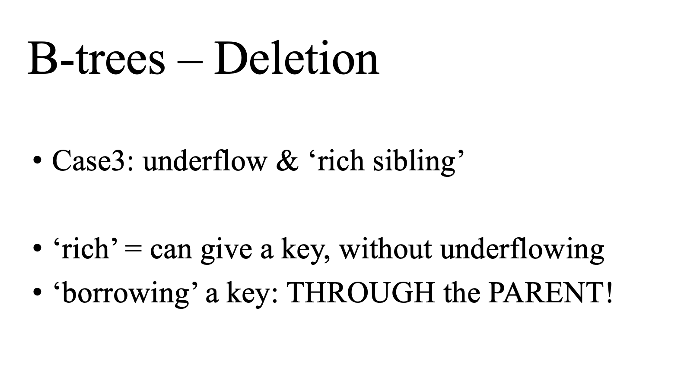

Slide 54
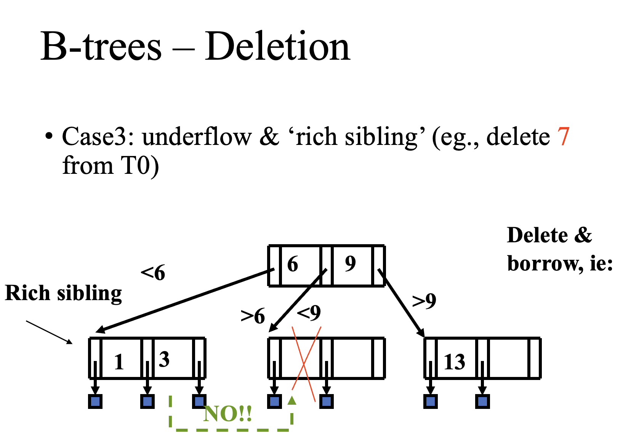

Slide 55
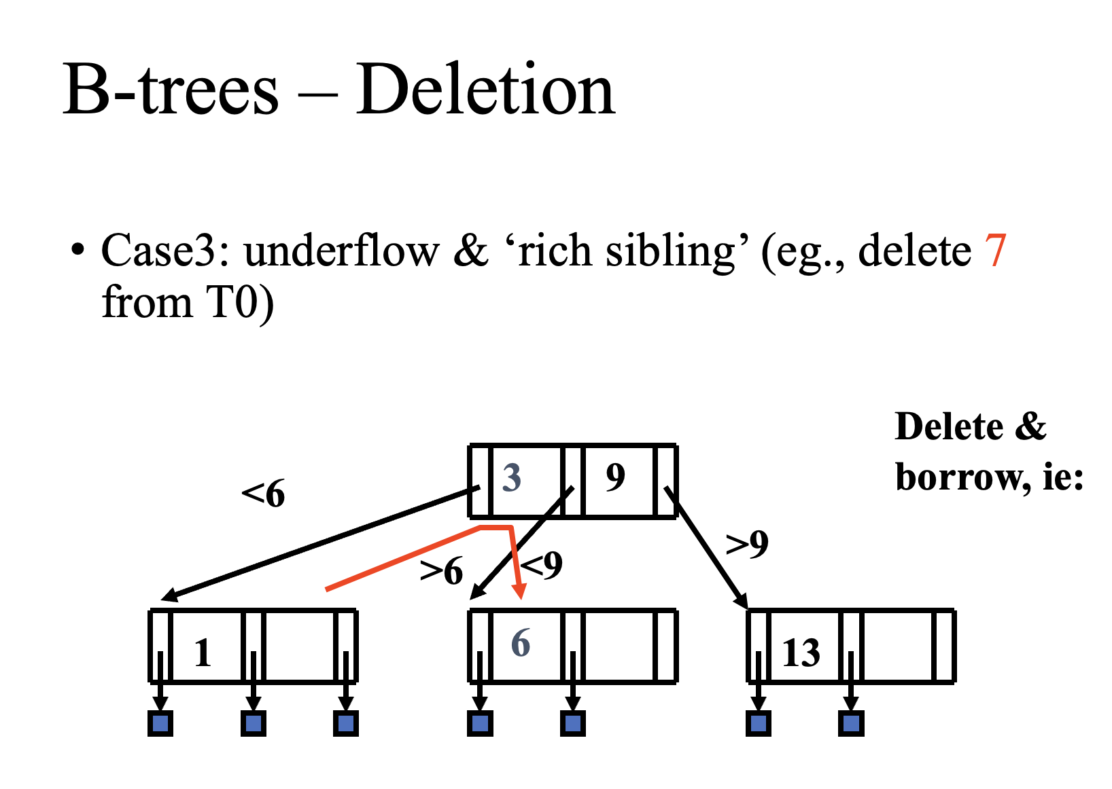

Slide 56
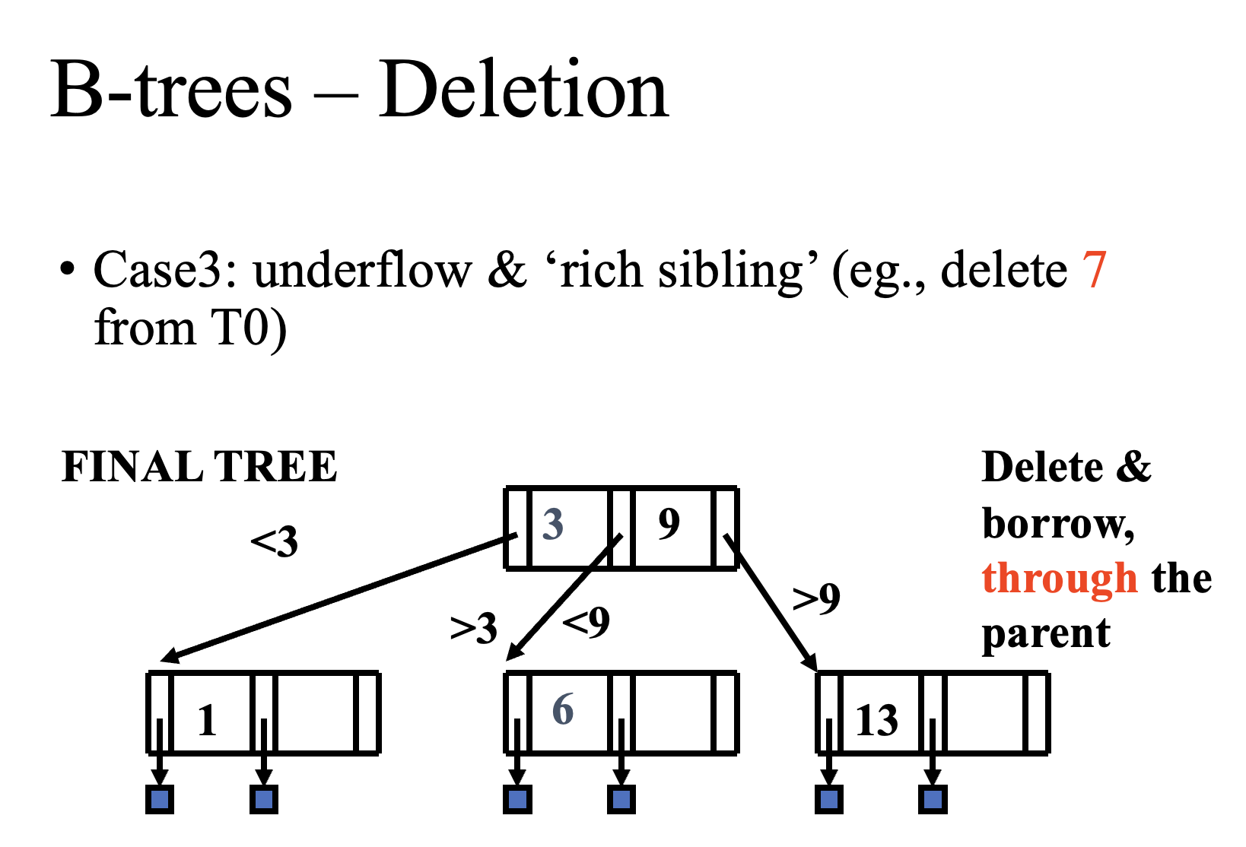

Slide 57


Slide 58


Slide 59

Notes:
In order to merge, what else should we do?

Slide 60


Slide 61


Slide 62


Slide 63


Slide 64


Slide 65

Notes:
Each node maps to a disk page

Slide 66


Slide 67


Slide 68


Slide 69


Slide 70


Slide 71


Slide 72


Slide 73


Slide 74


Slide 75


Slide 76


Slide 77


Slide 78


Slide 79


Slide 80


Slide 81


Slide 82


Slide 83


