Slide 1


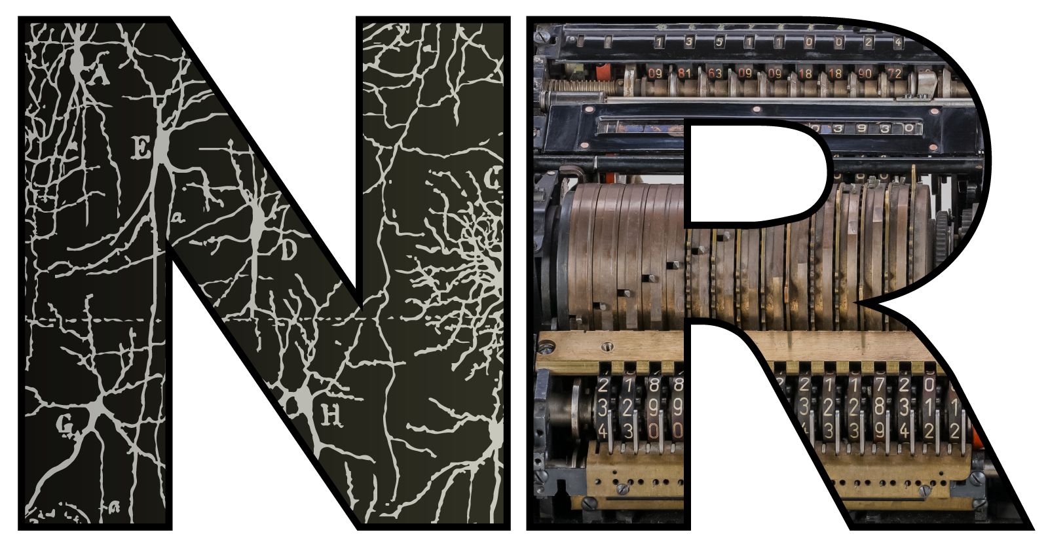

Learning to use neuromodulation for efficient sensory processing
Abdal AlKilany and Goodman 2026
Dan Goodman
Imperial College London
Department of Electrical and Electronic Engineering
neural-reckoning.org

Slide 2
Philosophical intro: what can we learn from neural models?
Last minute addition:
ALL parameters solve the task
Many (partially) match data
Worth asking this question because everyone sees it differently
Plus, we’ll be talking about this later in the Discussion
I’m interested in understanding “intelligence”, not just the brain (multiply realisable)
This opens up many questions that might not obviously interest neuroscientists
But they should!
We can’t understand the brain’s unique solution to “intelligence” without understanding a bit about the space of possible alternative solutions
My limited approach to neural models:
- not just about fitting or predicting data
pure theory, comparison across realisations, no fitting/prediction
Baseline neuron model
+ Bio-inspired feature
= New computational capacity
Biological neuron
Experimentally validated
Known to exist in brain, mechanism and function not fully understood
Hypothesis for mechanism-function link in brain

Slide 3
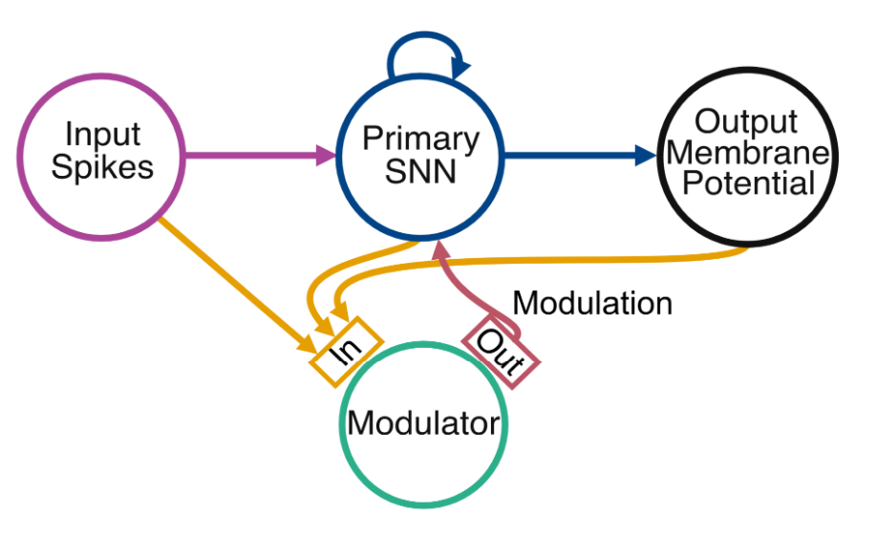
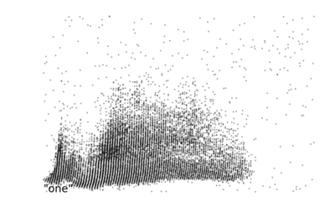
The neuromodulation model
Following the formula on the previous slide, the approach will be this:
Baseline LIF model + Abstract model of neuromodulation = Lots of nice things (you’ll see)
Recurrent SNN trained with surrogate GD
Spike-coded sensory data
Auditory: SHD, SSC
Visual: DVS
Linear readout
Classification task
Changes parameters of LIF neurons
Can model neurotransmitter release and diffusion
Spikes as input to modulator
Can turn each connection on/off
Can introduce bottlenecks
Can compress
Modulator can be either:
MLP (an ANN)
SNN

Slide 4
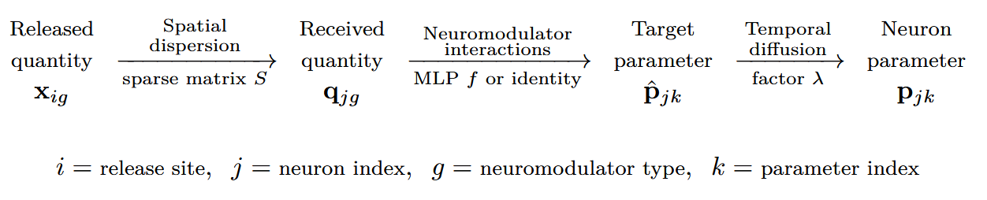
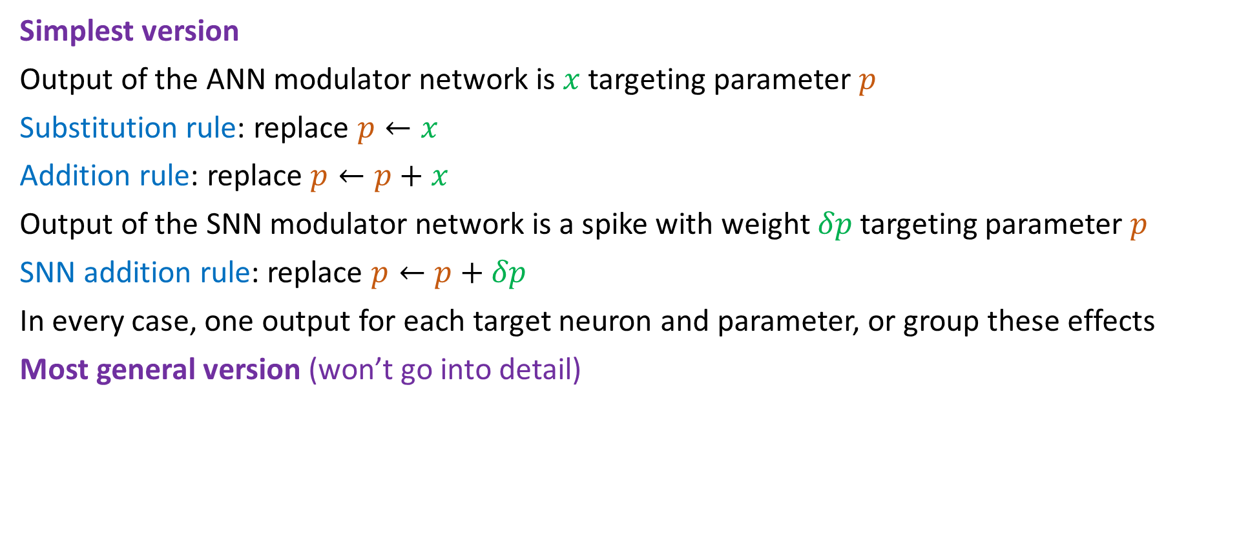
The equations slide (feel free to doze if it’s not your thing)
Simplest version
Output of the ANN modulator network is $x$ targeting parameter $p$
Substitution rule: replace $p←x$
Addition rule: replace $p←p+x$
Output of the SNN modulator network is a spike with weight $δp$ targeting parameter $p$
SNN addition rule: replace $p←p+δp$
In every case, one output for each target neuron and parameter, or group these effects
Most general version (won’t go into detail)

Slide 5
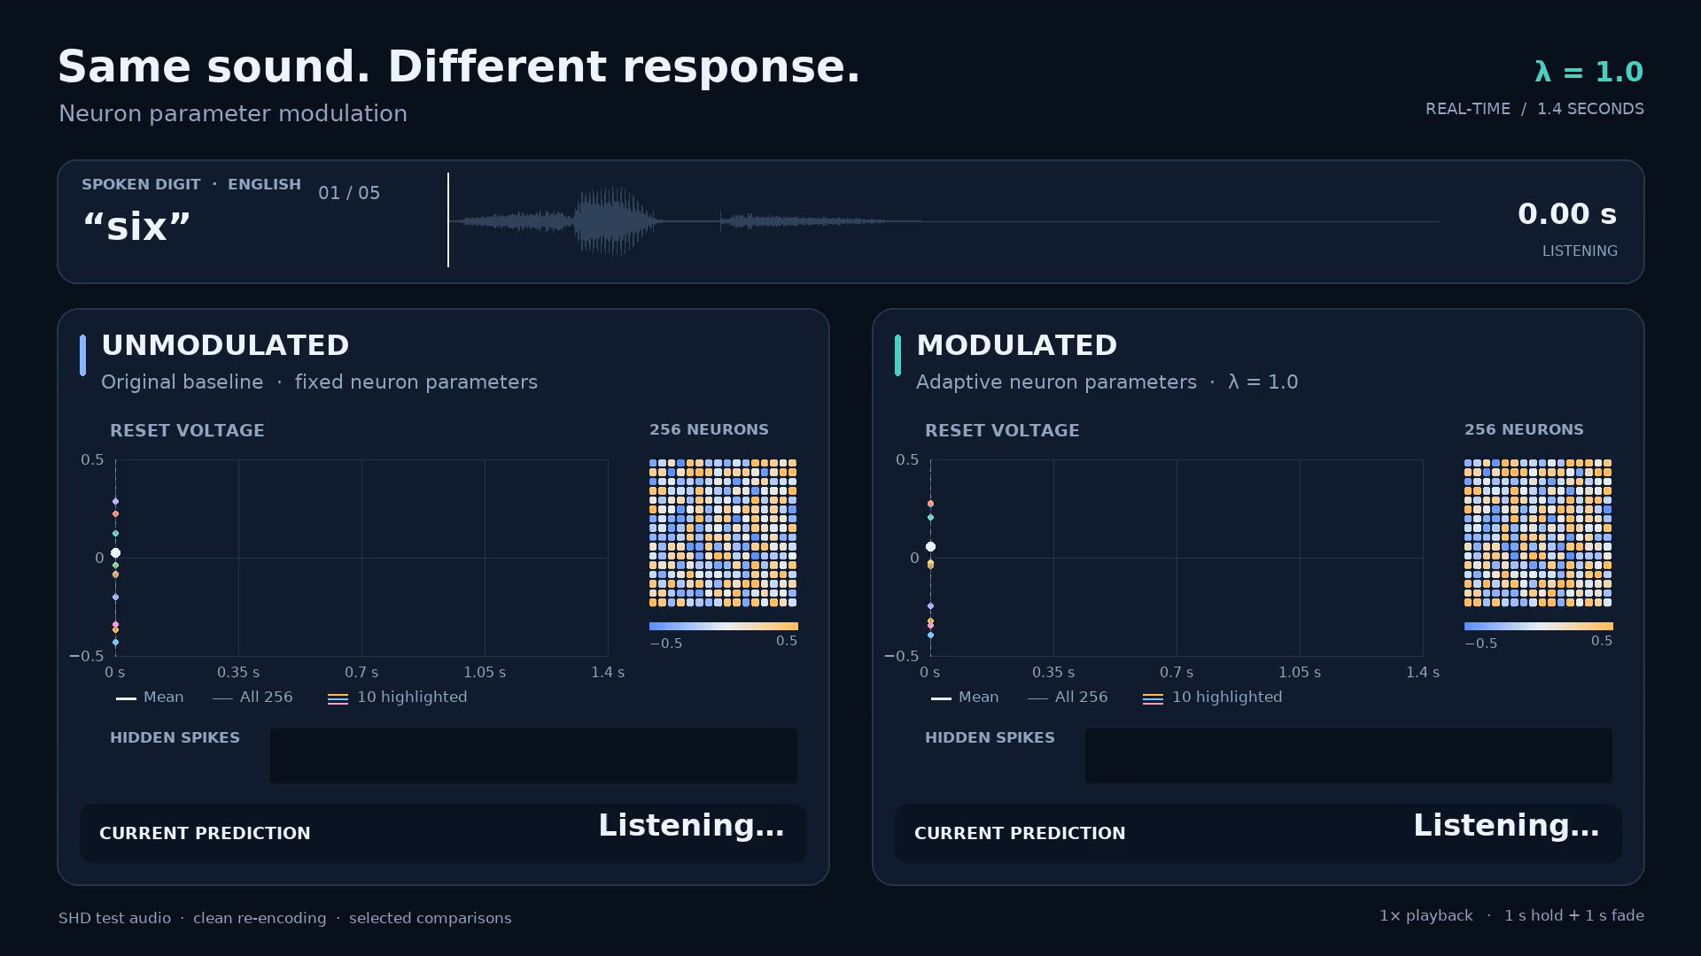
Notes:
I’m going to play audio clips and show you what happens to the neurons’ parameters by the modulator network.
On the left is the unmodulated…
On right is the modulated…
We are gonna see a different type of parameter displayed on each clip. So reset etc
These parameters are trained to try and identify which words are being spoken.
As we can see, the modulator changes the parameters of the spiking neurons in interesting, non uniform ways.
Linker: And now lets see if this helps it do any better in terms of performance…

Slide 6
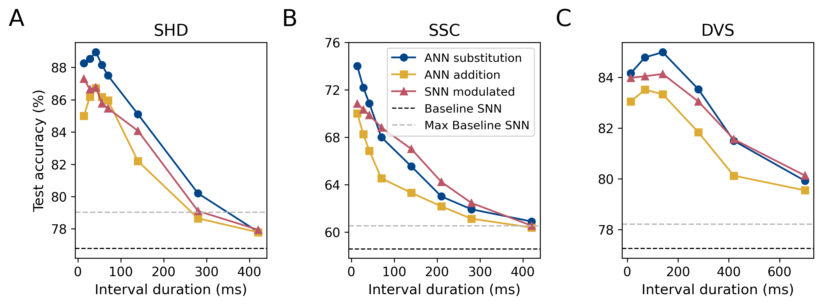
It works!
Modulation
Improvement ~12%
Optimal non-modulated SNN performance (large network)
Clean audio SHD
Noisy audio SSC
Video DVS-GESTURES
Baseline (unmodulated SNN)
How often the parameters are updated

Slide 7
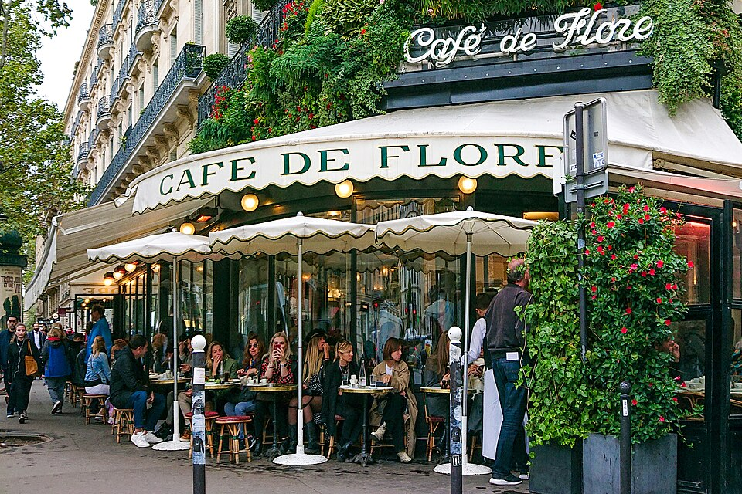
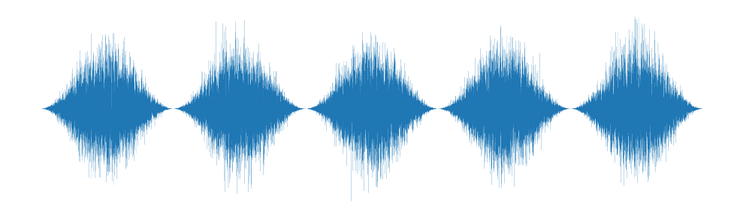
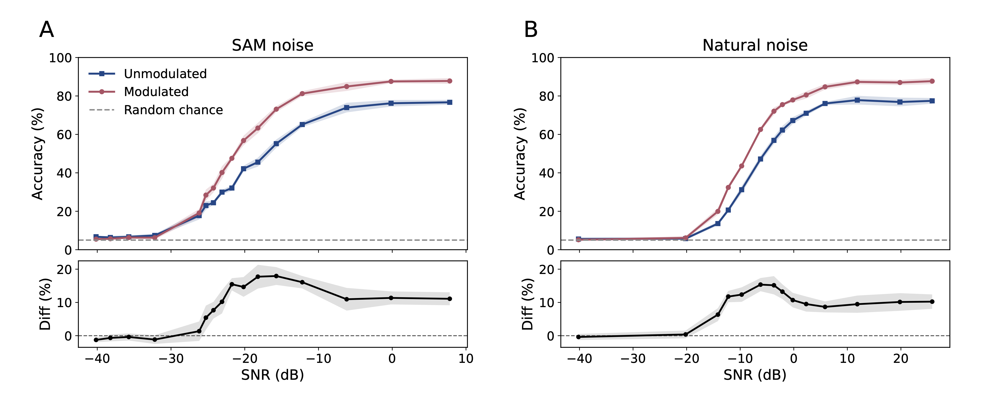
More challenging version: speech in noise
Sinusoidally amplitude modulated (SAM) noise

Slide 8
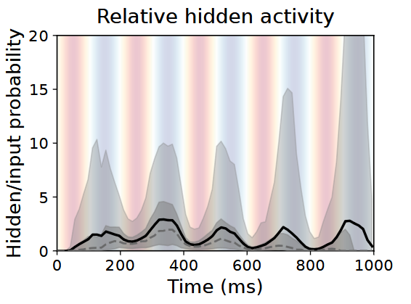
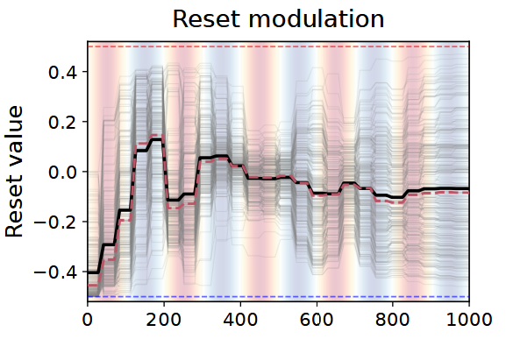
Learns dynamic gain control strategy (“listening in the dips”)

Slide 9
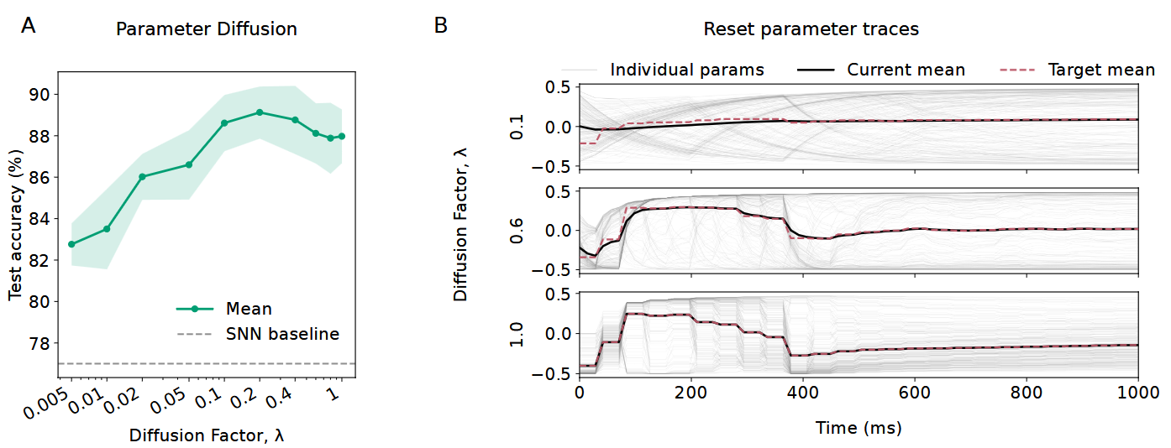
Temporal diffusion can help performance
Slow modulation
Optimal modulation speed is slow
Instant modulation

Slide 10
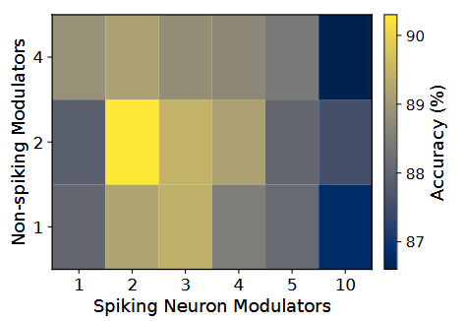
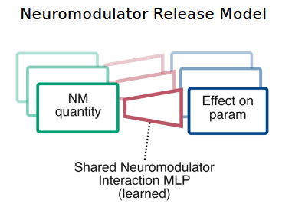
A small number of neuromodulator types is best
Previous results
Optimal performance with fewer modulator types
Number of spiking neuron parameters = 5

Slide 11
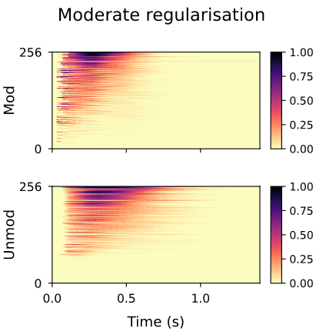
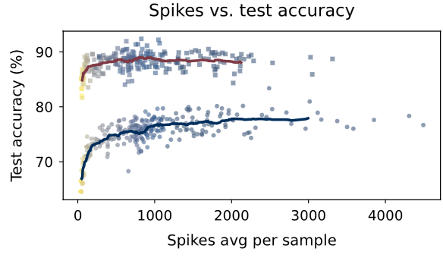
Can use many fewer spikes (lower energy cost)
Modulated
Unmodulated
Wasted neurons (never active)

Slide 12
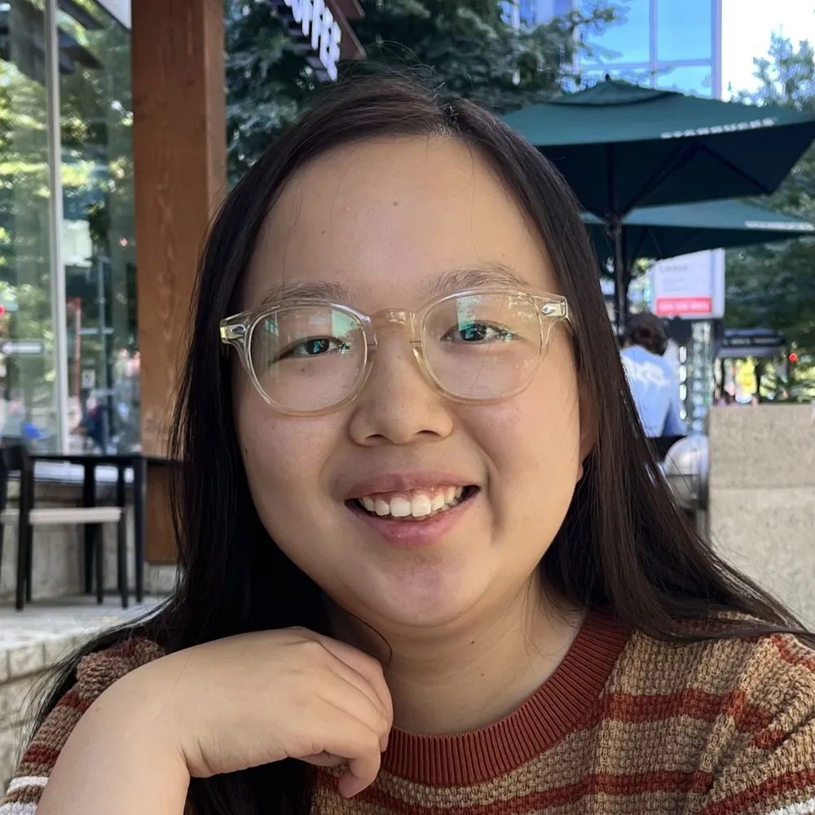

AlKilany and Goodman 2026
Conclusions
Can add neuromodulation to SNNs
Easy to implement and train (GitHub code with tutorials)
Improves performance, parameter efficient
Allows strong spike regularisations (useful for neuromorphic)
Generate hypotheses for biological brains
Thanks to
Abdal AlKilany
P4-3 (ground floor)
Wed 14:00-15:30
And thanks to you!
❤️
Lab poster advert
Yishu Zhang
P1-44 (first floor)
Tue 16:30-18:00
Do heterogeneous brains remember better?
Nicolas Dundov
P4-38 (first floor)
Wed 14:00-15:30
Blood and modularity: a brain-inspired approach to functional disentangled neural representations

Slide 13
Backup slides

Slide 14
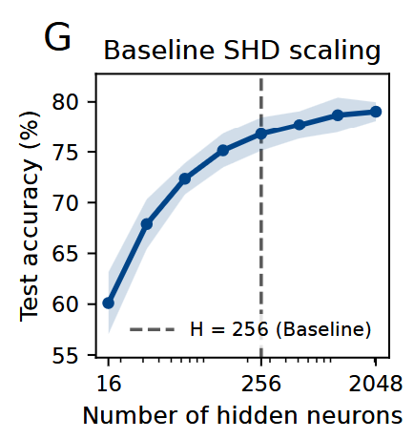

Slide 15
