Slide 1
Search Engines
Information Retrieval in Practice
Annotations by Michael L. Nelson
All slides ©Addison Wesley, 2008

Slide 2
Social Search
Social search
  Communities of users actively participating in the search process
  Goes beyond classical search tasks
Key differences
  Users interact with the system
  Users interact with other users either implicitly or explicitly

Slide 3
Web 2.0
Social search includes, but is not limited to, the so-called social media sites
  Collectively referred to as “Web 2.0” as opposed to the classical notion of the Web (“Web 1.0”)
Social media sites
  User generated content
  Users can tag their own and other’s content
  Users can share favorites, tags, etc., with others
Examples:
  Digg, Twitter, Flickr, YouTube, Del.icio.us, CiteULike, MySpace, Facebook, and LinkedIn

Slide 4
Social Search Topics
User tags
Searching within communities
Adaptive filtering
Recommender systems
Peer-to-peer and metasearch

Slide 5
User Tags and Manual Indexing
Then: Library card catalogs
  Indexing terms chosen with search in mind
  Experts generate indexing terms
  Terms are very high quality
  Terms chosen from controlled vocabulary
Now: Social media tagging
  Tags not always chosen with search in mind
  Users generate tags
  Tags can be noisy or even incorrect
  Tags chosen from folksonomies

Slide 6
Types of User Tags
Content-based
  car, woman, sky
Context-based
  new york city, empire state building
Attribute
  nikon (type of camera), black and white (type of movie), homepage (type of web page)
Subjective
  pretty, amazing, awesome
Organizational
  to do, my pictures, readme

Slide 7
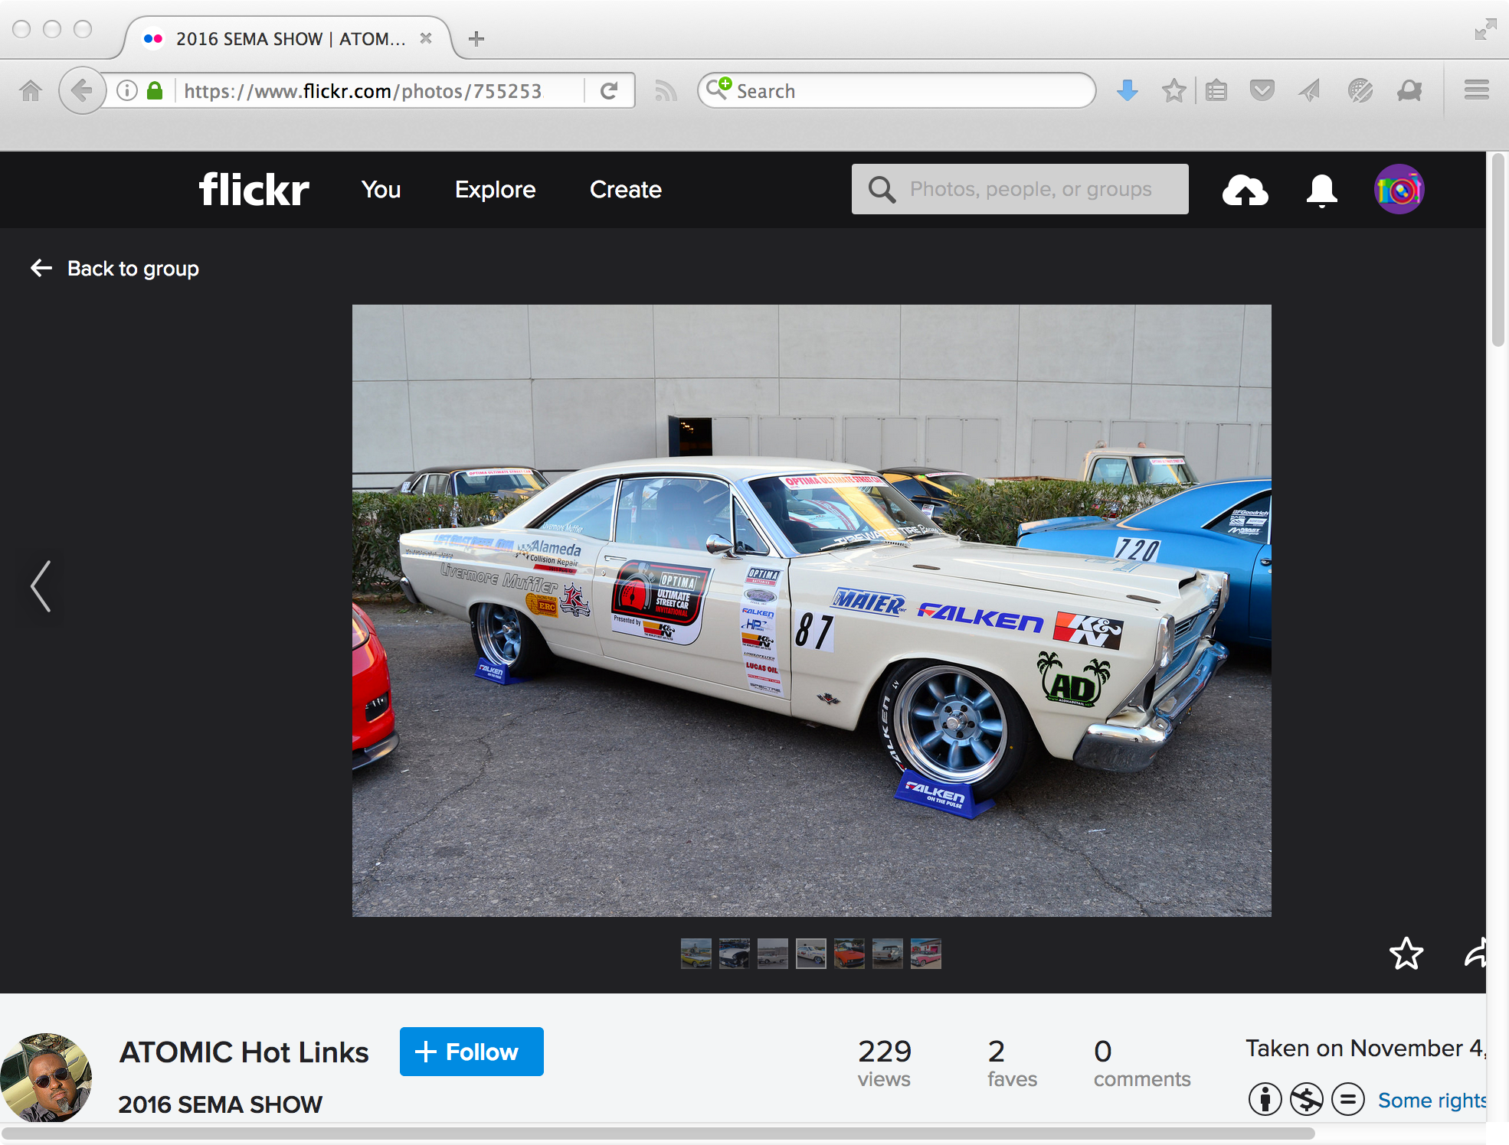
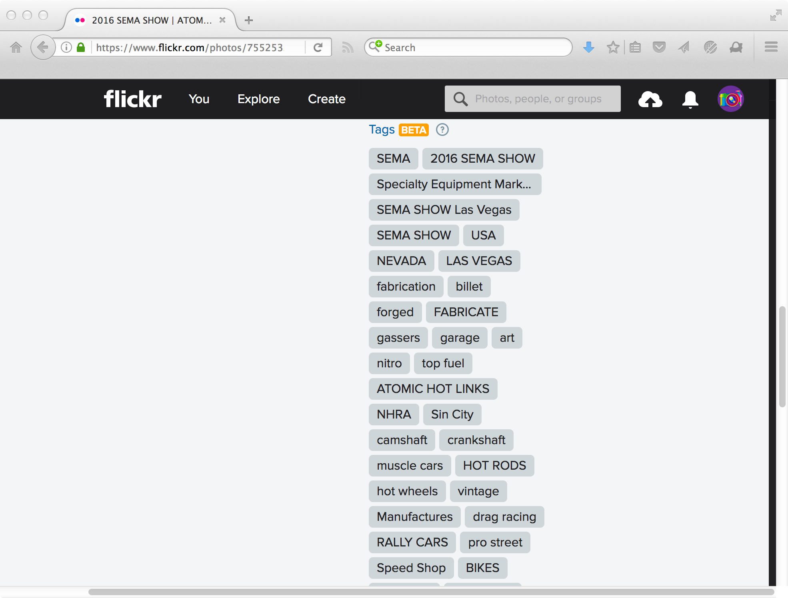
Some Tags Are Useful
https://www.flickr.com/photos/7552532@N07/31015450505/in/pool-908525@N20/

Slide 8
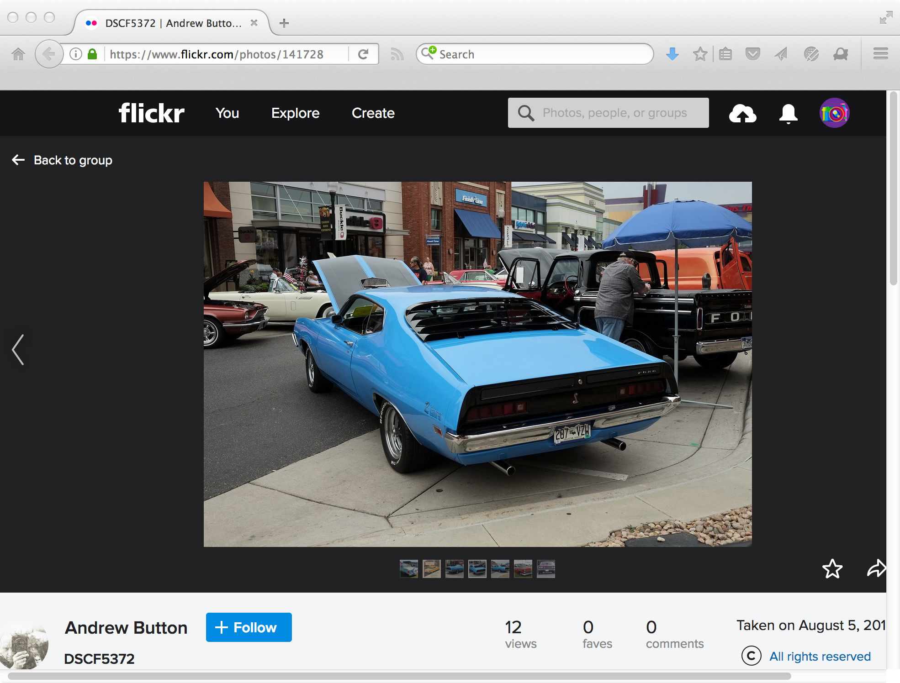
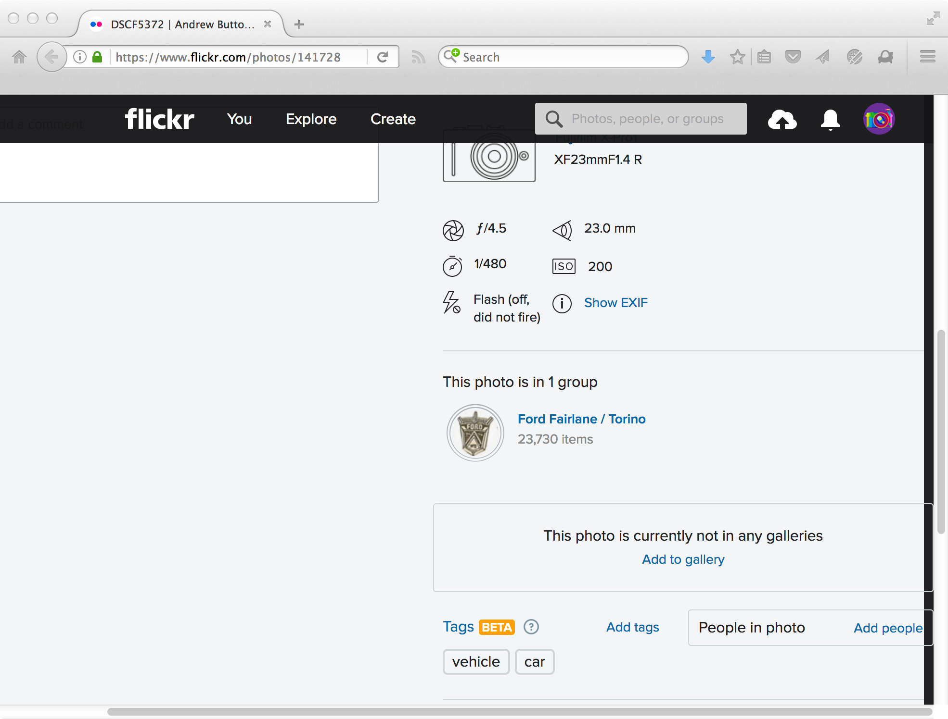
Most Tags Are Sparse, Uneven
https://www.flickr.com/photos/141728736@N08/31416669335/in/pool-908525@N20/

Slide 9
Searching Tags
Searching user tags is challenging
  Most items have only a few tags
  Tags are very short
Boolean, probabilistic, vector space, and language modeling will fail if use naïvely
Must overcome the vocabulary mismatch problem between the query and tags
  “fairlane” and “torino” will not match the tags in the previous examples

Slide 10
Tag Expansion
Can overcome vocabulary mismatch problem by expanding tag representation with external knowledge
Possible external sources
  Thesaurus
  Web search results
  Query logs
After tags have been expanded, can use standard retrieval models

Slide 11
Tag Expansion Using Search Results
Age of Aquariums - Tropical Fish
Huge educational aquarium site for tropical fish hobbyists, promoting responsible fish keeping internationally since 1997.
The Krib (Aquaria and Tropical Fish)
This site contains information about tropical fish aquariums, including archived usenet postings and e-mail discussions, along with new ...
…
Keeping Tropical Fish and Goldfish in Aquariums, Fish Bowls, and ...
Keeping Tropical Fish and Goldfish in Aquariums, Fish Bowls, and Ponds at AquariumFish.net.
snippets are awesome!
somebody worked hard
to create them (ch6),
so reuse them!
fish
tropical
aquariums
goldfish
bowls
P(w | “tropical fish” )

Slide 12
Searching Tags
Even with tag expansion, searching tags is challenging
Tags are inherently noisy and incorrect
Many items may not even be tagged!
Typically easier to find popular items with many tags than less popular items with few/no tags

Slide 13
Inferring Missing Tags
How can we automatically tag items with few or no tags?
Uses of inferred tags
  Improved tag search
  Automatic tag suggestion

Slide 14
Methods for Inferring Tags
TF.IDF
  Suggest tags that have a high TF.IDF weight in the item
  Only works for textual items
Classification
  Train binary classifier for each tag
  Performs well for popular tags, but not as well for rare tags
Maximal marginal relevance
  Finds tags that are relevant to the item and novel with respect to existing tags

Slide 15
Browsing and Tag Clouds
Search is useful for finding items of interest
Browsing is more useful for exploring collections of tagged items
Various ways to visualize collections of tags
  Tag lists
  Tag clouds
  Alphabetical order
  Grouped by category
  Formatted/sorted according to popularity

Slide 16
Example Tag Cloud
animals architecture art australia autumn baby band barcelona beach berlin
birthday black blackandwhite blue california cameraphone canada canon
car cat chicago china christmas church city clouds color concert day dog
england europe family festival film florida flower flowers food
france friends fun garden germany girl graffiti green halloween hawaii
holiday home house india ireland italy japan july kids lake landscape light live
london macro me mexico music nature new newyork night
nikon nyc ocean paris park party people portrait red river rock
sanfrancisco scotland sea seattle show sky snow spain spring street
summer sunset taiwan texas thailand tokyo toronto travel
tree trees trip uk usa vacation washington water wedding
tag clouds on Porter Stemmer output == yuck

Slide 17
Searching with Communities
What is an online community?
  Groups of entities that interact in an online environment and share common goals, traits, or interests
Examples
  Baseball fan community
  Digital photography community
Not all communities are made up of humans!
  Web communities are collections of web pages that are all about a common topic

Slide 18
Finding Communities
What are the characteristics of a community?
  Entities within a community are similar to each other
  Members of a community are likely to interact more with other members of the community than those outside of the community
Can represent interactions between a set of entities as a graph
  Vertices are entities
  Edges (directed or undirected) indicate interactions between the entities

Slide 19
Graph Representation
1
2
4
3
5
6
7
Node:
1
2
3
4
5
6
7
0
0
0
0
0
0
0
0
0
0
0
0
1
0
1
0
0
0
1
1
0
0
0
0
0
0
1
0
1
0
0
0
0
0
0
0
0
0
0
0
0
0
0
0
0
0
0
0
0
Vector:

Slide 20
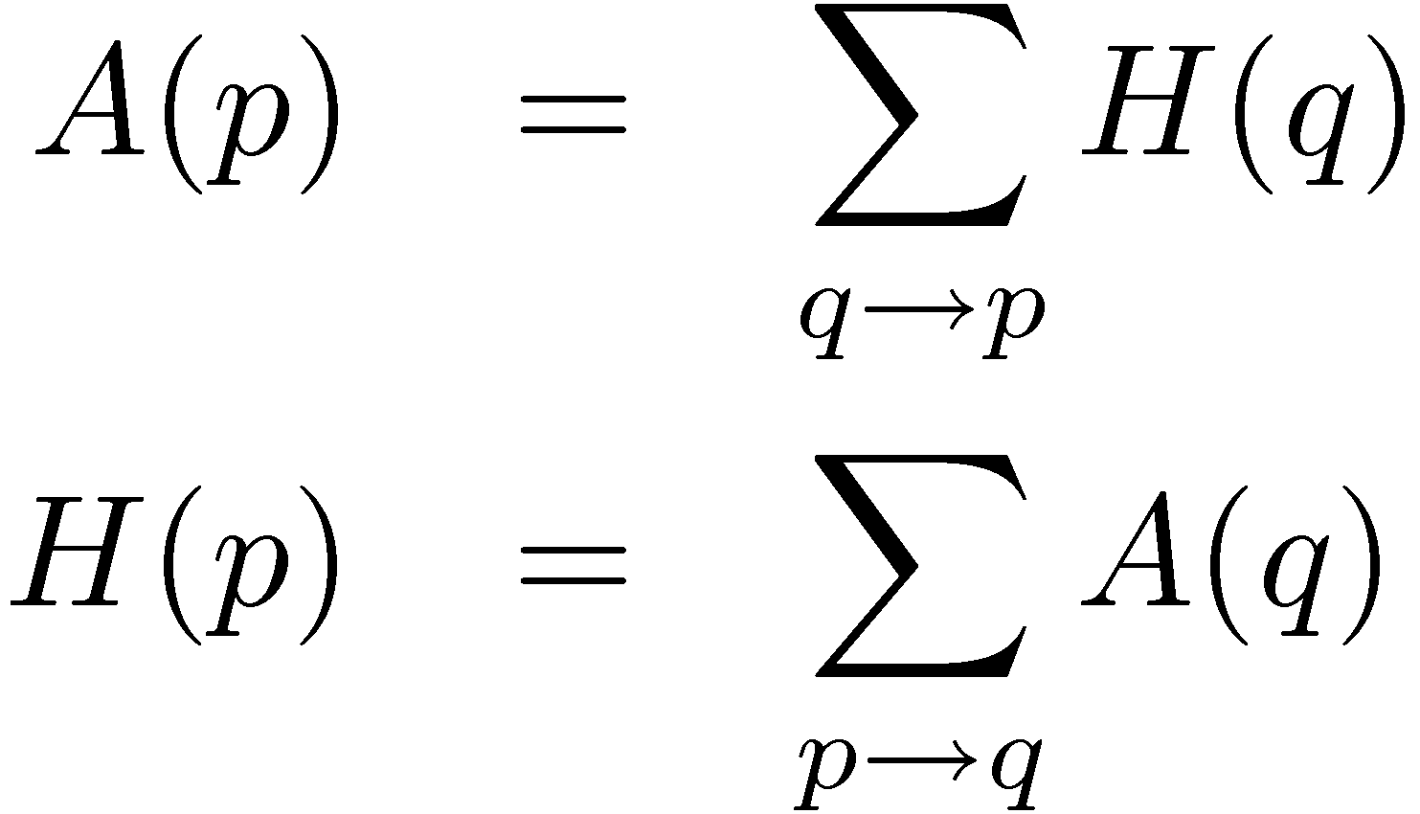
HITS
Hyperlink-induced Topic Search (HITS) algorithm can be used to find communities
  Link analysis algorithm, like PageRank
  Each entity has a hub and authority score
Based on a circular set of assumptions
  Good hubs point to good authorities
  Good authorities are pointed to by good hubs
Iterative algorithm:

Slide 21
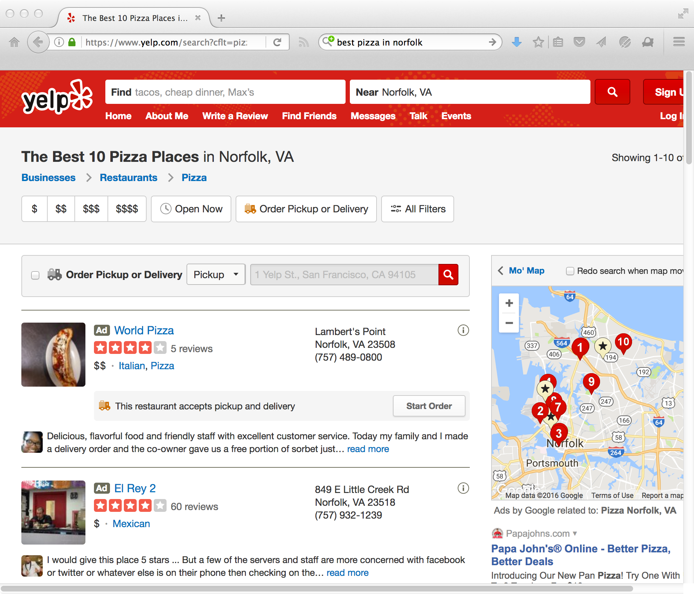
A Good Hub

Slide 22
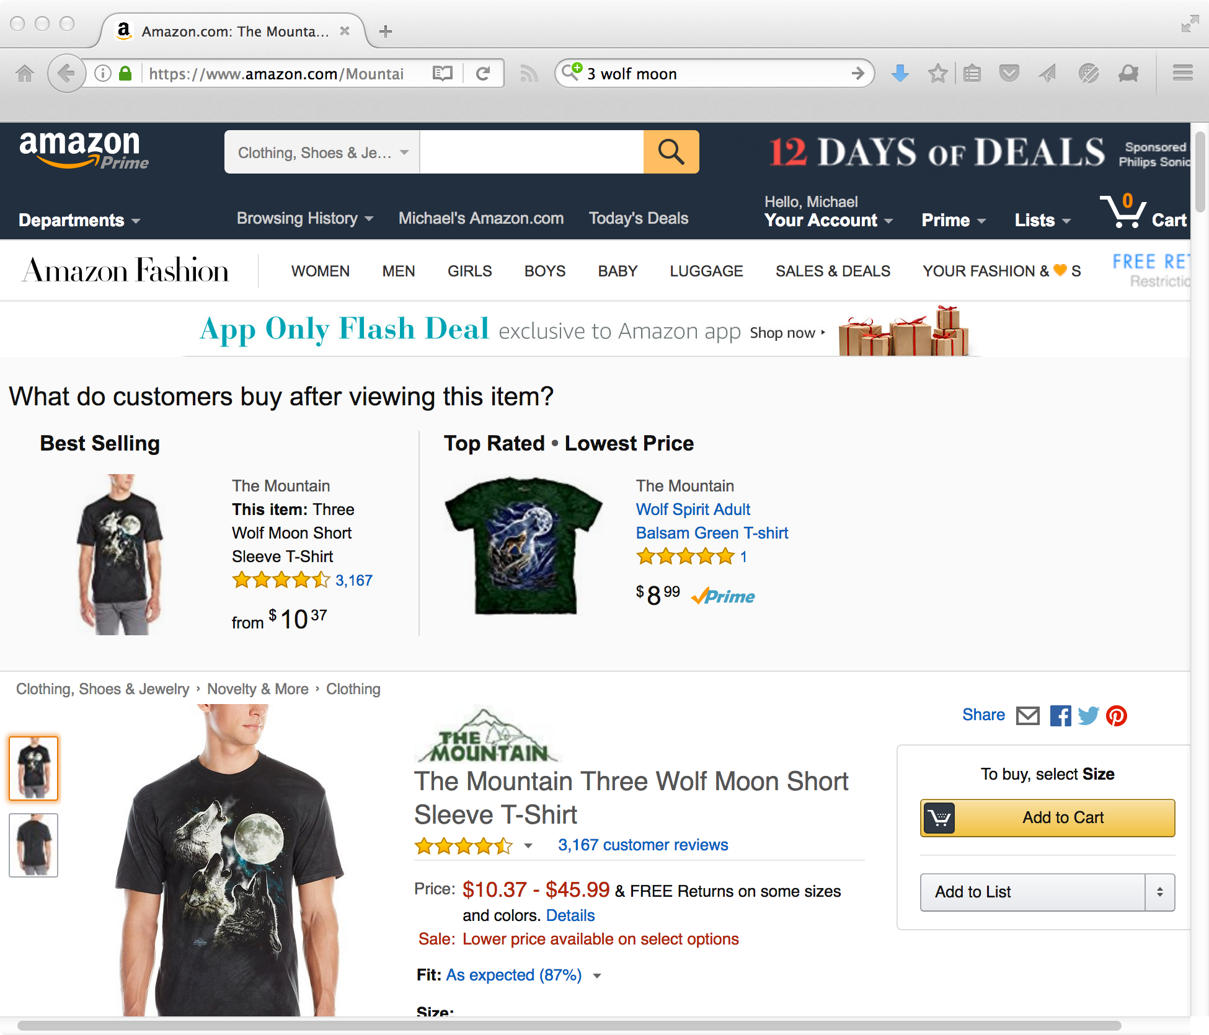
A Good Authority

Slide 23
HITS Example
(Authority, Hub)
Iteration 1: Input
Iteration 1: Update Scores
Iteration 1: Normalize Scores
1, 1
1, 1
2, 0
0, 1
.33, 0
0, .17
1, 1
1, 1
0, 3
0, 1
0, .50
0, .17
1, 1
1, 1
1, 1
0, 0
.17, .17
0,0
1, 1
3, 0
.50, 0
Iteration 2: Input
Iteration 2: Update Scores
Iteration 2: Normalize Scores
.33, 0
0, .17
.67, 0
.67=.5+.17
0, .50
.33, 0
0, .21
0, .50
0, .17
0, 1
0, .50
0, .43
0, .21
.17, .17
0,0
.50, .33
0,0
.25, .14
0,0
.50, 0
.83, 0
.83=.5+.17+.17
.42, 0
Iteration 3: Input
Iteration 3: Update Scores
Iteration 3: Normalize Scores
.33, 0
0, .21
.57, 0
0, .42
.31, 0
0, .19
0, .43
0, .21
0,1
0, .42
0, .46
0, .19
.25, .14
0,0
.43, .33
0,0
.23, .16
0,0
.42, 0
.86, 0
.46, 0

Slide 24
Finding Communities
HITS
  Can apply HITS to entity interaction graph to find communities
  Entities with large authority scores are the “core” or “authoritative” members of the community
Clustering
  Apply agglomerative or K-means clustering to entity graph
  How to choose K?
Evaluating community finding algorithms is hard
Can use communities in various ways to improve search, browsing, expert finding, recommendation, etc.

Slide 25
Community Based Question Answering
Some complex information needs can’t be answered by traditional search engines
  Information from multiple sources
  Human expertise
Community based question answering tries to overcome these limitations
  Searcher enters question
  Community members answer question

Slide 26
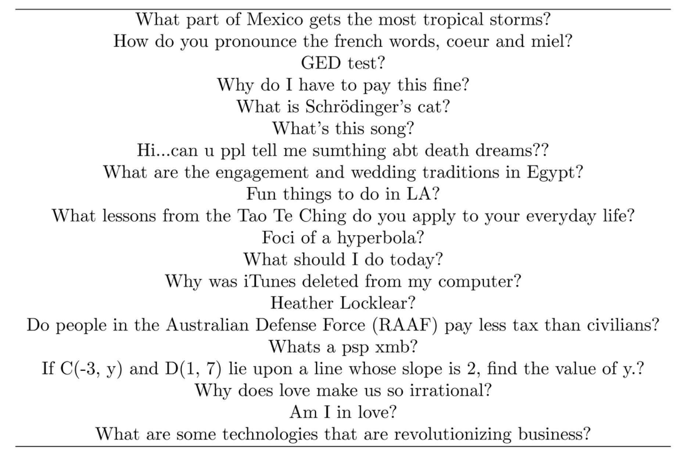
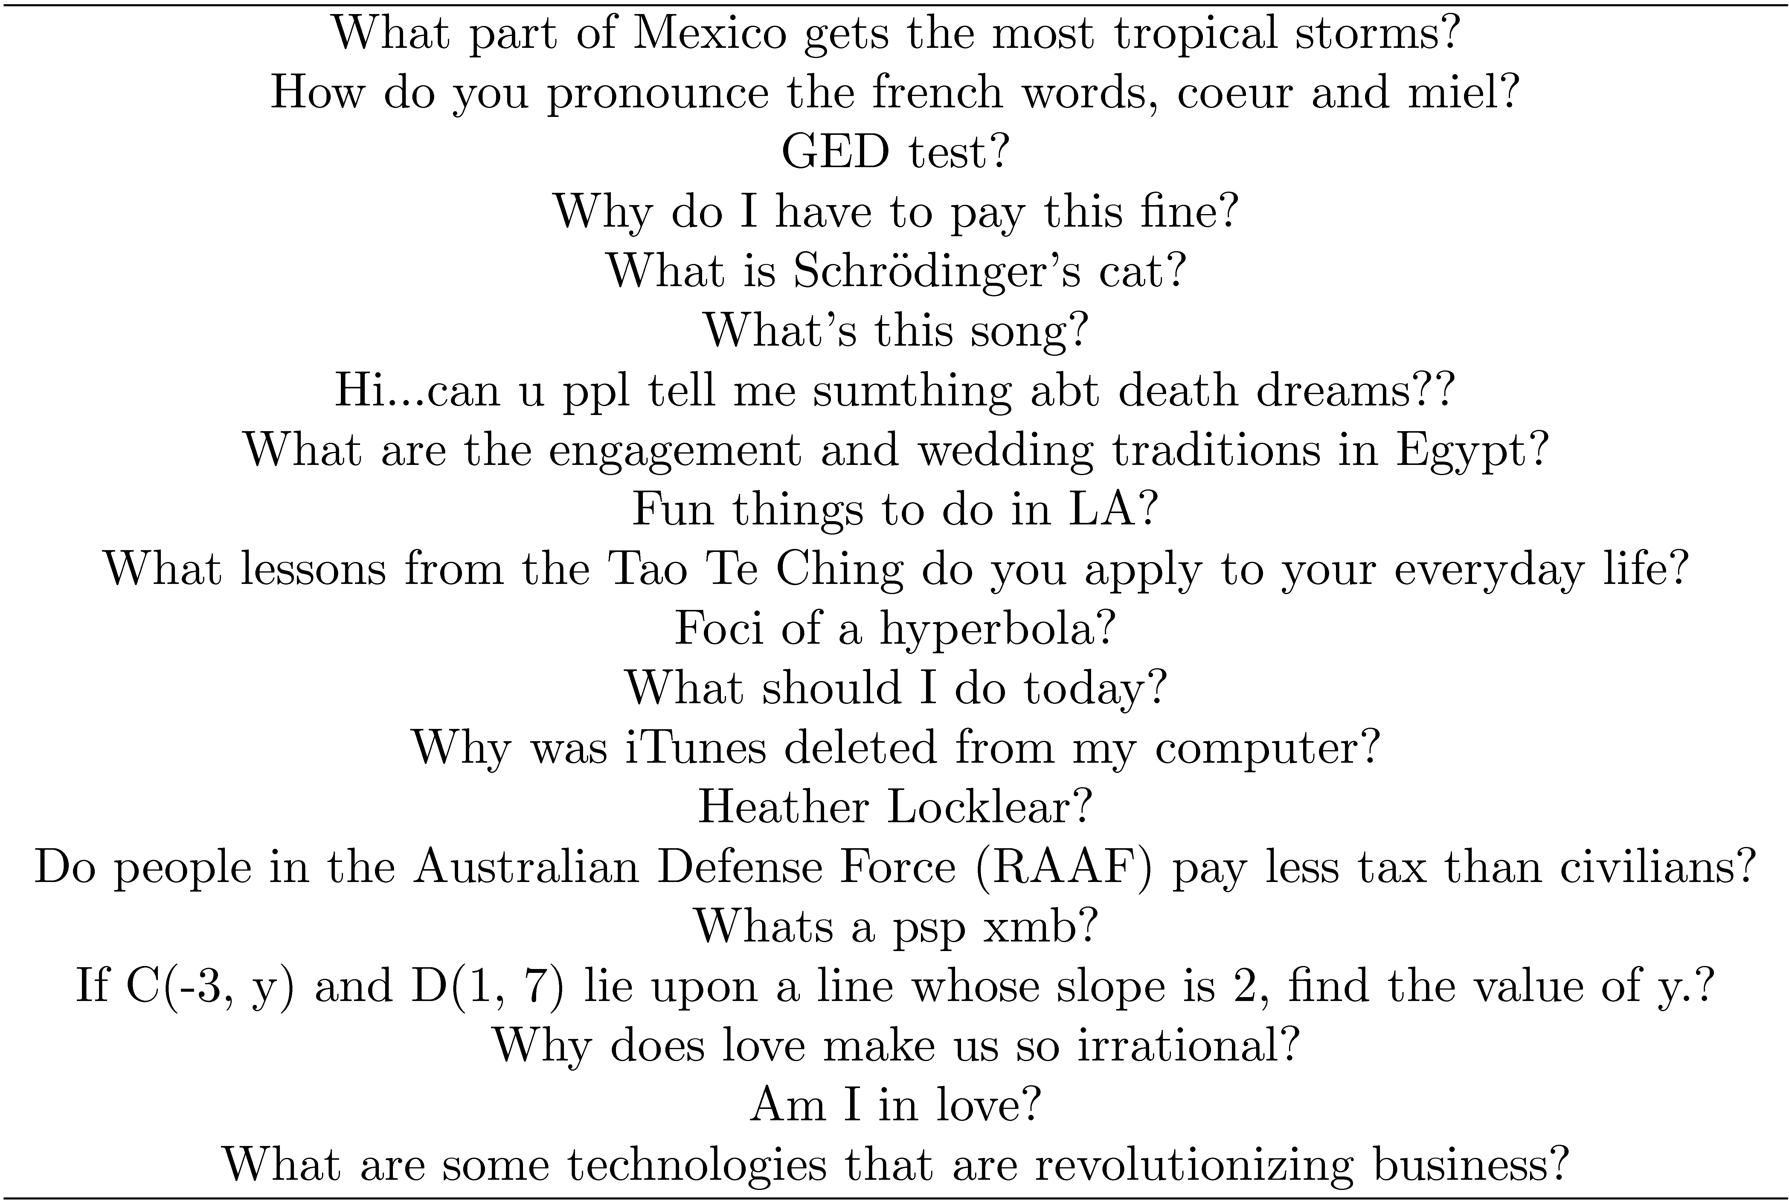
Example Questions

Slide 27
Community Based Question Answering
Pros
  Can find answers to complex/obscure questions
  Answers are from humans, not algorithms
  Can search archive of previous questions/answers
Cons
  Often takes time to get a response
  Some questions never get answered
  Answers may be wrong

Slide 28
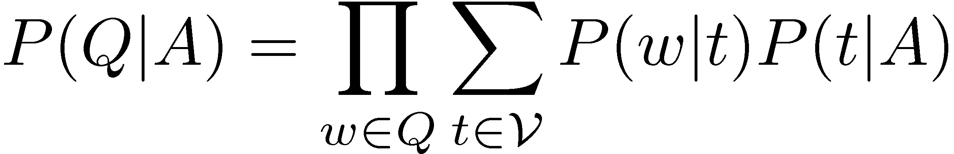
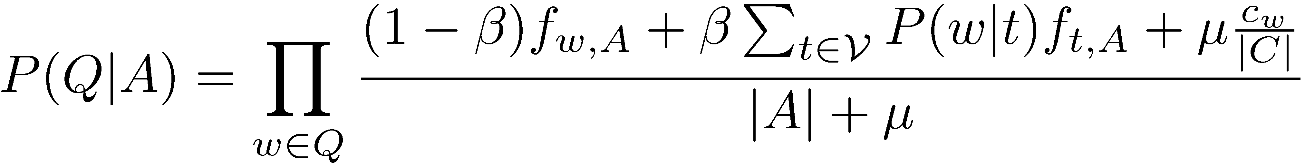
Question Answering Models
How can we effectively search an archive of question/answer pairs?
Can be treated as a translation problem
  Translate a question into a related question
  Translate a question into an answer
Translation-based language model:
Enhanced translation model:
Quora, Stack Overflow,
etc. == goldmine
translating terms
independently (P(w|t))
can lead to “answering
the wrong question”
adjust β to influence translation weight

Slide 29
Computing Translation Probabilities
Translation probabilities are learned from a parallel corpus
Most often used for learning inter-language probabilities
Can be used for intra-language probabilities
  Treat question / answer pairs are parallel corpus
Various tools exist for computing translation probabilities from a parallel corpus

Slide 30
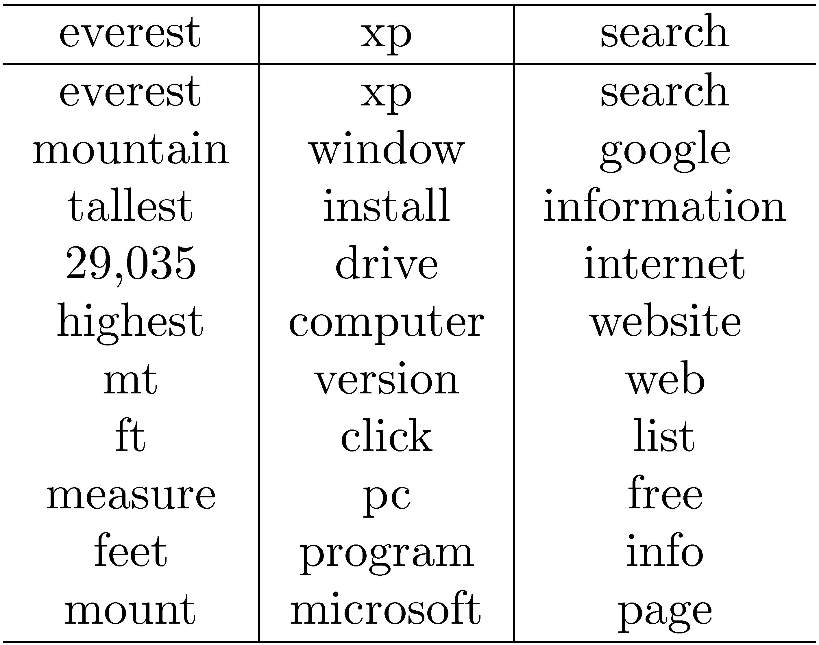
Example Question/Answer Translations

Slide 31
Collaborative Searching
Traditional search assumes single searcher
Collaborative search involves a group of users, with a common goal, searching together in a collaborative setting
Example scenarios
  Students doing research for a history report
  Family members searching for information on how to care for an aging relative
  Team member working to gather information and requirements for an industrial project

Slide 32
Collaborative Search
Two types of collaborative search settings depending on where participants are physically located
Co-located
  Participants in same location
  CoSearch system
Remote collaborative
  Participants in different locations
  SearchTogether system

Slide 33

Collaborative Search Scenarios
Co-located Collaborative Searching
Remote Collaborative Searching

Slide 34
Collaborative Search
Challenges
  How do users interact with system?
  How do users interact with each other?
  How is data shared?
  What data persists across sessions?
Very few commercial collaborative search systems
Likely to see more of this type of system in the future

Slide 35
Document Filtering
Ad hoc retrieval
  Document collections and information needs change with time
  Results returned when query is entered
Document filtering
  Document collections change with time, but information needs are static (long-term)
  Long term information needs represented as a profile
  Documents entering system that match the profile are delivered to the user via a push mechanism

Slide 36
Profiles
Represents long term information needs
Can be represented in different ways
  Boolean or keyword query
  Sets of relevant and non-relevant documents
  Relational constraints
    “published before 1990”
    “price in the $10-$25 range”
Actual representation usually depends on underlying filtering model
Can be static (static filtering) or updated over time (adaptive filtering)

Slide 37
Document Filtering Scenarios
Profile
1
Profile
1
Profile 1.1
Profile
2
Profile
2
Profile 2.1
Profile
3
Profile
3
Profile
3.1
t = 2
t = 3
t = 5
t = 8
t = 2
t = 3
t = 5
t = 8
Document Stream
Document Stream
Static Filtering
Adaptive Filtering

Slide 38
Static Filtering
Given a fixed profile, how can we determine if an incoming document should be delivered?
Treat as information retrieval problem
  Boolean
  Vector space
  Language modeling
Treat as supervised learning problem
  Naïve Bayes
  Support vector machines

Slide 39
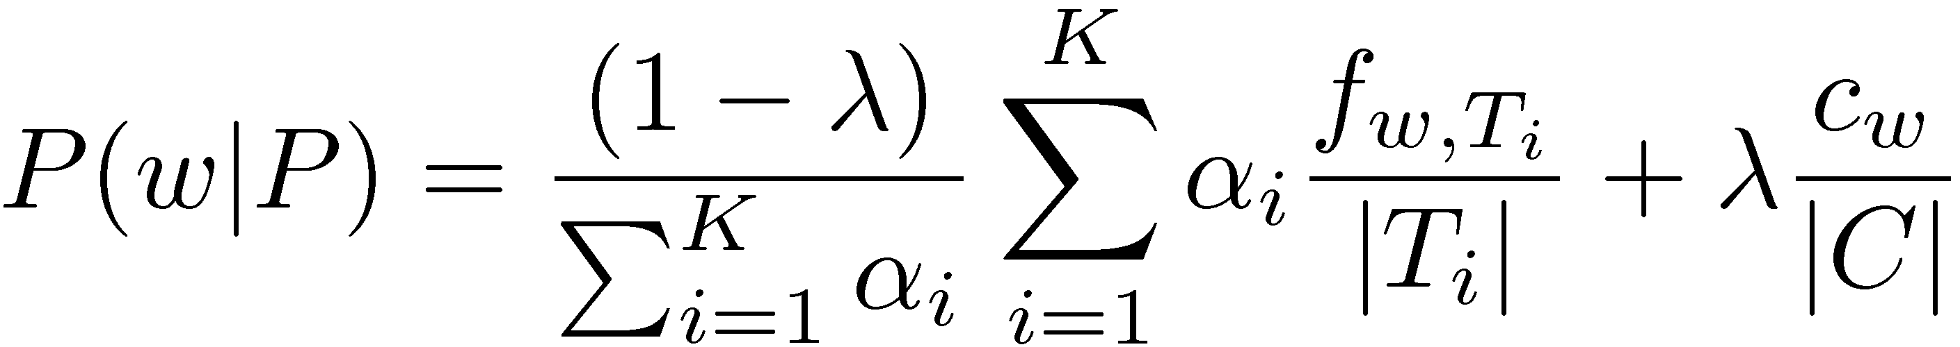
Static Filtering with Language Models
Assume profile consists of K relevant documents (T_{i}), each with weight α_{i}
Probability of a word given the profile is:
KL divergence between profile and document model is used as score:
If –KL(P||D) ≥ θ, then deliver D to P
  Threshold (θ) can be optimized for some metric

Slide 40
Adaptive Filtering
In adaptive filtering, profiles are dynamic
How can profiles change?
  User can explicitly update the profile
  User can provide (relevance) feedback about the documents delivered to the profile
  Implicit user behavior can be captured and used to update the profile

Slide 41
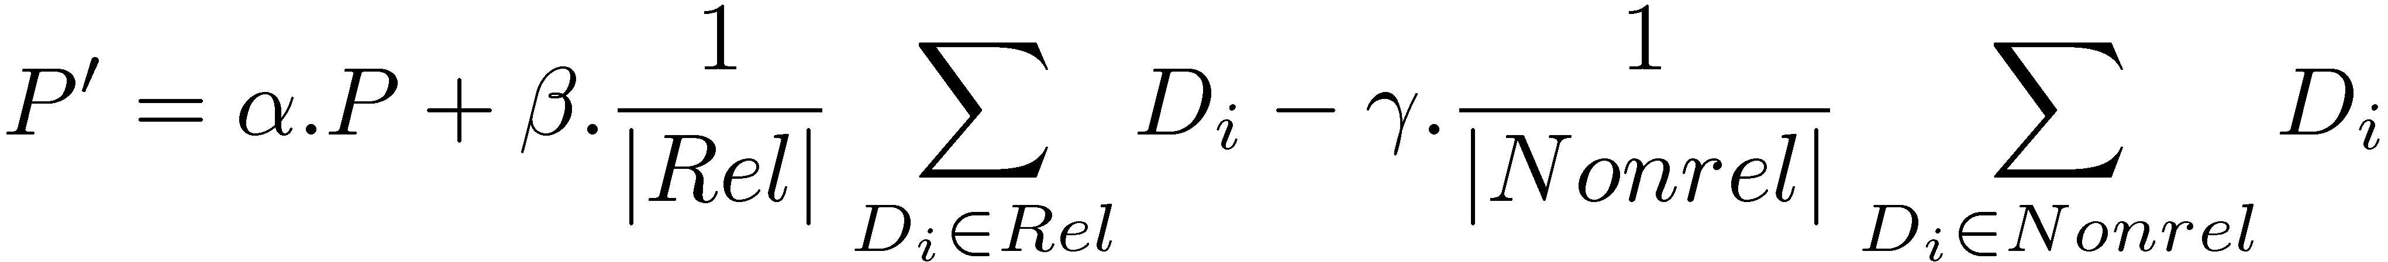
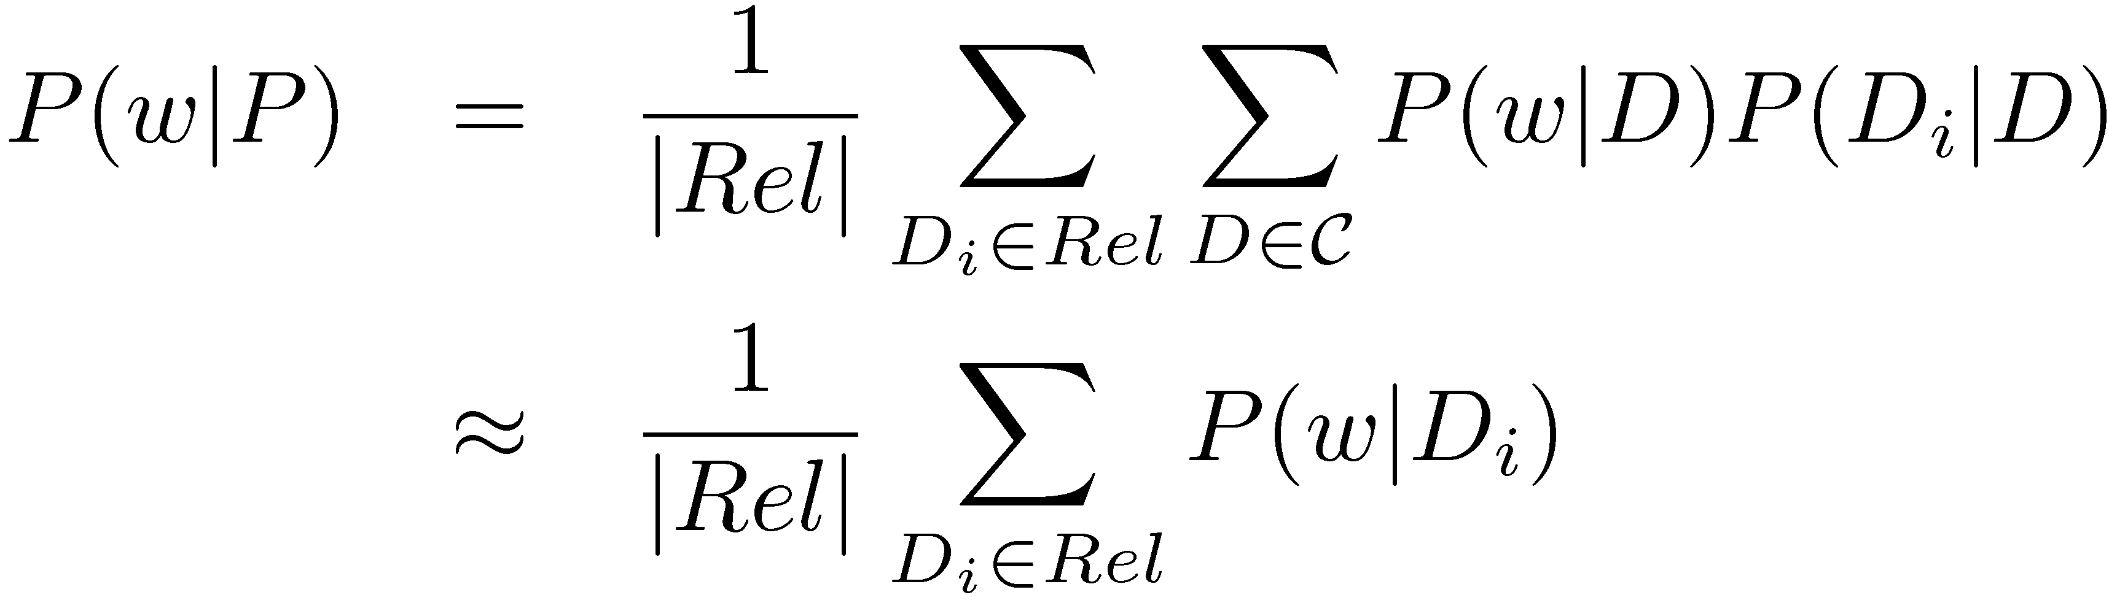
Adaptive Filtering Models
Rocchio
  Profiles treated as vectors
Relevance-based language models
  Profiles treated as language models

Slide 42
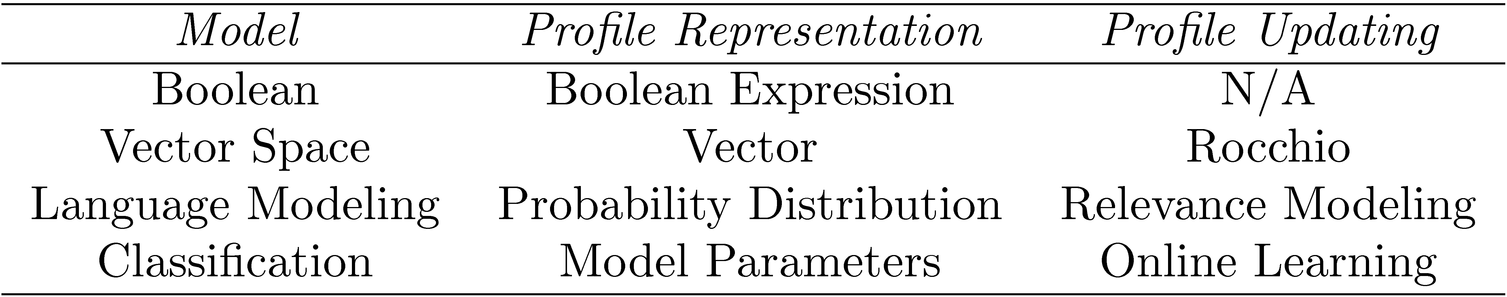
Summary of Filtering Models

Slide 43
Fast Filtering with Millions of Profiles
Real filtering systems
  May have thousands or even millions of profiles
  Many new documents will enter the system daily
How to efficiently filter in such a system?
  Most profiles are represented as text or a set of features
  Build an inverted index for the profiles
  Distill incoming documents as “queries” and run against index

Slide 44
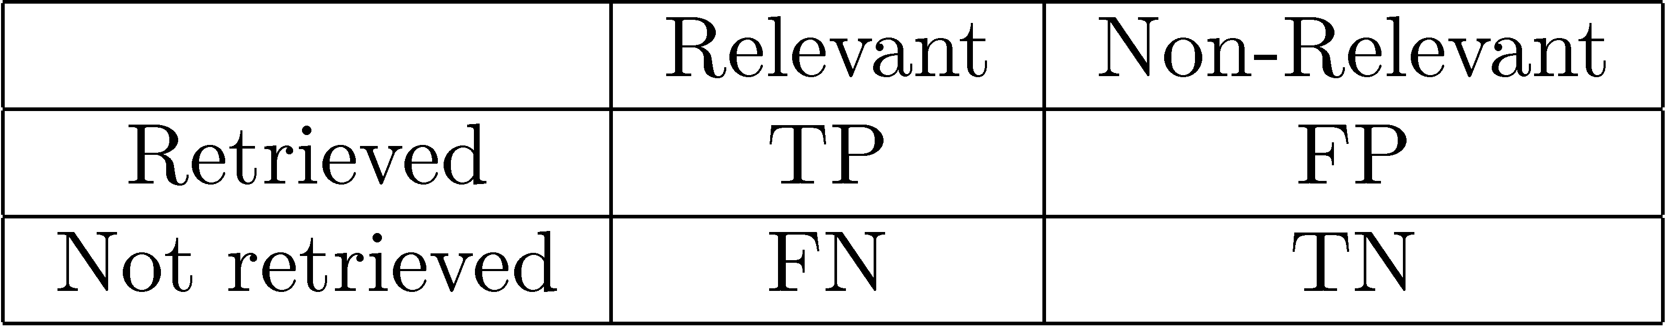
Evaluation of Filtering Systems
Definition of “good” depends on the purpose of the underlying filtering system
Generic filtering evaluation measure:
α = 2, β = 0, δ = -1, and γ = 0 is widely used

Slide 45
Collaborative Filtering
In static and adaptive filtering, users and their profiles are assumed to be independent of each other
Similar users are likely to have similar preferences
Collaborative filtering exploits relationships between users to improve how items (documents) are matched to users (profiles)

Slide 46
Recommender Systems
Recommender systems recommend items that a user may be interested in
Examples
  Amazon.com
  NetFlix
Recommender systems use collaborative filtering to recommend items to users
e.g., https://en.wikipedia.org/wiki/Netflix_Prize

Slide 47
Recommender System Algorithms
Input
  (user, item, rating) tuples for items that the user has explicitly rated
  Typically represented as a user-item matrix
Output
  (user, item, rating) tuples for items that the user has not rated
  Can be thought of as filling in the missing entries of the user-item matrix
Most algorithms infer missing ratings based on the ratings of similar users

Slide 48
Recommender Systems
1
?
1
1
2
1
5
?
4
3
?
?
5
5

Slide 49
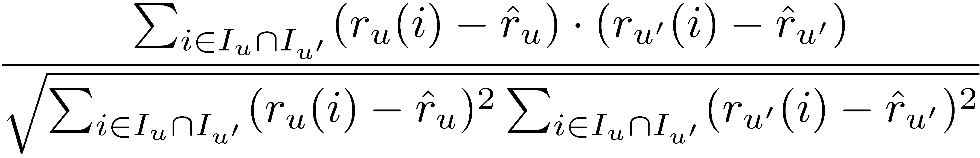
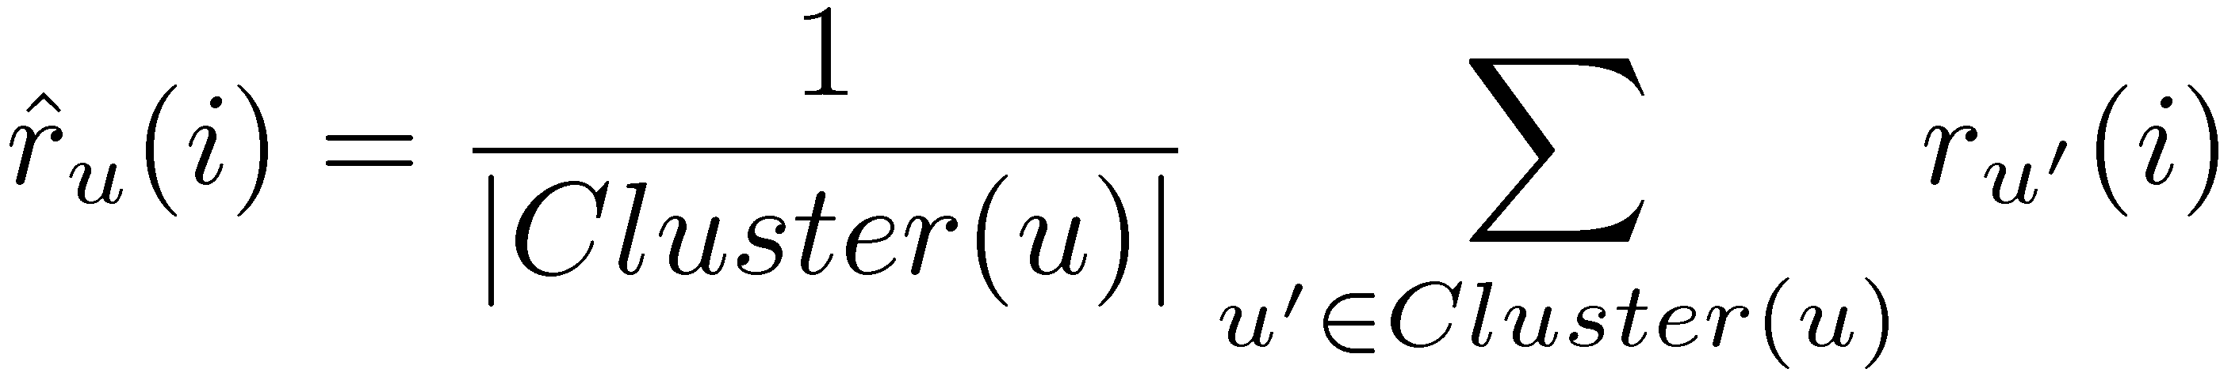
Rating using User Clusters
Clustering can be used to find groups of similar users
Measure user/user similarity using rating correlation:
Use average rating of other users within the same cluster to rate unseen items:

Slide 50
Cluster-Based Collaborative Filtering
B
1
?
A
1
1
2
1
C
5
?
4
3
?
D
?
5
5

Slide 51
Cluster-Based Collaborative Filtering
B
1
1
A
1
1
2
1
C
5
1
4
3
4
D
3
5
5

Slide 52
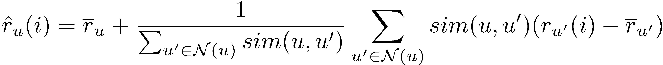
Rating using Nearest Neighbors
Can also infer ratings based on nearest neighbors
Similar to K-nearest neighbors clustering
Weight ratings of nearest neighbor according to similarity
Best to use (rating - average rating) because ratings are relative, not absolute

Slide 53
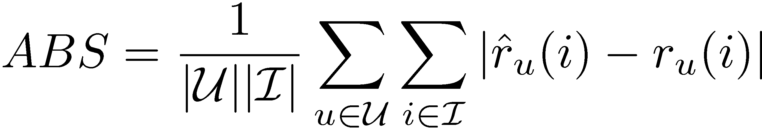
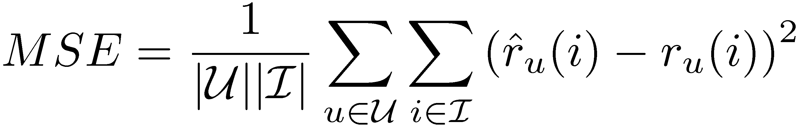
Evaluating Collaborative Filtering
Standard metrics, such as precision are too strict for evaluating recommender systems
Want to quantify how different predicted rating are from actual ratings
  Absolute error
  Mean squared error

Slide 54
Distributed Search
What is distributed search?
  Searching over networks or communities of nodes
  Each node contains some searchable data
Distributed search applications
  Metasearch
    Node: search engines
    Data: index
  Peer-to-peer (P2P)
    Node: user machines
    Data: index, files, etc.

Slide 55
Distributed Search Tasks
Resource representation
  How is a node represented?
Resource selection
  Which nodes should be searched for the given information need?
Result merging
  How do we combine the results obtained from all of the nodes?

Slide 56
Metasearch Engine Architecture

Slide 57
Resource Representation and Selection Using Language Models
Resource representation
  Language model of the documents on the node
  If document statistics are not available, a model can be estimated using query-based sampling
Resource selection
  Given a query, rank resources according to the likelihood their language model generated the query

Slide 58
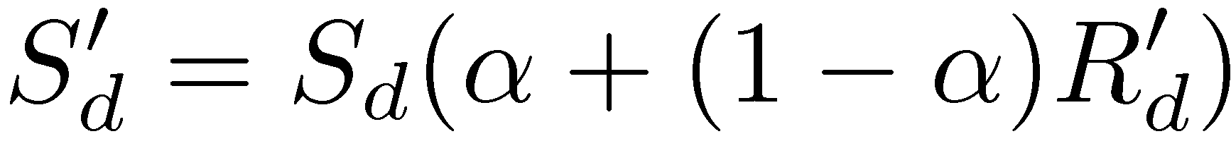
Result Merging
Scores returned from each resource may not be comparable
Must normalize the scores to produce a ranked list for the merged results
Scores can be normalized using:
S_{d} is the local score, R_{d} is the resource score, and R_{min} and R_{max} are the minimum and maximum scores returned from the resource

Slide 59
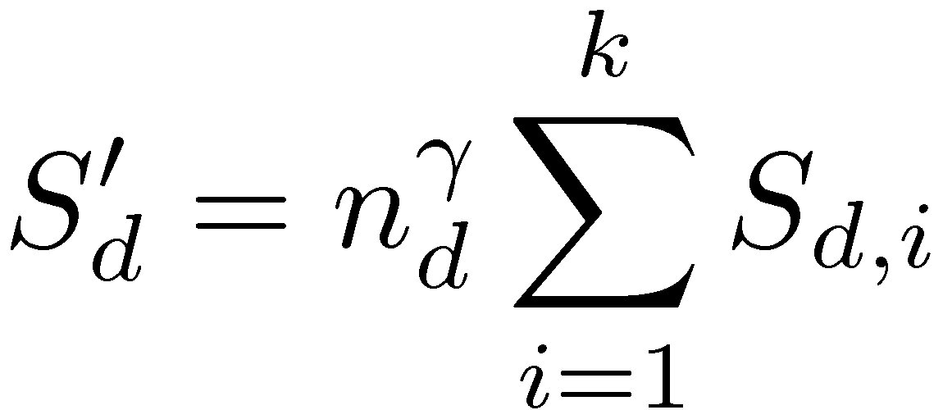
Result Merging for Metasearch
Merging results in metasearch is different because the same result may appear in multiple result sets
Scores from various search engines can be combined as follows:
n_{d} is the number of result sets that contain d and γ is typically set to -1, 0, or 1
γ = 1 (often called CombMNZ) has been shown to be highly effective for combining scores

Slide 60
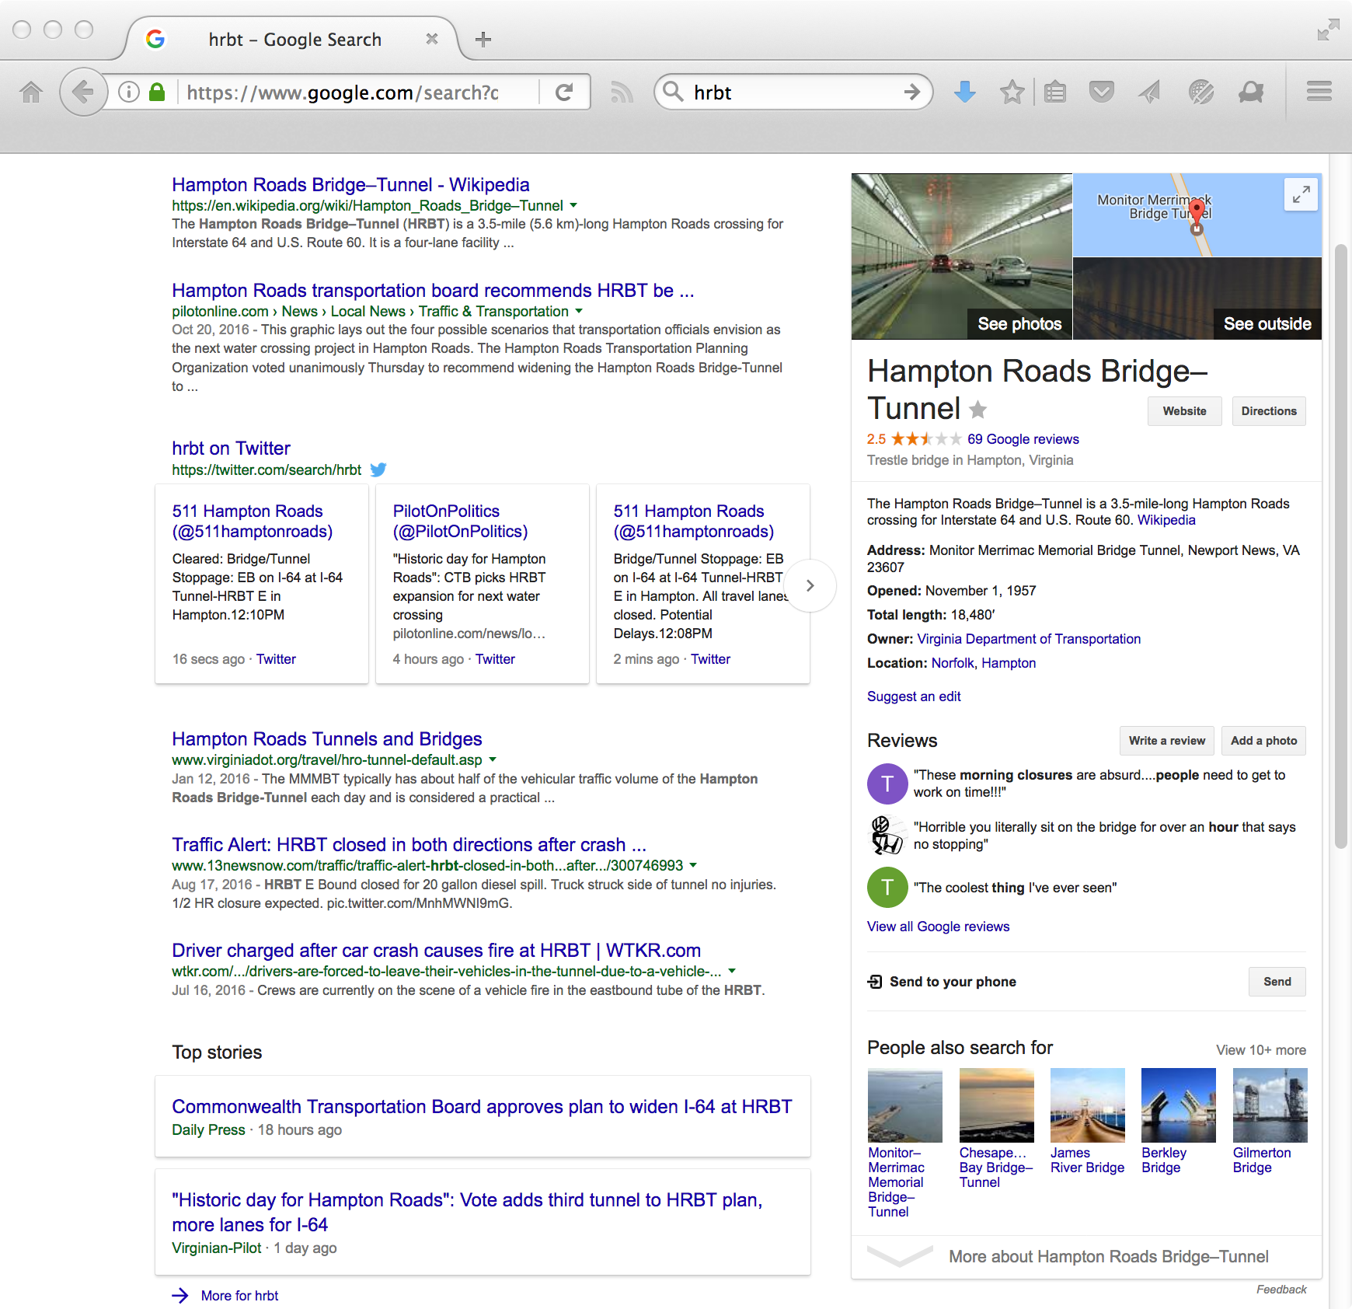
Mostly metasearch is no longer interesting, but you do have blended results from verticals

Slide 61
Peer-to-Peer Networks
Communities of users sharing data and files
  KaZaA
  BearShare
  BitTorrent
Clients issue queries to initiate search
Servers respond to queries with files and may also route queries to other nodes
Nodes can act as clients, servers, or both, depending on the network architecture

Slide 62
P2P Architectures
Central hub
  Clients send queries to hub, which routes them to nodes that contain matching files
  Susceptible to attacks on the central hub
Pure P2P (Gnutella 0.4)
  Queries flooded into network with limited horizon
  Connections between nodes are random
  Nodes only know about neighbor nodes
  Does not scale well
Hierarchical (Superpeer Network)
  Two-level hierarchy of hub nodes and leaf nodes
  Leaf nodes are either clients or servers and only connect to hubs
  Hubs provide directory services for the leaf nodes

Slide 63
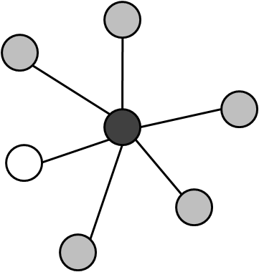
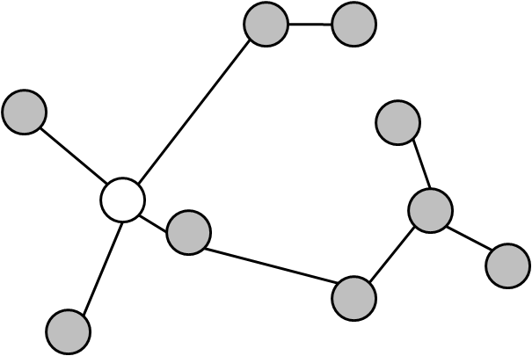
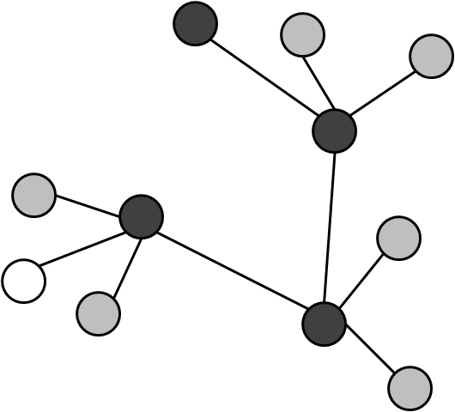
Distributed Search Architectures
Central Hub
Pure P2P
Hierarchical P2P

Slide 64
Network Neighborhoods
Flooding is inefficient due to the network traffic generated
Rather than generating descriptions for each node, generate them for neighborhoods of nodes
Improve efficiency of query routing

Slide 65
Neighborhoods of a Hub Node

