Slide 1
Search Engines
Information Retrieval in Practice
Annotations by Michael L. Nelson
All slides ©Addison Wesley, 2008

Slide 2
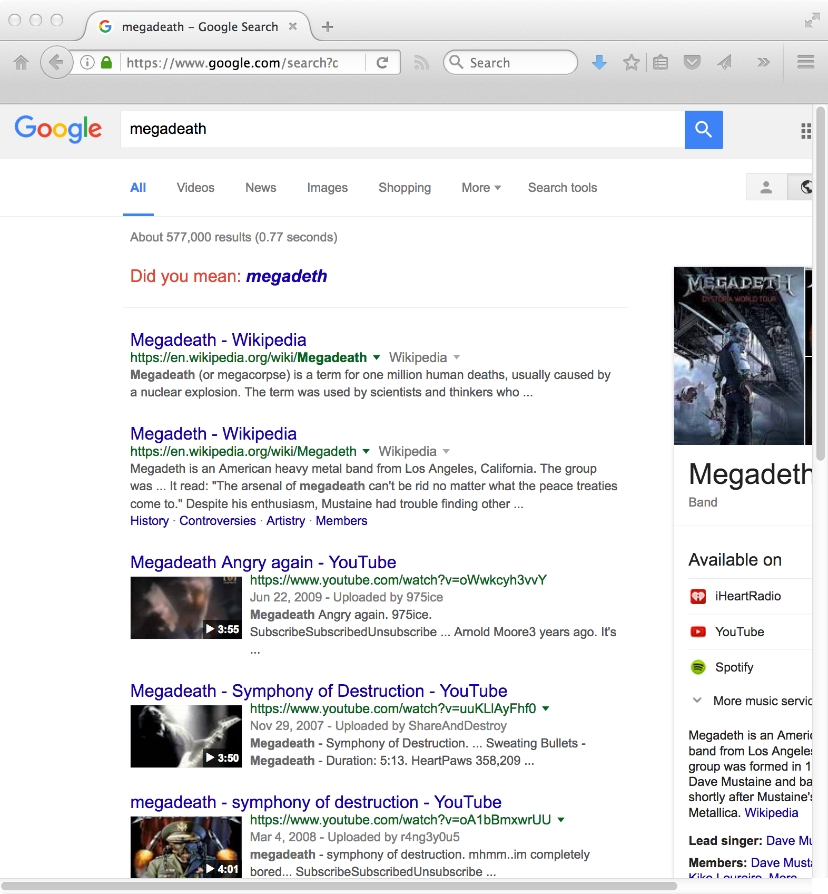
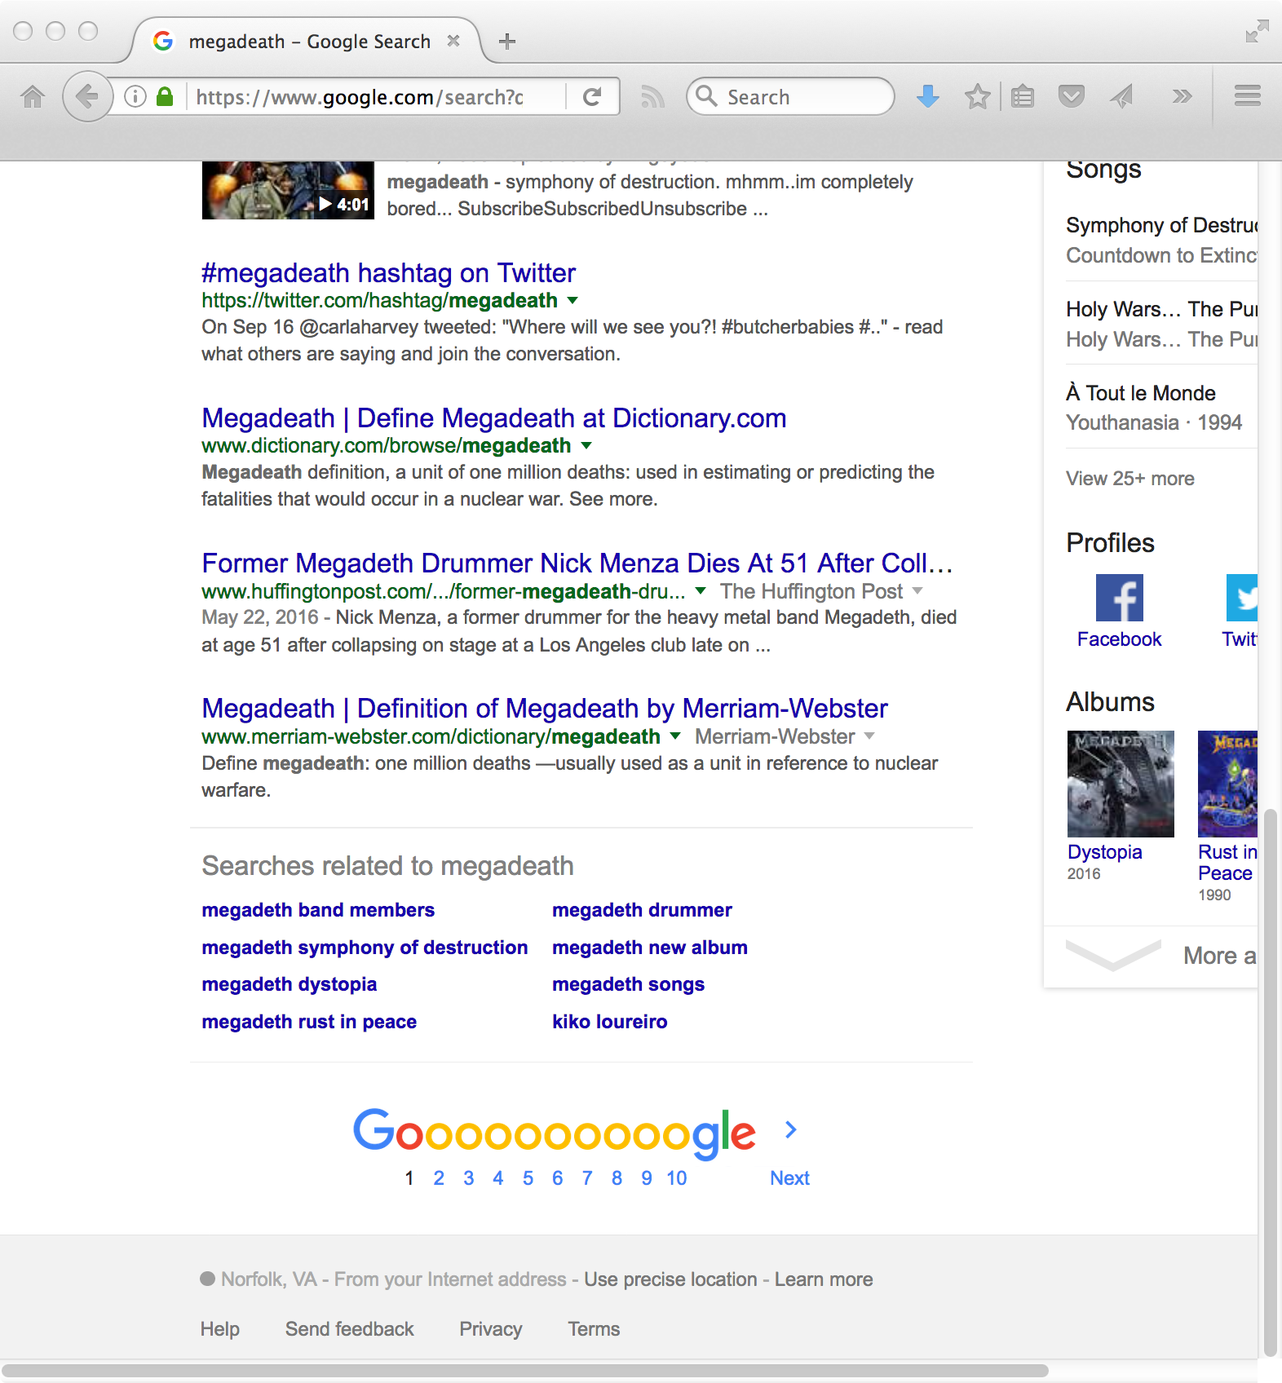
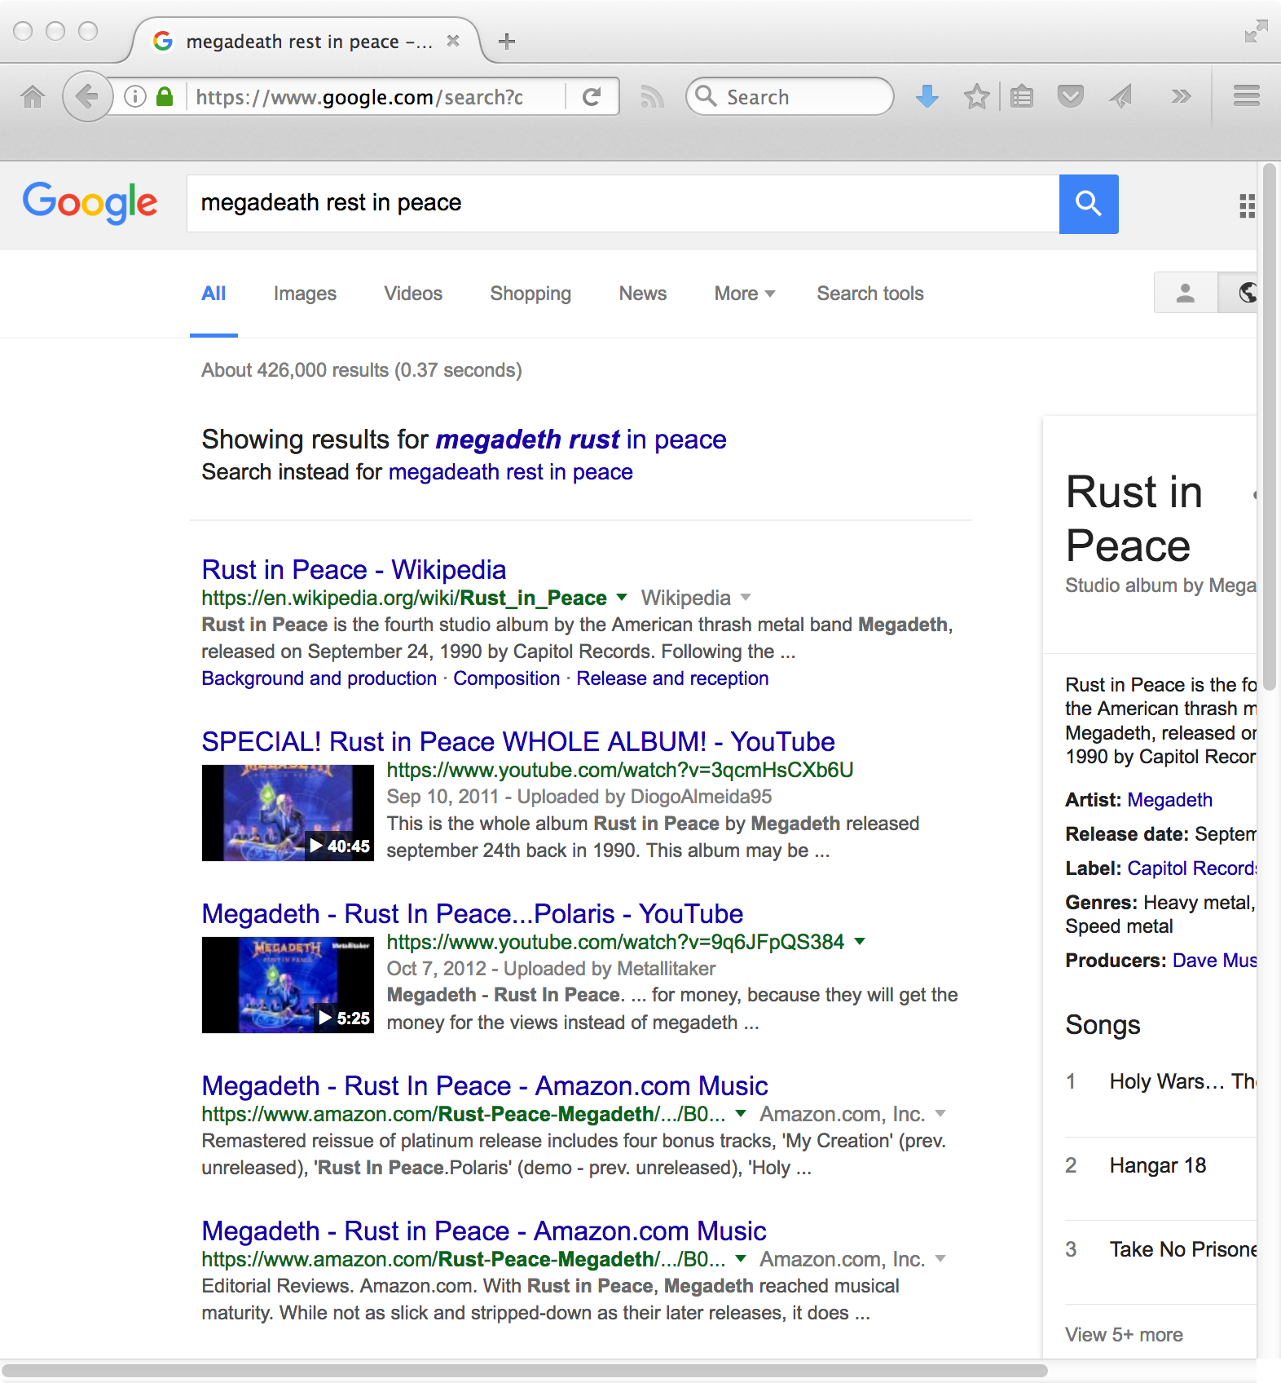
Guessing what you meant…

Slide 3
Information Needs
An information need is the underlying cause of the query that a person submits to a search engine
  sometimes called information problem to emphasize that information need is generally related to a task
Categorized using variety of dimensions
  e.g., number of relevant documents being sought
  type of information that is needed
  type of task that led to the requirement for information

Slide 4
Queries and Information Needs
A query can represent very different information needs
  May require different search techniques and ranking algorithms to produce the best rankings
A query can be a poor representation of the information need
  User may find it difficult to express the information need
  User is encouraged to enter short queries both by the search engine interface, and by the fact that long queries don’t work

Slide 5
Interaction
Interaction with the system occurs
  during query formulation and reformulation
  while browsing the result
Key aspect of effective retrieval
  users can’t change ranking algorithm but can change results through interaction
  helps refine description of information need
    e.g., same initial query, different information needs
    how does user describe what they don’t know?

Slide 6
ASK Hypothesis
Belkin et al. (1982) proposed a model called Anomalous State of Knowledge
ASK hypothesis:
  difficult for people to define exactly what their information need is, because that information is a gap in their knowledge
  Search engine should look for information that fills those gaps
Interesting ideas, little practical impact (yet)

Slide 7
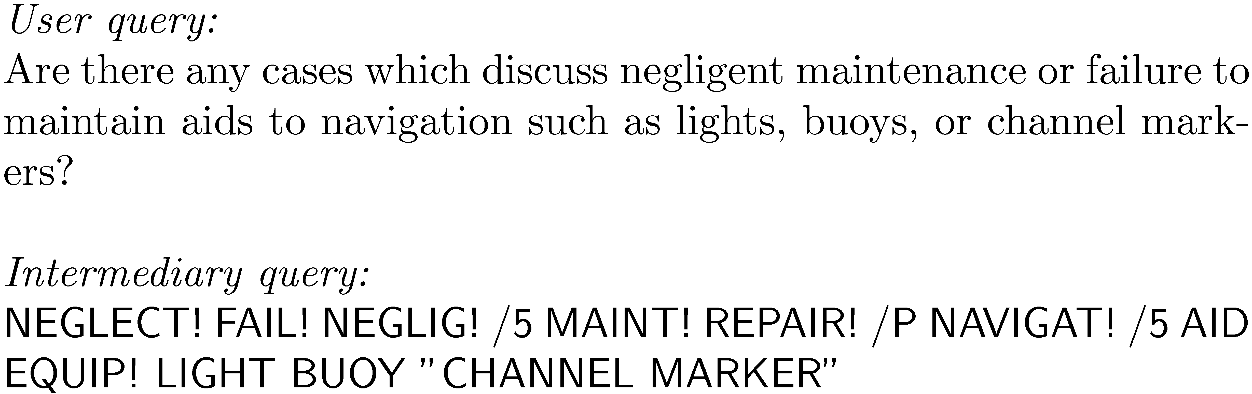
Keyword Queries
Query languages in the past were designed for professional searchers (intermediaries)

Slide 8
Keyword Queries
Simple, natural language queries were designed to enable everyone to search
Current search engines do not perform well (in general) with natural language queries
People trained (in effect) to use keywords
  compare average of about 2.3 words/web query to average of 30 words/CQA query
Keyword selection is not always easy
  query refinement techniques can help

Slide 9
Query-Based Stemming
Make decision about stemming at query time rather than during indexing
  improved flexibility, effectiveness
Query is expanded using word variants
  documents are not stemmed
  e.g., “rock climbing” expanded with “climb”, not stemmed to “climb”

Slide 10
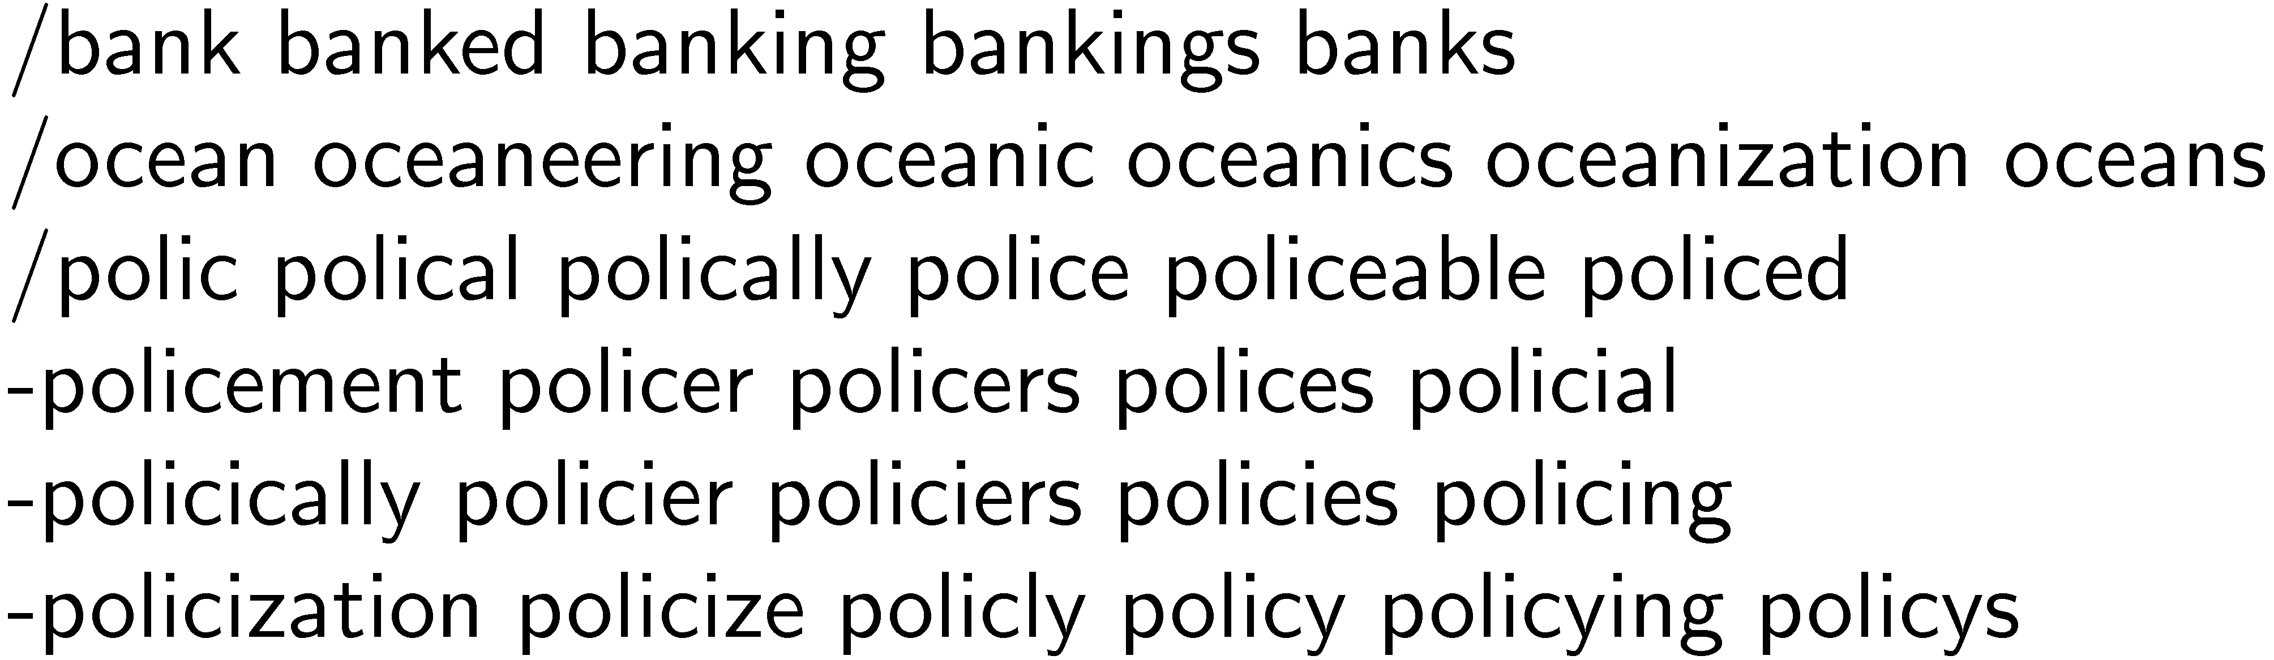
Stem Classes
A stem class is the group of words that will be transformed into the same stem by the stemming algorithm
  generated by running stemmer on large corpus
  e.g., Porter stemmer on TREC News

Slide 11
Stem Classes
Stem classes are often too big and inaccurate
Modify using analysis of word co-occurrence
Assumption:
  Word variants that could substitute for each other should co-occur often in documents

Slide 12
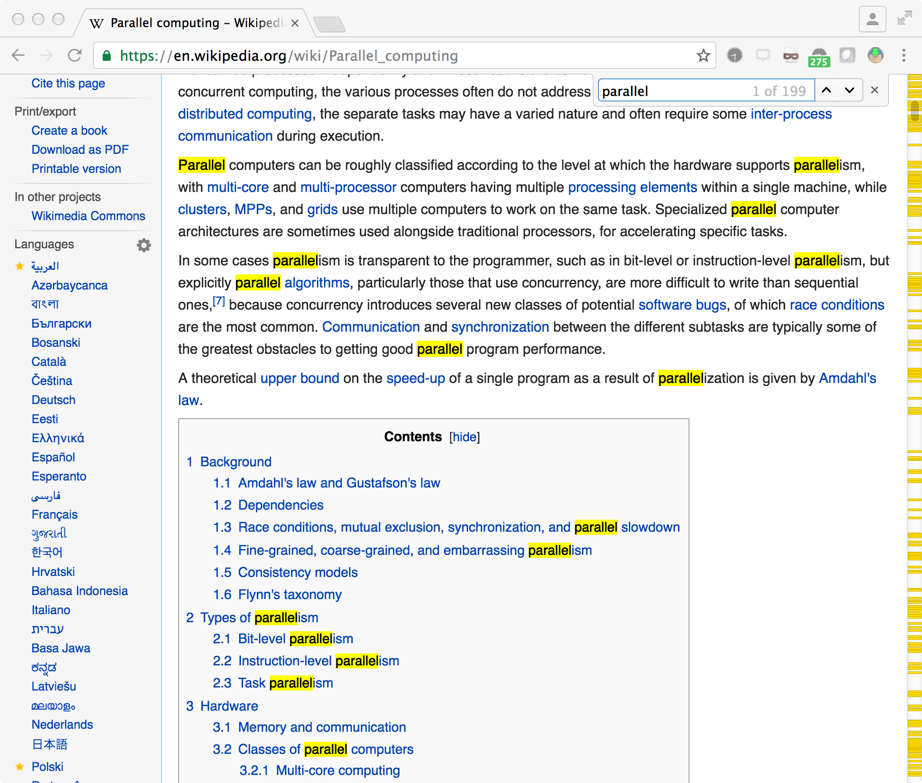
Stem co-occurrence
include: parallel, parallelism, parallelization
exclude: parallelogram
(but corpus dependent!)

Slide 13
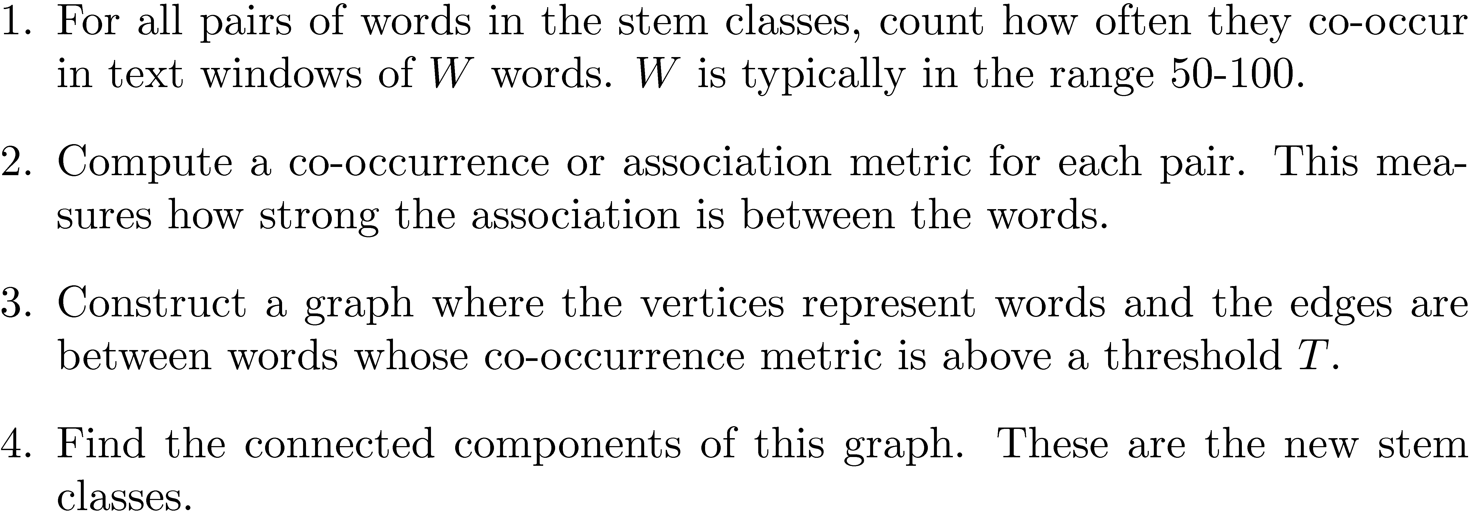
Modifying Stem Classes

Slide 14
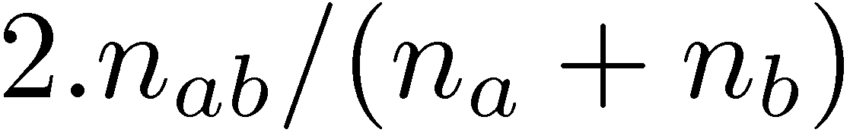
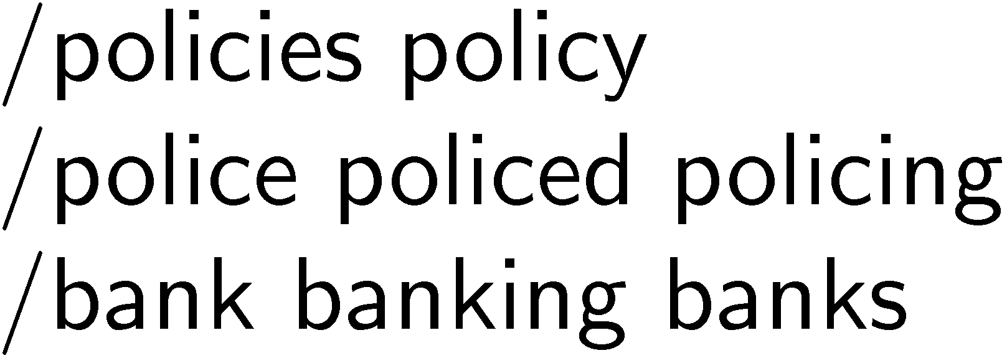
Modifying Stem Classes
Dices’ Coefficient is an example of a term association measure
    where n_{x} is the number of windows containing x
Two vertices are in the same connected component of a graph if there is a path between them
  forms word clusters
Example output of modification

Slide 15
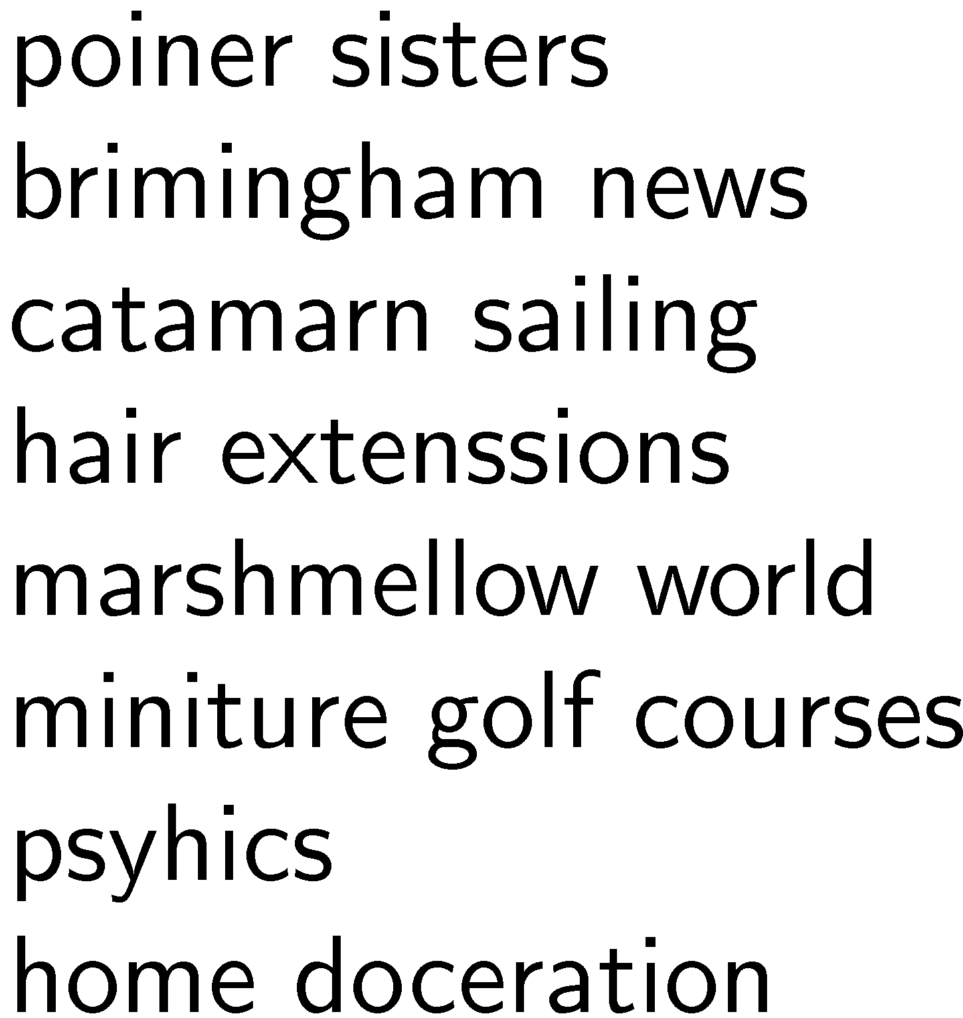
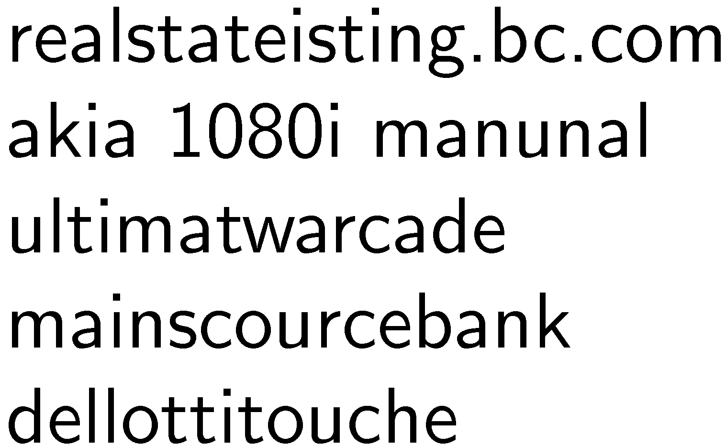
Spell Checking
Important part of query processing
  10-15% of all web queries have spelling errors
Errors include typical word processing errors but also many other types, e.g.

Slide 16
Spell Checking
Basic approach: suggest corrections for words not found in spelling dictionary
Suggestions found by comparing word to words in dictionary using similarity measure
Most common similarity measure is edit distance
  number of operations required to transform one word into the other

Slide 17
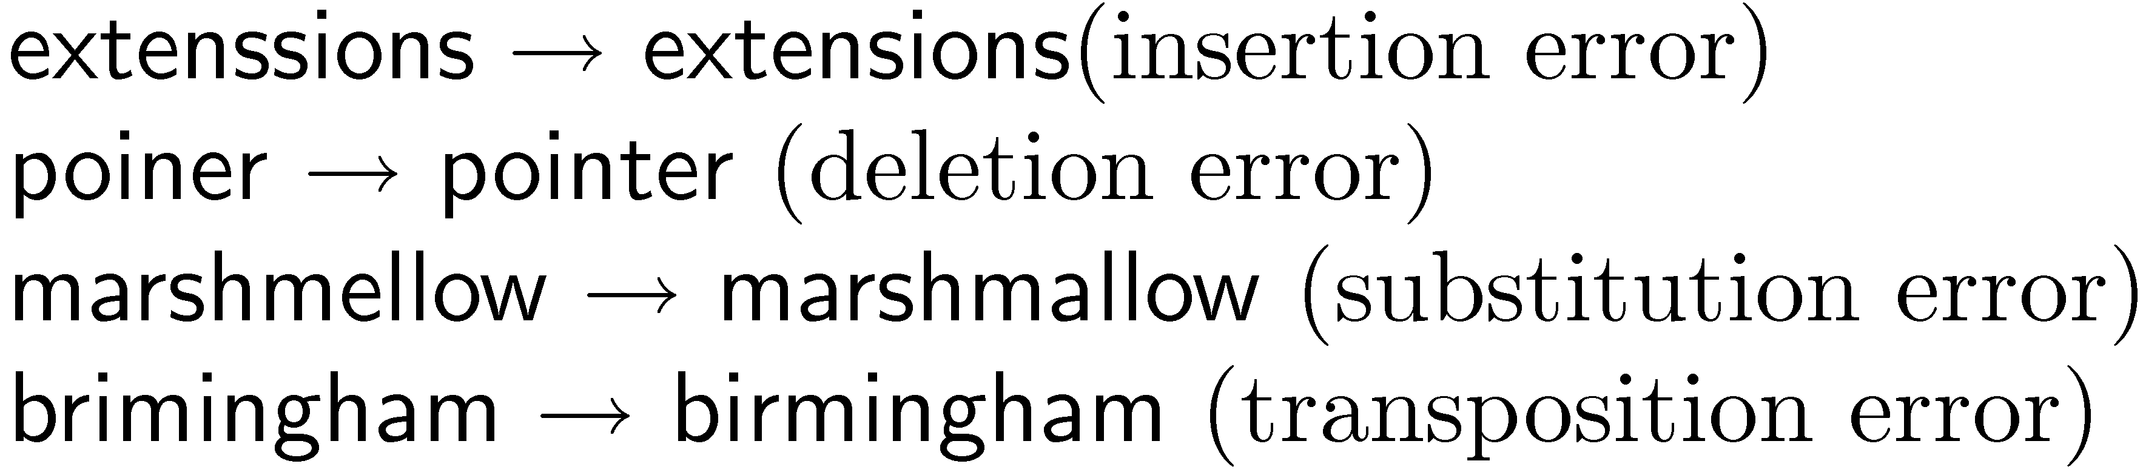

Edit Distance
Damerau-Levenshtein distance
  counts the minimum number of insertions, deletions, substitutions, or transpositions of single characters required
  e.g., Damerau-Levenshtein distance 1
  distance 2

Slide 18
Edit Distance
Number of techniques used to speed up calculation of edit distances
  restrict to words starting with same character
  restrict to words of same or similar length
  restrict to words that sound the same
Last option uses a phonetic code to group words
  e.g. Soundex
still a good assumption
with mobile devices?

Slide 19
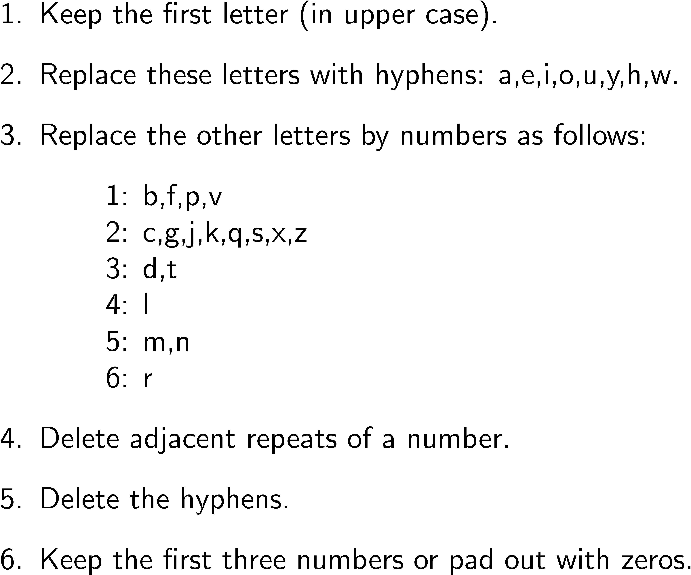
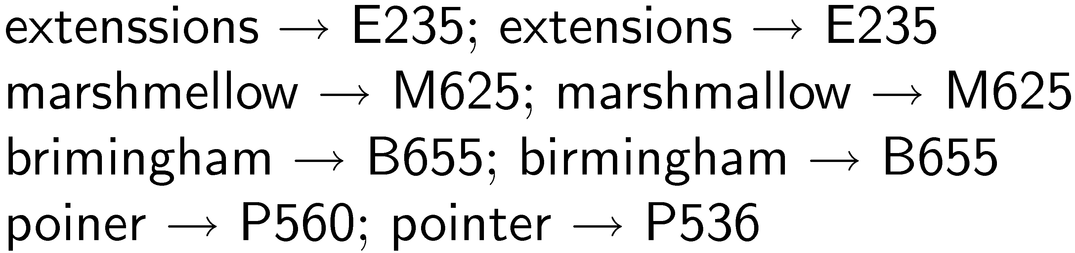
Soundex Code

Slide 20
Spelling Correction Issues
Ranking corrections
  “Did you mean...” feature requires accurate ranking of possible corrections
Context
  Choosing right suggestion depends on context (other words)
  e.g., lawers → lowers, lawyers, layers, lasers, lagers but trial lawers → trial lawyers
Run-on errors
  e.g., “mainscourcebank”
  missing spaces can be considered another single character error in right framework

Slide 21
Noisy Channel Model
User chooses word w based on probability distribution P(w)
  called the language model
  can capture context information, e.g. P(w₁|w₂)
User writes word, but noisy channel causes word e to be written instead with probability P(e|w)
  called error model
  represents information about the frequency of spelling errors

Slide 22
Noisy Channel Model
Need to estimate probability of correction
  P(w|e) = P(e|w)P(w)
Estimate language model using context
  e.g., P(w) = λP(w) + (1 − λ)P(w|w_{p})
  w_{p} is previous word
e.g.,
  “fish tink”
  “tank” and “think” both likely corrections, but P(tank|fish) > P(think|fish)

Slide 23
Noisy Channel Model
Language model probabilities estimated using corpus and query log
Both simple and complex methods have been used for estimating error model
  simple approach: assume all words with same edit distance have same probability, only edit distance 1 and 2 considered
  more complex approach: incorporate estimates based on common typing errors

Slide 24
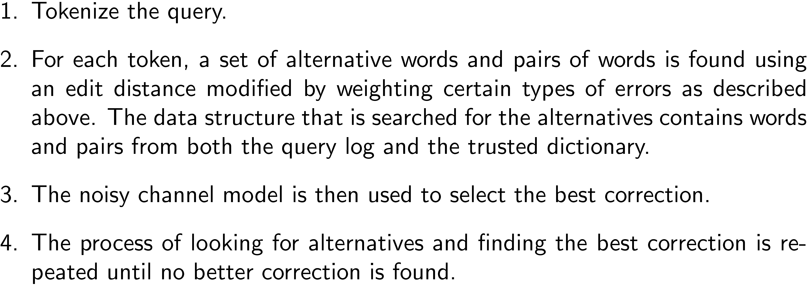
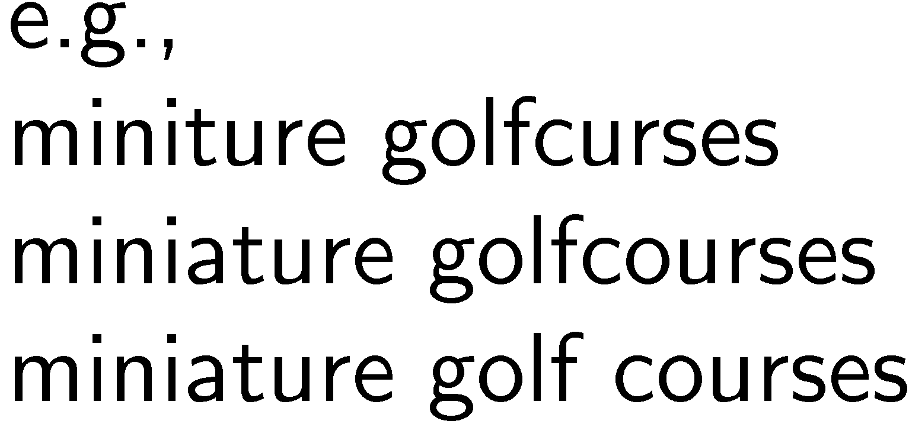
Example Spellcheck Process

Slide 25
The Thesaurus
Used in early search engines as a tool for indexing and query formulation
  specified preferred terms and relationships between them
  also called controlled vocabulary
Particularly useful for query expansion
  adding synonyms or more specific terms using query operators based on thesaurus
  improves search effectiveness

Slide 26
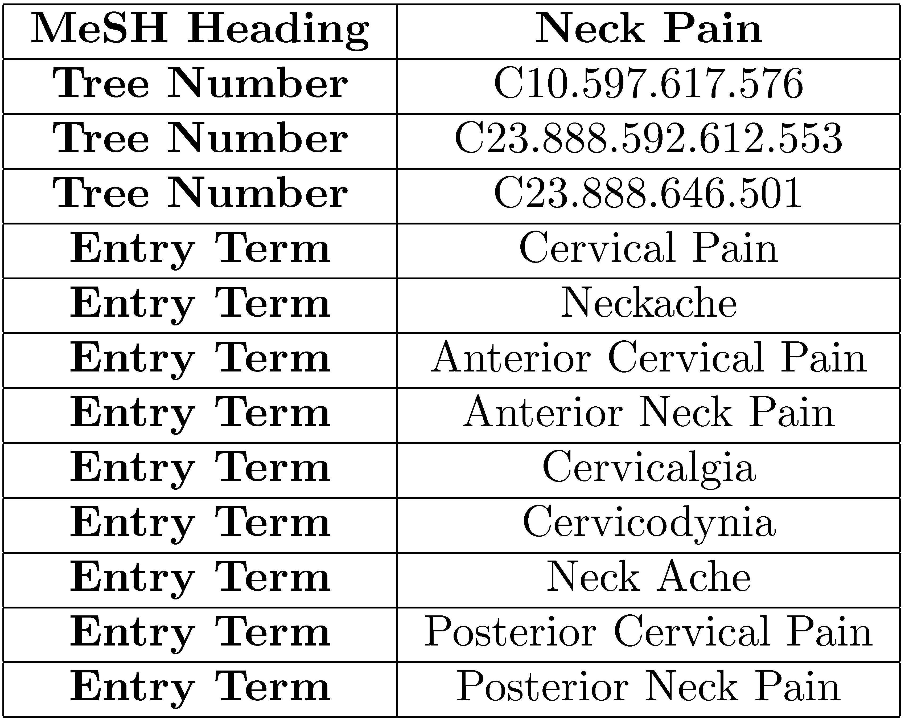
MeSH Thesaurus

Slide 27
Query Expansion
A variety of automatic or semi-automatic query expansion techniques have been developed
  goal is to improve effectiveness by matching related terms
  semi-automatic techniques require user interaction to select best expansion terms
Query suggestion is a related technique
  alternative queries, not necessarily more terms

Slide 28
Query Expansion
Approaches usually based on an analysis of term co-occurrence
  either in the entire document collection, a large collection of queries, or the top-ranked documents in a result list
  query-based stemming also an expansion technique
Automatic expansion based on general thesaurus not effective
  does not take context into account

Slide 29
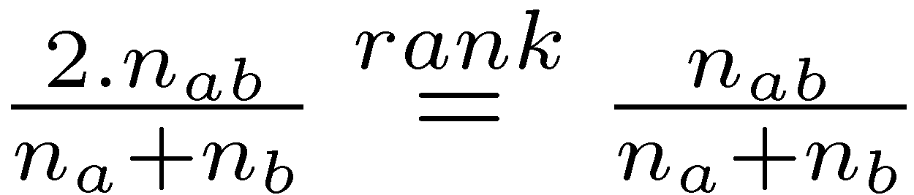
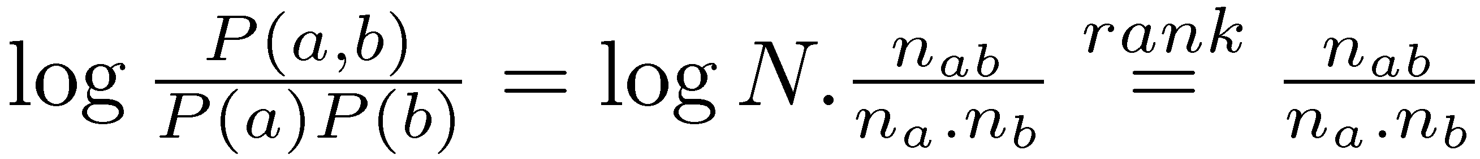
Term Association Measures
Dice’s Coefficient
Mutual Information

Slide 30
Term Association Measures
Mutual Information measure favors low frequency terms
Expected Mutual Information Measure (EMIM)
  actually only 1 part of full EMIM, focused on word occurrence

Slide 31
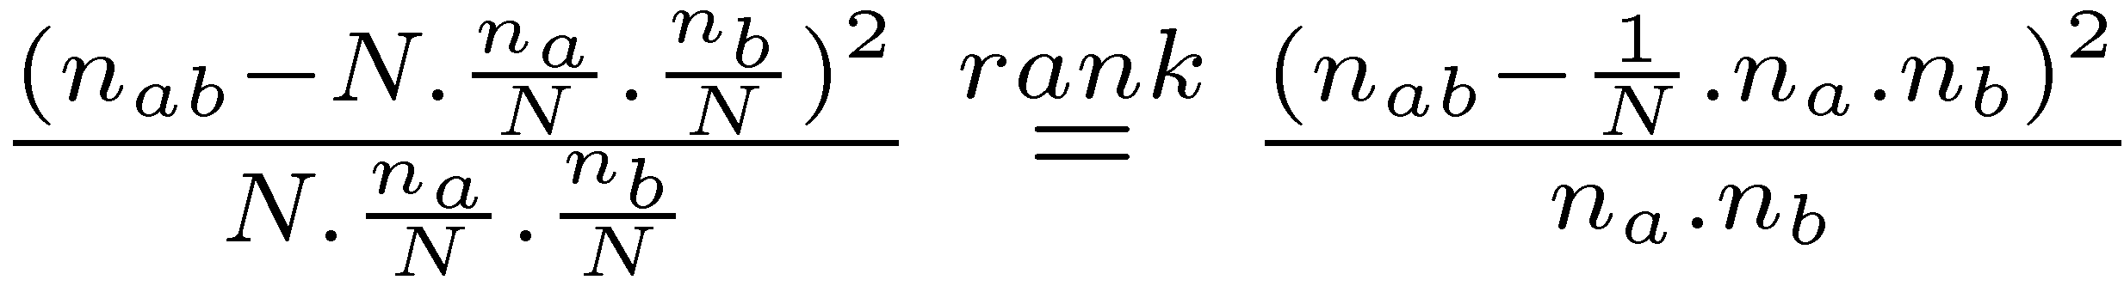
Term Association Measures
Pearson’s Chi-squared (χ²) measure
  compares the number of co-occurrences of two words with the expected number of co-occurrences if the two words were independent
  normalizes this comparison by the expected number
  also limited form focused on word co-occurrence

Slide 32
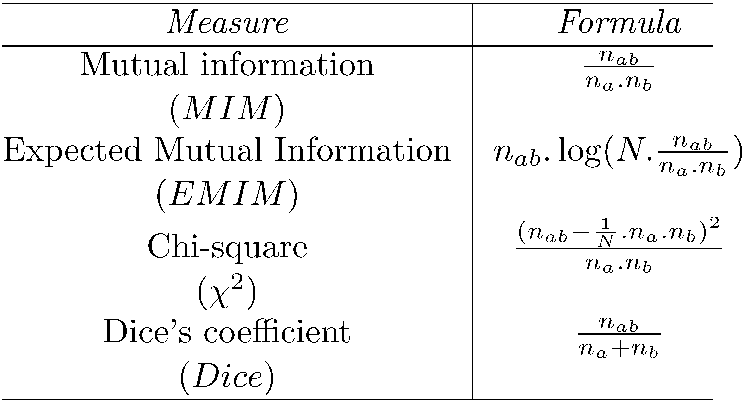
Association Measure Summary

Slide 33
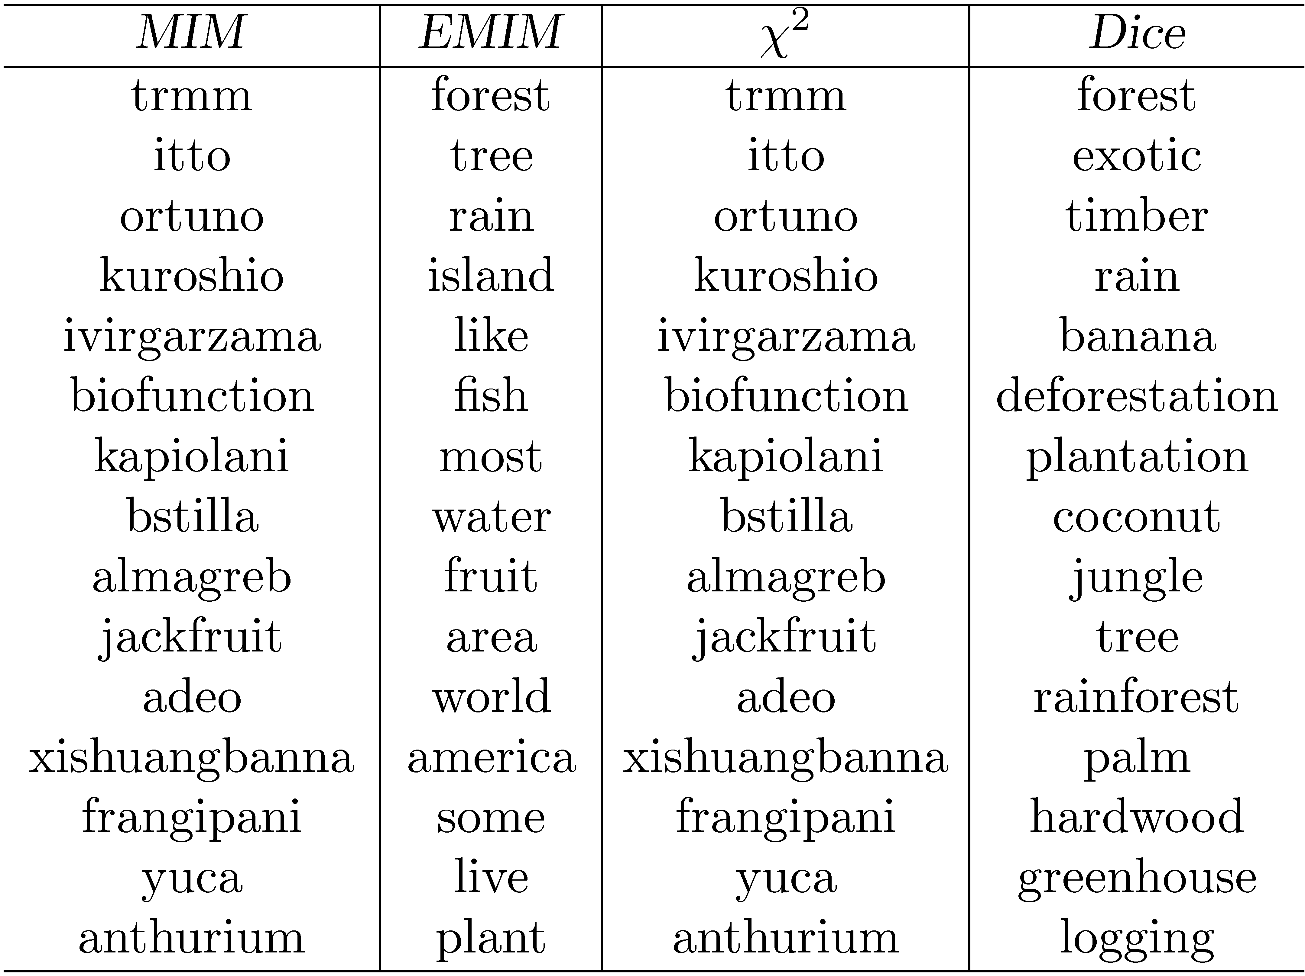
Association Measure Example
Most strongly associated words for “tropical” in a collection of TREC news
stories. Co-occurrence counts are measured at the document level.

Slide 34
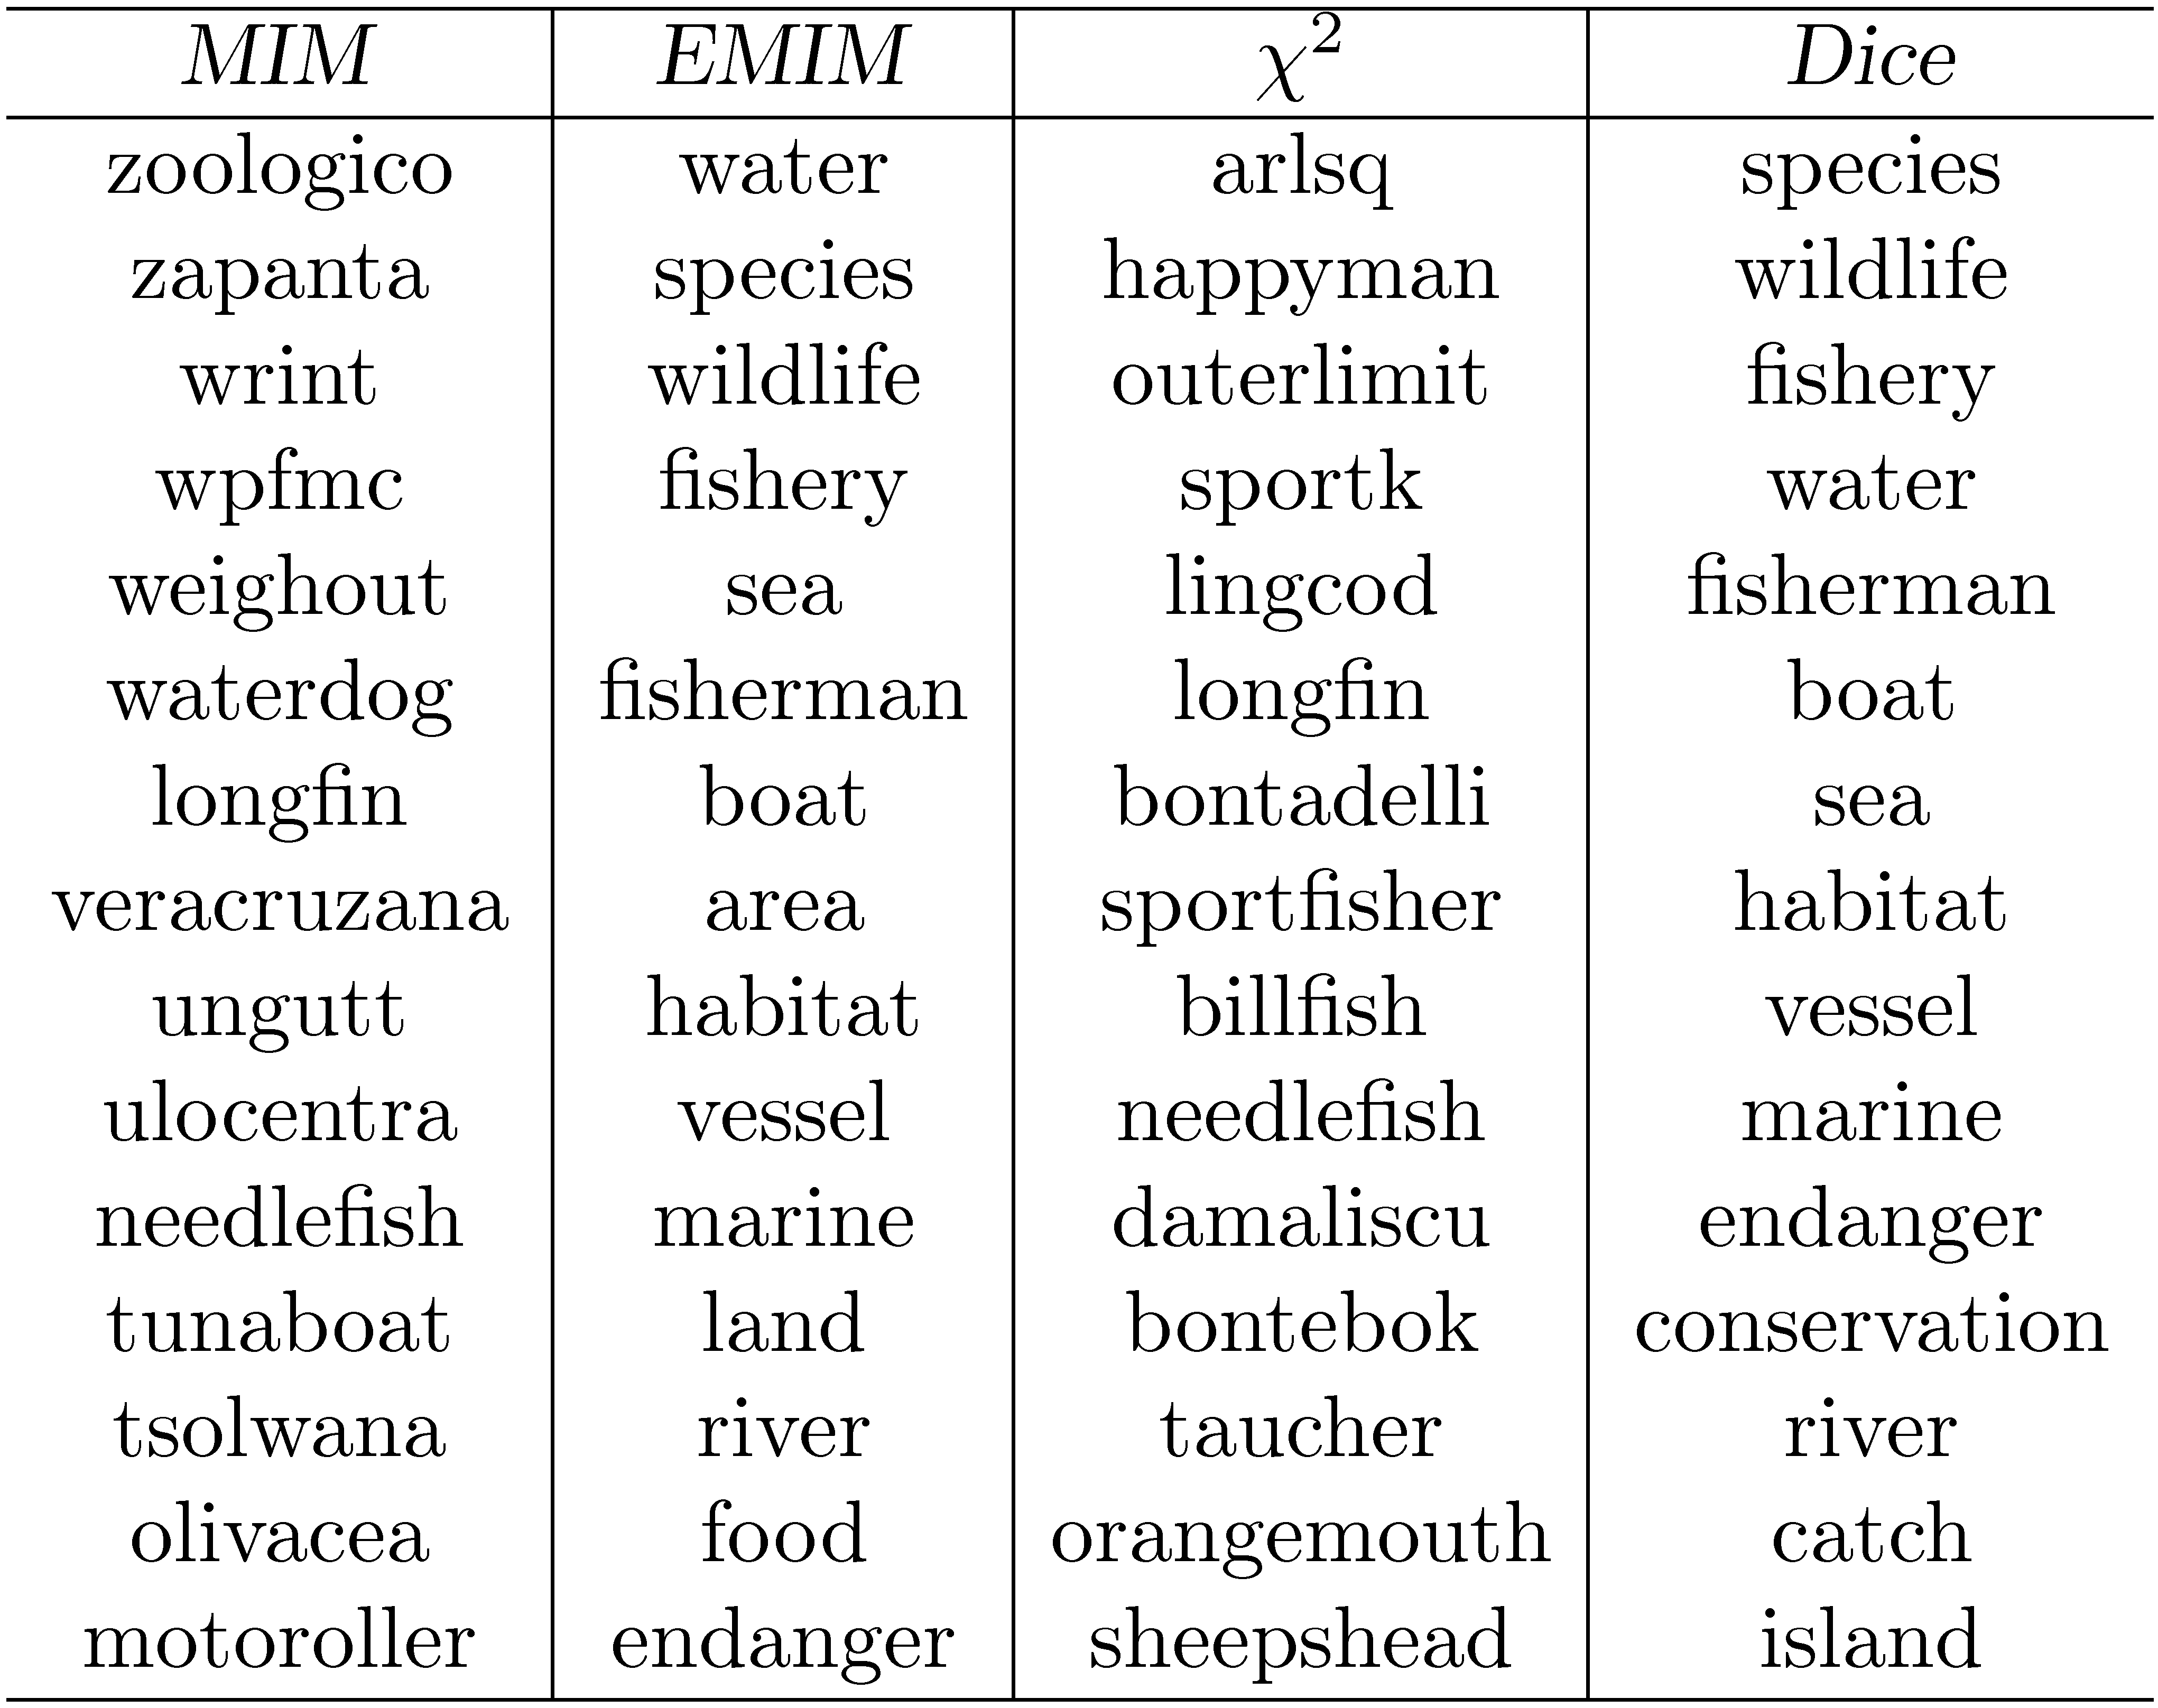
Association Measure Example
Most strongly associated words for “fish” in a collection of TREC news stories.

Slide 35
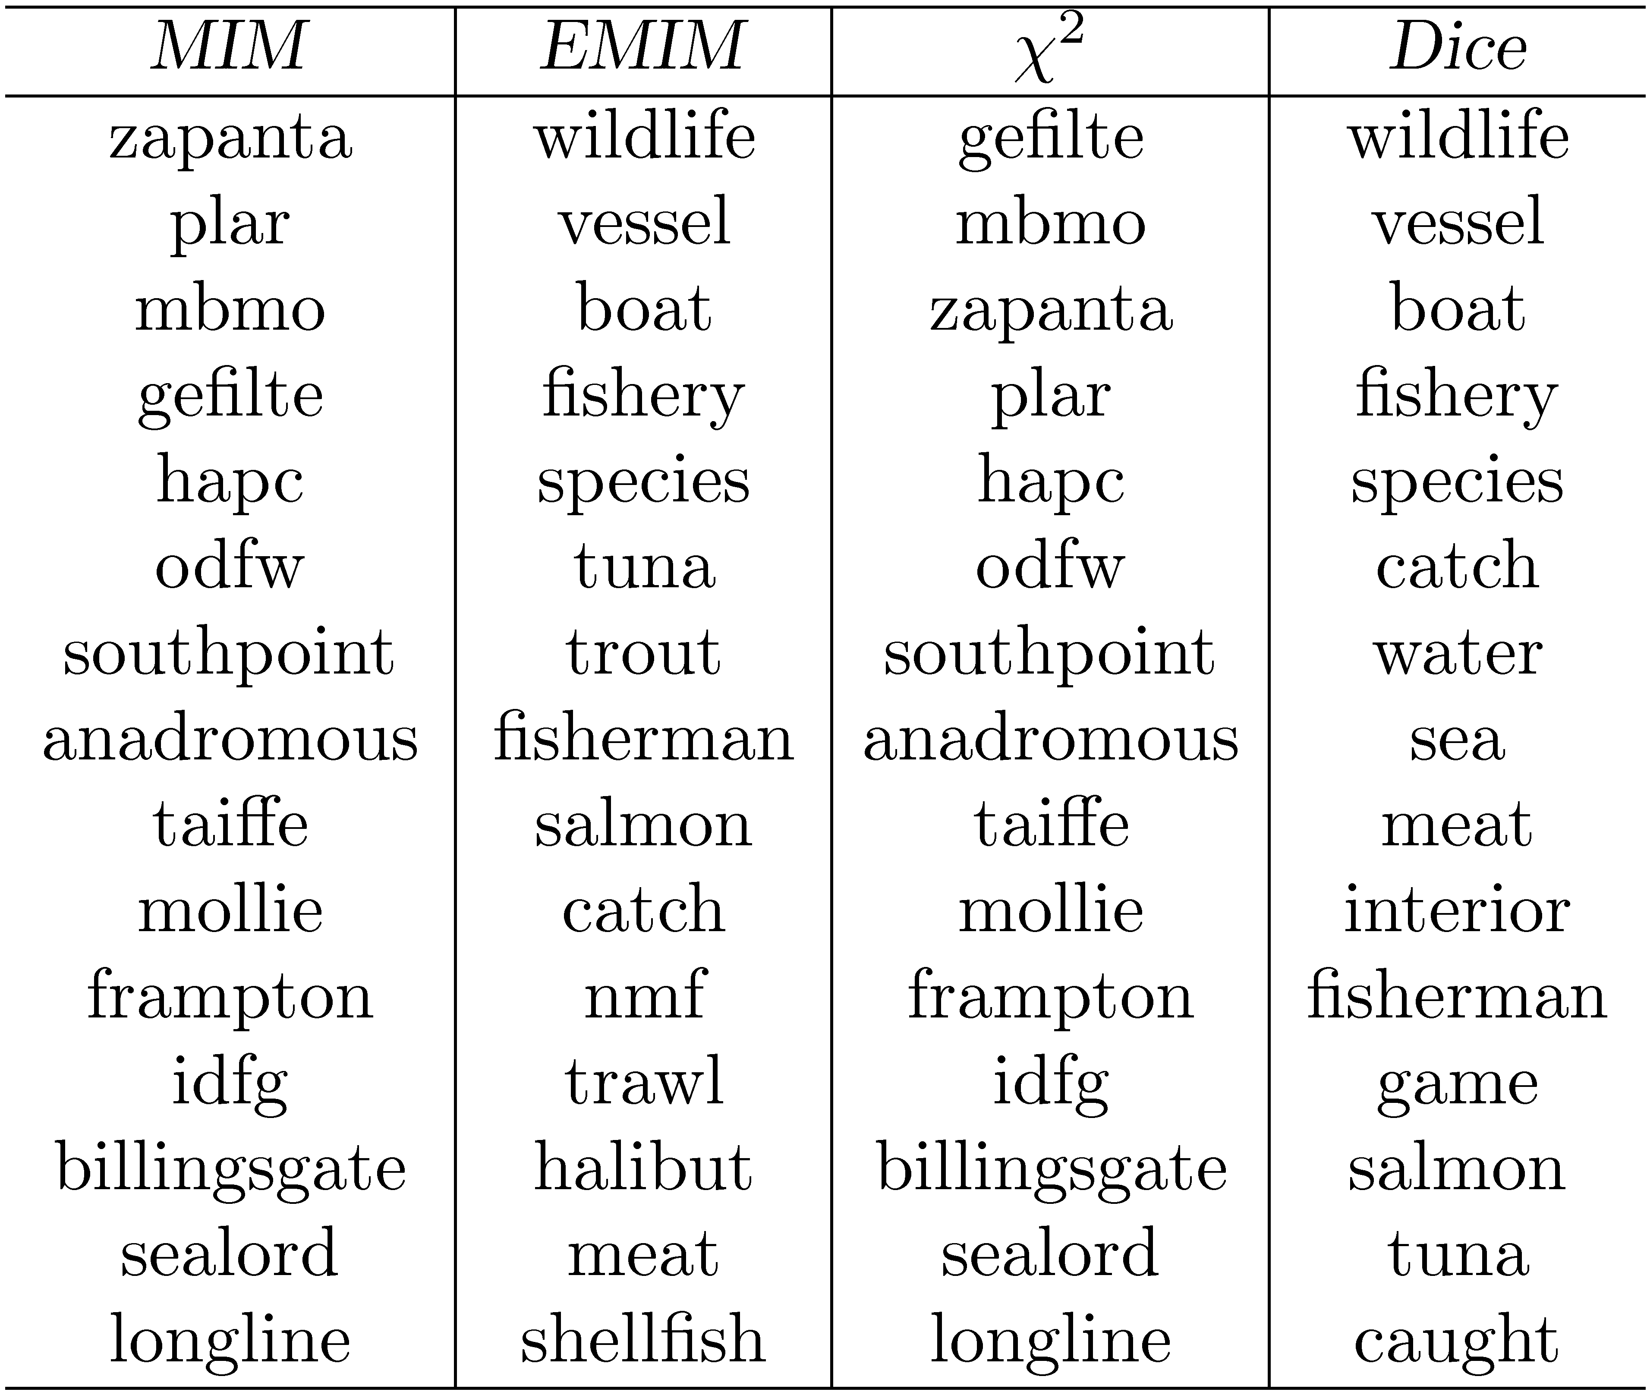
Association Measure Example
Most strongly associated words for “fish” in a collection of TREC news stories. Co-occurrence counts are measured in windows of 5 words.

Slide 36
Association Measures
Associated words are of little use for expanding the query “tropical fish”
Expansion based on whole query takes context into account
  e.g., using Dice with term “tropical fish” gives the following highly associated words:
    goldfish, reptile, aquarium, coral, frog, exotic, stripe, regent, pet, wet
Impractical for all possible queries, other approaches used to achieve this effect

Slide 37
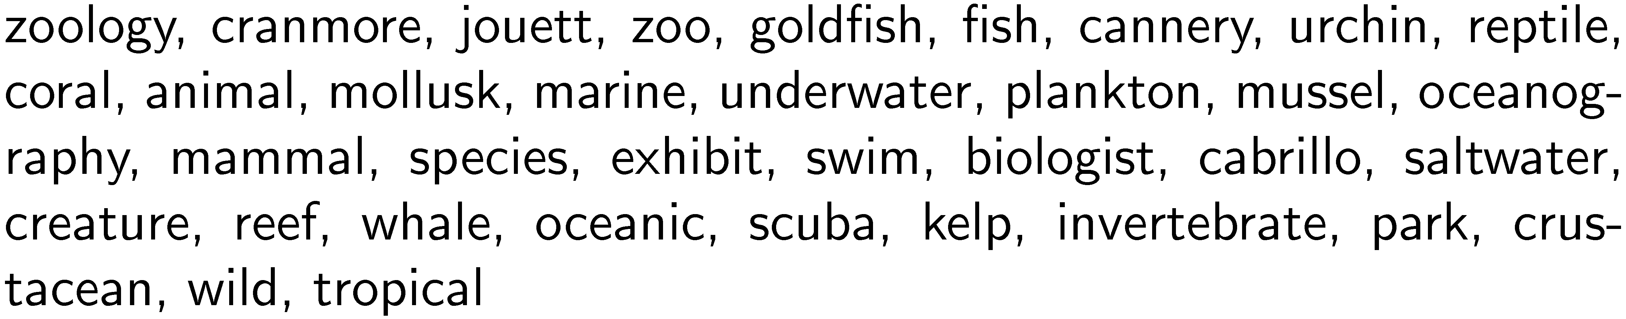
Other Approaches
Pseudo-relevance feedback
  expansion terms based on top retrieved documents for initial query
Context vectors
  Represent words by the words that co-occur with them
      e.g., top 35 most strongly associated words for “aquarium” (using Dice’s coefficient):
  Rank words for a query by ranking context vectors
A query for “tropical fish” would produce a hit for the context vector for “aquarium”,
so it’s likely a related word. cf. query =
“tropical jungle”

Slide 38
Other Approaches
Query logs
  Best source of information about queries and related terms
    short pieces of text and click data
  e.g., most frequent words in queries containing “tropical fish” from MSN log:
    stores, pictures, live, sale, types, clipart, blue, freshwater, aquarium, supplies
  query suggestion based on finding similar queries
    group based on click data

Slide 39
Relevance Feedback
User identifies relevant (and maybe non-relevant) documents in the initial result list
System modifies query using terms from those documents and reranks documents
  example of simple machine learning algorithm using training data
  but, very little training data
Pseudo-relevance feedback just assumes top-ranked documents are relevant – no user input

Slide 40
Relevance Feedback Example
Top 10 documents
for “tropical fish”

Slide 41
Relevance Feedback Example
If we assume top 10 are relevant, most frequent terms are (with frequency):
    a (926), td (535), href (495), http (357), width (345), com (343), nbsp (316), www (260), tr (239), htm (233), class (225), jpg (221)
    too many stopwords and HTML expressions
Use only snippets and remove stopwords
    tropical (26), fish (28), aquarium (8), freshwater (5), breeding (4), information (3), species (3), tank (2), Badman’s (2), page (2), hobby (2), forums (2)

Slide 42
Relevance Feedback Example
If document 7 (“Breeding tropical fish”) is explicitly indicated to be relevant, the most frequent terms are:
    breeding (4), fish (4), tropical (4), marine (2), pond (2), coldwater (2), keeping (1), interested (1)
Specific weights and scoring methods used for relevance feedback depend on retrieval model

Slide 43
Relevance Feedback
Both relevance feedback and pseudo-relevance feedback are effective, but not used in many applications
  pseudo-relevance feedback has reliability issues, especially with queries that don’t retrieve many relevant documents
Some applications use relevance feedback
  filtering, “more like this”
Query suggestion more popular
  may be less accurate, but can work if initial query fails

Slide 44
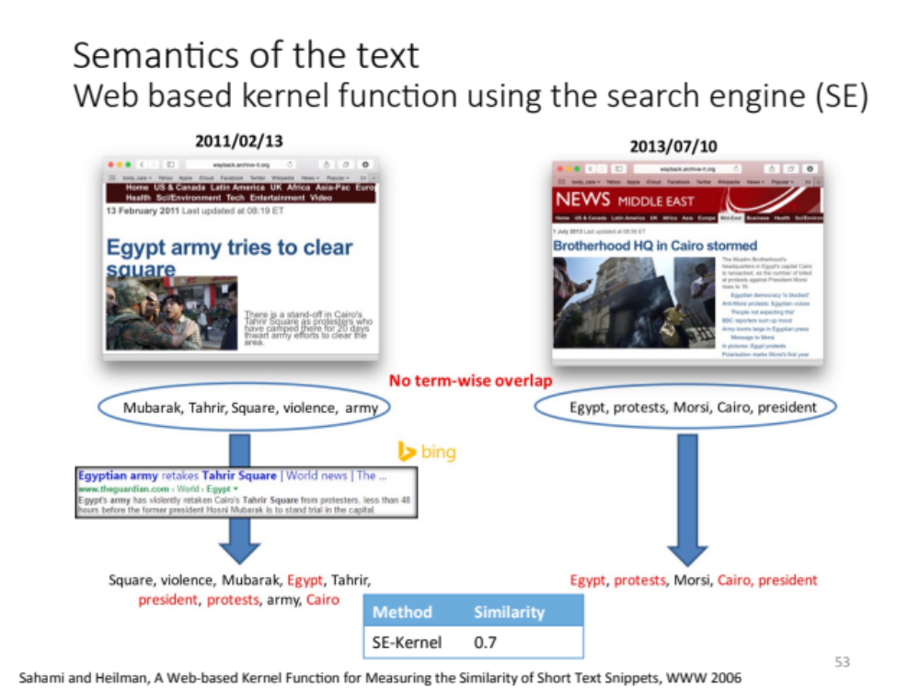
Snippet example from
Yasmin AlNoamany’s PhD
http://www.slideshare.net/phonedude/summarizing-archival-collections-using-storytelling-techniques

Slide 45
Context and Personalization
If a query has the same words as another query, results will be the same regardless of
  who submitted the query
  why the query was submitted
  where the query was submitted
  what other queries were submitted in the same session
These other factors (the context) could have a significant impact on relevance
  difficult to incorporate into ranking

Slide 46
User Models
Generate user profiles based on documents that the person looks at
  such as web pages visited, email messages, or word processing documents on the desktop
Modify queries using words from profile
Generally not effective
  imprecise profiles, information needs can change significantly

Slide 47
Query Logs
Query logs provide important contextual information that can be used effectively
Context in this case is
  previous queries that are the same
  previous queries that are similar
  query sessions including the same query
Query history for individuals could be used for caching

Slide 48
Local Search
Location is context
Local search uses geographic information to modify the ranking of search results
  location derived from the query text
  location of the device where the query originated
e.g.,
  “underworld 3 cape cod”
  “underworld 3” from mobile device in Hyannis

Slide 49
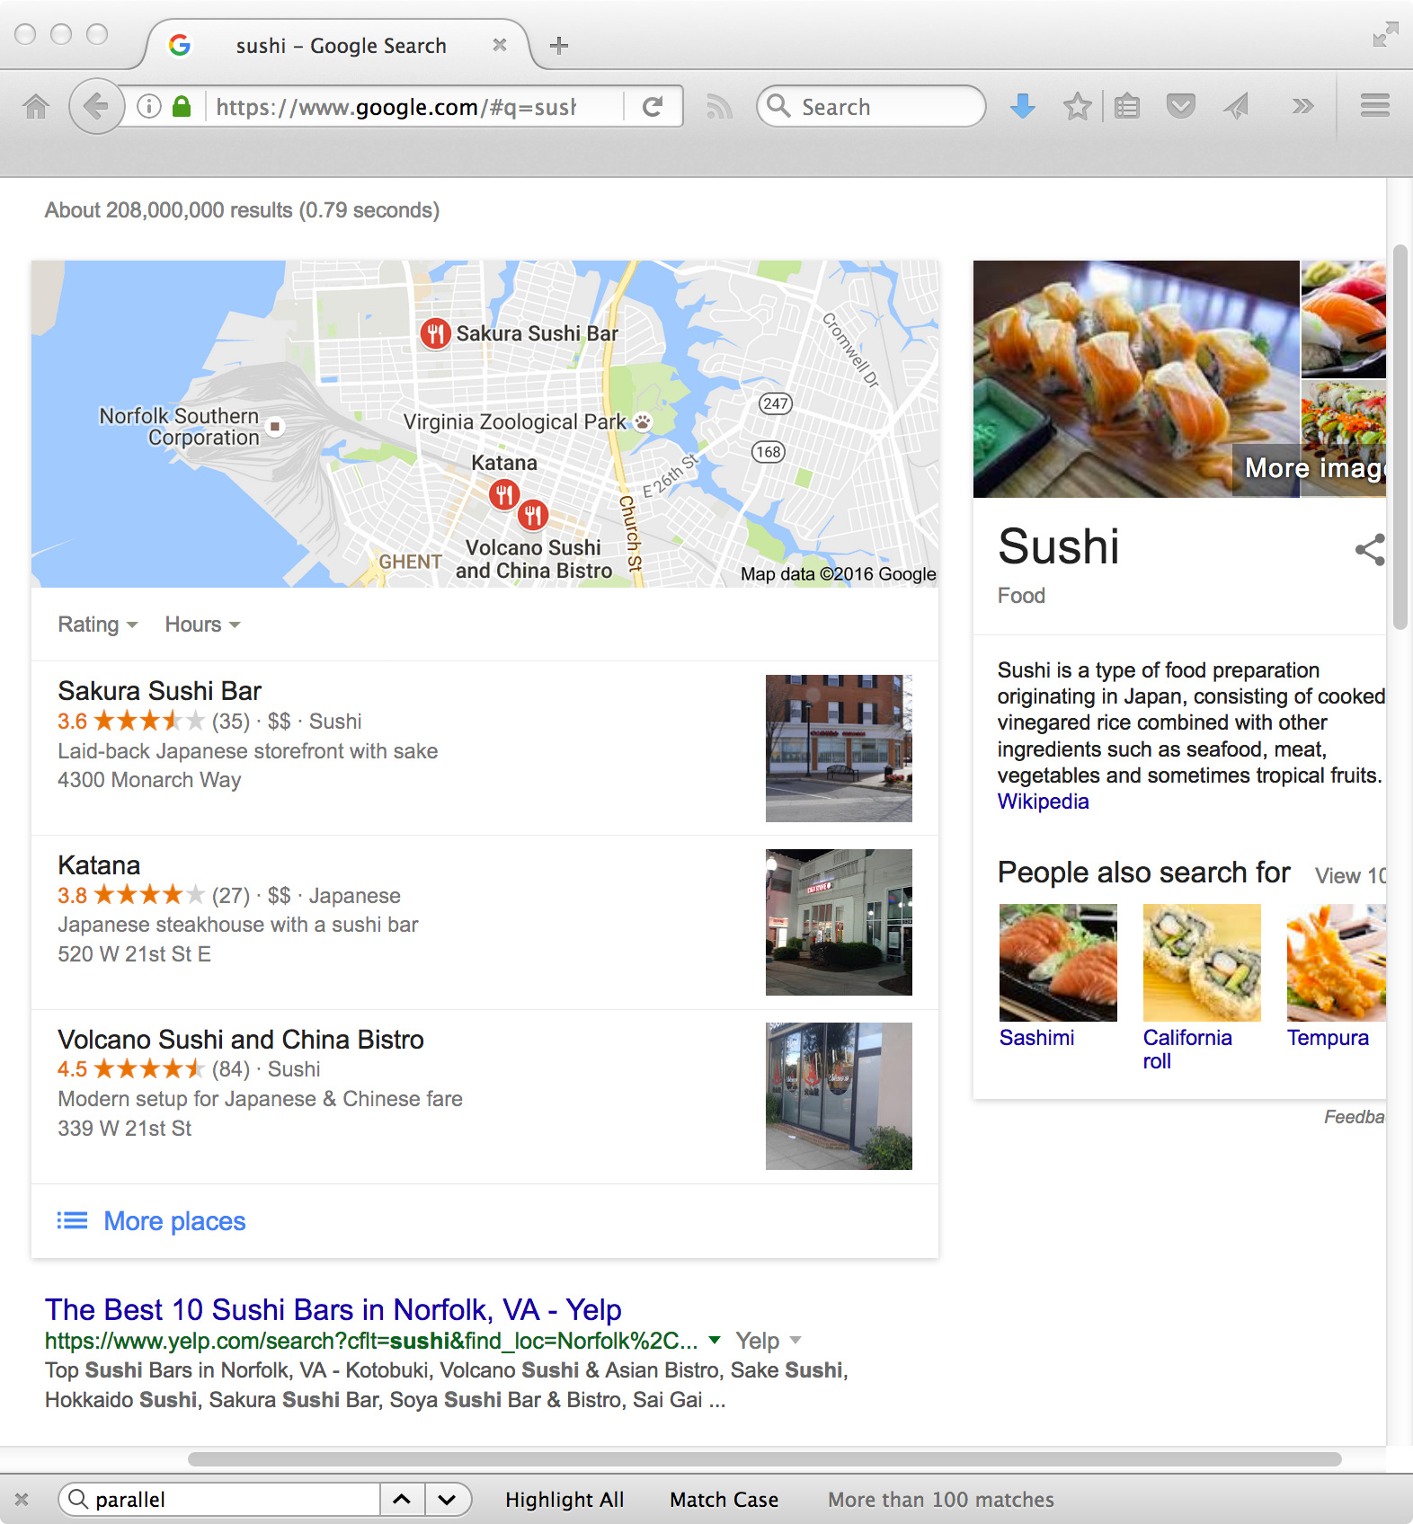
Sushi!

Slide 50
Local Search
Identify the geographic region associated with web pages
  use location metadata that has been manually added to the document,
  or identify locations such as place names, city names, or country names in text
Identify the geographic region associated with the query
  10-15% of queries contain some location reference
Rank web pages using location information in addition to text and link-based features

Slide 51
Extracting Location Information
Type of information extraction
  ambiguity and significance of locations are issues
Location names are mapped to specific regions and coordinates
Matching done by inclusion, distance

Slide 52
Snippet Generation
Query-dependent document summary
Simple summarization approach
  rank each sentence in a document using a significance factor
  select the top sentences for the summary
  first proposed by Luhn in 50’s
50s

Slide 53
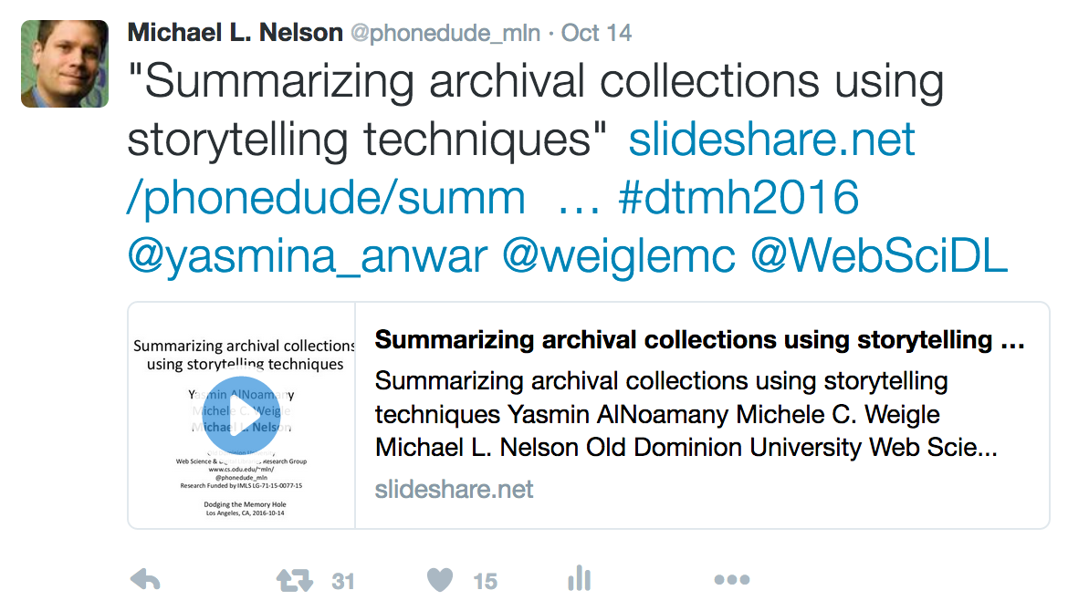
Detour: document independent summary example

Slide 54
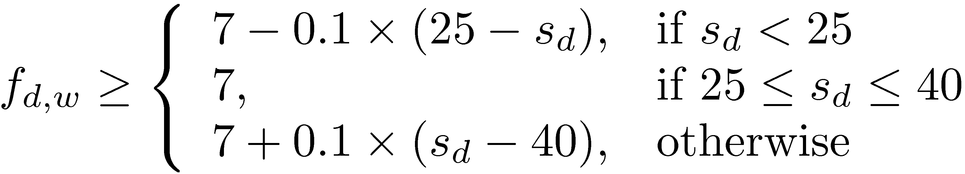
Sentence Selection
Significance factor for a sentence is calculated based on the occurrence of significant words
  If f_{d,w} is the frequency of word w in document d, then w is a significant word if it is not a stopword and
    where s_{d} is the number of sentences in document d
  text is bracketed by significant words (limit on number of non-significant words in bracket)

Slide 55
Sentence Selection
Significance factor for bracketed text spans is computed by dividing the square of the number of significant words in the span by the total number of words
e.g.,
Significance factor = 4²/7 = 2.3

Slide 56
Snippet Generation
Involves more features than just significance factor
e.g. for a news story, could use
  whether the sentence is a heading
  whether it is the first or second line of the document
  the total number of query terms occurring in the sentence
  the number of unique query terms in the sentence
  the longest contiguous run of query words in the sentence
  a density measure of query words (significance factor)
Weighted combination of features used to rank sentences

Slide 57
Snippet Generation
Web pages are less structured than news stories
  can be difficult to find good summary sentences
Snippet sentences are often selected from other sources
  metadata associated with the web page
    e.g., <meta name="description" content= ...>
  external sources such as web directories
    e.g., Open Directory Project, http://www.dmoz.org
Snippets can be generated from text of pages like Wikipedia

Slide 58
Snippet Guidelines
All query terms should appear in the summary, showing their relationship to the retrieved page
When query terms are present in the title, they need not be repeated
  allows snippets that do not contain query terms
Highlight query terms in URLs
Snippets should be readable text, not lists of keywords

Slide 59
Advertising
Sponsored search – advertising presented with search results
Contextual advertising – advertising presented when browsing web pages
Both involve finding the most relevant advertisements in a database
  An advertisement usually consists of a short text description and a link to a web page describing the product or service in more detail

Slide 60
Searching Advertisements
Factors involved in ranking advertisements
  similarity of text content to query
  bids for keywords in query
  popularity of advertisement
Small amount of text in advertisement
  dealing with vocabulary mismatch is important
  expansion techniques are effective

Slide 61
Example Advertisements
Advertisements retrieved for query “fish tank”

Slide 62
Searching Advertisements
Pseudo-relevance feedback
  expand query and/or document using the Web
  use ad text or query for pseudo-relevance feedback
  rank exact matches first, followed by stem matches, followed by expansion matches
Query reformulation based on search sessions
  learn associations between words and phrases based on co-occurrence in search sessions

Slide 63
Clustering Results
Result lists often contain documents related to different aspects of the query topic
Clustering is used to group related documents to simplify browsing
Example clusters for
query “tropical fish”

Slide 64
Result List Example
Top 10 documents
for “tropical fish”

Slide 65
Clustering Results
Requirements
Efficiency
  must be specific to each query and are based on the top-ranked documents for that query
  typically based on snippets
Easy to understand
  Can be difficult to assign good labels to groups
  Monothetic vs. polythetic classification

Slide 66
Types of Classification
Monothetic
  every member of a class has the property that defines the class
  typical assumption made by users
  easy to understand
Polythetic
  members of classes share many properties but there is no single defining property
  most clustering algorithms (e.g. K-means) produce this type of output

Slide 67
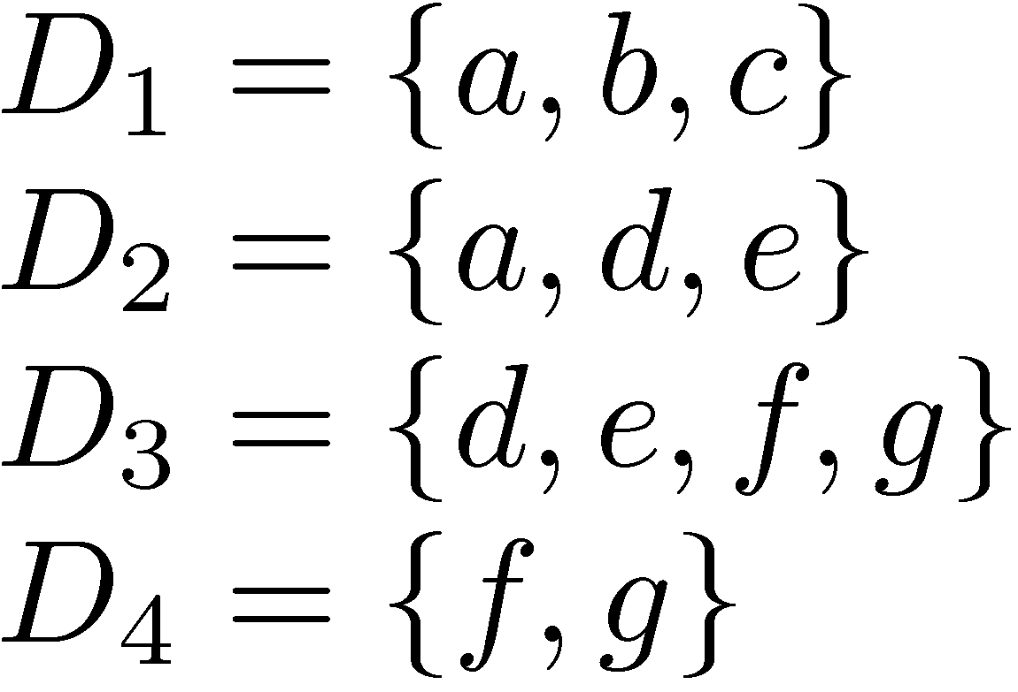
Classification Example
Possible monothetic classification
  {D₁,D₂} (labeled using a) and {D₂,D₃} (labeled e)
Possible polythetic classification
  {D₂,D₃,D₄}, D₁
  labels?

Slide 68
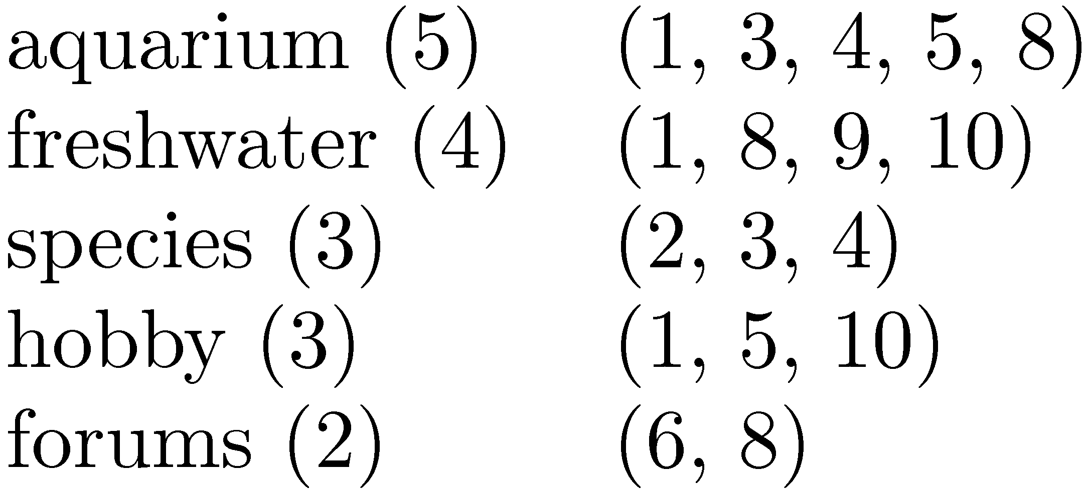
Result Clusters
Simple algorithm
  group based on words in snippets
Refinements
  use phrases
  use more features
    whether phrases occurred in titles or snippets
    length of the phrase
    collection frequency of the phrase
    overlap of the resulting clusters,

Slide 69
Faceted Classification
A set of categories, usually organized into a hierarchy, together with a set of facets that describe the important properties associated with the category
Manually defined
  potentially less adaptable than dynamic classification
Easy to understand
  commonly used in e-commerce

Slide 70
Example Faceted Classification
Categories for “tropical fish”

Slide 71
Example Faceted Classification
Subcategories and facets for “Home & Garden”

Slide 72
Cross-Language Search
Query in one language, retrieve documents in multiple other languages
Involves query translation, and probably document translation
Query translation can be done using bilingual dictionaries
Document translation requires more sophisticated statistical translation models
  similar to some retrieval models

Slide 73
Cross-Language Search

Slide 74
Statistical Translation Models
Models require parallel corpora for training
  probability estimates based on aligned sentences
Translation of unusual words and phrases is a problem
  also use transliteration techniques
    e.g., Qathafi, Kaddafi, Qadafi, Gadafi, Gaddafi, Kathafi, Kadhafi, Qadhafi, Qazzafi, Kazafi, Qaddafy, Qadafy, Quadhaffi, Gadhdhafi, al-Qaddafi, Al-Qaddafi

Slide 75
Translation
Web search engines also use translation
  e.g. for query “pecheur france”
  translation link translates web page
  uses statistical machine translation models
http://ws-dl.blogspot.com/2016/03/2016-03-22-language-detection-where-to.html

Slide 76
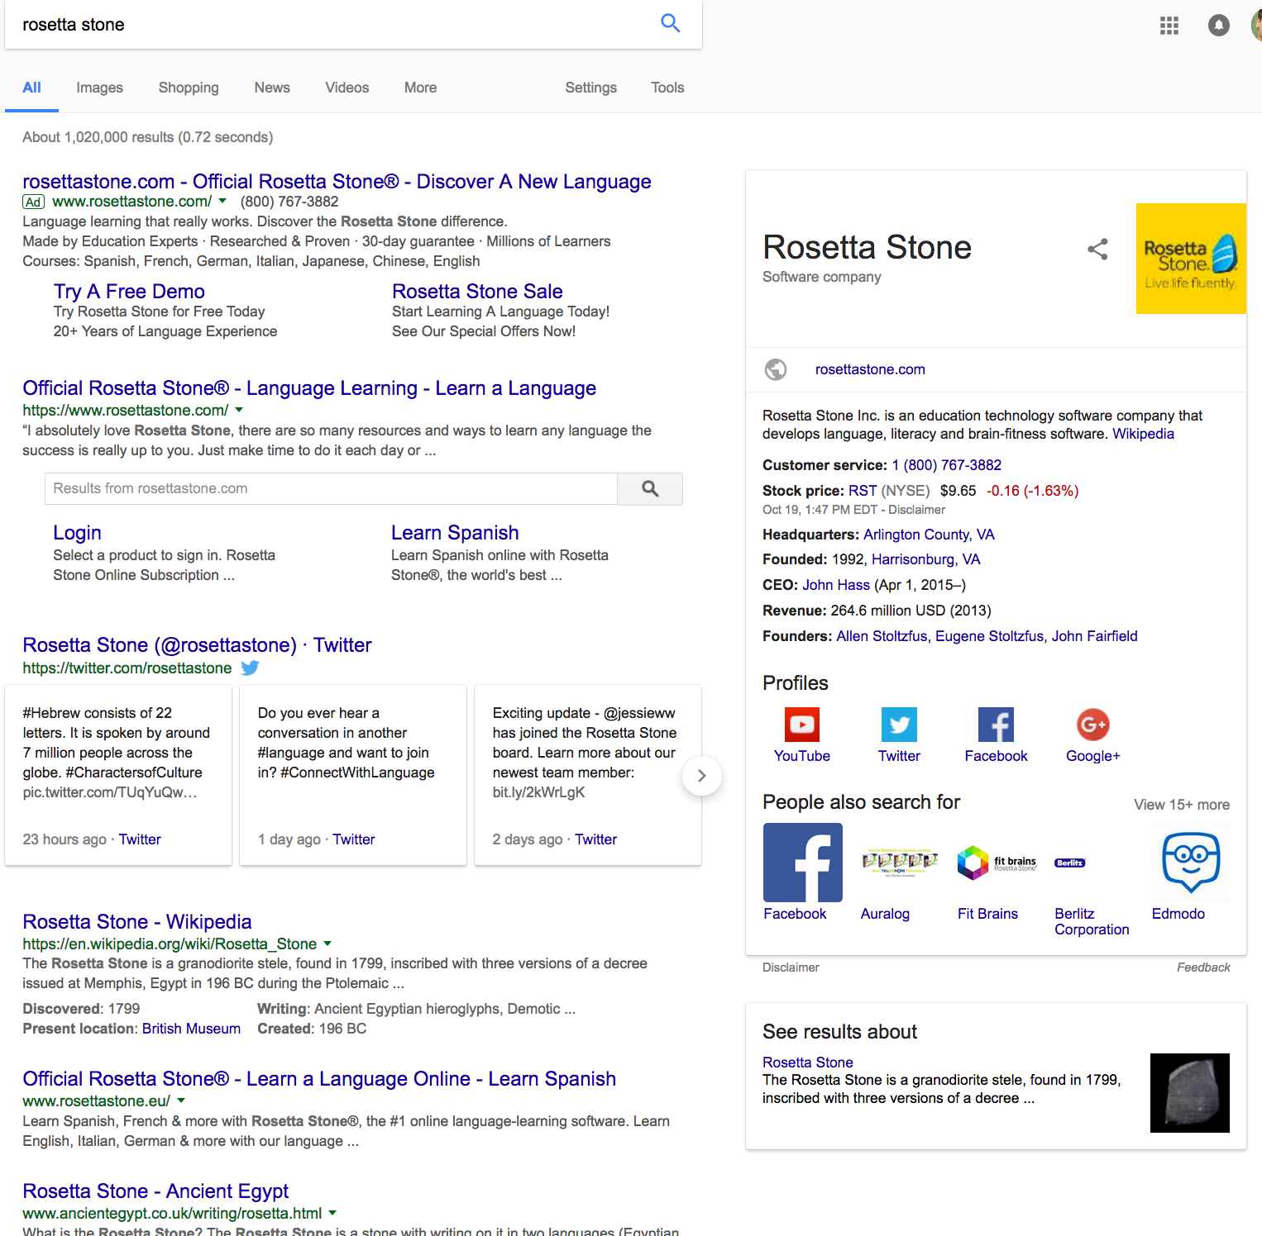
the most famous
parallel corpus?

