Slide 1
Search Engines
Information Retrieval in Practice
Annotations by Michael L. Nelson
All slides ©Addison Wesley, 2008

Slide 2
Evaluation
Evaluation is key to building effective and efficient search engines
  measurement usually carried out in controlled laboratory experiments
  online testing can also be done
Effectiveness, efficiency and cost are related
  e.g., if we want a particular level of effectiveness and efficiency, this will determine the cost of the system configuration
  efficiency and cost targets may impact effectiveness
“better, cheaper, faster: choose two”

Slide 3
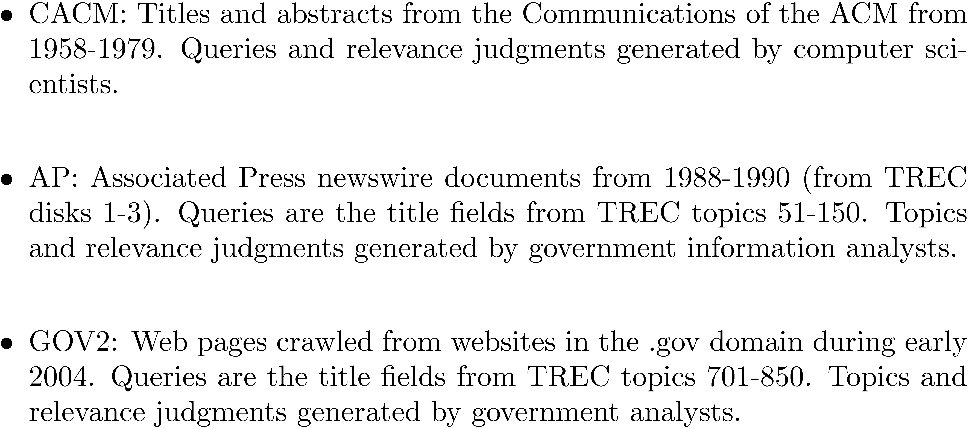
Evaluation Corpus
Test collections consisting of documents, queries, and relevance judgments, e.g.,

Slide 4
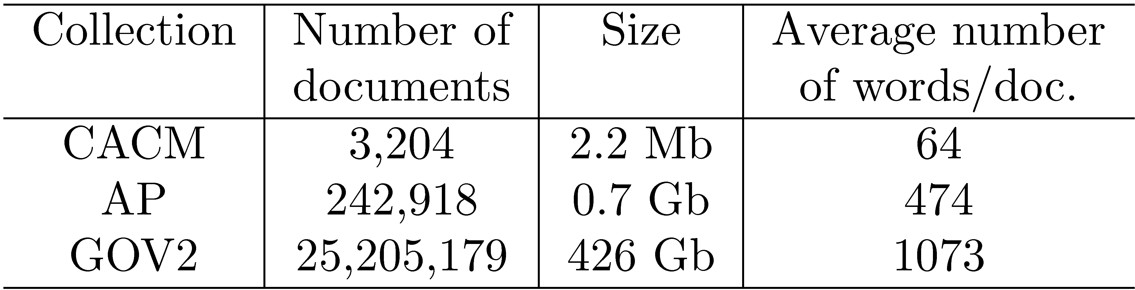
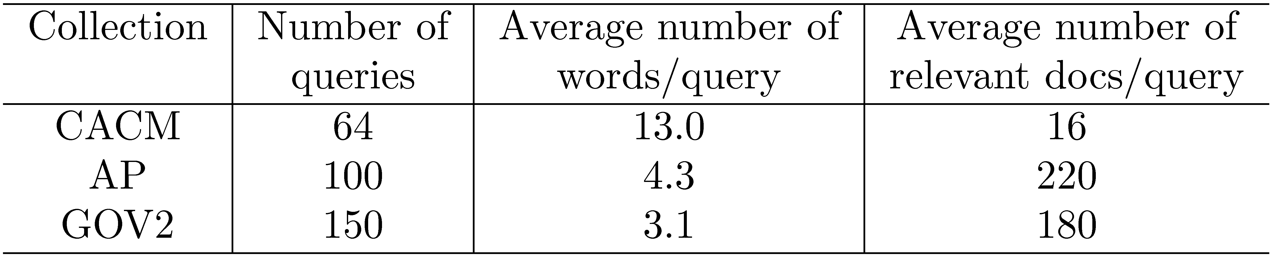
Test Collections
Words/query is the
only thing shrinking!

Slide 5
TREC Topic Example
short query
long query
criteria for
relevance
(not a query)

Slide 6
Relevance Judgments
Obtaining relevance judgments is an expensive, time-consuming process
  who does it?
  what are the instructions?
  what is the level of agreement?
TREC judgments
  depend on task being evaluated
  generally binary
  agreement good because of “narrative”

Slide 7
Pooling
Exhaustive judgments for all documents in a collection is not practical
Pooling technique is used in TREC
  top k results (for TREC, k varied between 50 and 200) from the rankings obtained by different search engines (or retrieval algorithms) are merged into a pool
  duplicates are removed
  documents are presented in some random order to the relevance judges
Produces a large number of relevance judgments for each query, although still incomplete

Slide 8
Query Logs
Used for both tuning and evaluating search engines
  also for various techniques such as query suggestion
Typical contents
  User identifier or user session identifier
  Query terms - stored exactly as user entered
  List of URLs of results, their ranks on the result list, and whether they were clicked on
  Timestamp(s) - records the time of user events such as query submission, clicks

Slide 9
Query Logs
Clicks are not relevance judgments
  although they are correlated
  biased by a number of factors such as rank on result list
Can use clickthough data to predict preferences between pairs of documents
  appropriate for tasks with multiple levels of relevance, focused on user relevance
  various “policies” used to generate preferences

Slide 10
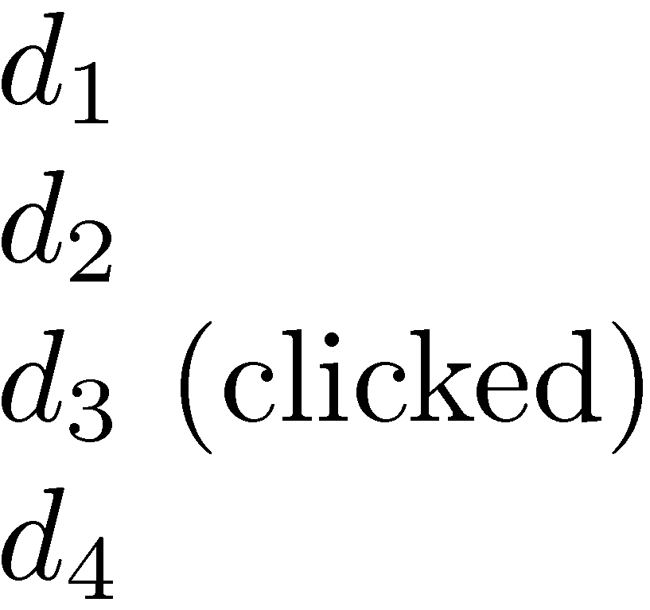
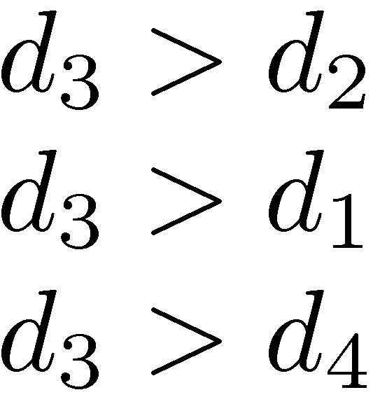
Example Click Policy
Skip Above and Skip Next
  click data
  generated preferences
note: doesn’t tell you
anything about d₅, d₆, etc.

Slide 11
Query Logs
Click data can also be aggregated to remove noise
Click distribution information
  can be used to identify clicks that have a higher frequency than would be expected
  high correlation with relevance
  e.g., using click deviation to filter clicks for preference-generation policies

Slide 12
Filtering Clicks
Click deviation CD(d, p) for a result d in position p:
  O(d,p): observed click frequency for a document in a rank position p over all instances of a given query
  E(p): expected click frequency at rank p averaged across all queries

Slide 13
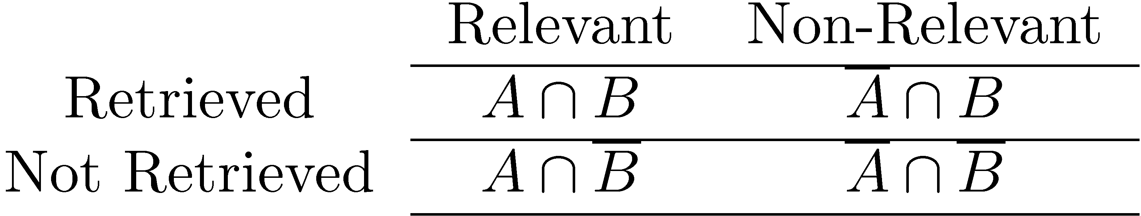
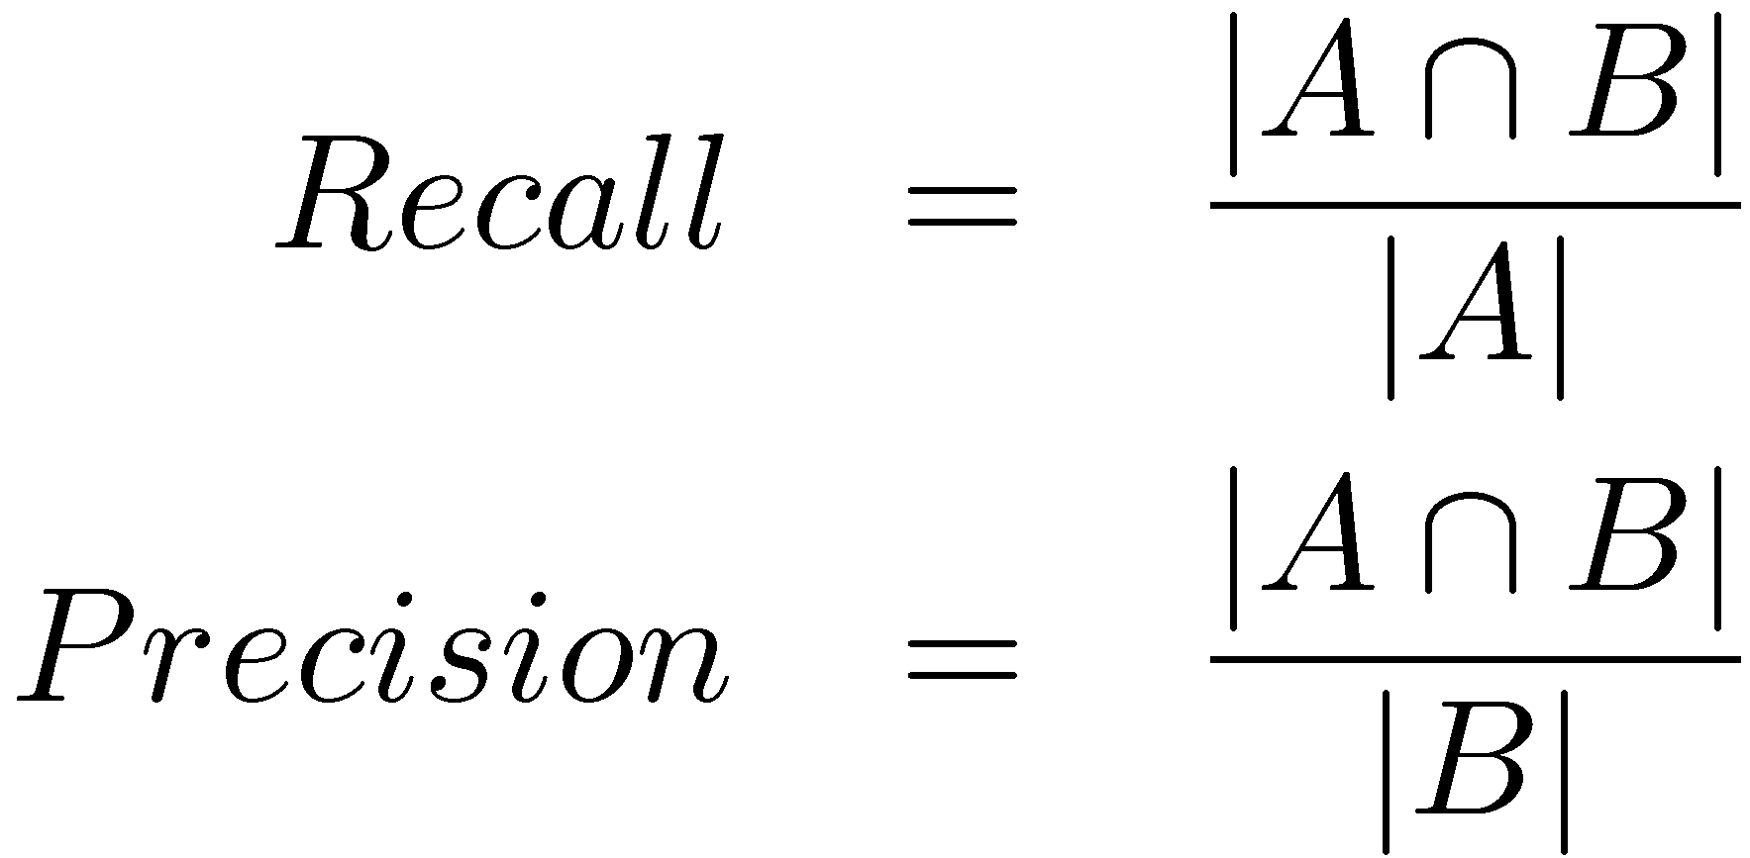
Effectiveness Measures
A is set of relevant documents,
B is set of retrieved documents

Slide 14
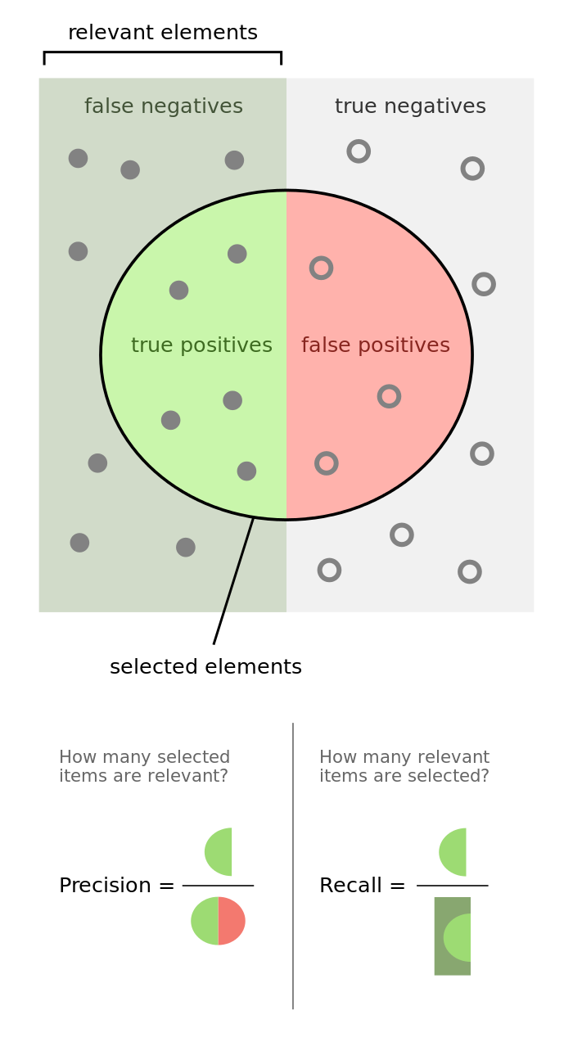
Precision and Recall in Diagrams
From: https://en.wikipedia.org/wiki/Precision_and_recall

Slide 15
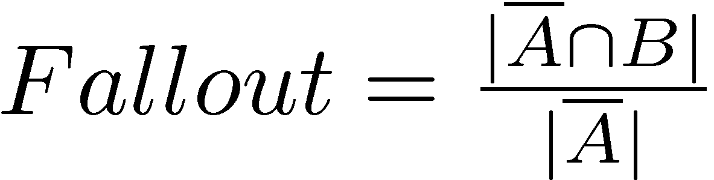
Classification Errors
False Positive (Type I error)
  a non-relevant document is retrieved
False Negative (Type II error)
  a relevant document is not retrieved
  1- Recall
Precision is used when probability that a positive result is correct is important

Slide 16
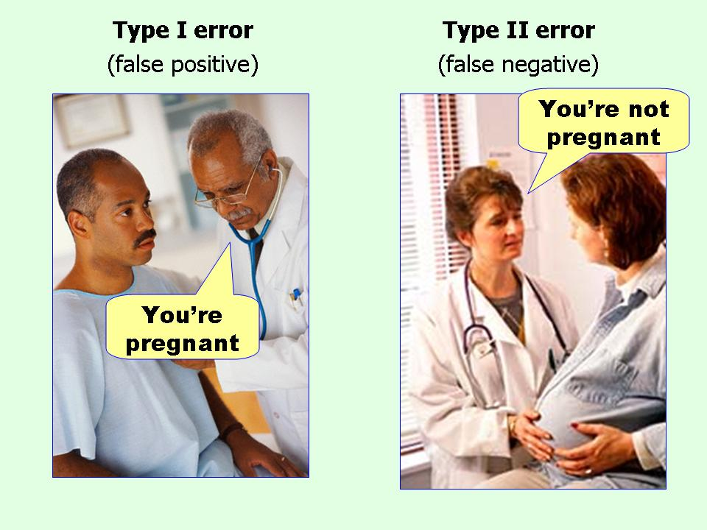
Mnemonic for I vs. II
From: http://effectsizefaq.com/category/type-ii-error/

Slide 17
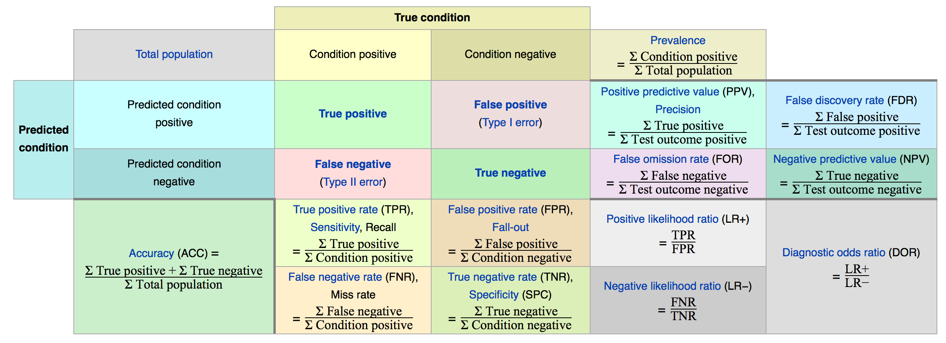
More than just P&R…
From: https://en.wikipedia.org/wiki/Precision_and_recall

Slide 18
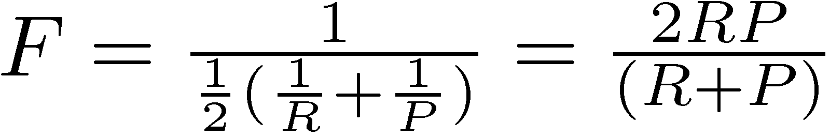
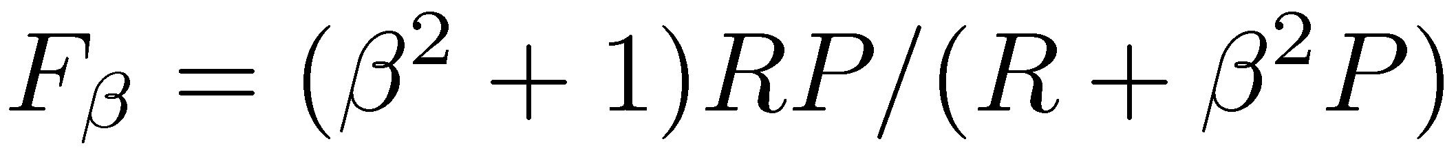
F Measure
Harmonic mean of recall and precision
  harmonic mean emphasizes the importance of small values, whereas the arithmetic mean is affected more by outliers that are unusually large
More general form
  β is a parameter that determines relative importance of recall and precision
F > 1: recall more important
F < 1 : precision more important

Slide 19
F₁ Examples
P=0.50, R=0.50
  mean = 0.50 + 0.50 / 2 = 0.50
  F₁ = 2 * 0.50 * 0.50 / (0.50 + 0.50) = 0.50/1.0 = 0.50
P=0.90, R=0.50
  mean = 0.90 + 0.50 / 2 = 0.70
  F₁ = 2 * 0.90 * 0.50 / (0.90 + 0.50) = 0.90/1.4 = 0.64
P=0.90, R=0.20
  mean = 0.90 + 0.20 / 2 = 0.55
  F₁ = 2 * 0.90 * 0.20 / (0.90 + 0.20) = 0.36/1.1 = 0.33

Slide 20
Ranking Effectiveness

Slide 21
Summarizing a Ranking
Calculating recall and precision at fixed rank positions
  e.g., P@1, P@5, P@10 (typical SERP), P@20
Calculating precision at standard recall levels, from 0.0 to 1.0
  requires interpolation
Averaging the precision values from the rank positions where a relevant document was retrieved

Slide 22
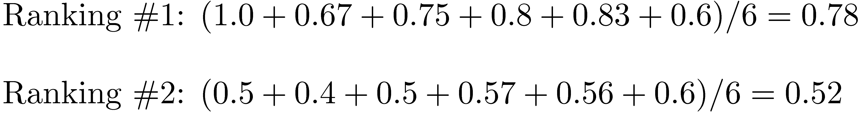
Average Precision
no relevant document == skip that position

Slide 23
Averaging Across Queries

Slide 24
Averaging
Mean Average Precision (MAP)
  summarize rankings from multiple queries by averaging average precision
  most commonly used measure in research papers
  assumes user is interested in finding many relevant documents for each query
  requires many relevance judgments in text collection
Recall-precision graphs are also useful summaries

Slide 25
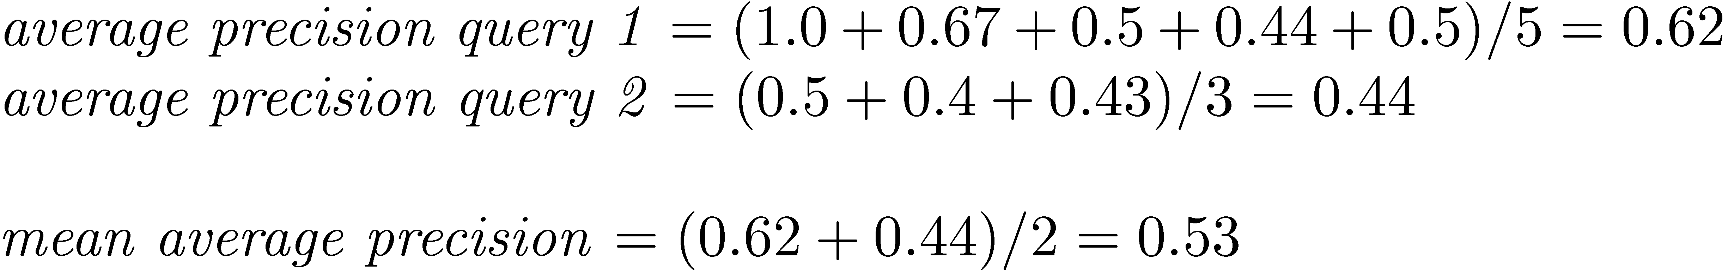
MAP

Slide 26
Recall-Precision Graph

Slide 27
Interpolation
To average graphs, calculate precision at standard recall levels:
  where S is the set of observed (R,P) points
Defines precision at any recall level as the maximum precision observed in any recall-precision point at a higher recall level
  produces a step function
  defines precision at recall 0.0

Slide 28
Interpolation
0.67 “pushed left”
0.43 “pushed left”
Result = monotonically decreasing curves

Slide 29
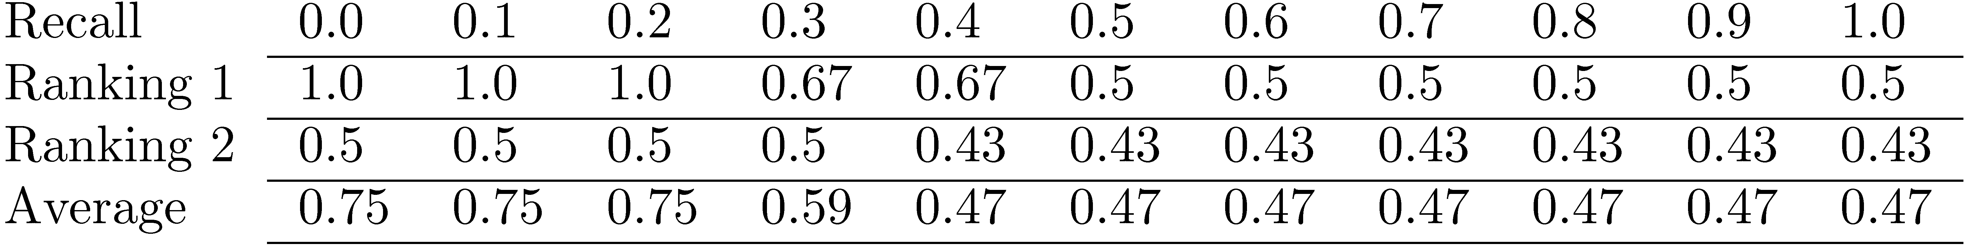
Average Precision at
Standard Recall Levels
Recall-precision graph plotted by simply
joining the average precision points at
the standard recall levels

Slide 30
Average Recall-Precision Graph

Slide 31
Graph for 50 Queries

Slide 32
Focusing on Top Documents
Users tend to look at only the top part of the ranked result list to find relevant documents
Some search tasks have only one relevant document
  e.g., navigational search, question answering
Recall not appropriate
  instead need to measure how well the search engine does at retrieving relevant documents at very high ranks

Slide 33
Focusing on Top Documents
Precision at Rank R
  R typically 5, 10, 20
  easy to compute, average, understand
  not sensitive to rank positions less than R
Reciprocal Rank
  reciprocal of the rank at which the first relevant document is retrieved
  Mean Reciprocal Rank (MRR) is the average of the reciprocal ranks over a set of queries
  very sensitive to rank position
1/1, 1/2, 1/3, 1/4, 1/5, etc. == gets small quickly

Slide 34
Discounted Cumulative Gain
Popular measure for evaluating web search and related tasks
Two assumptions:
  Highly relevant documents are more useful than marginally relevant document
  the lower the ranked position of a relevant document, the less useful it is for the user, since it is less likely to be examined

Slide 35
Discounted Cumulative Gain
Uses graded relevance as a measure of the usefulness, or gain, from examining a document
Gain is accumulated starting at the top of the ranking and may be reduced, or discounted, at lower ranks
Typical discount is 1/log (rank)
  With base 2, the discount at rank 4 is 1/2, and at rank 8 it is 1/3
More clear definition & examples: https://en.wikipedia.org/wiki/Discounted_cumulative_gain#Example

Slide 36
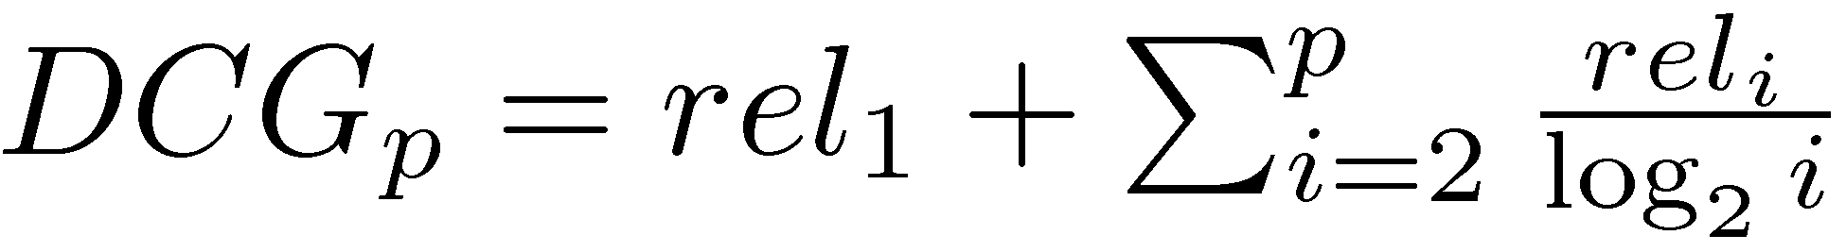
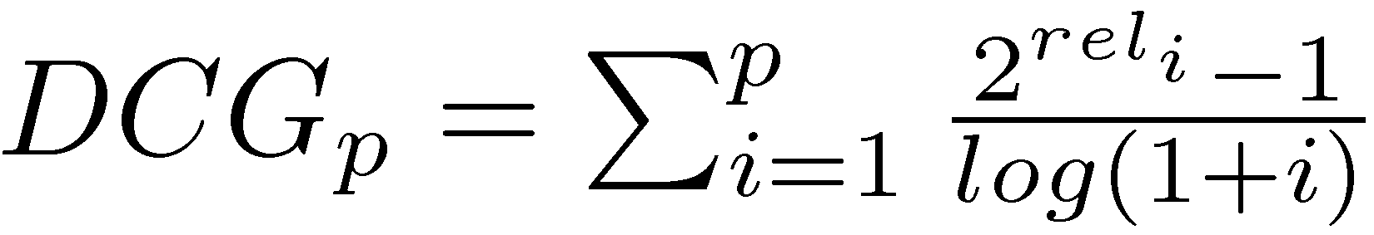
Discounted Cumulative Gain
DCG is the total gain accumulated at a particular rank p:
Alternative formulation:
  used by some web search companies
  emphasis on retrieving highly relevant documents

Slide 37
DCG Example
10 ranked documents judged on 0-3 relevance scale:
  3, 2, 3, 0, 0, 1, 2, 2, 3, 0
discounted gain:
  3, 2/1, 3/1.59, 0, 0, 1/2.59, 2/2.81, 2/3, 3/3.17, 0
  = 3, 2, 1.89, 0, 0, 0.39, 0.71, 0.67, 0.95, 0
DCG:
  3, 5, 6.89, 6.89, 6.89, 7.28, 7.99, 8.66, 9.61, 9.61

Slide 38
Normalized DCG
DCG numbers are averaged across a set of queries at specific rank values
  e.g., DCG at rank 5 is 6.89 and at rank 10 is 9.61
DCG values are often normalized by comparing the DCG at each rank with the DCG value for the perfect ranking
  makes averaging easier for queries with different numbers of relevant documents

Slide 39
NDCG Example
Perfect ranking:
  3, 3, 3, 2, 2, 2, 1, 0, 0, 0
ideal DCG values:
  3, 6, 7.89, 8.89, 9.75, 10.52, 10.88, 10.88, 10.88, 10
NDCG values (divide actual by ideal):
  1, 0.83, 0.87, 0.76, 0.71, 0.69, 0.73, 0.8, 0.88, 0.88
  NDCG ≤ 1 at any rank position

Slide 40
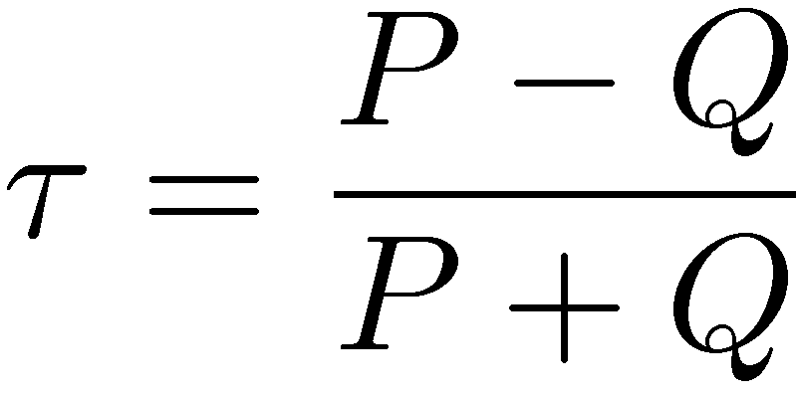
Using Preferences
Two rankings described using preferences can be compared using the Kendall tau coefficient (τ ):
  P is the number of preferences that agree and Q is the number that disagree
For preferences derived from binary relevance judgments, can use BPREF
e.g.: learned 15 prefs from clickthrough & your ranking “agrees” with 10: τ = (10-5) / 15 = 0.33

Slide 41
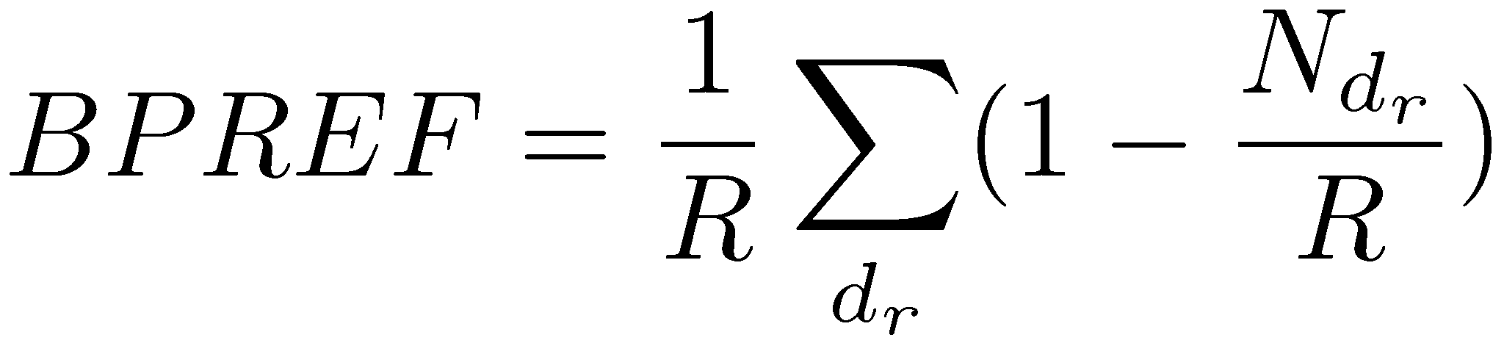
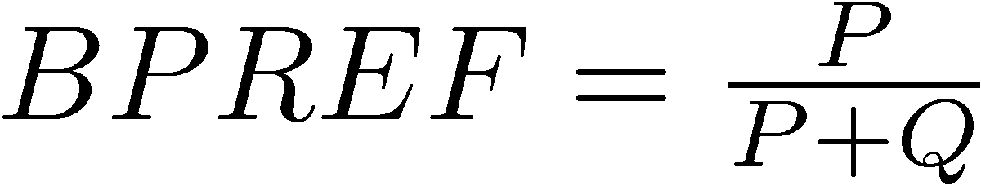
BPREF
For a query with R relevant documents, only the first R non-relevant documents are considered
  d_{r} is a relevant document, and N_{dr} gives the number of non-relevant documents (from the set of R non-relevant documents that are considered) that are ranked higher than d_{r}
Alternative definition
e.g.: learned 15 prefs from clickthrough & your ranking “agrees” with 10: BPREF = 10/ 15 = 0.66
note that BPREF values are [0,1] and τ [-1,1]

Slide 42
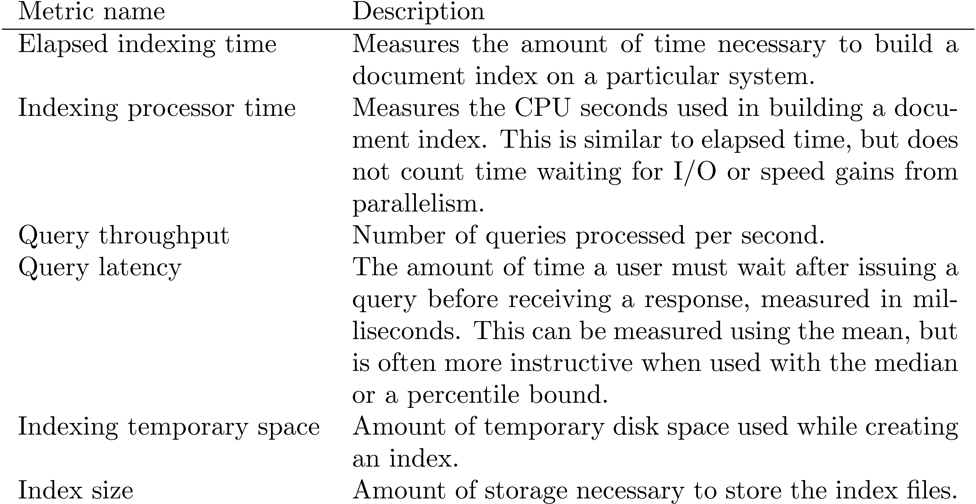
Efficiency Metrics

Slide 43
Significance Tests
Given the results from a number of queries, how can we conclude that ranking algorithm A is better than algorithm B?
A significance test enables us to reject the null hypothesis (no difference) in favor of the alternative hypothesis (B is better than A)
  the power of a test is the probability that the test will reject the null hypothesis correctly
  increasing the number of queries in the experiment also increases power of test

Slide 44
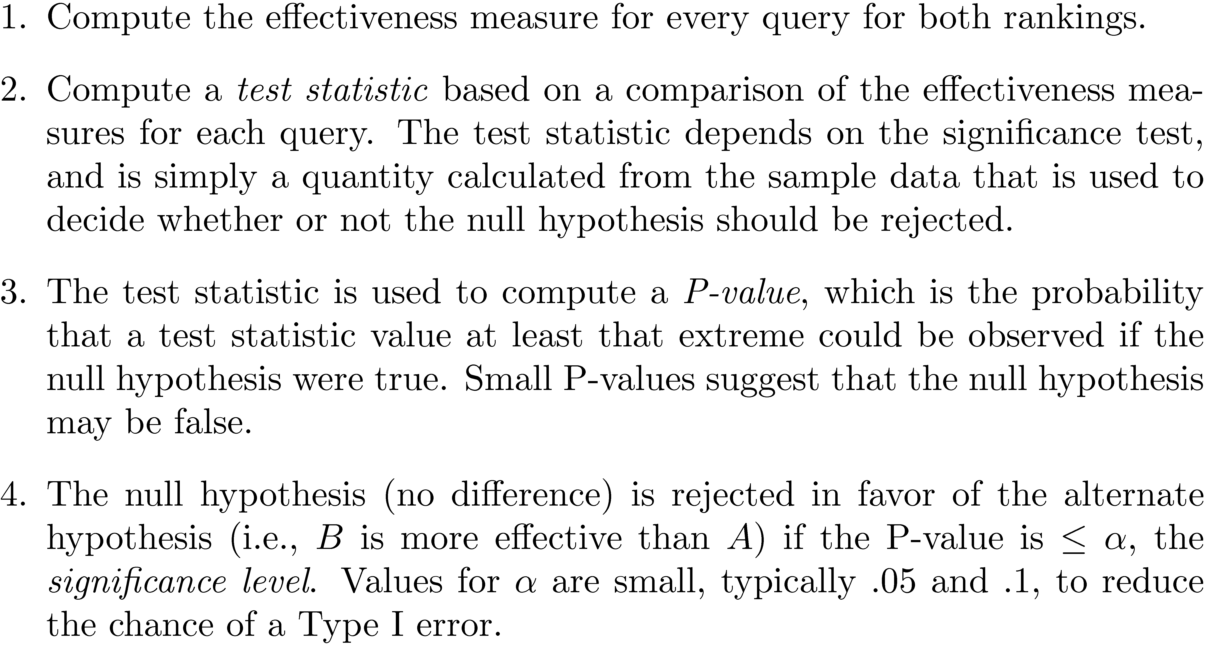
Significance Tests

Slide 45
One-Sided Test
Distribution for the possible values of a test statistic assuming the null hypothesis
    shaded area is region of rejection
if just showing a difference
between A & B, we’d use a
two-sided test
https://en.wikipedia.org/wiki/One-_and_two-tailed_tests
Re: P-values: http://phys.org/wire-news/145707973/the-problem-with-p-values-how-significant-are-they-really.html
http://blogs.plos.org/publichealth/2015/06/24/p-values/
http://www.nature.com/news/scientific-method-statistical-errors-1.14700

Slide 46
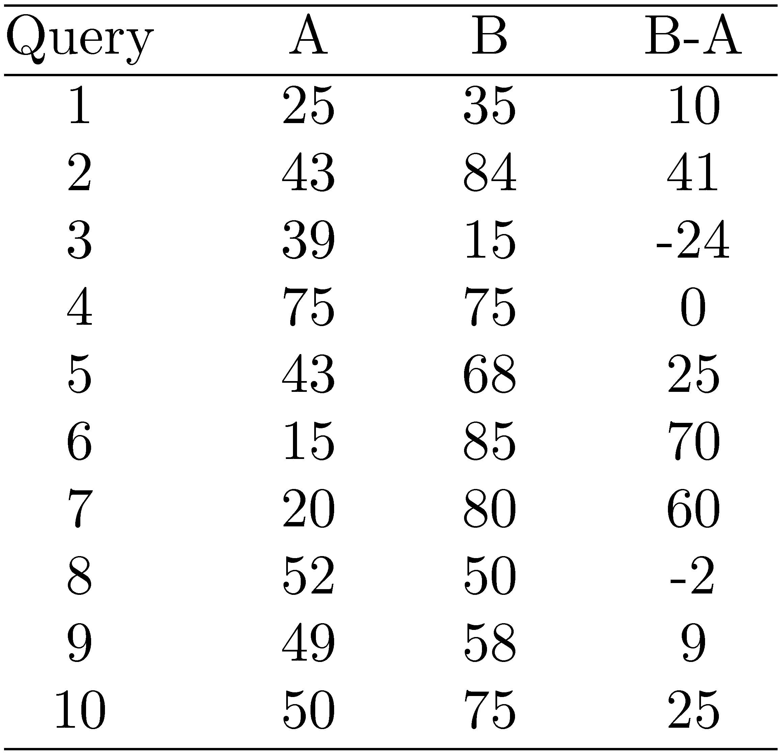
Example Experimental Results

Slide 47

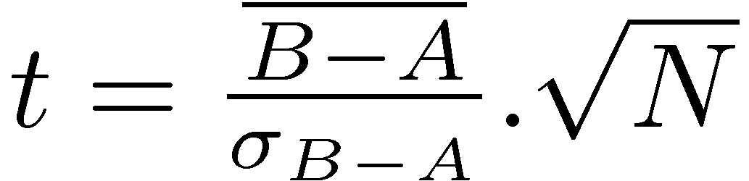
t-Test
Assumption is that the difference between the effectiveness values is a sample from a normal distribution
Null hypothesis is that the mean of the distribution of differences is zero
Test statistic
  for the example,
see: https://en.wikipedia.org/wiki/William_Sealy_Gosset

Slide 48
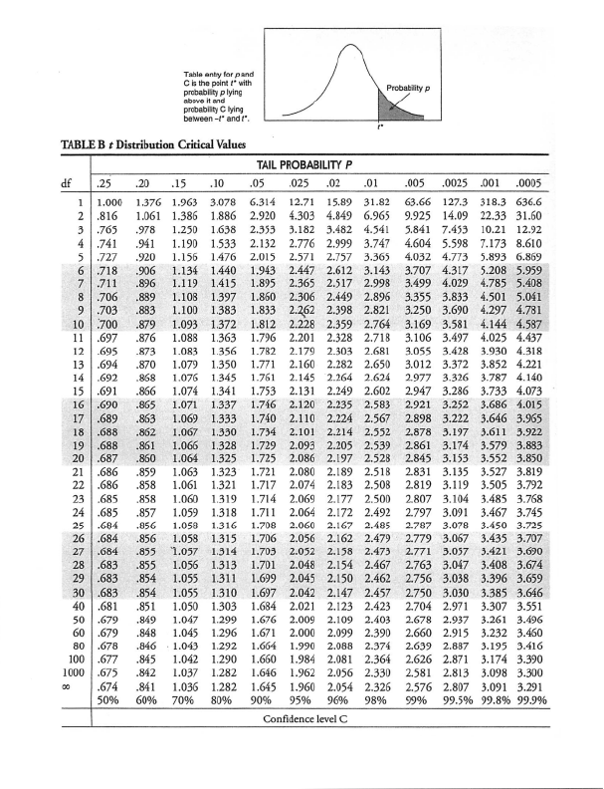
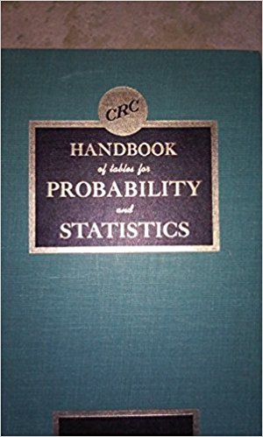
The t values come from look up tables
https://www.amazon.com/CRC-Handbook-tables-Probability-Statistics/dp/0849306922
See also: https://en.wikipedia.org/wiki/Student's_t-distribution
From: http://media1.shmoop.com/images/common-core/stats-tables-3.png

Slide 49
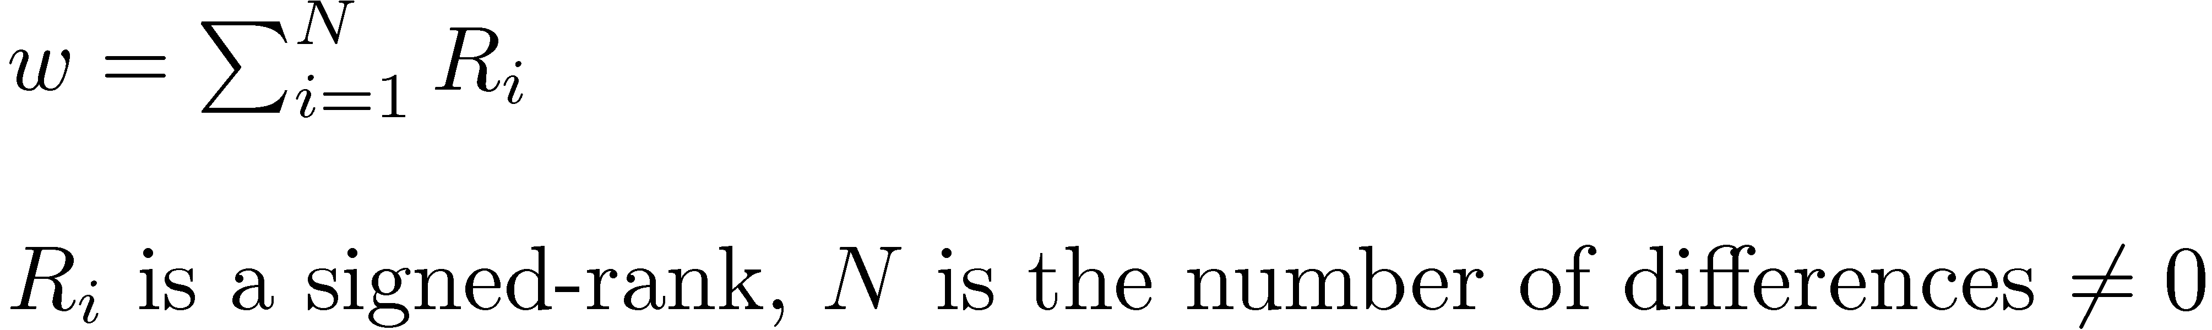
Wilcoxon Signed-Ranks Test
Nonparametric test based on differences between effectiveness scores
Test statistic
  To compute the signed-ranks, the differences are ordered by their absolute values (increasing), and then assigned rank values
  rank values are then given the sign of the original difference

Slide 50
Wilcoxon Example
9 non-zero differences are (in rank order of absolute value):
  2, 9, 10, 24, 25, 25, 41, 60, 70
Signed-ranks:
  -1, +2, +3, -4, +5.5, +5.5, +7, +8, +9
w = 35, p-value = 0.025
reminder

Slide 51
Sign Test
Ignores magnitude of differences
Null hypothesis for this test is that
  P(B > A) = P(A > B) = ½
  number of pairs where B is “better” than A would be the same as the number of pairs where A is “better” than B
Test statistic is number of pairs where B>A
For example data,
  test statistic is 7, p-value = 0.17
  cannot reject null hypothesis
reminder

Slide 52
Setting Parameter Values
Retrieval models often contain parameters that must be tuned to get best performance for specific types of data and queries
For experiments:
  Use training and test data sets
  If less data available, use cross-validation by partitioning the data into K subsets
  Using training and test data avoids overfitting – when parameter values do not generalize well to other data

Slide 53
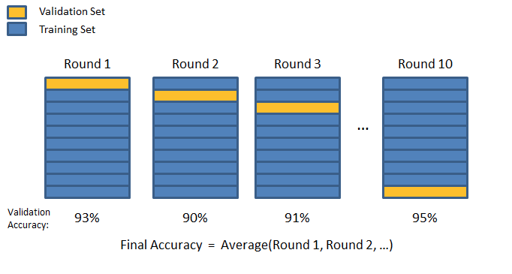
10-Fold Cross Validation
image from: https://chrisjmccormick.wordpress.com/2013/07/31/k-fold-cross-validation-with-matlab-code/
https://en.wikipedia.org/wiki/Cross-validation_%28statistics%29

Slide 54

Finding Parameter Values
Many techniques used to find optimal parameter values given training data
  standard problem in machine learning
In IR, often explore the space of possible parameter values by brute force
  requires large number of retrieval runs with small variations in parameter values (parameter sweep)
SVM optimization is an example of an efficient procedure for finding good parameter values with large numbers of parameters
https://upload.wikimedia.org/wikipedia/commons/8/8e/PawelLucki20060424.jpg

Slide 55
Online Testing
Test (or even train) using live traffic on a search engine
Benefits:
  real users, less biased, large amounts of test data
Drawbacks:
  noisy data, can degrade user experience
Often done on small proportion (1-5%) of live traffic
See: https://en.wikipedia.org/wiki/A/B_testing

Slide 56
Ch. 8, p. 334: Do it all…
In many settings, all of the following measures and tests could be carried out with little additional effort:
Mean average precision - single number summary, popular measure, pooled relevance judgments.
Average NDCG - single number summary for each rank level, emphasizes top ranked documents, relevance judgments needed only to a specific rank depth (typically to 10).
Recall-precision graph - conveys more information than a single number mea- sure, pooled relevance judgments.
Average precision at rank 10 - emphasizes top ranked documents, easy to understand, relevance judgments limited to top 10.
Using MAP and a recall-precision graph could require more effort in relevance judgments, but this analysis could also be limited to the relevant documents found in the top 10 for the NDCG and precision at 10 measures.

Slide 57
Query Summary

Slide 58
Summary
No single measure is the correct one for any application
  choose measures appropriate for task
  use a combination
  shows different aspects of the system effectiveness
Use significance tests (t-test)
Analyze performance of individual queries

