Slide 1
The W3C Web Architecture, the Memento Protocol, and
Research Issues With Web Archiving
Michael L. Nelson & Michele C. Weigle
Old Dominion University
Web Science & Digital Libraries Research Group
@WebSciDL
https://phonedude.github.io/cs891-f17/
With:
Los Alamos National Laboratory: Herbert Van de Sompel
ODU: Hany SalahEldeen, Matthias Prellwitz, Justin Brunelle, Mat Kelly, Ahmed AlSum, Scott Ainsworth, Sawood Alam
ODU CS 891 – Fall 2017
2017-09-06

Slide 2
HTTP Mechanics and the Web Architecture

Slide 3
Defining the Web / HTTP
HTTP was originally defined by Request for Comments (RFCs)1945, 2068, 2616
  http://en.wikipedia.org/wiki/Request_for_Comments
  and several others for defining URLs, URIs, etc.
  since replaced by RFCs 7230—7235 https://www.mnot.net/blog/2014/06/07/rfc2616_is_dead
We have another document for the “Web” (URIs + protocols + formats), a slightly revisionist but ultimately useful unifying document:
  The Architecture of the World Wide Web, Volume One.
    http://www.w3.org/TR/webarch/

Slide 4
Uniform Resource Identifiers
URI
RFC 2396
RFC 2141
URL
RFC 1738
URN
URI & URL: http://www.cs.odu.edu/
URL: ftp://ftp.isi.edu/pub/
URI: info:pmid/12376099
URN: urn:uuid:6e8bc430-9c3a-11d9-9669-0800200c9a66

Slide 5
From RFC 2396
“A URI can be further classified as a locator, a name, or both. The
term "Uniform Resource Locator" (URL) refers to the subset of URI
that identify resources via a representation of their primary access
mechanism (e.g., their network "location"), rather than identifying
the resource by name or by some other attribute(s) of that resource.
The term "Uniform Resource Name" (URN) refers to the subset of URI
that are required to remain globally unique and persistent even when
the resource ceases to exist or becomes unavailable.”

Slide 6
URI Schemes
foo://username:password@example.com:8042/over/there/index.dtb;type=animal?name=ferret#nose
\ / \________________/\_________/ \__/ \___/ \_/ \_________/ \_________/ \__/
| | | | | | | | |
| userinfo hostname port | | parameter query fragment
| \_______________________________/ \_____________|____|____________/
scheme | | | |
| authority |path|
| | |
| path interpretable as filename
| ___________|____________ |
/ \ / \ |
urn:example:animal:ferret:nose interpretable as extension
taken from: http://en.wikipedia.org/wiki/URI_scheme
registered URI schemes: http://www.iana.org/assignments/uri-schemes
registered URN namespaces: http://www.iana.org/assignments/urn-namespaces

Slide 7
How To Read RFCs
(quoting from RFC 2119)
The key words "MUST", "MUST NOT", "REQUIRED", "SHALL", "SHALL
NOT", "SHOULD", "SHOULD NOT", "RECOMMENDED", "MAY", and
"OPTIONAL" in this document are to be interpreted as described in
RFC 2119.
1. MUST This word, or the terms "REQUIRED" or "SHALL", mean that the
definition is an absolute requirement of the specification.
2. MUST NOT This phrase, or the phrase "SHALL NOT", mean that the
definition is an absolute prohibition of the specification.
3. SHOULD This word, or the adjective "RECOMMENDED", mean that there
may exist valid reasons in particular circumstances to ignore a
particular item, but the full implications must be understood and
carefully weighed before choosing a different course.
4. SHOULD NOT This phrase, or the phrase "NOT RECOMMENDED" mean that
there may exist valid reasons in particular circumstances when the
particular behavior is acceptable or even useful, but the full
implications should be understood and the case carefully weighed
before implementing any behavior described with this label.
5. MAY This word, or the adjective "OPTIONAL", mean that an item is
truly optional. One vendor may choose to include the item because a
particular marketplace requires it or because the vendor feels that
it enhances the product while another vendor may omit the same item.
An implementation which does not include a particular option MUST be
prepared to interoperate with another implementation which does
include the option, though perhaps with reduced functionality. In the
same vein an implementation which does include a particular option
MUST be prepared to interoperate with another implementation which
does not include the option (except, of course, for the feature the
option provides.)

Slide 8
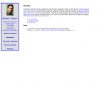
Important Web Architecture Concepts
URIs
Resources
http://www.cs.odu.edu/~mln/
Identify
Represent
Representations*
<html>
<head>
<title>
Home:: Michael L. Nelson, Old Dominion University
</title>
<link rel="stylesheet" type="text/css" href="mln.css"/>
<script type="text/javascript" src="mln.js"></script>
…
As defined by the Web Architecture
http://www.w3.org/TR/webarch/
*= we’ll see this use of “representations”
conflates many terms from RFC-2616

Slide 9
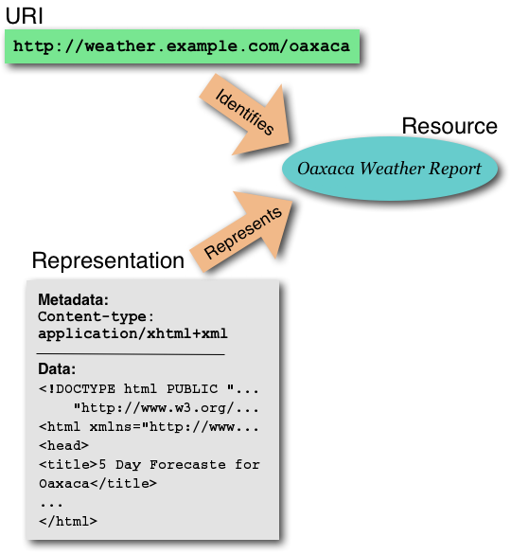
Original W3C Figure

Slide 10
W3C Web Architecture
Representation 2
URI
Represents
Identifies
Resource
Content Negotiation
Represents
Representation 1
slide from Herbert Van de Sompel
Notes:
10

Slide 11
HTTP Operation
request = (method, URI, version, “MIME-like” message)
Origin
Server
Client
response = (version, response code, “MIME-like” message)

Slide 12
General Template, CR/LF, and Magic Blank Lines
Client:
Method URI HTTP/1.1
Some-Request-Header-1: value1
Some-Request-Header-2: value2
…
(1st magic blank line)
HTTP 1.1 Code String
Some-Response-Header-1: value1
Some-Response-Header-2: value2
…
(2nd magic blank line)
entity-body
Server:

Slide 13
Talking to HTTP servers…
% curl --head http://www.cs.odu.edu/~mln/
HTTP/1.1 200 OK
Date: Mon, 12 Jan 2009 15:44:19 GMT
Server: Apache/2.2.0
Last-Modified: Fri, 09 Jan 2009 17:18:37 GMT
ETag: "88849-1c71-f28dd540"
Accept-Ranges: bytes
Content-Length: 7281
Content-Type: text/html
“curl” is convenient, but
speaking raw HTTP is
more fun…
% curl --head http://www.google.com/
HTTP/1.1 200 OK
Cache-Control: private, max-age=0
Date: Mon, 12 Jan 2009 15:45:57 GMT
Expires: -1
Content-Type: text/html; charset=ISO-8859-1
Set-Cookie: PREF=ID=9a80d3f602b685f3:TM=1231775157:LM=1231775157:S=imGxRyNsTD0Zczm5;
expires=Wed, 12-Jan-2011 15:45:57 GMT; path=/; domain=.google.com
Server: gws
Content-Length: 0

Slide 14
GET
AIHT:~/Desktop/cs595-s06 mln$ telnet www.cs.odu.edu 80
Trying 128.82.4.2...
Connected to xenon.cs.odu.edu.
Escape character is '^]'.
GET /~mln/index.html HTTP/1.1
Connection: close
Host: www.cs.odu.edu
HTTP/1.1 200 OK
Date: Mon, 09 Jan 2006 17:07:04 GMT
Server: Apache/1.3.26 (Unix) ApacheJServ/1.1.2 PHP/4.3.4
Last-Modified: Sun, 29 May 2005 02:46:53 GMT
ETag: "1c52-14ed-42992d1d"
Accept-Ranges: bytes
Content-Length: 5357
Connection: close
Content-Type: text/html
<html>
<head>
<title>Home Page for Michael L. Nelson</title>
<style type="text/css">
<!--
[lots of html deleted]
Connection closed by foreign host.
Request
(ends w/ CRLF)
Response

Slide 15
HEAD
AIHT:~/Desktop/cs595-s06 mln$ telnet www.cs.odu.edu 80
Trying 128.82.4.2...
Connected to xenon.cs.odu.edu.
Escape character is '^]'.
HEAD /~mln/index.html HTTP/1.1
Connection: close
Host: www.cs.odu.edu
HTTP/1.1 200 OK
Date: Mon, 09 Jan 2006 17:14:39 GMT
Server: Apache/1.3.26 (Unix) ApacheJServ/1.1.2 PHP/4.3.4
Last-Modified: Sun, 29 May 2005 02:46:53 GMT
ETag: "1c52-14ed-42992d1d"
Accept-Ranges: bytes
Content-Length: 5357
Connection: close
Content-Type: text/html
Connection closed by foreign host.

Slide 16
OPTIONS
(many methods)
AIHT:~/Desktop/cs595-s06 mln$ telnet www.cs.odu.edu 80
Trying 128.82.4.2...
Connected to xenon.cs.odu.edu.
Escape character is '^]'.
OPTIONS /~mln/index.html HTTP/1.1
Connection: close
Host: www.cs.odu.edu
HTTP/1.1 200 OK
Date: Mon, 09 Jan 2006 17:16:46 GMT
Server: Apache/1.3.26 (Unix) ApacheJServ/1.1.2 PHP/4.3.4
Content-Length: 0
Allow: GET, HEAD, POST, PUT, DELETE, CONNECT, OPTIONS, PATCH, PROPFIND, PROPPATCH,
MKCOL, COPY, MOVE, LOCK, UNLOCK, TRACE
Connection: close
Connection closed by foreign host.

Slide 17
OPTIONS
(fewer methods)
% telnet www.cs.odu.edu 80
Trying 128.82.4.2...
Connected to xenon.cs.odu.edu.
Escape character is '^]'.
OPTIONS /~mln/index.html HTTP/1.1
Connection: close
Host: www.cs.odu.edu
HTTP/1.1 200 OK
Date: Tue, 10 Jan 2012 17:26:44 GMT
Server: Apache/2.2.17 (Unix) PHP/5.3.5 mod_ssl/2.2.17 OpenSSL/0.9.8q
Allow: GET,HEAD,POST,OPTIONS
Content-Length: 0
Connection: close
Content-Type: text/html
Connection closed by foreign host.

Slide 18
Response Codes
from section 6.1.1 of RFC 2616
not “error” codes!
- 1xx: Informational - Request received, continuing process
- 2xx: Success - The action was successfully received,
understood, and accepted
- 3xx: Redirection - Further action must be taken in order to
complete the request
- 4xx: Client Error - The request contains bad syntax or cannot
be fulfilled
- 5xx: Server Error - The server failed to fulfill an apparently
valid request

Slide 19
501 - Method Not Implemented
AIHT:~/Desktop/cs595-s06 mln$ telnet www.cs.odu.edu 80
Trying 128.82.4.2...
Connected to xenon.cs.odu.edu.
Escape character is '^]'.
NOTAREALMETHOD /index.html HTTP/1.1
Connection: close
Host: www.cs.odu.edu
HTTP/1.1 501 Method Not Implemented
Date: Mon, 09 Jan 2006 17:22:40 GMT
Server: Apache/1.3.26 (Unix) ApacheJServ/1.1.2 PHP/4.3.4
Allow: GET, HEAD, POST, PUT, DELETE, CONNECT, OPTIONS, PATCH, PROPFIND, PROPPATCH, MKCOL, COPY,
MOVE, LOCK, UNLOCK, TRACE
Connection: close
Transfer-Encoding: chunked
Content-Type: text/html; charset=iso-8859-1
15f
<!DOCTYPE HTML PUBLIC "-//IETF//DTD HTML 2.0//EN">
<HTML><HEAD>
<TITLE>501 Method Not Implemented</TITLE>
</HEAD><BODY>
<H1>Method Not Implemented</H1>
NOTAREALMETHOD to /index.html not supported.<P>
Invalid method in request NOTAREALMETHOD /index.html HTTP/1.1<P>
<HR>
<ADDRESS>Apache/1.3.26 Server at www.cs.odu.edu Port 80</ADDRESS>
</BODY></HTML>
0
Connection closed by foreign host.

Slide 20
301 - Moved Permanently
AIHT:~/Desktop/cs595-s06 mln$ telnet www.cs.odu.edu 80
Trying 128.82.4.2...
Connected to xenon.cs.odu.edu.
Escape character is '^]'.
GET /~mln HTTP/1.1
Connection: close
Host: www.cs.odu.edu
Connection closed by foreign host.
HTTP/1.1 301 Moved Permanently
Date: Mon, 09 Jan 2006 19:32:24 GMT
Server: Apache/1.3.26 (Unix) ApacheJServ/1.1.2 PHP/4.3.4
Location: http://www.cs.odu.edu/~mln/
Connection: close
Transfer-Encoding: chunked
Content-Type: text/html; charset=iso-8859-1
12e
<!DOCTYPE HTML PUBLIC "-//IETF//DTD HTML 2.0//EN">
<HTML><HEAD>
<TITLE>301 Moved Permanently</TITLE>
</HEAD><BODY>
<H1>Moved Permanently</H1>
The document has moved <A HREF="http://www.cs.odu.edu/~mln/">here</A>.<P>
<HR>
<ADDRESS>Apache/1.3.26 Server at www.cs.odu.edu Port 80</ADDRESS>
</BODY></HTML>
0

Slide 21
301- Moved Permanently
% telnet bit.ly 80
Trying 69.58.188.39...
Connected to bit.ly.
Escape character is '^]'.
HEAD http://bit.ly/s2FPFa HTTP/1.1
Host: bit.ly
Connection: close
HTTP/1.1 301 Moved
Server: nginx
Date: Tue, 10 Jan 2012 17:34:29 GMT
Content-Type: text/html; charset=utf-8
Connection: close
Set-Cookie: _bit=4f0c76a5-002b9-048b1-331cf10a;domain=.bit.ly;
expires=Sun Jul 8 17:34:29 2012;path=/; HttpOnly
Cache-control: private; max-age=90
Location: http://bit.ly/bundles/phonedude/e
MIME-Version: 1.0
Content-Length: 125
the response code is REQUIRED;
phrase is RECOMMENDED

Slide 22
302 - Found
% telnet doi.acm.org 80
Trying 64.238.147.57...
Connected to doi.acm.org.
Escape character is '^]'.
HEAD http://doi.acm.org/10.1145/1998076.1998100 HTTP/1.1
Host: doi.acm.org
Connection: close
HTTP/1.1 302 Found
Date: Tue, 10 Jan 2012 17:53:36 GMT
Server: Apache/2.2.3 (Red Hat)
Location: http://dl.acm.org/citation.cfm?doid=1998076.1998100
Connection: close
Content-Type: text/html; charset=iso-8859-1

Slide 23
303 - See Other
% telnet dx.doi.org 80
Trying 38.100.138.149...
Connected to dx.doi.org.
Escape character is '^]'.
HEAD http://dx.doi.org/10.1007/978-3-642-24469-8_16 HTTP/1.1
Host: dx.doi.org
Connection: close
HTTP/1.1 303 See Other
Server: Apache-Coyote/1.1
Location: http://www.springerlink.com/index/10.1007/978-3-642-24469-8_16
Expires: Wed, 11 Jan 2012 12:04:29 GMT
Content-Type: text/html;charset=utf-8
Content-Length: 210
Date: Tue, 10 Jan 2012 17:56:41 GMT
Connection: close

Slide 24
Hidden Semantics in Redirects
301 – different URI for the same resource, don’t use this URI in the future
302 – different URI for the same resource, but use this URI for future requests
303 – different URI for a different but related resource

Slide 25
HTTP 307 vs. 308
+-------------------------------------------+-----------+-----------+
| | Permanent | Temporary |
+-------------------------------------------+-----------+-----------+
| Allows changing the request method from | 301 | 302 |
| POST to GET | | |
| Does not allow changing the request | - | 307 |
| method from POST to GET | | |
+-------------------------------------------+-----------+-----------+
308
from: https://tools.ietf.org/html/rfc7238

Slide 26
404 - Not Found
% telnet www.cs.odu.edu 80
Trying 128.82.4.2...
Connected to xenon.cs.odu.edu.
Escape character is '^]'.
HEAD /lasdkfjalsdkfjldaskfj HTTP/1.1
Host: www.cs.odu.edu
Connection: close
HTTP/1.1 404 Not Found
Date: Tue, 10 Jan 2012 17:39:15 GMT
Server: Apache/2.2.17 (Unix) PHP/5.3.5 mod_ssl/2.2.17 OpenSSL/0.9.8q
Connection: close
Content-Type: text/html; charset=iso-8859-1
Connection closed by foreign host.

Slide 27
404s and nigh-404s
$ curl -I https://newsle.com/MichaelLNelson
HTTP/1.1 404 Not Found
Date: Thu, 02 Feb 2017 21:09:39 GMT
Server: WebServer
X-Content-Type-Options: nosniff
X-Frame-Options: SAMEORIGIN
Vary: Host,Accept-Encoding
[…]
$ curl -I https://twitter.com/Farrah3m/status/31727870736859137
HTTP/1.1 404 Not Found
cache-control: no-cache, no-store, must-revalidate, pre-check=0, post-check=0
content-length: 4458
content-type: text/html;charset=utf-8
date: Thu, 02 Feb 2017 21:12:25 GMT
[…]
$ # not all 404s will give you a 404…
$ curl -IL http://topsy.com/twitter.com/EmmaWay20
curl: (6) Could not resolve host: topsy.com
$ curl -I https://www.youtube.com/watch?v=c4vqkn0X1pM
HTTP/1.1 200 OK
Content-Type: text/html; charset=utf-8
Cache-Control: no-cache
Date: Thu, 02 Feb 2017 21:18:45 GMT
[…]
$ curl -I http://gdata.youtube.com/feeds/base/videos/SkJDKdOlUGQ/comments
HTTP/1.1 410 Gone
Content-Type: text/html; charset=UTF-8
Content-Length: 19
Date: Thu, 02 Feb 2017 21:21:03 GMT
Expires: Thu, 02 Feb 2017 21:21:03 GMT
[…]
27

Slide 28
401 - Unauthorized
% telnet www4.cs.odu.edu 80
Trying 128.82.5.93...
Connected to www4.cs.odu.edu.
Escape character is '^]'.
HEAD http://www4.cs.odu.edu/Conference/index.aspx HTTP/1.1
Host: www4.cs.odu.edu
Connection: close
HTTP/1.1 401 Unauthorized
Content-Length: 1656
Content-Type: text/html
Server: Microsoft-IIS/6.0
WWW-Authenticate: Basic realm="www4.cs.odu.edu"
MicrosoftOfficeWebServer: 5.0_Pub
X-Powered-By: ASP.NET
Date: Tue, 10 Jan 2012 17:43:57 GMT
Connection: close

Slide 29
400 - Bad Request
% telnet www.cs.odu.edu 80
Trying 128.82.4.2...
Connected to xenon.cs.odu.edu.
Escape character is '^]'.
HEAD http://www.cs.odu.edu/~mln/ HTTP/1.1
Connection: close
HTTP/1.1 400 Bad Request
Date: Tue, 10 Jan 2012 18:24:17 GMT
Server: Apache/2.2.17 (Unix) PHP/5.3.5 mod_ssl/2.2.17 OpenSSL/0.9.8q
Connection: close
Content-Type: text/html; charset=iso-8859-1

Slide 30
505 - HTTP Version Not Supported
% telnet www.cs.odu.edu 80
Trying 128.82.4.2...
Connected to xenon.cs.odu.edu.
Escape character is '^]'.
HEAD / HTTP/9.9
Host: www.cs.odu.edu
Connection: close
HTTP/1.1 200 OK
Date: Tue, 10 Jan 2012 17:40:05 GMT
Server: Apache/2.2.17 (Unix) PHP/5.3.5 mod_ssl/2.2.17 OpenSSL/0.9.8q
Accept-Ranges: bytes
Connection: close
Content-Type: text/html
Connection closed by foreign host.
Servers are often wrong!!!
see: http://ws-dl.blogspot.com/2014/05/2014-05-08-support-for-various-http.html

Slide 31
505 - HTTP Version Not Supported
% telnet www.w3c.org 80
Trying 128.30.52.45...
Connected to dolph.w3.org.
Escape character is '^]'.
HEAD / HTTP/9.9
Host: www.w3c.org
Connection: close
HTTP/1.0 403 Forbidden
Cache-Control: no-cache
Connection: close
Content-Type: text/html
<html><body><h1>403 Forbidden</h1>
Request forbidden by administrative rules.
</body></html>
a curious response…
505 not defined in HTTP 1.0!

Slide 32
Many, Many Response Codes…
10.2 Successful 2xx ..............................................58
10.2.1 200 OK ...................................................58
10.2.2 201 Created ..............................................59
10.2.3 202 Accepted .............................................59
10.2.4 203 Non-Authoritative Information ........................59
10.2.5 204 No Content ...........................................60
10.2.6 205 Reset Content ........................................60
10.2.7 206 Partial Content ......................................60
10.3 Redirection 3xx .............................................61
10.3.1 300 Multiple Choices .....................................61
10.3.2 301 Moved Permanently ....................................62
10.3.3 302 Found ................................................62
10.3.4 303 See Other ............................................63
10.3.5 304 Not Modified .........................................63
10.3.6 305 Use Proxy ............................................64
10.3.7 306 (Unused) .............................................64
10.3.8 307 Temporary Redirect ...................................65
10.4 Client Error 4xx ............................................65
10.4.1 400 Bad Request .........................................65
10.4.2 401 Unauthorized ........................................66
10.4.3 402 Payment Required ....................................66
10.4.4 403 Forbidden ...........................................66
10.4.5 404 Not Found ...........................................66
10.4.6 405 Method Not Allowed ..................................66
10.4.7 406 Not Acceptable ......................................67
10.4.8 407 Proxy Authentication Required .......................67
10.4.9 408 Request Timeout .....................................67
10.4.10 409 Conflict ............................................67
10.4.11 410 Gone ................................................68
10.4.12 411 Length Required .....................................68
10.4.13 412 Precondition Failed .................................68
10.4.14 413 Request Entity Too Large ............................69
10.4.15 414 Request-URI Too Long ................................69
10.4.16 415 Unsupported Media Type ..............................69
10.4.17 416 Requested Range Not Satisfiable .....................69
10.4.18 417 Expectation Failed ..................................70
10.5 Server Error 5xx ............................................70
10.5.1 500 Internal Server Error ................................70
10.5.2 501 Not Implemented ......................................70
10.5.3 502 Bad Gateway ..........................................70
10.5.4 503 Service Unavailable ..................................70
10.5.5 504 Gateway Timeout ......................................71
10.5.6 505 HTTP Version Not Supported ...........................71

Slide 33
Date/Time Format
note: HTTP doesn’t support
finer than second granularity!
from 3.3.1 RFC 2616
Sun, 06 Nov 1994 08:49:37 GMT ; RFC 822, updated by RFC 1123
Sunday, 06-Nov-94 08:49:37 GMT ; RFC 850, obsoleted by RFC 1036
Sun Nov 6 08:49:37 1994 ; ANSI C's asctime() format
…
HTTP/1.1 clients and servers that parse the date value MUST accept
all three formats (for compatibility with HTTP/1.0), though they MUST
only generate the RFC 1123 format for representing HTTP-date values
in header fields. See section 19.3 for further information
problem that won’t go away:
RFC 1123 date/times
vs.
ISO 8601 variant, e.g. 20110809104522

Slide 34
REST
REST == Representational State Transfer
  http://en.wikipedia.org/wiki/Representational_State_Transfer
  URIs are nouns, not verbs
  in contrast with RPC-style web applications:
RPC: foo.com/bigApp.jsp?verb=showThing&id=123
REST: foo.com/thing/123 (w/ GET method)
RPC: foo.com/bigApp.jsp?verb=editThing&id=123
REST: foo.com/thing/123 (w/ PUT method)
RPC: foo.com/bigApp.jsp?verb=newThing
REST: foo.com/thing/ (w/ POST method)

Slide 35
HATEOAS
HATEOAS == Hypermedia as the Engine of Application State
  https://en.wikipedia.org/wiki/HATEOAS
  response provides transitions to other states:
GET /accounts/12345 HTTP/1.1
Host: bank.example.com
Accept: application/xml
...
HTTP/1.1 200 OK
Content-Type: application/xml
Content-Length: ...
<?xml version="1.0"?>
<account>
<account_number>12345</account_number>
<balance currency="usd">100.00</balance>
<link rel="deposit" href="https://bank.example.com/accounts/12345/deposit" />
<link rel="withdraw" href="https://bank.example.com/accounts/12345/withdraw" />
<link rel="transfer" href="https://bank.example.com/accounts/12345/transfer" />
<link rel="close" href="https://bank.example.com/accounts/12345/close" />
</account>
see: http://ws-dl.blogspot.com/2013/11/2013-11-19-rest-hateoas-and-follow-your.html

Slide 36

Memento: Time Travel for the Web
Notes:
36

Slide 37
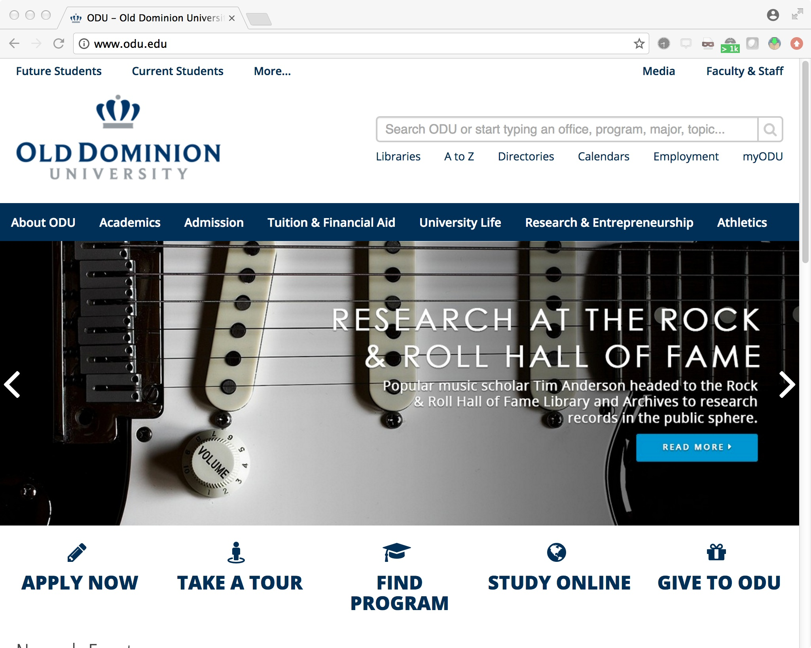

Slide 38
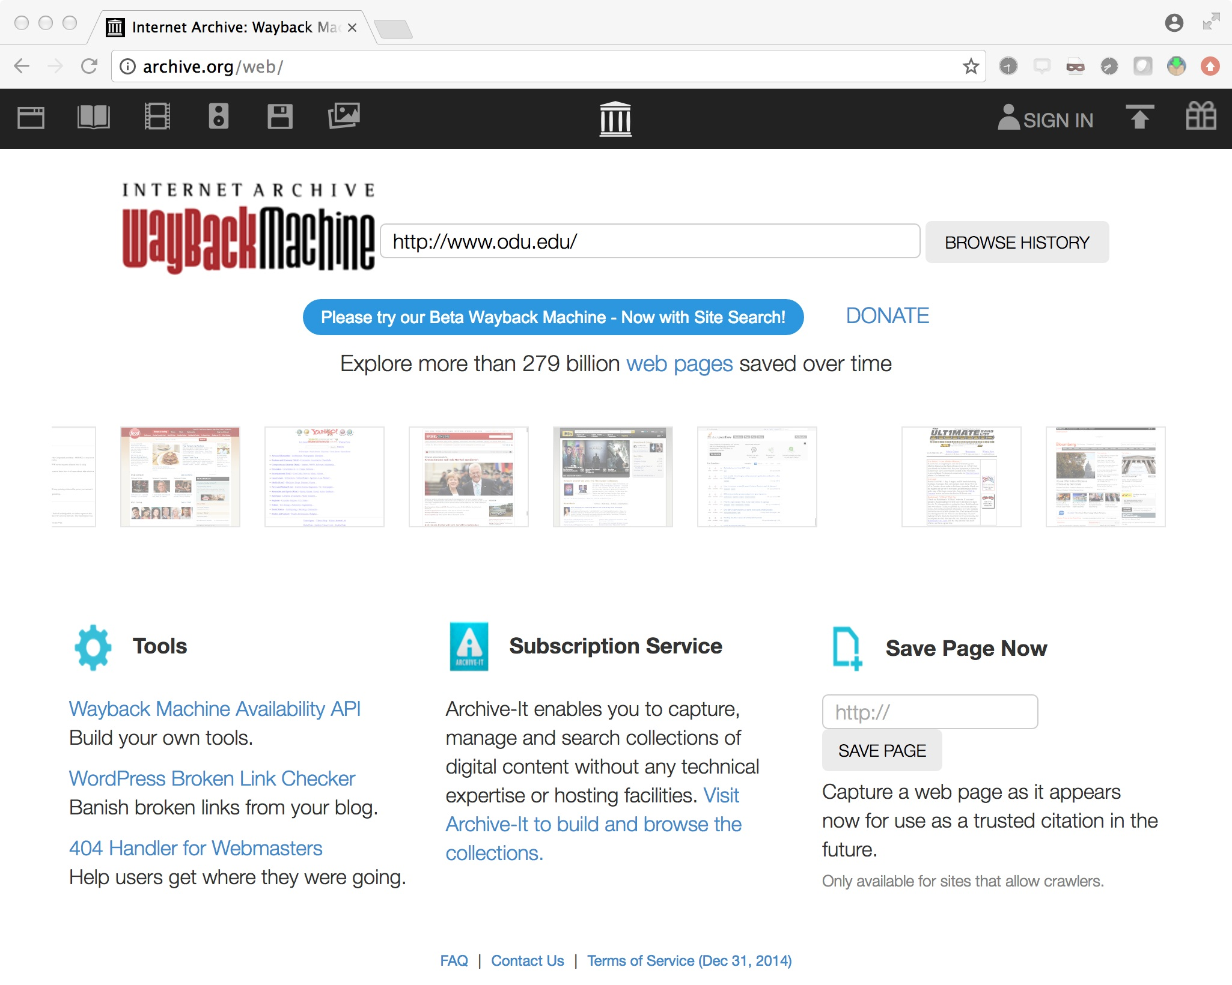
http://web.archive.org/web/*/http://www.odu.edu/
also: http://whatdiditlooklike.mementoweb.org/tagged/odu.edu

Slide 39
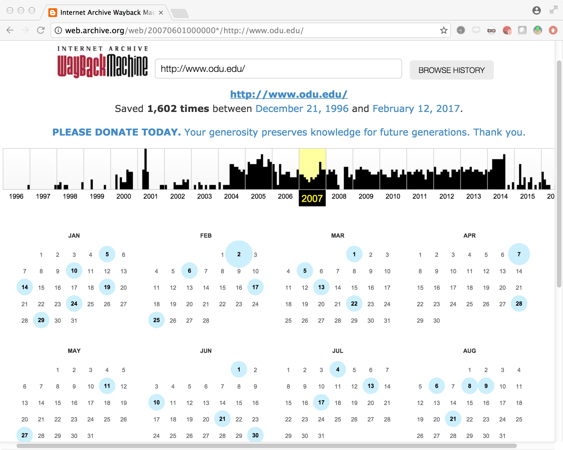

Slide 40
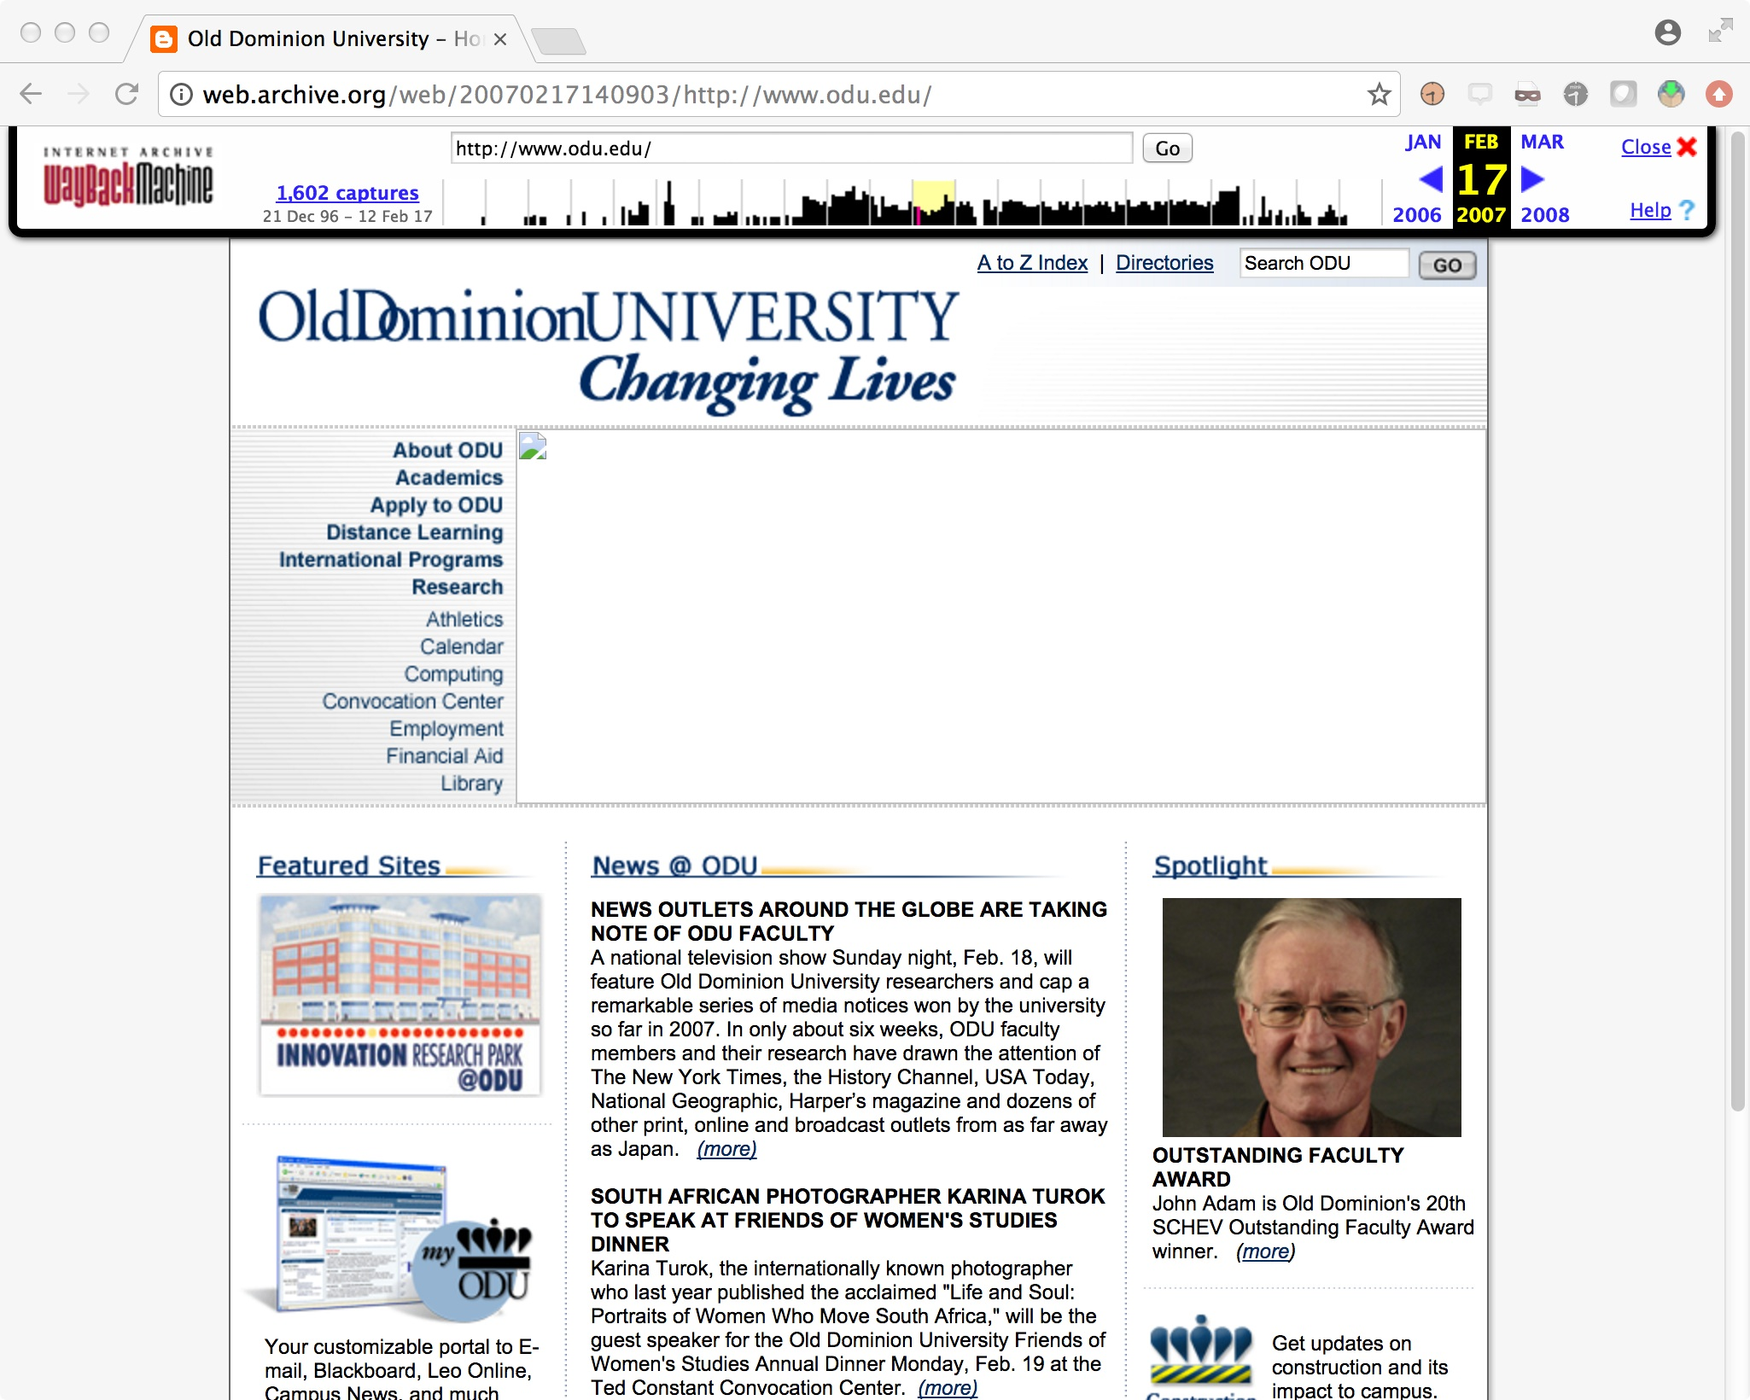
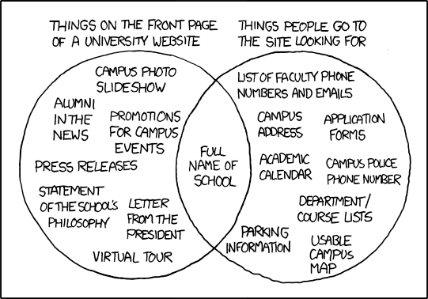
what was here?
we’ll likely never know…
(ok, xkcd gives us an idea…)

Slide 41
Memento wants to make it easy
to access the Web of the Past.
41

Slide 42
Memento achieves this by technically integrating
the present Web and the past Web, by introducing
a uniform version access capability for the Web.
42

Slide 43
Memento’s version access approach:
Is distributed: versions may exist on several servers;
Uses datetime as a global version indicator;
Is based on the primitives of the Web: resource, resource state, representation, content negotiation, link.
43

Slide 44
Since Memento’s access approach is distributed,
and is based on Web primitives, it scales like the Web.
44

Slide 45
Memento’s core components:
Ability to speak about a resource as it existed in the past;
A bridge between present and past: link and content negotiation;
A bridge between past and present: link.
45

Slide 46
W3C Web Architecture: Resource – URI - Representation
dereference
URI
Identifies
Resource
Represents
Representation
Notes:
46

Slide 47
W3C Web Architecture: Resource – URI - Representation
dereference
content negotiation
URI
Identifies
Resource
Represents
Representation 1
Represents
Representation 2
Notes:
47

Slide 48
Resources

Slide 49
Resources have Representations

Slide 50
Resources have Representations that Change over Time

Slide 51
Only the Current Representation is Available from a Resource

Slide 52
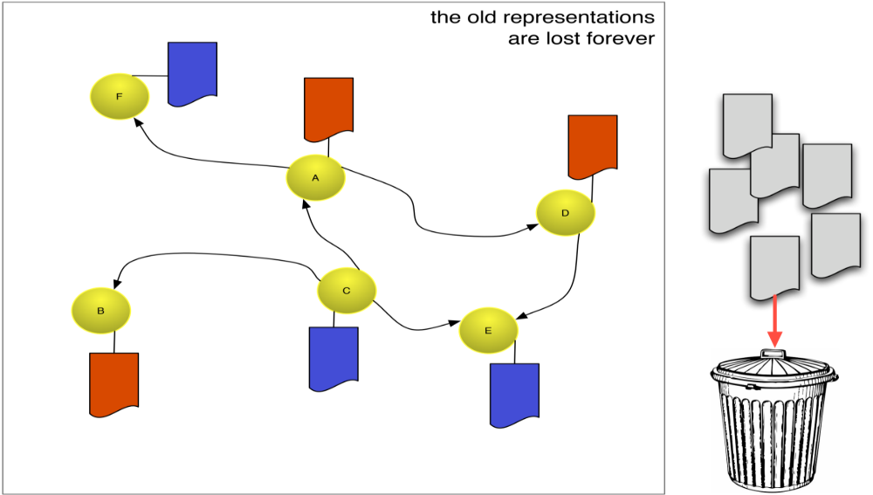
Old Representations are Lost Forever

Slide 53
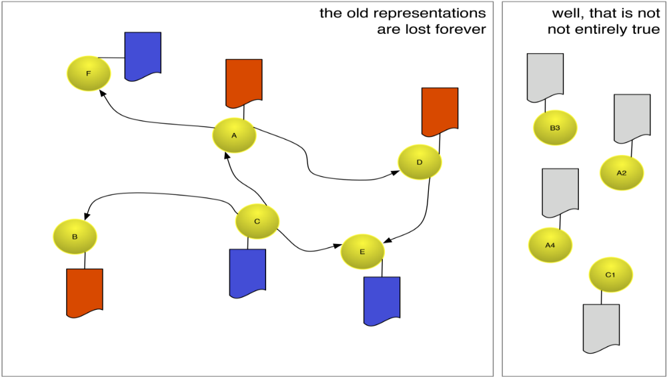
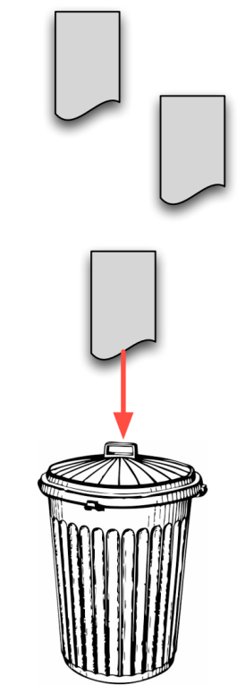
Archived Resources Exist

Slide 54
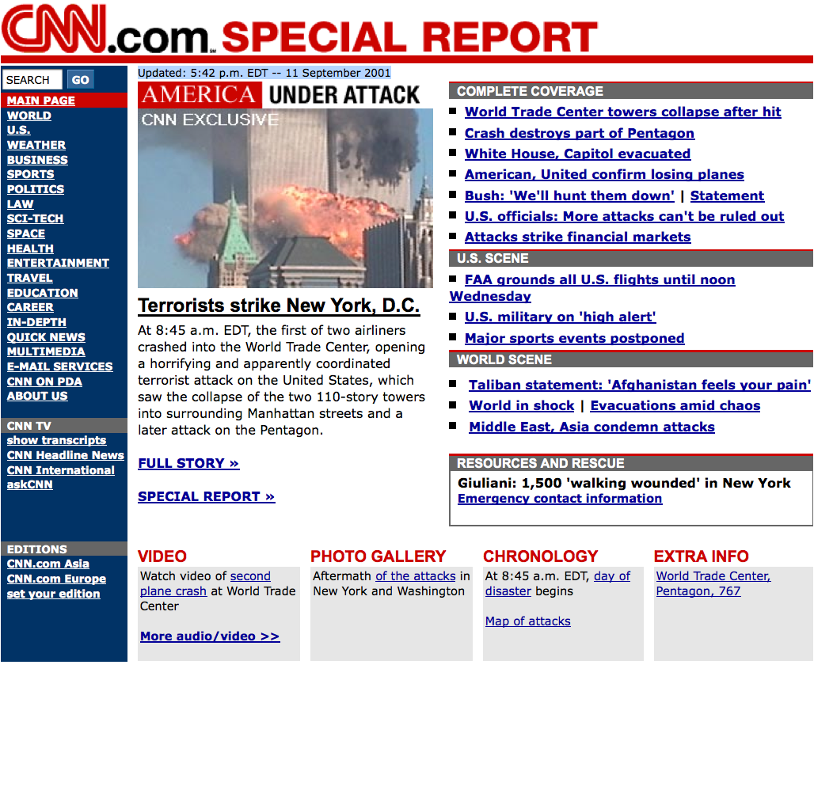
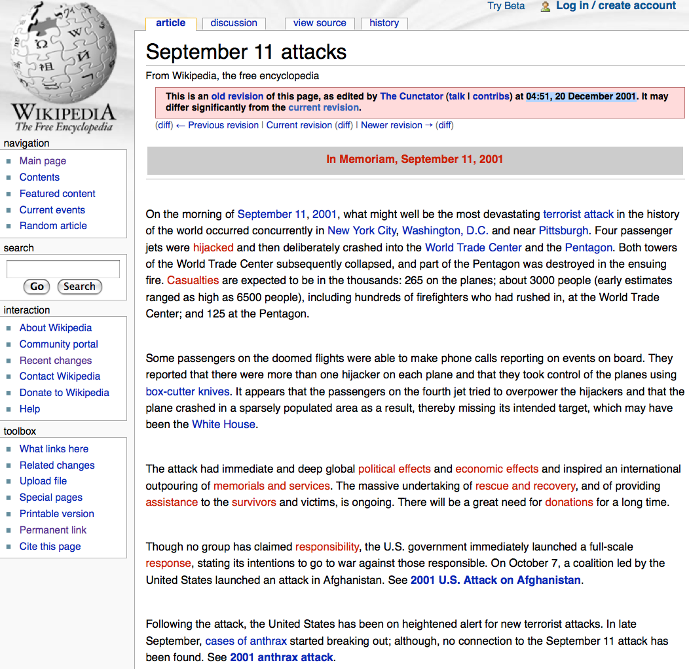
Archived Resources
Sep 11 2001, 20:36:10 UTC
Dec 20 2001, 4:51:00 UTC
http://en.wikipedia.org/w/index.php?title=September_11_attacks&oldid=282333 archived resource for http://en.wikipedia.org/wiki/September_11_attacks
http://web.archive.org/web/20010911203610/http://www.cnn.com/ archived resource for http://cnn.com
Notes:
54

Slide 55
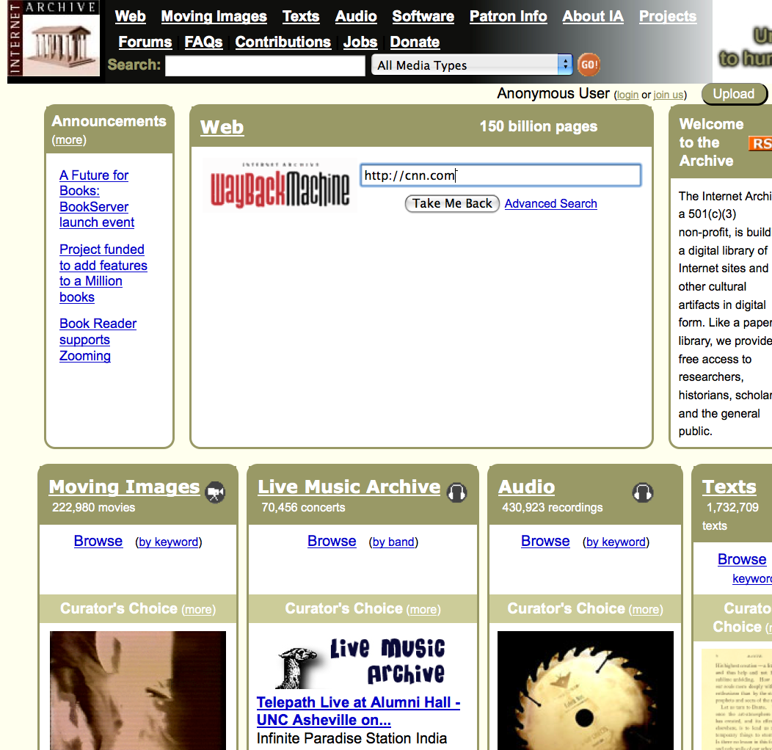
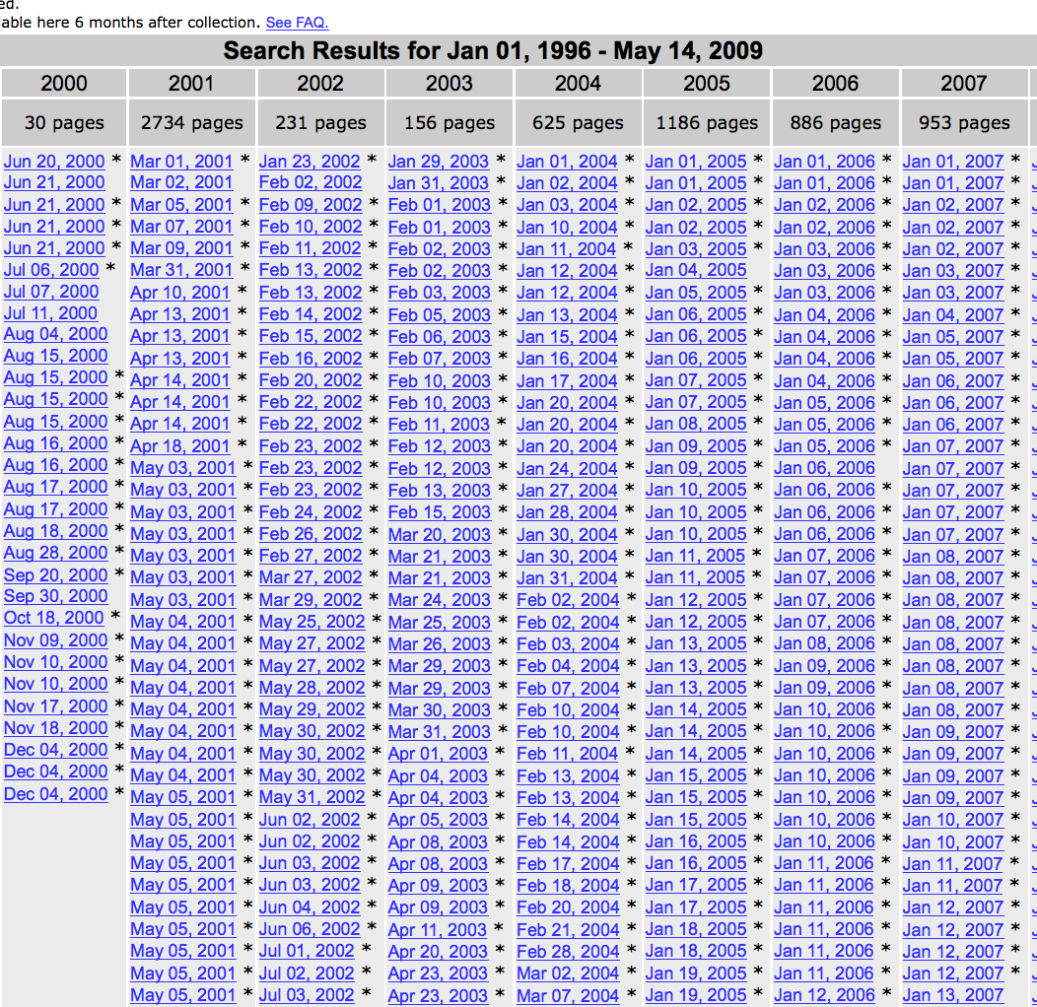
Finding Archived Resources
Go to http://www.archive.org/ and search
http://cnn.com
On http://web.archive.org/web/*/http://cnn.com, select desired datetime
Notes:
55

Slide 56
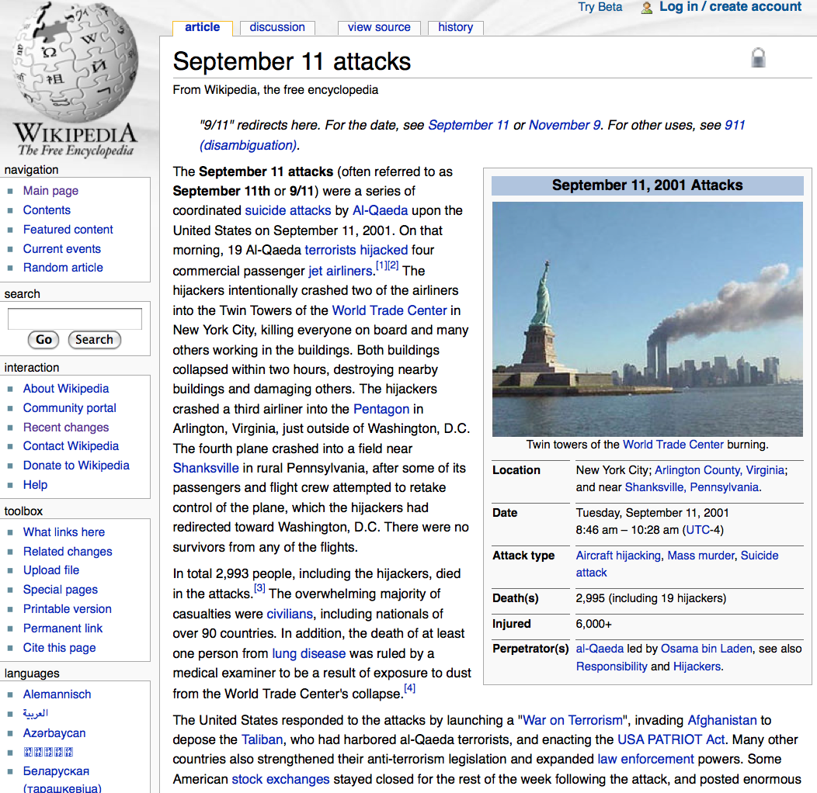
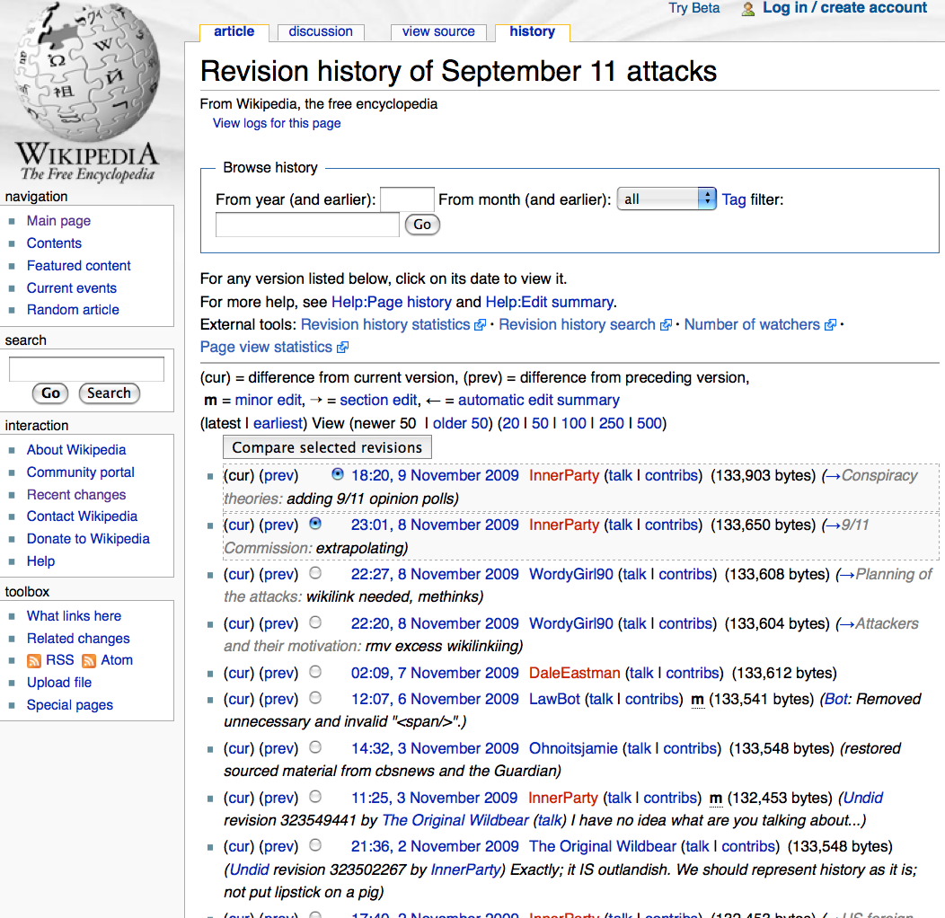
Finding Archived Resources
Go to
http://en.wikipedia.org/wiki/September_11_attacks
and click History
Browse History
Notes:
56

Slide 57
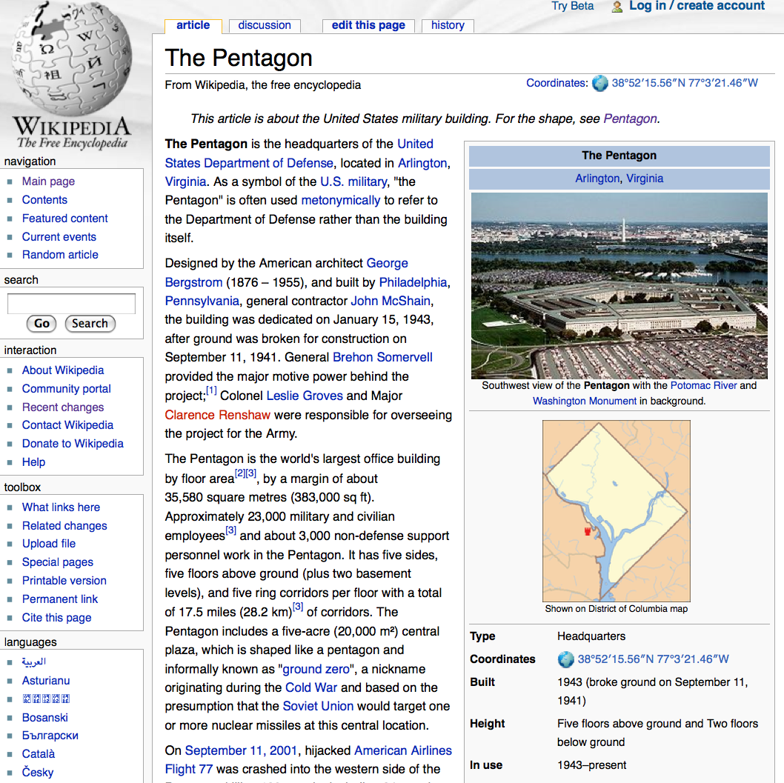
Navigating Archived Resources
Dec 20 2001, 4:51:00 UTC
current
Pentagon
http://en.wikipedia.org/w/index.php?title=September_11_attacks&oldid=282333 archived resource for http://en.wikipedia.org/wiki/September_11_attacks3
http://en.wikipedia.org/wiki/The_Pentagon
Notes:
57

Slide 58
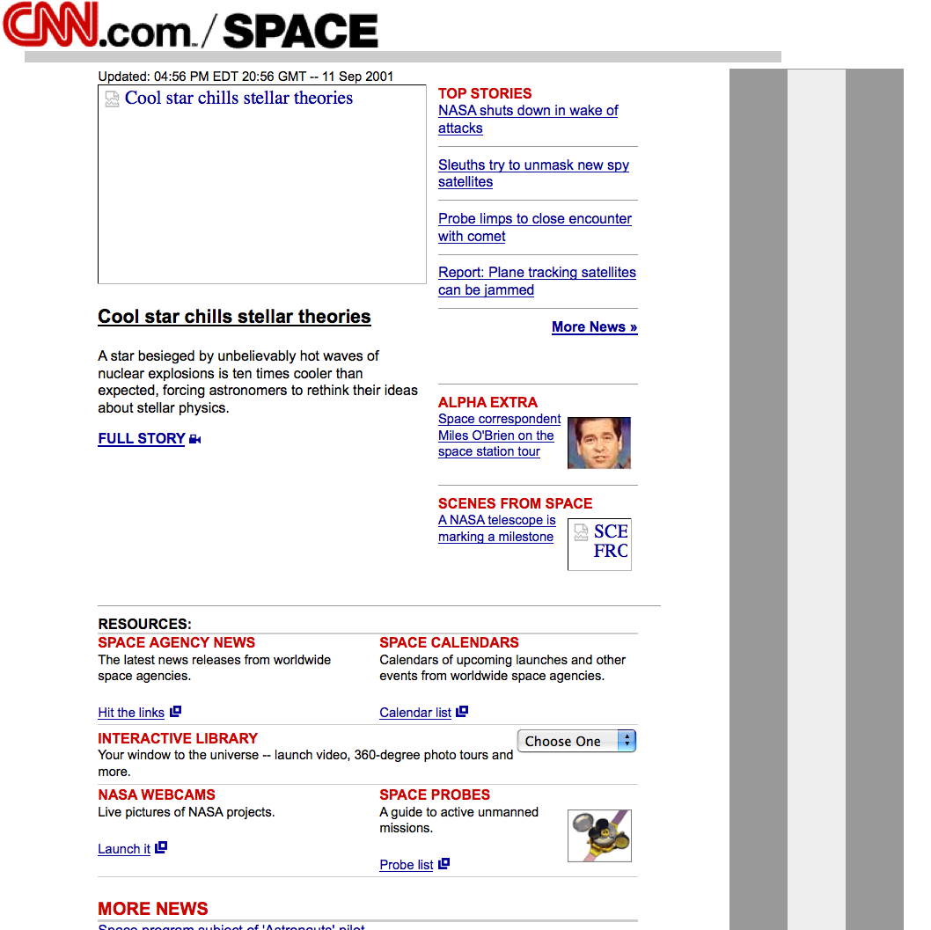
Navigating Archived Resources
Sep 11 2001, 20:36:10 UTC
Sep 11 2001, 21:38:55 UTC
SPACE
http://web.archive.org/web/20010911203610/http://www.cnn.com/ archived resource for http://cnn.com
http://web.archive.org/web/20010911213855/www.cnn.com/TECH/space/
Notes:
58

Slide 59
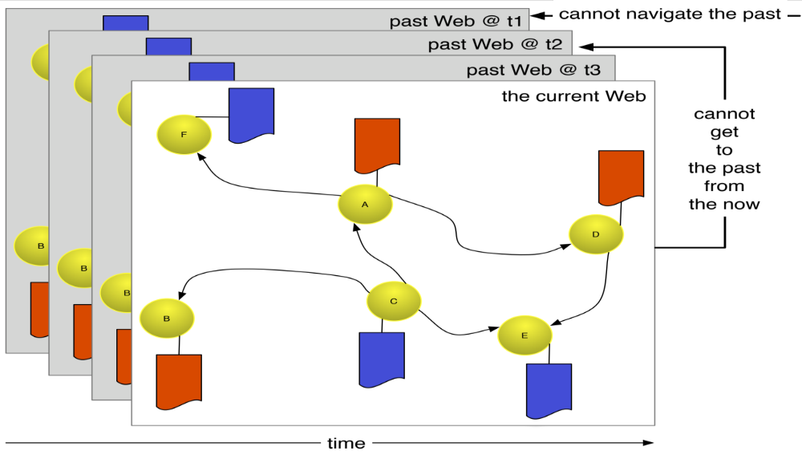
Current and Past Web are Not Integrated
Current and Past Web based on same technology.
But, going from Current to Past Web is a matter of (manual) discovery.
Memento wants to make going from Current to Past Web a (HTTP) protocol matter.
Memento wants to integrate Current And Past Web.

Slide 60
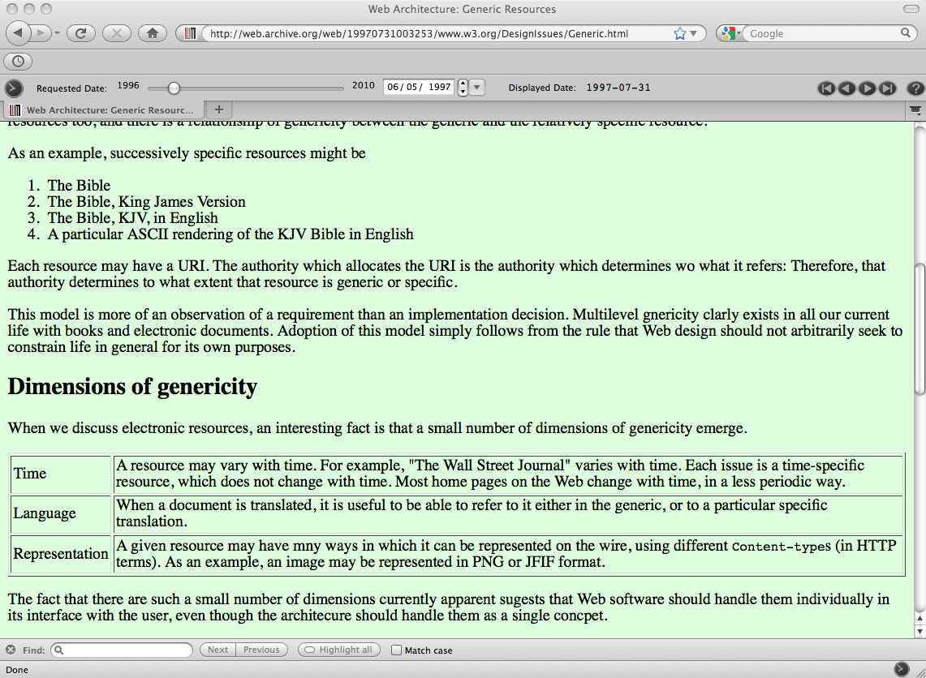
TBL on Generic vs. Specific Resources
http://www.w3.org/DesignIssues/Generic.html

Slide 61
In The Beginning… there was the inode
struct stat {
dev_t st_dev; /* ID of device containing file */
ino_t st_ino; /* inode number */
mode_t st_mode; /* protection */
nlink_t st_nlink; /* number of hard links */
uid_t st_uid; /* user ID of owner */
gid_t st_gid; /* group ID of owner */
dev_t st_rdev; /* device ID (if special file) */
off_t st_size; /* total size, in bytes */
blksize_t st_blksize; /* blocksize for filesystem I/O */
blkcnt_t st_blocks; /* number of blocks allocated */
time_t st_atime; /* time of last access */
time_t st_mtime; /* time of last modification */
time_t st_ctime; /* time of last status change */
};

Slide 62
Limited Time Semantics…
% telnet www.digitalpreservation.gov 80
Trying 140.147.249.7...
Connected to www.digitalpreservation.gov.
Escape character is '^]'.
HEAD /images/ndiipp_header6.jpg HTTP/1.1
Host: www.digitalpreservation.gov
Connection: close
HTTP/1.1 200 OK
Date: Mon, 19 Jul 2010 21:41:04 GMT
Server: Apache
Last-Modified: Thu, 18 Jun 2009 16:25:54 GMT
ETag: "1bc861-10935-dca24880"
Accept-Ranges: bytes
Content-Length: 67893
Connection: close
Content-Type: image/jpeg
Connection closed by foreign host.

Slide 63
Time Semantics Becoming Less,
Not More Available
% telnet www.digitalpreservation.gov 80
Trying 140.147.249.7...
Connected to www.digitalpreservation.gov.
Escape character is '^]'.
HEAD / HTTP/1.1
Host: www.digitalpreservation.gov
Connection: close
HTTP/1.1 200 OK
Date: Mon, 19 Jul 2010 21:36:00 GMT
Server: Apache
Accept-Ranges: bytes
Connection: close
Content-Type: text/html
Connection closed by foreign host.

Slide 64
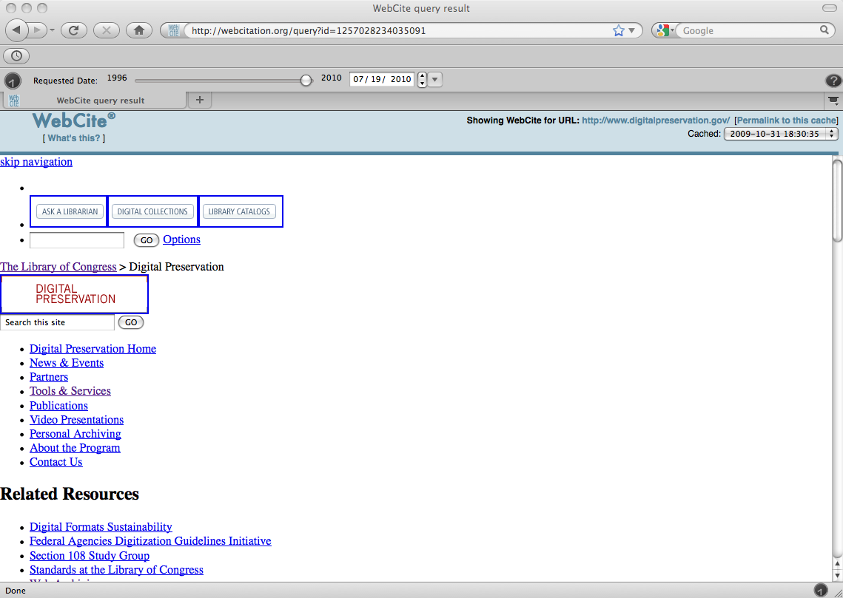
The Past Links to the Present…
explicit HTML link;
no HTTP links;
opaque URI

Slide 65
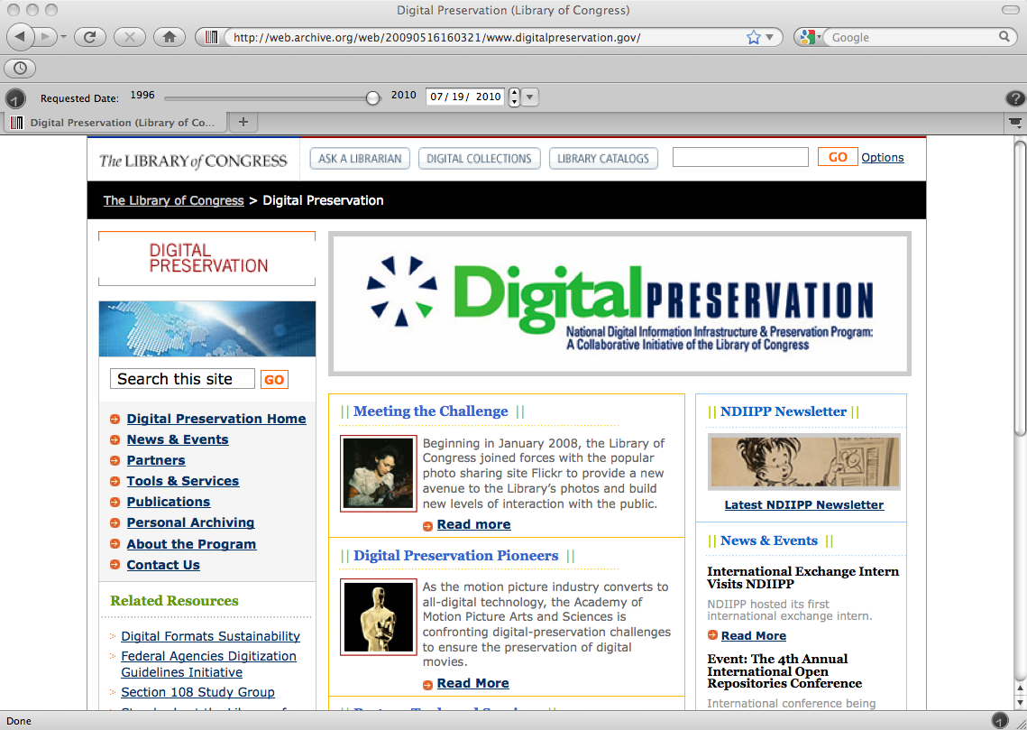
The Past Links to the Present…
no HTML links;
no HTTP links;
implicit from URI

Slide 66
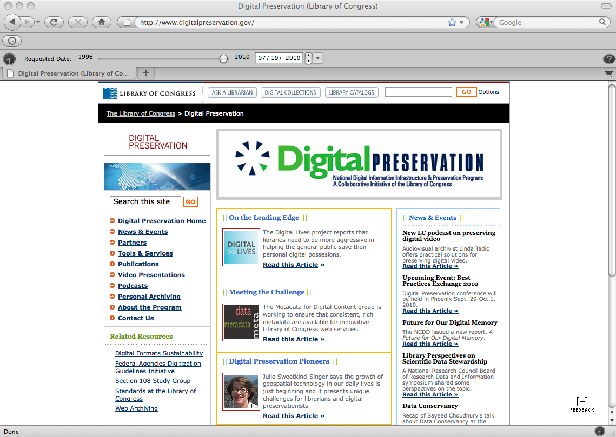
But the Present Does Not Link to the Past
no hints in HTML,
HTTP, or URI
% telnet www.digitalpreservation.gov 80
Trying 140.147.249.7...
Connected to www.digitalpreservation.gov.
Escape character is '^]'.
HEAD / HTTP/1.1
Host: www.digitalpreservation.gov
Connection: close
HTTP/1.1 200 OK
Date: Mon, 19 Jul 2010 21:36:00 GMT
Server: Apache
Accept-Ranges: bytes
Connection: close
Content-Type: text/html
Connection closed by foreign host.

Slide 67
Linking the Past and the Present
Codify existing methods to create linkage from the past to the present
  easy: an archived version knows for which URI it is an archived version
Create a linkage from the present to the past
  hard: solve with a level of indirection from present to past

Slide 68


Normal HTTP Flow
GET R
200 OK

Slide 69
Normal HTTP Flow
GET R
200 OK

Slide 70
The Web without a Time Dimension
70

Slide 71
The Web without a Time Dimension
71

Slide 72
The Web without a Time Dimension
Need to use a different URI to access archived versions of a resource and its current version
72

Slide 73
The Web with Time Dimension added by Memento
In Memento: use URI of the current version to access archived versions, but qualify it with datetime
73

Slide 74
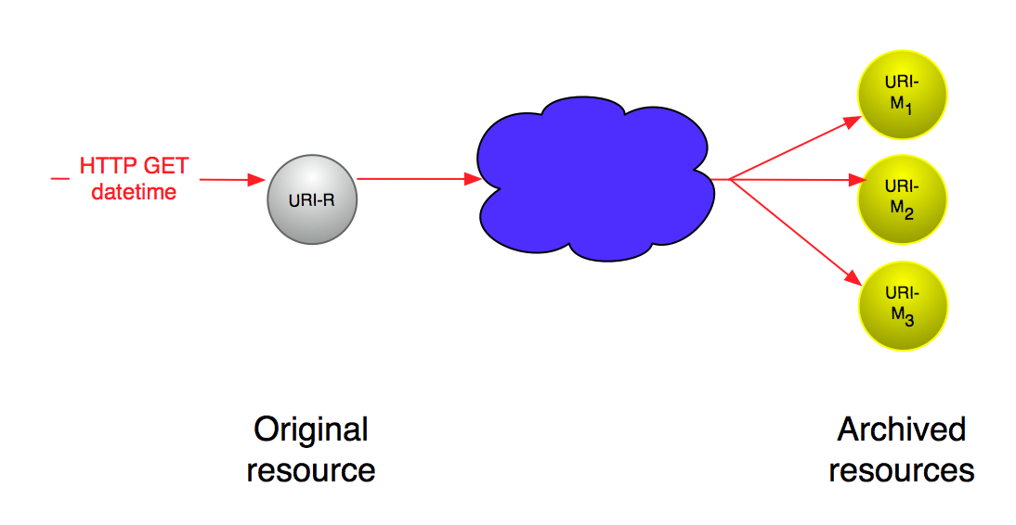
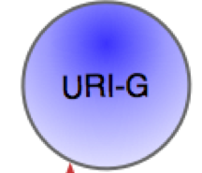
The Web with Time Dimension added by Memento
TimeGate
… and arrive at an archived version via level of indirection
74

Slide 75
Content Negotiation in the datetime dimension
Many systems support content negotiation for media type:
  Your client by default asks for HTML and gets HTML;
  But it could get PDF via the same URI.
Memento proposes a new dimension for content negotiation – time:
  Your client by default asks for the current time, and gets it
  But it could get an older version via the same URI
Can be accomplished with two new HTTP headers:
  Request header: Accept-Datetime
    Conveys datetime of content requested by client
  Response header: Memento-Datetime
    Conveys datetime of content returned by server
75
Notes:
75

Slide 76


Memento HTTP Flow
HEAD R, Accept-Datetime
200, Link➔G
GET G, Accept-Datetime
302➔M, Vary, Link➔R,B,M
GET M, Accept-Datetime
200, Memento-Datetime, Link➔R,B,M
Notes:
76

Slide 77
Memento HTTP Flow
HEAD R, Accept-Datetime
200, Link➔G
GET G, Accept-Datetime
302➔M, Vary, Link➔R,B,M
GET M, Accept-Datetime
200, Memento-Datetime, Link➔R,B,M
Notes:
77

Slide 78
Memento HTTP Flow
HEAD R, Accept-Datetime
200, Link➔G
GET G, Accept-Datetime
302➔M, Vary, Link➔R,B,M
GET M, Accept-Datetime
200, Memento-Datetime, Link➔R,B,M
Notes:
78

Slide 79
Memento HTTP Flow
HEAD R, Accept-Datetime
200, Link➔G
GET G, Accept-Datetime
302➔M, Vary, Link➔R,B,M
GET M, Accept-Datetime
200, Memento-Datetime, Link➔R,B,M
Notes:
79

Slide 80
Memento HTTP Flow
HEAD R, Accept-Datetime
200, Link➔G
GET G, Accept-Datetime
302➔M, Vary, Link➔R,B,M
GET M, Accept-Datetime
200, Memento-Datetime, Link➔R,B,M
Notes:
80

Slide 81
Memento HTTP Flow
HEAD R, Accept-Datetime
200, Link➔G
GET G, Accept-Datetime
302➔M, Vary, Link➔R,B,M
GET M, Accept-Datetime
200, Memento-Datetime, Link➔R,B,M
Notes:
81

Slide 82
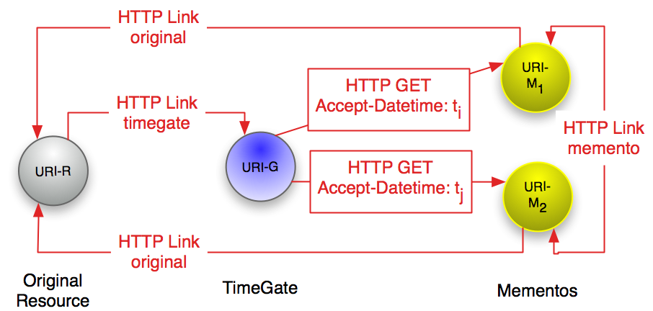
The Memento Framework
http://timetravel.mementoweb.org/
https://tools.ietf.org/html/rfc7089

Slide 83
Hints from the live web server
HEAD /demo-special/index.php/Daenerys_Targaryen HTTP/1.1
User-Agent: curl/7.19.7 (x86_64-redhat-linux-gnu) libcurl/7.19.7 NSS/3.14.3.0 zlib/1.2.3 libidn/1.18 libssh2/1.4.2
Host: localhost:8080
Accept: */*
Accept-Datetime: Thu, 01 Jan 2012 00:00:00 GMT
HTTP/1.1 200 OK
Date: Mon, 14 Apr 2014 22:35:17 GMT
Server: Apache/2.2.15 (Red Hat)
X-Powered-By: PHP/5.3.3
X-Content-Type-Options: nosniff
Link: <http://ws-dl-10.cs.odu.edu/demo-special/index.php/Daenerys_Targaryen>; rel="original latest-version",
<http://ws-dl-10.cs.odu.edu/demo-special/index.php/Special:TimeGate/Daenerys_Targaryen>; rel="timegate",
<http://ws-dl-10.cs.odu.edu/demo-special/index.php/Special:TimeMap/Daenerys_Targaryen>; rel="timemap";
type="application/link-format"
Content-language: en
Vary: Accept-Encoding,Accept-Datetime,Cookie
Cache-Control: s-maxage=18000, must-revalidate, max-age=0
Last-Modified: Tue, 08 Apr 2014 00:20:01 GMT
Connection: close
Content-Type: text/html; charset=UTF-8
http://ws-dl.blogspot.com/2014/04/2014-04-18-timegate-design-options-for.html

Slide 84
Aggregator TimeMap
$ curl -i http://memgator.cs.odu.edu/timemap/link/http://www.cs.odu.edu/~mln/
HTTP/1.1 200 OK
Server: nginx/1.11.3
Date: Thu, 02 Feb 2017 05:45:05 GMT
Content-Type: application/link-format
Transfer-Encoding: chunked
Connection: keep-alive
Access-Control-Allow-Origin: *
Access-Control-Expose-Headers: Link, Location, X-Memento-Count, X-Generator
X-Generator: MemGator:1.0-rc7
X-Memento-Count: 338
<http://www.cs.odu.edu/~mln/>; rel="original",
<http://memgator.cs.odu.edu/timemap/link/http://www.cs.odu.edu/~mln/>; rel="self";
type="application/link-format",
<http://web.archive.org/web/20020526053005/http://www.cs.odu.edu/~mln/>; rel="first memento";
datetime="Sun, 26 May 2002 05:30:05 GMT",
<http://web.archive.org/web/20020528083321/http://www.cs.odu.edu/~mln/>; rel="memento";
datetime="Tue, 28 May 2002 08:33:21 GMT",
<http://web.archive.org/web/20020720051448/http://www.cs.odu.edu/~mln>; rel="memento";
datetime="Sat, 20 Jul 2002 05:14:48 GMT",
<http://web.archive.org/web/20020724230216/http://www.cs.odu.edu/~mln/>; rel="memento";
datetime="Wed, 24 Jul 2002 23:02:16 GMT",
<http://web.archive.org/web/20020811035033/http://www.cs.odu.edu/~mln>; rel="memento";
datetime="Sun, 11 Aug 2002 03:50:33 GMT",
[deletia]
https://github.com/oduwsdl/memgator

Slide 85
More Than Just IA!
$ curl -i http://memgator.cs.odu.edu/timemap/link/http://www.cs.odu.edu/~mln/ | grep -v web.archive.org
Server: nginx/1.11.3
Date: Thu, 02 Feb 2017 05:46:35 GMT
Content-Type: application/link-format
Transfer-Encoding: chunked
Connection: keep-alive
Access-Control-Allow-Origin: *
Access-Control-Expose-Headers: Link, Location, X-Memento-Count, X-Generator
X-Generator: MemGator:1.0-rc7
X-Memento-Count: 338
<http://www.cs.odu.edu/~mln/>; rel="original",
<http://memgator.cs.odu.edu/timemap/link/http://www.cs.odu.edu/~mln/>; rel="self"; type="application/link-format",
<http://archive.is/20130618185742/http://www.cs.odu.edu/~mln/>; rel="memento"; datetime="Tue, 18 Jun 2013 18:57:42 GMT",
<http://archive.is/20130621194047/http://www.cs.odu.edu/~mln/>; rel="memento"; datetime="Fri, 21 Jun 2013 19:40:47 GMT",
<http://archive.is/20130723172543/http://www.cs.odu.edu/~mln/>; rel="memento"; datetime="Tue, 23 Jul 2013 17:25:43 GMT",
<http://archive.is/20130723173951/http://www.cs.odu.edu/~mln/>; rel="memento"; datetime="Tue, 23 Jul 2013 17:39:51 GMT",
<http://archive.is/20130728010336/http://www.cs.odu.edu/~mln/>; rel="memento"; datetime="Sun, 28 Jul 2013 01:03:36 GMT",
<http://archive.is/20131217200455/http://www.cs.odu.edu/~mln/>; rel="memento"; datetime="Tue, 17 Dec 2013 20:04:55 GMT",
<http://archive.is/20141015185128/http://www.cs.odu.edu/~mln/>; rel="memento"; datetime="Wed, 15 Oct 2014 18:51:28 GMT",
<http://archive.is/20141020194524/http://www.cs.odu.edu/~mln/>; rel="memento"; datetime="Mon, 20 Oct 2014 19:45:24 GMT",
<http://archive.is/20141112185338/http://www.cs.odu.edu/~mln/>; rel="memento"; datetime="Wed, 12 Nov 2014 18:53:38 GMT",
<http://archive.is/20141120172147/http://www.cs.odu.edu/~mln/>; rel="memento"; datetime="Thu, 20 Nov 2014 17:21:47 GMT",
<http://archive.is/20141207184200/http://www.cs.odu.edu/~mln/>; rel="memento"; datetime="Sun, 07 Dec 2014 18:42:00 GMT",
<http://archive.is/20141207184737/http://www.cs.odu.edu/~mln/>; rel="memento"; datetime="Sun, 07 Dec 2014 18:47:37 GMT",
<http://archive.is/20150205233109/http://www.cs.odu.edu/~mln/>; rel="memento"; datetime="Thu, 05 Feb 2015 23:31:09 GMT",
<http://archive.is/20150514160142/http://www.cs.odu.edu/~mln/>; rel="memento"; datetime="Thu, 14 May 2015 16:01:42 GMT",
<http://archive.is/20150519034827/http://www.cs.odu.edu/~mln/>; rel="memento"; datetime="Tue, 19 May 2015 03:48:27 GMT",
<http://archive.is/20150519041853/http://www.cs.odu.edu/~mln/>; rel="memento"; datetime="Tue, 19 May 2015 04:18:53 GMT",
<http://archive.is/20150707000027/http://www.cs.odu.edu/~mln/>; rel="memento"; datetime="Tue, 07 Jul 2015 00:00:27 GMT",
<http://wayback.archive-it.org/all/20150921151807/http://www.cs.odu.edu/%7Emln/>; rel="memento";
datetime="Mon, 21 Sep 2015 15:18:07 GMT",
<http://wayback.archive-it.org/all/20150921164637/http://www.cs.odu.edu/~mln/>; rel="memento";
datetime="Mon, 21 Sep 2015 16:46:37 GMT",
[deletia]

Slide 86
Aggregator TimeGate
$ curl -I -H "Accept-datetime: Mon, 22 Jul 2013 00:00:00 GMT" \
http://memgator.cs.odu.edu/timegate/http://www.cs.odu.edu/~mln/
HTTP/1.1 302 Found
Server: nginx/1.11.3
Date: Thu, 02 Feb 2017 05:49:13 GMT
Content-Type: text/plain; charset=utf-8
Connection: keep-alive
Access-Control-Allow-Origin: *
Access-Control-Expose-Headers: Link, Location, X-Memento-Count, X-Generator
Link: <http://www.cs.odu.edu/~mln/>; rel="original",
<http://web.archive.org/web/20020526053005/http://www.cs.odu.edu/~mln/>;
rel="first memento"; datetime="Sun, 26 May 2002 05:30:05 GMT",
<http://web.archive.org/web/20130702115017/http://www.cs.odu.edu/~mln/>;
rel="prev memento"; datetime="Tue, 02 Jul 2013 11:50:17 GMT",
<http://archive.is/20130723172543/http://www.cs.odu.edu/~mln/>; rel="memento";
datetime="Tue, 23 Jul 2013 17:25:43 GMT",
<http://web.archive.org/web/20130730042519/http://www.cs.odu.edu/~mln/>;
rel="next memento"; datetime="Tue, 30 Jul 2013 04:25:19 GMT",
<http://archive.is/20170202053722/http://www.cs.odu.edu/~mln/>; rel="last memento";
datetime="Thu, 02 Feb 2017 05:37:22 GMT",
<http://memgator.cs.odu.edu/timemap/link/http://www.cs.odu.edu/~mln/>; rel="timemap";
type="application/link-format",
<http://memgator.cs.odu.edu/timemap/json/http://www.cs.odu.edu/~mln/>;
rel="timemap"; type="application/json",
<http://memgator.cs.odu.edu/timemap/cdxj/http://www.cs.odu.edu/~mln/>;
rel="timemap"; type="application/cdxj+ors",
<http://memgator.cs.odu.edu/timegate/http://www.cs.odu.edu/~mln/>; rel="timegate"
Location: http://archive.is/20130723172543/http://www.cs.odu.edu/~mln/
Vary: accept-datetime
X-Generator: MemGator:1.0-rc7

Slide 87
Reminder that 302s can have entities…
$ curl -H "Accept-datetime: Mon, 22 Jul 2013 00:00:00 GMT" \
http://memgator.cs.odu.edu/timegate/http://www.cs.odu.edu/~mln/
<a href="http://archive.is/20130723172543/http://www.cs.odu.edu/~mln/">Found</a>.
$ curl -i -H "Accept-datetime: Mon, 22 Jul 2013 00:00:00 GMT" \
http://memgator.cs.odu.edu/timegate/http://www.cs.odu.edu/~mln/
HTTP/1.1 302 Found
Server: nginx/1.11.3
Date: Thu, 02 Feb 2017 05:54:20 GMT
Content-Type: text/html; charset=utf-8
Content-Length: 83
Connection: keep-alive
[deletia – all headers + entity]

Slide 88
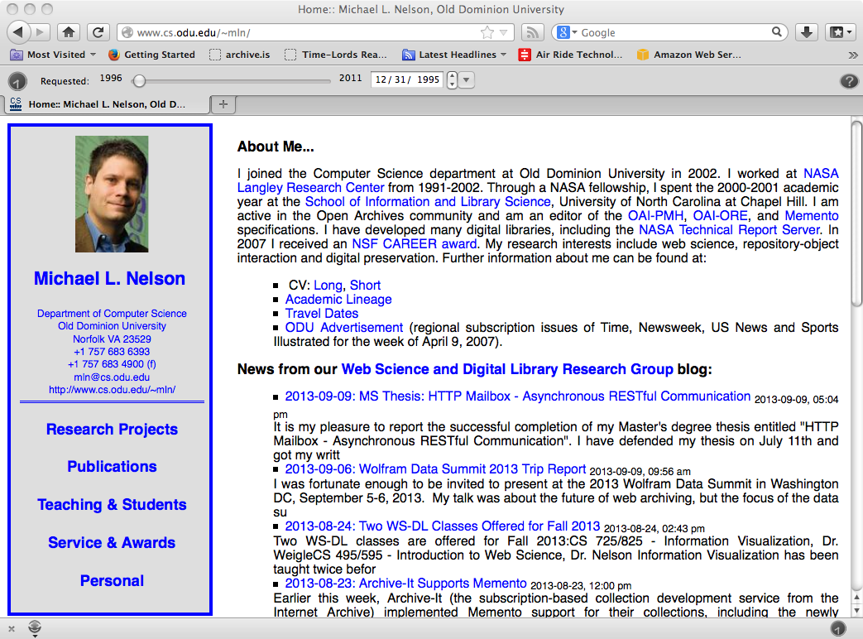
MementoFox: https://addons.mozilla.org/en-us/firefox/addon/mementofox/ (now deprecated)

Slide 89
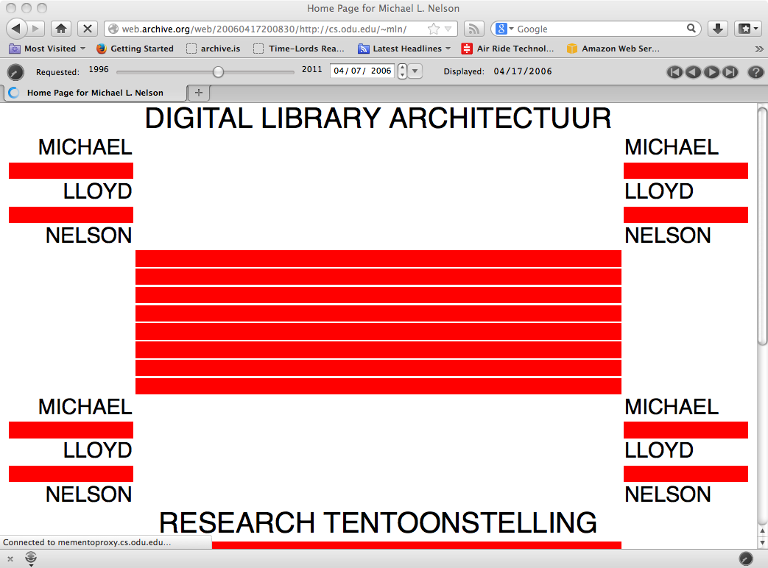
art history http://artsalesindex.artinfo.com/asi/lots/5074380

Slide 90
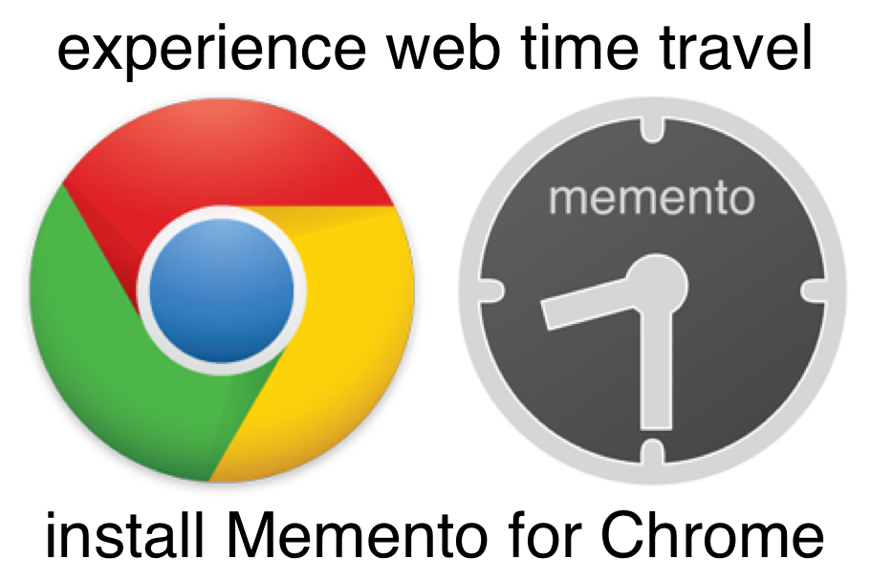
Time Travel with Memento for Chrome
http://ws-dl.blogspot.com/2013/10/2013-10-14-right-click-to-past-memento.html

Slide 91

Time Travel with Mink
http://matkelly.com/mink/

Slide 92
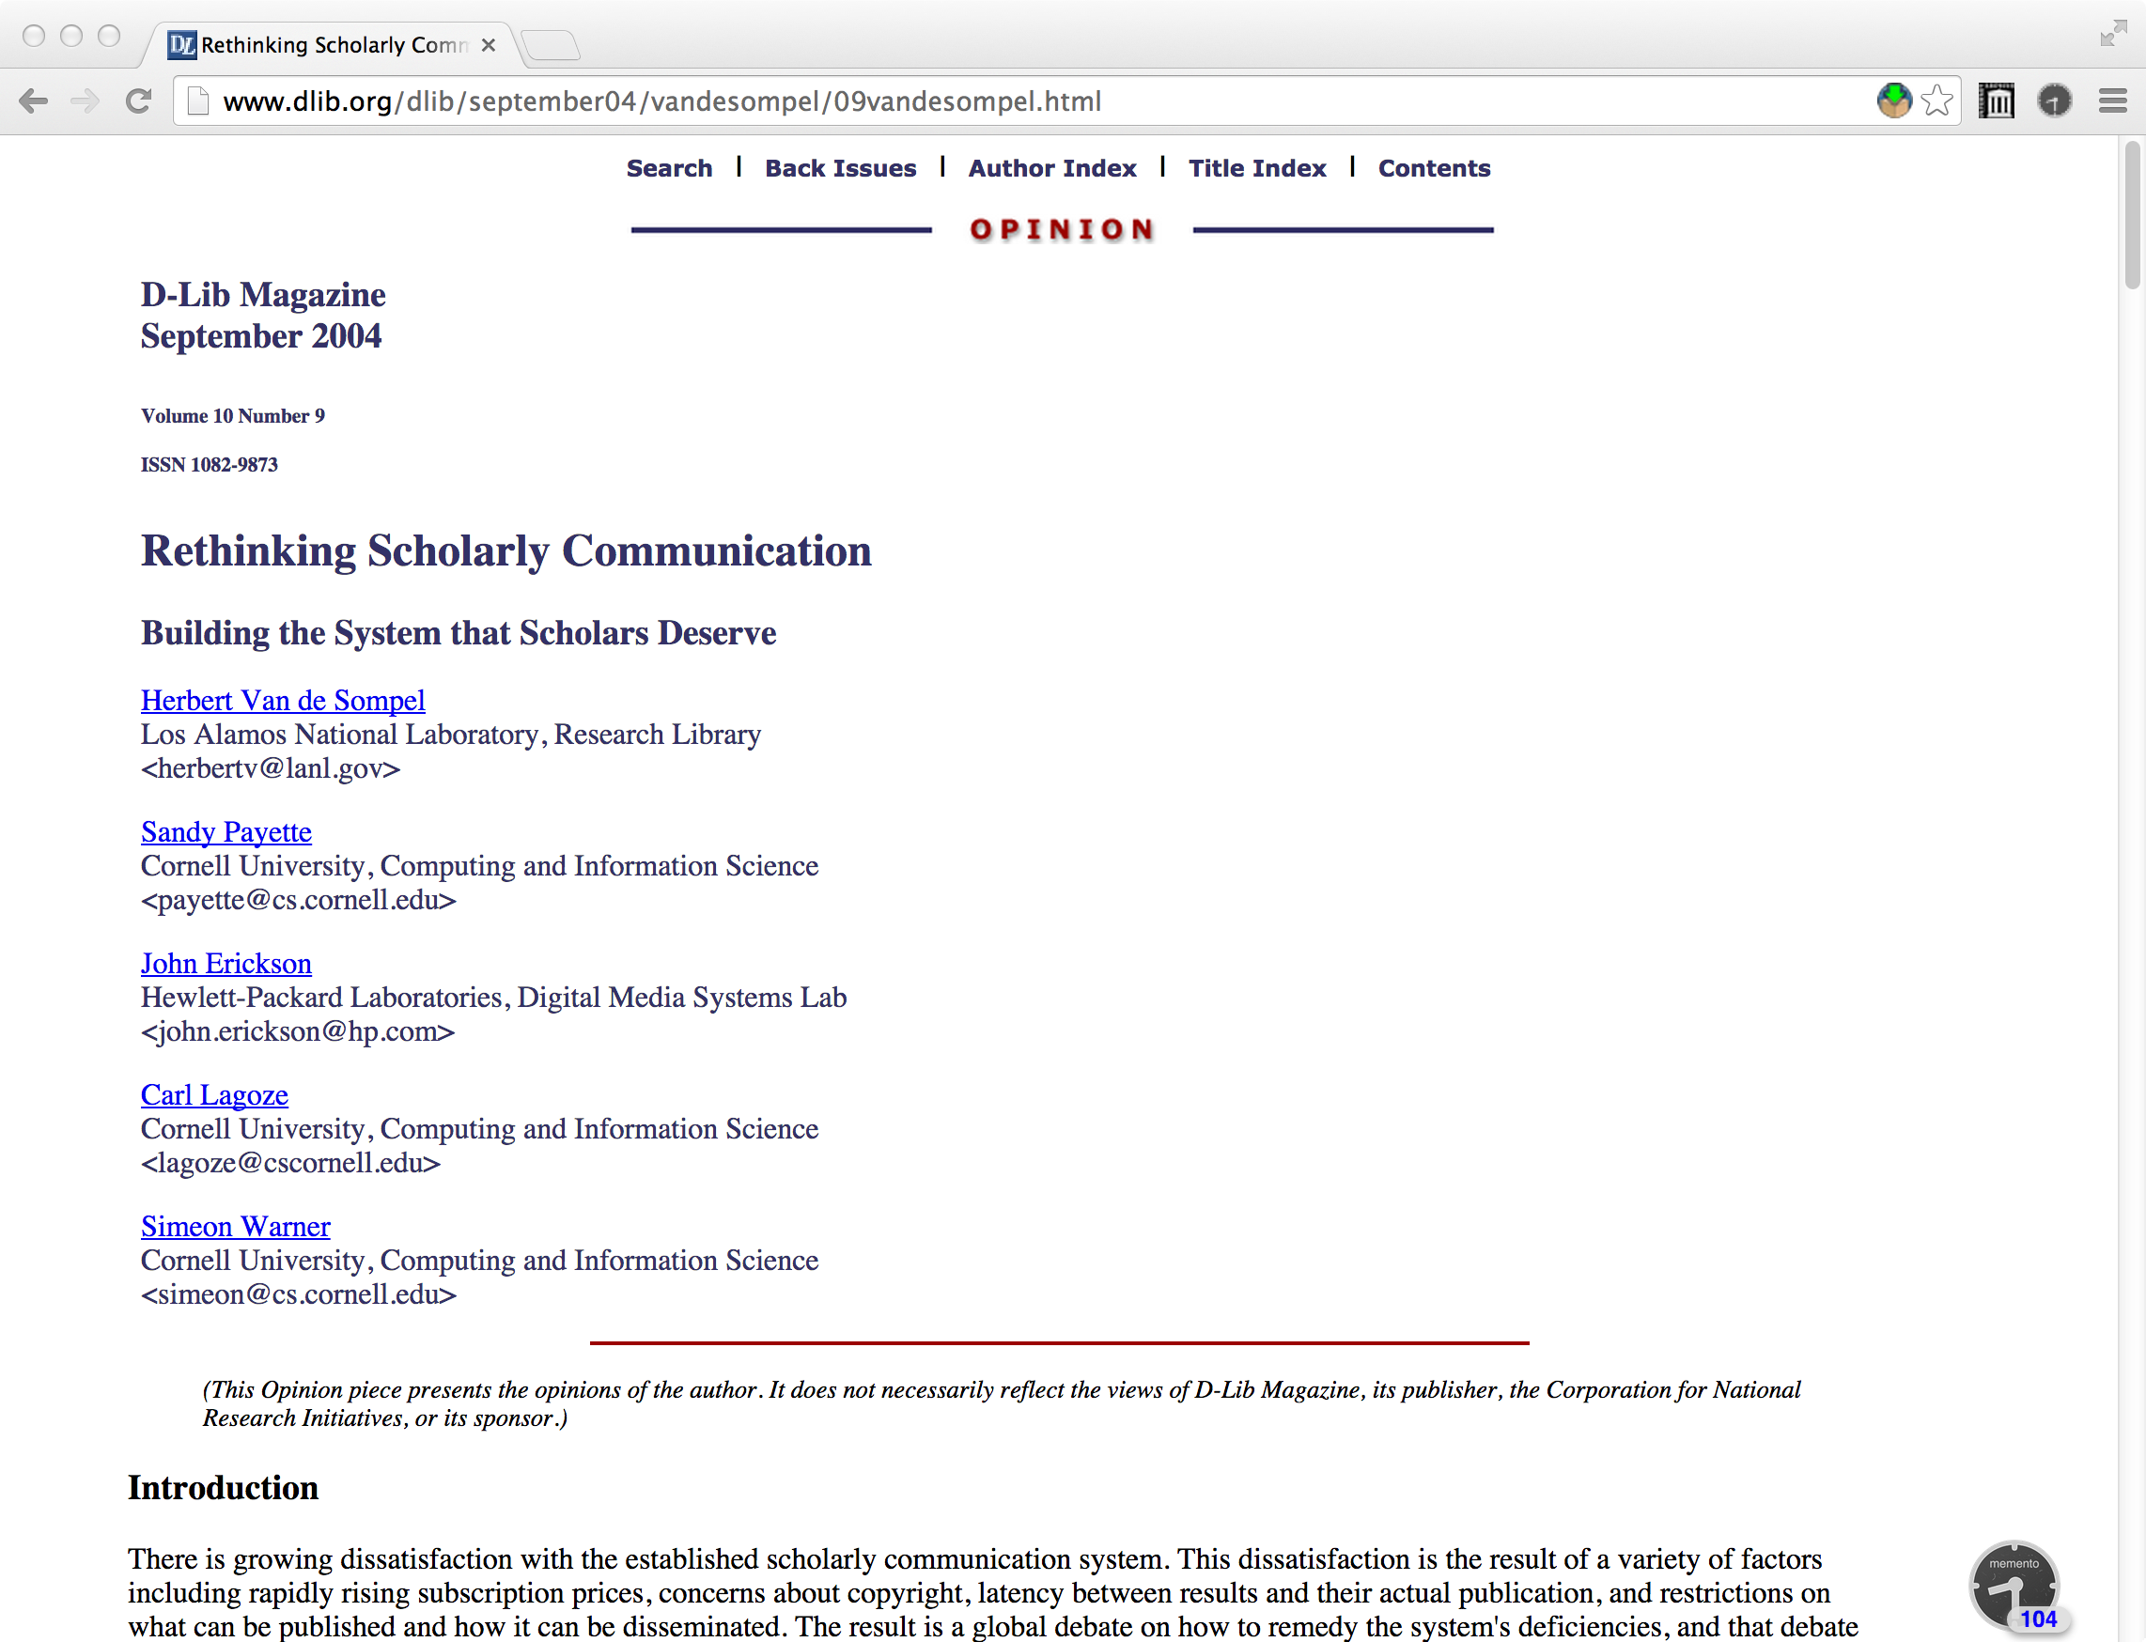
Time Travel: Read Like It's 2004
http://www.dlib.org/dlib/september04/vandesompel/09vandesompel.html

Slide 93
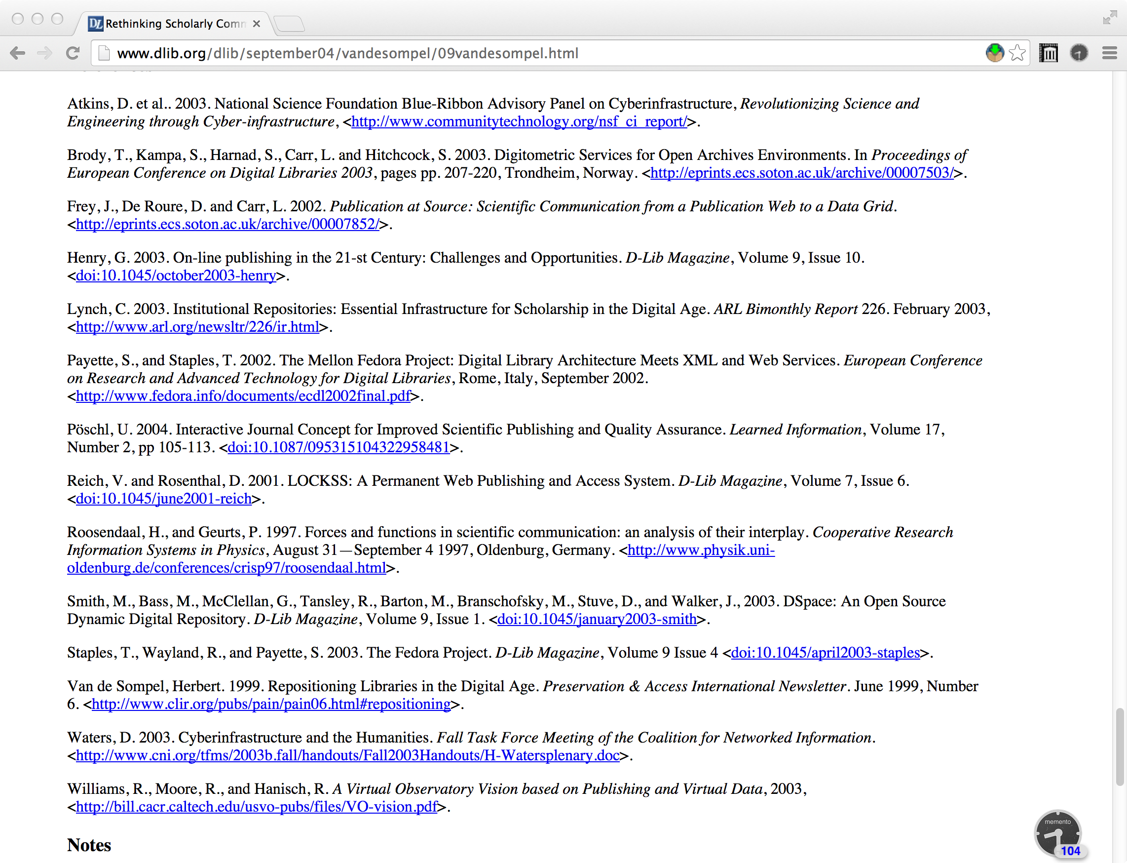
Time Travel: Scroll To The Bottom, First Reference

Slide 94
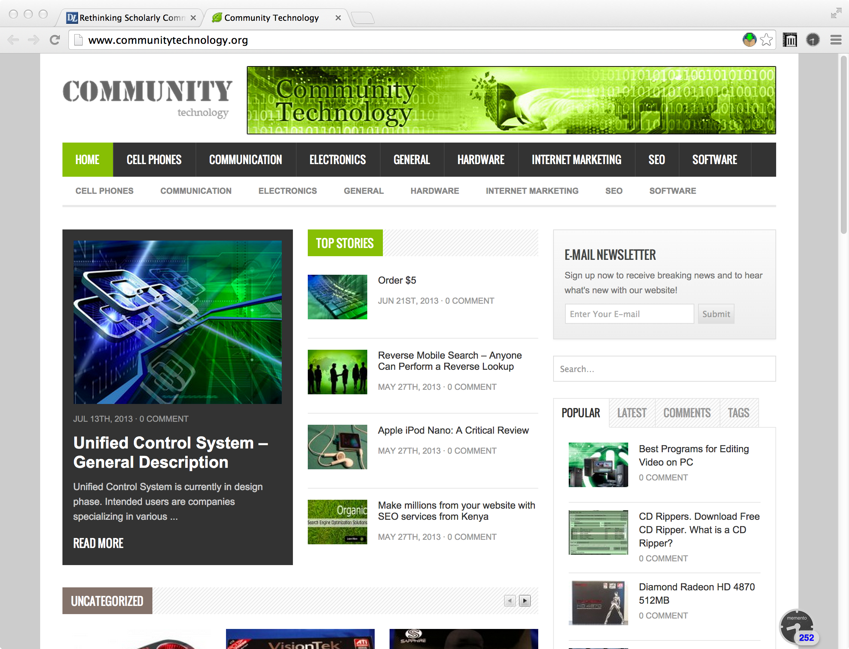
Time Travel: Link In 2014 Redirects To Main Site

Slide 95
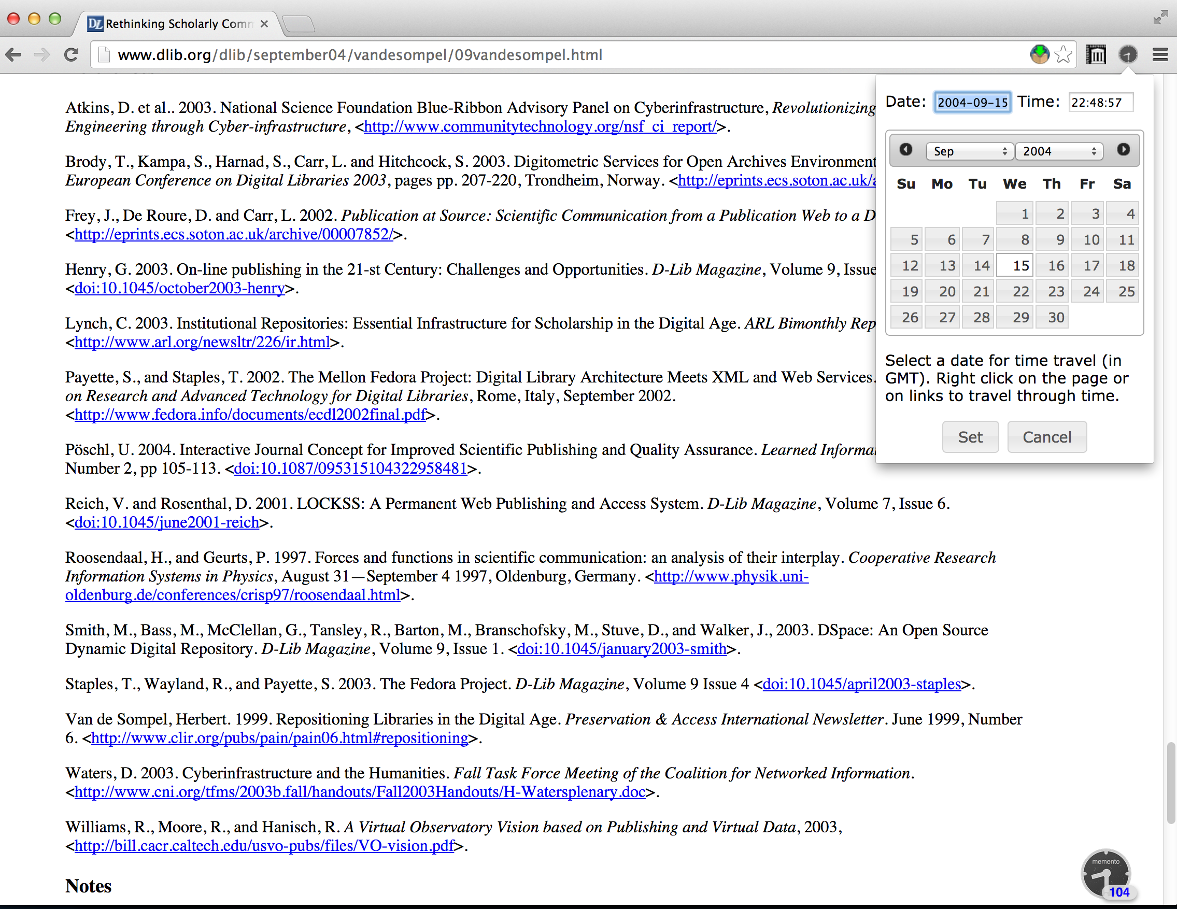
Time Travel: Set For September 15, 2004

Slide 96
Time Travel: Right Click On The Link

Slide 97
Time Travel: The Report @ 2004-10-12

Slide 98
Time Travel: Second Reference

Slide 99
Time Travel: Second Reference In 2014

Slide 100
Time Travel: Right Click On The Link

Slide 101
Time Travel: Page @ 2004-12-11

Slide 102
Time Travel: Fifth Reference

Slide 103
Time Travel: Current Page Is 404

Slide 104
Time Travel: Right Link On The Link

Slide 105
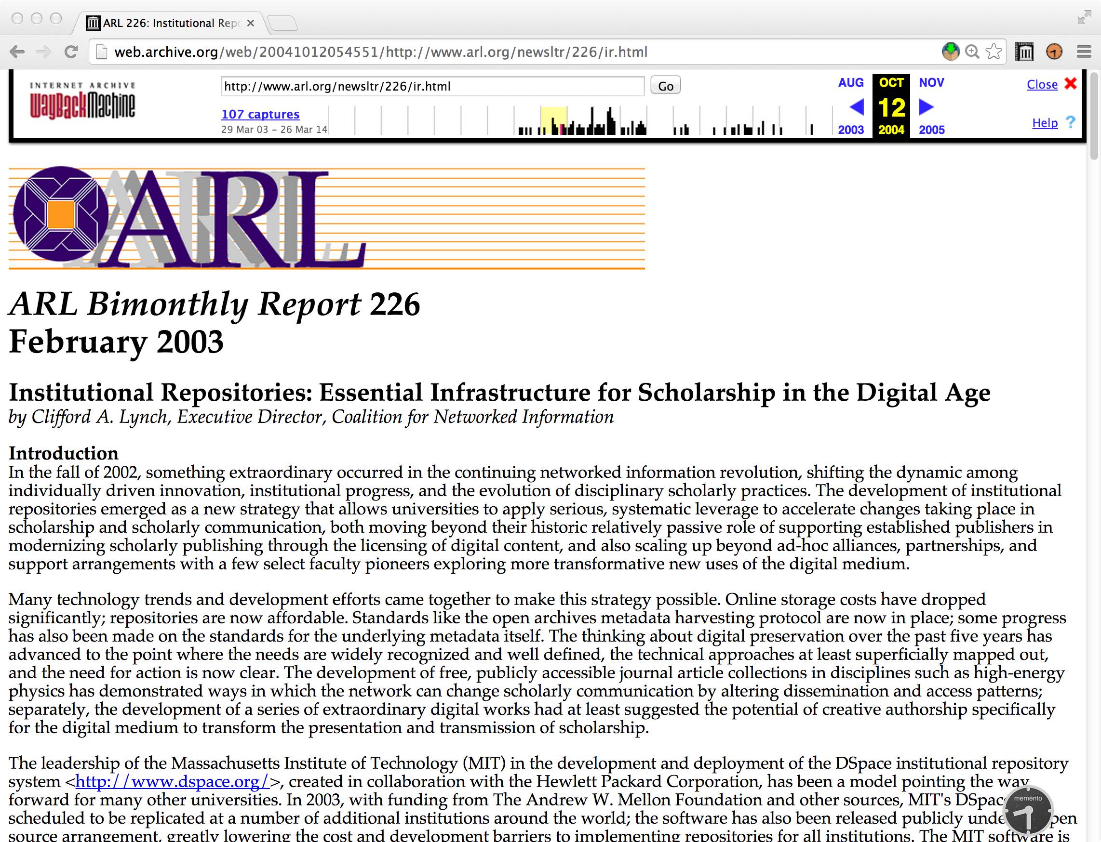
Time Travel: Page As Of 2004-10-12

Slide 106
A More Fun Example…

Slide 107
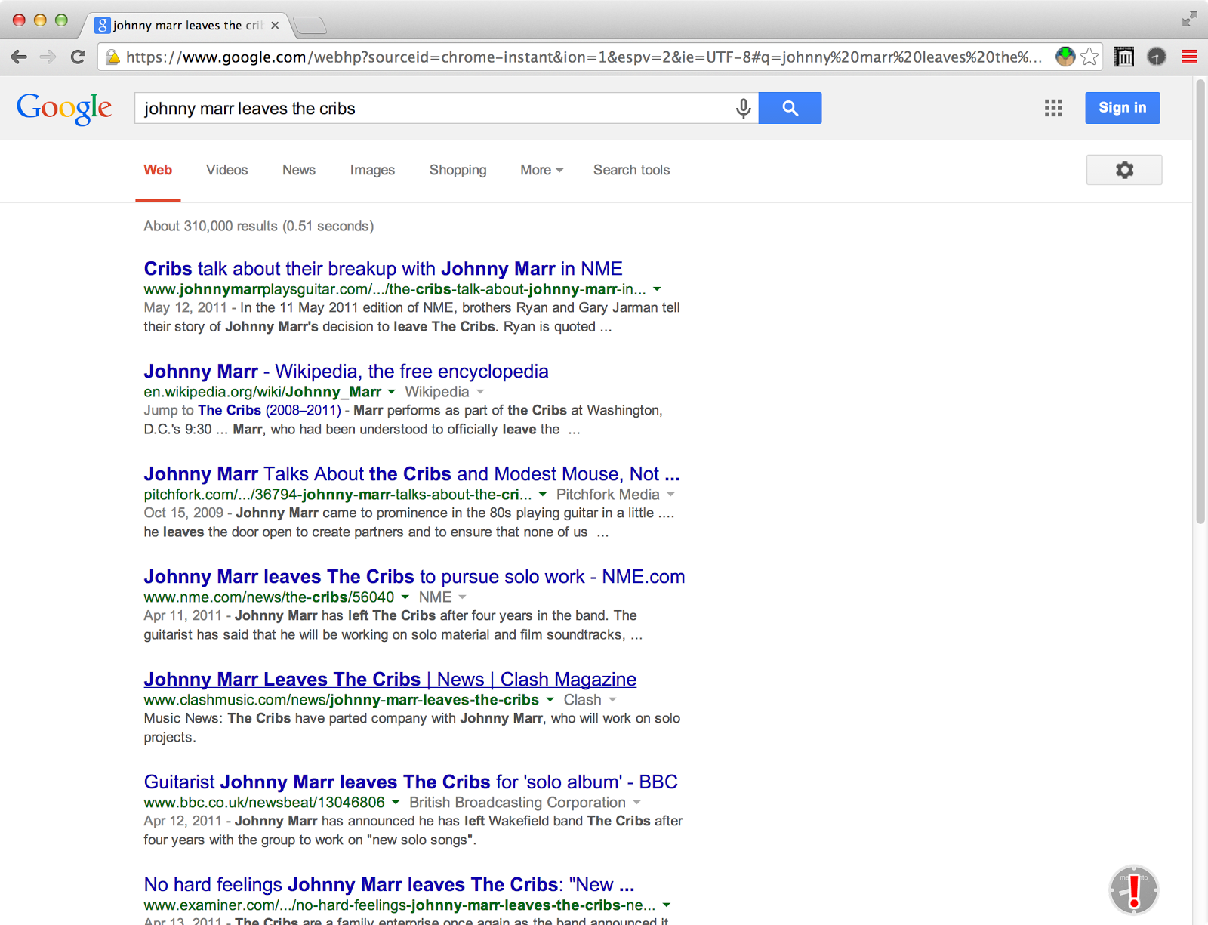
Fixing 404 Pages: Google Results Page

Slide 108
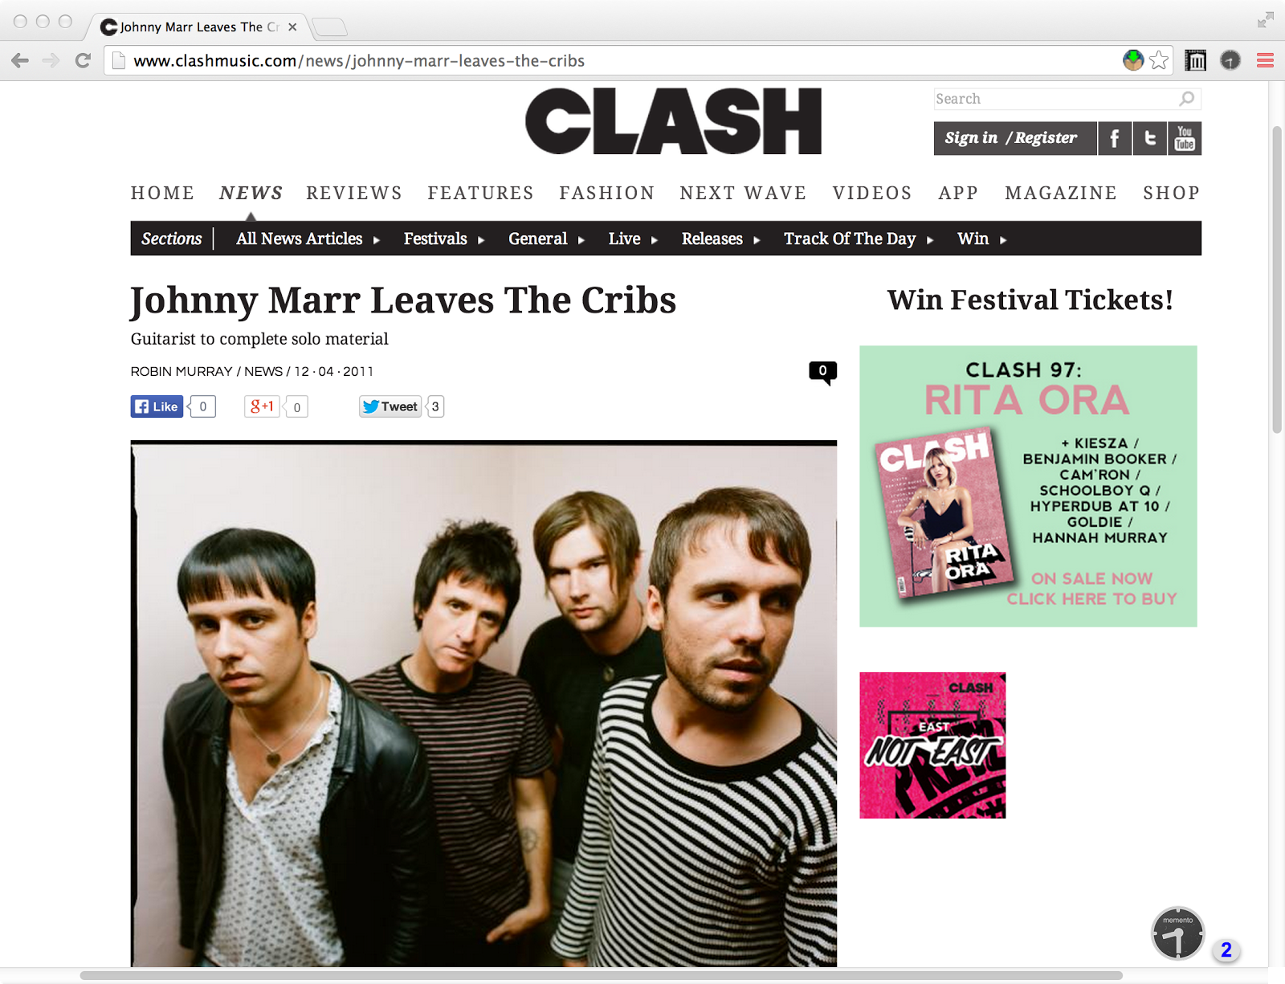
Fixing 404 Pages: Result Page
http://www.clashmusic.com/news/johnny-marr-leaves-the-cribs

Slide 109
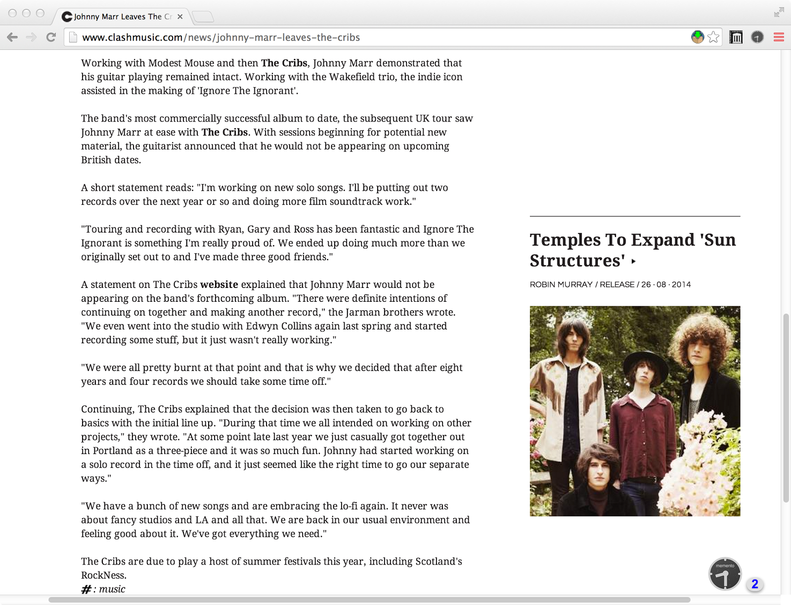
Fixing 404 Pages: Scrolling Down

Slide 110
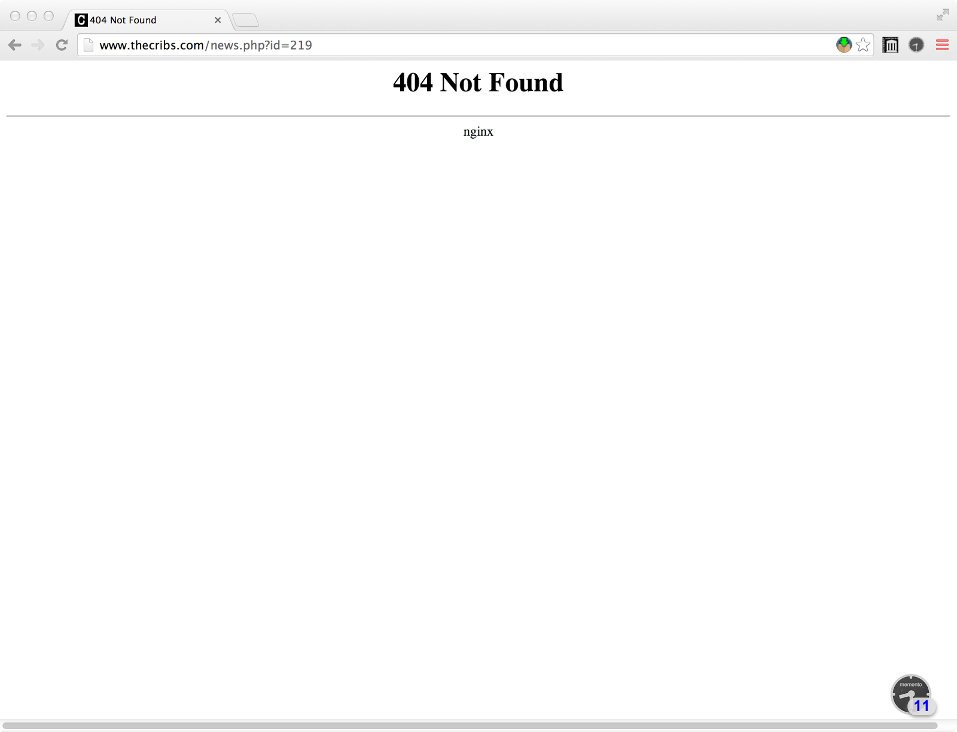
Fixing 404 Pages: Server Up, Page 404

Slide 111
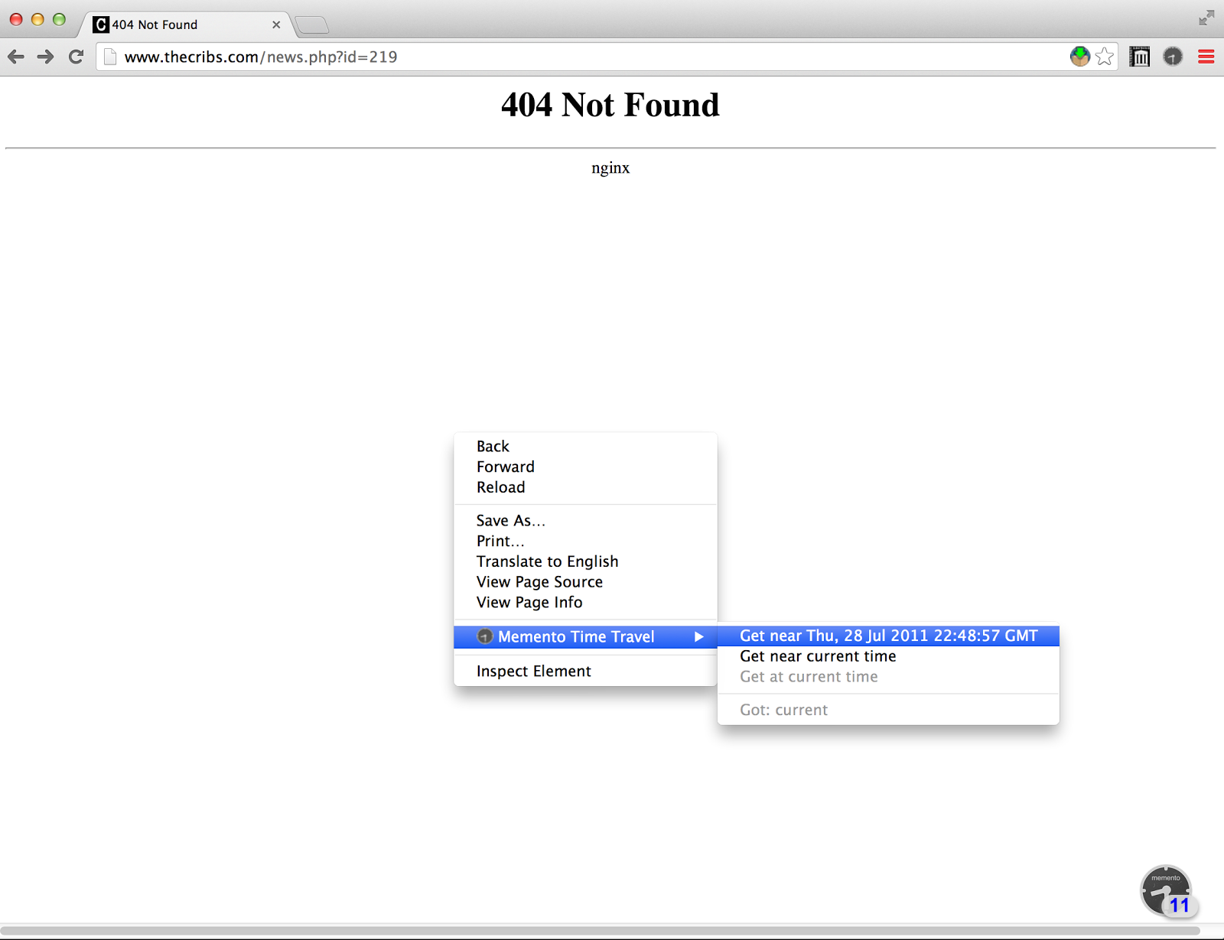
Fixing 404 Pages: Using Memento For Chrome

Slide 112
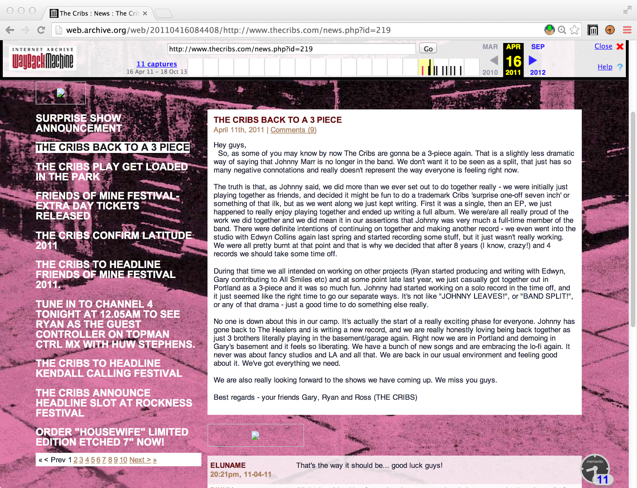
Fixing 404 Pages: Archived Page 2011-04-16

Slide 113
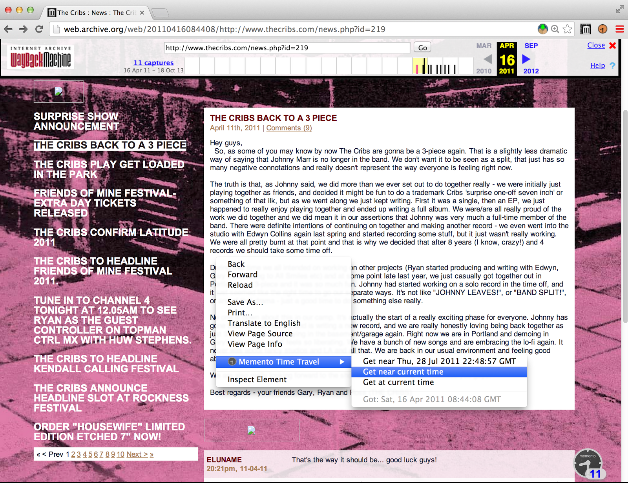
Fixing 404 Pages: Get Most Recent Archived Version

Slide 114
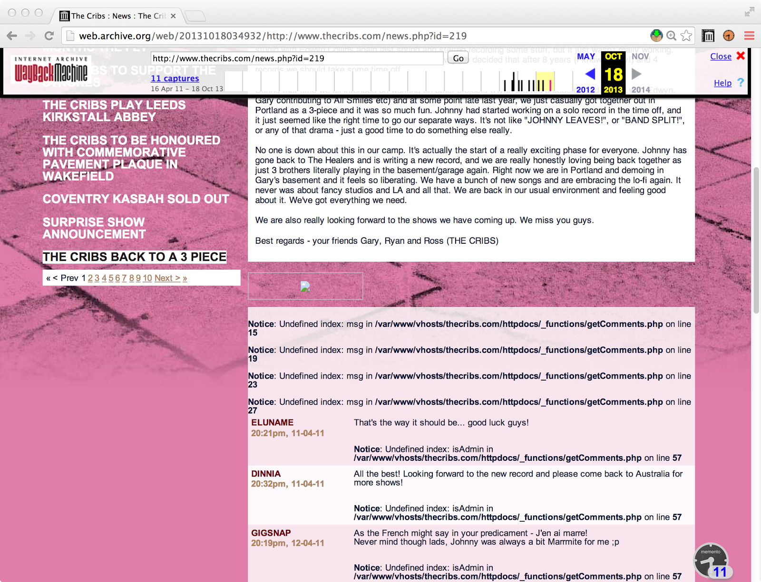
Fixing 404 Pages: 2013-10-18 Version (404 Imminent)

Slide 115
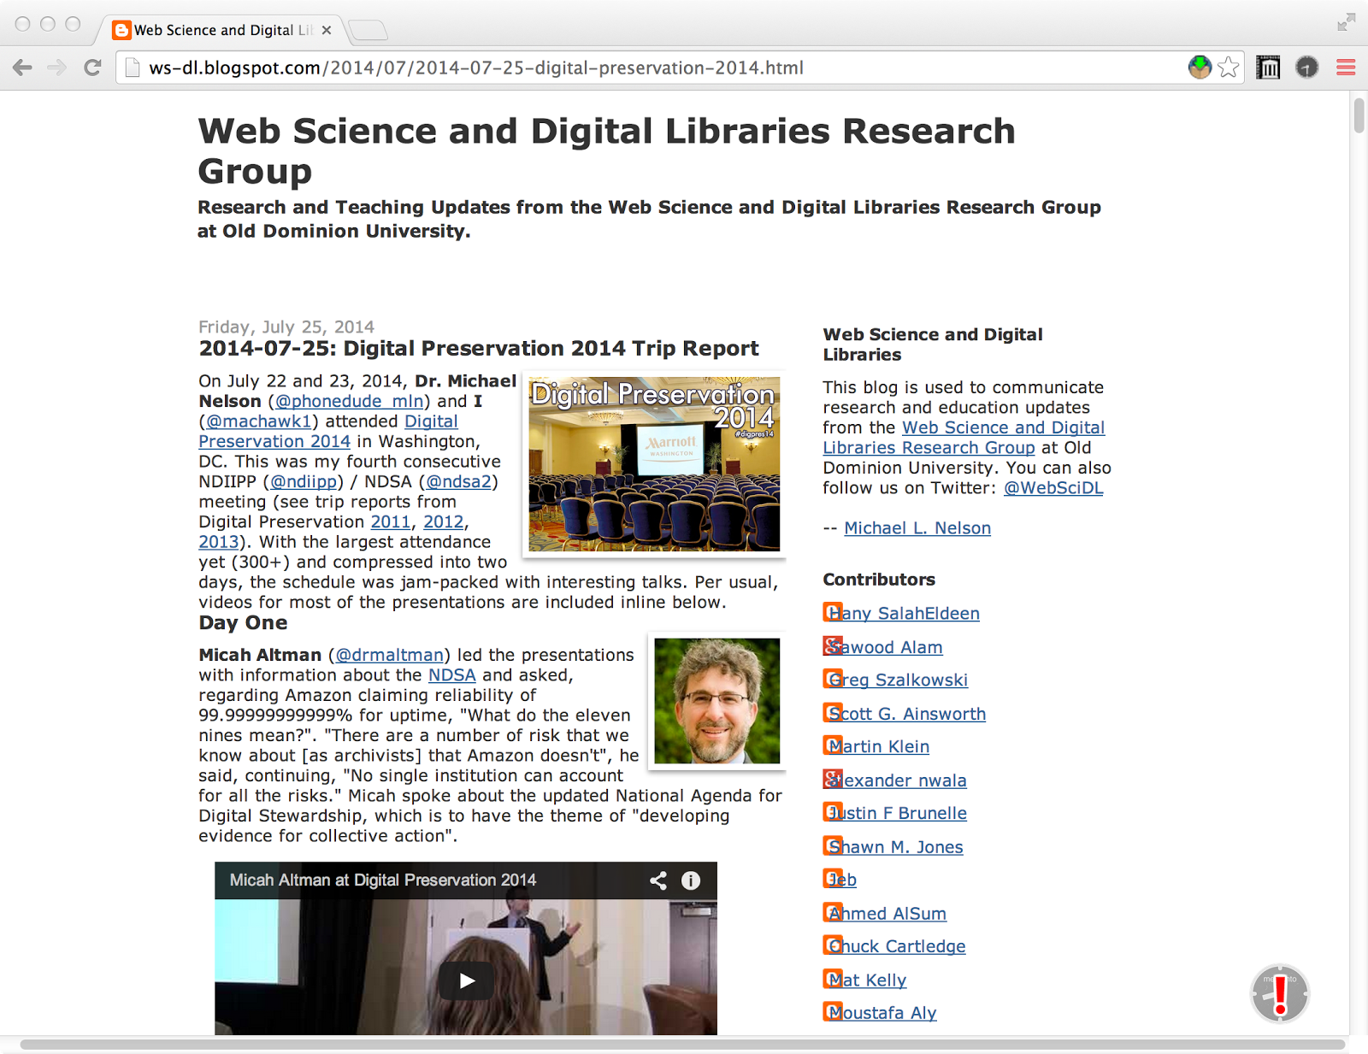
Proactive Archiving: Page Not Archived
http://ws-dl.blogspot.com/2014/07/2014-07-25-digital-preservation-2014.html

Slide 116
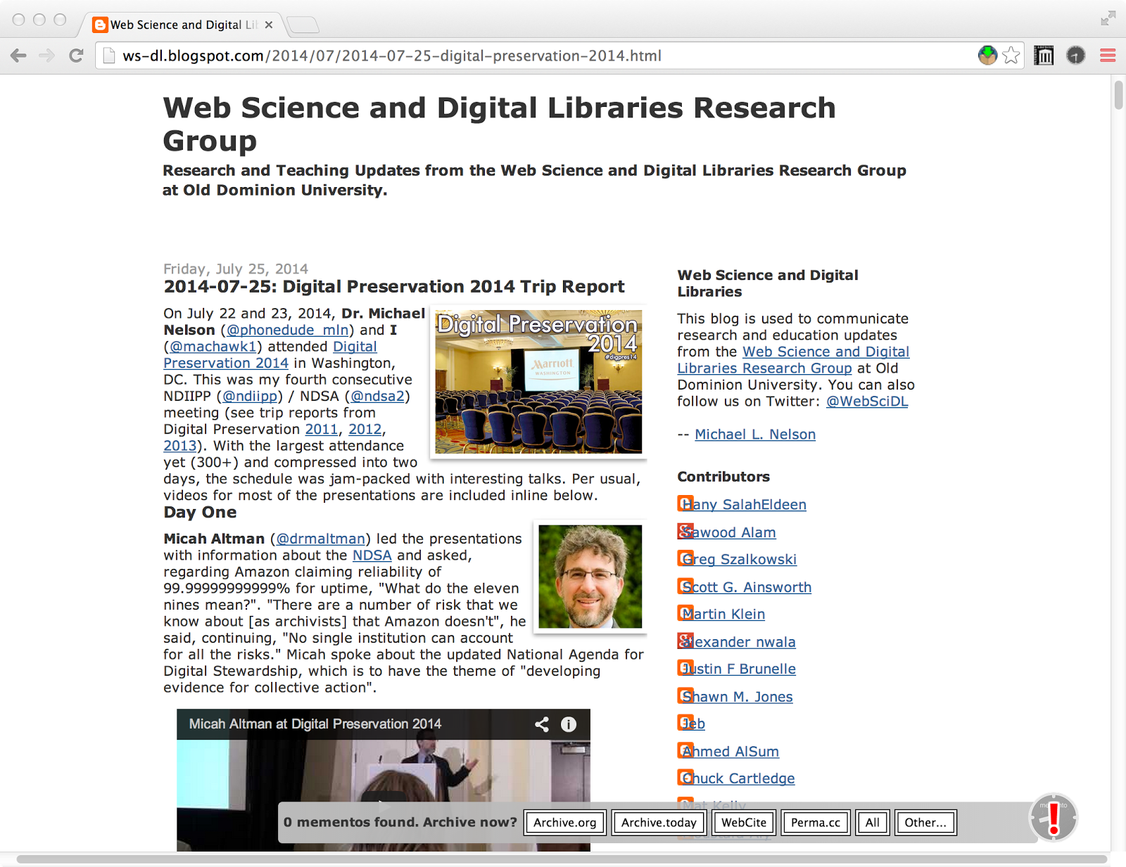
Proactive Archiving: "Archive Now?" Bar

Slide 117
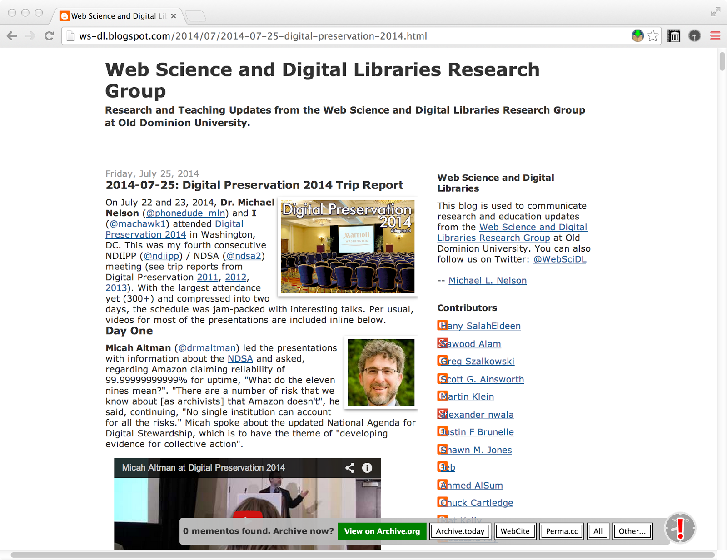
Proactive Archiving: Submit to Archive.org

Slide 118
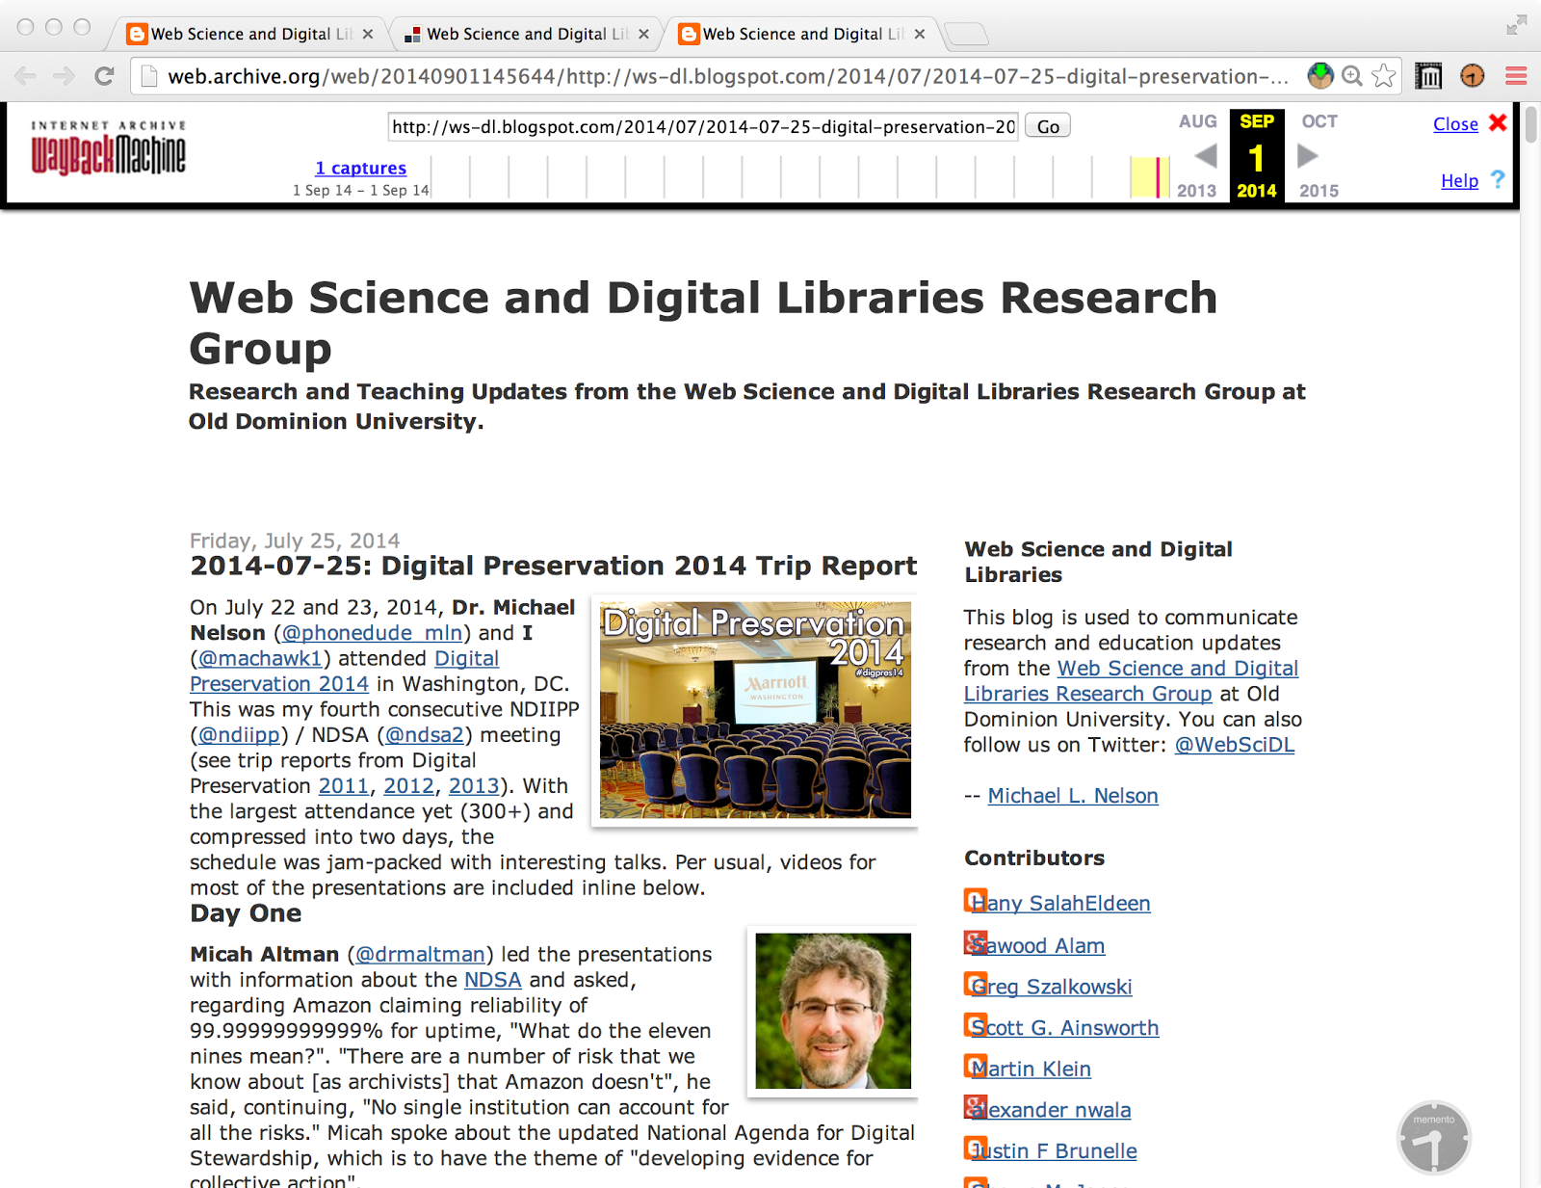
Proactive Archiving: Archived @ Archive.org

Slide 119
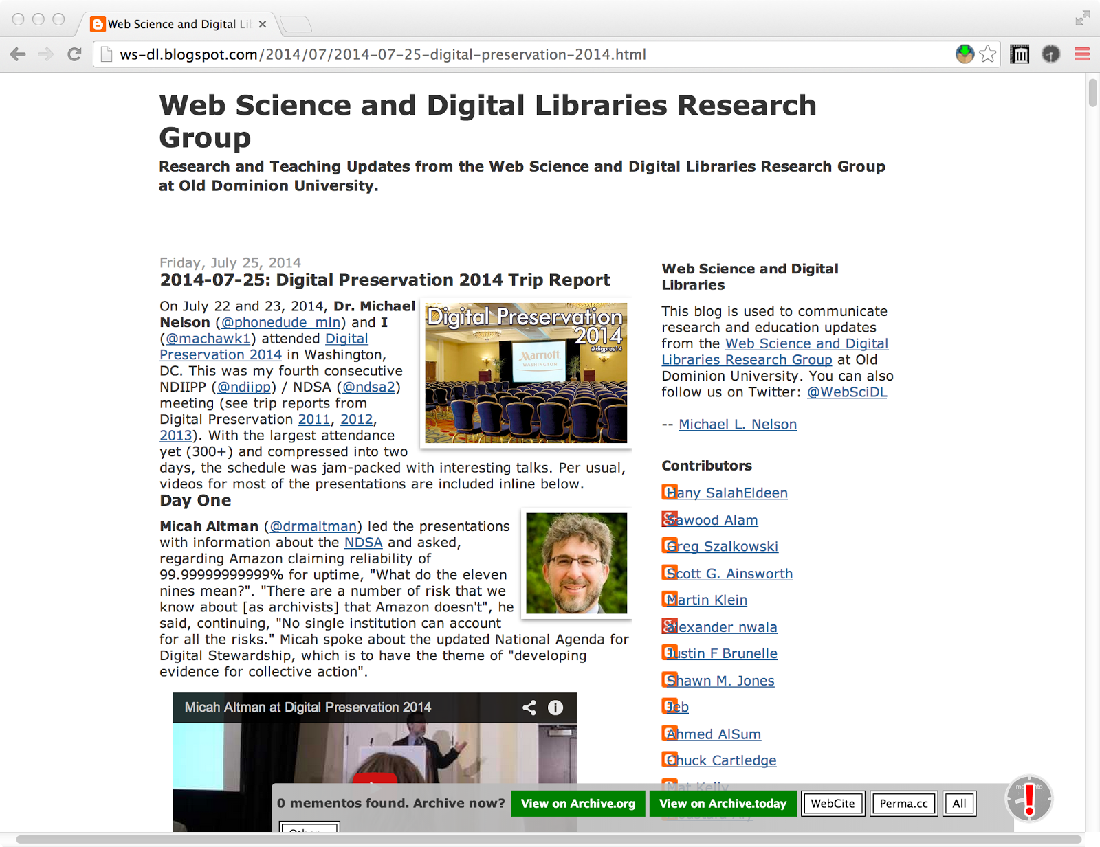
Proactive Archiving: Submit to Archive.today

Slide 120
Proactive Archiving: Archive.today Progress Page

Slide 121
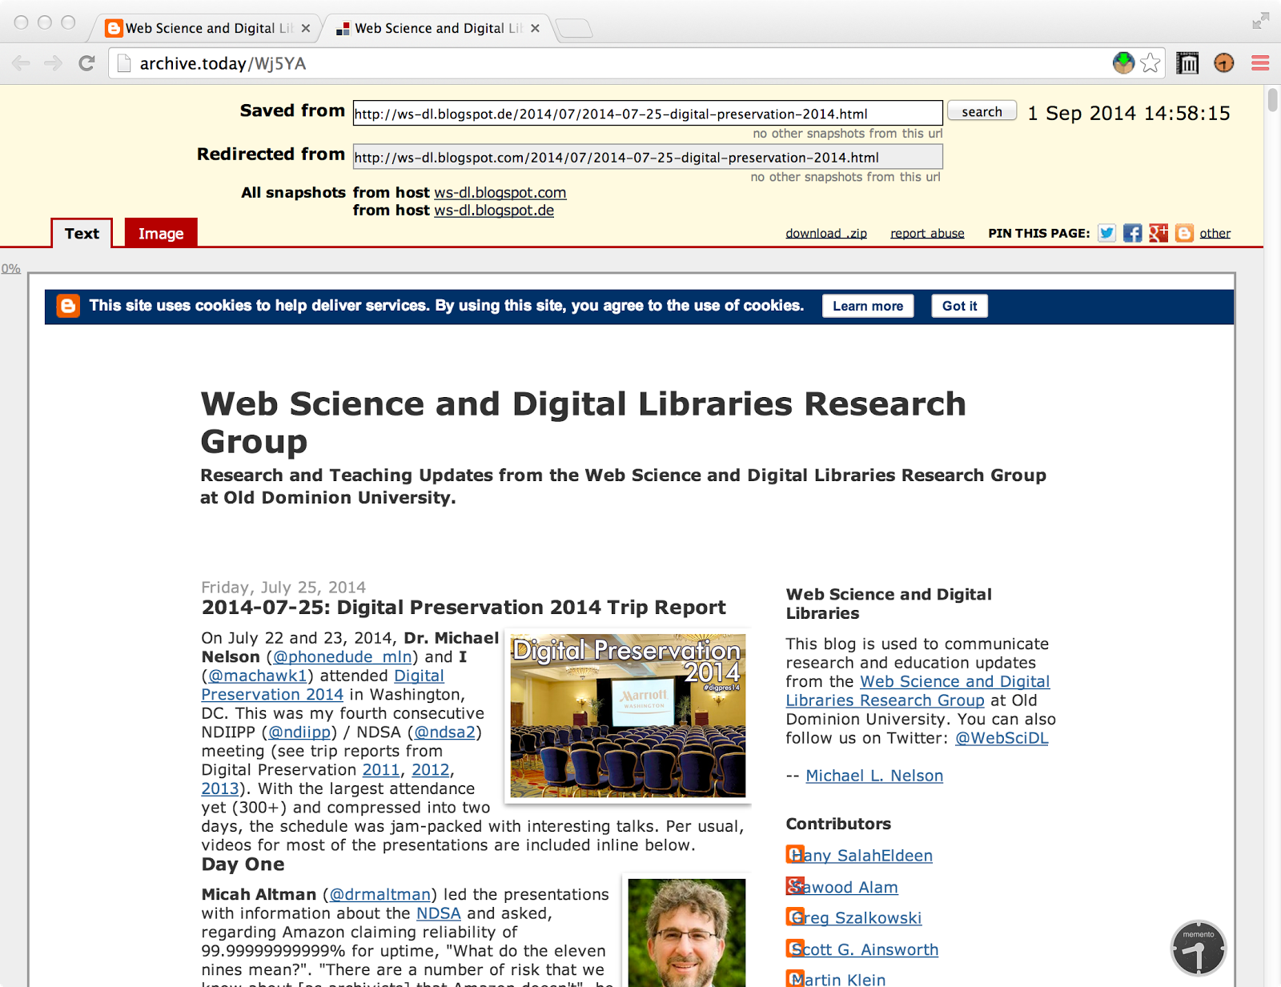
Proactive Archiving: Archived @ Archive.today

Slide 122
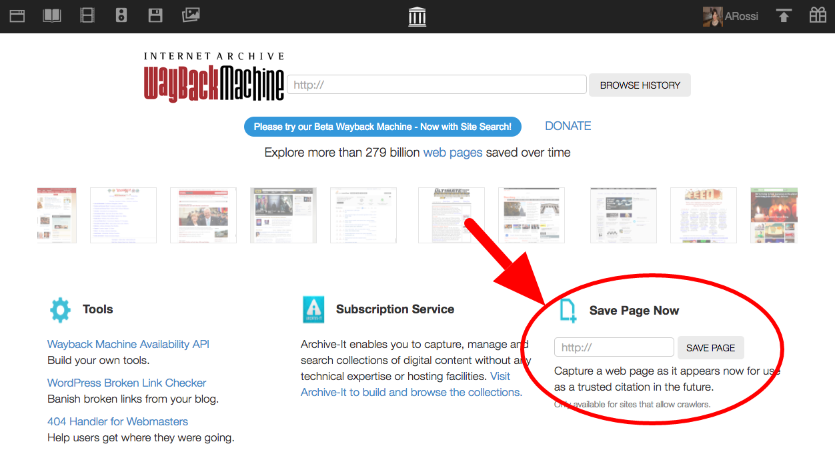
“If you see something, save something”
(if you haven’t installed Mink yet…)
https://blog.archive.org/2017/01/25/see-something-save-something/

Slide 123
Easily accessing the past Web means
archives should be infrastructure, not destinations.
(why archives are important and current research issues)

Slide 125
http://bit.ly/memento-for-chrome

Slide 129
Integrating Multiple Archives more info: http://mementoweb.org/ https://tools.ietf.org/html/rfc7089
Notes:
129

Slide 130
www.odu.edu is archived in six archives…
curl --silent -i http://memgator.cs.odu.edu/timemap/link/http://www.odu.edu \
| grep datetime | awk '{print $1}' | awk -v FS=/ '{print $3}' | sort | uniq –c
9 archive.is
1 arquivo.pt
39 wayback.archive-it.org
1 wayback.vefsafn.is
1748 web.archive.org
86 webarchive.loc.gov

Slide 131

Long Tail of Archives
Archive.is

Slide 132
Long Tail of Archives

Slide 133
Memento Aggregator

Slide 134
Memento Aggregator

Slide 135
Memento Aggregator

Slide 136
Memento Aggregator

Slide 137
Memento Aggregator

Slide 138
Memento Aggregator

Slide 139
Using Only Top-k Archives for URI Lookup Yields Good Results
Even when there are 100s of archives, we only need to talk to a few.
see: http://www.cs.odu.edu/~mln/pubs/tpdl-2013/paper_134.pdf
http://dx.doi.org/10.1007/s00799-014-0118-y

Slide 140
OK, so
More Archives == More Better
But why care about archiving at all?

Slide 141
Why Care About The Past?
From an anonymous WWW 2010 reviewer about our
Memento paper (emphasis mine):
"Is there any statistics to show that many or a good number of Web
users would like to get obsolete data or resources? "
one answer: replay of contemporary pages >> summary pages
http://www.slideshare.net/phonedude/why-careaboutthepast
http://www.nytimes.com/2013/06/19/books/seven-american-deaths-and-disasters-transcribes-the-news.html

Slide 142
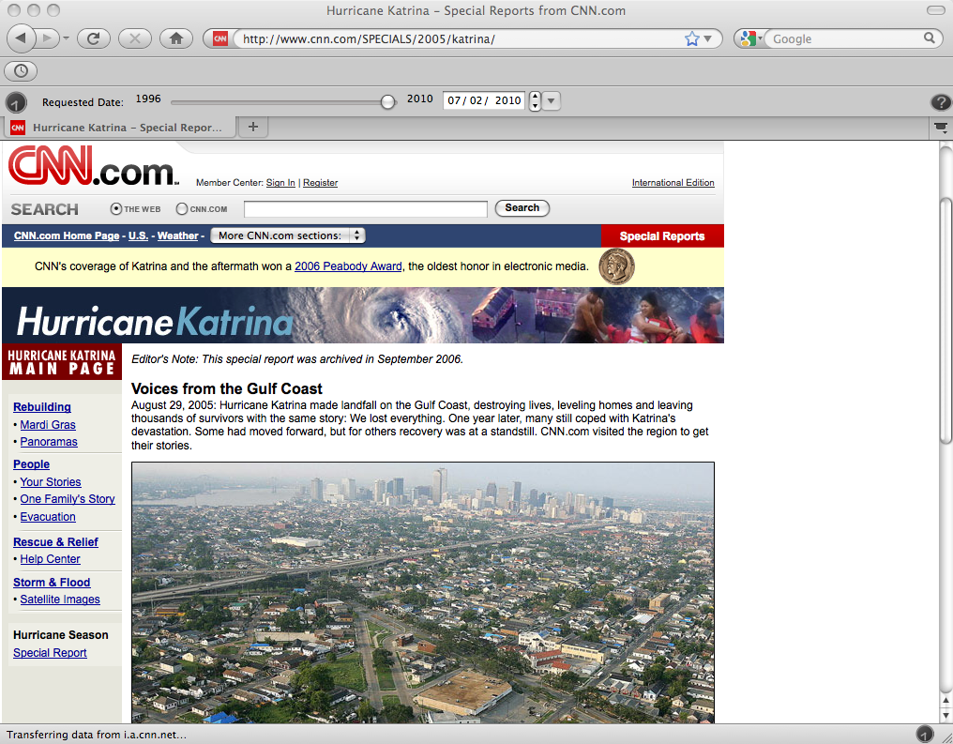

Slide 143
vs.

Slide 144


Slide 153


Slide 154


Slide 155


Slide 156
Archiving Moves At Hurricane Speed,
Most News Stories Move Faster

Slide 157


Slide 158


Slide 159


Slide 160


Slide 161

A Youtube video of a TV show where celebrities read “mean” Tweets about themselves
Our social discourse is dominated by the web. Q.E.D.
https://www.youtube.com/watch?v=LABGimhsEys

Slide 162

Our scholarly record is in jeopardy…
http://dx.doi.org/10.1371/journal.pone.0115253
See also: http://blog.dshr.org/2015/02/the-evanescent-web.html
http://dx.doi.org/10.1371/journal.pone.0167475

Slide 163

As is our legal record…
http://www.nytimes.com/2013/09/24/us/politics/in-supreme-court-opinions-clicks-that-lead-nowhere.html
See also: http://blogs.law.harvard.edu/futureoftheinternet/2013/09/22/perma/
http://ssnat.com/

Slide 164

As is our scientific record…
https://www.wired.com/2017/02/diehard-coders-just-saved-nasas-earth-science-data/

Slide 165

And our popular culture as well…
http://f-measure.blogspot.com/2009/02/pink-floyd-hour-with-pink-floyd-kqed-lp.html

Slide 166


Half-Life of Popular Music Youtube Videos
Individual URLs die, but new versions arise
Matthias Prellwitz, Michael L. Nelson,
Music Video Redundancy and Half-Life in YouTube,
Proceedings of TPDL 2011
http://www.cs.odu.edu/~mln/pubs/tpdl-2011/tpdl-2011-prellwitz.pdf

Slide 167
So we won’t lose every copy of “Shake It Off”…
What about the grist of history?

Slide 168

On January 28 2011, three days into the fierce protests that would
eventually oust the Egyptian president Hosni Mubarak, a Twitter
user called Farrah posted a link to a picture that supposedly showed
an armed man as he ran on a “rooftop during clashes between police
and protesters in Suez”. I say supposedly, because both the tweet
and the picture it linked to no longer exist. Instead they have
been replaced with error messages that claim the message – and its
contents – “doesn’t exist”.
http://www.bbc.com/future/story/20120927-the-decaying-web

Slide 169


Missing Tweet & Pic
https://twitter.com/Farrah3m/status/31727870736859137
http://twitpic.com/3uvo6z
http://ws-dl.blogspot.com/2013/05/2013-05-07-who-is-archiving-your-tweets.html

Slide 170

In May 2013, both are “archived” by topsy.com

Slide 171

In February 2015, they’re completely missing.
http://topsy.com/http://twitpic.com/3uvo6z

Slide 172

In 2016, redirecting…
http://topsy.com/http://twitpic.com/3uvo6z

Slide 173

…to a random (?) apple.com page
http://topsy.com/http://twitpic.com/3uvo6z

Slide 174

No Server == No HTTP Event == Nothing to Archive
http://topsy.com/http://twitpic.com/3uvo6z

Slide 175

Missing: 11% year 1, 7%/year afterwards
Archived: 7% year 1, 15%/year afterwards
Hany M. SalahEldeen, Michael L. Nelson, Losing My Revolution: How Many Resources Shared on Social Media Have Been Lost?, Proceedings of TPDL 2012. http://arxiv.org/abs/1209.3026
Hany SalahEldeen, Michael L. Nelson, Resurrecting My Revolution: Using Social Link Neighborhood in Bringing Context to the Disappearing Web, Proceedings of TPDL 2013. http://arxiv.org/abs/1309.2648

Slide 176
Why we need multiple, independent archives…

Slide 177

A single archive is vulnerable
http://www.bbc.com/news/uk-politics-24924185
http://ws-dl.blogspot.com/2013/11/2013-11-21-conservative-party-speeches.html

Slide 178

Houston, Tranquility Base Here. The Eagle has landed.
see also: http://ws-dl.blogspot.com/2013/03/2013-03-22-ntrs-web-archives-and-why-we.html
http://ws-dl.blogspot.com/2013/06/2013-06-18-ntrs-memento-and-handles.html

Slide 179

http://www.theguardian.com/technology/2015/feb/19/google-acknowledges-some-people-want-right-to-be-forgotten

Slide 180



$ curl –I "http://www.thedailybeast.com/articles/2016/08/11/i-got-three-grindr-dates-in-an-hour-in-the-olympic-village.html"
HTTP/1.1 301 Moved Permanently
Access-Control-Allow-Origin: *
Age: 0
Cache-Control: max-age=60
Content-Type: text/html; charset=iso-8859-1
Date: Thu, 18 Aug 2016 01:13:46 GMT
Location: http://www.thedailybeast.com/articles/2016/08/11/a-note-from-the-editors.html
RealAge: 0
Server: Apache
Vary: Accept-Encoding, User-Agent
Via: 1.1 varnish
X-BackEnd: default
X-Cache: MISS
X-Cacheable: YES
X-Restarts: 0
X-UA-Device: pc
X-Varnish: 995407903
Connection: keep-alive
http://www.usnews.com/news/articles/2016-08-17/wayback-machine-wont-censor-archive-for-taste-director-says-after-olympics-article-scrubbed

Slide 181

But who pays for those extra archives?
1TB endowment = ~$4700: http://blog.dshr.org/2011/02/paying-for-long-term-storage.html
see also: http://blog.dshr.org/2011/01/memento-marketplace-for-archiving.html

Slide 182

Archives aren’t magic web sites
They’re just web sites.
If you used Mummify, you’re now left with a bunch of defunct, shortened links like:
https://mummify.it/XbmcMfE3

Slide 183
Don’t Throw Away the Original URL –
Use Robust Links!
<a href="http://www.w3.org/"
data-versionurl="https://archive.today/r7cov"
data-versiondate="2015-01-21">
my robust link to the live web</a>
<a href="https://archive.today/r7cov"
data-originalurl="http://www.w3.org/"
data-versiondate="2015-01-21">
my robust link to an archived version</a>
<!DOCTYPE html>
<html lang="en" itemscope itemtype="http://schema.org/WebPage"
itemid="http://robustlinks.mementoweb.org/spec/">
<head>
<meta charset="utf-8" />
<meta itemprop="dateModified" content="2015-02-02">
<meta itemprop="datePublished" content="2015-01-23">
<title>Page Level Metadata Is The Least You Can Do</title>
More examples / scenarios at: http://robustlinks.mementoweb.org/spec/

Slide 184
Economics Working Against Archives
“In the paper world in order to monetize their content the
copyright owner had to maximize the number of copies
of it. In the Web world, in order to monetize their content
the copyright owner has to minimize the number of copies.
Thus the fundamental economic motivation for Web
content militates against its preservation in the ways
that Herbert and I would like.”
--David Rosenthal
http://blog.dshr.org/2015/02/the-evanescent-web.html

Slide 185
“We’ll use the cloud!”

Slide 186

https://www.chriswatterston.com/blog/my-there-no-cloud-sticker
"...when all costs are taken in to account,
cloud storage is not cheaper for long-term preservation than doing it yourself
once you get to a reasonable scale.”
http://blog.dshr.org/2014/11/talk-costs-why-do-we-care.html

Slide 187
Historicity of Web Archives

Slide 188
Malaysia Airlines Flight 17 (MH17)
http://web.archive.org/web/20140717152222/http://vk.com/strelkov_info
http://www.csmonitor.com/World/Europe/2014/0717/Web-evidence-points-to-pro-Russia-rebels-in-downing-of-MH17-video
http://www.newyorker.com/magazine/2015/01/26/cobweb

Slide 189


Slide 190


(not really archived as well as you think)

Slide 191

Ed and I Discuss Who Has What…
https://twitter.com/phonedude_mln/status/490171976389238784

Slide 192

Remember MH17?
https://twitter.com/phonedude_mln/status/490171976389238784

Slide 193

Alex is now 404.
Would multiple archives have convinced him?
https://twitter.com/quicknquiet

Slide 194
Do we really have
“a perfect tool to produce `evidence’ of any kind”?

Slide 195

@gary4205 mansplains to @AstroKatie
https://twitter.com/AstroKatie/status/765344020184739840
see also: http://www.someecards.com/news/so-that-happened/mansplain-astronaught-jessica-meir-twitter/

Slide 196

But can you prove he didn’t say this?

Slide 197

Or that she didn’t say this?
(remember: black hats can use tools created by white hats)
we working on this: https://mellon.org/grants/grants-database/grants/old-dominion-university/11600663/

Slide 198
Assessing the Quality of Web Archiving
"Hooray! It's in the archive!"
vs.
"How well was it archived?"
current:
the question
we should
be asking:

Slide 199
Temporal Drift
August 27, 2005
11:16 a.m. EDT
link

Slide 200

Temporal Drift: Now 3 Hours in the Past
August 27, 2005
11:16 a.m. EDT
link
August 27, 2005
8:00 a.m. EDT
link

Slide 201

Temporal Drift: Now 17 Days in the Future
August 27, 2005
11:16 a.m. EDT
link
August 27, 2005
8:00 a.m. EDT
link
September 13, 2005
8:12 a.m. EDT
link

Slide 202

Temporal Drift: Now 23 (or 6) Days in the Future
August 27, 2005
11:16 a.m. EDT
link
August 27, 2005
8:00 a.m. EDT
link
September 13, 2005
8:12 a.m. EDT
link
September 19, 2005
8:25 a.m. EDT
link
10+ clicks in the archive results in median drift of ~45 days (standard UI)
or ~15 days with Memento. ~2% of the sessions have drift of > 1 year.
see: http://www.cs.odu.edu/~mln/pubs/jcdl-2013/jcdl93-ainsworth.pdf

Slide 203
Sometimes the Live Web
"Leaks" Into the Archive…

Slide 204

Sept 3, 2008
2012
see: http://ws-dl.blogspot.com/2012/10/2012-10-10-zombies-in-archives.html

Slide 205
Not All Mementos Are Created Equal:
Measuring The Impact Of Missing Resources
JCDL 2014
http://www.cs.odu.edu/~mln/pubs/jcdl-2014/jcdl-2014-brunelle-damage.pdf

Slide 206

Synthetic Damage:
Removing Images From xkcd.com
M = 0.17
D = 0.09
(live web)
M = 0.24
D = 0.41
(missing main)
M = 0.29
D = 0.36
(missing logo + navigation)
damage (D) differs from % missing (M)!

Slide 207


Was missing
resource
important?
<img>and
<embed>
can leave hints
about size and
centrality.
For CSS, we
look at the
distribution of
background
color in page
divided into
vertical thirds.
33%
26%
29%
84%
15%
1%

Slide 208

Weights from Turker Assessment of Damage
first: establish that Turkers
can determine damaged vs.
undamaged pages (81% of the time)
second: find weights that match
Turker's rankings of (real) differently
damaged versions of the same page

Slide 209

Good News:
Although %Missing (M) is steady/increasing, weighted Damage (D) is decreasing

Slide 210
A Framework for Evaluation of
Composite Memento Temporal Coherence
Hypertext 2015
http://ws-dl.blogspot.com/2015/12/2015-12-08-evaluating-temporal.html

Slide 211

As Presented by IA
http://web.archive.org/web/20041209190926/http://www.wunderground.org/cgi-bin/findWeather/getForecast?query=50593 (now 404, but that's a different story…)
Notes:
A memento a presented by the Internet Archive.
211

Slide 212

Not Everything Is 200412091900926
+ 9 months

Slide 213
Only 1 in 5 pages complete and without violations
Description | Closest Single Archive | Closest Multi-Archive | Bracket Single Archive | Bracket Multi-Archive
Completeness
Mean complete | 76.1% | 80.2% | 76.2% | 80.3%
Mean missing | 23.9% | 19.8% | 23.8% | 19.7%
Temporal Coherence
Mean prima facie coherent | 41.0% | 40.9% | 54.7% | 54.6%
Mean possibly coherent | 27.3% | 27.3% | 12.8% | 14.2%
Mean probably violative | 2.5% | 5.3% | 2.5% | 5.3%
Mean prima facie violative | 5.3% | 5.3% | 6.2% | 6.2%
At least 5% of pages can be shown to be temporal violations
http://ws-dl.blogspot.com/2015/12/2015-12-08-evaluating-temporal.html
Notes:
mindist = minimum distance = closest
bracket = closest, but choose bracket if available
213

Slide 214
Closing Observations

Slide 215

Wrong Metaphor for Web Archives

Slide 216



Web Archives Are Not Destinations
This is a destination.
This is not a destination.
Memento is about linking the past and present web,
archives as infrastructure.

Slide 217


Turn Archiving Into A Social Activity…
see also: http://xkcd.com/1034/,
Marshall & Shipman, JCDL 2011

Slide 218

…But Don't Use the "A" Word
Ed: Are there any zombies out there?
Shaun: Don't say that!
Ed: What?
Shaun: That.
Ed: What?
Shaun: That. The Z word. Don't say it.
Ed: Why not?
Shaun: Because it's ridiculous!
— Shaun of the Dead

Slide 219

Pinterest: Anonymous Mementos
http://media-cache-ec3.pinterest.com/upload/47639708527755289_AhxhItiQ_c.jpg
is a memento of:
http://3.bp.blogspot.com/_d0vByWRfhvU/S_Ygk_oX4xI/AAAAAAAACCQ/LXgC3S0KYEo/s400/_MG_8091.jpg
but there is no machine-readable indication of this relationship
repins are by-reference

Slide 220

When all else fails, justify project with:
“web archiving is Big Data”

Slide 221
To Do For Next Week…
Create a GitHub account and fork:
  https://github.com/phonedude/cs891-f17
Make sure you’re signed up for:
  https://groups.google.com/group/cs891-f17
Create a Twitter account and follow:
  @WebSciDL
  @weiglemc
  @phonedude_mln
  and others… figure it out yourself
Every week: tweet something interesting with “#TIL @WebSciDL”; be prepared to give a 1 minute summary at the beginning of each class

