Slide 1


How to Prepare and Give an Academic Presentation
Michele C. Weigle and Michael L. Nelson
CS 891 – Web Archiving Seminar
Fall 2017
@WebSciDL
https://phonedude.github.io/cs891-f17/

Slide 2
Flashback: What is a PhD?
A PhD program is very different from getting a Bachelor’s degree, and you must treat it as a strange type of job.
Initiative, tenacity, flexibility, interpersonal skills, organizational skills, and communication skills are all critical and not things that universities typically test for in selecting incoming students.
http://www.cs.unc.edu/~azuma/hitch4.html

Slide 3
Flashback: Communication Skills
You will write (a lot)
You will present your ideas (a lot)
It will be so much better (and more efficient) for all of us if we spend more time talking about research ideas than about organization, grammar, and typos
I cannot over-emphasize how important this is
http://www.cs.unc.edu/~azuma/hitch4.html

Slide 4
Giving a presentation is a lot like telling a story.
http://www.brunswick.k12.me.us/hdwyer/files/2011/11/storyboarding-freytags-pyramid.jpg

Slide 5
First, you set the scene.
Title slide - Title of your paper, your name and names of your collaborators, your affiliation, talk venue, date
Background - Provide just enough so the audience can appreciate the problem.
http://www.brunswick.k12.me.us/hdwyer/files/2011/11/storyboarding-freytags-pyramid.jpg

Slide 6
Then, you present the problem.
Make it sound important, even interesting.
“Web pages can disappear, we need to save them!”
“Web archives can’t completely capture today's web pages!”
http://www.brunswick.k12.me.us/hdwyer/files/2011/11/storyboarding-freytags-pyramid.jpg

Slide 7
Highlight your brilliant approach to solving the problem.
Skip the boring stuff.
Give clear explanations.
Leave a little mystery.
http://www.brunswick.k12.me.us/hdwyer/files/2011/11/storyboarding-freytags-pyramid.jpg

Slide 8
Show that your approach solves the problem and is better than others.
Describe your evaluation.
Present compelling results.
http://www.brunswick.k12.me.us/hdwyer/files/2011/11/storyboarding-freytags-pyramid.jpg

Slide 9
End with a convincing summary.
Recap the problem.
Summarize the approach.
Repeat the most important points of the results.
Provide contact information.
http://www.brunswick.k12.me.us/hdwyer/files/2011/11/storyboarding-freytags-pyramid.jpg

Slide 10
Concrete Tips

Slide 11
Consider the audience
Include enough background material that your audience will be able to follow your talk.
  but, don’t bore them with background they already know
Don’t provide too much detail
  details are in the paper
Keep in mind your time limit
  leave time for questions

Slide 12
What’s the story you want to tell?
What three things do you want the audience to walk away knowing?
  what should be tweeted about your talk?
“Tell them what you’ll tell them, then tell them, then tell ‘em what you’ve told them”
  don’t make the audience infer your main points or conclusions
Use the slide title to convey the main point of each slide

Slide 13
A picture is worth 1000 words
Include helpful figures and illustrations
  but not useless clip art
If you use a figure from another source, give attribution
Annotate your charts
  what's the main point of the chart?

Slide 14
Help the audience
Include your twitter handle (and @WebSciDL) in the footer of each slide
  live tweeters will advertise for you
Always use slide numbers
  questioners can refer to specific slides by number

Slide 15
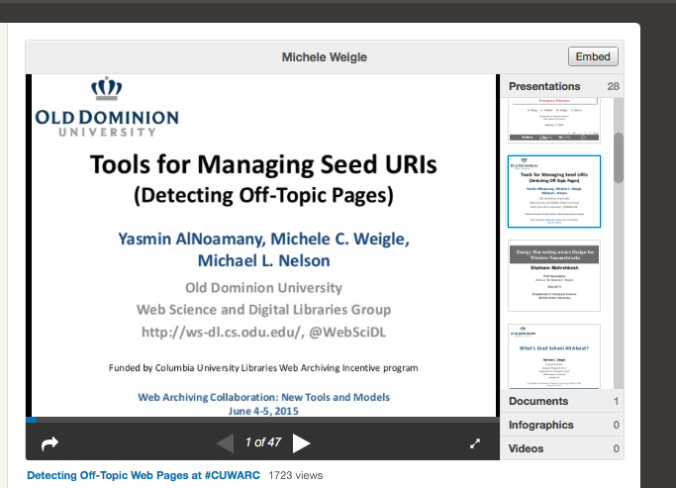
Consider the future life of the slides
Include contact information
Include links to more info (esp. WS-DL blog posts!)
Un-roll animations
https://www.slideshare.net/mweigle

Slide 16
Things to Avoid

Slide 17
Introduction
In particular, when you first write the slides it's natural to write lots of bullet points and whole sentences of text, because you write down everything that you want to say.
Once you've done this, try to remove as much text as possible, by (a) converting text to other forms (and note that small animations can be invaluable for guiding an audience's attention around a picture), and (b) presenting the remaining text as concisely as possible.
This is hard work -- text is faster to create than pictures, tables, etc -- but it results in a much better talk.
http://njn.valgrind.org/good-talk.html

Slide 18

My Awful Slide
It really doesn’t matter what this slide says. It’s already awful.
Now with animation!

Slide 19
My Slightly Better, but Still Kinda Awful Slide
This is a little better
But only a little bit

Slide 20
References
Corren G. McCoy, Michael L. Nelson and Michele C. Weigle, "University Twitter Engagement: Using Twitter Followers to Rank Universities," Technical report arXiv:1708.05790, August 2017.
Lulwah Alkwai, Michael L. Nelson and Michele C. Weigle, "Comparing the Archival Rate of Arabic, English, Danish, and Korean Language Web Pages," ACM Transactions on Information Systems (TOIS), Vol. 36, No. 1, July 2017, pp. 1:1-1:34.
John Berlin, Mat Kelly, Michael L. Nelson and Michele C. Weigle, "WAIL: Collection-Based Personal Web Archiving," In Proceedings of the ACM/IEEE Joint Conference on Digital Libraries (JCDL). Toronto, Ontario, Canada, June 2017, pp. 340-341.
Yasmin AlNoamany, Michele C. Weigle and Michael L. Nelson, "Generating Stories from Archived Collections," In Proceedings of the 9th International ACM Web Science Conference. Troy, NY, June 2017. (PDF, BibTeX)
Mat Kelly, Lulwah M. Alkwai, Sawood Alam, Michael L. Nelson, Michele C. Weigle and Herbert Van de Sompel, "Impact of URI Canonicalization on Memento Count," In Proceedings of the ACM/IEEE Joint Conference on Digital Libraries (JCDL). Toronto, Ontario, Canada, June 2017, pp. 303-304, Best Poster Award.
Alexander C. Nwala, Michele C. Weigle, Michael L. Nelson, Adam B. Ziegler and Anastasia Aizman, "Local Memory Project: Providing Tools to Build Collections of Stories for Local Events from Local Sources," In Proceedings of the ACM/IEEE Joint Conference on Digital Libraries (JCDL). Toronto, Ontario, Canada, June 2017.
Sawood Alam, Mat Kelly, Michele C. Weigle and Michael L. Nelson, "Client-side Reconstruction of Composite Mementos Using ServiceWorker," In Proceedings of the ACM/IEEE Joint Conference on Digital Libraries (JCDL). Toronto, Ontario, Canada, June 2017
Justin F. Brunelle, Michele C. Weigle and Michael L. Nelson, "Archival Crawlers and JavaScript: Discover More Stuff but Crawl More Slowly," In Proceedings of the ACM/IEEE Joint Conference on Digital Libraries (JCDL). Toronto, Ontario, Canada, June 2017.
Yasmin AlNoamany, Michele C. Weigle and Michael L. Nelson, "Stories From the Past Web," Technical report arXiv:1705.06218, May 2017.
Mat Kelly, Lulwah M. Alkwai, Michael L. Nelson, Michele C. Weigle and Herbert Van de Sompel, "Impact of URI Canonicalization on Memento Count," Technical report arXiv:1703.03302, March 2017.
Shahram Mohrehkesh, Michele C. Weigle and Sajal K. Das, "Energy Harvesting in Nanonetworks," In Modeling, Methodologies and Tools for Molecular and Nano-scale Communications. (Junichi Suzuki, Tadashi Nakano, Michael John Moore, Eds.), Springer International Publishing, pp. 319-347.
Shahram Mohrehkesh, Michele C. Weigle and Sajal Das, "Energy Harvesting in Electromagnetic Nanonetworks," IEEE Computer, No. 2, February 2017, pp. 59-67.

Slide 22
Good Examples

Slide 23
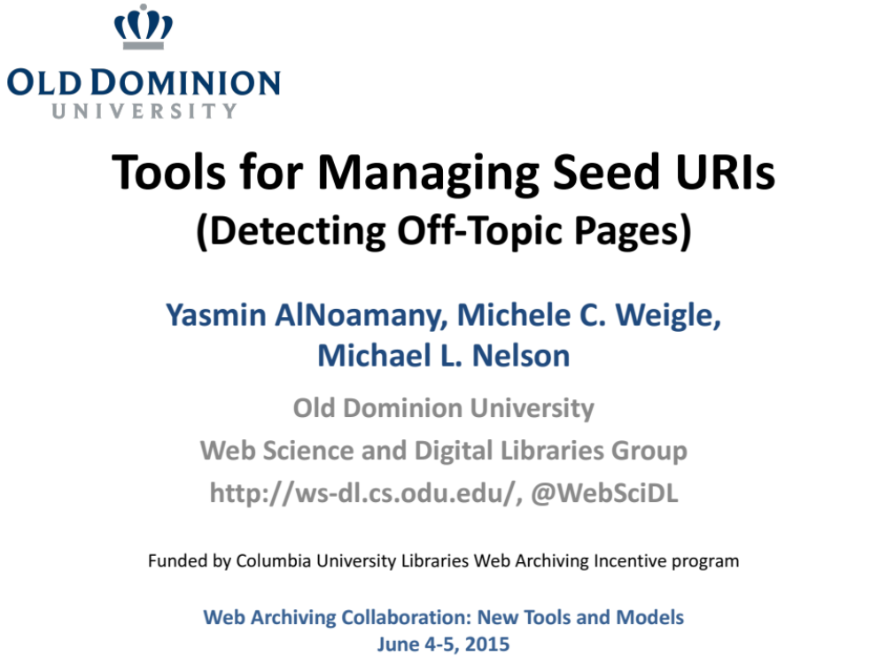
https://www.slideshare.net/mweigle/detecting-offtopic-web-pages-at-cuwarc

Slide 24
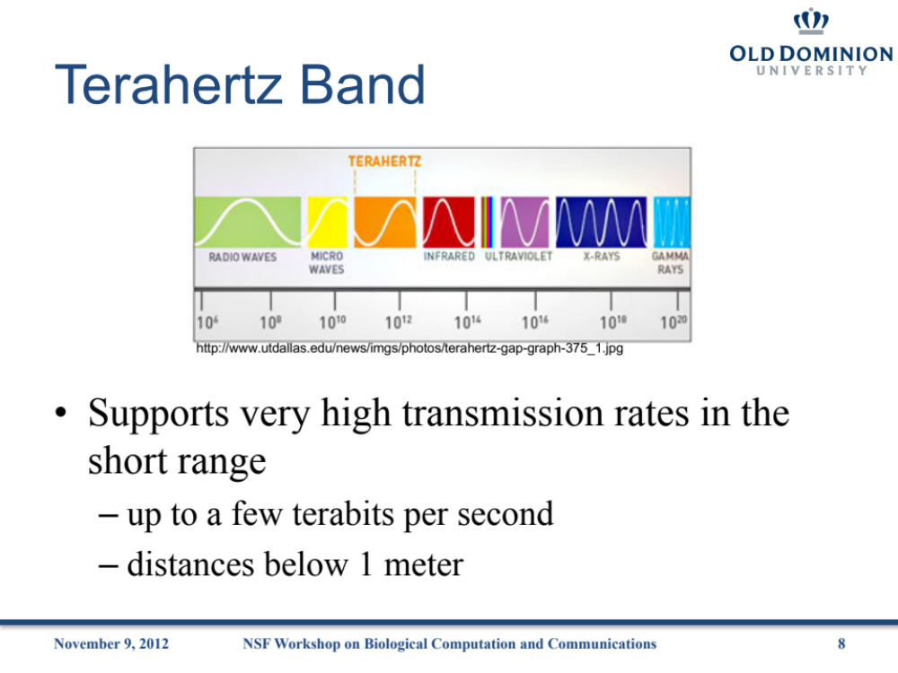
https://www.slideshare.net/mweigle/communications-and-energyharvesting-in-nanosensor-networks

Slide 25
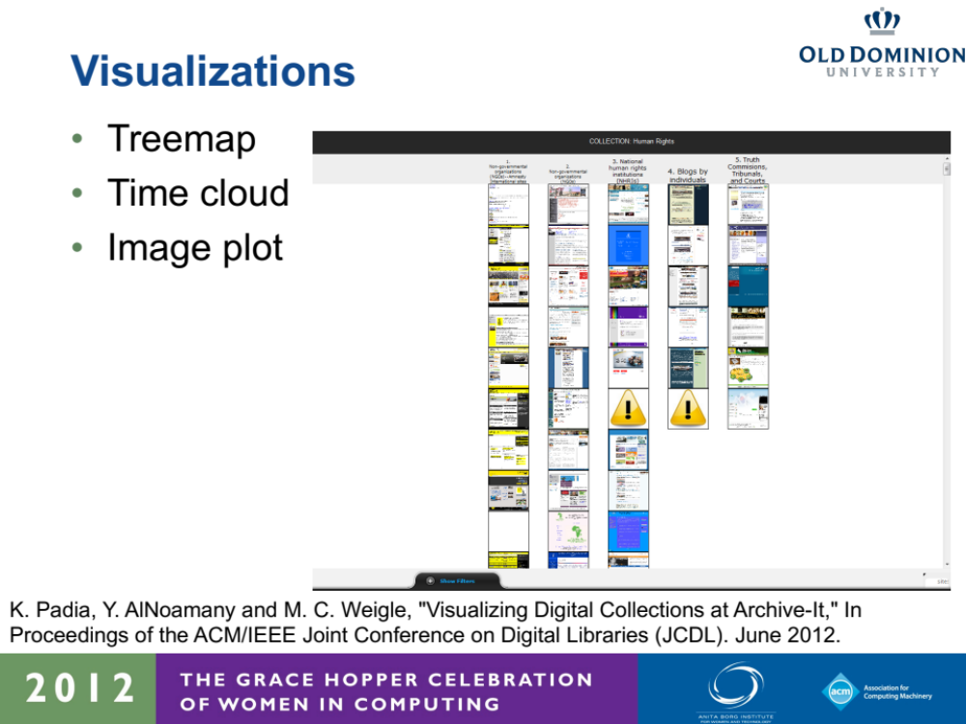
https://www.slideshare.net/mweigle/information-visualization-visualizing-digital-collections-at-archiveit

Slide 26
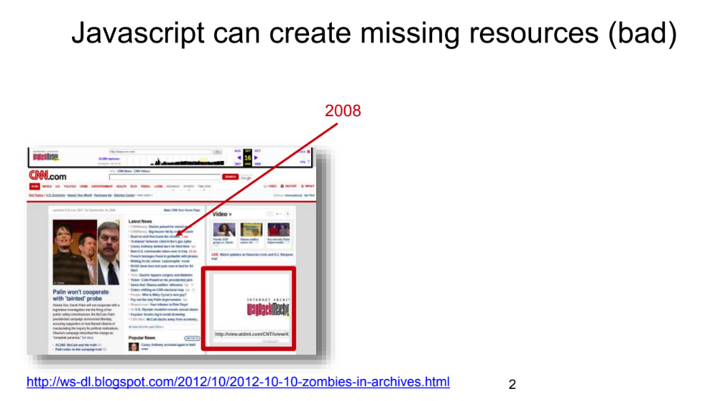
https://www.slideshare.net/phonedude/combining-heritrix-and-phantomjs-for-better-crawling-of-pages-with-javascript

Slide 27
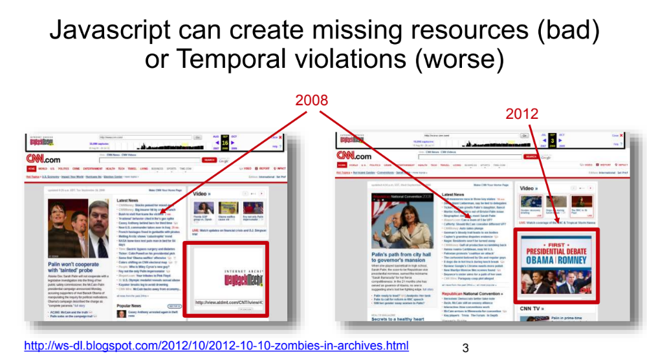
https://www.slideshare.net/phonedude/combining-heritrix-and-phantomjs-for-better-crawling-of-pages-with-javascript

Slide 28
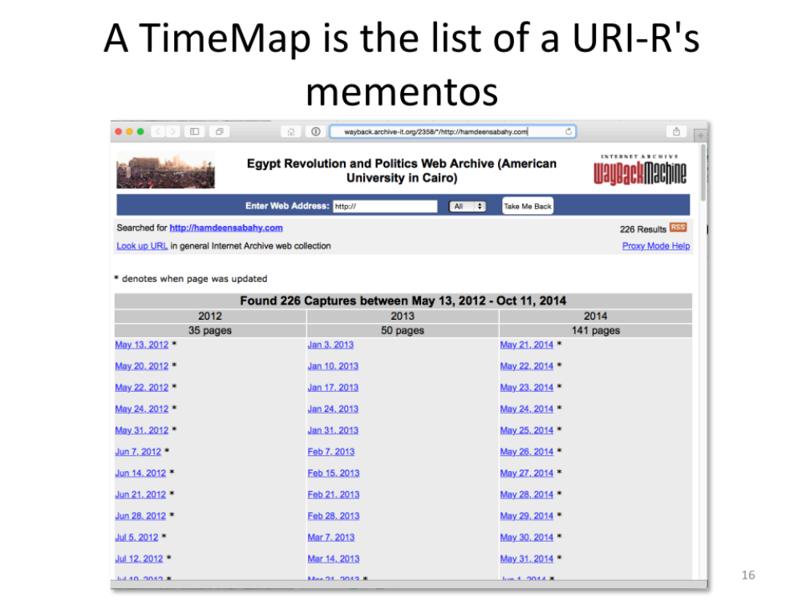
https://www.slideshare.net/mweigle/detecting-offtopic-web-pages-at-cuwarc

Slide 29
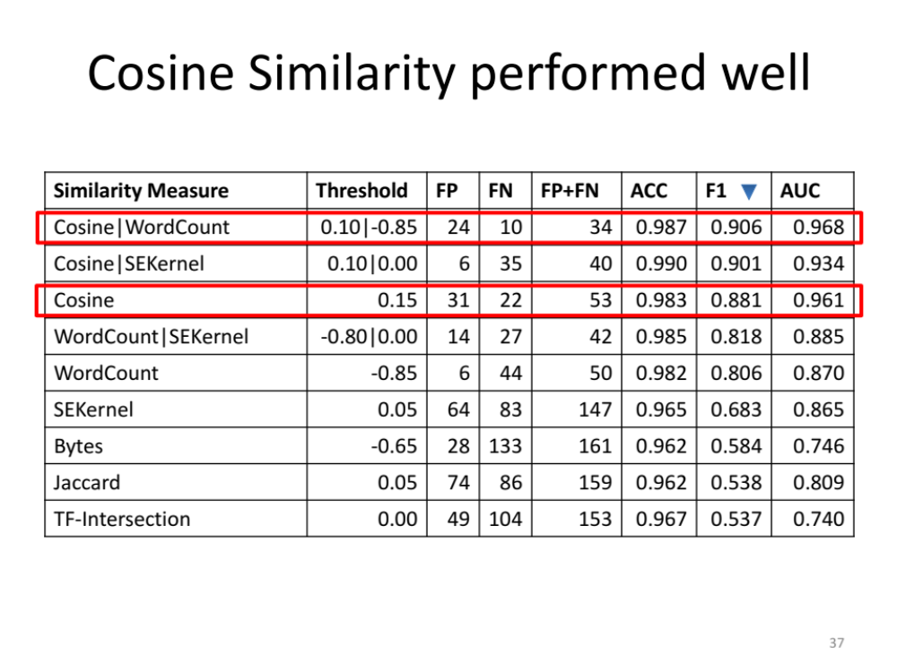
https://www.slideshare.net/mweigle/detecting-offtopic-web-pages-at-cuwarc

Slide 30
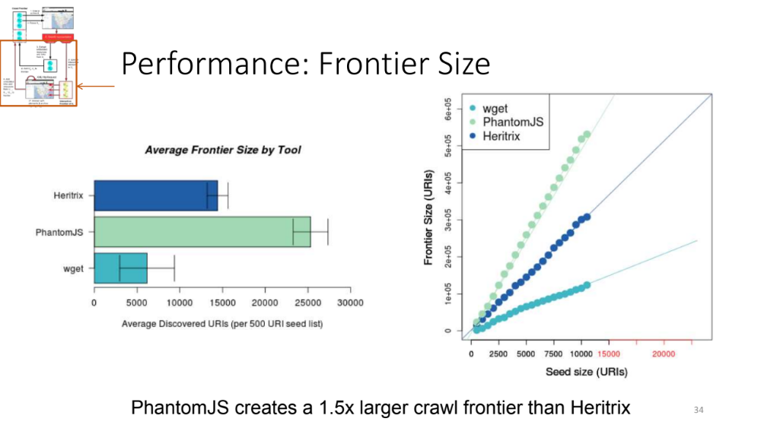
https://www.slideshare.net/phonedude/combining-heritrix-and-phantomjs-for-better-crawling-of-pages-with-javascript

Slide 31
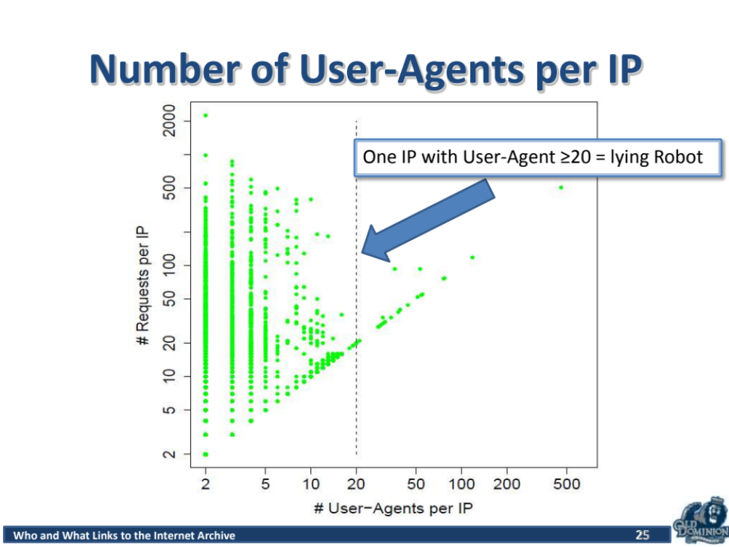
https://www.slideshare.net/phonedude/who-and-what-links-to-the-internet-archive-26545925

Slide 32
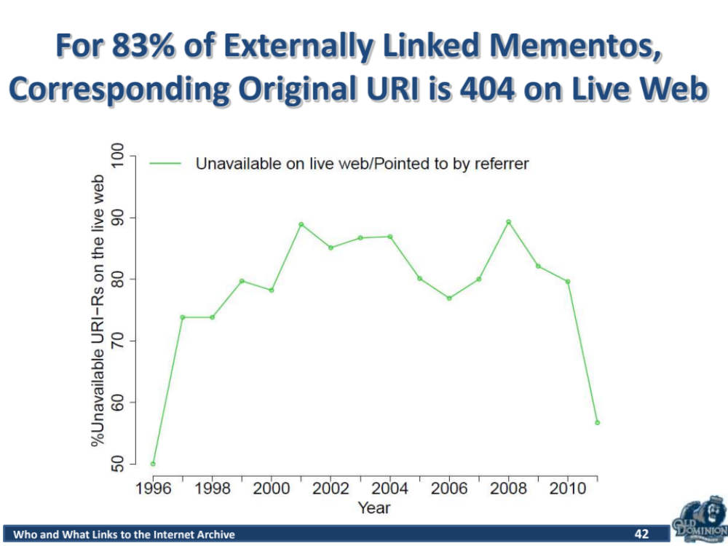
https://www.slideshare.net/phonedude/who-and-what-links-to-the-internet-archive-26545925

Slide 33
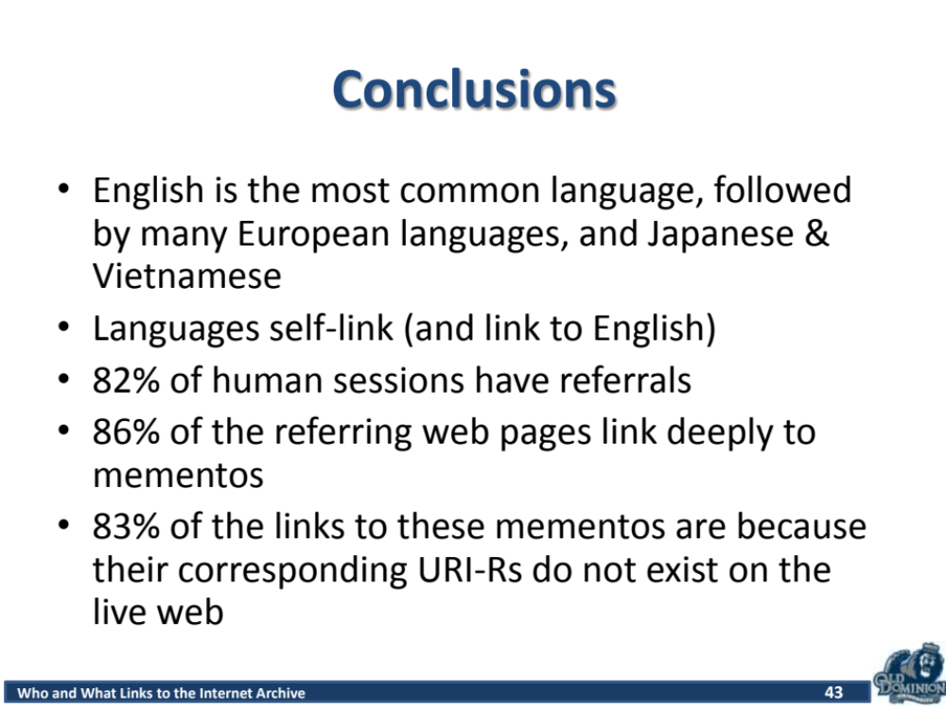
https://www.slideshare.net/phonedude/who-and-what-links-to-the-internet-archive-26545925

Slide 34
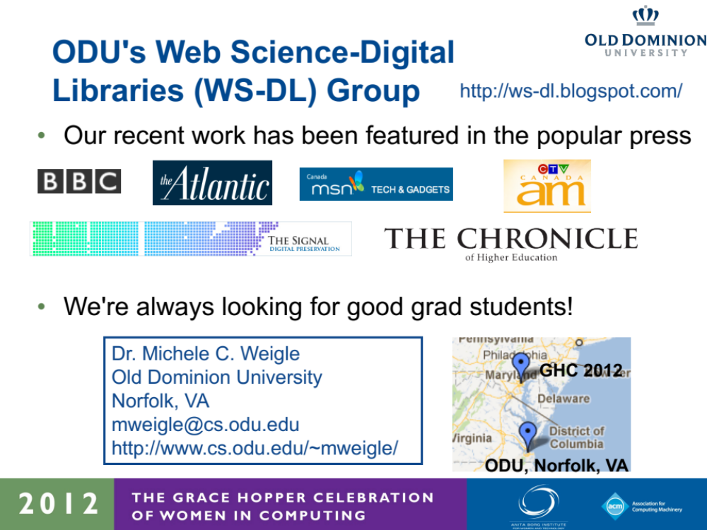
https://www.slideshare.net/mweigle/information-visualization-visualizing-digital-collections-at-archiveit

Slide 35
Delivery Tips

Slide 36
Delivery Tips
Speak clearly and slowly
Face the audience, not the screen
Make transitions between topics smooth
  don’t just read the title of each slide as a transition
Having notes may be helpful, but don’t write out the entire talk and don’t try to memorize it
Practice! Practice! Practice!
  and get feedback from others
From Writing for Computer Science by Justin Zobel

Slide 37
Beginnings and Endings
Do plan out your first sentence and last sentence
First sentence – plan your transition from title slide to motivation slide
Last sentence – write a concluding sentence that clearly wraps things up and then say “thank you”

Slide 38
Practice, Practice, Practice!
You need to do practice talks. This means you!
The first time you give a particular talk is always less coherent than later ones.
Then you can refine it, both at the structural level and the slide-by-slide tweak level.
The more you practice, the more comfortable you will be.
Tamara Munzner, http://www.cs.ubc.ca/~tmm/policy.txt

Slide 39
Delivery Advice from an Actor

Slide 40
Tips and Tricks for Giving Talks
You are the HERO of your talk
Your objective or TASK is to get your audience excited enough that:
  They want to read the paper
  They want to talk to you after class or at the networking session
  They will remember to contact you later
  They want to hire you for a job that pays real money
ActingforScientists.com, Jenifer Alonzo

Slide 41
Delivery and storytelling are your tools for achieving your objective
It is likely that developing your skills in DELIVERY and STORYTELLING will be an awkward, uncomfortable process.
You will want to refuse to develop these skills.
You might DIE.
Sadly, presentation skills are required for EVERY. SINGLE. JOB that will support a middle-class lifestyle – Even the job you want.
ActingforScientists.com, Jenifer Alonzo

Slide 42
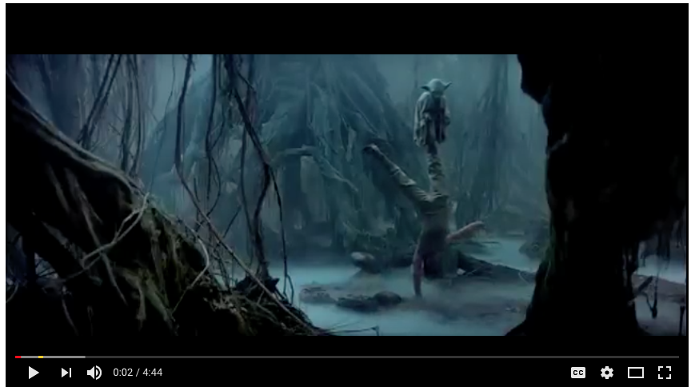
Your Training Will Be Awkward and Uncomfortable (or, my turn for a movie clip)
https://www.youtube.com/watch?v=7YkbgvRMpW0

Slide 43
Delivery
YOU HAVE TO FAKE CONFIDENCE AND EXCITEMENT EVEN IF YOU HAVE NEITHER
Warm-up
Power Pose
Know your material
Give vocal and visual interest
Practice
  give yourself an assignment – info, timing, transitions, movement, vocal change
ActingforScientists.com, Jenifer Alonzo

Slide 44
Only because these are class lecture slides…
Giving a Good Research Talk, http://njn.valgrind.org/good-talk.html
How To Give a Talk, Arnaud Legout - comprehensive set of guidelines, includes advice on slide design, http://cel.archives-ouvertes.fr/cel-00529505/en/
Creating Effective Slides video, (1:03:03), https://www.youtube.com/watch?v=meBXuTIPJQk
English Communication for Scientists, Giving Oral Presentations (includes delivering as a non-native speaker), https://www.nature.com/scitable/ebooks/english-communication-for-scientists-14053993/giving-oral-presentations-14239332

Slide 45
Summary
Giving a presentation is a lot like telling a story.
A picture is worth 1000 words.
Consider the audience and help them (to understand and to provide feedback).

