Slide 1


INTRODUCING

Slide 2

what is density?
analyze density distributions over a given specific area
cellular triangulation often lacks precision
idea initiated from personal experience involving the busy nature of UW library
applications include:
  aiding emergency services
  inventory
  traffic patterns
  accessibility of highly shared common resources e.g libraries, amusement parks
  optimize in store pathways

Slide 3

density collect
ESP8266 wifi module is put into promiscuous mode and is used to read and capture all surrounding Wifi data
wifi frames are stripped off everything except Mac addresses which are used to identify the presence of a device
packet data is sorted filtered and passed onto density mesh component through serial communication

Slide 4

density mesh
ESP8266 wifi Chips creates ADHOC mesh network for data transmission across an open field
synchronizes time across devices so channels are scanned simultaneously in order to perform triangulation
each microcontroller creates an access point and connects to other access points to allow to connect to an infinite amount of access points over an infinite space
data is received on server and is passed onto density compute

Slide 5
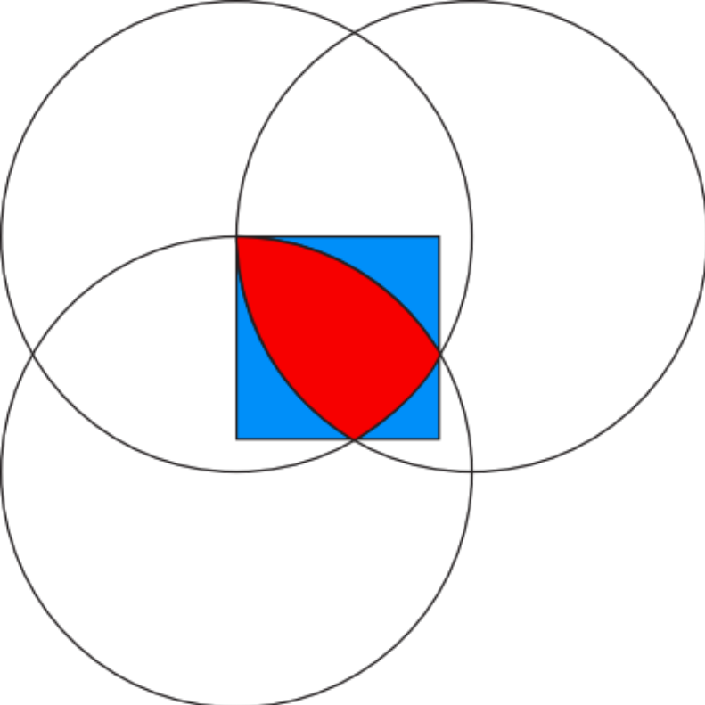
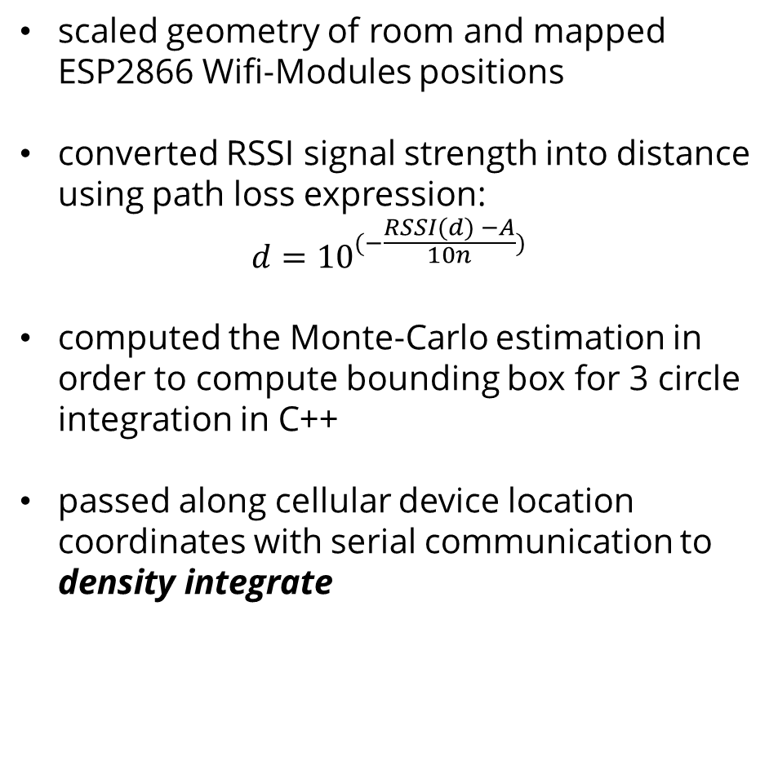
density compute
scaled geometry of room and mapped ESP2866 Wifi-Modules positions
converted RSSI signal strength into distance using path loss expression:
$$d={10}^{(−\frac{RSSI(d) −A}{10n}) }$$
computed the Monte-Carlo estimation in order to compute bounding box for 3 circle integration in C++
passed along cellular device location coordinates with serial communication to density integrate

Slide 6

density integrate
receiving packets through TCP/IP protocol from C++ in density compute
script written in Node.Js safety sends json objects to density visualize
WebSocket connection is created with React.js front-end to maintain ongoing stream of device data points

Slide 7

density visualize
prototyped front-end design on Sketch
collected payload data by listening to WebSocket data passed by density integrate
implemented front-end and UI components in React.Js
integrated heatmap.Js API with WebSocket payload data to visualize population densities on custom maps

Slide 8

BMO challenge
software system is installed in BMO branches is used to optimize branch floor space by:
  improving line wait times and staff responsiveness
  gauging effectiveness of advertising displays in storefront
  analyzing store traffic to optimize staff scheduling
  giving users an indication on estimated wait time at local branch
  compiling data on employee efficiency

Slide 9

ITradeNetwork challenge
software system can be used by ITradeNetwork in order to aide the supply chain process by:
  tracking location density at various times in order to isolate for contamination outbreaks
  improving delivery wait times and vendor responsiveness
  analyzing supply chain process in order to decrease time from manufacturer to shelf

Slide 10
is it safe?
mac addresses of users are hashed using a SHA1 function to keep users anonymous
entire transport is encrypted in AES

Slide 11
…so what next?
commercial stores can gather suggestions for ad placements and item popularity
can optimize store paths to increase customer ease and product exposure
can be used to create extensive datasets for machine learning
integrating it with other services such as Google nearby to increase fidelity

