Slide 1
CS162
Operating Systems and
Systems Programming
Lecture 2
Introduction to the Process
August 31st, 2015
Prof. John Kubiatowicz
http://cs162.eecs.Berkeley.edu

Slide 2
Recall: What is an operating system?
Special layer of software that provides application software access to hardware resources
  Convenient abstraction of complex hardware devices
  Protected access to shared resources
  Security and authentication
  Communication amongst logical entities
appln
appln
appln
OS
Hardware

Slide 3



Review: What is an Operating System?
Referee
  Manage sharing of resources, Protection, Isolation
    Resource allocation, isolation, communication
Illusionist
  Provide clean, easy to use abstractions of physical resources
    Infinite memory, dedicated machine
    Higher level objects: files, users, messages
    Masking limitations, virtualization
Glue
  Common services
    Storage, Window system, Networking
    Sharing, Authorization
    Look and feel

Slide 4
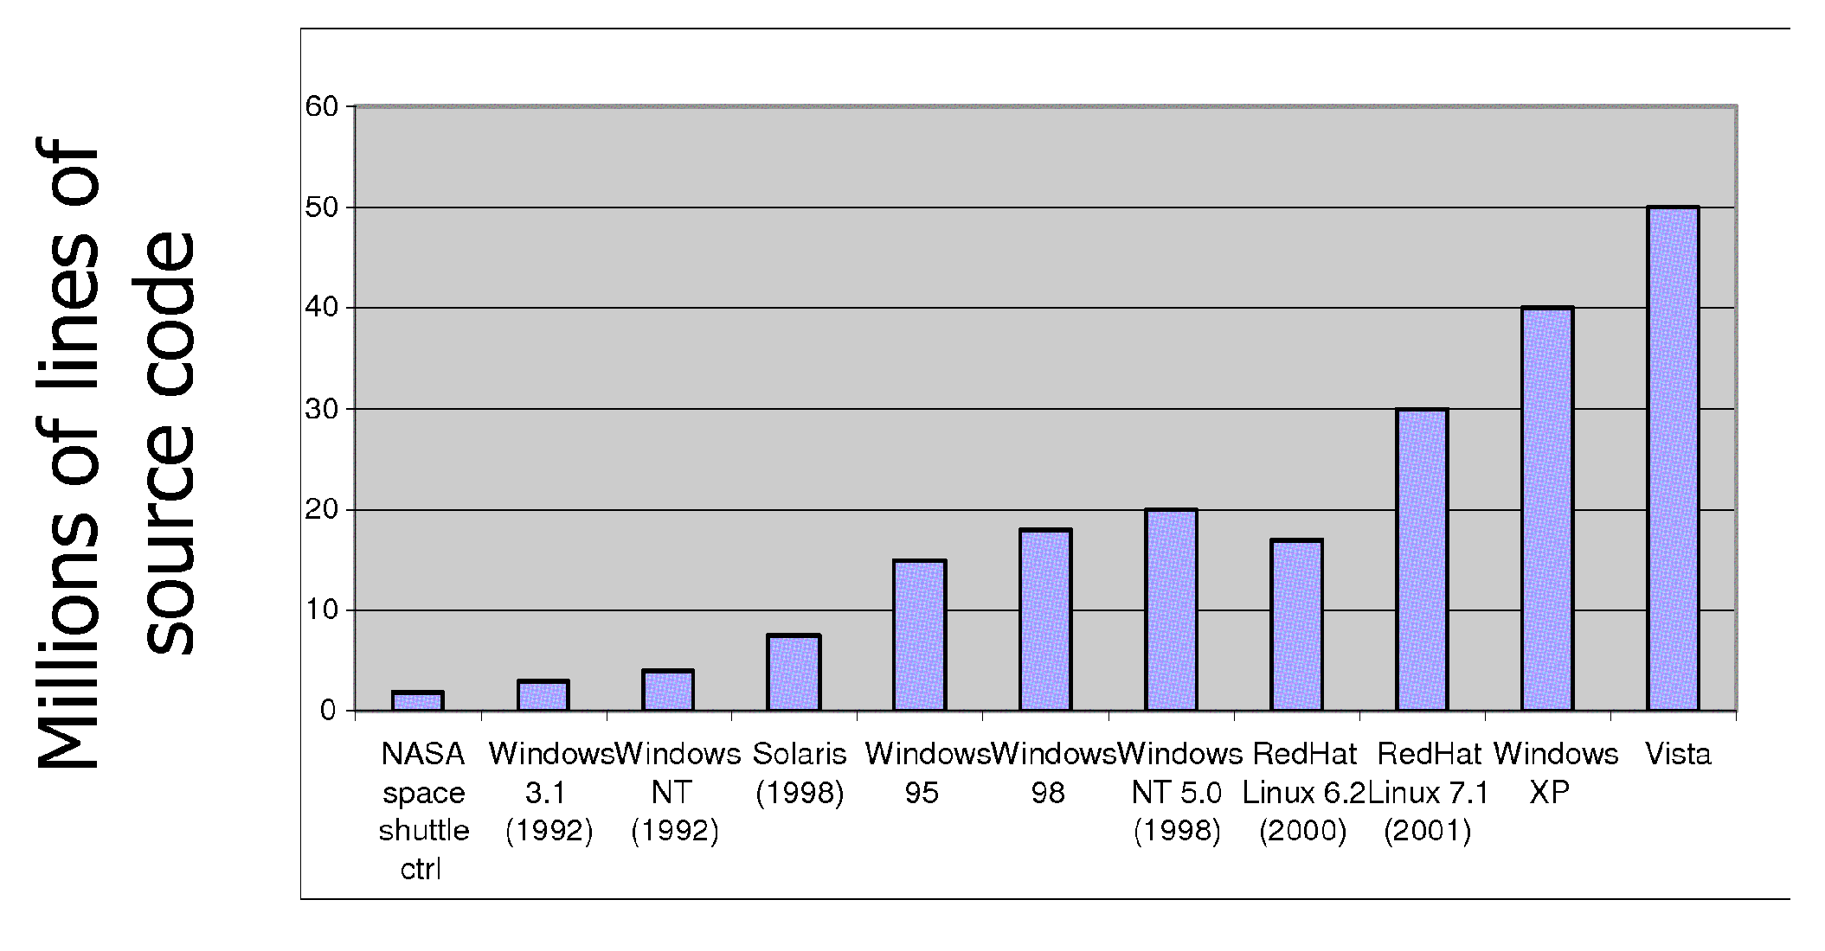
Review: Increasing Software Complexity
From MIT’s 6.033 course

Slide 5
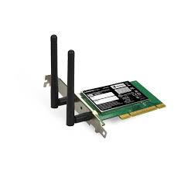
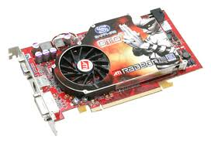
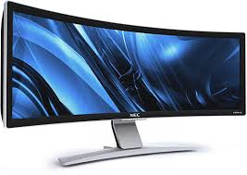

Recall: Loading
Threads
Address Spaces
Windows
Processes
Files
Sockets
Software
OS Hardware Virtualization
Hardware
ISA
Memory
Processor
Protection Boundary
OS
Ctrlr
storage
Networks
Displays
Inputs

Slide 6
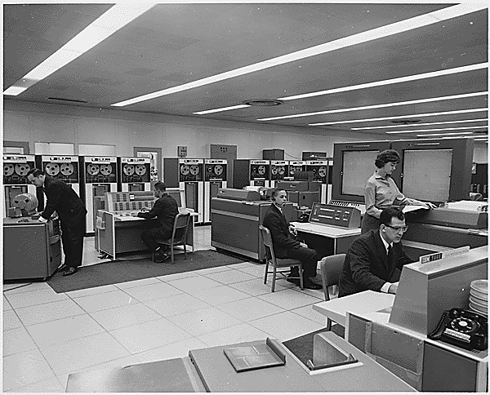
Very Brief History of OS
Several Distinct Phases:
  Hardware Expensive, Humans Cheap
    Eniac, … Multics
  Hardware Cheaper, Humans Expensive
    PCs, Workstations, Rise of GUIs
  Hardware Really Cheap, Humans Really Expensive
    Ubiquitous devices, Widespread networking
"I think there is a world market for maybe five computers." -- Thomas Watson, chairman of IBM, 1943

Slide 7
Very Brief History of OS
Several Distinct Phases:
  Hardware Expensive, Humans Cheap
    Eniac, … Multics
  Hardware Cheaper, Humans Expensive
    PCs, Workstations, Rise of GUIs
  Hardware Really Cheap, Humans Really Expensive
    Ubiquitous devices, Widespread networking
Thomas Watson was often called “the worlds greatest salesman” by the time of his death in 1956
Notes:
That’s what you call “managing expectations”

Slide 8
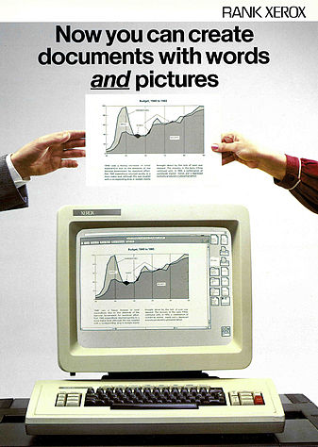
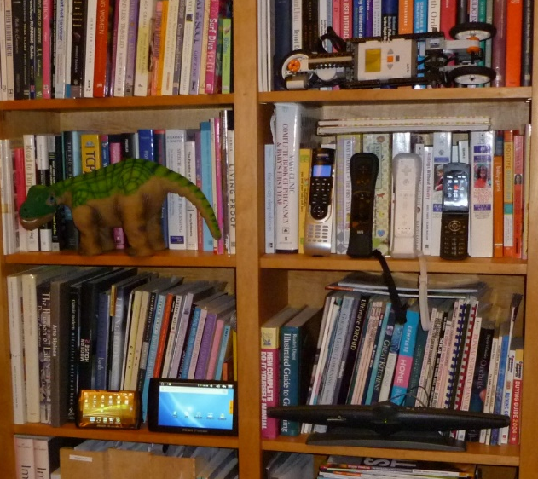
Very Brief History of OS
Several Distinct Phases:
  Hardware Expensive, Humans Cheap
    Eniac, … Multics
  Hardware Cheaper, Humans Expensive
    PCs, Workstations, Rise of GUIs
  Hardware Really Cheap, Humans Really Expensive
    Ubiquitous devices, Widespread networking
Notes:
Gone from people serving computers to computers serving people.
Except for the odd outlier like Pleo, that people need to take care of, virtually feed and play with.

Slide 9
Very Brief History of OS
Several Distinct Phases:
  Hardware Expensive, Humans Cheap
    Eniac, … Multics
  Hardware Cheaper, Humans Expensive
    PCs, Workstations, Rise of GUIs
  Hardware Really Cheap, Humans Really Expensive
    Ubiquitous devices, Widespread networking
Rapid Change in Hardware Leads to changing OS
  Batch ⇒ Multiprogramming ⇒ Timesharing ⇒ Graphical UI ⇒ Ubiquitous Devices
  Gradual Migration of Features into Smaller Machines
Situation today is much like the late 60s
  Small OS: 100K lines/Large: 10M lines (5M browser!)
  100-1000 people-years

Slide 10
OS Archaeology
Because of the cost of developing an OS from scratch, most modern OSes have a long lineage:
Multics → AT&T Unix → BSD Unix → Ultrix, SunOS, NetBSD,…
Mach (micro-kernel) + BSD → NextStep → XNU →
Apple OSX, iphone iOS
Linux → Android OS
CP/M → QDOS → MS-DOS → Windows 3.1 → NT → 95 → 98 → 2000 → XP → Vista → 7 → 8 → phone → …
Linux → RedHat, Ubuntu, Fedora, Debian, Suse,…
Notes:
Multics: MIT, GE, Bell Labs, 1969
Revolutionary but “bloated” at 135kB
Famous “failures”: Multics, Mach, NextStep: innovative but too flawed to succeed.
Microsoft established itself by writing an OS to compete with CP/M which IBM couldn’t negotiate with its author. They instead bought QDOS from a small code author who had written it from the CP/M manual.
Interestingly, there were some other OSes that didn’t have such a long lineage (e.g. IBM OS/2)

Slide 11
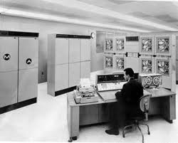
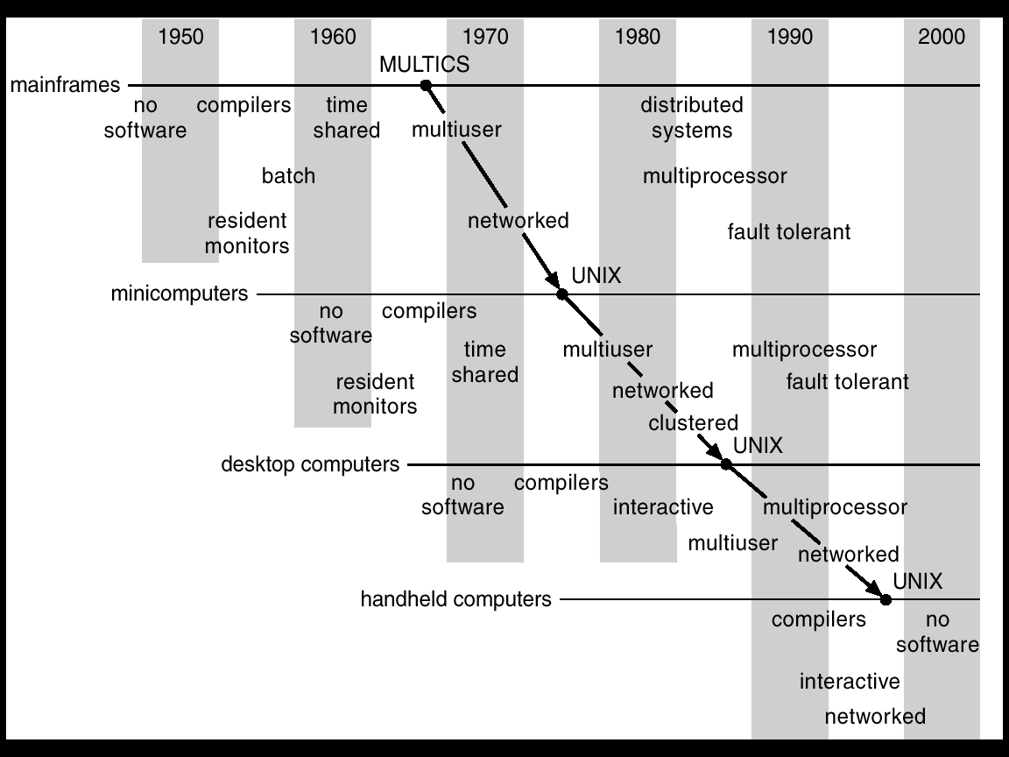
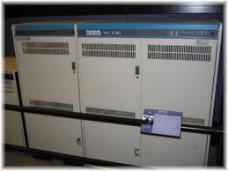
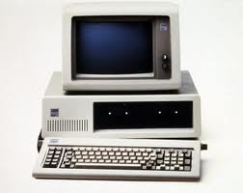
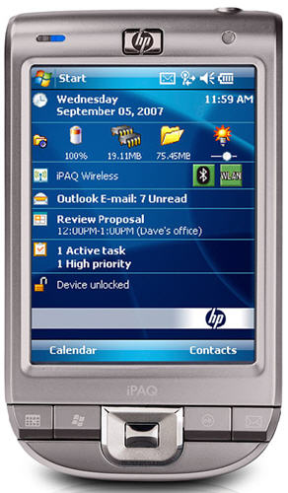
Migration of OS Concepts and Features

Slide 12
Today: Four fundamental OS concepts
Thread
  Single unique execution context
  Program Counter, Registers, Execution Flags, Stack
Address Space w/ Translation
  Programs execute in an address space that is distinct from the memory space of the physical machine
Process
  An instance of an executing program is a process consisting of an address space and one or more threads of control
Dual Mode operation/Protection
  Only the “system” has the ability to access certain resources
  The OS and the hardware are protected from user programs and user programs are isolated from one another by controlling the translation from program virtual addresses to machine physical addresses

Slide 13

OS Bottom Line: Run Programs
0xFFF…
OS
Executable
Program Source
stack
int main()
{ … ;
}
Load & Execute
compiler
data
Memory
editor
heap
instructions
data
foo.c
a.out
instructions
Load instruction and data segments of executable file into memory
Create stack and heap
“Transfer control to it”
Provide services to it
While protecting OS and it
0x000…
PC:
registers
Processor

Slide 14
Today we need one key 61B concept
The instruction cycle
Memory
Processor
next
PC:
Instruction fetch
instruction
Decode
decode
Registers
Execute
ALU
data

Slide 15
Recall (61C): What happens during program execution?
Addr 2³²-1
R0
…
R31
F0
…
F30
PC
…
Data1
Data0
Inst237
Inst236
…
Inst5
Inst4
Inst3
Inst2
Inst1
Inst0
Fetch
Exec
Execution sequence:
  Fetch Instruction at PC
  Decode
  Execute (possibly using registers)
  Write results to registers/mem
  PC = Next Instruction(PC)
  Repeat
PC
PC
PC
PC
Addr 0

Slide 16
First OS Concept: Thread of Control
Thread: Single unique execution context
  Program Counter, Registers, Execution Flags, Stack
A thread is executing on a processor when it is resident in the processor registers.
PC register holds the address of executing instruction in the thread.
Certain registers hold the context of thread
  Stack pointer holds the address of the top of stack
    Other conventions: Frame Pointer, Heap Pointer, Data
  May be defined by the instruction set architecture or by compiler conventions
Registers hold the root state of the thread.
  The rest is “in memory”

Slide 17
Second OS Concept: Program’s Address Space
Address space ⇒ the set of accessible addresses + state associated with them:
  For a 32-bit processor there are 2³² = 4 billion addresses
What happens when you read or write to an address?
  Perhaps Nothing
  Perhaps acts like regular memory
  Perhaps ignores writes
  Perhaps causes I/O operation
    (Memory-mapped I/O)
  Perhaps causes exception (fault)
0xFFF…
stack
heap
Static Data
code
0x000…

Slide 18
Address Space: In a Picture
0xFFF…
stack
PC:
SP:
heap
Processor
registers
Static Data
instruction
Code Segment
0x000…
What’s in the code segment? Data?
What’s in the stack segment?
  How is it allocated? How big is it?
What’s in the heap segment?
  How is it allocated? How big?

Slide 19
Multiprogramming - Multiple Threads of Control
Proc 1
Proc 2
Proc n
stack
…
heap
Static Data
OS
code
stack
heap
Static Data
code
stack
heap
Static Data
code

Slide 20
Administrivia: Getting started
Start homework 0 immediately ⇒ Due next Monday!
  Gets cs162-xx@cory.eecs.berkeley.edu (and other inst m/c)
  Github account
  Registration survey
  Vagrant virtualbox – VM environment for the course
    Consistent, managed environment on your machine
  Get familiar with all the cs162 tools
  Submit to autograder via git
Unlike last term:
We are not allowing you to drop 1 homework!
This Friday (9/4) is drop day!
  Very hard to drop afterwards…
Should be going to section already!
Group sign up form out next week (after drop deadine)
  Get finding groups ASAP
  4 people in a group!
  Try to attend either same section or 2 sections by same TA

Slide 21
Administrivia (Con’t)
Midterm conflicts:
  There are a couple of people with midterm conflicts – we are still figuring out what to do (if anything)
Kubiatowicz Office Hours:
  1pm-2pm, Monday/Wednesday
  May change as need arises (still have a bit of fluidity here)
Online Textbooks:
  Click on “Projects” link, under “Resources”, there is a pointer to “Online Textbooks”
  Can read these for free as long as on campus
    First ones: Book on Git, two books on C
Webcast:
  We are webcasting this class
  Will put link up off main page, but for now, go to:
    Calcentral.Berkeley.edu and click on cs162
    Available to officially registered students (not sure about waitlisted students)
  Webcast is *NOT* a replacement for coming to class!

Slide 22


CS 162 Collaboration Policy
Explaining a concept to someone in another group
Discussing algorithms/testing strategies with other groups
Helping debug someone else’s code (in another group)
Searching online for generic algorithms (e.g., hash table)
Sharing code or test cases with another group
Copying OR reading another group’s code or test cases
Copying OR reading online code or test cases from from prior years
We compare all project submissions against prior year submissions and online solutions and will take actions (described on the course overview page) against offenders

Slide 23
How can we give the illusion of multiple processors?
vCPU1
vCPU2
vCPU3
vCPU1
vCPU2
vCPU3
vCPU1
vCPU2
Shared Memory
Time
Assume a single processor. How do we provide the illusion of multiple processors?
  Multiplex in time!
Each virtual “CPU” needs a structure to hold:
  Program Counter (PC), Stack Pointer (SP)
  Registers (Integer, Floating point, others…?)
How switch from one virtual CPU to the next?
  Save PC, SP, and registers in current state block
  Load PC, SP, and registers from new state block
What triggers switch?
  Timer, voluntary yield, I/O, other things

Slide 24
The Basic Problem of Concurrency
The basic problem of concurrency involves resources:
  Hardware: single CPU, single DRAM, single I/O devices
  Multiprogramming API: processes think they have exclusive access to shared resources
OS has to coordinate all activity
  Multiple processes, I/O interrupts, …
  How can it keep all these things straight?
Basic Idea: Use Virtual Machine abstraction
  Simple machine abstraction for processes
  Multiplex these abstract machines
Dijkstra did this for the “THE system”
  Few thousand lines vs 1 million lines in OS 360 (1K bugs)

Slide 25
Properties of this simple multiprogramming technique
All virtual CPUs share same non-CPU resources
  I/O devices the same
  Memory the same
Consequence of sharing:
  Each thread can access the data of every other thread (good for sharing, bad for protection)
  Threads can share instructions
  (good for sharing, bad for protection)
  Can threads overwrite OS functions?
This (unprotected) model is common in:
  Embedded applications
  Windows 3.1/Early Macintosh (switch only with yield)
  Windows 95—ME (switch with both yield and timer)

Slide 26
Protection
Operating System must protect itself from user programs
  Reliability: compromising the operating system generally causes it to crash
  Security: limit the scope of what processes can do
  Privacy: limit each process to the data it is permitted to access
  Fairness: each should be limited to its appropriate share of system resources (CPU time, memory, I/O, etc)
It must protect User programs from one another
Primary Mechanism: limit the translation from program address space to physical memory space
  Can only touch what is mapped into process address space
Additional Mechanisms:
  Privileged instructions, in/out instructions, special registers
  syscall processing, subsystem implementation
    (e.g., file access rights, etc)

Slide 27
Third OS Concept: Process
Process: execution environment with Restricted Rights
  Address Space with One or More Threads
  Owns memory (address space)
  Owns file descriptors, file system context, …
  Encapsulate one or more threads sharing process resources
Why processes?
  Protected from each other!
  OS Protected from them
  Processes provides memory protection
  Threads more efficient than processes (later)
  Fundamental tradeoff between protection and efficiency
    Communication easier within a process
    Communication harder between processes
Application instance consists of one or more processes

Slide 28
Fourth OS Concept: Dual Mode Operation
Hardware provides at least two modes:
  “Kernel” mode (or “supervisor” or “protected”)
  “User” mode: Normal programs executed
What is needed in the hardware to support “dual mode” operation?
  a bit of state (user/system mode bit)
  Certain operations / actions only permitted in system/kernel mode
    In user mode they fail or trap
  User->Kernel transition sets system mode AND saves the user PC
    Operating system code carefully puts aside user state then performs the necessary operations
  Kernel->User transition clears system mode AND restores appropriate user PC
    return-from-interrupt

Slide 29
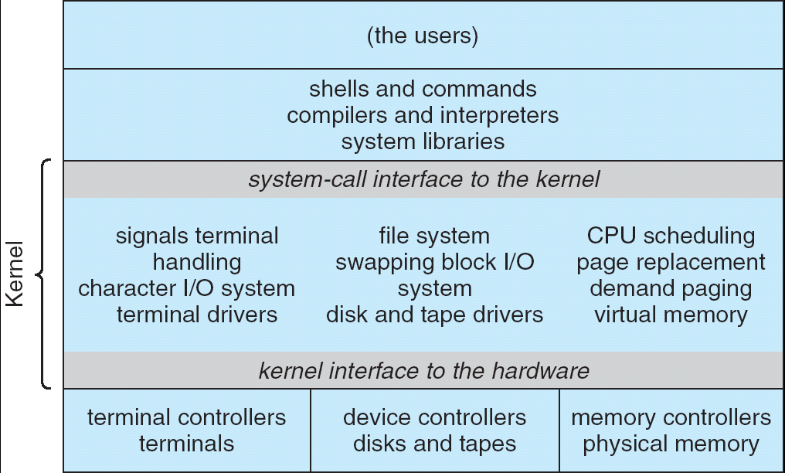
For example: UNIX System Structure
Applications
User Mode
Standard Libs
Kernel Mode
Hardware

Slide 30
User/Kernal(Priviledged) Mode
User Mode
interrupt
exception
syscall
rtn
rfi
Kernel Mode
exit
exec
Limited HW access
Full HW access

Slide 31
Simple Protection: Base and Bound (B&B)
0000…
0000…
code
code
Static Data
Static Data
heap
heap
stack
Base
stack
1000…
1000…
>=
code
Program
address
Static Data
<
heap
Bound
1100…
stack
1100…
Requires relocating loader
Still protects OS and isolates pgm
No addition on address path
FFFF…

Slide 32
Another idea: Address Space Translation
Program operates in an address space that is distinct from the physical memory space of the machine
“physical address”
0x000…
“virtual address”
Processor
translator
Memory
0xFFF…

Slide 33
A simple address translation with Base and Bound
0000…
0000…
code
code
Static Data
Static Data
heap
heap
stack
Base Address
stack
1000…
1000…
code
Program
address
Static Data
heap
Bound
<
stack
1100…
0100…
Can the program touch OS?
Can it touch other programs?
FFFF…

Slide 34
Tying it together: Simple B&B: OS loads process
0000…
Proc 1
Proc 2
Proc n
code
…
Static Data
OS
heap
stack
sysmode
1
1000…
code
Base
xxxx …
0000…
Static Data
Bound
xxxx…
FFFF…
heap
uPC
xxxx…
stack
1100…
PC
code
3000…
regs
Static Data
…
heap
stack
3080…
FFFF…

Slide 35
Simple B&B: OS gets ready to switch
0000…
Proc 1
Proc 2
Proc n
code
RTU
…
Static Data
OS
heap
stack
sysmode
1
1000…
code
Base
1000 …
0000…
Static Data
Bound
1100…
FFFF…
heap
uPC
0001…
stack
1100…
PC
code
3000…
regs
00FF…
Static Data
Priv Inst: set special registers
RTU
…
heap
stack
3080…
FFFF…

Slide 36
Simple B&B: “Return” to User
0000…
Proc 1
Proc 2
Proc n
code
…
Static Data
OS
heap
stack
sysmode
0
1000…
code
Base
1000 …
0000…
Static Data
Bound
1100…
FFFF…
heap
uPC
xxxx…
stack
1100…
PC
0001…
code
3000…
regs
00FF…
Static Data
How to return to system?
…
heap
stack
3080…
FFFF…

Slide 37
3 types of Mode Transfer
Syscall
  Process requests a system service, e.g., exit
  Like a function call, but “outside” the process
  Does not have the address of the system function to call
  Like a Remote Procedure Call (RPC) – for later
  Marshall the syscall id and args in registers and exec syscall
Interrupt
  External asynchronous event triggers context switch
  eg. Timer, I/O device
  Independent of user process
Trap or Exception
  Internal synchronous event in process triggers context switch
  e.g., Protection violation (segmentation fault), Divide by zero, …
All 3 are an UNPROGRAMMED CONTROL TRANSFER
  Where does it go?

Slide 38
How do we get the system target address of the “unprogrammed control transfer?”

Slide 39
Interrupt Vector
Address and properties of each interrupt handler
interrupt number
(i)
intrpHandler_i () {
….
}
Where else do you see this dispatch pattern?

Slide 40
Simple B&B: User => Kernel
0000…
Proc 1
Proc 2
Proc n
code
…
Static Data
OS
heap
stack
sysmode
0
1000…
code
Base
1000 …
0000…
Static Data
Bound
1100…
FFFF…
heap
uPC
xxxx…
stack
1100…
PC
0000 1234
code
3000…
regs
00FF…
Static Data
How to return to system?
…
heap
stack
3080…
FFFF…

Slide 41
Simple B&B: Interrupt
0000…
Proc 1
Proc 2
Proc n
code
…
Static Data
OS
heap
stack
sysmode
1
1000…
code
Base
1000 …
0000…
Static Data
Bound
1100 …
FFFF…
heap
uPC
0000 1234
stack
1100…
PC
IntrpVector[i]
code
3000…
regs
00FF…
Static Data
How to save registers and set up system stack?
…
heap
stack
3080…
FFFF…

Slide 42
Simple B&B: Switch User Process
0000…
Proc 1
Proc 2
Proc n
code
RTU
…
Static Data
OS
heap
stack
sysmode
1
1000…
1000 …
code
Base
3000 …
0000…
Static Data
1100 …
Bound
0080 …
FFFF…
heap
0000 1234
uPC
0000 0248
regs
stack
1100…
PC
0001 0124
00FF…
code
3000…
regs
00D0…
Static Data
How to save registers and set up system stack?
…
heap
stack
3080…
FFFF…

Slide 43
Simple B&B: “resume”
0000…
Proc 1
Proc 2
Proc n
code
RTU
…
Static Data
OS
heap
stack
sysmode
0
1000…
1000 …
code
Base
3000 …
0000…
Static Data
1100 …
Bound
0080 …
FFFF…
heap
0000 1234
uPC
xxxx xxxx
regs
stack
1100…
PC
000 0248
00FF…
code
3000…
regs
00D0…
Static Data
How to save registers and set up system stack?
…
heap
stack
3080…
FFFF…

Slide 44
What’s wrong with this simplistic address translation mechanism?

Slide 45
x86 – segments and stacks
code
Static Data
Processor Registers
heap
CS
EIP
stack
SS
ESP
CS:
EIP:
code
EAX
DS
EBX
ES
ECX
Static Data
EDX
ESI
EDI
heap
Start address, length and access rights associated with each segment
SS:
ESP:
stack

Slide 46
Virtual Address Translation
Simpler, more useful schemes too!
Give every process the illusion of its own BIG FLAT ADDRESS SPACE
  Break it into pages
  More on this later

Slide 47
Providing Illusion of Separate Address Space:
Load new Translation Map on Switch
Code
Data
Heap
Stack
Data 2
Code
Data
Heap
Stack
Stack 1
Heap 1
Code 1
Stack 2
Prog 1
Virtual
Address
Space 1
Data 1
Prog 2
Virtual
Address
Space 2
Heap 2
Code 2
OS code
Translation Map 1
OS data
Translation Map 2
OS heap &
Stacks
Physical Address Space

Slide 48
Running Many Programs ???
We have the basic mechanism to
  switch between user processes and the kernel,
  the kernel can switch among user processes,
  Protect OS from user processes and processes from each other
Questions ???
How do we decide which user process to run?
How do we represent user processes in the OS?
How do we pack up the process and set it aside?
How do we get a stack and heap for the kernel?
Aren’t we wasting are lot of memory?
…

Slide 49
Process Control Block
Kernel represents each process as a process control block (PCB)
  Status (running, ready, blocked, …)
  Register state (when not ready)
  Process ID (PID), User, Executable, Priority, …
  Execution time, …
  Memory space, translation, …
Kernel Scheduler maintains a data structure containing the PCBs
Scheduling algorithm selects the next one to run

Slide 50
Scheduler
if ( readyProcesses(PCBs) ) {
nextPCB = selectProcess(PCBs);
run( nextPCB );
} else {
run_idle_process();
}

Slide 51
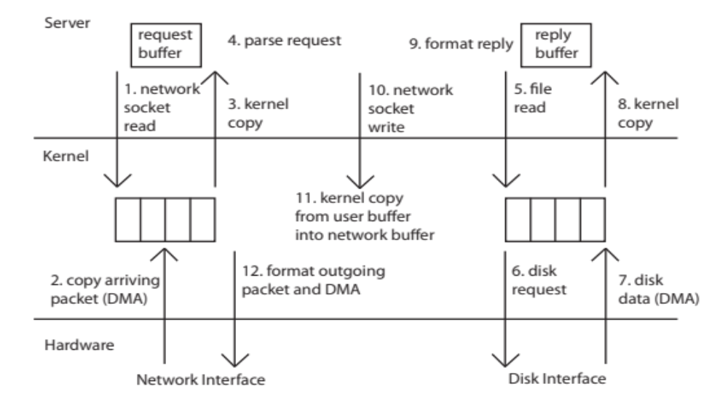
Putting it together: web server
syscall
syscall
RTU
RTU
wait
wait
interrupt
interrupt

Slide 52
Digging Deeper: Discussion & Questions

Slide 53
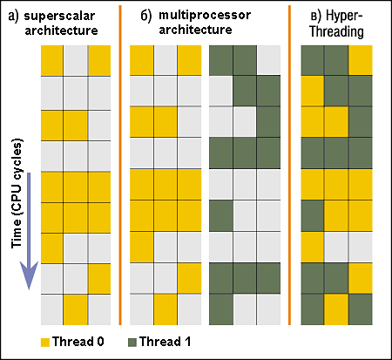
Simultaneous MultiThreading/Hyperthreading
Hardware technique
  Superscalar processors can
  execute multiple instructions
  that are independent.
  Hyperthreading duplicates
  register state to make a
  second “thread,” allowing
  more instructions to run.
Can schedule each thread
as if were separate CPU
  But, sub-linear speedup!
Original technique called “Simultaneous Multithreading”
  http://www.cs.washington.edu/research/smt/index.html
  SPARC, Pentium 4/Xeon (“Hyperthreading”), Power 5
Colored blocks show
instructions executed
Notes:
Intel seems to be discarding SMT in Silvermont because of power problems

Slide 54
Implementing Safe Mode Transfers
Carefully constructed kernel code packs up the user process state an sets it aside.
  Details depend on the machine architecture
Should be impossible for buggy or malicious user program to cause the kernel to corrupt itself.
Interrupt processing not be visible to the user process:
  Occurs between instructions, restarted transparently
  No change to process state
  What can be observed even with perfect interrupt processing?

Slide 55
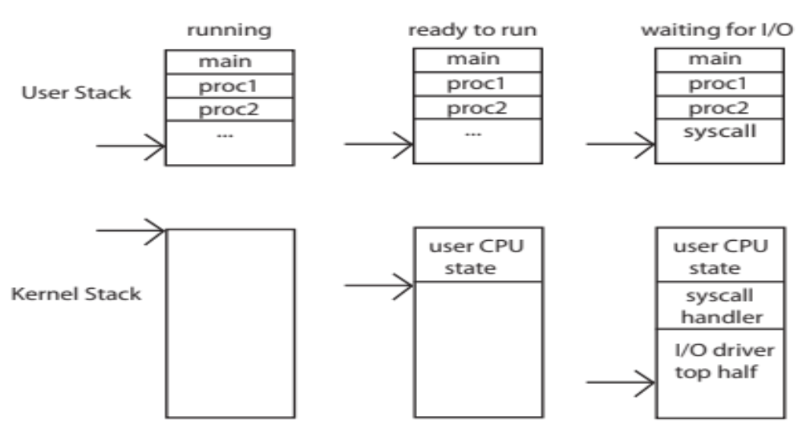
Kernel Stack Challenge
Kernel needs space to work
Cannot put anything on the user stack (Why?)
Two-stack model
  OS thread has interrupt stack (located in kernel memory) plus User stack (located in user memory)
  Syscall handler copies user args to kernel space before invoking specific function (e.g., open)
  Interrupts (???)

Slide 56
Hardware support: Interrupt Control
Interrupt Handler invoked with interrupts ‘disabled’
  Re-enabled upon completion
  Non-blocking (run to completion, no waits)
  Pack it up in a queue and pass off to an OS thread to do the hard work
    wake up an existing OS thread
OS kernel may enable/disable interrupts
  On x86: CLI (disable interrupts), STI (enable)
  Atomic section when select next process/thread to run
  Atomic return from interrupt or syscall
HW may have multiple levels of interrupt
  Mask off (disable) certain interrupts, eg., lower priority
  Certain non-maskable-interrupts (nmi)
    e.g., kernel segmentation fault

Slide 57
How do we take interrupts safely?
Interrupt vector
  Limited number of entry points into kernel
Kernel interrupt stack
  Handler works regardless of state of user code
Interrupt masking
  Handler is non-blocking
Atomic transfer of control
  “Single instruction”-like to change:
    Program counter
    Stack pointer
    Memory protection
    Kernel/user mode
Transparent restartable execution
  User program does not know interrupt occurred

Slide 58
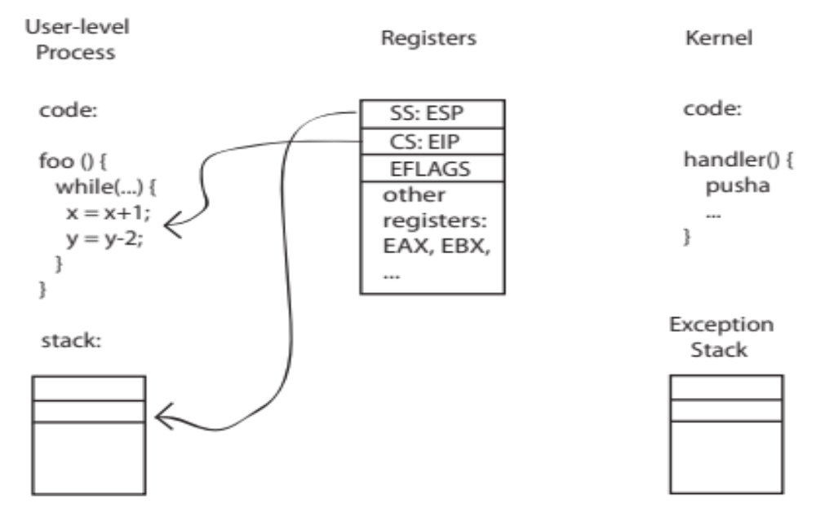
Before

Slide 59
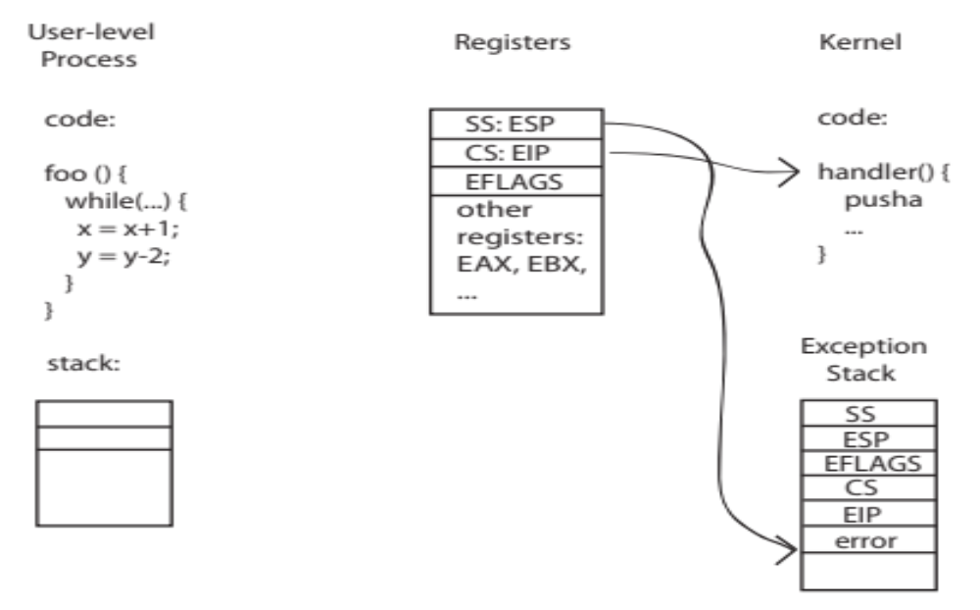
During

Slide 60
Kernel System Call Handler
Locate arguments
  In registers or on user(!) stack
Copy arguments
  From user memory into kernel memory
  Protect kernel from malicious code evading checks
Validate arguments
  Protect kernel from errors in user code
Copy results back
  into user memory

Slide 61
Conclusion: Four fundamental OS concepts
Thread
  Single unique execution context
  Program Counter, Registers, Execution Flags, Stack
Address Space w/ Translation
  Programs execute in an address space that is distinct from the memory space of the physical machine
Process
  An instance of an executing program is a process consisting of an address space and one or more threads of control
Dual Mode operation/Protection
  Only the “system” has the ability to access certain resources
  The OS and the hardware are protected from user programs and user programs are isolated from one another by controlling the translation from program virtual addresses to machine physical addresses

