Slide 1
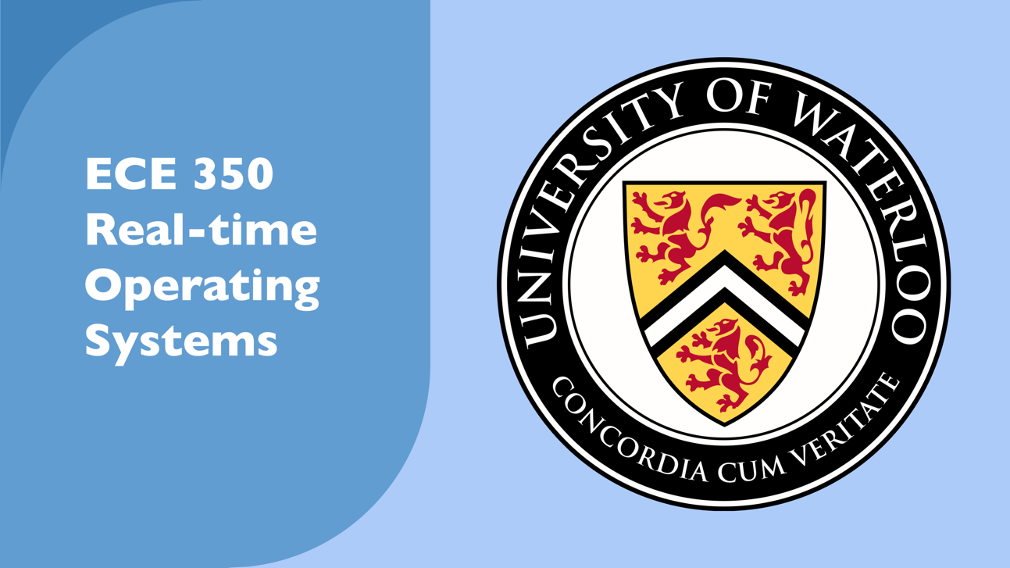

Slide 2
Lecture 2: OS Concepts
Prof. Seyed Majid Zahedi
https://ece.uwaterloo.ca/~smzahedi

Slide 3
Outline
Brief history of OSes
Four fundamental OS concepts
  Thread
  Address space
  Process
  Dual-mode operation/protection

Slide 4
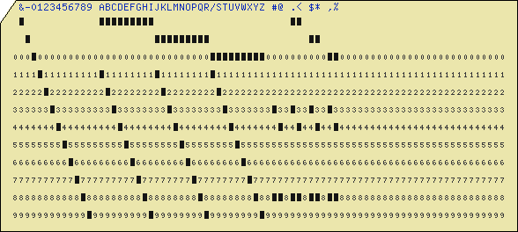
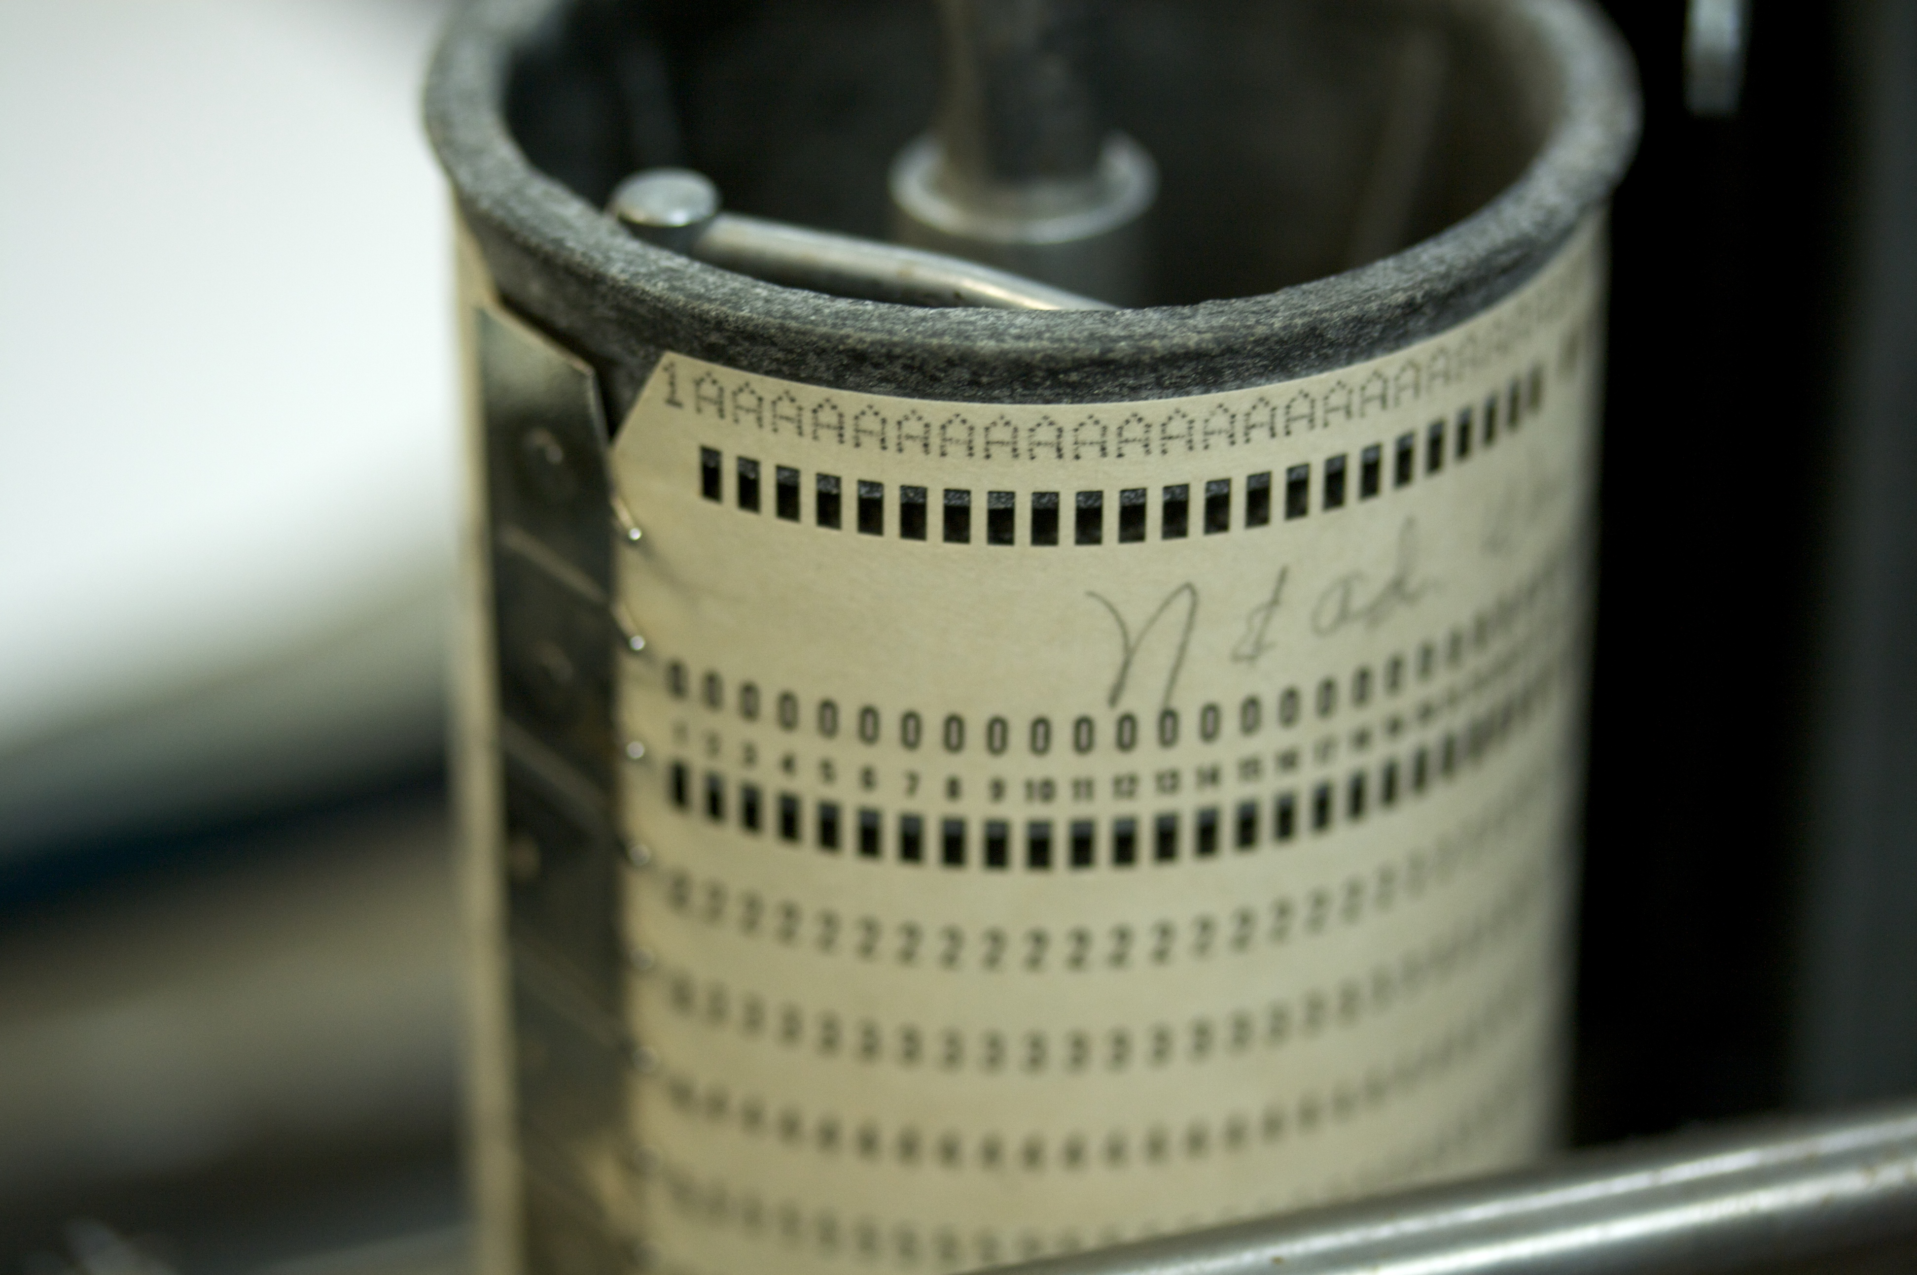
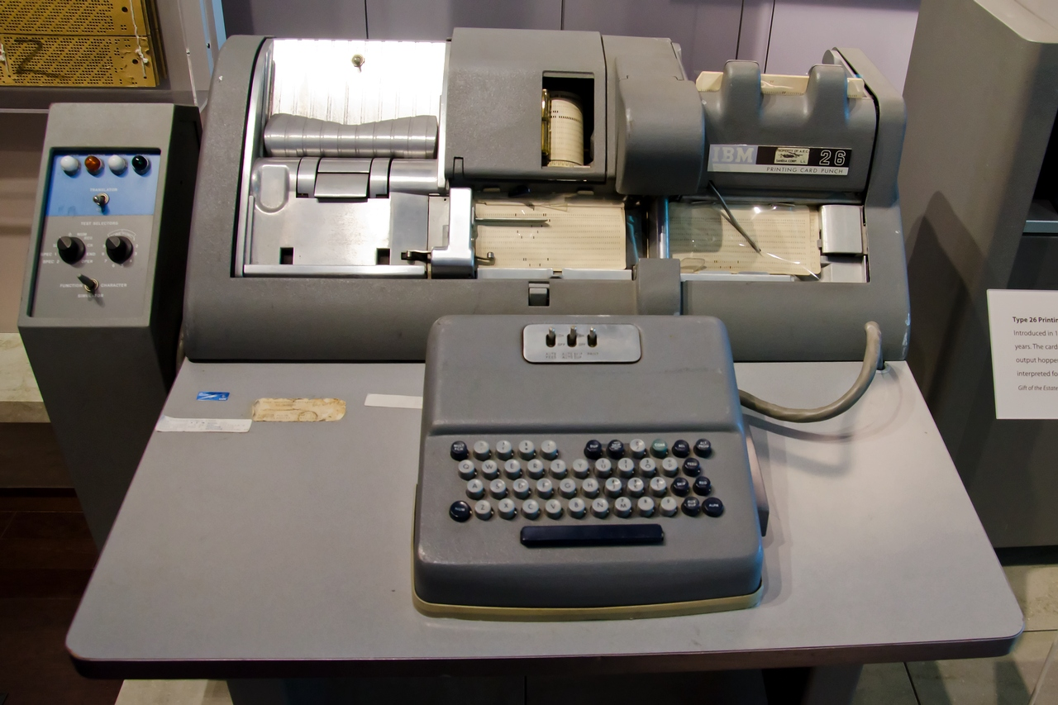
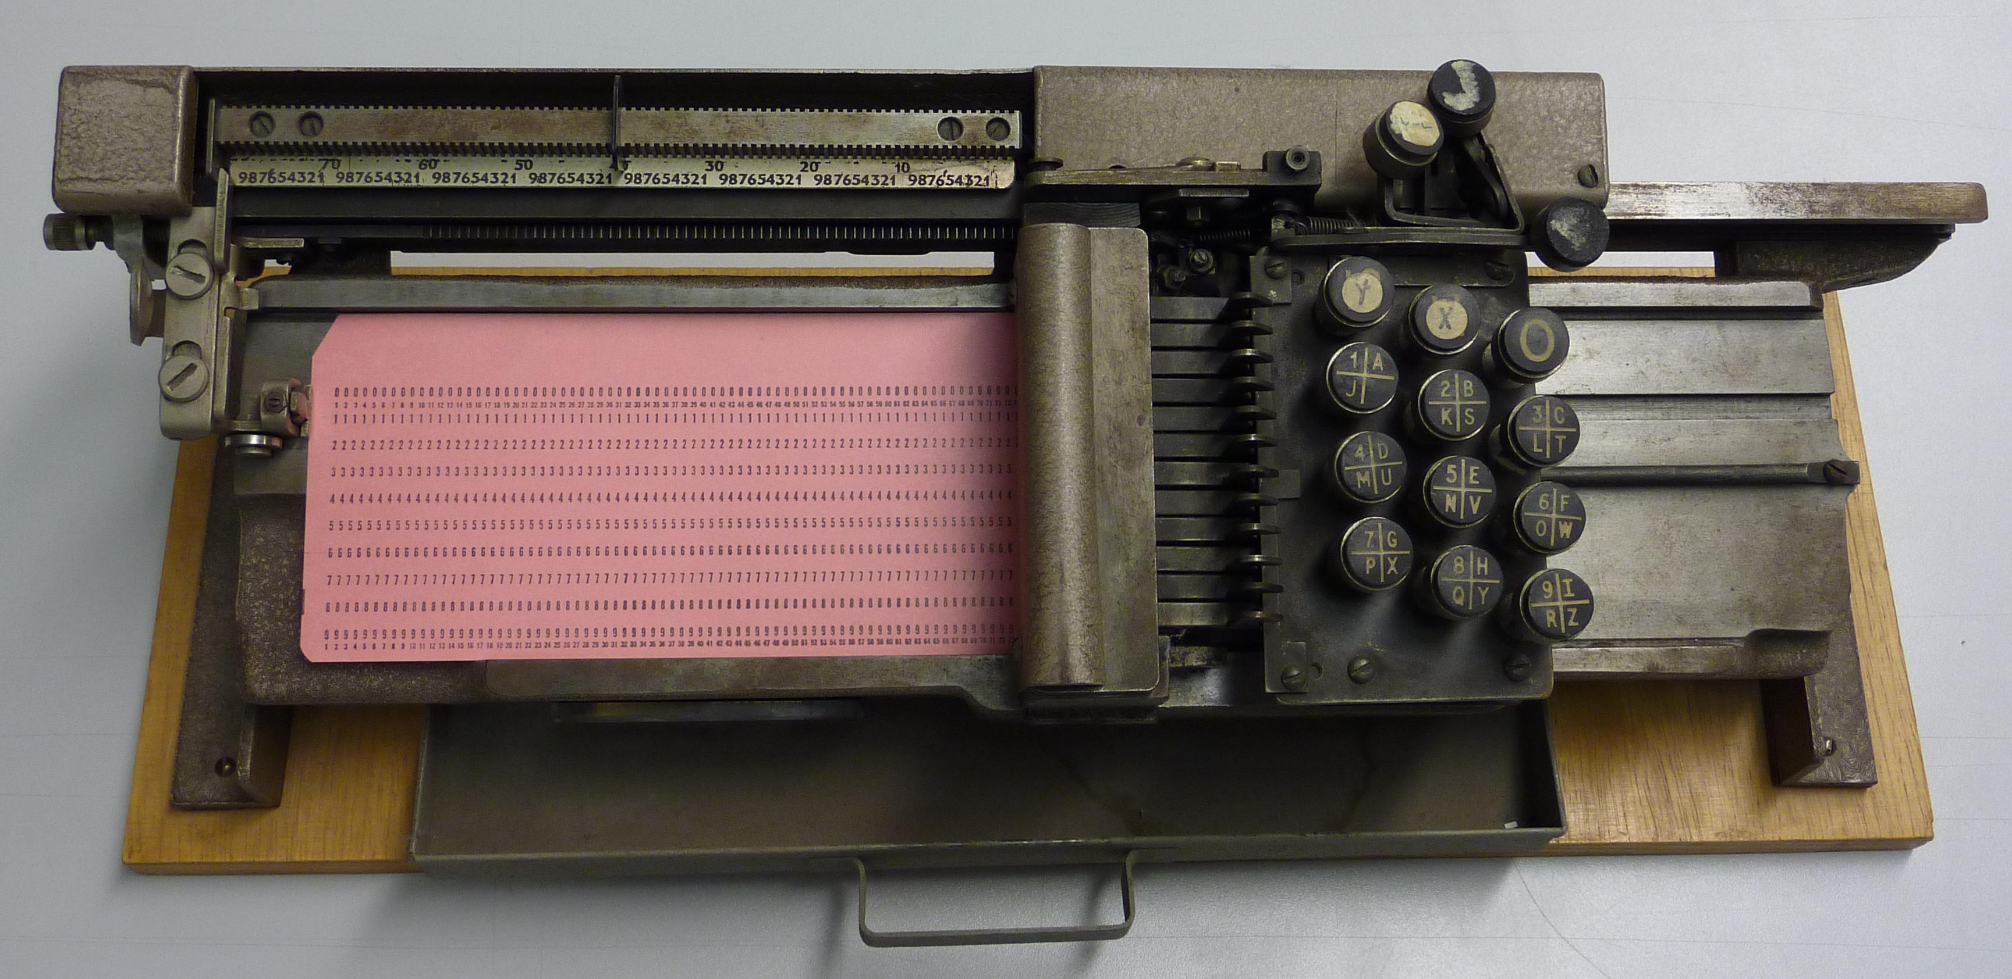
Serial Processing
Machines did not have operating systems
Run from console with display lights, toggle switches, input device, and printer
Machine is used by a single user (users had to reserve time to use machines)
Running programs had long lead time (users had to load compiler and source program, save compiled program, and then load and link it)
Debugging programs was extremely hard
wikimedia.org
columbia.edu

Slide 5
Evolution of OSes
Simple batch OS
  Jobs with same requirement and grouped into batches
  Special program, called monitor, monitors and manages each program
  Erroneous or misbehaving jobs could corrupt entire system
  Automatic job sequencing improves throughput, but I/O is still slow
Multiprogramming batch OS
  When running job requires I/O, OS switches to another job
  While this maximizes CPU utilization, response time could still suffer
Time-sharing OS
  Multiple users simultaneously access system through terminals
  Processor’s time is shared among multiple users
  Primary focus is to minimize response time

Slide 6
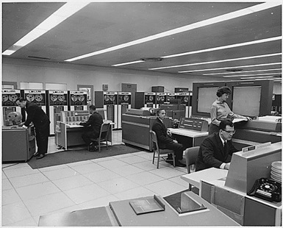
Very Brief History of OS
Several distinct phases:
  Hardware expensive, humans cheap
    Eniac, … Multics
“I think there is a world market for maybe five computers.” – Thomas Watson, chairman of IBM, 1943
Thomas Watson was often called “the worlds greatest salesman” by the time of his death in 1956
Notes:
Gone from people serving computers to computers serving people.
Except for the odd outlier like Pleo, that people need to take care of, virtually feed and play with.

Slide 7
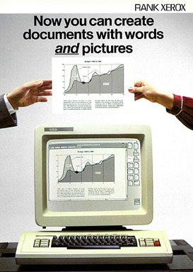

Very Brief History of OS (cont.)
Several distinct phases:
  Hardware expensive, humans cheap
    Eniac, … Multics
  Hardware cheaper, humans expensive
    PCs, workstations, rise of GUIs
  Hardware very cheap, humans very expensive
    Ubiquitous devices, widespread networking
Notes:
Gone from people serving computers to computers serving people.
Except for the odd outlier like Pleo, that people naeed to take care of, virtually feed and play with.

Slide 8
Very Brief History of OS (cont.)
Several distinct phases:
  Hardware expensive, humans cheap
    Eniac, … Multics
  Hardware cheaper, humans expensive
    PCs, workstations, rise of GUIs
  Hardware very cheap, humans very expensive
    Ubiquitous devices, widespread networking
Rapid change in hardware leads to changing OS
  Batch ⇒ multiprogramming ⇒ timesharing ⇒ GUI ⇒ ubiquitous devices
  Gradual migration of features into smaller machines
Today
  Small OS: 100K lines / Large: 20M lines (10M browser!)
  100-1000 people-years

Slide 9

OS Archaeology
Due to high cost of building OS from scratch,
most modern OS’s have long lineage
Multics ⇒ AT&T Unix ⇒ BSD Unix ⇒
Ultrix, SunOS, NetBSD,…
Mach (micro-kernel) + BSD ⇒ NextStep ⇒
XNU ⇒ Apple OS X, iPhone iOS
MINIX ⇒ Linux ⇒ Android, Chrome OS, RedHat, Ubuntu, Fedora, Debian, Suse,…
CP/M ⇒ QDOS ⇒ MS-DOS ⇒ Windows 3.1 ⇒ NT ⇒ 95 ⇒ 98 ⇒ 2000 ⇒ XP ⇒ Vista ⇒ 7 ⇒ 8 ⇒ 10 ⇒ …
anthropology4u.medium.com
Notes:
Multics: MIT, GE, Bell Labs, 1969
Revolutionary but “bloated” at 135kB
Famous “failures”: Multics, Mach, NextStep: innovative but too flawed to succeed.
Microsoft established itself by writing an OS to compete with CP/M which IBM couldn’t negotiate with its author. They instead bought QDOS from a small code author who had written it from the CP/M manual.
Interestingly, there were some other OSes that didn’t have such a long lineage (e.g. IBM OS/2)

Slide 10
Today: Four Fundamental OS Concepts
Thread
  Single unique execution context which fully describes program state
  Program counter, registers, execution flags, stack
Address space (with translation)
  Address space which is distinct from machine’s physical memory addresses
Process
  Instance of executing program consisting of address space and 1+ threads
Dual-mode operation/protection
  Only “system” can access certain resources
  OS and hardware are protected from user programs
  User programs are isolated from one another by controlling translation from program virtual addresses to machine physical addresses

Slide 11
Booting OS
Physical
Memory
Disk
(1)
BIOS copies
bootloader
BIOS
In most x86 systems, BIOS is stored on Boot ROM
  Expensive and writing to it is slow
Why not storing kernel on Boot ROM?
  Hard to update (OS updates are frequent)
Why does BIOS load bootloader not OS?
  Might have multiple OSes installed
  BIOS needs to read raw bytes from disk, whereas bootloader needs to know how to read from filesystem
Bootloader instructions and data
Bootloader
(2)
Bootloader
copies OS
kernel
OS kernel instructions and data
OS kernel
Login app
(3)
OS kernel
copies login
application
Login app instructions and data

Slide 12

OS Bottom Line: Run Programs
0xFFF…F
Source
Code
Executable Image
Edits
Compiler
OS
learnworthy.net
Data
Instructions
OS Loads
Stack
Load instruction and data segments of executable file into memory
Create stack and heap
“Transfer control to program”
Provide services to program
While protecting OS and program
Heap
Memory
Data
Instructions
OS Starts Execution
0x000…0
PC
Processor Registers

Slide 13
Instruction Cycle:
Fetch, Decode, Execute
Memory
Data
ALU
Execution sequence
  Fetch instruction at PC
  Decode
  Execute (possibly using registers)
  Write results to registers/memory
  PC ← Next(PC)
  Repeat
Registers
Decode
Instructions
PC
Next
Next instruction or jump
to new address …

Slide 14
Thread (1st OS Concept)
Thread is short for thread of execution
Thread of execution is sequence of executable commands that can run on CPU
Threads have some state and store some local variables
  Execution state (ready, running, waiting, …)
  Saved context when not running
  Execution stack
  Local variables
  …
Multithreaded programs use more than one thread (some of the time)
  Program begins with single initial thread (where the main method is)
  Threads can be created and destroyed within programs dynamically
Thread 3
Thread 1
Thread 2
Thread 4
Thread 7
Thread 5
Thread 6
Time

Slide 15
Recall: The POSIX Thread
pthread refers to POSIX standard that defines thread behavior in UNIX
pthread_create
  Creates new thread to run a function
pthread_exit
  Quit thread and clean up, wake up joiner if any
  To allow other threads to continue execution, the main thread should terminate by calling pthread_exit() rather than exit(3)
pthread_join
  In parent, wait for children to exit, then return
pthread_yield
  Relinquish CPU voluntarily
…

Slide 16
Thread Lifecycle
Create
pthread_create
Init
Ready
Scheduled
Running
Finished
Created
Exits
Yields/Suspended
pthread_exit
pthread_yield
Even happens
Waits for event
pthread_exit
pthread_cond_signal/broadcast
pthread_join
pthread_cond_wait
Waiting
A process can go directly from ready or waiting to finished (example: main thread calls exit)

Slide 17
Thread Control Block (TCB)
Data structure in OS containing information needed to manage a thread
  Thread unique identifier (tid)
  Stack pointer (points to thread's stack in the process)
  Program counter (points to the current program instruction of the thread)
  State of the thread (e.g., running, ready, waiting, etc.)
  Thread's register values
  Pointer to process control block (PCB) of the process that the thread lives on

Slide 18
Address Space (2nd OS Concept)
Address space: set of accessible addresses and their state
Physical memory: data storage medium
Physical addresses: addresses available on physical memory
  For 4GB of memory: 2³²B ~ 4 billion addresses
Virtual addresses: addresses generated by program
  For 64-bit processor: 2⁶⁴ > 18 quintillion (10¹⁸) addresses

Slide 19
Virtual Address Space Layout of
C Programs
0xFFFF…F
Command line args and environment vars
#include <stdio.h>
#include <stdlib.h>
int x;
int y = 15;
int main(int argc, char *argv[]) {
int *values;
int I;
values = (int *)malloc(sizeof(int)*5);
for (i = 0; i < 5; i++)
values[i] = i;
return 0;
}
Stack
Shared library
Shared library
Heap
Uninitialized Data
Initialized Data
Binary Code
0x0000…0

Slide 20
Stack Example
Stack
Pointer
tmp = 1
ret = ext
A0: A(int tmp) {
A1: if (tmp<2)
A2: B();
A3: printf(tmp);
A4: }
B0: B() {
B1: C();
B2: }
C0: C() {
C1: A(2);
C2: }
A(1);
ext:
Stack holds temporary results
Permits recursive execution
Crucial to modern languages

Slide 21
Stack Example
Stack
Pointer
tmp = 1
ret = ext
A0: A(int tmp) {
A1: if (tmp<2)
A2: B();
A3: printf(tmp);
A4: }
B0: B() {
B1: C();
B2: }
C0: C() {
C1: A(2);
C2: }
A(1);
ext:
Stack holds temporary results
Permits recursive execution
Crucial to modern languages

Slide 22
Stack Example
Stack
Pointer
tmp = 1
ret = ext
A0: A(int tmp) {
A1: if (tmp<2)
A2: B();
A3: printf(tmp);
A4: }
B0: B() {
B1: C();
B2: }
C0: C() {
C1: A(2);
C2: }
A(1);
ext:
Stack holds temporary results
Permits recursive execution
Crucial to modern languages

Slide 23
Stack Example
tmp = 1
ret = ext
A0: A(int tmp) {
A1: if (tmp<2)
A2: B();
A3: printf(tmp);
A4: }
B0: B() {
B1: C();
B2: }
C0: C() {
C1: A(2);
C2: }
A(1);
ext:
Stack
Pointer
ret = A3
Stack holds temporary results
Permits recursive execution
Crucial to modern languages

Slide 24
Stack Example
tmp = 1
ret = ext
A0: A(int tmp) {
A1: if (tmp<2)
A2: B();
A3: printf(tmp);
A4: }
B0: B() {
B1: C();
B2: }
C0: C() {
C1: A(2);
C2: }
A(1);
ext:
ret = A3
Stack
Pointer
ret = B2
Stack holds temporary results
Permits recursive execution
Crucial to modern languages

Slide 25
Stack Example
tmp = 1
ret = ext
A0: A(int tmp) {
A1: if (tmp<2)
A2: B();
A3: printf(tmp);
A4: }
B0: B() {
B1: C();
B2: }
C0: C() {
C1: A(2);
C2: }
A(1);
ext:
ret = A3
ret = B2
Stack
Pointer
tmp = 2
ret = C2
Stack holds temporary results
Permits recursive execution
Crucial to modern languages

Slide 26
Stack Example
tmp = 1
ret = ext
A0: A(int tmp) {
A1: if (tmp<2)
A2: B();
A3: printf(tmp);
A4: }
B0: B() {
B1: C();
B2: }
C0: C() {
C1: A(2);
C2: }
A(1);
ext:
ret = A3
ret = B2
Stack
Pointer
tmp = 2
ret = C2
> 2
Stack holds temporary results
Permits recursive execution
Crucial to modern languages

Slide 27
Stack Example
tmp = 1
ret = ext
A0: A(int tmp) {
A1: if (tmp<2)
A2: B();
A3: printf(tmp);
A4: }
B0: B() {
B1: C();
B2: }
C0: C() {
C1: A(2);
C2: }
A(1);
ext:
ret = A3
ret = B2
Stack
Pointer
tmp = 2
ret = C2
> 2
Stack holds temporary results
Permits recursive execution
Crucial to modern languages

Slide 28
Stack Example
tmp = 1
ret = ext
A0: A(int tmp) {
A1: if (tmp<2)
A2: B();
A3: printf(tmp);
A4: }
B0: B() {
B1: C();
B2: }
C0: C() {
C1: A(2);
C2: }
A(1);
ext:
ret = A3
Stack
Pointer
ret = B2
> 2
Stack holds temporary results
Permits recursive execution
Crucial to modern languages

Slide 29
Stack Example
tmp = 1
ret = ext
A0: A(int tmp) {
A1: if (tmp<2)
A2: B();
A3: printf(tmp);
A4: }
B0: B() {
B1: C();
B2: }
C0: C() {
C1: A(2);
C2: }
A(1);
ext:
Stack
Pointer
ret = A3
> 2
Stack holds temporary results
Permits recursive execution
Crucial to modern languages

Slide 30
Stack Example
Stack
Pointer
tmp = 1
ret = ext
A0: A(int tmp) {
A1: if (tmp<2)
A2: B();
A3: printf(tmp);
A4: }
B0: B() {
B1: C();
B2: }
C0: C() {
C1: A(2);
C2: }
A(1);
ext:
> 21
Stack holds temporary results
Permits recursive execution
Crucial to modern languages

Slide 31
Stack Example
Stack
Pointer
tmp = 1
ret = ext
A0: A(int tmp) {
A1: if (tmp<2)
A2: B();
A3: printf(tmp);
A4: }
B0: B() {
B1: C();
B2: }
C0: C() {
C1: A(2);
C2: }
A(1);
ext:
> 21
Stack holds temporary results
Permits recursive execution
Crucial to modern languages

Slide 32
Stack Example
A0: A(int tmp) {
A1: if (tmp<2)
A2: B();
A3: printf(tmp);
A4: }
B0: B() {
B1: C();
B2: }
C0: C() {
C1: A(2);
C2: }
A(1);
ext:
> 21
Stack holds temporary results
Permits recursive execution
Crucial to modern languages

Slide 33
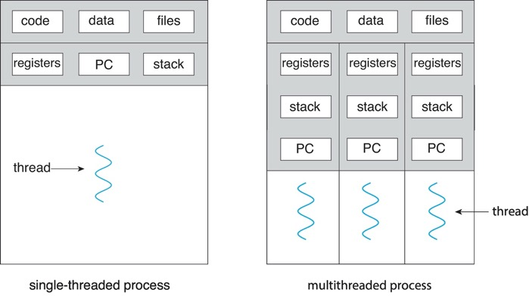
Process (3rd OS Concept)
Process: execution environment with restricted rights
  Address space with one or more threads
  Owns memory (address space)
  Owns file descriptors, file system context, …
Fundamental tradeoff between protection and efficiency
  Communication easier within a process
  Communication harder between processes

Slide 34
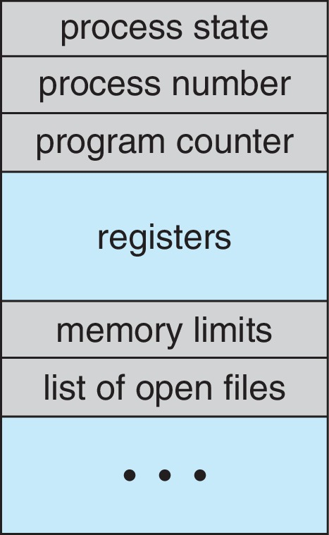
Recall: Process Control Block (PCB)
Is a data structure for managing processes
Is created and updated by OS for each running process
  Is kept up to date constantly as process executes
Is held in memory and maintained in some container (e.g., list) by kernel
Contains everything OS needs to know about the process
  Unique process identifier (PID), state, priority
  Program counter (PC)
  Register data
  Memory pointers
  I/O status information,
  Accounting information
PC and register data do not need to be updated when program is running
  They are needed when a system call (trap) or process switch occurs

Slide 35
Recall: Process Lifecycle (7 States)
Create
Init
Ready
Scheduled
Running
Finished
Created
Exits
Swapped in
Suspended
Created
Unblocked
Blocked
Ready-Swapped
Swapped out
Blocked
Swapped in
Unblocked
Blocked-Swapped
Swapped out
As in the five state model, there are some omitted transitions to “finished” and one from “running” to
“ready-swapped”

Slide 36
What Does it Take to Create Process?
Must construct new PCB
  Inexpensive
Must set up new page tables for address space (more on this later)
  More expensive
Copy data from parent process? (Unix fork() )
  With Unix fork(), child process gets copy of parent’s memory and I/O state
  Originally very expensive
  Much less expensive with “copy on write” (more on this later)
Copy I/O state (file handles, etc.)
  Medium expense

Slide 37

Multithreaded Processes
bbci.co.uk
Threads encapsulate concurrency and are active components
Address spaces encapsulate protection and are passive part
  Keeps buggy program from trashing system
Why have multiple threads per address space?
  Processes are expensive to start, switch between, and communicate between

Slide 38
Multiple Processes vs. Single Process With Multiple Threads
Fundamental tradeoff between protection and efficiency
Communication harder between processes
  This is basically IPC
  It necessarily involves OS
Communication easier within a process
  All threads of process share state and resources of process
  If one thread opens a file, other threads in the process can access it
  It does not involve OS

Slide 39
Memory Footprint of Multiple Threads
How do we position stacks relative to each other?
What maximum size should we choose for stacks?
  8KB for kernel-level stacks in Linux on x86
  Less need for tight space constraint for user-level stacks
What happens if threads violate this?
  “… program termination and/or corrupted data”
How might you catch violations?
  Place guard values at top and bottom of each stack
  Check values on every context switch
Stack 1
Stack 2
Address Space
Heap
Global Data
Code

Slide 40
Multiprogramming:
Running Multiple Processes
Physical memory
Proc 1
Proc 2
…
Proc n
Stack
OS
Heap
Data
Code
Stack
Heap
Data
Code
Virtual address spaces
Stack
Heap
Data
Code

Slide 41
Time Sharing:
Multiprogramming on Single CPU
Process
1
Process
2
Process
3
Process
1
Process
2
Process
3
Process
1
Process
2
CPU
Time
Illusion: infinite number of processors
  Each thread runs on dedicated virtual processor
Reality: few processors, multiple threads running at variable speed
How can we give illusion of infinite number of processors?
  Multiplex in time!
How do we switch from one process to next?
  Save PC, SP, and registers in current PCB
  Load PC, SP, and registers from new PCB
What triggers switch?
  Timer, voluntary yield, I/O interrupts, …

Slide 42
How Do We Multiplex Processes?
Scheduling: OS decides which process uses CPU time
  Only one process is “running” on each CPU at any time
  Scheduler could give more time to important processes
Protection: OS divides non-CPU resources among processes
  E.g., give each process their own address space
  E.g., multiplex I/O through system calls

Slide 43

Scheduling
Kernel scheduler decides which
processes/threads receive CPU
There are variety of scheduling policies for …
  Fairness or
  Realtime guarantees or
  Latency optimization or …
Kernel scheduler maintains data structure containing PCBs
if (readyProcesses(PCBs)) {
nextPCB = selectProcess(PCBs);
run(nextPCB);
} else {
run_idle_process();
}

Slide 44

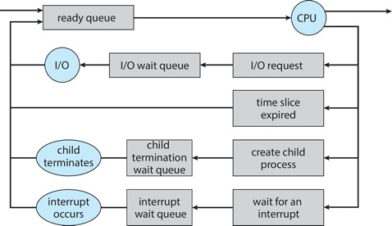
Ready Queue
PCBs move from queue to queue as they change state
  Decisions about which order to remove from queues are scheduling decisions
  Many algorithms possible (more on this in a few weeks)

Slide 45
Ready Queue And I/O Device Queues
Process not running ⇒ PCB is in some scheduler queue
  Separate queue for each device/signal/condition
  Each queue can have different scheduler policy
Ready
Queue
Head
Link
Link
Link
Tail
Registers
Registers
Registers
Other State
PCB₉
Other State
PCB₆
Oher State
PCB₁₆
USB
Unit 0
Head
Tail
Disk
Unit 0
Head
Link
Link
Tail
Registers
Registers
Disk
Unit 2
Other State
PCB₂
Other State
PCB₃
Head
Tail
Ether
Netwk 0
Head
Link
Tail
Registers
Other State
PCB₈

Slide 46

Protection
OS must protect itself from user programs
  Reliability: prevent OS from crashing
  Security: limit scope of what processes can do
  Privacy: limit data each process can access
  Fairness: enforce appropriate share of HW
It must protect user programs from one another
Main method is to limit translation from virtual to physical address space

Slide 47
How to Protect Processes from One Another?
Protection of memory
  Every process does not have access to all memory
Protection of I/O devices
  Every process does not have access to every device
Protection of access to processor
  Preemptive switching from process to process
  Use of timer
  Must not be possible to disable timer from user code

Slide 48
Address Translation Maps:
Illusion of Separate Address Space
Physical Address Space
Code 2
Stack
Code 1
Stack
Heap
Data 2
Heap
Data
Data 1
Data
Translation Map 1
Translation Map 2
Code
Stack 2
Code
Stack 1
Process 1
Virtual Address Space 1
Heap 2
Process 2
Virtual Address Space 2
Heap 1
OS code
OS data
OS heap &
Stacks

Slide 49
Putting it Together: Process
(Unix) Process
A(int tmp) {
if (tmp<2)
B();
printf(tmp);
}
B() {
C();
}
C() {
A(2);
}
A(1);
…
Memory
Stack
Resources
Sequential stream of instructions
I/O State
(e.g., file, socket contexts)
CPU state (PC, SP, registers..)
Stored in OS

Slide 50
Putting it Together: Processes
Process 1
Process 2
Process N
Switch overhead: high
  CPU state: low
  Memory/IO state: high
Process creation: high
Protection
  CPU: yes
  Memory/IO: yes
Sharing overhead: high (involves at least one context switch)
Mem.
Mem.
Mem.
IO
state
IO
state
…
IO
state
CPU
state
CPU
state
CPU
state
CPU scheduler
OS
1 process at a time
CPU
(1 core)

Slide 51
Putting it Together: Threads
Process 1
Process N
threads
threads
Switch overhead: medium
  CPU state: low
Thread creation: medium
Protection
  CPU: yes
  Memory/IO: no
Sharing overhead: low(ish) (thread switch overhead low)
Mem.
Mem.
…
IO
state
…
…
IO
state
CPU
state
CPU
state
CPU
state
CPU
state
CPU scheduler
OS
1 thread at a time
CPU
(1 core)

Slide 52
Putting it Together: Multi-cores
Process 1
Process N
threads
threads
Switch overhead: low
(only CPU state)
Thread creation: low
Protection
  CPU: yes
  Memory/IO: no
Sharing overhead: low
(thread switch overhead low, may not need to switch at all!)
Mem.
Mem.
…
IO
state
…
…
IO
state
CPU
state
CPU
state
CPU
state
CPU
state
CPU scheduler
OS
4 threads at a time
Core 1
Core 2
Core 3
Core 4
CPU

Slide 53
Hyperthreading
Superscalar
Architecture
Multi-processor
Architecture
Fine-grained
Multithreading
Simultaneous
Multithreading
Colored blocks show
executed instructions
Thread 1
Thread 2
Time (cycles)
Superscalar processors can execute multiple instructions that are independent
Multiprocessors can execute multiple independent threads
Fine-grained multithreading executes two independent threads by switches between them
Hyperthreading duplicates register state to make second (hardware) “thread” (virtual core)
  From OS’s point of view, virtual cores are separate CPUs
  OS can schedule as many threads at a time as there are virtual cores (but, sub-linear speedup!)
  See: http://www.cs.washington.edu/research/smt/index.html

Slide 54
Putting it Together: Hyperthreading
Process 1
Process N
threads
threads
Switch overhead between hardware-threads: very-low (done in hardware)
Contention for ALUs/FPUs may hurt performance
Mem.
Mem.
…
IO
state
…
…
IO
state
CPU
state
CPU
state
CPU
state
CPU
state
hardware-threads
(VCores)
CPU scheduler
OS
8 threads at a time
PCore 1
PCore 2
PCore 3
PCore 4
CPU

Slide 55
Dual-mode Operation
(4th OS Concept)
Hardware provides at least two modes
  Kernel mode (or “supervisor” or “protected”)
  User mode, which is how normal programs are executed
How can hardware support dual-mode operation?
  Single bit of state (user/system mode bit)
  Certain operations/actions only permitted in system/kernel mode
    In user mode they fail or trap
  User to kernel transition sets system mode AND saves user PC
    OS code carefully puts aside user state then performs necessary actions
  Kernel to user transition clears system mode AND restores user PC
    E.g., rfi: return-from-interrupt

Slide 56
Three Types of Mode Transfer
System call: request for kernel services
  E.g., open, close, read, write, lseek
  Usually implemented by calling trap or syscall instruction
    Special instruction is not strictly required; on some systems, processes trigger system calls by executing some instruction with specific invalid opcode
Processor exception: internal, synchronous, hardware event
  E.g., divide by zero, illegal instruction, segmentation fault, page fault
  Caused by software behavior
Interrupt: external asynchronous event
  E.g., timer, disk ready, network
  Interrupts can be disabled, exceptions and traps cannot!

Slide 57
Requirements for Safe Mode Transfer
Limited entry into kernel
  HW must ensure entry point into kernel is one set up by kernel
  User programs cannot be allowed to jump to arbitrary locations in kernel
Atomic changes to processor state
  In user mode, PC and SP point to memory locations in user process
  In kernel mode, PC and SP point to memory locations in kernel
  Mode, PC, SP, and memory protection should all change atomically
Transparent, restartable execution
  User-level process could get interrupted between any two instructions
  OS must restore state of user process exactly as it was before interrupt

Slide 58
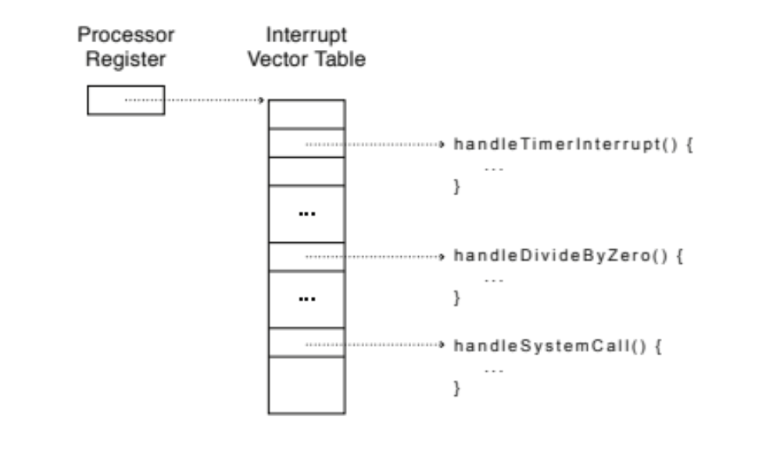
Interrupt Vector Table
Table set up by OS pointing to
code to run on system calls,
processor exceptions, and interrupts
On x86, vector numbers 0-31 are
for different types of processor exceptions
(e.g., divide-by-zero)
Vector numbers 32-255 are for different types of interrupts (e.g., timer)
Vector number 64 is for system call handler

Slide 59

Interrupt Stack
User process state should be saved
OS should not save anything
on user stack (why?)
  Reliability: what if user program’s
  SP is not valid?
  Security: what if other threads in
  process change kernel’s return address?
Most OSes go one step further and allocate separate kernel interrupt stack (also called kernel stack) for each user-level thread
  PCB could store pointer to kernel stack
memegenerator.net

Slide 60
Two-stack Model Example
Running
Handling syscall
Ready to run
main
main
main
Proc1
Proc1
Proc1
User stack
Proc2
Proc2
Proc2
syscall
syscall
user CPU state
user CPU state
syscall
handler
Kernel stack
I/O driver

Slide 61
Interrupt Masking
Interrupt handler runs with interrupts disabled
This simplifies interrupt handling
Interrupts are re-enabled when interrupt completes
Interrupts are deferred (masked) not ignored
HW buffers new interrupts until interrupts are re-enabled
If interrupt are disabled for long time, some interrupts may be lost
On x86, cli disables interrupts and sti enables interrupts
  Only applies to current CPU (on a multicore)
  User programs cannot use these instructions (why?)
Notes:
Instructions to enable or disable interrupts must be privileged

Slide 62
Mode Transfer Steps in x86
Mask interrupts
Save PS, SP, and execution flags in temporary HW registers
Switch onto kernel interrupt stack (specified in special HW register)
Push the three key values onto interrupt stack
Optionally save an error code
Invoke interrupt handler

Slide 63
Example: x86 Mode Transfer
Kernel
handler() {
pushad;
…
}
Processor
Registers
PC
SP
Kernel stack
foo() {
while (…) {
x = x + 1;
y = y – 2;
}
}
EFLAGS
User-level
process
Other Regs
EAX, EXB,
…
User stack
foo
…

Slide 64
Example: x86 Mode Transfer (cont.)
Kernel
Single instruction to
  Save some registers (e.g., SP, PC)
  Change PC and SP
  Switch Kernel/user mode
handler() {
pushad;
…
}
Processor
Registers
PC
SP
Kernel stack
foo() {
while (…) {
x = x + 1;
y = y – 2;
}
}
EFLAGS
User-level
process
Other Regs
EAX, EXB,
…
Error
User stack
PC
foo
EFLAGS
…
SP

Slide 65
Example: x86 Mode Transfer (cont.)
Kernel
Single instruction to save all registers
Why is stack pointer saved twice?
  Hint: are they the same?
handler() {
pushad;
…
}
Processor
Registers
PC
SP
Kernel stack
foo() {
while (…) {
x = x + 1;
y = y – 2;
}
}
EFLAGS
User-level
process
Other Regs
EAX, EXB,
…
…
EXB
EXA
SP
All Regs
Error
User stack
PC
foo
EFLAGS
…
SP

Slide 66
Example: System Call Handler
Vector through well-defined system call entry points!
  Table mapping system call number to handler
Locate arguments
  In registers or on user (!) stack
Copy arguments (copy before check)
  From user memory into kernel memory
  Protect kernel from malicious code evading checks
Validate arguments
  Protect kernel from errors in user code
Copy results back
  Into user memory

Slide 67
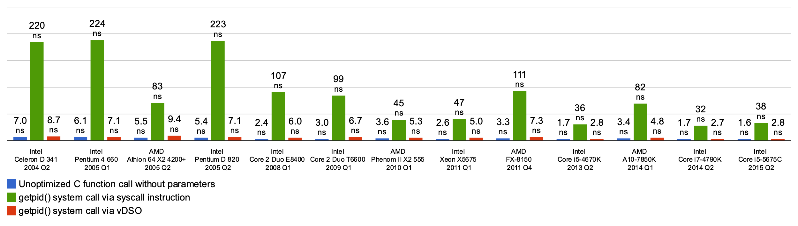
Basic Cost of System Calls
Min syscall has ~ 25x cost of function call
Linux vDSO (virtual dynamic shared object) runs some system calls in user space
  E.g., gettimeofday or getpid

Slide 68
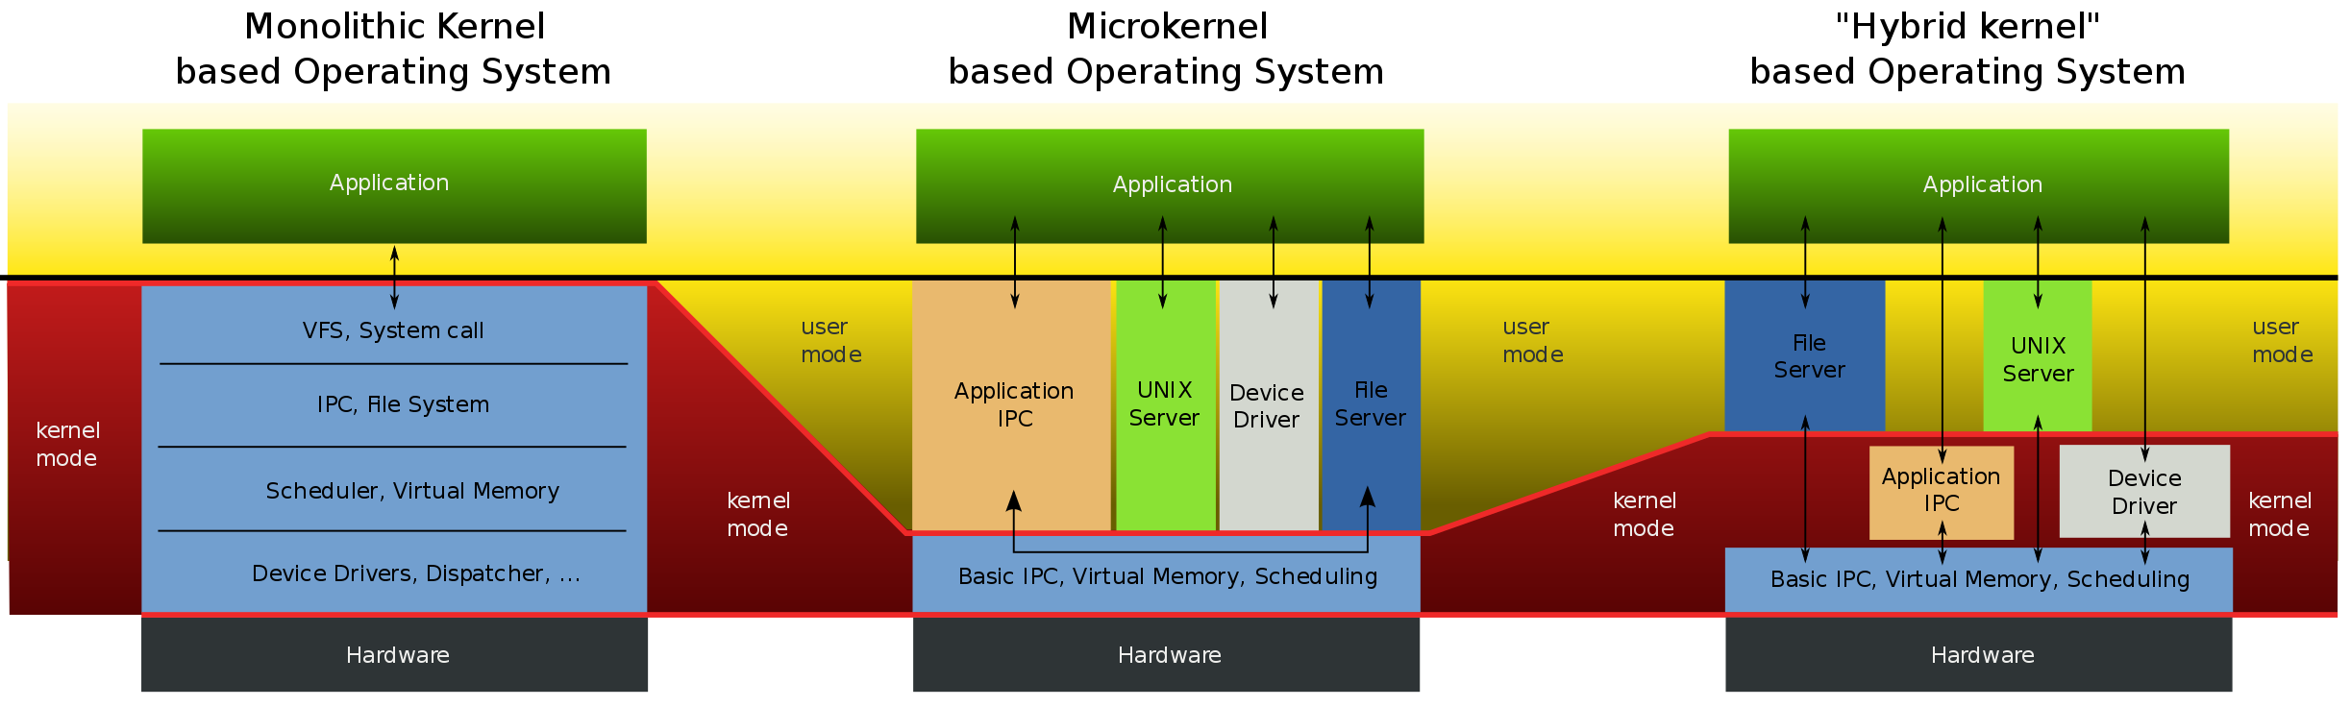
Aside: Monolithic vs Microkernel OS
Users
Operating
system
en.wikipedia.org

Slide 69
Aside: Influence of Microkernels
Microkernels provide better modularity, security, and fault tolerance, but they introduce higher communication overhead
  Too many context switches
Many OSes provide some services externally, like microkernels
  OS X and Linux: windowing (graphics and UI)
Some currently monolithic OSes started as microkernels
  Windows family originally had microkernel design
  OS X is hybrid of Mach microkernel and FreeBSD monolithic kernel

Slide 70
Kernel to User Mode Switch Examples
New process/new thread start
  Jump to first instruction in program/thread
Return from interrupt, exception, system call
  Resume suspended execution
Process/thread context switch
  Resume some other process
User-level upcall (UNIX signal)
  Asynchronous notification to user program
    Preemptive user-level threads
    Asynchronous I/O notification
    Interprocess communication
    User-level excepting handling
    User-level resource allocation

Slide 71
Example: User/Kernel Mode Transfers
User Mode
rtn
interrupt
exception
syscall
rfi
Kernel Mode
exit
exec
Hardware
Limited HW access
Full HW access

Slide 72
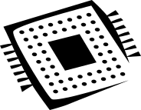



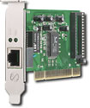
System Call Interface:
Access Point to Hardware Resources
The System Call Interface
Process
Management
Memory
Management
Filesystems
Device
Control
Networking
Concurrency,
multitasking
Virtual
memory
Files and dirs:
the VFS
TTYs and
device access
Connectivity
Architecture
Dependent
Code
Memory
Manager
File System Types
Device
Control
Network
Subsystem
Block
Devices
IF drivers

Slide 73
Device Drivers
Device-specific code in kernel that interacts directly with device hardware
  Supports standard, internal interface
  Same kernel I/O system can interact easily with different device drivers
  Special device-specific configuration supported with ioctl() syscall
Device drivers are typically divided into two pieces
  Top half: accessed in call path from system calls
    implements a set of standard, cross-device calls like
    open(), close(), read(), write(), ioctl(), etc.
    This is kernel’s interface to device driver
    Top half will start I/O to device, may put thread to sleep until finished
  Bottom half: run as interrupt routine
    Gets input or transfers next block of output
    May wake sleeping threads if I/O now complete

Slide 74
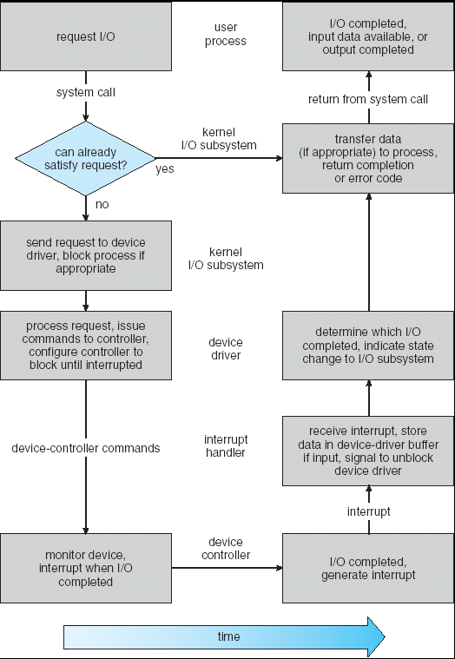
Life Cycle of an I/O Request
User
Program
Kernel I/O
Subsystem
Device Driver
Top Half
Device Driver
Bottom Half
Device
Hardware

Slide 75
I/O Data Transfer
Programmed I/O
  Each byte transferred via processor in/out or load/store
  + Simple hardware, easy to program
  − Consumes processor cycles proportional to data size
Direct memory access (DMA)
  Give controller access to memory bus
  Ask it to transfer data blocks to/from memory directly

Slide 76
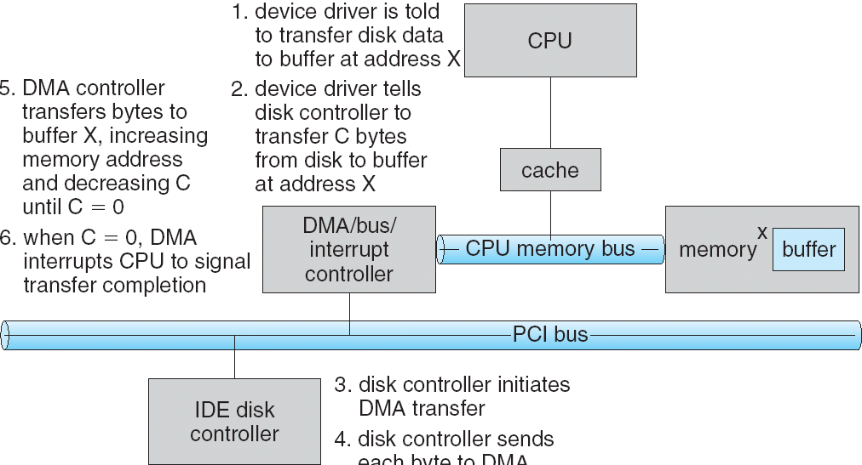
DMA Transfer
1
6
5
2
4
3
Device driver is told to transfer disk data to buffer at address x
Device driver tells disk controller to transfer C bytes from disk to buffer at address x
Disk controller initiates DMA transfer
Disk controller send each byte to DMA controller
DMA controller transfers bytes to buffer x, increasing address and decreasing C
When C = 0, DMA interrupts CPU to signal transfer completion

Slide 77
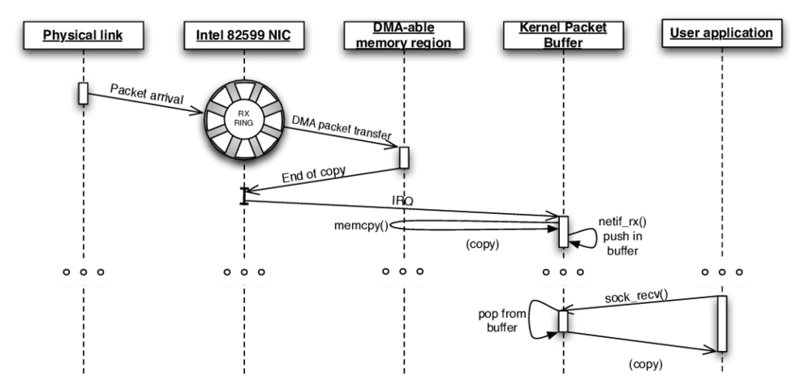
DMA Example: Network Stack in
Linux Kernels before 2.6
García-Dorado, José Luis, et al. "High-performance network traffic processing systems using commodity hardware." Data traffic monitoring and analysis. Springer, Berlin, Heidelberg, 2013. 3-27.

Slide 78

How Does Kernel Provide Services?
You said that applications request services from OS via syscall, but …
  I’ve been writing all sorts of applications, and I never ever saw a “syscall” !!!
That’s right!
It was buried in the programming language runtime library (e.g., libc.a)
  … Layering

Slide 79



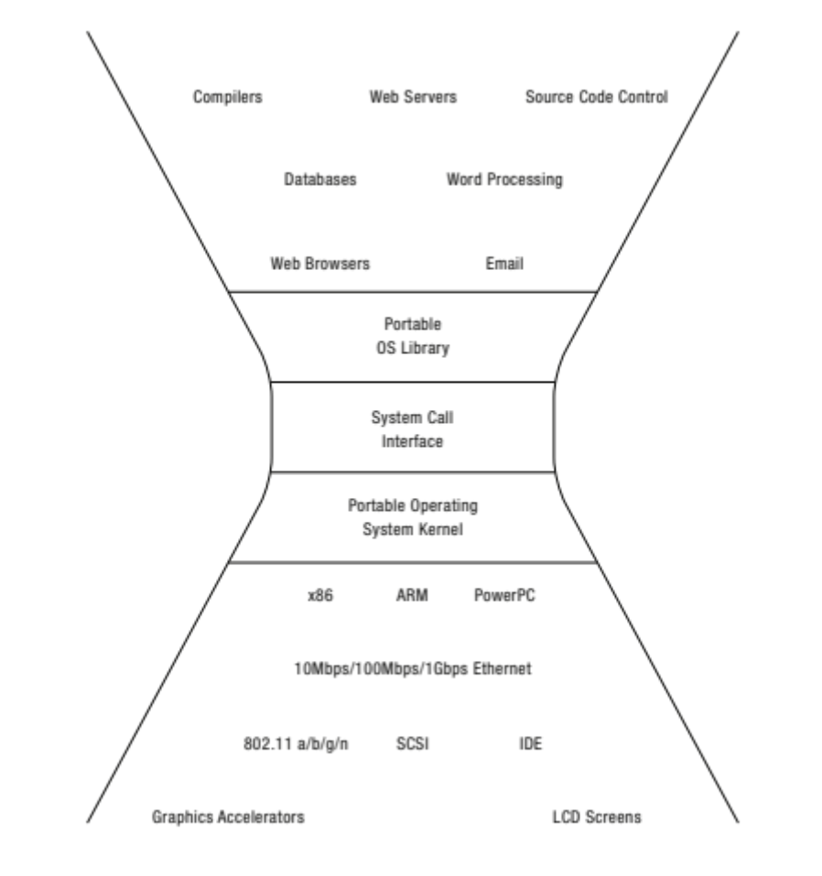















OS Run-time Library
Proc 1
Proc 2
…
Proc n
OS
Proc 1
Proc 2
Proc n
…
OS Library
OS Library
OS Library
OS

Slide 80
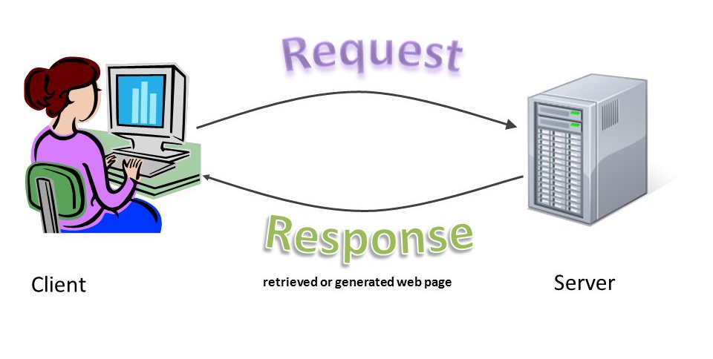
Putting it Together: Web Server
Request
Reply
(retrieved by web server)
Client
Web Server

Slide 81
Putting it Together: Web Server (cont.)
Server
4. parse request
9. format reply
request
buffer
reply
buffer
network
socket
read
3. kernel
copy
10. network
socket
write
5. file
read
8. kernel
copy
syscall
syscall
syscall
Kernel
wait
RTU
11. kernel copy
from user buffer
to network buffer
RTU
interrupt
interrupt
2. copy arriving
packet (DMA)
12. format outgoing
packet and DMA
6. disk
request
7. disk data
(DMA)
Hardware
Network
interface
Disk interface
Request
Reply

Slide 82
Summery
Thread
  Single unique execution context which fully describes program state
  Program counter, registers, execution flags, stack
Address space (with translation)
  Address space which is distinct from machine’s physical memory addresses
Process
  Instance of executing program consisting of address space and 1+ threads
Dual-mode operation/protection
  Only “system” can access certain resources
  OS and hardware are protected from user programs
  User programs are isolated from one another by controlling translation from program virtual addresses to machine physical addresses

Slide 83

Questions?
globaldigitalcitizen.org

Slide 84
Acknowledgment
Slides by courtesy of Anderson, Culler, Stoica, Silberschatz, Joseph, Zarnett, and Canny

