Slide 1


Slide 2
Lecture 5:
Multiprocessor Systems
Prof. Seyed Majid Zahedi
https://ece.uwaterloo.ca/~smzahedi

Slide 3
Outline
Background on multiprocessor architecture
  Heterogeneity, NUMA, cache hierarchy
Multithreading on multiprocessors
  Mitigating lock contention: MCS and RCU locks
Load balancing in multiprocessors
  Load tracking, NUMA domains, cache reuse, energy efficiency
Scheduling policies for multithreaded programs
  Oblivious scheduling, gang scheduling, …

Slide 4

Multiprocessor Scheduling
Scheduling’s simple invariant
  Ready threads should be scheduled on available CPUs
Properties of multiprocessors make implementing this invariant very hard
  E.g., high cost of cache coherence and synchronization
  E.g., non-uniform memory access latencies (NUMA)

Slide 5

Background: Symmetric vs. Asymmetric Multiprocessors
In symmetric multiprocessor, all processors are identical
Asymmetric multiprocessors could include processors with different performance and energy characteristics
  Processors with different microarchitectures
  Processors running at different voltage and frequencies
ARM big.LITTLE architecture is example of both
  Big CPUs have more pipeline stages, bigger caches, and smarter predictors than LITTLE CPUs
  Big CPUs also reach higher voltage and frequencies than LITTLE ones can
Asymmetric multiprocessors could provide better energy efficiency while meeting workloads’ performance targets
Fig. www.arm.com

Slide 6
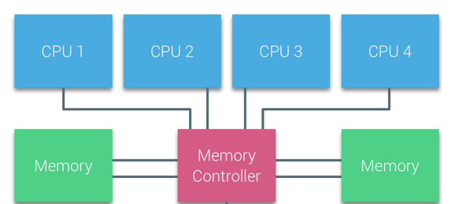
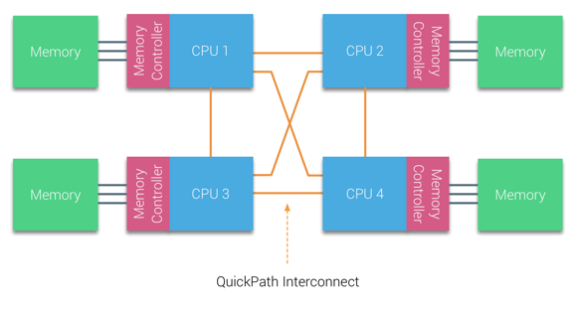
Background: NUMA
Uniform memory access (UMA):
processors experience same, uniform
access time to any memory block
Non-uniform memory access (NUMA):
processors access their local memory blocks
faster than remote memory blocks
Local access
Remote access
Photos from: http://www.evoventurepartners.com

Slide 7
Background:
Cache Hierarchy in Multiprocessors
CPU 0
CPU 1
CPU 2
CPU 3
Private
L1 Cache
Private
L1 Cache
Private
L1 Cache
Private
L1 Cache
Private
L2 Cache
Private
L2 Cache
Private
L2 Cache
Private
L2 Cache
Shared L3
Memory Controller
http://www.cpushack.com

Slide 8
Background: Cache Coherence
Scenario
  Thread A modifies data inside critical section and unlocks mutex
  Thread B locks mutex and reads data
Easy if all accesses go to main memory
  Thread A changes main memory; thread B reads it
What if new data is cached at processor running thread A?
What if old data is cached at processor running thread B?

Slide 9
Cache-coherence Problem (Step 1)
CPU A
CPU B
ld r2, x
Private
L1 Cache
Private
L1 Cache
Time
Interconnection Network
Main Memory
x

Slide 10
Cache-coherence Problem (Step 2)
CPU A
CPU B
ld r2, x
ld r2, x
add r1, r2, r4
Private
L1 Cache
Private
L1 Cache
Time
Interconnection Network
Main Memory
x

Slide 11
Cache-coherence Problem (Step 3)
CPU A
CPU B
ld r2, x
ld r2, x
add r1, r2, r4
st x, r1
Private
L1 Cache
Private
L1 Cache
Time
Interconnection Network
Main Memory
x

Slide 12
Background:
Cache-coherence Protocols
Enforce two invariants (time divided into intervals)
  Single-writer-multiple-readers: at any time, any given block has either
    One writer: one CPU has read-write access
    Zero or more readers: some CPUs have read-only access
  Up-to-date data: value at the beginning of each interval is equal to value at the end of the most recently completed read-write interval
Read-only
CPUs: A, B
Value = 2
Read-write
CPU: C
Value = 2 → 7
Read-only
CPUs: A, B, C
Value = 7
Time

Slide 13
Cache-coherence States
Each cache block has coherence state denoting
  Validity: invalid or invalid
  Dirtiness: dirty or clean
  Exclusivity: exclusive or not exclusive
  Ownership: owned or not owned
  Permission: read-only or read-write
Five (common) states are
  Modified (M): read-write, exclusive, owned, dirty
  Owned (O): read-only, owned, dirty
  Exclusive (E): read-only, exclusive, clean
  Shared (S): read-only, clean
  Invalid (I): invalid
Different cache coherence protocols use subset of these states
  E.g., MSI, MESI, MOSI, MOESI
Ownership
(ownership doesn’t always
imply exclusivity)
O
Dirtiness
S
M
Validity
E
Exclusivity
I

Slide 14
Coherence Protocols: Big Picture
CPUs issue ld/st/rmw request to caches
If insufficient permissions, cache controller
issues coherence requests
  To where? Depends on protocol
  Get requests block and Put writes
  block back to memory
  E.g., for rmw, get exclusive access, prevent any other cache from reading block until instruction completes
Owner responds to request with data
CPU
Loads and
Stores
Loaded
Values
Cache
Cache
Controller
Issued Coherence
Requests and
Responses
Received
Coherence Requests
and Responses
Interconnect Network

Slide 15
Common Coherence Requests
Request | Goal of Requestor
GetShared (GetS) | Obtain block in shared (read-only) state
GetModified (GetM) | Obtain block in Modified (read-only) state
PutShared (PutS) | Evict block in Shared state
PutExclusive (PutE) | Evict block in Exclusive state
PutOwned (PutO) | Evict block in Owned state
PutModified (PutM) | Evict block in Modified state
Upgrade (Upg) | Upgrade block state from read-only (Shared or Owned) to read-write (Modified); Upg (unlike GetM) does not require data to be sent to requestor

Slide 16

Snooping Cache-coherence Protocol
Any CPU that wants block broadcasts to all CPUs
Each cache controller “snoops” all bus transactions
Example: MSI protocol
Load/Stores
M
Store / Own-GetM
- / Other-GetS
S
Load / -
- / Other-GetS
Store / Own-GetM
- / Other-GetM
Eviction / Own-PutM
- / Other-GetM
Eviction / -
Load / Own-GetS
I

Slide 17
Directory-based
Cache-coherence Protocols
Limitations of snooping
  Broadcasting uses lots of “bus” bandwidth
  Snooping every transaction uses lots of controller bandwidth
  Shared wire buses are EE nightmare
Snooping is OK for small or medium-sized machines
  Largest snooping system had 128 processors
Directory-based cache-coherence protocol
  Avoids broadcasting requests to all nodes on cache misses
  Maintains directory of which nodes have cached copies of block
  On misses, cache controller sends message to directory
  Directory determines what (if any) protocol action is required
    E.g., sending invalidations to Shared CPUs

Slide 18
Aside: Coherence vs. Consistency
Coherence concerns only one memory location
  Remember: coherence = the two invariants
  Are not visible to software
Consistency concerns apparent ordering for all locations
  Defines contract between system and programmers
  Restricts ordering of all loads and stores
  Are visible to software
Notes:
The data consistency model specifies a contract between programmer and system, wherein the system guarantees that if the programmer follows the rules, memory will be consistent and the results of reading, writing, or updating memory will be predictable. This is different from coherence, which occurs in systems that are cached or cache-less and is consistency of data with respect to all processors. Coherence deals with maintaining a global order in which writes to a single location or single variable are seen by all processors. Consistency deals with the ordering of operations to multiple locations with respect to all processors.

Slide 19
Memory Consistency Example
// initially flag = data = r1 = r2 = 0
CPU1 CPU2
S1: data = NEW; L1: r1 = flag;
S2: flag = SET; B1: if (r1 != SET) goto L1;
L2: r2 = data;
Intuition says we should print r2 = NEW
Yet, in some consistency models, this isn’t required!
Coherence doesn’t say anything … why?

Slide 20
Sequential Consistency
“The result of any execution is the same as if the operations of all processors (CPUs) were executed in some sequential order, and the operations of each individual processor (CPU) appear in this sequence in the order specified by its program.”
Lamport, 1979
Program Order of CPU1
Memory Order
Program Order of CPU2
L1: r1 = flag; // 0
S1: data = NEW;
L1: r1 = flag; // 0
L1: r1 = flag; // 0
S2: flag = SET;
L1: r1 = flag; // SET
L2: r2 = data; // NEW

Slide 21

Sequential Consistency (cont.)
“The result of any execution is the same as if the operations of all processors (CPUs) were executed in some sequential order, and the operations of each individual processor (CPU) appear in this sequence in the order specified by its program.”
Lamport, 1979
Program Order of CPU1
Memory Order
Program Order of CPU2
L1: r1 = flag; // 0
S1: data = NEW;
L1: r1 = flag; // 0
L1: r1 = flag; // 0
S2: flag = SET;
L1: r1 = flag; // SET
L2: r2 = data; // NEW

Slide 22
x86 Memory-consistency Model
// initially x = y = r1 = r2 = r3 = r4 = 0
CPU1 CPU2
S1: x = NEW; S2: y = NEW;
L1: r1 = x; L3: r3 = y;
L2: r2 = y; L4: r4 = x;
Program Order of CPU1
Memory Order
Program Order of CPU2
S1: x = NEW; // NEW
S2: y = NEW; // NEW
L1: r1 = x; // NEW
L3: r3 = y; // NEW
L2: r2 = y; // 0
L4: r4 = x; // 0

Slide 23

Multithreading on Multiprocessors
Multithreading doesn’t guarantee performance
  Overheads: creating/managing threads introduces costs (memory/computation)
  Lock contention: only one thread can hold lock at any time
  Communication of shared data: shared data might ping back and forth between CPUs’ caches (enforced by cache coherence protocol)
  False sharing: CPUs may still have to communicate for data that is not shared because coherence protocols track blocks at fixed granularity (e.g., 64 byte)

Slide 24
Reducing Lock Contention
Fine-grained locking
  Partition object into subsets, each protected by its own lock
  E.g., divide hash table key space
Per-processor data structures
  Partition object so that most/all accesses are made by one processor
  E.g., partition heap into per-processor memory regions
Staged architecture
  Each stage includes private state and set of worker threads
  Different stages communicate by sending messages via producer/consumer queues
  Each worker thread pulls next message and processes it
  E.g., pipeline operations in web server
Read Static Page
Send Page
Client
Request
Master Thread
Read and Parse
Thread Pool
Generate Dynamic Page

Slide 25
What If Locks are Still Mostly Busy?
MCS (Mellor-Crummey-Scott) lock
  Optimize lock implementation for when lock is contended
RCU (read-copy-update) lock
  Efficient readers/writers lock used in Linux kernel
  Readers proceed without first acquiring lock
  Writer ensures that readers are done
Both rely on atomic read-modify-write instructions

Slide 26
Lock Contention Example
// test-and-set
Counter::Increment() {
while (test&set(&lock));
value++;
lock = FREE;
memory_barrier();
}
What happens if many processors run this code?
  All processors will try to gain exclusive access to memory location of lock to execute test&set
  Processor that wants to set value of lock to FREE also needs exclusive access
  Value of lock pings between caches

Slide 27

Lock Contention Example (cont.)
// test and test-and-set
Counter::Increment() {
while (lock == BUSY ||
test_and_set(&lock));
value++;
lock = FREE;
memory_barrier();
}
Would this solve the problem?
  Once lock is FREE, its value must be communicated to all processors
  Eventually one processor reads FREE and sets it to BUSY
  Other processors will still be busy fetching FREE value of lock, trying to execute test&set, preventing lock value to be set to FREE again

Slide 28

MCS Lock
Maintain list of threads waiting for lock
  Front of list holds the lock
  Tail is last thread in list
  New thread uses compare&swap to add itself to list
Lock is passed by setting flag for next thread in line
  Next thread spins while its flag is FALSE

Slide 29
MCS Lock Implementation
class MCSLock {
private:
TCB *tail = NULL;
}
MCSLock::unlock() {
if (compare_and_swap(&tail,
myTCB, NULL)) {
// If tail == myTCB, no one
// is waiting, lock is free
} else {
// Someone is waiting,
// spin until next is set
while (myTCB->next == NULL);
// Tell next thread to proceed
myTCB->next->MCS_flag = TRUE;
}
}
MCSLock::lock() {
TCB *oldTail = tail;
myTCB->next = NULL;
while (!compare_and_swap(&tail,
oldTail, &myTCB)) {
// Try again if someone else
// changed tail
oldTail = tail;
}
// If oldTail == NULL, lock acquire,
// otherwise, wait!
if (oldTail != NULL) {
myTCB->MCS_flag = FALSE;
memory_barrier();
oldTail->next = myTCB;
while (myTCB->MCS_flag);
}
}

Slide 30
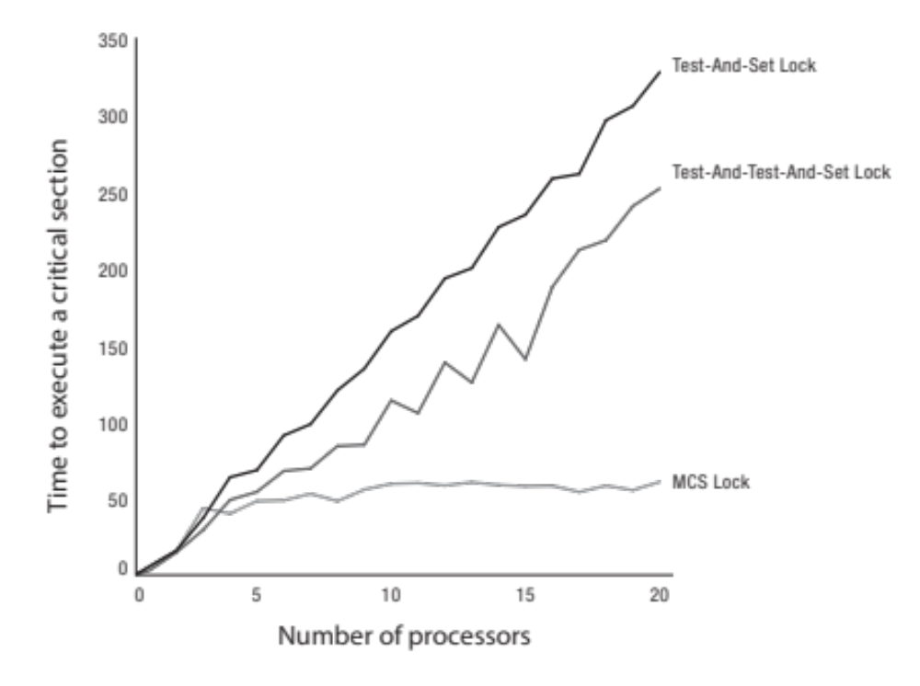
Performance Comparison

Slide 31
RCU Lock
Goal is to allow very fast reads to shared data
  Reads proceed without first acquiring a lock
Writers are only allowed to make restricted updates
  Make a copy of old version of data
  Updates the copy
  Publishes pointer to updated copy with single atomic instruction
Multiple concurrent versions of data can coexist
  Readers may see old or new version
RCU needs integration with thread scheduler
  To guarantee all readers complete within grace period, and then garbage collect old version

Slide 32
RCU Lock in Action
Update is
Published
Grace Period
Ended
Read (Old)
Read (New)
Read (Old)
Read (New)
Read (Old or New)
Read (New)
Read (Old or New)
Write (New)
Delete (Old)
Time

Slide 33
RCU Lock Implementation
Readers disable interrupts on entry
  Guarantees they complete critical section in a timely fashion
  No read or write lock
Writer
  Acquire write lock
  Compute new data structure
  Publish new version with atomic instruction
  Release write lock
  Wait for time slice on each CPU
  Only then, garbage collect old version of data structure

Slide 34
Scheduling in Multiprocessors
There could be one ready queue for all CPUs
Notice any problems?
  Single bottleneck: contention for ready queue’s spinlock
  Limited cache reuse: lack of data locality as threads get
  scheduled on different CPUs
Solution: each CPU has its own private ready queue
Notice any problems?
  Load balancing: some CPUs might be idle
  while threads pile up on others ready queues
  Priorities: one queue has one low-priority
  thread and another has ten high-priority ones
Solution: load balancing!
CPU 1
 |  | T₄ | T₃ | T₂ | T₁
CPU 2
CPU 3
CPU 4
CPU 1
 |  |  | T₃ | T₂ | T₁
CPU 2
 |  |  |  |  | T₄
CPU 3
 |  | T₈ | T₇ | T₆ | T₅
CPU 4

Slide 35
Load Tracking Metric
Option 1: balance queues based on number of threads
  Two queues could have same number of threads, in one all are high-priority, and in other all are low-priority
  Low-priority threads get the same amount of CPU time as high-priority ones
Option 2: balance queues based on threads’ weights
  One queue has 1 thread with weight 9, other has 9 threads with weight 1
  High-priority thread often sleeps, its CPU must frequently steal work from other queue
Option 3: balance queues based on threads’ weights and CPU utilization
  Metric called load used in Linux’s completely fair scheduling (CFS)
  If thread does not use much of CPU, its load will be decreased accordingly
  CFS further uses autogroup feature to normalize load based on number of threads per process

Slide 36
Load Balancing is Simple, isn’t it?
“I suspect that making the scheduler use per-CPU queues together with some inter-CPU load balancing logic is probably trivial . Patches already exist, and I don’t feel that people can screw up the few hundred lines too badly.”
  Linus Torvalds, 2001^{[1]}
In 2001, server systems typically had only few CPUs
Today, datacenter servers could have hundreds of CPUs
Load balancing has become expensive procedure
  Computation: requires iterating over dozens of ready queues
  Communication: involves modifying remotely cached data structures, causing extremely expensive cache misses and synchronization
Scheduler try to avoid running load-balancing procedure often
  Results in cases where CPU becomes idle while others are busy
Schedule runs “emergency” load balancing (work stealing) when CPUs become idle
[1] L. Torvalds. The Linux Kernel Mailing List. http://tech-insider.org/linux/research/2001/1215.html, Feb. 2001.

Slide 37
Processor Affinity
Processor affinity: when thread runs on one processor, cache contents of that processor stores recent memory accesses by that thread
Migration: load balancing may affect affinity as threads move between processors
  Performance of migrated thread suffers because it loses its cached contents
  Migration is justified only if performance loss is less than waiting time
Soft affinity: OS tries to keep threads on same CPU, but no guarantees
Hard affinity: OS allows threads to specify set of CPUs they may run on

Slide 38
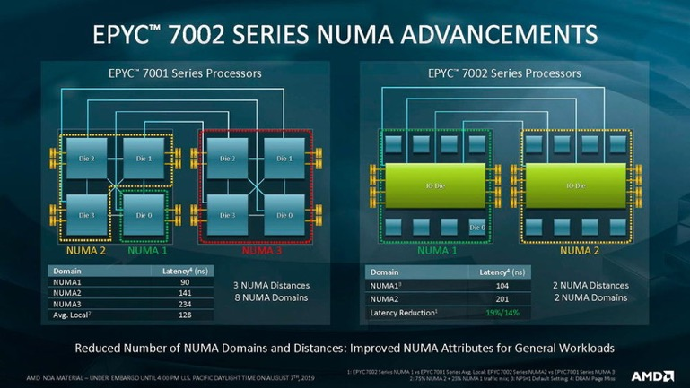
NUMA Nodes and Scheduling Domains
Group of processors sharing last level cache (LLC) form NUMA node
NUMA nodes are grouped according to their level of connectivity
Each level of hierarchy is called scheduling domain
  Scheduling domain differ from each processor’s perspective
  E.g., above photo shows scheduling domains from perspective of processors in NUMA1 node
Load balancing is run for each scheduling domain

Slide 39

Load Balancing Newly-ready Threads
Where should OS schedule newly-created threads?
  Linux typically schedules new threads on
  the same processor that runs parent thread!
Where should OS schedule awakened threads?
  For cache reuse, OS might want to schedule
  thread on same node it was put to sleep
  But this is not optimal if all processors of
  the same node are busy while other nodes are idle
One strategy
  If there are no idle processors, schedule newly-ready threads on original node
  If there are idle processors, pick one that has been idle for longest period
    Processor with short idle time could still be overloaded with lots of threads that frequently
    sleep due to synchronization or I/O

Slide 40
Energy Aware Scheduling (EAS)
Goal of EAS is to maximize performance per watt
  Performance is instruction per second
  Maximizing performance per watt = minimizing energy per instruction
EAS needs to know each processor’s
  Capacity: amount of work it can do when running at its highest frequency compared to the most capable processor in system
  Energy model: power cost table per performance domain
Using utilization and capacity, EAS estimates how big/busy each task/CPU is
EAS assigns awakened threads to processor that is predicted to yield best energy consumption without harming performance
Fig. www.arm.com

Slide 41
Aside: History of Linux CPU Scheduler
Linux kernel between v2.4 and v2.6 used O(n) Scheduler
  Only one ready queue for all CPUs implementing MFQ
  High algorithmic complexity, performed poorly for highly multithreaded workloads
In 2003, it was replaced by O(1) Scheduler (from v2.6.0 to v2.6.22)
  Supporting constant O(1) scheduling complexity
  Better scalability, not so friendly with interactive and audio applications
  Initially successful, soon required lots of patches for new architectures
  (e.g., NUMA and SMT)
In 2007, Completely Fair Scheduler was introduced replacing O(1) Scheduler (from v2.6.23)
  Sacrificing O(1) complexity for O(log n) (read-black tree)
  Implementing fair scheduling with lots of heuristics and optimizations for corner cases
In 2009, Brain Fuck Scheduler was introduced as alternative to CFS
  Not intended for mainline kernel, providing simple scheduler not needing heuristics and tunning
  Only one ready queue, behavior that resembles weighted RR
  Eventually retired in favor of Multiple Queue Skiplist Scheduler

Slide 42
Scheduling Multithreaded Programs: Oblivious Scheduler
CPU 1
CPU 2
CPU 3
P1.1
P2.1
P1.2
Time
P2.3
P3.2
P3.1
P1.3
P2.4
P2.2
Px.y: thread y in process x
Oblivious scheduling: CPUs independently schedule threads in their queue
  Each thread is treated as independent thread
What happens if one thread gets time-sliced while others are still running?
  Assuming program uses mutexes and condition variables, it will still be correct
  Performance, however, could suffer if threads actually depend on one another

Slide 43
Problem with Oblivious Scheduling:
Bulk Synchronous Delay
Data parallelism is common programming design pattern
  Data is split into roughly equal sized chunks
  Chunks are processed independently by threads
  Once all chunks are processed, threads synchronize and communicate their results to next stage of computation
  E.g., Google MapReduce
CPU 1
CPU 2
CPU 3
P1.1
P1.2
P1.3
Synchronization
Time
Communication
Synchronization
P1.1
P1.2
P1.3
Notes:
A model for writing parallel programs.
Eg., PageRank

Slide 44
Problem with Oblivious Scheduling:
Bulk Synchronous Delay
CPU 1
CPU 2
CPU 3
P1.1
P1.2
P1.3
P2.X
Time
P1.3
Synchronization
Communication
Synchronization
P1.1
P1.2
P1.3
At each step, computation is limited by the slowest thread
If thread is preempted on one CPU, it stalls all other threads
Notes:
A model for writing parallel programs.
Eg., PageRank

Slide 45
Problem with Oblivious Scheduling:
Producer-Consumer Delay
CPU 1
CPU 2
CPU 3
Thread 1
Thread 2
Thread 3
Producer-consumer design patter is also very common
Preempting a thread on one CPU stalls all others in the chain
Some other problems with oblivious scheduling
  Preempting a thread on the critical path will slow down the entire process
  Preempting thread that has locked mutex stalls others until it is re-scheduled

Slide 46
Gang Scheduling
CPU 1
CPU 2
CPU 3
P1.4
P1.2
P1.3
Time
P2.1
P2.2
P2.3
P3.1
P3.2
Time is divided into equal intervals
Threads from same process are scheduled at beginning of each interval
Notice any problems?
  CPU cycles are waisted when threads have different lengths
  Some CPUs remain idle when a process doesn’t have enough threads for all CPUs
Notes:
Schedule the same task at the same time everywhere.
Problems? What about single threaded processes? You would waste time on the other processors.

Slide 47
Space Sharing
CPU 1
CPU 2
CPU 3
CPU 4
CPU 5
CPU 6
T₁
T₂
T₃
T₁
T₂
T₃
Time
T₅
T₄
T₄
T₆
T₇
T₆
T₅
T₇
Process 1
Process 2
Each process is assigned a subset of CPUs
  Minimizes processor context switches

Slide 48
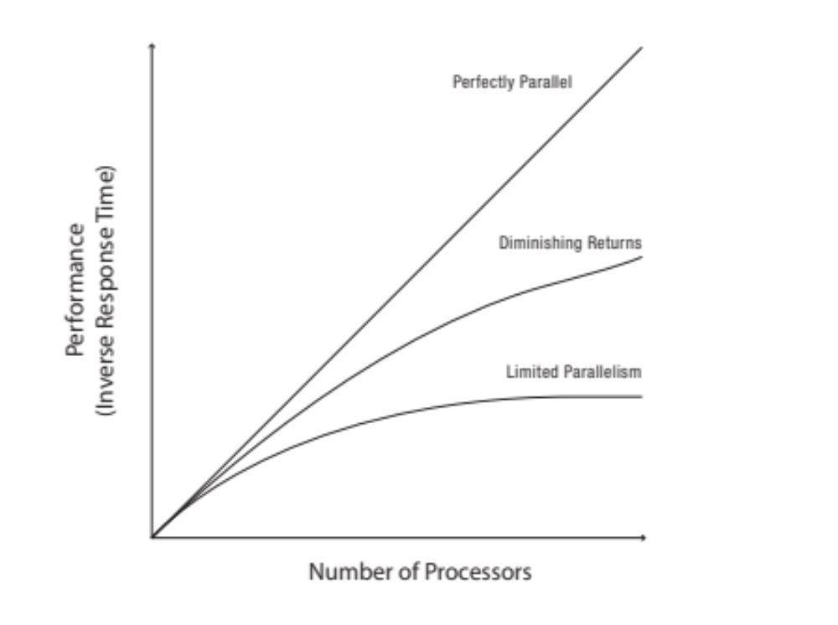
How Many CPUs
Does a Process Need?
There are overheads
  E.g., creating extra threads, synchronization, communication
Overheads shift the curve down

Slide 49
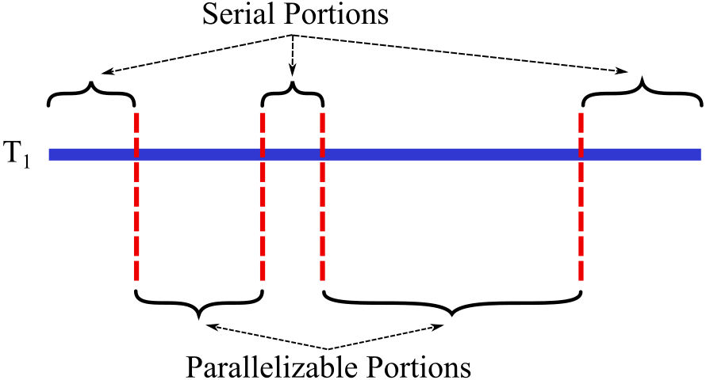
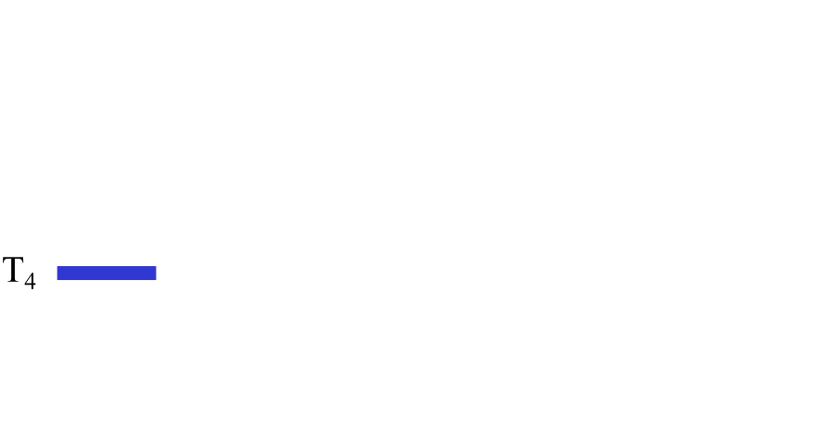

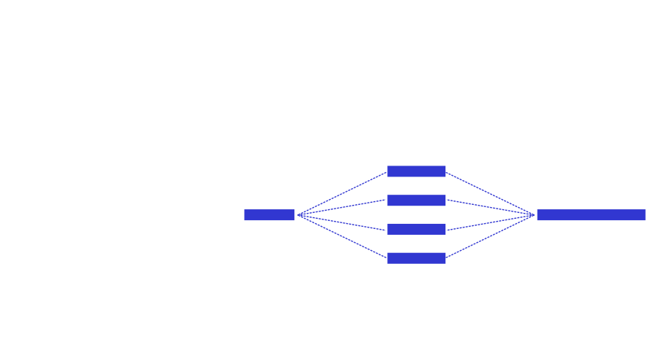
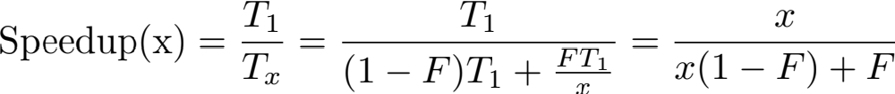
Amdahl’s Law
[G. Amdahl 1967]
Architects use it to estimate upper bounds on speedups

Slide 50
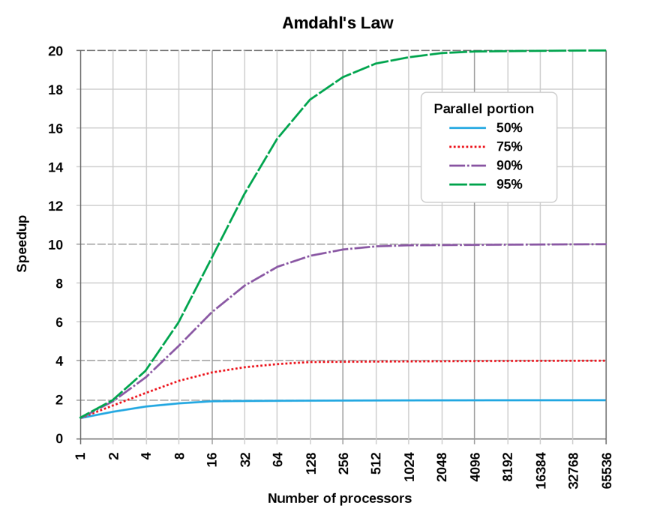
Amdahl’s Law (cont.)
[G. Amdahl 1967]

Slide 51

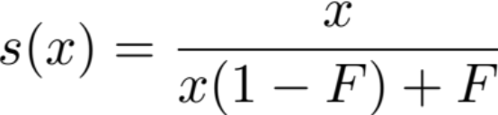
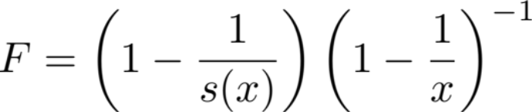
What Portion of Code is Parallelizable?
[Allen Karp and Horace Flatt 1990]
Expert programmers may not know!
Fortunately, we can measure speedup
Set
Measure
Calculate
Karp-Flatt
Metric
?
Fig. criticallyrated.files.wordpress.com

Slide 52
Summary
Properties of multiprocessors make scheduling them complex
  Symmetric vs. asymmetric multiprocessors
  Uniform vs. non-uniform memory access
  Cache coherence problem
Concurrency doesn’t always mean higher performance
  Lock contention solutions: MCS and RCU locks
Scheduling multiprocessors typically boils down to efficient load balancing
  Load balancing newly-ready threads based on different goals
Orchestrating threads when scheduling multiple multithreaded programs could have great impact on performance
  Gang scheduling, space sharing

Slide 53

Questions?
globaldigitalcitizen.org

Slide 54
Acknowledgment
Slides by courtesy of Anderson, Culler, Stoica, Silberschatz, Joseph, Canny, Sorin

