Slide 1


Slide 2
Lecture 6:
Real-time Systems
Prof. Seyed Majid Zahedi
https://ece.uwaterloo.ca/~smzahedi

Slide 3
Outline
Real-time systems
  Definitions and features
Real-time operating systems
  Desirable properties, interrupt handling, memory management
Uniprocessor real-time scheduling
  RM, EDF, LLF, …
  Priority inversion
Multiprocessor scheduling
  Different scheduling classes, remote blocking

Slide 4
Real-time Systems (RTSes)
Definition
  Systems whose correctness depends on their temporal aspects as well as their functional aspects
Performance measure
  Timeliness on timing constraints (deadlines)
  Speed/average case performance are less significant
Key property
  Predictability on timing constraints

Slide 5
Types of Real-time Systems
Soft: must try to meet all deadlines
  System does not fail if a few
  deadlines are missed
Firm: result has no use outside
deadline window
  Tasks that fail are discarded
Hard: must always meet all deadlines
  System fails if deadline window is missed
Value/usefulness
Deadline
Time
Value/usefulness
Deadline
Time
Value/usefulness
Deadline
Time

Slide 6
Real-time Spectrum
No RT
Soft RT
Hard RT
Computer
simulation
User
interface
Internet
video/audio
Cruise
control
Tele-
communication
Flight
control
Electronic
engine

Slide 7
General-purpose OS are Inadequate for RTSes
Multitasking/scheduling
  Provided through system calls
  Does not take time into account and could introduce unbounded delays
Interrupt management
  Achieved by setting interrupt priority more than process priority
  Increases system reactivity but may cause unbounded delays even due to unimportant interrupts
Basic IPC and synchronization primitives
  May cause priority inversion
  Causes unbounded delays

Slide 8

Real-time Operating System (RTOS):
Desirable Properties
Predictability
  Guaranteeing in advance deadline satisfaction
  Notifying when deadline cannot be guaranteed
Timeliness
  Handling tasks with explicit time constraints
Fault tolerance
  Avoiding crashes even with HW/SW failures
Design for peak load
  All scenarios must be considered
Maintainability

Slide 9

Microarchitecture
I/O devices and CPU typically share the same bus
  DMA steals CPU memory cycle to
  transfer data (cycle stealing)
  CPU waits until the transfer is completed
    Source of non-determinism!
  Possible solution: time-slice method
    Each memory cycle is split in two adjacent
    time slots one for CPU one for DMA
    More costly, but more predictable!
Caches speedup execution by keeping data close to CPU
  The same load/store instruction could experience different delays depending on hitting or missing in cache ⇒ source of non-determinism!
  Possible solution: processors without cache
    Slow execution, but more predictable!

Slide 10

System Calls and Interrupts
System call handler is usually non-preemptable
  Real-time task could be delayed while handler runs
  Delays could lead to missed deadlines
  Possible solution: make all kernel primitives,
  including system call handlers, preemptable!
Interrupt handler should remain non-preemptable
  Interrupt handler runs immediately when interrupts happen
  While handler runs, execution of interrupted task is delayed
  Solution1: disable all interrupts, only keep timer interrupt, tasks directly communicate with any I/O devices they need, data is transferred by polling
    + Unbounded delays due to unexpected device handling is eliminated
    + Time for data transfers can be estimated precisely
    + No change of kernel is needed when adding devices
    − Performance of processor is degraded (busy waiting)
    − Tasks must know low level details of drives

Slide 11
System Calls and Interrupts (cont.)
Solution II: disable interrupts, only keep timer interrupts, handle I/O by timer-activated device routines within kernel tasks, data is transferred by polling
  + Unbounded delays due to unexpected device handling is eliminated
  + Execution time of periodic device routines can be estimated in advance
  + Hardware details are encapsulated in dedicated device routines
  − Performance of processor is degraded (still busy waiting for I/O)
  − Kernel has to be modified every time new device is added
  − Communicating with devices involves more inter-task communications than first solution
Solution III: enable interrupts, reduce device drivers to least possible size, driver activates proper task to handle device, kernel runs driver-activated tasks like any other task, user tasks may have higher priority than driver-activated tasks
  + Busy waiting is eliminated
  + Kernel doesn’t need to be modified when adding new devices!
  o Communicating with devices may still involve some inter-task communications
  o Unbounded delay due to unexpected device handling is not eliminated but is dramatically reduced

Slide 12
Memory Management
General-purpose OSes allow each process to access only its own virtual address
  Virtual and physical address spaces are divided into virtual and physical pages
  Virtual to physical page translations are stored in memory as page tables (PT)
  To speedup memory accesses, PT entries are cached in translation lookaside buffer (TLB)
  TLBs introduce non-deterministic delay (hit or miss)
  Possible solution: avoid using virtual memory, allow user tasks to use physical memory
When memory is full, most OSes swap out some pages to make room for others
(this is called paging, more about it later!)
  Accessing evicted pages causes page fault
  Page fault handling & page replacement policy cause non-deterministic delays
  Possible solution: use selective page locking to increase determinism

Slide 13

Programming Languages
Dynamic memory operations (e.g., malloc and free) are unpredictable
  Memory allocator runs non-deterministic space optimization algorithms
  Requests could fail due to fragmentation even if there is free memory
  Possible solution: partition memory into fixed-size blocks (partition pools)
  Another solution: prevent dynamic data structures all together
    Flexibility is reduced in dynamic environment
Recursion could lead to unbounded execution time
  Possible solution: only allow time-bound loops
Example of RT programming languages
  Real-Time Java, Concurrent C, Euclid
p1 = malloc(3)
p2 = malloc(4)
Defragmentation is not feasible, all copies of p2 become broken if OS moves allocated
free(p1)
p1 = malloc(4)

Slide 14
Scheduling
General-purpose schedulers are system-oriented
  Maximize avg. system throughput
RTSes need task-centric scheduling
  Minimize worst-case response time for each task
  Predictability ≠ fast computing
Real-time tasks
  Periodic: set of jobs arriving at fixed period (p)
    Each job has worst-case execution time (e) and hard relative deadline (d ≤ p, usually d = p)
    Utilization of task is e / p
  Aperiodic: arrive randomly without any hard deadline
  Sporadic task arrives randomly with hard deadline
  Independent vs. interdependent and preemptable vs. non-preemptable
Execution
time
T: (7, 4)
Period = Relative deadline

Slide 15
Terminology of Real-time Scheduling
Static scheduling: priority of each task does not change over time
  E.g., rate monotonic (RM)
Dynamic scheduling: priority of each job does not change over time
  E.g., earliest deadline first (EDF)
Fully-dynamic scheduling: priority of each job could change over time
  E.g., least laxity first (LLF)
Schedule S is feasible if all deadline are met
Task set T is schedulable under scheduling class C if there exists scheduling algorithm A in C that produces feasible schedule for T
Scheduling algorithm A is optimal w.r.t. scheduling class C if it produces feasible schedule for any schedulable task set T under C

Slide 16
General-purpose Schedulers for RTSes
RR example:
T2 missed its deadline!
T₁: (2, 1)
T₂: (5, 1)
T₃: (10, 3)
0
5
10

Slide 17
Rate Monotonic (RM)
RM makes following assumptions
  Tasks are periodic and independent with known and fixed execution times
RM is static online scheduling policy
  Higher priorities are assigned to tasks with shorter periods
  Priority of each task is fixed and doesn’t change at run-time
  RM is optimal w.r.t. static schedulers
T₁: (2, 1)
T₂: (5, 1)
T₃: (10, 3)
0
5
10

Slide 18
RM: Schedulability
T₁: (3, 1)
T₂: (5, 2)
T₃: (8, 2)
0
5
10
T₃ missed
its deadline!

Slide 19
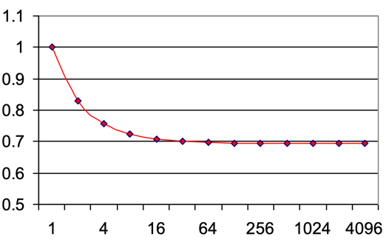
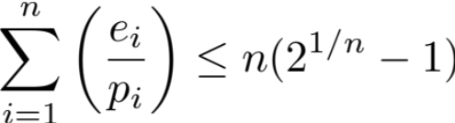
RM: Schedulability Test [Liu & Layland 1973]
For n periodic tasks with execution time e_{i} and deadline and period p_{i}, RM is guaranteed to produce feasible schedule if
  If condition does not hold, then deadlines may or may not be met!
  Example: T₁(3,1), T₂(5,2), T₃(8,2)
    1/3 + 2/5 + 2/8 (= 0.9833) ≥ 3(2^{1/3}-1) (≈ 0.78) ⇒ No guarantee!
Utilization
Number of tasks

Slide 20
Earliest Deadline First (EDF)
EDF is dynamic online scheduling policy
  Scheduler always schedules active task with earliest deadline
  Current priority of tasks depends on how close their deadline is
  Tasks’ priorities change during execution
  EDF is optimal w.r.t. all online schedulers
T₁: (3, 1)
T₂: (5, 2)
T₃: (8, 2)
0
5
10
15

Slide 21
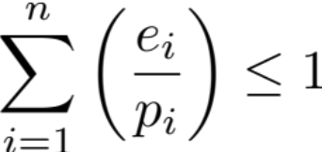
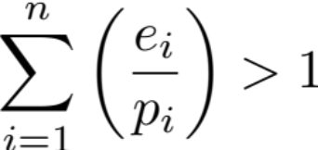
EDF: Schedulability Test [Liu & Layland 1973]
Even EDF won't work if you have too many tasks
For n periodic tasks with execution time e_{i} and deadline and period p_{i}, EDF is guaranteed to produce feasible schedule if
System is overloaded if

Slide 22
Overloaded System under EDF
EDF schedule could be suboptimal for overloaded system
Domino effect example: T₁(4,3), T₂(5,3), T₃(6,3), T₄(7,3)
Better schedules
T₁
T₂
T₃
T₄
0
5
10
T₁
T₃
0
5
10
T₁
T₄
0
5
10

Slide 23
Least Laxity First (LLF)
LLF dynamically assigns priority to jobs based on their laxity (slack)
  With absolute deadline d and remaining execution time e, laxity at time t is l = d – t – e
  Job with the smallest laxity has the highest priority
  LLF is also optimal w.r.t. all online schedulers
  LLF is impractical to implement because laxity tie results in frequent context switches
l
e
t
d
T₂: (5, 2)
T₃: (6, 3)
0
5
l₁
l₂
3
3
2.5
2.5
2
2
1.5
1.5
1

Slide 24
RM vs. EDF vs. LLF
Rate monotonic (RM)
  Simpler implementation, even in systems without explicit support for timing constraints (periods, deadlines)
  Predictability for highest priority tasks
Earliest deadline first (EDF)
  Full processor utilization
  Misbehavior during overload conditions
Least laxity first (LLF)
  Full processor utilization
  Misbehavior when there are jobs with equal laxity

Slide 25
Scheduling Mixed Periodic and Aperiodic Tasks
One idea: run aperiodic tasks as soon as they arrive
  Response time for aperiodic tasks is minimized, but it’s unbounded for periodic tasks
Another idea: assign aperiodic tasks lowest priority (run if no periodic task runs)
  Simple, bad response time for aperiodic tasks (applicable if they have no strict timing requirement)
Better idea: aperiodic tasks can be served by periodically invoked server
  Server can be accounted for in periodic task schedulability analysis
  Server has period p_{s} and budget B_{s}
  Server can serve aperiodic tasks until budget expires
  Servers have different flavors depending on details of when they are invoked, what priority they have, and how budgets are replenished
Aperiodic Tasks
Server
Periodic Tasks
CPU
Ready Queue

Slide 26
Polling Server (PS)
Periodic tasks and PS are scheduled based on RM
Aperiodic arrivals are queued until PS is invoked
At the beginning of its period, PS serves queued aperiodic tasks
PS suspends itself when queue becomes empty or budget expires
PS is treated as regular periodic task in schedulability analysis
T₁: (4,2)
Budget over time
PS: (5,2)
Aperiodic Tasks
Why aren’t we running these right away?

Slide 27
Deferrable Server (DC)
Basic approach is like polling server
DS preserves its budget when queue becomes empty
  But no cumulation: at the beginning of period, budget is reset to its full value
DS is demand driven
  Periodic tasks are ready to run at the beginning of their periods
  DS can run during its period only in response to aperiodic-task arrivals
T₁: (4,2)
Budget over time
DS: (5,2)
Aperiodic Tasks
Although DS has budget, its priority is lower than T₁

Slide 28
Total-bandwidth Server (TBS)
Periodic tasks and TBS are scheduled based on EDF
  Aperiodic and periodic tasks are both inserted in the same ready queue
  Aperiodic tasks are artificially assigned deadline such that TBS’s utilization does not exceed its given bandwidth U_{TBS}
  Aperiodic task T_{i} with computation time C_{i} arriving at time a_{i} is assigned deadline d_{i} = max(d_{i-1}, a_{i}) + C_{i} / U_{TBS}
  Example: T₁(3,1) and T₂(6,2),
    T₁ and T₂ are schedulable if U_{TBS} ≤ 1 – 2/3 = 1/3
T₁: (3,1)
T₂: (6,2)
Aperiodic Tasks
0
5
10
15
a₁=1, C₁=1
d₁=1+1/(1/3)=4
a₃=8, C₃=2
d₃=8+2/(1/3)=14
a₂=3, C₂=0.5
d₂=max(3,4)+
0.5/(1/3)=5.5
a₄=9, C₄=0.5
d₄=max(9,14)+
0.5/(1/3)=15.5

Slide 29
Scheduling Interdependent Tasks: Synchronization
Problem of deciding whether it is possible to schedule set of periodic tasks, that use semaphores to enforce mutual exclusion is NP-hard ^{[1]}
General-purpose synchronization primitives allow priority inversion
  High-priority task is indirectly preempted by lower-priority task
Try R₁, block
How long does this take?
H blocked
H
Lock R₁
Priority
M
L
Lock R₁
Lock R₁
Lock R₁
5
10
15
Time
Release R₁
[1] A.K. Mok, ‘‘Fundamental Design Problems of Distributed Systems for Hard Real Time Environments’’, PhD Thesis, Laboratory for Computer Science (MIT), MIT/LCS/TR-297. (1983).

Slide 30

Priority Inversion and MARS Pathfinder
Landed on Martian surface on July 4th, 1997
After it started gathering data, it began experiencing total system resets, each resulting in losses of data
  Pathfinder had single shared information bus used by
  low and high-priority tasks
  Low-priority task ran infrequently and used bus to
  publish its data, while holding mutex on bus
  Every system reset started by low-priority task
  getting interrupted while holding mutex
  Interrupt handler scheduled medium-priority task
  High-priority task was blocked waiting for low-priority task
  which was waiting for medium-priority task to finish
  After some time, watchdog timer went off,
  noticing that bus has not been executed for some time,
  it concluded that something had gone bad,
  and initiated total system reset

Slide 31
Priority-inheritance Protocol (PIP)
PIP increases priority of task to maximum priority of any task waiting for any resource locked by the task
  If lower-priority task L has locked any resources required by higher-priority task H, then priority of L is increased to priority of H
  Once task unlocks resources, it runs with its original priority
PIP does not prevent deadlock
Try R₁, block
H
Lock R₂
L
Lock R₁
Lock R₁
Try R₂, deadlock

Slide 32
PIP and Chained Blocking
PIP does not prevent chained blocking
  H must wait for L and M
Try R₂, block
M inherits H’s priority
Try R₁, block
H
Lock R₂
M
Lock R₂
Lock R₁ and R₂
L
Lock R₁
Lock R₁
Lock R₁
Release R₁
L inherits M’s priority
Release R₁

Slide 33
Priority-ceiling Protocol (PCP)
Each resource is assigned priority ceiling
  Equal to the highest priority of any task that can lock it
Each task can lock resources only if its priority is higher than priority
ceilings of all resources currently locked by other tasks
Each task runs at its assigned priority unless it has locked any
resource needed by higher priority task
After task unlocks resources, it runs with its original priority
PCP prevents deadlocks
Try R₂, block (because priority is not higher than ceiling of R₁)
H
Lock R₂
L
Lock R₁
Lock R1
Lock R₁ and R₂
Lock R1
L inherits H’s priority

Slide 34
PCP Prevents Chained Blocking
H does not wait for L
Try R₂, block
(M is not higher than ceiling of R₁)
H
Lock R₂
M
Lock R₂
Lock R₁ and R₂
L
Lock R₁
Lock R₁
L inherits M’s priority
Release R₁

Slide 35
EDF and Deadline Interchange
Deadline interchange is analogous to priority inversion
Task which has locked resources could be preempted by another task with earlier deadline that needs those resources
To avoid this, scheduler should assign to running task earliest deadline from among other tasks waiting for it

Slide 36
Multiprocessors and Remote Blocking
In uniprocessors, it is acceptable if high-priority task pre-empts lower-priority ones
In multiprocessors, this is not necessarily desirable
  Example: high-priority task H and low-priority task L are assigned to CPU₁
  Medium-priority task M runs on CPU₂
  H is more important than either M or L, but is it more important than M and L?
L Locks R₁
H arrives
H is done
L unlocks R₁
CPU₁
L
H
L
CPU₂
M
M
Time
Try R1, block
H blocks both L and M

Slide 37
Multiprocessor Scheduling
No migration (partitioned): each task and its jobs must run on single CPU
Restricted migration: each job must run on single CPU
  Different jobs of the same task may run on different CPUs
Full migration: each job can migrate between CPUs
 | No Migration | Restricted Migration | Full Migration
Static | (S,N) | (S,R) | (S,F)
Dynamic | (D,N) | (D,R) | (D,F)
Fully Dynamic | (F,N) | (F,R) | (F,F)

Slide 38
(.,N)-based Schedulers
Finding optimal assignment of N periodic tasks to M CPUs is equivalent to bin-packing
  It’s NP-hard problem
Several polynomial-time heuristics have been proposed
  First fit: assign each task to CPU that can accept it
  (based on feasibility test according to that CPU’s uniprocessor scheduler)
  Best fit: assign each task to CPU that can accept it and will have minimal remaining spare capacity
Worst-case utilization is (M+1)/2
  E.g., M+1 tasks with e = 1 + 𝜀 and p = 2 cannot be scheduled by any (.,N) scheduler
  Almost half of resources could be left underutilized

Slide 39
Some Other Scheduling Classes
(D,R)-based: jobs have fixed priority and must run on single CPU
  Suitable for task sets in which each job has considerable amount of state
  (it is not desirable to migrate jobs between processors)
(D,F)-based: jobs have fixed priority but can migrate
  Preemption, and hence migration, can only happen because of new job arrival
  E.g., global EDF: use single ready queue for all CPUs, set priorities according to EDF
    No longer optimal: T₁(10,5), T₂(10,5), T₃(11,7) on 2 CPUs
    EDF runs T₁ and T₂ first in parallel ⇒ T₃ misses its deadline
(S,F)-based: tasks have fixed priority, jobs can migrate
  E.g., global RM: us single ready queue for all CPUs, set priorities according to RM
Worst-case utilization of any (x,y)-based scheduler is (M+1)/2, unless x = y = F ^{[1]}
[1] Carpenter, J., Funk, S., Holman, P., Srinivasan, A., Anderson, J. H., & Baruah, S. K. (2004). A Categorization of Real-Time Multiprocessor Scheduling Problems and Algorithms.

Slide 40

(F,F)-based Schedulers
Global LLF: use single ready queue for all CPUs, set priorities based on LLF
  It schedules any instance that global EDF can schedule
  Like global EDF, it is not optimal
P-fair scheduling: allocate CPU time to enforce proportionate progress
  Is optimal (both for uniprocessors and multiprocessors)
  Produces feasible schedule for M CPUs and any task set T with U_{T} ≤ M

Slide 41
P-fairness
Main idea: allocate CPU time to each task i in proportion to its weight w_{i} = e _{i} / p_{i}
Divide time into small time quanta
  All parameters are integer multiples of time quantum (e.g., e_{i}, p_{i} ∈ ℤ⁺)
Define lag for each task to captures discrepancy between what it should have received and what it actually received
  lag(i,t) = t x w_{i} – allocated(i,t)
Schedule S is periodic if and only if for all task i and any integer k
  allocated(i,k x p_{i}) = k x e_{i}
Schedule S is P-fair if and only if for all task i and time t
  –1 < lag(i,t) < 1
Any P-fair schedule is periodic
  At t = k x p_{i}, allocated(i,t) and t x w_{i} are both integers ⇒ allocated(i,t) = k x e_{i}
  Periodic schedules aren’t necessarily P-fair (why?)

Slide 42
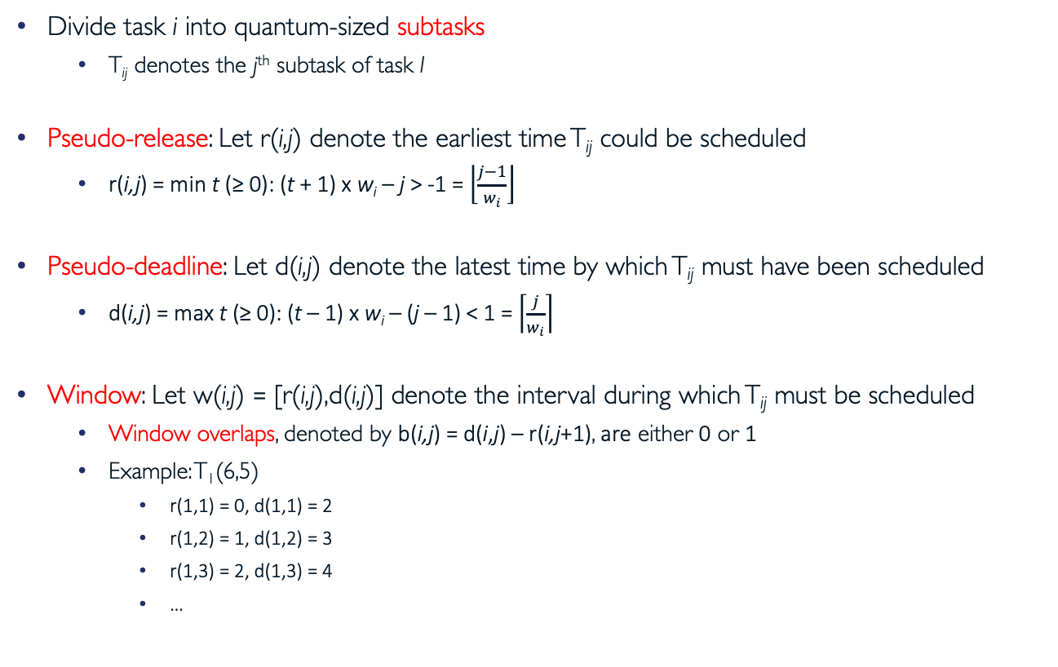
Subtasks and Pseudo Parameters
Divide task i into quantum-sized subtasks
  T_{ij} denotes the j^{th} subtask of task I
Pseudo-release: Let r(i,j) denote the earliest time T_{ij} could be scheduled
  r(i,j) = min t (≥ 0): (t + 1) x w_{i} – j > -1 = $\left\lfloor \frac{j−1}{w_{i}}\right\rfloor$
Pseudo-deadline: Let d(i,j) denote the latest time by which T_{ij} must have been scheduled
  d(i,j) = max t (≥ 0): (t – 1) x w_{i} – (j – 1) < 1 = $\left\lceil \frac{j}{w_{i}}\right\rceil$
Window: Let w(i,j) = [r(i,j),d(i,j)] denote the interval during which T_{ij} must be scheduled
  Window overlaps, denoted by b(i,j) = d(i,j) – r(i,j+1), are either 0 or 1
  Example: T₁(6,5)
    r(1,1) = 0, d(1,1) = 2
    r(1,2) = 1, d(1,2) = 3
    r(1,3) = 2, d(1,3) = 4
    …
w(1,4)
w(1,5)
w(1,2)
w(1,3)
w(1,7)
w(1,1)
w(1,6)
0
1
2
3
4
5
6
7
8
9

Slide 43
Existence of P-fair Schedule
Example: scheduling T₁(2,1), T₂(6,5), and T₃(3,2) on two CPUs
Integral flow theorem: If all edges have integral capacity, then integral maximal flow exists
Network flow problem has integer solution ⇒ P-fair schedule exists
w(1,1)
1
T₁₁
Utilization = Num of CPUs
Num of Subtasks = Num jobs x e_{i}
T₁ runs at t = 0
T₁
1
T₁₂
T₁ runs at t = 1
t=0
1
T₁ runs at t = 2
2
T₁₃
T₁ runs at t = 3
LCM(2,3,6)
3 x 1
T₁ runs at t = 4
t=1
2
1
T₂₁
T₁ runs at t = 5
1
T₂₂
T₂ runs at t = 0
2
2 x 6
1 x 5
T₂ runs at t = 1
t=2
T₂
1
T₂₃
T₂ runs at t = 2
1
T₂ runs at t = 3
2
1
T₂₄
T₂ runs at t = 4
t=3
T₂₅
T₂ runs at t = 5
2
Utilization =
Num of CPUs
(if utilization is less
than num of CPUs
add dummy task)
2 x 2
T₃ runs at t = 0
t=4
2
1
T₃₁
T₃ runs at t = 1
1
T₃₂
T₃ runs at t = 2
T₃
1
T₃ runs at t = 3
t=5
1
T₃₃
T₃ runs at t = 4
T₃₄
T₃ runs at t = 5

Slide 44
P-fair (PF) Scheduling Algorithm
PF priorities subtasks on earliest-pseudo-deadline-first (EPDF) basis
At time t, T_{ij} has higher priority than T_{mn} (T_{ij} ≻ T_{mn}), if any of following holds
  d(i,j) < d(m,n)
  d(i,j) = d(m,n) and b(i,j) > b(m,n)
  d(i,j) = d(m,n), b(i,j) = b(m,n) = 1, and T_{i(j+1)} ≻ T_{m(n+1)}
If neither subtask has priority over other, then tie can be broken arbitrarily
Intuition behind (II): scheduling T_{ij} earlier prevents it from shortening w(i,j+1)
  Makes it easier to schedule T_{i(j+1)} by its pseudo-deadline
  Similar intuition behind (III)

Slide 45
PF Discussion
PF incurs very high overheads by making scheduling decisions at every time quantum
Also, all processors need to synchronize on boundary between quanta when scheduling decisions are made
Extensions to PF try to mitigate some of these problems
  E.g., PD, PD², ERfair

Slide 46
Summary
Real-time systems have strict timing constraints
General-purpose operating systems are inadequate for real-time systems
Real-time operating systems should provide predictability
  Memory management, interrupt handling, scheduling, etc.
Scheduling in real-time systems is task-centric
  All tasks should meet their deadlines
  Worst-case execution time is important not average throughput
Optimal scheduler exist for uniprocessor systems
  RM, EDF, and LLF
Scheduling real-time tasks on multiprocessors is challenging
  Optimal uniprocessor scheduler are no longer optimal for multiprocessors
  Partitioning tasks between processors is a “hard” problem
  Optimal schedulers exist, but they typically incur high overhead

Slide 47

Questions?
globaldigitalcitizen.org

Slide 48
Acknowledgment
Slides by courtesy of Anderson, Culler, Stoica, Silberschatz, Joseph, Canny, Lee (Insup), Drews, and Andersson (Björn)

