Slide 1


Slide 2
Lecture 8: Caching
Prof. Seyed Majid Zahedi
https://ece.uwaterloo.ca/~smzahedi

Slide 3
Outline
Principle of locality
  Temporal locality: Locality in time
  Spatial locality: Locality in space
Cache organizations
  Direct-mapped, set-associative, fully-associative
Major categories of cache misses
  Compulsory, conflict, capacity, coherence
Translation lookaside buffer (TLB): caching applied to address translation
  Cache relatively small number of PTEs
  On TLB miss, page table is traversed

Slide 4

Caching Concept
Cache is repository for copies that can be accessed more quickly
  Make frequent case fast and infrequent case less dominant
Caching underlies many techniques used today to make computers fast
  We can cache memory locations, address translations, pages, file blocks, file names, network routes, etc…
Only good if
  Frequent case is frequent enough and
  Infrequent case is not too expensive

Slide 5
Why Bother with Caching?
Processor-DRAM Memory Gap (latency)
60% per year
(2X/1.5 year)
1000
CPU
“Moore’s Law”
(really Joy’s Law)
Processor-Memory
Performance Gap:
(grows 50% / year)
100
Normalized Performance Growth
10
9% per year
(2X/10 years)
DRAM
1
1980
1981
1982
1983
1984
1985
1986
1987
1988
1989
1990
1991
1992
1993
1994
1995
1996
1997
1998
1999
2000
Time

Slide 6
Why Does Caching Help?
Probability
of reference
0
Address Space
2^{n}-1
Temporal locality (locality in time):
  Cache recently accessed data items
Spatial locality (locality in space):
  Cache contiguous blocks
Notes:
In order to take advantage of the temporal locality, that is the locality in time, the memory hierarchy will keep those more recently accessed data items closer to the processor because chances are (points to the principle), the processor will access them again soon.
In order to take advantage of the spatial locality, not ONLY do we move the item that has just been accessed to the upper level, but we ALSO move the data items that are adjacent to it.

Slide 7
Some Terminology
Block: group of spatially contiguous and aligned bytes (words)
  Typical sizes are 32B, 64B, 128B
Hit: access cache and find what we want
  Hit time: time to hit (or discover miss)
Miss: access cache and fail to find what we want
  Miss time: time to satisfy miss
  Misses are expensive (take a long time) ⇒ try to avoid them
  But, if they happen, amortize their costs ⇒ bring in more than just specific word you want ⇒ bring in whole block (multiple words)

Slide 8
Some Terminology (cont.)
Hit rate = num of hits / (num of hits + num of misses)
  Miss rate = 1 – hit rate
  High hit rate means high probability of finding what we want
Average access time = hit rate x hit time + miss rate x (hit time + miss time)
  = hit time + miss rate x miss time
Problem: hard to get low hit time and miss rate in one memory structure
  Large memory structures have low miss rate but high hit time
  Small memory structures have low hit time but high miss rate
Solution: use hierarchy of memory structures

Slide 9
Memory Hierarchy of Modern Computer Systems
Goal: bring average memory access time close to L1’s
Compiler
Managed
Hardware
Managed
Software
Managed (by OS)
Core
Processor
L2 Cache
Secondary
Storage
(Disk)
L1 Cache
Registers
Secondary
Storage
(SSD)
Main
Memory
(DRAM)
Core
L3 Cache
(shared)
L2 Cache
L1 Cache
Registers
Speed (ns):
0.3
1
3
10-30
100
100,000
(0.1 ms)
10,000,000
(10 ms)
Size (bytes):
100Bs
10KiBs
100KiBs
MiBs
GiBs
100GiBs
TiBs
Notes:
The design goal is to present the user with as much memory as is available in the cheapest technology (points to the disk).
While by taking advantage of the principle of locality, we like to provide the user an average access speed that is very close to the speed that is offered by the fastest technology.
(We will go over this slide in details in the next lecture on caches).

Slide 10
Abstract Hierarchy Performance
M4
M3
CPU
M1
M2
Miss time at level X = Average access time at level X + 1
Avg. memory access time = Avg-time_{M1}
= Hit-time_{M1} + (Miss-ratio_{M1} x Miss-time_{M1})
= Hit-time_{M1} + (Miss-ratio_{M1} x Avg-time_{M2})
= Hit-time_{M1} + (Miss-ratio_{M1} x (Hit-time_{M2} + (Miss-ratio_{M2} x Miss-time_{M2})))
= Hit-time_{M1} + (Miss-ratio_{M1} x (Hit-time_{M2} + (Miss-ratio_{M2} x Avg-time_{M3})))
= …

Slide 11

Caching Questions
11111
11110
8-byte cache, 32-byte memory, 1 block = 1 byte
Assume CPU accesses 01100
How do you know whether byte @ 01100 is cached?
11101
11100
11011
11010
11001
11000
Cache
10111
10110
111
10101
110
10100
(01100)
101
10011
100
10010
011
10001
Physical Memory
010
10000
001
01111
000
01110
01101
01100
01011
01010
01001
01000
00111
00110
00101
00100
00011
00010
00001
00000

Slide 12
Caching Questions (cont.)
11111
11110
8-byte cache, 32-byte memory, 1 block = 1 byte
Assume CPU accesses 01100
How do you know whether byte @ 01100 is cached?
If not, at which location in cache should it be placed?
11101
11100
11011
11010
11001
11000
Cache
10111
10110
111
10101
110
10100
101
10011
100
10010
011
10001
Physical Memory
010
(01100)
10000
001
01111
000
01110
01101
01100
01011
01010
01001
01000
00111
00110
00101
00100
00011
00010
00001
00000

Slide 13

Caching Questions (cont.)
11111
11110
8-byte cache, 32-byte memory, 1 block = 1 byte
Assume CPU accesses 01100
How do you know whether byte @ 01100 is cached?
If not, at which location in cache should it be placed?
If cache is full, which cached byte should be evicted?
11101
11100
11011
11010
11001
11000
Cache
10111
10110
111
10101
110
10100
101
10011
100
10010
011
10001
Physical Memory
010
10000
001
01111
000
01110
01101
01100
01011
01010
01001
01000
00111
00110
00101
00100
00011
00010
00001
00000

Slide 14
Where to Put Blocks in Cache?
Divide cache into disjoint sets of blocks
  There is 1-to-1 mapping from block address to set
M-way set-associative cache: each set holds M number of blocks
  E.g., 4 blocks per set ⇒ 4-way set-associative cache
Fully-associative cache: whole cache has just one set
  + Most flexible
  − Longest access latency
Direct-mapped cache: each set has one block (= 1-way set-associative)
  + Shortest access latency
  − Least flexible

Slide 15
Example: Direct-mapped Cache
11111
11110
Each byte (block) in physical memory is
cached to single cache location
  Least significant bits of address (last 3 bits) index cache
  (00100),(01100),(10100),(11100) cached to 100
How do we know which byte is cached?
  Tag each byte with the most significant two bits
11101
11100
11011
11010
11001
11000
10111
10110
10101
10100
Tag
Cache
10011
10010
111
10001
Physical Memory
110
10000
101
01111
100
01
01110
011
01101
010
01100
001
01011
000
01010
01001
01000
00111
00110
00101
00100
00011
00010
00001
00000

Slide 16
Example: Fully-associative Cache
11111
11110
Each byte (block) can be stored at any location in cache
How do you know which byte is cached?
  Tag entire address of cached byte
11101
11100
11011
11010
11001
11000
10111
10110
10101
10100
Tag
Cache
10011
10010
111
10001
Physical Memory
110
10000
101
01111
100
01100
01110
011
01101
010
01100
001
01011
000
01010
01001
01000
00111
00110
00101
00100
00011
00010
00001
00000

Slide 17
Where to Put Blocks in Cache? (cont.)
Example: where is block 12 placed in 8-block cache?
32-Block
Address Space
0
0
0
1
0
2
0
3
0
4
0
5
0
6
0
7
0
8
0
9
1
0
1
1
1
2
1
3
1
4
1
5
1
6
1
7
1
8
1
9
2
0
2
1
2
2
2
3
2
4
2
5
2
6
2
7
2
8
2
9
3
0
Block address
3
1
Direct-mapped
Block 12 can go only into block 4
(12 mod 8)
2-way set-associative
Block 12 can go anywhere in set 0
(12 mod 4)
Fully-associative
Block 12 can go anywhere
Set number
0
1
2
3
0
1
2
0
3
1
2
3
4
5
6
7
0
0
0
0
0
0
0
First
Block
Second
Block
0
01
100
011
00
01100
Tag
Index
Tag
Index
Tag
Index

Slide 18
How is Block Found in Cache?
Memory address
Cache Tag
Cache Index
Byte Select
Byte select field used to select data within block
  Offset of byte in block
Cache index used to lookup candidate blocks in cache
  Index identifies set
Cache tag used to identify actual copy among candidate blocks
  If no candidate matches, then declare cache miss

Slide 19
Direct-mapped Cache
Direct-mapped 2^{N} byte cache with block size of 2^{M} bytes
  Uppermost (32 - N) bits of address are cache tag
  Lowest M bits are byte select, rest are cash index
Example: 1KiB direct-mapped cache with 32B blocks
  Log₂32 = 5 bits for byte select, 32 – Log₂1024 = 22 bits for cache tag
  32 – 5 – 22 = 5 bits for cache index
Memory address
31
9
4
0
Cache Tag
Cache Index
Byte Select
Example: 0x50
0x01
0x00
Valid
Bit
Cache Tag
Cache Data
B31
:
B1
B0
0
1
0x50
B63
:
B33
B32
1
2
Cache structure
3
:
:
:
B1023
:
B992
31

Slide 20
Set-associative Cache
2^{K}-way set-associative 2^{N} byte cache with block size of 2^{M} bytes
  Lowest M bits for byte select, (32 – N + K) bits for cache tag, rest for cache index
  2^{K} direct-mapped caches operates in parallel
Previous example, now with 2-way set-associativity
  Cache Index selects “set” from cache, there are 16 sets ⇒ 4 bits for index
Memory address
31
8
4
0
Cache Tag
Cache Index
Byte Select
Valid
Bit
Valid
Bit
Cache Tag
Cache Data
Cache Tag
Cache Data
Cache Block 0
Cache Block 0
0
Cache Block 1
Cache Block 1
1
Cache
Structure
:
:
:
:
:
:
2
3
Cache Block 15
Cache Block 15
15
=
1
0
=
selc1
selc0
Hit
OR
Cache Block

Slide 21
Fully-associative Cache
Every cache block can hold any memory block
  Address does not include cache index
  Compare cache tags of all cache blocks in parallel
Previous example now with fully-associative cache
Memory address
31
4
0
Cache Tag
Byte Select
Valid
Bit
Cache Tag
Cache Data
=
B31
:
B1
B0
0
=
B63
:
B33
B32
1
2
Cache
Structure
3
:
:
:
:
=
B1023
:
B992
31
Hit

Slide 22

Effective Cache
Consider 2-MiB, 8-way-set-associative cache and 4KiB physical pages
Suppose HW uses low-order bits of physical address to index cache
Suppose process A is allocated physical pages that are separated by 256KiB
How much cache capacity process A can effectively use?
  Bytes in memory that are separated by 256KiB are mapped to same cache set
  A will only be able to use 32KiB (4KiB pages times 8-way set associativity)
  A can only use less than 2% of cache!

Slide 23
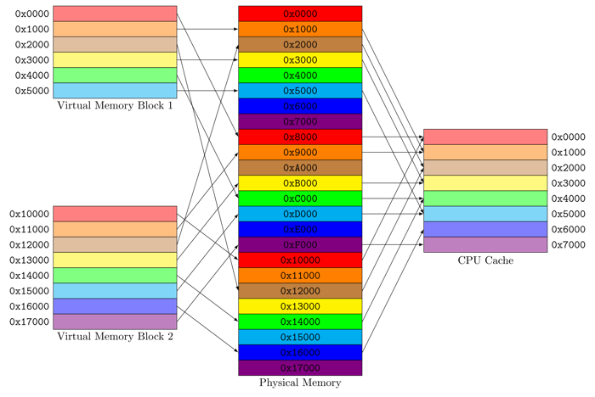
Page Coloring
Physical pages are given colors
Pages with same color will be mapped to the same set in cache
  In above example, there will be 64 different colors (256KiB divided by 4KiB pages)
Kernel maps sequential virtual pages to physical pages with different colors
  Sequential pages in virtual memory do not contend for the same cache set
en.wikipedia.org

Slide 24
Possible Sources of Cache Misses
Compulsory (cold)
  Cache hasn’t seen this block before (start or migration of process)
  “Cold” fact of life: not whole lot you can do about it
Capacity
  Cache cannot contain all blocks accessed by program
  Solution: increase cache size
Conflict (collision)
  Multiple memory locations mapped to the same cache location
  Solution 1: increase cache size
  Solution 2: increase associativity (no conflict misses in fully-associative cache)
Coherence (invalidation)
  Other process (e.g., I/O) updates memory

Slide 25
Replaced Policy on Cache Miss?
Easy for direct-mapped: only one possibility
For set-associative or fully-associative
  Random
  Least Recently Used (LRU, more on this later)

Slide 26
What Happens on Write?
Write-through: write to both cache and lower-level memory
  + Read misses cannot result in writes
  − Processor held up on writes unless writes are buffered
Write-back: write only to cache
  Modified cache block is marked dirty
  On replacement, dirty block is written to lower-level memory
  + Repeated writes are not sent to DRAM
  + Processor not held up on writes
  − More complex
  − Read miss may require writeback of dirty data

Slide 27
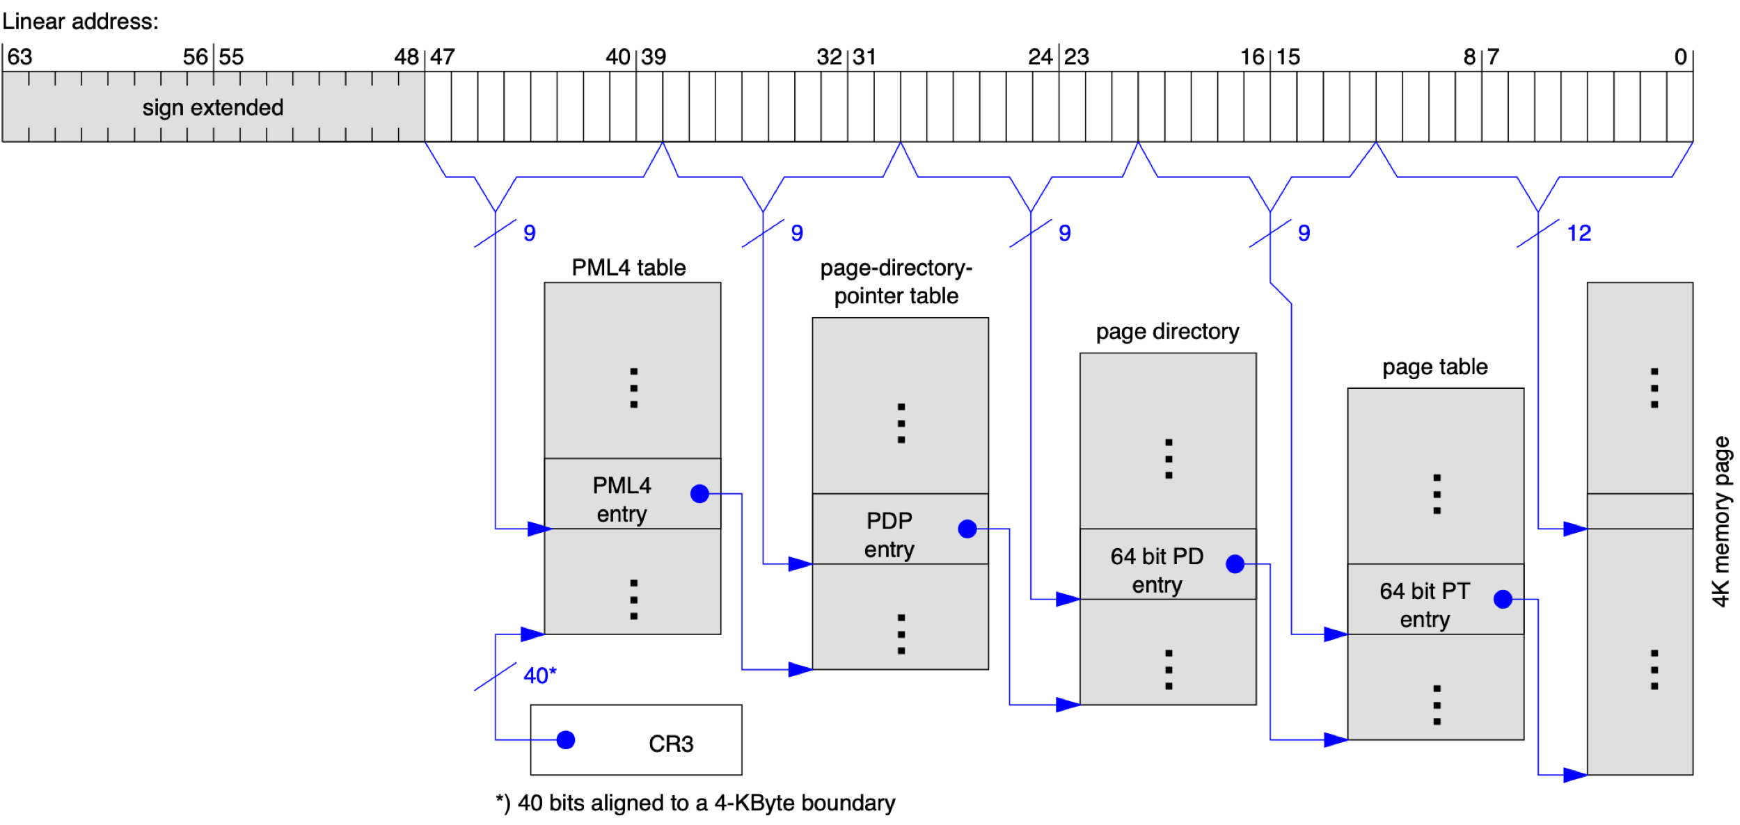
Caching Address Translations
Cannot afford to translate on every access
  At least five DRAM accesses per actual DRAM access
  Or: perhaps I/O if page table partially resides on disk!
  Even worse, what if we use caches to make memory access faster than DRAM access?

Slide 28
Recall: Memory Hierarchy
Address Translation needs to occur here
Page table lives here (perhaps cached)
Compiler
Managed
Hardware
Managed
Software
Managed (by OS)
Core
Processor
L2 Cache
Secondary
Storage
(Disk)
L1 Cache
Registers
Secondary
Storage
(SSD)
Main
Memory
(DRAM)
Core
L3 Cache
(shared)
L2 Cache
L1 Cache
Registers
PT
Speed (ns):
0.3
1
3
10-30
100
100,000
(0.1 ms)
10,000,000
(10 ms)
Size (bytes):
100Bs
10KiBs
100KiBs
MiBs
GiBs
100GiBs
TiBs
Notes:
The design goal is to present the user with as much memory as is available in the cheapest technology (points to the disk).
While by taking advantage of the principle of locality, we like to provide the user an average access speed that is very close to the speed that is offered by the fastest technology.
(We will go over this slide in details in the next lecture on caches).

Slide 29
Translation Lookaside Buffer (TLB)
Main idea: cache recent virtual page number to physical page number translations
TLB hit provides physical address without reading any of page tables!
  Caches end-to-end result
  Even if translation involved multiple levels
Does page locality exist?
  Instruction accesses: sequential accesses ⇒ Frequent accesses to the same page ⇒ Yes!
  Stack accesses: definite locality of reference ⇒ Yes!
  Data accesses: less page locality, but still some ⇒ Yes, so so!

Slide 30
TLB: Caching Applied to Address Translation
Virtual
Address
TLB
Page
Tables
CPU
Miss
Invalid
Raise
Exception
Hit
Cache
Valid
Physical
Memory
Offset
+
Physical Address
Data

Slide 31
TLB Consistency with PTEs
If PTE permission is reduced: TLB entry should be invalidated
  Early computers discarded entire TLB
  Modern architectures allow removal of individual entries
If PTE permission is added: nothing needs to be done
  E.g., changing invalid to read-only or read-only to read-write
  Any reference would cause exception, OS removes TLB entry
If PTE is invalidated: TLB entry should be invalidated too
  E.g., swapping out page from memory to disk (more on this later)

Slide 32
Accessed and Dirty Bits
TLB entries generally don’t have accessed bit
  If address is cached in TLB, it already should have been accessed
  Page-table walk sets accessed bit of PTE on TLB miss
TLB entries do have dirty bit
  When write misses in TLB, page-table walk sets dirty bit in PTE and TLB
  Even when write hits in TLB, page-table walk is necessary to set dirty bit if it isn’t set
  If dirty bit is set in TLB, no page-table walk is necessary (saving memory bandwidth)
Do we really need dirty bit in PTE and TLB?
  No! OS can emulate it (e.g., BSD Unix)
  Initially, mark all pages as read-only
  On write, trap to OS, set software dirty bit, and mark page as read-write
Do we really need access bit in PTE?
  No! OS can emulate it
  Initially, mark all pages as invalid
  On read, trap to OS (invalid), set software access bit, and mark page read-only
  On write, trap to OS (invalid or read-only), set software access and dirty bits, mark page read-write

Slide 33
Homonyms
Definition: single virtual address mapped to different physical addresses
Problem: TLB entries are invalid after context switching to another process
Solution 1: invalidate all TLB entries
  + Simple
  − Expensive (what if switching frequently between processes)
Solution 2: tag each TLB entry with process-context identifier (PCID)
  + Less expensive
  − Needs extra hardware

Slide 34
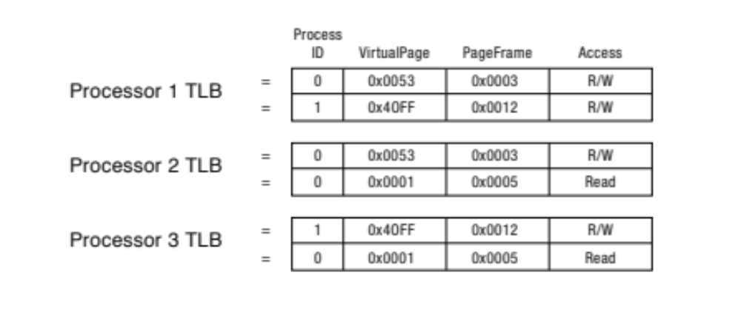
TLB Shootdown
If processor1 updates process 0’s PTE for page 0x53, then it should
  Remove old entry from its TLB
  Send inter-processor interrupt to other processors telling them to remove their old entries
Shootdown is complete once all processors verify that their old entry is removed
TLB shootdown overhead increases linearly with number of processors

Slide 35
What Happens on TLB Miss?
Hardware-traversed page tables
  On TLB miss, hardware walks through current page tables to fill TLB
  (could be multiple levels)
    Valid PTE: Hardware fills TLB and processor never notices
    Invalid PTE: CPU raises page fault ⇒ Kernel decides what to do next
Software-traversed page tables
  On TLB miss, CPU raises TLB fault
  Kernel walks through page table(s) to find PTE
    Valid PTE: Fills TLB and returns from fault
    Invalid, internally calls page fault handler

Slide 36
TLB Fault and Page Fault Exceptions
Unlike interrupts, exceptions are synchronous, caused by particular instruction
  E.g., TLB fault or page fault, divide by zero
In general, faulting instruction needs to be restarted after exception is handled
Side effects of faulting instruction need to be undone
  Example: push 10
    What if page fault occurs when write to stack pointer?
    Was sp incremented before or after page fault?
Partially executed instructions should also be undone in out-of-order execution
  Example 1: mul r1, r2, r3
  bne r1, r4, loop
  ld r5,(r6)
    What if it take many cycles to see if r1 = r4, but load has already caused page fault?
  Example 2: div r1, r2, r3
  ld r4, (r5)
    What if it takes many cycles to discover divide-by-zero, but load has already caused page fault?

Slide 37
Precise Exceptions
Instructions retire when their results become visible in architectural state
  E.g., processor registers, memory, etc.
  Architectural state ≠ micro-architectural state (e.g., caches)
To implement precise exceptions, instructions should retire in program’s sequential order
  Execution could still be out-of-order
Exception should only be raised when faulting instruction tries to retire
  All instructions before faulting instruction should have already retired
When exception is raised, architectural state should be preserved
  Faulting instruction and all following instructions act as if they have not even started
User
Faulting
Inst 1
Faulting
Inst 1
Faulting
Inst 2
Faulting
Inst 2
Page Fault
Page Fault
OS
Fetch Page/Load TLB
Fetch page/Load TLB

Slide 38
Improve Efficiency Even More!
TLB improves performance by caching recent translations
How to improve performance even more?
  Multi-level TLBs
What is the cost of first-level TLB miss?
  Second-level TLB lookup
What is the cost of second-level TLB miss?
  x86: 2-4 level page table walk

Slide 39
Virtually-addressed Cache
Virtual
Address
Virtual
Cache
Virtual
Address
TLB
Page
Tables
CPU
Miss
Invalid
Raise
Exception
Miss
Hit
Hit
Cache
Valid
Physical
Memory
Offset
+
Physical Address
Data
Too slow to access TLB before looking up address in memory
Instead, add virtually-addressed cache (virtual cache)
In parallel, access TLB to generate physical address in case of cache miss

Slide 40
Synonym
Definition: different virtual addresses mapped to same physical address
  Could be in same virtual address space or different virtual address spaces
  E.g., mmap() same file multiple times in same process or once in multiple processes
Aliasing problem: synonyms could be mapped to different locations in virtual cache
Typical solution: virtually-indexed-physically-tagged virtual cache
  Map synonyms to the same cache set (kernel ensures assigned VAs agree in index bits)
  Tag each virtual cache block by physical address
  Lookup virtual cache and TLB in parallel
  Update/invalidate other copies if physical address from TLB matches multiple entries
Synonym problem could affect any HW structure that deals with memory accesses
  E.g., load with synonym VA misses in store buffer if entries are tagged by VA and PID

Slide 41
Aside: Memory-mapped Files
Traditional I/O involves explicit transfers between buffers in process address space to/from regions of file
  This involves multiple copies into caches in memory, plus system calls
OS can map region of file into empty region of process address space
  Implicitly page it in when we read it
  Write it and eventually page it out
Executable files are treated this way when we exec the process

Slide 42
Putting it Together: Address Translation
Virtual Address
V-P1 Index
V-P2 Index
Offset
Physical
Page
Physical Address
P-Page #
Offset
PT Pointer
Page Table
(2nd Level)
Page Table
(1st Level)

Slide 43
Putting it Together: TLB
Virtual Address
V-P1 Index
V-P2 Index
Offset
Physical
Page
Physical Address
P-Page #
Offset
PT Pointer
Page Table
(2nd Level)
Page Table
(1st Level)
:
TLB

Slide 44
Putting it Together: Physical Cache
Virtual Address
V-P1 Index
V-P2 Index
Offset
Physical
Page
Physical Address
P-Page #
Offset
Tag
Index
Byte
Cache
PT Pointer
Tag
Block
Page Table
(2nd Level)
Page Table
(1st Level)
:
:
TLB

Slide 45
Putting it Together:
Page Table, TLB, and Caches
Virtual
Address
Virtual
Cache
Virtual
Address
TLB
Page
Tables
CPU
Miss
Invalid
Raise
Exception
Miss
Hit
Hit
Cache
Valid
Physical
Memory
Physical
Address
Physical
Cache
Physical
Address
Offset
+
Miss
Hit
Data

Slide 46
Recall: Memory Hierarchy
Can TLB misses get resolved without ever going to main memory?
Compiler
Managed
Hardware
Managed
Software
Managed (by OS)
Core
Processor
L2
Secondary
Storage
(Disk)
TLB
L1
Registers
Caching
Secondary
Storage
(SSD)
PTE
PTE
Main
Memory
(DRAM)
Core
L3
TLB
L2
L1
Registers
PTE
PTE
PTE
PT

Slide 47
TLB Set Associativity
Memory
CPU
TLB
Cache
Average memory access time = hit-time_{TLB} + (miss-ratio_{TLB} x miss-time_{TLB})
TLB hit time is added to all memory accesses
Should TLB be direct-mapped or have low associativity?
  No! TLB needs to have very few conflicts!
  Miss time is extremely high!
TLBs are typically fully-associative
  Significantly reduce conflict misses in return for slightly higher hit time

Slide 48
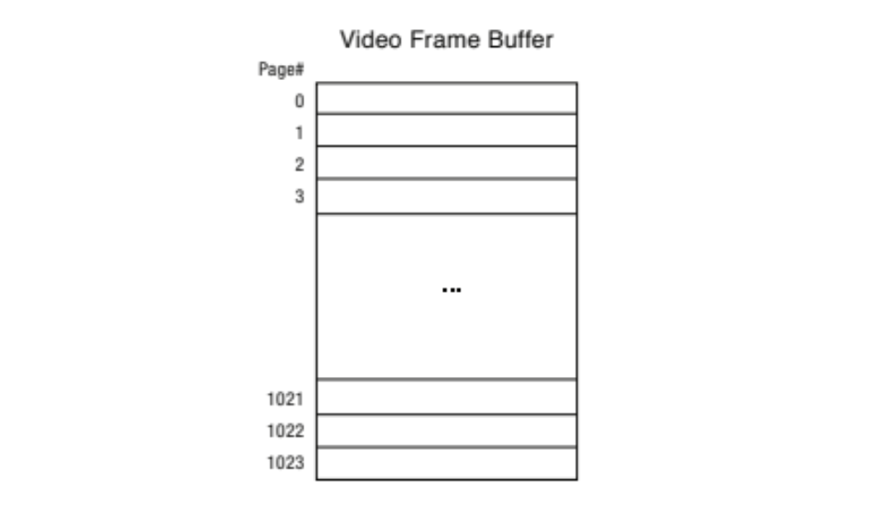
Do TLBs Always Improve Performance?
Example: for HD displays, video frame buffer could be large
  E.g., 4k display: 32 bits x 4K x 3K = 48MiB (spans12K of 4KiB pages)
Even large on-chip TLB with 256 entries cannot cover entire display
Each horizontal line of pixels could be on on page
Drawing vertical line could require loading a new TLB entry

Slide 49
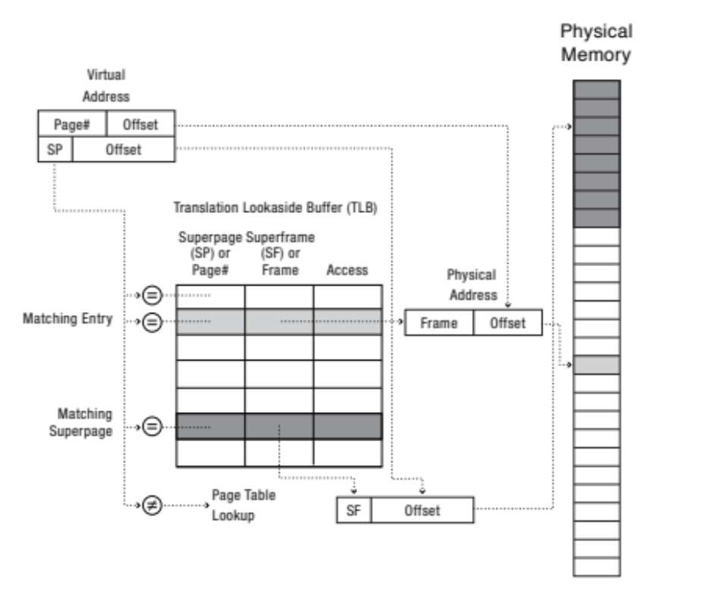
Superpages: Improving TLB Hit Rate
Reduce number of TLB entries for large, contiguous regions of memory
  Represent 2 adjacent 4KB pages by single 8KB superpage
By setting a flag, TLB entry can be a page or a supperpage
  E.g., in x86: 4KB (12 bits offset), 2MB (21 bits offset), or 1GB (30 bits offset)

Slide 50
Linux Virtual Memory Map
Prior to KPTI Patch
1GiB
0xFFFFFFFF
128TiB
0xFFFFFFFFFFFFFFFF
Kernel
Addresses
Kernel
Addresses
0xC0000000
User
Addresses
0xFFFF800000000000
3GiB Total
Empty
Space
Canonical Hole
128TiB
0x00007FFFFFFFFFFF
User
Addresses
0x00000000
0x0000000000000000
32-Bit Virtual Address Space
64-Bit Virtual Address Space
Address space of user process includes kernel memory
Kernel memory is protected from user process by owner bit
+ On system calls or interrupts, kernel page tables are always present
  Mitigating context-switch overheads (e.g., TLB flush, page-table swapping, etc.)
– It exposes serious security vulnerabilities that have been exploited by various attacks
  E.g. Meltdown and Spectre attacks

Slide 51

Meltdown Attack: Background
Branches can significantly slow down out-of-order execution
  E.g., processor has to wait for many cycles to determine direction of conditional jump
To speed up out-of-order execution, modern processors implement branch predictors (BP)
  BP predicts whether conditional branch will be taken before its execution
  Predictions are usually based on previous executions of the branch
  Processor executes next instructions speculatively
  On branch misprediction, processor rolls back speculatively-executed instructions
    Their results do not change architectural state

Slide 52
Meltdown Attack
Meltdown was announced in 2018
It affects Intel x86, IBM Power, and some ARM processors
Kernel page-table isolation (KPTI) patch was released to mitigate Meltdown
  Without PCID tag in TLB, KPTI needs to flush TLB twice on syscall and interrupts (800% overhead!)
  Need at least kernel v4.14 which utilizes PCID tag in new HW to avoid flushing
char array[256 * 4096]; // Skip 4096 to avoid HW cache prefetch
flush_cache(array); // Make sure array is not cached
try { // catch and ignore SIGSEGV (illegal access)
char result = *(char *)kernel_address; // Segmentation fault
char dummy = array[result * 4096]; // Leak info!
} catch(){;} // Could use signal() to catch SIGSEGV
for (int i = 0; i < 256; i++)
if (is_in_cache(array[i * 4096]))
printf(“%d\n”); // found byte at kernel_address

Slide 53
Summary
Principle of locality
  Programs access small portion of address space at any instant of time
Cache organizations
  Direct-mapped, set-associative, fully-associative
Three (+1) major categories of cache misses
  Compulsory, conflict, capacity, coherence
TLB: caching applied to address translations
  Cache relatively small number of PTEs
  Fully-associative (since conflict misses expensive)
  On TLB miss, page table is traversed and if PTE is invalid, cause page fault
  On change in page table, TLB entries must be invalidated

Slide 54

Questions?
globaldigitalcitizen.org

Slide 55
Acknowledgment
Slides by courtesy of Anderson, Ousterhout, Sorin, Asanovic, Culler, Stoica, Silberschatz, Joseph, and Canny

