Slide 1


Slide 2
Lecture 9: Demand Paging
Prof. Seyed Majid Zahedi
https://ece.uwaterloo.ca/~smzahedi

Slide 3
Outline
Demand paging
Replacement policies
  FIFO, MIN, LRU
Clock algorithm
N^{th}-chance algorithm

Slide 4
Demand Paging
Modern programs require a lot of physical memory
  Memory per system is growing faster than 25%-30% per year
But they don’t use all their memory most of the time
  90-10 rule: programs spend 90% of their time in 10% of their code
  Wasteful to require all of user’s code to be in memory
Solution: demand paging (also known as paging)
  Use main memory as cache for disk
Core
Processor
L2 Cache
Secondary
Storage
(Disk)
L1 Cache
Paging
Registers
Secondary
Storage
(SSD)
Caching
Main
Memory
(DRAM)
Core
L3 Cache
(shared)
L1 Cache
L2 Cache
Registers

Slide 5

Demand Paging is Just Caching …
What is block size?
  One page
What is organization of cache structure?
  Fully associative
How do we find pages in cache?
  First check TLB, then page-table traversal
What is page replacement policy?
  This requires more explanation… (coming next!)
What happens on misses?
  Go to lower level (i.e., disk) to resolve miss
What happens on writes?
  Write-back

Slide 6
Recall: x86 64-bit PTE
NX
SW
Reserved
P-Page Number
U
P
CW
GL
L
D
A
CD
WT
O
W
V
63
62-52
51-40
39-12
11
10
9
8
7
6
5
4
3
2
1
0
V: Valid
W: Read/write
O: Owner (user/kernel)
WT: Write-through (more on this soon)
CD: Cache-disabled (page cannot be cached)
A: Accessed: page has been accessed recently
D: Dirty bit (page has been modified recently)
L: Large page
G: Global
CP: Copy-on-write
P: Prototype PTE
U: Reserved
SW: Software (working set index)
NX: No-execute

Slide 7
Demand Paging Overview
PTE helps us implement demand paging
  Valid ⇒ page in memory, PTE points to physical page
  Invalid ⇒ page not in memory; use info in PTE to find it on disk when necessary
What happens on references to page with invalid PTE?
  Page-fault exception ⇒ trap to OS
What does OS do on page fault?
  Allocate physical page to referenced virtual page
  Load new page into memory from disk and make PTE valid
What if there are no free physical pages?
  Evict one and write back its content to disk if it has been modified (i.e., dirty bit is set)
  Invalidate PTEs and TLB entries pointing to evicted physical page
While pulling pages off disk for one process, run another one from ready queue
  Suspended process sits on disk’s waiting queue

Slide 8
Paging Big Picture!
Memory
CPU
PT
Instruction
Virtual address
V-Page#
P-Page#
Retry
Offset
Page-fault
exception
P-Page#
Scheduler
Offset
Update PTE
Page-fault
handler
Disk
Load page from disk

Slide 9
Example: Loading Executable
Disk
Virtual Address
Space
Memory
Kernel
Kernel
pages
Stack
exe
Info
Data
Code
User
pages
Heap
Data
Code
Each executable file lives on disk in file system
  Contains contents of code & data segments, relocation entries and symbols
OS loads executable file into memory, initializes registers (and initial stack pointer)
Program sets up stack and heap upon initialization (e.g., crt0() in C)

Slide 10
Example: Provide Backing Store
Disk
VAS
PT
Memory
Kernel
Kernel
pages
Stack
exe
Stack
User
page tables
Info
Data
Heap
Code
Data
Code
User
pages
Heap
Data
Code
All used virtual pages are backed by page blocks on disk (called backing store or swap file)
User page tables map entire virtual address space
  OS must record where to find non-resident virtual pages on disk
  Some OSs utilize spare space in PTE for paged blocks
  Portion of page tables that HW needs to access must be also resident in memory

Slide 11
Example: On Page Fault …
Disk
VAS1
PT1
Memory
Kernel
Kernel
pages
Stack
Stack
User
page tables
Heap
VAS2
PT2
Data
Kernel
User
pages
Code
Stack
Stack
Heap
User
pages
Data
Heap
Code
Data
Code
Heap
Data
Current PT
Code

Slide 12
Example: On Page Fault … Schedule Other Process
Disk
VAS1
PT1
Memory
Kernel
Kernel
pages
Stack
Stack
User
page tables
Heap
VAS2
PT2
Data
Kernel
User
pages
Code
Stack
Stack
Heap
User
pages
Data
Heap
Code
Data
Code
Heap
Data
Current PT
Code

Slide 13
Example: On Page Fault … Update PTE
Disk
VAS1
PT1
Memory
Kernel
Kernel
pages
Stack
Stack
User
page tables
Heap
VAS2
PT2
Data
Kernel
User
pages
Code
Stack
Stack
Heap
User
pages
Data
Heap
Code
Data
Code
Heap
Data
Current PT
Code

Slide 14
Example: Resume from Faulting Instruction
Disk
VAS1
PT1
Memory
Kernel
Kernel
pages
Stack
Stack
User
page tables
Heap
VAS2
PT2
Data
Kernel
User
pages
Code
Stack
Stack
Heap
User
pages
Data
Heap
Code
Data
Code
Heap
Data
Current PT
Code

Slide 15
Demand Paging Cost Model
Effective access time (EAT) = Hit time + Miss ratio x Miss time
Example:
  Memory access time = 200ns, avg page-fault service time = 8ms, and miss ratio = p
  EAT = 200ns + p x 8ms = 200ns + p x 8,000,000ns
If one out of 1,000 accesses causes page fault, then EAT = 8.2μs
  40x slowdown!
What if we want slowdown of less than 10%?
  200ns x 1.1 > EAT ⇒ p < 2.5 x 10⁻⁶
  This is approximately single page fault in every 400,000 accesses!

Slide 16
What Factors Lead to Misses?
Compulsory misses
  Pages that have never been paged into memory before
  How might we remove these misses?
    Prefetching: loading them into memory before needed
    Need to predict future somehow!
Capacity misses
  Not enough memory; must somehow increase available memory size
  Can we do this?
    One option is increasing amount of DRAM (not quick fix!)
    Another option is adjusting percentage of memory allocated to process if multiple processes are in memory
Conflict misses
  Technically, conflict misses don’t exist in virtual memory, since it is “fully-associative” cache
Policy misses
  Caused when pages were in memory, but kicked out prematurely because of replacement policy
  How to fix this?
    Better replacement policy

Slide 17
Page Replacement Policies
Random
  Pick random page for every replacement
  + Simple hardware (typical solution for TLB’s)
  – Very unpredictable (makes it hard to provide any real-time guarantees)
First-in-first-out (FIFO)
  Throw out oldest page
  + Fair (let every page live in memory for same amount of time)
  – Not optimal (could throw out heavily used pages instead of infrequently used)
Minimum (MIN)
  Replace page that won’t be used for the longest time in future
  + Optimal (perfect benchmark)
  – Impractical (how can we really know future?)
Least-recently-used (LRU):
  Replace page that hasn’t been used for the longest time (if it hasn’t been used for a while, it’s unlikely to be used in near future)
  + Seems like LRU should be good approximation to MIN
  – High implement overhead (need to track all references to all pages)

Slide 18
Example: FIFO
Suppose we have 3 p-pages , 4 v-pages, and following reference stream:
FIFO: 7 faults
When referencing D, replacing A is bad choice, since we’ll need A again right away
Ref
Page
A
B
C
A
B
D
A
D
B
C
B
1
A
D
C
2
B
A
3
C
B

Slide 19
Example: MIN
MIN: 5 faults
  Where will D be brought in? Look for page not referenced farthest in future
What will LRU do?
  Same decisions as MIN here but won’t always be true!
Ref
Page
A
B
C
A
B
D
A
D
B
C
B
1
A
C
2
B
3
C
D

Slide 20
When Will LRU Perform Badly?
Every reference leads to page fault!
Ref
Page
A
B
C
D
A
B
C
D
A
B
C
D
1
A
D
C
B
2
B
A
D
C
3
C
B
A
D

Slide 21
When will LRU Perform Badly? (cont.)
MIN Does much better
Ref
Page
A
B
C
D
A
B
C
D
A
B
C
D
1
A
B
2
B
C
3
C
D

Slide 22
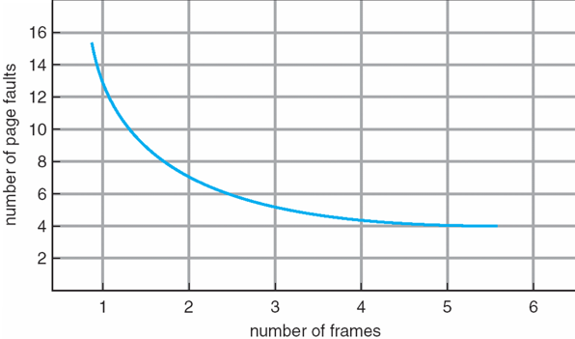
Memory Size and Page Fault Rate
One desirable property: When you add memory the miss rate drops
  Does this always happen?
  Seems like it should, right?
No: Bélády’s anomaly
  Certain replacement policies don’t have this obvious property!

Slide 23
Bélády's Anomaly
After adding memory:
  With FIFO, contents can be completely different
  With LRU or MIN, contents of memory with X pages are a subset of contents with X+1 Page
Ref:
Page:
A
B
C
D
A
B
E
A
B
C
D
E
1
A
D
E
2
B
A
C
3
C
B
D
Ref:
Page:
A
B
C
D
A
B
E
A
B
C
D
E
1
A
E
D
2
B
A
E
3
C
B
4
D
C

Slide 24
LRU Implementation
How to implement LRU? Use a list!
  On each use, remove page from list and place at head, LRU page is at tail
Problems with this scheme for paging?
  Need to know when each page is used to change its position in list
  Add extra overhead to each memory access
Head
Page 6
Page 7
Page 1
Page 2
Tail (LRU)

Slide 25
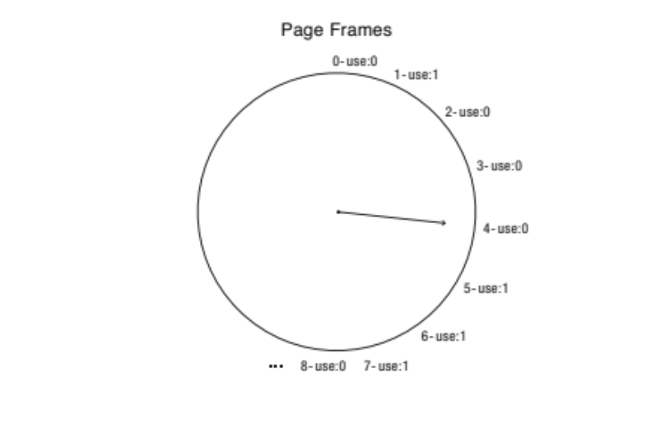
Clock Algorithm: LRU Approximation
Arrange physical pages in circle with single clock hand
Page-table walk sets accessed bit of PTE on TLB miss
  No change on further accesses resolved in TLB!
  (recall: TLB entries usually don’t have accessed bit)
On page fault, advance clock hand and then check access bit
  If 1, clear it, invalidate TLB entry, advance clock hand, and repeat
  If 0, pick candidate for replacement and terminate
Clock algorithm finds an old page, not the oldest page
Will this algorithm always find replacement page, or does it loop forever?
  If all use accessed bits are set, clock hand will eventually loop around ⇒ FIFO

Slide 26
Clock Algorithm: Discussion
What if hand is moving slowly? Is it a good sign or a bad sign?
  A good sign! Not many page faults and/or find page quickly
What if hand is moving quickly?
  Not a good sign! Lots of page faults and/or lots of reference bits set
One way to view clock algorithm
  Crude partitioning of pages into two groups: young and old
  Why not partition into more than 2 groups?

Slide 27

N^{th}-chance Algorithm:
Modified Clock Algorithm
Give each page N chances
  OS keeps counter per page to track number
  of times it qualifies for replacement
  On page fault, advance clock hand and
  check access bit
    1 → clear it, invalidate TLB entry, clear counter,
    advance clock hand, and repeat
    0 → increment counter; if counter is N,
    pick as replacement candidate
How do we pick N?
  Large N: better approximation to LRU, more overhead to find replacement candidate
  Small N: more efficient, less accurate
What about dirty pages?
  It takes extra overhead to replace dirty page, let dirty pages survive one extra sweep
  If counter is N and dirty bit is set, decrement counter and write back to disk

Slide 28
Clock Algorithms: Discussion
Can run synchronously with page-fault handler
  When page-fault handler, run clock algorithm to find next page to evict
Can run asynchronously with page-fault handler
  Maintain pool of candidate pages
  On page fault, evict one page from pool
  Run clock algorithm when size of pool decreases beyond fixed threshold
  Write dirty pages back to disk when they are added to pool
  Remove page from pool if it is accessed before eviction

Slide 29
Allocation of Physical Pages
How do we allocate memory among different processes?
  Does every process get same fraction of memory?
  Should we completely swap some processes out of memory?
Each process needs minimum number of pages
  All processes loaded into memory should make progress
Possible replacement scopes
  Global replacement – to make space for one process’s page, replacement is selected from all processes’ pages
  Local replacement – to make space for one process’s page, replacement is selected from process’ set of allocated pages

Slide 30
Fixed-priority Allocation
Equal allocation (fixed scheme)
  Every process gets same amount of memory
  Example: 100 physical pages, 5 processes → Each. process gets 20 pages
Proportional allocation (fixed scheme)
  Allocate according to size of process
  Computation proceeds as follows:
    s_{i} = size of process p_{i} and S = sum of s_{i}’s for all p_{i}’s
    m = total number of physical pages
    a_{i} = allocation for pi = (s_{i} x m) / S
Priority allocation
  Proportional scheme using priorities rather than size
  Possible behavior: If process p_{i} generates page fault, select for replacement page from process with lower priority number
Perhaps we should use an adaptive scheme instead?
  What if some application just needs more memory?

Slide 31
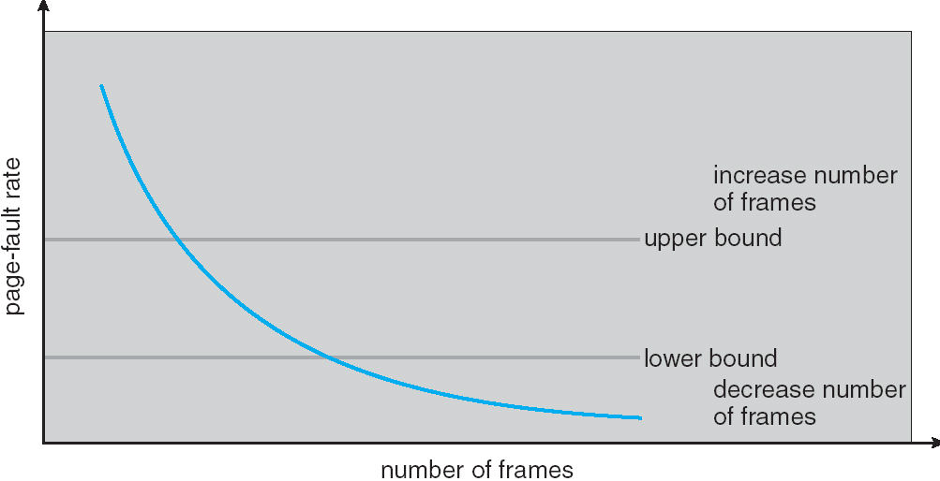
Page-fault Rate: Capacity Misses
Can we reduce capacity misses by dynamically changing # of pages per application?
Establish “acceptable” page-fault rate
  If actual rate too low, process loses page
  If actual rate too high, process gains page
Question: what if we just don’t have enough memory?

Slide 32
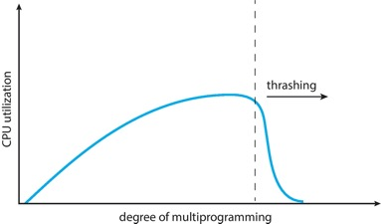
Thrashing
If process does not have “enough” pages, page-fault rate is very high which leads to
  Low CPU utilization
  OS spends most of its time swapping pages to disk
Thrashing ≡ process is busy swapping pages in and out disk
Questions:
  How do we detect thrashing?
  What is best response to thrashing?
Notes:
Example: one program, touches 50 pages (each equally likely). Have only 40 physical page frames.
How bad is this?
- Does your program run at 80% speed?
- Does your program run at 20% speed?
Performance is really bad
If we have enough pages, 200 ns/ref, but if too few pages, assume every 5th page reference causes a page fault
= 4 refs x 200 ns
1 page fault x 10 ms for disk I/O
= 5 refs, 10 ms + 800 ns => 2 ms/ref (not 100 MIPS, but 500 IPS! Factor of 10,000)
Machine appears to have stopped!

Slide 33
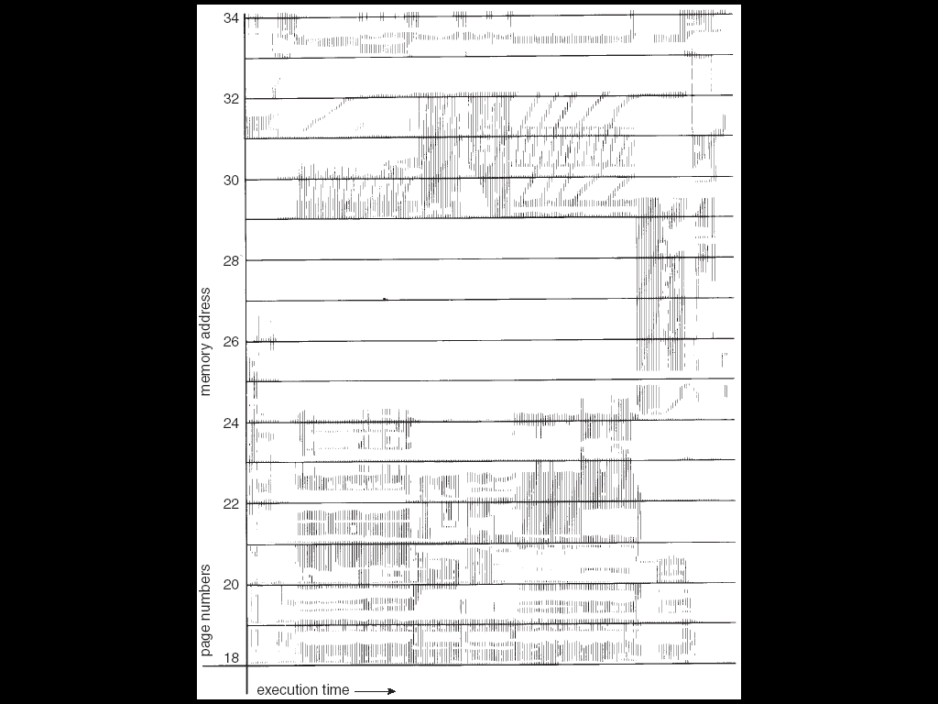
Locality In Memory References
Working set: set of pages referenced in sampling window
Not enough memory for working set causes thrashing
At any sampling window, hit rate is impacted by number of working sets that fit into memory
1
New working
set fits
Hit Rate
0
Memory Allocation

Slide 34
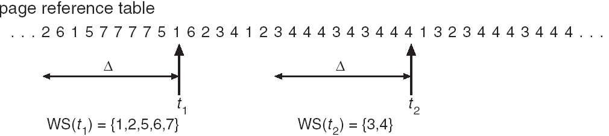
Working-set Model
Δ ≡ sampling window ≡ fixed number of page references
  Example: 10,000 instructions
WS_{i} (working set of p_{i}) = total set of pages referenced in most recent Δ (varies in time)
  if Δ too small will not encompass entire locality
  if Δ too large will encompass several localities
  if Δ = ∞ ⇒ will encompass entire program
D = Σ|WS_{i}| ≡ total demand frames
if D > m ⇒ Thrashing
  Policy: if D > m, then suspend/swap out processes
  This can improve overall system behavior by a lot!

Slide 35
Page-fault Rate: Compulsory Misses
Recall that compulsory misses are misses that occur first time that page is seen
  Pages that are touched for the first time
  Pages that are touched after process is swapped out/swapped back in
Clustering
  On page-fault, bring in multiple pages “around” the faulting page
  Since efficiency of disk reads increases with sequential reads, makes sense to read several sequential pages
Working set tracking
  Use algorithm to track working set of applications
  When swapping process back in, swap in working set

Slide 36
Core-map: Reverse Page Mapping
Physical page frames often shared by many different address spaces/page tables
  All children forked from given process
  Shared memory pages between processes
Whatever reverse mapping mechanism that is in place must be very fast
  Must hunt down all page tables pointing at given page frame when freeing a page
  Must hunt down all PTEs when seeing if pages “active”
Implementation options:
  For every page descriptor, keep linked list of page table entries that point to it
    Management nightmare – expensive
  Linux 2.6: object-based reverse mapping
    Link together memory region descriptors instead (much coarser granularity)

Slide 37
Summary
Replacement policies
  FIFO: Place pages on queue, replace page at end
  MIN: Replace page that will be used farthest in future
  LRU: Replace page used farthest in past
Clock Algorithm: Approximation to LRU
  Arrange all pages in circular list
  Sweep through them, marking as not “in use”
  If page not “in use” for one pass, then can replace
N^{th}-chance clock algorithm: Another approximate LRU
  Give pages multiple passes of clock hand before replacing
Thrashing: process is busy swapping pages in and out
  Process will thrash if working set doesn’t fit in memory
  Need to swap out a process

Slide 38

Questions?
globaldigitalcitizen.org

Slide 39
Acknowledgment
Slides by courtesy of Anderson, Culler, Stoica, Silberschatz, Joseph, and Canny

