Slide 1


Slide 2
Lecture 11: File Systems
Prof. Seyed Majid Zahedi
https://ece.uwaterloo.ca/~smzahedi

Slide 3
Outline
File systems: files and directories
File Allocation Table (FAT)
Unix Fast File System (FSS)
New Technology File System (NTFS)
Buffer caches

Slide 4
Building File Systems
File system: OS abstraction that provides persistent, named data
  Data is stored until it is explicitly deleted, even with crashes or power loss
  Data can be accessed via human-readable identifier
Goal: transform block interface of devices to interface with
  Naming: interface to find files by name, not by blocks
  Date-storage management: organize data-storage blocks into files
  Protection: keep data secure and isolated
  Reliability/durability: keep files durable despite crashes, failures, attacks, etc.

Slide 5
Files
Named set of blocks in file system
  Data: information put by user or program
  Metadata: information about file understood and managed by OS
    Owner, size, modification time, permissions, …
User’s view
  Durable data structures
System’s view
  System-call interface: array of untyped bytes (UNIX)
    Doesn’t matter what kind of data structures is store on disk!
    Occasionally might need to parse file’s data (e.g., ELF, a.out, bash scripts)
  File system: collection of blocks
    Block (logical transfer unit) size ≥ sector (physical transfer unit) size

Slide 6

File Access Patterns
Sequential access: bytes read in order
  E.g., “give me the next X bytes, then give me next, etc.”
  Most of file accesses are of this flavor
Random access: read/write element out of middle of array
  E.g., “give me bytes from i to j”
  E.g., mem. page from swap file
  Less frequent, but still important, want this to be fast
    Don’t want to have to read all bytes to get to middle of file
Content-based access
  E.g., “find me 100 bytes starting with RTOS”
  E.g., find employee X’s records and increase their salary by a factor of 2
  Many systems don’t provide this; instead, build DBs to index content
  (still requires efficient random access)
    E.g., Mac OSX Spotlight search

Slide 7


From User to System View
File
System
What happens if user asks for bytes 2 to 12?
  File system fetches block corresponding to those bytes
  System call returns just the correct portion of the block
What about writing bytes 2 to 12?
  Same as before, fetch block, modify relevant portions, write out block
Everything inside file system is handled in terms of blocks
  E.g., getc() and putc() buffer 4KiB only to access one byte at a time
  Physical storage devices might work with sectors

Slide 8
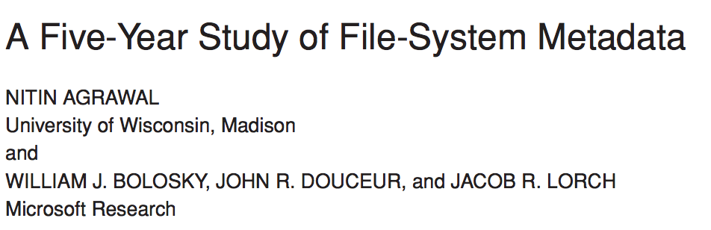
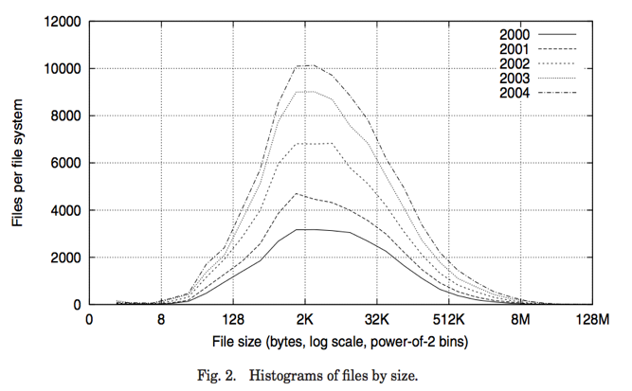
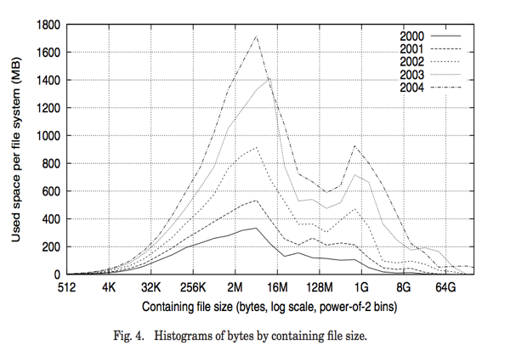
Characteristics of Files
Notes:
FAST’07 paper
Data from >10K PCs at MS
May be skewed by corporate distros

Slide 9

Characteristics of Files (cont.)
Most files are small, growing numbers of files over time
Notes:
From 30k to 90k files

Slide 10
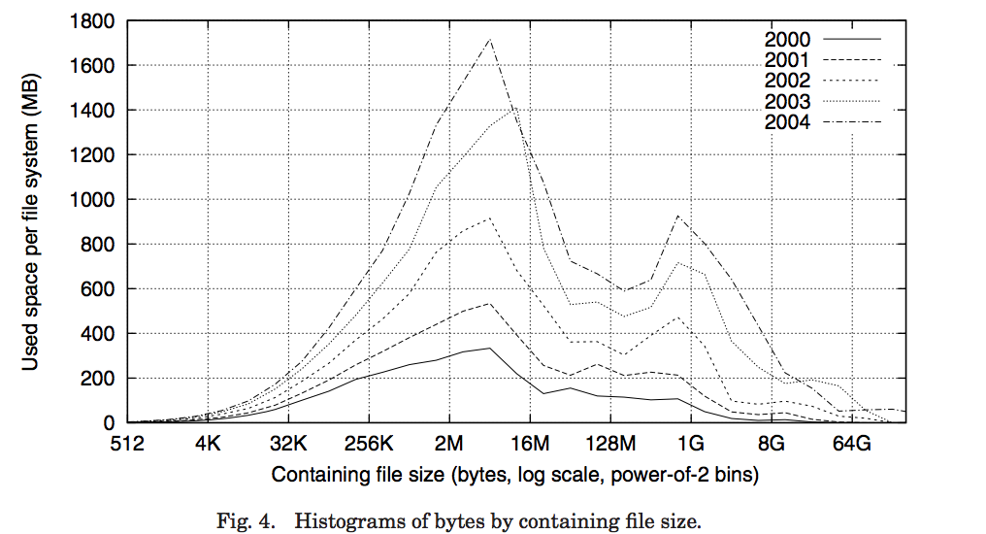
Characteristics of Files (cont.)
Most of disk space is occupied by rare big ones
Notes:
15% file size growth/year
New peaks are DB, video, and blob (email) files
Median capacity from 5 to 40GB

Slide 11
Putting it Together: File Usage Patterns
Observation1: most files are small
Observation 2: large files use up most of storage space (and devices BW)
  May seem contradictory, but few big files ≈ large # of small files
Although we will use these observations, beware!
  Good idea to look at usage patterns
    Beat competitors by optimizing for frequent patterns
  Except: changes in performance or cost can alter usage patterns.
    Maybe UNIX has lots of small files because big files are handled inefficiently?

Slide 12

Directory
List of human-readable names and mapping from each name to file or directory
  Folder that contains documents (files) and other folders (directories)
  Basically a hierarchical structure
Root directory: thinking of directory as tree, root of tree is root directory
  E.g., “/” in Unix
Path: string that identifies file or directory
  Absolute path: e.g., /home/smz/foo.txt
  Relative path: e.g., from /home directory, smz/foo.txt

Slide 13


Links
Hard link: create another name (path) for given file
  E.g., ln /path/to/file /path/to/link (in Unix)
  If original file is deleted, hard link is still valid
Soft link: map one name to another name
  E.g., ln –s /path/to/file /path/to/link (in Unix)
  If original file is deleted, soft link will point to nothing
/usr
/usr/lib
/usr/lib7
/usr/lib7/foo
/usr/lib/foo

Slide 14
Directory Access Pattern
Directories are stored as files
  Can be read from and written to
System calls to access directories
  open/create to traverse the structure
  mkdir/rmdir to add/remove entries
  link/unlink to link/unlink existing file to directory
When can file be deleted?
  Maintain ref-count of links to each file
  Delete after last reference is gone
Libc support
  DIR * opendir (const char *dirname)
  struct dirent * readdir (DIR *dirstream)
  int readdir_r (DIR *dirstream, struct dirent *entry, struct dirent **result)

Slide 15
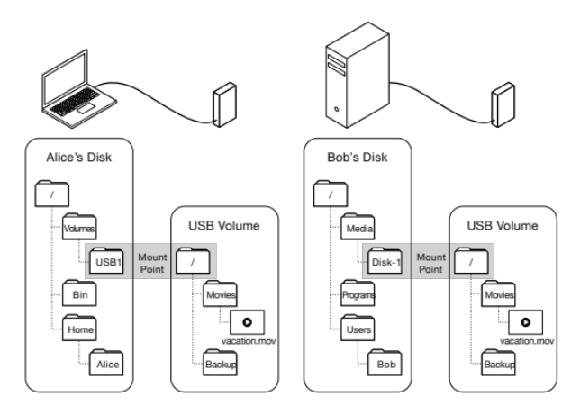
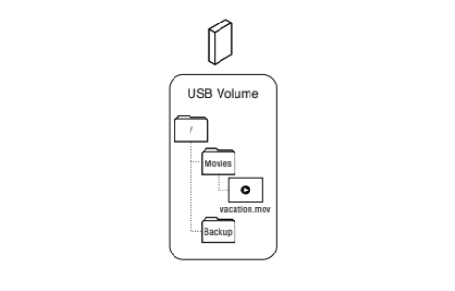
Volume
Set of physical storage resources that form logical storage device
  Each instance of file system manages files and directories for single volume
Multiple volumes can be mounted on existing file system
  Map path in file system to root directory of mounted volume’s file system
    Mounted file system controls mappings for all extensions of that path
    Single machine can use multiple file systems stored on multiple volumes

Slide 16
Road Map
directory
index
structure
File name
File number
Storage block

Slide 17

File System: Naming Data
To access file, file system first translates file’s name to its number
Directories are files
Each directory is linked-list of entries
Each entry contains <file_name, file_number> mapping
E.g., to find file number for file foo.txt, file system scans its directory /home/smz
se350 739
ece350 924
foo.txt 158

Slide 18

How Do We Find Directory?
File 2
“/”
bin 651
usr 733
home 119
File 119
“/home”
taa 569
smz 110
File 110
“/home/smz”
se350 739
ece350 924
foo.txt 158
Recursive file lookup
Many Unix and Linux file systems use 2 as predefined file number for root directory
File 158
“/home/smz
/foo.txt”
Some
text

Slide 19
Linked-list Directory Layout:
Early Implementations
File 110
“/home/smz”
Name
. | .. | se350 | ece350 | Free Space | foo.txt | Free Space
110 | 119 | 739 | 924 |  | 158
File Number
Next
Store linear lists of file name, file number pairs in directory files
  E.g., original version of Linux Ext2
+ Simple
  Work fine when the number of directory entries is small
– Could become sluggish when there are thousands of files in directories

Slide 20
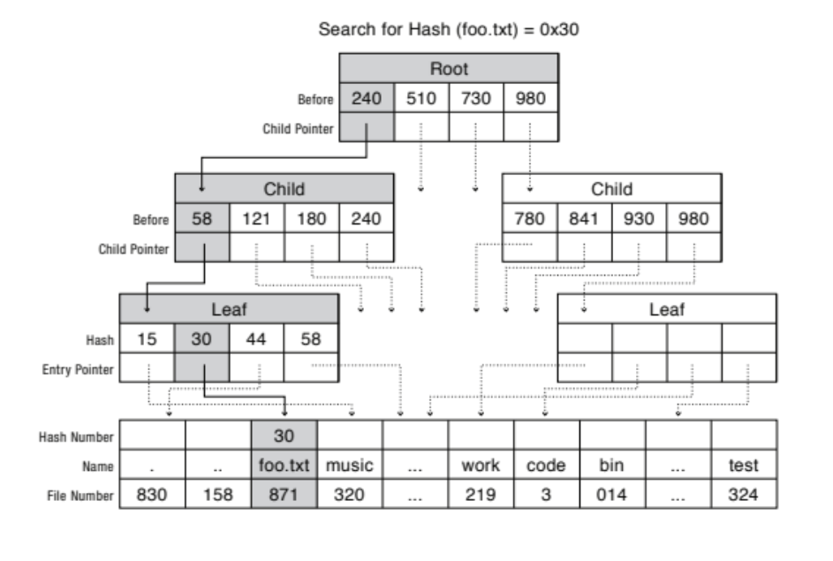
Tree-based Directory Layout:
Modern File Systems (Logical View)
Linux XFS, Microsoft NTFS, and Oracle ZFS organize directory’s contents as tree
Example: B+tree is indexed by hash of file’s name
Internal nodes contain array of sorted hash keys, each pointing to child node
Child node’s keys are smaller than parent’s key entry but larger than parent’s previous keys
File system searches node for first entry with key larger than target
File number at leaf nodes points to target directory entry

Slide 21
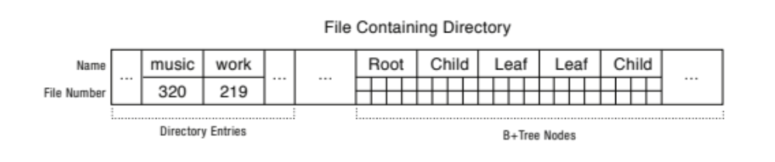
Tree-based Directory Layout:
Modern File Systems (Physical Storage)
Directory entries are usually stored in first part of directory file
Tree’s root is at well-known offset within file
Fixed-size internal and leaf nodes are stored after root node
Variable-size directory entries are stored at start of directory file
Each tree node includes pointers to where in the file its children are stored

Slide 22
Recall: Road Map
directory
index
structure
File name
File number
Storage block

Slide 23

File Systems: Finding Data
Index structure
  How do we locate blocks of a file?
Index granularity
  What block size do we use?
Free space
  How do we find unused blocks on storage device?
Locality
  How do we preserve spatial locality?
Reliability
  What if machine crashes in middle of file system operation?

Slide 24
FAT (File Allocation Table)
FAT
Storage Blocks
0:
0:
Introduced in 1977 to be used on floppy disks
  It is still a widely-used file system
File number is used to index into FAT
  There is one FAT entry per storage block
  Each entry is 32 bit (4 bits are reserved)
  File’s number is index of file’s first entry
Each file is represented by linked list of FAT entries
  Each FAT entry contains pointer to next FAT entry
File 31, Block 0
File 31, Block 1
File number 31
File 31, Block 2
File 31, Block 2
memory
Storage
N-1:
N-1:

Slide 25
FAT Properties
FAT
Storage Blocks
0:
0:
File number is index of root
of block list for each file
Unused blocks are marked free
(no ordering, must scan to find)
File 31, Block 0
File 31, Block 1
File number 31
free
File 31, Block 2
N-1:
N-1:
Storage

Slide 26
FAT Properties (cont.)
FAT
Storage Blocks
0:
0:
File number is index of root
of block list for each file
Unused blocks are marked free
(no ordering, must scan to find)
Grow file by allocating free blocks
and linking them
File 31, Block 0
File 31, Block 1
File number 31
File 63, Block 1
File 63, Block 0
File 31, Block 3
File number 63
File 31, Block 2
N-1:
N-1:
Storage

Slide 27
FAT Assessment
Where is FAT stored?
  On disk, on boot cache in memory, second (backup) copy on disk
What happens when you format disk?
  Zero all blocks, mark FAT entries “free”
What happens when you quick format disk?
  Mark all entries in FAT as free
What is the most significant advantage of FAT? It is simple!
  Easy to find free block
  Easy to append to files
  Easy to delete files

Slide 28
Disadvantages of FAT
Random access is very slow (traversing linked-list)
  Finding random block in large file takes long time
Poor locality
  File blocks for given file may be scattered
  Files in the same directory may be scattered
  Defragmentation could be used to improve performance
No support for hard links
  File metadata in stored with directory entries with the file’s name
  Each file must be accessed via exactly one directory entry
Limited volume and file sizes
  FAT volume can have at most 2²⁸ entries ⇒ with 4KiB blocks, max volume size is 1TiB
  File size is encoded into 32 bit ⇒ max file size is 2³² – 1, which is just under 4GiB
Security and reliability vulnerabilities
  FAT doesn’t support access rights & transactional update methods (more on this later)

Slide 29
Berkeley Unix Fast File System (FFS)
Originally, inode format appeared in Berkeley Standard Distribution (BSD) 4.1
  Similar structure for Linux Ext2/3
File number (inumber) is used to index into inode array
  Each inode tracks file blocks for single file
Each inode has multi-level-index structure
  Great for little and large files
  Asymmetric tree with fixed sized blocks
  Stores metadata associated with each file
Free space is managed using bitmap with one bit per storage block
  Placed in fixed position when file system is formatted

Slide 30
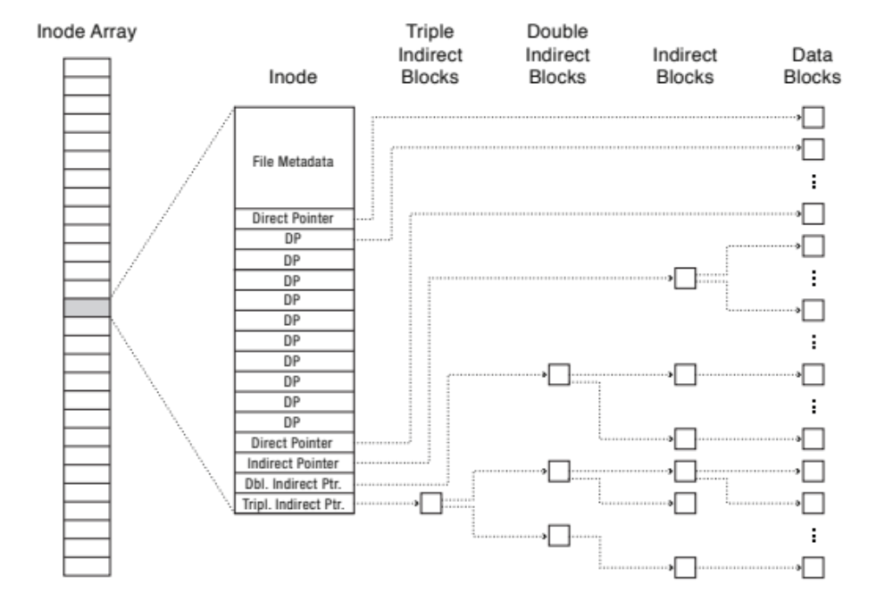
Inode Structure
User
Group
9 basic access control bits
- UGO x RWX
Setuid bit
- execute at owner permissions
rather than user
Setgid bit
- execute at group’s permissions

Slide 31

Inode Structure (cont.)
Direct pointers
4KiB blocks ⇒ Sufficient for files up to 48KiB

Slide 32
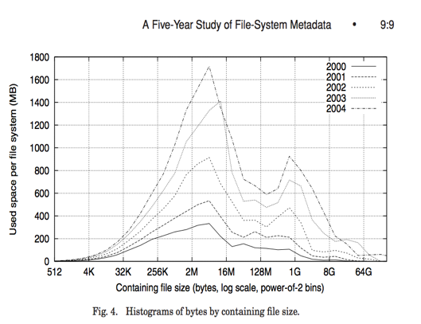
Inode Structure (cont.)
Indirect pointers
- point to a disk block
containing only pointers
- 4KiB blocks ⇒ 1024 pointers
⇒ 4MiB @ level 2
⇒ 4GiB @ level 3
⇒ 4TiB @ level 4

Slide 33
Summary: Inode Details
Metadata
  File owner, access permissions, access times, …
Direct-block pointers
  With 4KiB blocks ⇒ max size of 48KiB
Indirect-block pointer
  Pointer to on-disk indirect block which contains array of direct-block pointers
  With 4KiB indirect block and 4B block pointer ⇒ 2¹⁰ direct-block pointers
  With 4KiB blocks ⇒ max size of 4MiB (+ 48KiB)
Doubly-indirect-block pointer
  2¹⁰ indirect-block pointers ⇒ 2²⁰ direct-block pointers
  With 4KiB blocks ⇒ max size of 4GiB (+ 4MiB + 48KiB)
Triply-indirect-block pointer
  2¹⁰ doubly indirect blocks ⇒ 2³⁰ direct-block pointers
  With 4KiB blocks ⇒ max size of 4TiB (+ 4GiB + 4MiB + 48KiB)

Slide 34

FFS Asymmetric Tree
Small files: shallow tree
  Efficient storage for small files
Large files: deep tree
  Efficient lookup for random access in large files
Sparse files: only fill pointers if needed
www.assetbasedlife.com

Slide 35
Multi-level-indexed Files Example
How many accesses for block #5 (assuming file header accessed on open)?
  One: one for data block
How many accesses for block #23?
  Two: one for indirect-block pointer, one for data block
How many accesses for lock #340?
  Three: double-indirect block, direct block, and data block
…

Slide 36
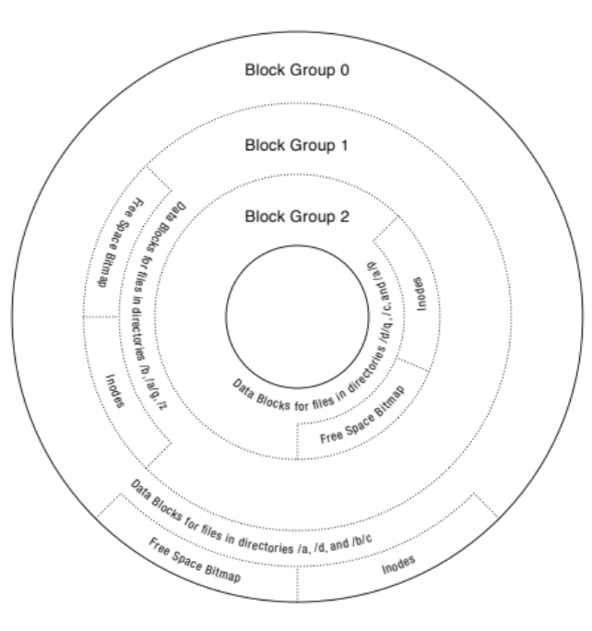
FFS on Magnetic Storage
In early FFS, inode array was stored at fixed location in outermost cylinders
  At formatting time, fixed number of inodes are created
  Each is given unique number (inumber)
  To read small files, disk head had to seek to get header, seek back to data
In later versions, disk is divided into groups (neighboring tracks)
  Data blocks, inodes, and bitmaps are scattered across groups
  Avoid seeks between user data and file system structure
  Try to put directory and its files in the same block group
FFS reserves some fraction space (e.g., 10%)
  When most block groups become almost full, new
  writes will be scattered around disk
  To avoid this, if actual free space falls below
  reserved fraction, FFS prevents new writes (i.e., they fail)
  Only super user’s processes can allocate new blocks,
  allowing admin to log in and clean things up

Slide 37
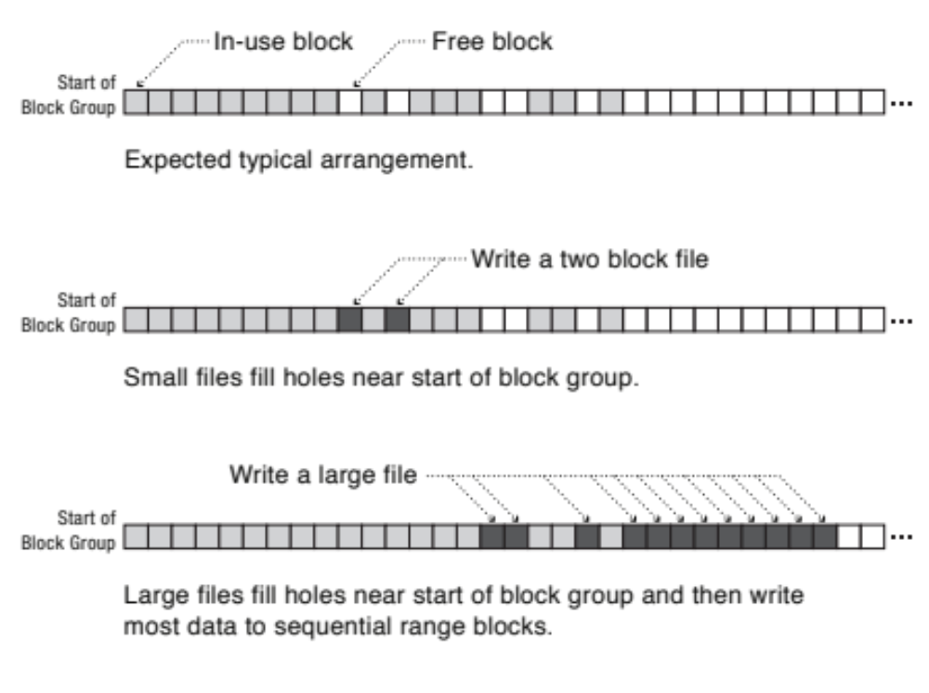
Data Block Placement:
First-free Heuristic
To expand file, use first free blocks in group using the group’s bitmap
This might scatter sequential writes into holes near start of group
But it leads to contiguous free space at the end of group

Slide 38
FFS Analysis
+ Efficient storage for both small and large files
+ Locality for both small and large files
+ Locality for metadata and data
+ No defragmentation necessary!
– Inefficient for tiny files (a 1 B file requires both inode and data block)
– Inefficient encoding when file is mostly contiguous on disk
– Need to reserve 10-20% of free space to prevent fragmentation

Slide 39
Putting it Together:
File-system API (Unix)
File number
(inumber)
Storage blocks
File name
File-index
Structure
Directory
Structure
One Block = multiple sectors
E.g., 512B sector, 4KiB block
…
inode
open() performs name resolution
  Resolves file name, finds inode
  Creates file descriptor in PCB
  Returns file handle (another integer) to user process
read(), write(), seek(), and sync() operate on file handle to locate inode
  Perform appropriate read, write, etc. operations

Slide 40
New Technology File System (NTFS)
NTFS is proprietary file system developed by Microsoft
NTFS provides improvements over FAT
  File metadata, security, and reliability (journaling)
Extents represent regions of file stored in contiguous regions of storage device
  Similar approach in Linux (Ext4)
Files are represented by trees containing pointers to file’s extents
  File with small # of extents is stored in shallow tree even if file is large
  Deeper trees are only needed for fragmented files
Roots of trees are stored in master file table (MFT)
  Like inode array
Directories are organized in B+tree structure

Slide 41
Master File Table (MFT)
Create time, modify time, access time, owner id, security specifier, flags (read-only, hidden, sys)
Small files could fit in MFT record (resident attribute)
MFT
Std. Info.
File Name
Data (resident)
(free)
Start
Start
Data of non-fragmented files (small or large) could be stored as nonresident attribute in one record
Std. Info.
File Name
Data (nonresident)
(free)
Length
Length
Data Extent
Data Extent
Std. Info.
Attr. List
File Name
Data (nonresident)
Data Extent
When file has too many attributes (e.g., fragmented file with many data extents), multiple MFT records are used
Attribute list in first record indicates where to find each attribute
Data Extent
Data (nonresident)
Data Extent
Data Extent
Data Extent

Slide 42
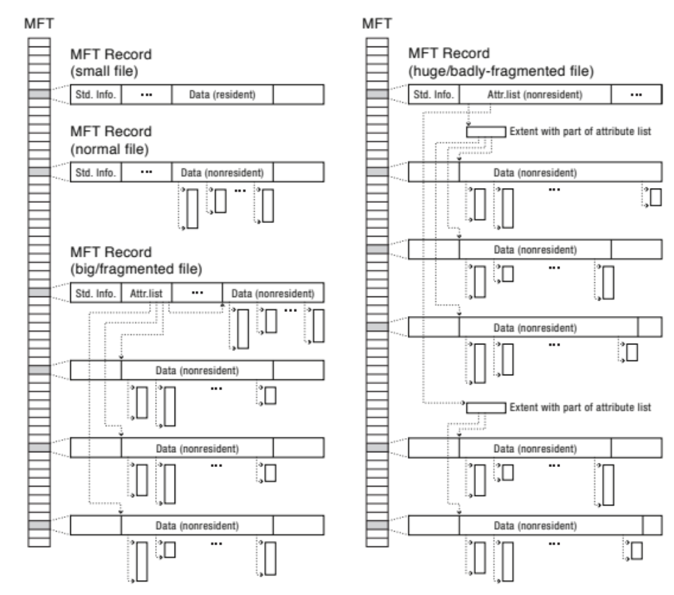
MTF Record Stages
MTF
MTF
For huge files or fragmented file system, attribute list can become non-resident, allowing almost arbitrarily numbers of MFT records

Slide 43
Some NTFS Details
Almost all of metadata is stored as files with well-known file numbers
  E.g., file number 5 for root directory and 6 for free space bitmap
Security and access control information is stored in $Secure file (file number 9)
  Each unique access control has fixed-length unique key
  Each individual file stores appropriate fixed-length key in its MFT record
Master file table is stored in $MFT file (file number 0)
NTFS uses variation of best-fit allocation policy
NTFS allows application to specify expected size of file at creation time
To prevent $MFT to become fragmented, NTFS reserves fraction of volume
NTFS defragmentation rewrites fragmented files to contiguous regions of storage

Slide 44
File Systems: Design Options
 | FAT | FFS | NTFS
Index structure | Linked list | Tree (fixed, asymmetric) | Tree (dynamic)
Granularity | Block | Block | Extent
Free space tracking | FAT array scan | Bitmap (fixed location) | Bitmap (file)
Locality | Defragmentation | Block groups + reserve space | Extents + best fit + defragmentation

Slide 45
Buffer Cache
Kernel must copy disk blocks to main memory to access their contents and write them back if modified
  Could be data blocks, inodes, directory contents, etc.
  Possibly dirty (modified and not written back)
Key idea: exploit locality by caching storage data in memory
  Name translations: mapping from paths → inodes
  Disk blocks: mapping from block address → disk content
Buffer cache: memory used to cache kernel resources, including disk blocks and name translations
  Implemented entirely in OS software (unlike memory caches and TLB)

Slide 46
File-system Caching
Replacement policy? LRU!
  Because we can afford overhead of timestamps for each disk block
  + Works very well for name translation
  + Works well if memory is big enough to accommodate working set of file blocks
  – Some apps scan through file system, flushing cache with data used only once
    E.g., find . –exec grep foo {} \;
Other replacement policies?
  Some systems allow applications to request other policies
  E.g., use once: file system can discard blocks as soon as they are used
How much memory should OS allocate to buffer cache?
  Too much memory ⇒ OS will have less memory to allocate to applications
  Too little memory ⇒ applications may run slowly (inefficient disk caching)
  Solution: dynamically adjust allocation to balance paging and file access time

Slide 47
File-system Caching (cont.)
Read-ahead prefetching: fetch sequential blocks early
  Fast to access; file system tries to obtain sequential layout
  Applications tend to do sequential reads and writes
How much to prefetch?
  Too many ⇒ delaying requests by other applications
  Too few ⇒ missed opportunities to improve performance

Slide 48
Delayed Writes
Every write() copies data from user space to kernel buffer
  Other apps read data from cache instead of disk
  Cache is transparent to user programs
Buffer cache is write-back cache
  Writes are not immediately sent to disk
  Buffer cache is flushed to disk periodically
    E.g., in Linux, kernel threads flush buffer cache very 30 sec. in default setup
  Some files never actually make it all the way to disk
    There are many short-lived files
But what if system crashes before buffer cache is flushed to disk?
  And what if this was for a directory file?
    Lose pointer to inode
File systems need recovery mechanisms

Slide 49
Important “abilities”
Reliability: ability of system or component to perform its required functions under stated conditions for specified time
  System is not only “up”, but also working correctly
  Includes availability, security, fault tolerance/durability
  Data must survive system crashes, disk crashes, other problems
Availability: probability that system can accept and process requests
  Can build highly-available systems, despite unreliable components
    Involves independence of failures and redundancy
  Often as “nines” of probability. 99.9% is “3-nines of availability”
Durability: ability of system to recover data despite faults
  This idea is fault-tolerance applied to data
  Doesn’t necessarily imply availability: information on pyramids was very durable, but could not be accessed until discovery of Rosetta Stone

Slide 50
Summary
File system
  Abstraction that provides persistent, named data
  Optimize for access and usage patterns
File Allocation Table (FAT)
  Linked-list approach, widely-used file system (e.g., cameras, USB drives, SD cards)
  Simple to implement, but poor performance and no security
Unix Fast File System (FFS)
  Tracking files’ blocks using inodes, indirect blocks, double indirect blocks, etc.
New Technology File System (NTFS)
  Variable extents, dynamic tree, tiny files data is in header
Buffer caches
  Exploiting locality by caching storage data in memory

Slide 51

Questions?
globaldigitalcitizen.org

Slide 52
Acknowledgment
Slides by courtesy of Anderson, Culler, Stoica, Silberschatz, Joseph, and Canny

